Slide 1
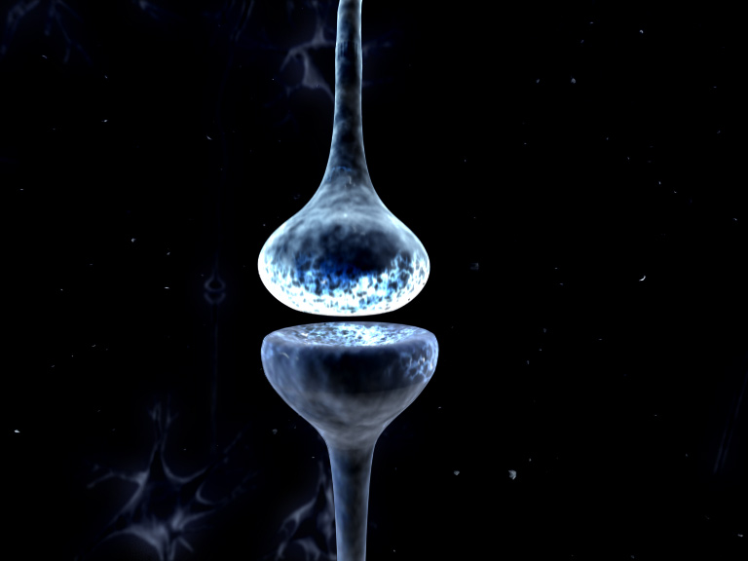
l
Dynamic causal models for Steady State Responses
Rosalyn Moran
Virginia Tech Carilion Research Institute
Bradley Department of Electrical & Computer Engineering
Department of Psychiatry & Behavioral Medicine, Virginia Tech Carilion School of Medicine
SPM Course M/EEG, Queen Square, May 16-18th 2016

Slide 2
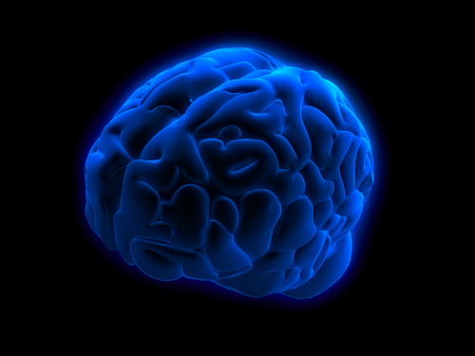
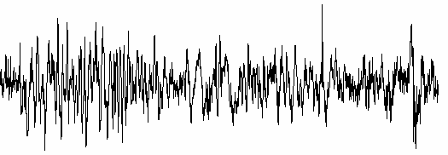
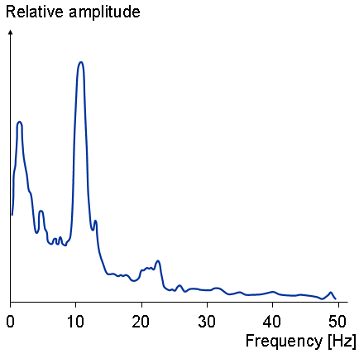
Connectivity from EEG/LFP Data: Dynamic Causal Models
Milliseconds: M/EEG
mV
time
Event related potentials & Oscillations of different frequencies
Implicated in specific cognitive tasks/regions
Eg. Hippocampal Theta (4 – 8 Hz) & Sensory Gamma (30 – 60 Hz)

Slide 3
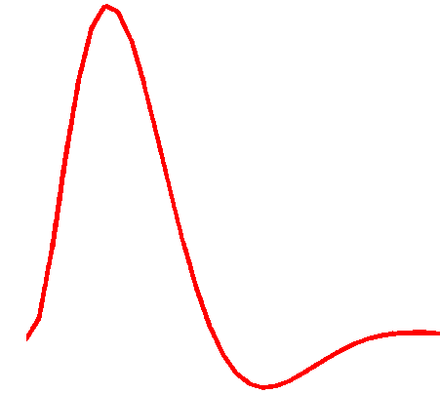
Dynamic Causal Modeling: Generic Framework
“theta”
Electromagnetic
forward model:
neural activity EEG
MEG
LFP
Time Domain ERP Data
Phase Domain Data
Time Frequency Data
Spectral Data
Hemodynamic
forward model:
neural activity BOLD
Time Domain Data
Resting State Data
Power (mV²)
Frequency (Hz)
Neural state equation:
fMRI
EEG/MEG
detailed neuronal model
(synaptic time scales)
simple neuronal model
(slow time scale)
A Neural Mass Model

Slide 4


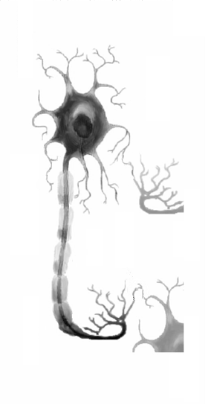
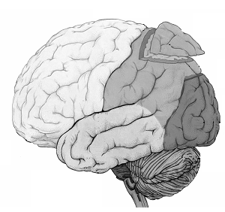
Macro and meso-scales: The Neural Mass Model
macro-scale
meso-scale
micro-scale
external granular
layer
external pyramidal
layer
internal granular
layer
internal pyramidal
layer
The state of a neuron comprises a number of attributes, membrane potentials, conductances etc. Modelling these states can become intractable. Mean field approximations summarise the states in terms of their ensemble density. Neural mass models consider only point densities and describe the interaction of the means in the ensemble
Notes:
4

Slide 5
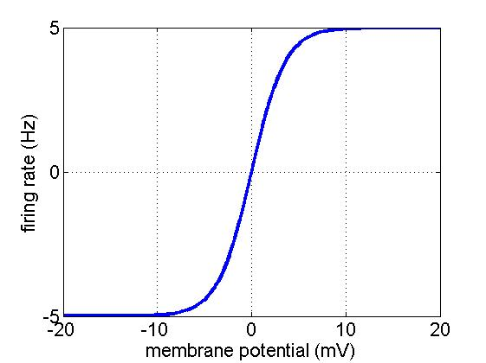
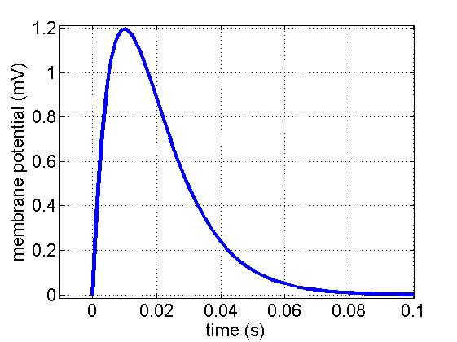


Meso-scale dynamics
AP generation zone
external granular
layer
$$θ(2)$$
external pyramidal
layer
synapses
internal granular
layer
internal pyramidal
layer
$$θ(1)$$
AP generation zone
Notes:
5

Slide 6
Convolution Based Neural Mass Models

Slide 7

Convolution-Based Neural Mass Models in DCM
Spiny stellate cells
Pyramidal cells
$v_{post}=σ(v_{pre})$ $⨂$ $h$
Take one spiny stellate cell…..

Slide 8

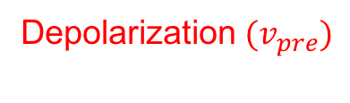
Convolution-Based Neural Mass Models in DCM
Spiny stellate cells
Pyramidal cells
$v_{post}=σ(v_{pre})$ $⨂$ $h$
$$H(v_{pre})$$
Heaviside function
Take a population of spiny stellate
cells & assume either:
Unimodal distribution over firing thresholds
Unimodal distribution over population
Membrane depolarizations
P(Action Potential)
Depolarization $(v_{pre})$

Slide 9
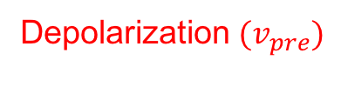

Convolution-Based Neural Mass Models in DCM
Spiny stellate cells
Pyramidal cells
$v_{post}=σ(v_{pre})$ $⨂$ $h$
$$H(v_{pre})$$
$$σ(v_{pre})$$
Sigmoidal
Presynaptic Firing Function
Heaviside function
P(Action Potential)
Average Firing Rate
Ensemble Synchronicity/Gain
Depolarization $(v_{pre})$
Depolarization $(v_{pre})$

Slide 10



Convolution-Based Neural Mass Models in DCM
Spiny stellate cells
Pyramidal cells
$v_{post}=σ(v_{pre})$ $⨂$ $h$
$$σ(v_{pre})$$
Sigmoidal
Presynaptic Firing Function
$$h$$
Postsynaptic Kernel
Depends on postsynaptic receptor
activated by particular neurotransmitter
Average Firing Rate
$$v_{post}$$
Depolarization $(v_{pre})$
Time (msec)

Slide 11
Convolution-Based Neural Mass Models in DCM
Spiny stellate cells
E.g. Glutamate from SS to AMPA receptor
Pyramidal cells
$v_{post}=σ(v_{pre})$ $⨂$ $h$
$$σ(v_{pre})$$
Sigmoidal
Presynaptic Firing Function
$$h$$
Postsynaptic Kernel
+depolarization
Average Firing Rate
$$v_{post}$$
time constant ~ 15msec
Depolarization $(v_{pre})$
Time (msec)

Slide 12
Convolution-Based Neural Mass Models in DCM
Inhibitory interneuron
E.g. GABA from inhibitory interneuron to GABAa receptor
Pyramidal cells
$v_{post}=σ(v_{pre})$ $⨂$ $h$
$$σ(v_{pre})$$
Sigmoidal
Presynaptic Firing Function
$$h$$
Postsynaptic Kernel
Time (msec)
Average Firing Rate
time constant ~ 8msec
$$v_{post}$$
-hyperpolarization
Depolarization $(v_{pre})$

Slide 13




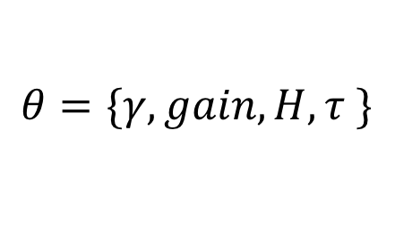
Convolution-Based Neural Mass Models in DCM
Spiny stellate cells
$$γ$$
Pyramidal cells
Connectivity?
$v_{post}=γσ(v_{pre})$ $⨂$ $h$
$$θ=\{γ,gain, H, τ \}$$
$$γσ(v_{pre})$$
Sigmoidal
Presynaptic Firing Function
$$h$$
Postsynaptic Kernel
Maximum
Postsynaptic Potential
connectivity
Average Firing Rate
gain
$$v_{post}$$
Time constant
$$1/κ$$
Depolarization $(v_{pre})$
Time (msec)

Slide 14

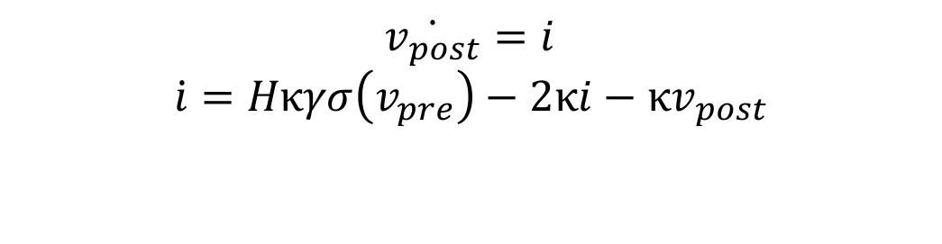
Convolution to ODEs
Spiny stellate cells
Pyramidal cells
$v_{post}=γσ(v_{pre})$ $⨂$ $h$
$v_{post}=\int_{0}^{t}{h(t−τ)}γσ(v_{pre})$ $dτ$
Convolution Equation
By parts twice
$$\ddot{v_{post}}=Hκγσ\left(v_{pre}\right)−2κ\dot{v_{post}}−κv_{post}$$
Second Order Differential Equation
$$\dot{v_{post}}=i$$
$$\dot{i}=Hκγσ\left(v_{pre}\right)−2κi−κv_{post}$$
.
2 Coupled First Order Differential
For each transmitter receptor pair

Slide 15
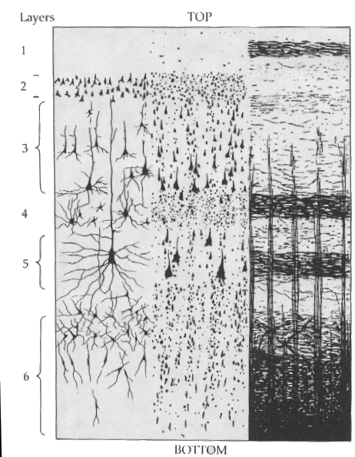
Multilaminar NMMS
Inhibitory interneuron
Assume GABA from inhibitory interneurons activate GABAa receptors
Spiny stellate cells
Pyramidal cells
Assume glutamate from pyramidal cells & spiny stellate cells activate AMPA receptors
Then construct interlaminar connectivity
5 connections giving 5x2 coupled first order differential equations

Slide 16
One region: 12 equations 10 + 2 difference
Inhibitory cells in extragranular layers
Inhibitory interneuron
γ
5
Spiny stellate cells
Pyramidal cells
Excitatory spiny cells being granular layers
Excitatory pyramidal cells in extragranular layers

Slide 17
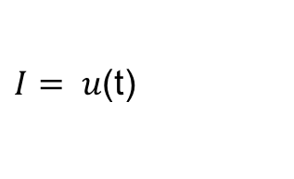
One region: 12 equations 10 + 2 difference
Inhibitory cells in extragranular layers
Inhibitory interneuron
γ
5
Spiny stellate cells
Pyramidal cells
Excitatory spiny cells being granular layers
$I= u$(t)
Dipole
Exogenous Input
Excitatory pyramidal cells in extragranular layers
Measured response:

Slide 18
Conductance Based Neural Mass Models

Slide 19
Conductance-Based Neural Mass Models in DCM
Current in =
Conductance
X Potential Difference
C
&
=
−
V
g
(
V
V
)
Ohm’s Law V = IR
Ohm’s Law for a Capacitor I = C dv/dt
rev
Gaba
Glutamate

Slide 20
Conductance-Based Neural Mass Models in DCM
Current in =
Conductance
X Potential Difference
Ohm’s Law V = IR
Ohm’s Law for a Capacitor I = C dv/dt
Dynamic Conductance
C
&
=
−
V
g
(
V
V
)
rev
g
=
κ
γ
- g)
&
(
aff
Gaba
Glutamate

Slide 21

Conductance-Based Neural Mass Models in DCM
Connectivity driven by different
neurotransmitters and receptors
State equations & parameters
Notes:
80 – 20 split
Gamma noise term

Slide 22


Conductance-Based Neural
Mass Models in DCM
Inhibitory cells in extragranular layers
Inhibitory interneuron
Spiny stellate cells
Exogenous input
Excitatory spiny cells in granular layers
Pyramidal cells
$$γ_{ii}$$
$$γ_{ec}$$
Excitatory pyramidal cells in extragranular layers
Measured response

Slide 23
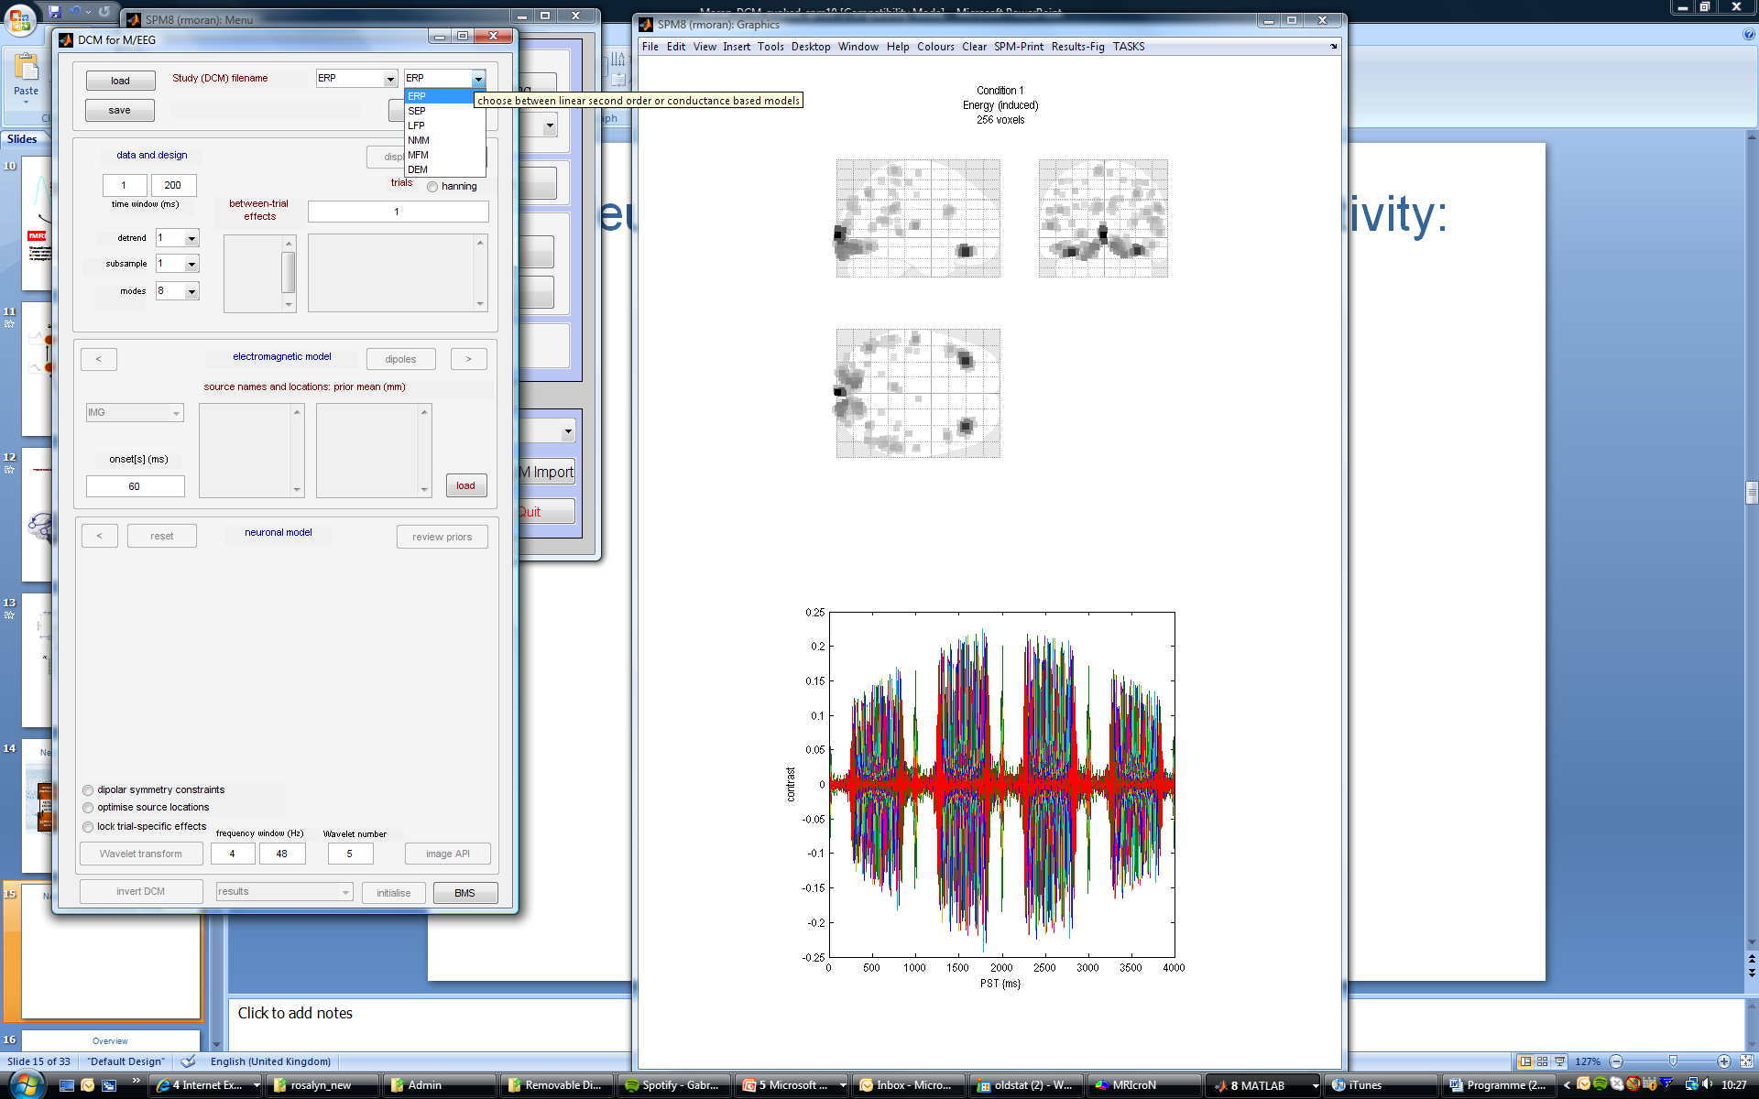
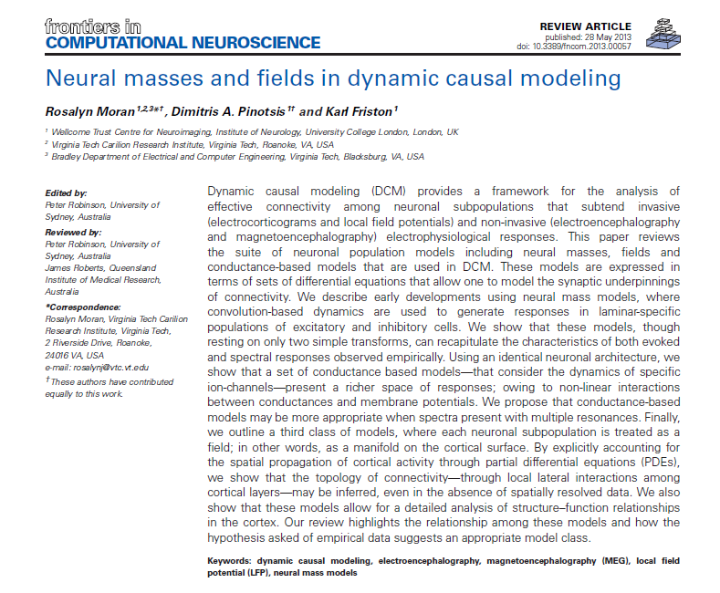
A selection of intrinsic architectures in SPM
A suite of neuronal population models including neural masses, fields and conductance-based models…expressed in terms of sets of differential equations

Slide 24
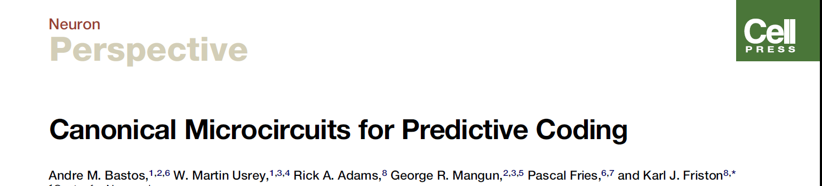
Predictive coding-based
Neural Mass Models in DCM
Inhibitory interneuron
Superficial pyramidal
Forward
Extrinsic Output
Spiny stellate
Spiny stellate
Inhibitory interneuron
Extrinsic Output
Backward
Extrinsic Output
Pyramidal cells
Deep pyramidal
GABA Receptors
AMPA Receptors
NMDA Receptors
4-subpopulation
Canonical Microcircuit
Moran et al. 2011, Neuroimage

Slide 25


Model Inversion & Inference
Bayes’ rules:
Free Energy:
max
Inference on models
Inference on parameters
Bayesian Inversion
Model 1
Model 2
Model 1
Model comparison via Bayes factor:
accounts for both accuracy and complexity of the model
allows for inference about structure (generalisability) of the model

Slide 26
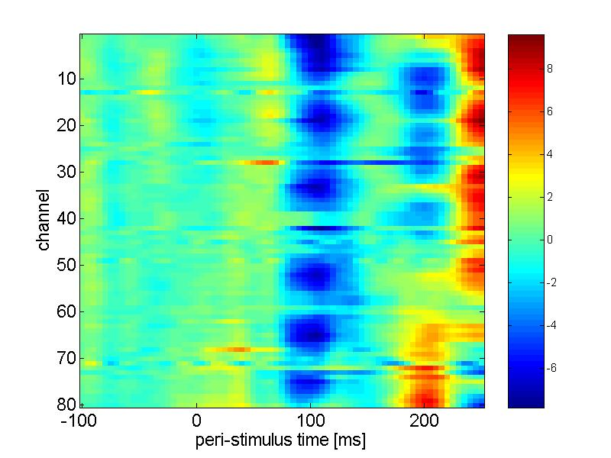
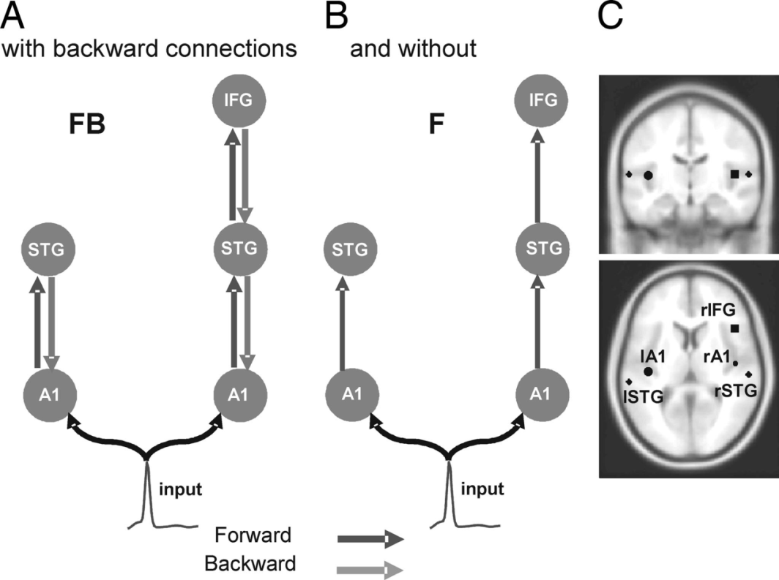
Data & Hypotheses
Model 1
Event-Related Potentials
Model selection:
data y
Model 2
Channels
Time
...
STG
STG
STG
Model n
A1
A1
A1
A1
best?

Slide 27
Data & Hypotheses
Cross-Spectral Responses
1
Model 1
2
Model selection:
3
Model 2
4
1
2
3
4
...
STG
STG
STG
Model n
A1
A1
A1
A1
best?

Slide 28
Inversion in the real & complex domain
prediction and response: E-Step: 32
prediction and response: E-Step: 32
3.5
1
3
0.8
0.6
2.5
0.4
2
0.2
real
0
imaginary
1.5
-0.2
1
-0.4
-0.6
0.5
-0.8
0
0
10
20
30
40
50
-1
0
10
20
30
40
50
Frequency (Hz)
Frequency (Hz)
conditional [minus prior] expectation
1.5
1
0.5
0
-0.5
-1
-1.5
-2
0
10
20
30
40
50
60
70
80
parameter

Slide 29
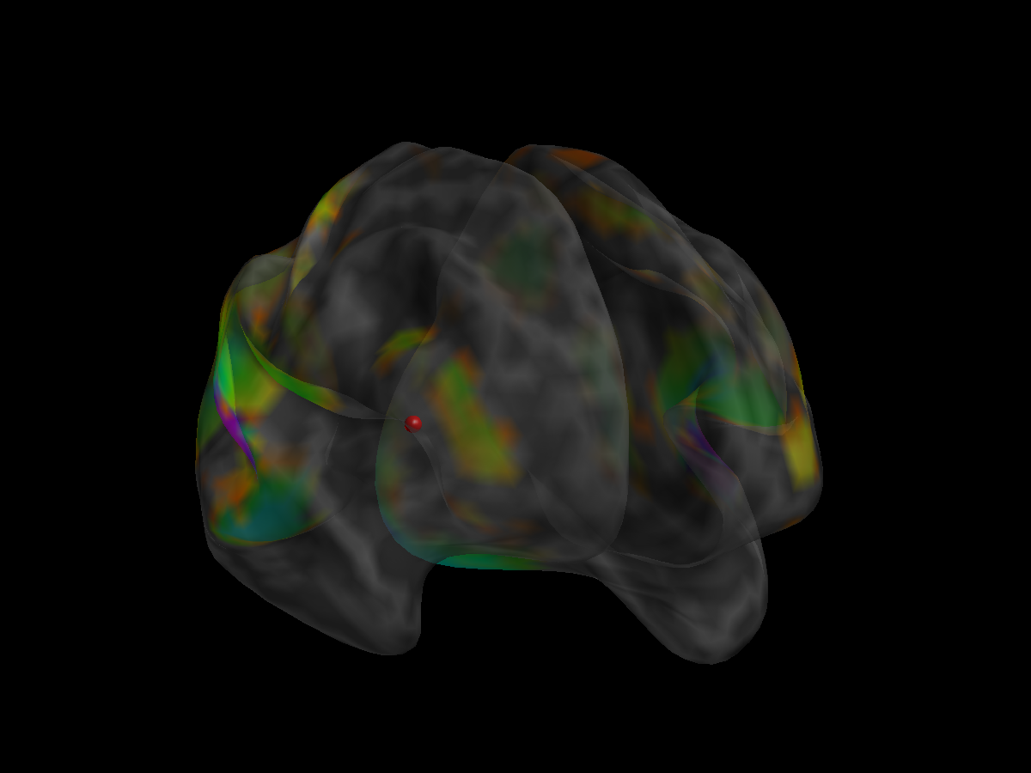


Forward Model: Neural Mass Models in DCM
Empirical Observations
(eg Sensor Level)
$$Y=g(θg,v6)$$
Lead Field
$$\dot{v}=f(θf,u)$$
Interconnected
Neural mass models

Slide 30


Neural Mass Models in DCM for ERPs
data y
Channels
$$Y=g(θg,v6)$$
$$u=u(t)$$
Time
Lead Field
Event-Related Potentials
$$\dot{v}=f(θf,u)$$
Interconnected
Neural mass models

Slide 31



State equations from time to spectral domain
Linearise
Analytic Transfer Function in the Frequency domain
Time Differential Equations
$$Y=g(θg,v6)$$
$$Y=g(θg,v6)$$
$$H(s)=g\left(sI−A\right)B$$
$$\dot{v}=A\left(θf\right)+Bu$$
$$\dot{v}=f(θf,u)$$
mV
White/Pink Noise

Slide 32
DCM for SSR/CSD Examples

Slide 33

Connectivity changes underlying
spectral EEG changes during propofol-induced loss of consciousness.
Wake
Mild Sedation: Responsive to command
Deep Sedation: Loss of Consciousness
Boly, Moran, Murphy, Boveroux, Bruno, Noirhomme, Ledoux, Bonhomme, Brichant, Tononi, Laureys, Friston, J Neuroscience, 2012

Slide 34
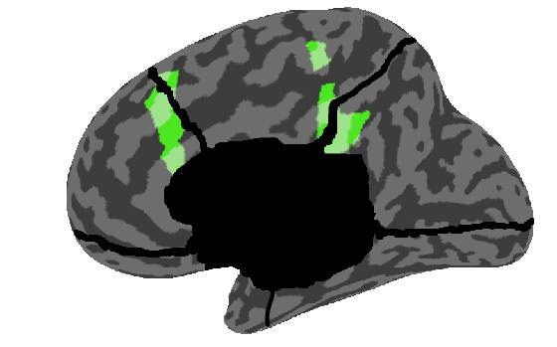
Propofol-induced loss of consciousness
Wake
Mild Sedation: Responsive to command
Deep Sedation: Loss of Consciousness
Precuneus
/Posterior Cingulate
Anterior Cingulate/mPFC

Slide 35
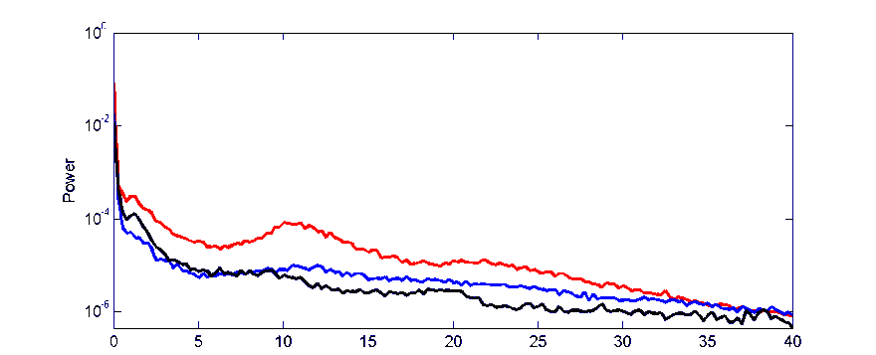
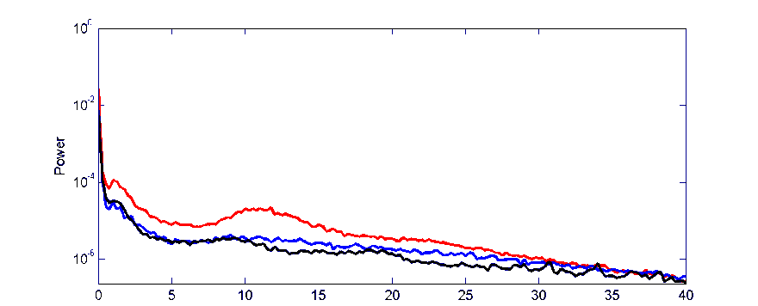
Propofol-induced loss of consciousness
Wake
Mild Sedation: Responsive to command
Deep Sedation: Loss of Consciousness
Precuneus
/Posterior Cingulate
Anterior Cingulate/mPFC
Murphy et al. 2011
Increased gamma power in Propofol vs Wake
Increased low frequency power when consiousness is lost

Slide 36
Bayesian Model Selection
Propofol-induced loss of consciousness
Wake
Mild Sedation
Deep Sedation
ACC
PCC
ACC
PCC
ACC
PCC
Thalamus
Thalami

Slide 37
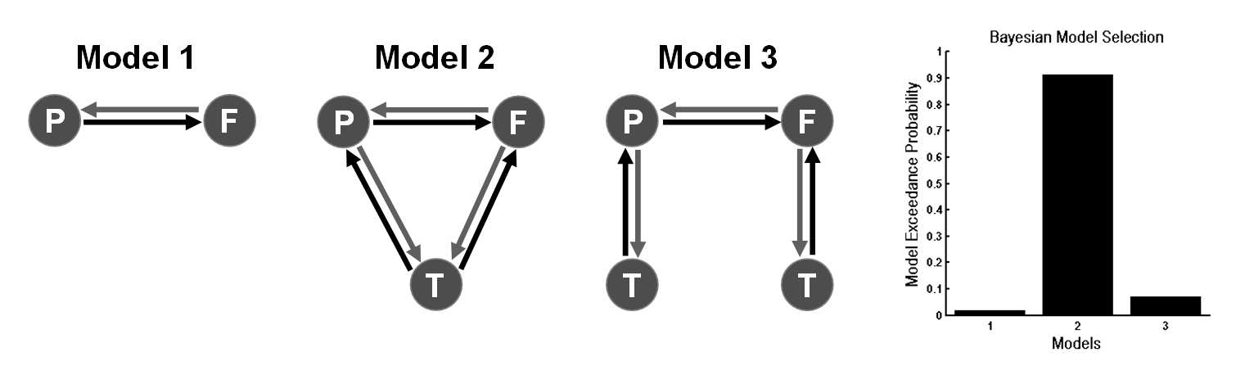
Propofol-induced loss of consciousness
Wake
Mild Sedation
Deep Sedation
ACC
PCC
ACC
PCC
ACC
PCC
Thalamus
Thalami

Slide 38
Parameters of Winning Model
Propofol-induced loss of consciousness
ACC
PCC
Wake
Thalamus

Slide 39
Propofol-induced loss of consciousness
ACC
PCC
Wake
Thalamus
ACC
PCC
Mild Sedation
Thalamus
:Increase in thalamic excitability

Slide 40
Propofol-induced loss of consciousness
ACC
PCC
Wake
Thalamus
ACC
PCC
ACC
PCC
Mild Sedation
Thalamus
:Increase in thalamic excitability
Thalamus
Loss of Consciousness
:Breakdown in Cortical Backward Connections

Slide 41
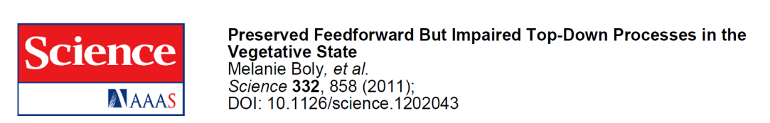
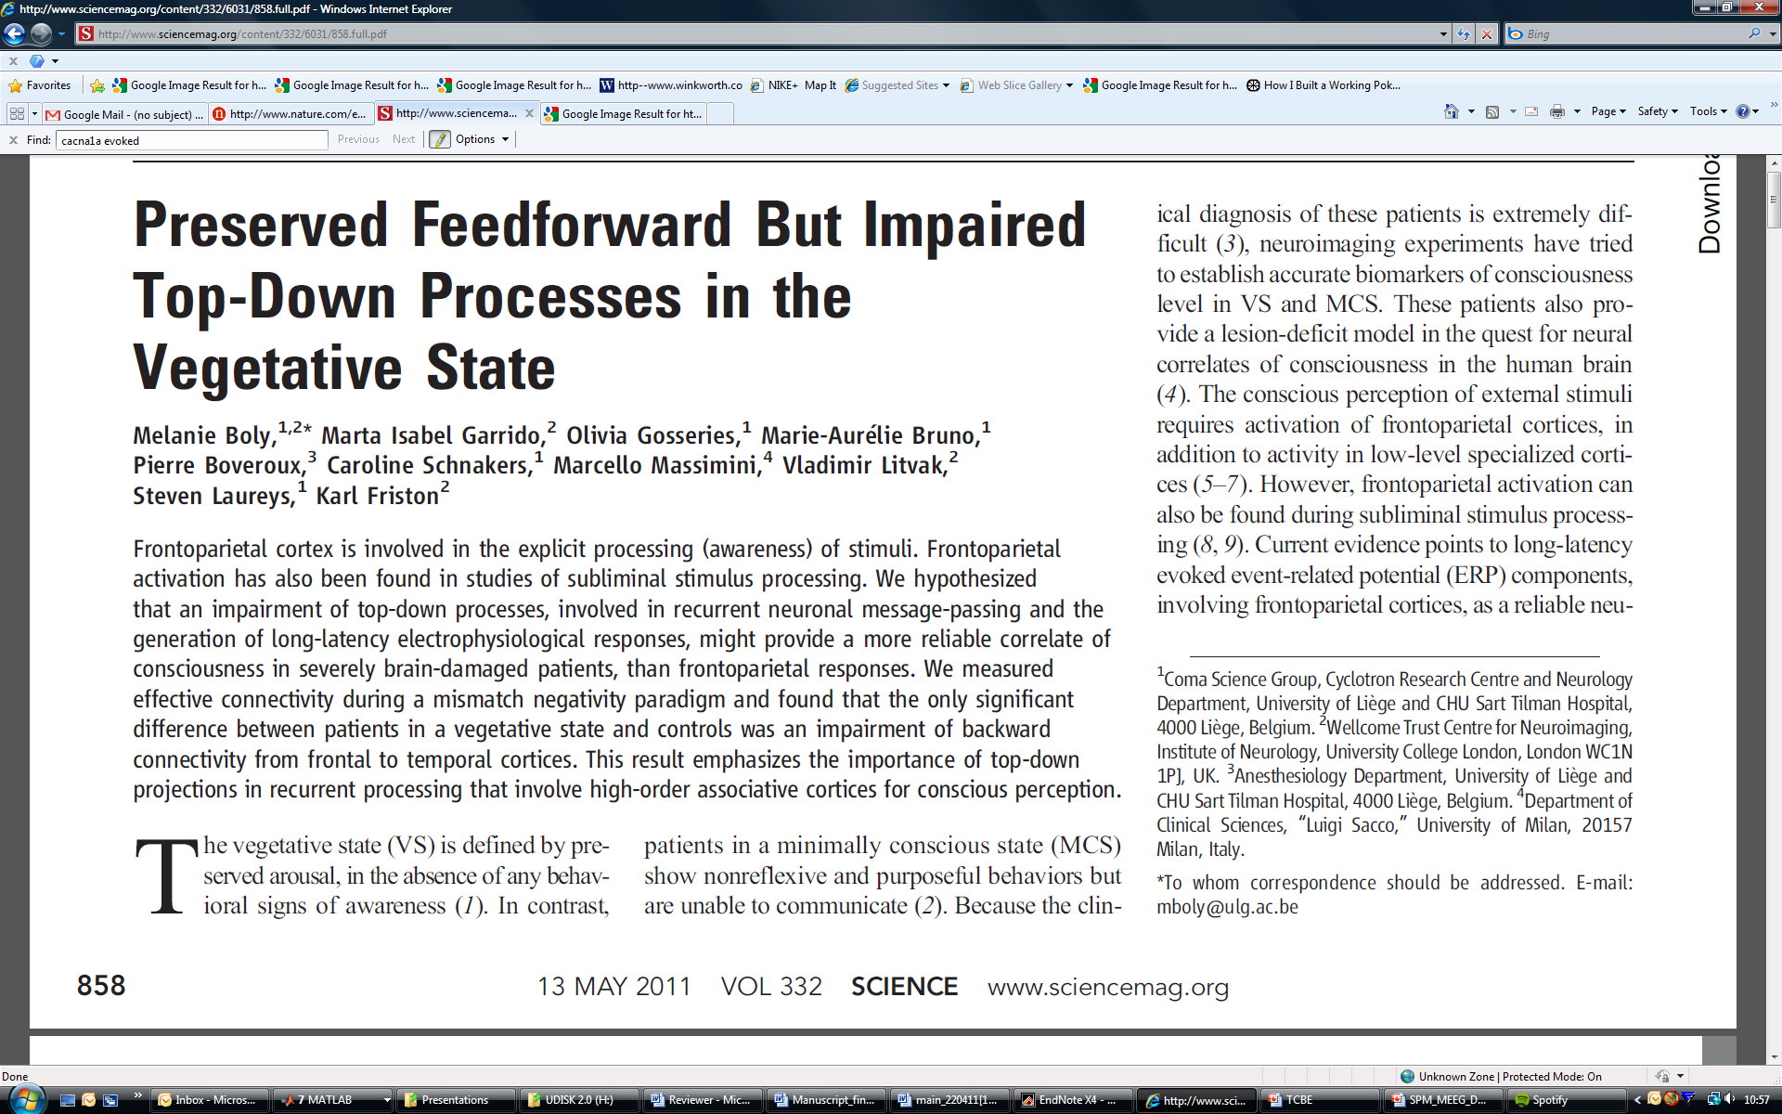
Propofol-induced loss of consciousness
ACC
PCC
Thalamus
Loss of Consciousness
:Breakdown in Cortical
Backward Connections
Boly, Moran, Murphy,
Boveroux, Bruno, Noirhomme,
Ledoux, Bonhomme, Brichant,
Tononi, Laureys, Friston, J Neuroscience, 2012

Slide 42
The Ketamine Model of Psychosis & Schizophrenia
Noncompetitive NMDA-r antagonist
Dissociative anaesthetic:
"... a peculiar anaesthetic state in which marked sensory loss and analgesia as well as amnesia is not accompanied by actual loss of consciousness.” (Bonta, 2004)
Subanaesthetic Doses:
Model of psychosis in animals, producing hyperlocomotion and disruption of PPI
Reproduces in humans both positive and negative symptoms of schizophrenia along with associated cognitive deficits.
Notes:
Faces appear convex when they are concave

Slide 43
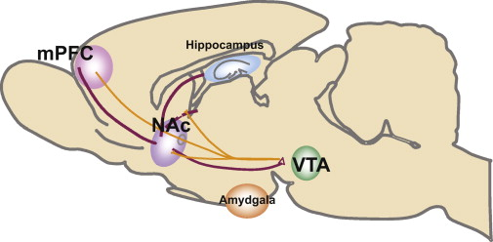
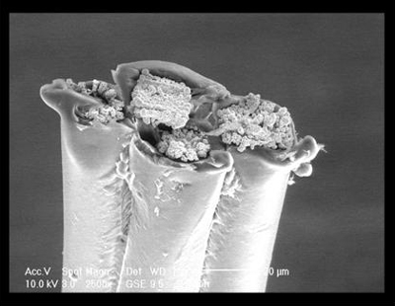
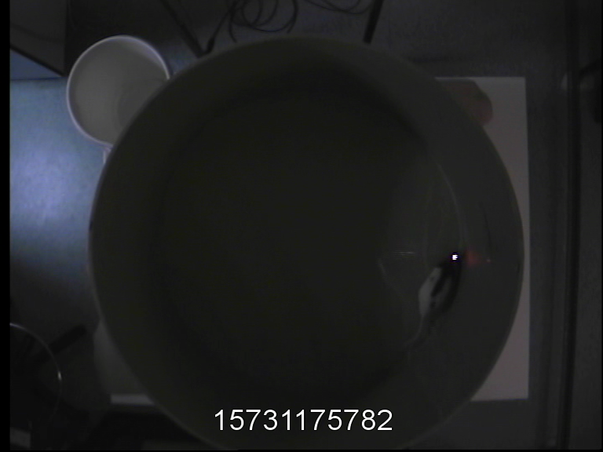
The Ketamine Model of Psychosis
& Schizophrenia
With Matthew Jones, University of Bristol
Bowers et al. 2010
Ketamine Dose: 0, 2, 4, 8, 30 mgkg-1
Hippocampal & Prefrontal Recordings
5 mins of recordings from freely moving rat: tetrodes in dCA1 & mPFC
Notes:
Add tetrode pic

Slide 44
The Ketamine Model of Psychosis & Schizophrenia
Effects on Oscillations:
Theta reduction in the hippocampus and Gamma enhancement in hippocampus and neocortex.
Antipsychotic drugs (D2 antagonists) acutely reduce cortical gamma oscillations in rats (Jones et al. 2011).
Aberrant beta and gamma synchrony observed in patient populations (Uhlhaas et al. 2008).
Reduced or enhanced gamma depending on state late/prodromal ( Sun et al. 2011).
Connectivity
Behaviour
Receptor Neurochemistry
Notes:
Faces appear convex when they are concave

Slide 45
Behavioural Phenotype
Hyper-locomotion
**
**
20
18
16
14
Speed of movement
12
10
8
6
mean ± std
4
2
4
8
0
Mg Ketamine/kg
Notes:
P_corrected -ttest=
0.3251 3.5992 0.0024 0.3981 0.0024
P – WRS
0.1349 0.8016 0.0079 0.2222 0.0079

Slide 46
Oscillatory Characteristics
40
HPC-HPC
5
35
4.5
HPC-PFC
30
4
*
**
3.5
25
Power a.u.
Power a.u.
3
20
2.5
15
2
10
1.5
1
*
5
0.5
0
0
10
20
30
40
50
60
70
80
0
0
10
20
30
40
50
60
70
80
Frequency (Hz)
Frequency (Hz)
15
Recorded
PFC-PFC
Veh (13)
2mg (8)
4mg (8)
8mg (13)
30 mg (5)
10
Power a.u.
5
*
p < 0.005 **
p < 0.05 *
5 minutes : freely moving
0
0
10
20
30
40
50
60
70
80
Frequency (Hz)
Notes:
Log 6Hz: p = 0.0049 in HPC , p = 0.0155 in cross and p = 0.61 in PFC
Log 40-60Hz : p = 0.0026 in HPC , p = 0.0166 in cross and p = 0.0008 in PFC
Log 50Hz: p = 0.073 HPC, p= 0.04 cross, p =0.0067 PFC

Slide 47
Hypothesis, Data & Model-based analysis:
NMDA
Frontal Regions
Temporal Cortex
Glutamate &
NMDA Receptor
Dopamine
Gamma
Gaba
Glutamate &
AMPA Receptor
“Bottom-up”
Hippocampal & Prefrontal Recordings
5 mins of recordings from freely moving rat: tetrodes in dCA1 & mPFC
Ketamine Dose: 0, 2, 4, 8, 30 mgkg-1
Notes:
Add tetrode pic

Slide 48
Hypothesis, Data & Model-based analysis:
40
HPC-HPC
5
35
4.5
HPC-PFC
30
4
*
What Cortico-Limbic Connectivity Changes are responsible for theta and gamma changes under ketamine?
What Intrinsic Connectivity Changes are responsible for theta and gamma changes?
What Receptors are involved at these extrinsic & intrinsic synapses?
**
3.5
25
Power a.u.
Power a.u.
3
20
2.5
15
2
10
1.5
1
*
5
0.5
0
0
10
20
30
40
50
60
70
80
0
0
10
20
30
40
50
60
70
80
Frequency (Hz)
Frequency (Hz)
15
Recorded
PFC-PFC
Veh (13)
2mg (8)
4mg (8)
8mg (13)
30 mg (5)
10
Power a.u.
5
*
p < 0.005 **
p < 0.05 *
5 minutes : freely moving
0
0
10
20
30
40
50
60
70
80
Frequency (Hz)

Slide 49
Proposed Architecture
Pyramidal Cells
Inhibitory Interneurons
AMPA Receptor
NMDA Receptor
GABA_{A} Receptor
mPFC
CA1
mPFC
HPC
iis
SPys
CA1
CA3
DPys
Notes:
Add tetrode pic

Slide 50
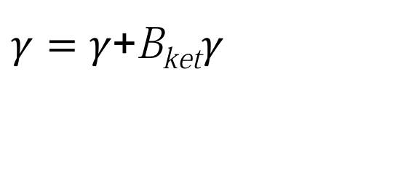
Model Comparison
Ketamine doses parametrically modulate:
All extrinsic connections,
Intrinsic NMDA and
Inhibitory / Modulatory processes
$γ=γ$+B_{ket}$γ$
mPFC
HPC
Notes:
Add tetrode pic

Slide 51
Model Comparison
Ketamine doses parametrically modulate:
All extrinsic connections,
Intrinsic NMDA and
Inhibitory / Modulatory processes
$γ=γ$+B_{ket}$γ$
mPFC
HPC
Model 1
Model 1
Notes:
Add tetrode pic

Slide 52
Model Comparison
Ketamine modulates:
All extrinsic connections,
Intrinsic NMDA and
Inhibitory / Modulatory processes
Model 2
mPFC
HPC
Model 2
Notes:
Add tetrode pic

Slide 53
Model Comparison
Ketamine modulates:
All extrinsic connections,
Intrinsic NMDA and
Inhibitory / Modulatory processes
Model 3
mPFC
HPC
Model 3
Notes:
Add tetrode pic

Slide 54
Model Comparison
Ketamine modulates:
All extrinsic connections,
Intrinsic NMDA and
Inhibitory / Modulatory processes
mPFC
HPC
Model 4
Model 4
Notes:
Add tetrode pic

Slide 55
Model Comparison
Ketamine modulates:
All extrinsic connections,
Intrinsic NMDA and
Inhibitory / Modulatory processes
mPFC
HPC
Model 5
Model 5
Notes:
Add tetrode pic

Slide 56
Model Comparison
Model 4
Pyramidal Cells
Inhibitory Interneurons
Extrinsic Input
Model 1
Model 2
Model 5
AMPA Receptor
NMDA Receptor
GABA_{A} Receptor
Model 3
Extrinsic Output
HPC
Tetrode Placement
SPy
mPFC
CA1
CA3
DPy
10000
Bayesian Model Selection: FFX
9000
8000
7000
6000
Log-evidence (relative)
5000
4000
3000
2000
1000
0
1
2
3
4
5
Models

Slide 57
Model Fits
Gamma in dCA1
Gamma in dCA1-mPFC
0.35
0.06
0.3
0.05
0.25
0.04
Spectral density
(modulus)
0.2
0.03
0.15
0.02
0.1
0.01
0.05
0
0
40
45
50
55
60
65
70
75
40
45
50
55
60
65
70
75
frequency (Hz)
Gamma in mPFC
0.35
0.3
0.25
0.2
0.15
0.1
predicted: saline vehicle
0.05
observed: saline vehicle
0
40
45
50
55
60
65
70
75
predicted: 2 mgkg⁻¹
frequency (Hz)
observed: 2 mgkg⁻¹
predicted: 4 mgkg⁻¹
observed: 4 mgkg⁻¹
Theta in dCA1
Theta in dCA1-mPFC
observed: 8 mgkg⁻¹
observed: 8 mgkg⁻¹
1.4
0.15
predicted: 30 mgkg⁻¹
1.2
observed: 30 mgkg⁻¹
Spectral density
(modulus)
0.1
1
0.8
0.6
0.05
0.4
0.2
0
0
2
4
6
8
10
2
4
6
8
10
frequency (Hz)
Theta in mPFC
0.25
0.2
0.15
0.1
0.05
0
2
4
6
8
10
frequency (Hz)

Slide 58
Extrinsic Connectivity Changes
under Ketamine
Theta Model
Gamma Model
NMDA-mediated input to HPC from mPFC
100
100
strength (%)
50
50
0
0
dCA1
mPFC
NMDA-mediated input to PFC from dCA1
100
100
strength (%)
50
50
0
0
AMPA-mediated input to PFC from dCA1
200
200
150
150
strength (%)
100
100
50
50
0
0
0
2
4
0
2
4
8
30
Ketamine Dose
Ketamine Dose

Slide 59

Intrinsic Connectivity
Changes under Ketamine
Theta Model
Gamma Model
NMDA-mediated excitation of hippocampal Interneurons
Confirmed by MUA in CA1:
High but uncorrelated unit activity
100
100
strength (%)
50
50
dCA1
0
0
1/Signal to Noise Ratio in the Hippocampus
2000
400
1500
300
strength (%)
1000
200
500
100
0
0
0
2
4
0
2
4
8
30
Ketamine Dose
Ketamine Dose
Notes:
Spinning its wheels

Slide 60
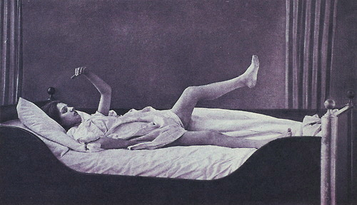

Losing Control Under Ketamine
Reduced Theta
Without NMDA
Frontal Regions
Temporal Cortex
Enhanced Gamma
With AMPA
Reduced Cortico-Limbic Control mediated by NMDA
Enhanced Limbic-Cortico Drive via AMPA:
Runaway bottom-up sensory-driven processing : disorganised cognition & environmental interactions
Large difference in intrinsic processing: early dopaminergic D2 problem in schizophrenia?

Slide 61
Why these models?

Slide 62
DCM for SSR/CSD
Why I think these models are useful:
Models of Synaptic Activity using invasive and non-invasive electrophysiological time series from large neuronal populations.
Useful models of pharmacological effects – where are the drug’s effects most prominent, are other receptors affected?
Useful link to predictive coding: top-down vs. bottom up and their belief mappings.
Potential to scale to clinical settings: could patients be stratified based on endogenous connectivity profiles?

Slide 63
DCM for SSR/CSD
Why these models can be more than mildly irritating :
Local Minima (not the model’s fault)

Slide 64

Thank You
VTCRI
Jessica Gilbert
Jian Li
Wynn Legon
Sarah Adams
Steven Punzell
Ehsan Dowlatti
Karl Friston, UCL
Matt Jones, University of Bristol
Rick Adams, UCL
Klaas Stephan, University of Zurich

