Slide 1

Group Analyses
Guillaume Flandin
Wellcome Trust Centre for Neuroimaging
University College London
With many thanks to W. Penny, S. Kiebel, T. Nichols, R. Henson, J.-B. Poline, F. Kherif
SPM Course
London, October 2016

Slide 2
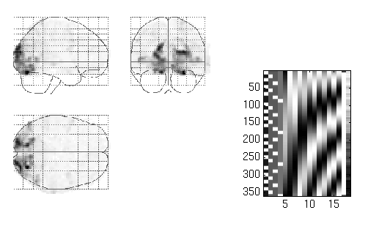
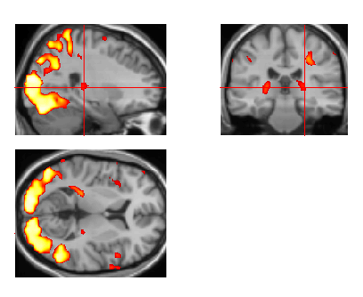

Image time-series
Spatial filter
Design matrix
Statistical Parametric Map
Realignment
Smoothing
General Linear Model
Statistical
Inference
RFT
Normalisation
Anatomical
reference
p <0.05
Parameter estimates

Slide 3
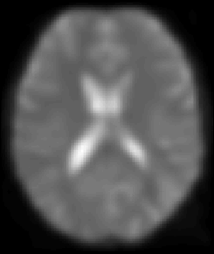
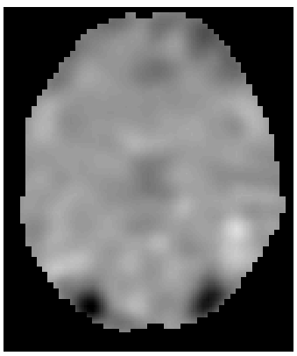
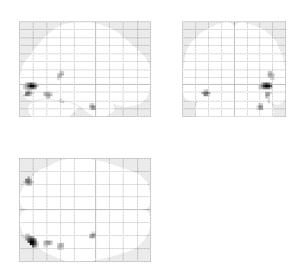
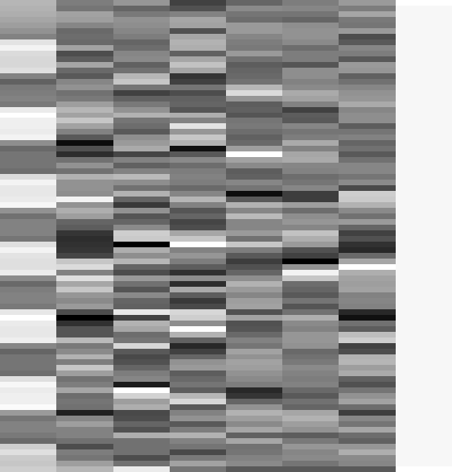
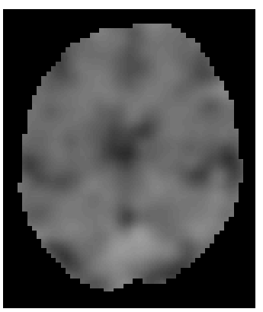
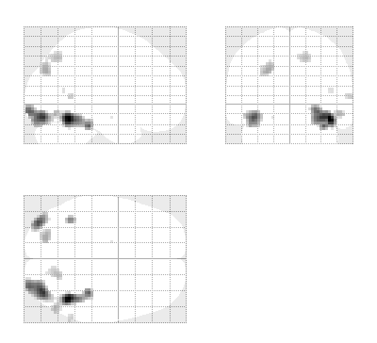
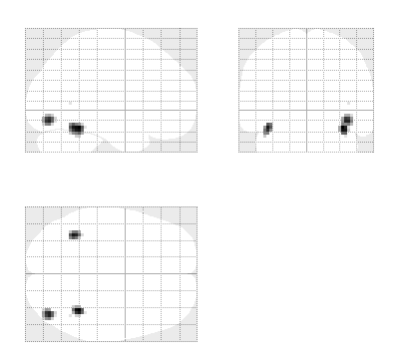
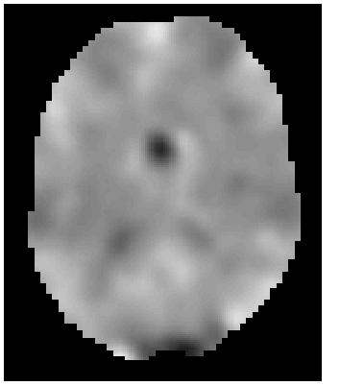
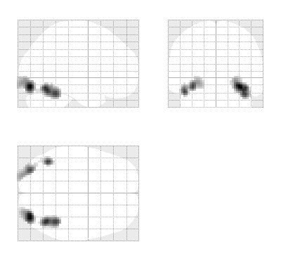
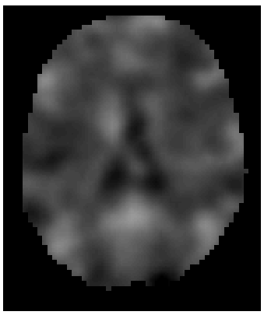
GLM: repeat over subjects
fMRI data
Design Matrix
Contrast Images
SPM{t}
Subject 1
Subject 2
…
Subject N

Slide 4
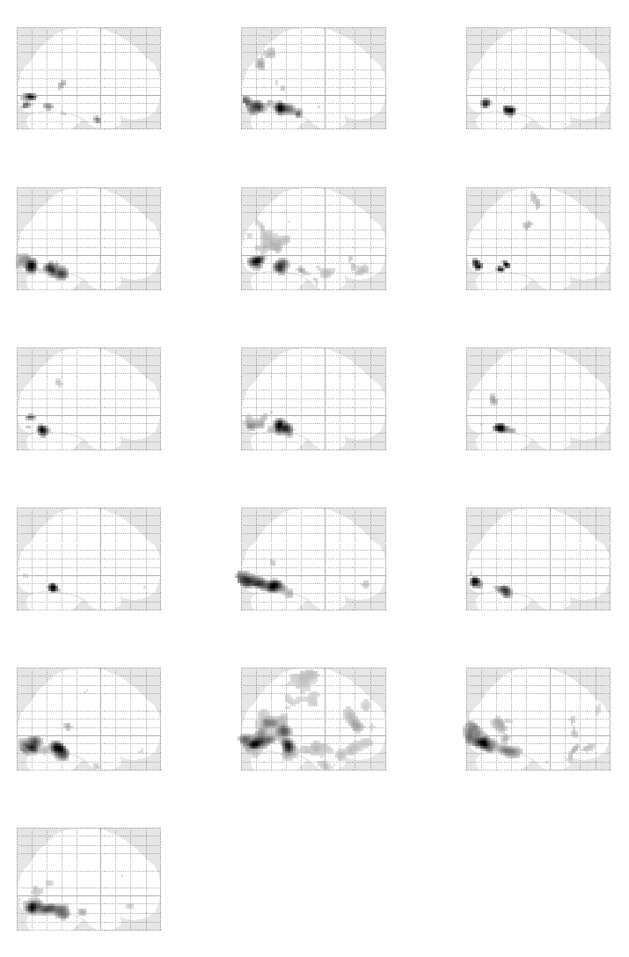
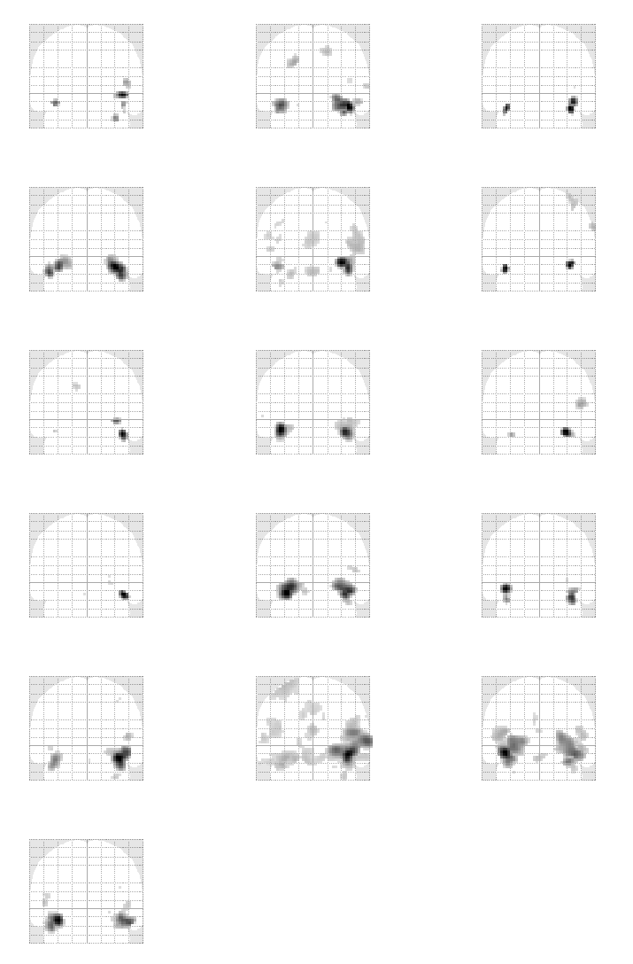
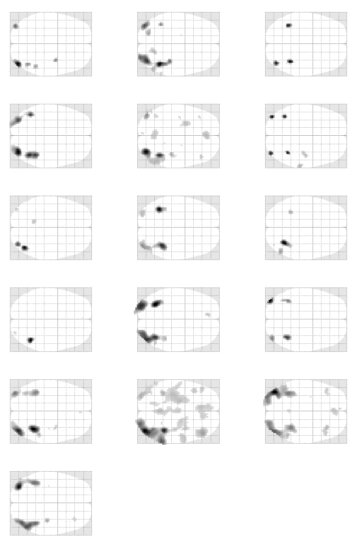
First level analyses (p<0.05 FWE):
Data from R. Henson

Slide 5
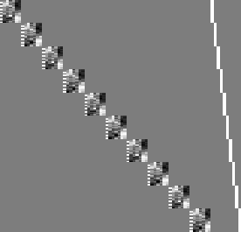
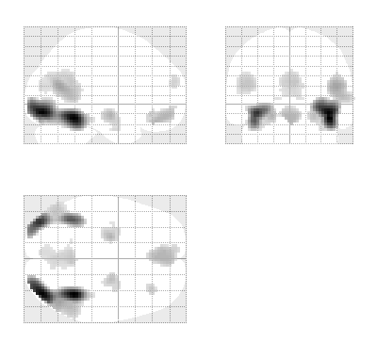
Fixed effects analysis (FFX)
Subject 1
Modelling all subjects at once
Simple model
Lots of degrees of freedom
Large amount of data
Assumes common variance over subjects at each voxel
Subject 2
Subject 3
…
Subject N

Slide 6

Fixed effects analysis (FFX)
Modelling all subjects at once
Simple model
Lots of degrees of freedom
Large amount of data
Assumes common variance over subjects at each voxel
=
+

Slide 7
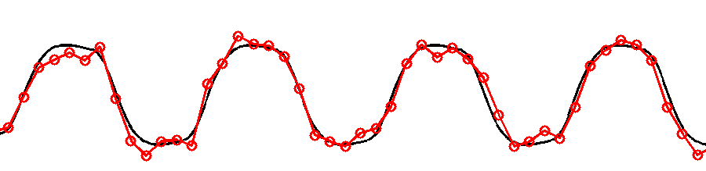
Fixed effects
Only one source of random variation (over sessions):
  measurement error
True response magnitude is fixed.
Within-subject Variance

Slide 8
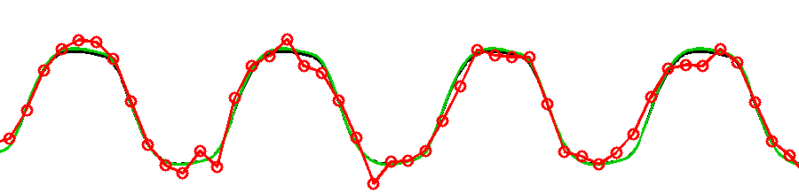
Random effects
Two sources of random variation:
  measurement errors
  response magnitude (over subjects)
Response magnitude is random
  each subject/session has random magnitude
Within-subject Variance
Between-subject Variance

Slide 9
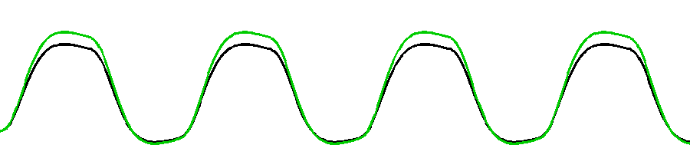
Random effects
Two sources of random variation:
  measurement errors
  response magnitude (over subjects)
Response magnitude is random
  each subject/session has random magnitude
  but population mean magnitude is fixed.
Within-subject Variance
Between-subject Variance

Slide 10
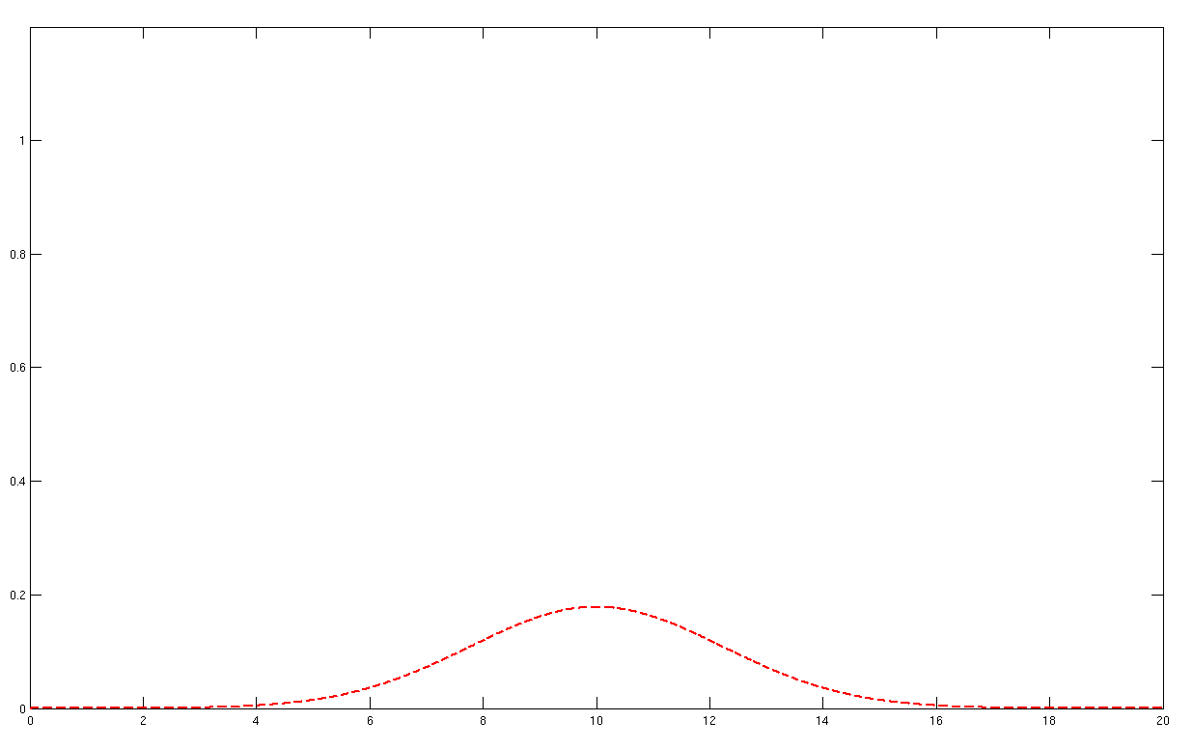
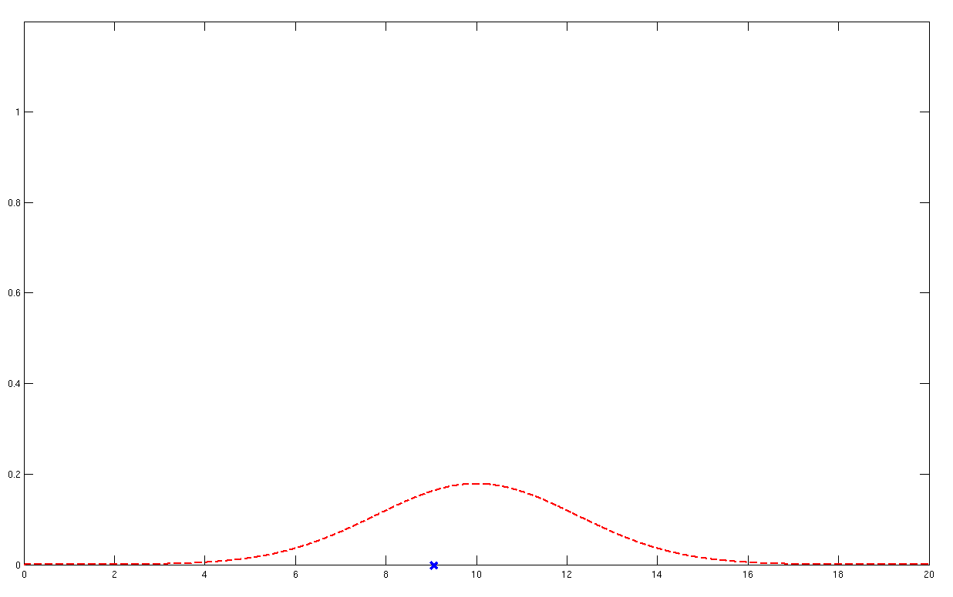
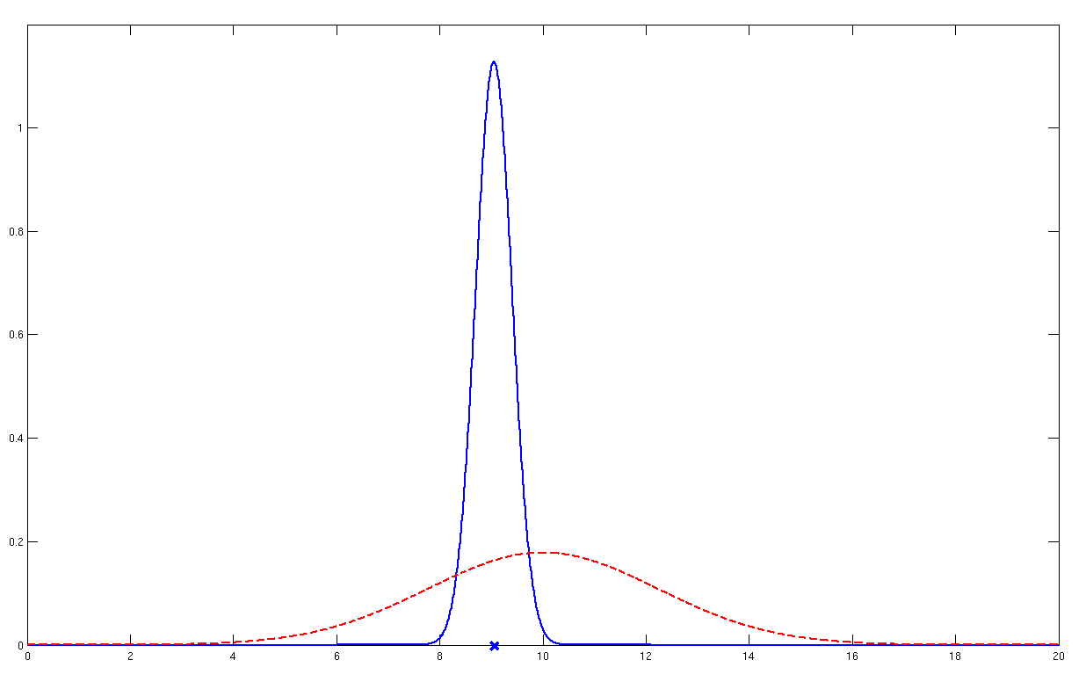
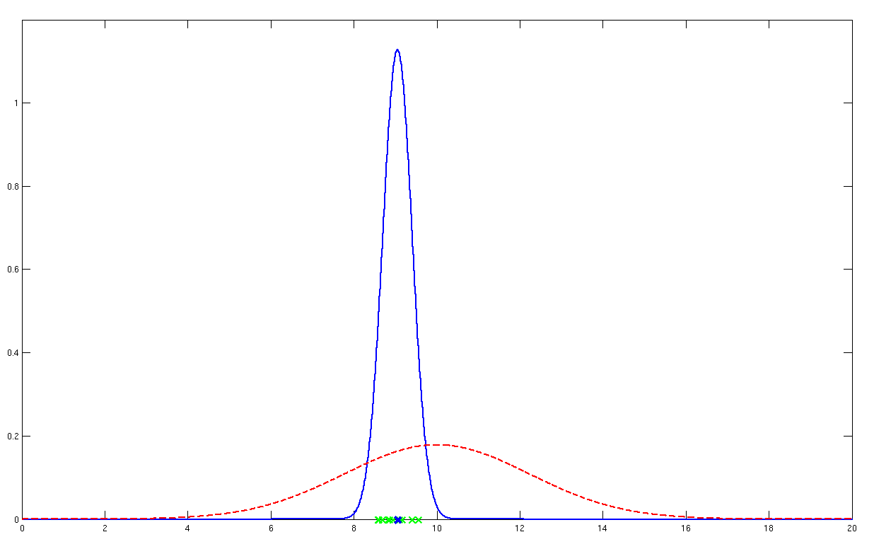
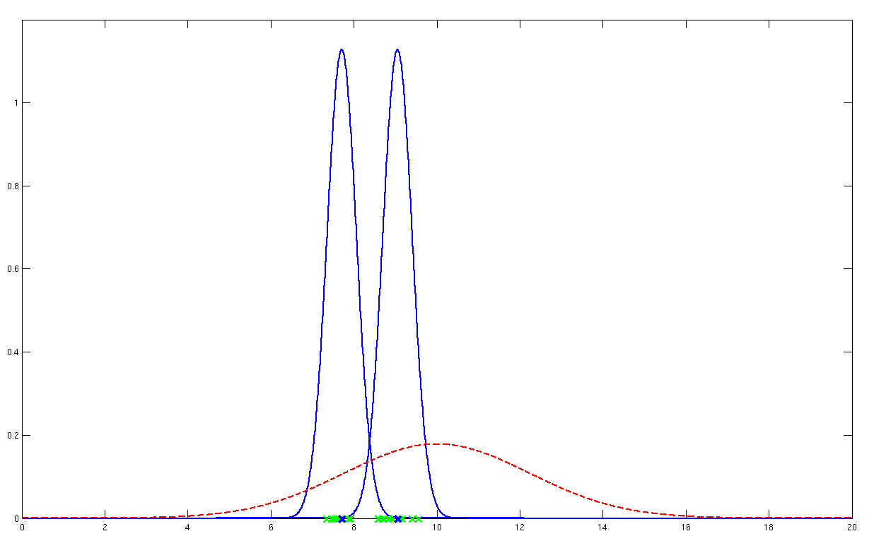
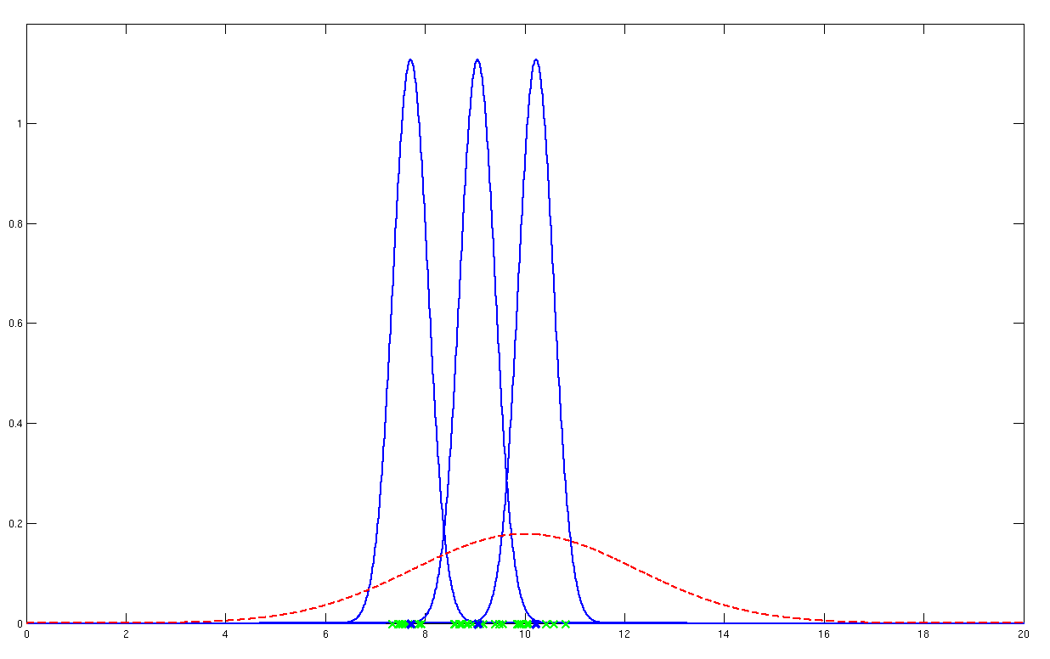
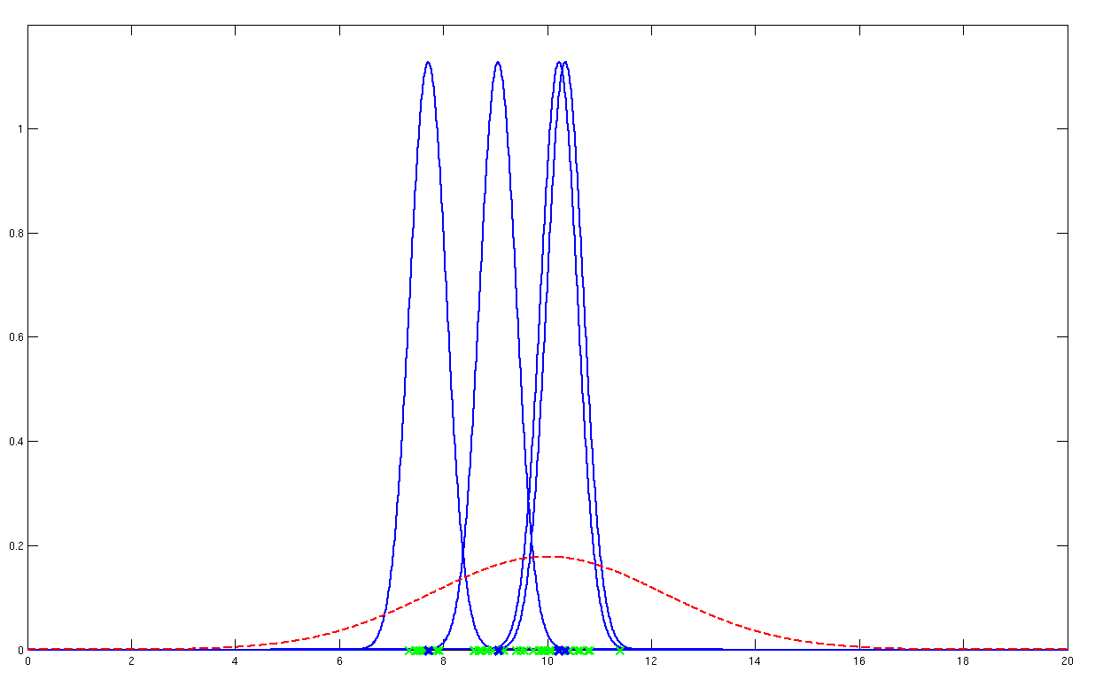
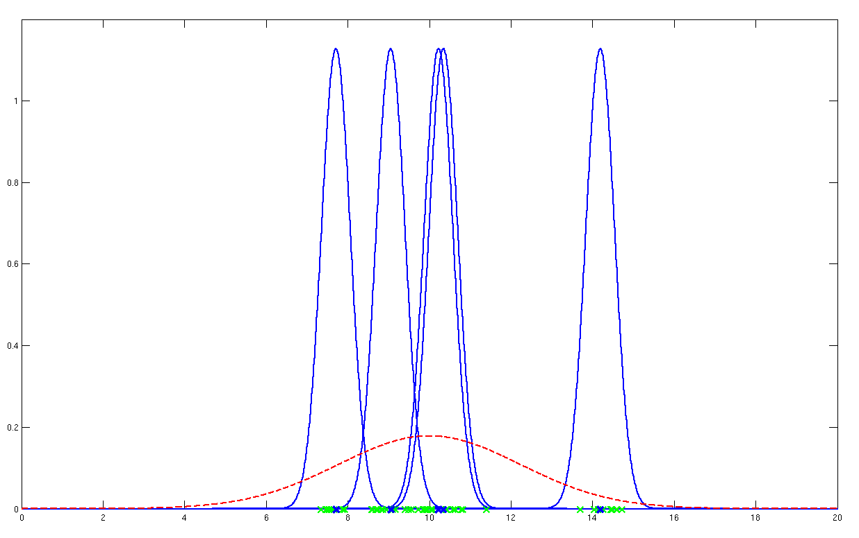


Random effects
$σ_{w}^{2}$
$σ_{b}^{2}$
Probability model underlying random effects analysis

Slide 11
Fixed vs random effects
With Fixed Effects Analysis (FFX) we compare the group effect to the within-subject variability. It is not an inference about the population from which the subjects were drawn.
With Random Effects Analysis (RFX) we compare the group effect to the between-subject variability. It is an inference about the population from which the subjects were drawn. If you had a new subject from that population, you could be confident they would also show the effect.

Slide 12
Fixed vs random effects
Fixed isn’t “wrong”, just usually isn’t of interest.
Summary:
  Fixed effects inference:
  “I can see this effect in this cohort”
  Random effects inference:
  “If I were to sample a new cohort from the same
  population I would get the same result”

Slide 13
Terminology
Hierarchical linear models:
Random effects models
Mixed effects models
Nested models
Variance components models
… all the same
… all alluding to multiple sources of variation
(in contrast to fixed effects)

Slide 14
Hierarchical models
Example: Two level model
=
+
=
+
Second level
First level

Slide 15
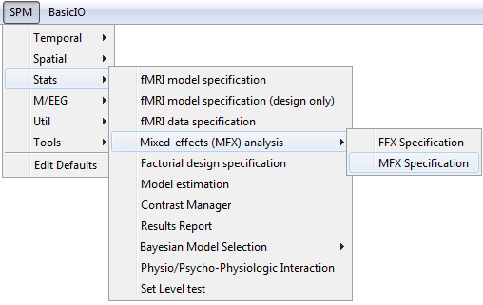
Hierarchical models
Restricted Maximum Likelihood (ReML)
Parametric Empirical Bayes
Expectation-Maximisation Algorithm
But:
Many two level models are just too big to compute.
And even if, it takes a long time!
Any approximation?
spm_mfx.m
Mixed-effects and fMRI studies. Friston et al., NeuroImage, 2005.

Slide 16
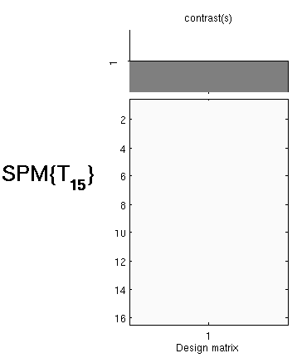
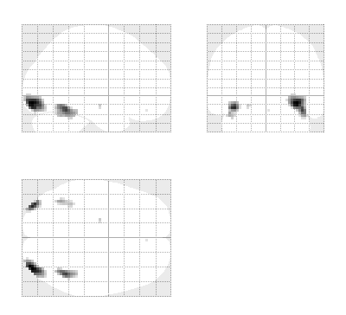
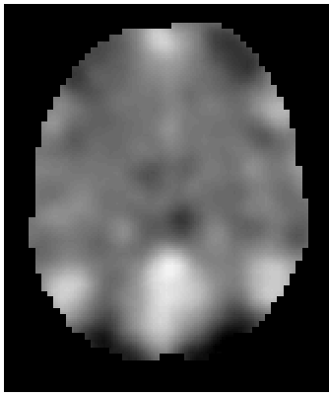
Summary Statistics RFX Approach
First level
Second level
fMRI data
Design Matrix
Contrast Images
One-sample t-test @ second level
Subject 1
…
Subject N
  Generalisability, Random Effects & Population Inference. Holmes & Friston, NeuroImage,1998.
Notes:
Two-stage procedure

Slide 17
Summary Statistics RFX Approach
Assumptions
The summary statistics approach is exact if for each session/subject:
  Within-subjects variances the same
  First level design the same (e.g. number of trials)
Other cases: summary statistics approach is robust against typical violations.
Mixed-effects and fMRI studies. Friston et al., NeuroImage, 2005.
Statistical Parametric Mapping: The Analysis of Functional Brain Images. Elsevier, 2007.
  Simple group fMRI modeling and inference. Mumford & Nichols. NeuroImage, 2009.
Notes:
Might use a hierarchical model in epilepsy research where number of seizures is not under experimental control and is highly variable over subjects.
Balanced designs

Slide 18
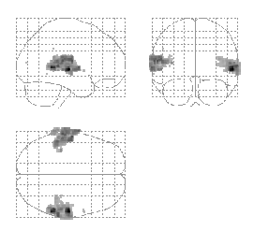
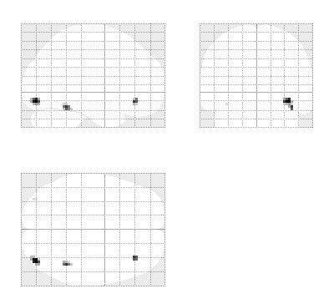

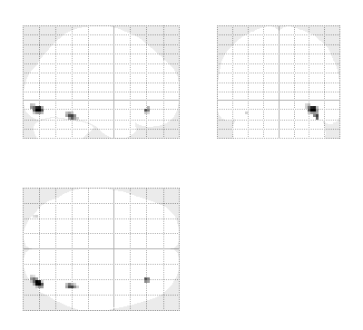
Summary Statistics RFX Approach
Robustness
Summary
statistics
Hierarchical
Model
Listening to words
Viewing faces
Mixed-effects and fMRI studies. Friston et al., NeuroImage, 2005.

Slide 19
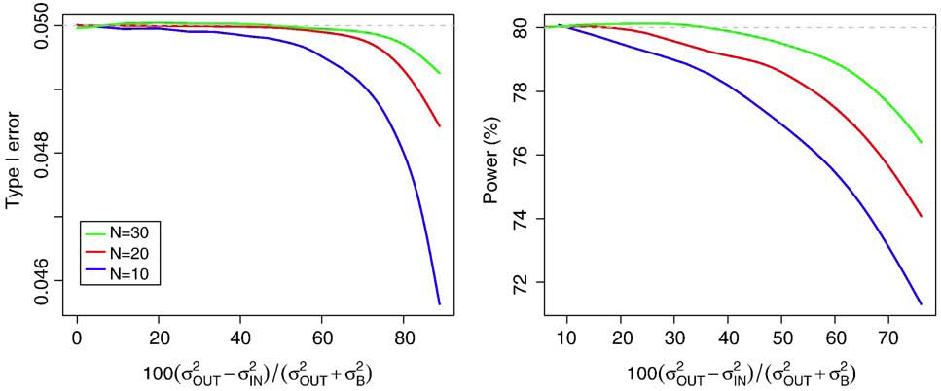
Summary Statistics RFX Approach
Robustness
In practice, validity & efficiency are excellent
  For one sample case, SS-RFX almost impossible to break
  False Positive Rate
  Power Relative to Optimal
  (outlier severity)
  (outlier severity)
  Mumford & Nichols. Simple group fMRI modeling and inference. NeuroImage, 2009.
Notes:
2-sample & correlation might give trouble
Dramatic imbalance or heteroscedasticity

Slide 20
ANOVA & non-sphericity
One effect per subject:
  Summary statistics approach
  One-sample t-test at the second level
More than one effect per subject or multiple groups:
  Non-sphericity modelling
  Covariance components and ReML

Slide 21
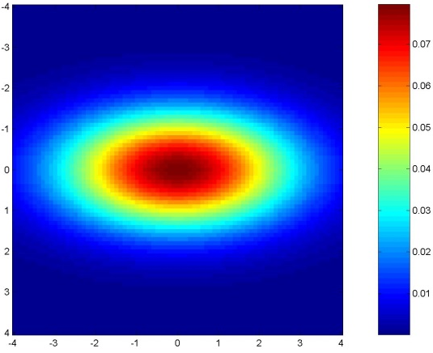
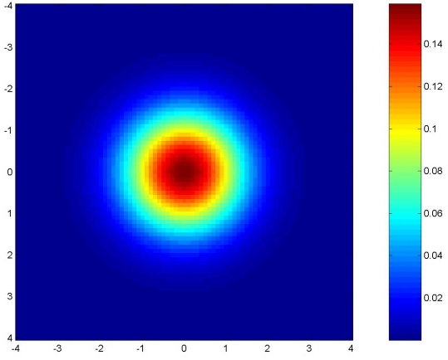
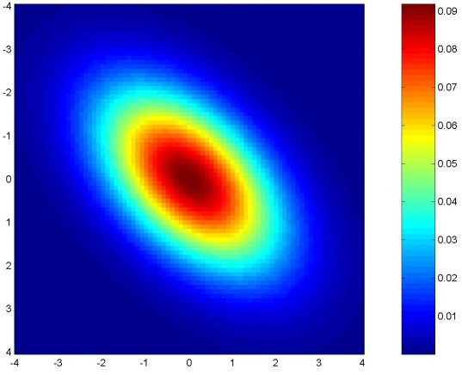
GLM assumes Gaussian “spherical” (i.i.d.) errors
sphericity = iid:
error covariance is scalar multiple of identity matrix:
Cov(e) = σ²I
Examples for non-sphericity:
non-identically
distributed
non-independent

Slide 22
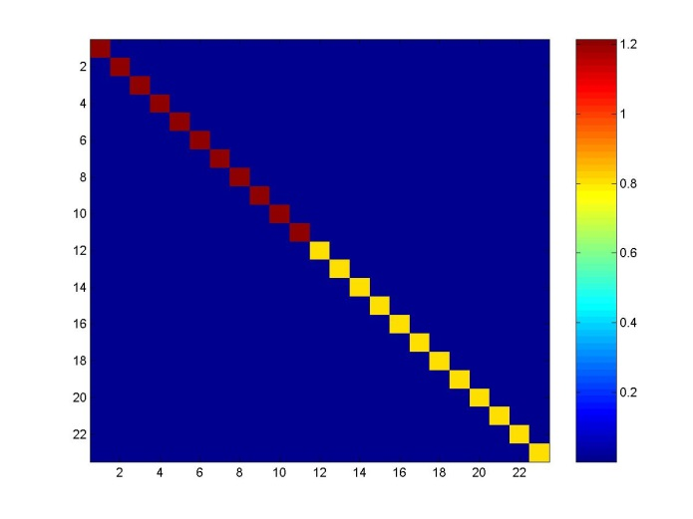
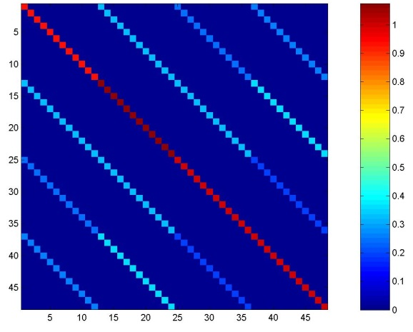
2nd level: Non-sphericity
Error covariance matrix
Errors are independent
but not identical
(e.g. different groups (patients, controls))
Errors are not independent
and not identical
(e.g. repeated measures for each subject (multiple basis functions, multiple conditions, etc.))
Notes:
Clinical populations
same subjects on placebo, drug1, drug2

Slide 23
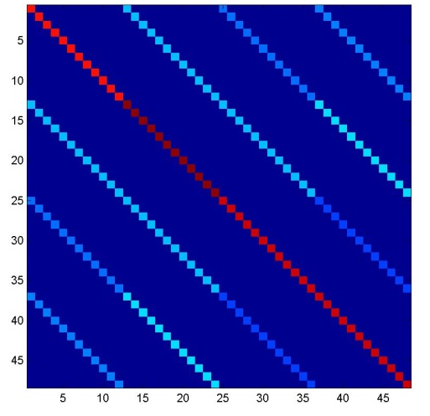
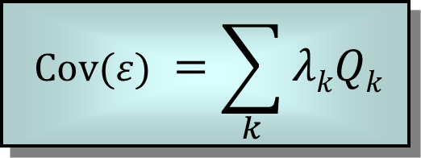
2nd level: Variance components
Error covariance matrix
$$\text{Cov}(ε) =\sum_{k}{λkQk }$$
Q_{k}’s:
Q_{k}’s:
Notes:
Clinical populations
same subjects on placebo, drug1, drug2

Slide 24
Example 1: between-subjects ANOVA
Stimuli:
  Auditory presentation (SOA = 4 sec)
  250 scans per subject, block design
  2 conditions
    Words, e.g. “book”
    Words spoken backwards, e.g. “koob”
Subjects:
  12 controls
  11 blind people
Data from Noppeney et al.

Slide 25

Example 1: Covariance components
Two-sample t-test:
  Errors are independent
  but not identical.
  2 covariance components
Q_{k}’s:
Error covariance matrix

Slide 26
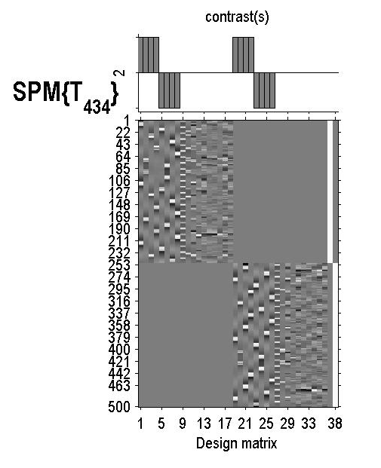


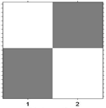
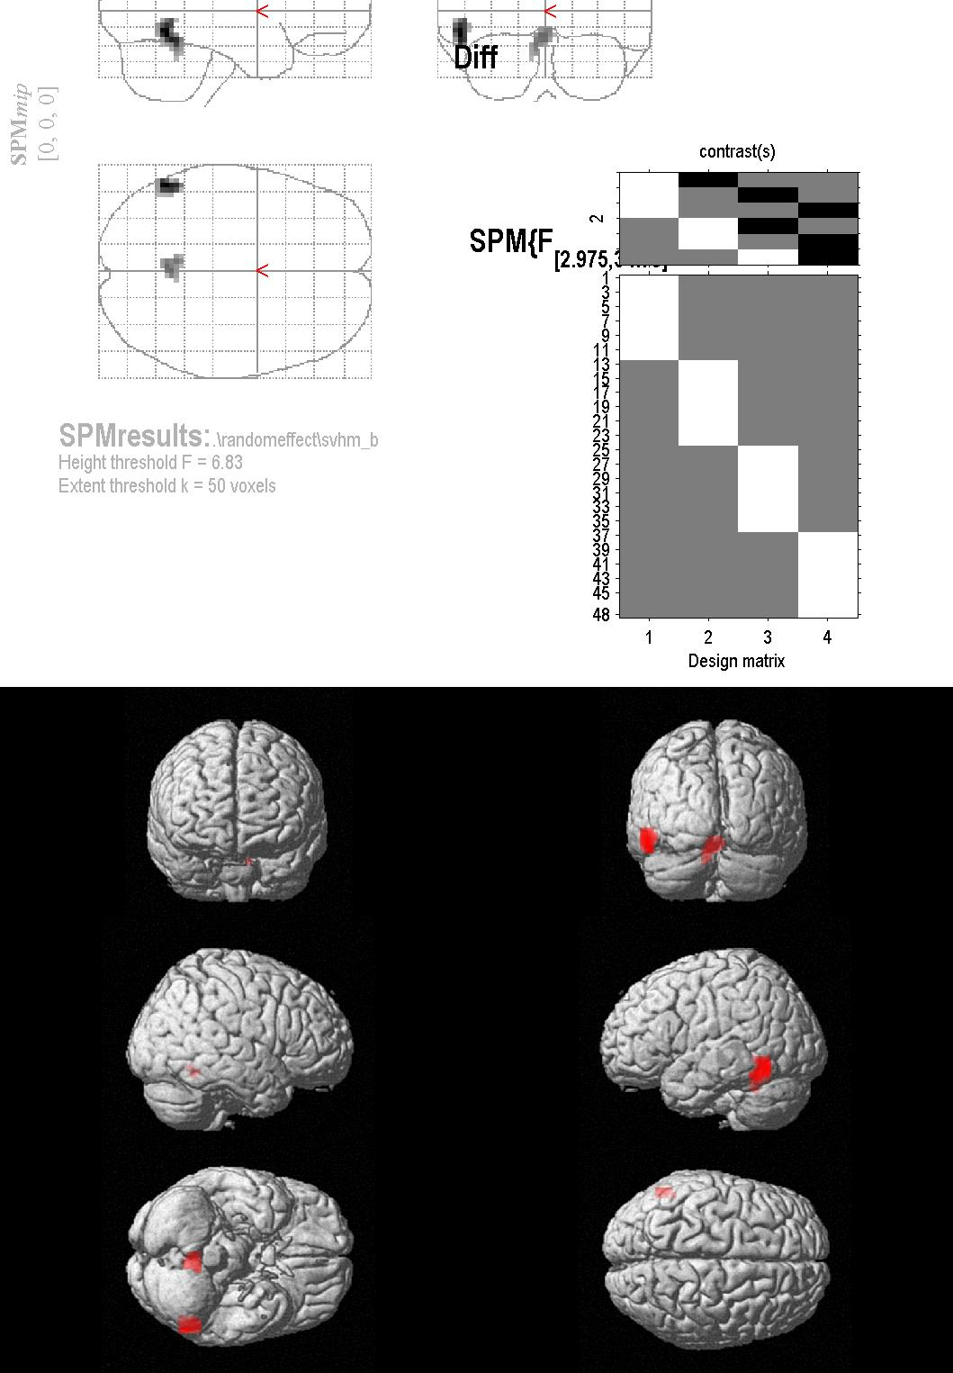
Example 1: Group differences
controls
blinds
First
Level
Second
Level
design matrix

Slide 27
Example 2: within-subjects ANOVA
Stimuli:
  Auditory presentation (SOA = 4 sec)
  250 scans per subject, block design
  Words:
Subjects:
  12 controls
Question:
  What regions are generally affected by the semantic content of the words?
Motion
Sound
Visual
Action
“jump”
“click”
“pink”
“turn”
Noppeney et al., Brain, 2003.

Slide 28

Example 2: Covariance components
Error covariance matrix
Errors are not independent
and not identical
Q_{k}’s:

Slide 29
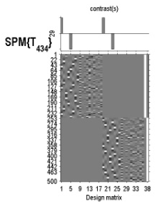


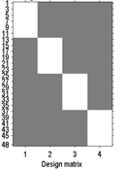
Example 2: Repeated measures ANOVA
Motion
Sound
Visual
Action
First
Level
?
?
?
=
=
=
Second
Level

Slide 30
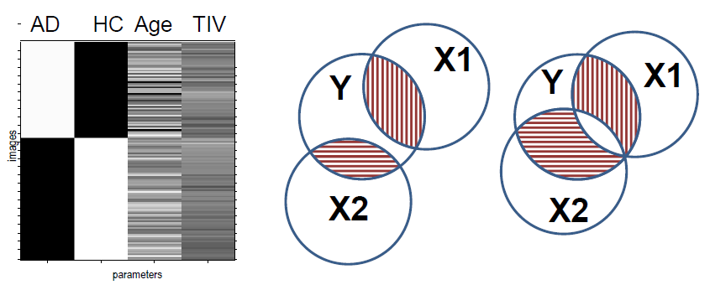
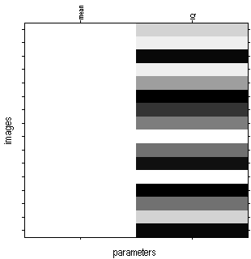
ANCOVA model
Mean centering continuous covariates for a group fMRI analysis, by J. Mumford:
http://mumford.fmripower.org/mean_centering/

Slide 31


Analysis mask: logical AND
16
12
8
4
0

Slide 32
SPM interface: factorial design specification
Many options…
  One-sample t-test
  Two-sample t-test
  Paired t-test
  Multiple regression
  One-way ANOVA
  One-way ANOVA – within subject
  Full factorial
  Flexible factorial

Slide 33





General Linear Model
$$y=Xβ+ε$$
$$y=Xβ+ε$$
X
$$ε∼N(0,σ^{2}C_{ε})$$
y
+
=
$$C_{ε}=\sum_{k}{λ_{k}Q_{k}}$$
$$C_{ε}=\sum_{k}{λ_{k}Q_{k}}$$
Model is specified by
Design matrix X
Assumptions about ε

Slide 34








One-sample t-test
Two-sample t-test
Paired t-test
One-way ANOVA
One-way ANOVA within-subject
Full Factorial
Flexible Factorial
Flexible Factorial

Slide 35
Summary
Group Inference usually proceeds with RFX analysis, not FFX. Group effects are compared to between rather than within subject variability.
Hierarchical models provide a gold-standard for RFX analysis but are computationally intensive.
Summary statistics approach is a robust method for RFX group analysis.
Can also use ‘ANOVA’ or ‘ANOVA within subject’ at second level for inference about multiple experimental conditions or multiple groups.

Slide 36

Bibliography:
Statistical Parametric Mapping: The Analysis of Functional Brain Images. Elsevier, 2007.
  Generalisability, Random Effects & Population Inference.
  Holmes & Friston, NeuroImage,1998.
Classical and Bayesian inference in neuroimaging: theory.
Friston et al., NeuroImage, 2002.
Classical and Bayesian inference in neuroimaging: variance component estimation in fMRI.
Friston et al., NeuroImage, 2002.
Mixed-effects and fMRI studies.
Friston et al., NeuroImage, 2005.
  Simple group fMRI modeling and inference.
  Mumford & Nichols, NeuroImage, 2009.

