Slide 1
An introduction to Bayesian inference
and model comparison
J. Daunizeau
ICM, Paris, France
TNU, Zurich, Switzerland

Slide 2
Overview of the talk
An introduction to probabilistic modelling
Bayesian model comparison
SPM applications

Slide 3
Overview of the talk
An introduction to probabilistic modelling
Bayesian model comparison
SPM applications

Slide 4
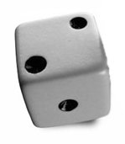
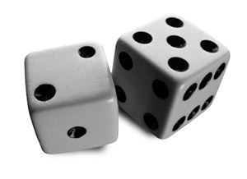


Probability theory: basics
Degree of plausibility desiderata:
- should be represented using real numbers (D1)
- should conform with intuition (D2)
- should be consistent (D3)
• normalization:
a=2
• marginalization:
• conditioning :
(Bayes rule)
b=5
a=2
Notes:
Bayesian theory of probabilities furnishes:
- a language allowing to represent information and uncertainty.
- calculus tools able to manipulate these notions in a coherent manner.
It is an extension to formal logic, which works with propositions which are either true or false.
Theory of probabilities rather works with propositions which are more or less true or more or less false.
In other words, these propositions are characterized by their degree of plausibility.
D2: e.g., a higher degree of plausibility should correspond to a higher number.
D3: i.e. should not contain contradictions.
E.g., when a result can be derived in different ways, all calculus should yield the same result.
Finally, equal states of belief should correspond to equal degrees of plausibility.
- plausibility can be measured on probability scale (sum to 1)

Slide 5
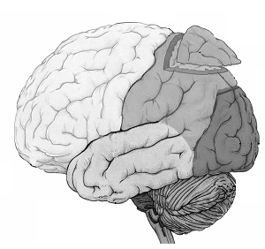
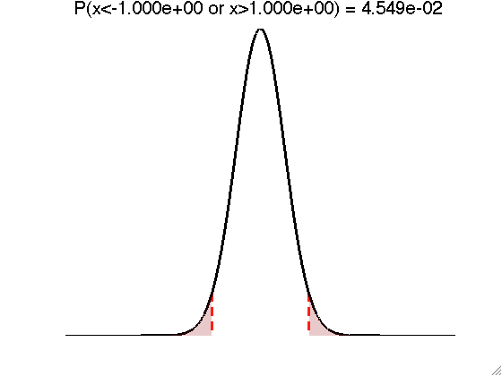
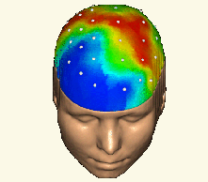
Deriving the likelihood function
- Model of data with unknown parameters:
e.g., GLM:
- But data is noisy:
- Assume noise/residuals is ‘small’:
f
→ Distribution of data, given fixed parameters:
Notes:
Bayesian theory of probabilities furnishes:
- a language allowing to represent information and uncertainty.
- calculus tools able to manipulate these notions in a coherent manner.
It is an extension to formal logic, which works with propositions which are either true or false.
Theory of probabilities rather works with propositions which are more or less true or more or less false.
In other words, these propositions are characterized by their degree of plausibility.
D2: e.g., a higher degree of plausibility should correspond to a higher number.
D3: i.e. should not contain contradictions.
E.g., when a result can be derived in different ways, all calculus should yield the same result.
Finally, equal states of belief should correspond to equal degrees of plausibility.
- plausibility can be measured on probability scale (sum to 1)

Slide 6
Forward and inverse problems
forward problem
likelihood
model
data
posterior distribution
inverse problem
Notes:
6

Slide 7

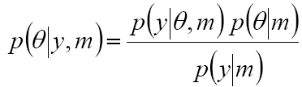
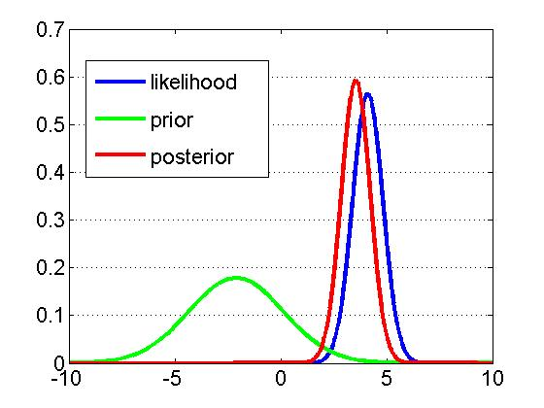
Likelihood, priors and the model evidence
Likelihood:
Prior:
Bayes rule:
generative model m
Notes:
EXAMPLE:
-Y : EEG electric potential measured on the scalp
-theta : connection strength between two nodes of a network

Slide 8
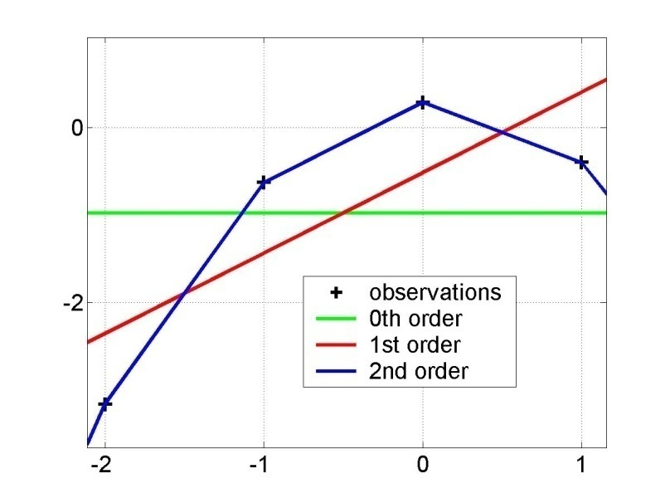
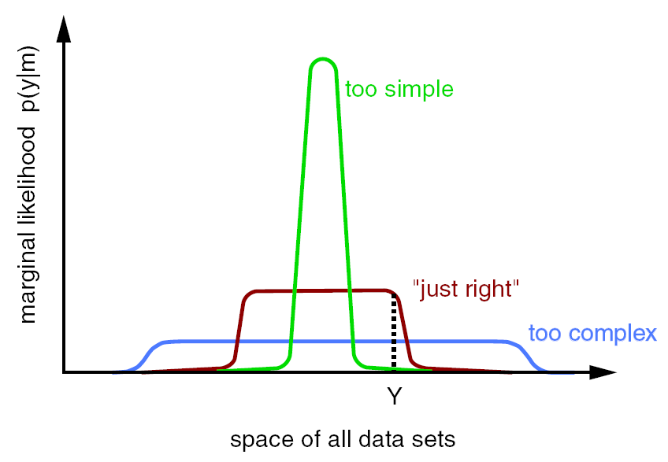
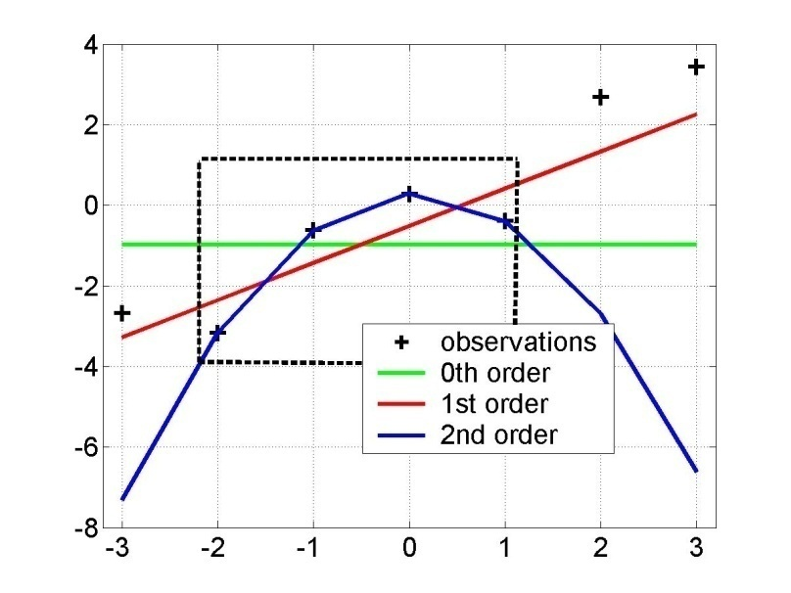
Bayesian model comparison
Principle of parsimony :
« plurality should not be assumed without necessity »
Model evidence:
y = f(x)
“Occam’s razor” :
x
model evidence p(y|m)
y=f(x)
space of all data sets

Slide 9
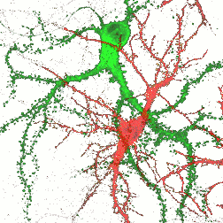

Hierarchical models
•••
inference
causality

Slide 10
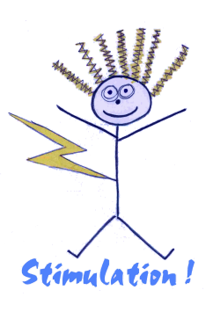
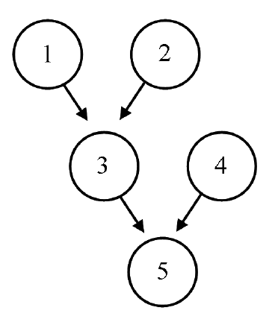

Directed acyclic graphs (DAGs)

Slide 11
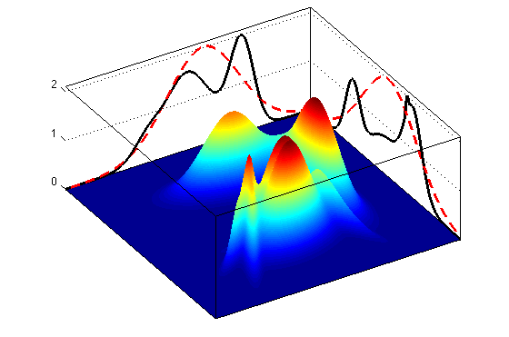
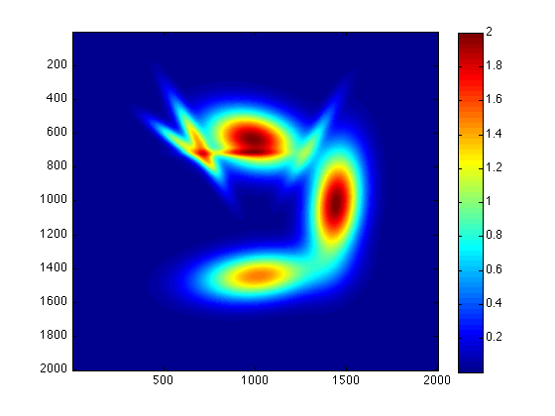
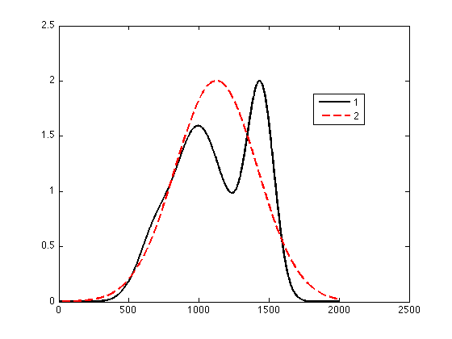
Variational approximations (VB, EM, ReML)
→ VB : maximize the free energy F(q) w.r.t. the approximate posterior q(θ)
under some (e.g., mean field, Laplace) simplifying constraint

Slide 12
Type, role and impact of priors
Types of priors:
  Explicit priors on model parameters (e.g., Gaussian)
  Implicit priors on model functional form (e.g., evolution & observation functions)
  Choice of “interesting” data features (e.g., response magnitude vs response profile)
Role of explicit priors (on model parameters):
  Resolving the ill-posedness of the inverse problem
  Avoiding overfitting (cf. generalization error)
Impact of priors:
  On parameter posterior distributions (cf. “shrinkage to the mean” effect)
  On model evidence (cf. “Occam’s razor”)

Slide 13
Overview of the talk
An introduction to probabilistic modelling
Bayesian model comparison
SPM applications

Slide 14
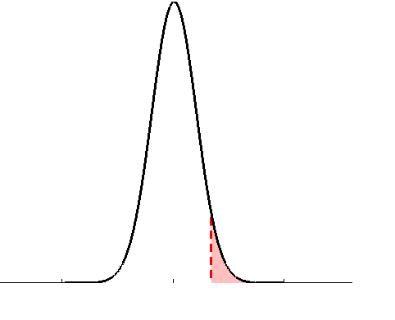
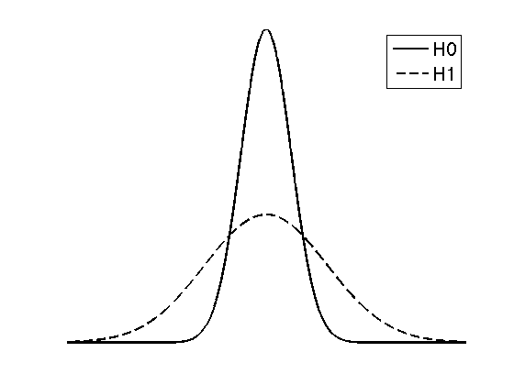
Frequentist versus Bayesian inference
• define the null, e.g.:
• define two alternative models, e.g.:
• estimate parameters (obtain test stat.)
space of all datasets
• apply decision rule, i.e.:
• apply decision rule, e.g.:
if
then reject H0
if
then accept m₀
classical (null) hypothesis testing
Bayesian Model Comparison

Slide 15
Family-level inference
model selection error risk:
P(m₁|y) = 0.04
P(m₂|y) = 0.25
A
B
A
B
P(m₂|y) = 0.01
P(m₂|y) = 0.7
A
B
A
B
u
u

Slide 16
Family-level inference
model selection error risk:
P(m₁|y) = 0.04
P(m₂|y) = 0.25
A
B
A
B
family inference
(pool statistical evidence)
P(m₂|y) = 0.01
P(m₂|y) = 0.7
A
B
A
B
u
u
P(f₁|y) = 0.05
P(f₂|y) = 0.95

Slide 17
Sampling subjects as marbles in an urn
→ i^{th} marble is blue
→ i^{th} marble is purple
= frequency of blue marbles in the urn
→ (binomial) probability of drawing a set of n marbles:
…
Thus, our belief about the frequency of blue marbles is:

Slide 18
RFX group-level model comparison
At least, we can measure how likely is the i^{th} subject’s data under each model!
…
…
…
Our belief about the frequency of models is:
…
Exceedance probability:

Slide 19
SPM: frequentist vs Bayesian RFX analysis
parameter estimates
subjects

Slide 20
Overview of the talk
An introduction to probabilistic modelling
Bayesian model comparison
SPM applications

Slide 21



segmentation
and normalisation
posterior probability
maps (PPMs)
dynamic causal
modelling
multivariate
decoding
realignment
smoothing
general linear model
statistical
inference
Gaussian
field theory
normalisation
p <0.05
template

Slide 22
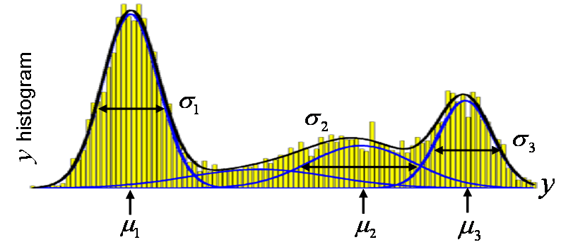
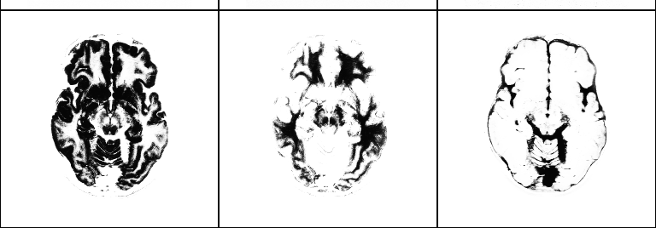
aMRI segmentation
mixture of Gaussians (MoG) model
class variances
…
i^{th} voxel
label
…
i^{th} voxel
value
class
frequencies
class
means
grey matter
white matter
CSF

Slide 23
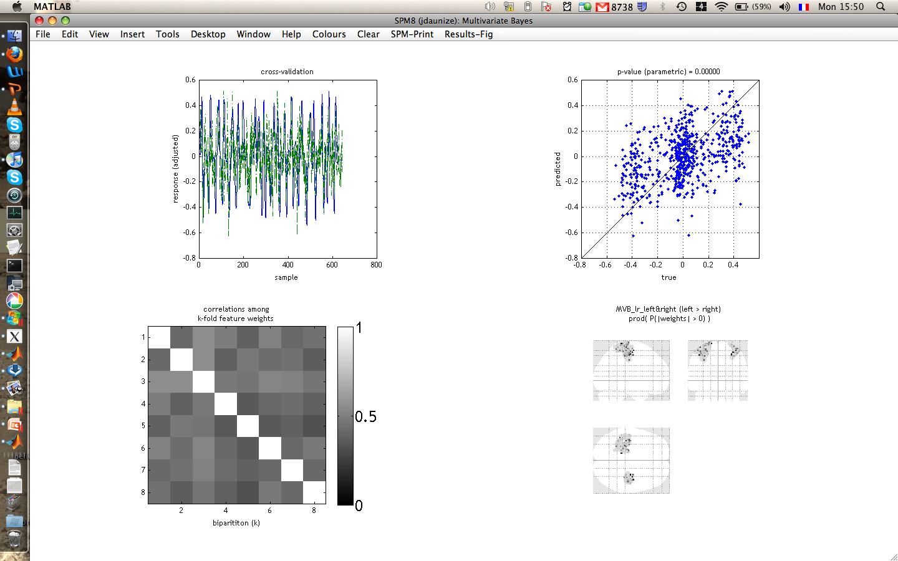

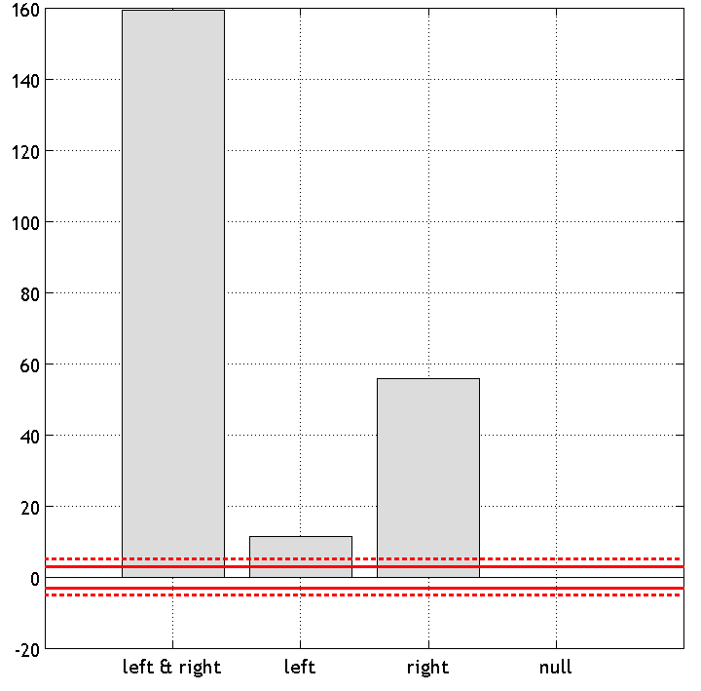
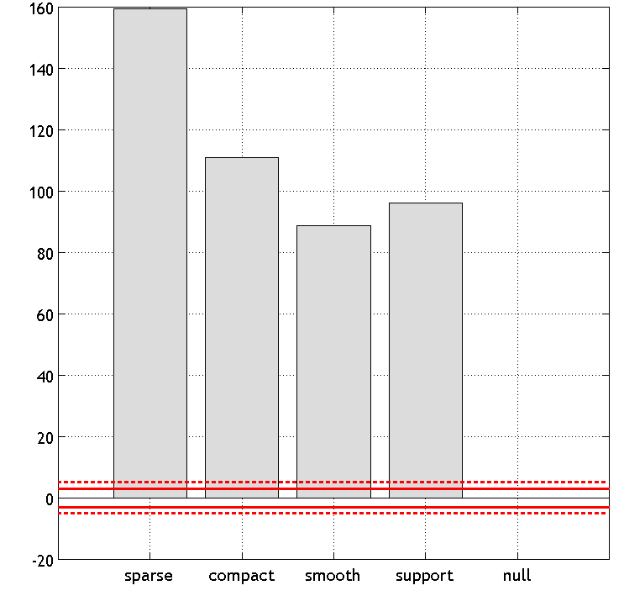
Decoding of brain images
recognizing brain states from fMRI
fixation cross
pace
response
+
>>
log-evidence of X-Y sparse mappings:
effect of lateralization
log-evidence of X-Y bilateral mappings:
effect of spatial deployment

Slide 24
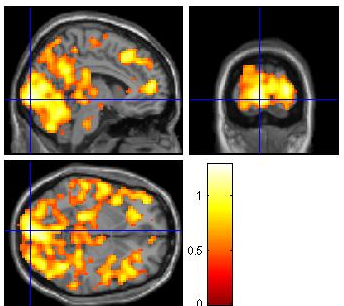
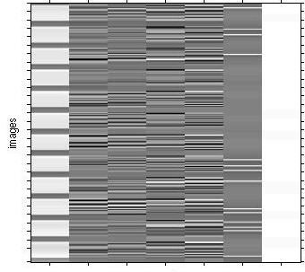
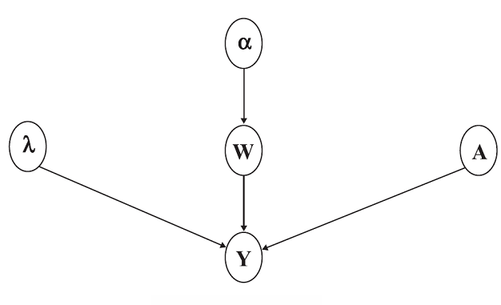
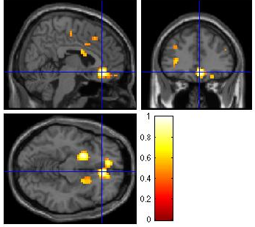
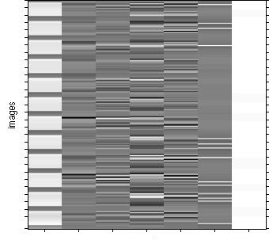
fMRI time series analysis
spatial priors and model comparison
PPM: regions best explained
by short-term memory model
short-term memory
design matrix (X)
prior variance
of GLM coeff
PPM: regions best explained by long-term memory model
prior variance
of data noise
AR coeff
(correlated noise)
long-term memory
design matrix (X)
GLM coeff
fMRI time series

Slide 25
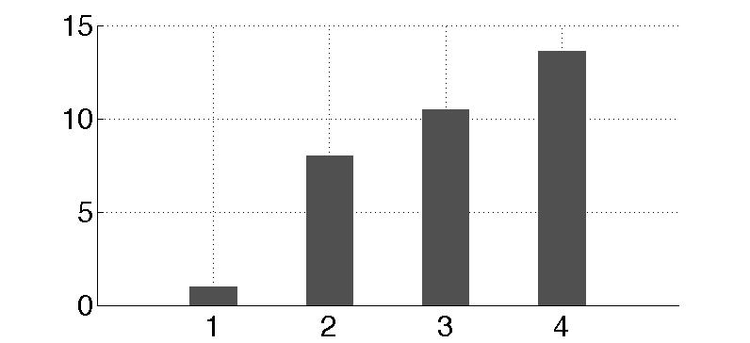
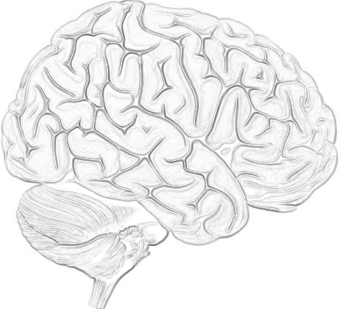
Dynamic Causal Modelling
network structure identification
m₁
m₂
m₃
m₄
attention
attention
attention
attention
PPC
PPC
PPC
PPC
stim
V1
V5
stim
V1
V5
stim
V1
V5
stim
V1
V5
attention
models marginal likelihood
0.10
estimated
effective synaptic strengths
for best model (m₄)
15
PPC
0.39
10
1.25
0.26
stim
0.26
V1
0.13
V5
5
0.46
0
m₁
m₂
m₃
m₄

Slide 26
I thank you for your attention.

Slide 27
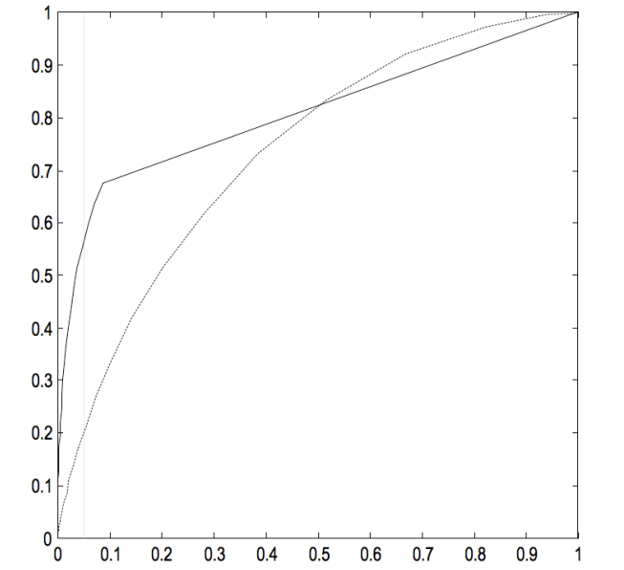
A note on statistical significance
lessons from the Neyman-Pearson lemma
Neyman-Pearson lemma: the likelihood ratio (or Bayes factor) test
is the most powerful test of size to test the null.
what is the threshold u, above which the Bayes factor test yields a error I rate of 5%?
ROC analysis
MVB (Bayes factor)
u=1.09, power=56%
1 - error II rate
CCA (F-statistics)
F=2.20, power=20%
error I rate

