Slide 1
Dynamic Causal Modelling
Introduction
SPM Course (fMRI), October 2016
Sasha Ondobaka
Wellcome Trust Centre for Neuroimaging
University College London
(thanks to Peter Zeidman for the slides)

Slide 2
Dynamic Causal Modelling (DCM)
.
z
z
DCM explains how current neural states (z),
external inputs (u) and connectivity strengths (θ)
generate or produce observed fMRI data.
Notes:
DCM is an approach used to model connectivity or coupling among neuronal populations, using neuroimaging data (BOLD).

Slide 3
Overview
DCM basics
  Effective connectivity
  DCM framework for effective connectivity
  generative models
Generative Model specification
  Neural and haemodynamic models
Model estimation or inversion
  model inversion (fitting the data to the model)
  parameter inference (making sense of connectivity)
Preparing data and an example

Slide 4
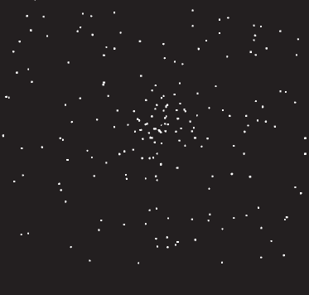
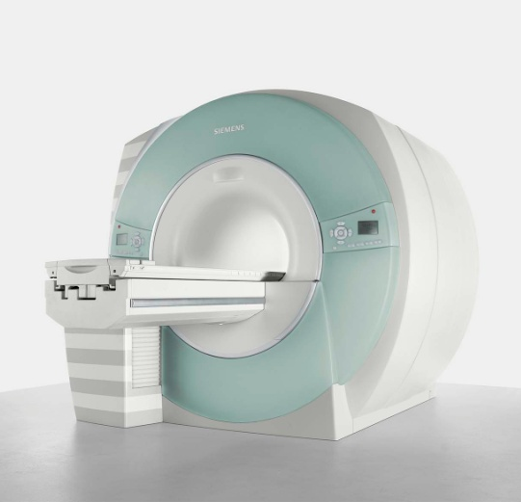
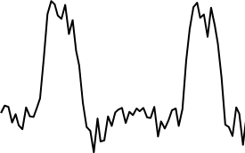
Classical fMRI analysis
Experimental Stimulus
Observations (BOLD)
Vector u
Vector y
on
BOLD
off
time
time
Stimulus from Buchel and Friston, 1997
Notes:
Experimental stimulation causes changes in neural activity. Neural activity in turn causes the BOLD response, which we observe via the scanner.

Slide 5
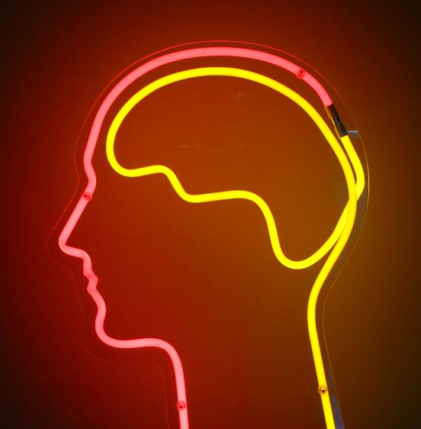
The dynamic system of interest
Experimental Stimulus
(Hidden) Neural dynamics
Observations (BOLD)
Vector u
Vector y
on
?
BOLD
off
time
time
Stimulus from Buchel and Friston, 1997
Brain by Dierk Schaefer, Flickr, CC 2.0
Notes:
We are interested in the hidden neural activity, which we cannot directly observe - so it must be estimated or inferred.

Slide 6
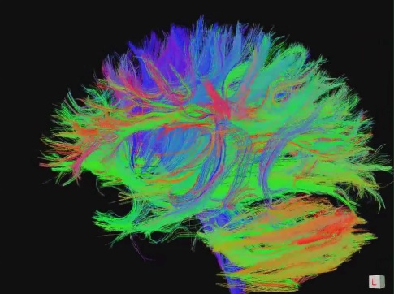
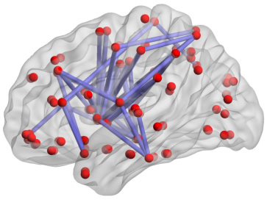
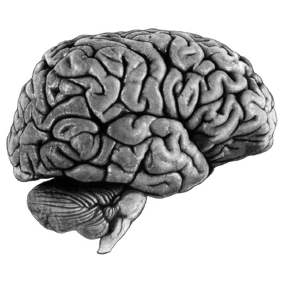
Different sorts of Connectivity
Structural Connectivity
Physical connections of the brain
Functional Connectivity
Dependencies between BOLD observations
Effectivity Connectivity
Causal relationships between brain regions
"Connectome" by jgmarcelino. CC 2.0 via Wikimedia Commons
Figure 1, Hong et al. 2013 PLOS ONE.
KE Stefan, SPM Course 2011
Notes:
Connectivity analysis is another way to look at neural activity. The most interesting or informative one, if your aim is to understand the brain function is effective connectivity – interactions at the neural level.

Slide 7
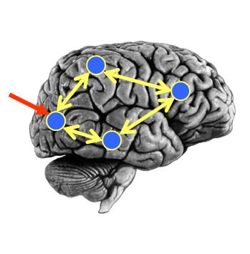
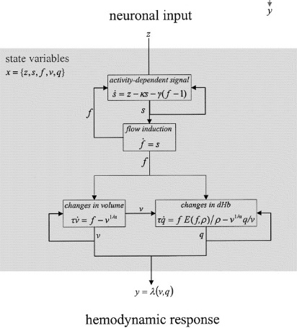

DCM approach
Neural Model
Observation Model
Experimental Stimulus (u)
Observations (y)
How brain activity z changes over time
What we would see in the scanner, y, given the neural model?
.
z = f(z,u,θ^{n})
y = g(z, θ^{h})
Stimulus from Buchel and Friston, 1997
Figure 3 from Friston et al., Neuroimage, 2003
Brain by Dierk Schaefer, Flickr, CC 2.0

Slide 8
DCM approach
Neural Model
Observation Model
Experimental Stimulus (u)
Observations (y)
Generative model
Stimulus from Buchel and Friston, 1997
Figure 3 from Friston et al., Neuroimage, 2003
Brain by Dierk Schaefer, Flickr, CC 2.0

Slide 9
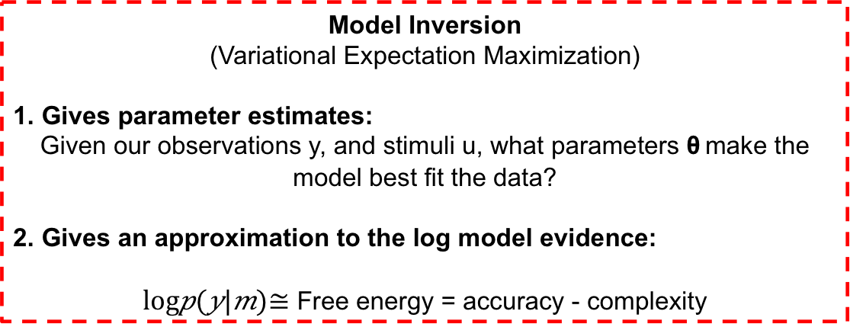
DCM approach
Neural Model
Observation Model
Experimental Stimulus (u)
Observations (y)
Model Inversion
(Variational Expectation Maximization)
1. Gives parameter estimates:
Given our observations y, and stimuli u, what parameters θ make the model best fit the data?
2. Gives an approximation to the log model evidence:
$log⁡p(y|m)≅$ Free energy = accuracy - complexity

Slide 10



DCM approach
Experimental Stimulus (u)
Neural Model
Observation Model
Observations (y)
Model 1:
Model comparison: Which model best explains my observed data?
Experimental Stimulus (u)
Neural Model
Observation Model
Observations (y)
Model 2:

Slide 11
DCM approach
We embody each of our hypotheses in a generative model.
  the generative model separates neural activity from haemodynamics
We perform model estimation (inversion)
  The inversion identifies:
  parameters θ = {θ^{n},θ^{h}} which make the model best fit the data
  free energy (F) that represents log model evidence
We inspect the estimated parameters and/or we compare models to see which best explains the data.

Slide 12
Overview
DCM basics
  Effective connectivity
  DCM framework
  generative models
Generative Model specification
  Neural and haemodynamic models
Model estimation or inversion
  model inversion (fitting the data to the model)
  parameter inference (making sense of connectivity)
Example

Slide 13
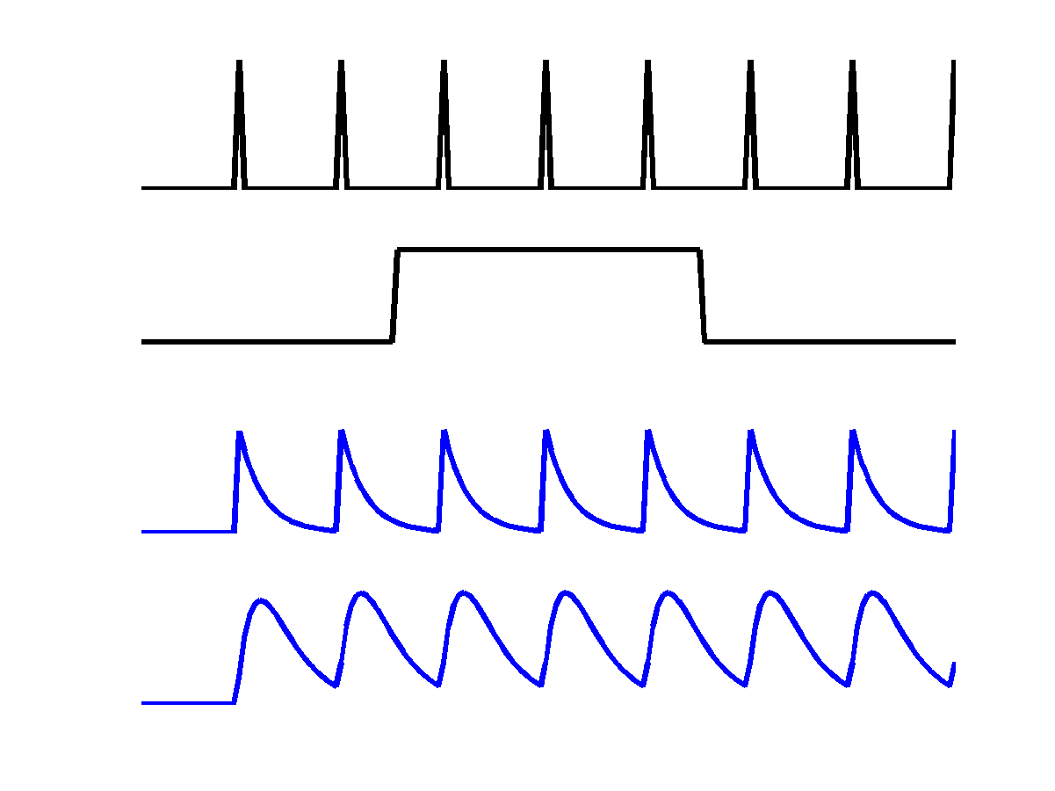
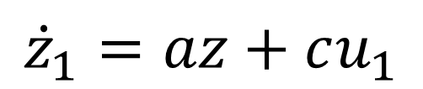
How does brain activity (z) change over time
V1
u₁
z₁
a
c
z₁
Driving input u₁
z₂
$${\dot{z}}_{1}=az+cu_{1}$$
Inhibitory self-connection (Hz).
Rate constant: controls rate of decay in region 1.
More negative = stronger connectivity (faster decay)

Slide 14


How does brain activity (z) change over time
Change of activity in V1:
V5
a₂₂
z₂
$${\dot{z}}_{1}=a_{11}z_{1}+c_{11}u_{1}$$
a₂₁
Change of activity in V5:
V1
$${\dot{z}}_{2}=a_{22}z_{2}+a_{21}z_{1}$$
z₁
a₁₁
c₁₁
Self decay
V1 input
driving input (stimulus) u₁

Slide 15
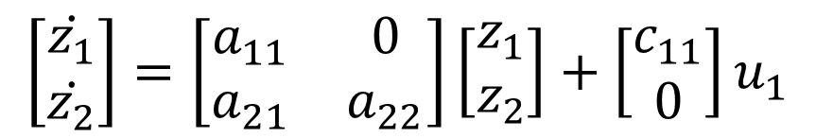

How does brain activity (z) change over time
$$\left[\begin{matrix}\dot{z_{1}} \\ \dot{z_{2}}\end{matrix}\right]=\left[\begin{matrix}a_{11} & 0 \\ a_{21} & a_{22}\end{matrix}\right]\left[\begin{matrix}z_{1} \\ z_{2}\end{matrix}\right]+\left[\begin{matrix}c_{11} \\ 0\end{matrix}\right]u_{1}$$
V5
a₂₂
z₂
a₂₁
Columns are outgoing connections
Rows are incoming connections
V1
z₁
a₁₁
$$\dot{z}=Az+Cu_{1}$$
c₁₁
driving input (stimulus) u₁

Slide 16

How does brain activity (z) change over time
$$\dot{z}=Az+Cu_{1}$$
V5
a₂₂
z₂
u₁
a₂₁
V1
z₁
a₁₁
z₁
z₂
c₁₁
driving input (stimulus) u₁

Slide 17
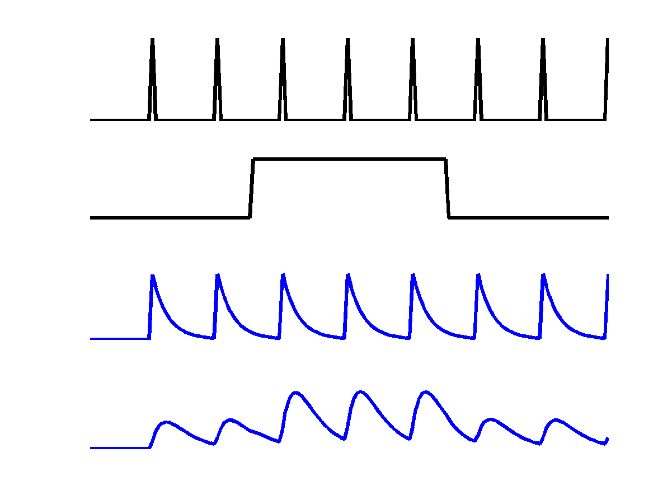
How does brain activity (z) change over time
V5
a₂₂
u₁
z₂
b₂₁
u₂
a₂₁
Attention u₂
V1
z₁
z₁
a₁₁
c₁₁
z₂
driving input (stimulus) u₁
Could model be used to model a main effect and interaction

Slide 18


How does brain activity (z) change over time
Change of activity in V1:
V5
a₂₂
z₂
$$\dot{z_{1}}=a_{11}z_{1}+c_{11}u_{1}$$
b₂₁
a₂₁
Attention u₂
V1
Change of activity in V5:
z₁
a₁₁
$$\dot{z_{2}}=a_{22}z_{2}+a_{21}z_{1}+{(b}_{21}^{}u_{2}{)z}_{1}$$
c₁₁
driving input (stimulus) u₁
Self decay
V1 input
Modulatory input

Slide 19
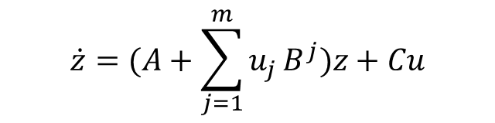

How does brain activity (z) change over time
V5
a₂₂
z₂
b₂₁
Attention u₂
a₂₁
V1
a₁₁
z₁
For m inputs:
c₁₁
$$\dot{z}=(A+\sum_{j=1}^{m}{u_{j}}B^{j})z+Cu$$
Driving input u₁
A: Structure
B: Modulatory
Input
C: Driving
Input
$$\left[\begin{matrix}{\dot{z}}_{1} \\ {\dot{z}}_{2}\end{matrix}\right]=\left(\left[\begin{matrix}a_{11} & 0 \\ a_{21} & a_{22}\end{matrix}\right]+u_{2}\left[\begin{matrix}0 & 0 \\ b_{21} & 0\end{matrix}\right]\right)\left[\begin{matrix}z_{1} \\ z_{2}\end{matrix}\right]+\left[\begin{matrix}c_{11} & 0 \\ 0 & 0\end{matrix}\right]\left[\begin{matrix}u_{1} \\ u_{2}\end{matrix}\right]$$
Change in
activity per
region
External input 2
(attention)
Current
activity
per region
All
external input

Slide 20
DCM approach
Neural Model
Observation Model
Experimental Stimulus (u)
Observations (y)
How brain activity z changes over time, given intrinsic and extrinsic dynamics
What fMRI signal would we observe, given the neural model?
.
z = f(z,u,θ^{n})
y = g(z, θ^{h})
Stimulus from Buchel and Friston, 1997
Figure 3 from Friston et al., Neuroimage, 2003
Brain by Dierk Schaefer, Flickr, CC 2.0

Slide 21
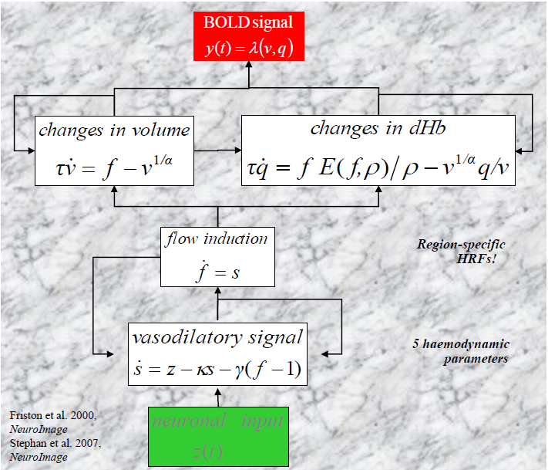
The haemodynamic (observation) model

Slide 22
Overview
DCM basics
  Effective connectivity
  DCM framework
  generative models
Generative Model specification
  Neural and haemodynamic models
Model estimation or inversion
  model inversion (fitting the data to the model)
  parameter inference (making sense of connectivity)
Preparing data and an example

Slide 23
DCM model inversion
Neural Model
Observation Model
Observations (y)
θ^{n}
(and θ^{h})
θ^{n} are the interesting connectivity parameters

Slide 24
Bayesian inference and model estimation
p(parameters θ^{n}θ^{h}| data y) ≈
p(data y | parameters θ^{n}θ^{h}) * p(parameters θ^{n}θ^{h})
posterior
(model parameter estimates)
likelihood
(new fMRI data)
prior
(knowledge)

Slide 25

Priors
All parameters have prior distributions, $p(θ)$
Between-regions neuronal coupling parameters have shrinkage priors.
Haemodynamic parameters have empirical priors.
Prior means stored in DCM.M.pE, covariance in DCM.M.pC
Prior on between-region coupling
N(0,1/64)
-1
-0.5
0
0.5
1
Connection strength (Hz)

Slide 26
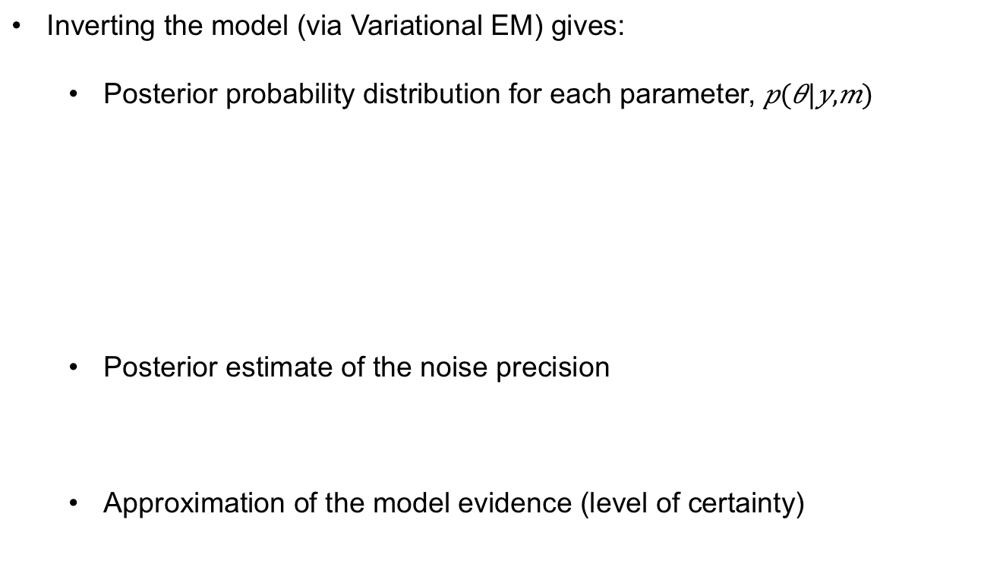
Model Estimation
Inverting the model (via Variational EM) gives:
  Posterior probability distribution for each parameter,
  Posterior estimate of the noise precision
  Approximation of the model evidence (level of certainty)
Posterior mean stored in DCM.Ep
Posterior variance stored in DCM.Vp
p(parameters θ| data y)
Noise precision stored in DCM.Ce
        Free energy stored in DCM.F

Slide 27
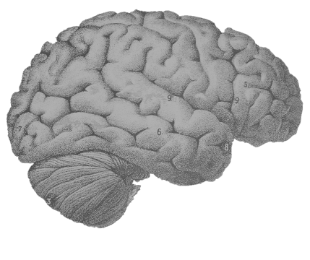
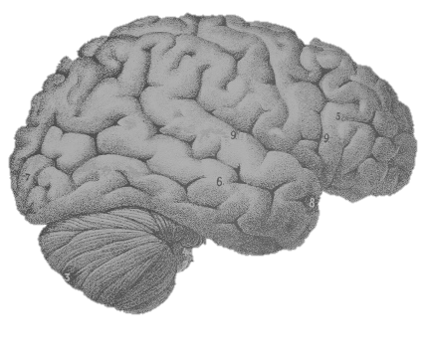
Bayesian model selection
Model 1
Model 2
Model 3
Option 1:
Individually fit each model to the data,
then inspect or compare the model evidences
Option 2:
Fit only the full model (model 1) then use ‘post-hoc model reduction’ (Bayesian Model Reduction) to estimate the others

Slide 28
Contents
Overview of DCM
  Effective connectivity, DCM framework, generative models
Model specification
  Neural model, haemodynamic model
Model estimation
  Model inversion, parameter inference
Preparing data and an example

Slide 29
Preparing data

Slide 30
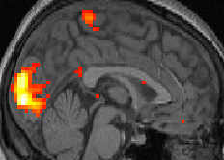
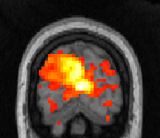
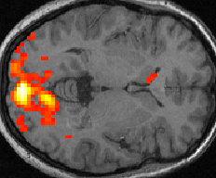

Preparing the data for DCM
We generally start with SPM results and choose our regions of interest (ROIs)
12
10
8
6
4
2
0

Slide 31

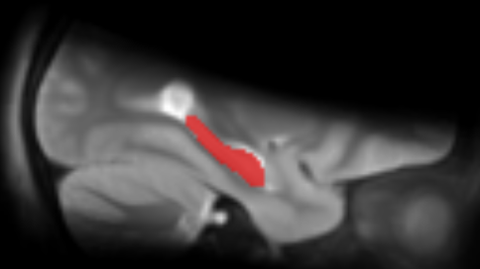
ROI Options
1. A sphere with given radius
2. An anatomical mask
Positioned at the group peak
or
Allowed to vary for each subject, within a radius of the group peak
+

Slide 32
Pre-processing
Regress out nuisance effects (anything not specified in the ‘effects of interest f-contrast’)
Remove confounds such as low frequency drift
Summarise the ROI by performing PCA and retaining the first component
1st eigenvariate: test
3
2
1
0
-1
-2
-3
-4
200
400
600
800
1000
time \{seconds\}
230 voxels in VOI from mask VOI_test_mask.nii
Variance: 81.66%

Slide 33
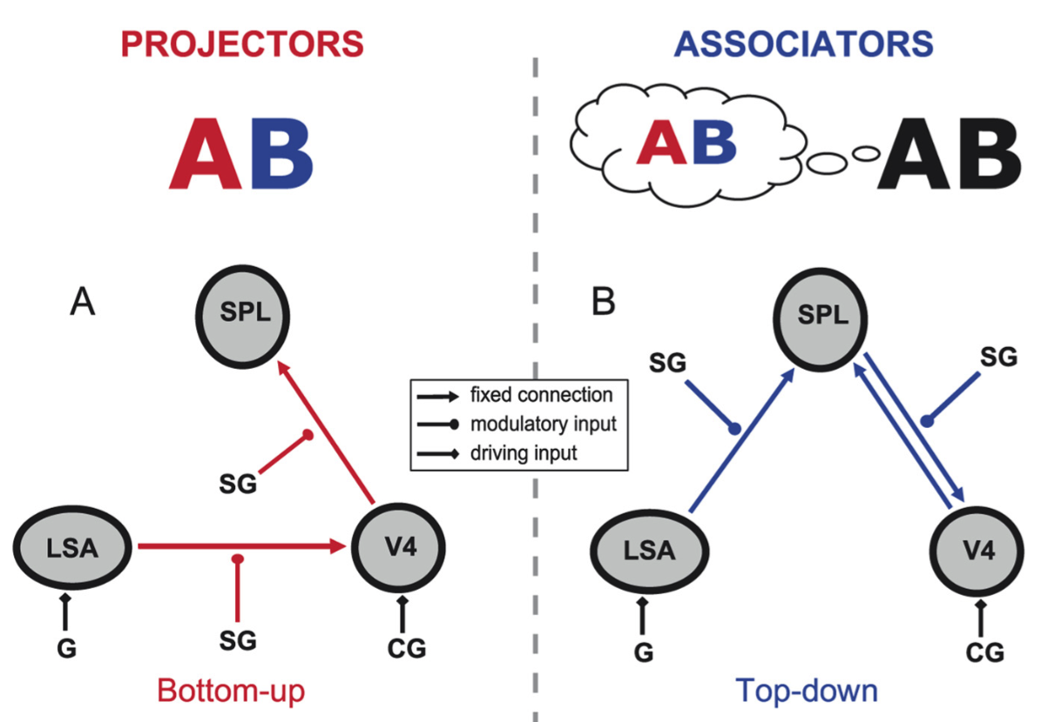
Example DCM of synaesthesia

Slide 34
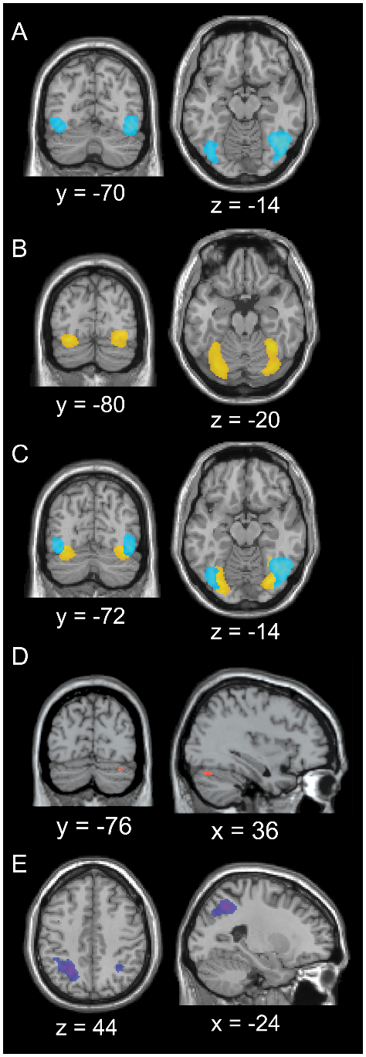
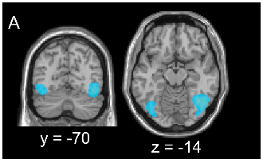
Grapheme-colour integration in synaesthesia
Synaesthesia related activations
in SPL
Grapheme processing
in FG
Colour processing
related activations
in V4
Van Leeuwen et al., 2010, PLOSOne

Slide 35
Neural mechanisms of underlying synaestesia
Extraction of
a time-course from SPL
Extraction of
a time-course
from FG
Extraction of
a time-course
from V4
Van Leeuwen et al., 2012, JNeurosci

Slide 36
Neural mechanisms of underlying synaestesia
Projectors perceive the
colour ‘externally’
Associators perceive the
colour ‘internally’
DCM was used to test the hypothesis that group differences are due to differences in effective connectivity in the grapheme-colour synesthesia network.
G = grapheme
SG = synestesia-inducing
grapheme
CG = colour grapheme
Van Leeuwen et al., 2012, JNeurosci

Slide 37
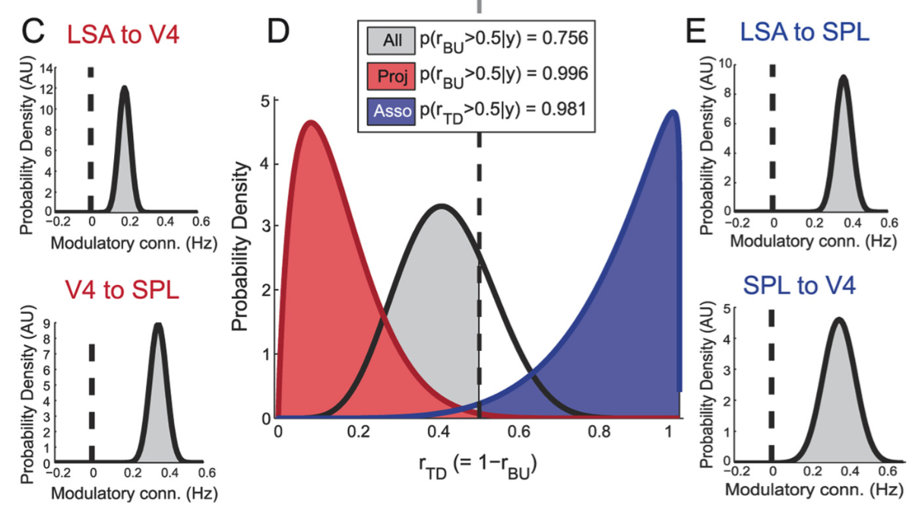
Neural mechanisms of underlying synaestesia
Individual differences in subjective grapheme-colour integration are determined by altered feed forward and feedback coupling:
For projectors bottom-up activation of V4 is the best explanation.
For associators top-down activation of V4 is the best explanation.
Van Leeuwen, Den Ouden, Hagoort, 2012, JNeurosci

Slide 38
Further Reading
The original DCM paper | Friston et al. 2003, NeuroImage
Descriptive / tutorial papers
Role of General Systems Theory | Stephan 2004, J Anatomy
DCM: Ten simple rules for the clinician | Kahan et al. 2013, NeuroImage
Ten Simple Rules for DCM | Stephan et al. 2010, NeuroImage
DCM Extensions
Two-state DCM | Marreiros et al. 2008, NeuroImage
Non-linear DCM | Stephan et al. 2008, NeuroImage
Stochastic DCM | Li et al. 2011, NeuroImage Friston et al. 2011, NeuroImage Daunizeau et al. 2012, Front Comput Neurosci
Post-hoc DCM | Friston and Penny, 2011, NeuroImage Rosa and Friston, 2012, J Neuro Methods
A DCM for Resting State fMRI | Friston et al., 2014, NeuroImage

Slide 39
Thank you
Many thanks for your attention!
Thanks to Guillaume for organization.
Karl Friston and the Theoretical Neurobiology and Neuroimaging Methods groups

Slide 40
extras

Slide 41


Variational Bayes
Approximates:
The log model evidence:
Posterior over parameters:
The log model evidence is decomposed:
The difference between the true and
approximate posterior
Free energy (Laplace approximation)
Accuracy
-
Complexity

Slide 42
The Free Energy
Accuracy
-
Complexity
Complexity
Distance between
prior and posterior
means
Occam’s factor
Volume of
prior parameters
posterior-prior
parameter means
Prior precisions
Volume of
posterior parameters
(Terms for hyperparameters not shown)

Slide 43
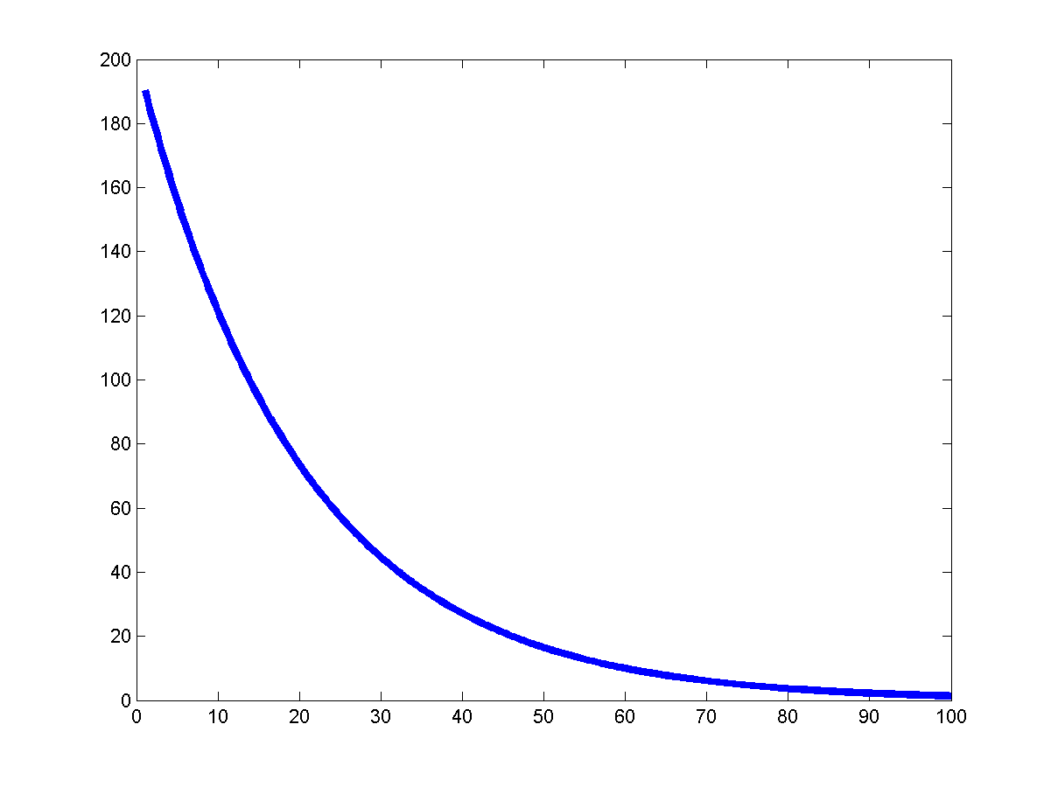
DCM parameters = rate constants
Integration of a first-order linear differential equation gives an
exponential function:
Coupling parameter a is inversely
proportional to the half life τ of x(t):
The coupling parameter ‘a’
thus describes the speed of
the exponential change in x(t)

Slide 44
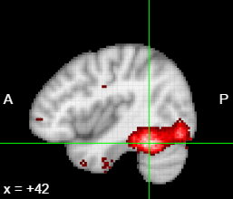
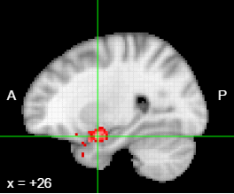
A factorial design translates easily to DCM
A (fictitious!) example of a 2x2 design:
Factor 1:
Stimulus (face or inverted face)
Factor 2:
Valence (neutral or angry)
Main effect of face: FFA
Interaction of
Stimulus x Valence:
Amygdala
Valence
From a factorial design:
Main effects → driving inputs
Interactions → modulatory inputs
Face
FFA
Amy

