Slide 1
Dynamic Causal Modelling
“Advanced” Topics
SPM Course (fMRI), October 2016
Peter Zeidman
Wellcome Trust Centre for Neuroimaging
University College London

Slide 2


Preprocessing
Statistical inference (voxels / clusters)
Connectivity analysis
Image time-series
Design matrix
Statistical Parametric Map
Model
Realignment
Smoothing
General Linear Model
Statistical
Inference
Dynamic
Causal
Modelling
Normalisation
Random Field Theory
Anatomical
reference
Functional timeseries
p < 0.05

Slide 3
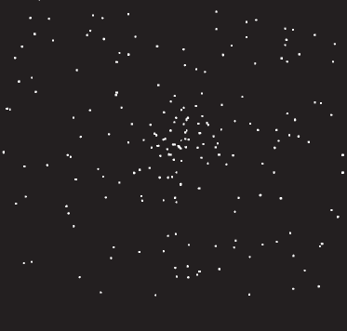

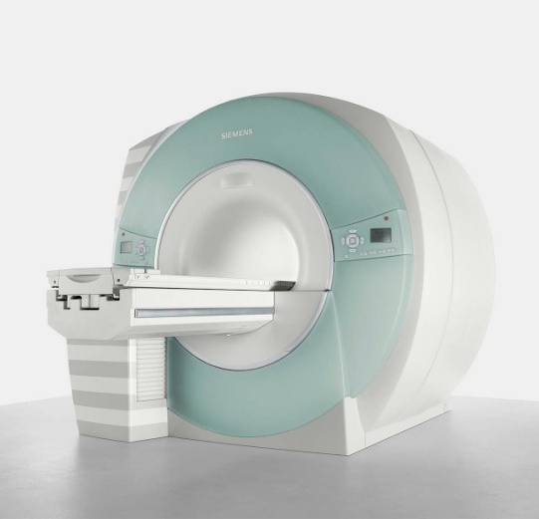
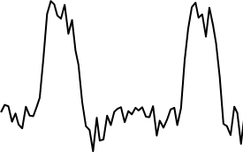
The system of interest
Experimental Stimulus
(Hidden) Neural Activity
Observations (BOLD)
Vector u
Vector y
on
?
BOLD
off
time
time
Stimulus from Buchel and Friston, 1997
Brain by Dierk Schaefer, Flickr, CC 2.0
Notes:
Experimental stimulation causes changes in neural activity. Neural activity in turn causes the BOLD response, which we observe via the scanner. We are interested in the hidden neural activity, which we cannot directly observe - so it must be inferred.

Slide 4
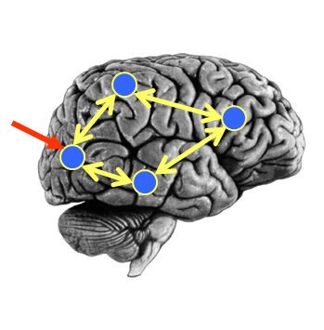
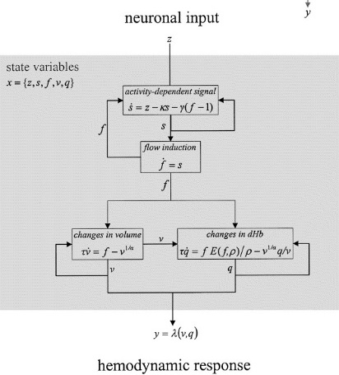

DCM Framework
Neural Model
Observation Model
Experimental Stimulus (u)
Observations (y)
How brain activity z changes over time
What we would see in the scanner, y, given the neural model?
.
z = f(z,u,θ^{n})
y = g(z, θ^{h})
Stimulus from Buchel and Friston, 1997
Figure 3 from Friston et al., Neuroimage, 2003
Brain by Dierk Schaefer, Flickr, CC 2.0

Slide 5
DCM Recipe
Identify regions of interest
Design your model space
Extract timeseries
Specify a DCM for each subject
Estimate (fit) model
Build a second level model (PEB)
Test hypotheses
Planning
1st level
2nd level

Slide 6
DCM Recipe
Identify regions of interest
Design your model space
Extract timeseries
Specify a DCM for each subject
Estimate (fit) model
Build a second level model (PEB)
Test hypotheses
Planning
1st level
2nd level

Slide 7
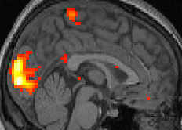
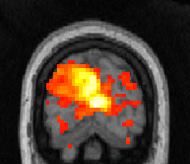
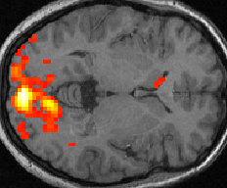

1. Identify Regions of Interest
We generally start with SPM results
We could also do an initial simple connectivity analysis (e.g. PPI for task-based studies, ICA for resting state)
Psychophysiological interactions (PPI)
Where in the brain has increased correlation with early visual cortex (V1) when paying attention relative to relaxing?
Voxel y neuronal activity
12
Attention
10
8
6
No Attention
4
2
0
V1 neuronal activity

Slide 8
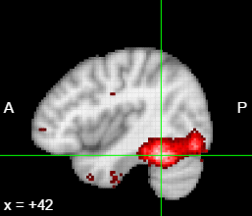
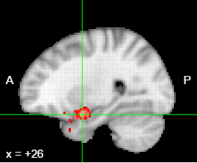
2. Design your model space
A (fictitious!) example of a 2x2 design:
Factor 1:
Stimulus (face or inverted face)
Factor 2:
Valence (neutral or angry)
Main effect of face: FFA
Interaction of
Stimulus x Valence:
Amygdala
Valence
From a factorial design:
Main effect 1 → driving inputs
Main effect 2 → modulatory input
thus testing for an interaction
Face
FFA
Amy

Slide 9
2. Design your model space
Valence
Face
FFA
Amy
“Full” model
Valence
FFA→Amygdala model
Face
FFA
Amy
Valence
Amygdala→ FFA model
Face
FFA
Amy

Slide 10
DCM Recipe
Identify regions of interest
Design your model space
Extract timeseries
Specify a DCM for each subject
Estimate (fit) model
Build a second level model (PEB)
Test hypotheses
Planning
1st level
2nd level

Slide 11

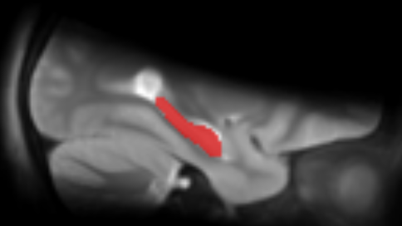
3. Extract timeseries
A sphere with given radius
An anatomical mask
Positioned at the group peak of an SPM, PPI or ICA analysis
or
Allowed to vary for each subject, within a radius of the group peak
+

Slide 12
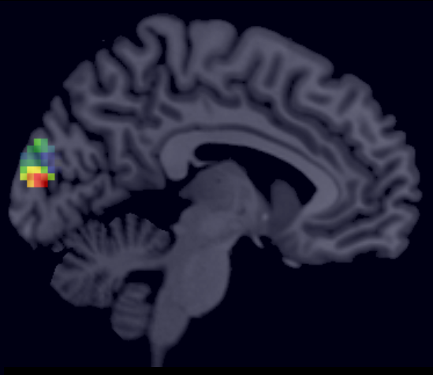
3. Extract timeseries
Regress out nuisance effects (anything not specified in the ‘effects of interest f-contrast’)
Remove confounds such as low frequency drift
Summarise the ROI by performing PCA and retaining the first component
1st eigenvariate: test
3
New in SPM12: VOI_xx_eigen.nii
(When using the batch only)
2
1
0
-1
-2
-3
-4
200
400
600
800
1000
time \{seconds\}
230 voxels in VOI from mask VOI_test_mask.nii
Variance: 81.66%

Slide 13
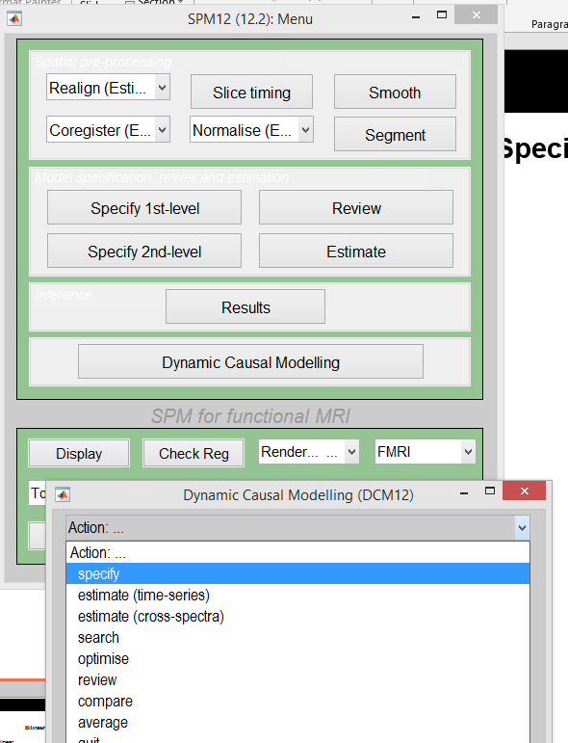
4. Specify DCM

Slide 14
4. Specify DCM
Bilinear or nonlinear?
Bilinear
Non-linear
R2
R2
z₂
z₂
R3
R3
R1
R1
z₁
z₁
Modulatory
Nonlinear
Stephan et al. 2008, NeuroImage

Slide 15
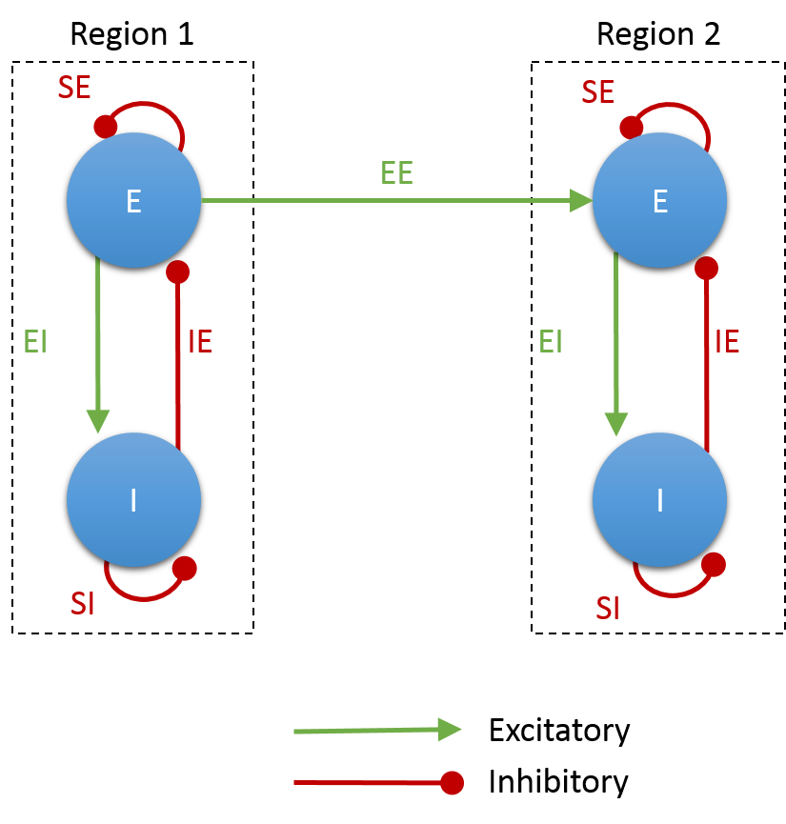
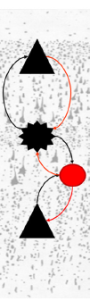
4. Specify DCM
States per region?
1-state DCM
2-state DCM
Microcircuit
R2
z₂
Superficial
Pyramidal
Spiny stellate
Inhibitory interneurons
R1
Deep
pyramidal
z₁
Friston et al., in preparation

Slide 16

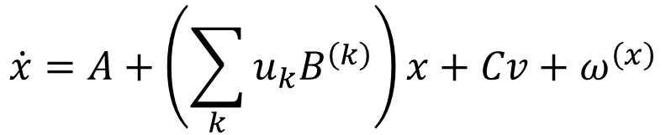
4. Specify DCM
Stochastic effects?
In stochastic DCM, random fluctuations can drive the network:
$$\dot{x}=A+\left(\sum_{k}{u_{k}B^{\left(k\right)}}\right)x+Cv+ω^{\left(x\right)}$$
$$v=u+ω^{\left(v\right)}$$
Li et al., NeuroImage, 2011

Slide 17
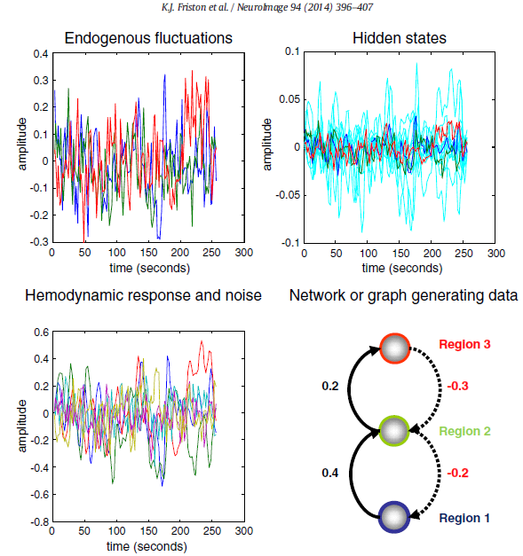
4. Specify DCM
Timeseries or CSD?
DCM for Cross-Spectral Densities
Operates in the frequency domain
rather than the time domain.
Ideal for resting state analysis
Friston et al. 2014,
NeuroImage

Slide 18
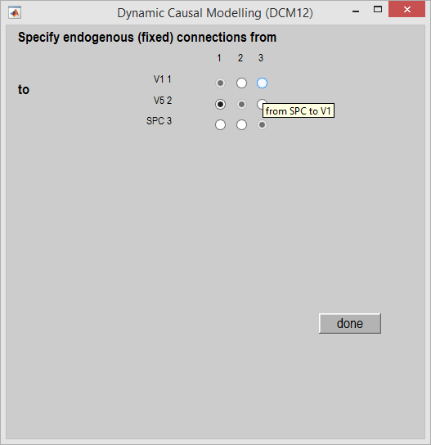
4. Specify DCM
Which connections?
On / off switches set the priors
Valence
Face
FFA
Amy
Connection ‘on’
Connection ‘off’
Probability
0
0
Connect strength (Hz)
Connect strength (Hz)

Slide 19
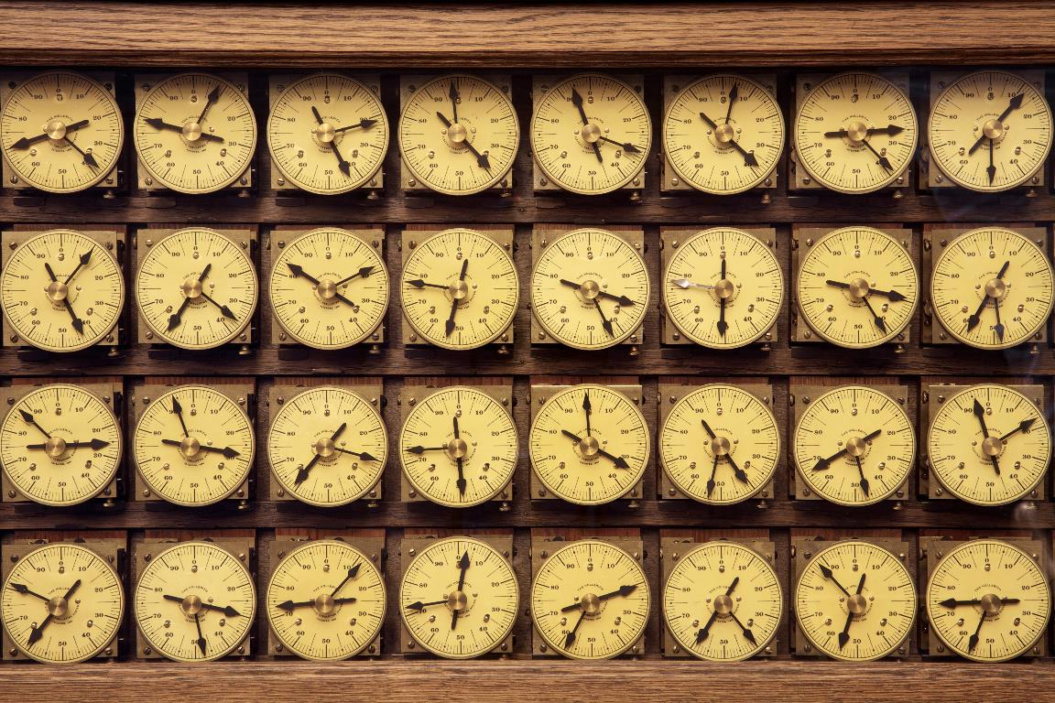


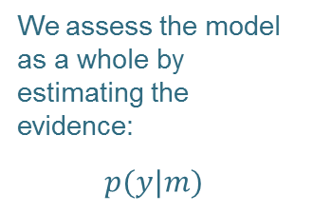

5. Estimate each subject’s model
(Experimental inputs)
time
Our belief about each parameter is represented by a normal distribution with a mean and variance (uncertainty)
We represent and estimate the full covariance matrix between parameters:
Predicted data (e.g. timeseries)
Image credit: Marcin Wichary, Flickr

Slide 20
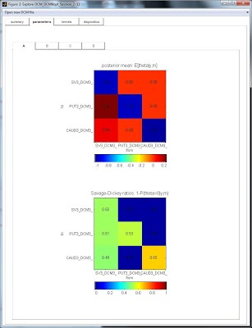
5. Estimate each subject’s model (diagnostics)
spm_dcm_fmri_check(DCM)
spm_dcm_explore (DCM)
From Jean Daunizeau’s website

Slide 21
DCM Recipe
Identify regions of interest
Design your model space
Extract timeseries
Specify a DCM for each subject
Estimate (fit) model
Build a second level model (PEB)
Test hypotheses
Planning
1st level
2nd level

Slide 22
Group analyses
Options:
Model of models
Question: “I think that different subjects had their data generated by different DCMs. Which of several DCMs best explains my data?”
Conclusion: “There is a 96% probability that any randomly chosen subject had their data generated by DCM 1 rather than DCM 2”
→ Random effects Bayesian Model Selection (Stephan et al. 2009)
Model of parameters
Question: “Do patients have stronger connectivity between two regions in my DCM compared to matched controls?”
Conclusion: “Patients have 20% stronger self-inhibition within PFC”
→ Parametric Empirical Bayes (Friston et al. 2016)

Slide 23
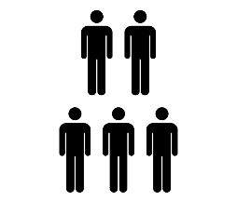
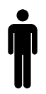





6. Build a second level model (Parametric Empirical Bayes)
PEB GLM
Second level
$$θ=Xβ+ε_{2}$$
$$ε_{2} \sim N(0,Σ)$$
DCM: Subject 1
DCM: Subject N
First level
$$θ^{\left(1\right)}$$
$$θ^{\left(N\right)}$$
…
$$y=Γ\left(θ\right)+ε_{1}$$

Slide 24



6. Build a second level model (Parametric Empirical Bayes)
$$θ=Xβ+ε_{2}$$
“I want to know the mean connection
strength across subjects”
“I also want to know the difference
in connection strength
between patients and controls”
$$X=$$
$$X=$$
1
-1

Slide 25
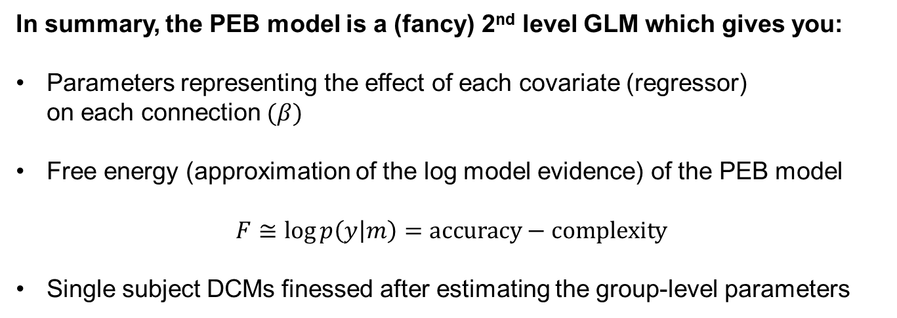
6. Build a second level model (Parametric Empirical Bayes)
In summary, the PEB model is a (fancy) 2nd level GLM which gives you:
Parameters representing the effect of each covariate (regressor)
on each connection $(β)$
Free energy (approximation of the log model evidence) of the PEB model
$$F≅\log{p\left(y | m\right)}=\text{accuracy}−\text{complexity}$$
Single subject DCMs finessed after estimating the group-level parameters

Slide 26
7. Test hypotheses
Valence
Face
FFA
Amy
“Full” model
Valence
FFA → Amygdala model
Face
FFA
Amy
Valence
Amygdala → FFA model
Face
FFA
Amy

Slide 27




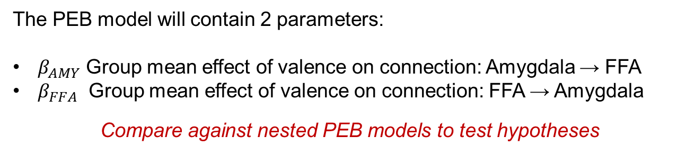





7. Test hypotheses
The PEB model will contain 2 parameters:
$β_{AMY}$ Group mean effect of valence on connection: Amygdala → FFA
$β_{FFA}$ Group mean effect of valence on connection: FFA → Amygdala
Compare against nested PEB models to test hypotheses
Nested PEB models
Full PEB model
FFA-> Amyg
Amyg->FFA
$$β_{AMY}$$
$$β_{AMY}$$
$$β_{AMY}$$
$$β_{FFA}$$
$$β_{FFA}$$
$$β_{FFA}$$
Evidence
$$F_{1}≅p(y|m_{1})$$
$$F_{2}≅p(y|m_{2})$$
$$F_{3}≅p(y|m_{3})$$

Slide 28
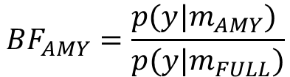

7. Test hypotheses
Bayesian Model Comparison
Free energy
(Relative to
worst model)
6.1
3.1
Full
FFA
AMY
PEB Model
We compare models’ evidence using the Bayes factor
$$BF_{AMY}=\frac{p(y|m_{AMY}) }{p(y|m_{FULL})}$$
20 = 95% probability
$$\log{BF=\log{p\left(y | m_{AMY}\right)−\log{p(y|m_{FULL})}}}$$
$$=F_{amy}−F_{FULL}$$
3 = 95% probability

Slide 29
7. Test hypotheses
Model
probability
0.95
Full
FFA
AMY
PEB Model

Slide 30
7. Test hypotheses
Bayesian Model Averaging
Free energy
(Relative to
worst model)
Full
FFA
AMY
PEB Model
Weighted average
of parameters across
models

Slide 31




7. Test hypotheses
Alternatively, we can automatically search over nested models
Full PEB model
Nested PEB model
$$β_{AMY}$$
$$β_{AMY}$$
Bayesian Model Reduction
$$β_{FFA}$$
$$β_{FFA}$$
Parameters which don’t contribute to the free energy are switched off

Slide 32
DCM Recipe
Identify regions of interest
Design your model space
Extract timeseries
Specify a DCM for each subject
Estimate (fit) model
Build a second level model (PEB)
Test hypotheses
+ Prediction
Planning
1st level
2nd level

Slide 33
Further Reading
The original DCM paper | Friston et al. 2003, NeuroImage
Descriptive / tutorial papers
Role of General Systems Theory | Stephan 2004, J Anatomy
DCM: Ten simple rules for the clinician | Kahan et al. 2013, NeuroImage
Ten Simple Rules for DCM | Stephan et al. 2010, NeuroImage
DCM Extensions
Two-state DCM | Marreiros et al. 2008, NeuroImage
Non-linear DCM | Stephan et al. 2008, NeuroImage
Stochastic DCM | Li et al. 2011, NeuroImage Friston et al. 2011, NeuroImage Daunizeau et al. 2012, Front Comput Neurosci
A DCM for Resting State fMRI | Friston et al., 2014, NeuroImage

Slide 34
Further Reading
Group Analysis
Bayesian model selection for group studies | Stephan et al. 2009, NeuroImage
Bayesian model reduction and empirical Bayes for group (DCM) studies | Friston et al. 2016, NeuroImage

