Slide 1



Event-related fMRI
SPM course at the Wellcome Trust Centre for Neuroimaging
13th October 2017
Dr Helen Barron | Junior Research Fellow
University of Oxford
@HelenCBarron

Slide 2
Overview
Block designs
Event related designs
Modelling events
Optimising the design
Notes:
Following on from Mona’s talk, here I will assume that you have now chosen your research question and your stimuli. You have also decided your contrasts of interests. But what you haven’t decided is how to model your data and how to present your stimuli. The presentation of your stimuli is particularly tricky as you need to decide the order in which you’ll present them to maximise statistical efficiency in detecting BOLD response to each of your conditions of interest. This isn’t a trivial problem and in this talk I will discuss various factors you need to consider.

Slide 3
Overview
Block designs
Event related designs
Modelling events
Optimising the design

Slide 4
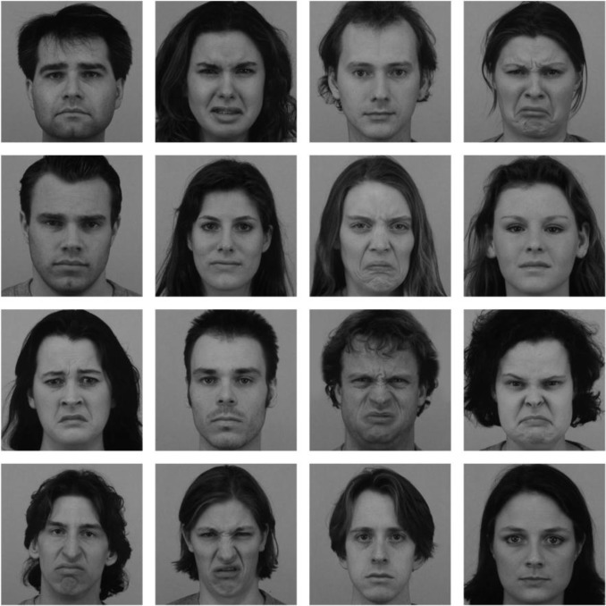
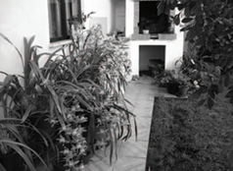
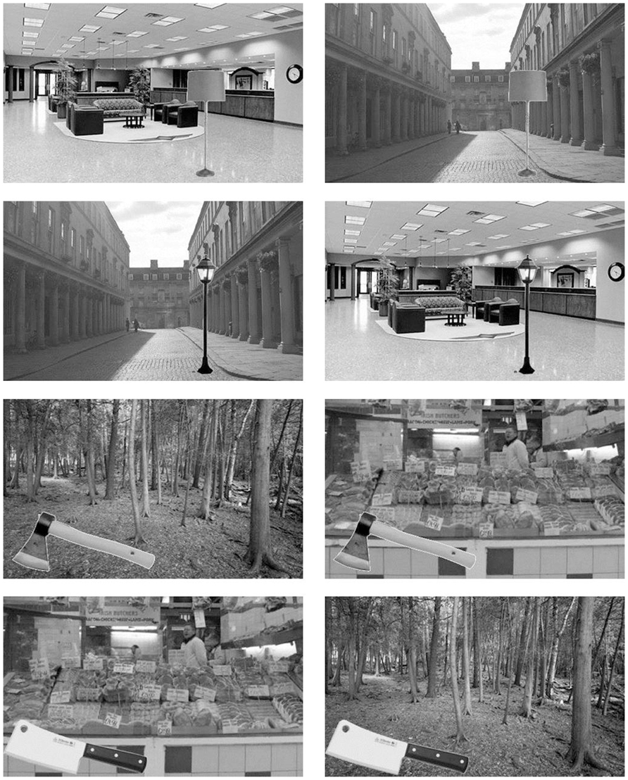
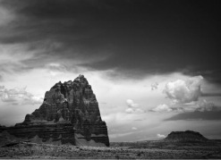
Example block design
Research question of interest: is there a double dissociation between face and scene processing?
Stimuli for your experiment: match for size, luminosity etc.
Contrasts of interest: face vs scene
Faces
Scenes
What about trial order?
Notes:
Fusiform face area (FFA) codes for faces while parahippocampal place area (PPA) codes for scenes.
Double dissociation: evidence for specialisation of function to different brain areas.

Slide 5
BOLD response is slow
Initial undershoot
Peak 4-6s post-stimulus
Undershoot before returning to baseline
Total time: approx. 20 seconds
Peak
Brief
Stimulus
Undershoot
Initial
Undershoot
Given how slow the BOLD response is, how often should we present our stimuli and in what order?
Notes:
BOLD response is slow. This is typical for primary visual cortex. Should we just present one stimulus every 25s?

Slide 6
Block design: face vs scene processing
Faces
Scenes
scenes
faces
scenes
faces
time
Note: remember the high pass filter! Block lengths must not be too long (15-20s is optimal and survives the 0.01Hz cut off)
What activity do we predict from this design?

Slide 7
Block design: face vs scene processing
Block Design
PPA
Design:
scene stimulus
face stimulus
time
FFA
FFA: functional specialization for faces
PPA: functional specialization for scenes
Double dissociation in FFA and PPA revealed using block design
Notes:
Here we assume that there is constant activity in the relevant processing region during the block, which means that the BOLD response isn’t being explictly modelled. Block designs have statistical power. But in general they can only be used to answer very simple research questions, most of which have already been addressed.

Slide 8
Overview
Block designs
Event related designs
Modelling events
Optimising the design
Notes:
Modeling: events in a GLM, the BOLD response, convolution models, and temporal basis functions. Timing issues where solutions exist.
Given all these principles how can we optimise our design?

Slide 9
What is an event-related design?
Stimuli are typically presented in a random order
time
scene stimulus
face stimulus
time
From the known presentation order of the stimuli, the BOLD response must be explicitly modelled.
Because the BOLD response is slow, the timing and the order of the stimuli must be carefully chosen.
What is the advantage of using an event-related design?
Notes:
Blocked design: assume constant activity
Event related: explicitly account for each haemodynamic response. We do have to make some assumptions about what the BOLD response looks like but we are no longer constrained to blocking.
The main advantage of event related design is that we can randomise the trial order, preventing people from expecting what is coming next. Some cognitive processes just can’t be blocked such as decision making. So there is a strong incentive to use event related design to enable analysis of certain psychological processes.

Slide 10
Advantages of event-related designs (1)
Advantages over block designs:
Post-hoc classification of trials by the experimenter
  e.g. by subsequent memory, Wagner et al., 1998
Fixation trial (2 secs)
“Null event”
Word trial (2 secs)
cheese
+
+
time
750ms
1250ms
2000ms
Notes:
Can assess the response to events that are only classified post-hoc. For example, show people words in the scanner and only after scanning classify these trials into remembered or forgotten.
They found significant encoding effects in prefrontal regions, left parahippocampal and fusiform gyrus.
Therefore event related modeling allows you to classify trial types according to some behavioural measure that isn’t available at the time of scanning.

Slide 11
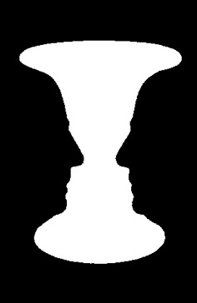
Advantages of event-related designs (2)
Advantages over block designs:
Events which can only be indicated by the participant
  e.g. decision making, perceptual changes,
  Kleinschmidt et al., 1998
Notes:
What about when the event can be classified using behaviour inside the scanner? Here we are interested in what happens at the time of a perceptual switch. For example this bistable stimulus that can be perceived as a vase or two faces. Participants can indicate the perceptual switch inside the scanner using a button press. This is similar to many decision making tasks where we don’t know a priory what the subject will do. Rather it is the performance of the subject inside the scanner determines classification of the event.

Slide 12
Advantages of event-related designs (3)
Advantages over block designs:
Paradigms which cannot be blocked
  where surprise is important, oddball designs
time
Notes:
There are also experiments where the critical events of interest are surprising, such as oddball paradigms. It is not possible to measure surprise signals like this using a block design.

Slide 13
Advantages of event-related designs (4)
Advantages over block designs:
Representational fMRI
  Repetition suppression, Representational Similarity Analysis (RSA), Multivoxel Pattern Analysis (MVPA)
Hassabis et al., Current Biology 2009
Event related design to decode position within VR environment using MVPA analysis
Notes:
Over the last decade or so, fMRI has increasingly been used to investigate the representational content of activity in different brain regions. This in contrast to earlier work which focused on localising categorical information, areas sensitive to all faces for example. While block designs were well suited to the categorical approach, event related designs are typically more appropriate if we want to assess representations at the level of individual stimuli.
In this example, the aim was to decode position A from B within a VR room. The events A and B were assigned posthoc and the multivoxel pattern used from those time points to train a classifier. This classifier was then presented with ‘test trials’ and % accuracy for decoding position assessed.

Slide 14
Advantages of ER designs (summary)
Advantages over block designs:
Post-hoc classification of trials by the experimenter
  e.g. by subsequent memory
Events which can only be indicated by the participant
  e.g. decision-making , perceptual changes
Paradigms that cannot be blocked
  e.g. oddball designs
Representational fMRI
  e.g. designs that require RSA, MVPA, repetition suppression analysis
What is the disadvantage? – Often not as efficient as blocked designs and we need to explicitly model the expected BOLD response
Notes:
Also worth noting that event related design may give a more accurate model than a block design where the assumption of sustained activity throughout the block is not justified. But we must remember that blocked designs often more efficient. Blocked vs event related depends on your question.

Slide 15
Overview
Block designs
Event related designs
Modelling events
Optimising the design
Notes:
Modeling: events in a GLM, the BOLD response, convolution models, and temporal basis functions. Timing issues where solutions exist.
Given all these principles how can we optimise our design?

Slide 16
Terminology clarification
for consistency with previous literature
Event: brief stimulus presentation thought to lead to a brief burst in neural activity
Epoch: sustained stimulus presentation thought to lead to sustained neural activity
Impulse response: BOLD response to an event
ITI
(Inter-Trial Interval)
ITI
(Inter-Trial Interval)
Trial
Trial
Trial
time
SOA
(Stimulus Offset Asynchrony)
Trial + ITI
Notes:
Terms that are used to describe features in our model and design, so relevant to both this section and the next.
Inter-stimulus interval (ISI): time between the offset of one event/epoch and the onset of the next
Stimulus Onset Asynchrony (SOA): time between onsets of event/epoch

Slide 17
Modelling events in an fMRI design
X
Block
Design
Model
time
Event related
Design
Model
time
How to we optimise the design? How do we optimise the model?
Notes:
Design: how we present the stimuli. Model: how we model the events to account for the haemodynamic response.
In this section I will focus on optimising the model, while in the next section I will focus on how we optimise the design. Note that the design and model, and various optimising factors involved must often be consider hand in hand with one another.
Design: can be blocked or event related
Model: we expect sustained neural activity during the blocks. We can model this using a sustained box-car function, or we can actually achieve the same prediction by modelling multiple delta functions that we use to model brief neural activity. We then convolve this with the HRF as I will show you later.
To model the epoch: set duration of the delta function above 0: SPM implements multiple delta functions which are densely spaced.

Slide 18
The design matrix (1)
=
X
+
X constitutes our design matrix, our model that we use to infer the contribution of a given voxel to our contrast of interest

Slide 19
The design matrix (2)
X=
Peak
Brief
Stimulus
Undershoot
Initial
Undershoot
Regressor 1: Face
Regressor 2: Scene
Regressor 3: Constant
How do we model stimulus events?
Notes:
We know that what the prototypical BOLD response looks like however it is likely to vary between subjects and between brain regions. So how do we deal with this variance in the shape of the BOLD impulse response?
We could show a stimulus, empirically sample the response and then wait 25s. This is very efficient approach!

Slide 20
The design matrix (3)
Events across time
Temporal basis
functions
time
convolution
down-sample for each scan
Design matrix (X)
Assume linear summation of the impulse response to accommodate overlap in the HRF of neighbouring stimuli. This assumption is justified if the impulse response are spaced by approx. >2 seconds
Notes:
What are we doing when we model our events? We come up with a model of our events across time and then convolve this with the hemodynamic response along with a set of temporal basis functions. We now have a model which has a hemodynamic response for each event. This results in a timeseries model for neural activity, but this has much higher temporal resolution than we actually have sampled during scanning. We therefore downsample the model so that we have one sample for each scan. This then forms our design matrix.
It is actually possible to accommodate the overlap of the impulse response using models where the the overlap of the hemodynamic response summates linearly. We can then decompose the contribution of different events using the GLM. The assumption of linear summation is justified if the impulse response are still spaced by at least 2 seconds.

Slide 21
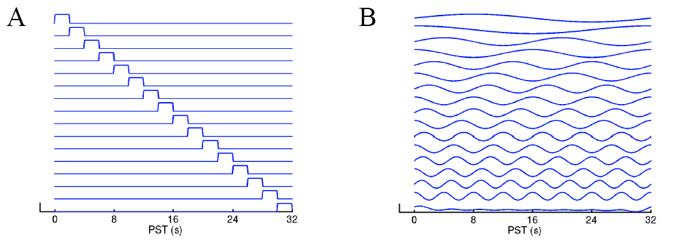
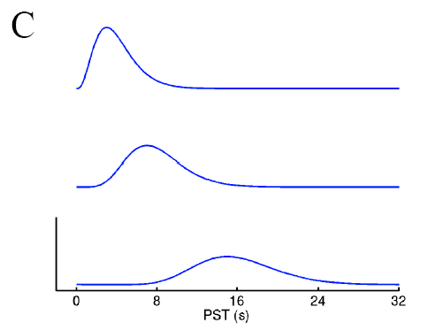
Temporal basis functions: options
Finite Impulse Response (FIR)
Fourier
No assumptions regarding HRF shape, but this flexibility can result in modelling of noise and lots of regressors.
Gamma function
Notes:
Temporal basis functions are important as they allow us to estimate different components of the hemodynamic response to your experimental manipulations. SPM offers a few different choices that differ in their flexibility and their biological interpretability.
A and B: flexible models. Make no assumptions about the shape of the HRF. Can model almost any shape, even if biologically implausible. A linear combination across these basis functions can capture the BOLD response, using an F test to make inferences.
C: Actually try and model the haemodynamic response directly. Use different Gamma functions to model the different components of the HRF. Do F test across these to make inferences.

Slide 22
Temporal basis functions: standard approach
Canonical Haemodynamic Response Function (HRF) used in SPM
2 gamma functions
Assumed to be the same everywhere in the brain
Canonical HRF
What about variation across brain regions and across individuals?
Notes:
The standard approach: The canonical HRF which is the predicted BOLD response as a function of time.
Peak ~6s, followed by an undershoot at around 10-30s.
There is variation across individuals and brain regions and we can cope with this using temporal derivatives.

Slide 23
Modelling the HRF across brain regions
For example, using ascending or descending slice acquisition means that different slices are collected at different times
Our snapshot of the HRF will therefore look different in different brain regions
*
medial PFC
*
*
motor cortex
visual cortex
Slice time correction corrects for the difference in timing between slices:
Uses a reference slice to align the timing of events to the slice of interest using interpolation
Slice time correction can correct for differences across brain regions
Notes:
It is worth noting here that the difference between timings that arise as a consequence of slice acquisition can be corrected for during pre-processing using slice-time correction. Given that we tend to collect ventral slices prior to dorsal slices the different regions of the brain are not in synch with each other. We can correct for this by interpolating what the BOLD signal should have been if we fix the timing to a given slice. But note that the further away from the reference slice you are the more error is introduced as a result of this interpolation.

Slide 24
Standard HRF + derivatives
Negatively weight temporal
Positively weight temporal
Canonical Haemodynamic Response Function (HRF) used in SPM
2 gamma functions
+
Multivariate Taylor expansion in time (Temporal Derivative)
Canonical
Temporal
Notes:
We add a temporal derivative, a multivariate taylor expansion in time. The weighting of the temporal derivative determines the time of the peak HRF.
Weighted linear sum of these two functions allows for the hemodynamic response to shift forward and backward in time.
Again we need to use an F test to make inferences because these two functions are not independent of each other.

Slide 25
Standard HRF + derivatives
Canonical Haemodynamic Response Function (HRF) used in SPM
2 gamma functions
+
Multivariate Taylor expansion in time (Temporal Derivative)
+
Multivariate Taylor expansion in width (Dispersion Derivative)
Canonical
Temporal
Dispersion
Now it is possible to account for variation between brain regions, without need for interpolation
Notes:
What about the shape of the HRF? we can alter the shape by adding a dispersion derivative. Again allowing this to vary from negative to positive.
Positive: narrower, Negative: wider. Together these now allow for both the timing and the shape to be altered.
Of course these extra temporal derivatives add extra regressors into the design matrix. So if I have five regressors then I have fifteen when I add both derivatives which reduces the degrees of freedom. But if we’re still not sure about the timing of our neural events and we don’t have many regressors then these temporal derivatives are useful. They only add temporal flexibility up to a point.

Slide 26
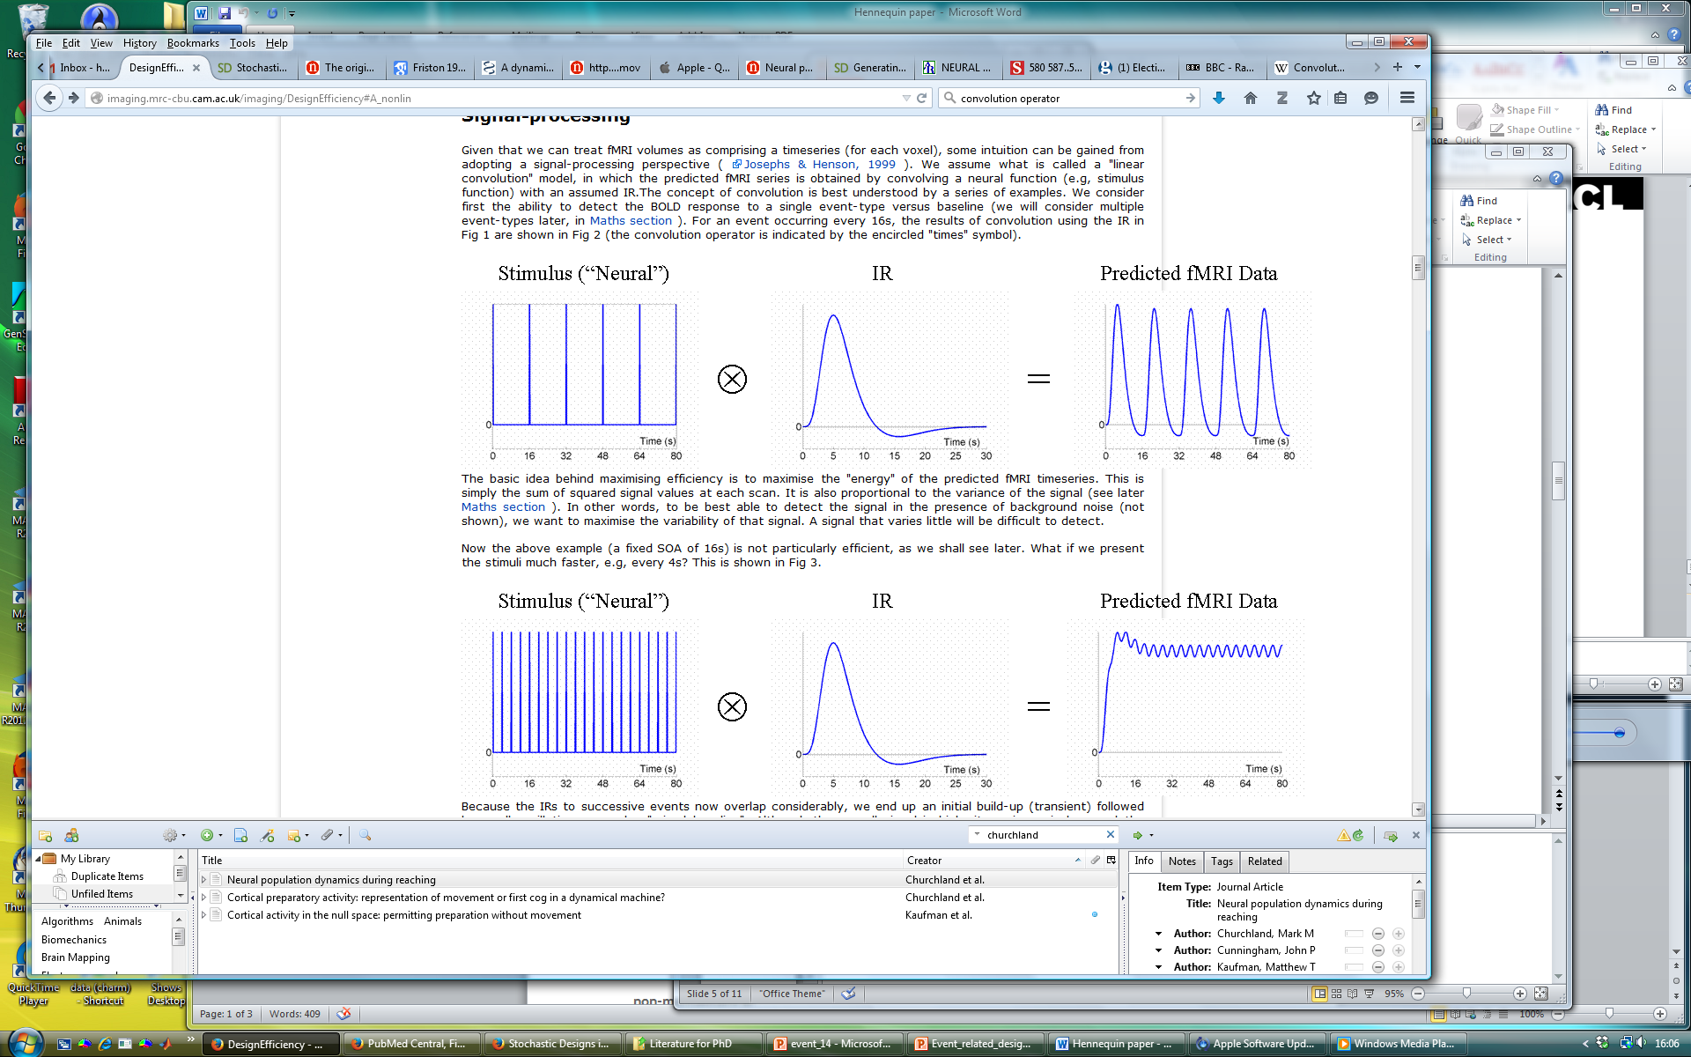
Design efficiency: convolution
Which design is more efficient?
See Rik Henson’s advice here: http://imaging.mrc-cbu.cam.ac.uk/imaging/DesignEfficiency
Notes:
Illustrating the principle of convolution with a series of examples. Let’s assume that we know what the impulse response function looks like, but we don’t know it’s amplitude. The predicted fmRI signal is obtained by convolving the event onsets with an assumed impulse response.

Slide 27
Overview
Block designs
Event related designs
Modelling events
Optimising the design
Notes:
Given all these principles how can we optimise our design?

Slide 28
General advice
Scan for as long as possible: more scans more degrees of freedom
Include lots of subjects
Avoid contrasting trials that are far apart in time (remember the high pass filter used to remove low frequency noise)
Randomise the order of stimuli or time between stimuli, or both!
Optimise the time between stimuli/conditions (SOA)
How do we optimise stimulus order?
Notes:
The last two points refer to how we can tease out brain activity that is attributed to events that occur less than 2s apart in time.

Slide 29
Terminology clarification
for consistency with previous literature
Event: brief stimulus presentation thought to lead to a brief burst in neural activity
Epoch: sustained stimulus presentation thought to lead to sustained neural activity
Impulse response: BOLD response to an event
ITI
(Inter-Trial Interval)
ITI
(Inter-Trial Interval)
Trial
Trial
Trial
time
SOA
(Stimulus Offset Asynchrony)
Trial + ITI
Notes:
Terms that are used to describe features in our model and design, so relevant to both this section and the next.
Inter-stimulus interval (ISI): time between the offset of one event/epoch and the onset of the next
Stimulus Onset Asynchrony (SOA): time between onsets of event/epoch

Slide 30
Optimising the design: the aim
We want to:
Maximize our t-statistic where there’s an effect – i.e. our efficiency or sensitivity
We need to choose a good:
Stimulus order
Appropriate timings: duration of stimuli and time between stimuli
What is the optimal SOA?

Slide 31
Which SOA is optimal? (1)
16s SOA
Not very efficient…
4s SOA
Very inefficient…
Which design is more efficient? Neither are very good
See Rik Henson’s advice here: http://imaging.mrc-cbu.cam.ac.uk/imaging/DesignEfficiency
Notes:
We can think of the HRF as a filter, only allowing signals to pass that have frequencies to pass that correspond to the dominant frequency in the HRF.
16s SOA is not very efficient. 4s SOA is also inefficient because the high pass filter will remove most of the signal.

Slide 32
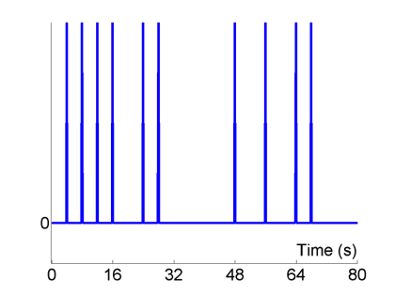
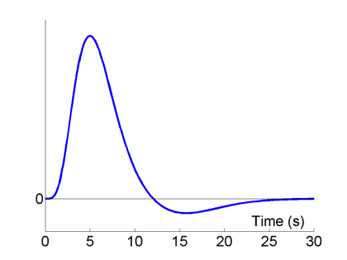
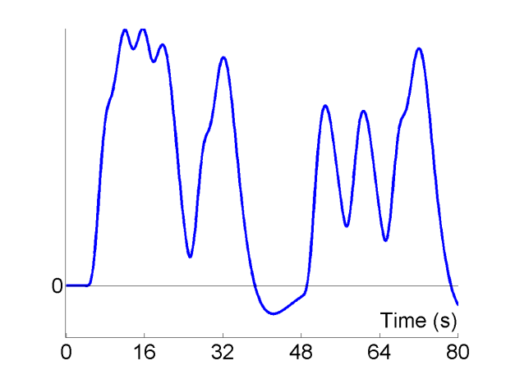
Short randomised SOA
Which SOA is optimal? (2)
Stimulus (“Neural”)
HRF
Predicted Data
⊗
=
Null events
More efficient due to high variability in the signal intensity
See Rik Henson’s advice here: http://imaging.mrc-cbu.cam.ac.uk/imaging/DesignEfficiency
Notes:
High variance in the event onsets gives an efficient design.

Slide 33
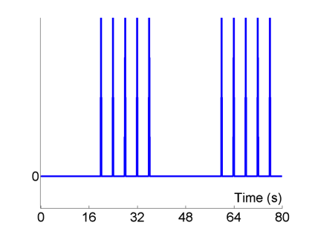
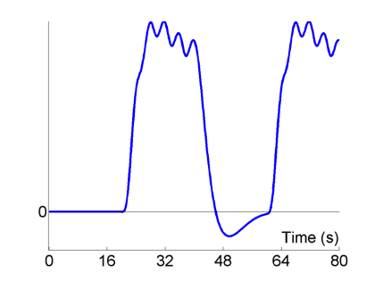
Block design SOA
Which SOA is optimal? (3)
Stimulus (“Neural”)
HRF
Predicted Data
⊗
=
Even more efficient…why?
See Rik Henson’s advice here: http://imaging.mrc-cbu.cam.ac.uk/imaging/DesignEfficiency
Notes:
Blocks of 4s alternative with 20s of rest.

Slide 34
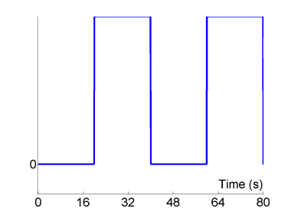
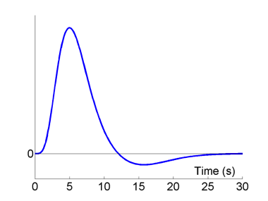
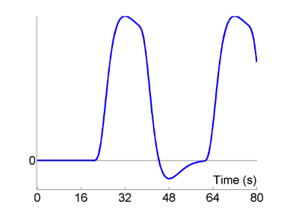
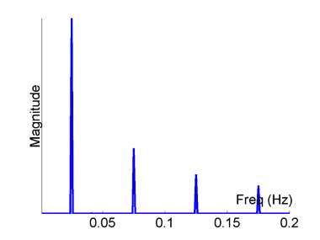
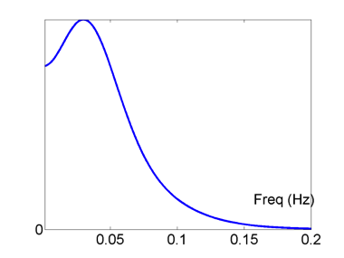
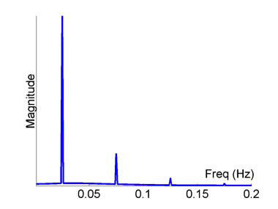
Analysing efficiency: Fourier transform (1)
Block Design, blocks (epochs) = 20s, short ISI
Stimulus (“Neural”)
HRF
Predicted Data
⊗
=
Fourier Transform
Fourier Transform
×
=
See Rik Henson’s advice here: http://imaging.mrc-cbu.cam.ac.uk/imaging/DesignEfficiency
Notes:
We can use a fourier analysis to assess the efficiency of a design: taking the fourier transform of each of these functions on the top row gives the functions on the bottom row. This is a helpful approach as convolution in time is equivalent to a multiplication in frequency space. We can assess the frequencies of our design and then consider the HRF as a low pass filter that will attenuate the high frequencies in our design. This means that repeating the same stimulus every 4s, as in the example above, is very inefficient.
The square wave has a dominant frequency plus a series of harmonics. You can see that the dominant frequency of the blocked design can get past the filtering that the HRF applies to our stimulus design. So it is the predominant low frequency of a blocked design (though not too low!) that makes the design efficient.

Slide 35
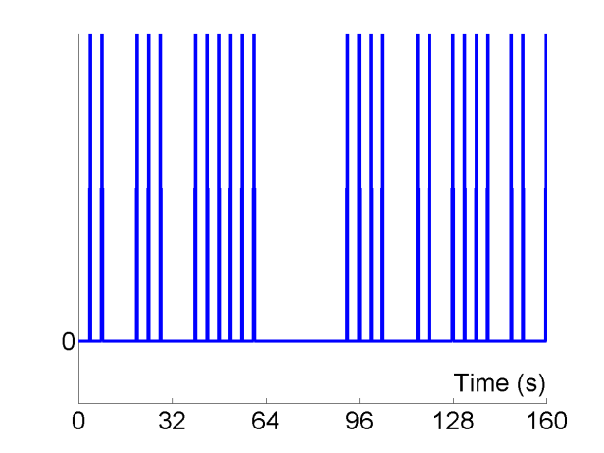
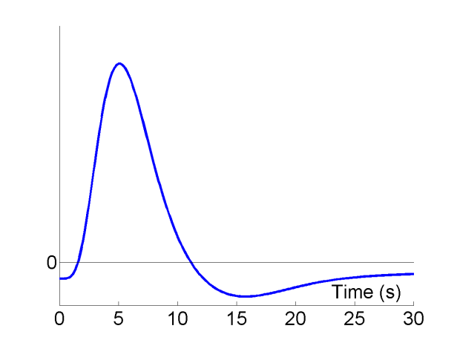
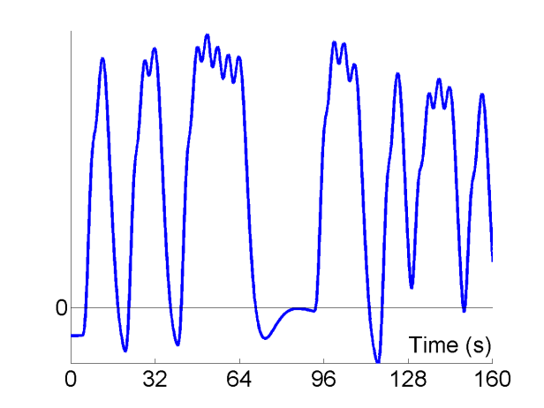
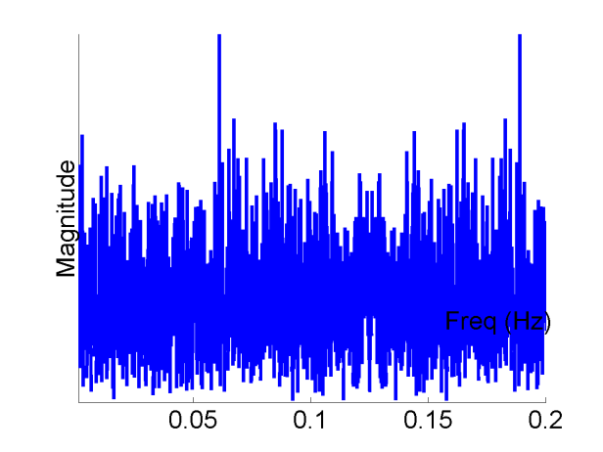
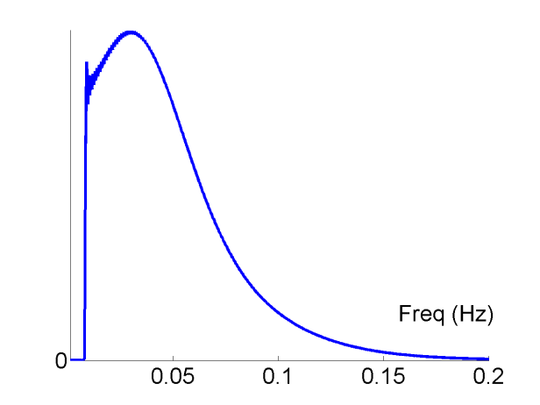
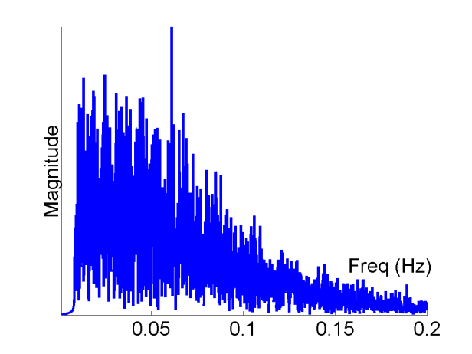
Analysing efficiency: Fourier transform (2)
Randomised Design, SOA_{min} = 4s, highpass filter = 1/120s
Stimulus (“Neural”)
HRF
Predicted Data
⊗
=
Fourier Transform
Fourier Transform
×
=
See Rik Henson’s advice here: http://imaging.mrc-cbu.cam.ac.uk/imaging/DesignEfficiency
Notes:
Spread the power across frequency bands, allows for more signal to be recovered. So this is another way of considering the advantage of having a jittered ITI.
But how do we estimate design efficiency formally?

Slide 36
Formal estimation of design efficiency
Maximise efficiency by maximising t, by minimising the squared variance:
X: design matrix
c: contrast vector
β: beta vector
Assuming that the error in our model is ‘iid’, each observation is drawn independently from a Gaussian distribution:
Assuming σ is independent of our design, taking a fixed contrast we can only alter our design matrix to improve efficiency.
Formal definition of design efficiency minimises variance:
Given the contrast of interest, minimise covariance in the design matrix
Efficiency can be estimated before using the design
Notes:
How can we maximise our t value? We want to minimise the variance, so this is the contrast weighted variance. We assume that the noise sigma^2 is not affected by changes in X. We can change the design matrix for a given contrast to optimise the efficiency.
e is a relative measure (no units).
Covariance given the contrast: If two regressors are anticorrelated then contrast a-b is very efficient as it captures a large amount of variance. But contrast a+b is very inefficient. Randomised SOAs (or SOA + null events) effectively minimise temporal correlations between regressors.

Slide 37

Example efficiency estimation for SOA (1)
Happy (A) vs sad (B) faces: need to know both (A-B) and (A + B)
Two event types, A and B
Randomly intermixed (event-related):
ABBAABABB…
Transition matrix
 | A | B
A | 0.5 | 0.5
B | 0.5 | 0.5
Values are probabilities of that condition occurring
What is the most efficient SOA?
Notes:
We want to know both the timing and the order of the stimuli presentation. We want to know where in the brain responds to faces (face vs baseline) and where, within this region, is there a differential effect for happy vs sad?
For each event there is 50% probability of A occurring and 50% probability of B occurring.

Slide 38
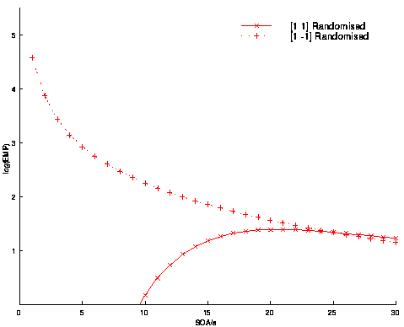
Example efficiency estimation for SOA (2)
Given two contrasts of interests, estimate the design efficiency for a range of SOAs:
Contrast for Differential Effect (A-B)
Contrast for Common Effect (A+B)
Efficiency
SOA (s)
Optimal efficiency
A+B: 16-20s, A-B: →0s
Note: the optimal SOA for the two contrasts differ
For a particular design, different contrasts have different efficiencies.
Notes:
But for the difference effect remember that under linear assumptions there is the issue of saturation at short SOAs

Slide 39
Example efficiency estimation for SOA (3)
What if we change the transition matrix for our stimuli?
Randomly intermixed (event-related) with null events:
AB-BAA--B---ABB…
Transition matrix
 | A | B
A | 0.33 | 0.33
B | 0.33 | 0.33
Values are probabilities of that condition occurring
What is the most efficient SOA?
Notes:
Null events are just extensions of the ITI, i.e. fixation cross. They simply provide a convenient way of randomising the SOA between the events of interest.

Slide 40
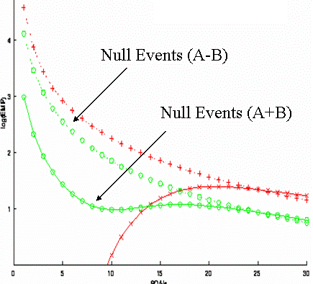
Example efficiency estimation for SOA (4)
Given two contrasts of interests, estimate the design efficiency for a range of SOAs:
(A-B)
Efficiency
(A+B)
SOA (s)
Optimal efficiency
A+B: →0s, A-B: →0s
With the addition of null events the optimal SOA
is roughly matched for the two contrasts.
Should we just use SOAs of 0s?
Notes:
Why add null events? The efficiency for detecting the common effect at short SOAs is improved (with a small reduction of efficiency for detecting the differential effect).

Slide 41
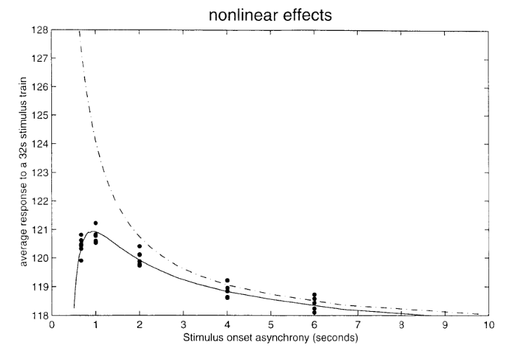
Considering non-linear effects for SOA
If the IRs sum in a linear manner then we are OK!
But at short SOAs we get non-linearities in the data (saturation effects).
Assume linear summation of BOLD response, up to a certain temporal proximity of event
Linear model is good until SOAs of <1s-2s
Trade off between packing more events in and having nonlinear saturation effects which are not modelled.
Linear model
Average response to stimulus
Non linear data
(‘saturation effect’)
SOA (s)
Friston et al., 1999
SOAs of >2s allow for assumption of linear model
Notes:
Saturation: neural or haemodynamic or both

Slide 42
Practical solution to choosing SOA
Example truncated gamma distribution:
Use Matlab or preferred software package to generate a truncated gamma distribution for the ITIs that you use, e.g. gamrnd function in matlab.
Set minimum value: >=1.5s (or 2s to be safe!)
Set maximum value: something large
Check that the distribution looks reasonable!
Sample one ITI for each trial of your task.
Minimum: 1.5s
Maximum: 10s
Mean: 2.9s
Generate a truncated gamma distribution for your ITIs to introduce randomised ‘null’ events into your scan task
Notes:
Saturation: neural or haemodynamic or both

Slide 43
Efficiency Summary
Block designs:
Generally efficient but often not appropriate.
Optimal block length 16s with short SOA (beware of high-pass filter).
Event-related designs:
Both the model and design require some thought
Efficiency of the design depends on the contrast of interest
With short SOAs ‘null events’ (jittered ITI) can optimise efficiency across multiple contrasts.
Non-linear effects start to become problematic at SOA<2s
Given a particular contrast, it is often necessary to minimise correlation between regressors to maximise design efficiency
To introduce short randomised SOAs, sample from a sensible distribution, for example, truncated gamma distribution

Slide 44
Overall Summary
Choosing whether to use an event-related or block design
Choosing how to model the BOLD response
Optimising the timing of the experiment (design efficiency)

Slide 45
Further Reading
Books (http://www.fil.ion.ucl.ac.uk/spm/doc/)
  Statistical Parametric Mapping
  Human Brain Function
Online lectures
  SPM Course http://www.fil.ion.ucl.ac.uk/spm/course/video/
Websites
  http://mindhive.mit.edu/imaging
  http://imaging.mrc-cbu.cam.ac.uk/imaging/DesignEfficiency

Slide 46
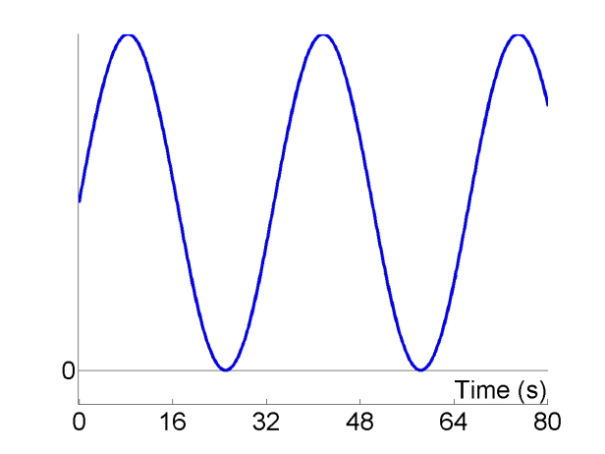

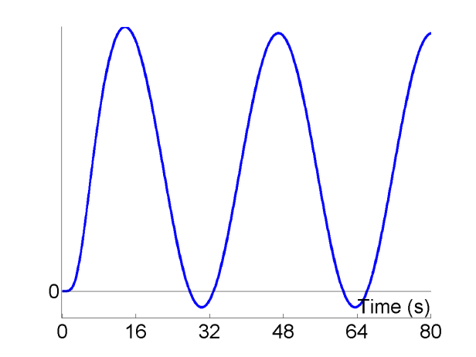
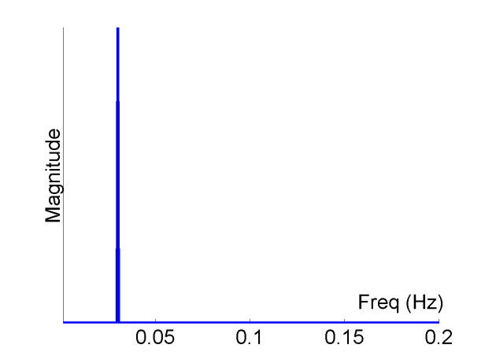
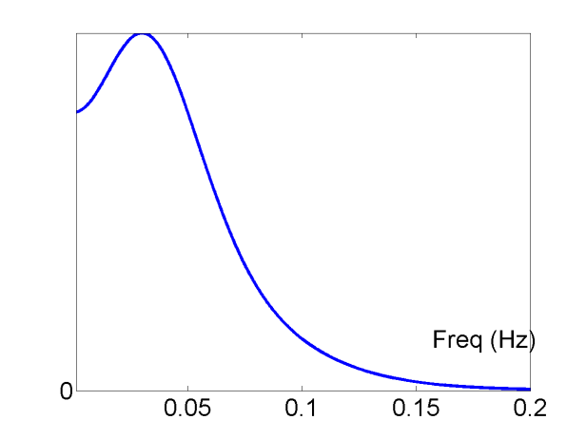
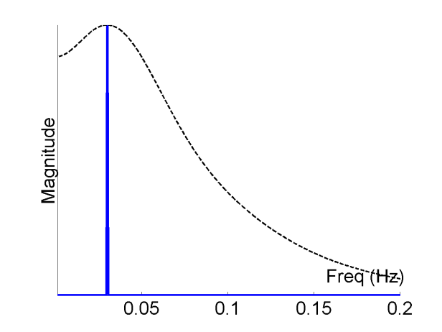
The optimal SOA
Sinusoidal modulation, f=1/33s
Stimulus (“Neural”)
HRF
Predicted Data
⊗
=
=
Fourier Transform
Fourier Transform
×
=
Notes:
Dominant frequency of the signal is passed by the HRF filter.
0.03Hz is the optimal frequency. Now when we convolve a sinusoid which has a single frequency of 0.03Hz we find that it is fully recovered.

Slide 47
Advantages of random ITI, ‘null events’
*
*
Say TR=4s, events always at the start of each trial then we only sample at 4s and 8s
But now we miss part of the HRF
Don’t always sample the neural activity at the same point in the trial
Introduce jittered ITI or SOA that is non-integer of TR, e.g. 1.5TR.
Notes:
It is worth noting here that the difference between timings that arise as a consequence of slice acquisition can be corrected for during pre-processing using slice-time correction. Given that we always collect ventral slices prior to dorsal slices the different regions of the brain are not in synch with each other. We can correct for this by interpolating what the BODL signal should have been if we fix the timing to a given slice. But not that the further away from the reference slice you are the more error is introduced as a result of this interpolation.

