Slide 1
Event-related fMRI demo
Misun Kim
Wellcome Trust Centre for Neuroimaging
University College London
SPM course
Notes:
In this session, I am going to demonstrate how we can analyse the fMRI data from event-related design using SPM. The basic principle of data analysis and SPM machinery is same for both event-related design and block design you looked yesterday. We are going to construct a general linear model to explain our fMRI timeseries and test our hypothesis using a linear contrast. But, compared to block design, we can ask more flexible question using an event-related design experiment, like whether the shape of the fMRI activation is different for each experimental condition, and whether there is a parametric modulation of brain response in some experimental condition.

Slide 2
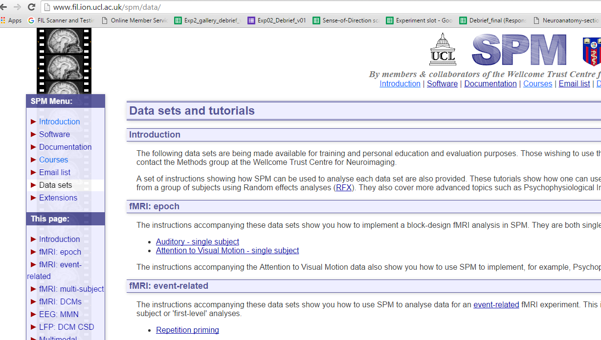
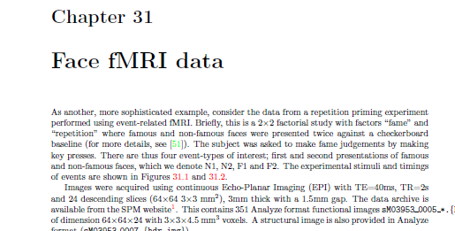
Data available online:
http://www.fil.ion.ucl.ac.uk/spm/data/
fMRI: event-related (Rik Henson)
Instructions within the SPM manual:
spm12/man/manual.pdf
Notes:
The data we will use today is called ‘face data’ and you can download it from spm website. And the instruction for this data analysis is included in SPM manual, so you can review it later.

Slide 3


Event-related fMRI – Face data
Design
26 famous/non-famous faces were presented twice.
2 x 2 factorial design
 |  | Fame
 |  | Famous | Non-famous
Repetition | First | F1 | N1
 | Second | F2 | N2
Novel stimulus
: No suppression
Repeated stimulus
: Repetition suppression
Henson et al (2002) Face repetition effects in implicit and explicit memory tests as measured by fMRI, Cerebral Cortex
Notes:
In this experiment, 26 pictures of famous and non-famous faces were briefly presented for 0.5s with ISI of about 4s.. And each face was presented twice to test the repetition effect. The repetition effect is a well known phenomenon found in both invasive electrophysiology and fMRI that repeated stimulus evoke smaller neural response than novel stimulus. Based on this, one can localize the brain region which process the certain type of stimulus. So to summarise, this is 2 x 2 factorial design, we can ask a question whether there is different brain activation for famous and non-famous face, or whether the first and second presentation of the picture are different.

Slide 4
Questions we can ask
Main effect of fame?
Main effect of repetition?
Amplitude and/or shape of the activation profile
Response as a function of ‘lag’ (parametric effect)?

Slide 5
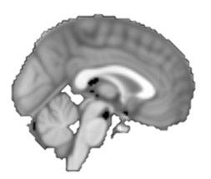

24 Slices/volume
(descending)
→ Microtime resolution: 24
Microtime onset:
time-bin at which the
regressors are
resampled to coincide
with the data (here: 12)
Volume
1
2
3
4
5
...
0 2 4 6 8 10
Time (sec)
1 TR = 2s
Notes:
The common practice of setting up this microresolution is using the number of slice within each scan and use the middle slice for the reference onset. In this example, 24 slices were used so the onset can be 12th slice. Having explained this concept of microresolution, I want to tell you that the microtimebin won’t and should not make a significant effect on the final result. SPM will re-sample again the convoluted regressor to the original fMRI sampling rate at the end. And you can leave it to default value of 16.

Slide 6
Hemodynamic basis function and microtime resolution
microtimebin
TR
upsample
Notes:
Let’s understand what the microtime resolution is. Sampling rate of typical fMRI data acquisition is 2 to 3 seconds. If we make the hemodynamic basis function with this low sampling frequency, the shape of HRF looks very coarse and discrete. And, particularly in event-related design, the precise timing is important and the event can occur at the beginning of 3s TR or middle or end of TR, and making a hrf with scan interval will ignore this temporal precision. Therefore, SPM create the basis function with finer resolution called microtime and decide when each event regressor is aligned.

Slide 7
Hemodynamic response function
Canonical
Canonical
Peak position
Temporal
Dispersion
Width (dispersion)

Slide 8
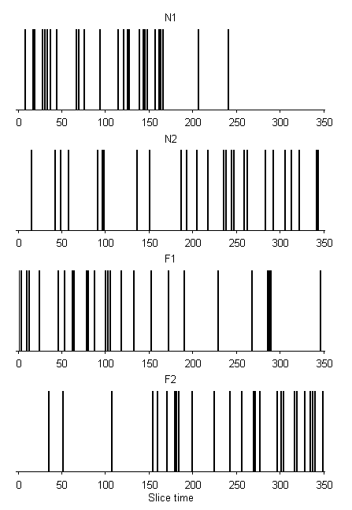
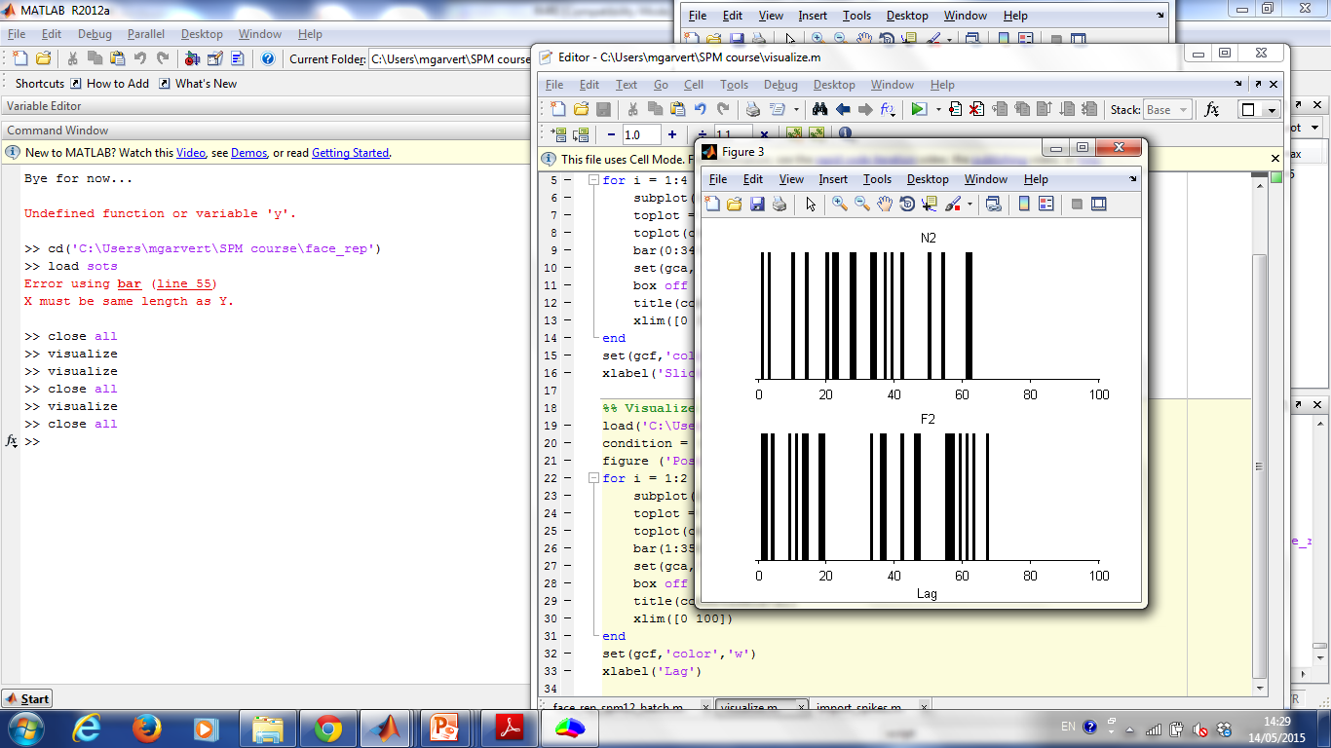
Face onset
Lag
N1
N2
F1
F2
Notes:
Several conditions with random onset
Duration: 0
Specify onsets

