Slide 1
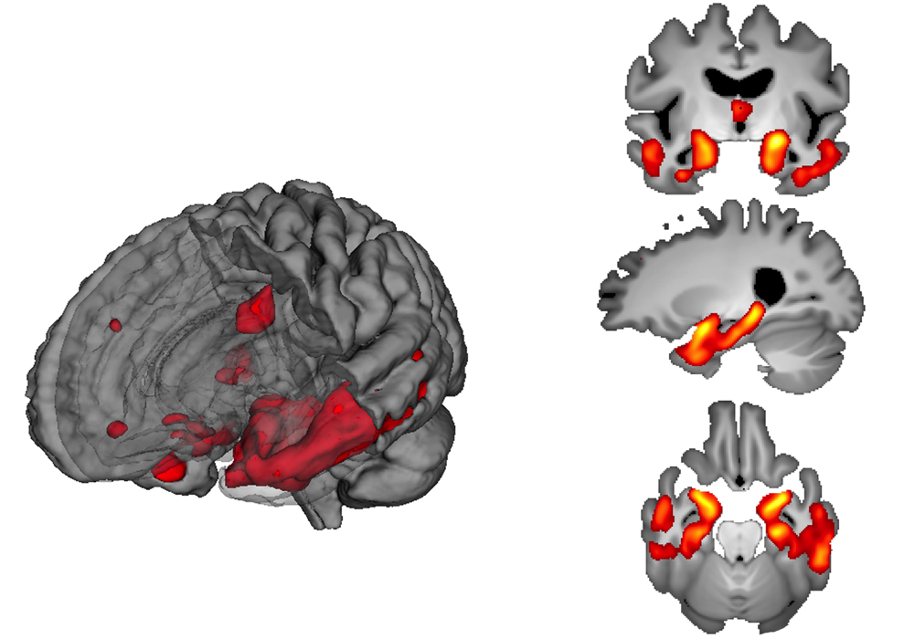
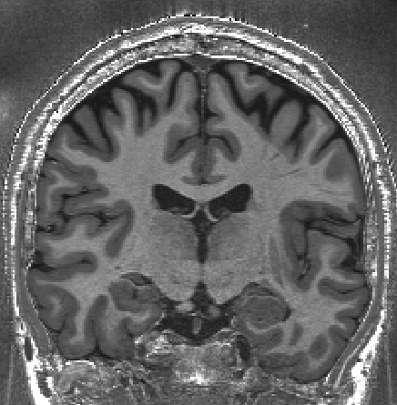
SPM Course October 2018:
Voxel-Based Morphometry
Dr Christian Lambert
Wellcome Centre for Human Neuroimaging, UCL

Slide 2
INTRODUCTION

Slide 3
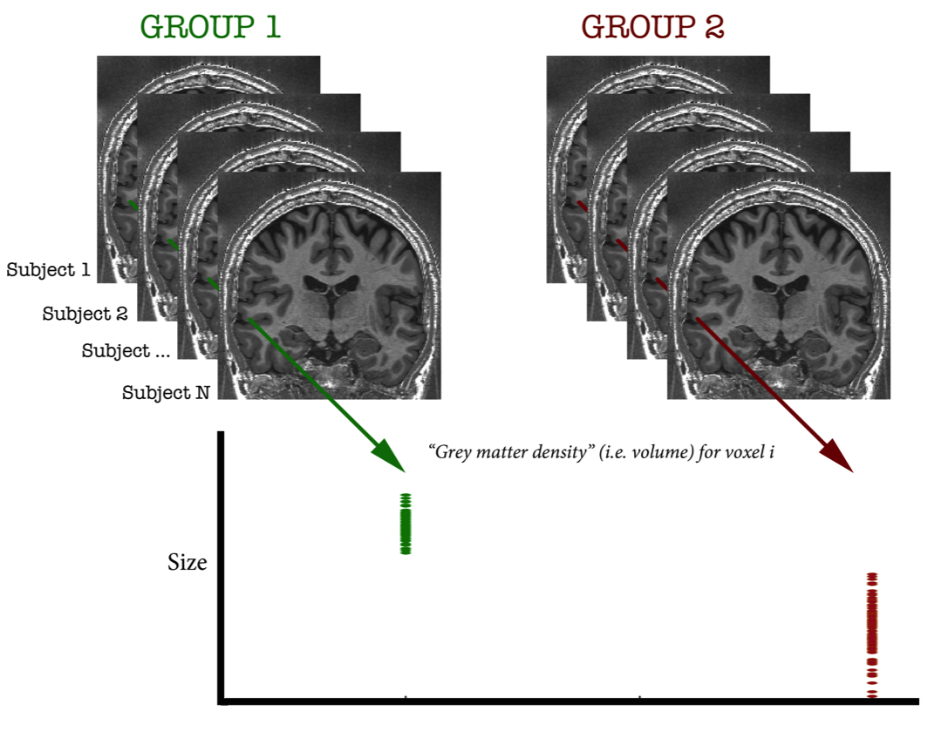
What is VBM?
Voxel-Based Morphometry:
  Size and shape of the brain and its structures (“morphometry”)
  Compared at a voxel wise level across a population

Slide 4
Examples applications of VBM
Many scientifically or clinically interesting questions might relate to changes in local volume of anatomical regions of the brain
For example, whether (and where) patterns of brain morphometry help to:
  Distinguish between groups (e.g. Alzheimer's vs. healthy controls)
  Explain changes seen in development and aging
  Identify plasticity, e.g. when learning new skills
  Find structural correlates (i.e. regions where the size correlates with scores, traits, genotype etc.,)

Slide 5
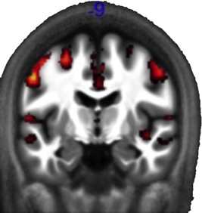
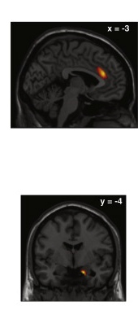
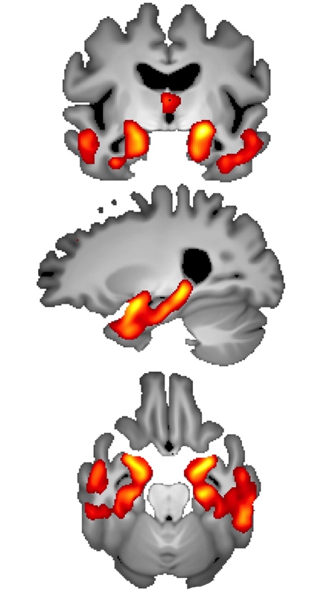
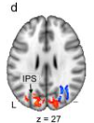
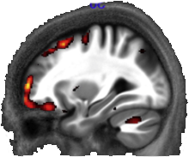
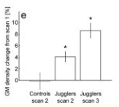
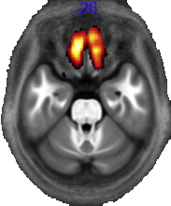
1. Phenotypic
patterns of disease
2. Ageing: GM
atrophy
3. Plasticity: Juggling
4. Correlates: Political orientation
Conservative - Decrease
Conservative - Increase
Atrophy - AD vs. healthy
Controls (ADNI2 Dataset)
Callaghan et al., 2014
Scholz et al., 2009
Kanai et al., 2011

Slide 6



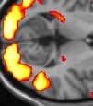
Overview of SPM
Statistical parametric map (SPM)
Image time-series
Kernel
Design matrix
Realignment
Smoothing
General linear model
Statistical
inference
Gaussian
field theory
Normalisation
p <0.05
Template
Parameter estimates

Slide 7
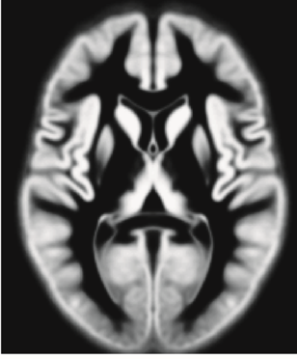
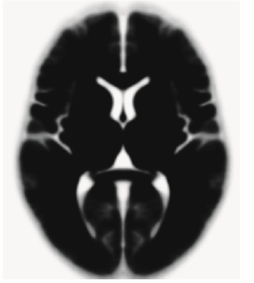
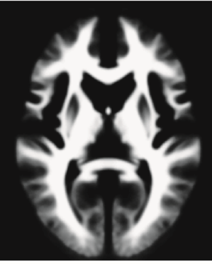
TISSUE SEGMENTATION

Slide 8
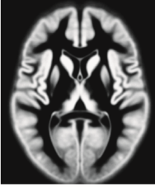
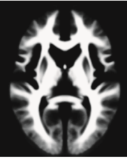
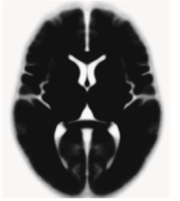
Tissue segmentation for VBM
High-resolution MRI reveals fine structural detail in the brain, but not all of it reliable or interesting
  Noise, intensity-inhomogeneity, vessels
  MR Intensity is usually not quantitatively meaningful
  Quantitative MRI is possible though, and promising, see Voxel Based Quantification (VBQ) e.g. Draganski et al. (2011) PMID:21277375
Regional volumes of the three main tissue types: gray matter, white matter and CSF, are well-defined and potentially very interesting

Slide 9
Tissue segmentation in SPM12 vs SPM8
SPM8 had a “New Segment” toolbox in addition to the main segmentation button
SPM8’s main segmentation has become the “Old Segment” toolbox in SPM12
SPM8’s New Segment provided the basis for SPM12’s segmentation, but there are several changes…
  New TPM.nii (from multispectral IXI database)
  Allowing rescaling of TPMs (like in Old Segment!)
  For full detail see SPM12 Release Notes and Appendix A in Malone et al. (2015) [PMID:25255942]

Slide 10
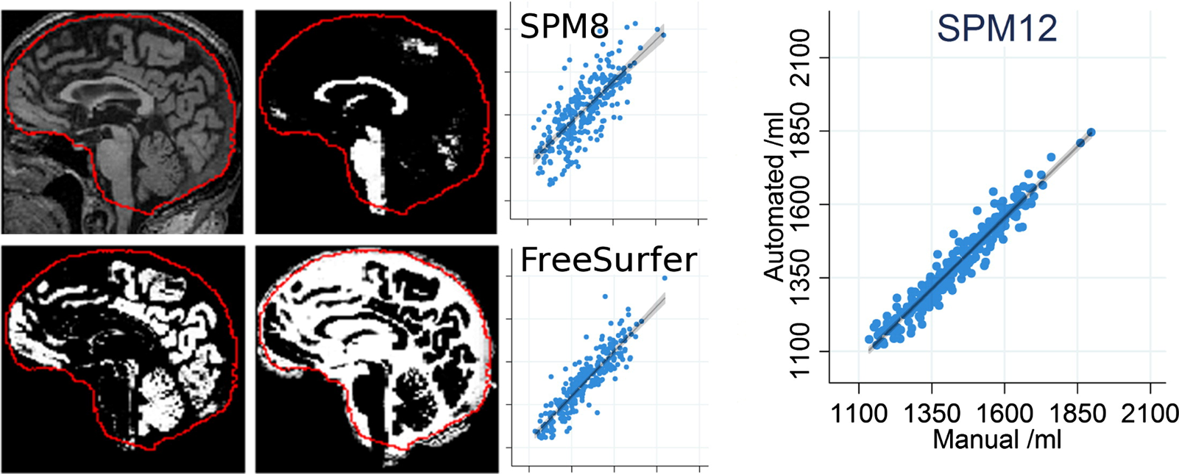
Tissue segmentation in SPM12 vs SPM8
Evaluation of SPM12 versus SPM8 (Old) in terms of total intracranial volume, compared to manual tracing

Slide 11
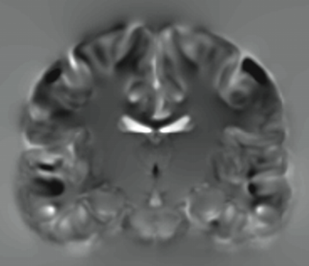
VOXEL BASED MORPHOMETRY

Slide 12
Voxel-Based Morphometry
In essence VBM is Statistical Parametric Mapping of regional segmented tissue density or volume
The exact interpretation of gray matter density or volume is complicated, and depends on the preprocessing steps used
  It is not interpretable as neuronal packing density or other cytoarchitectonic tissue properties
  The hope is that changes in these microscopic properties may lead to macro- or mesoscopic VBM-detectable differences
  One technique is to use VBM in combination with other quantitative structural measures (diffusion, MT, R2*, SWI) to make biophysical inferences (example later)

Slide 13
VBM overview
** ALWAYS VISUALLY CHECK YOUR DATA**
- Poor scan quality, artefacts, abnormal tissue (ischaemia, dural thickening), abnormal brains (hydrocephalus) relatively close rigid alignment (header issues)
Unified segmentation and spatial normalisation
  More flexible groupwise normalisation using DARTEL/Shoot
Modulation to preserve tissue volume
  Otherwise, tissue “density” (harder to interpret, registration errors)
  See also Radua et al. (2014) [PMID:23933042]
Optional computation of tissue totals/globals
Gaussian smoothing
Voxel-wise statistical analysis

Slide 14
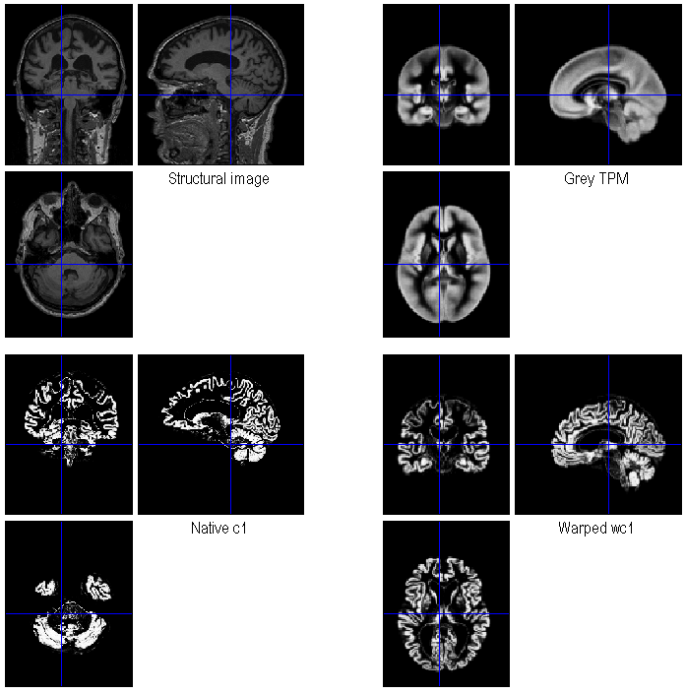
VBM in pictures
Segment
Normalise

Slide 15
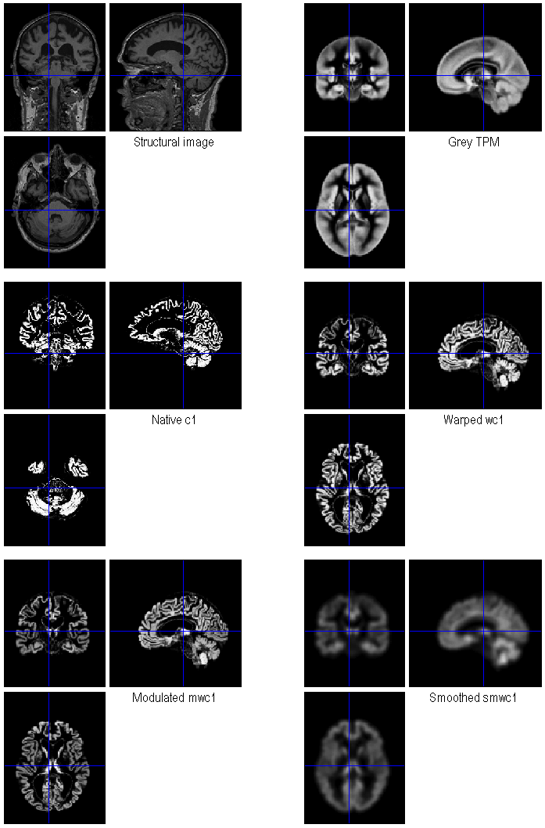
VBM in pictures
Segment
Normalise
Modulate
Smooth

Slide 16
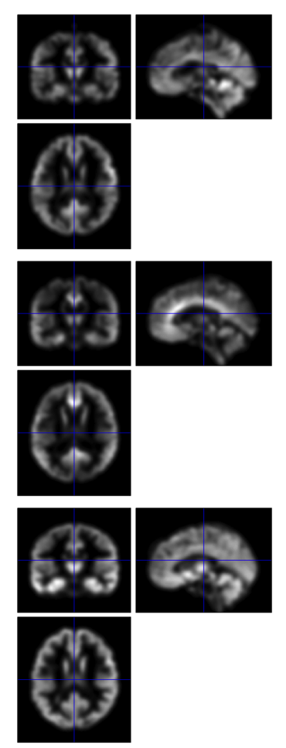
VBM in pictures
Segment
Normalise
Modulate
Smooth
Voxel-wise statistics

Slide 17
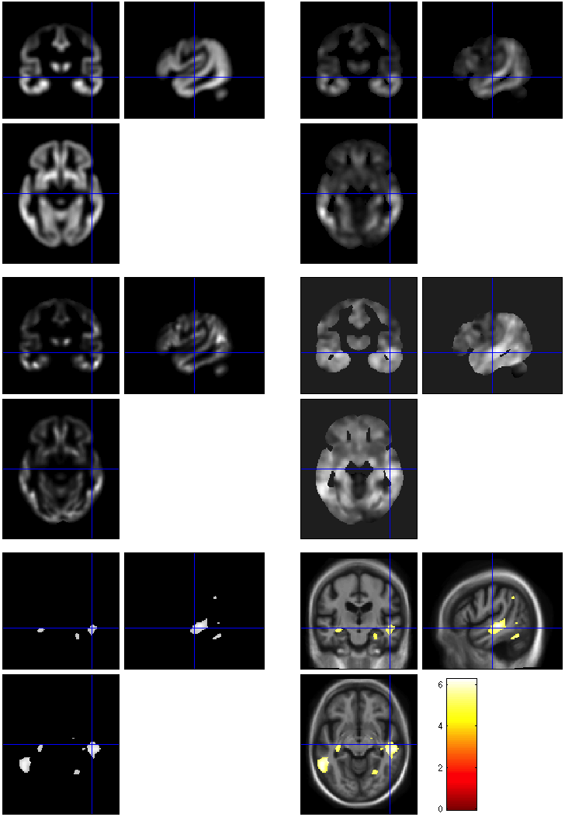
VBM in pictures
beta_0001
con_0001
Segment
Normalise
Modulate
Smooth
Voxel-wise statistics
ResMS
spmT_0001
FWE < 0.05

Slide 18
VBM SUBTLETIES
Modulation
How much to smooth
Interpreting results
Adjusting for total GM or Intracranial Volume
Statistical validity

Slide 19
Modulation
(“preserve amounts”)
1 1
Native
intensity =
tissue probability
Multiplication of warped (normalised) tissue intensities so that their regional total is preserved
  Can detect differences in completely registered areas
Otherwise, we preserve concentrations, and are detecting mesoscopic effects that remain after approximate registration has removed the macroscopic effects
  Flexible (not necessarily “perfect”) warping leaves less
Unmodulated
1 1 1 1
Modulated
2/3 1/3 1/3 2/3
See also http://tinyurl.com/ModulationTutorial

Slide 20
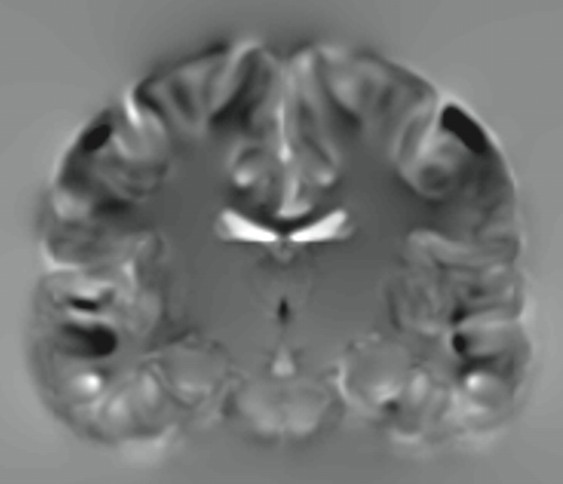
JACOBIAN DETERMINANT IMAGE (j_<image>.nii)

Slide 21
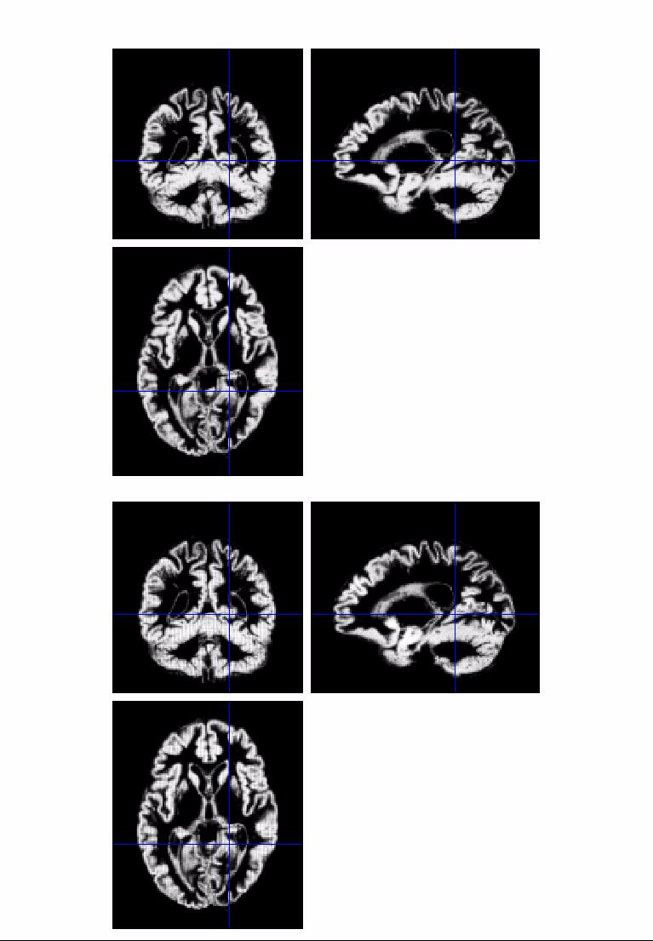
Modulation
(“preserve amounts”)
Top shows “unmodulated”
data (wc1), with intensity or concentration preserved
  Intensities are constant
Below is “modulated” data (mwc1) with amounts or totals preserved
  The voxel at the cross-hairs brightens as more tissue is compressed at this point

Slide 22
Smoothing
The analysis will be most sensitive to effects that match the shape and size of the kernel
The data will be more Gaussian and closer to a continuous random field for larger kernels
  Usually recommend >= 6mm
Results will be rough and noise-like if too little smoothing is used
Too much will lead to distributed, indistinct blobs (i.e. loss of spatial sensitivity)
  Usually recommend <= 12mm
Small subcortical nuclei (e.g. STN/SN) represent a special case where <<4mm may be warranted (see de Hollander et al., 2015)

Slide 23
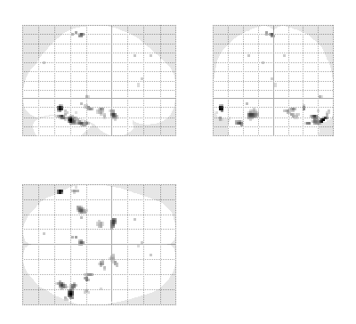
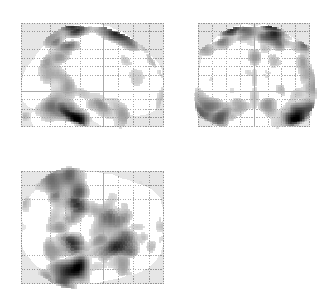
Smoothing
The results below show two fairly extreme choices
  5mm on the left, and 16mm on the right

Slide 24
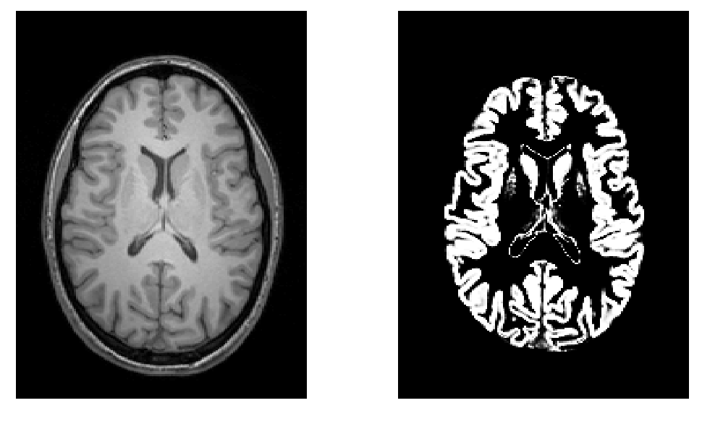
Smoothing as a locally weighted ROI
VBM > ROI: no subjective (or arbitrary) boundaries
VBM < ROI: harder to interpret blobs & characterise error

Slide 25
Interpreting findings
Thinning
Mis-register
Mis-classify
Contrast
Mis-register
Thickening
Folding

Slide 26
Adjustment for “nuisance” variables
Anything which might explain some variability in regional volumes of interest should be considered
  Age and gender are obvious and commonly used
    Consider age & age² to allow quadratic effects
  Site or scanner if more than one
  (Note: model as factor, not covariate; multiple binary columns)
Total intracranial volume (TIV/ICV) often used for VBM
  Changes interpretation when correlated with local volumes (shape is a multivariate concept… See next slide)
  See also Barnes et al. (2010); Malone et al. (2015)

Slide 27
VBM’s statistical validity
Residuals are not normally distributed
  Little impact for comparing reasonably sized groups
  Potentially problematic for comparing single subjects or tiny patient groups with a larger control group
    (Scarpazza et al, 2013; DOI: 10.1016/j.neuroimage.2012.12.045)
  Mitigate with large amounts of smoothing
  Or use nonparametric tests, e.g. permutation testing (SnPM)
    Though also not suitable for single case versus control group…
Smoothness is not spatially stationary
  Bigger blobs expected by chance in smoother regions
  NS toolbox http://www.fil.ion.ucl.ac.uk/spm/ext/#NS
Voxel-wise FDR is common, but not recommended

Slide 28
NORMALISATION

Slide 29
Spatial normalisation with DARTEL/Shoot
VBM is crucially dependent on registration performance
  The limited flexibility of DCT normalisation has been criticised
  Inverse transformations are useful, but not always well-defined
  More flexible registration requires careful modelling and regularisation (prior belief about reasonable warping)
  MNI/ICBM templates/priors are not universally representative
The DARTEL toolbox combines several methodological advances to address these limitations
  Voxel-wise DF, integrated flows, group-wise registration of GM & WM tissue segments to their (iteratively evolving) average

Slide 30
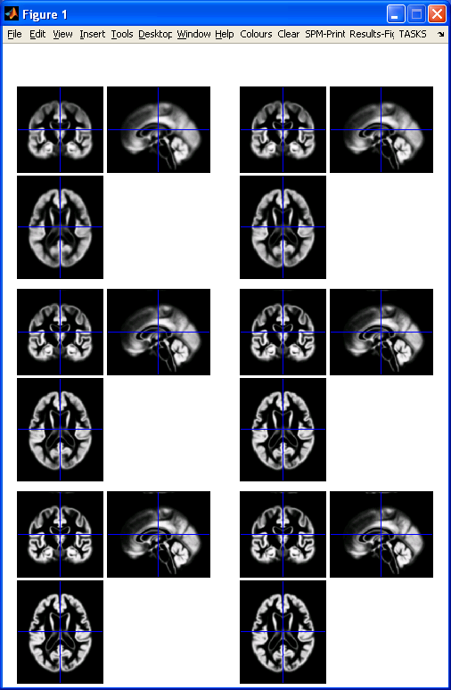
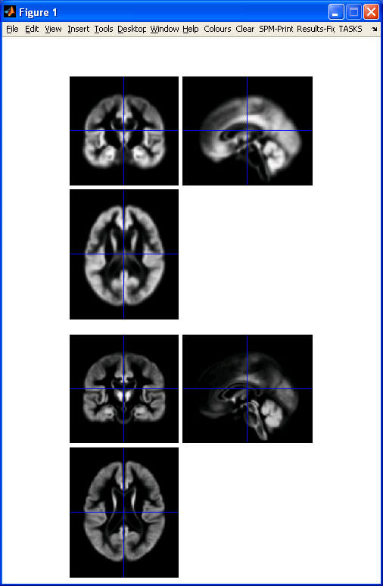
DARTEL average template evolution
Template
1
Rigid average
(Template_0)
Average of
mwc1 using
segment/DCT
Template
6
Notes:
60 images from OASIS cross-sectional data (as in VBM practical)

Slide 31
Two diffeomorphic approaches in SPM
Dartel.
Geodesic Shooting
Uses the same small deformation composed multiple times.
Faster than Geodesic Shooting.
Gives similar deformations to Geodesic Shooting.
Currently more additional utilities.
Uses the optimal series of small deformations, which are composed together.
More mathematically correct than Dartel.
Gives nicer maps of volume change than Dartel.
Likely to replace Dartel in future.

Slide 32
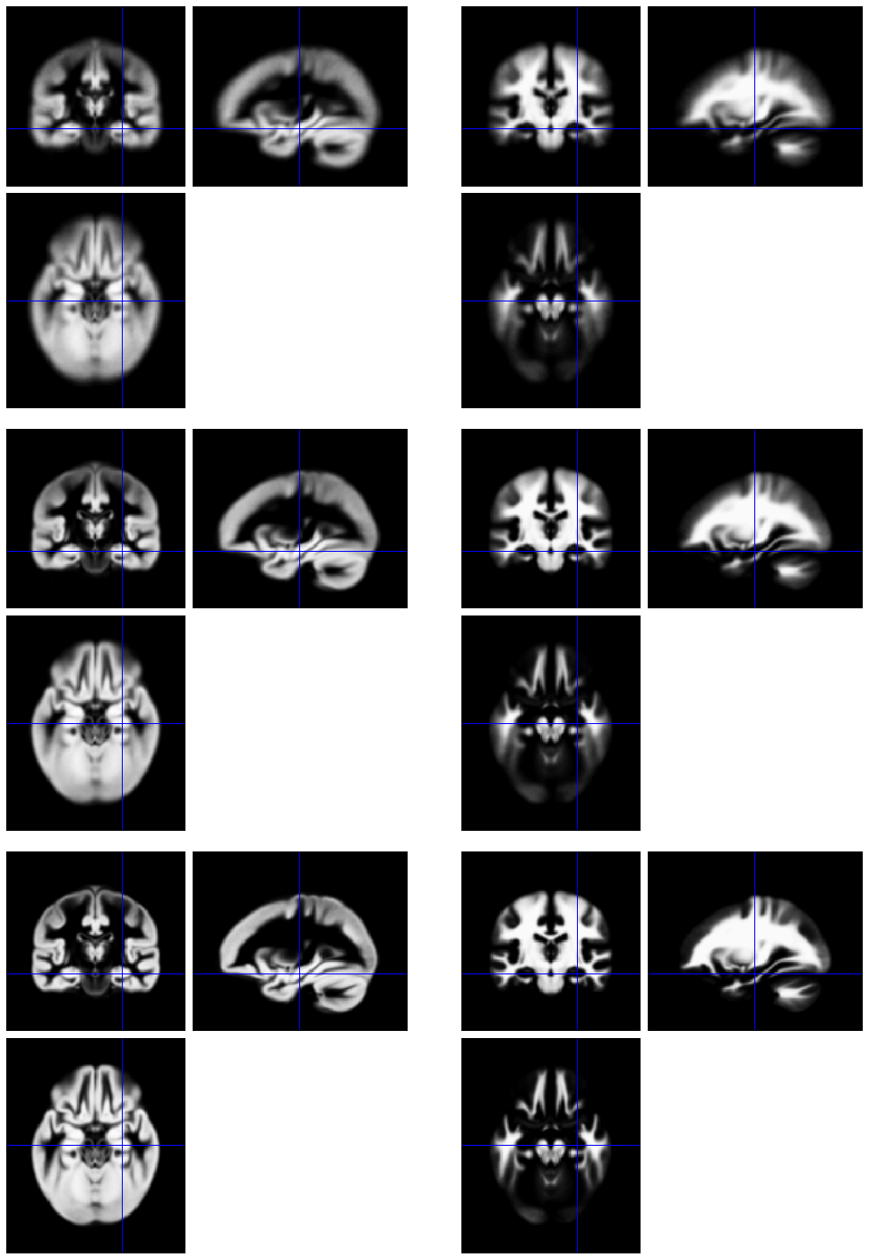
Group-wise alignment
Initial Average
Template implicitly generated from data in study.
Findings less biased by choice of template.
After a few iterations
Final template

Slide 33
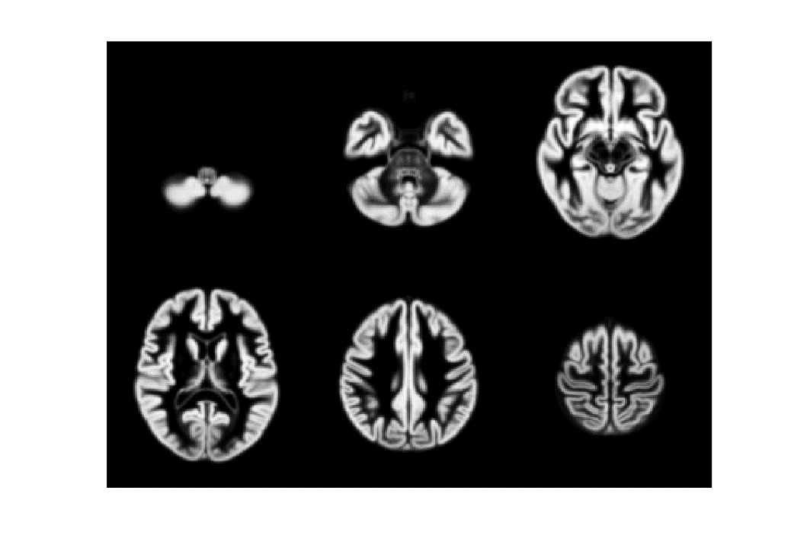
471 Subject Average

Slide 34
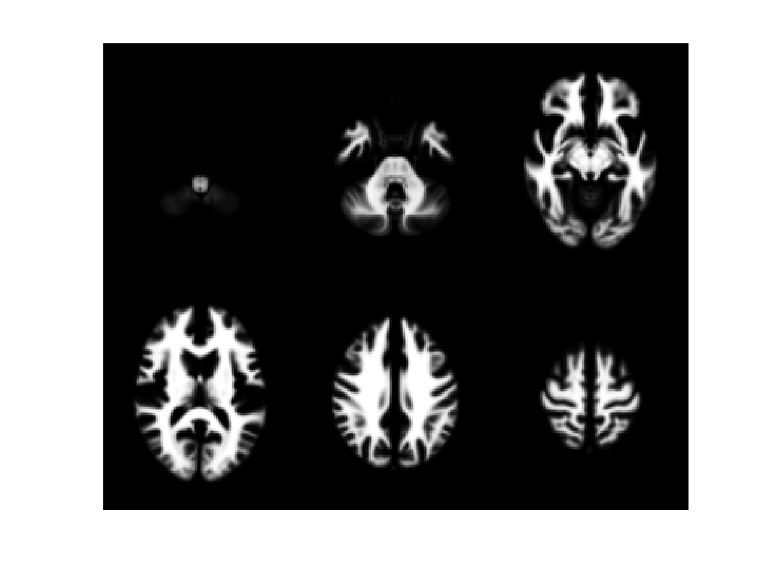
471 Subject Average

Slide 35
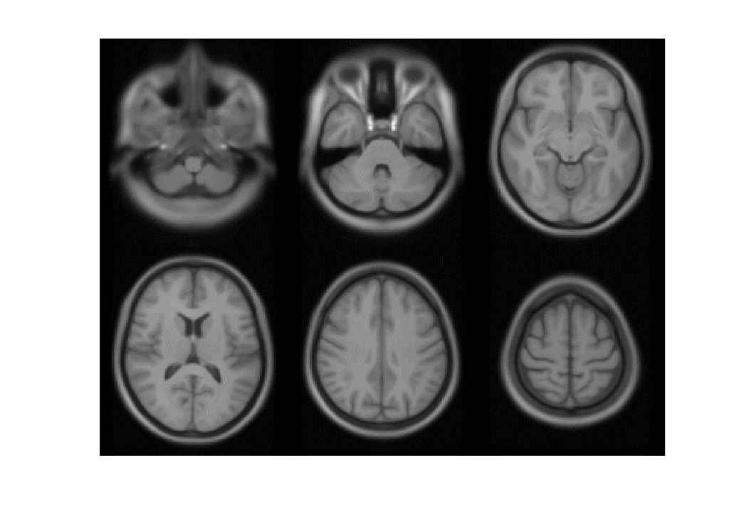
471 Subject Average

Slide 36
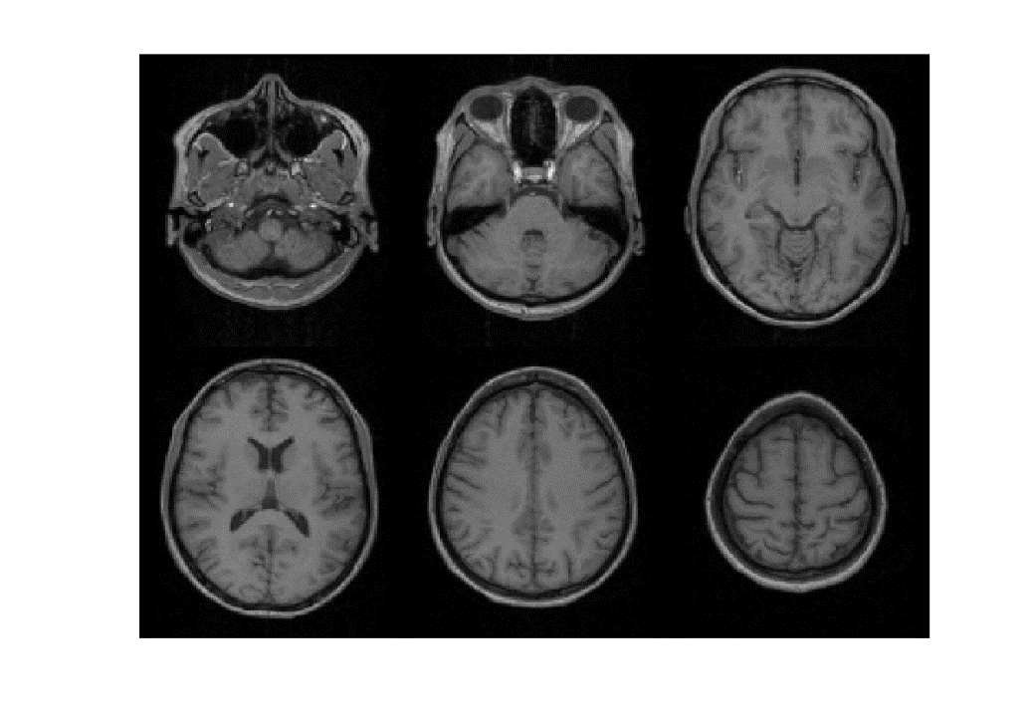
Subject 1

Slide 37
471 Subject Average

Slide 38
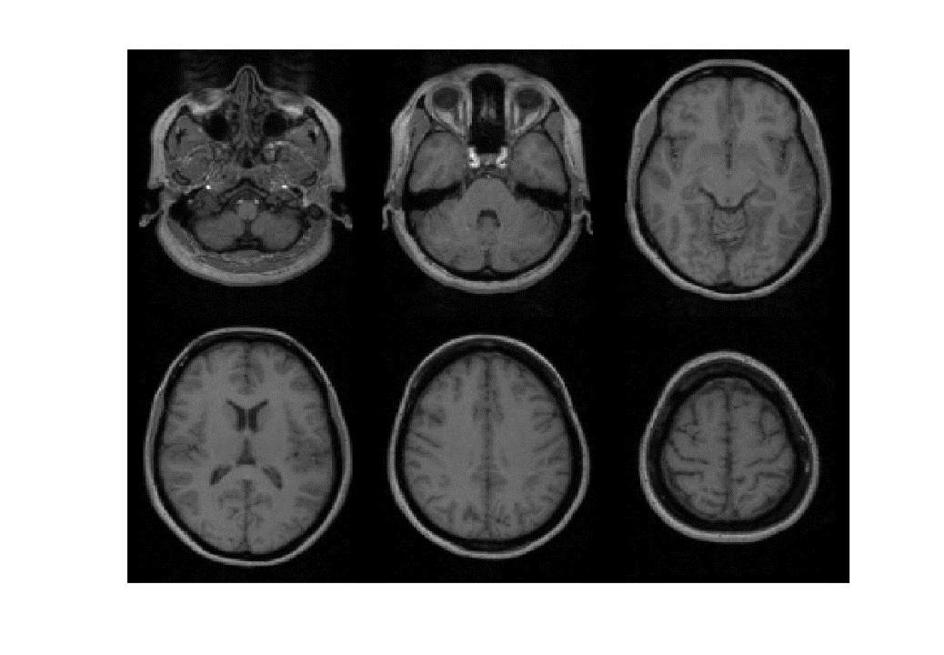
Subject 2

Slide 39
471 Subject Average

Slide 40
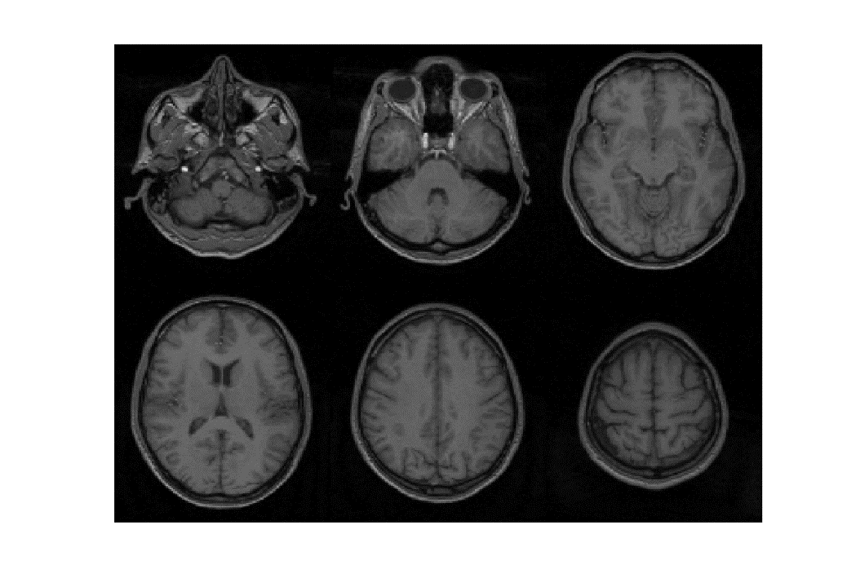
Subject 3

Slide 41
471 Subject Average

Slide 42
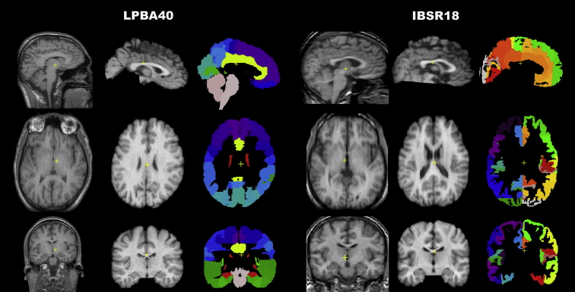
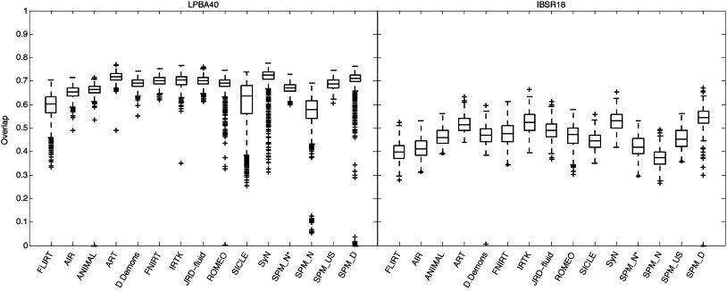
Part of Fig.1 in Klein et al.
Part of Fig.5 in Klein et al.

Slide 43
Summary
VBM performs voxel-wise statistical analysis on smoothed (modulated) normalised tissue segments
SPM performs segmentation and spatial normalisation in a unified generative model
  Based on Gaussian mixture modelling, with warped spatial prior probability maps, and multiplicative bias field
Subsequent (non-unified) use of DARTEL or SHOOT toolboxes improves spatial normalisation for VBM
  (and probably also fMRI...)

Slide 44
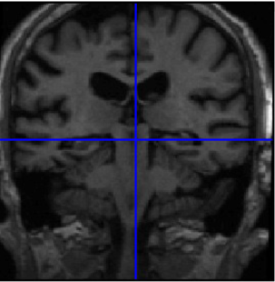
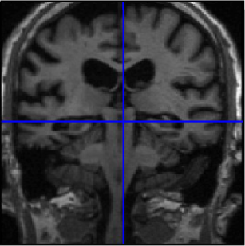
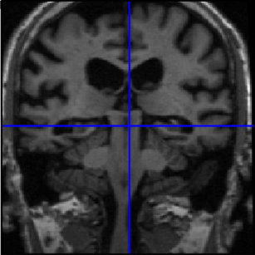
LONGITUDINAL ANALYSIS

Slide 45
Longitudinal VBM – motivation
Development, growth, plasticity, aging, degeneration, and treatment-response are inherently longitudinal
Serial data have major advantages over multiple cross-sectional samples at different stages
Increasing power
  Subtlety of change over time vs. inter-individual variation
Reducing confounds
  Separating within-subject changes from cohort effects
  Demonstrating causality with interventions

Slide 46
Longitudinal VBM – preprocessing
Intra-subject registration over time is much more accurate than inter-subject normalisation
Simple approach: rigid realignment within-subject
  Apply one spatial normalisation to all timepoints
  E.g. Draganski et al (2004) Nature 427: 311-312
More sophisticated approaches use nonlinear within-subject registration
  Information transferred to volume-change maps

Slide 47
Longitudinal VBM – asymmetry & bias
Within-subject image processing often treats one time-point differently from the others
  Later scans registered (rigidly or non-rigidly) to baseline
Asymmetry can introduce methodological biases
  E.g. only baseline has no registration interpolation error
  Baseline seg. more accurate than propagated segs.
  Change in later intervals more regularised/constrained

Slide 48
Longitudinal VBM – registration in SPM12
Ashburner & Ridgway (2013) [PMID: 23386806]
“Unified” rigid and non-rigid registration with model of differential intensity inhomogeneity (bias)
“Generative” – each time-point is a reoriented, spatially warped, intensity biased version of avg.
“Symmetric” with respect to permutation of images
“Consistent” with direct registration between pair
“Diffeomorphic” – complex warping without folding

Slide 49
Longitudinal VBM – modelling
The longitudinal registration produces a within-subject average and maps of volume change relative to it
  Can perform cross-sectional VBM (Dartel, etc.) on averages
  Same spatial normalisation for volume-change maps
  Can multiply volume change with GM, then smooth
Simplest longitudinal statistical analysis: two-stage summary statistic approach (like in fMRI)
  Contrast on the slope parameter for a linear regression against time within each subject (usual group analyses of con images)
  For two time-points with interval approximately constant over subjects, equivalent to simple time2 – time1 difference image

Slide 50
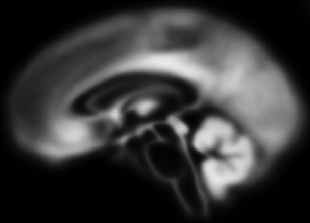
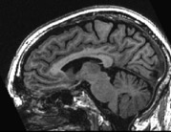

Longitudinal Analysis Model
Each individual is warped to their average
Each average template will be warped to a total group average
Each individual timepoint will produce diveregence & jacobian image
These can be used to calculate single “rate” maps
By repeating the segment-warp steps on the average images, VBQ-type analysis can be performed on the warped rate maps
Group Mean Template
Shoot
LVBM
Time_{years}
Individual Longitudinal Templates
T₀
T₁
T₃
T₄
Subjects

Slide 51
Longitudinal VBM – Getting started…
No longitudinal examples in SPM manual yet…
  Support on SPM list http://www.fil.ion.ucl.ac.uk/spm/support/
  Or email: ged.ridgway@gmail.com
The following slides illustrate usage of the longitudinal registration toolbox in the batch interface in SPM12

Slide 52
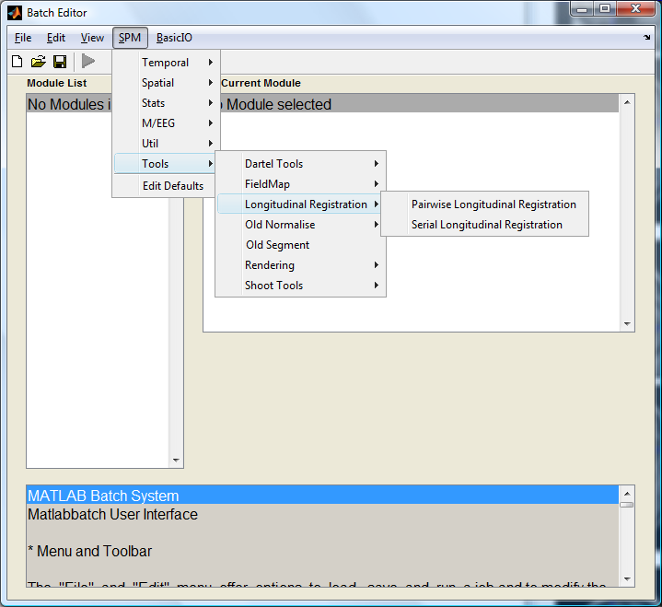
No Longitudinal button, but found in Batch menu, like Dartel, etc.
Choice of paired or general serial.
No difference in model, but easier specification and results for pairs.

Slide 53
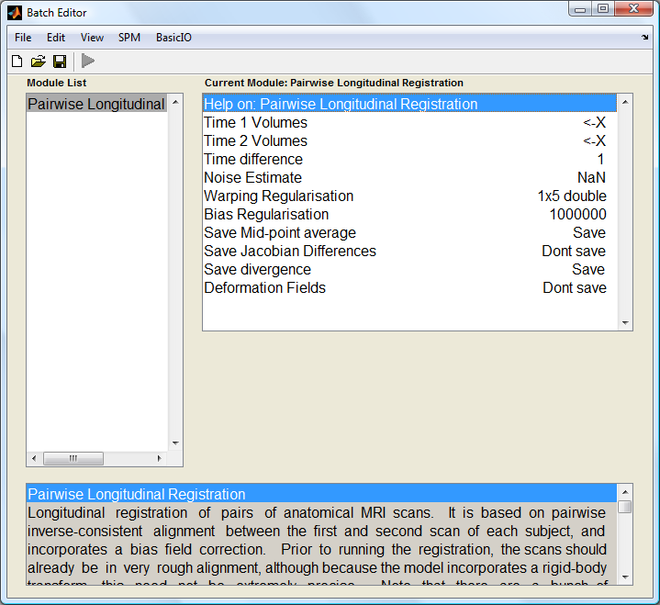
Specify Time 1 scans for all subjects, then all Time 2 scans (in same order!)
Vector (list) of time intervals (yr)
Default values can be left; NaN to automatically estimate (Rician) noise

Slide 54
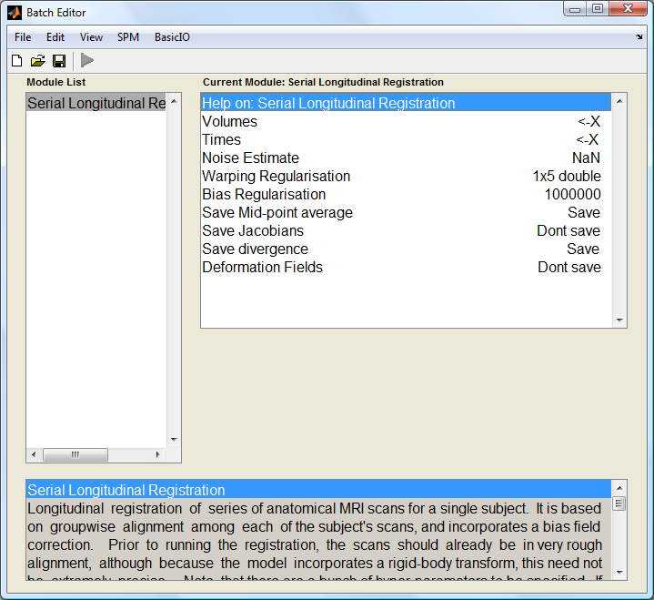
One module
per subject (scripting required if many subjects!)
Select all scans for this subject
Vector (list) of times relative to arbitrary datum (e.g. baseline=0)
Jacobian output useful to quantify interpretable ROI volumes (in litres)

Slide 55
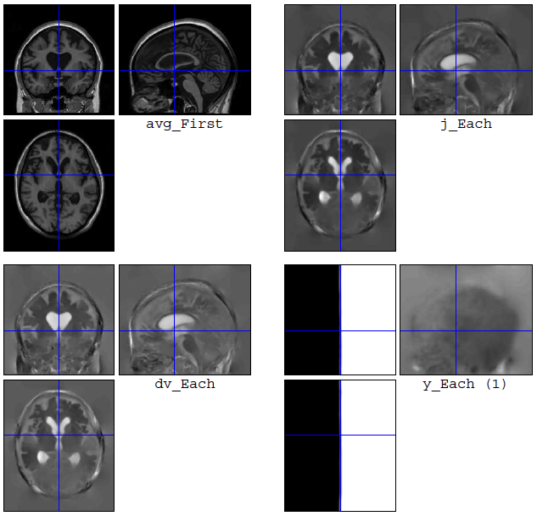
Output/results
  Average image
  Jacobians or divergences
  Deformations
Next steps
  Segment avg
  Run Dartel/Shoot
  Warp e.g. dv to standard space
  SPM stats on dv (TBM)
  Or combine with seg of avg (VBM)

Slide 56
Group Mean Template
Shoot
LVBM
Time_{years}
Individual Longitudinal Templates
T₀
T₁
T₃
T₄
Subjects

Slide 57
Oasis Data
OAS2 0048
66 year old male, with MCI (MMSE=19, CDR=1).

Slide 58
Oasis Data
Data from first 82 subjects (OAS2 0001 to OAS2 0099).
Computed average expansion/contraction rates for each subject.
Warped all data to common anatomical space.
Generated averages.
Mean image intensity
Control subjects
Dementia subjects

Slide 59
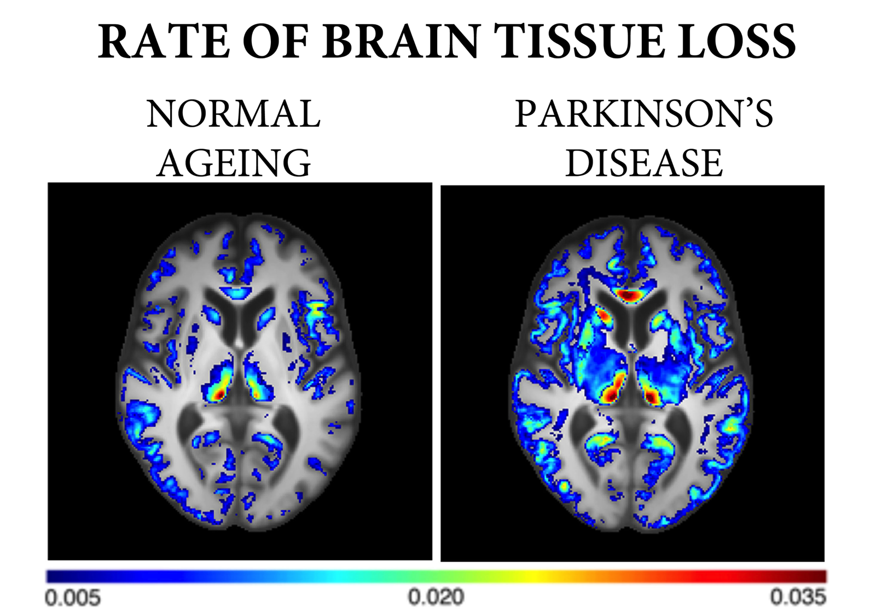

Slide 60
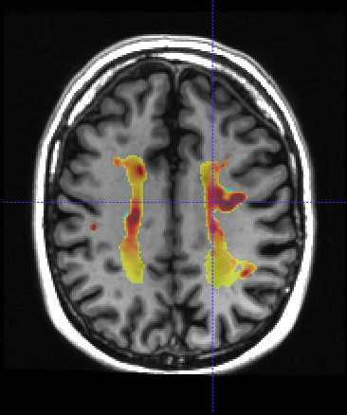



WMH RATE
-0.5
0
0.5
“ATROPHY”
“GROWTH”

Slide 61


Slide 62


Combining VBM with other measures
VBM provides a measure of voxel wise volumetric change.
In isolation, it can be tricky to infer underlying biophysical process i.e. what is driving volume change
Including additional quantitative MRI acquisitions in experimental design can augment this.
These can be analysed using “Voxel based Quantification” framework (very similar to VBM – see: Draganski et al. (2011) PMID:21277375)

Slide 63
CONCLUSION
Introduced VBM & Potential uses
Tissue Segmentation
Statistics
VBM Subtleties
Normalisation via DARTEL/SHOOT
Longitudinal Toolbox
There is a lot more(!):
Quantitative MRI, Voxel based quantification, Cortical thickness analysis, lesion analysis, structural covariance, combining with multivariate machine learning techniques.. etc.,

Slide 64


