Slide 1
Dynamic Causal Modelling
SPM for MRI Course, May 2018
Peter Zeidman
Wellcome Trust Centre for Neuroimaging,
University College London

Slide 2
Dynamic Causal Modelling
is a framework
for inferring neural responses / effective connectivity
in the brain

Slide 3
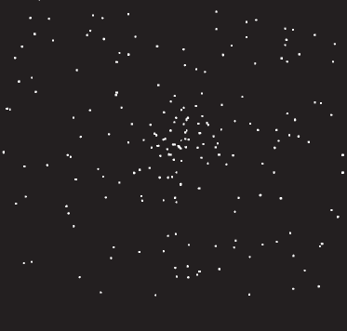
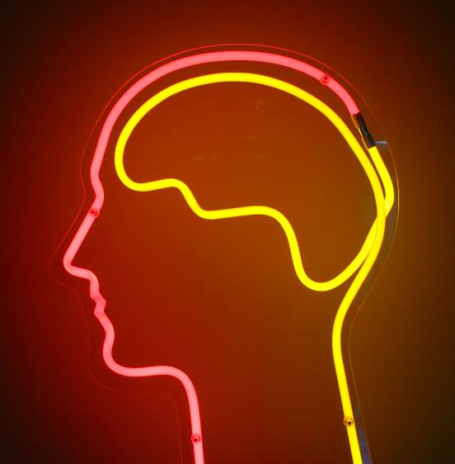
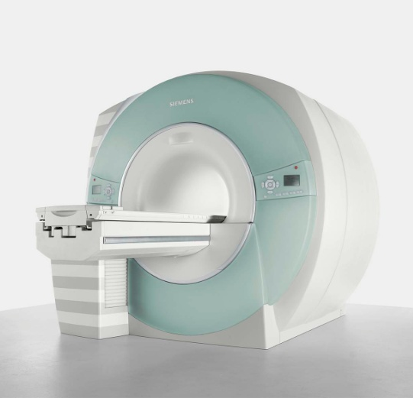
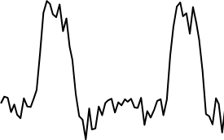
The system of interest
Experimental Stimulus
(Hidden) Neural Activity
Observations (BOLD)
Vector u
Vector y
on
?
BOLD
off
time
time
Stimulus from Buchel and Friston, 1997
Brain by Dierk Schaefer, Flickr, CC 2.0
Notes:
Experimental stimulation causes changes in neural activity. Neural activity in turn causes the BOLD response, which we observe via the scanner. We are interested in the hidden neural activity, which we cannot directly observe - so it must be inferred.

Slide 4
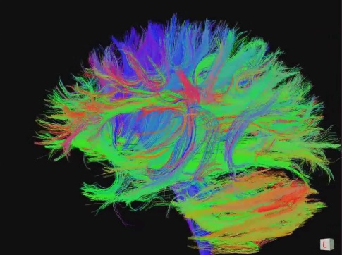
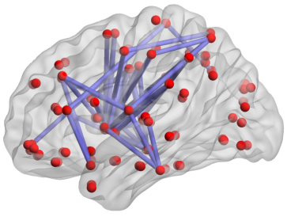
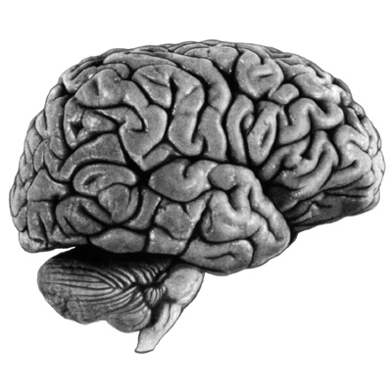
Connectivity
Structural Connectivity
Physical connections of the brain
Functional Connectivity
Dependencies between BOLD observations
Effectivity Connectivity
Causal relationships between brain regions
"Connectome" by jgmarcelino. CC 2.0 via Wikimedia Commons
Figure 1, Hong et al. 2013 PLOS ONE.
KE Stefan, SPM Course 2011
Notes:
Connectivity analysis is another way to look at neural activity. The most interesting is effective connectivity – interactions at the neural level.

Slide 5

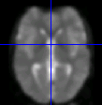

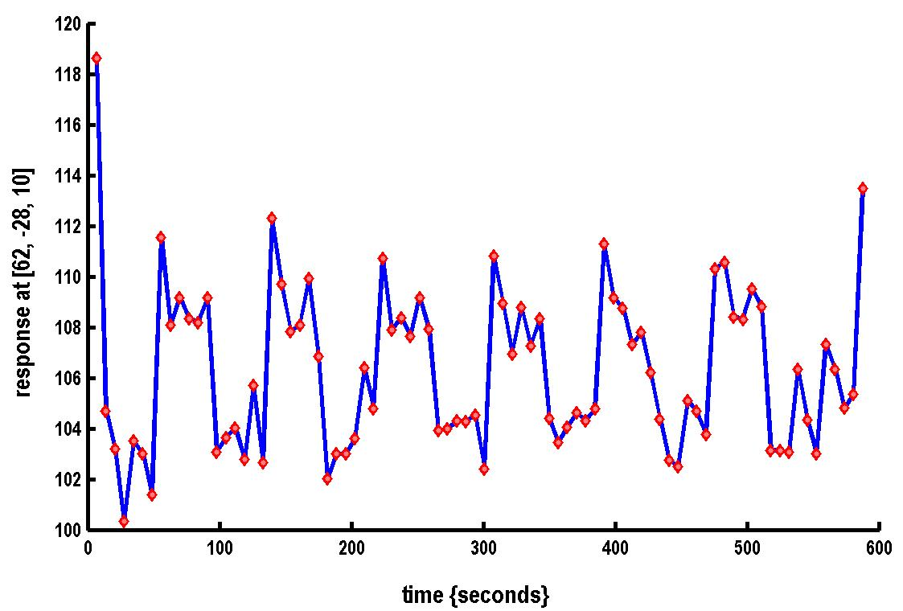
Where DCM sits in the pipeline
Functional MRI acquisition and image reconstruction
Image preprocessing (realignment, coregistration, normalisation, smoothing)
Statistical Parameter Mapping (SPM) / General Linear Model
Dynamic Causal Modelling (DCM)
Timeseries extraction from Regions of Interest (ROIs)

Slide 6
Recipe
Specify a DCM for each subject
Estimate the DCMs
Specify a group level model (PEB)
Test hypotheses at the group level
(Optional: Perform cross-validation)

Slide 7
MODEL SPECIFICATION
FIRST LEVEL ANALYSIS

Slide 8
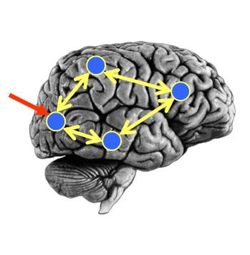
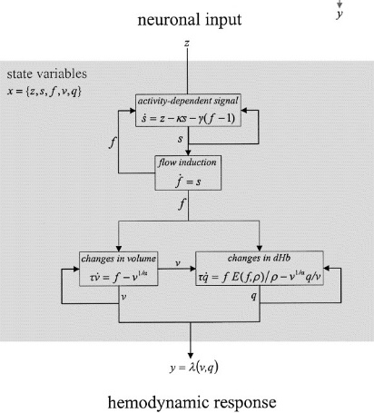
DCM Framework
Neural Model
Observation Model
Experimental Stimulus (u)
Observations (y)
How brain activity z changes over time
What we would see in the scanner, y, given the neural model?
z = f(z,u,θ^{n})
y = g(z, θ^{h})
Stimulus from Buchel and Friston, 1997
Figure 3 from Friston et al., Neuroimage, 2003
Brain by Dierk Schaefer, Flickr, CC 2.0

Slide 9

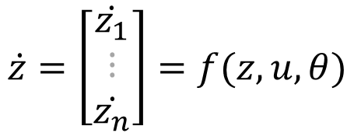
The Neural Model
$$z=\left[\begin{matrix}z_{1} \\ ⋮ \\ z_{n}\end{matrix}\right]$$
The brain activity in each of n regions:
The “response” of these regions is their change over time:
$$\dot{z}=\left[\begin{matrix}\dot{z_{1}} \\ ⋮ \\ \dot{z_{n}}\end{matrix}\right]=f(z,u,θ)$$
Neural response
function
Parameters (e.g. connection strengths)
Experimental input

Slide 10
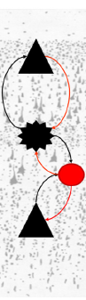
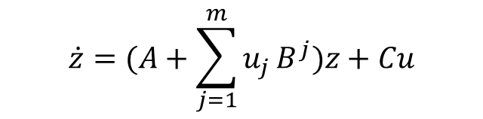


The Neural Model
$$\dot{z}=\left[\begin{matrix}\dot{z_{1}} \\ ⋮ \\ \dot{z_{n}}\end{matrix}\right]=f(z,u,θ)$$
Deterministic DCM for fMRI
DCM for CSD
Canonical Microcircuit
Task
Resting State
Multi-modal data
$$\dot{z}=(A+\sum_{j=1}^{m}{u_{j}}B^{j})z+Cu$$
$$\dot{z}=Az+v$$
Friston et al., Neuroimage, 2003
Friston et al., Neuroimage, 2014
Friston et al., Neuroimage, 2017

Slide 11

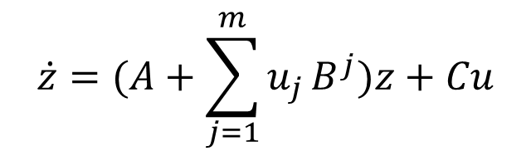
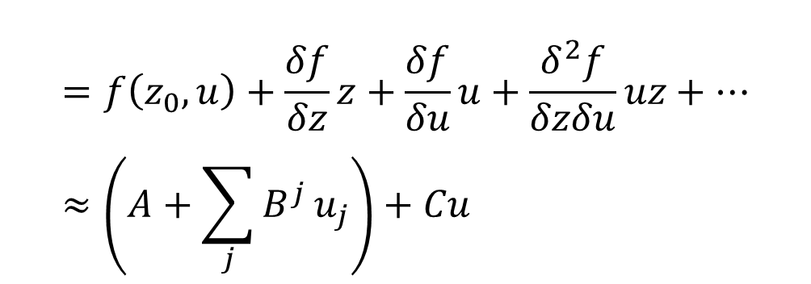
The Neural Model
$$\dot{z}=(A+\sum_{j=1}^{m}{u_{j}}B^{j})z+Cu$$
Where does this come from?
$$\dot{z}=f\left(z,u\right)$$
$$=f\left(z_{0},u\right)+\frac{δf}{δz}z+\frac{δf}{δu}u+\frac{δ^{2}f}{δzδu}uz+… \\ ≈\left(A+\sum_{j}{B^{j}}u_{j}\right)+Cu$$
Taylor series

Slide 12
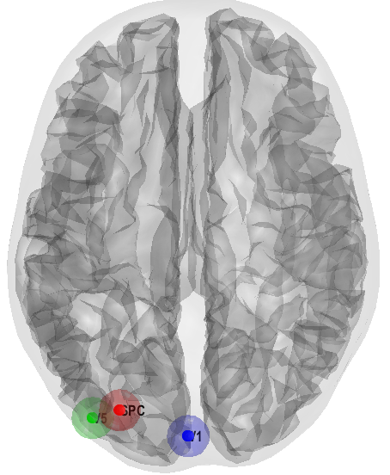
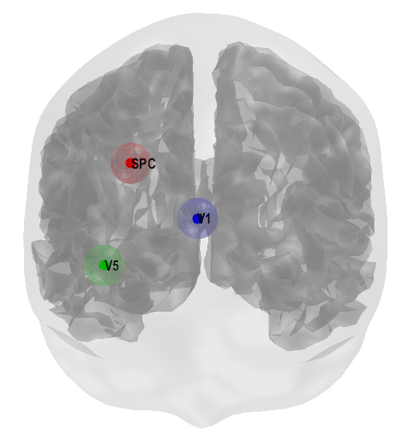
The Neural Model
“How does brain activity, z, change over time?”
Subjects viewed moving dots during fMRI
On some trials, subjects were instructed to pay attention to the speed of the dots’ motion
Question: How does attention to motion change the strength of the connections between V1, V5 and Superior Parietal Cortex?
V1
V5
SPC

Slide 13
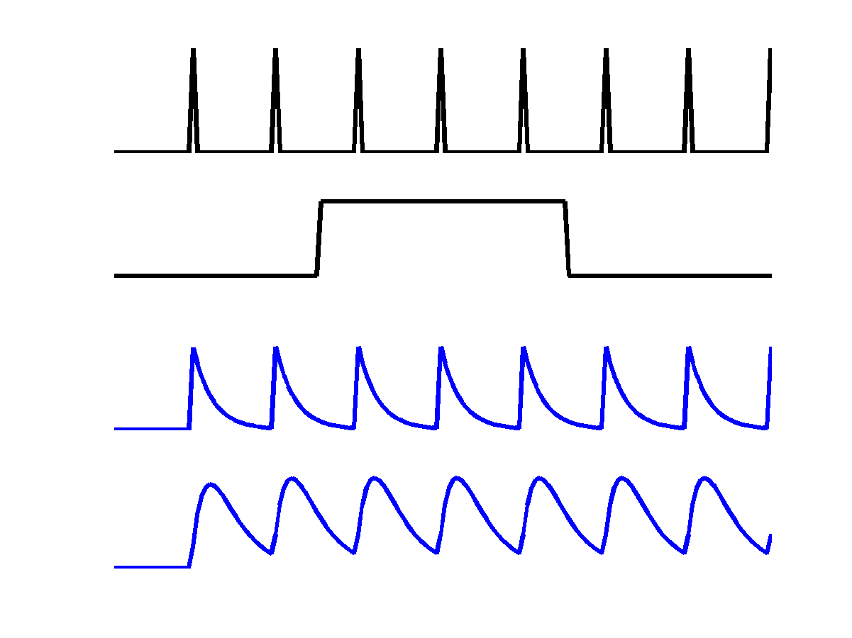
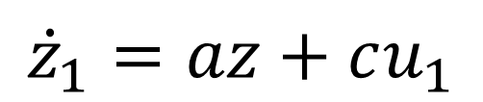
The Neural Model
“How does brain activity, z, change over time?”
V1
u₁
z₁
a
c
z₁
Driving input u₁
z₂
$${\dot{z}}_{1}=az+cu_{1}$$
Inhibitory self-connection (Hz).
Rate constant: controls rate of decay in region 1. More negative = faster decay.

Slide 14


The Neural Model
“How does brain activity, z, change over time?”
Change of activity in V1:
V5
a₂₂
z₂
$${\dot{z}}_{1}=a_{11}z_{1}+c_{11}u_{1}$$
a₂₁
Change of activity in V5:
V1
$${\dot{z}}_{2}=a_{22}z_{2}+a_{21}z_{1}$$
z₁
a₁₁
c₁₁
Self decay
V1 input
Driving input u₁

Slide 15
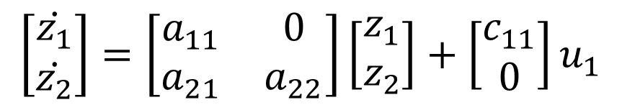

The Neural Model
“How does brain activity, z, change over time?”
$$\left[\begin{matrix}\dot{z_{1}} \\ \dot{z_{2}}\end{matrix}\right]=\left[\begin{matrix}a_{11} & 0 \\ a_{21} & a_{22}\end{matrix}\right]\left[\begin{matrix}z_{1} \\ z_{2}\end{matrix}\right]+\left[\begin{matrix}c_{11} \\ 0\end{matrix}\right]u_{1}$$
V5
a₂₂
z₂
a₂₁
Columns are outgoing connections
Rows are incoming connections
V1
z₁
a₁₁
$$\dot{z}=Az+Cu_{1}$$
c₁₁
Driving input u₁

Slide 16

The Neural Model
“How does brain activity, z, change over time?”
$$\dot{z}=Az+Cu_{1}$$
V5
a₂₂
z₂
u₁
a₂₁
V1
z₁
a₁₁
z₁
z₂
c₁₁
Driving input u₁

Slide 17
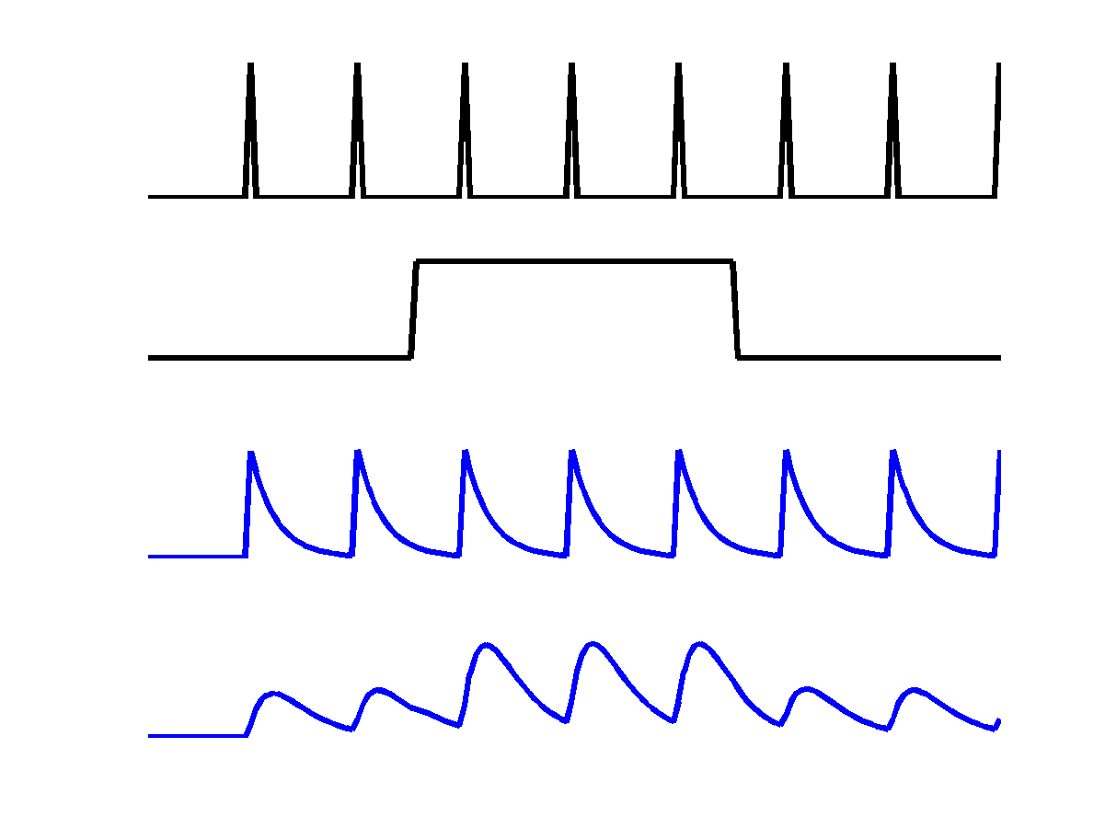
The Neural Model
“How does brain activity, z, change over time?”
V5
a₂₂
u₁
z₂
b₂₁
u₂
a₂₁
Attention u₂
V1
z₁
z₁
a₁₁
c₁₁
z₂
Driving input u₁
Could model be used to model a main effect and interaction

Slide 18


The Neural Model
“How does brain activity, z, change over time?”
Change of activity in V1:
V5
a₂₂
z₂
$$\dot{z_{1}}=a_{11}z_{1}+c_{11}u_{1}$$
b₂₁
a₂₁
Attention u₂
V1
Change of activity in V5:
z₁
a₁₁
$$\dot{z_{2}}=a_{22}z_{2}+a_{21}z_{1}+{(b}_{21}^{}u_{2}{)z}_{1}$$
c₁₁
Driving input u₁
Self decay
V1 input
Modulatory input

Slide 19

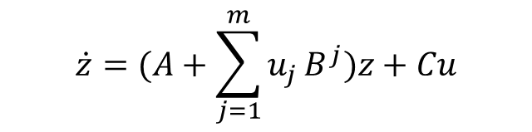
The Neural Model
V5
z₂
a₂₂
b₂₁
a₂₁
“How does brain activity, z, change over time?”
Attention u₂
V1
a₁₁
z₁
For m inputs:
c₁₁
$$\dot{z}=(A+\sum_{j=1}^{m}{u_{j}}B^{j})z+Cu$$
Driving input u₁
Columns: outgoing connections
Rows: incoming connections
A: Structure
B: Modulatory
Input
C: Driving
Input
$$\left[\begin{matrix}{\dot{z}}_{1} \\ {\dot{z}}_{2}\end{matrix}\right]=\left(\left[\begin{matrix}a_{11} & 0 \\ a_{21} & a_{22}\end{matrix}\right]+u_{2}\left[\begin{matrix}0 & 0 \\ b_{21} & 0\end{matrix}\right]\right)\left[\begin{matrix}z_{1} \\ z_{2}\end{matrix}\right]+\left[\begin{matrix}c_{11} & 0 \\ 0 & 0\end{matrix}\right]\left[\begin{matrix}u_{1} \\ u_{2}\end{matrix}\right]$$
Change in
activity per
region
External input 2
(attention)
Current
activity
per region
All
external input

Slide 20
DCM Framework
Neural Model
Observation Model
Experimental Stimulus (u)
Observations (y)
How brain activity z changes over time
What we would see in the scanner, y, given the neural model?
.
z = f(z,u,θ^{n})
y = g(z, θ^{h})
Stimulus from Buchel and Friston, 1997
Figure 3 from Friston et al., Neuroimage, 2003
Brain by Dierk Schaefer, Flickr, CC 2.0

Slide 21
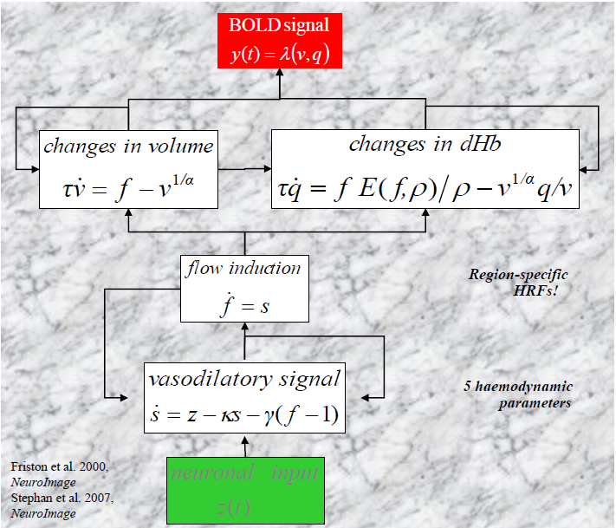
The Haemodynamic Model

Slide 22
Recipe
Specify a DCM for each subject
Estimate the DCMs
Specify a group level model (PEB)
Test hypotheses at the group level
(Optional: Perform cross-validation)

Slide 23
MODEL estimation
FIRST LEVEL ANALYSIS

Slide 24
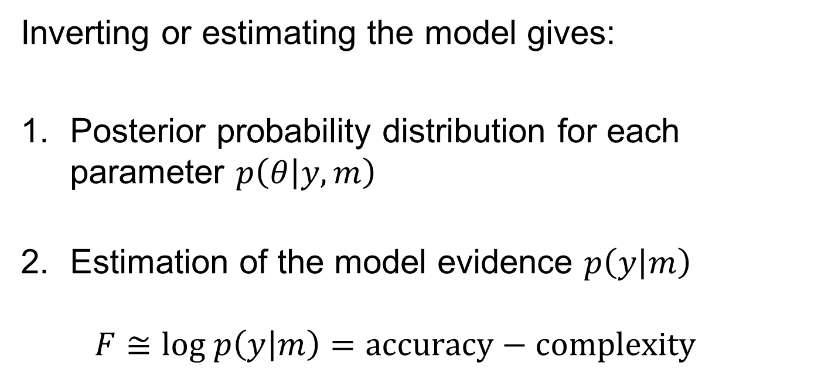
Model estimation
Inverting or estimating the model gives:
Posterior probability distribution for each parameter $p\left(θ | y,m\right)$
Estimation of the model evidence $p\left(y | m\right)$
$F≅\text{log} p\left(y | m\right)=\text{accuracy}−\text{complexity}$
Free energy

Slide 25
Recipe
Specify a DCM for each subject
Estimate the DCMs
Specify a group level model (PEB)
Test hypotheses at the group level
(Optional: Perform cross-validation)

Slide 26
SPECIFY A PEB MODEL
SECOND LEVEL ANALYSIS

Slide 27

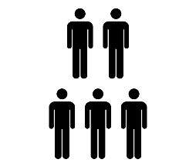

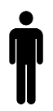

Hierarchical model of parameters
Parametric Empirical Bayes
Priors on second level parameters
Second level
$$θ^{(1)}=Xθ^{(2)}+ε^{(2)}$$
Between-subject error
Second level general linear model
First level
Measurement noise
DCM for subject i
Image credit: Wilson Joseph from Noun Project

Slide 28







Second level model (Bayesian GLM)
$$θ^{(1)}=Xθ^{(2)}+ε^{(2)}$$
Group average of each connection
Group difference 1
Group difference 2
$$θ^{(1)}$$
$$θ^{(2)}$$
$$ε$$
Subject 1
Subject 2
$$=$$
$$+$$
DCM parameter
$$X$$
Subject N
Regressor
We estimate $θ^{(2)}$ which contains the commonalities and differences across subjects

Slide 29
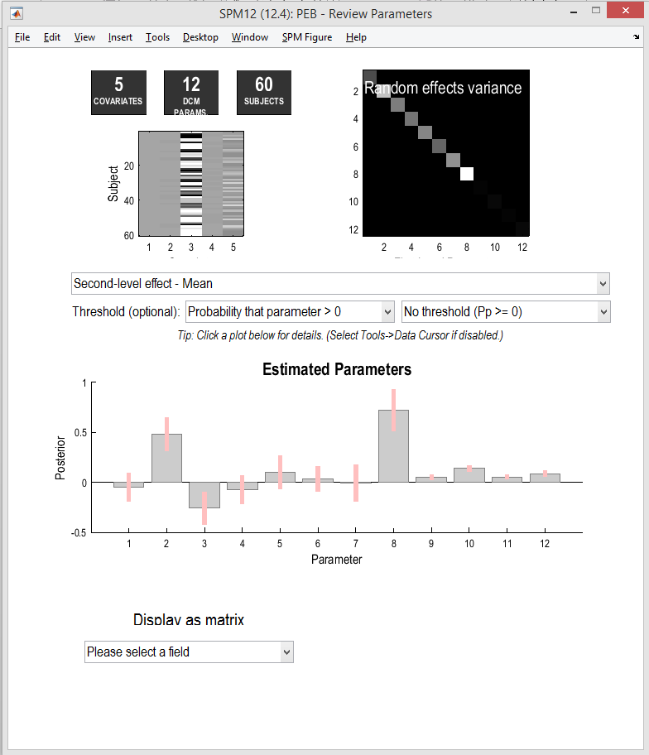

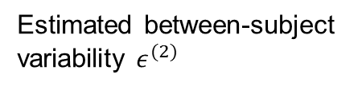
PEB results
Estimated between-subject
variability $ε^{(2)}$
Covariates
Group-level parameters $θ^{(2)}$

Slide 30
Recipe
Specify a DCM for each subject
Estimate the DCMs
Specify a group level model (PEB)
Test hypotheses at the group level
(Optional: Perform cross-validation)

Slide 31
Test hypotheses
SECOND LEVEL ANALYSIS

Slide 32






Question: Is there an effect of diagnosis on connectivity?
‘Full’ GLM
‘Reduced’ GLM
Group level GLM parameters $θ^{(2)}$
Group level GLM parameters $θ^{(2)}$
4
Commonalities
Diagnosis
4
Commonalities
Diagnosis
3
3
2
2
Estimate
Estimate
1
1
0
0
-1
-1
-2
0
5
10
15
20
25
-2
0
5
10
15
20
25
GLM Parameter $θ^{(2)}$
GLM Parameter $θ^{(2)}$
Get the evidence (free energy) $F_{1}$
Get the evidence (free energy) $F_{2}$
Compare models using Log Bayes Factor: $LBF=F_{1}−F_{2}$

Slide 33
Hypothesis testing using PEB
‘Bayesian model reduction’ enables alternative models to be assessed in milliseconds.
Applications:
Compare GLMs with / without particular connections (spm_dcm_peb_bmc.m)
Compare GLMs with / without particular covariates (spm_dcm_bmc_peb.m)
Automatically search over reduced models to find the best combination of parameters (spm_dcm_peb_bmc.m)

Slide 34

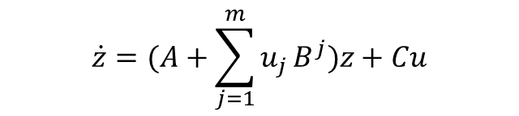



Summary
First level analysis
Second level analysis
1. Specify a DCM to model effective connectivity
3. Estimate a group-
level Bayesian GLM
$$θ^{(1)}=Xθ^{(2)}+ε^{(2)}$$
4. Test hypotheses by switching on and off combinations of parameters $θ^{(2)}$ to see how that changes the evidence
$$\dot{z}=(A+\sum_{j=1}^{m}{u_{j}}B^{j})z+Cu$$
2. Estimate the DCM for each subject to get:
Connectivity parameters
$θ^{(1)}=(A,B,C)$
Evidence (free energy)
$F≈\ln{p(y|m)}$
5. Optionally, perform cross-validation to see if effect sizes are large enough to be useful.

Slide 35
Further Reading
The original DCM paper | Friston et al. 2003, NeuroImage
The original PEB paper | Friston et al. 2016, NeuroImage
Descriptive / tutorial DCM papers
Role of General Systems Theory | Stephan 2004, J Anatomy
DCM: Ten simple rules for the clinician | Kahan et al. 2013, NeuroImage
Ten Simple Rules for DCM | Stephan et al. 2010, NeuroImage
Extensions to DCM for fMRI
Two-state DCM | Marreiros et al. 2008, NeuroImage
Non-linear DCM | Stephan et al. 2008, NeuroImage
Stochastic DCM | Li et al. 2011, NeuroImage Friston et al. 2011, NeuroImage Daunizeau et al. 2012, Front Comput Neurosci
A DCM for Resting State fMRI | Friston et al., 2014, NeuroImage
Multi-modal canonical microcircuit | Friston et al., 2017, NeuroImage

Slide 36
example

Slide 38
Reading > fixation (29 controls)
Lesion (Patient AH)

Slide 39
1. Extracted regions of interest. Spheres placed at the peak SPM coordinates from two contrasts:
A. Reading in patient > controls
B. Reading in controls
2. Asked which region should receive the driving input

Slide 40
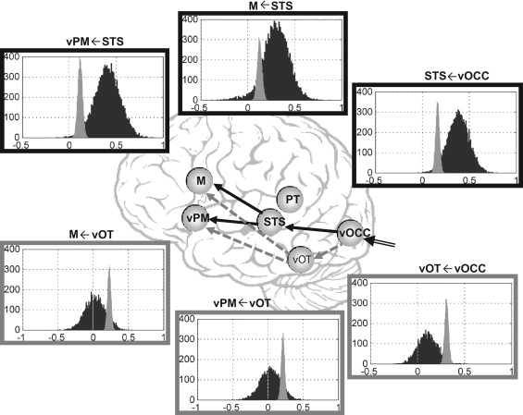
Bayesian Model Averaging
Key:
Controls
Patient
Seghier et al., Neuropsychologia, 2012

Slide 41
Learning Objectives
By the end of today, you should be able to:
Place DCM in the fMRI analysis pipeline
State the difference between structural, functional and effective connectivity
Explain how a generative model helps to separate the BOLD signal into neuronal activity (effective connectivity), haemodynamics and noise.
Explain the interpretation of the parameters in the neuronal formula in DCM for fMRI
Explain how parameter estimates and the log model evidence are used to test hypotheses

Slide 42
Further Reading
The original DCM paper | Friston et al. 2003, NeuroImage
Descriptive / tutorial papers
Role of General Systems Theory | Stephan 2004, J Anatomy
DCM: Ten simple rules for the clinician | Kahan et al. 2013, NeuroImage
Ten Simple Rules for DCM | Stephan et al. 2010, NeuroImage
DCM Extensions
Two-state DCM | Marreiros et al. 2008, NeuroImage
Non-linear DCM | Stephan et al. 2008, NeuroImage
Stochastic DCM | Li et al. 2011, NeuroImage Friston et al. 2011, NeuroImage Daunizeau et al. 2012, Front Comput Neurosci
Post-hoc DCM | Friston and Penny, 2011, NeuroImage Rosa and Friston, 2012, J Neuro Methods
A DCM for Resting State fMRI | Friston et al., 2014, NeuroImage

