Slide 1
What are we measuring with M/EEG?
James Bonaiuto
Institut des Sciences Cognitives, CNRS, Lyon, France
SPM course, 7 May 2018

Slide 2
Overview
Biophysical origin of M/EEG signals
Instrumentation and recording
Sensitivity to deep and radial sources
Forward models

Slide 3
Overview
Biophysical origin of M/EEG signals
Instrumentation and recording
Sensitivity to deep and radial sources
Forward models

Slide 4
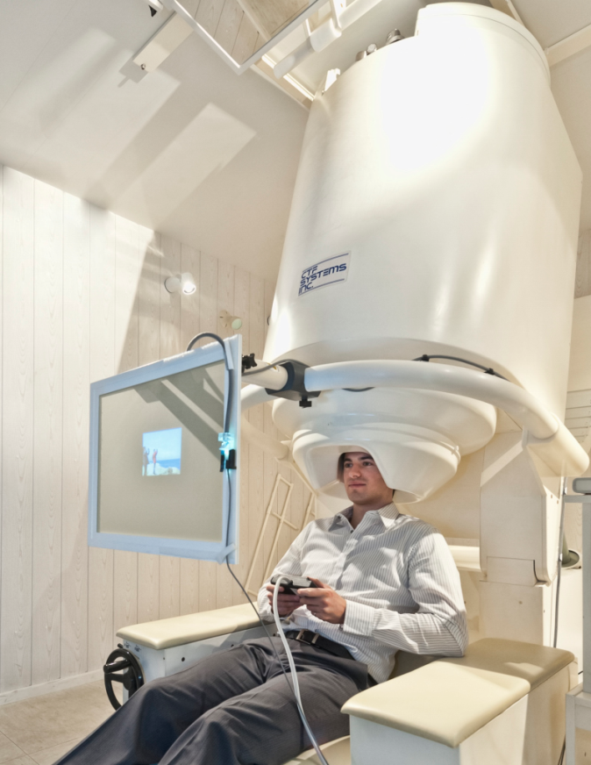
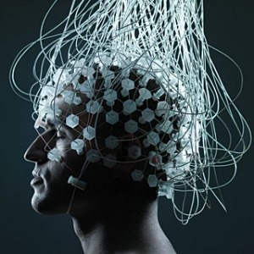
EEG and MEG measure the same underlying neural currents
EEG: Measures differences in electric potential at the scalp
MEG: Measures changes in magnetic flux density outside of the head
Both are non-invasive, cover the whole head, and have very high temporal resolution

Slide 5
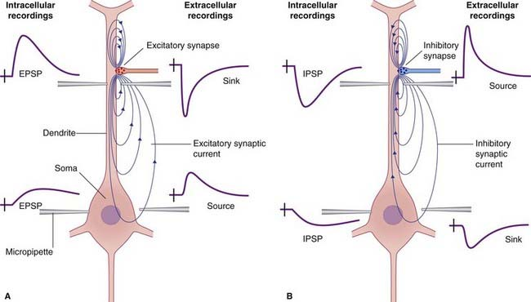
Origin of the M/EEG Signal: Post-synaptic potentials
Synaptic input leads to ionic currents across the postsynaptic membrane
Excitatory Post-Synaptic Potential (EPSP): influx of positive Na+ ions at apical dendrites causes depolarization of the postsynaptic cell
Extracellular volume currents complete the loop of ionic flow so that there is no build-up of charge
MEG is more sensitive to intracellular currents, EEG to extracellular
https://clinicalgate.com/electroencephalography/

Slide 6
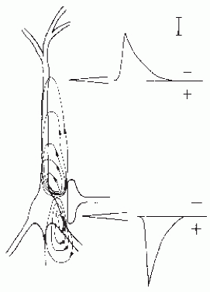
Current flow direction depends on type and location of synaptic input
Inhibitory Post-Synaptic Potential (IPSP): influx of negative Cl- ions causes hyperpolarization of the postsynaptic cell
Direction of current flow
depends on location of
synapse
https://clinicalgate.com/electroencephalography/
From Lopes da Silva, Mag. Res. Imag., 2004

Slide 7
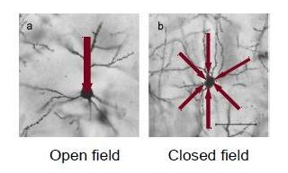
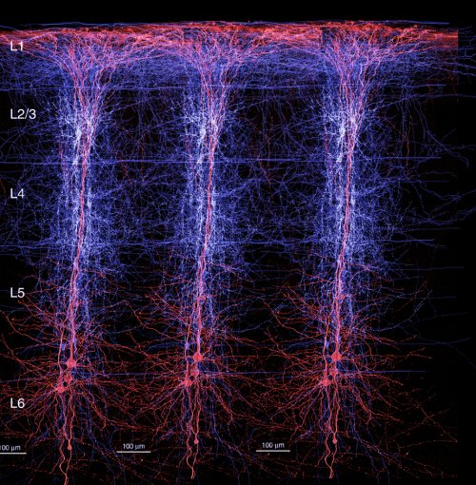
From single neuron to neural population
The geometry of the neuron must give rise to a net dipole current to contribute to the M/EEG signal
A large number of neurons have to be active simultaneously to generate a measurable M/EEG signal
Churchill, BMC Neuroscience 2004
Layer II/II and V pyramidal cells are ideal as current generators because they are:
spatially aligned
perpendicular to the cortical surface
recurrently connected
receive synchronous inputs
BBP/EPFL
Notes:
Note that we can’t measure all neural activity, eg inhibitory interneurons.
But detected indirectly bc they influence PSPs

Slide 8
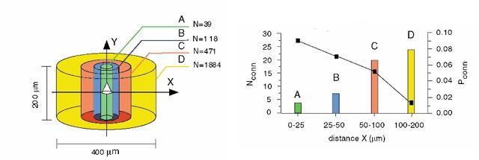
Local connectivity patterns result in similar excitation patterns
Holmgren et al., 2003
The current densities across a small cortical area are often modeled as an Equivalent Current Dipole (ECD)
This ECD is considered a single point source with a dipole moment Q

Slide 9
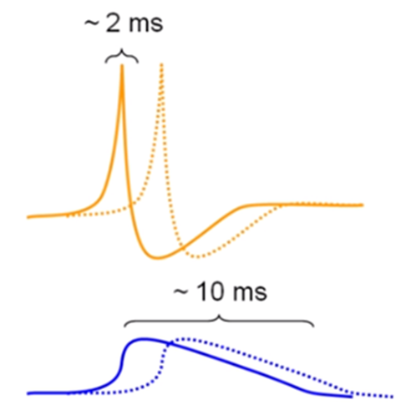
M/EEG directly measure neural activity
But what kind of neuronal activity?
Action potentials are biphasic - not ideal for summation due to cancellation
Postsynaptic potentials are monophasic and slower – ideal for summation
Notes:
APs that are not perfectly synchronized will cancel each other out because it is a biphasic signal
We don’t measure all neural activity. Inhibitory inter-neurons eg are not oriented symmetrically so we can’t see them

Slide 10
Realistic modeling of current sources
Neuronal models of detailed morphology were excited by virtually injecting current
ECD moment was estimated by summing elementary dipoles across neural segments
50,000 cells sufficient to generate a dipolar source of 10nAm
Spikes produce large current densities → about 10,000 firing neurons could yield a MEG measurable signal
Murakami et al., 2006

Slide 11
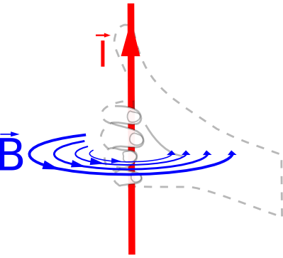
Primary intracellular currents give rise to volume currents and a magnetic field
Magnetic field
Current
MEG pick-up coils
Electrical potential difference (EEG)
Magnetic field
scalp
skull
MEG measures the changes in the magnetic field generated by an electric current (Sarvas 1987, Hämäläinen 1993)
These magnetic fields are mainly induced by primary currents based on excitatory activity (Okada et al. 1997)
Volume currents yield potential differences on the scalp that can be measured by EEG
cortex
Volume currents

Slide 12
Overview
Biophysical origin of M/EEG signals
Instrumentation and recording
Sensitivity to deep and radial sources
Forward models

Slide 13
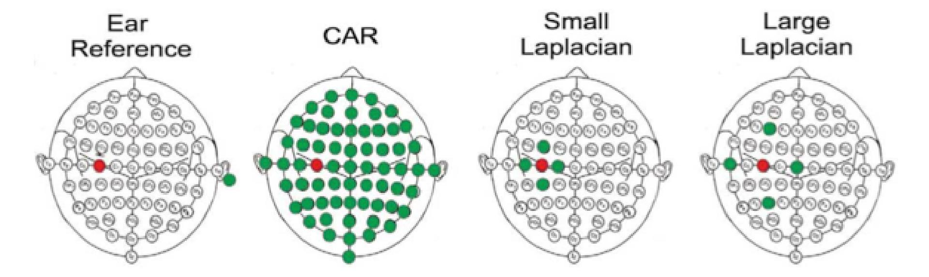
EEG measures potential differences at the scalp
EEG records potential differences at the scalp using a set of active electrodes and a reference
The ground electrode is important to eliminate noise from the amplifier circuit
The representation of the EEG channels is referred to as a montage
  Unipolar/Referential ⇒ potential difference between electrode and designated reference
  Bipolar ⇒ represents difference between adjacent electrodes (e.g. ECG, EOG)
Potential differences are then amplified and filtered
McFarland et al.,
1997

Slide 14
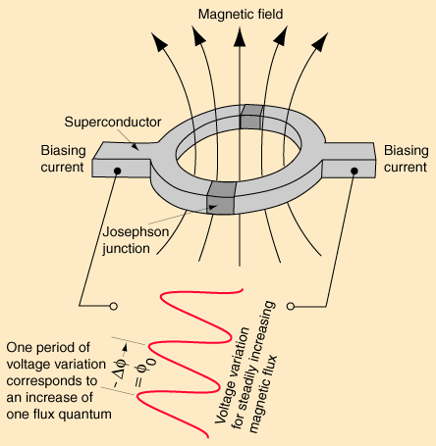
SQUID – Superconducting QUantum Interference Device
It is an ultra-sensitive detector of magnetic flux made up of a superconducting ring interrupted by one or two Josephson junctions.
Output is voltage dependent on magnetic flux
Can measure field changes of the order of 10⁻¹⁵ (femto) Tesla (compare to the earth’s field of 10⁻⁴ Tesla)
Cooling achieved by liquid Helium
But: recent advances in using optically-pumped magnetometers for
MEG (Boto et al., 2016, 2017, 2018)
Adapted from J Clarke, Scientific American 1994

Slide 15
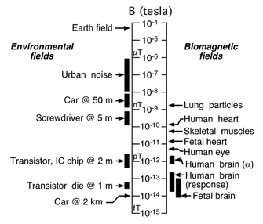
More sensitivity = more noise
The signal is tiny!
We need magnetically shielded rooms to minimize noise and very sensitive sensors to measure anything
From Vrba (2002)
Notes:
So how big is the signal?
Like a needle in a haystack
For example a car at 2km distance would cause a similar change in magnetic flux to that due to brain activity (Weinstock 1996). The next major problem is to separate the brain signal from the external noise.

Slide 16
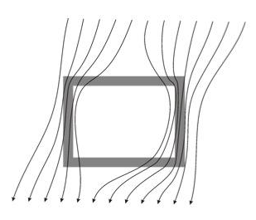
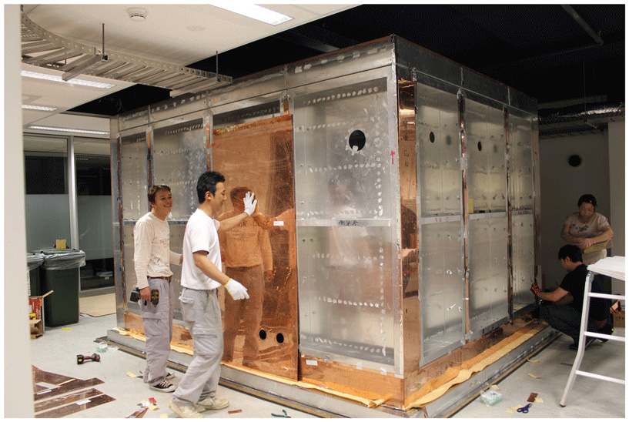
Magnetically shielded room
Provides passive shielding against noise from the environment
The external magnetic field ‘bends’ around the MSR
Concentric shells of mu metal and aluminium
Notes:
An msr = passive shield against environmental magnetic noise
Consists of concentric shells of mu metal and aluminium

Slide 17
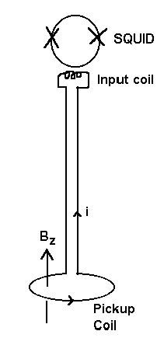
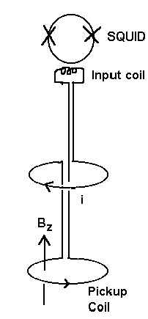
Flux transformers can enhance the sensitivity of the SQUIDs to magnetic fields
Magnetometers: measure the magnetic flux through a single coil
Gradiometers: when more flux passes through the lower coil (near the head) than the upper get a net change in current flow at the inut coil.
Notes:
There are different types of MEG sensors.
In all cases, they use coils that transform the magnetic flux through the surface coil into a tiny electric current whose intensity will be instantaneously compensated and hence measured by the SQUID. This is the amount of compensatory current that is related to the magnetic field and yield the MEG signal.
Now with a single coil, we get a magnetometer that measures the local magnetic field directly.
Other systems like the one downstairs from CTF is using gradiometers. Here is a 1st order axial gradiometer.
Axial because the z vertical axis is radially oriented with respect to the scalp. 1st order because it is made of two coils and thus computes the first derivative of the magnetic flux locally by computing the difference between the two opposite currents generated in each coil. One can even couple gradiometers to compute higher order differences and planar instead of axial gradiometers also exist.
Gradiometers are less sensitive to distant sources, meaning that they are both less sensitive to noise from the environment and to deep sources.
This is why some MEG systems like the finish Elekta machine do couple magnetometers and gradiometers.
The type of sensors depend upon the machine you have. However, there are some mathematical tranformations that enable you to represent your data in one way or another, a bit like Laplacian operators transform the EEG data into maps of SCD.

Slide 18
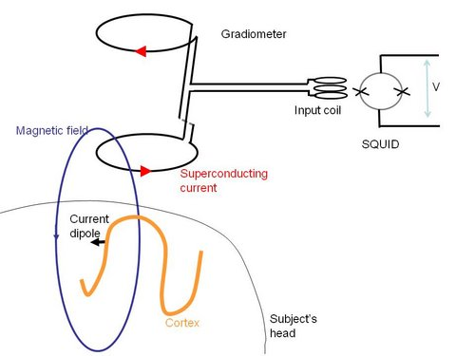
Flux transformers and SQUIDS
1st order
Neural population becomes active, current and magnetic field is created.
Changes in magnetic flux → current flow in superconducting sensor coil
Change in superconducting current is transferred through input coil to SQUID
This induces magnetic flux across SQUID which also induces a change in voltage.
The flux transformer here has two coils. Good for minimizing noise because the magnetic field decreases very sharply with distance.
Notes:
The flux transformer is connected to an input coil which is in turn inductively coupled to the SQUID. In this case the flux transformer is a first order gradiometer and consists of two coils (one ~1cm from the head) wound in opposite directions. As magnetic flux density falls off very sharply with distance, more magnetic flux will pass through the gradiometer coil closest to the head. This causes a net current flow which passes through the input coil causing the voltage across the SQUID to change because of the change in magnetic flux (through the SQUID). By contrast, a car passing some distance away will induce equal and opposite voltages within the two gradiometer coils, meaning that no net current will flow through the input coil and there will be no change in output of the SQUID.

Slide 19
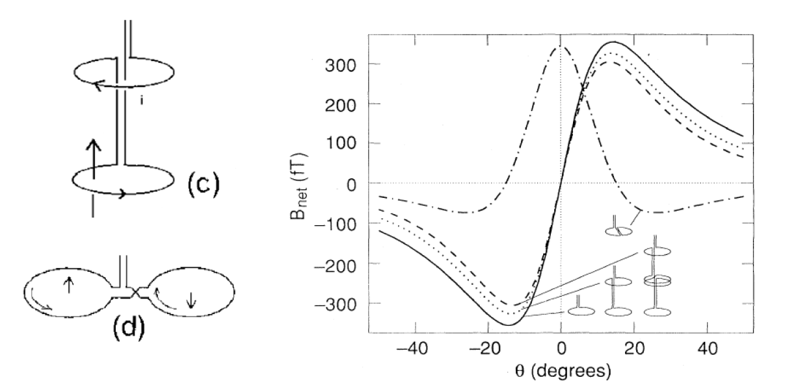
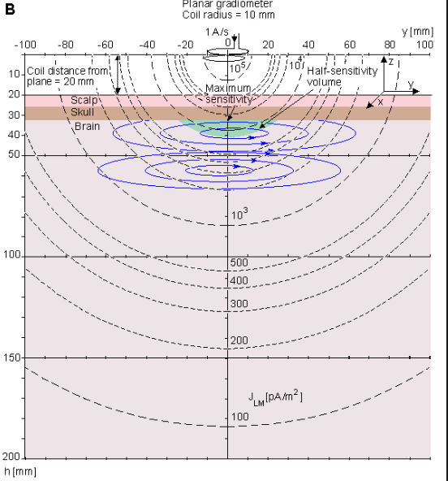
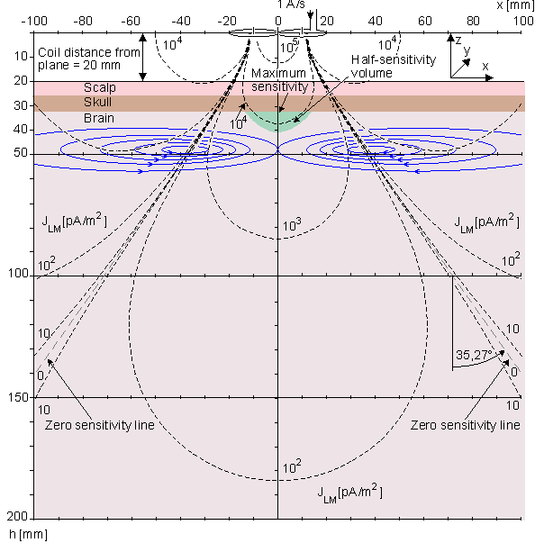
Axial and planar gradiometers have different sensitivity profiles
Axial
Planar

Slide 20
Overview
Biophysical origin of M/EEG signals
Instrumentation and recording
Sensitivity to deep and radial sources
Forward models

Slide 21
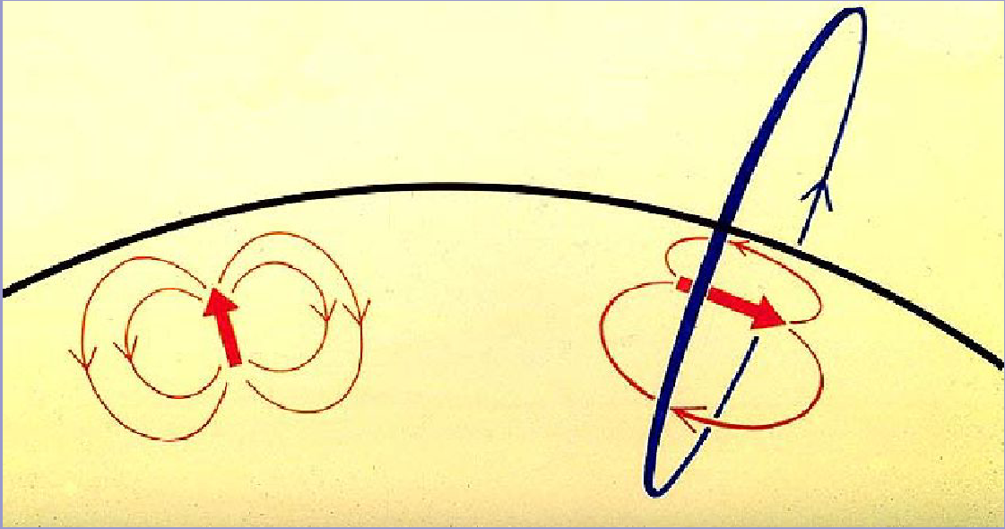
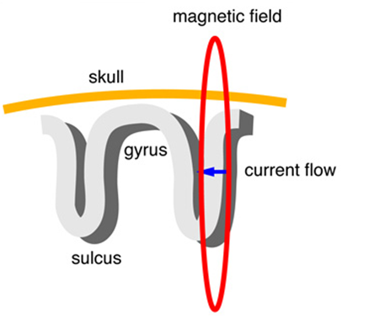
Source orientation: Tangential versus radial
The magnetic field generated by an electric current can be described by Biot-Savart's law
For a spherically symmetric volume conductor MEG is only sensitive to the tangential component of the primary current
This could be a problem for gyral sources!
MEG pick-up coils
Tangential
Radial
From D. Cohen
Notes:
The cortex curves

Slide 22
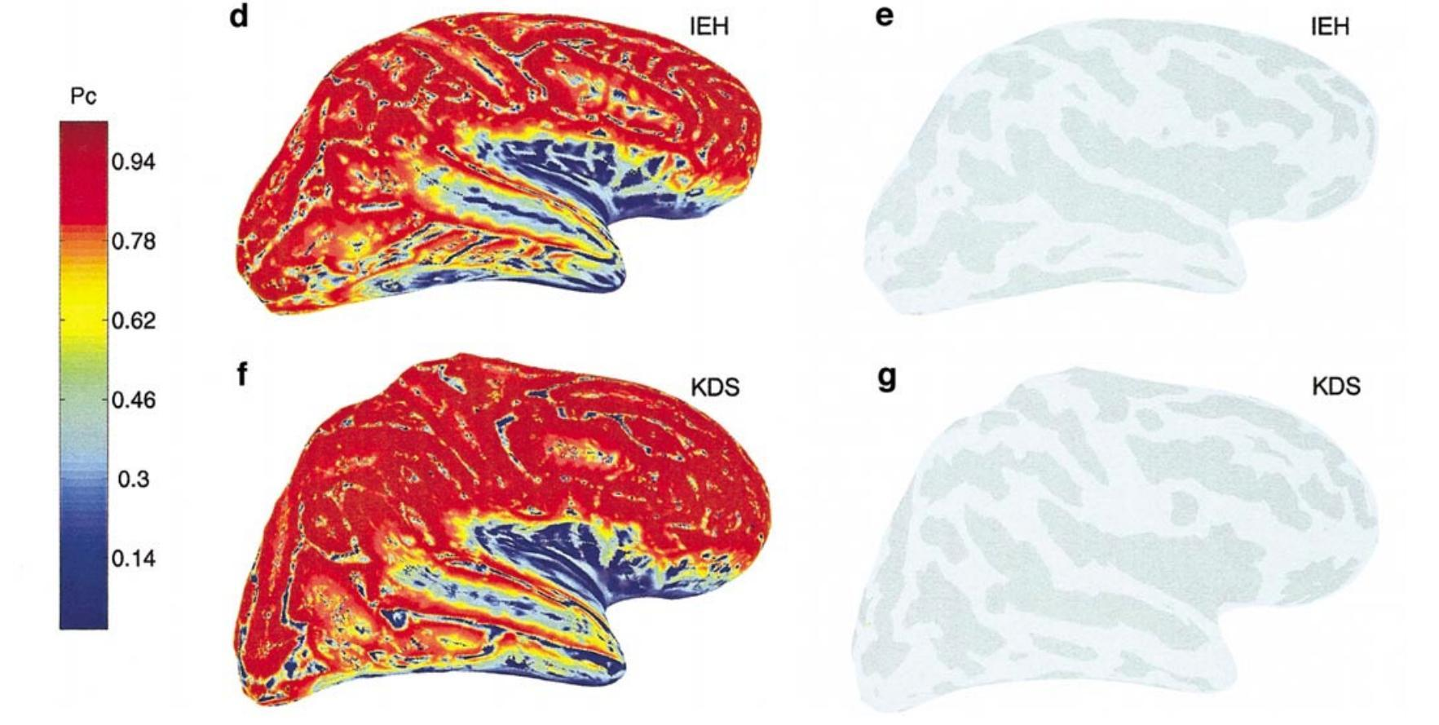
Gyral sources still partly visible
However,
  The head isn’t actually a sphere.
  Only a very small proportion of cell populations are actually radial (at the top of a gyrus)
  3. Sources have spatial spread and may move
  ∴ in practice, this is not a great concern
Hillebrand and Barnes,
2002

Slide 23
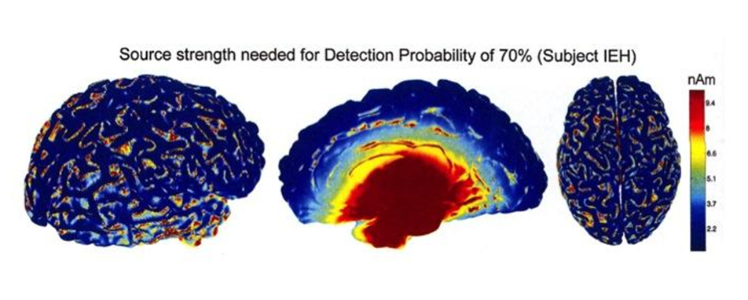
Depth is a limiting factor
MEG is less sensitive to magnetic fields generated by deeper sources
Sensitivity loss is proportional to squared distance between source & sensor
Hillebrand & Barnes, 2002

Slide 24
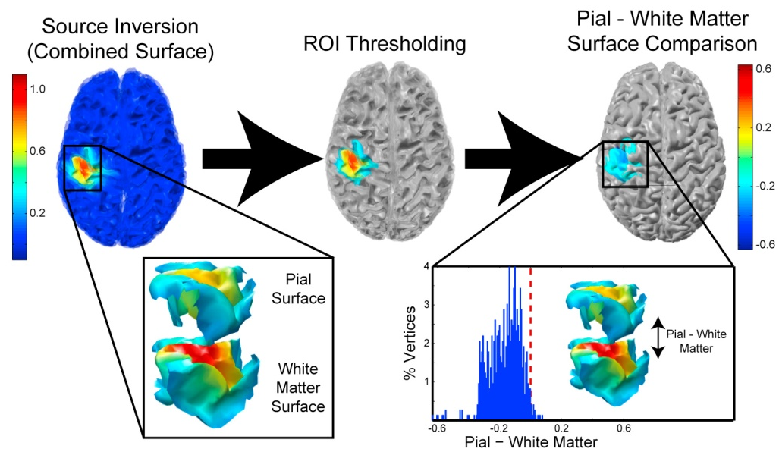
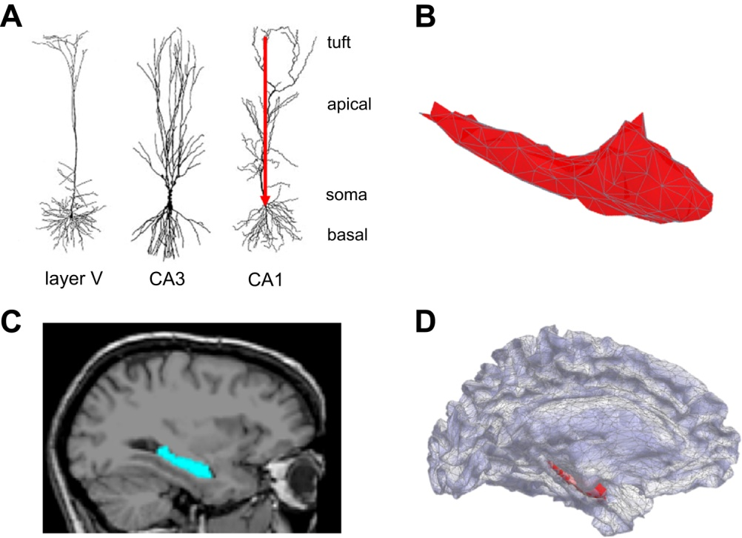
But I want to look at deep sources!
Good news: with high SNR data and accurate generative models this is possible
Deep versus superficial cortical layers
Hippocampus
Bonaiuto et al., 2018
Meyer et al., 2017

Slide 25
Overview
Biophysical origin of M/EEG signals
Instrumentation and recording
Sensitivity to deep and radial sources
Forward models

Slide 26
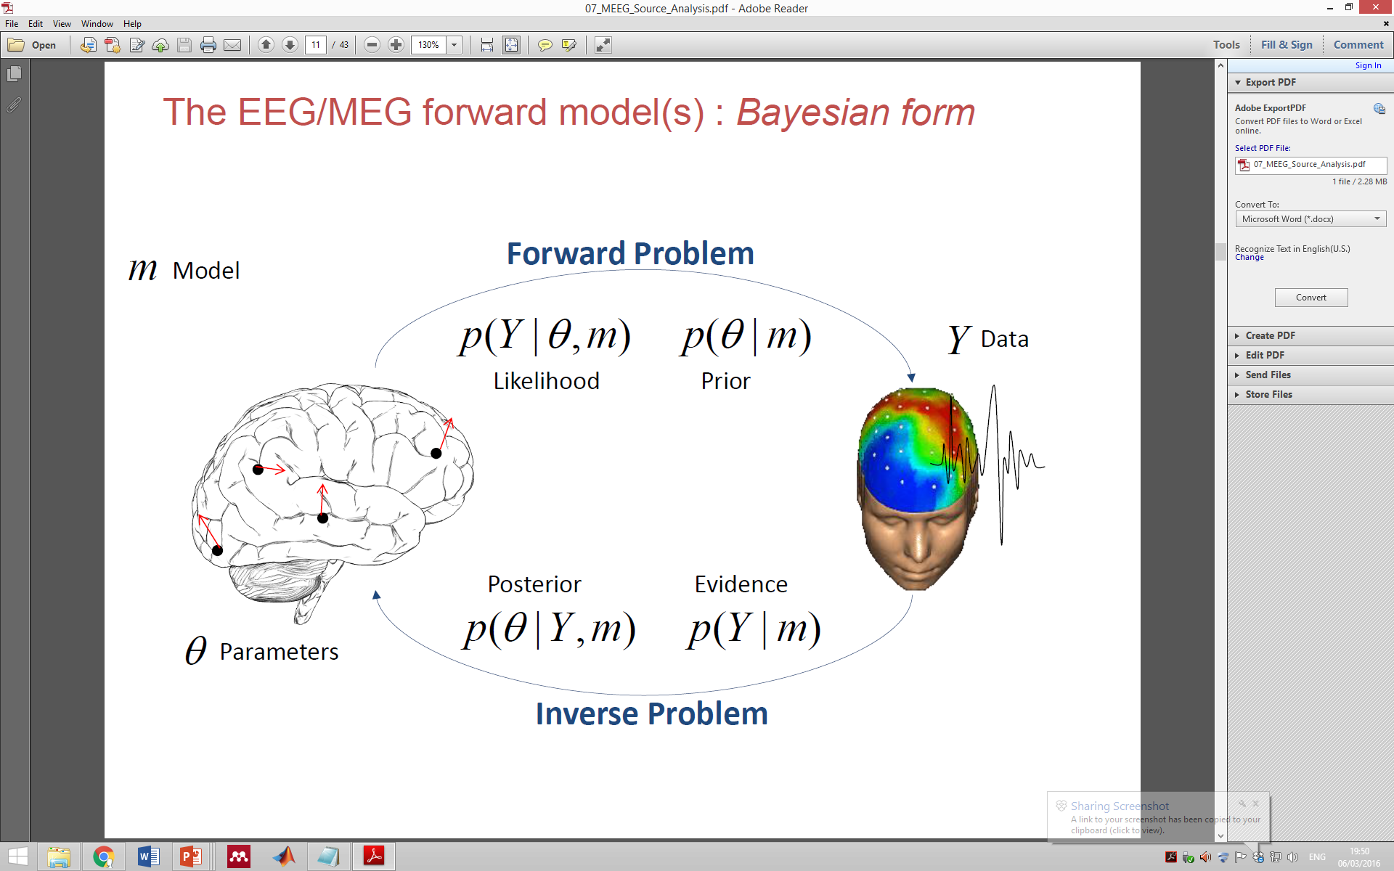
Forward and inverse problems
Given a known current distribution inside the brain, can we compute the magnetic field outside the brain (data)?
Given a known magnetic field distribution outside the head (data), can we compute the current distribution inside the brain?
Notes:
We can place a source of activity in a specific place in a brain model, and calculate what the distribution would look like for that given dipole. Then, we can compare it with the actual activity to see if it matches our model. Thus, we can solve the inverse problem by applying a forward model.

Slide 27
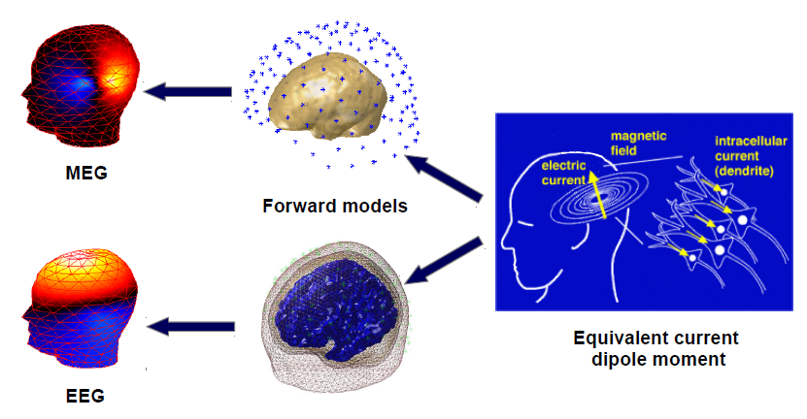
Forward models predict M/EEG surface signals from current dipoles in the brain
Determining output which will be generated by a particular primary current source
MEG is relatively straightforward compared to EEG
UNIQUENESS – there is only one possible solution

Slide 28
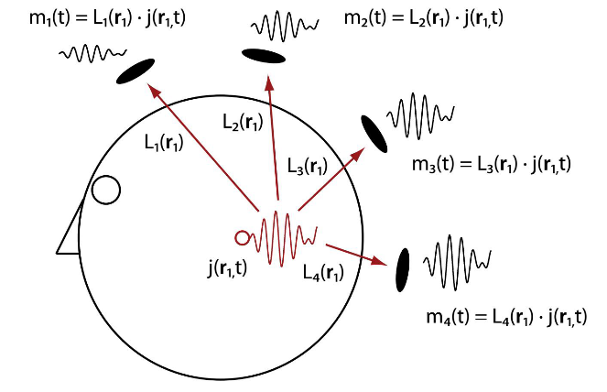
Forward models predict M/EEG surface signals from current dipoles in the brain
From Wibral et al., 2010
Leadfields of the forward model describe the sensor activity evoked by a unit strength source at a given location and orientation
The leadfield matrix L depends on:
the type, location, and orientation of sensors
the source space (e.g. cortical surface or volume image)
the head geometry
the conductivity of head tissues

Slide 29
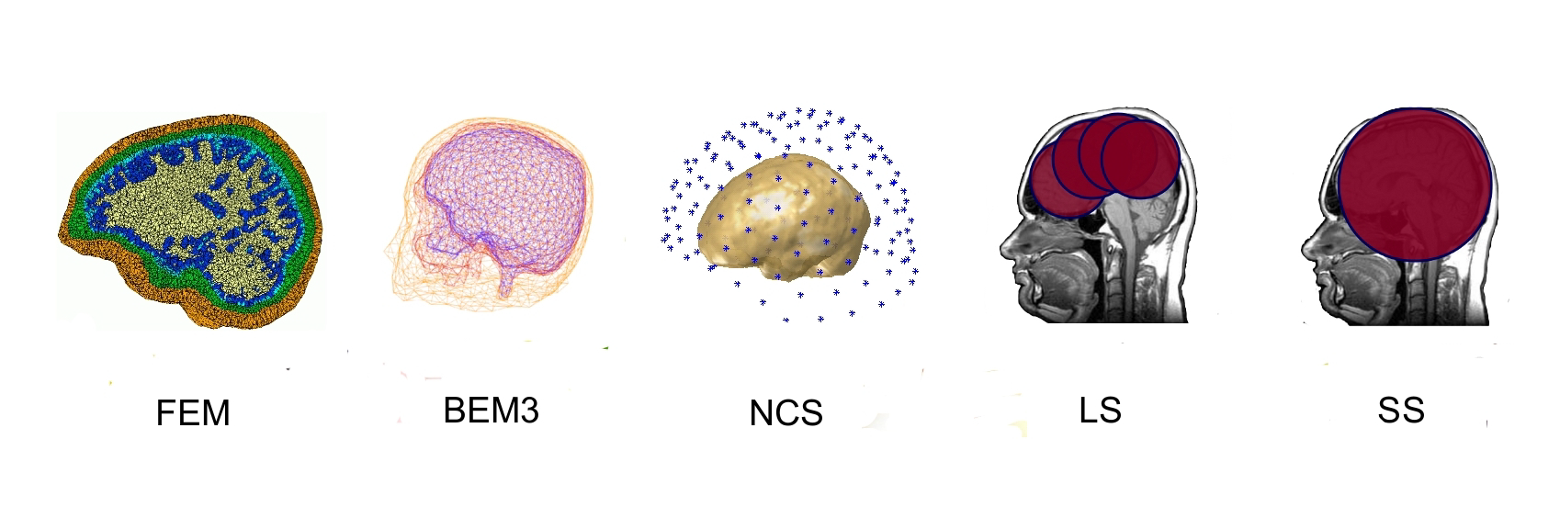
Head models can have different degrees of complexity
Simpler models are not able to predict the electric potential differences at the scalp accurately enough
Complex models:
1) are computationally more expensive
2) require more prior knowledge about the anatomy and conductivity
values

Slide 30
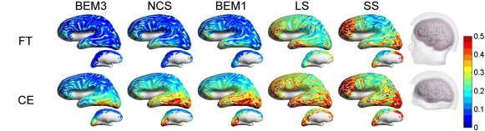
MEG may also benefit from more complex head models
From Stenroos et al., 2014
Earlier studies used only coarse surface meshes and employed a
lower skull conductivity which might have biased the results for MEG to single shell models
Simpler models are affected by segmentation errors as well

Slide 31
Summary
Electromagnetic signals predominately based on aggregate postsynaptic currents of tens of thousands of pyramidal cells
  But other cells types as well as action potentials will also contribute to the signal
MEG is more sensitive to tangential than to radial sources, while EEG 'sees' both components
EEG has a higher sensitivity to deep sources, but is more strongly affected by the conductivity changes between brain, skull and scalp
Forward models describe how primary currents in the brain give rise to electric potentials or magnetic fields measured outside the head

Slide 32
Further reading
An Introduction to the Event-Related Potential Technique by Steven J. Luck
MEG: An Introduction to Methods, Edited: Hansen, Kringelbach, and Salmelin
Magnetic Source Imaging of the Human Brain, Edited by Lu and Kaufman
Magnetoencephalographytheory, instrumentation, and applications to noninvasive studies of the working human brain, Hämäläinen et al., Rev. Mod. Phys. (1993)
Basic mathematical and electromagnetic concepts of the biomagnetic inverse problem, Sarvas, Phys. Med. Biol. (1987)
Thank you!
(and thanks to Saskia Helbling & Sofie Meyer)

