Slide 1


Advanced applications of the GLM:
Cross-frequency coupling
SPM course for MEG & EEG 2018
Bernadette van Wijk
University of Amsterdam Department of Psychology
University College London Wellcome Trust Centre for Neuroimaging

Slide 2
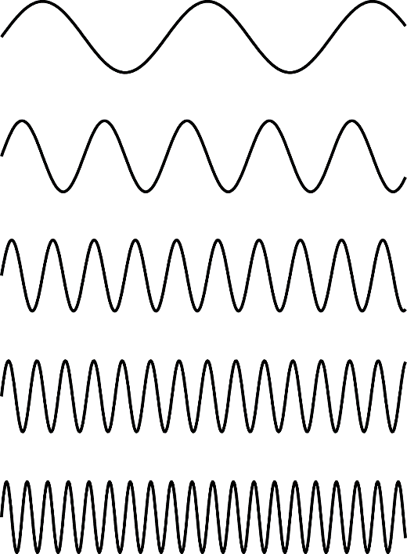

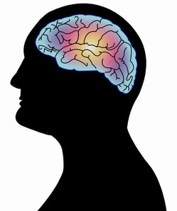
Why care about cross-frequency coupling?
Brain needs to integrate information at different frequencies and time scales
Unexplored mechanisms of information processing

Slide 3
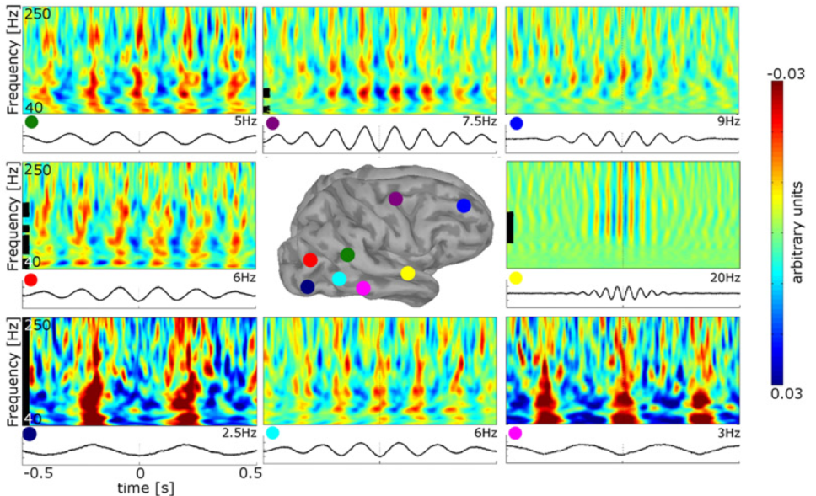
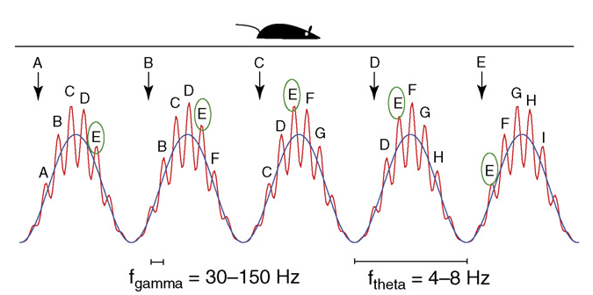
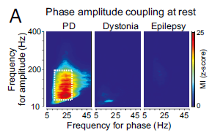
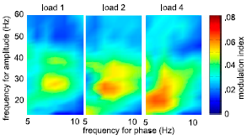
Resting state
Modulation by behavioural task
Spatial navigation
Canolty et al. (2006) Science
Florin & Baillet (2015) Neuroimage
Jensen & Colgin (2007) TiCS
Modulation by pathology
Working memory
de Hemptinne et al. (2013) PNAS
Axmacher et al. (2009) PNAS

Slide 4
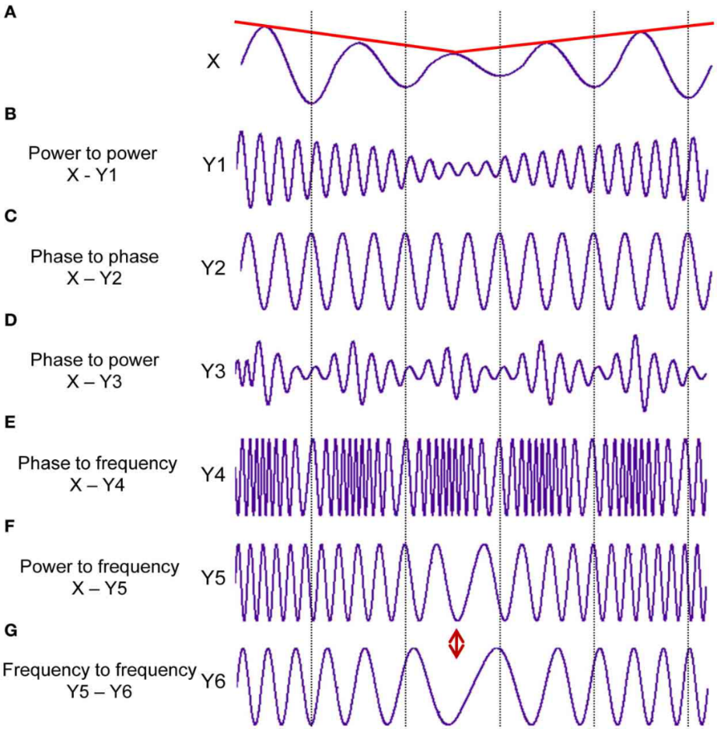
Various forms of cross-frequency coupling
delta-alpha
theta-beta
theta-gamma
alpha-gamma
beta-gamma
etc.
Frequency combinations
Within a recorded signal (brain region)
Between two different signals (brain regions)
Many
combinations!
Jirsa & Müller, 2013; Frontiers in Comp Neurosci

Slide 5
Cross-Frequency Coupling
Amplitude
Amplitude
Phase
Phase
Phase
Amplitude
Phase
Frequency
Amplitude
Frequency
Frequency
Frequency
Envelope correlation
Dynamic causal modelling
n:m phase locking index
Bispectrum
Bicoherence
Modulation Index
Entropy
Vector length
GLM
Phase locking envelope/
phase
Correlation envelope/
signal
Event-related PAC
…
Correlation
Optimization cross-frequency estimates
Instantaneous frequency tracking
Modelling non-sinusoidal waves
Selection of high-amplitude time bins
Spatial filters
Low-frequency phase modulates High-frequency amplitude

Slide 6
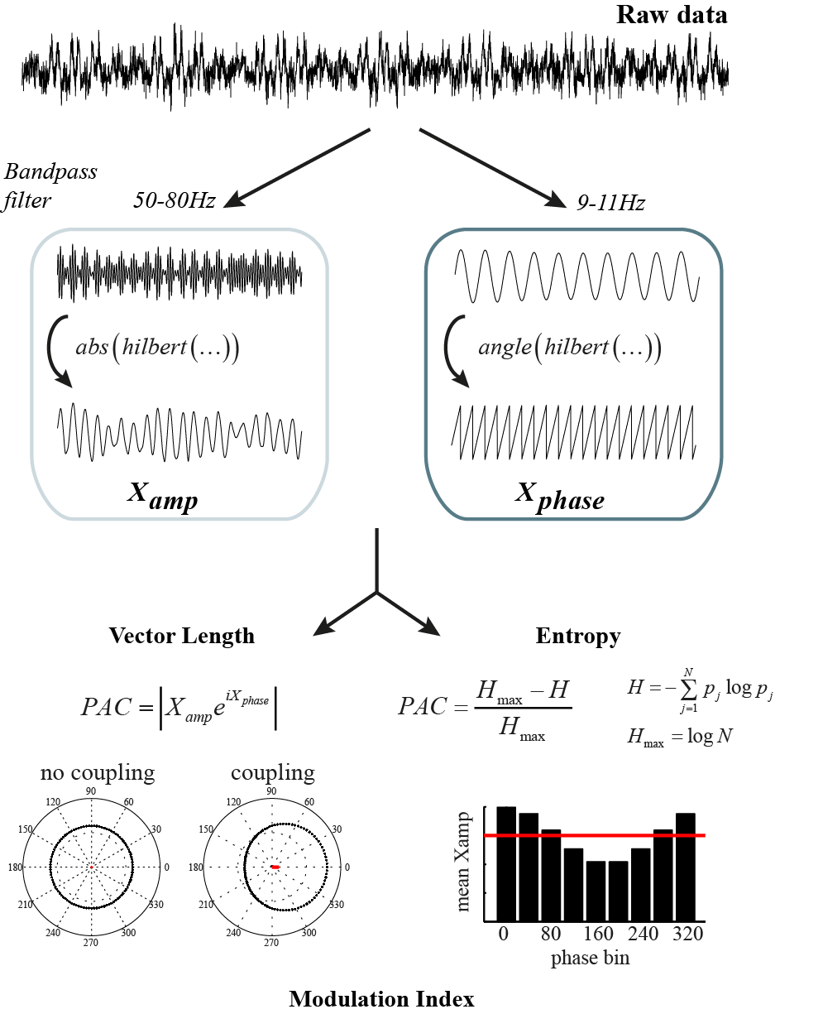
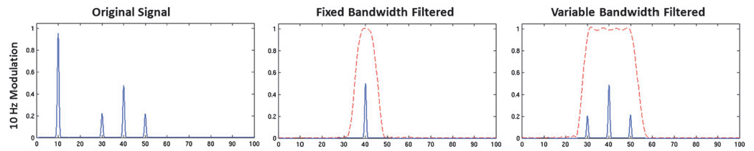
PAC: How to detect it
How to detect PAC
Extraction of time series
for phase and amplitude
Bandpass filtering
Phase: narrow band
Amplitude: bandwidth should include carrier frequency ± modulating frequency
Berman et al., 2012; Brain Connectivity

Slide 7
How to detect PAC
Assessment of distribution amplitude as function of phase
Statistical evaluation
(often permutation tests)

Slide 8
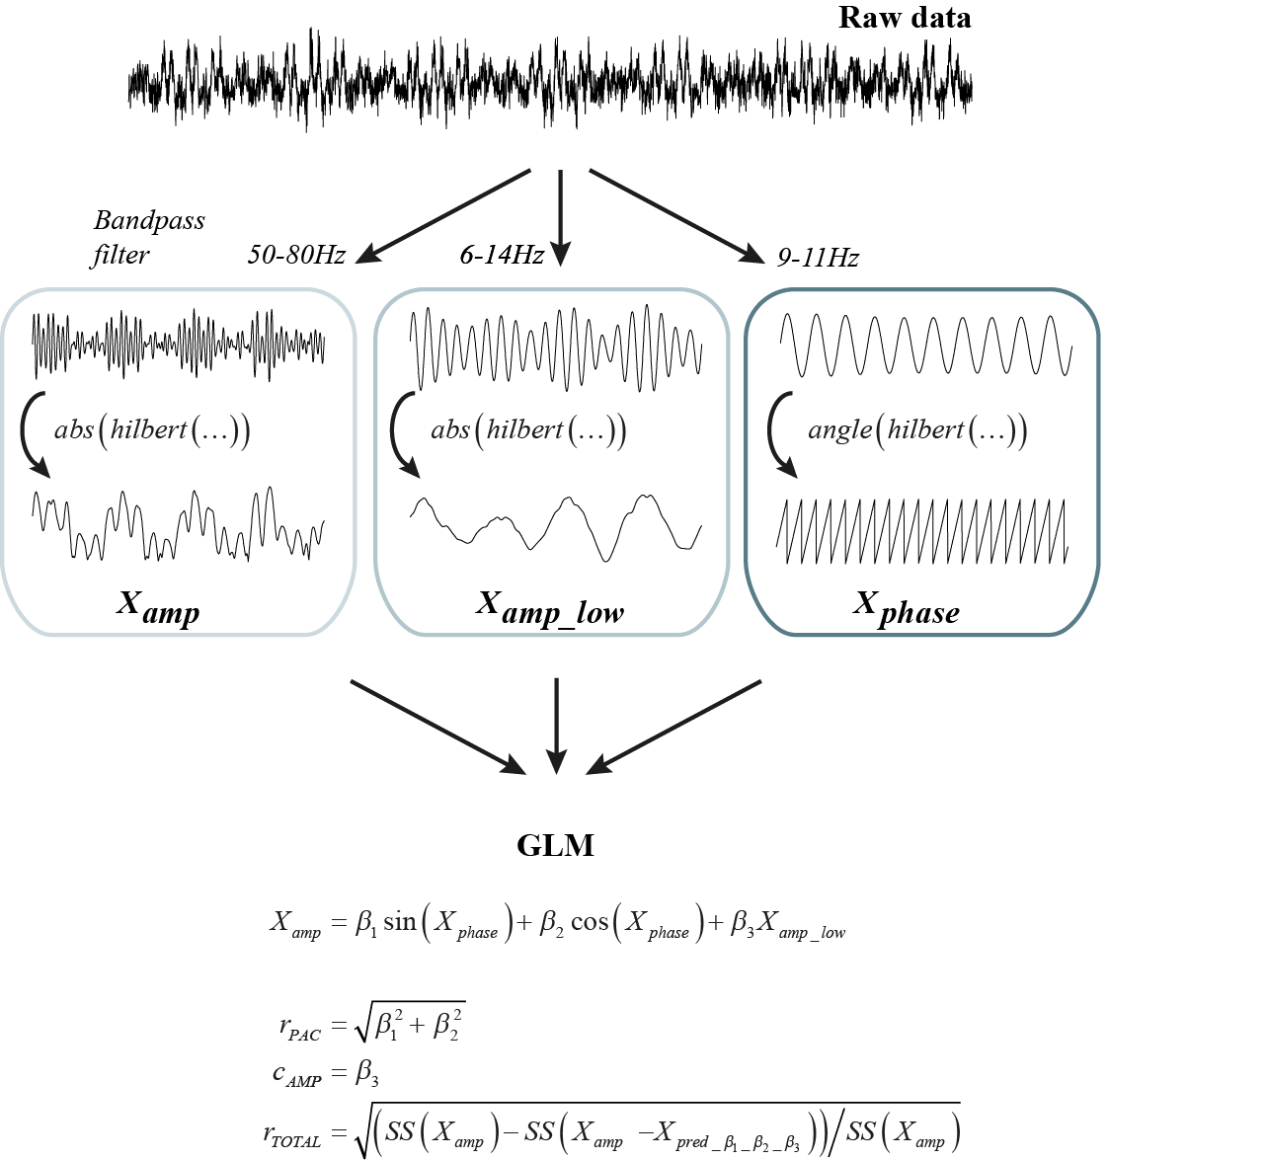
PAC: How to detect it
General Linear Model
Parametric approach
No surrogate time series
Equal to normalized vector length when standardizing (Z-scoring) variables. Values between 0 and 1.
Penny et al. (2008) J Neurosci Methods
Van Wijk et al. (2015) J Neurosci Methods

Slide 9
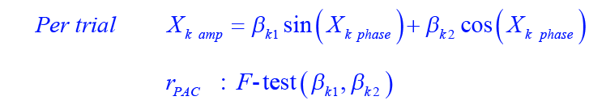
General Linear Model
Parametric approach
No surrogate time series
Equal to normalized vector length when standardizing (Z-scoring) variables. Values between 0 and 1.
Van Wijk et al. (2015) J Neurosci Methods

Slide 10
PAC: How to detect it
General Linear Model
Easy to include other predictors:
amplitude correlations
non-linearities
confounding factors
Van Wijk et al. (2015) J Neurosci Methods

Slide 11
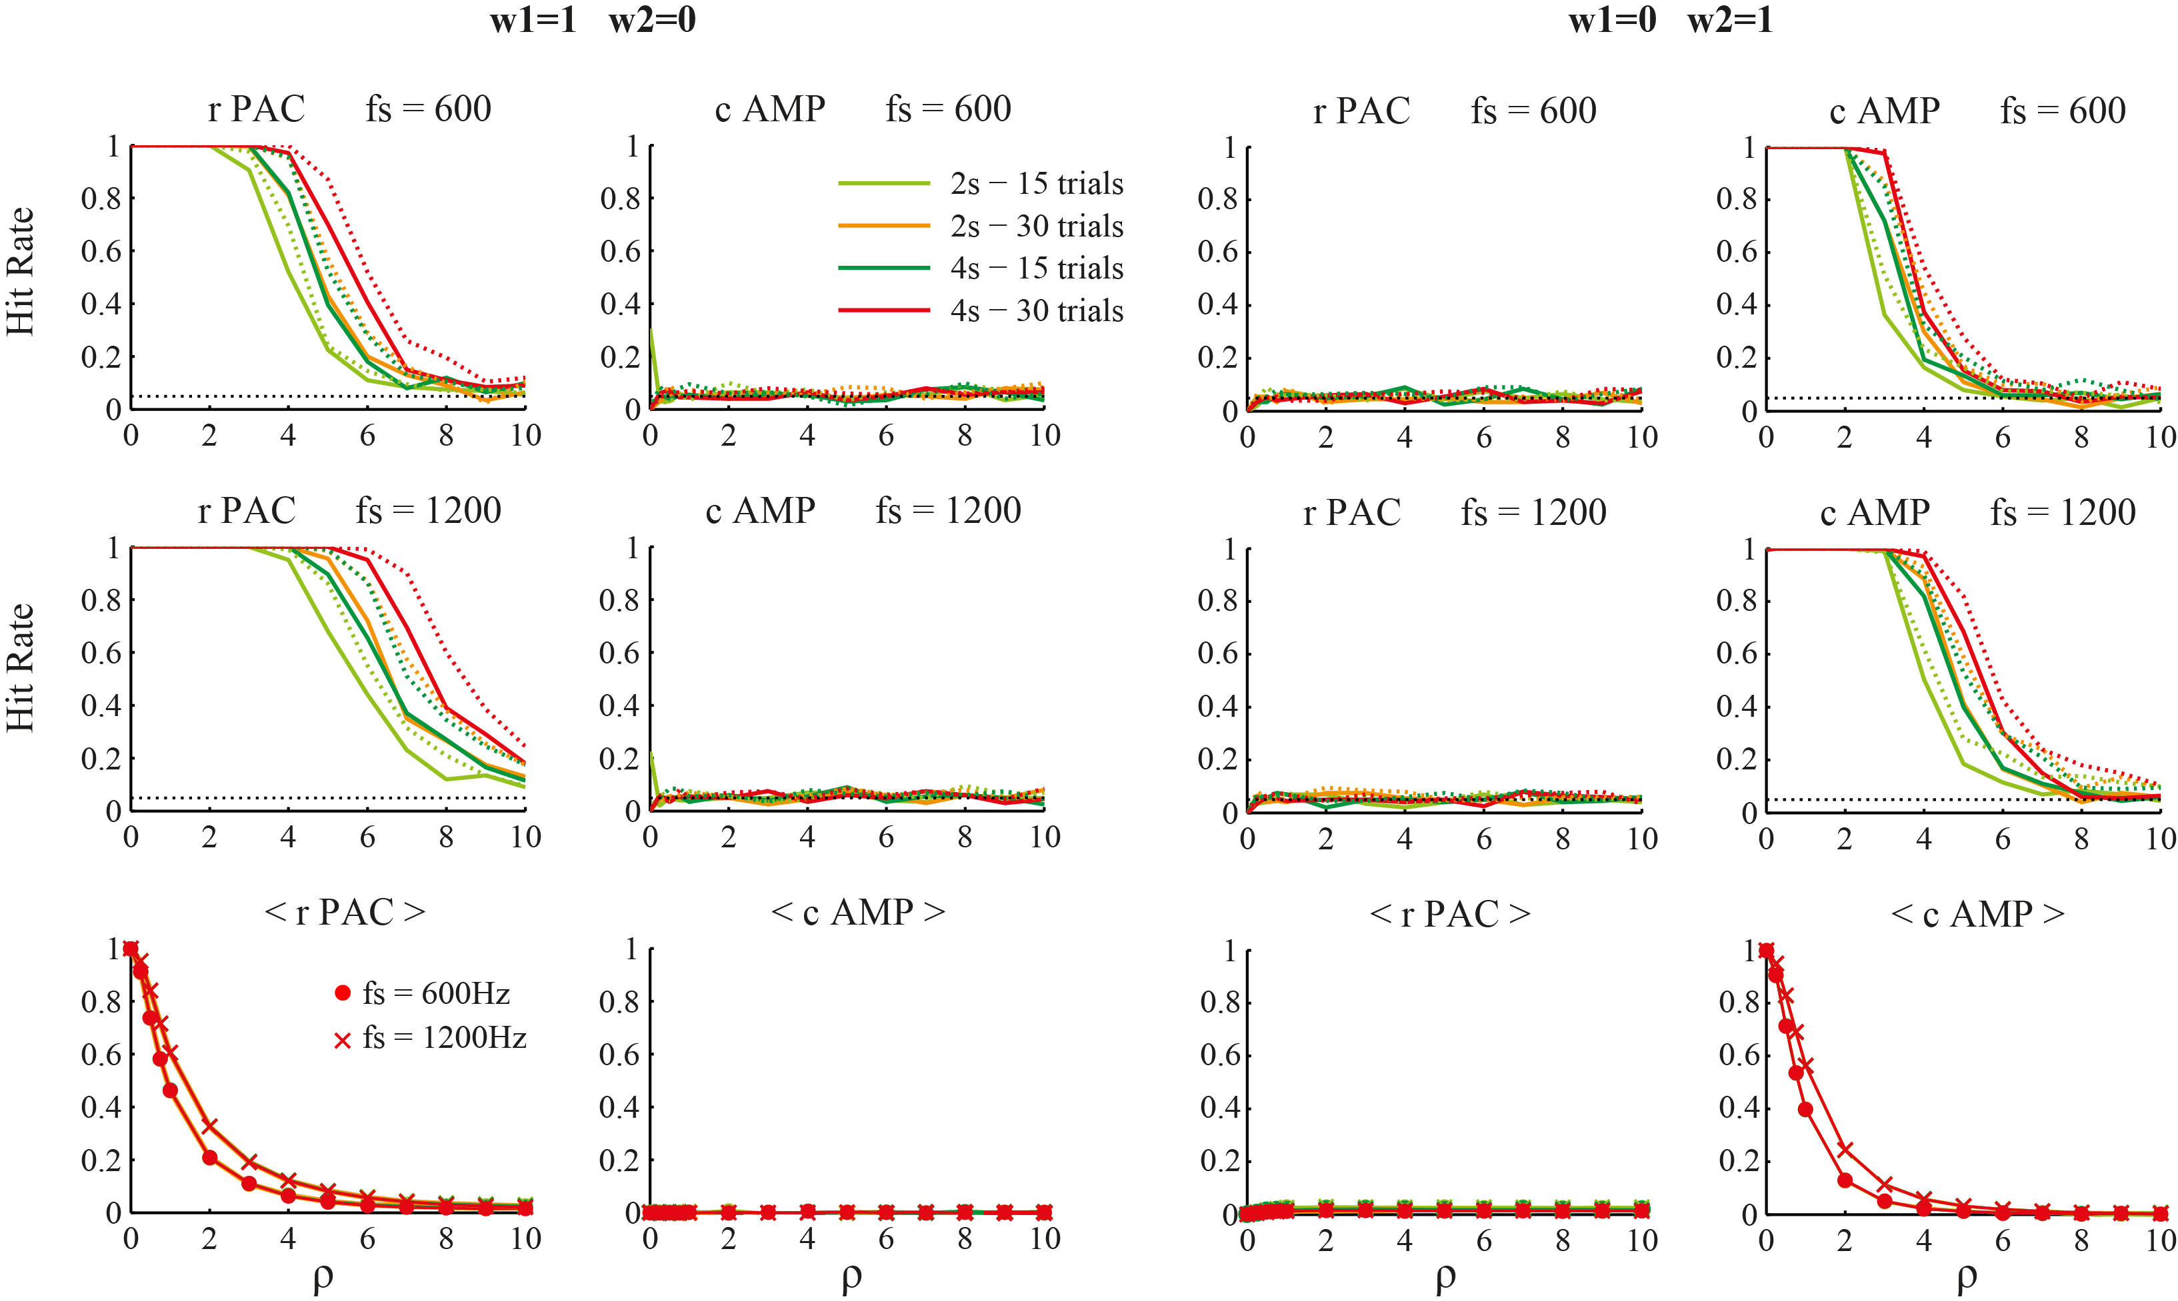
GLM vs permutation tests: simulations
GLM
permutations
Noise level ρ
Slightly lower statistical power for GLM
van Wijk et al. (2015) J Neurosci Methods

Slide 12
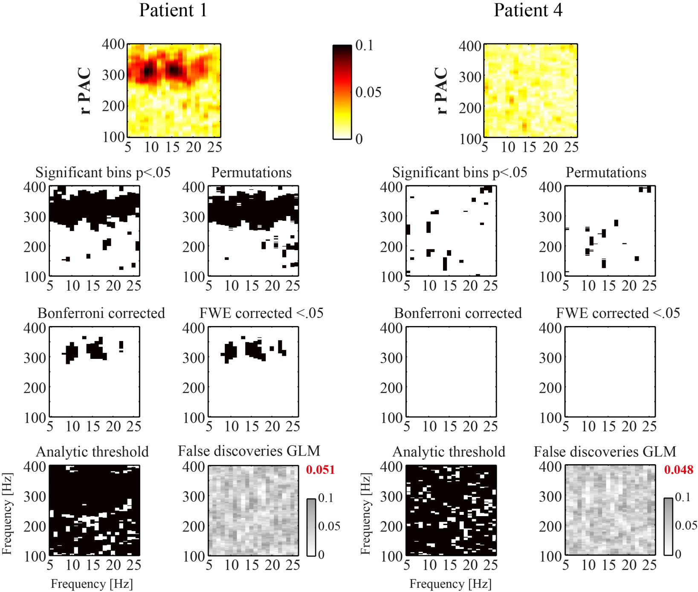
GLM vs permutation tests: real data
GLM 200 permutations
<7min 159min
GLM ~24x faster to compute
van Wijk et al. (2015) J Neurosci Methods

Slide 13
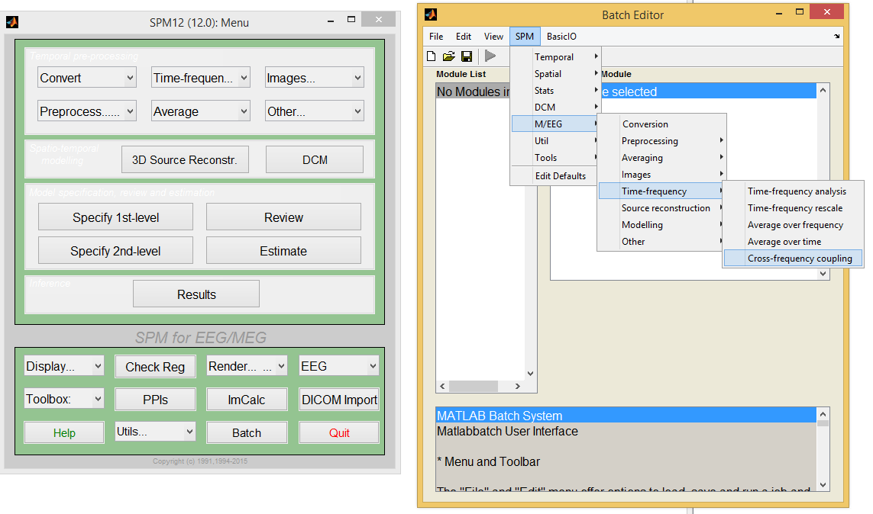
PAC: How to detect it
GLM for PAC within SPM

Slide 14
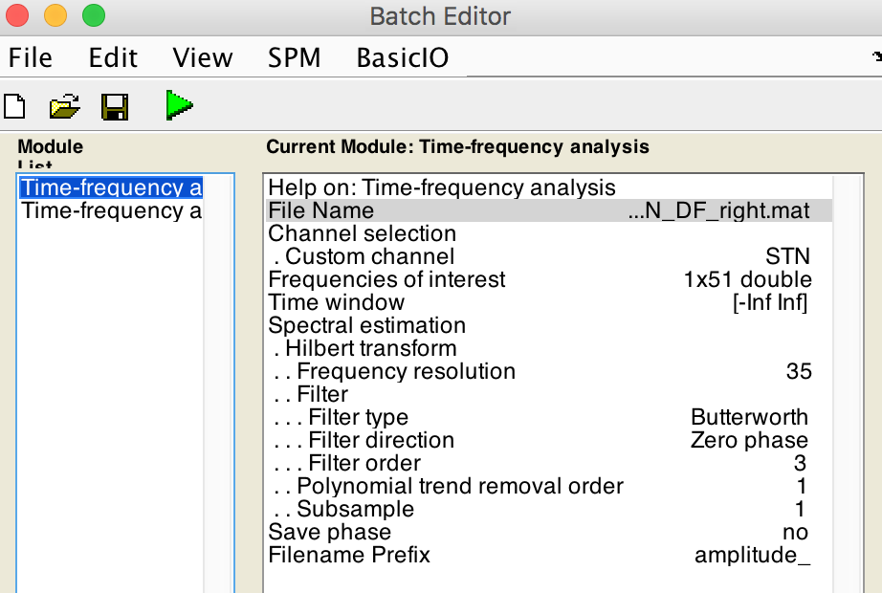

First step: Time-frequency analysis
Compute amplitude time series and phase time series for frequencies of interest
Create two separate files because of filter settings
Amplitude
Phase

Slide 15
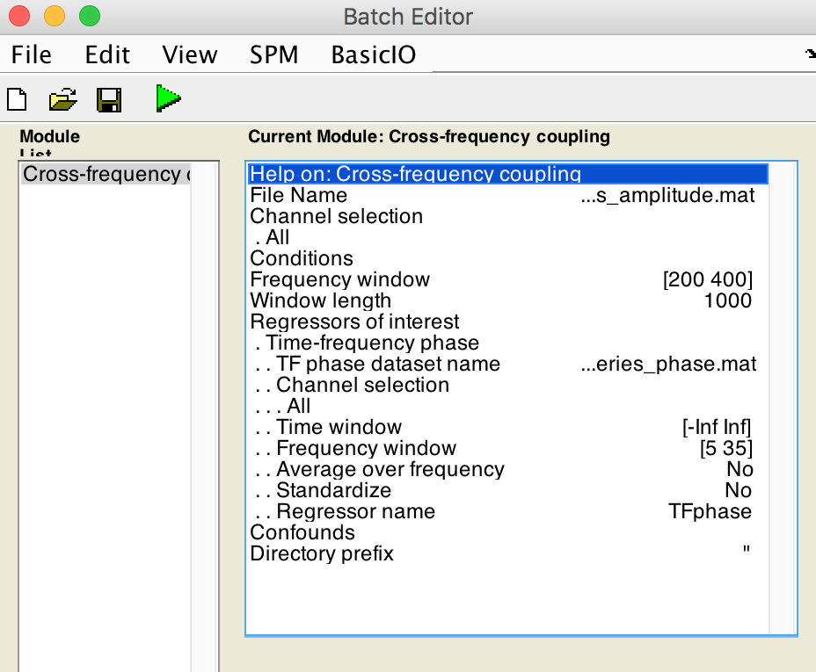
Second step: Cross-frequency coupling
Data set with amplitude time series
Select epoch size here (for stats)
Data set with phase time series
Add other time series as regressors
Select phase or
amplitude as regressors

Slide 16
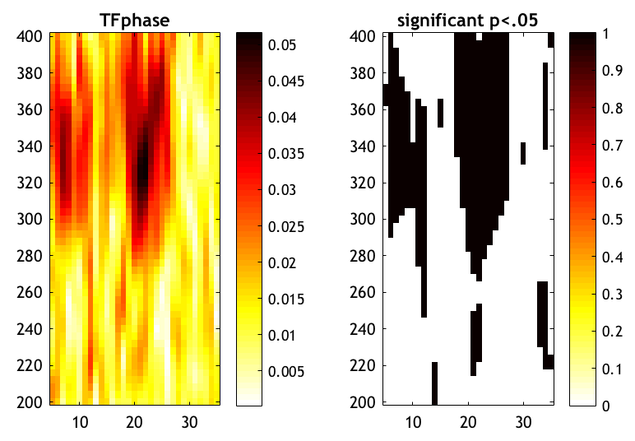
Results
Figure is plotted + .nii images saved
Amplitude Frequency
Phase Frequency
Phase Frequency

Slide 17
Get in touch for an example batch and/or script:
vanwijk.bernadette@gmail.com
Or ask for help during the practical session on Wednesday

