Slide 1
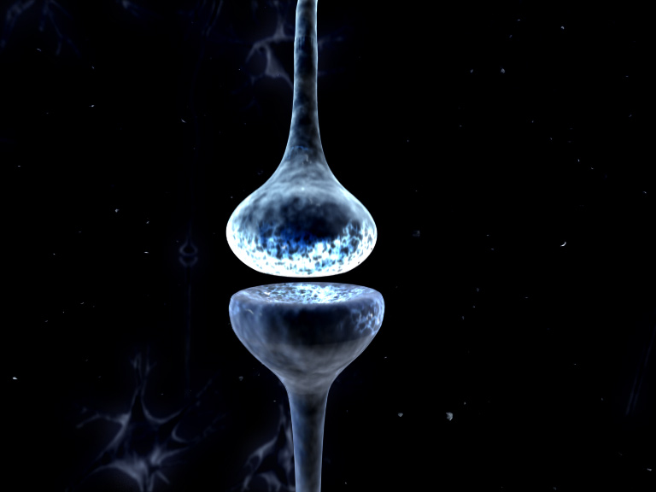
l
Dynamic Causal Models for Steady State Responses/
Cross Spectral Densities
Rosalyn Moran
IOPPN, KCL
SPM Course M/EEG, May 8th, Queen Square 2018

Slide 2
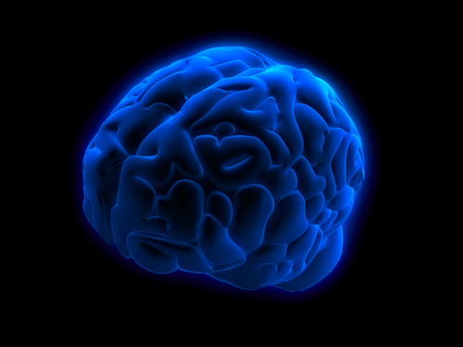
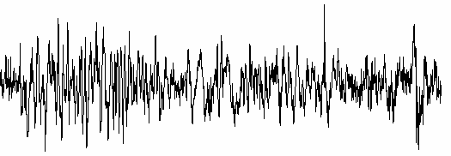
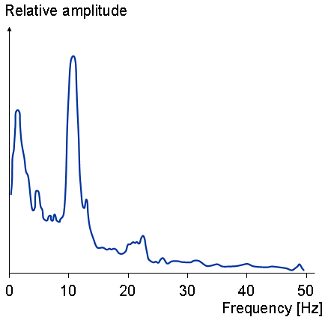
Connectivity from EEG/LFP Data: Dynamic Causal Models
Milliseconds: M/EEG
mV
time
Event related potentials & Oscillations of different frequencies
Implicated in specific cognitive tasks/regions
Eg. Hippocampal Theta (4 – 8 Hz) & Sensory Gamma (30 – 60 Hz)

Slide 3
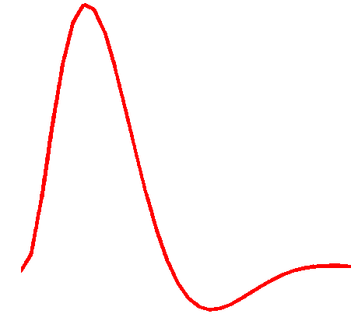
Dynamic Causal Modeling: Generic Framework
“theta”
Electromagnetic
forward model:
neural activity EEG
MEG
LFP
Time Domain ERP Data
Phase Domain Data
Time Frequency Data
Spectral Data
Hemodynamic
forward model:
neural activity BOLD
Time Domain Data
Resting State Data
Power (mV²)
Frequency (Hz)
Neural state equation:
fMRI
EEG/MEG
detailed neuronal model
(synaptic time scales)
simple neuronal model
(slow time scale)

Slide 4
Dynamic Causal Modeling: Generic Framework
“theta”
Electromagnetic
forward model:
neural activity EEG
MEG
LFP
Time Domain ERP Data
Phase Domain Data
Time Frequency Data
Spectral Data
Power (mV²)
Frequency (Hz)
Neural state equation:
EEG/MEG
detailed neuronal model
(synaptic time scales)
A Neural Mass Model

Slide 5


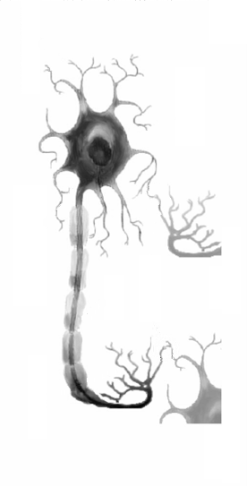
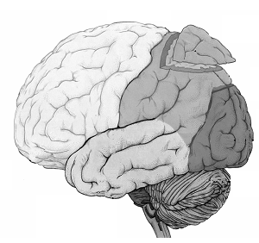
Macro and meso-scales: The Neural Mass Model
macro-scale
meso-scale
micro-scale
external granular
layer
external pyramidal
layer
internal granular
layer
internal pyramidal
layer
The state of a neuron comprises a number of attributes, membrane potentials, conductances etc. Modelling these states can become intractable. Mean field approximations summarise the states in terms of their ensemble density. Neural mass models consider only point densities and describe the interaction of the means in the ensemble
Notes:
5

Slide 6
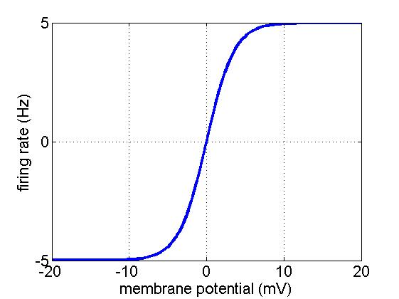
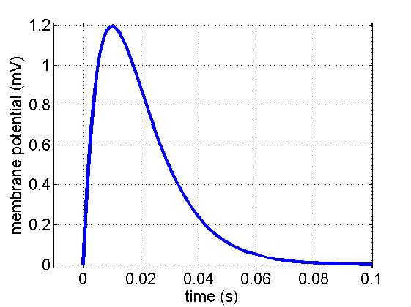


Meso-scale dynamics
AP generation zone
external granular
layer
$$θ(2)$$
external pyramidal
layer
synapses
internal granular
layer
internal pyramidal
layer
$$θ(1)$$
AP generation zone
Notes:
6

Slide 7
Convolution Based Neural Mass Models

Slide 8

Convolution-Based Neural Mass Models in DCM
Spiny stellate cells
Pyramidal cells
$v_{post}=σ(v_{pre})$ $⨂$ $h$
Take one spiny stellate cell…..

Slide 9

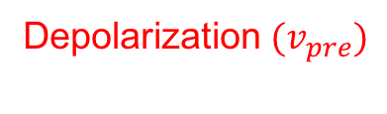
Convolution-Based Neural Mass Models in DCM
Spiny stellate cells
Pyramidal cells
$v_{post}=σ(v_{pre})$ $⨂$ $h$
$$H(v_{pre})$$
Heaviside function
Take a population of spiny stellate
cells & assume either:
Unimodal distribution over firing thresholds
Unimodal distribution over population
Membrane depolarizations
P(Action Potential)
Depolarization $(v_{pre})$

Slide 10

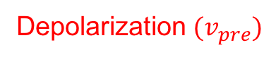
Convolution-Based Neural Mass Models in DCM
Spiny stellate cells
Pyramidal cells
$v_{post}=σ(v_{pre})$ $⨂$ $h$
$$H(v_{pre})$$
$$σ(v_{pre})$$
Sigmoidal
Presynaptic Firing Function
Heaviside function
P(Action Potential)
Average Firing Rate
Ensemble Synchronicity/Gain
Depolarization $(v_{pre})$
Depolarization $(v_{pre})$

Slide 11



Convolution-Based Neural Mass Models in DCM
Spiny stellate cells
Pyramidal cells
$v_{post}=σ(v_{pre})$ $⨂$ $h$
$$σ(v_{pre})$$
Sigmoidal
Presynaptic Firing Function
$$h$$
Postsynaptic Kernel
Depends on postsynaptic receptor
activated by particular neurotransmitter
Average Firing Rate
$$v_{post}$$
Depolarization $(v_{pre})$
Time (msec)

Slide 12
Convolution-Based Neural Mass Models in DCM
Spiny stellate cells
E.g. Glutamate from SS to AMPA receptor
Pyramidal cells
$v_{post}=σ(v_{pre})$ $⨂$ $h$
$$σ(v_{pre})$$
Sigmoidal
Presynaptic Firing Function
$$h$$
Postsynaptic Kernel
+depolarization
Average Firing Rate
$$v_{post}$$
time constant ~ 15msec
Depolarization $(v_{pre})$
Time (msec)

Slide 13
Convolution-Based Neural Mass Models in DCM
Inhibitory interneuron
E.g. GABA from inhibitory interneuron to GABAa receptor
Pyramidal cells
$v_{post}=σ(v_{pre})$ $⨂$ $h$
$$σ(v_{pre})$$
Sigmoidal
Presynaptic Firing Function
$$h$$
Postsynaptic Kernel
Time (msec)
Average Firing Rate
time constant ~ 8msec
$$v_{post}$$
-hyperpolarization
Depolarization $(v_{pre})$

Slide 14




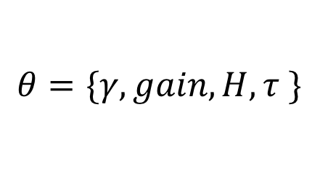

Convolution-Based Neural Mass Models in DCM
Spiny stellate cells
$$γ$$
Pyramidal cells
Connectivity?
$v_{post}=γσ(v_{pre})$ $⨂$ $h$
$$θ=\{γ,gain, H, τ \}$$
$$γσ(v_{pre})$$
Sigmoidal
Presynaptic Firing Function
$$h$$
Postsynaptic Kernel
Maximum
Postsynaptic Potential
connectivity
$$H$$
Average Firing Rate
gain
$$v_{post}$$
Time constant
$$1/κ$$
Depolarization $(v_{pre})$
Time (msec)

Slide 15
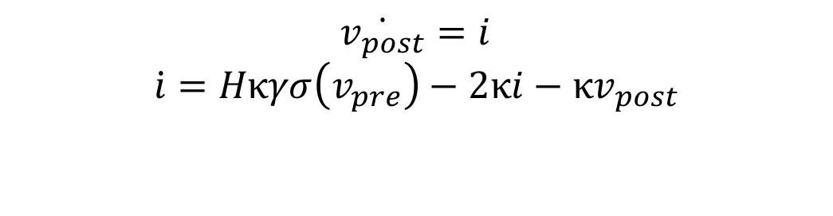

Convolution to ODEs
Spiny stellate cells
Pyramidal cells
$v_{post}=γσ(v_{pre})$ $⨂$ $h$
$v_{post}=\int_{0}^{t}{h(t−τ)}γσ(v_{pre})$ $dτ$
Convolution Equation
By parts twice
$$\ddot{v_{post}}=Hκγσ\left(v_{pre}\right)−2κ\dot{v_{post}}−κv_{post}$$
Second Order Differential Equation
$$\dot{v_{post}}=i$$
$$\dot{i}=Hκγσ\left(v_{pre}\right)−2κi−κv_{post}$$
.
2 Coupled First Order Differential
For each transmitter receptor pair

Slide 16
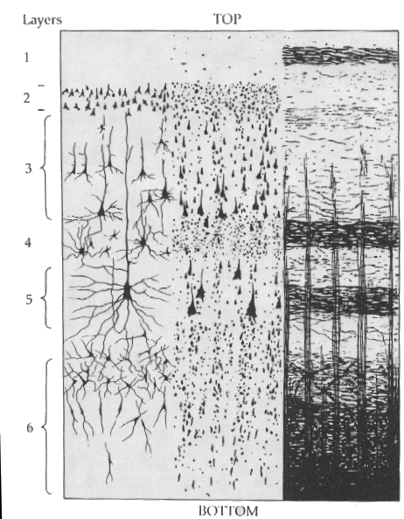
Multilaminar NMMS
Inhibitory interneuron
Assume GABA from inhibitory interneurons activate GABAa receptors
Spiny stellate cells
Pyramidal cells
Assume glutamate from pyramidal cells & spiny stellate cells activate AMPA receptors
Then construct interlaminar connectivity
5 connections giving 5x2 coupled first order differential equations

Slide 17
One region: 12 equations 10 + 2 difference
Inhibitory cells in extragranular layers
Inhibitory interneuron
γ
5
Spiny stellate cells
Pyramidal cells
Excitatory spiny cells being granular layers
Excitatory pyramidal cells in extragranular layers

Slide 18
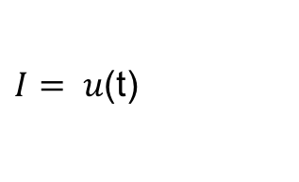
One region: 12 equations 10 + 2 difference
Inhibitory cells in extragranular layers
Inhibitory interneuron
γ
5
Spiny stellate cells
Pyramidal cells
Excitatory spiny cells being granular layers
$I= u$(t)
Dipole
Exogenous Input
Excitatory pyramidal cells in extragranular layers
Measured response:

Slide 19
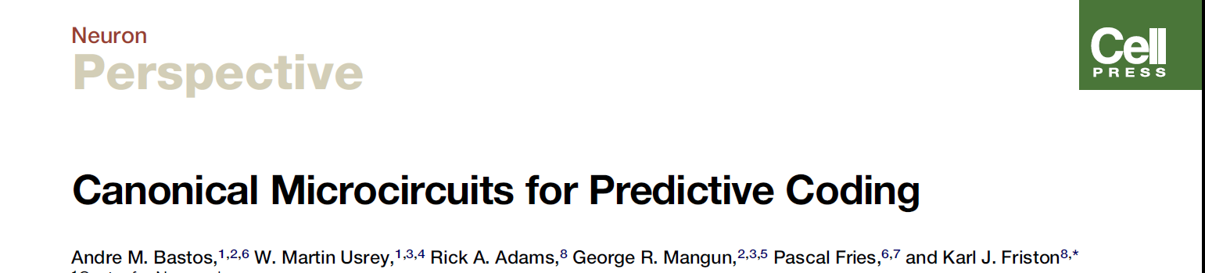
Predictive coding-based
Neural Mass Models in DCM
Inhibitory interneuron
Superficial pyramidal
Forward
Extrinsic Output
Spiny stellate
Spiny stellate
Inhibitory interneuron
Extrinsic Output
Backward
Extrinsic Output
Pyramidal cells
Deep pyramidal
4-subpopulation
Canonical Microcircuit

Slide 20
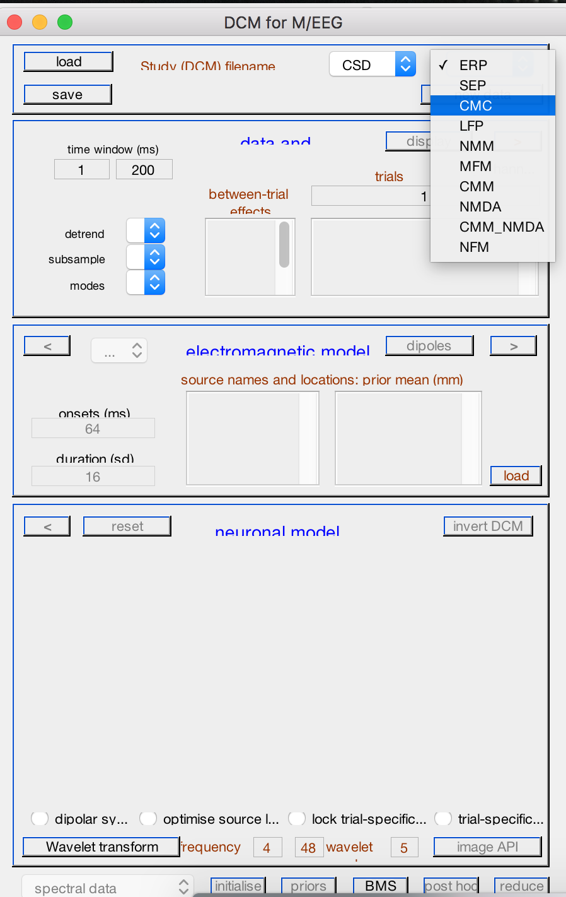
Predictive coding-based
Neural Mass Models in DCM
Inhibitory interneuron
Forward
Extrinsic Output
Prediction Error
Superficial pyramidal
Spiny stellate
Spiny stellate
Inhibitory interneuron
Extrinsic Output
Backward
Extrinsic Output
Predictions
Pyramidal cells
Deep pyramidal
4-subpopulation
Canonical Microcircuit

Slide 21
Conductance Based Neural Mass Models

Slide 22
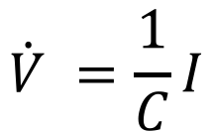
Conductance-Based Neural Mass Models in DCM
V=IR
Ohm’s Law
Ohm’s Law for a Capacitor
$$\dot{V} =\frac{1}{C}I$$
Gaba
Glutamate

Slide 23
Conductance-Based Neural Mass Models in DCM
V=IR
Ohm’s Law
Ohm’s Law for a Capacitor
$$\dot{V} =\frac{1}{C}I$$
Gaba
Glutamate
Capacitive Membrane
Postsynaptic Currents, I?

Slide 24
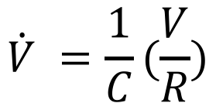
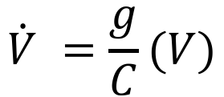
Conductance-Based Neural Mass Models in DCM
V=IR
Ohm’s Law
Ohm’s Law for a Capacitor
$$\dot{V} =\frac{1}{C}(\frac{V}{R})$$
$$\dot{V} =\frac{g}{C}(V)$$
Gaba
Glutamate
Use Ohms Law again

Slide 25

Conductance-Based Neural Mass Models in DCM
$$\dot{V} =\frac{g}{C}(V)$$
Gaba
Glutamate
Describe gV, Ion flow….
Na⁺
Ca²⁺
Cl⁻

Slide 26

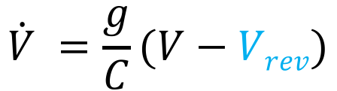
Conductance-Based Neural Mass Models in DCM
$$\dot{V} =\frac{g}{C}(V)$$
Effective Potential Difference
$$\dot{V} =\frac{g}{C}(V−Vrev)$$
Gaba
Glutamate
Ion flow….
Na⁺
Ca²⁺
Cl⁻

Slide 27
Conductance-Based Neural Mass Models in DCM
Current in =
Conductance
X Potential Difference
C
&
=
−
V
g
(
V
V
)
rev
Gaba
Glutamate

Slide 28

Conductance-Based Neural Mass Models in DCM
Current in =
Conductance
X Potential Difference
C
&
=
−
V
g
(
V
V
)
rev
Dynamic Conductance, g, where receptors opening and closing,
with a particular time constant
=
κ
γ$σ$
g
&
− )
g
(
aff
Gaba
Glutamate

Slide 29

Conductance-Based Neural Mass Models in DCM
Connectivity driven by different
neurotransmitters and receptors
State equations & parameters
Notes:
80 – 20 split
Gamma noise term

Slide 30
Conductance-Based Models: Summary
Membrane fluctuations in Depolarization (Contributions to current dipole)
Notes:
80 – 20 split
Gamma noise term

Slide 31
Conductance-Based Models: Summary
Presynaptic Firing rates
Notes:
80 – 20 split
Gamma noise term

Slide 32
Conductance-Based Models: Summary
Connectivity from Inhibitory
Interneurons
Connectivity from Pyramidal Cells
Notes:
80 – 20 split
Gamma noise term

Slide 33
Conductance-Based Models: Summary
NMDA- nonlinear
Notes:
80 – 20 split
Gamma noise term

Slide 34


Conductance-Based Models: Summary
Inhibitory cells in extragranular layers
Inhibitory interneuron
Spiny stellate cells
Exogenous input
Excitatory spiny cells in granular layers
Pyramidal cells
$$γ_{ii}$$
$$γ_{ec}$$
Excitatory pyramidal cells in extragranular layers
Measured response

Slide 35
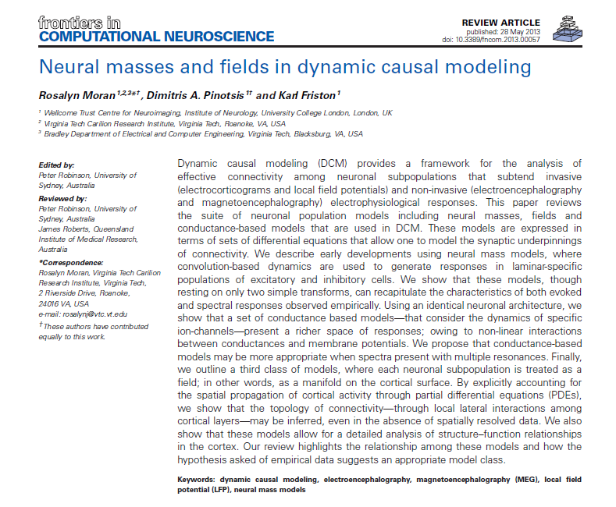
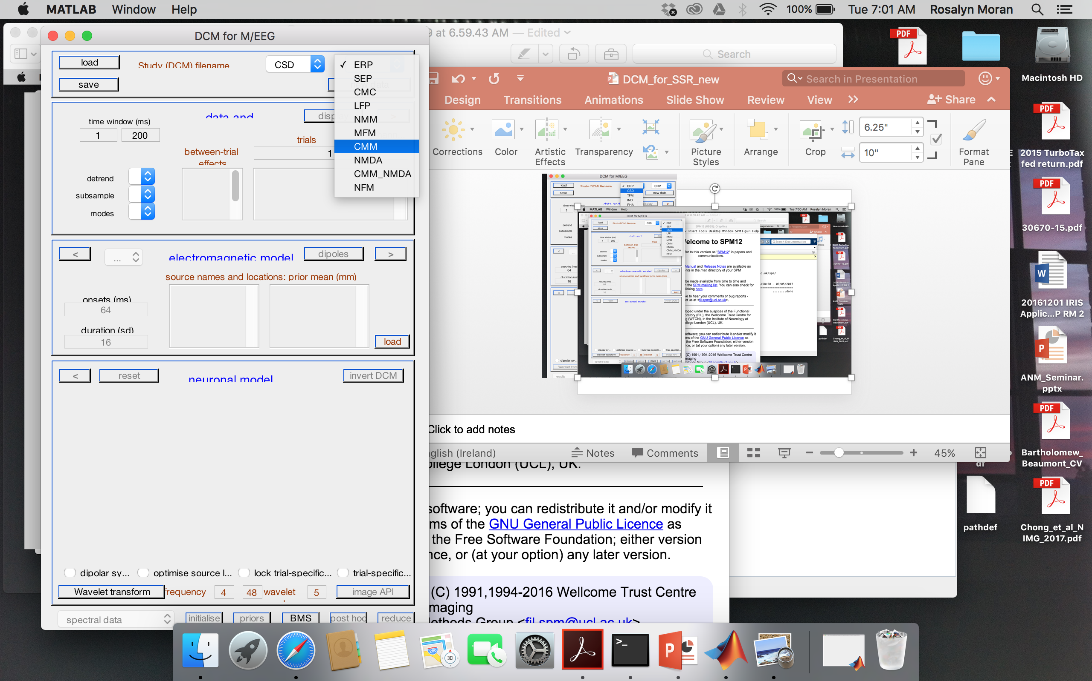
A selection of intrinsic architectures in SPM
(e.g. conductance based CMC)
A suite of neuronal population models including neural masses, fields and conductance-based models…expressed in terms of sets of differential equations

Slide 36
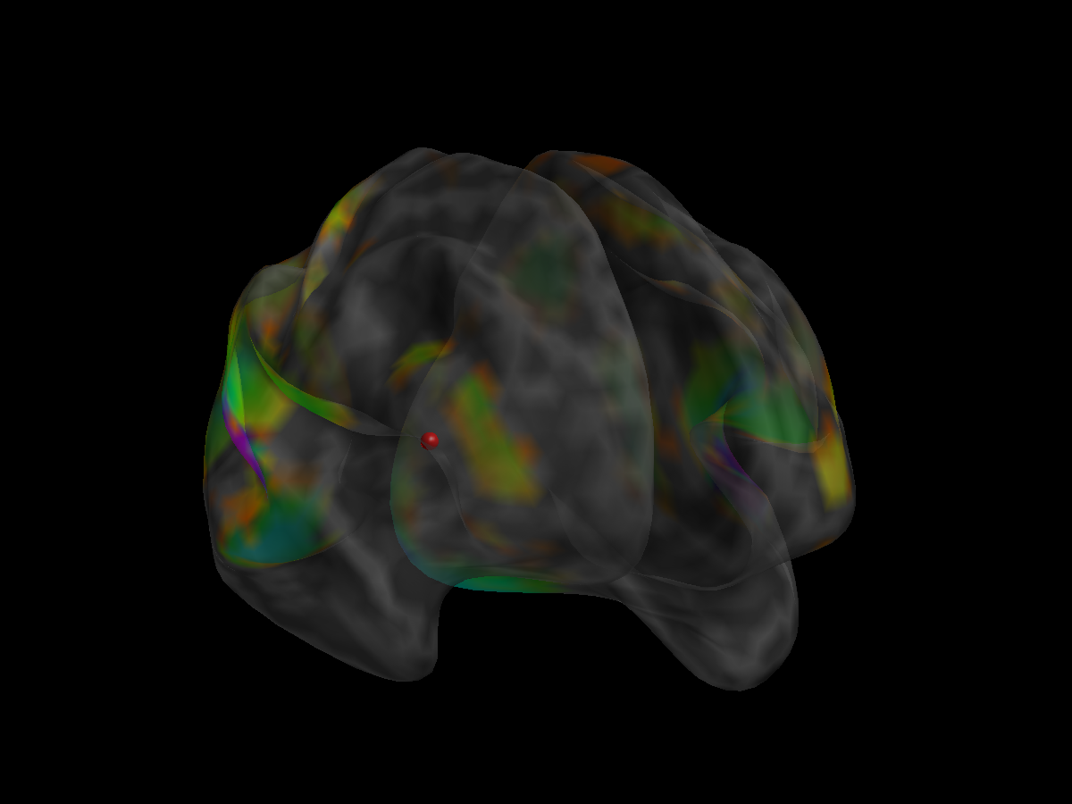


Forward Model: Neural Mass Models in DCM
Empirical Observations
(eg Sensor Level)
$$Y=g(θg,v6)$$
Lead Field
$$\dot{v}=f(θf,u)$$
Interconnected
Neural mass models

Slide 37
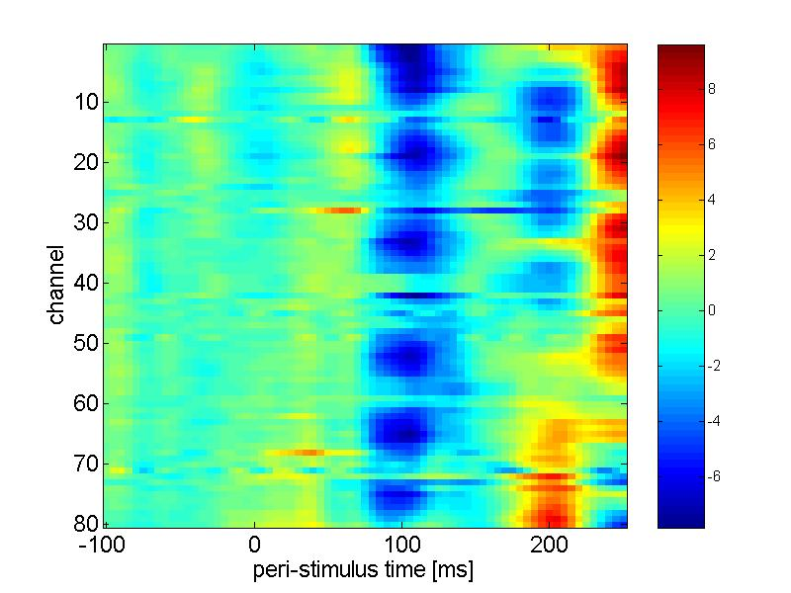
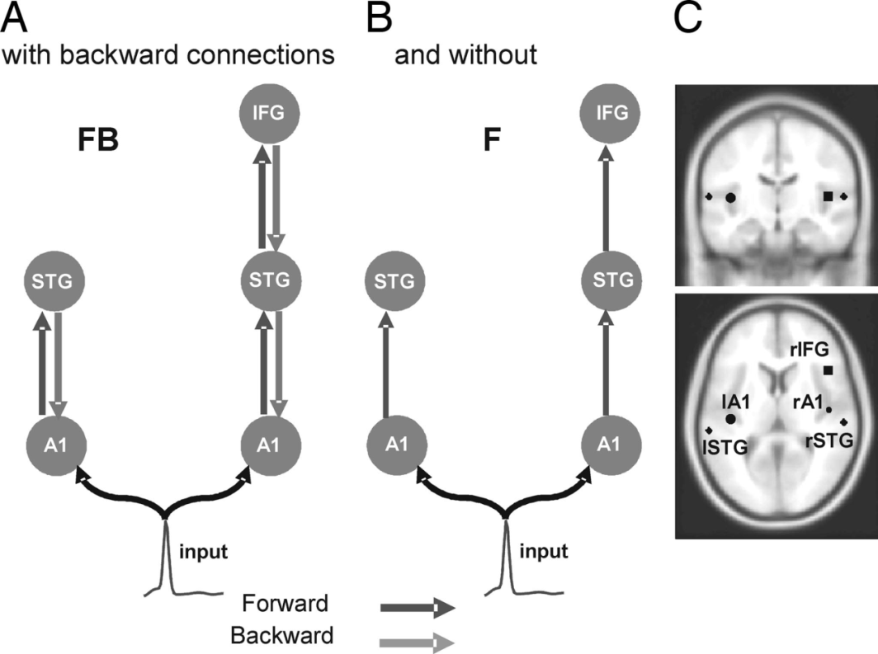


Neural Mass Models in DCM for ERPs
data y
Channels
$$Y=g(θg,v6)$$
$$u=u(t)$$
Time
Lead Field
Event-Related Potentials
$$\dot{v}=f(θf,u)$$
Interconnected
Neural mass models

Slide 38



State equations from time to spectral domain
Linearise
Analytic Transfer Function in the Frequency domain
Time Differential Equations
$$Y=g(θg,v6)$$
$$Y=g(θg,v6)$$
$$H(s)=g\left(sI−A\right)B$$
$$\dot{v}=A\left(θf\right)+Bu$$
$$\dot{v}=f(θf,u)$$
mV
White/Pink Noise

Slide 39


Model Inversion & Inference
Bayes’ rules:
Free Energy:
max
Inference on models
Inference on parameters
Bayesian Inversion
Model 1
Model 2
Model 1
Model comparison via Bayes factor:
accounts for both accuracy and complexity of the model
allows for inference about structure (generalisability) of the model

Slide 40
Data & Hypotheses
Model 1
Event-Related Potentials
Model selection:
data y
Model 2
Channels
Time
...
STG
STG
STG
Model n
A1
A1
A1
A1
best?

Slide 41
Data & Hypotheses
Cross-Spectral Responses
1
Model 1
2
Model selection:
3
Model 2
4
1
2
3
4
...
STG
STG
STG
Model n
A1
A1
A1
A1
best?

Slide 42
Inversion in the real & complex domain
prediction and response: E-Step: 32
prediction and response: E-Step: 32
3.5
1
3
0.8
0.6
2.5
0.4
2
0.2
real
0
imaginary
1.5
-0.2
1
-0.4
-0.6
0.5
-0.8
0
0
10
20
30
40
50
-1
0
10
20
30
40
50
Frequency (Hz)
Frequency (Hz)
conditional [minus prior] expectation
1.5
1
0.5
0
-0.5
-1
-1.5
-2
0
10
20
30
40
50
60
70
80
parameter

Slide 43
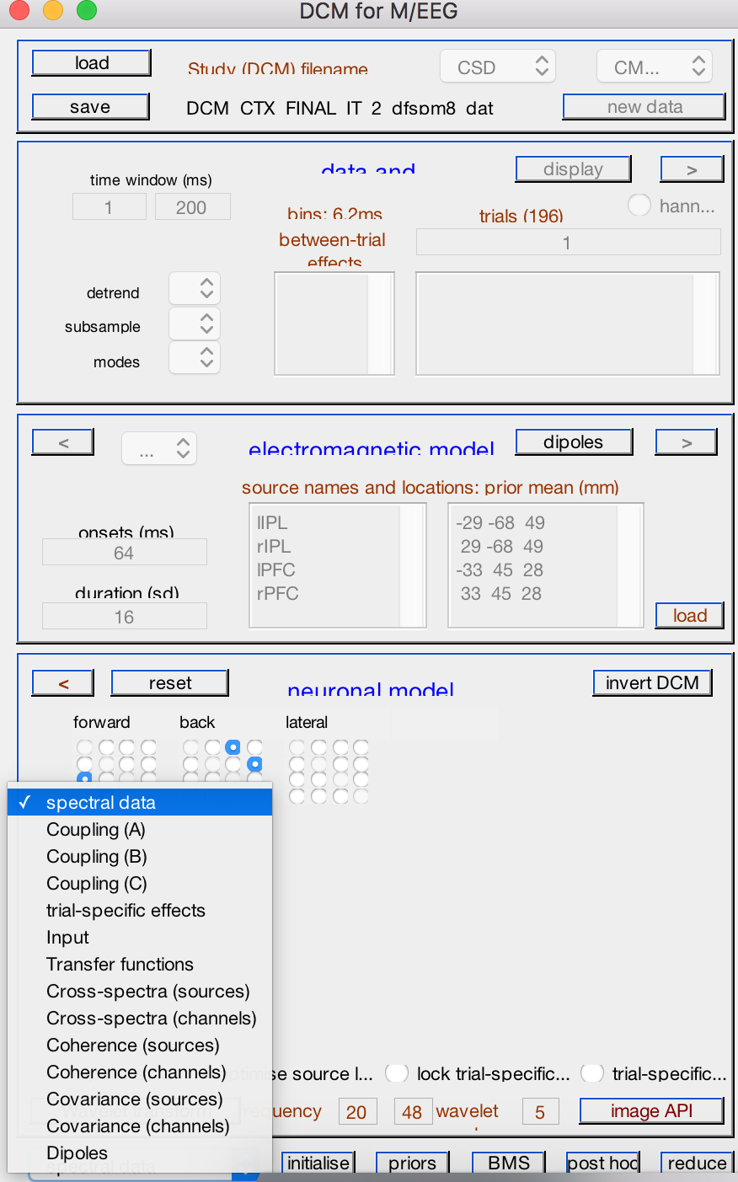
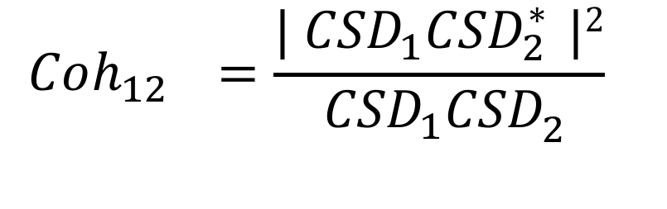
Coherence for free!
(derivatives of the data features also recapitulated in the models)
*(Complex Conjugate)
$$Coh_{{12}_{}}=\frac{{{| CSD}_{1}CSD}_{2}^{∗ }|2}{{{ CSD}_{1}CSD}_{2}^{ }} _{ }$$

Slide 44
DCM for SSR/CSD Examples

Slide 45

Connectivity changes underlying
spectral EEG changes during propofol-induced loss of consciousness.
Wake
Mild Sedation: Responsive to command
Deep Sedation: Loss of Consciousness
Boly, Moran, Murphy, Boveroux, Bruno, Noirhomme, Ledoux, Bonhomme, Brichant, Tononi, Laureys, Friston, J Neuroscience, 2012

Slide 46
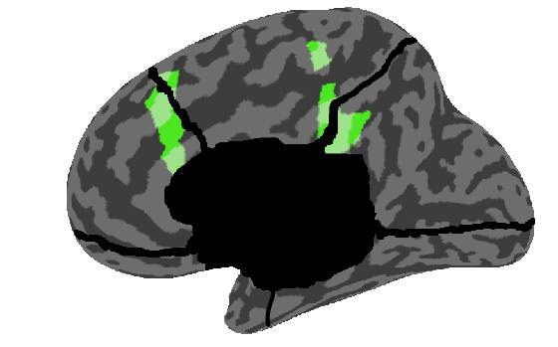
Propofol-induced loss of consciousness
Wake
Mild Sedation: Responsive to command
Deep Sedation: Loss of Consciousness
Precuneus
/Posterior Cingulate
Anterior Cingulate/mPFC

Slide 47
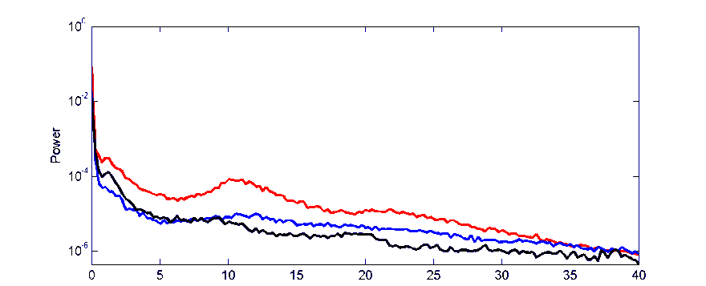
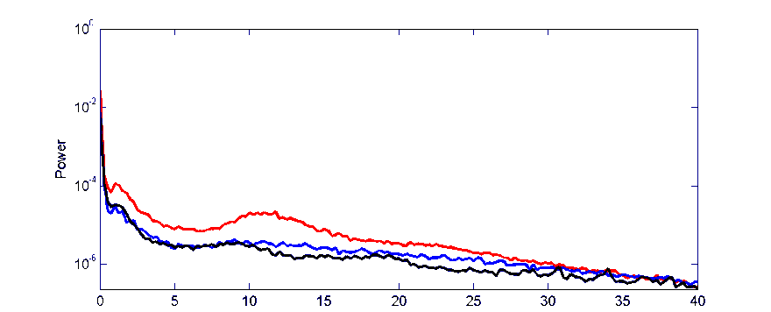
Propofol-induced loss of consciousness
Wake
Mild Sedation: Responsive to command
Deep Sedation: Loss of Consciousness
Precuneus
/Posterior Cingulate
Anterior Cingulate/mPFC
Murphy et al. 2011
Increased gamma power in Propofol vs Wake
Increased low frequency power when consiousness is lost

Slide 48
Bayesian Model Selection
Propofol-induced loss of consciousness
Wake
Mild Sedation
Deep Sedation
ACC
PCC
ACC
PCC
ACC
PCC
Thalamus
Thalami

Slide 49
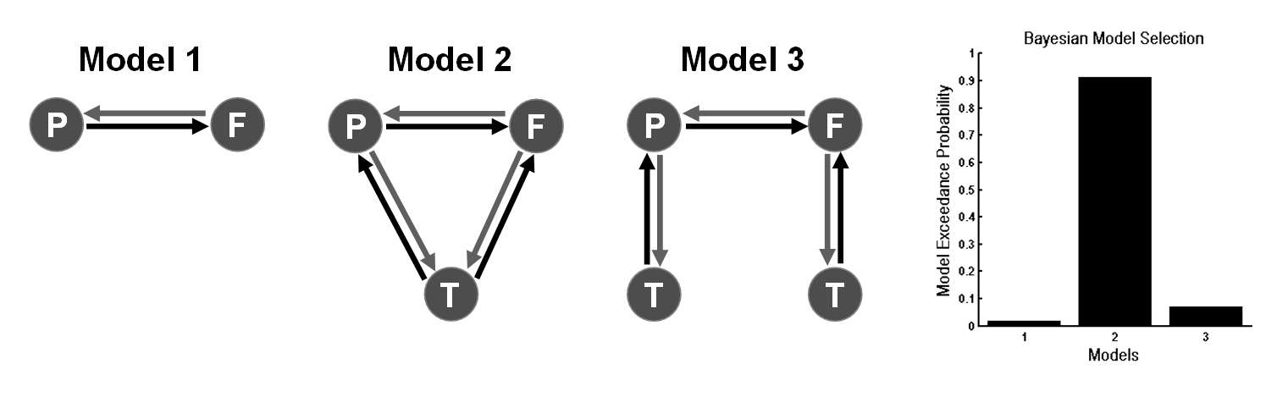
Propofol-induced loss of consciousness
Wake
Mild Sedation
Deep Sedation
ACC
PCC
ACC
PCC
ACC
PCC
Thalamus
Thalami

Slide 50
Parameters of Winning Model
Propofol-induced loss of consciousness
ACC
PCC
Wake
Thalamus

Slide 51
Propofol-induced loss of consciousness
ACC
PCC
Wake
Thalamus
ACC
PCC
Mild Sedation
Thalamus
:Increase in thalamic excitability

Slide 52
Propofol-induced loss of consciousness
ACC
PCC
Wake
Thalamus
ACC
PCC
ACC
PCC
Mild Sedation
Thalamus
:Increase in thalamic excitability
Thalamus
Loss of Consciousness
:Breakdown in Cortical Backward Connections

Slide 53
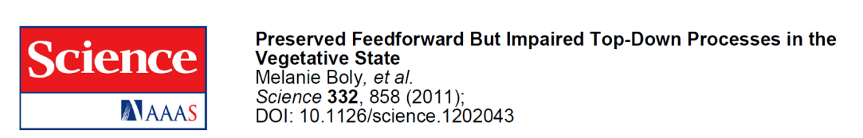
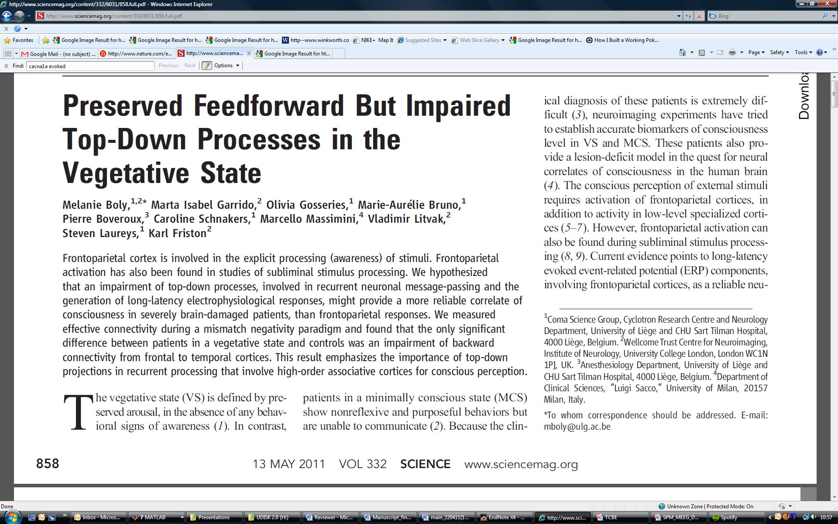
Propofol-induced loss of consciousness
ACC
PCC
Thalamus
Loss of Consciousness
:Breakdown in Cortical
Backward Connections
Boly, Moran, Murphy,
Boveroux, Bruno, Noirhomme,
Ledoux, Bonhomme, Brichant,
Tononi, Laureys, Friston, J Neuroscience, 2012

Slide 54
Predictive Coding & Psychosis
Yes I was mumbling
to myself
IFG
STS
Subvocal
Speech area
IFG
A1
Broken!
STS
Subvocal
Speech area
Somebody’s
talking to me!
A1
Dysconnection Hypothesis, Friston & Frith, 1996

Slide 55
False Inference & Psychosis (Adams et al 2013)
Our perspective provides a normative (Bayes-optimal) account of action and perception … We will consider hallucinosis, abnormal eye movements, sensory attenuation deficits, catatonia, and delusions as various expressions of the same core pathology: namely, an aberrant encoding of precision. The Computational Anatomy of Psychosis
The main neuromodulatory (trait) abnormalities include the hypofunction of cortical NMDA-Rs and GABAergic neurons
A decrease in the precision (post-synaptic gain of prediction error units) at higher levels of cortical hierarchies, relative to the precision at sensory levels…. a reduction in the precision of empirical prior beliefs, relative to sensory precision.
Bayesian modeling suggests that jumping to conclusions may reflect greater “cognitive noise” in delusional patients which may speak to reduced precision of higher level (cognitive) representations and consequently a greater influence of new sensory evidence

Slide 56


An autoimmune model of psychosis
“I was walking through Times Square, during which colors appeared aggressively bright. I remember thinking: “I’m seeing everything in a sinister light now. Everything is dripping in terrible meaning.”.”
“In the spring of 2009, I was the 217th person ever to be diagnosed with anti-NMDA-receptor autoimmune encephalitis. Just a year later, that figure had doubled. Now the number is in the thousands. Yet Dr. Bailey, considered one of the best neurologists in the country, had never heard of it.”

Slide 57
Anti-NMDA Receptor Encephalitis
“A severe, multistage, treatable disorder presenting with psychosis” (Wandinger, Dalmua, 2011)
Autoimmune disorder – including a paraneoplastic syndrome from teratoma or other tumors
Autoantibodies attenuate NMDAR function through the internalization of NMDAR
Symptoms
Diagnosis: A positive antibody titer
Treatment: Tumor removal, intravenous corticosteroids
and intravenous immunoglobulins
Prognosis: 75% Recovery, 6 – 25% mortality
Memory / Perceptual
Disturbances
Emotional Disturbances
Dyskinesias
Dysautonomia
Psychosis
Seizures
+ve
-ve
Notes:
80:20 women to men
Tumors can be lung, breast, thyroid …thought the body produced antibodies to something like and NMDA protien in the tumor
Immunoflourescent test

Slide 58
Anti-NMDA Receptor Encephalitis: Reduced Connectivity at NMDA receptors
Anti-NMDA Receptor Encephalitis +ve Serum titer | Encephalopathy (Brain slowing)
N = 31, Age 28 yrs +/- 16, (22 Female) | N = 18, Age 28 +/- 5, (11 Female)
12 minutes Resting State 32-channel EEG | 12 minutes Resting State 32-channel EEG
Acute, Subacute Recovering or Chronic | Etiology: Metabolic, Infectious & Hypoxic Cause
Treatment: steroids, plasma exchange, IVG
Neurological Patient Controls
N = 18, Age 31 +/- 6, (10 Female)
12 minutes Resting State 32-channel EEG
4
p = 0.054
3
West Haven EEG Grade
2
1
0
Other
Encephalopathy
NMDA
Encephalitis
EEGs indistinguishable
on clinical inspection
Notes:
80:20 women to men
Tumors can be lung, breast, thyroid …thought the body produced antibodies to something like and NMDA protien in the tumor

Slide 59
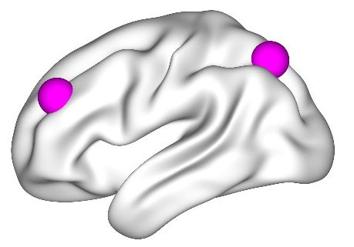
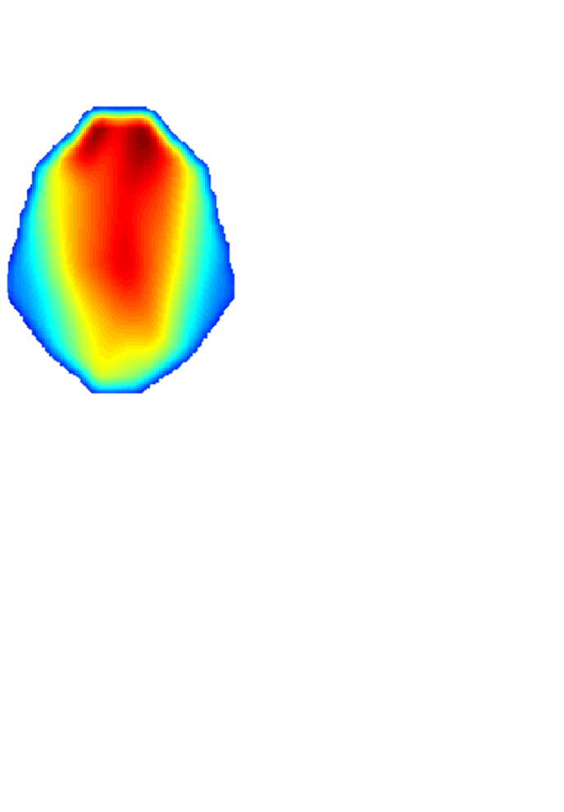
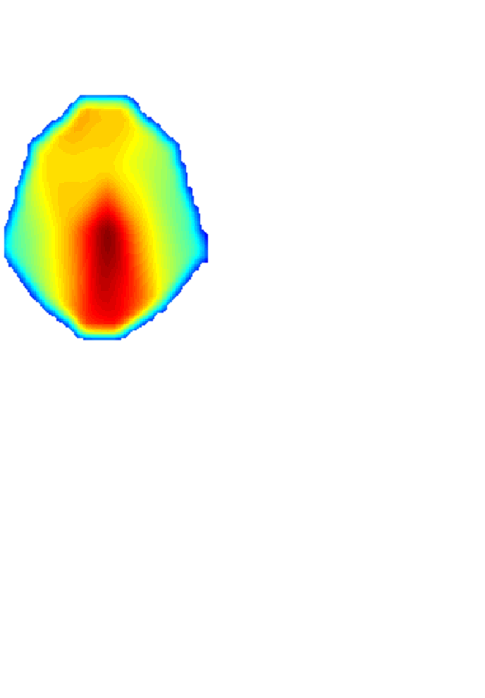
Anti-NMDA Receptor Encephalitis: Spectral Responses (Explanandum)
0.5
Delta/Theta Power
Cntl
NMDA
Enceph
0
log (μV²)
-0.5
Power a.u. (2-6 Hz)
-1
-1.5
-2
Delta Power
Gamma Power
-2.5
-3
**
1.8 2.2 2.7 3.3 4.1 4.9 6.0 7.4
*
Hz
*
-1.5
Beta/Gamma Power
8
0.15
-2
(μV²)
log(μV²)
-2.5
Power a.u. (20-48 Hz)
-3
6
-3.5
0.1
-4
(μV²)
(μV²)
-4.5
4
-5
16.4 20.1 24.5 29.9 36.6 44.7 54.6
Hz
0.05
2
0
0
Cntl
NMDA
Enceph
Cntl
NMDA
Enceph
Notes:
ANOVA beta:
28 29 30 31 32 33 34 35 36 37 38 39 40 Hz: p 0.031 (F= 3.63) (post hoc sig diff nmda and normal 0.0321
P = 0.032 (corrected) (1 v2)
ANOVA delta Hz: 2:4 p: 0.0041 (F=6.0)
1 v 3: p=P = 0.003
2v3 : P = 0.0429 (corrected)

Slide 60
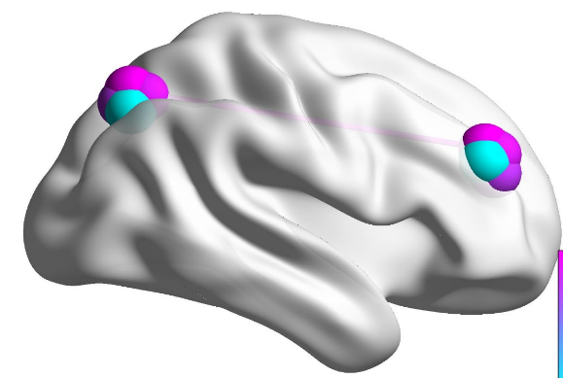
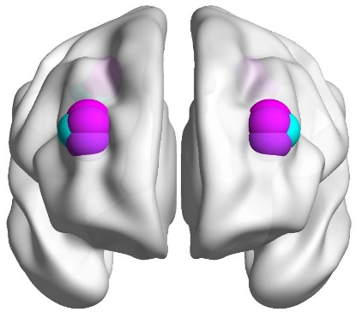
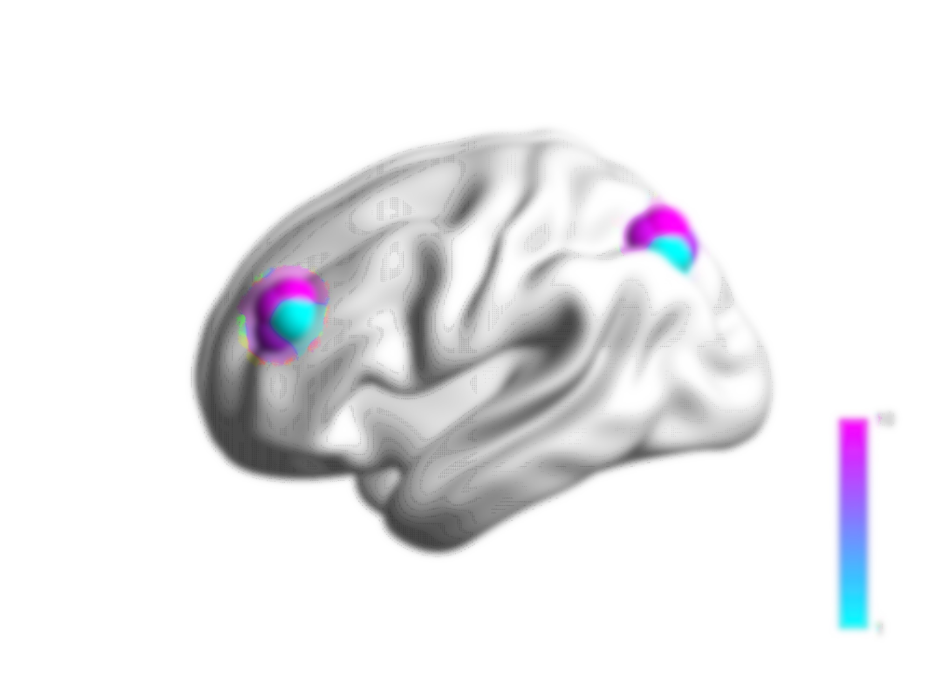
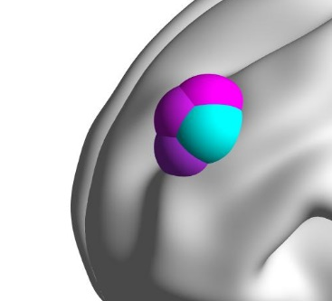
DCM: Anti-NMDA Receptor Encephalitis
Superficial
Pyramidal Cells
Inhibitory
Interneurons
Bilateral network with frontoparietal connections and regional Neural Mass Models
Layer IV
Stellates
Layer IV
Stellates
Superficial
Pyramidal Cells
Deep
Pyramidal
Cells
Inhibitory
Interneurons
NMDA Receptor
AMPA Receptor
GABA_{A} Receptor
Deep
Pyramidal Cells
Neural Mass Model’s Intrinsic Connectivity
Model Fits
NMDA Encephalitis
Other Encephalopathy
Neurological Patient Control
Beta/Gamma DCMs
Delta/Theta DCMs
0.09
0.09
0.15
n.s.
1
Data
DCM
1
0.06
0.06
0.1
0.8
0.8
Power (a.u.)
0.6
0.6
% Variance Explained
0.03
0.03
0.05
0.4
0.4
0
0
0
0.2
0.2
20
25
30
35
40
45
20
25
30
35
40
45
20
25
30
35
40
45
0
N E C
0
N E C
Frequency (Hz)
Frequency (Hz)
Frequency (Hz)

Slide 61
Group Effects (PEB)
Effect of Encephalopathy
Effect of anti-NMDAR Encephalitis
0.5
0.4
0.2
Effect Size
Effect Size
0
0
-0.2
-0.5
-0.4
-0.6
-1
0
5
10
15
20
25
30
35
-0.8
0
5
10
15
20
25
30
35
Parameter
*
Parameter
*
*
****
**
** * * **** * * *
1
1
0.9
0.9
0.8
0.8
0.7
0.7
0.6
Probability of Effect
Probability of Effect
0.6
0.5
0.5
0.4
0.4
0.3
0.3
0.2
0.2
0.1
0.1
0
0
0
5
10
15
20
25
30
35
0
5
10
15
20
25
30
35
Parameter
Parameter
Receptor
Summary
Receptor Summary
NMDA Receptor*
AMPA Receptor*
GABA_{A} Receptor*
NMDA Receptor*
AMPA Receptor
GABA_{A} Receptor
*
*
*
n.s.
*
n.s.
Symmonds, Moran, Leite, Irani, Buckley, Stephan, Friston & Moran, Brain, (2018)

Slide 62
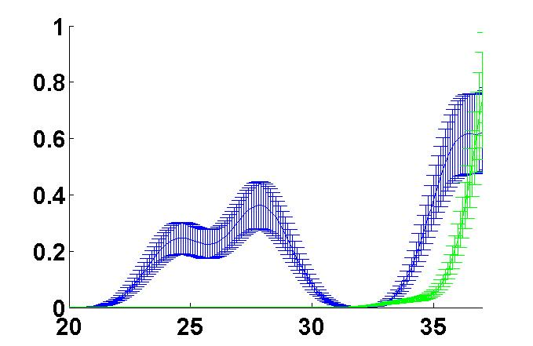
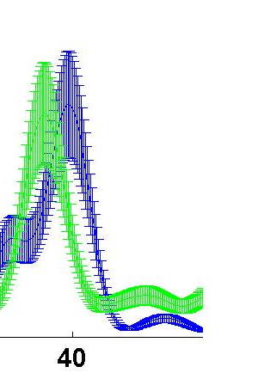
Network Reorganization: Top-down vs Bottom up Effects
NMDA antibody encephalitis
Control
Lack of precision at high level regions reduce top-down expectations
Power (a.u.)
NMDA antibody encephalitis
Control
Beta
Frontal Regions
Beta Frequency (Hz)
Association Cortices
Gamma
Power (a.u.)
50
Gamma Frequency (Hz)
Symmonds, Moran, Leite, Irani, Buckley, Stephan, Friston & Moran, Brain, (2018)

Slide 63
Why these models?

Slide 64
DCM for SSR/CSD
Why I think these models are useful:
Models of Synaptic Activity using invasive and non-invasive electrophysiological time series from large neuronal populations.
Useful models of pharmacological effects – where are the drug’s effects most prominent, are other receptors affected?
Useful link to predictive coding: top-down vs. bottom up and their belief mappings.
Potential to scale to clinical settings: could patients be stratified based on endogenous connectivity profiles?

Slide 65
DCM for SSR/CSD
Why these models can be more than mildly irritating :
Local Minima (not the model’s fault)

Slide 66
Thank You
The FIL Methods Group

