Slide 1
Experimental design
Mona Garvert
Max-Planck-Institute for Cognitive and Brain Sciences, Leipzig, Germany
With thanks to:
Sara Bengtsson
Christian Ruff
Rik Henson
Notes:
- Straightforward interpretability

Slide 2
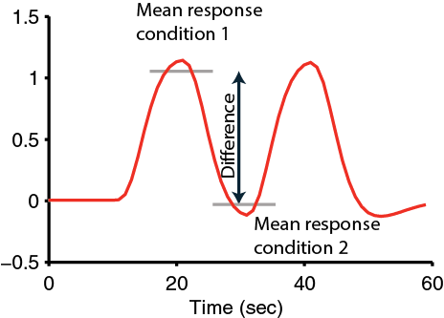
Goal
The BOLD signal does NOT provide you with an absolute measure of neural activity
Therefore, you need to compare activity across conditions (use contrasts).
What?
Your question
How?
Experimental design
Contrasts / Parameters
The sensitivity of your design depends on maximizing the relative change between conditions
Notes:
Compare the task of interest with some control task where subjects are either at rest or performing a simple baseline task
What type of experimental designs are there?
The choice of design is extremely important
What parameters will you be able to estimate?
What contast will you be able to compute?
BOLD by itself has no meaning
You always need to compare it to another process
Task B matched in all aspecs, except process P is not involved
Consider really carefully! Make sure you’ve chosen your analysis method and contrasts before you start your experiment!

Slide 3
Experimental designs
Subtraction
Conjunction
Factorial
Parametric
Psycho-physiological Interaction (PPI)
Indexing neural representations
Notes:
Categoriecal designs
Different between tasks/conditions
Parametric:
- Cognitive dimension that differ on a scale

Slide 4
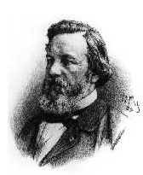
Simple subtraction
Aim: Isolation of a cognitive process
  Compare the neural signal for a task that activates the cognitive process of interest and a second task that controls for all but the process of interest
  >> The critical assumption of „pure insertion“
  Assume that adding components does not affect other processes
  > A good control task is critical!
F.C. Donders, 1868
Notes:
You always need to compare it to another process
Task B matched in all aspects, except process P is not involved
What is a good control task?
Relies on the assumption of pure insertion. Add/subtract single process without influencing any other process

Slide 5
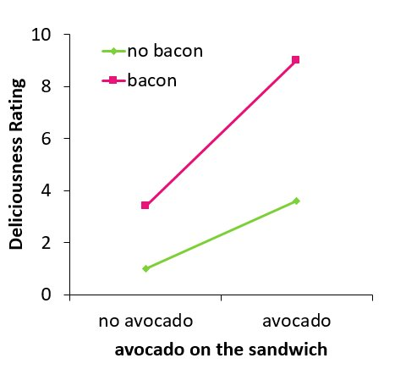
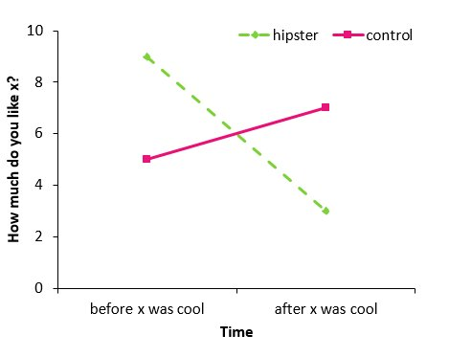

Simple subtraction
Examples of a violation of the critical assumption of „pure insertion“
Vanessa Loiza
@vmloaiza1

Slide 6
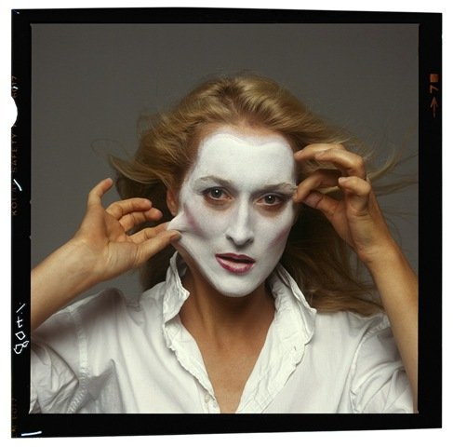
Simple subtraction
Aim: Isolation of a cognitive process
  Compare the neural signal for a task that activates the cognitive process of interest and a second task that controls for all but the process of interest
  >> The critical assumption of „pure insertion“
  Assume that adding components does not affect other processes
  > A good control task is critical!
  Question: Which region is specialized for assigning names to faces?
F.C. Donders, 1868
Notes:
You always need to compare it to another process
Task B matched in all aspects, except process P is not involved
What is a good control task?
Relies on the assumption of pure insertion. Add/subtract single process without influencing any other process

Slide 7
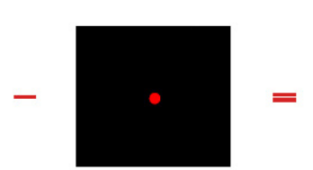
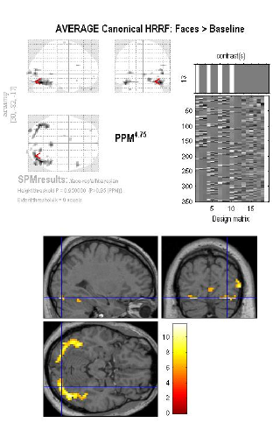
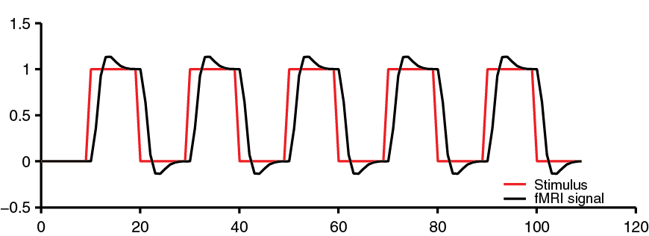
Simple subtraction
Aim: Isolation of a cognitive process
  Compare the neural signal for a task that activates the cognitive process of interest and a second task that controls for all but the process of interest
Notes:
What is a good control task?
Relies on the assumption of pure insertion. Add/subtract single process without influencing any other process

Slide 8
Simple subtraction
Aim: Isolation of a cognitive process
  Compare the neural signal for a task that activates the cognitive process of interest and a second task that controls for all but the process of interest
Not a great contrast
Rest may not be truly rest
Will give wide-spread activation. Hard to draw conclusions about specific cognitive processes
Null events or long SOAs (stimulus onset asynchrony) essential for estimation, which may result in an inefficient design.
But can be useful to find regions generally involved in the task
Notes:
Not great contrast
Hard to control what people thin about when they are resting
Will give wide-spread activation. Hard to draw conclusions about cognitive processes
May be inefficient because you need long SOAs
Could be useful as a mask to find regions of interested. Helps with multiple comparisions.

Slide 9

Choosing your baseline
Problem: Difficulty of finding baseline tasks that activate all but the process of interest
Different stimuli and task
Related stimuli
+
vs.
vs.
‘Meryl Streep’
‘I am so hungry…’
Famous? Mum?
→ P implicit in control task?
→ Difficulty matched?
→ Several components differ!
Same stimulus, different tasks
vs.
Name the person! Name the gender!
→ Specific naming-related activity
Notes:
subjects’ brains may be responding to things you didn’t tell them to do
different stimulus configurations don’t afford different strategies
A Rest may not be truly rest
Need to control as much as possible to isolate component of interest
B Even if a task does not explicitly involve a particular component, subjects may engage in it anyway – E.g. rehearsing previous stimuli
Activation in brain region in area related to face processing, but also all kinds of other aspects, such as color
Related stimuli much better
Famous vs non-famous faces
Matched in terms of visual perception.
But do particpiants spend more time processing one of the tasks?
Easy to spot the famous person, but people might have associations with the control
Most elegant:
Same stimulus for both conditions
But different tasks, e.g. name the person vs name the gender
Activity now very specific – namely naming the face. Some more automatic processes might be lost

Slide 10
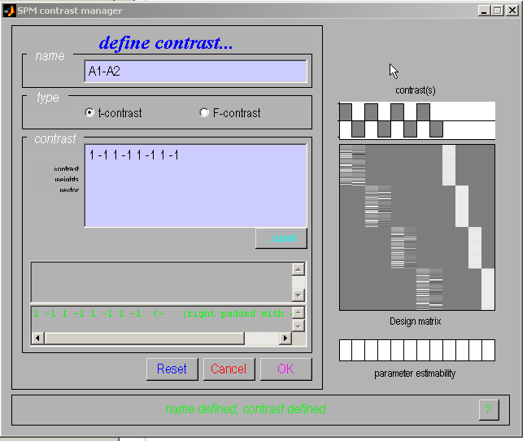
Categorical responses
SPM
Task 1
Task 2
Session
Notes:
1 condition
-1 control task
Here: four sessions. In each session they performed A1 and A2

Slide 11
Subtraction
Problems:
Difficulty of finding baseline tasks that activate all but the process of interest
Subtraction depends on the assumption of “pure insertion”
  an extra cognitive component can be inserted without affecting the pre-existing components
B
B
B
B
A
A
A
A
Friston et al., (1996)
A
B
A+B
AxB
AxB

Slide 12
Experimental designs
Subtraction
Conjunction
Factorial
Parametric
Psycho-physiological Interaction (PPI)
Indexing neural representations
Notes:
Categoriecal designs
Different between tasks/conditions
Parametric:
- Cognitive dimension that dif

Slide 13
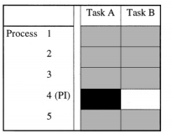
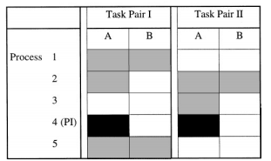
Conjunction
Minimization of “the baseline problem” by isolating the same cognitive process by two or more separate contrasts
Conjunctions can be conducted across different contexts: tasks, stimuli, senses (vision, audition), …
Note: The contrasts entering a conjunction have to be independent
Subtraction
Conjunction analysis
only the component of interest is common to all task pairs

Slide 14
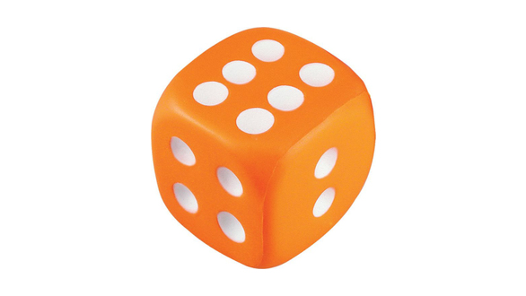
Conjunction analysis
Which neural structures support phonological retrieval, independent of item?
What is this object?
Visual analysis
Object recognition
Phonological retrieval
Verbal output
Recalling
appropriate
speech
sounds
Notes:
What do you see on the screen here?

Slide 15
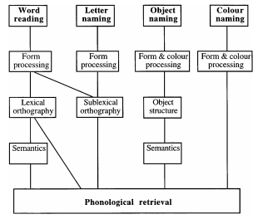
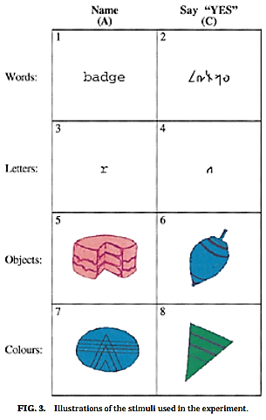
Conjunction analysis
Which neural structures support phonological retrieval, independent of item?
Phonological retrieval is the only cognitive component common to all task pair differences
Price & Friston (1996)

Slide 16
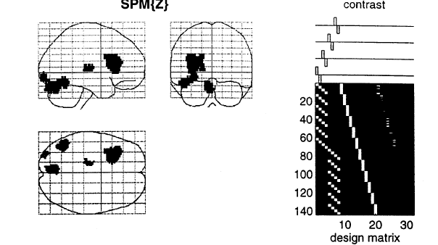
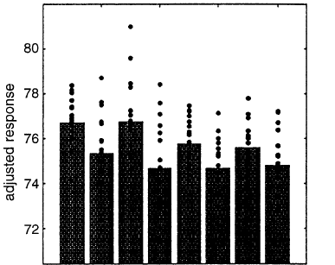
Conjunction analysis
Isolates the process of Phonological retrieval, no interaction with visual processing etc
Overlap of 4 subtractions
Areas are identified in which task-pair effects are jointly significant and are not significantly different
Price & Friston (1996)
Notes:
Plot activation in IT
For each item there is more activation in experimental task compared to control task
Enables us to distinguish areas that are functionally specialized from areas that are not
E.g. if the activation of an area by phonological retrieval depended upon the presence of color this would imply that the area was specialized for the integration of phonological retrieval and color processing rather than being dedicated to phonological retrieval per se
On the other hand if an area responds to, and only to, phonological retrieval (i.e., it is unaffected by the type of naming task or the context in which names were generated), then a true conjunction will ensue, implying that the area is specialized for phonological retrieval irrespective of other processing requirements

Slide 17
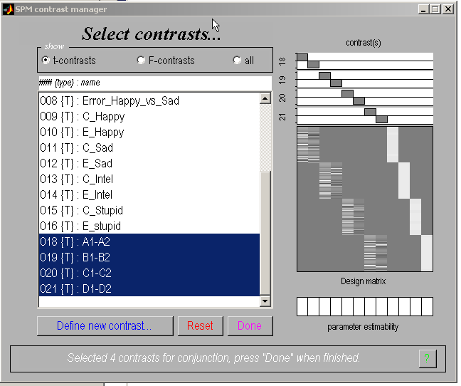
Conjunction analysis
SPM
1 task/session

Slide 18
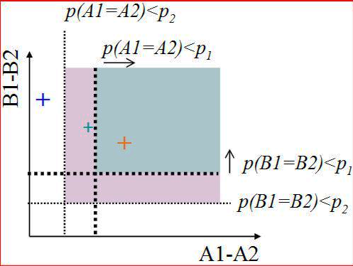
Conjunction: 2 ways of testing for significance
Significance testing
Test of global null hypothesis:
Significant set of consistent effects
“Which voxels show effects of similar direction (but not necessarily individual significance) across contrasts?”
Test of conjunction null hypothesis:
Set of consistently significant effects
“Which voxels show, for each specified contrast, effects > threshold?”
Friston et al., (2005). Neuroimage, 25:661-7.
Nichols et al., (2005). Neuroimage, 25:653-60.
Notes:
Conjunction with two contrasts, A and B
Which voxel shows for each contrast a
Global null hypothesis: pink square > more sensitive
Conjunction null: could end up in blue area

Slide 19
Experimental designs
Subtraction
Conjunction
Factorial
Parametric
Psycho-physiological Interaction (PPI)
Indexing neural representations
Notes:
Categoriecal designs
Different between tasks/conditions
Parametric:
- Cognitive dimension that dif

Slide 20

Factorial design
Is the inferiotemporal cortex sensitive to both object recognition and phonological retrieval of object names?
Visual analysis
Object recognition
Phonological retrieval
Verbal output

Slide 21
Factorial design
Is the inferiotemporal cortex sensitive to both object recognition and phonological retrieval of object names?
A
Say ‘yes’ when you see an abstract image
Say ‘yes’ when you see an object
Name the object
Visual analysis
Verbal output
B
Visual analysis
Object recognition
Verbal output
C
Visual analysis
Object recognition
Phonological retrieval
Verbal output

Slide 22
Factorial design
Is the inferiotemporal cortex sensitive to both object recognition and phonological retrieval of object names?
A
Say ‘yes’ when you see an abstract image
Say ‘yes’ when you see an object
Name the object
Friston et al., (1997)
Results in inferotemporal cortex:
B
A
B
C
B
A
>
Object recognition
C
B
C
=
IT not involved in phonological retrieval?!
Problem:
We assumed that IT response to object recognition is context independent

Slide 23
Interactions
Is the task the sum of its component processes, or does A modulate B?
B
B
B
B
Object recognition
Phonological retrieval
A
A
A
A
Vary A and B independently!

Slide 24




Main effects
Factorial design
Price et al., (1996);
Friston et al., (1997)
Is the task the sum of its component processes, or does A modulate B?
 | No phonological retrieval | Phonological retrieval
No object recognition
Object recognition
A
C
B
D
C
D
A
B
Main effect, phonological retrieval: ( + )>( + )
Main effect, object recognition: ( + )>( + )
C
D
A
B
B
D
B
D
A
C
C
A

Slide 25
Main effects
Price et al., (1996);
Friston et al., (1997)
Is the task the sum of its component processes, or does A modulate B?
 | No phonological retrieval | Phonological retrieval
No object recognition
Object recognition
Inferotemporal (IT) responses do discriminate between situations where phonological retrieval
is present or not. In the absence of object recognition, there is a deactivation in IT cortex, in the
presence of phonological retrieval.
A
C
B
D
Interaction: ( - ) > ( - )
D
C
B
A
A
Notes:
masking with main effect

Slide 26
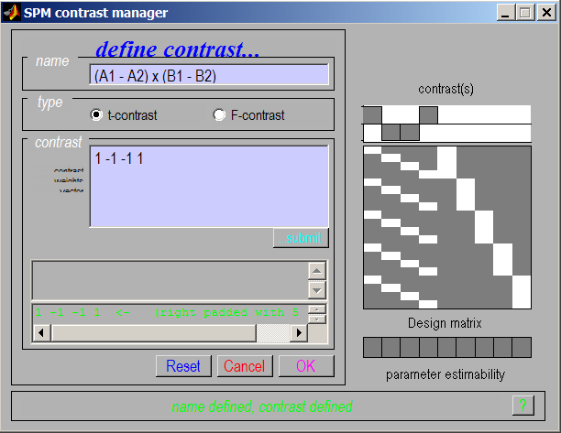
Interaction in SPM
Interactions:
cross-over
and
simple
We can selectively inspect our data for one or the other by masking during inference
Notes:
You can mask interaction with main effects because they are orthogonal

Slide 27
Experimental designs
Subtraction
Conjunction
Factorial
Parametric
Psycho-physiological Interaction (PPI)
Indexing neural representations
Notes:
Categoriecal designs
Different between tasks/conditions
Parametric:
- Cognitive dimension that dif

Slide 28
Parametric designs
Does activity vary systematically with a continuously varying parameter?
Varying the stimulus-parameter of interest on a continuum, in multiple (n>2) steps...
  ... and relating BOLD to this parameter
  Possible tests for such relations :
        Linear
        Nonlinear: Quadratic/cubic/etc.
        „Data-driven“ (e.g., neurometric functions, computational modelling)
Avoids pure insertion but does assume no qualitative change in processing
Notes:
Your computational model resuls in regressors which you can then correlate with your neural data
Often less sensitive

Slide 29
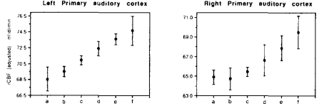
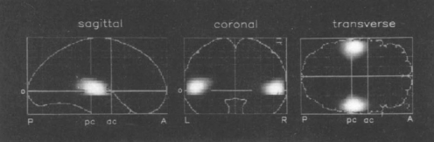
Parametric designs
PET
Auditory words presented at different rates (rest, 5 rates between 10wpm and 90 wpm)
Activity in primary auditory cortex is linearly related to word frequency
Price et al. 1992

Slide 30
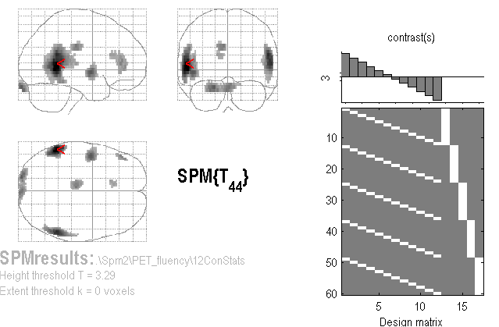
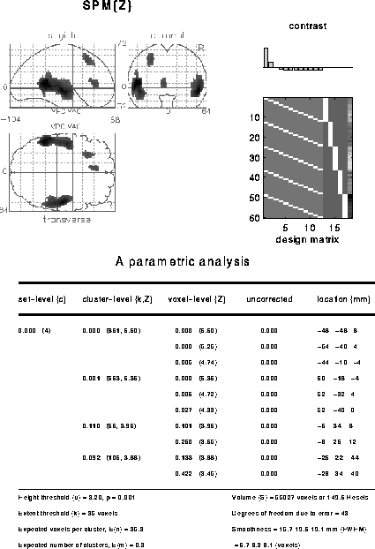
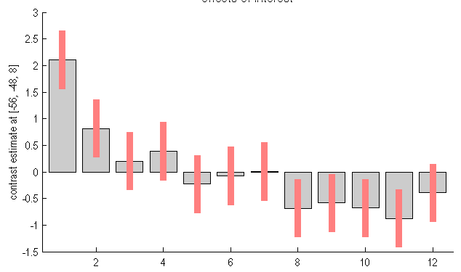
A linear parametric contrast
Is there an adaptation effect if people listen to words multiple times?
Linear effect of time
Non-linear effect of time
Notes:
Fixed effects design
Five participants
Their scans devided into twelve time bins
Which areas shows a linear decrease in activity over time?
Average vector needs to equal 0
If you plot parameter estimates in posterior temporal lobe, you can see that there are non-linear effects here
If you want to look at linear and nonlinear effects at the same time you need to bring them into the same design matrix.

Slide 31
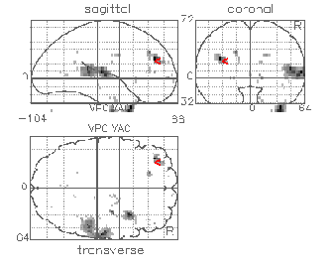
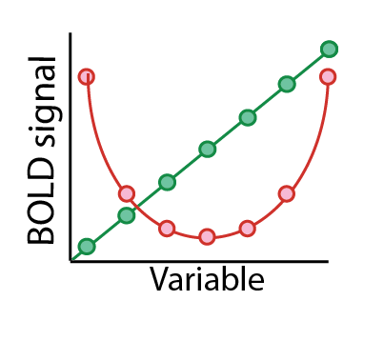
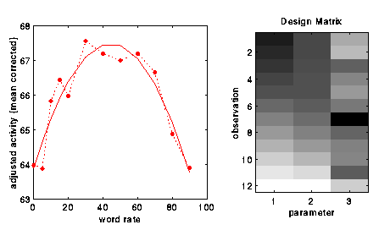
A non-linear parametric design matrix
Polynomial expansion:
f(x) = b₁ x + b₂ x² + ...
…up to (N-1)^{th} order for N levels
F-contrast [1 0] on linear param
F-contrast [0 1] on quadratic param
SPM offers polynomial
expansion as option during creation
of parametric modulation regressors.
SPM{F}
Büchel et al., (1996)
Notes:
Brain activation as a function of word rate
Participant who had a stroke
Linear effect of word rate in the auditory cortex
Inverted u-shape in left lateral prefrontal cortex. Not seen in healthy participants.
Non-linear parametric analysis helps discover interesting things in the data.

Slide 32
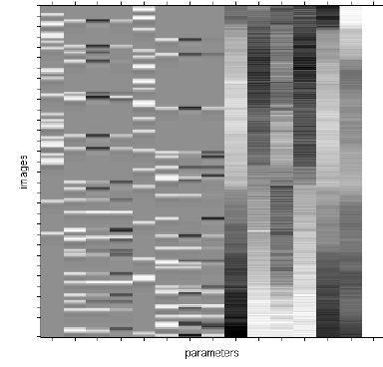
Parametric modulation
Quadratic param regress
Linear param regress
Delta function
seconds
Delta
Stick function
Parametric
regressor
Notes:
How hard to squeeze the ball
Two task conditions

Slide 33
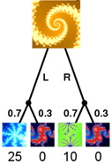

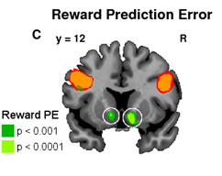
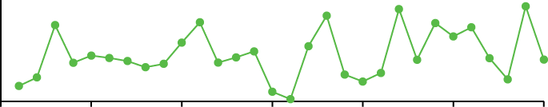
Parametric design: Model-based regressors
Signals derived from a computational model are correlated against BOLD, to determine brain regions showing a response profile consistent with the model, e.g. Rescorla-Wagner prediction error
Time-series of a model-derived reward prediction error
Reward
Prediction
error
Trial number
Gläscher & O’Doherty (2010)

Slide 34
Experimental designs
Subtraction
Conjunction
Factorial
Parametric
Psycho-physiological Interaction (PPI)
Indexing neural representations
Notes:
Categoriecal designs
Different between tasks/conditions
Parametric:
- Cognitive dimension that dif

Slide 35
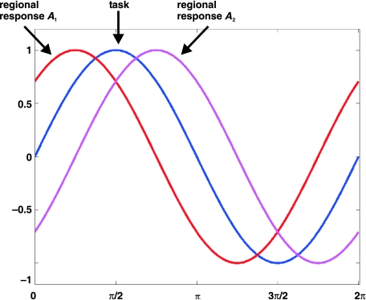
Psycho-physiological Interaction (PPI)
Functional connectivity measure
Can activity in a part of the brain be predicted by an interaction between task and activity in another part of the brain?
If two areas are jointly correlated to a task component ( ‘co-activated’) this does not mean that they are functionally connected to each other
Stephan, 2004
Notes:
PPI: type of factorial design
Not two cognitive factors,
But brain activation x task
Number of areas are active. Doesn’t mean they are interacting. If they are interacting they will display synchronous activity
Red and pink are not correlated with one another, but each correlated with the task

Slide 36
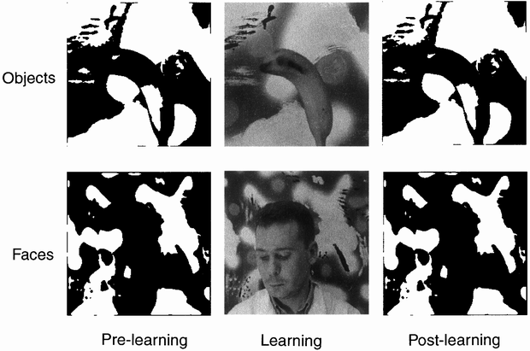
Psycho-physiological Interaction (PPI)
Factorial design
Learning
Objects before (Ob) | Objects after (Oa)
Faces before (Fb) | Faces after (Fa)
Stimuli
Dolan et al., 1997
Notes:
Scanning pre-learning & post-learning

Slide 37
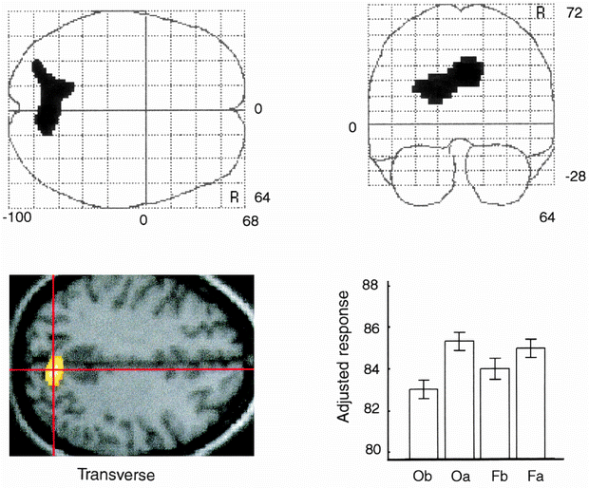
Psycho-physiological Interaction (PPI)
Main effect of learning
Learning
Objects before (Ob) | Objects after (Oa)
Faces before (Fb) | Faces after (Fa)
Stimuli
Dolan et al., 1997
Notes:
Parietal cortex, increased activation
Scanning pre-learning & post-learning

Slide 38
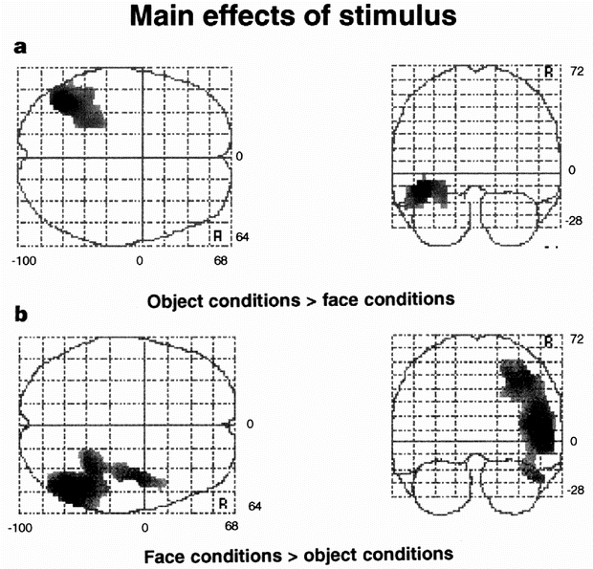
Psycho-physiological Interaction (PPI)
Main effect of stimulus
Learning
Objects before (Ob) | Objects after (Oa)
Faces before (Fb) | Faces after (Fa)
Stimuli
Does learning involve functional connectivity between parietal cortex and stimuli specific areas?
Dolan et al., 1997
Notes:
Stimulus-specific areas
1. left inferior temporal region
2. right superior temporal region
Main effect of faces vs main effect of objects

Slide 39
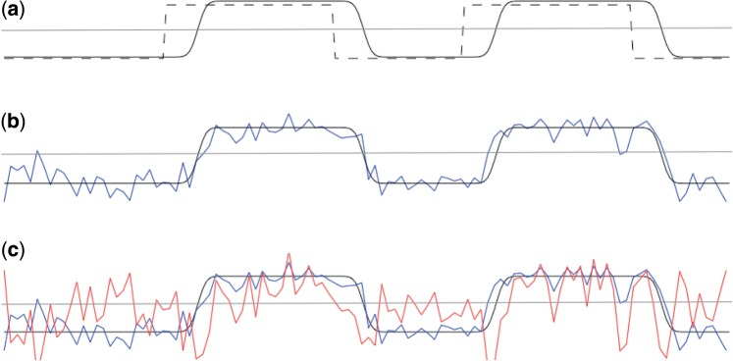
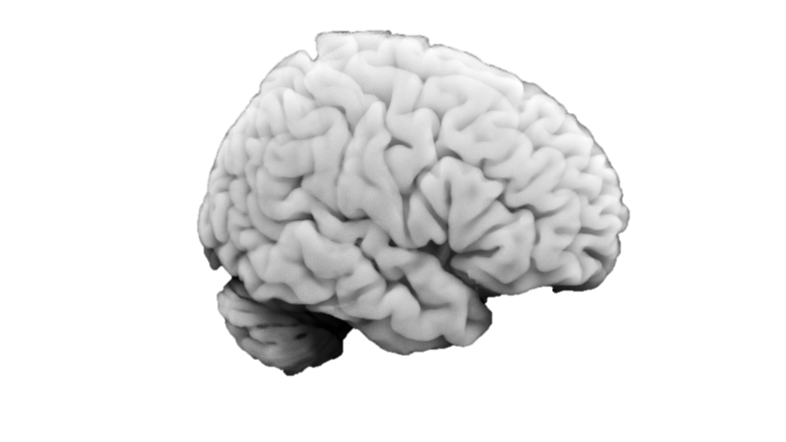
Psycho-physiological Interaction (PPI)
Does learning involve functional connectivity between parietal cortex and stimuli specific areas?
Main effect of task (Faces - objects)
Activity in parietal cortex
Seed region
PPI regressor = HRF convolved task x seed ROI regressors
Whole brain
correlated for faces
Anti-correlated for objects
O’Reilly (2012)
Notes:
We start with a regressor representing the main effect of task (in this case, a block design) (dashed line), and convolve it with the HRF to get an HRF convolved task regressor (black line).
We extract a time course from our seed region of interest (blue line). If this region of interest was active during the task, the time course of activity from the seed region will be correlated with the HRF convolved task regressor.
PPI regressor is correlated with the seed region time course during task blocks, but anti-correlated with it during rest blocks.
voxels that are always correlated with the seed ROI (e.g. due to anatomical connections that are not task-relevant) will have an overall regression co-efficient of zero for the PPI regressor, but voxels which are more correlated with the seed ROI during task blocks than during rest will show a positive correlation with the PPI regressor.

Slide 40
Psycho-physiological Interaction (PPI)
Does learning involve functional connectivity between parietal cortex and stimuli specific areas?
1 0 0
Main effect of task (Faces - Objects)
Activity in parietal cortex
PPI regressor = HRF convolved task x seed ROI regressors
PPI activity task
The interaction term should account for variance over and above what is accounted for by the main effect of task and physiological correlation
correlated for faces
Anti-correlated for objects
O’Reilly (2012)
Notes:
We start with a regressor representing the main effect of task (in this case, a block design) (dashed line), and convolve it with the HRF to get an HRF convolved task regressor (black line).
We extract a time course from our seed region of interest (blue line). If this region of interest was active during the task, the time course of activity from the seed region will be correlated with the HRF convolved task regressor.
PPI regressor is correlated with the seed region time course during task blocks, but anti-correlated with it during rest blocks.

Slide 41
Psycho-physiological Interaction (PPI)
Learning
Objects before (Ob) | Objects after (Oa)
Faces before (Fb) | Faces after (Fa)
Stimuli
Orthogonal contrasts reduce correlation between PPI vector and the regressors of no interest
Dolan et al., 1997
Notes:
Stimulus-specific areas
1. left inferior temporal region
2. right superior temporal region

Slide 42
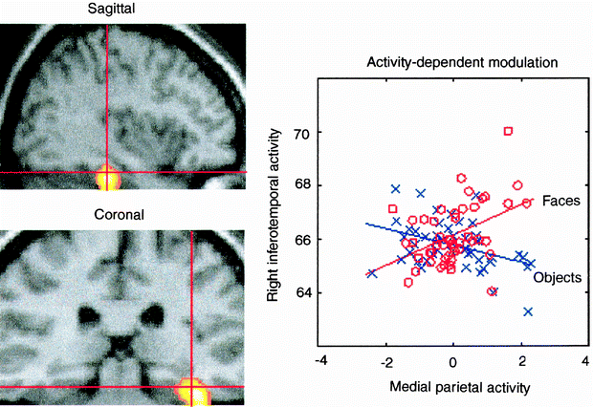
Psycho-physiological Interaction (PPI)
Coupling between ITC and parietal cortex depends on the stimulus
Coupling between the temporal face area and the medial parietal cortex when, and only when, faces were perceived
Dolan et al., 1997
Notes:
Coupling between the temporal face area and the medial parietal cortex when, and only when, faces were perceived

Slide 43
Psycho-physiological interactions (PPI)
A standard PPI analysis does not make inferences about the direction of information flow (causality)
Stimuli:
Faces or objects
Stimuli:
Faces or objects
Modulation of
stimulus-specific
responses
Context-sensitive
connectivity
PPC
PPC
IT
IT
Notes:
2 ways of interpreting the data

Slide 44
Experimental designs
Subtraction
Conjunction
Factorial
Parametric
Psycho-physiological Interaction (PPI)
Indexing neural representations

Slide 45
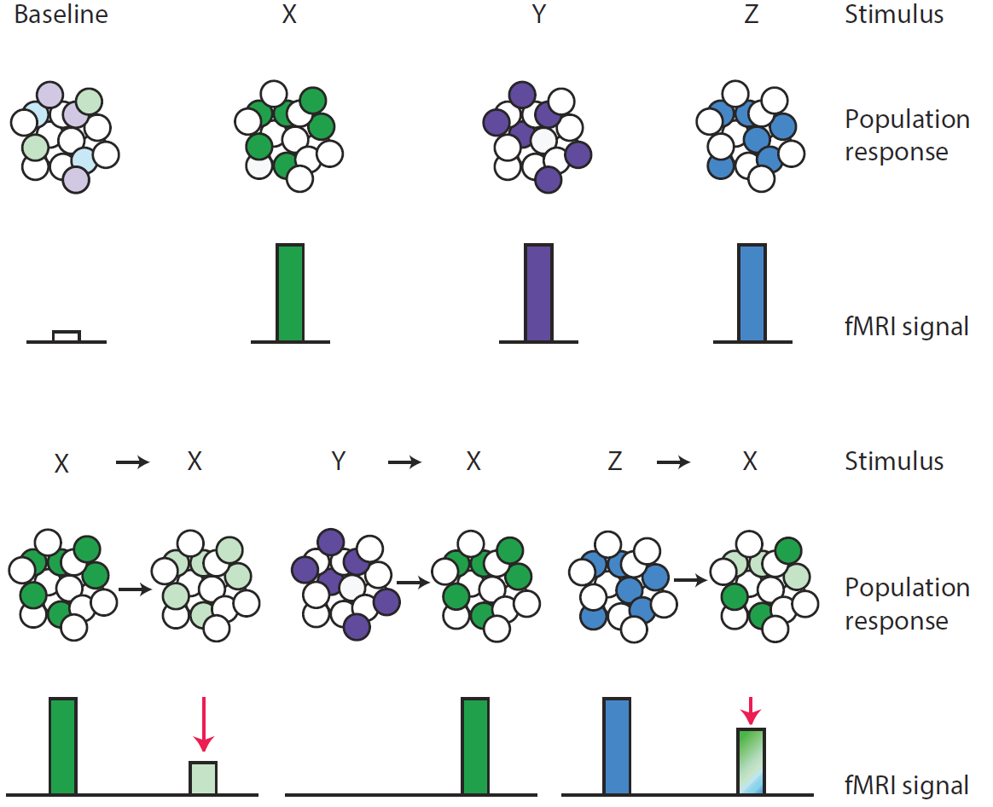
Representational neuroimaging
Approaches described so far investigate the involvement of regions in a specific mental activity rather than the representational content of regions or voxels
Barron, Garvert, Behrens 2016

Slide 46
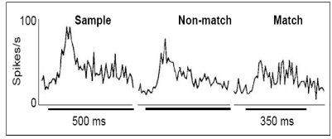
Repetition suppression
Neurons in inferotemporal cortex display a diminished response if a stimulus is repeated
Li et al. (1993),
Grill-Spector (2006)

Slide 47
Conventional fMRI vs fMRI adaptation
Repetition suppression as an index of representational similarity
Barron, Garvert, Behrens 2016

Slide 48
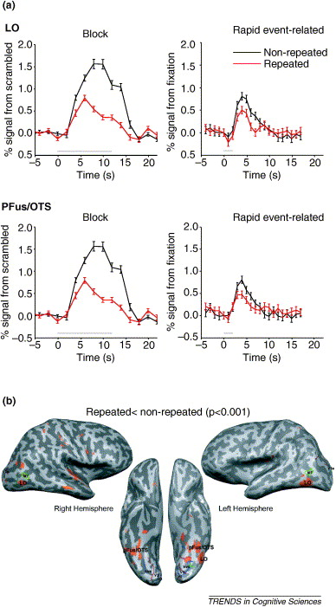
fMRI adaptation
Object-repetition effects measured with fMRI
Grill-Spector et al. (2006)

Slide 49
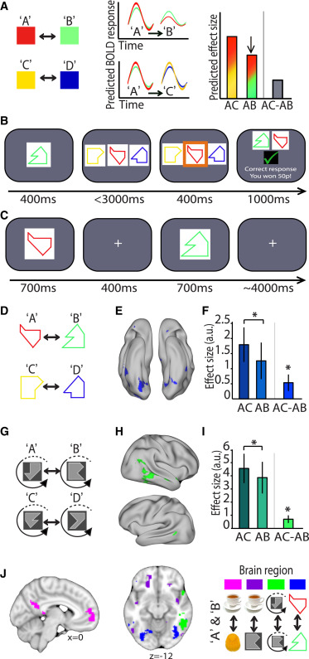
Indexing cortical associations in the human brain using cross-stimulus adaptation
Barron et al. 2016

Slide 50
fMRI adaptation
Famous faces: 1st time vs 2nd time
Peri-stimulus time (sec)
Notes:
Famous face 1st time vs famous faces 2nd time
Orthogonal contrast for defining an ROI!

Slide 51
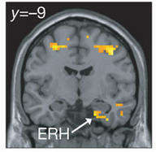
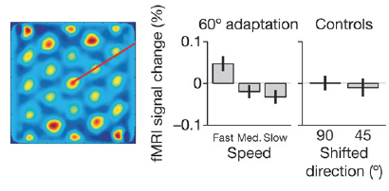
fMRI adaptation as a tool for measuring complex computations in the human brain
Doeller et al. (2010)

Slide 52
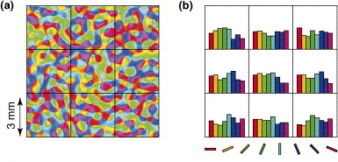
Multivariate vs. univariate methods
Multivariate methods investigate the representational content of regions
Information is represented in a distributed fashion
fine-grained spatial structure across voxels

Slide 53
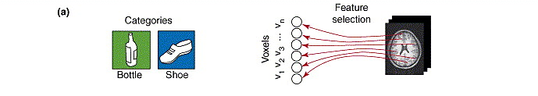
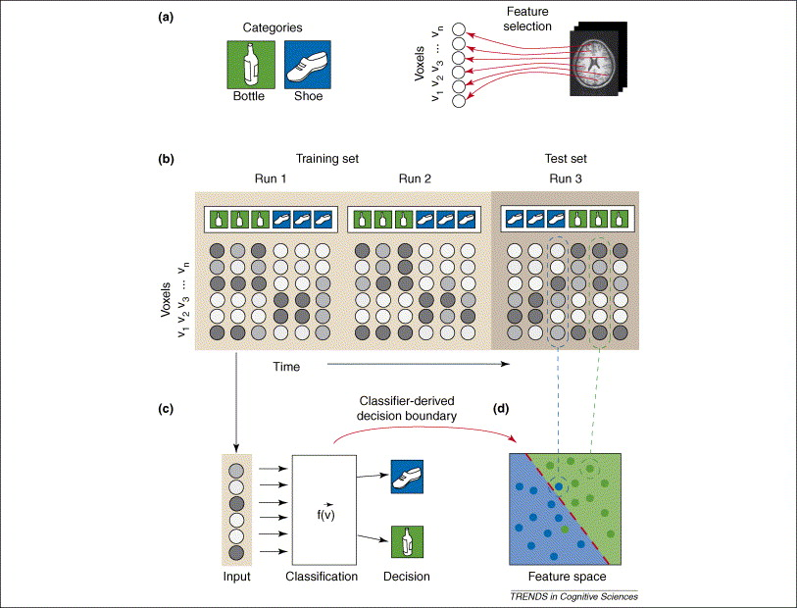
Multi-variate pattern analysis
Norman et al. 2006

Slide 54
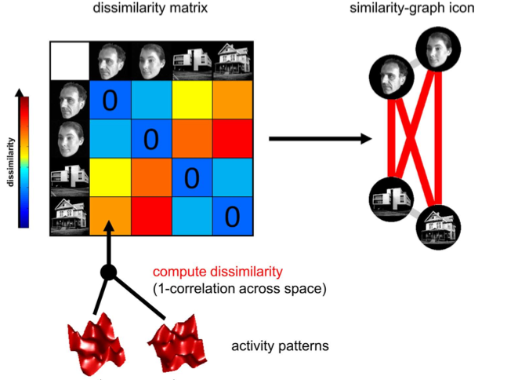


Representational similarity analysis
Comparing representations across experimental conditions
Kriegeskorte et al. (2008)

Slide 55
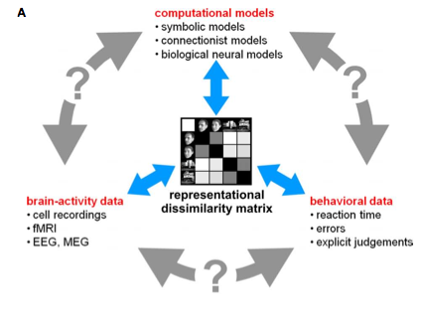
Connecting research branches
Kriegeskorte et al. (2008)

Slide 56
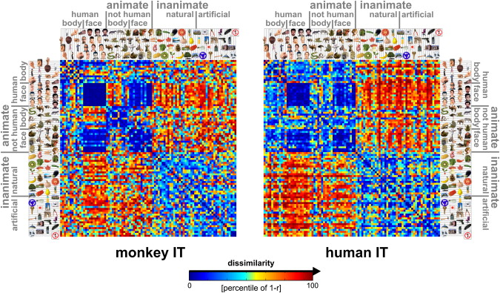
Matching object representations in inferior temporal cortex of man and monkey
Kriegeskorte et al. (2008)

Slide 57
Questions?

