Slide 1
Dynamic Causal Modelling
SPM for MRI Course, October 2018
Peter Zeidman
Wellcome Centre for Human Neuroimaging
12 Queen Square
University College London

Slide 2
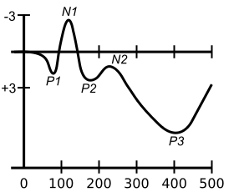
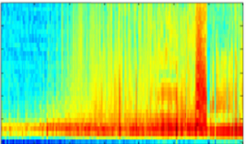
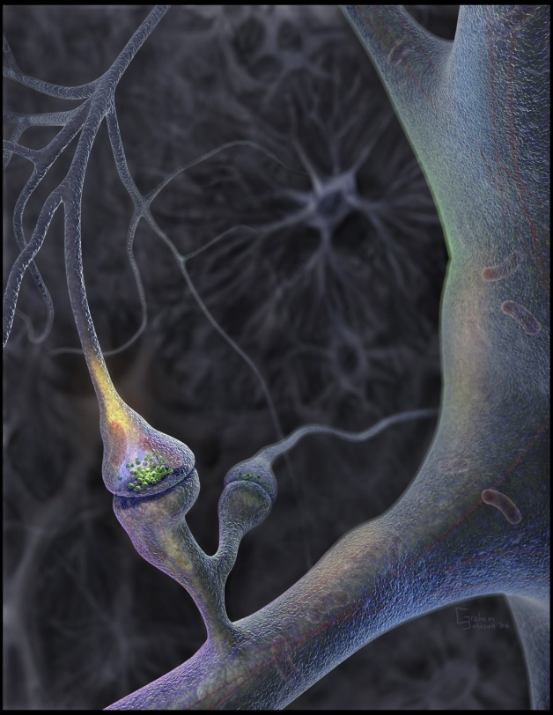
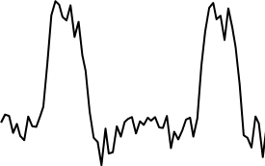
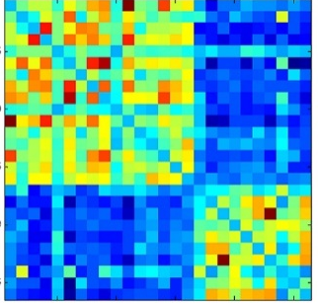
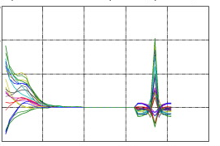
Neuronal causes
Data Features
ERPs
Induced Responses
EEG / MEG
frequency
microvolts
time
time
Timeseries
Forward model
signal
Model inversion
time
Functional connectivity
Cross-spectral density
Neural circuitry
(effective connectivity)
fMRI
CSD
Frequency

Slide 3
Learning Objectives
By the end of today, you should be able to:
Place DCM in the fMRI analysis pipeline
State the difference between structural, functional and effective connectivity
Explain how a generative model helps to separate the BOLD signal into neuronal activity (effective connectivity), haemodynamics and noise.
Explain the interpretation of the parameters in the neuronal formula in DCM for fMRI
Explain how parameter estimates and the log model evidence are used to test hypotheses

Slide 4
Contents
Overview of DCM
  Effective connectivity, DCM framework, generative models
Specific models for fMRI
  Neural model, haemodynamic model
Clinical example
  Model specification, inversion, parameter inference

Slide 5
Dynamic Causal Modelling
is a framework
for inferring effective connectivity
in the brain

Slide 6
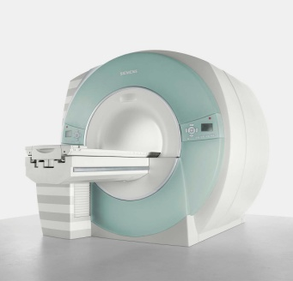
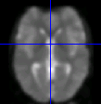

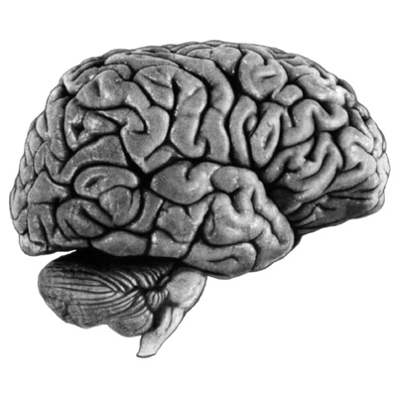
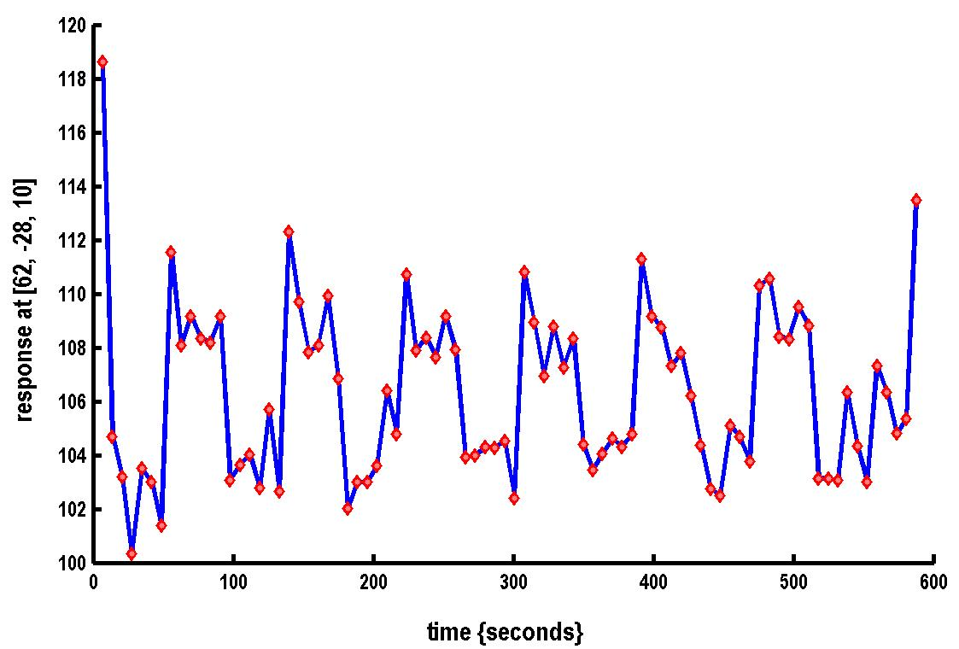
Where DCM sits in the pipeline
Functional MRI acquisition and image reconstruction
Image preprocessing (realignment, coregistration, normalisation, smoothing)
Statistical Parameter Mapping (SPM) / General Linear Model
Dynamic Causal Modelling (DCM)
Timeseries extraction from Regions of Interest (ROIs)

Slide 7
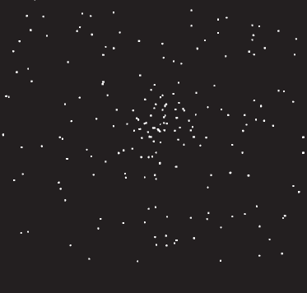
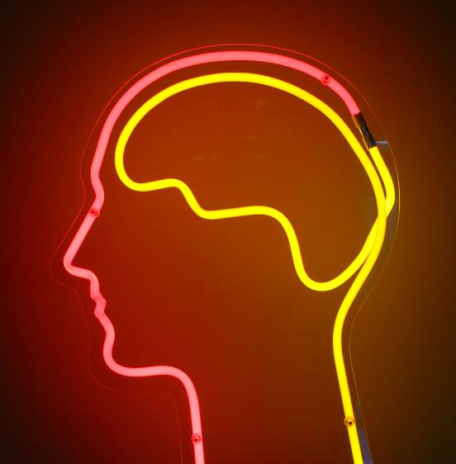

The system of interest
Experimental Stimulus
(Hidden) Neural Activity
Observations (BOLD)
Vector u
Vector y
on
?
BOLD
off
time
time
Stimulus from Buchel and Friston, 1997
Brain by Dierk Schaefer, Flickr, CC 2.0
Notes:
Experimental stimulation causes changes in neural activity. Neural activity in turn causes the BOLD response, which we observe via the scanner. We are interested in the hidden neural activity, which we cannot directly observe - so it must be inferred.

Slide 8
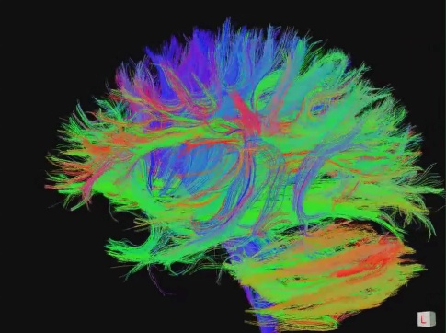
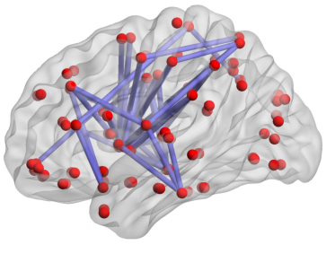
Connectivity
Structural Connectivity
Physical connections of the brain
Functional Connectivity
Dependencies between BOLD observations
Effective Connectivity
Causal relationships between brain regions
"Connectome" by jgmarcelino. CC 2.0 via Wikimedia Commons
Figure 1, Hong et al. 2013 PLOS ONE.
KE Stefan, SPM Course 2011
Notes:
Connectivity analysis is another way to look at neural activity. The most interesting is effective connectivity – interactions at the neural level.

Slide 9
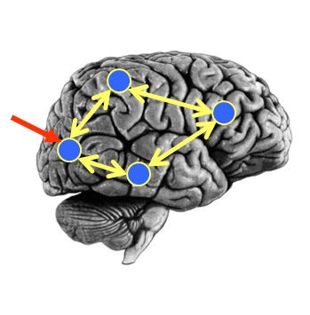
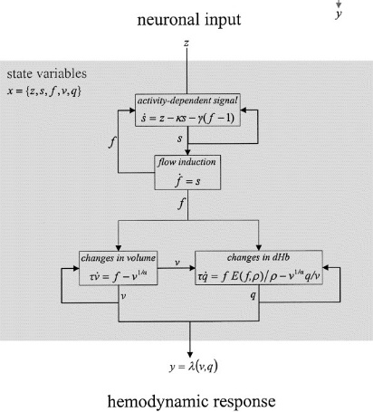
DCM Framework
Neural Model
Observation Model
Experimental Stimulus (u)
Observations (y)
How brain activity z changes over time
What we would see in the scanner, y, given the neural model?
.
z = f(z,u,θ^{n})
y = g(z, θ^{h})
Stimulus from Buchel and Friston, 1997
Figure 3 from Friston et al., Neuroimage, 2003
Brain by Dierk Schaefer, Flickr, CC 2.0

Slide 10
DCM Framework
Neural Model
Observation Model
Experimental Stimulus (u)
Observations (y)
Model Inversion
(Variational Laplace)
Given our observations y, and stimuli u, what parameters θ make the model best fit the data?

Slide 11



DCM Framework
Experimental Stimulus (u)
Neural Model
Observation Model
Observations (y)
Model 1:
Model comparison: Which model best explains my observed data?
Experimental Stimulus (u)
Neural Model
Observation Model
Observations (y)
Model 2:

Slide 12
DCM Framework
We embody each of our hypotheses in a generative model.
  The generative model separates neural activity from haemodynamics
We perform model estimation (inversion)
  This identifies parameters θ = {θ^{n},θ^{h}} which make the model best fit the data. (Variational EM.)
We inspect the estimated parameters and / or we compare models to see which best explains the data.

Slide 13
Contents
Overview of DCM
  Effective connectivity, DCM framework, generative models
Specific models for fMRI
  Neural model, haemodynamic model
Clinical example
  Model specification, inversion, parameter inference

Slide 14
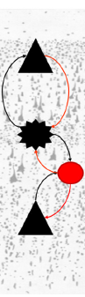
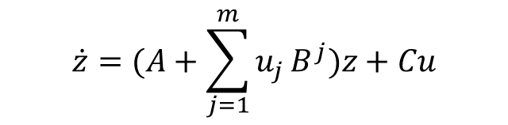


The Neural Model
$$\dot{z}=\left[\begin{matrix}\dot{z_{1}} \\ ⋮ \\ \dot{z_{n}}\end{matrix}\right]=f(z,u,θ)$$
Deterministic DCM for fMRI
DCM for CSD
Canonical Microcircuit
Task
Resting State
Coming soon
$$\dot{z}=(A+\sum_{j=1}^{m}{u_{j}}B^{j})z+Cu$$
$$\dot{z}=Az+v$$
(Taylor approximation)
Friston et al., Neuroimage, 2003
Friston et al., Neuroimage, 2014
Friston et al., Neuroimage, 2017

Slide 15
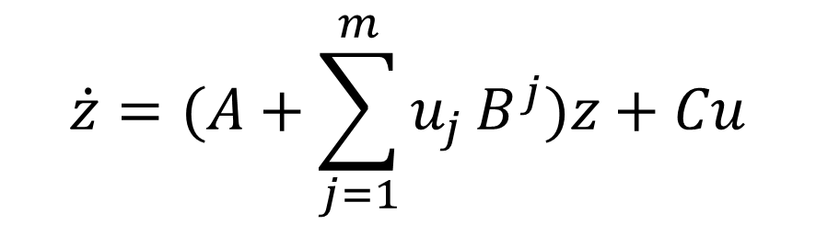
The Neural Model
“How does brain activity, z, change over time?”
$$\dot{z}=(A+\sum_{j=1}^{m}{u_{j}}B^{j})z+Cu$$
Friston et al. 2003

Slide 16
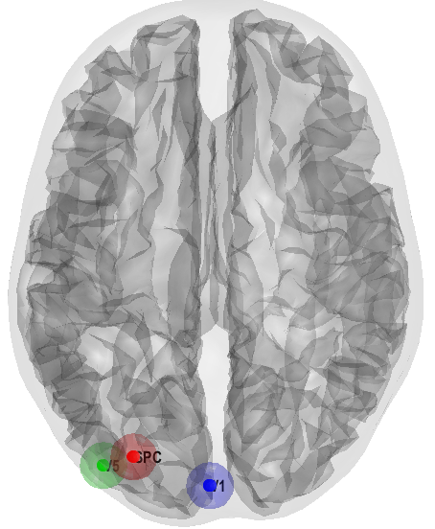
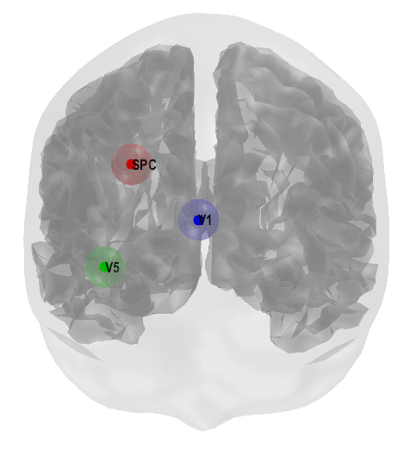
The Neural Model
“How does brain activity, z, change over time?”
Subjects viewed moving dots during fMRI
On some trials, subjects were instructed to pay attention to the speed of the dots’ motion
Question: How does attention to motion change the strength of the connections between V1, V5 and Superior Parietal Cortex?
V1
V5
SPC

Slide 17
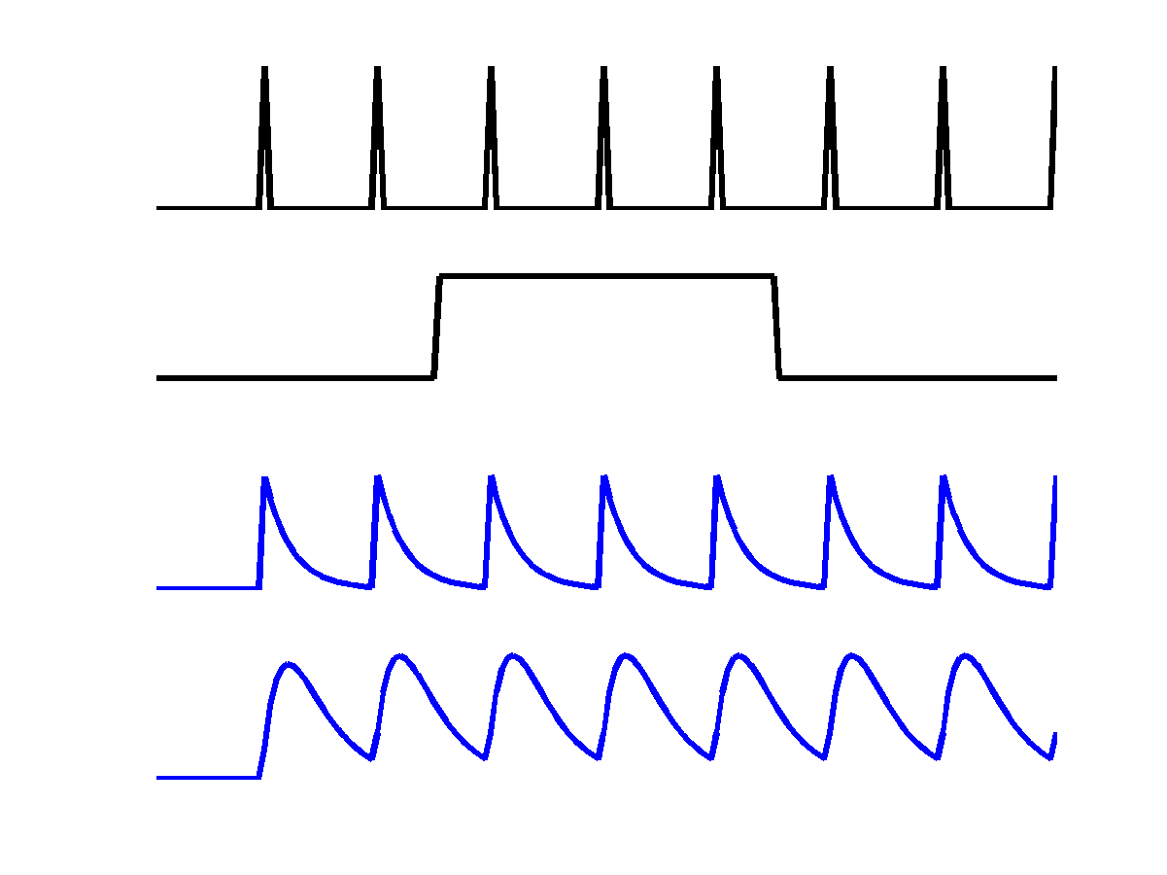
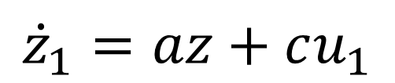
The Neural Model
“How does brain activity, z, change over time?”
V1
u₁
z₁
a
c
z₁
Driving input u₁
z₂
$${\dot{z}}_{1}=az+cu_{1}$$
Inhibitory self-connection (Hz).
Rate constant: controls rate of decay in region 1. More negative = faster decay.

Slide 18


The Neural Model
“How does brain activity, z, change over time?”
Change of activity in V1:
V5
a₂₂
z₂
$${\dot{z}}_{1}=a_{11}z_{1}+c_{11}u_{1}$$
a₂₁
Change of activity in V5:
V1
$${\dot{z}}_{2}=a_{22}z_{2}+a_{21}z_{1}$$
z₁
a₁₁
c₁₁
Self decay
V1 input
Driving input u₁

Slide 19
The Neural Model
“How does brain activity, z, change over time?”
V5
a₂₂
z₂
u₁
a₂₁
V1
z₁
a₁₁
z₁
z₂
c₁₁
Driving input u₁

Slide 20
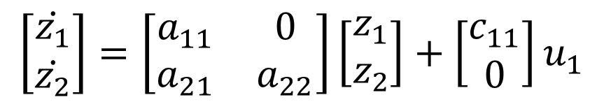

The Neural Model
“How does brain activity, z, change over time?”
$$\left[\begin{matrix}\dot{z_{1}} \\ \dot{z_{2}}\end{matrix}\right]=\left[\begin{matrix}a_{11} & 0 \\ a_{21} & a_{22}\end{matrix}\right]\left[\begin{matrix}z_{1} \\ z_{2}\end{matrix}\right]+\left[\begin{matrix}c_{11} \\ 0\end{matrix}\right]u_{1}$$
V5
a₂₂
z₂
a₂₁
Columns are outgoing connections
Rows are incoming connections
V1
z₁
a₁₁
$$\dot{z}=Az+Cu_{1}$$
c₁₁
Driving input u₁

Slide 21
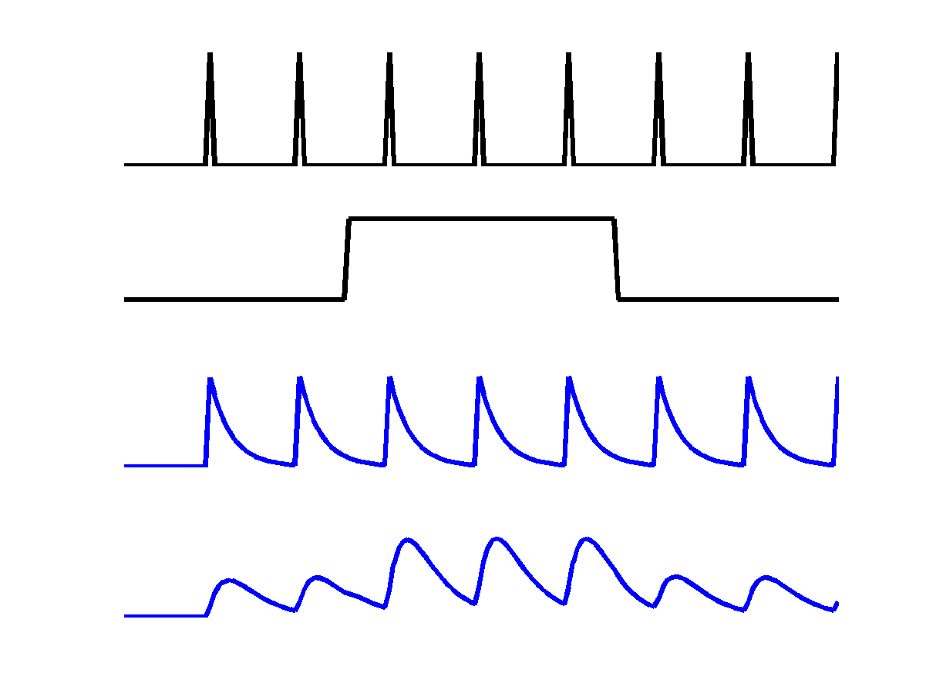
The Neural Model
“How does brain activity, z, change over time?”
V5
a₂₂
u₁
z₂
b₂₁
u₂
a₂₁
Attention u₂
V1
z₁
z₁
a₁₁
c₁₁
z₂
Driving input u₁

Slide 22


The Neural Model
“How does brain activity, z, change over time?”
Change of activity in V1:
V5
a₂₂
z₂
$$\dot{z_{1}}=a_{11}z_{1}+c_{11}u_{1}$$
b₂₁
a₂₁
Attention u₂
V1
Change of activity in V5:
z₁
a₁₁
$$\dot{z_{2}}=a_{22}z_{2}+a_{21}z_{1}+{(b}_{21}^{}u_{2}{)z}_{1}$$
c₁₁
Driving input u₁
Self decay
V1 input
Modulatory input

Slide 23

The Neural Model
V5
z₂
a₂₂
b₂₁
a₂₁
“How does brain activity, z, change over time?”
Attention u₂
V1
a₁₁
z₁
For m inputs:
c₁₁
$$\dot{z}=(A+\sum_{j=1}^{m}{u_{j}}B^{j})z+Cu$$
Driving input u₁
Columns: outgoing connections
Rows: incoming connections
A: Structure
B: Modulatory
Input
C: Driving
Input
$$\left[\begin{matrix}{\dot{z}}_{1} \\ {\dot{z}}_{2}\end{matrix}\right]=\left(\left[\begin{matrix}a_{11} & 0 \\ a_{21} & a_{22}\end{matrix}\right]+u_{2}\left[\begin{matrix}0 & 0 \\ b_{21} & 0\end{matrix}\right]\right)\left[\begin{matrix}z_{1} \\ z_{2}\end{matrix}\right]+\left[\begin{matrix}c_{11} & 0 \\ 0 & 0\end{matrix}\right]\left[\begin{matrix}u_{1} \\ u_{2}\end{matrix}\right]$$
Change in
activity per
region
External input 2
(attention)
Current
activity
per region
All
external input

Slide 24
DCM Framework
Neural Model
Observation Model
Experimental Stimulus (u)
Observations (y)
How brain activity z changes over time
What we would see in the scanner, y, given the neural model?
.
z = f(z,u,θ^{n})
y = g(z, θ^{h})
Stimulus from Buchel and Friston, 1997
Figure 3 from Friston et al., Neuroimage, 2003
Brain by Dierk Schaefer, Flickr, CC 2.0

Slide 25
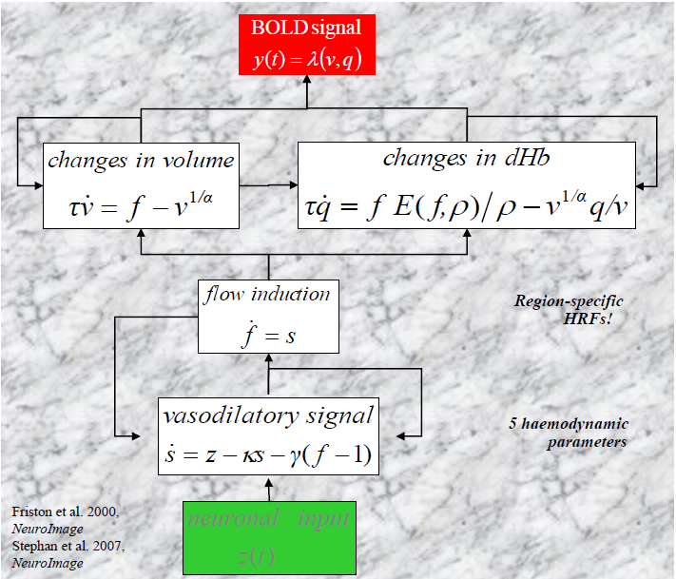
The Haemodynamic Model

Slide 26
Contents
Overview of DCM
  Effective connectivity, DCM framework, generative models
Specific models for fMRI
  Neural model, haemodynamic model
Clinical example
  Model specification, inversion, parameter inference

Slide 28
Reading > fixation (29 controls)
Lesion (Patient AH)

Slide 29
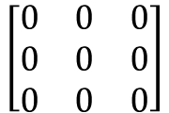
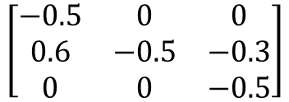
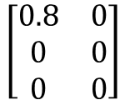
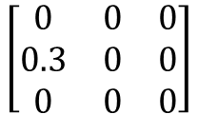
Hypothesis: Patients with damage to vOT use an alternative pathway for reading, via STS.
Two inputs (U):
All trials (some trials reading, some baseline naming trials)
Reading (a subset of trials on which subjects read words)
PM
3.
-0.5
STS
-0.5
2.
Three regions:
OCC - Occipital (visual) cortex
STS – Superior temporal sulcus
PM – Pre-motor cortex
OCC
1.
-0.5
C: 0.8
A
B⁽¹⁾: All trials
B⁽²⁾: Reading
C
$$\left[\begin{matrix}−0.5 & 0 & 0 \\ 0.6 & −0.5 & −0.3 \\ 0 & 0 & −0.5\end{matrix}\right]$$
$$\left[\begin{matrix}0 & 0 & 0 \\ 0 & 0 & 0 \\ 0 & 0 & 0\end{matrix}\right]$$
$$\left[\begin{matrix}0 & 0 & 0 \\ 0.3 & 0 & 0 \\ 0 & 0 & 0\end{matrix}\right]$$
$$\left[\begin{matrix}0.8 & 0 \\ 0 & 0 \\ 0 & 0\end{matrix}\right]$$
Tip #1: For A and B, the columns are outgoing connections, rows are incoming
Tip #2: For C, the rows are brain regions and columns are inputs

Slide 30

Pipeline
We specified a DCM for every subject (patient and controls)
We fitted these models to the subjects’ data (model estimation or inversion) to give:
Posterior probability distribution for each parameter $p\left(θ | y,m\right)$
Estimate of the model evidence $p\left(y | m\right)$
$F≅\text{log} p\left(y | m\right)=\text{accuracy}−\text{complexity}$
Free energy

Slide 31
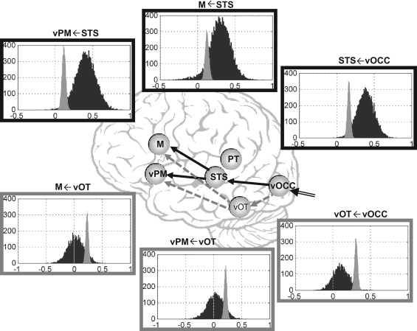
Results
Key:
Controls
Patient
Seghier et al., Neuropsychologia, 2012

Slide 32
Summary
DCM is a framework which enables us to make inferences about the effective connectivity of brain regions, which we can’t directly observe
We create one or more generative models, each expressing a hypothesis
We invert the model(s), using Bayesian inference to estimate coupling parameters and the model evidence
We compare models using Bayesian Model Comparison

Slide 33
Learning Objectives
By the end of today, you should be able to:
Place DCM in the fMRI analysis pipeline
State the difference between structural, functional and effective connectivity
Explain how a generative model helps to separate the BOLD signal into neuronal activity (effective connectivity), haemodynamics and noise.
Explain the interpretation of the parameters in the neuronal formula in DCM for fMRI
Explain how parameter estimates and the log model evidence are used to test hypotheses

Slide 34
Where DCM sits in the pipeline
Functional MRI acquisition and image reconstruction
Image preprocessing (realignment, coregistration, normalisation, smoothing)
Statistical Parameter Mapping (SPM) / General Linear Model
Dynamic Causal Modelling (DCM)
Timeseries extraction from Regions of Interest (ROIs)

Slide 35
In Saturday’s DCM workshop
PPI analysis – a simple connectivity method
Parametric Empirical Bayes (PEB) – A Bayesian ANOVA over connectivity parameters for group studies
Bayesian Model Reduction (BMR) – A tool for inferring the evidence and parameters of nested models in milliseconds

Slide 36
Further Reading
The original DCM paper | Friston et al. 2003, NeuroImage
Descriptive / tutorial papers
Role of General Systems Theory | Stephan 2004, J Anatomy
DCM: Ten simple rules for the clinician | Kahan et al. 2013, NeuroImage
Ten Simple Rules for DCM | Stephan et al. 2010, NeuroImage
DCM Extensions
Two-state DCM | Marreiros et al. 2008, NeuroImage
Non-linear DCM | Stephan et al. 2008, NeuroImage
Stochastic DCM | Li et al. 2011, NeuroImage Friston et al. 2011, NeuroImage Daunizeau et al. 2012, Front Comput Neurosci
Post-hoc DCM | Friston and Penny, 2011, NeuroImage Rosa and Friston, 2012, J Neuro Methods
A DCM for Resting State fMRI | Friston et al., 2014, NeuroImage

