Slide 1

Statistical Parametric Mapping for fMRI / MRI / VBM
Guillaume Flandin
Wellcome Centre for Human Neuroimaging
University College London
SPM Short Course
London, May 2019

Slide 2
Foreword
Emergency exit
Toilets
WiFi
“UCLGuest”
Questions
Slides
Feedback forms
https://www.fil.ion.ucl.ac.uk/spm/course/london/

Slide 3
Programme
Thursday 23th May
9.30 - 10.00 Welcome: Introduction and Overview Guillaume Flandin
10.00 - 11.00 Spatial Preprocessing John Ashburner
Coffee
11.30 - 12.00 The General Linear Model Marion Rouault
12.00 - 12.45 Contrasts and Classical Inference Christophe Phillips
Lunch
13.45 - 14.15 Group Analysis Will Penny
14.15 - 15.00 Random Field Theory Guillaume Flandin
Tea
15.30 - 16.15 Voxel-Based Morphometry
Christian Lambert
16.15 – 17.00 Demo: Voxel-Based Morphometry
Mikael Brudfors
17.00 - 18.00 “Questions and Answers” Clinic
Karl Friston
Friday 24th May
09.30 - 10.15 Experimental design
Sara Bengtsson
10.15 - 11.00 Event-related fMRI Christian Ruff
Coffee
11.30 - 12.15 Demo: Event-related fMRI Analysis
Ian Clark
12.15 - 13.00 Bayesian Inference
Chris Mathys
Lunch
14.00 - 14.30 Dynamic Causal Modelling Peter Zeidman
14.30 - 15.30 DCM neural and haemodynamic models Nadine Dijkstra
Tea
16.00 – 16.30 Demo: DCM for fMRI Amirhossein Jafarian
16.30 – 17.00 Group DCM analysis for cognitive and clinical studies Peter Zeidman
17.00 - 18.00 “Questions and Answers” Clinic
Karl Friston
18.30 - Social event
The Marquis Cornwallis

Slide 4

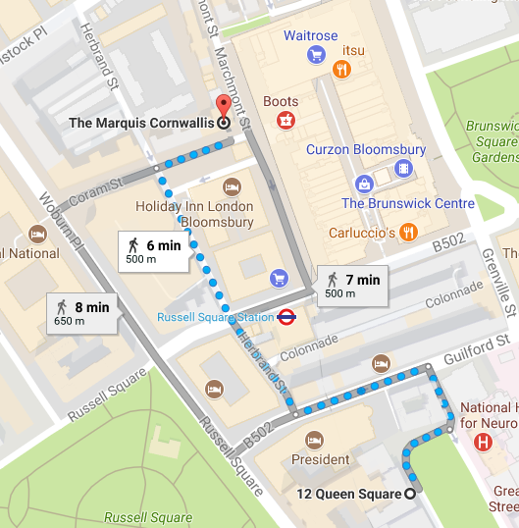
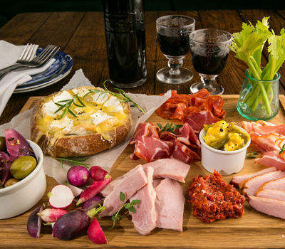


Social Event
Friday evening: The Marquis Cornwallis

Slide 5
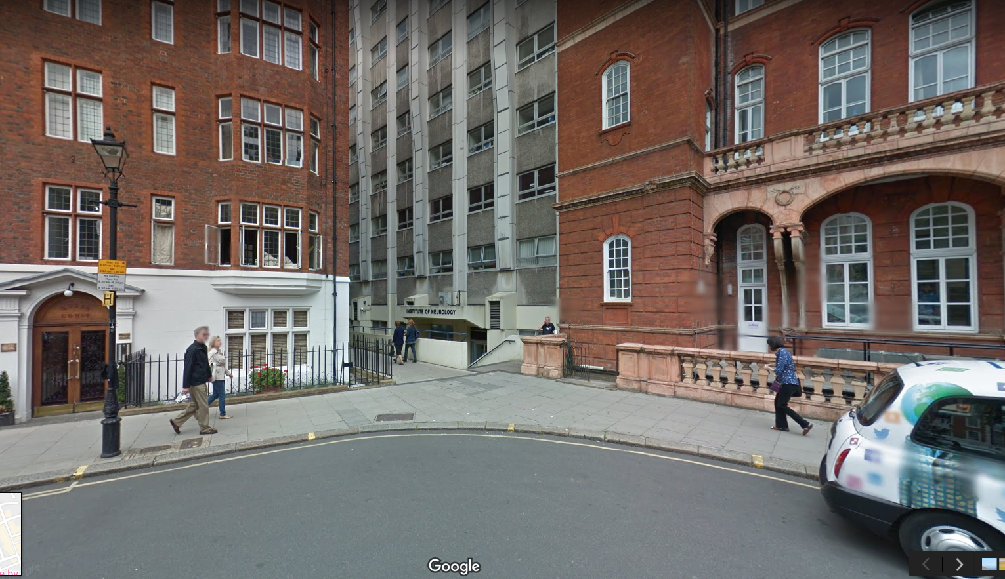
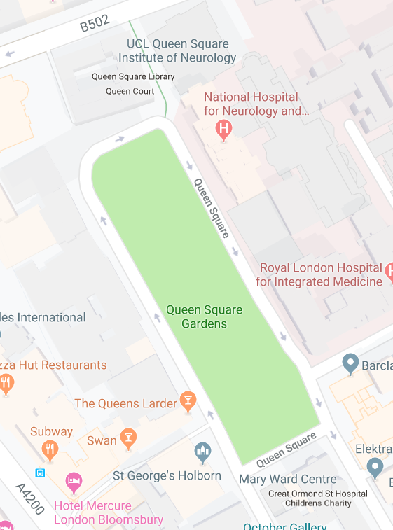
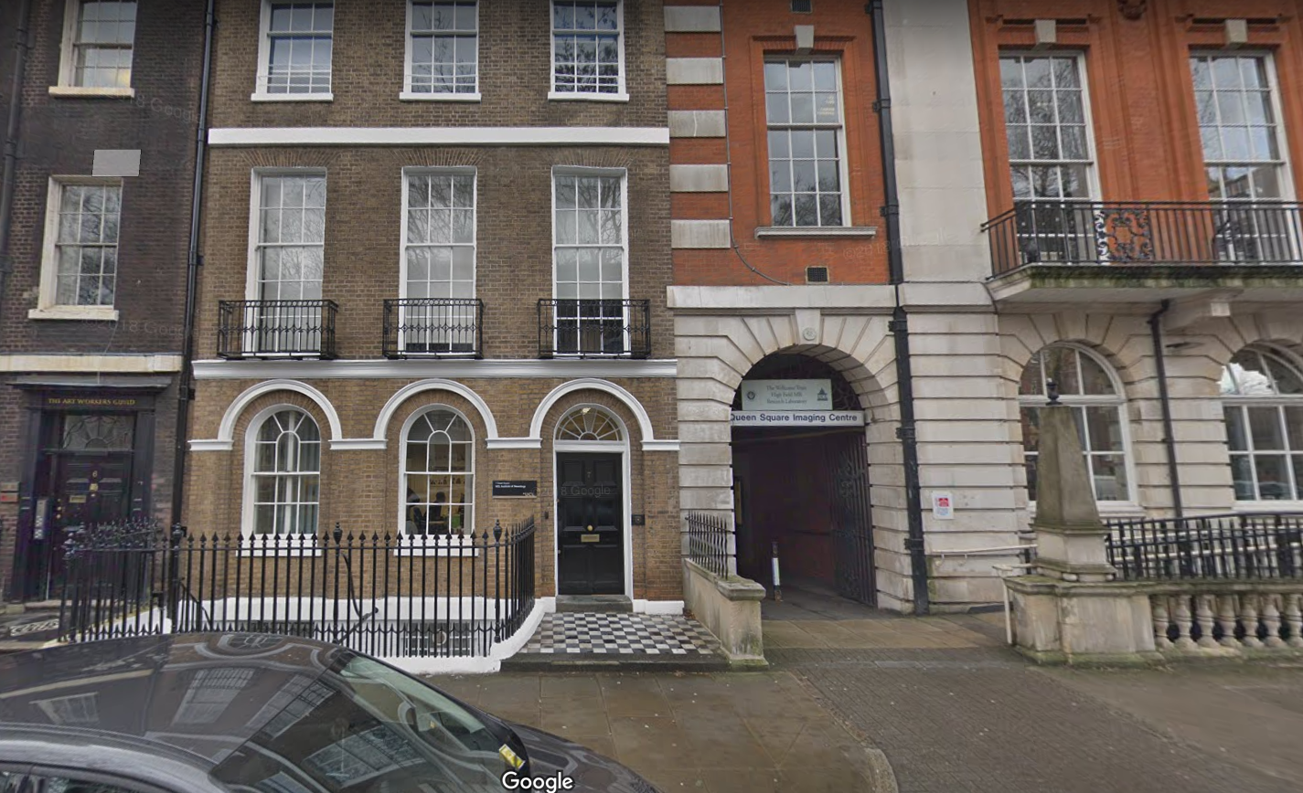
Practical Sessions
Queen Square
House
7 Queen Square

Slide 6
Statistical Parametric Mapping
Concepts
Software
Resources

Slide 7
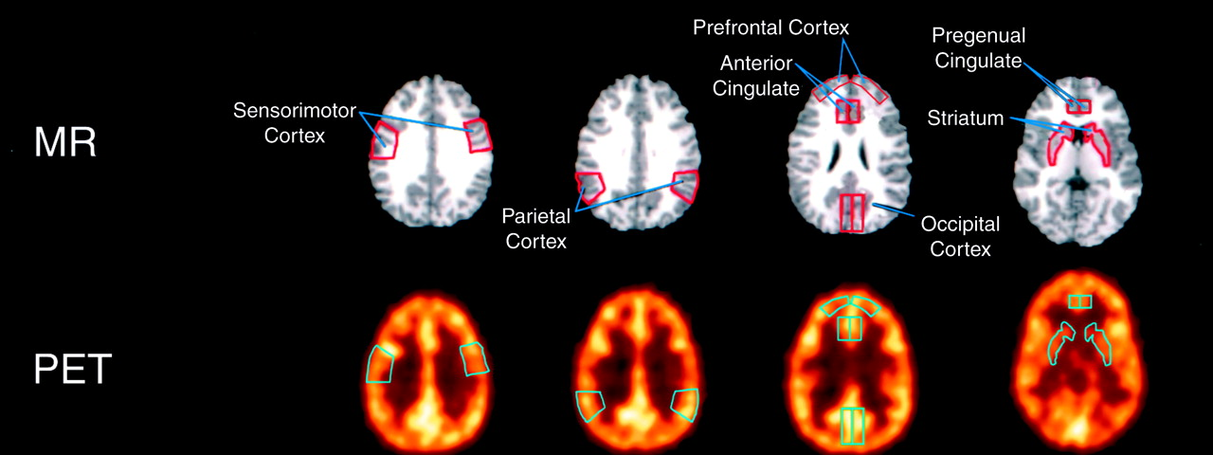
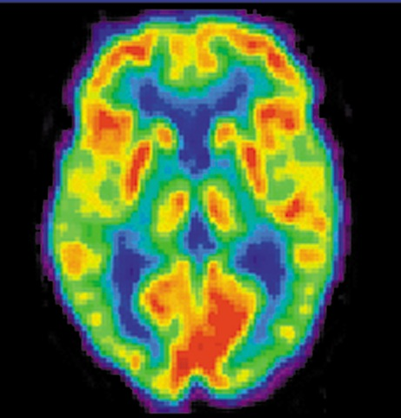
From PET analyses using ROIs…

Slide 8
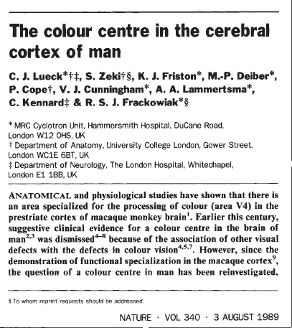
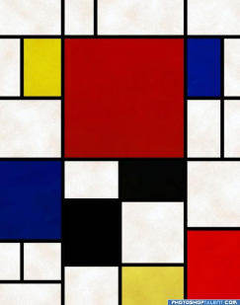
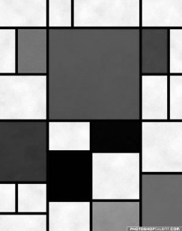
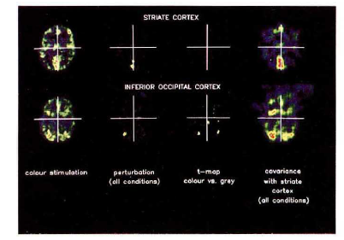
…to the very first SPM{t}
An area specialised for the processing of colour, the“colour centre” (V4) highlighted by cognitive substraction using PET.
Three subjects:
Compatible with earlier findings on monkeys using electrophysiology.
Colour trials
(2 scans)
Grey trials
(2 scans)
Notes:
8

Slide 9



Image time-series
Spatial filter
Design matrix
Statistical Parametric Map
Realignment
Smoothing
General Linear Model
Statistical
Inference
RFT
Normalisation
Anatomical
reference
p <0.05
Parameter estimates

Slide 10
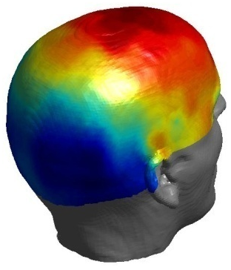
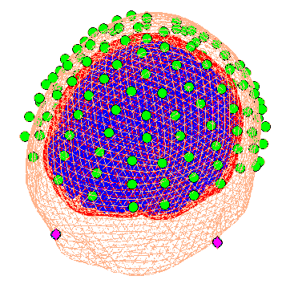
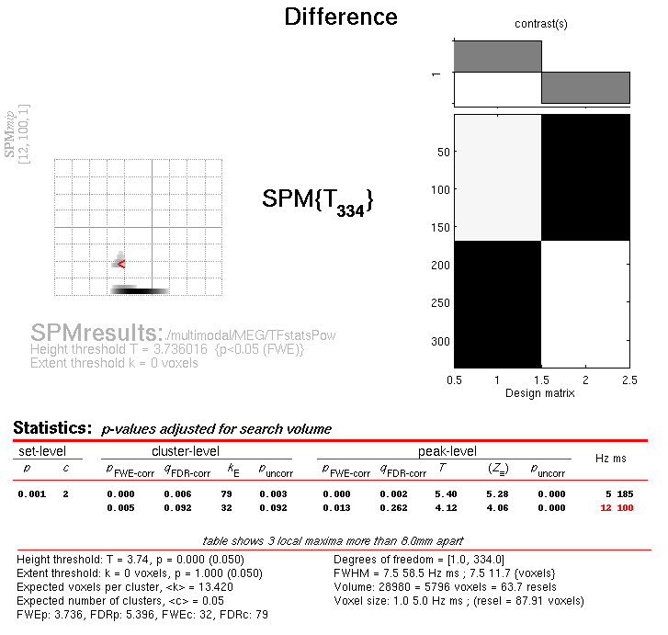
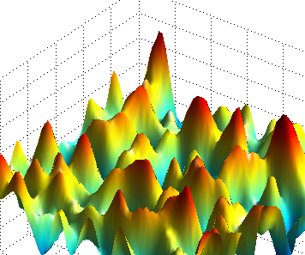
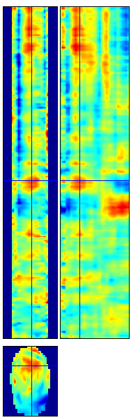
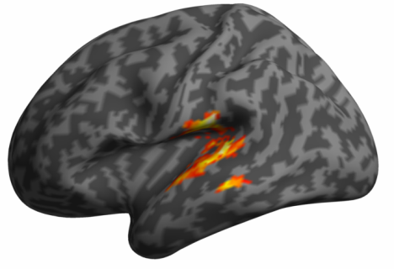
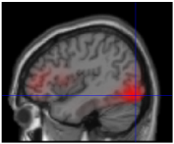
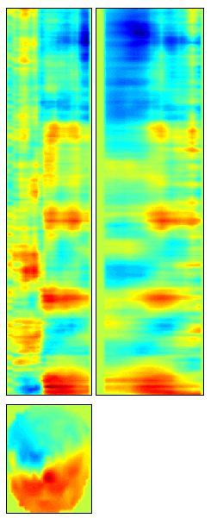
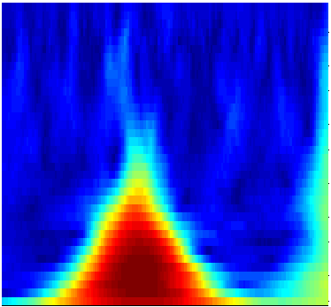
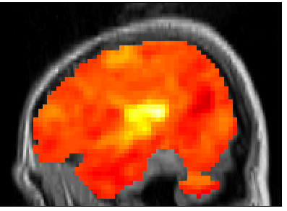
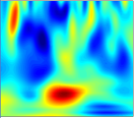
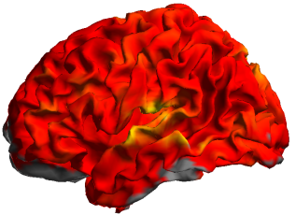

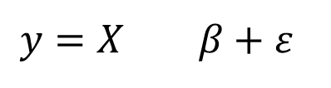

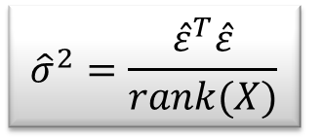
M/EEG Data Analysis
Random
Field Theory
$$y=X β+ε$$
Contrast c
Pre-
processings
General
Linear
Model
Statistical Inference
$$\hat{β}={\left(X^{T}X\right)}^{−1}X^{T}y$$
$${\hat{σ}}^{2}=\frac{{\hat{ε}}^{T}\hat{ε}}{rank(X)}$$
$$SPM\{T,F\}$$

Slide 11
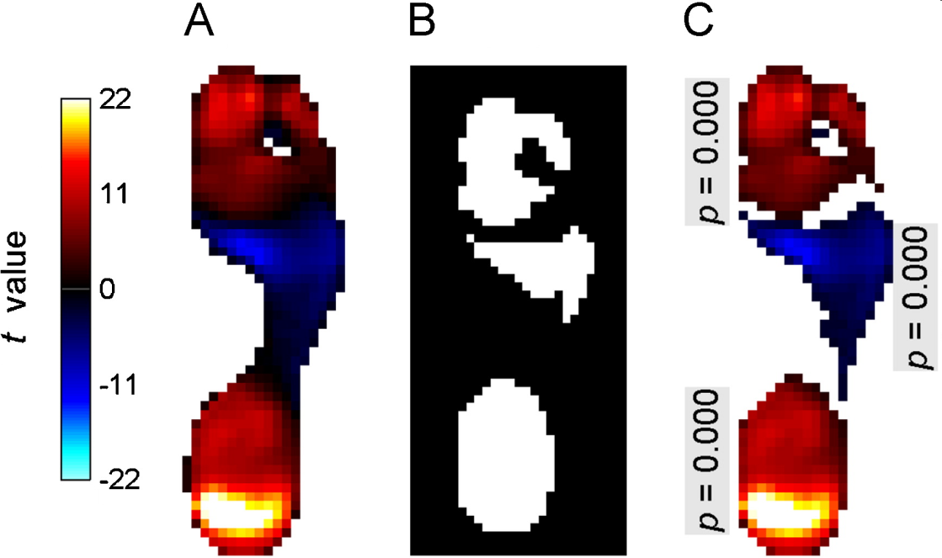
Statistical Parametric Mapping refers to the construction and assessment of spatially extended statistical processes used to test hypotheses about functional imaging data.
Pedobarographic statistical parametric mapping (pSPM), T. Pataky, Journal of Foot and Ankle Research, 2008.

Slide 12
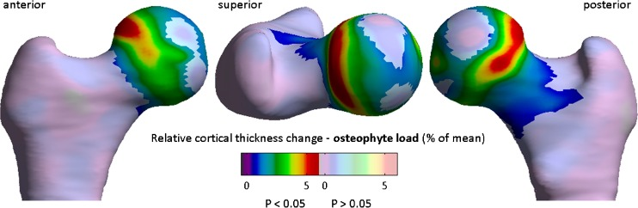
Cortical Bone Mapping (CBM)
Quantitative 3D analysis of bone in hip osteoarthritis using clinical computed tomography, Tom Turmezei et al, European Radiology, 2016.

Slide 13
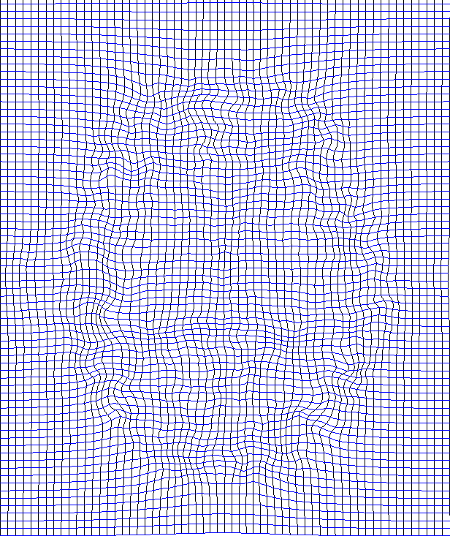
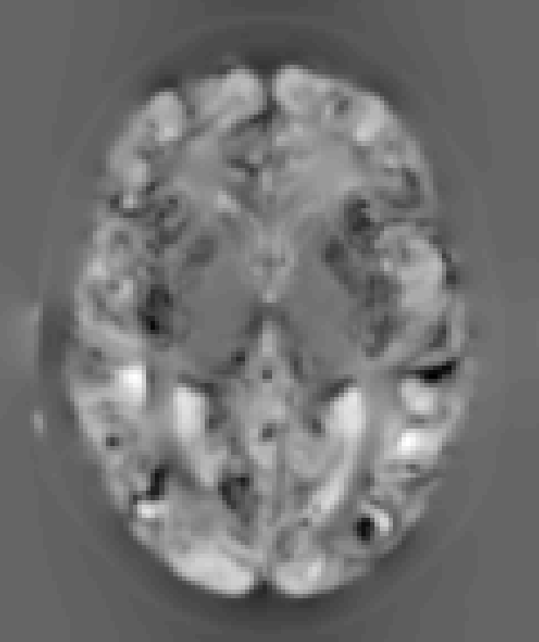
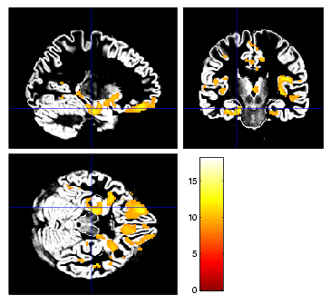
Voxel-Based Morphometry (VBM)
VBM is the most widely used method for computational neuroanatomy.
It is essentially Statistical Parametric Mapping of regional segmented tissue density or volume.
The same general linear modelling & RFT machinery in SPM can then be used to study differences in structure.
Notes:
If we can estimate the transformations that align and warp each subject to match a template, then we can study individual differences in these transformations or derivatives.

Slide 14
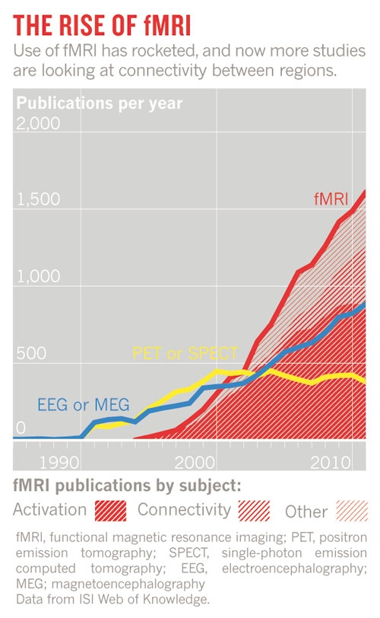
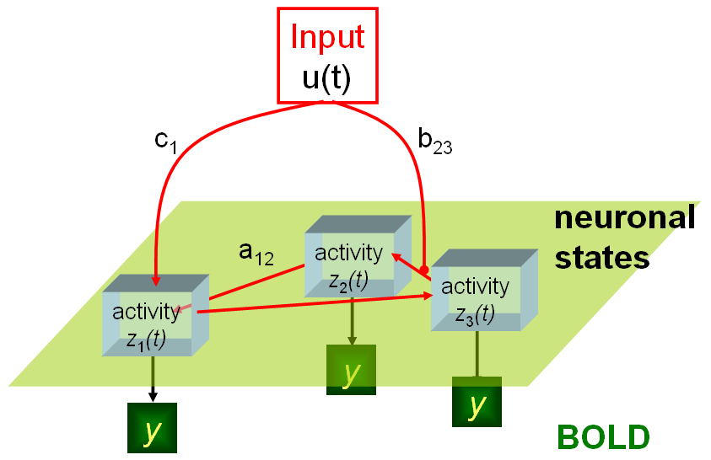
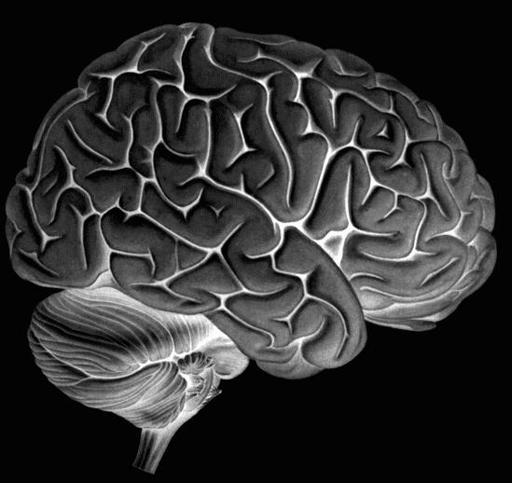
Dynamic Causal Models
Nature, April 2012

Slide 15
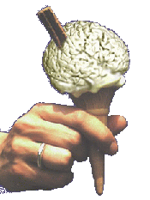
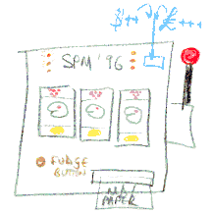
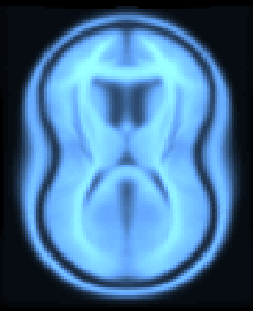
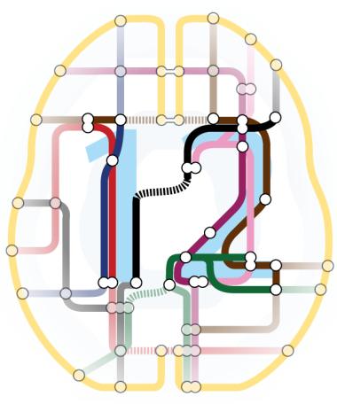
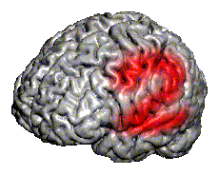
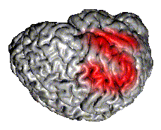
SPM Software
“The SPM software was originally developed by Karl Friston for the routine statistical analysis of functional neuroimaging data from PET while at the Hammersmith Hospital in the UK, and made available to the emerging functional imaging community in 1991 to promote collaboration and a common analysis scheme across laboratories.”
SPMclassic, SPM’94, SPM’96, SPM’99, SPM2, SPM5, SPM8 and SPM12 represent the ongoing theoretical advances and technical improvements of the original version.

Slide 16


Software: SPM12
Free and Open Source Software
(GPL)
Requirements:
  MATLAB: 7.4 (R2007a) to 9.6 (R2019a)
  no MathWorks toolboxes required
  Supported platforms:
  Linux, Windows and Mac
Standalone version available.

Slide 17
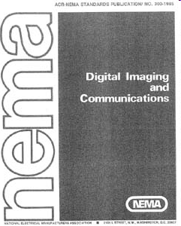
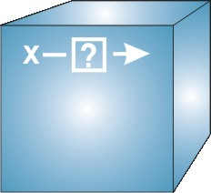
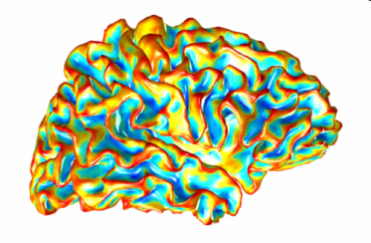
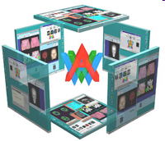
Data File Formats
DICOM: Digital Imaging and Communications in Medicine
NIfTI: Neuroimaging Informatics Technology Initiative
  NifTI: volumetric data format (*.nii,*.hdr/*.img)
  GIfTI: geometry data format (*.gii)
AnalyzeTM: Mayo Clinic Analyze 7.5 file format
(*.hdr/*.img)
Interoperability:
  Compatible with AFNI, BrainVISA, BrainVoyager, Caret, Freesurfer, FSL, …

Slide 18
Brain Imaging Data Structure (BIDS)
“A simple and intuitive way to organise and describe your neuroimaging and behavioural data.”
Benefits of a common standard:
Minimised curation
  Within a lab over time
  Between labs (collaboration and multi-centre studies)
  Between public databases (e.g. OpenfMRI)
Error reduction (automated validation)
Optimised usage of data analysis software
(completely automated analysis workflows)

Slide 19
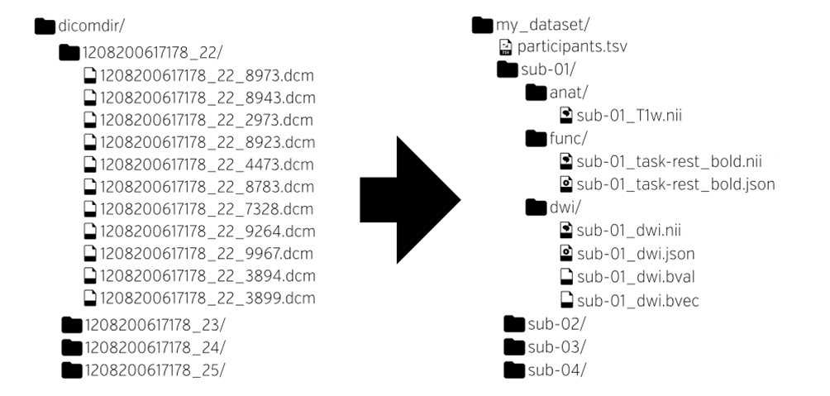
Brain Imaging Data Structure (BIDS)
“A simple and intuitive way to organise and describe your neuroimaging and behavioural data.”
http://bids.neuroimaging.io/
K.J. Gorgolewski et al. The brain imaging data structure, a format for organizing and describing outputs of neuroimaging experiments. Scientific Data (2016)

Slide 20

Brain Imaging Data Structure (BIDS)
participant_id age sex
Sub-001 34 M
Sub-002 22 F
Sub-003 33 F

Slide 21

Brain Imaging Data Structure (BIDS)
NIfTI

Slide 22

Brain Imaging Data Structure (BIDS)
{
“RepetitionTime”: 2,
“EchoTime”: 0.03,
“FlipAngle”: 78,
“SliceTiming”: [0,1.0325,0.06,…],
“PhaseEncodingDirection”: “j-”
}

Slide 23
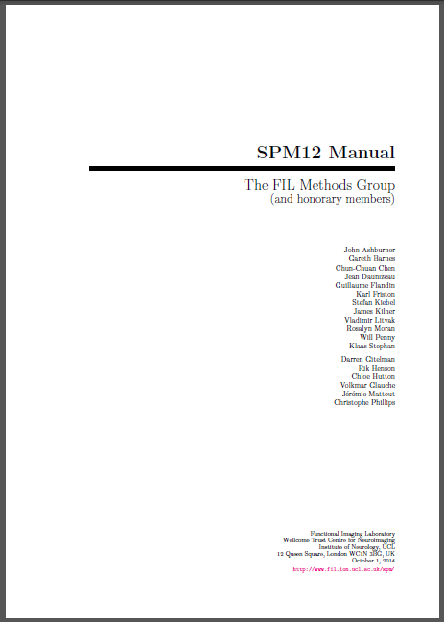
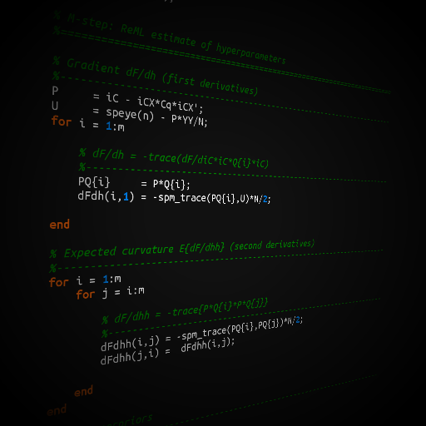
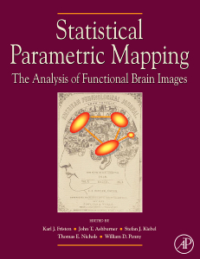
SPM Documentation
Peer reviewed literature
PDF
Manual
MATLAB
code and
comments
SPM
Book

Slide 24
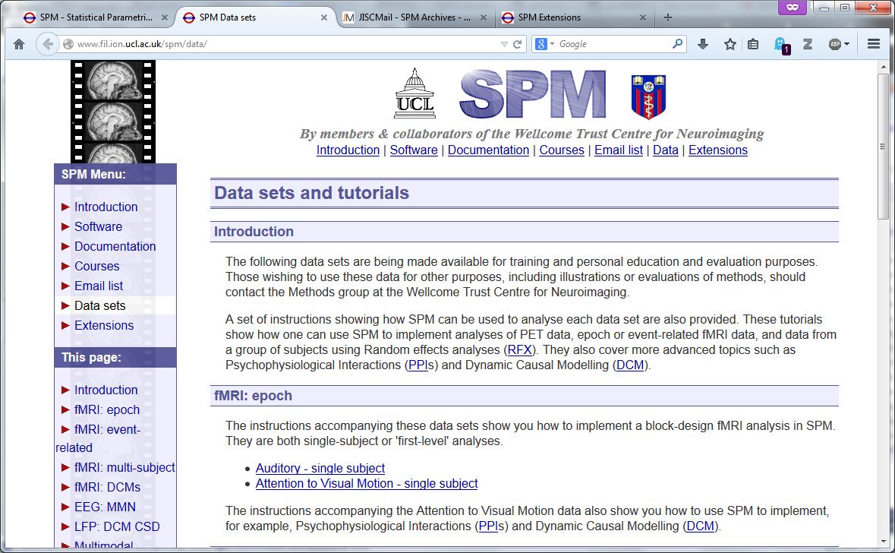
SPM datasets
PET, fMRI (1st and 2nd level), PPI, DCM, EEG, MEG, LFP.

Slide 25

Open Science
Open Methodology
Open Source
Open Data
Open Access
Open Peer Review
Open Educational Resources
https://en.wikipedia.org/wiki/Open_science

Slide 26
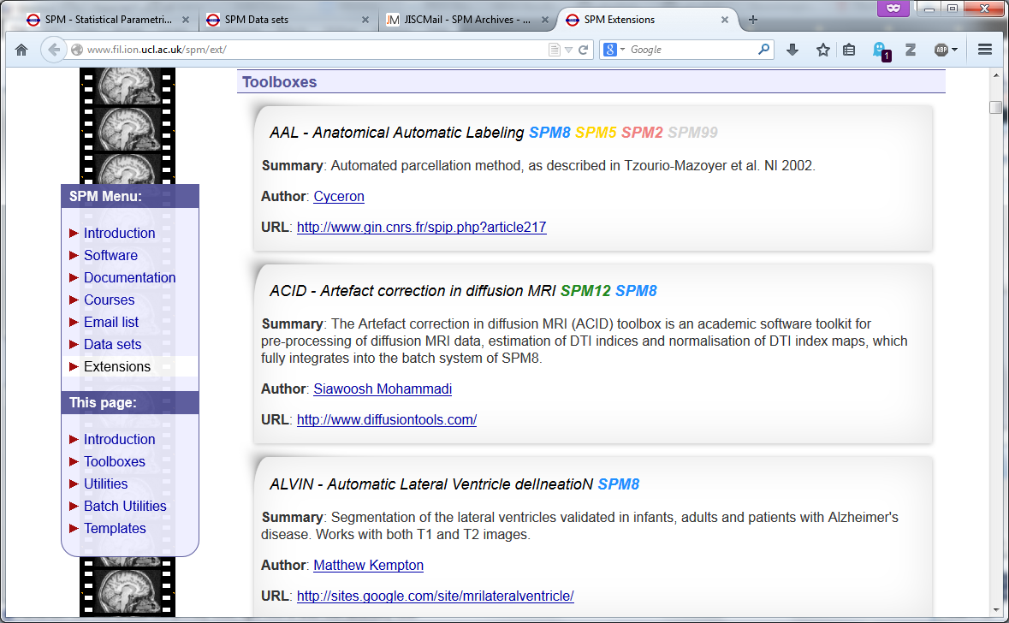
SPM Toolboxes
User-contributed SPM extensions:
http://www.fil.ion.ucl.ac.uk/spm/ext/

Slide 27
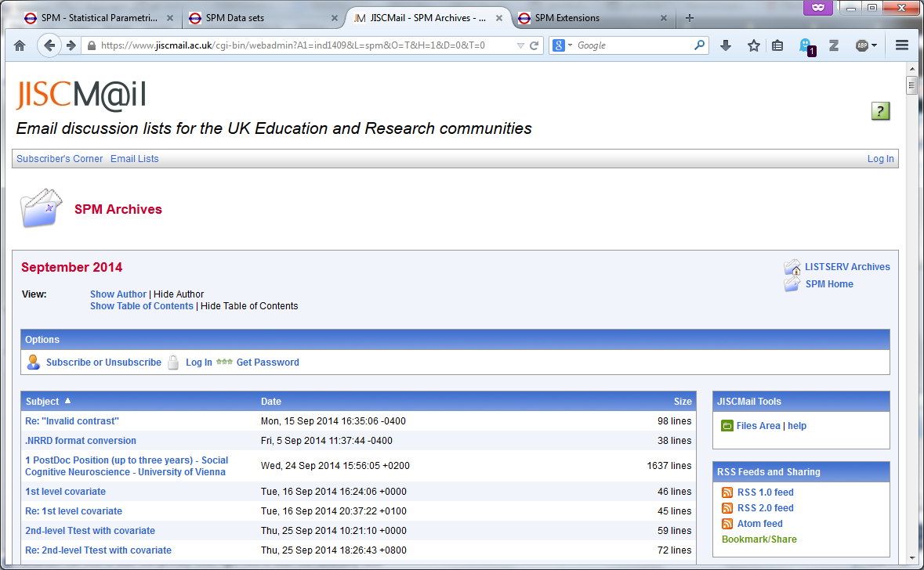
SPM Mailing List
http://www.fil.ion.ucl.ac.uk/spm/support/
spm@jiscmail.ac.uk

Slide 28



References
Twenty years of functional MRI: The science and the stories. P. Bandettini, NeuroImage, 2012.
http://dx.doi.org/10.1016/j.neuroimage.2012.04.026
fMRI25: 25 years of an imaging revolution.
http://www.fmri25.org/
SPM’s 20th Anniversary, K.J. Friston.
http://www.fil.ion.ucl.ac.uk/spm/course/video/#Overview

Slide 29
The SPM co-authors
Jesper Andersson
John Ashburner
Nelson Trujillo-Barreto
Gareth Barnes
Matthew Brett
Christian Buchel
CC Chen
Justin Chumbley
Jean Daunizeau
Olivier David
Guillaume Flandin
Karl Friston
Darren Gitelman
Daniel Glaser
Volkmar Glauche
Lee Harrison
Rik Henson
Andrew Holmes
Chloe Hutton
Maria Joao
Stefan Kiebel
James Kilner
Vladimir Litvak
Andre Marreiros
Jérémie Mattout
Rosalyn Moran
Tom Nichols
Robert Oostenveld
Will Penny
Christophe Phillips
Dimitris Pinotsis
Jean-Baptiste Poline
Ged Ridgway
Holly Rossiter
Mohamed Seghier
Klaas Enno Stephan
Sungho Tak
Bernadette Van Wijk
Peter Zeidman

Slide 30
Thank you for listening
I hope you will enjoy the course!

