Slide 1

The General Linear Model
Marion Rouault
Slides: Guillaume Flandin
Wellcome Centre for Human Neuroimaging
University College London
SPM fMRI Course
London, 23 May 2019

Slide 2



Image time-series
Spatial filter
Design matrix
Statistical Parametric Map
Realignment
Smoothing
General Linear Model
Statistical
Inference
RFT
Normalisation
Anatomical
reference
p <0.05
Parameter estimates
Notes:
So the data has been spatially preprocessed, and now the goal you want to achieve at the end of the day is THIS map,
But in between you have this step the general linear model, where we will be introducing knowledge we have about the experiment,
Which is quite central here in the data flow, and I will try to stick with the basics just to give you a clear intuition on how this step works.

Slide 3
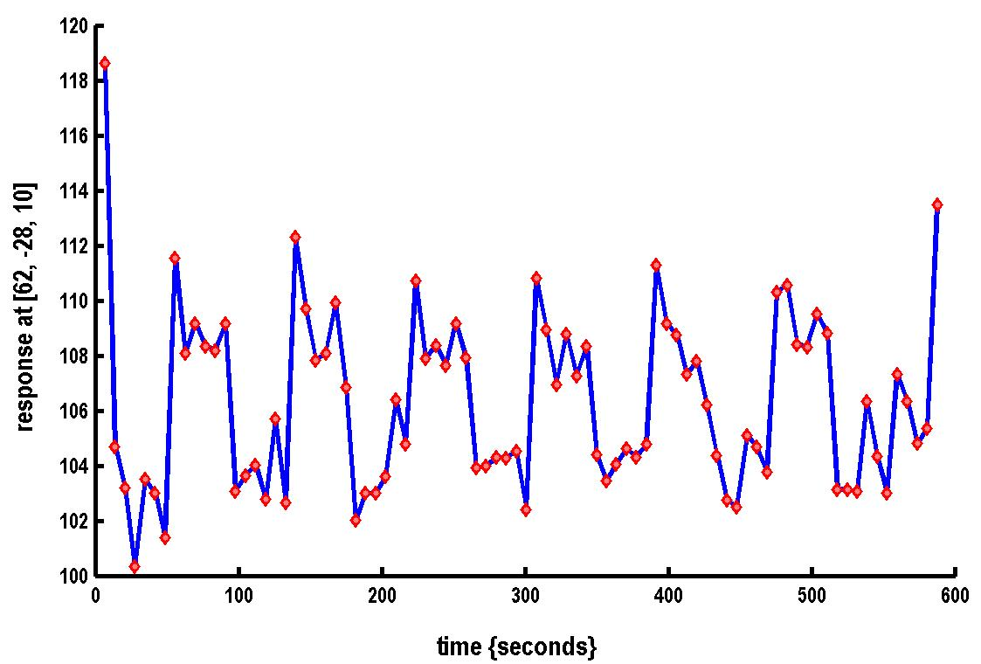

A very simple fMRI experiment
One session
Passive word listening
versus rest
7 cycles of
rest and listening
Blocks of 6 scans
with 7 sec TR
Stimulus function
Question: Is there a change in the BOLD response between listening and rest?
Notes:
I will start with a very simple experimental design, that other talks will come back to. We have one single session, one participant, she is lying down inside the scanner, either listening to words, or not doing anything. We have seven cycles of alternating conditions, so activity, rest, activity, rest, activity, etc.
So we have blocks of six scans, this is a very old data set, and the question we want to ask is whether there is a change in the BOLD response between listening, and rest so not listening to anything.
And where is this difference in the brain. This may not be a very exciting question nowadays, but a good example for us to work on. For answering this question, we want to model the data, to be able to make an inference on the effect of interest, that will be transformed into a parameter of our model, about which we can then make an inference.

Slide 4
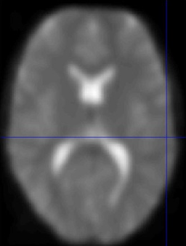
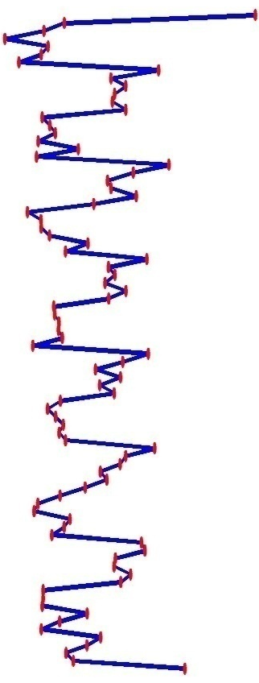
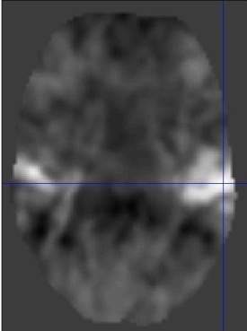
Voxel-wise time series analysis
Model
specification
Parameter
estimation
Time
Hypothesis
Statistic
Time
BOLD signal
single voxel
time series
SPM
Notes:
To proceed doing that, we have some data, that contains SIGNAL related to our process of interest, plus noise, unrelated to our process of interest.
So we would like to transform the data into an EFFECT, related to the signal, plus an error term, related to the noise.
We have on the left the time series, several volumes that we have acquired, here we are looking at 2D slices but we should think of it as a 3D volume.
For each single voxel in this brain volumes, we can plot the time course of activity so this is what we called the times series as displayed vertically here.
So as time passes, as we go down on the graph, the BOLD signal oscillates around a mean value.
This display corresponds to one time series for one voxel, but you have to imagine that in all voxels, there is a time series of BOLD signal.
and because we have done the realignment procedure, we know that this time series consistently comes from one voxel throughout the session.
With this, we would like first to model the time series, estimate some parameters that characterise it, given our data and given the model specified, then we will be able to test some hypothesis and come up with the associated statistics.
And because we can do that for each and every voxel, the whole idea of neuroimaging is that at the end you get a map or a volume of statistical values.
We will obtain a map that has the same number of points as our original time series, so this is why we call this approach a voxelwise time series analysis.

Slide 5

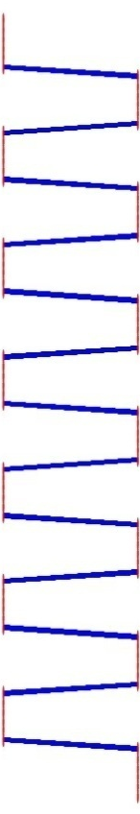

Single voxel regression model
error
=
β₁
+
β₂
+
Time
x₁
x₂
e
BOLD signal
Notes:
So now how do we define this model. We have similarly our time series here.
You remember that we were alternating between two conditions, listening and rest. 40 seconds of rest, and 40 seconds of activations.
We will model this as this regressor X1, alternating between periods of listening and rest. So for every volume we know precisely whether our participant was under listening or under rest conditions.
We anticipate that the signal could be oscillating, but also it could be flat, with no modulation according to whether we listen or whether we rest, so this is what is modelled under X2 here.
So x1 and x2 correspond to the two assumptions that we have for our model: either the signal will be different following listening vs. rest, oscillating around some average activity, or it will be the same.
For each regressor, x1 and x2, we have a weight parameter called beta [POINT], so beta1 for our regressor x1 and beta2 for our regressor x2.
You can see on our time series that the signal is not nice and smooth, it can be jittery, so there is some noise, some unexplained signal, and that will go into the error term.
The error term is also called the residuals; that the things that are not explained by our model so not explained by either of our two regressors.
Overall, you can see this as a way of splitting your time series into regressors of interest, and error, so things that are not explained or not of interest.
If we bring that in terms of equations, it says that on each time point, in each voxel, the signal can be explained as a combination of these terms.
So a weighted sum of the values of my regressors, weighted by beta parameters, plus some random value.

Slide 6
Mass-univariate analysis: voxel-wise GLM
X
y
+
=
Model is specified by
Design matrix X
Assumptions about e
N: number of scans
p: number of regressors
The design matrix embodies all available knowledge about experimentally controlled factors and potential confounds.
Notes:
To make it a bit more general, this is the definition of the GLM. So y is over time, you have N scans, N volumes if you want. Then you will be explaining your data by a number of regressors p, so in our example we had p=2, two regressors, but you can have many more, as long as you have fewer regressors than scans, which is usually not a problem because we have hundreds of scans.
So in X, we are providing the information about our experiment, and for each regressor, we have a single parameter, so in our example we have 2 beta parameters, and then our error terms.
This part X is called the design matrix. Specifying the design matrix is important, but it is not enough to define a GLM. What is also very important is that you have some assumptions about the error term.
Here is the equation about your signal.
The noise is going to be distributed according to a simple gaussian distribution with independent and identical noise throughout the whole time series. It simply means that at each time point, the noise is independent from the others, and it is always the same across time.
OUR GLM IS DEFINED BY THOSE TWO THINGS. What we put in our design matrix is what we know could be happening in the brain of our participant, the effects we are interested in, our experimal factors basically, and we should also put the potential confounds, for instance if we know that over time there may be an habituation effect, such that activity will decrease, then that something we should account for. Or for instance the level of stress if it varies across the experiment, it could modulate brain activity across time. So really it is about providing information about the variability underlying the measured brain signal. And anything that is not modelled goes into the error term. If we have forgotten important things in our design matrix, then the error term will grow, and then we will have problems estimating our GLM.

Slide 7
General Linear Model (GLM):
A flexible framework for parametric analyses
    one sample t-test
    two sample t-test
    paired t-test
    Analysis of Variance (ANOVA)
    Analysis of Covariance (ANCoVA)
    correlation
    linear regression
    multiple regression
Notes:
So the GLM specification looks very general and this is useful because we can then bring all these classic statistical tests within the framework of a GLM [READ]
All these tests can be brought as a specific case of a GLM, for which we can adapt the design matrix. So this generality makes the GLM a powerful and flexible tool, applicable to many cases.

Slide 8



Parameter estimation
Objective:
estimate parameters to minimize
=
+
y
X
Ordinary least squares estimation (OLS) (assuming i.i.d. error):
Notes:
So now that we have defined our design matrix, coded in terms of gray colors, so alternance of black and white stripes indicate our cycles of listening and rest, and the white column indicate our constant term, x2. just a convenient, graphical way to read our experimental design. On the left we still have our data, with the brighter, the higher the signal.
We want to estimate the parameters to explain the signal as best as possible, which means minimizing the unexplained stuff in our error terms. We want to minimize the sum of squares of the residuals, so the unexplained variability, should be as small as possible, given our model.
This looks very complicated, but for mathematicians this is actually a simple least squares estimation, assuming the error term is distributed independently and identically, you get a direct formula for estimating those beta parameters. So this is just one line in SPM, the rest of your work is preparing the data and so on.

Slide 9
Problems of this model with fMRI time series
The BOLD response has a delayed and dispersed shape.
The BOLD signal includes substantial amounts of low-frequency noise (e.g. due to scanner drift).
Due to breathing, heartbeat & unmodeled neuronal activity, the errors are serially correlated. This violates the assumptions of the noise model in the GLM.
Notes:
Our model needs to be improved and refined.
We know the BOLD signal is not changing very rapidly. So it is a bit of a sluggish response, that has a delayed and dispersed response. It takes 5-6 seconds to reach its maximum, and it will come back down to its original response in 20-25 seconds. So it is not like when we switch the light and the light comes immediately bright, but more like this energy-saving recent light bulbs that take about 5 seconds to be fully bright. And if you were to switch off the light immediately afterwards, it will take 20-25 seconds to fully switch off. So that is a first problem we need to account for.
Because we are acquiring the data with a complicated piece of equipment, there is bits of signal that are not useful and should be filtered out. For instance, if the scanner warms up a little bit, there could be a drift in our signal, that has nothing to do with the brain, but with the equipment. We should also account for this in our model.
Because our participants are alive in the scanner, they breath, their heart beats, and because we are acquiring the data at a relatively slow pace, in the signal there will be traces of this physiological activity. When people breath, more oxygen comes in, and because our BOLD signal is dependent on oxygen levels, this will affect our signal. So again this would be something that has nothing to do with our experiment but is still present in the signal. This will make the error terms serially correlated, which violates the assumptions we have to our error terms: namely, the random term is not independent from the next one.
So we will go through these problems one by one.

Slide 10
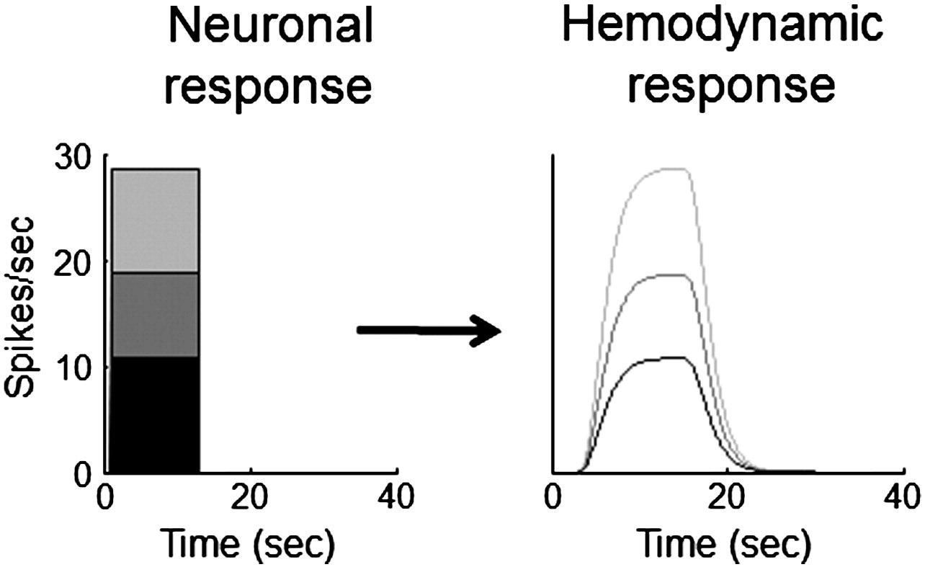
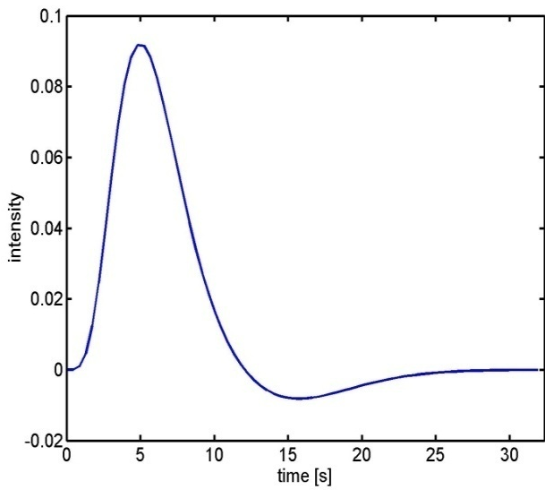
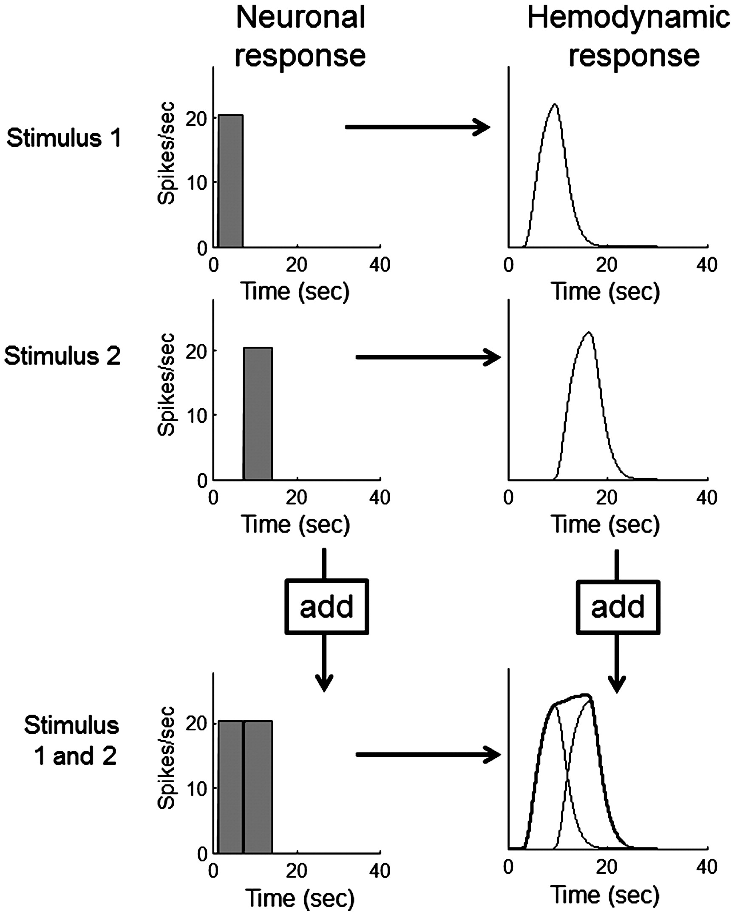

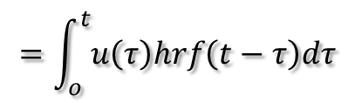
Problem 1: BOLD response
Hemodynamic response function (HRF):
Scaling
Shift
invariance
Linear time-invariant (LTI) system:
u(t)
hrf(t)
x(t)
Convolution operator:
$$x\left(t\right)=u\left(t\right)∗hrf\left(t\right)$$
Additivity
$$=\int_{o}^{t}{u\left(τ\right)hrf\left(t−τ\right)dτ}$$
Boynton et al, NeuroImage, 2012.
Notes:
This is what the hemodynamic response function looks like. If you are presenting something very short to your subjects, the response is going to be slow, and lasts well after the stimulus is gone, with a peak at 5 seconds and a slow decrease. So what we do is use a convolution function, which is a mathematical operator applied to model the expected signal. We can do that because of a property of additivity, such that if two stimuli are presented close in time with each other, they will add up. You can think of the convolution as a multiplication but in a space of functions. It will mix the time series with the response function (the hrf), then you can have an expected response. You don’t need to remember the mathematical details, but basically that this transformation will provide you with the shape of the expected response.
On the right panels, we have examples of expected responses before and after convolution with the HRF, on the bottom with the property of additivity.

Slide 11
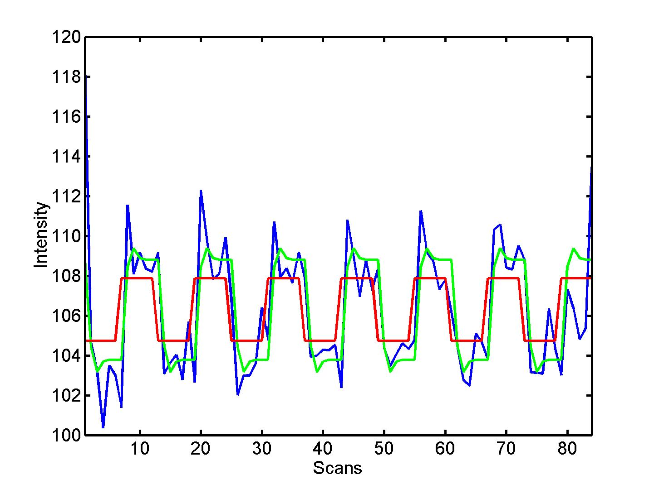


Convolution model of the BOLD response
Convolve stimulus function with a canonical hemodynamic response function (HRF):
⊗ HRF
Notes:
So what does the convolution do? In red we have our regressor from our example, seven cycles of listening vs. rest. The brain is switched on and off.
After convolution by the HRF we obtain the green expected response here, which is a bit different. First, it is slightly delayed, and then it is not completely flat, and if we look at the time course of our signal as a function of volumes, we can see the original regressor in red is now shifted slightly in time, and also it has a different shape, it peaks, has a plateau, and then drops, and so on. This green expected response is now more representative of the actual signal, displayed in blue, that we have recorded. So we have improved our model. The convolution is done under SPM after specifying your design, you don’t have to do these calculations manually.

Slide 12
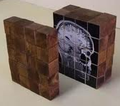
Fluctuation of a hidden variable over time:
e.g. subjective value of a food stimulus
time
Convolution with the hrf function
✕
Theoretical signal
Recorded signal
Compare
Recorded and theoretical signals
Notes:
Here I am showing another example of convolution just to show you that it can take different shapes. So if you present your subject with different food stimuli over time, that might have different internal subjective values, you can represent your design this way. So each stick corresponds to one stimuli, and the height of the stick is related to the value, the higher the stick, the higher the value of this food. After convolution with the hrf, you will obtain an expected response that looks like this, so a region that is more activated when value increases should look like this. And then as we will see, the objective is to compare it to our actual signal.

Slide 13
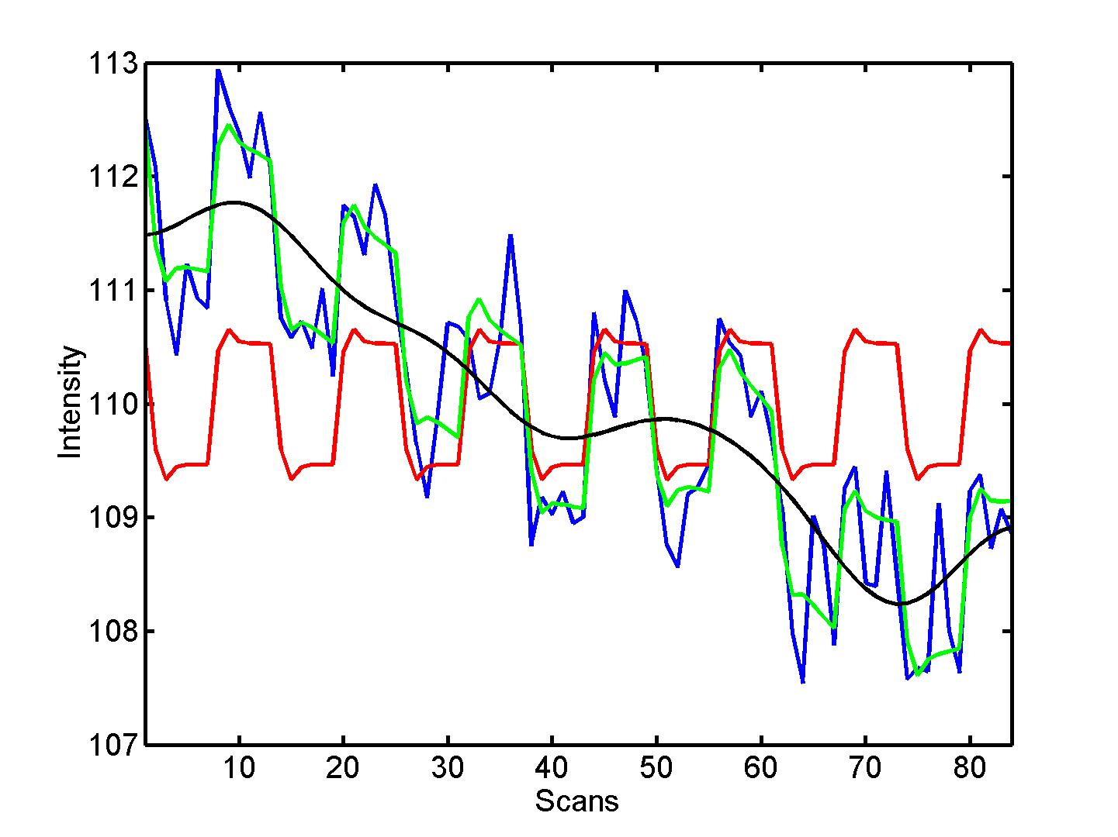

Problem 2: Low-frequency noise
Solution: High pass filtering
blue = data
black = mean + low-frequency drift
green = predicted response, taking into account low-frequency drift
red = predicted response, NOT taking into account low-frequency drift
discrete cosine transform (DCT) set
Notes:
Now on to our second problem, low frequency noise. So you have in your signal some part of it that we are not interested in. This is plotted in black on this graph.
Theoretically what we could do is to filter our data completely and then work on the filtered signal. Instead, what we are doing in SPM is add some regressors that will model explicitly these low frequencies.
On the left we have the same design as before with the listening vs. rest experiment, after convolution with the HRF. We then add these series of columns. It starts here [point column 3] starting high then go low, or high-low-high, and so on, over the time course of our experiment, representing the slow oscillations that we have in our signal.
Now if we focus on what it looks like for the constant [POINT], it would correspond to the black line here, over time. When we look at what we have modelled so far, we were with the red one, oscillating around a constant, which was obviously not fitting the blue, measured signal. But now when including all components, accounting for these slow oscillations over the course of the experiment, we arrive at the green curve which does a better job capturing the signal over time, with a better agreement with our true signal the blue one.
Basically, the part of the signal we are not interested in, the slow oscillations, are modelled in our design, so we will not look at them or analyse them, but importantly they are accounted for.
Note that there is a decision to be made regarding the threshold at which this filtering is done, with a default cut-off between the signal we are interested in is to be decided, in SPM the default will be 1/128.

Slide 14

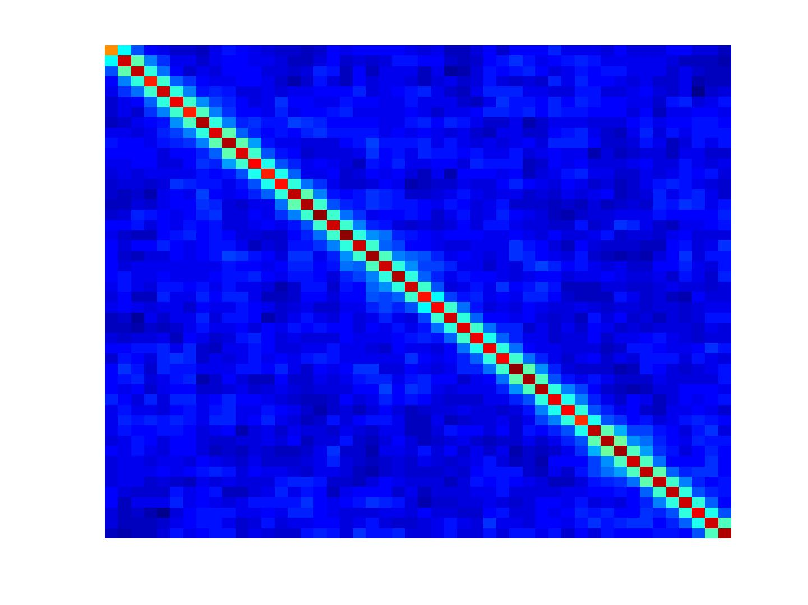
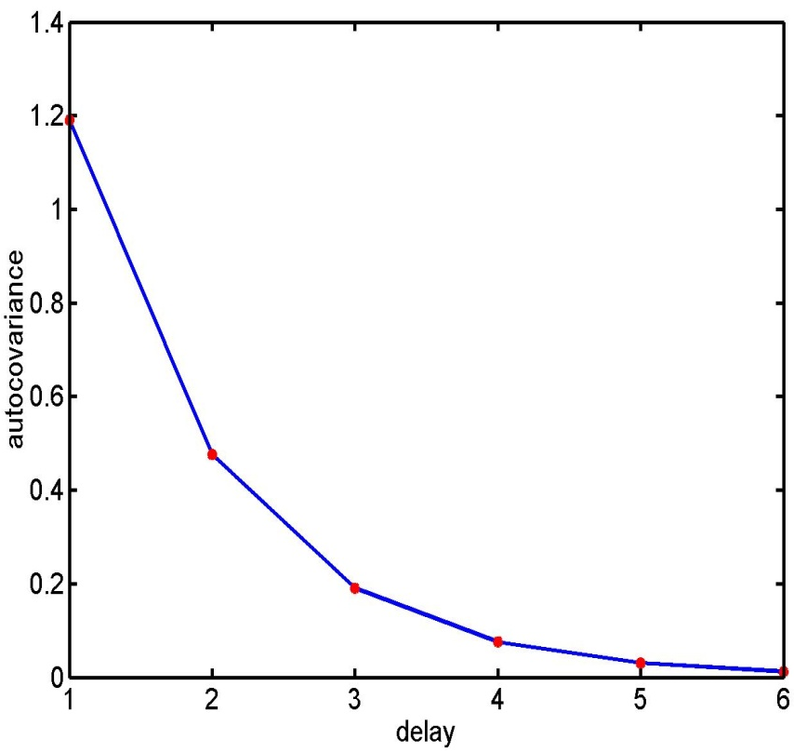

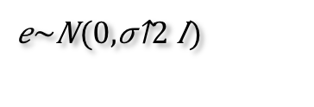
Problem 3: Serial correlations
i.i.d:
$$e\sim N(0,σ^{2}I)$$
autocovariance
function
e_{t} = ae_{t-1} + ε_{t} with ε_{t} ~ N(0,σ²)
Notes:
Finally with our last problem, serial correlations. We had seen that for estimating our GLM, we have to respect an assumption that our error term, capturing the noise not explained by our model, as to be independently and identically distributed. In practice, that is not the case. If this were the case, in the covariance matrix on the right I would see a clean diagonal line with only ones. As you can see that is not the case: the noise on one scan depends on the noise on the previous scan, and on the next scan and so on.
The way this is accounted for in SPM is to use an autoregressive model of first order plus white noise.
It means that the residuals can be expressed as a weighted equivalent of the previous residual and an error term that is normally distributed.
You can think of it as with the weather forecast: you always announce the weather you had yesterday and you are very close to the truth, plus some random component.

Slide 15
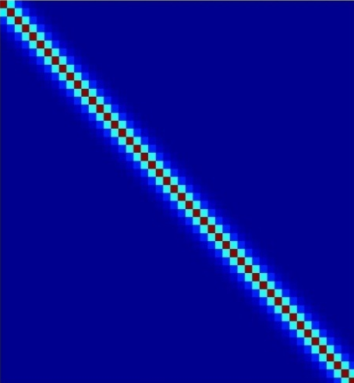
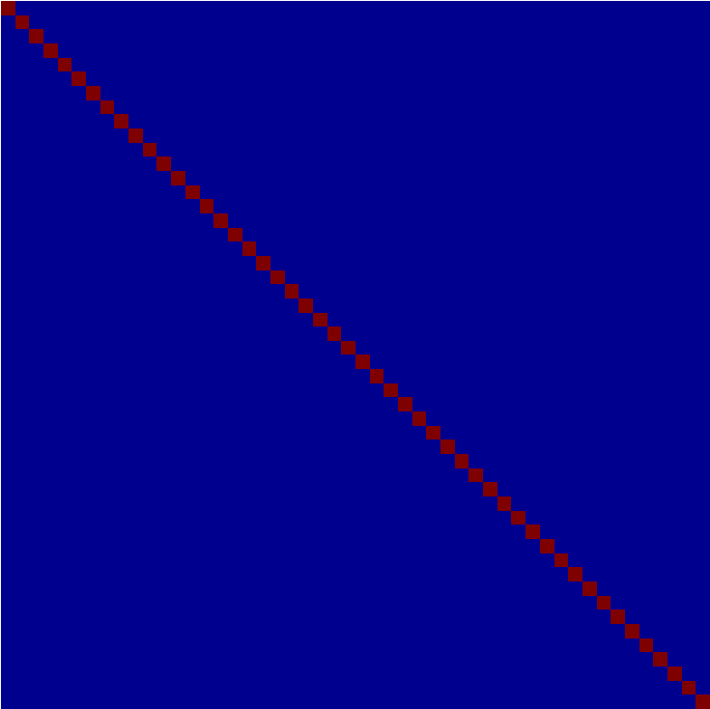
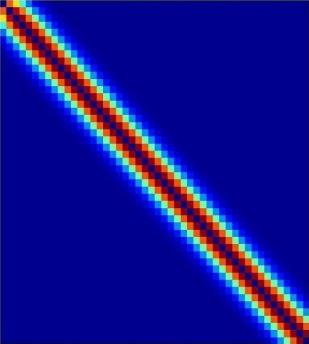
Multiple covariance components
enhanced noise model at voxel i
error covariance components Q and hyperparameters λ
V
Q₁
Q₂
=
λ₁
+ λ₂
Estimation of hyperparameters λ with ReML (Restricted Maximum Likelihood).
Notes:
This idea is then embodied in the fact that you have an enhanced noise model for each voxel i. So each voxel now has some model, it is not the sigma times identity matrix but here instead we have a C, so a covariance matrix. How is this covariance matrix defined? It is split into 2 things.
-A first component is voxel dependent, as you can see depending on voxel i, so the variance sigma squared. Some voxels will be noisier than others, so each voxel has their own sigma.
-And then there is this V, which models this covariance component, which will be the same for all the voxels in the brain.
Now the exact shape of V is not known, but we have a fairly good idea of what we want, because we want it to express an autoregressive model of first order plus white noise.
The way it works is that this V will be modelled as a linear combination of covariance matrices. Those Qs are fixed and lambda1 and lambda2 are parameters of your covariance matrix model. We refer to them as hyperparameters because they are parameters of your covariance model, so parameters of a model, not parameters of data.
The lambda hyperparameters are left free and will be estimated using a restricted maximum likelihood.
So to put it simple, the way we model noise is a bit more complicated than it appeared at the beginning. The variance at each voxel has to be estimated, this is voxel-specific. The lambdas will be estimated for the whole brain volumes and will show how this covariance over time happens. The assumption is that by pooling over all the voxels we can obtain a better estimate of these hyperparameters.

Slide 16
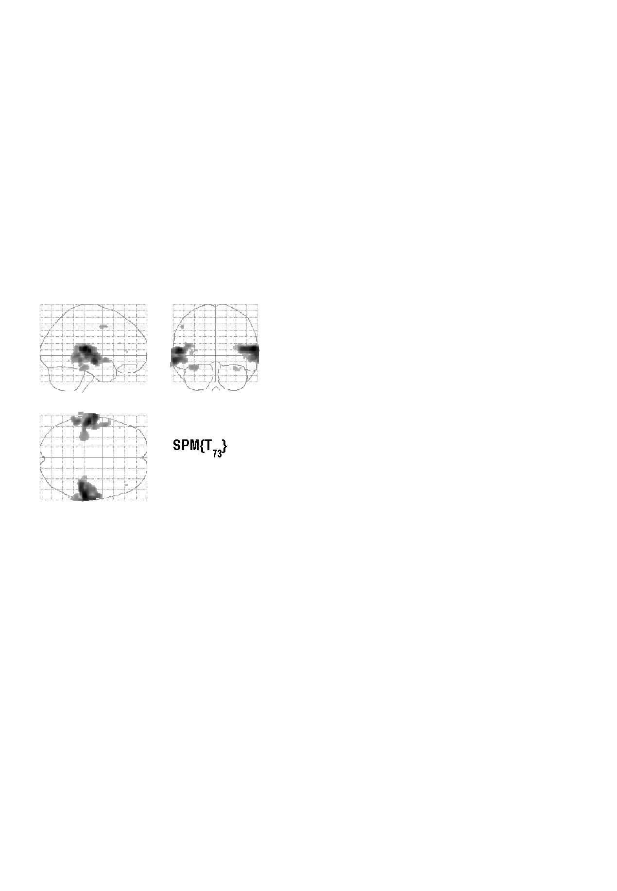


Contrasts &
statistical parametric maps
c = 1 0 0 0 0 0 0 0 0 0 0
Q: activation during listening ?
Null hypothesis:
Notes:
To answer the question of activation during listening, the hypothesis that we are interested in testing is whether beta1 equals zero, so our first regressor.
This is just a rapid overview but the next lecture will cover contrasts in more detail.
To test this estimated value of beta 1, we will use a contrast vector, that will give us a t-test [POINT]. Importantly this test will be performed for each voxel throughout the whole brain, giving you a T value for each voxel in the brain which we can visualise on maps like this. On this glass brain we have a projection of activations that indicate the regions for which the T value is above some threshold that we define.
If you have done your co-registration, you can visualise these voxels that are activated above some threshold on top of a structural map, and surprisingly, when contrasting listening vs. rest, we identify voxels in the auditory cortex.

Slide 17
Summary
Mass-univariate approach.
Fit GLMs with design matrix, X, to data at different points in space to estimate local effect sizes,
GLM is a very general approach
Hemodynamic Response Function
High pass filtering
Temporal autocorrelation
Notes:
To sum up, here we work voxel by voxel, so it is a mass univariate approach. We fit our GLM design matrix to our data. We use the same design matrix for all voxels in the brain, so it is a one size fits all if you want, but our betas will be different for each voxel.
The GLM is a very general approach. The critical part is when indicating what you want to put in your GLM, from your experimental design. It is useful when conceiving your experimental design, to think about the general linear model that you anticipate to construct, because this will determine the questions you will be able to answer.
Finally, you should account for the three particularities we have described: [READ], so these are elements that are also included in your design matrix.

Slide 18
References
Statistical parametric maps in functional imaging: a general linear approach, K.J. Friston et al, Human Brain Mapping, 1995.
Analysis of fMRI time-series revisited – again, K.J. Worsley and K.J. Friston, NeuroImage, 1995.
The general linear model and fMRI: Does love last forever?, J.-B. Poline and M. Brett, NeuroImage, 2012.
Linear systems analysis of the fMRI signal, G.M. Boynton et al, NeuroImage, 2012.

Slide 19
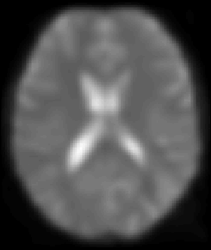
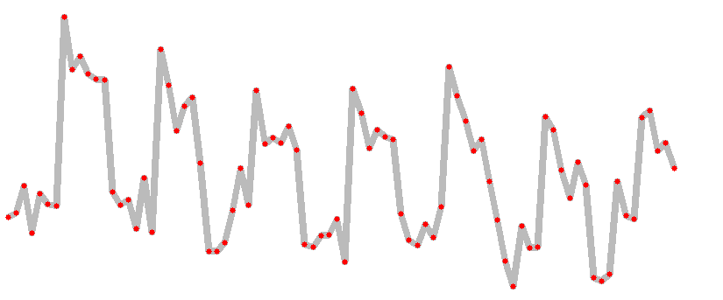
A mass-univariate approach
Summary
Time

Slide 20
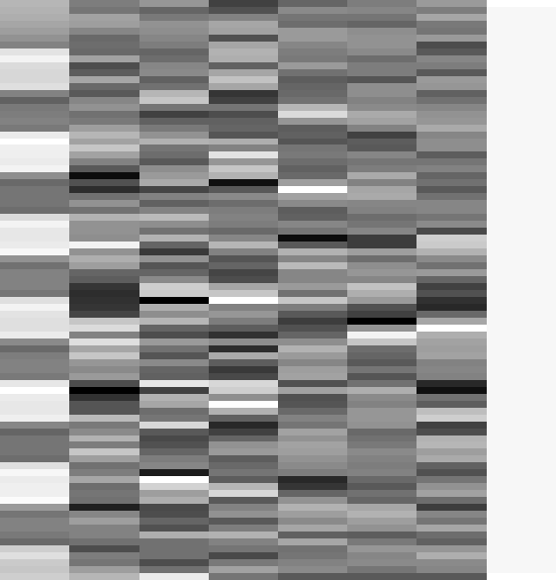
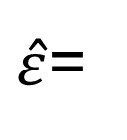
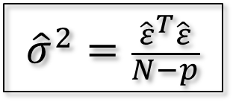

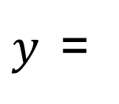


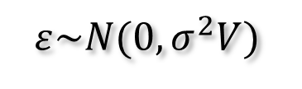
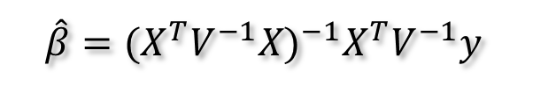


Estimation of the parameters
Summary
noise assumptions:
$$ε\sim N(0,σ^{2}V)$$
WLS:
$$\hat{β}={(X^{T}V^{−1}X)}^{−1}X^{T}V^{−1}y$$
$${\hat{β}}_{1}=3.9831$$
$${\hat{β}}_{2−7}=\{0.6871, 1.9598, 1.3902, 166.1007, 76.4770, −64.8189\}$$
$$β$$
$${\hat{β}}_{8}=131.0040$$
$y$=
$$+ε$$
$\hat{ε}$=
$${\hat{σ}}^{2}=\frac{{\hat{ε}}^{T}\hat{ε}}{N−p}$$
$$\hat{β}\sim N\left(β,σ^{2}{(X^{T}X)}^{−1}\right)$$

Slide 21
A geometric perspective on the GLM
Smallest errors (shortest error vector)
when e is orthogonal to X
y
e
x₂
O
x₁
Design space defined by X
Ordinary Least Squares (OLS)
Notes:
This is a geometric perspective. With more complicated designs, you can see x1 and x2, your two regressors, as two vectors.

Slide 22
Weighted Least Squares (WLS):
Let
Then
WLS equivalent to
OLS on whitened
data and design
where

Slide 23
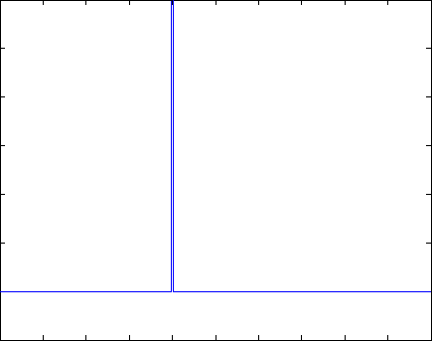
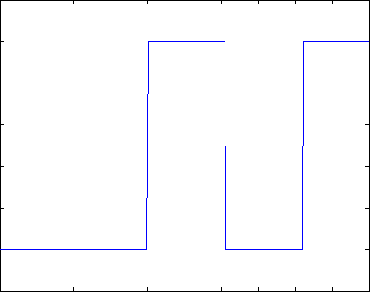
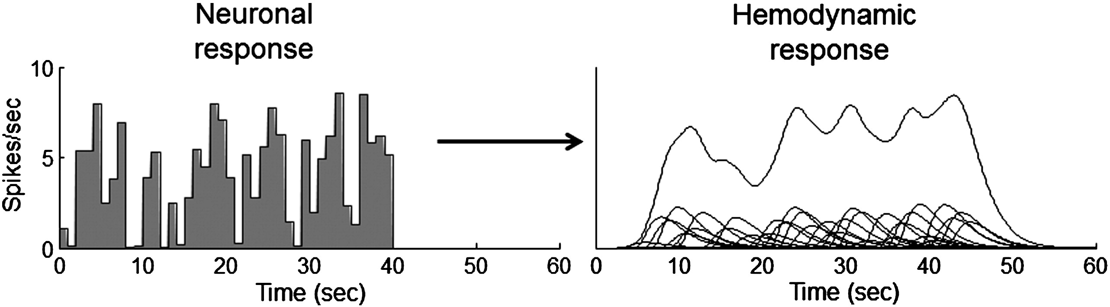
Problem 1: BOLD response
Solution: Convolution model
Notes:
Now we are going to see a few examples of convolution with the hemodynamic response function.

