Slide 1
Introduction to DCM for fMRI
Peter Zeidman, PhD
Methods Group
May 2019

Slide 2
Contents
Overview of DCM
Model specification
Model inversion
Model comparison

Slide 3
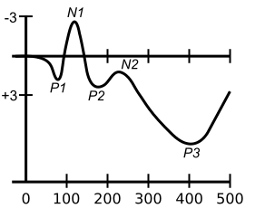
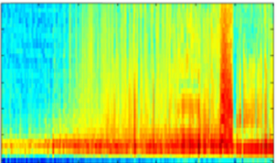
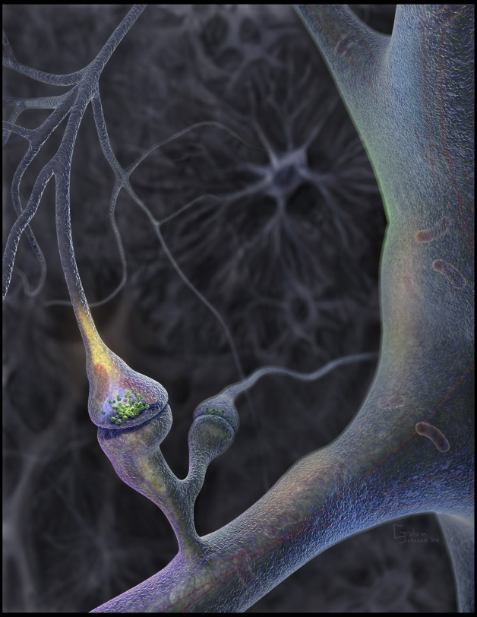
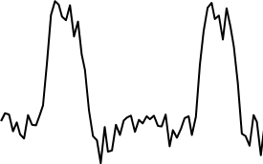
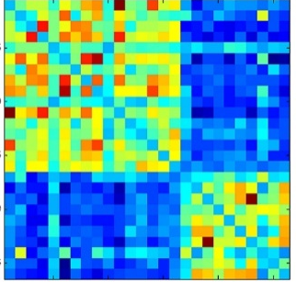
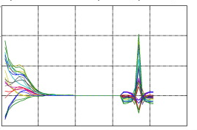
Neural circuitry (effective connectivity)
Data Features
Evoked responses
Induced responses
microvolts
frequency
time
Forward model
time
Timeseries
Model inversion
signal
time
Functional connectivity
Cross-spectral density
CSD
Frequency

Slide 4
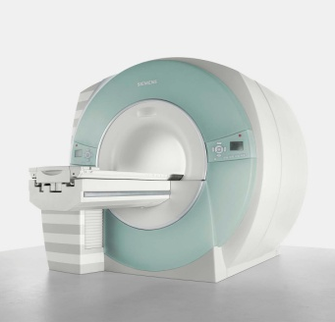
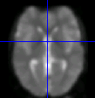

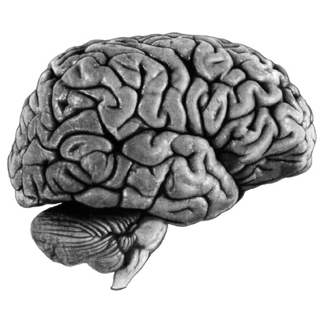
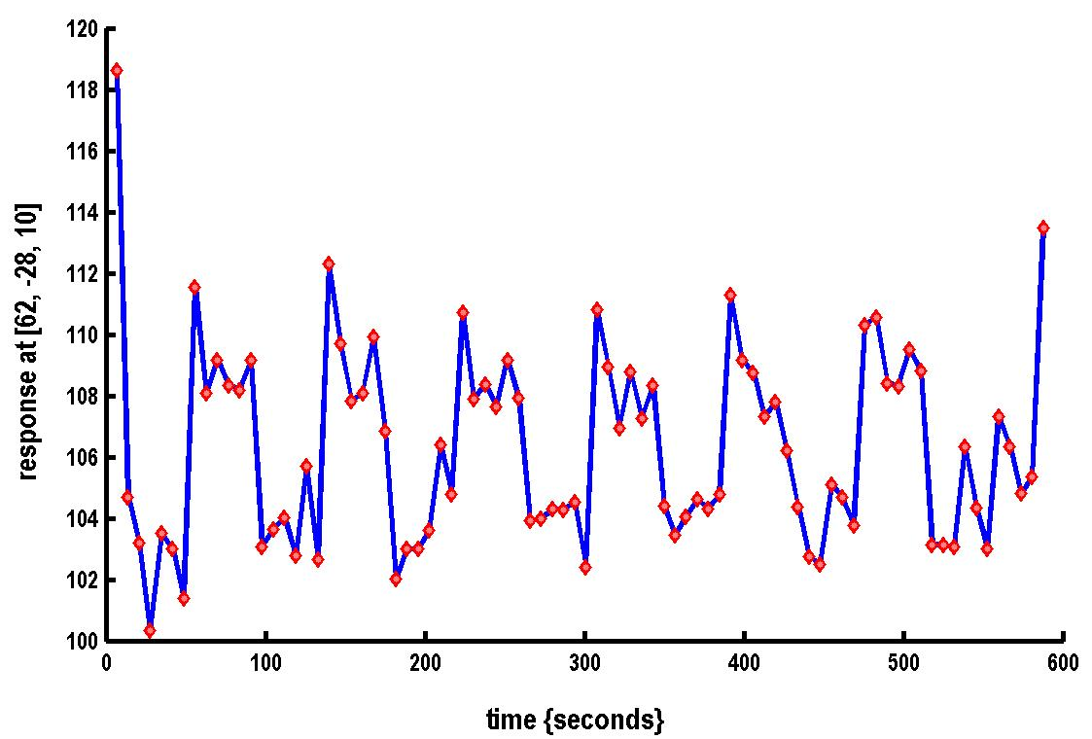
Where DCM sits in the pipeline
Functional MRI acquisition and image reconstruction
Image preprocessing (realignment, coregistration, normalisation, smoothing)
Statistical Parameter Mapping (SPM) / General Linear Model
Dynamic Causal Modelling (DCM)
Timeseries extraction from Regions of Interest (ROIs)

Slide 5
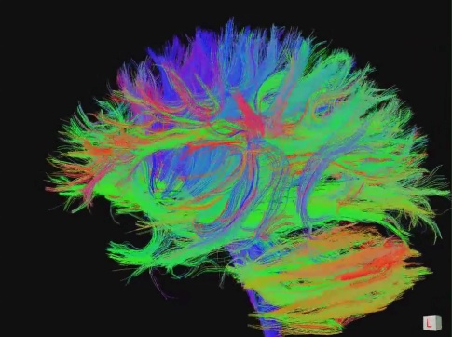
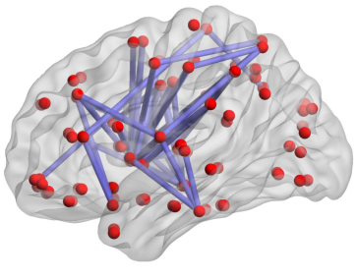
Types of connectivity
Structural Connectivity
Physical connections of the brain
Functional Connectivity
Dependencies between BOLD observations
Effective Connectivity
Causal relationships between brain regions
"Connectome" by jgmarcelino. CC 2.0 via Wikimedia Commons
Figure 1, Hong et al. 2013 PLOS ONE.
KE Stefan, SPM Course 2011
Notes:
Connectivity analysis is another way to look at neural activity. The most interesting is effective connectivity – interactions at the neural level.

Slide 6
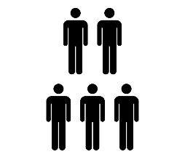
DCM Framework
1. Specify a forward model for each subject
2. Fit the models to the data
Data
Model
3. Second level analysis (GLM of connectivity parameters)
4. Bayesian model comparison
Probability
Model
5. Inspect parameters
Probability
Connection strength

Slide 7
Contents
Overview of DCM
Model specification
Model inversion
Model comparison

Slide 8
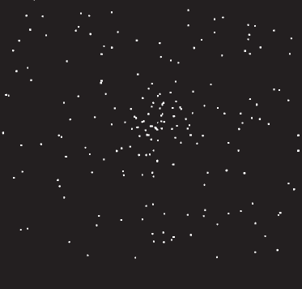
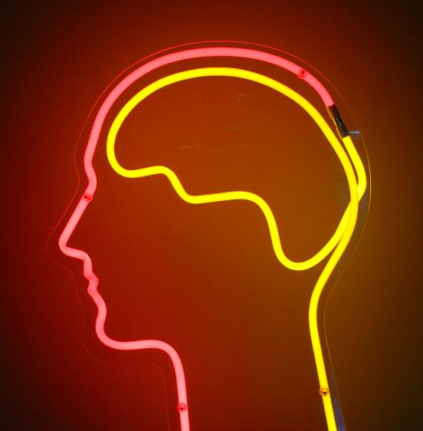

The system of interest
Experimental Stimulus
(Hidden) Neural Activity
Observations (BOLD)
Vector u
Vector y
on
?
BOLD
off
time
time
Stimulus from Buchel and Friston, 1997
Brain by Dierk Schaefer, Flickr, CC 2.0
Notes:
Experimental stimulation causes changes in neural activity. Neural activity in turn causes the BOLD response, which we observe via the scanner. We are interested in the hidden neural activity, which we cannot directly observe - so it must be inferred.

Slide 9
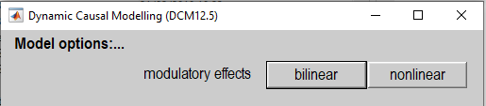


Model specification
Bilinear model
Non-linear Model
$$z_{2}$$
A
B
A
C
B
$$z_{1}$$
C
D
Friston et al., 2003
Stephan et al., 2008

Slide 10
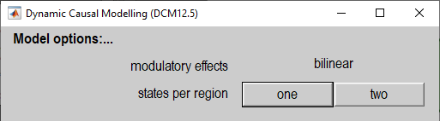


Model specification
One state per region
Two states per region
$$z_{2}$$
SE
E
E
EE
Excitation
IE
EI
Inhibition
$$z_{1}$$
I
I
SI
Friston et al., 2003
Marreiros et al., 2008

Slide 11
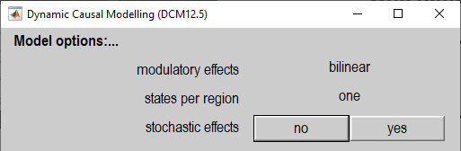



Model specification
Deterministic DCM
Stochastic DCM
$$\dot{z}=f\left(z,u,θ_{n}\right)$$
$$\dot{z}=f\left(z,u,θ_{n}\right)+ω$$
All dynamics driven by the stimuli $u$
Additionally driven by endogenous noise. Enables modelling mixed endogenous and task designs.
Friston et al., 2003
Li et al., 2011

Slide 12
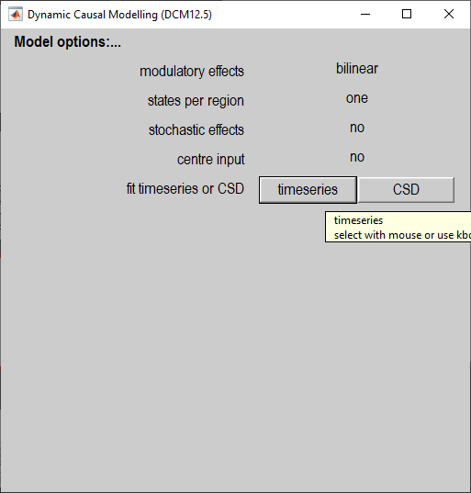
Model specification
For resting state data, select
Cross Spectral Density (CSD)
Endogenous
neural
fluctuations
Effective connectivity
BOLD response
Functional connectivity
For task-based data, select timeseries
Real
Imaginary
Effective connectivity
BOLD response
Stimuli
Frequency
Frequency
Data
Friston et al., 2014
Model

Slide 13
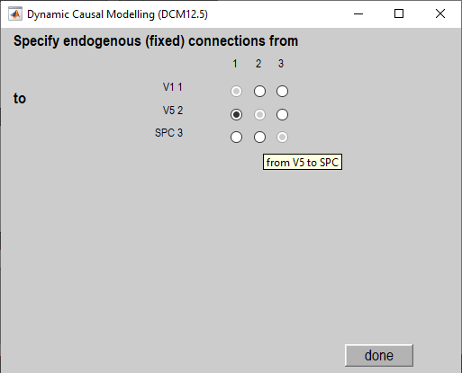



Model specification
SPC
$$z_{3}$$
V5
$$z_{2}$$
V1
$$z_{1}$$

Slide 14
Contents
Overview of DCM
Model specification
Model inversion
Model comparison

Slide 15
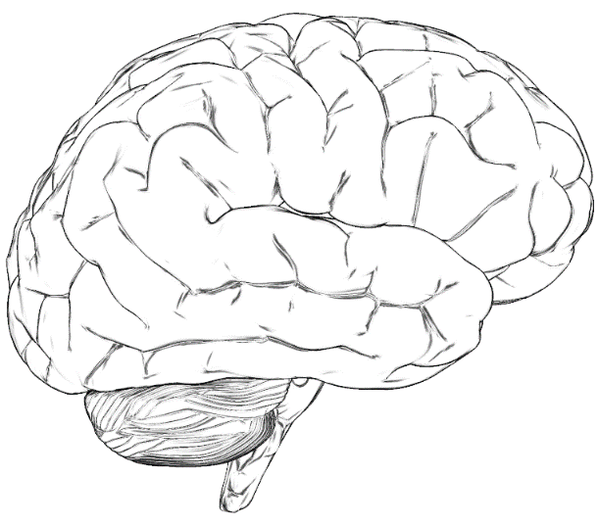
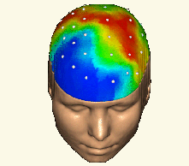







Bayesian modelling
Forward Problem
$$p(Y|θ,m)$$
Model
$$m$$
Likelihood
Data $Y$
Parameters
$$θ$$
Posterior Evidence
$$p(θ|Y,m)$$
$$p(Y|m)$$
With priors
$$p(θ|m)$$
Inverse Problem
Adapted from a slide by Rik Henson

Slide 16
Priors
Priors determine the structure of the model
Stimulus
R1
R2
Stimulus
R1
R2
Connection ‘on’
Connection ‘off’
Probability
0
0
Prior Connection strength (Hz)
Prior Connection strength (Hz)

Slide 17
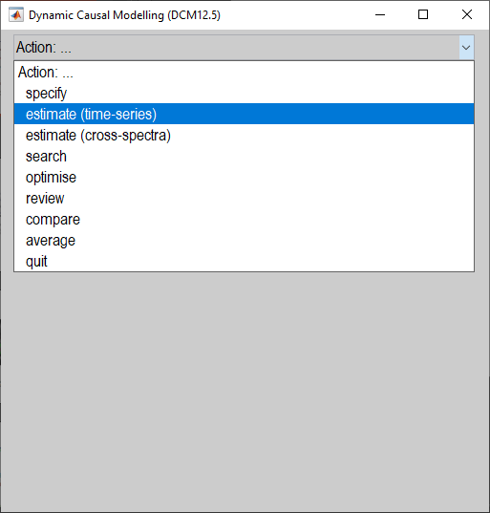
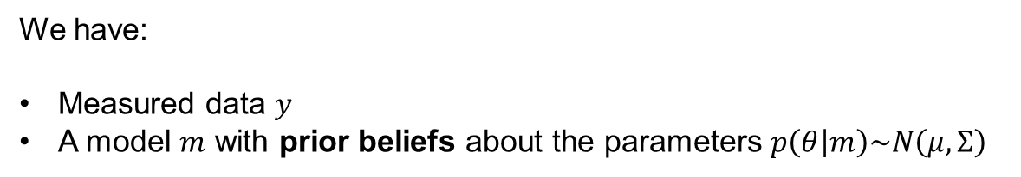

Model estimation
We have:
Measured data $y$
A model $m$ with prior beliefs about the parameters $p\left(θ | m\right)\sim N\left(μ,Σ\right)$
Model estimation (inversion) gives us:
A score for the model, which we can use to compare it against other models (Bayesian model comparison)
$F≅\log{p\left(y | m\right)=\text{accuracy}−\text{complexity}}$
Free energy
Uses the variational Laplace algorithm
2. Estimated parameters – i.e. the posteriors $p(θ|m,y)\sim N\left(μ,Σ\right)$
$μ$: DCM.Ep – expected value of each parameter
$Σ$: DCM.Cp – covariance matrix

Slide 18
Contents
Overview of DCM
Model specification
Model inversion
Model comparison

Slide 19
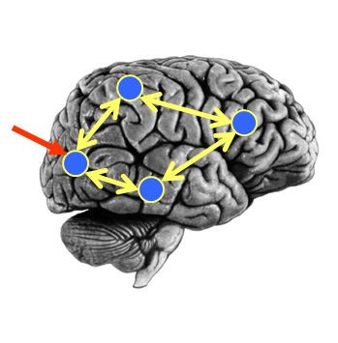
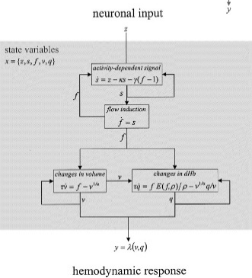


Model comparison
Neural Model
Observation Model
Experimental Stimulus (u)
Observations (y)
Model 1:
Model comparison: Which model best explains my observed data?
Neural Model
Observation Model
Experimental Stimulus (u)
Observations (y)
Model 2:

Slide 20
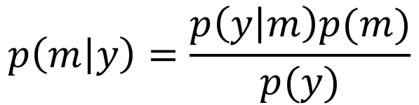
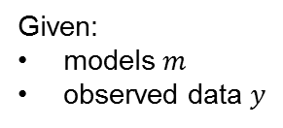

Bayes Rule for Models
Question: I’ve estimated 10 DCMs for a subject. What’s the posterior probability that any given model is the best?
Model evidence
Probability of each model given the data
Prior on each model

Slide 21
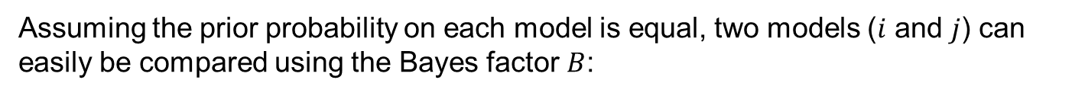
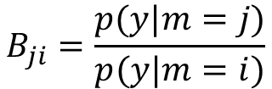

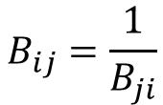

Bayes factors
Ratio of model evidence
From Raftery et al. (1995)
Note: The free energy approximates the log of the model evidence. So the log Bayes factor is:

Slide 22
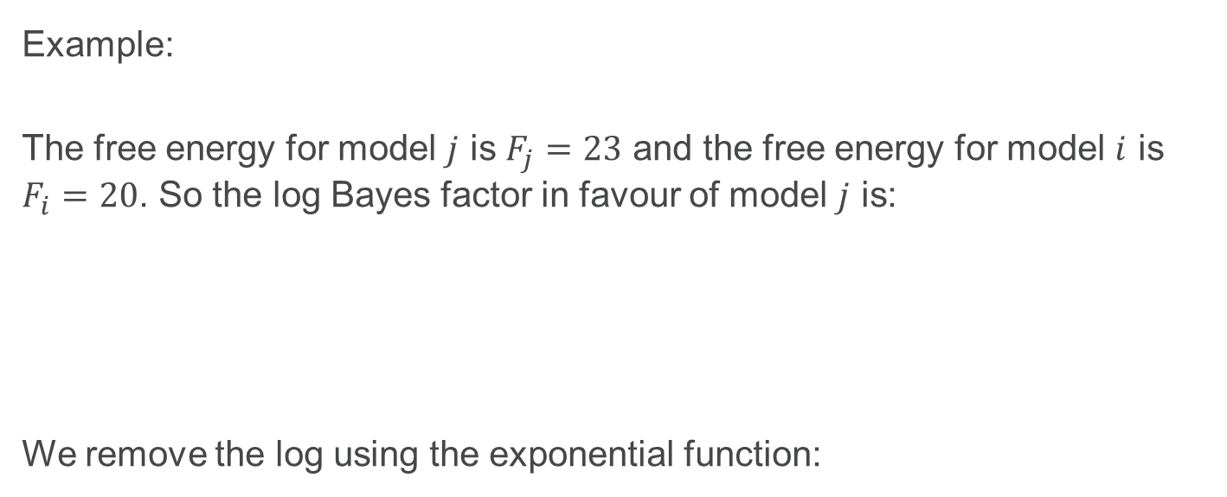
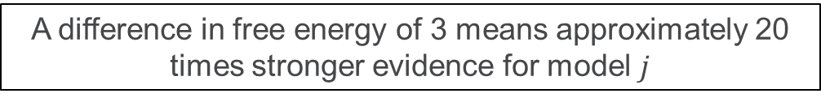

Bayes factors
Example:
The free energy for model $j$ is $F_{j}=23$ and the free energy for model $i$ is $F_{i}=20$. So the log Bayes factor in favour of model $j$ is:
We remove the log using the exponential function:
$$\ln{{BF}_{j}}=\ln{p\left(y | m_{j}\right)}−\ln{p\left(y | m_{i}\right)}=F_{j}−F_{i}=23−20=3$$
${BF}_{j}=\exp\left(3\right)≈20$
A difference in free energy of 3 means approximately 20 times stronger evidence for model $j$

Slide 23
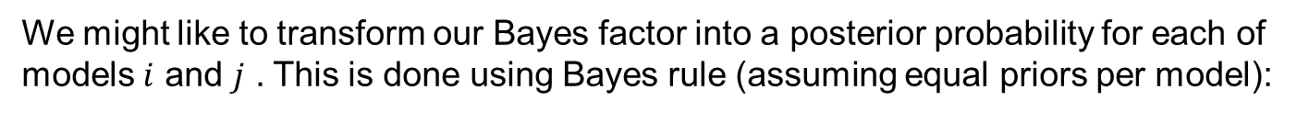

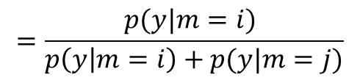
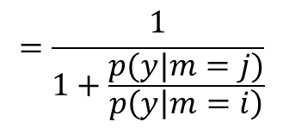



Posterior probability
Posterior probability of a model is
the sigmoid function of the log Bayes factor

Slide 24
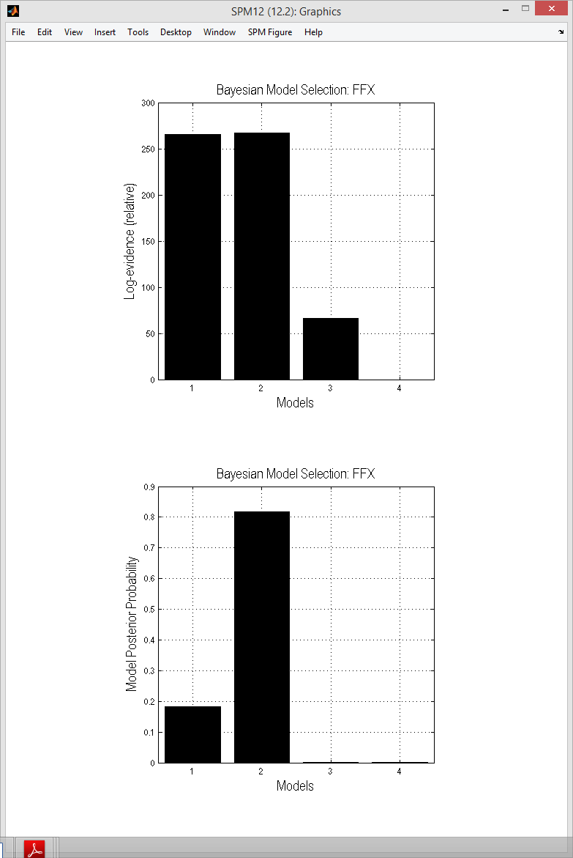




Log BF relative to worst model
Posterior probabilities

Slide 25

Further Reading
The original DCM paper | Friston et al. 2003, NeuroImage
A tutorial on group effective connectivity analysis (preprint) | https://github.com/pzeidman/dcm-peb-example
Other descriptive / tutorial papers
Role of General Systems Theory | Stephan 2004, J Anatomy
DCM: Ten simple rules for the clinician | Kahan et al. 2013, NeuroImage
Ten Simple Rules for DCM | Stephan et al. 2010, NeuroImage

