Slide 1
What are we measuring with M/EEG?
Tolga Esat Özkurt
tolgaozkurt@gmail.com
METU Graduate School of Informatics, Ankara
SPM Course, May 20, 2019

Slide 2
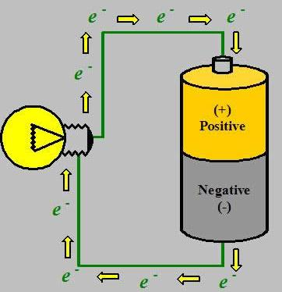
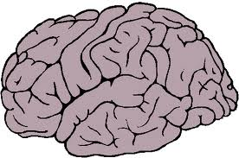
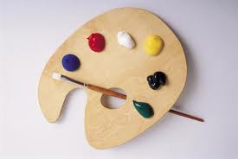
Electro
Encaphalo
Graphy
?
EEG

Slide 3
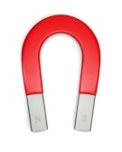
Magneto
Encaphalo
Graphy
?
MEG

Slide 4
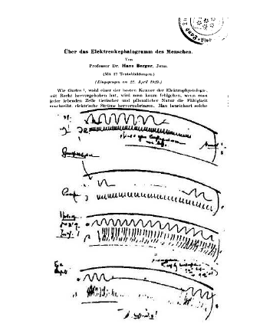
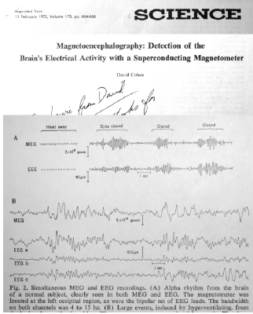
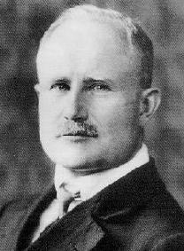
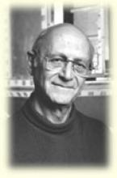
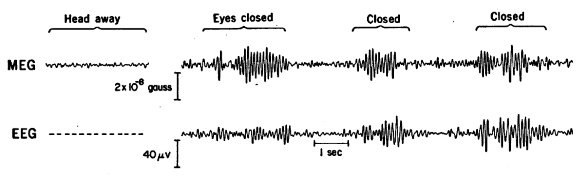
MEG (1968)
EEG (1929)
Hans Berger
(1873 – 1941)
David Cohen
(1930 – )

Slide 5
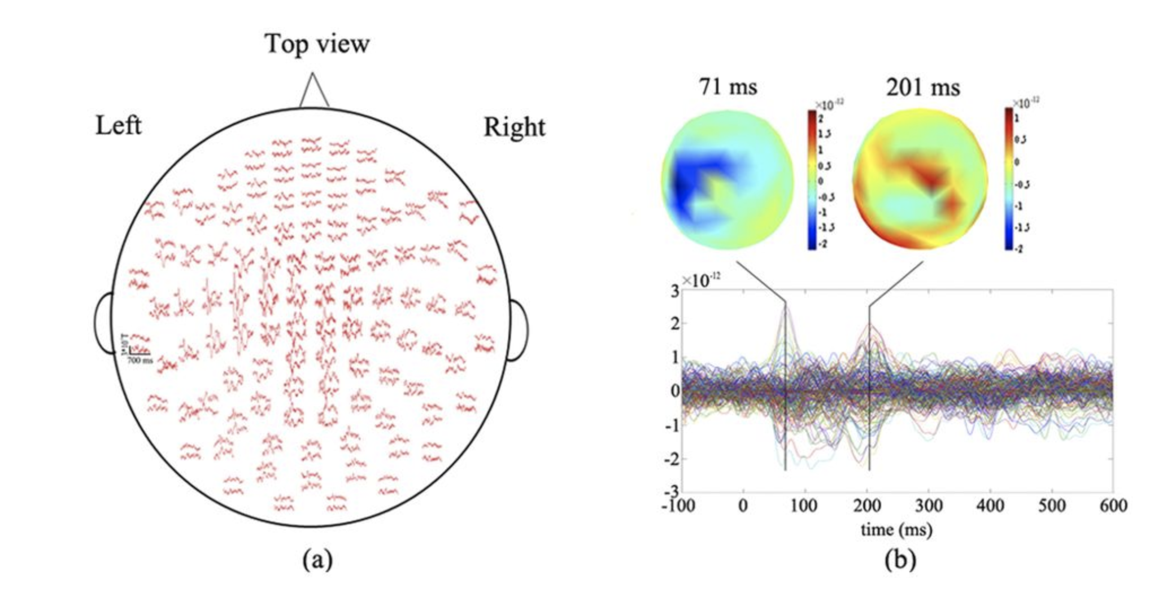
What do we obtain at the end of acquisition?
Gao et al., 2015
Spatial distribution of MEG averaged responses

Slide 6
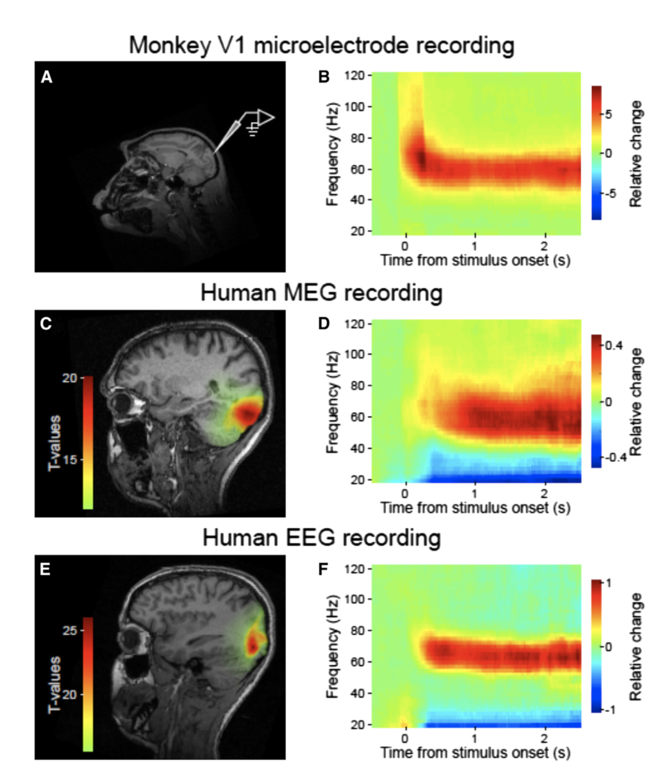
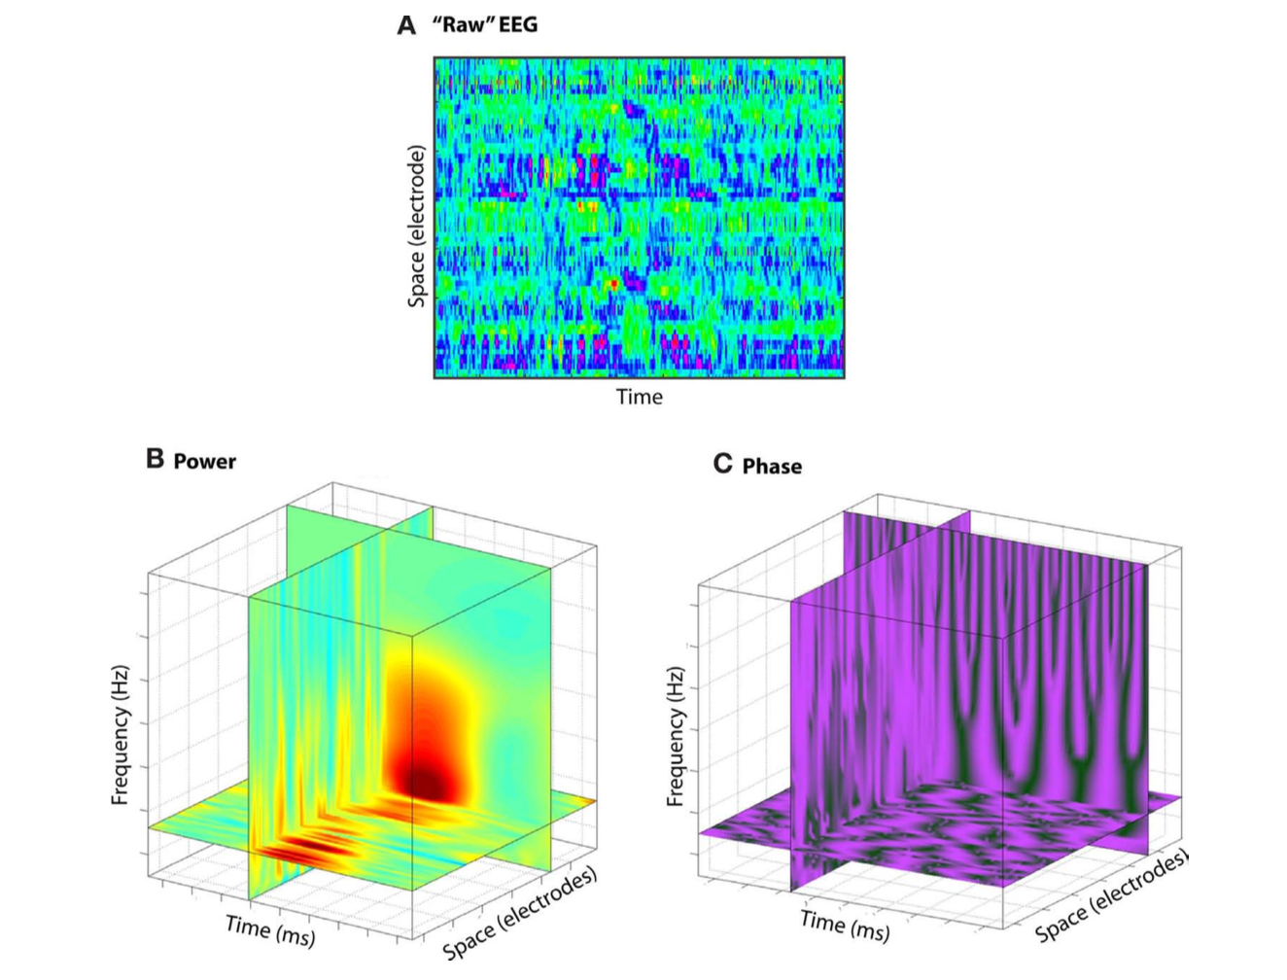
Manipulated Raw signals
Cohen, 2011
Fries, 2008

Slide 7
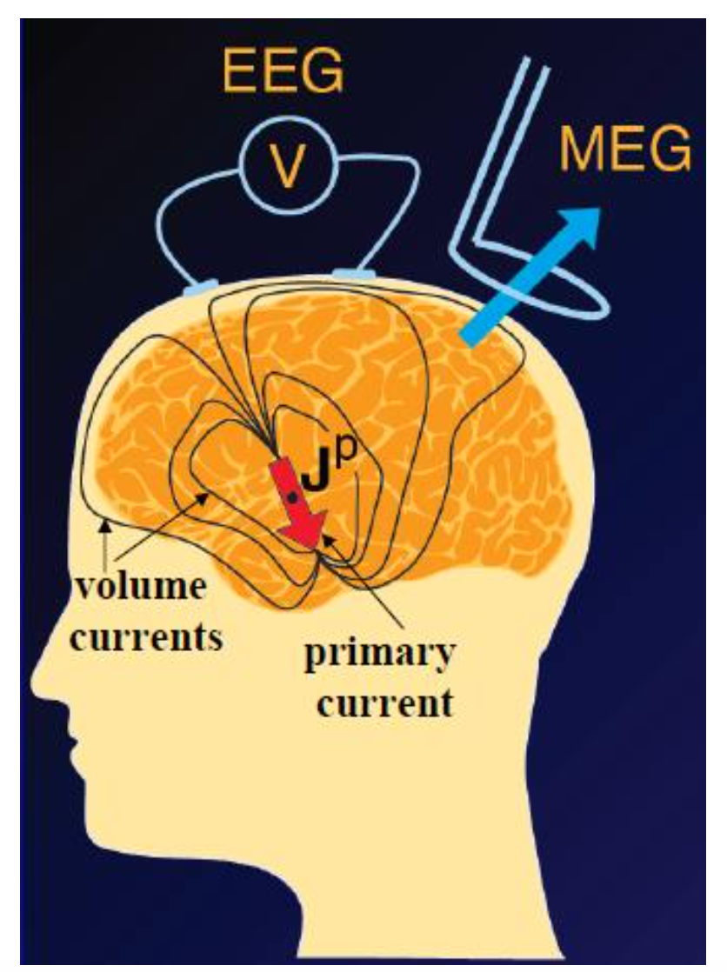
Why EEG and MEG ?
High temporal resolution
To capture direct brain activity and dynamics
Noninvasive and practical
Only tools to capture abnormal brain activity in neurological diseases such as epilepsy, Parkinson’s and schizophrenia

Slide 8
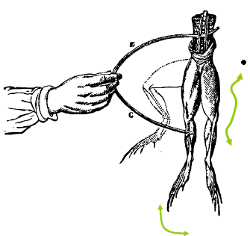
A brief history of electrophysiology
Luigi Galvani (1737-1798) : galvanic limb experiment
Hans Berger: Discovered EEG (1924)
David Cohen: Measured first MEG at MIT (1968)
Charles Ray & Charles Sherrington : stimulated dog brain, brain regionally specialized (1890)
Alessandro Volta (1745-1827): source is not the frog but the scalpel

Slide 9
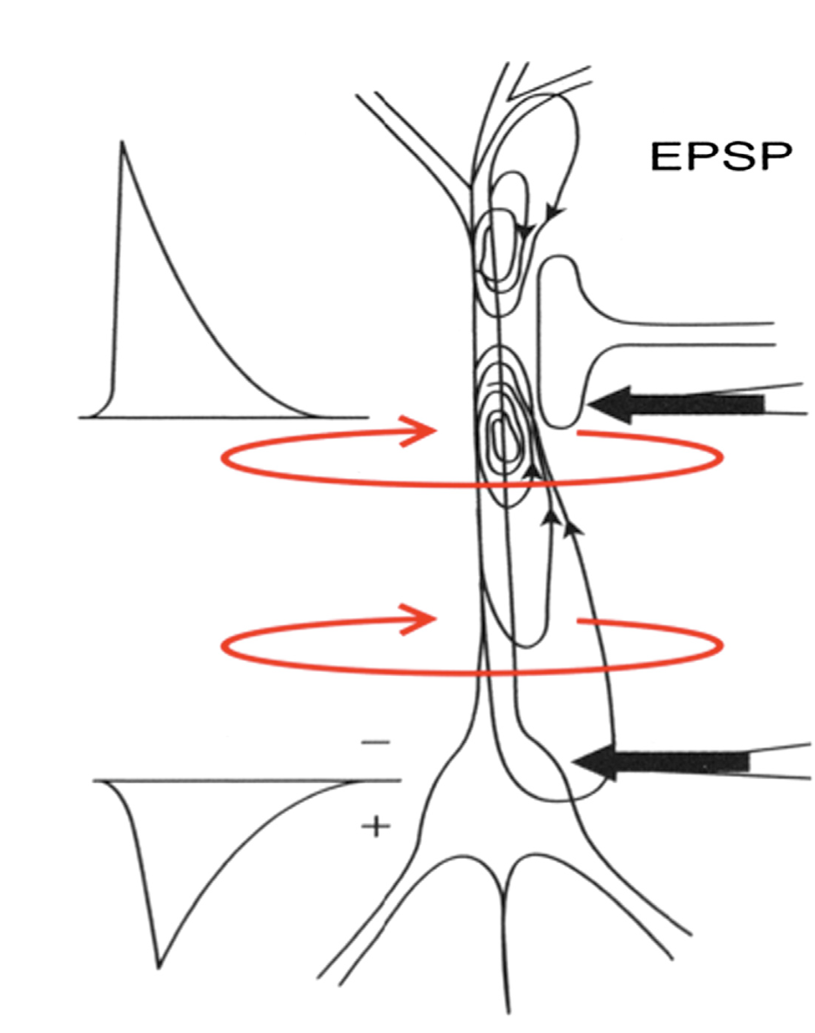
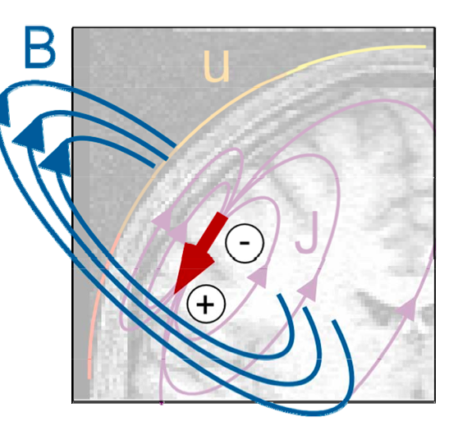
From neural activity to data
Synaptic neuronal activity causes electrical currents within the cell
A postsynaptic potential (PSP) emerges with action potential (change of membrane potential)
PSP: Excitatory & Inhibitory – The former might induce AP in the receiving neuron depending its synaptic input
Dipole: Representation of concentrated “primary current” produced by PSPs
Thousands of pyramidal neurons need to activate to “produce” dipoles and sensed by EEG and MEG
Dipole Q @ r_{Q}
Lopes da Silva, 2013

Slide 10
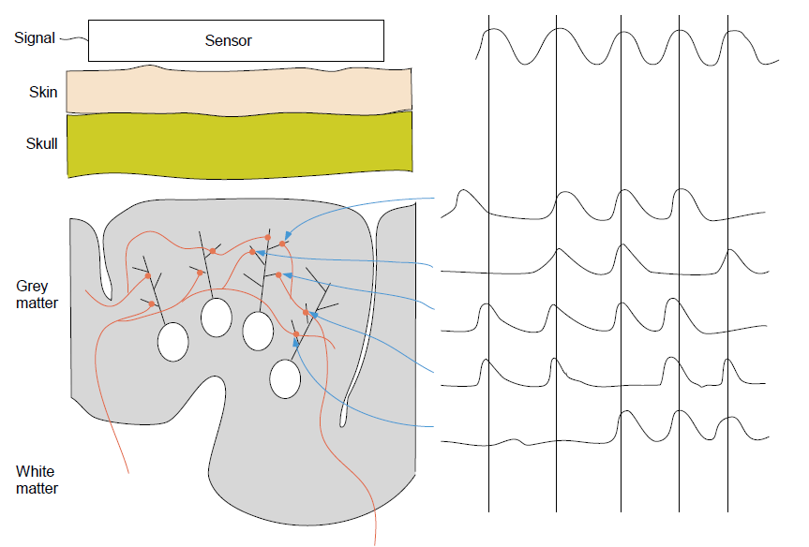
thousands of synchronously activated
large pyramidal cortical neurons leading to postsynaptic potentials at the dendrites (local field potentials)
Oostenveld, 2009

Slide 11
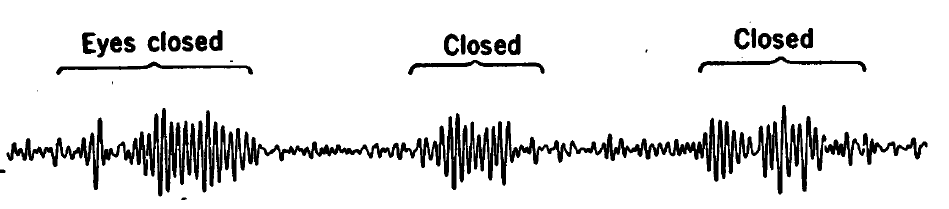
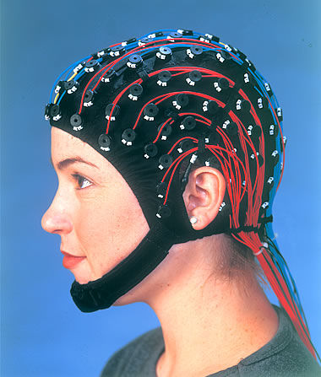
Dialectics of neural oscillations
Neural activity
(single neuron action potentials)
Summation of (excitatory / inhibitory ) postsynaptic potentials
Spatial average over many neurons
Oscillations (alpha, beta, gamma etc.)
Measured by LFP / EEG / MEG sensors

Slide 12
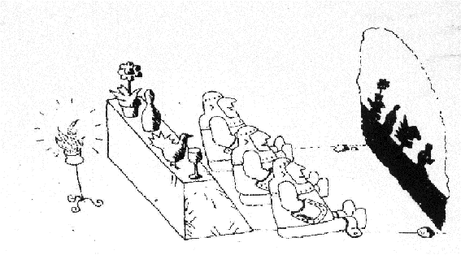
Forward problem
It is 1-1 mapping
Data are computed by this assumption
Truth is assumed to be known
ontological
B= L j
B : data
L: “leadfields”
j : brain sources

Slide 13
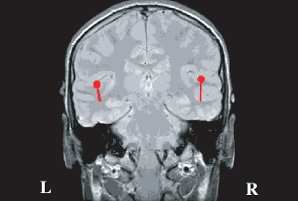
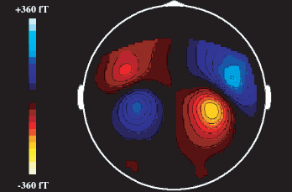
Forward problem
Calculate the magnetic fields (MEG) and electrical potentials (EEG) (outside the head and on the head surface) from a given primary source distribution within the brain
Source
the conductivity medium
Magnetic field
Electrical potential

Slide 14
Source and data spaces
data (M×1)
Leadfield vector @ r’
(they do not change with time)
Source @ r’
noise
- Current components orthogonal to the leadfield do not contribute data!
- Whose dimension is bigger, data space or source space?

Slide 15
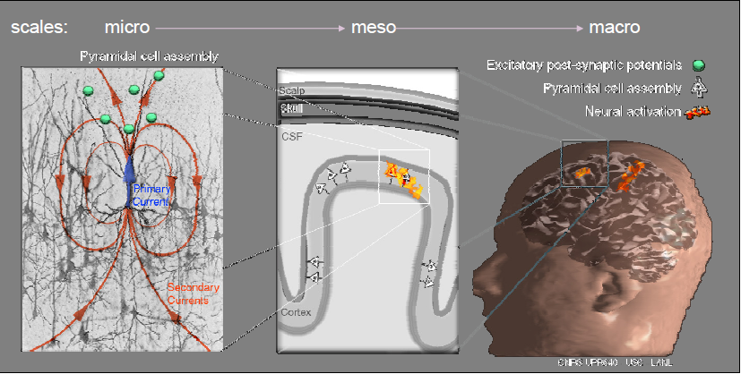
Maxwell equations
B and E vary in time slowly (below 1 KHz)
It is convenient to use quasistatic approximation of Maxwell equations to describe it
We are interested in primary currents J^{p}(r)

Slide 16
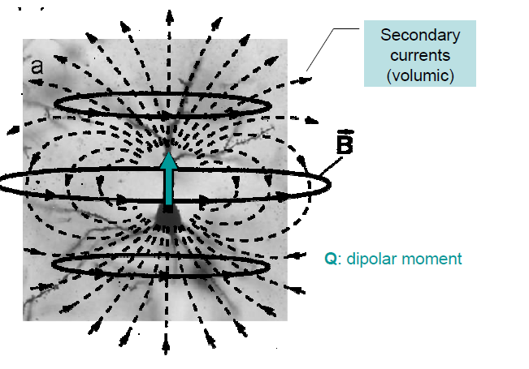
Extracellular
Primary
currents
Intracellular
Biot-Savart law

Slide 17
Unbounded homogenous medium
It is observed that in the homogenous space, the total current can be replaced by the primary current density only.
The volume (ohmic) current σ E does not contribute to neither B nor V, in this particular case.
Conductivity is constant everywhere
Simple enough but non-realistic
Primary magnetic field
Primary electrical potential

Slide 18
Piecewise homogenous conductor
The assumption is that the head consists of contiguous regions (brain, Cerebrospinal fluid, muscles, skull, scalp, etc.) which have constant isotropic conductivity i=1,…,M
Conductivity on the inner side of S_{ij}
n₃₄
S₂₃
n₁₂
S₁₂
S₁₃
G₂, σ₂
G₄, σ₄₌₀
G₁, σ₁
Conductivity on the outer side of S_{ij}
n₁₃
G₃, σ₃
S₃₄

Slide 19
EEG Forward problem
V₀ is the potential due to primary currents:
One has got to insert the conductivities and solve (*) to compute V(r) numerically – a tedious way
Once EEG forward problem is solved, the solution has to be given as input to the MEG forward problem
Fortunately, some “head models” having specific geometries yield pretty adequate solutions for MEG forward problem!

Slide 20
Realistic head models
In reality, our heads are anisotropic, inhomogeneous, nonspherical
Anatomical information can be obtained from MRI, X ray to solve the piecewise homogenous medium
BEM, FEM
They require accurate “conductivity” parameters and hundreds of storage and a lot of time to solve! (Computationally expensive)

Slide 21
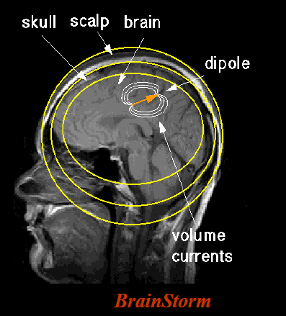
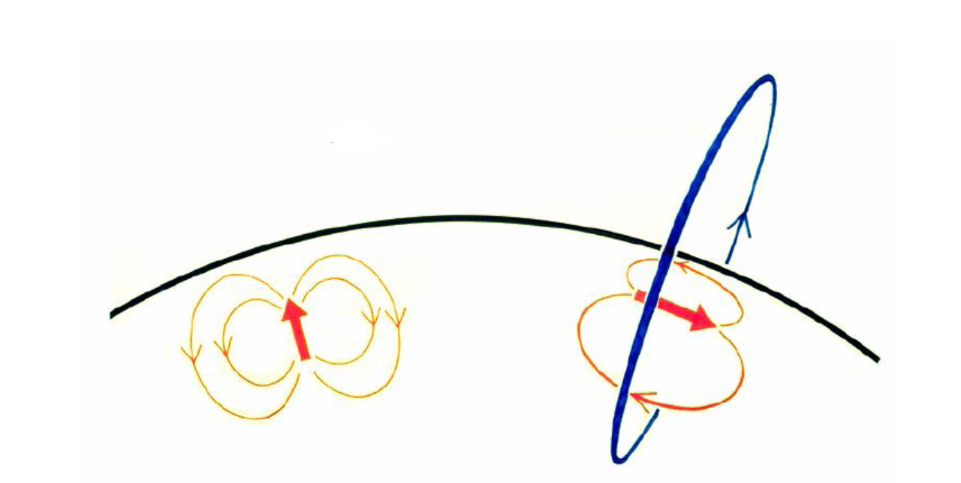
Spherically symmetric conductor for MEG
G is bounded and spherically symmetric with respect to the origin
Assume surfaces S_{ij} are concentric spheres
The magnetic field is not affected from concentric conductivities, which makes MEG a powerful tool to identify the primary currents
If Q is radial then Q x r_{Q} . r = 0 U=0, B(r)=0; that is if the source dipole is radial then B outside of G vanishes.
MEG is sensitive to only tangential components of the primary source density (Attention: only for ‘spherical’ heads – but our heads are not spheres!)
The forward solution with this model is reported to be pretty adequate for accuracy
radial source
tangential source
Sarvas’ formula
Sarvas , Phys. Med. Biol. ,1987

Slide 22
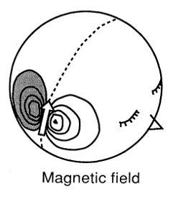
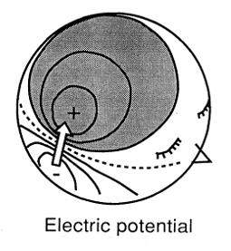
EEG & MEG
They both provide projections of primary source currents
Their sensitivity to current orientations differ
Instrumentation for MEG is much more expensive
Conductivities do not affect magnetic field as much as potential – hence MEG forward problem is easier to compute and better in accuracy
MEG is quicker and more practical to apply
MEG is more convenient and better for localization of epilepsy and Parkinson
They are in general complementary tools
Hämäläinen et al., 1993

Slide 23
Algebraic formulation
You need `orientation η and location r` for sensor and ‘orientation ϴ, location r_{q} and magnitude q ’ for source to solve the forward problem:
b(r)=a(r,r_{q},ϴ)q
- There are M sensors and N sources
B is data, S is source and L is the leadfield matrix whose each column expresses the forward solution for one of the sources.

Slide 24
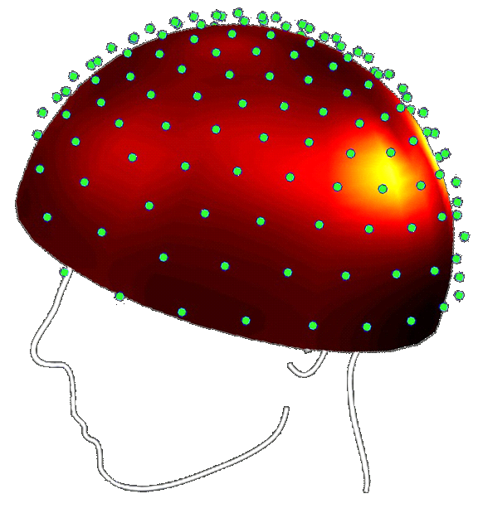
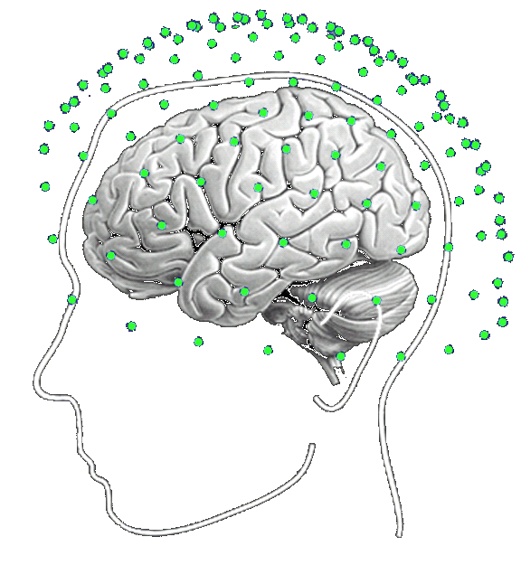
What is the forward problem for?
To obtain a model to identify source currents parameters in the brain, i.e., inverse solutions
These parameters are mainly source magnitudes, locations and orientations
Inverse Problem
B
s

Slide 25
Inverse problem
It is ill-posed (existence, uniqueness, stability may not hold)
Truth is unknown
s = ?
epistemological
Data is known
assumptions are required
B = L(s) + n
B : data
L : leadfield
s : brain sources
n: noise

Slide 26
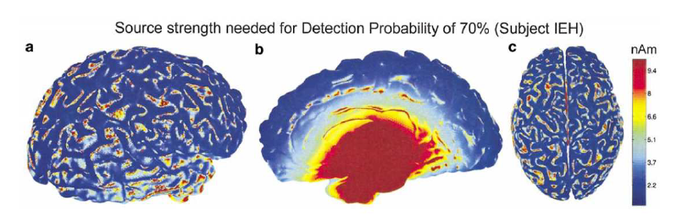
Can we really obtain all neuronal activity from M/EEG?
Physical and measurement based limitations
Sensitivity fades with the depth of the source
Remember: MEG might be blind or less sensitive to the currents in the radial direction
So you do not have the total information required to reconstruct an “exact” solution for neural sources
Hillebrand and Barnes, 2002

Slide 27
M/EEG Inverse Problem
M/EEG can localize neuronal activities using electromagnetic measurements with high temporal resolution
Its spatial resolution is limited by relatively small number of measurements and the physics behind
İll-posedness : different sources (neural distributions) may produce the same measurements
Solution: Force assumptions about the sources

Slide 28
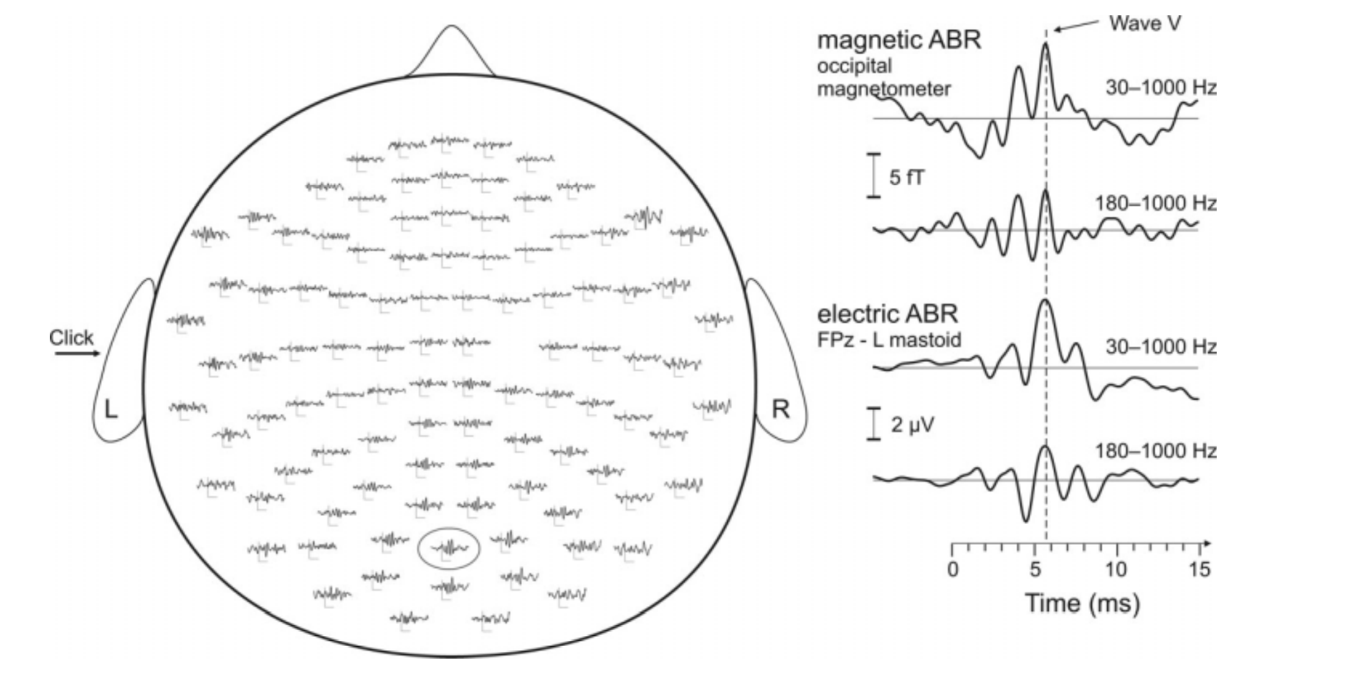
May one see “deep” sources by M/EEG?
Parkonen et al., 2009
ABR: Auditory Brainstem Responses

Slide 29
How to see / magnify the “deep” brain sources?
SNR should be kept high with “averaging” over many trials
“Advanced” signal processing and filtering methods such as
(Özkurt et al., 2008, 2009) also may be applied
Employing “realistic head models” for forward problem may enable to see deeper sources:
  Hippocampus (Riggs et al., 2008; Pu et al., 2017)
  Thalamus (Tesche et al., 2002)
  Cerebellum (Timmerman et al., 2002; Martin et al., 2006)
  …

Slide 30
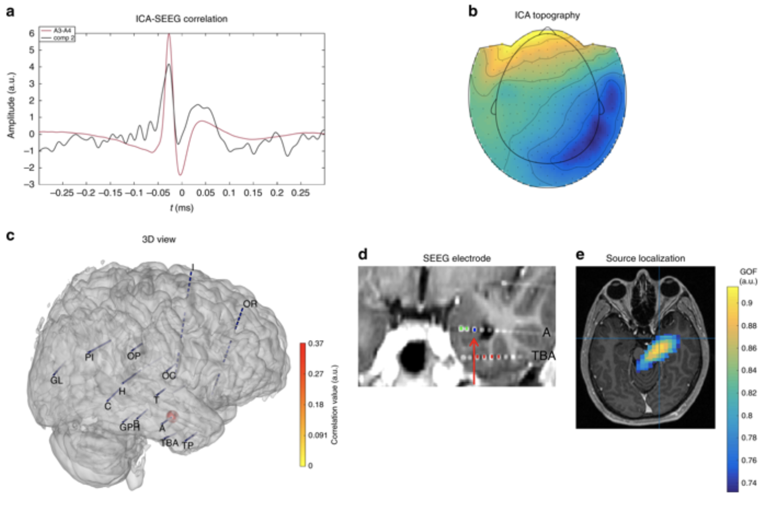
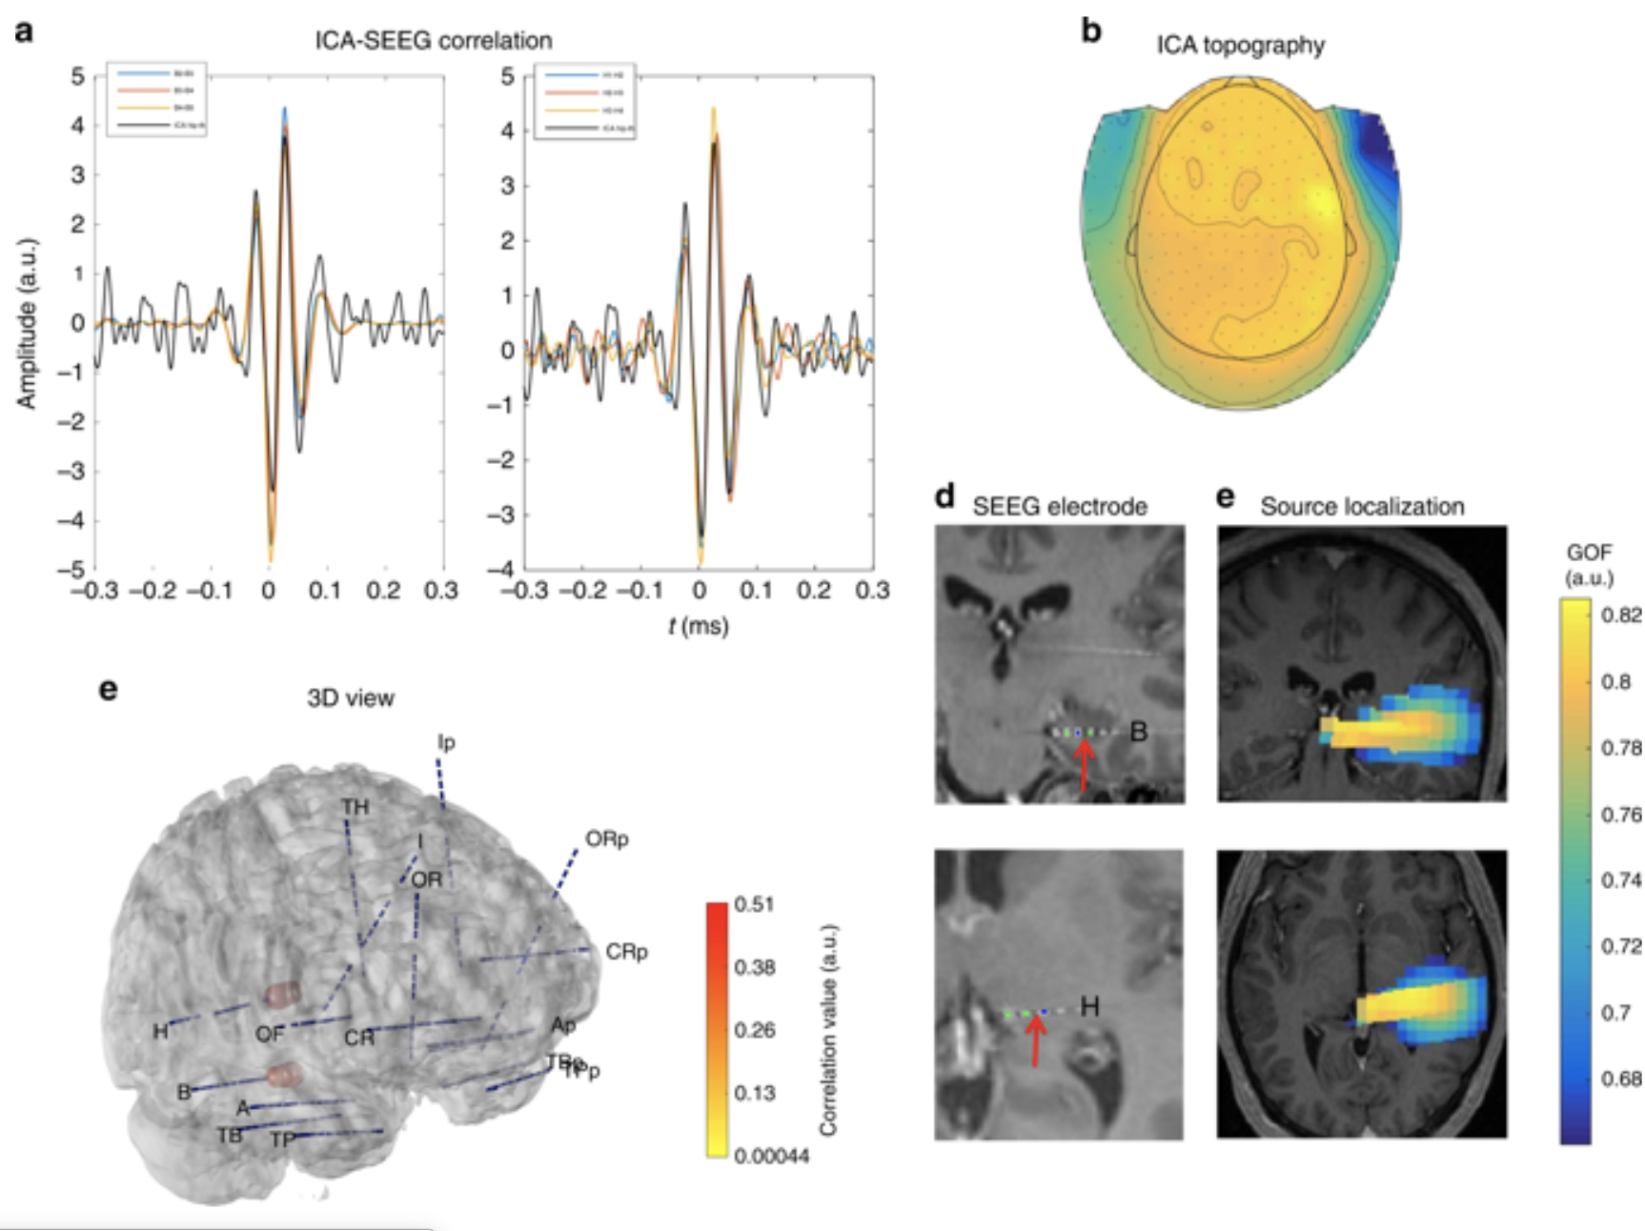
Are those deep signals “real” or artifacts?
amygdala
Hippocampus and thalamus
Pizzo et al., Deep brain activities can be detected with magnetoencephalography,
Nature Communications, 2019.

Slide 31
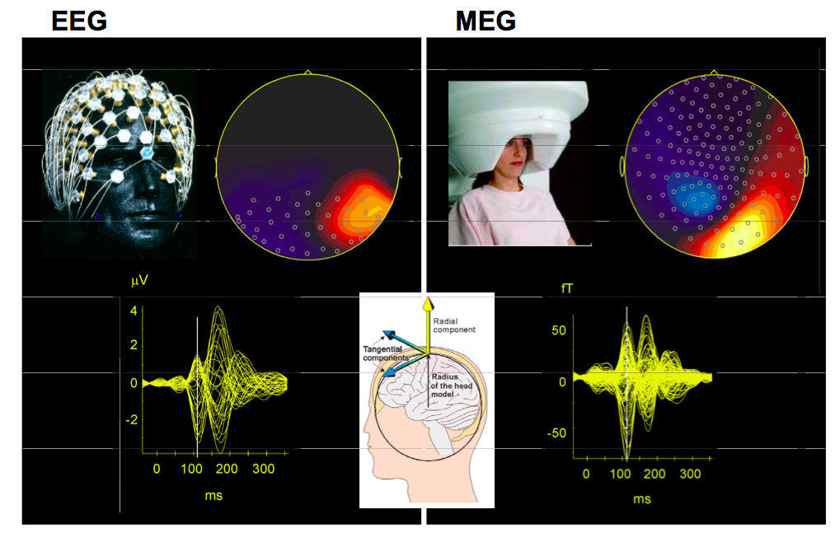
Instrumentation for EEG and MEG

Slide 32
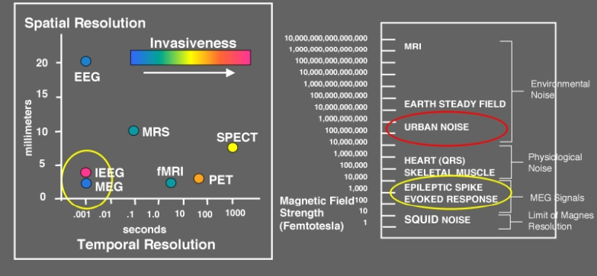

Slide 33
EEG | MEG
Measures electrical potential differences On the scalp ~ 0.1-5 μV Bipolar / monopolar Ag -Ag Cl electrodes Reference electrodes are used (nasion, linked mastoids, common average) Skin preparation essential (abrasion and cleansing) Seated better | Measures flux of magnetic fields A few cm’s away from the scalp 10-50 fT SQUIDs, Type: Magnetometers / gradiometers No reference needed Magnetically shielded room & helium tubes required Supine / seated

Slide 34
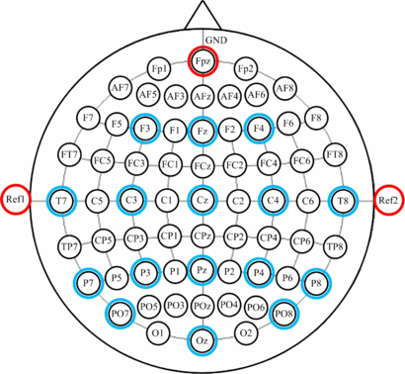
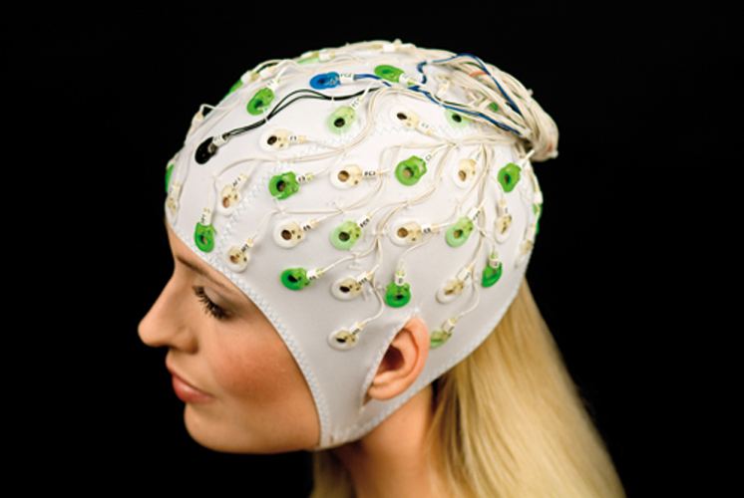
EEG electrodes and referencing
Bipolar montage: Electrodes in pairs, potential differences obtained in each pair
Monopolar montage: Potential differences obtained with respect to a reference electrode
Zhang et al., 2012
www.brainproducts.com

Slide 35
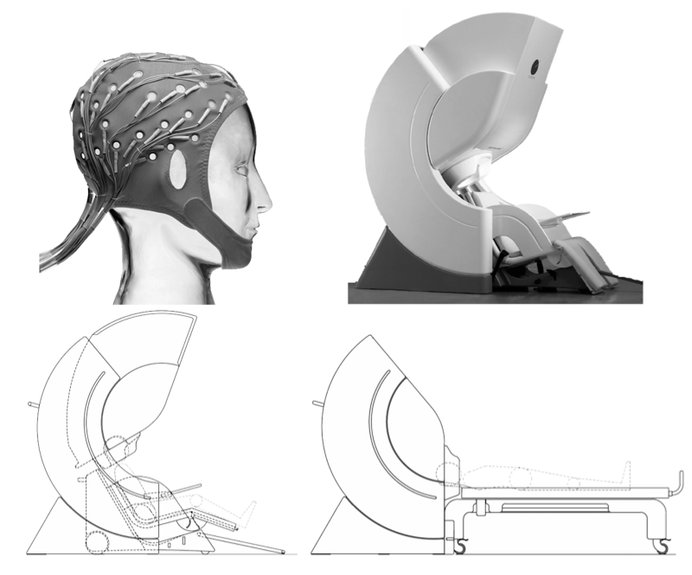
EEG
MEG
seated
supine
Baillet, 2010

Slide 36
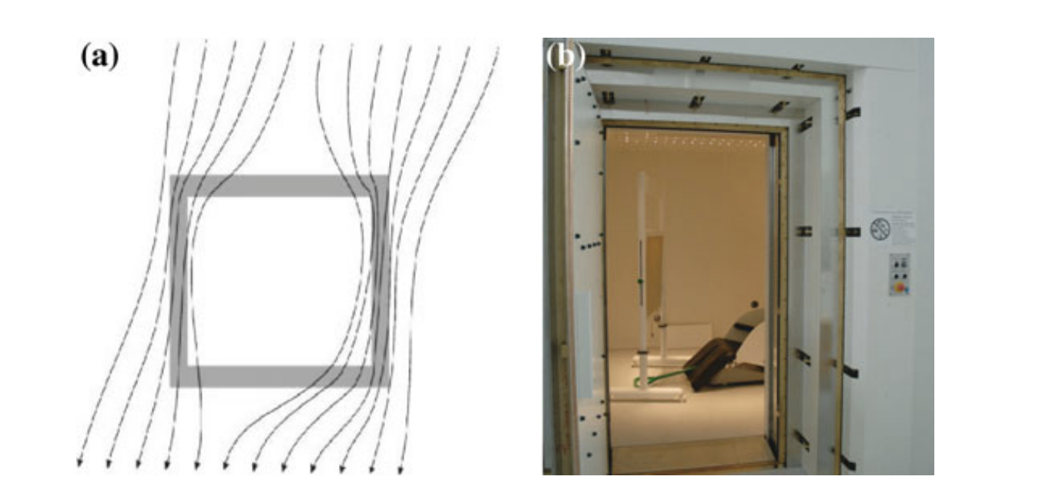
Magnetically shielded room
Made of aluminum and mu-metal shells
Passively shields the environmental magnetic disturbances such as the ones stemming from elevators, electric motors, trains etc.
Taulu et al., 2014

Slide 37
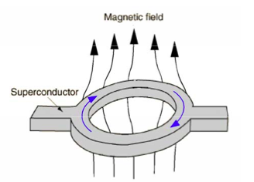
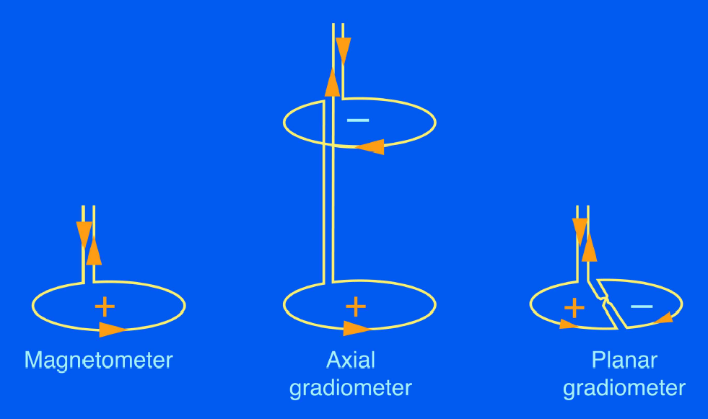
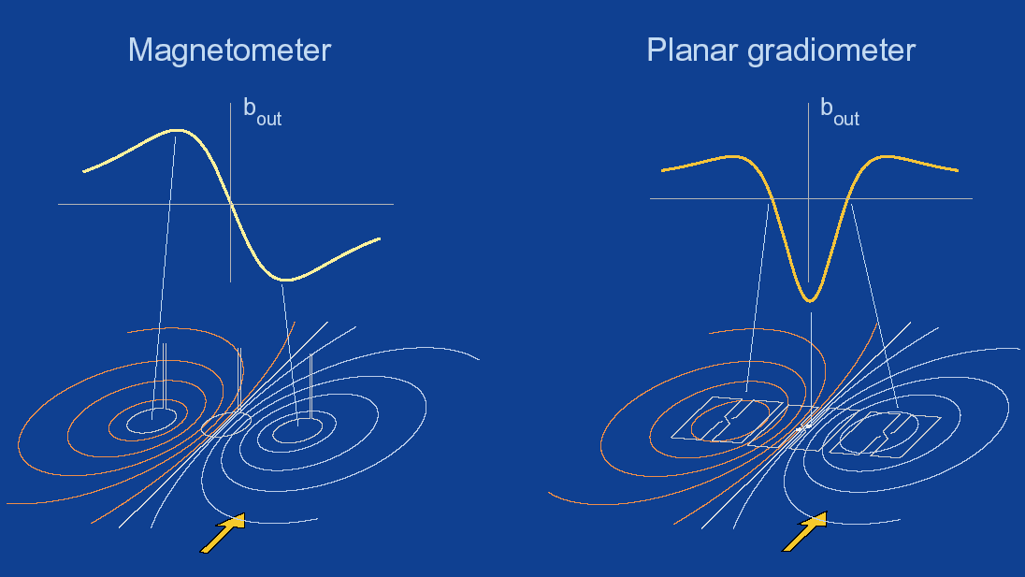
MEG sensor types
Magnetometer: B_{z}
Axial gradiometer: dB_{z} /dz
Planar gradiometer: dB_{z} /dx
- MEG systems have their own sensor types
Magnetometers sense deep sources better; but they are noisier than gradiometers
Gradiometers are “good” to cancel out the noise
They eliminate homogeneous magnetic disturbances of distant external noise sources
(For details, see Hamalainen, 1993: page 445)

Slide 38
Summing up…
M/EEG provide ms level high temporal resolution of brain activity
M/EEG signals are produced by tens of thousands of neuronal activations leading to sum of postsynaptic potentials
  Predominantly cortical pyramidal neurons
MEG is less vulnerable to anisotropic brain conductivity
EEG is more sensitive to radial sources than MEG
They are produced by same electrical neural sources with different physical mappings and are complementary techniques
Forward models are necessary to pass from sensor level to source level

