Slide 1
Bayesian Model Selection and Averaging
SPM for MEG/EEG course
Peter Zeidman
May 2019

Slide 2
Contents
DCM recap
Comparing models
Bayes rule for models, Bayes Factors
Rapidly evaluating models
Bayesian Model Reduction
Investigating the parameters
Bayesian Model Averaging
Multi-subject analysis
Parametric Empirical Bayes

Slide 3
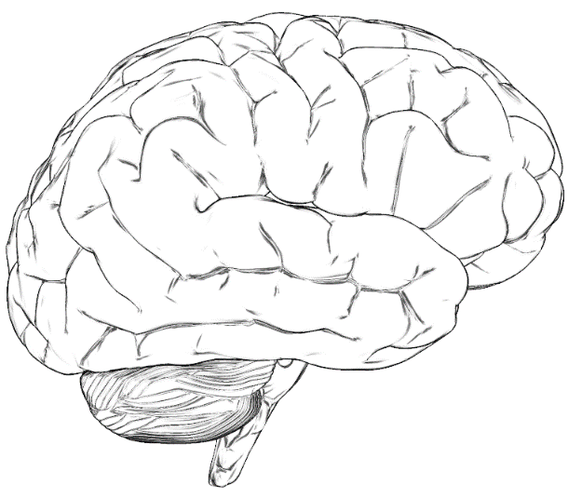
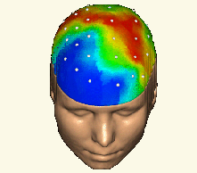







Forward Problem
$$p(Y|θ,m)$$
Model
$$m$$
Likelihood
Data $Y$
Parameters
$$θ$$
Posterior Evidence
$$p(θ|Y,m)$$
$$p(Y|m)$$
With priors
$$p(θ|m)$$
Inverse Problem
Adapted from a slide by Rik Henson

Slide 4
DCM Recap
Priors determine the structure of the model
Stimulus
R1
R2
Stimulus
R1
R2
Connection ‘on’
Connection ‘off’
Probability
0
0
Prior Connection strength (Hz)
Prior Connection strength (Hz)

Slide 5
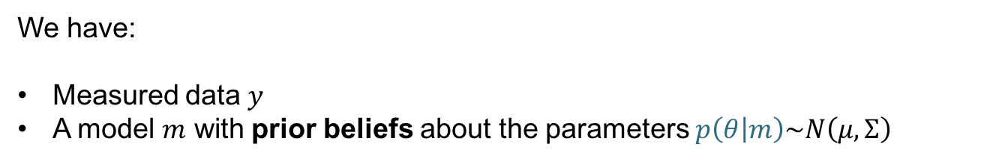

DCM Recap
We have:
Measured data $y$
A model $m$ with prior beliefs about the parameters $p\left(θ | m\right)\sim N\left(μ,Σ\right)$
Model estimation (inversion) gives us:
A score for the model, which we can use to compare it against other models
$F≅\log{p\left(y | m\right)=\text{accuracy}−\text{complexity}}$
Free energy
2. Estimated parameters – i.e. the posteriors $p(θ|m,y)\sim N\left(μ,Σ\right)$
$μ$: DCM.Ep – expected value of each parameter
$Σ$: DCM.Cp – covariance matrix

Slide 6
DCM Framework
We embody each of our hypotheses in a generative model. Each model differs in terms of connections that are present are absent (i.e. priors over parameters).
We perform model estimation (inversion)
We inspect the estimated parameters and / or we compare models to see which best explains the data.

Slide 7
Contents
DCM recap
Comparing models
Bayes rule for models, Bayes Factors
Rapidly evaluating models
Bayesian Model Reduction
Investigating the parameters
Bayesian Model Averaging
Multi-subject analysis
Parametric Empirical Bayes

Slide 8
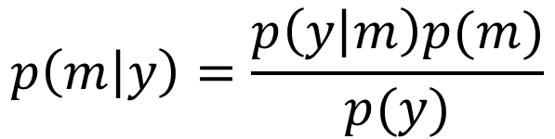
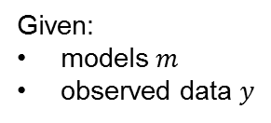

Bayes Rule for Models
Question: I’ve estimated 10 DCMs for a subject. What’s the posterior probability that any given model is the best?
Model evidence
Probability of each model given the data
Prior on each model

Slide 9
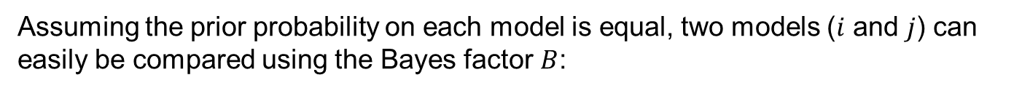
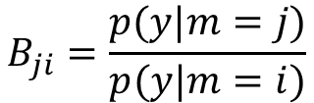

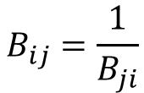

Bayes Factors
Ratio of model evidence
From Raftery et al. (1995)
Note: The free energy approximates the log of the model evidence. So the log Bayes factor is:

Slide 10
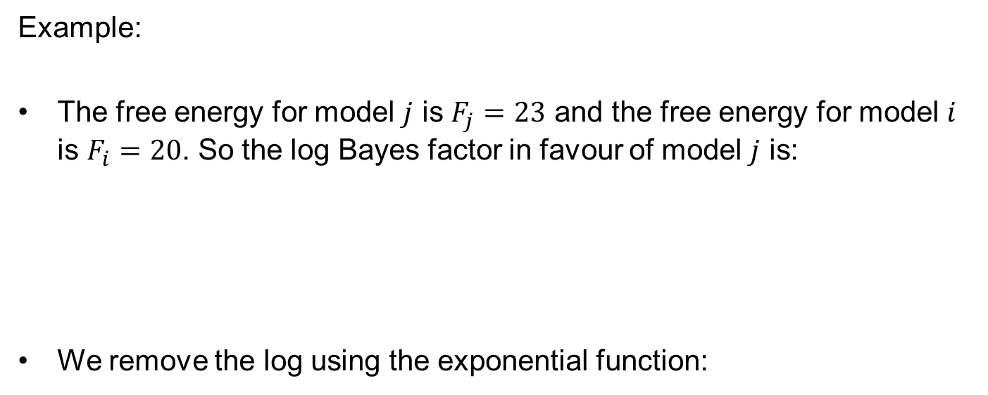
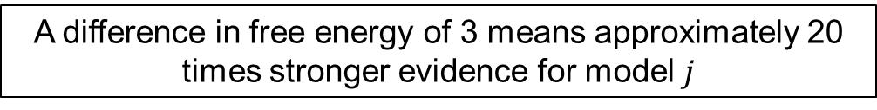

Bayes Factors
Example:
The free energy for model $j$ is $F_{j}=23$ and the free energy for model $i$ is $F_{i}=20$. So the log Bayes factor in favour of model $j$ is:
We remove the log using the exponential function:
$$\ln{{BF}_{j}}=\ln{p\left(y | m_{j}\right)}−\ln{p\left(y | m_{i}\right)}=F_{j}−F_{i}=23−20=3$$
${BF}_{j}=\exp\left(3\right)≈20$
A difference in free energy of 3 means approximately 20 times stronger evidence for model $j$

Slide 11
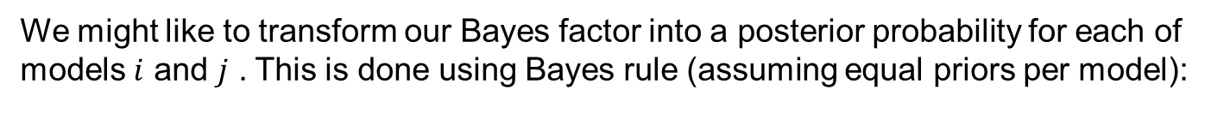

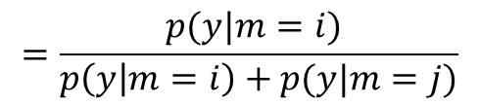
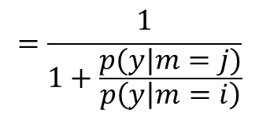



Bayes Factors cont.
Posterior probability of a model is
the sigmoid function of the log Bayes factor

Slide 12
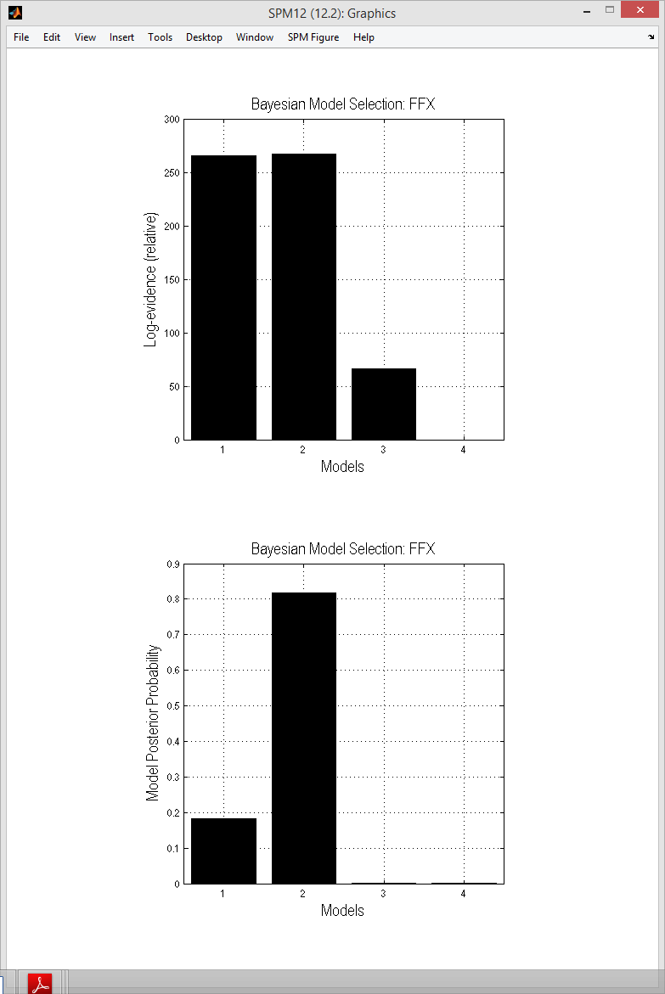




Log BF relative to worst model
Posterior probabilities

Slide 13
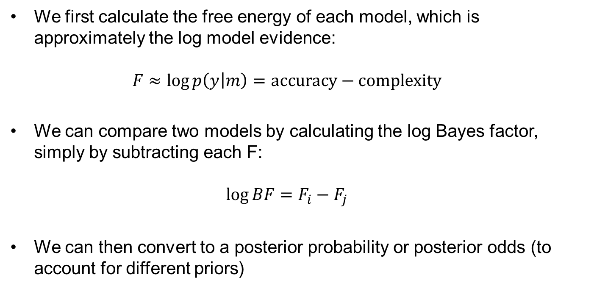
Interim summary

Slide 14
Contents
DCM recap
Comparing models
Bayes rule for models, Bayes Factors
Rapidly evaluating models
Bayesian Model Reduction
Investigating the parameters
Bayesian Model Averaging
Multi-subject analysis
Parametric Empirical Bayes

Slide 15







Bayesian model reduction (BMR)
Full model
Model inversion (VB)
Priors:
Nested / reduced model
X
Bayesian Model Reduction (BMR)
Priors:
Friston et al., Neuroimage, 2016

Slide 16
Contents
DCM recap
Comparing models
Bayes rule for models, Bayes Factors
Rapidly evaluating models
Bayesian Model Reduction
Investigating the parameters
Bayesian Model Averaging
Multi-subject analysis
Parametric Empirical Bayes

Slide 17

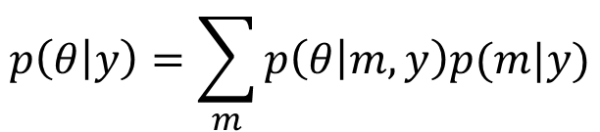
Bayesian Model Averaging (BMA)
Having compared models, we can look at the parameters (connection strengths). We average over models, weighted by the posterior probability of each model. This can be limited to models within the winning family.
SPM does this using sampling

Slide 18
Contents
DCM recap
Comparing models
Bayes rule for models, Bayes Factors
Rapidly evaluating models
Bayesian Model Reduction
Investigating the parameters
Bayesian Model Averaging
Multi-subject analysis
Parametric Empirical Bayes

Slide 19


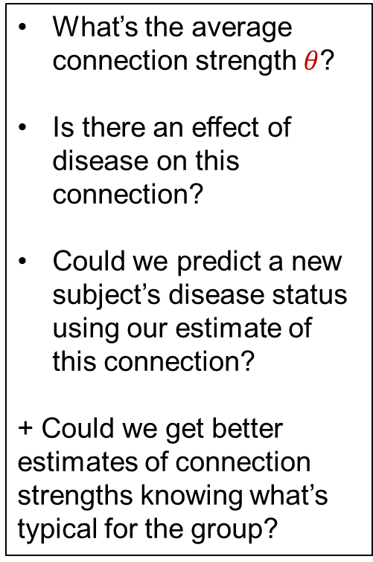

Hierarchical model of parameters
What’s the average connection strength $θ$?
Is there an effect of disease on this connection?
Could we predict a new subject’s disease status using our estimate of this connection?
+ Could we get better estimates of connection strengths knowing what’s typical for the group?
Group
Mean
Disease
First level DCM
$$θ$$
Image credit: Wilson Joseph from Noun Project

Slide 20



Hierarchical model of parameters
Parametric Empirical Bayes
Priors on second level parameters
Second level
Between-subject error
Second level (linear) model
First level
Measurement noise
DCM for subject i
Image credit: Wilson Joseph from Noun Project

Slide 21







GLM of connectivity parameters
$$θ^{(1)}=Xθ^{(2)}+ε^{(2)}$$
Unexplained between-subject variability
Design matrix
(covariates)
Group level parameters
Between-subjects effects
1
Group average connection strength
2
3
$$=$$
Effect of group on the connection
Subject
Subject
$$×$$
4
5
Effect of age on the connection
6
1
2
3
Covariate
$$θ^{(1)}$$
$$X$$
$$θ^{(2)}$$

Slide 22

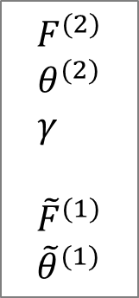

PEB Estimation
First level
Second level
DCMs
Subject 1
.
PEB Estimation
.
Subject N
First level free
energy / parameters
with empirical priors

Slide 23
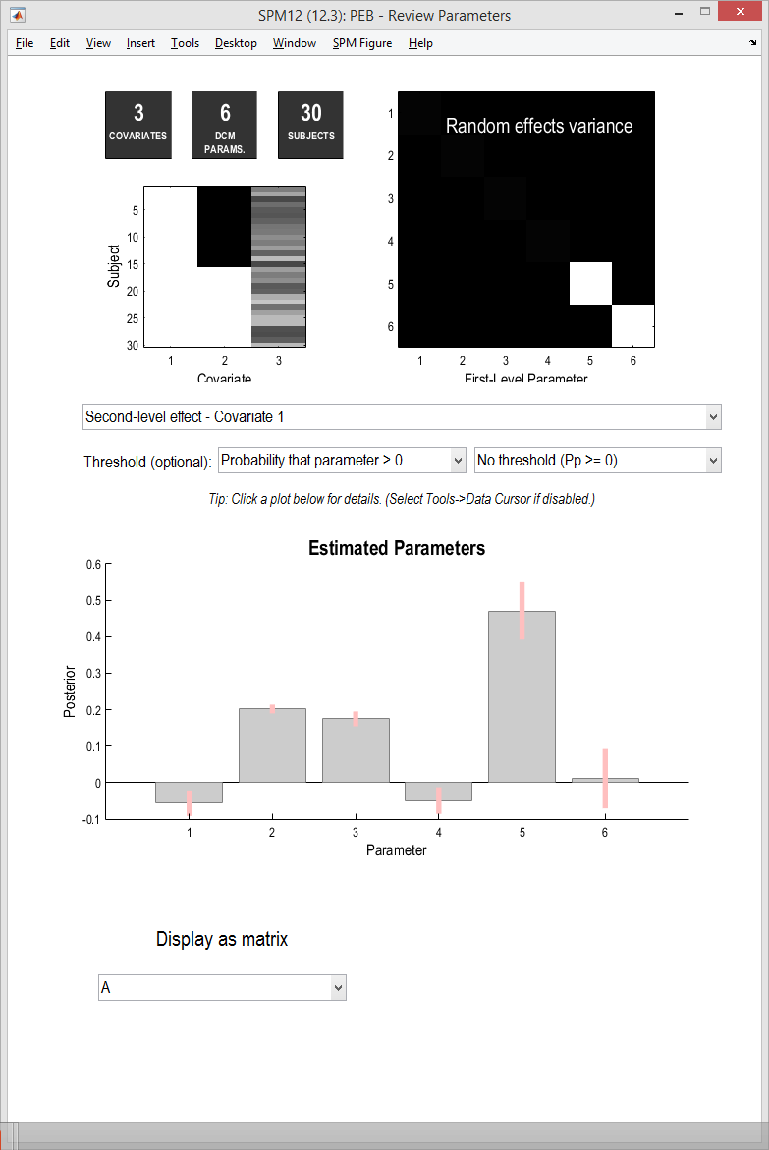
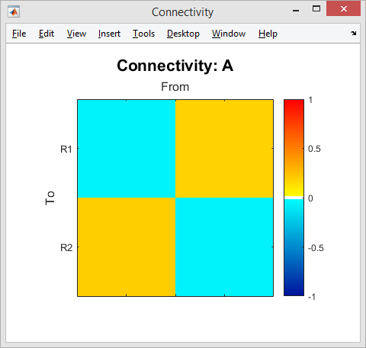
spm_dcm_peb_review

Slide 24
PEB Advantages / Applications
Properly conveys uncertainty about parameters from the subject level to the group level
Can improve first level parameters estimates
Can be used to compare specific reduced PEB models (switching off combinations of group-level parameters)
Or to search over nested models (BMR)
Prediction (leave-one-out cross validation)

Slide 25
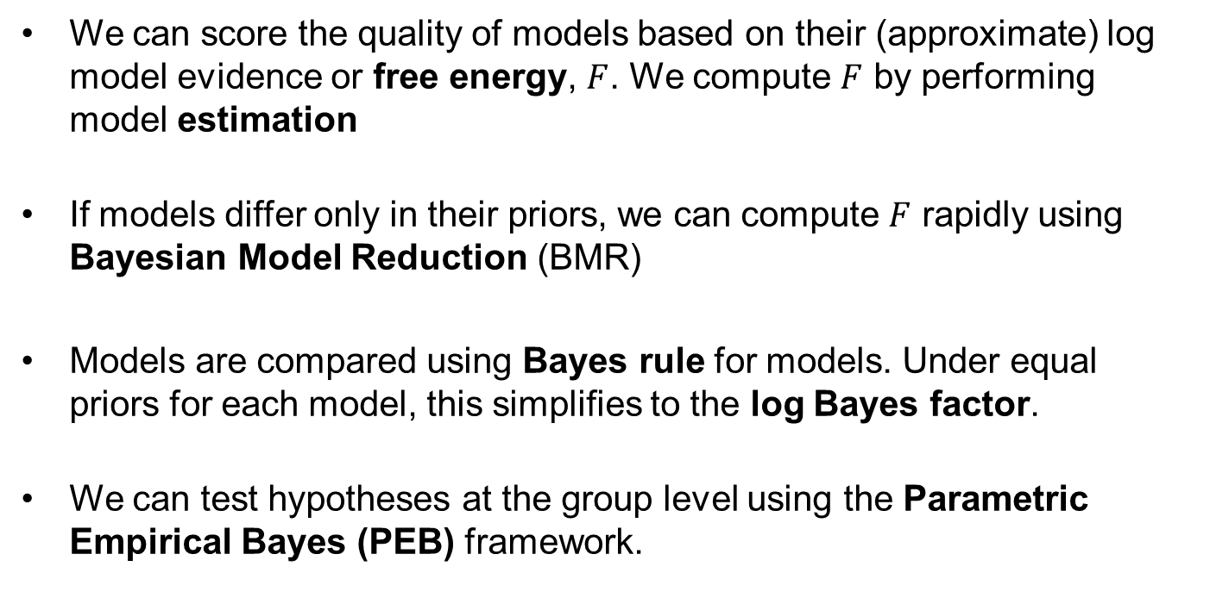
Summary
We can score the quality of models based on their (approximate) log model evidence or free energy, $F$. We compute $F$ by performing model estimation
If models differ only in their priors, we can compute $F$ rapidly using Bayesian Model Reduction (BMR)
Models are compared using Bayes rule for models. Under equal priors for each model, this simplifies to the log Bayes factor.
We can test hypotheses at the group level using the Parametric Empirical Bayes (PEB) framework.

Slide 26

Further reading
PEB tutorial: https://github.com/pzeidman/dcm-peb-example
Free energy:
Penny, W.D., 2012. Comparing dynamic causal models using AIC, BIC and free energy. Neuroimage, 59(1), pp.319-330.
Parametric Empirical Bayes (PEB):
Friston, K.J., Litvak, V., Oswal, A., Razi, A., Stephan, K.E., van Wijk, B.C., Ziegler, G. and Zeidman, P., 2015. Bayesian model reduction and empirical Bayes for group (DCM) studies. NeuroImage.
Thanks to Will Penny for his lecture notes: http://www.fil.ion.ucl.ac.uk/~wpenny/

Slide 27
extras

Slide 28
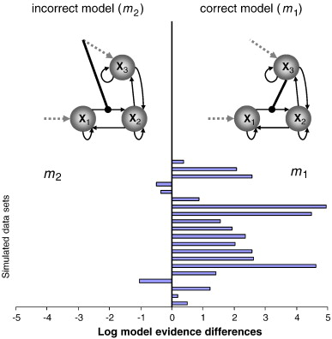
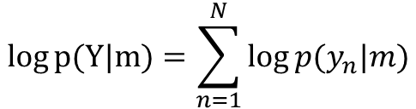
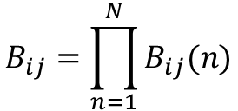
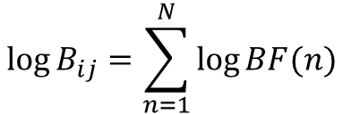
Fixed effects (FFX)
FFX summary of the log evidence:
Group Bayes Factor (GBF):
Stephan et al., Neuroimage, 2009

Slide 29
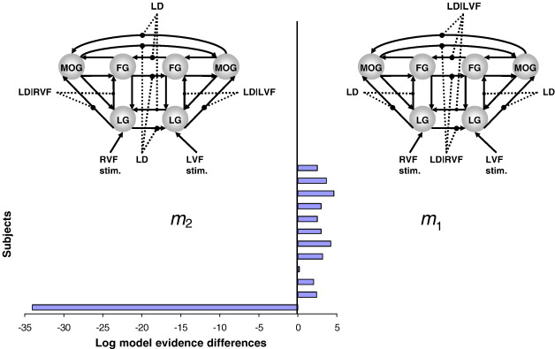
Fixed effects (FFX)
11 out of 12 subjects favour model 1
GBF = 15 (in favour of model 2).
So the FFX inference disagrees with most subjects.
Stephan et al., Neuroimage, 2009

Slide 30
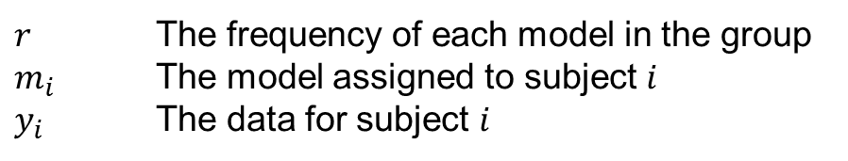


Random effects (RFX)
SPM estimates a hierarchical model with variables:
Outputs:
This is a model of models
Expected probability of model 2
Exceedance probability of model 2
Stephan et al., Neuroimage, 2009

Slide 31
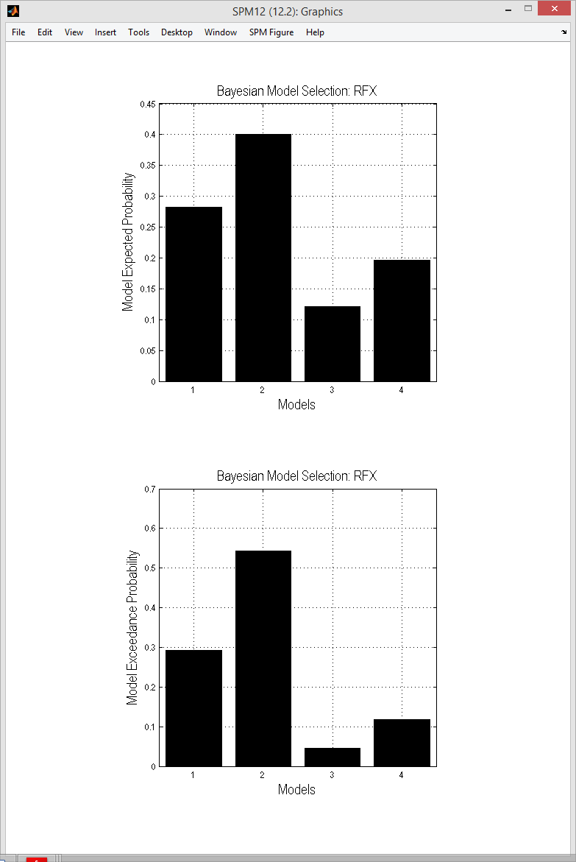
Expected probabilities
Exceedance probabilities

Slide 33


Variational Bayes
Approximates:
The log model evidence:
Posterior over parameters:
The log model evidence is decomposed:
The difference between the true and
approximate posterior
Free energy (Laplace approximation)
Accuracy
-
Complexity

Slide 34
The Free Energy
Accuracy
-
Complexity
Complexity
Distance between
prior and posterior
means
Occam’s factor
Volume of
prior parameters
posterior-prior
parameter means
Prior precisions
Volume of
posterior parameters
(Terms for hyperparameters not shown)

Slide 35




Bayes Factors cont.
If we don’t have uniform priors, we can easily compare models i and j using odds ratios:
The Bayes factor is still:
The prior odds are:
The posterior odds are:
So Bayes rule is:
eg. priors odds of 2 and Bayes factor of 10 gives posterior odds of 20
“20 to 1 ON” in bookmakers’ terms

Slide 36
Dilution of evidence
If we had eight different hypotheses about connectivity, we could embody each hypothesis as a DCM and compare the evidence:
Problem: “dilution of evidence”
Similar models share the probability mass, making it hard for any one model to stand out
Models 5 to 8 have ‘bottom-up’ connections
Models 1 to 4 have ‘top-down’ connections

Slide 37
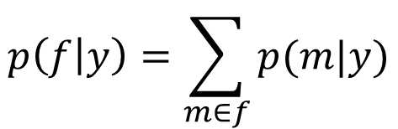
Family analysis
Grouping models into families can help. Now, one family = one hypothesis.
Family 1: four “top-down” DCMs
Posterior family probability:
Family 2: four “bottom-up” DCMs
Comparing a small number of models or a small number of families helps avoid the dilution of evidence problem

Slide 38
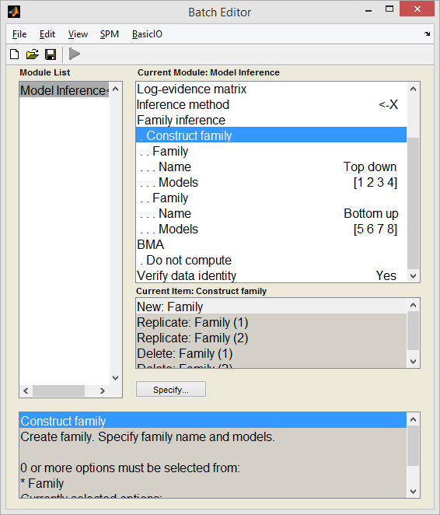
Family analysis

Slide 39



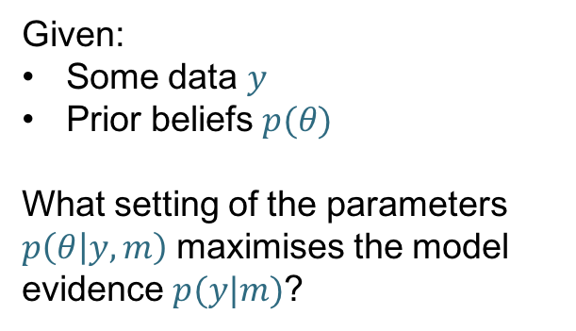

Timing of stimulus
Generative model (DCM) $m$
time
Forward problem
What data would we expect to measure given this model and a particular setting of the parameters?
$$p(y|m,θ)$$
Inverse Problem
Given:
Some data $y$
Prior beliefs $p(θ)$
What setting of the parameters $p\left(θ | y,m\right)$ maximises the model evidence $p(y|m)$?
Parameter $θ_{(i)}$
e.g. the strength of
a connection
Predicted data (e.g. ERP)
Image credit: Marcin Wichary, Flickr

