Slide 1
Introduction to DCM for fMRI
Sarah Gregory
Huntington’s Research Centre, UCL
November 2019

Slide 2
Contents
fMRI Connectivity
Overview of DCM
Model specification
Model estimation
Model comparison

Slide 3
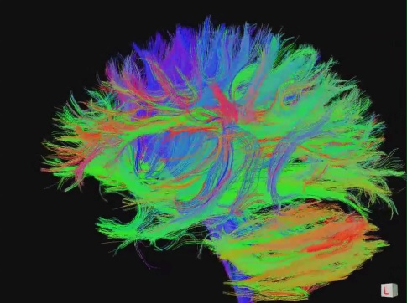
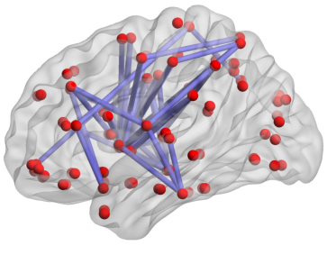
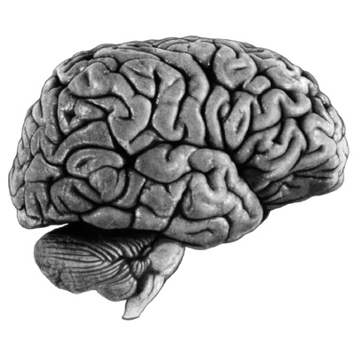
Types of connectivity
Structural Connectivity
Physical connections of the brain
Functional Connectivity
Dependencies between BOLD observations
Effective Connectivity
Causal relationships between brain regions

Slide 4
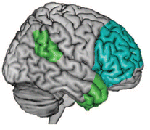
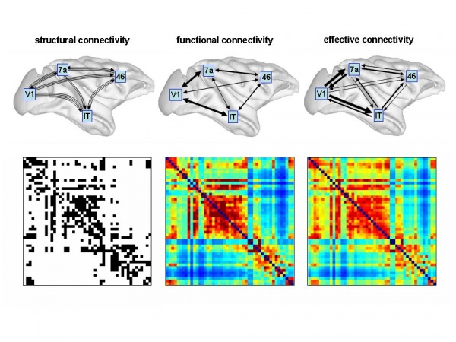

fMRI Connectivity Analysis
Specialisation Integration
Functional Connectivity
Temporally-correlated spatially-distinct regions
Notes:
Analyse fMRI in two ways: Localising function to a specific brain region OR Identifying ways in which specialised regions form a network
Functional Connectivity – Descriptive – spatially distinct – temporally correlated regions – not mechanistic or directed – SYMMETRIC
4

Slide 5
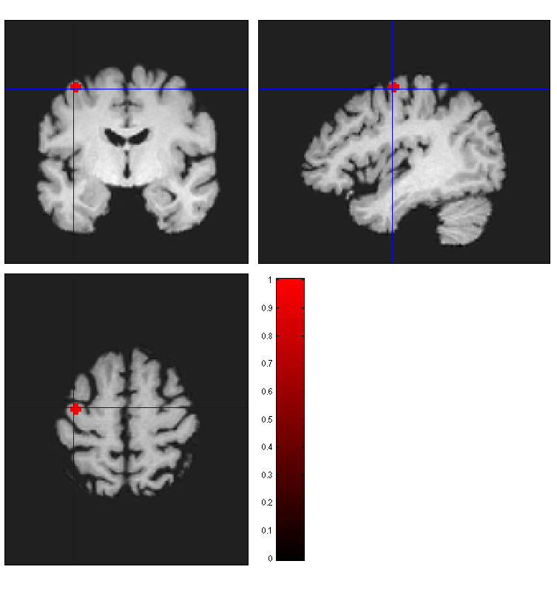
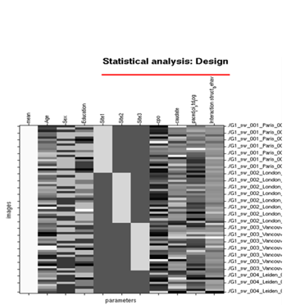
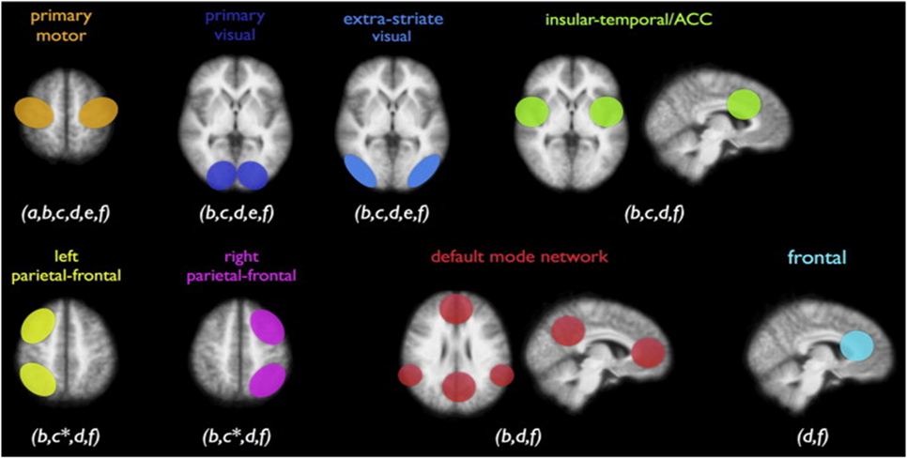
fMRI Connectivity Analysis:
Seed-based
Left Primary Motor Cortex
-Choose your ROI
-Extract Principal EV for each ppt.
-Temporally correlate activity in seed with all other voxels in the brain

Slide 6
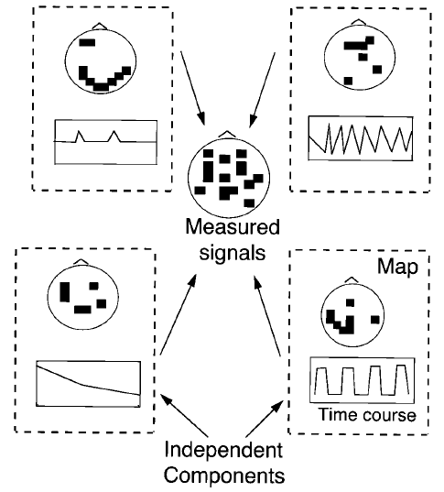
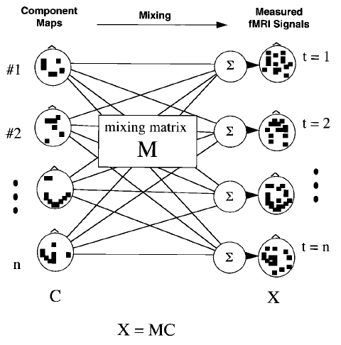
fMRI Connectivity Analysis:
ICA
The goal of ICA is to discover both the inputs
and how they were mixed.
Observed data =
sum of a set of inputs

Slide 7
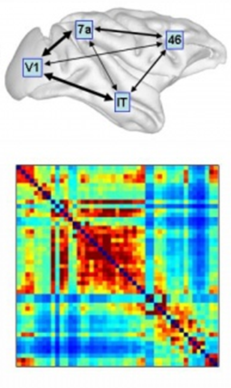

fMRI Connectivity Analysis
Specialisation Integration
Effective Connectivity
The influence one neuronal system exerts over another
Mechanistic and Causal
Functional Connectivity
Temporally-correlated spatially-distinct regions
Notes:
Analyse fMRI in two ways: Localising function to a specific brain region OR Identifying ways in which specialised regions form a network
Functional Connectivity – Descriptive – spatially distinct – temporally correlated regions – not mechanistic or directed – SYMMETRIC
Effective Connectivity – mechanistic – looks at effect of one neuronal system on another – ASYMMETRIC = what we use in TrackOn
7

Slide 8
Contents
fMRI Connectivity
Overview of DCM
Model specification
Model estimation
Model comparison

Slide 9
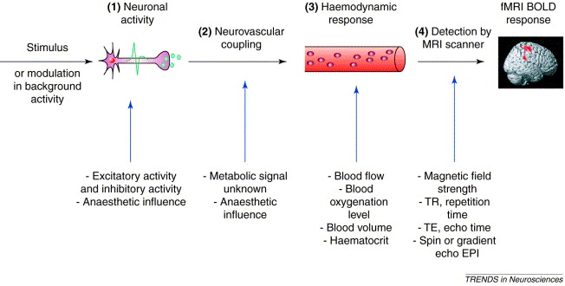
fMRI
Arthurs and Boniface, TINS, 2002

Slide 10
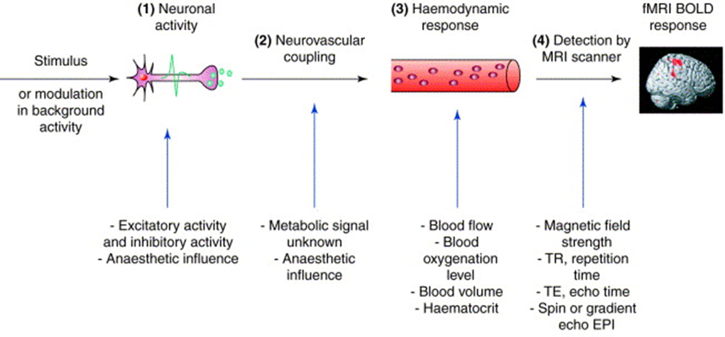
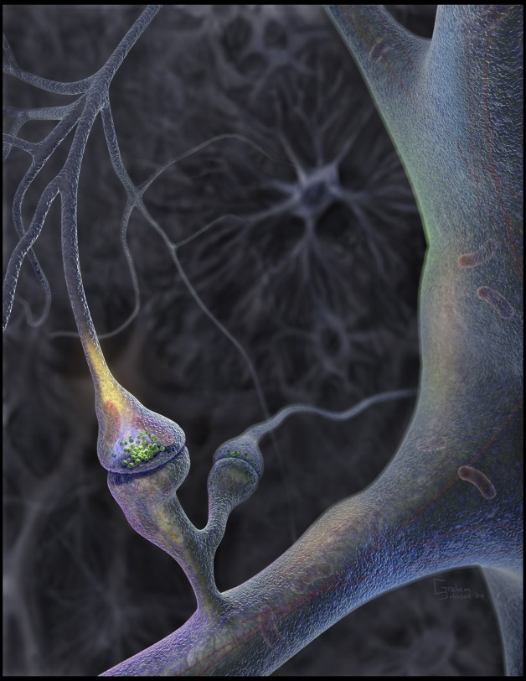
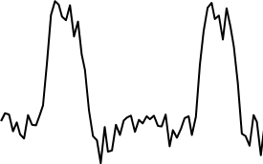
FORWARD PROBLEM:
PREDICT MEASURED DATA
GIVEN THE MODEL
Timeseries
Generative model
signal
Model inversion
INVERSE PROBLEM:
GIVEN MEASURED DATA
ESTIMATE THE MODEL
MODEL ESTIMATION/INVERSION
time

Slide 11
.
The aim of DCM is to estimate
parameters at the neuronal level such
that the modelled and measured
BOLD signals are optimally similar.
Notes:
DCM – effective connectivity
Developed for ‘deterministic systems’ - the effects of external stimuli on the connections within a specified network – where do exogenous inputs modulate connectivity
Way in which this done – Series of models, hypotheses – choose regions. Each modelled with a neural model and a haemodynamic model.
4) Explain neuronal state equation – a) intrinsic b) modualtory c) external
5) Convolve with HD model so that it can be used to understand BOLD data
6) For each model – Predicted BOLD signal for each model - estimated to see how closely it matches the observed BOLD signal
7) Each model is then ‘scored’ using Bayesian framework - model evidence = winning model - best explains data
8) HOWEVER - RS contains spontaneous activity which is unaccounted for in dDCM – therefore we use stochastic DCM which accounts for this random activity - just adds an ‘unknown’ to our equation
9) Follow similar model to dDCM BUT no external inputs and in the case of a single timepoint, no modulatory effects – just look at intrinsic connections – unexplained by external inputs
10) For TrackON – use sDCM and an exploratory method BND to try and tease out changes in patterns of netowrk connectivity between controls and patients – or between patient groups.
11

Slide 12
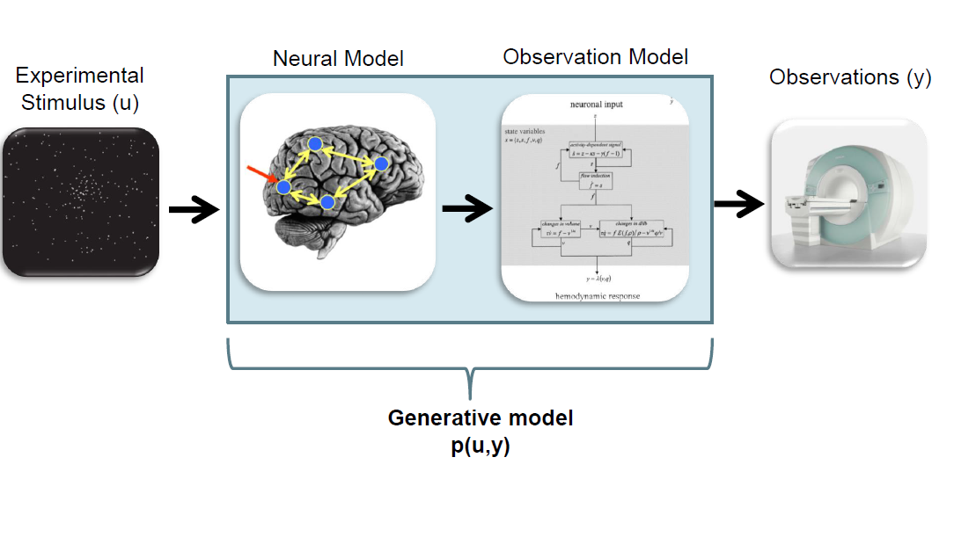
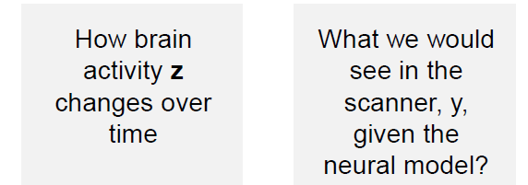
+ Hd Model

Slide 13
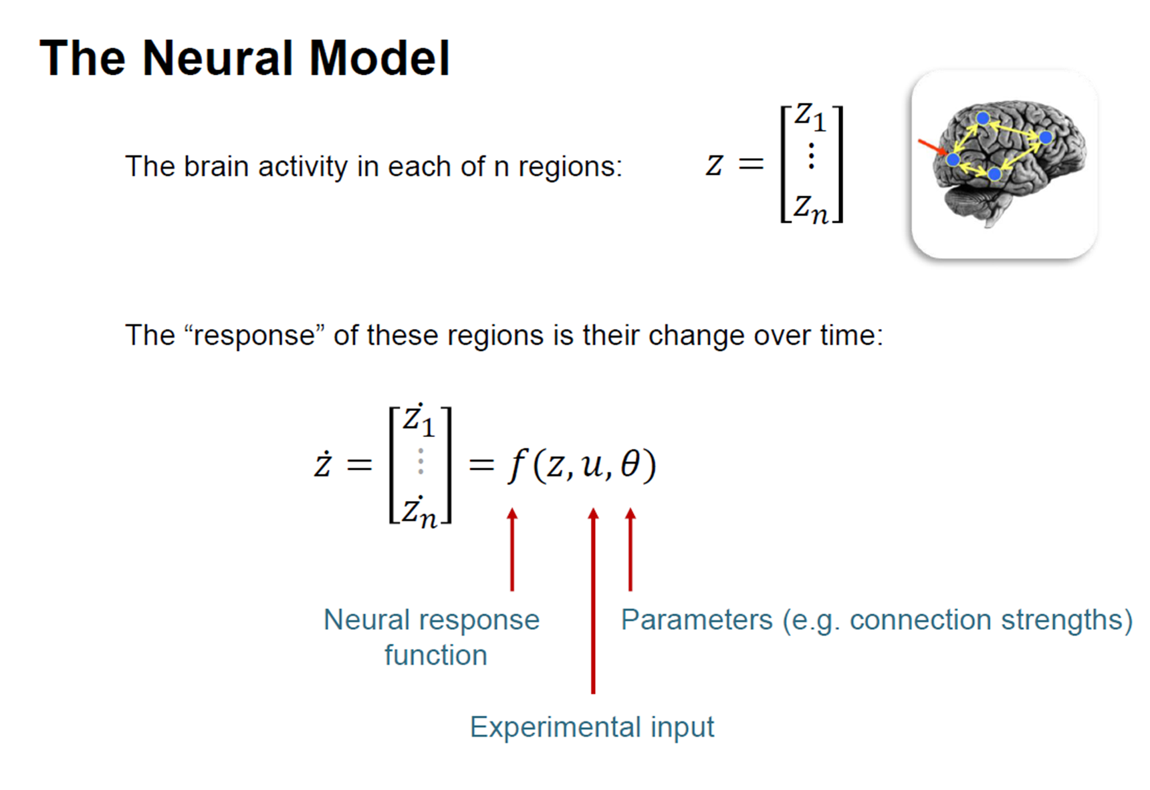
Neuronal Model
State changes of the
system states are
dependent on:
– the current state z
– external inputs u
– its connectivity θ
– time constants & delays
Input u(t)
connectivity parameters θ
system
z(t) state
.
Notes:
DCM – effective connectivity
Developed for ‘deterministic systems’ - the effects of external stimuli on the connections within a specified network – where do exogenous inputs modulate connectivity
Way in which this done – Series of models, hypotheses – choose regions. Each modelled with a neural model and a haemodynamic model.
4) Explain neuronal state equation – a) intrinsic b) modualtory c) external
5) Convolve with HD model so that it can be used to understand BOLD data
6) For each model – Predicted BOLD signal for each model - estimated to see how closely it matches the observed BOLD signal
7) Each model is then ‘scored’ using Bayesian framework - model evidence = winning model - best explains data
8) HOWEVER - RS contains spontaneous activity which is unaccounted for in dDCM – therefore we use stochastic DCM which accounts for this random activity - just adds an ‘unknown’ to our equation
9) Follow similar model to dDCM BUT no external inputs and in the case of a single timepoint, no modulatory effects – just look at intrinsic connections – unexplained by external inputs
10) For TrackON – use sDCM and an exploratory method BND to try and tease out changes in patterns of netowrk connectivity between controls and patients – or between patient groups.
13

Slide 14
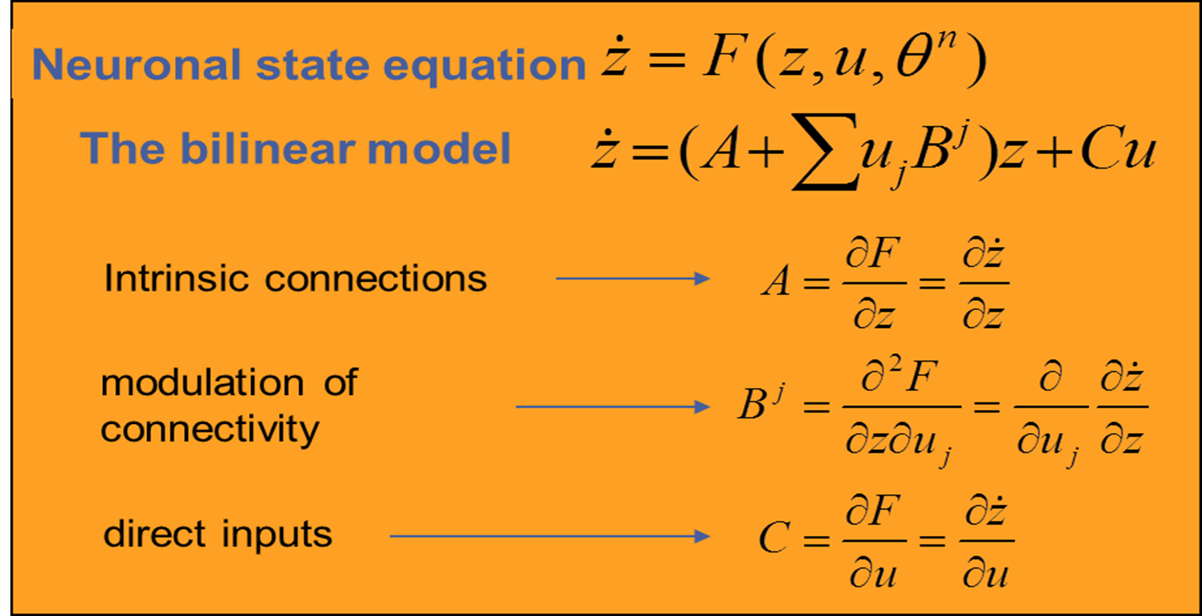
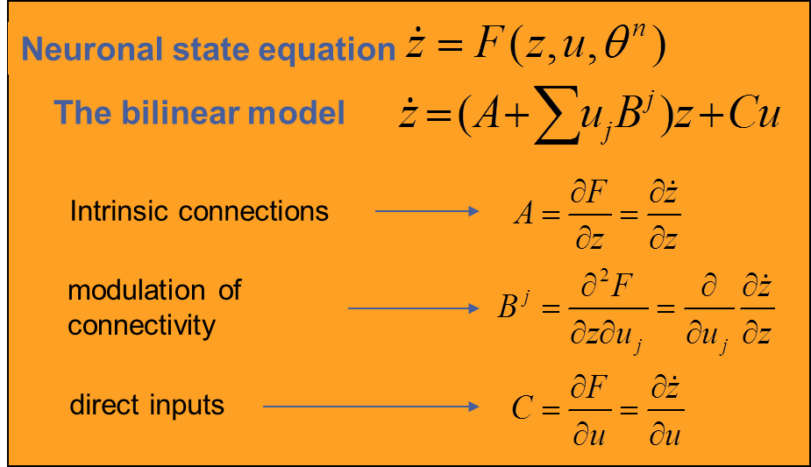
Neuronal Model
.
Notes:
DCM – effective connectivity
Developed for ‘deterministic systems’ - the effects of external stimuli on the connections within a specified network – where do exogenous inputs modulate connectivity
Way in which this done – Series of models, hypotheses – choose regions. Each modelled with a neural model and a haemodynamic model.
4) Explain neuronal state equation – a) intrinsic b) modualtory c) external
5) Convolve with HD model so that it can be used to understand BOLD data
6) For each model – Predicted BOLD signal for each model - estimated to see how closely it matches the observed BOLD signal
7) Each model is then ‘scored’ using Bayesian framework - model evidence = winning model - best explains data
8) HOWEVER - RS contains spontaneous activity which is unaccounted for in dDCM – therefore we use stochastic DCM which accounts for this random activity - just adds an ‘unknown’ to our equation
9) Follow similar model to dDCM BUT no external inputs and in the case of a single timepoint, no modulatory effects – just look at intrinsic connections – unexplained by external inputs
10) For TrackON – use sDCM and an exploratory method BND to try and tease out changes in patterns of netowrk connectivity between controls and patients – or between patient groups.
14

Slide 15
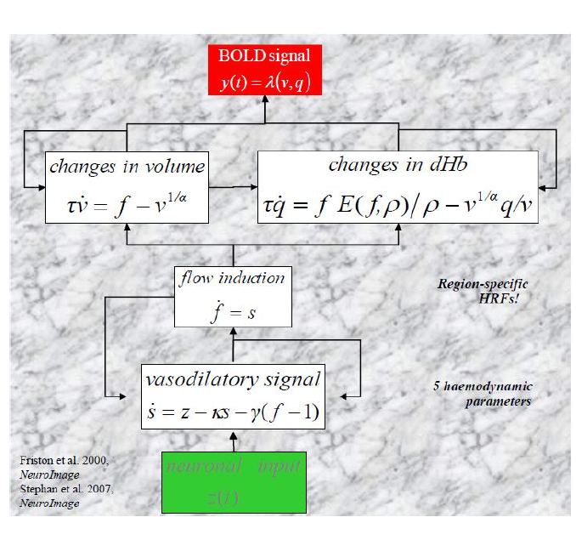
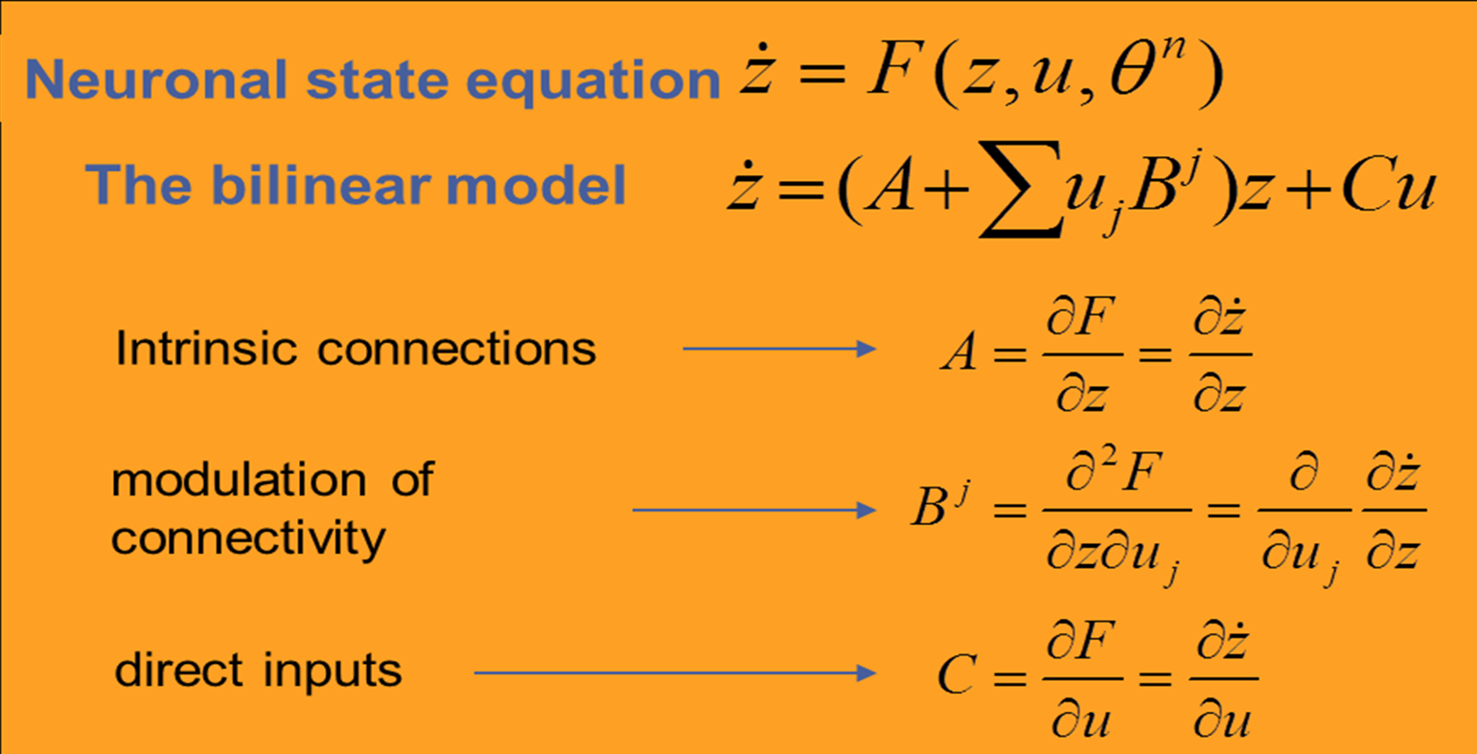
Haemodynamic Model

Slide 17
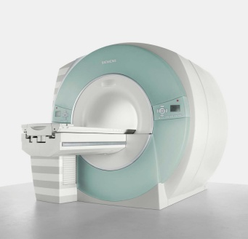
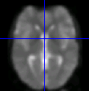

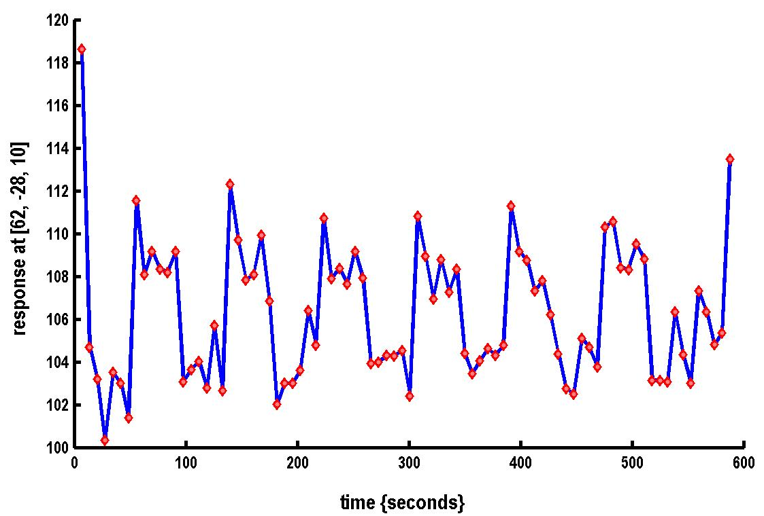
Where DCM sits in the pipeline
Functional MRI acquisition and image reconstruction
Image preprocessing (realignment, coregistration, normalisation, smoothing)
Statistical Parameter Mapping (SPM) / General Linear Model
Dynamic Causal Modelling (DCM)
Timeseries extraction from Regions of Interest (ROIs)

Slide 18
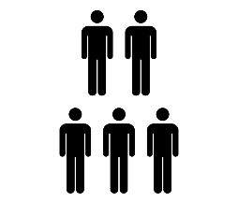
DCM Framework
1. Specify a forward model for each subject
2. Fit the models to the data
Data
Model
3. Second level analysis (GLM of connectivity parameters)
4. Bayesian model comparison
Probability
Model
5. Inspect parameters
Probability
Connection strength

Slide 19
Contents
fMRI Connectivity
Overview of DCM
Model specification
Model estimation
Model comparison

Slide 20
  For small systems (i.e., networks with a small number of nodes), it is possible to investigate all possible connectivity architectures.
  With increasing number of regions and inputs, evaluating all possible models, a fact that becomes practically impossible.
Motivate model space carefully – create a series of models based on biologically plausible hypotheses

Slide 21
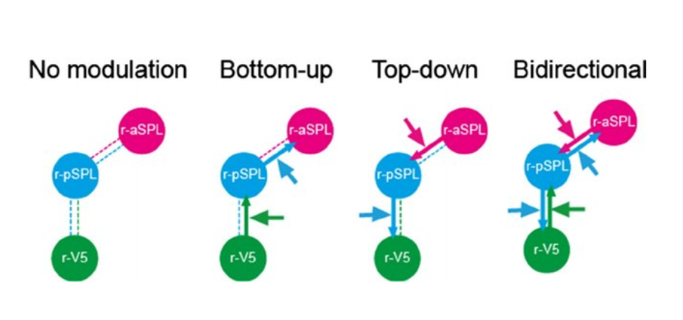
Mugumi et al, 2014

Slide 22
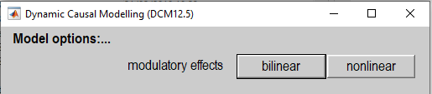


Model specification
Bilinear model
Non-linear Model
$$z_{2}$$
A
Intrinsic
B
Modulatory
A
Contribution of other units on connection
C
External
B
$$z_{1}$$
C
D
Friston et al., 2003
Stephan et al., 2008

Slide 23
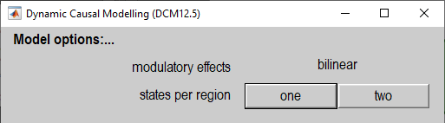


Model specification
One state per region
Two states per region
$$z_{2}$$
SE
E
E
EE
Excitation
IE
EI
Inhibition
$$z_{1}$$
I
I
SI
Friston et al., 2003
Marreiros et al., 2008

Slide 24
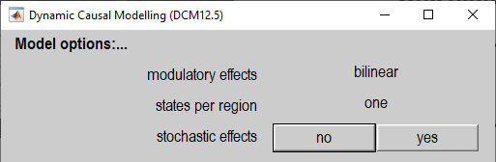



Model specification
Deterministic DCM
Stochastic DCM
$$\dot{z}=f\left(z,u,θ_{n}\right)$$
$$\dot{z}=f\left(z,u,θ_{n}\right)+ω$$
All dynamics driven by the stimuli $u$
Additionally driven by endogenous noise. Enables modelling mixed endogenous and task designs.
Friston et al., 2003
Li et al., 2011

Slide 25
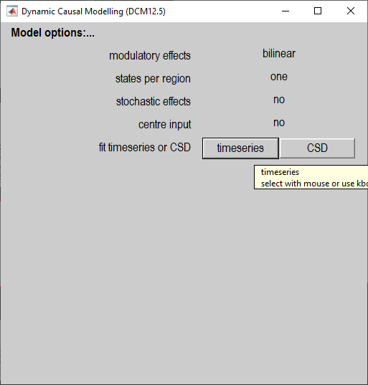
Model specification
For resting state data, select
Cross Spectral Density (CSD)
Endogenous
neural
fluctuations
Effective connectivity
BOLD response
Functional connectivity
For task-based data, select timeseries
Real
Imaginary
Effective connectivity
BOLD response
Stimuli
Frequency
Frequency
Data
Friston et al., 2014
Model

Slide 26
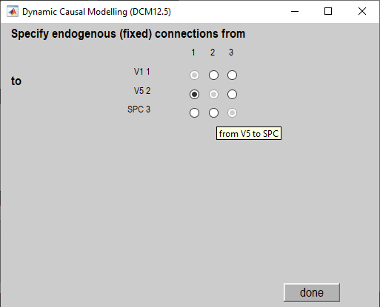



Model specification
SPC
$$z_{3}$$
V5
$$z_{2}$$
V1
$$z_{1}$$

Slide 27
Contents
fMRI Connectivity
Overview of DCM
Model specification
Model estimation
Model comparison

Slide 28
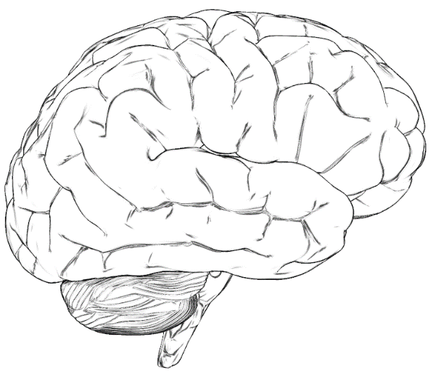
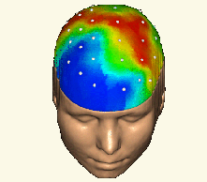







Bayesian Modelling
FORWARD PROBLEM:
Predict measured data
Given the model
$$p(Y|θ,m)$$
Model
$$m$$
Likelihood
Data $Y$
Parameters
$$θ$$
Posterior Evidence
$$p(θ|Y,m)$$
$$p(Y|m)$$
Evidence = Free Energy (F)
Minimise F to maximise likelihood
With priors
$$p(θ|m)$$
INVERSE PROBLEM:
Given measured data
Estimate the model
Posteriors are updated iteratively
Use Variational Laplace
Adapted from a slide by Rik Henson

Slide 29
Priors
Priors determine the structure of the model
Stimulus
R1
R2
Stimulus
R1
R2
Connection ‘on’
Connection ‘off’
Probability
0
0
Prior Connection strength (Hz)
Prior Connection strength (Hz)

Slide 30
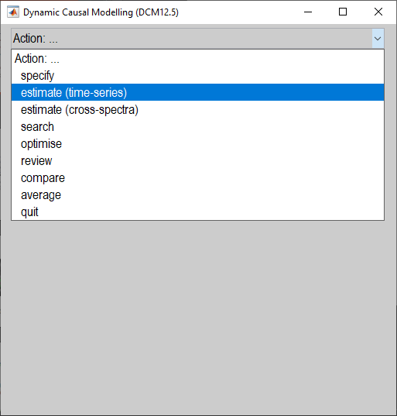
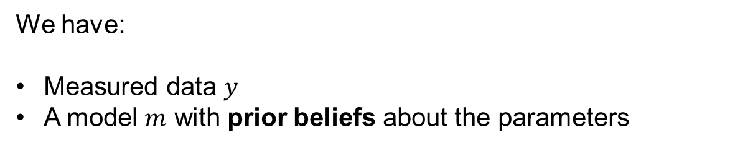
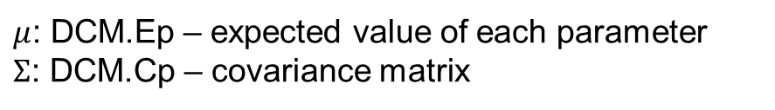
Model Estimation
We have:
Measured data $y$
A model $m$ with prior beliefs about the parameters
Model estimation (inversion) gives us:
A score for the model, which we can use to compare it against other models (Bayesian model comparison)
$F≅\log{p\left(y | m\right)=\text{accuracy}−\text{complexity}}$
2. Estimated parameters – i.e. the posteriors
$μ$: DCM.Ep – expected value of each parameter
$Σ$: DCM.Cp – covariance matrix

Slide 31
Contents
fMRI Connectivity
Overview of DCM
Model specification
Model estimation
Model comparison

Slide 32
  For small systems (i.e., networks with a small number of nodes), it is possible to investigate all possible connectivity architectures.
  With increasing number of regions and inputs, evaluating all possible models, a fact that becomes practically impossible.
The purpose of model selection is to determine which model, from a set of plausible alternatives, is most useful i.e., represents the best balance between accuracy and complexity.

Slide 33
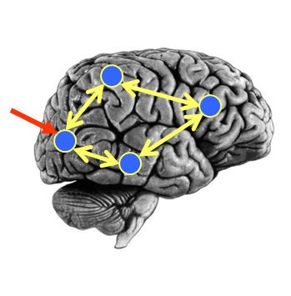
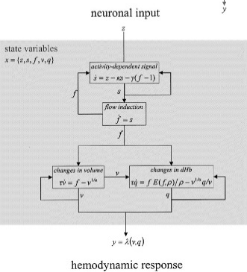
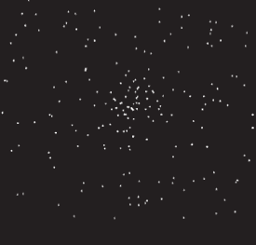

Model Comparison
Neural Model
Observation Model
Experimental Stimulus (u)
Observations (y)
Model 1:
Model comparison: Which model best explains my observed data?
Neural Model
Observation Model
Experimental Stimulus (u)
Observations (y)
Model 2:

Slide 34
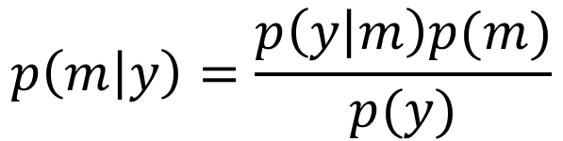
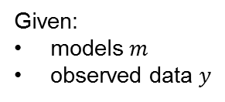
Bayes Rule for Models
Question: I’ve estimated 10 DCMs for a subject. What’s the posterior probability that any given model is the best?
Model evidence
Probability of each model given the data
Prior on each model

Slide 35
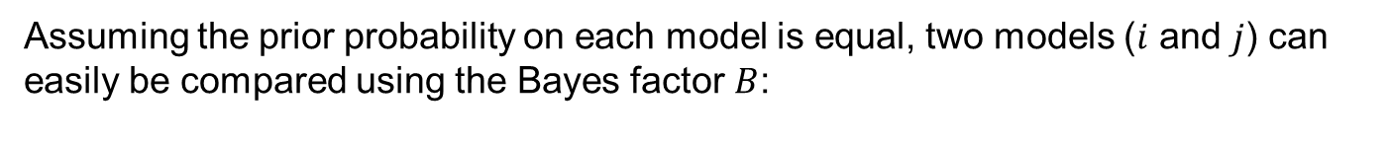
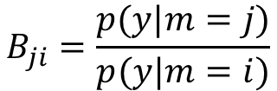

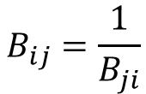

Bayes Factor
Ratio of model evidence
From Raftery et al. (1995)

Slide 36
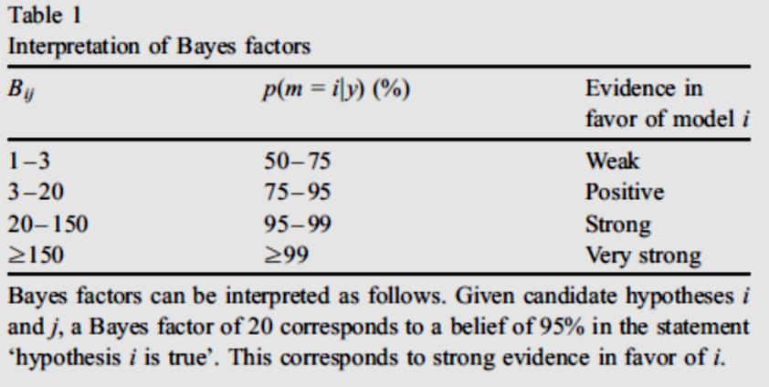
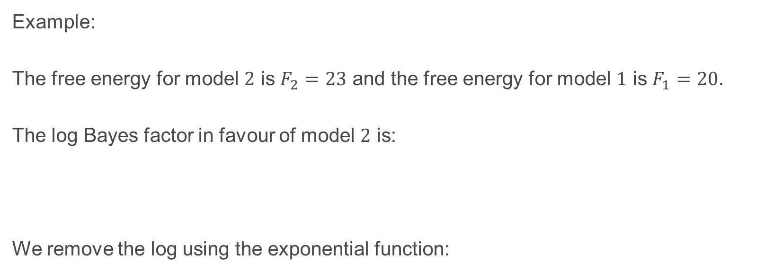
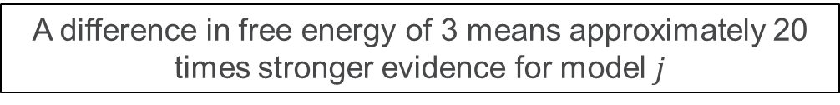

Bayes Factor
Example:
The free energy for model $2$ is $F_{2}=23$ and the free energy for model $1$ is $F_{1}=20$.
The log Bayes factor in favour of model $2$ is:
We remove the log using the exponential function:
$$\ln{{BF}_{2}}=\ln{p\left(y | m_{j}\right)}−\ln{p\left(y | m_{i}\right)}=F_{2}−F_{1}=23−20=3$$
${BF}_{2}=\exp\left(3\right)≈20$
A difference in free energy of 3 means approximately 20 times stronger evidence for model $j$

Slide 37

Further Reading
The original DCM paper | Friston et al. 2003, NeuroImage
A tutorial on group effective connectivity analysis (preprint) | https://github.com/pzeidman/dcm-peb-example
Other descriptive / tutorial papers
Role of General Systems Theory | Stephan 2004, J Anatomy
DCM: Ten simple rules for the clinician | Kahan et al. 2013, NeuroImage
Ten Simple Rules for DCM | Stephan et al. 2010, NeuroImage

Slide 38
With thanks to Peter Zeidman

