Slide 1
Group DCM analysis for cognitive & clinical studies
Peter Zeidman, PhD
Methods Group
October 2019

Slide 2
Contents
Recap
Model comparison
Rapidly evaluating models
Bayesian Model Reduction
Investigating the parameters
Bayesian Model Averaging
Multi-subject analysis
Parametric Empirical Bayes

Slide 3
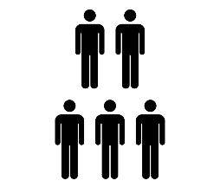
DCM+PEB Recipe
1. Specify a forward model for each subject
2. Fit the models to the data
Data
Model
3. Second level analysis (GLM of connectivity parameters)
4. Bayesian model comparison
Probability
Model
5. Inspect parameters
Probability
Connection strength

Slide 4
Recap - priors
Priors determine the structure of the model
Stimulus
R1
R2
Stimulus
R1
R2
Connection ‘on’
Connection ‘off’
Probability
0
0
Prior Connection strength (Hz)
Prior Connection strength (Hz)

Slide 5




Recap - priors
DCM uses multivariate normal probability densities
$$p\left(θ\right)=N(μ,Σ)$$
Expectation
Covariance
$$μ=\left[\begin{matrix}0 \\ 0\end{matrix}\right]$$
$$Σ=\left[\begin{matrix}1 & 0 \\ 0 & 1\end{matrix}\right]$$
$$p(θ)$$
In Matlab:
Prior expectation: DCM.M.pE
Prior covariance: DCM.M.pC
Posterior expectation: DCM.Ep
Posterior covariance: DCM.Cp
Parameter 1
Parameter 2

Slide 6
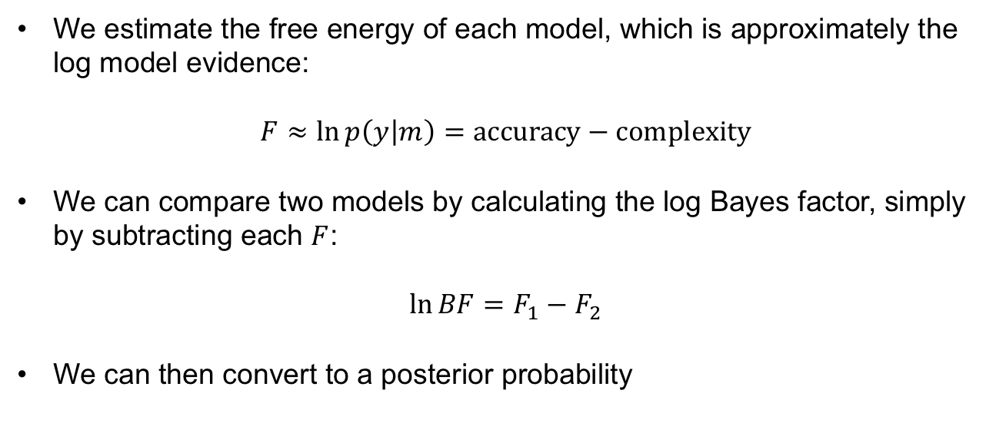
Recap – model comparison
We estimate the free energy of each model, which is approximately the log model evidence:
$$F≈\ln{p\left(y | m\right)=\text{accuracy}−\text{complexity}}$$
We can compare two models by calculating the log Bayes factor, simply by subtracting each $F$:
$$\ln{BF=F_{1}−F_{2}}$$
We can then convert to a posterior probability

Slide 7
Contents
Recap
Model comparison
Rapidly evaluating models
Bayesian Model Reduction
Investigating the parameters
Bayesian Model Averaging
Multi-subject analysis
Parametric Empirical Bayes

Slide 8







Bayesian model reduction (BMR)
Full model
Model inversion (VL)
Priors:
Nested / reduced model
X
Bayesian Model Reduction (BMR)
Priors:
Friston et al., Neuroimage, 2016

Slide 9
Contents
Recap
Rapidly evaluating models
Bayesian Model Reduction
Investigating the parameters
Bayesian Model Averaging
Multi-subject analysis
Parametric Empirical Bayes

Slide 10

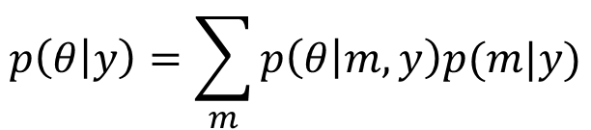
Bayesian Model Averaging (BMA)
Having compared models, we can look at the parameters (connection strengths). We average over models, weighted by the posterior probability of each model. This can be limited to models within the winning family.

Slide 11
Contents
Recap
Rapidly evaluating models
Bayesian Model Reduction
Investigating the parameters
Bayesian Model Averaging
Multi-subject analysis
Parametric Empirical Bayes

Slide 12
DCM+PEB Recipe
1. Specify a forward model for each subject
2. Fit the models to the data
Data
Model
3. Second level analysis (GLM of connectivity parameters)
4. Bayesian model comparison
Probability
Model
5. Inspect parameters
Probability
Connection strength

Slide 13
DCM+PEB Recipe

Slide 14
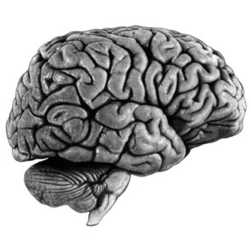



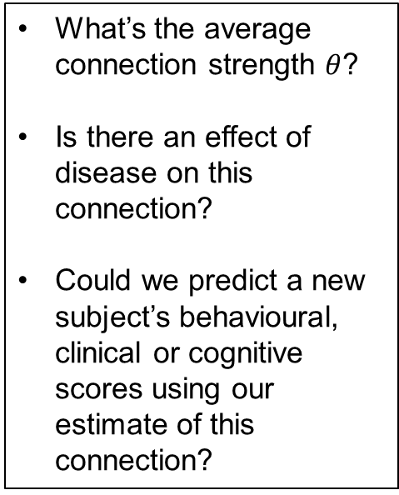



Hierarchical model of parameters
What’s the average connection strength $θ$?
Is there an effect of disease on this connection?
Could we predict a new subject’s behavioural, clinical or cognitive scores using our estimate of this connection?
Subject 1
$$θ_{1}$$
Probability
Connection strength $θ_{1}$
$$⋮$$
Subject n
$$θ_{n}$$
Probability
Connection strength $θ_{n}$
Image credit: Wilson Joseph from Noun Project

Slide 15

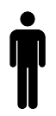


Hierarchical model of parameters
Parametric Empirical Bayes
Priors on second level parameters
Second level
$$θ^{(1)}=Xθ^{(2)}+ε^{(2)}$$
Between-subject error
Second level (linear) model
First level
$$y_{i}=g\left(θ_{i}\right)+ε_{i}^{(1)}$$
Measurement noise
DCM for subject i
Image credit: Wilson Joseph from Noun Project

Slide 16







GLM of connectivity parameters
$$θ^{(1)}=Xθ^{(2)}+ε^{(2)}$$
Unexplained between-subject variability
Design matrix
(covariates)
Group level parameters
Between-subjects effects
1
Group average connection strength
2
3
$$=$$
Effect of group on the connection
Subject
Subject
$$×$$
4
5
Effect of age on the connection
6
1
2
3
Covariate
$$θ^{(1)}$$
$$X$$
$$θ^{(2)}$$

Slide 17

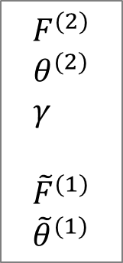

PEB Estimation
First level
Second level
DCMs
Subject 1
.
PEB Estimation
.
Subject N
First level free
energy / parameters
with empirical priors

Slide 18
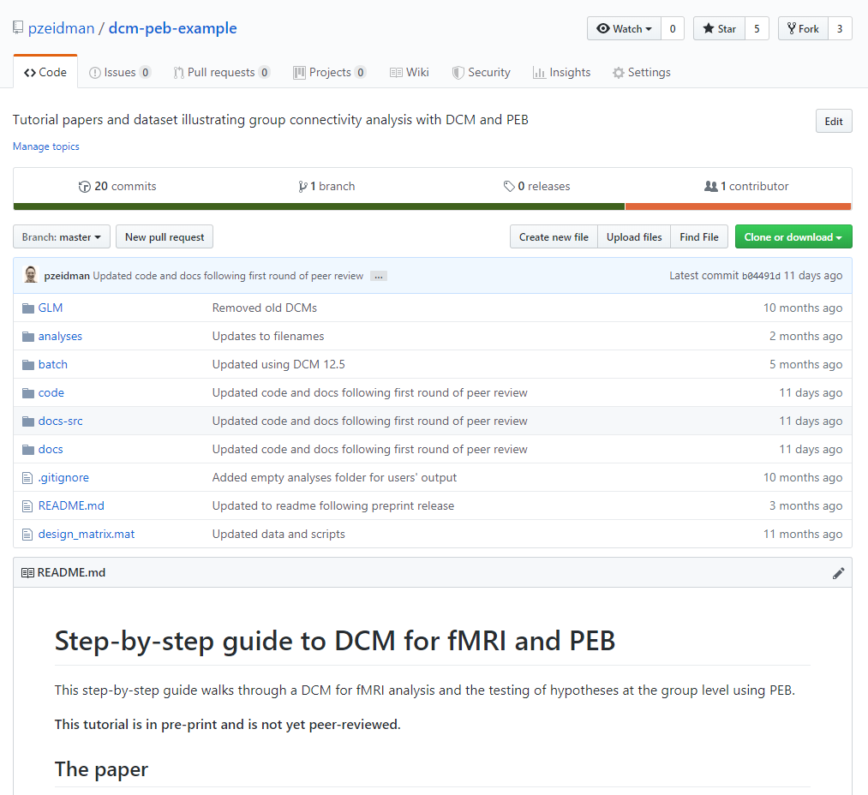
Example dataset
https://github.com/pzeidman/dcm-peb-example

Slide 19
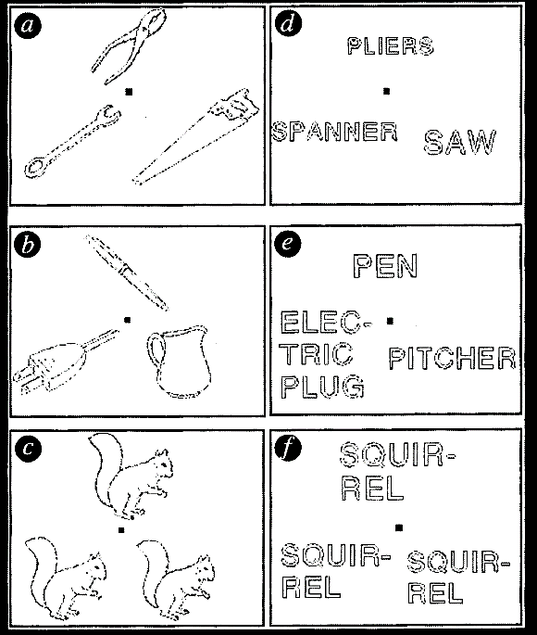
Laterality experiment
Question: Laterality Index is a number quantifying the difference in neuronal responses between left and right hemispheres, e.g. in the context of a language task. What’s the brain architecture underlying individual differences in Laterality Index?
Experimental design: A 2x2 factorial design with within-subject factors:
  Stimulus type (Pictures vs Words)
  Task (Semantic judgements vs baseline)
Seghier et al., Cerebral Cortex, 2010

Slide 20


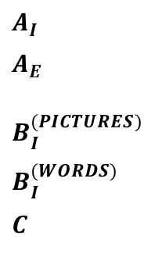
Laterality experiment
Design and data
DCM Model Specification
Matrix $U$ (inputs)
Matrix $Y$ (fMRI timeseries)
0
100
200
$$A_{I}$$
$$A_{E}$$
$$B_{I}^{(PICTURES)}$$
$$B_{I}^{(WORDS)}$$
$$C$$
300
ldF
rdF
Time (secs)
400
500
600
lvF
rvF
700
Task
Pictures
Words
lvF
ldF
rvF
rdF
Experimental Condition
Brain region

Slide 21

Laterality experiment
Assemble all subjects’ connectivity parameters
Specify PEB model (Bayesian GLM)
$$θ^{(1)}$$
Regressors in the design matrix:
Group mean effect of pictures on lvF
Group mean effect of pictures on ldF
Group mean effect of pictures on rvF
Group mean effect of pictures on rdF
Group mean effect of words on lvF
Group mean effect of words on ldF
Group mean effect of words on rvF
Group mean effect of words on rdF
Effect of laterality on the effect of pictures on lvF
Effect of laterality on the effect of pictures on ldF
Etc …
Subject 1 - effect of pictures on lvF
Subject 1 - effect of pictures on ldF
Subject 1 - effect of pictures on rvF
Subject 1 - effect of pictures on rdF
Subject 1 - effect of words on lvF
Subject 1 - effect of words on ldF
Subject 1 - effect of words on rvF
Subject 1 - effect of words on rdF
Subject 2 - effect of pictures on lvF
Etc …

Slide 22

Laterality experiment
Review the group-level parameters
Group level GLM parameters $θ^{(2)}$
Regressors in the design matrix:
Group mean effect of pictures on lvF
Group mean effect of pictures on ldF
Group mean effect of pictures on rvF
Group mean effect of pictures on rdF
Group mean effect of words on lvF
Group mean effect of words on ldF
Group mean effect of words on rvF
Group mean effect of words on rdF
…
4
Commonalities
Laterality
3
2
Estimate
1
0
-1
-2
1
8
9
16
GLM Parameter

Slide 23
Laterality experiment
Automatic search over reduced models (BMR)
Bayesian Model Average
Pictures 0.40
Words 0.43
Laterality (Words) 1.81
4
Common
Laterality
3
2
ldF
rdF
Estimate
1
0
lvF
rvF
-1
-2
1
8
9
16
Pictures -0.30
GLM Parameter

Slide 24
Laterality experiment
Comparing pre-defined reduced models (BMR)
Factor 1: Modulation of regions by (P)ictures or (W)ords?
C. Commonalities
D. Differences (LI)
1
1
P, W
P, W
W
W
P
P
P(Model 15)=74%
0.8
0.8
P(Model 4)=75%
0.6
0.6
Probability
Probability
P, W
P, W
W
W
P
P
0.4
0.4
0.2
0.2
Factor 2: Modulation of dorsal or ventral regions?
0
1
10
20
28
0
Model
1
10
20
28
Model
E. Model 4
F. Model 15
Pictures,Words
Pictures,Words
Words
Factor 3: Modulation of left or right hemisphere regions?
ldF
rdF
ldF
rdF
lvF
rvF
lvF
rvF

Slide 25
Laterality experiment
Can we predict a new subject’s Laterality Index from their estimated connection strengths?
Leave one out cross validation
Out of sample estimates
corr(df:58) = 0.34: p = 0.004
Actual
2
Prediction
2
1
1
Subject effect
Estimate
0
0
-1
-1
-2
-2
10
20
30
40
50
60
-1
-0.5
0
0.5
Subject
Actual subject effect
Prediction using the estimated effect of words on region rdF

Slide 26
DCM Framework
1. Specify a forward model for each subject
2. Fit the models to the data
Data
Model
3. Second level analysis (GLM of connectivity parameters)
4. Bayesian model comparison
Probability
Model
5. Inspect parameters
Probability
Connection strength

Slide 27

Further Reading
The original DCM paper | Friston et al. 2003, NeuroImage
A tutorial on group effective connectivity analysis | https://github.com/pzeidman/dcm-peb-example
Structure Learning in Coupled Dynamical Systems and Dynamic Causal Modelling | Jafarian et al. 2019, ArXiv
Other descriptive / tutorial papers
Role of General Systems Theory | Stephan 2004, J Anatomy
DCM: Ten simple rules for the clinician | Kahan et al. 2013, NeuroImage
Ten Simple Rules for DCM | Stephan et al. 2010, NeuroImage

Slide 28
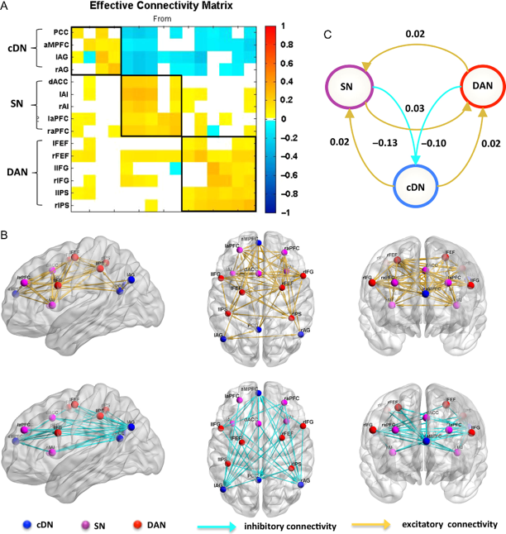
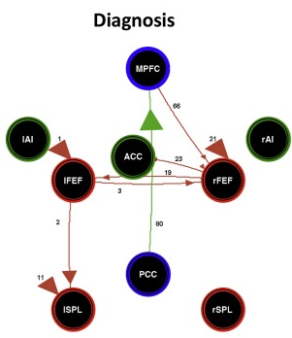
Applications
Resting state fMRI
Schizophrenia
*
Networks:
DAN
SN
DMN
* Patients > controls
Patients < controls
N=404
N=40 patients, 62 controls
Zhou et al., Cerebral Cortex 2017
Zhou et al., NeuroImage: Clinical 2018

Slide 29
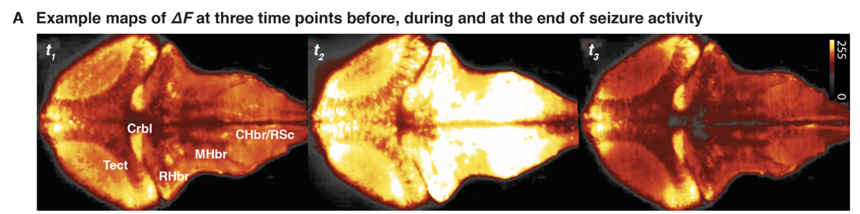
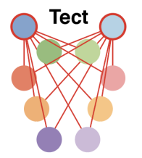
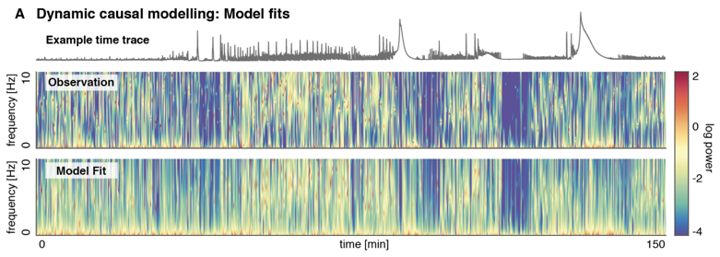
Applications
Sliding window DCM in Zebrafish
Rosch et al. bioRxiv 2017

Slide 30
Language example

Slide 31
Language example
Reading > fixation (29 controls)
Lesion (Patient AH)
Seghier et al., Neuropsychologia, 2012

Slide 32
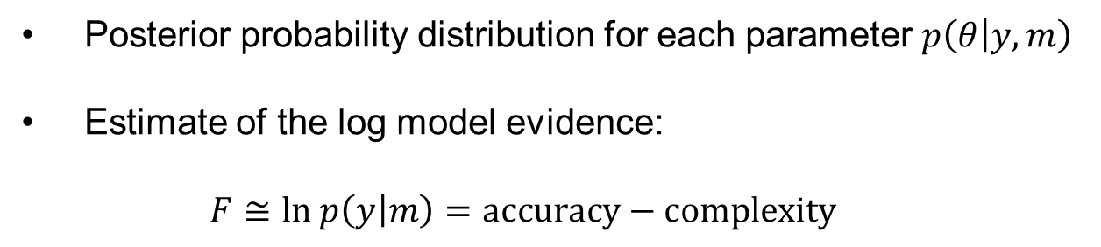
Pipeline
Language example
We specified a DCM for every subject (patient and controls)
We fitted these models to the subjects’ data (model estimation or inversion) to give:
Posterior probability distribution for each parameter $p\left(θ | y,m\right)$
Estimate of the log model evidence:
$F≅\text{ln} p\left(y | m\right)=\text{accuracy}−\text{complexity}$

Slide 33
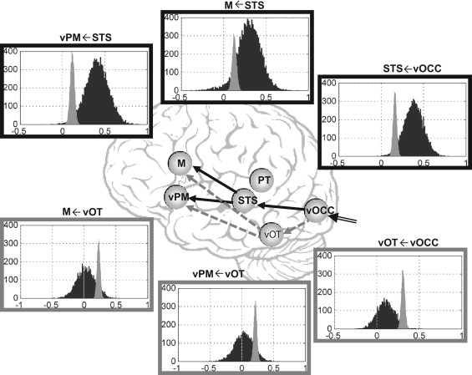
Language example
Results
Key:
Controls
Patient
Seghier et al., Neuropsychologia, 2012

