Slide 1
Experimental design
Elisa van der Plas
The MetaLab, Wellcome Centre for Human Neuroimaging
With thanks to:
Mona Garvert
Sara Bengtsson
Christian Ruff
Rik Henson

Slide 2
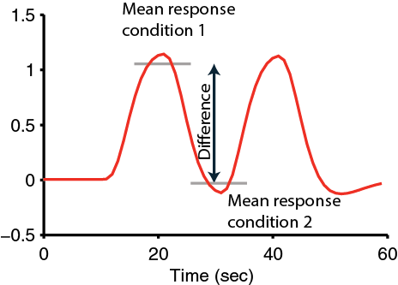
Goal
The BOLD signal does NOT provide you with an absolute measure of neural activity
Therefore, you need to compare activity across conditions
What?
Your question
How?
Experimental design
Contrasts / Parameters
The sensitivity of your design depends on maximizing the relative change between conditions

Slide 3



It all starts with a good design!
Statistical parametric map (SPM)
Image time-series
Kernel
Design matrix
Realignment
Smoothing
General linear model
Statistical
inference
Gaussian
field theory
Normalisation
Template
p <0.05
Parameter estimates

Slide 4
Overview
Categorical designs
Subtraction - Pure insertion, evoked / differential responses
Conjunction - Testing multiple hypotheses
Parametric designs
Linear - Adaptation, cognitive dimensions
Nonlinear - Polynomial expansions, neurometric functions
- Model-based regressors
Factorial designs
Categorical - Interactions and pure insertion
Parametric - Linear and nonlinear interactions
- Psychophysiological Interactions (PPI)

Slide 5
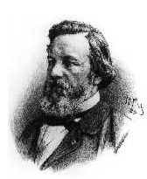
Neural subtractions
A good control task is critical!
Aim
  Neuronal structures underlying a single process P
Procedure
  Contrast: [Task with P] – [matched task without P ] → P
  The critical assumption of „pure insertion“
  Assume that adding components does not affect other processes
F.C. Donders, 1868

Slide 6
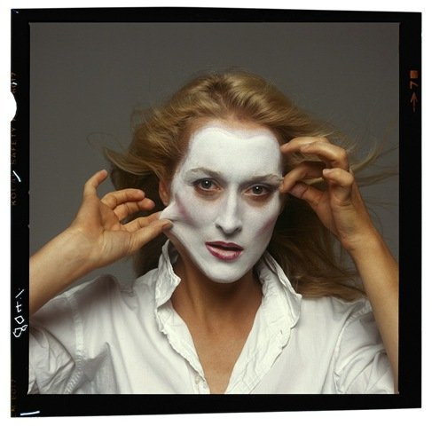
Simple subtraction
Question: Which neural structures support face recognition?

Slide 7
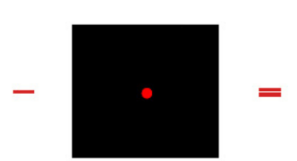
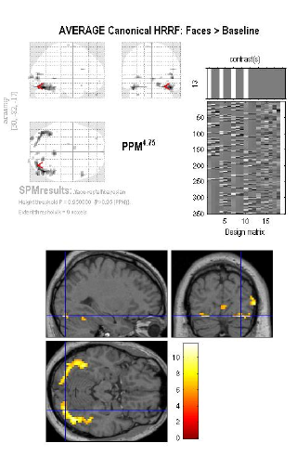
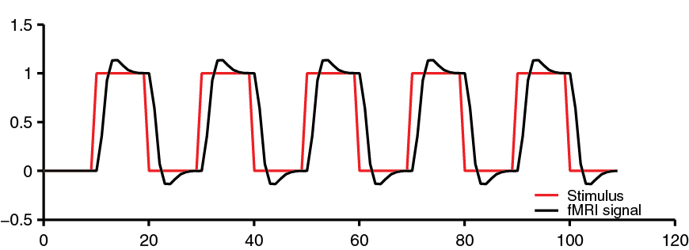
Simple subtraction
Aim: Isolation of a cognitive process
  Compare the neural signal for a task that activates the cognitive process of interest and a second task that controls for all but the process of interest

Slide 8
Simple subtraction
Aim: Isolation of a cognitive process
  Compare the neural signal for a task that activates the cognitive process of interest and a second task that controls for all but the process of interest
Not a great contrast!

Slide 9

Choosing your baseline
Problem: Difficulty of finding baseline tasks that activate all but the process of interest
Different stimuli and task
Related stimuli
+
vs.
vs.
‘Meryl Streep’
‘I am so hungry…’
Famous? Mum?
→ P implicit in control task?
→ Difficulty matched?
→ Several components differ!
Same stimulus, different tasks
vs.
Name the person! Name the gender!
→ Specific naming-related activity

Slide 10
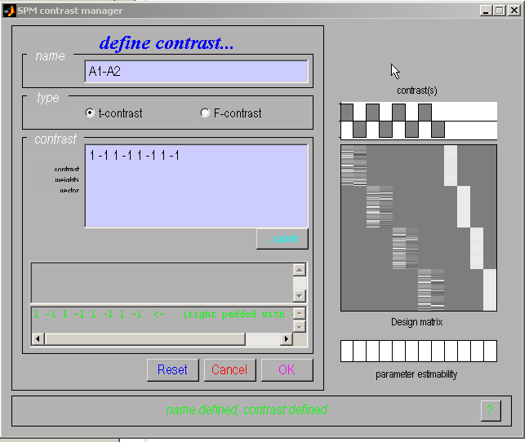
Categorical responses
SPM
Task 1
Task 2
Session

Slide 11
Subtraction
Problems:
Difficulty of finding baseline tasks that activate all but the process of interest
Subtraction depends on the assumption of “pure insertion” (an extra cognitive component can be inserted without affecting the pre-existing components)
B
B
B
B
A
A
A
A
A
B
A+B
AxB
AxB
Friston et al., (1996)

Slide 12
fMRI adaptation
Famous faces: 1st time vs 2nd time
Peri-stimulus time (sec)

Slide 13
Overview
Categorical designs
Subtraction - Pure insertion, evoked / differential responses
Conjunction - Testing multiple hypotheses
Parametric designs
Linear - Adaptation, cognitive dimensions
Nonlinear - Polynomial expansions, neurometric functions
- Model-based regressors
Factorial designs
Categorical - Interactions and pure insertion
Parametric - Linear and nonlinear interactions
- Psychophysiological Interactions (PPI)

Slide 14
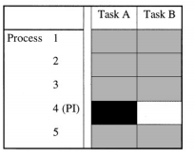
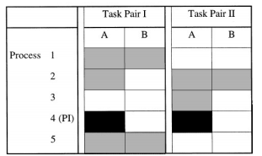
Conjunction
Minimization of “the baseline problem” by isolating the same cognitive process by two or more separate contrasts
Conjunctions can be conducted across different contexts: tasks, stimuli, senses (vision, audition), …
Note: The contrasts entering a conjunction have to be independent
Subtraction
Conjunction analysis
only the component of interest is common to all task pairs

Slide 15
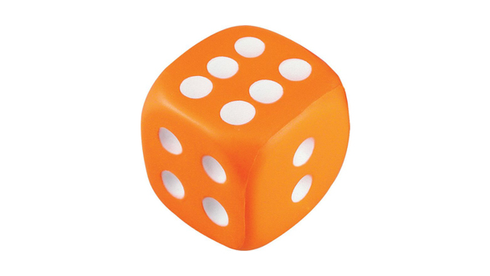
Factorial design
Question: Which neural structures support phonological retrieval, independent of item?
Visual analysis
Object recognition
Phonological retrieval
Verbal output

Slide 16
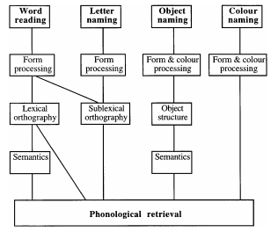
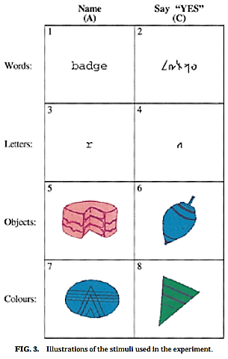
Conjunction analysis
Question: Which neural structures support phonological retrieval, independent of item?
Phonological retrieval is the only cognitive component common to all task pair differences
Price & Friston (1996)

Slide 17
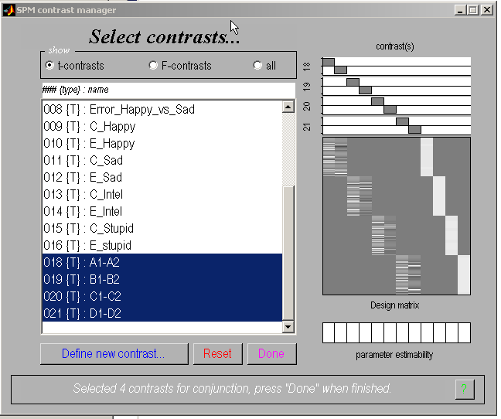
Conjunction analysis
SPM
1 task/session

Slide 18
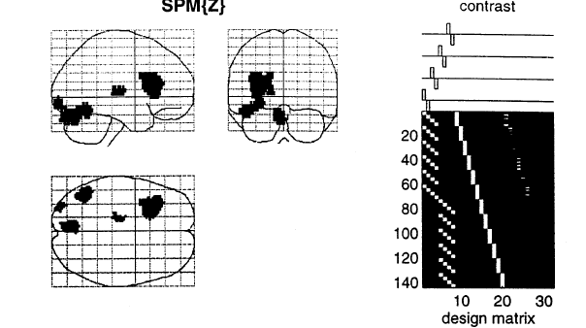
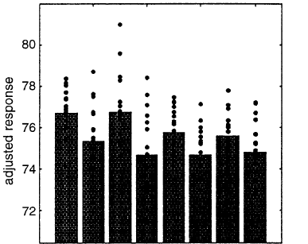
Conjunction analysis
Isolates the process of Phonological retrieval, no interaction with visual processing etc
Overlap of 4 subtractions
Areas are identified in which task-pair effects are jointly significant
Price & Friston (1996)

Slide 19
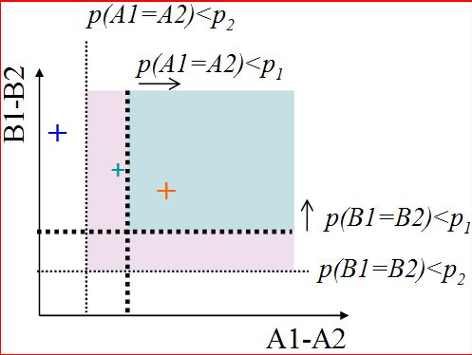
Conjunction: two ways of testing for significance
SPM offers two general ways to test
the significance of conjunctions:
  Test of global null hypothesis:
  Significant set of consistent effects
  “which voxels show effects of similar direction (but not necessarily individual significance) across contrasts?”
  Test of conjunction null hypothesis:
  Set of consistently significant effects
  “which voxels show, for each specified contrast,
  effects > threshold?”
Friston et al., (2005). Neuroimage, 25:661-7.
Nichols et al., (2005). Neuroimage, 25:653-60.

Slide 20
Overview
Categorical designs
Subtraction - Pure insertion, evoked / differential responses
Conjunction - Testing multiple hypotheses
Parametric designs
Linear - Adaptation, cognitive dimensions
Nonlinear - Polynomial expansions, neurometric functions
- Model-based regressors
Factorial designs
Categorical - Interactions and pure insertion
Parametric - Linear and nonlinear interactions
- Psychophysiological Interactions (PPI)

Slide 21
Parametric designs
Does activity vary systematically with a continuously varying parameter?
Varying the stimulus-parameter of interest on a continuum, in multiple (n>2) steps and relating BOLD to this parameter
  Possible tests for such relations :
        Linear
        Nonlinear: Quadratic/cubic/etc.
        „Data-driven“ (e.g., neurometric functions, computational modelling)
Avoids pure insertion but does assume no qualitative change in processing

Slide 22
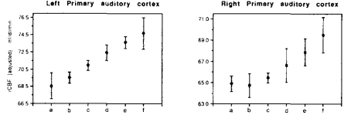
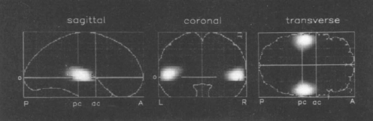
Parametric designs
PET
Auditory words presented at different rates (rest, 5 rates between 10wpm and 90 wpm)
Activity in primary auditory cortex is linearly related to word frequency
Price et al. 1992

Slide 23
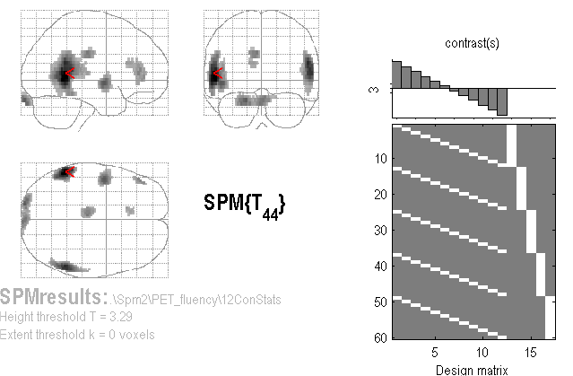
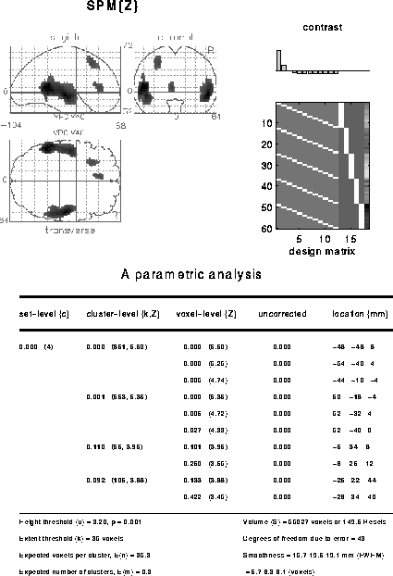
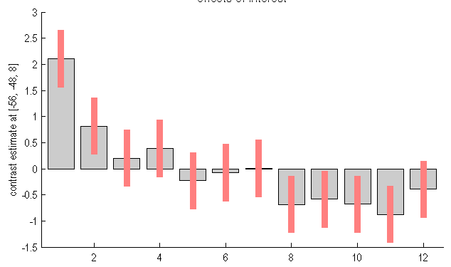
A linear parametric contrast
Is there an adaptation effect if people listen to words multiple times?
Linear effect of time
Non-linear effect of time

Slide 24
Overview
Categorical designs
Subtraction - Pure insertion, evoked / differential responses
Conjunction - Testing multiple hypotheses
Parametric designs
Linear - Adaptation, cognitive dimensions
Nonlinear - Polynomial expansions, neurometric functions
- Model-based regressors
Factorial designs
Categorical - Interactions and pure insertion
Parametric - Linear and nonlinear interactions
- Psychophysiological Interactions (PPI)

Slide 25
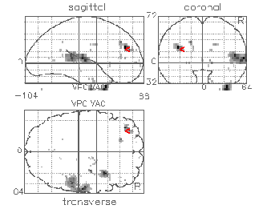
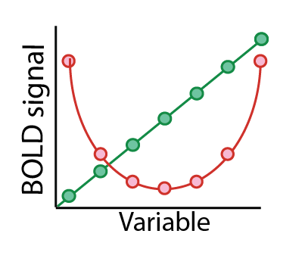
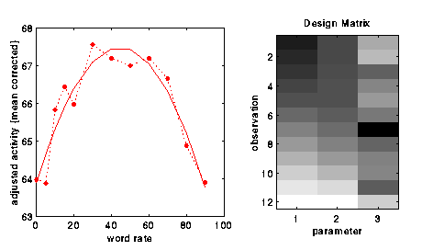
A non-linear parametric design matrix
Polynomial expansion:
f(x) = b₁ x + b₂ x² +
...up to (N-1)^{th} order for N levels
F-contrast [1 0] on linear param
F-contrast [0 1] on quadratic param
SPM offers polynomial
expansion as option during creation
of parametric modulation regressors.
SPM{F}
Büchel et al., (1996)

Slide 26
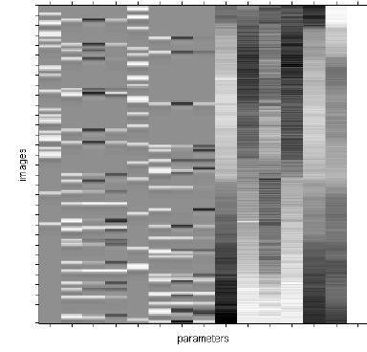
Parametric modulation
Quadratic param regress
Linear param regress
Delta function
seconds
Delta
Stick function
Parametric
regressor

Slide 27
Overview
Categorical designs
Subtraction - Pure insertion, evoked / differential responses
Conjunction - Testing multiple hypotheses
Parametric designs
Linear - Adaptation, cognitive dimensions
Nonlinear - Polynomial expansions, neurometric functions
- Model-based regressors
Factorial designs
Categorical - Interactions and pure insertion
Parametric - Linear and nonlinear interactions
- Psychophysiological Interactions (PPI)

Slide 28
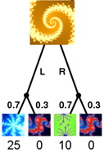

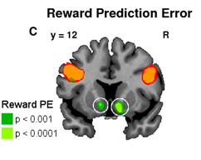
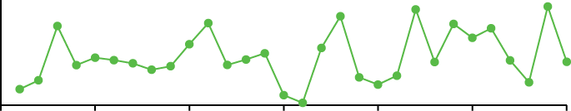
Parametric design: Model-based regressors
Signals derived from a computational model are correlated against BOLD, to determine brain regions showing a response profile consistent with the model, e.g. Rescorla-Wagner prediction error
Time-series of a model-derived reward prediction error
Reward
Prediction
error
Trial number
Gläscher & O’Doherty (2010)

Slide 29
Overview
Categorical designs
Subtraction - Pure insertion, evoked / differential responses
Conjunction - Testing multiple hypotheses
Parametric designs
Linear - Adaptation, cognitive dimensions
Nonlinear - Polynomial expansions, neurometric functions
- Model-based regressors
Factorial designs
Categorical - Interactions and pure insertion
Parametric - Linear and nonlinear interactions
- Psychophysiological Interactions (PPI)

Slide 30
Factorial design
Factor A
a
A
B
a B
A B
Factor B
b
a b
A b

Slide 31
Factorial design
Question: Is the inferiotemporal cortex sensitive to both object recognition and phonological retrieval of object names?
Visual analysis
Object recognition
Phonological retrieval
Verbal output

Slide 32
Factorial design
Question: Is the inferiotemporal cortex sensitive to both object recognition and phonological retrieval of object names?
A
Say ‘yes’ when you see an abstract image
Say ‘yes’ when you see an object
Name the object
Visual analysis
Verbal output
B
Visual analysis
Object recognition
Verbal output
C
Visual analysis
Object recognition
Phonological retrieval
Verbal output

Slide 33
Factorial design
Question: Is the inferiotemporal cortex sensitive to both object recognition and phonological retrieval of object names?
A
Say ‘yes’ when you see an abstract image
Say ‘yes’ when you see an object
Name the object
Friston et al., (1997)
Results in inferotemporal cortex:
B
A
B
C
B
A
>
Object recognition
C
B
C
=
IT not involved in phonological retrieval?!

Slide 34
Interactions
Is the task the sum of its component processes, or does A modulate B?
B
B
B
B
Object recognition
Phonological retrieval
A
A
A
A
Vary A and B independently!

Slide 35
Factorial designs: Main effects and interaction
Question: Is the inferiotemporal cortex sensitive to both object recognition and phonological retrieval of object names?
say ‘yes’
Non-object
a.
b.
c.
Visual
analysis
Speech
say ‘yes’
Object
Visual
analysis
Object
recognition
Speech
a
b
c
name
Object
Visual
analysis
Object
recognition
Phonological
retrieval
Speech
Friston et al., (1997)

Slide 36
Factorial designs: Main effects and interaction
name say ‘yes’
Main effect of task (naming): (ONAME + NNAME) – (OYES + NYES)
Main effect of stimuli (object): (OYES + ONAME) – (NYES + NNAME)
Interaction of task & stimuli: (ONAME + NYES) – (OYES + NNAME)
Objects
Non-objects
Can show a failure of pure insertion
interaction effect
(Stimuli x Task)
‘Say yes’ (Object vs Non-objects)
Phonological retrieval (Object vs Non-objects)
Inferotemporal (IT) responses do discriminate between situations where phonological retrieval
is present or not. In the absence of object recognition, there is a deactivation in IT cortex, in the
presence of phonological retrieval.
Friston et al., (1997)

Slide 37
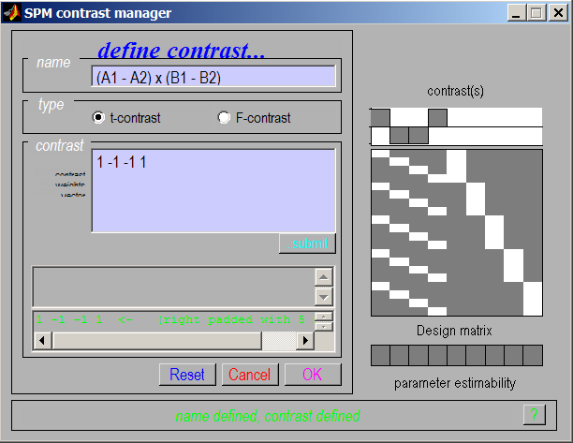
Interaction in SPM
Interactions:
cross-over
and
simple
We can selectively inspect our data for one or the other by masking during inference

Slide 38
Overview
Categorical designs
Subtraction - Pure insertion, evoked / differential responses
Conjunction - Testing multiple hypotheses
Parametric designs
Linear - Adaptation, cognitive dimensions
Nonlinear - Polynomial expansions, neurometric functions
- Model-based regressors
Factorial designs
Categorical - Interactions and pure insertion
Parametric - Linear and nonlinear interactions
- Psychophysiological Interactions (PPI)

Slide 39
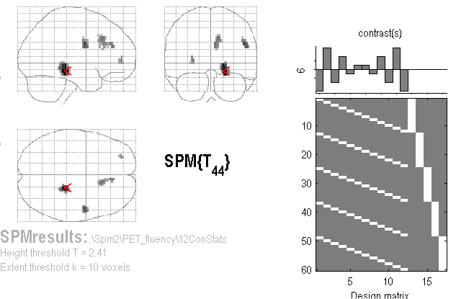
Linear Parametric Interaction
Question: Are there different kinds of adaptation for word generation and word repetition as a function of time?
A (Linear)
Time-by-Condition
Interaction
(“Generation strategy”?)
Contrast:
[5 3 1 -1 -3 -5](time) ⊗ [-1 1] (categorical)
= [-5 5 -3 3 -1 1 1 -1 3 -3 5 -5]

Slide 40

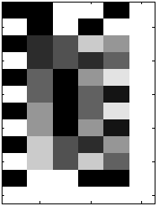
Non-Linear Parametric Interaction
F-contrast tests for
Generation-by-Time interaction
(including both linear and
Quadratic components)
Factorial Design with 2 factors:
Gen/Rep (Categorical, 2 levels)
Time (Parametric, 6 levels)
Time effects modelled with both linear and quadratic components…
G-R
Time
Lin
Time
Quad
G x T
Lin
G x T
Quad

Slide 41
Overview
Categorical designs
Subtraction - Pure insertion, evoked / differential responses
Conjunction - Testing multiple hypotheses
Parametric designs
Linear - Adaptation, cognitive dimensions
Nonlinear - Polynomial expansions, neurometric functions
- Model-based regressors
Factorial designs
Categorical - Interactions and pure insertion
Parametric - Linear and nonlinear interactions
- Psychophysiological Interactions (PPI)

Slide 42
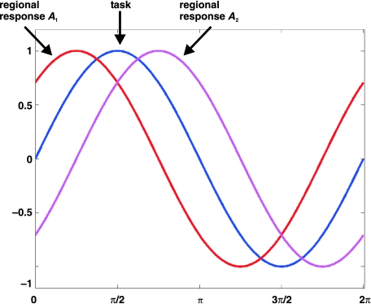
Psycho-physiological Interaction (PPI)
Functional connectivity measure
Can activity in a part of the brain be predicted by an interaction between task and activity in another part of the brain?
If two areas are jointly correlated to a task component ( ‘co-activated’) this does not mean that they are functionally connected to each other
Stephan, 2004

Slide 43
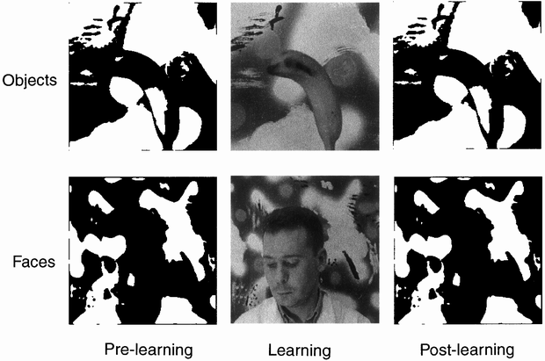
Psycho-physiological Interaction (PPI)
Factorial design
Learning
Objects before (Ob) | Objects after (Oa)
Faces before (Fb) | Faces after (Fa)
Stimuli
Dolan et al., 1997

Slide 44
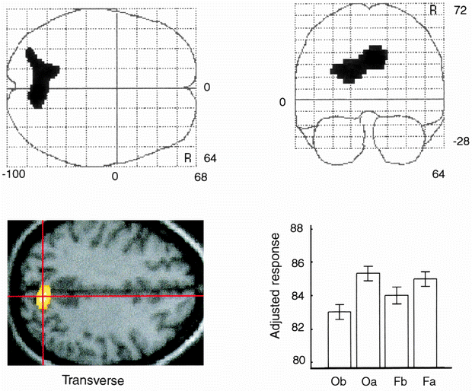
Psycho-physiological Interaction (PPI)
Main effect of learning
Learning
Objects before (Ob) | Objects after (Oa)
Faces before (Fb) | Faces after (Fa)
Stimuli
Dolan et al., 1997

Slide 45
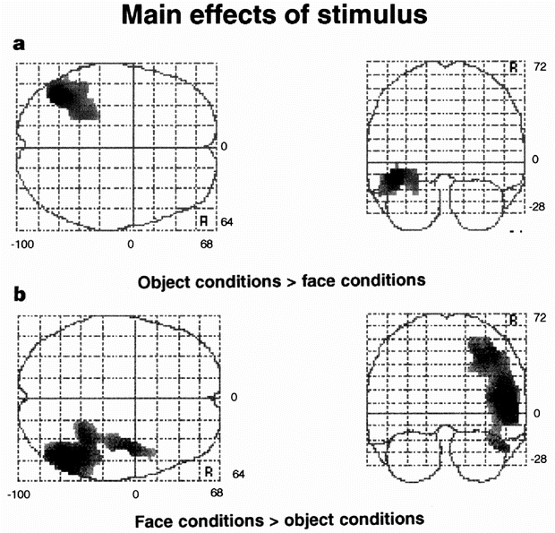
Psycho-physiological Interaction (PPI)
Main effect of stimulus
Learning
Objects before (Ob) | Objects after (Oa)
Faces before (Fb) | Faces after (Fa)
Stimuli
Does learning involve functional connectivity between parietal cortex and stimuli specific areas?
Dolan et al., 1997

Slide 46
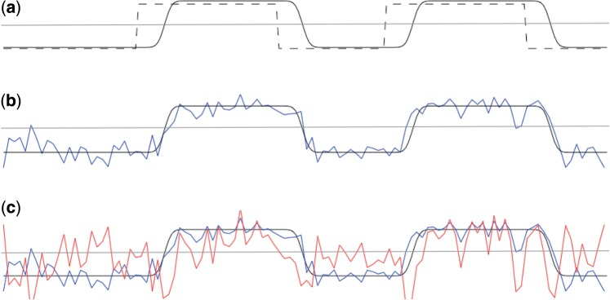
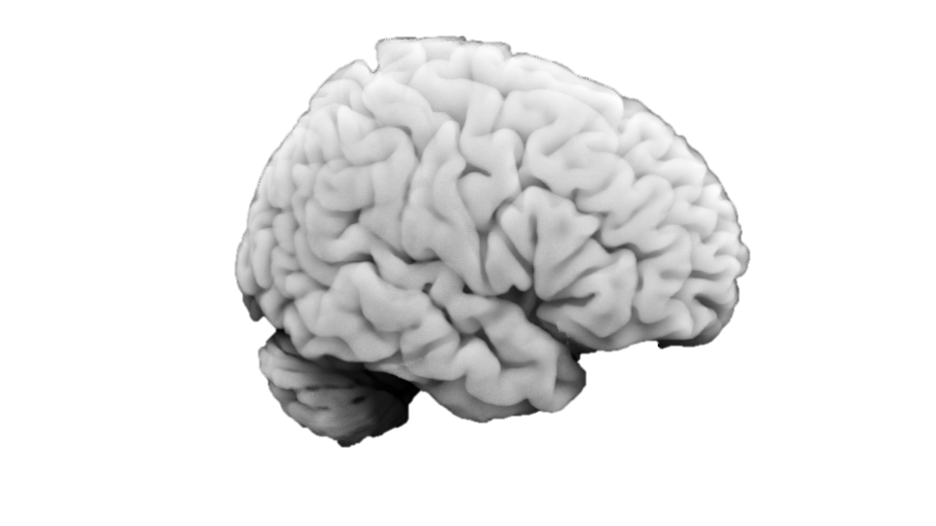
Psycho-physiological Interaction (PPI)
Does learning involve functional connectivity between parietal cortex and stimuli specific areas?
Main effect of task (Faces - objects)
Activity in parietal cortex (main effect learning)
Seed region
PPI regressor = HRF convolved task x seed ROI regressors
Whole brain
correlated for faces
Anti-correlated for objects
O’Reilly (2012)

Slide 47
Psycho-physiological Interaction (PPI)
Does learning involve functional connectivity between parietal cortex and stimuli specific areas?
1 0 0
Main effect of task (Faces - Objects)
Activity in parietal cortex (main effect of learning)
PPI regressor = HRF convolved task x seed ROI regressors
PPI activity task
The interaction term should account for variance over and above what is accounted for by the main effect of task and physiological correlation
correlated for faces
Anti-correlated for objects
O’Reilly (2012)

Slide 48
Psycho-physiological Interaction (PPI)
Learning
Objects before (Ob) | Objects after (Oa)
Faces before (Fb) | Faces after (Fa)
Stimuli
Orthogonal contrasts reduce correlation between PPI vector and the regressors of no interest
Dolan et al., 1997

Slide 49
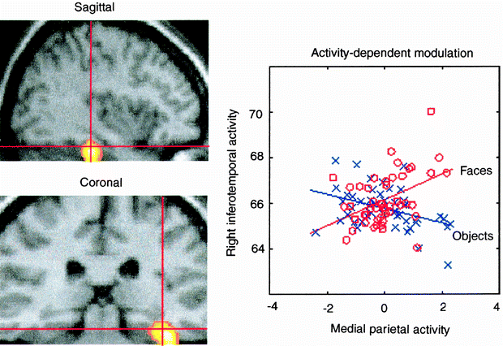
Psycho-physiological Interaction (PPI)
Coupling between ITC and parietal cortex depends on the stimulus
Coupling between the temporal face area and the medial parietal cortex when, and only when, faces were perceived
Dolan et al., 1997

Slide 50
Psycho-physiological interactions (PPI)
A standard PPI analysis does not make inferences about the direction of information flow (causality)
Stimuli:
Faces or objects
Stimuli:
Faces or objects
Modulation of
stimulus-specific
responses
Context-sensitive
connectivity
PPC
PPC
IT
IT

Slide 51
Overview
Categorical designs
Subtraction - Pure insertion, evoked / differential responses
Conjunction - Testing multiple hypotheses
Parametric designs
Linear - Adaptation, cognitive dimensions
Nonlinear - Polynomial expansions, neurometric functions
- Model-based regressors
Factorial designs
Categorical - Interactions and pure insertion
Parametric - Linear and nonlinear interactions
- Psychophysiological Interactions (PPI)

Slide 52
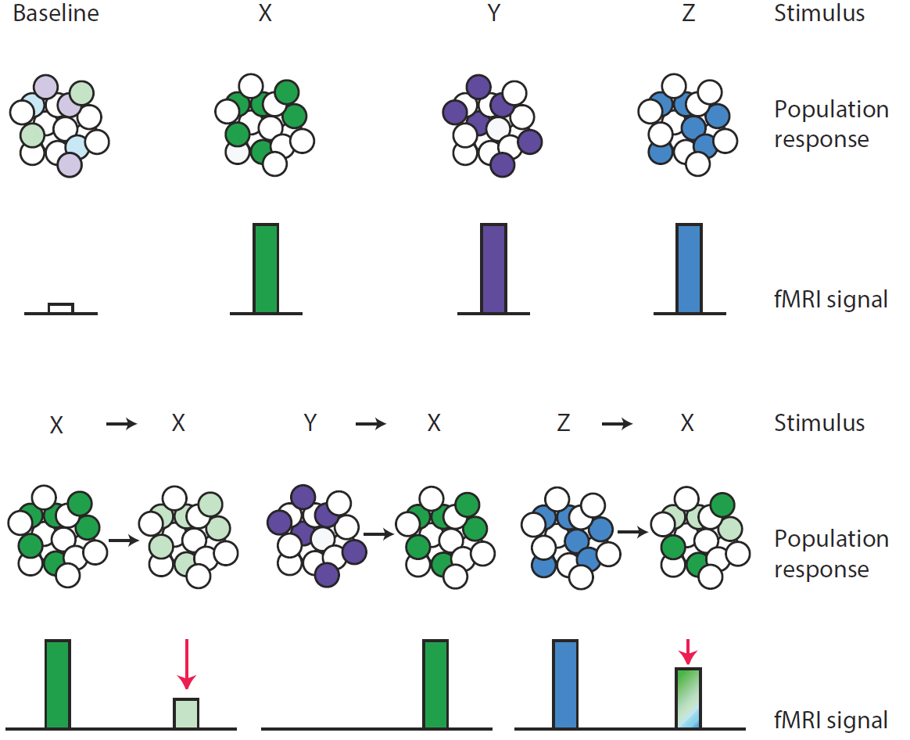
Representational neuroimaging
Approaches described so far investigate the involvement of regions in a specific mental activity rather than the representational content of regions or voxels
Barron, Garvert, Behrens 2016

Slide 53
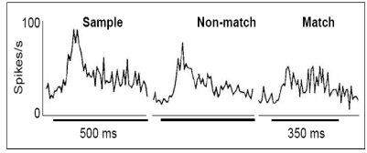
Repetition suppression
Neurons in inferotemporal cortex display a diminished response if a stimulus is repeated
Li et al. (1993),
Grill-Spector (2006)

Slide 54
Conventional fMRI vs fMRI adaptation
Repetition suppression as an index of representational similarity
Barron, Garvert, Behrens 2016

Slide 55
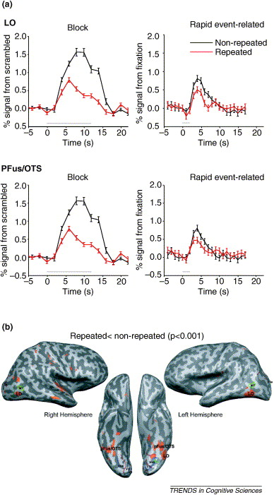
fMRI adaptation
Object-repetition effects measured with fMRI
Grill-Spector et al. (2006)

Slide 56
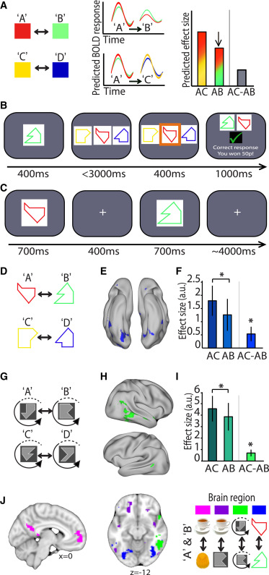
Indexing cortical associations in the human brain using cross-stimulus adaptation
Barron et al. 2016

Slide 57
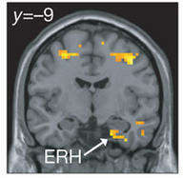
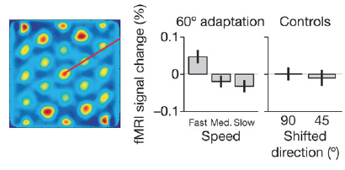
fMRI adaptation as a tool for measuring complex computations in the human brain
Doeller et al. (2010)

Slide 58
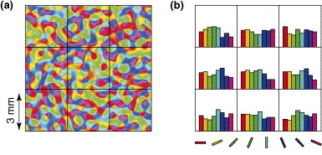
Multivariate vs. univariate methods
Multivariate methods investigate the representational content of regions
Information is represented in a distributed fashion
fine-grained spatial structure across voxels

Slide 59
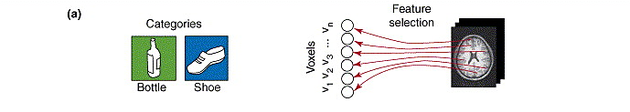
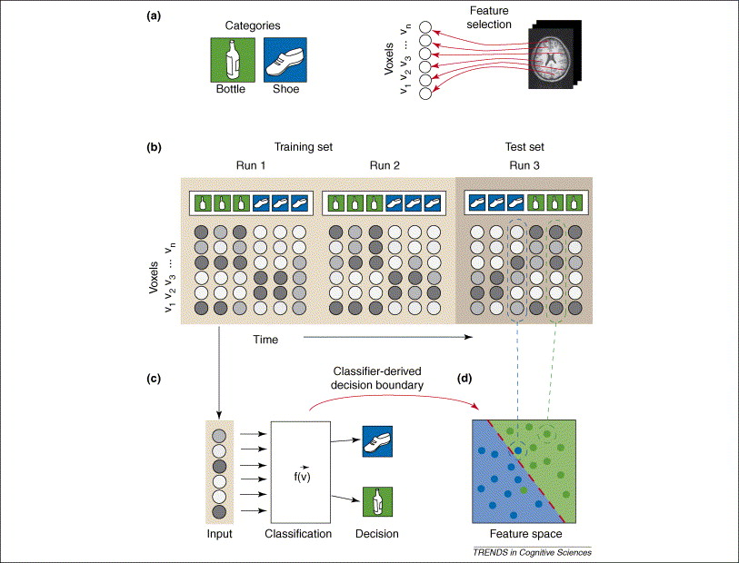
Multi-variate pattern analysis
Norman et al. 2006

Slide 60
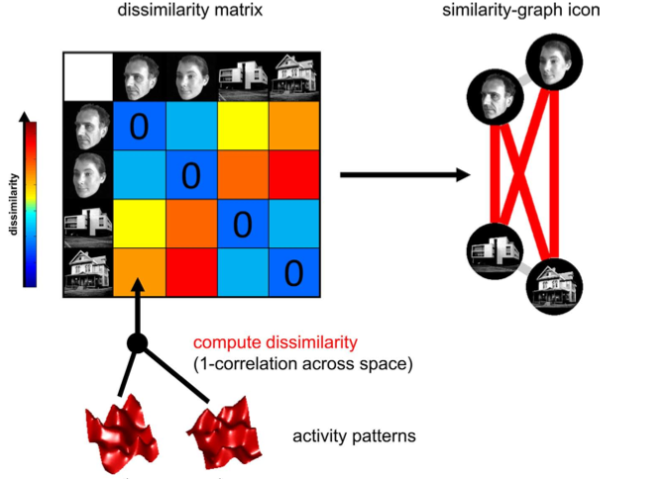


Representational similarity analysis
Comparing representations across experimental conditions
Kriegeskorte et al. (2008)

Slide 61
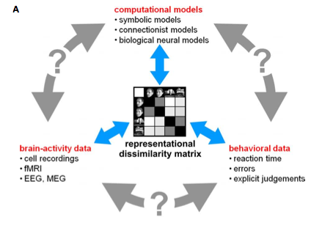
Connecting research branches
Kriegeskorte et al. (2008)

Slide 62
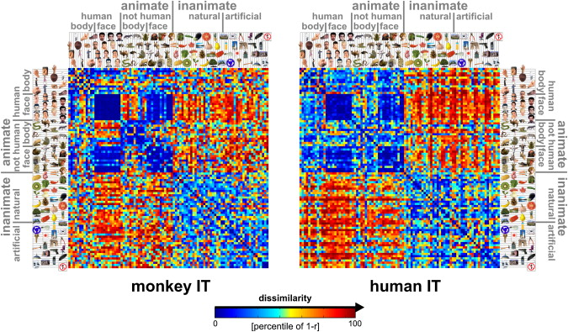
Matching object representations in inferior temporal cortex of man and monkey
Kriegeskorte et al. (2008)

Slide 63
Questions?

