Slide 1

What are we measuring with M/EEG?
George O’Neill
WCHN, Queen Square Institute of Neurology
University College London
✉ g.o’neill@ucl.ac.uk
@ofluff
SPM M/EEG Course

Slide 2
Overview
The biophysical origin of the M/EEG signal
M/EEG instrumentation
Source sensitivity
An brief introduction to source reconstruction: forward modelling

Slide 3
Part I
Biophysical origin of the M/EEG signals
M/EEG instrumentation.
Source sensitivity.
A brief introduction to source reconstruction: forward modelling

Slide 4
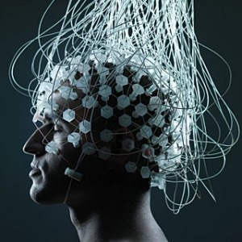
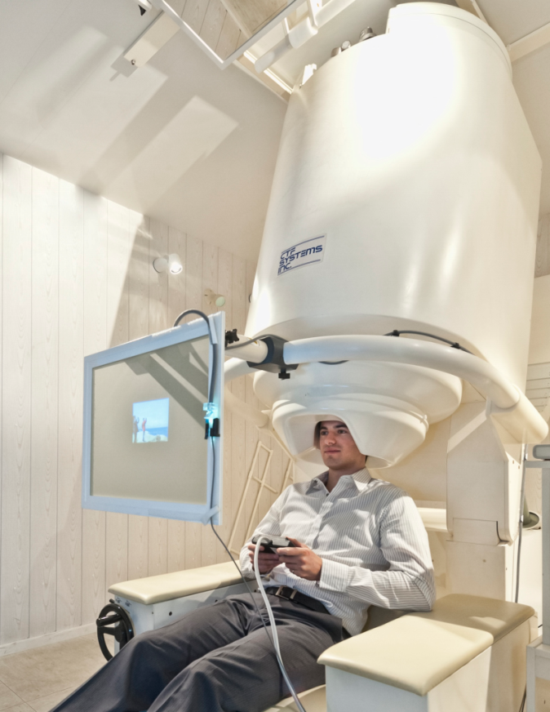
EEG and MEG
Electroencephalography (EEG) and magnetoencephalography (MEG) are non-invasive means that measure the same underlying neural currents.
EEG: Measures differences in electric potentials on the scalp
MEG: Measures changes in magnetic flux density outside of the head

Slide 5
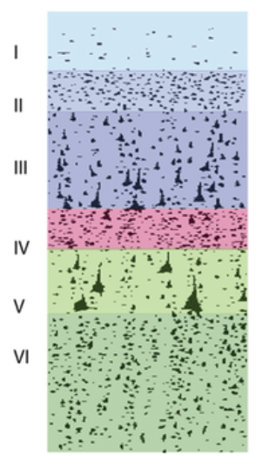
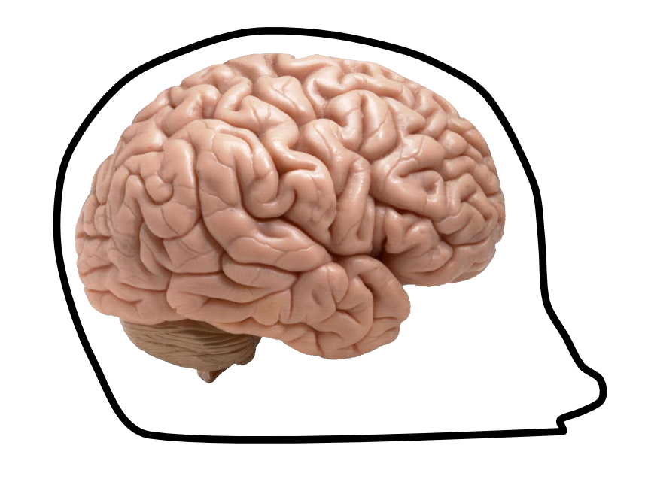
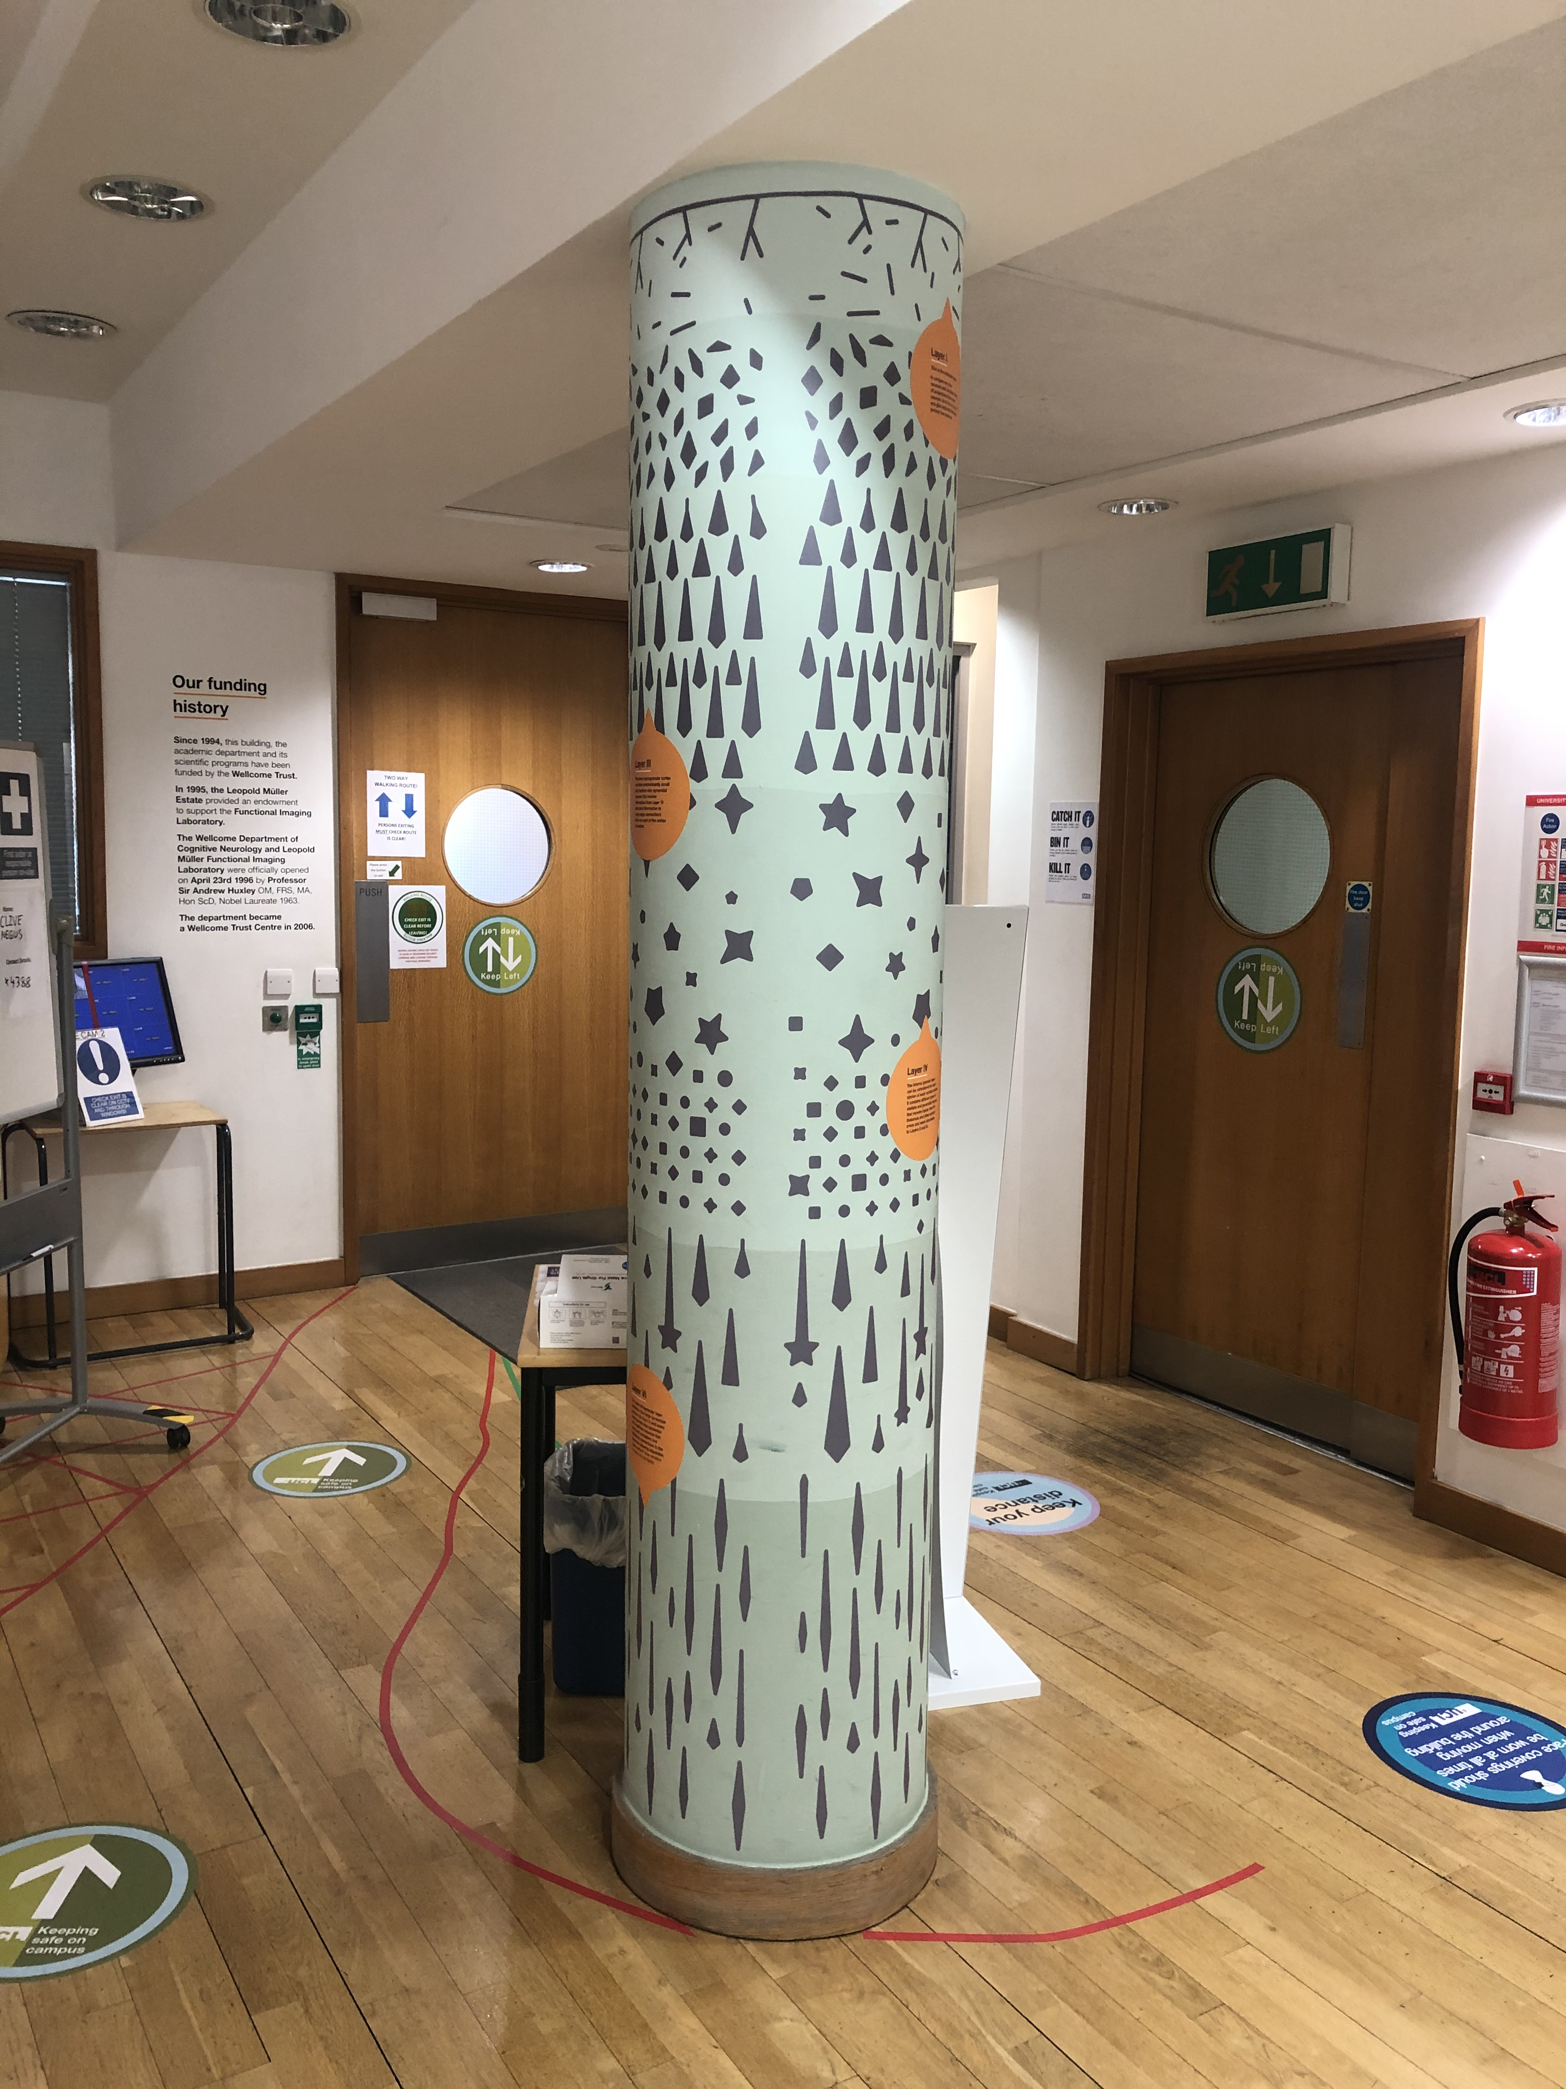
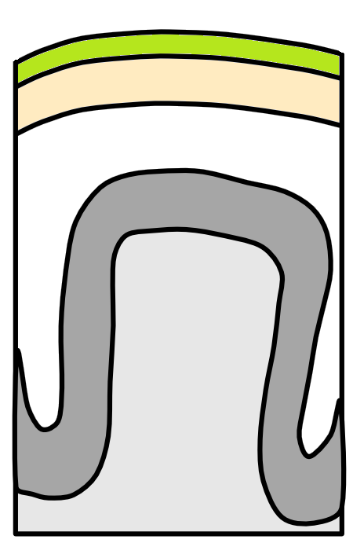
Origin of the MEEG signal
Scalp
Skull
CSF
Spocter et al, (2017)
Cortex
White matter

Slide 6
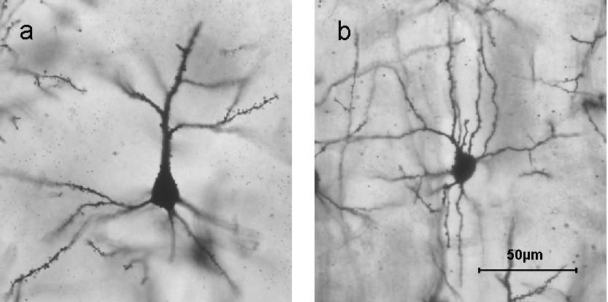
Origin of the MEEG signal
Pyramidal cells
Found in layers II/III and V
Organised so primary axis is perpendicular to the cortical surface
Open field layout makes this detectable with M/EEG
Stellate cells
This example from layer IV
Closed fields cancel out, not seen by M/EEG
Spocter et al, (2017)

Slide 7
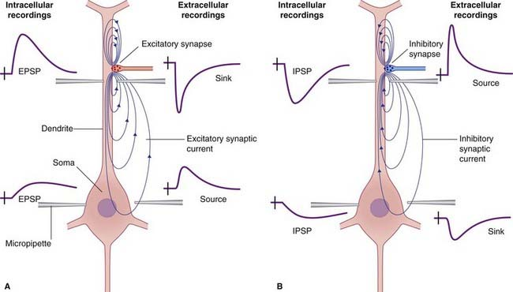
Post Synaptic Potentials
Synaptic input leads to ionic currents across the postsynaptic membrane
Excitatory Post-Synaptic Potential (EPSP): influx of positive Na+ ions at apical dendrites causes depolarization of the postsynaptic cell
Extracellular volume currents complete the loop of ionic flow so that there is no build-up of charge
MEG is more sensitive to intracellular currents, EEG to extracellular

Slide 8
Post Synaptic Potentials
Synaptic input leads to ionic currents across the postsynaptic membrane
Inhibitory Post-Synaptic Potential (IPSP): influx of negative Cl- ions causes hyperpolarization of the postsynaptic cell

Slide 9
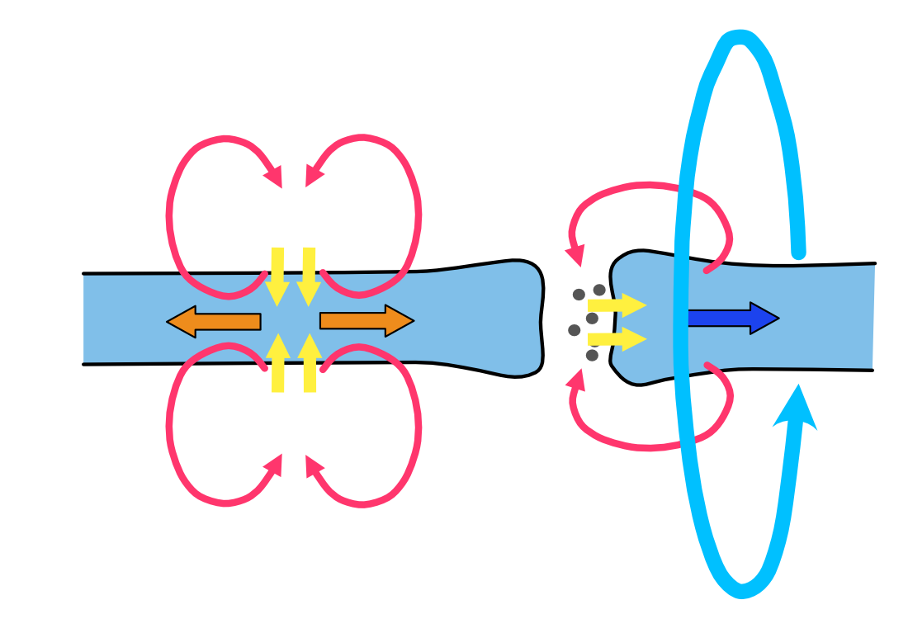
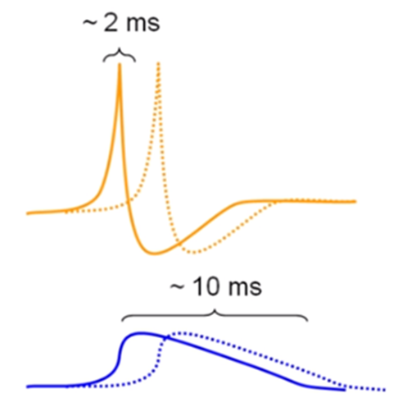
What about action potentials?
Action potentials (APs) are unlikely to contribute to the M/EEG signal.
APs produce electric quadropoles, which their intensity decline steeply with distance (1/r³). Postsynaptic currents are dipolar, which drop off as 1/r².
APs have a short duration. Would need to be highly synchronised to be measurable.
The bi-phasic nature of the depolarising and repolarising currents might result in mean field cancellation.
J_{vol}
B
Synapse
Action
Currents
Postsynaptic
Currents

Slide 10
How many neurons?
A single neuron is not detectable.
Neuronal models of detailed morphology were simulated, excited by virtually injecting current.
Equivalent current dipole (ECD) moment was estimate by summing across dipoles in an area.
50000 cells sufficient to generate a dipole source of 10 nAm
Murakami et al (2006)

Slide 11
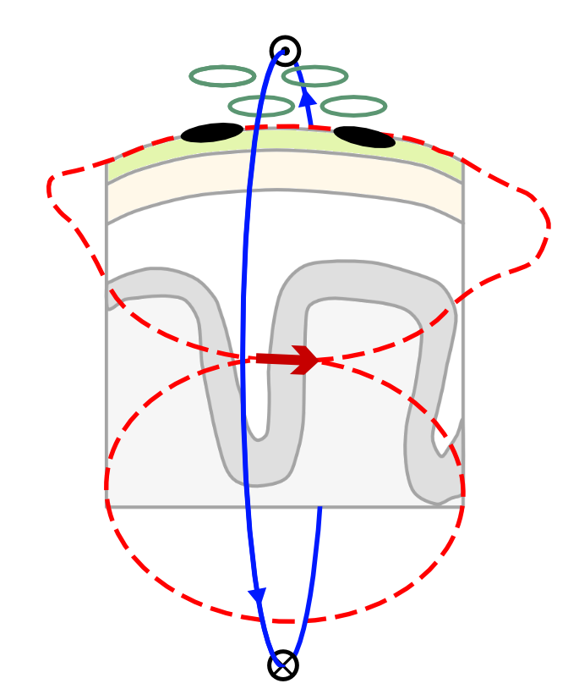
Primary and volume currents
MEG Coils
MEG measures changes in the magnetic field generated by an electric current (Sarvas 1987, Hämäläinen et al. 1993)
These magnetic field are mainly induced by primary currents based on excitatory activity (Okada et al. 1997).
Volume currents yield potential differences on the scalp that can be measured by EEG.
EEG Electrodes
Careful!
Volume current fields are heavily distorted by the insulating properties of the skull. This can limit the spatial resolution of EEG.
Volume
currents
Magnetic field

Slide 12
Part II
The biophysical origin of the M/EEG signal
M/EEG instrumentation.
Source sensitivity.
A brief introduction to source reconstruction: forward modelling

Slide 13
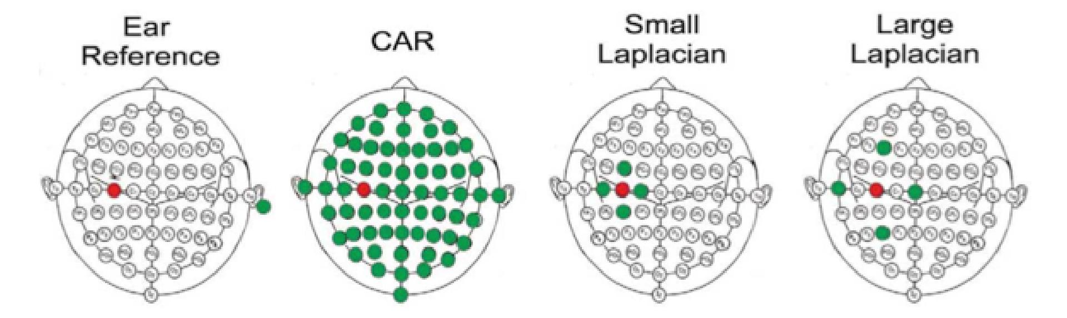
EEG Signal Detection: Electrodes
EEG records potential differences at the scalp using a set of active electrodes and a reference (ground) electrode.
The reference electrode is important as it eliminates noise from the amplifier circuit
The representation of the EEG channels is referred to as a montage
  Unipolar/Referential ➔ potential difference between an electrode and a designated reference
  Bipolar ➔ represents the difference between a pair of adjacent electrodes (e.g. ECG, EOG, EMG)
Potential differences are amplified, filtered and digitized.
McFarland et al., (1997)

Slide 14
EEG Signal Detection: Electrodes
EEG records potential differences at the scalp using a set of active electrodes and a reference (ground) electrode.
The reference electrode is important as it eliminates noise from the amplifier circuit
The representation of the EEG channels is referred to as a montage
  Unipolar/Referential ➔ potential difference between an electrode and a designated reference
  Bipolar ➔ represents the difference between a pair of adjacent electrodes (e.g. ECG, EOG, EMG)
Potential differences are amplified, filtered and digitized.
McFarland et al., (1997)

Slide 15
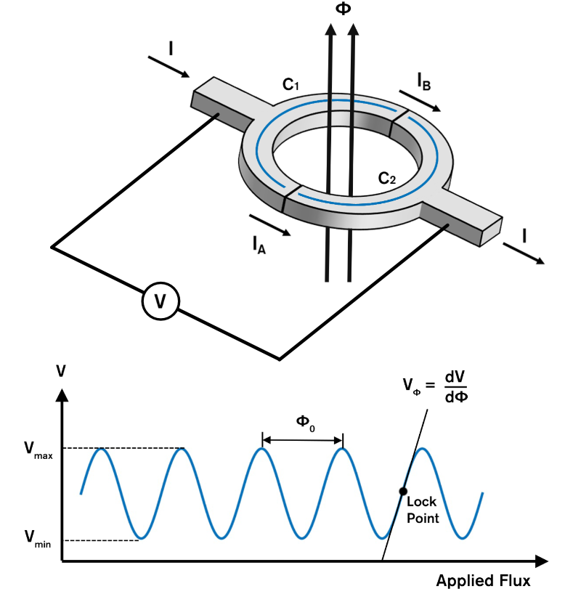
MEG Signal Detection: SQUIDs
Superconducting QUantum Interference Device
An ultra sensitive detector of magnetic flux (Φ). Consisting of two superconductors with “insulating” layers, forming two Josephson Junctions in parallel.
The measured voltage across the junctions is dependent on magnetic flux.
Measures changes on order of femtoTeslas (10⁻¹⁵ T).
Φ₀ = 2.06783383 × 10⁻¹⁵ Wb
(The magnetic flux quantum)
A 1cm² junction has a dynamic range of 10⁻¹¹ T

Slide 16
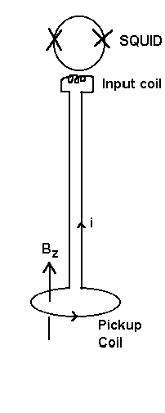
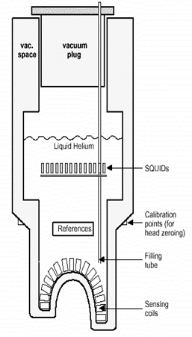
MEG Signal Detection: SQUIDs
Superconductors only become superconductors below in a certain temperature. The SQUIDs in a MEG are kept at 4 K (-269.15 °C) using a bath of liquid helium.
This makes SQUID-MEG quite limited in its applications.
Participant has to keep head still relative to sensors!
Bulky instrumentation
Liquid helium is expensive.

Slide 17
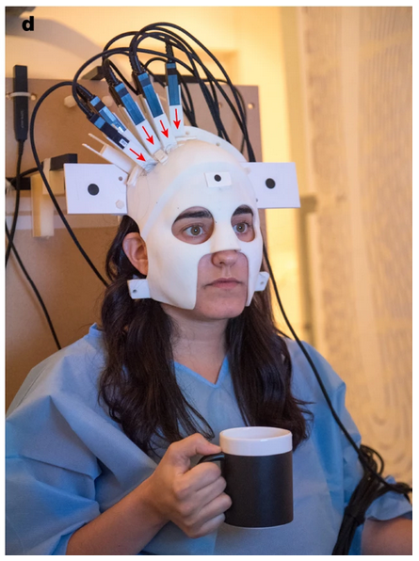
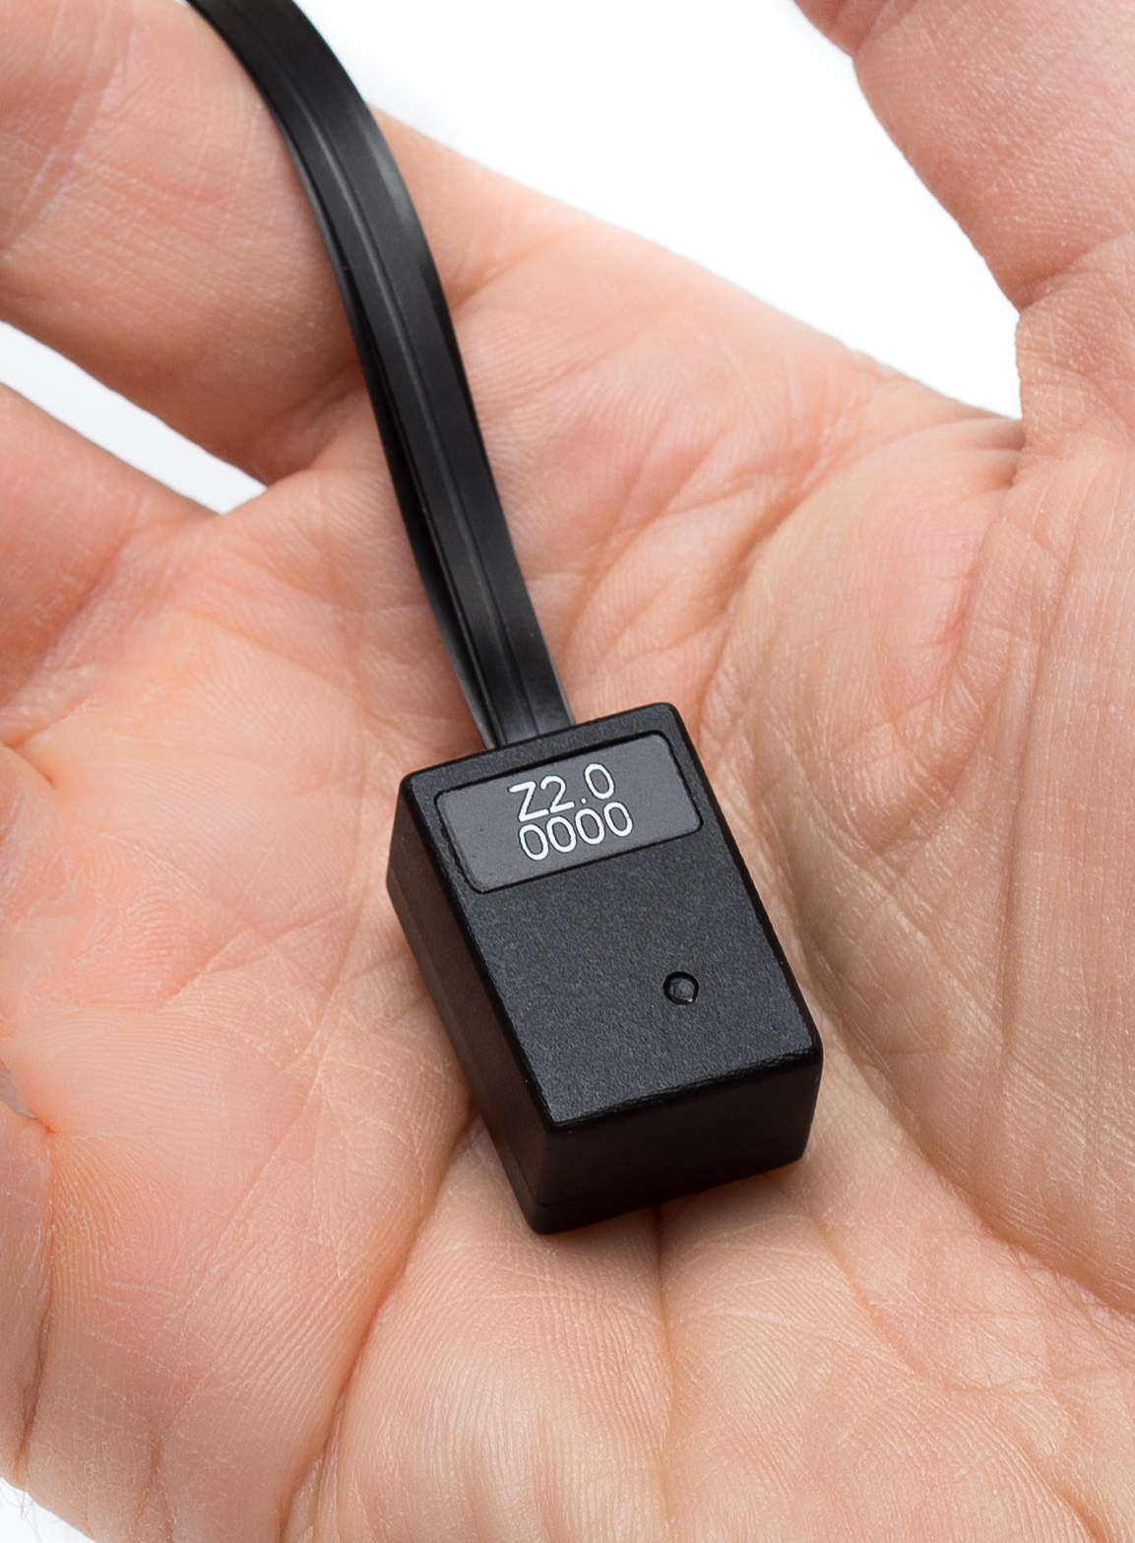
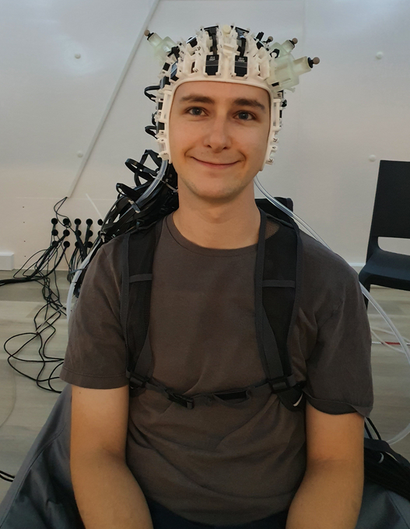
MEG Signal Detection: OPMs
A new generation of sensors which are just a sensitive, but can operate safely on the scalp. The most commonplace so far are Optically Pumped Magnetometers.
Theoretical improvements in SNR over SQUID MEG. EEG form factor a bonus.
Warning
No turn-key OP-MEG solution exits yet. Proceed with caution!
Boto et al. (2018)
QuSpin Inc.
WCHN 2021

Slide 18
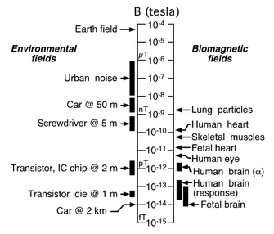
MEG Signal Challenges
The MEG signal is tiny!
We need approaches to shield our sensors from this noise to be able to measure anything useful.
Vrba (1999)

Slide 19
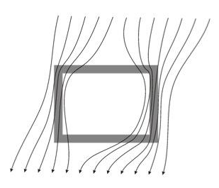
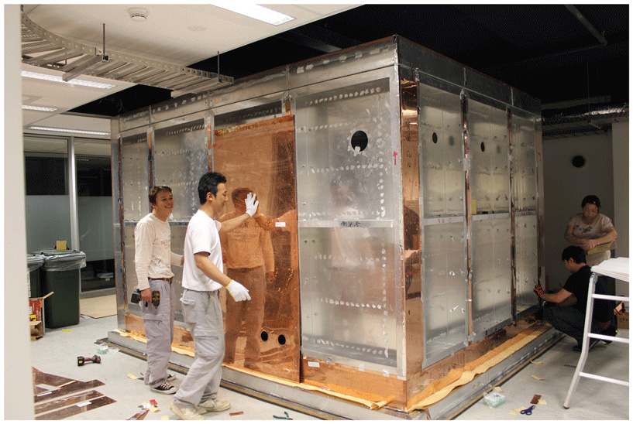
Magnetically shielded rooms
MEG systems are currently housed within Magnetically Shielded Rooms (MSRs), which give passive shielding against noise from the environment. The best rooms can get the residual background fields to the order of a few nanoTeslas.
Shielded interference
Concentric shells of mu metal, copper and aluminium bend external fields around the MSR

Slide 20
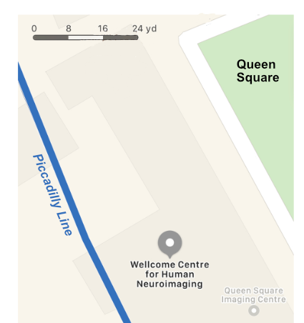
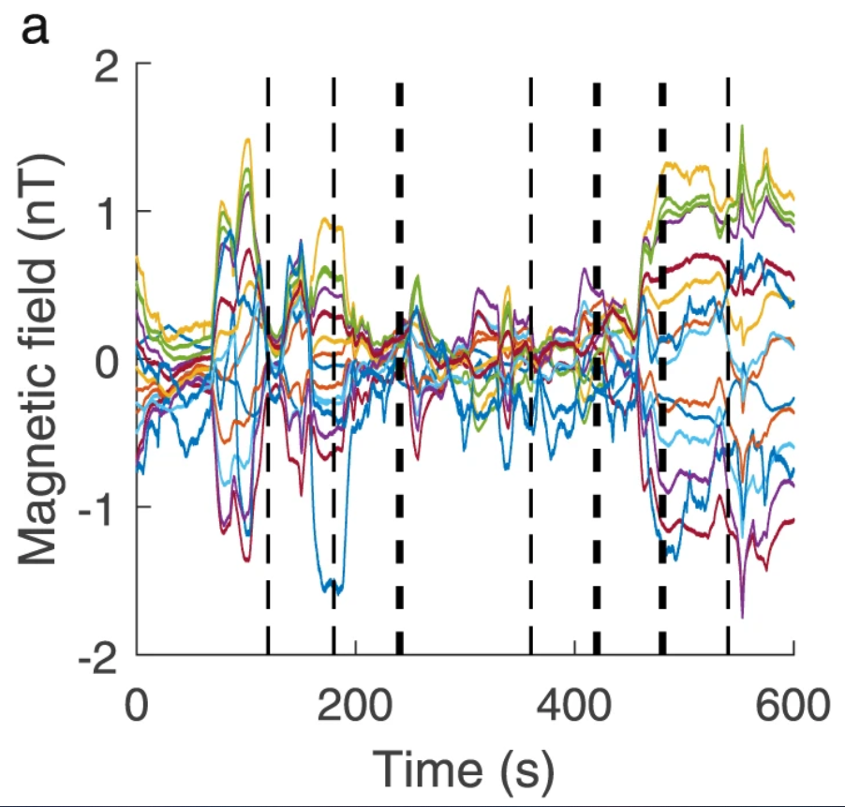
Magnetically shielded rooms
Some external interference is time-evolving.
The MEG at UCL is ~50 m from passing trains, which the MSR cannot eliminate in its entirety.
Trains departing nearby
Shielded interference
Holmes et al. (2019)

Slide 21
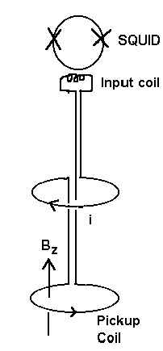
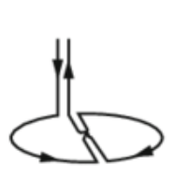
From magnetometers to gradiometers
Gradiometers used a second counter-wound coil a given distance aware from the primary coil, which allows it to sense the gradient of a field between the two coils.
Magnetometer
Planar
Gradiometer
Axial
Gradiometer

Slide 22
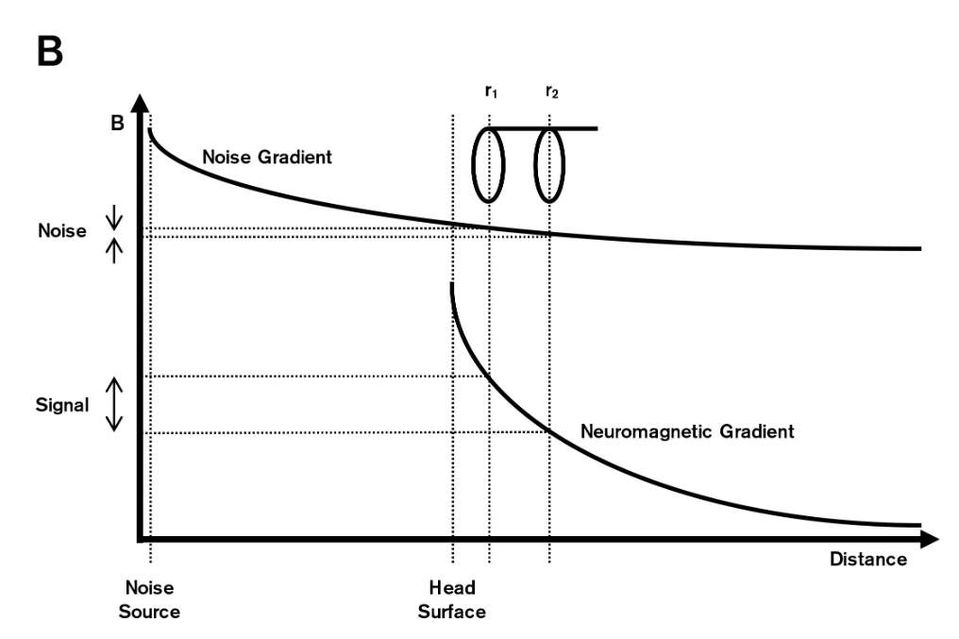
From magnetometers to gradiometers
Sources with which generate large magnetic fields but are far away produce small field gradients.
Nearby sources generate much larger gradients.
This allows us to push up the SNR of our data.
Signal
Noise
Axial
Gradiometer
Measured field
Magnetometer
Gradiometer

Slide 23
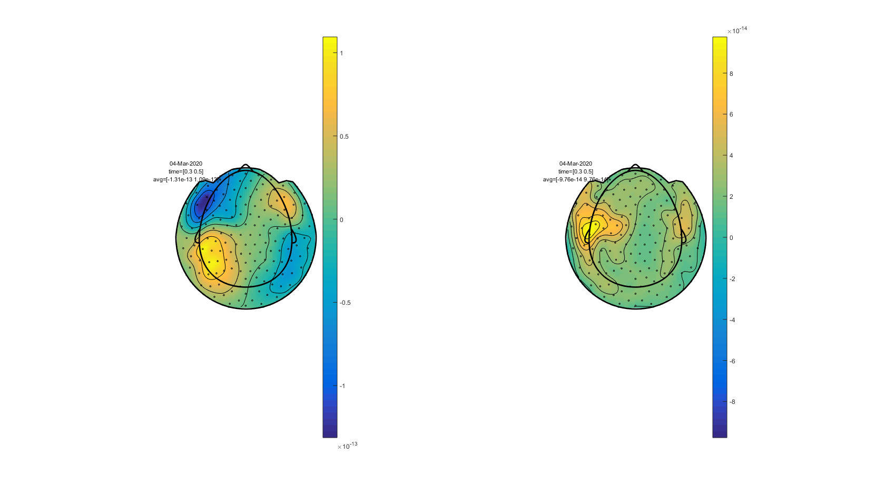
From magnetometers to gradiometers
The field patterns from axial gradiometers and planar gradiometers look quite different.
Axial
Planar
fieldtriptoolbox.org

Slide 24
Part III
The biophysical origin of the M/EEG signal
M/EEG instrumentation
Source sensitivity.
A brief introduction to source reconstruction: forward modelling

Slide 25
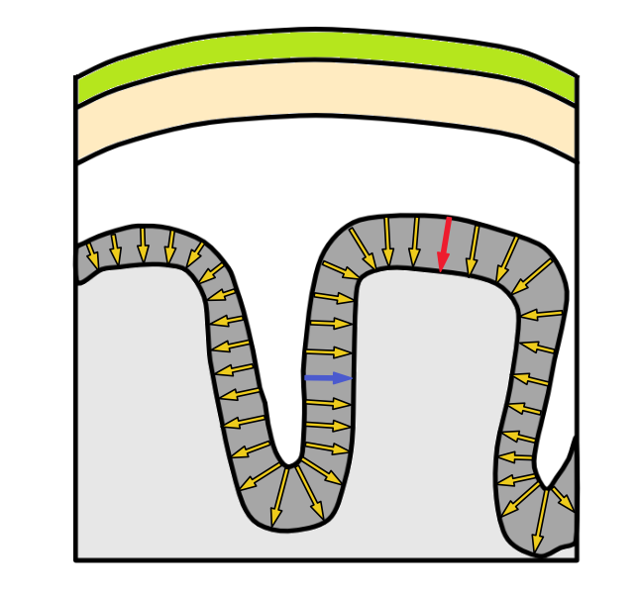
Source orientation
Bulk current flow from EPSPs is oriented perpendicular to the cortical ribbon.
Orientation of source is important….
EEG can detect both tangential and radial oriented dipoles
MEG can see tangential, but struggles to sense radial dipoles
  If you assume a symmetric sphere for the head, radial dipoles are impossible to detect!
Scalp
Skull
Cortex
Gyrus
Sulcus

Slide 26
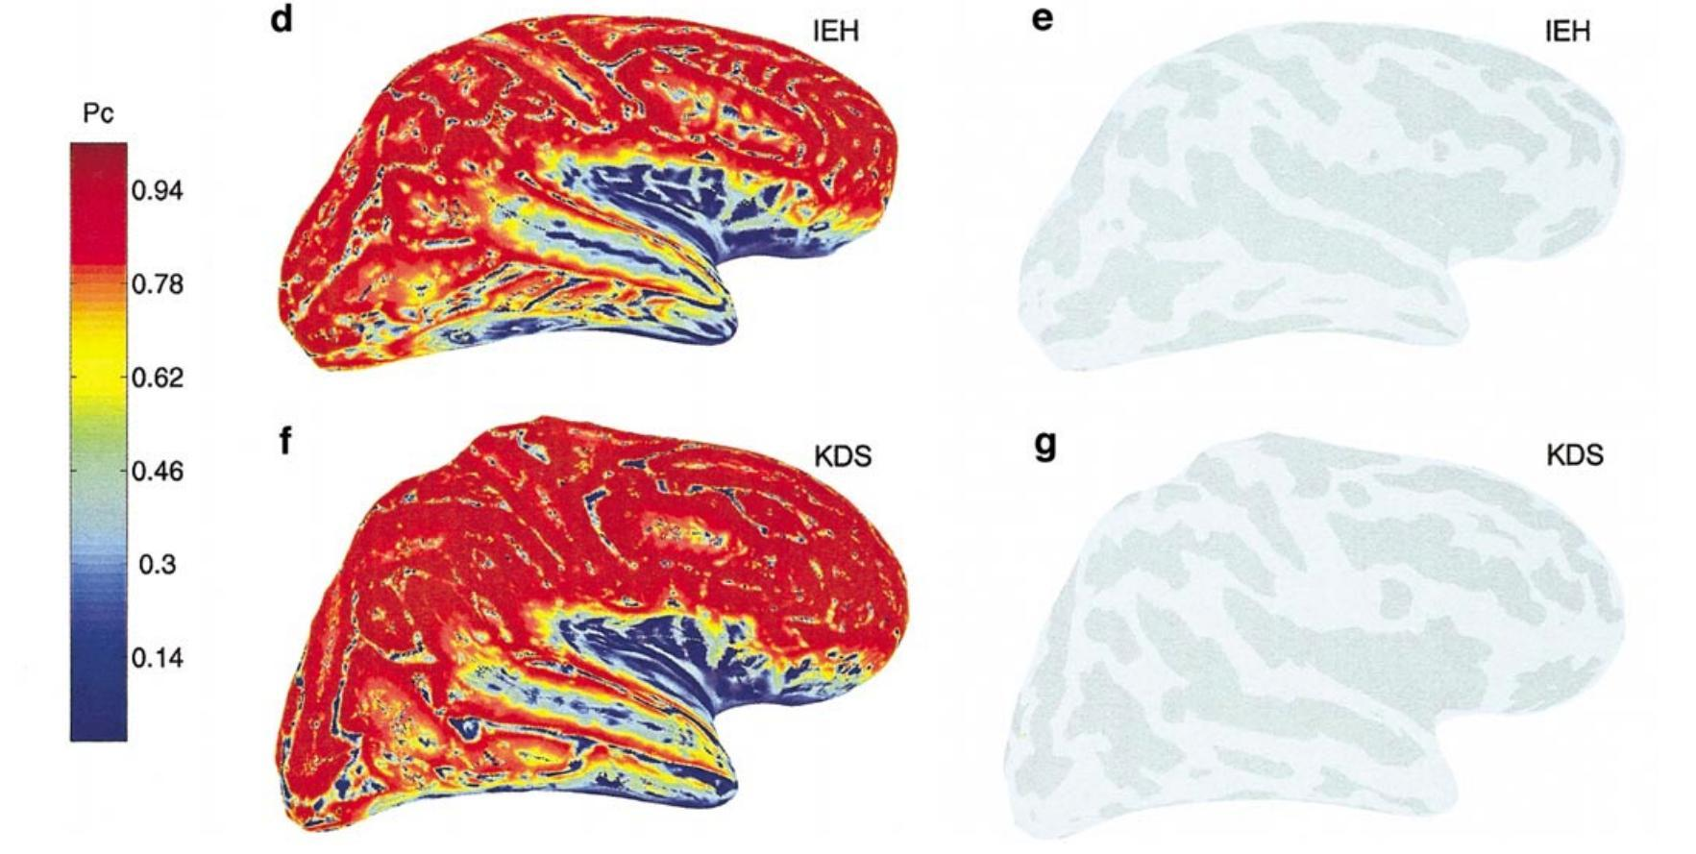
Source orientation
So what’s the point if MEG cannot see sources in the gyri/sulci?
The head isn’t a perfect sphere.
Even if you assume it is very few sources are truly radial
Most sources are not point sources, so will likely contain a tangential component.
tl;dr - it’s not a massive concern.
Hillebrand and Barnes (2002)

Slide 27
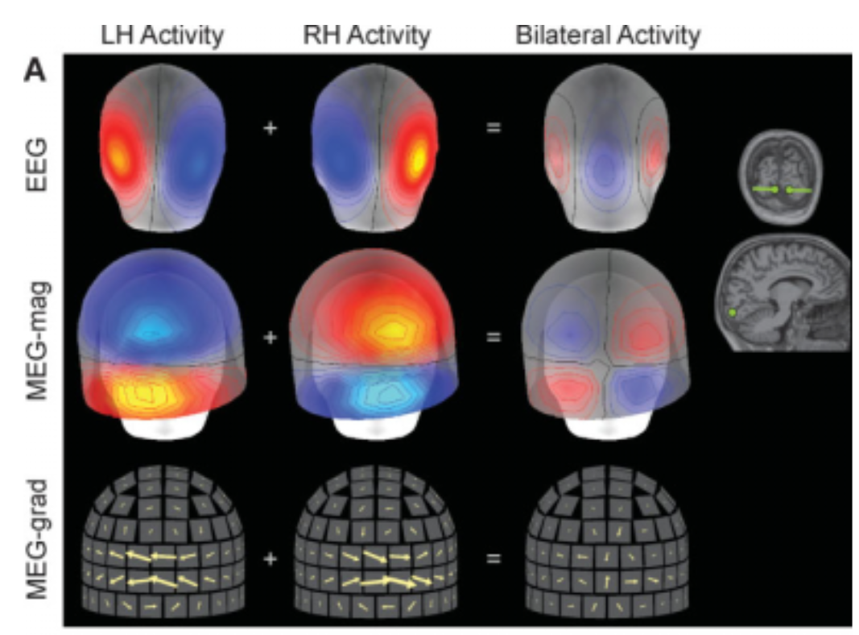
Source extent
Extended and neighbouring sources can lead to source cancellation at the sensor level.
Ahlfors et al. (2010)

Slide 28
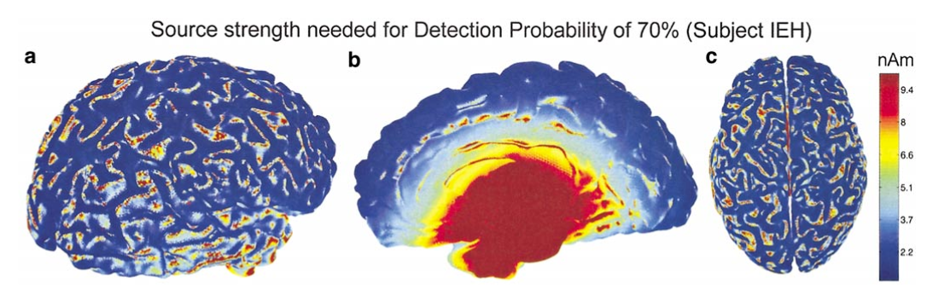
Source depth
Depth is a limiting factor in MEG measurements.
Hillebrand and Barnes (2002)
Sensor-level amplitude decreases with distance from source (1/r²)
Deeper sources appear more radial, which MEG is less sensitive to

Slide 29
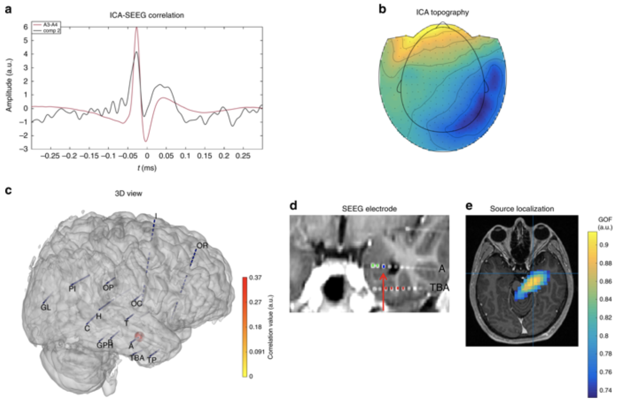
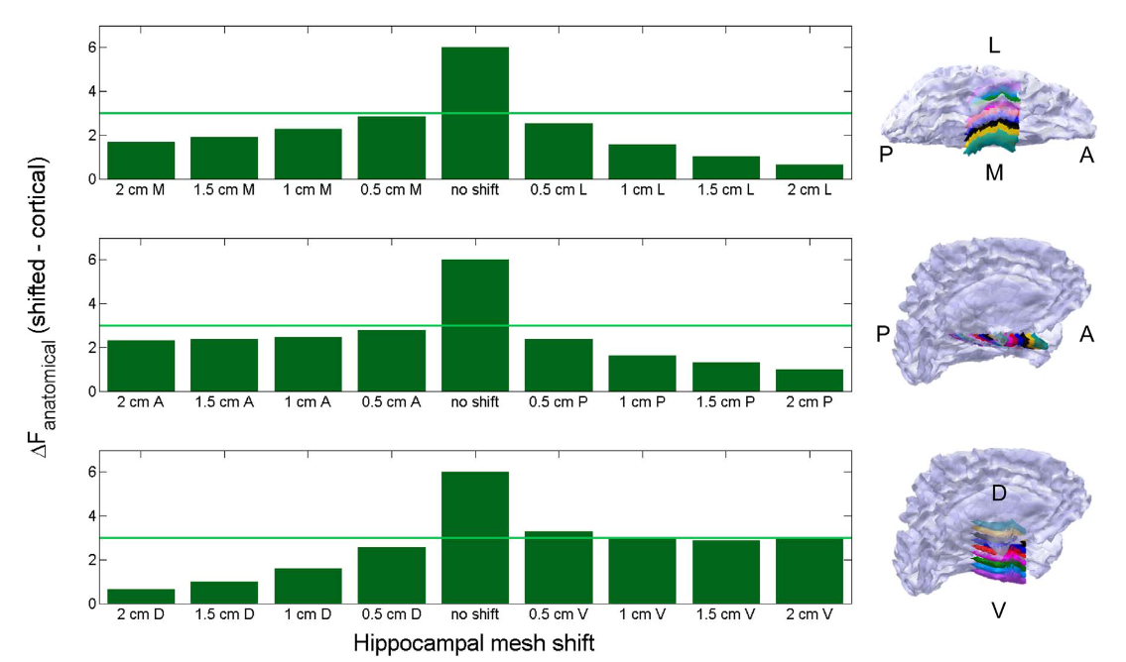
Source depth
Its hard, but not impossible given sufficient SNR
Pizzo et al. (2019)
Meyer et al. (2017)

Slide 30
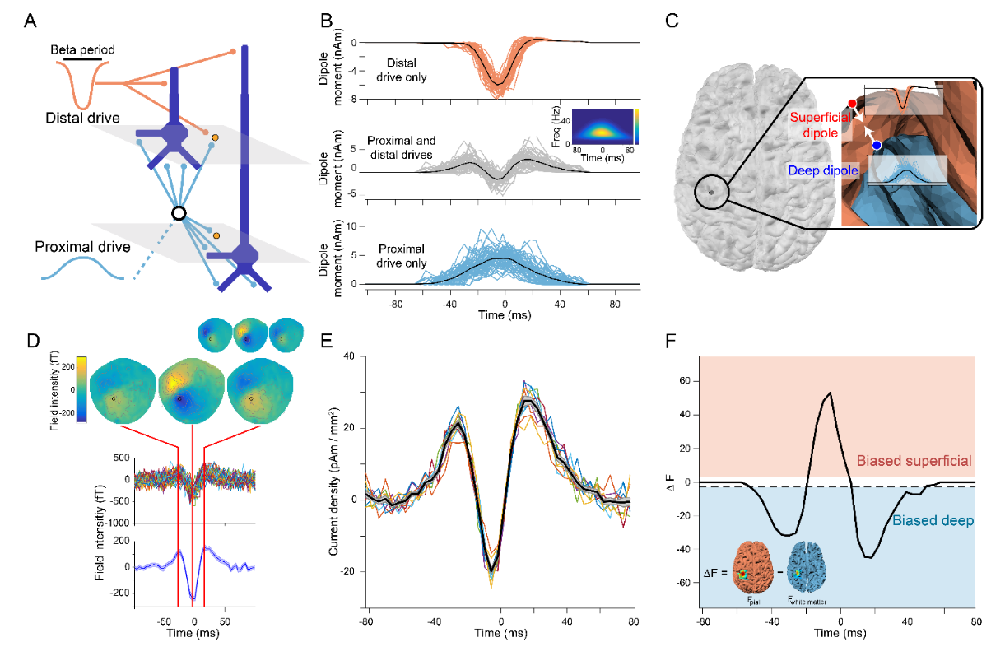
Source depth
If SNR is good enough, you should be able to discriminate between layers within the cortex!
Bonaiuto, Little, et al. (2021)
Beta bursts are hypothesised to employ both layer II/III and V pyramidal cells
MEG can pick apart which part of the event occurs for which layer.

Slide 31
Part IV
The biophysical origin of the M/EEG signal
M/EEG instrumentation
Source sensitivity.
A brief introduction to source reconstruction: forward modelling

Slide 32
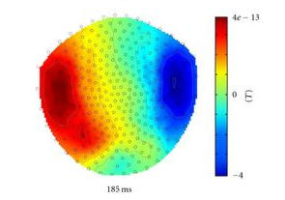
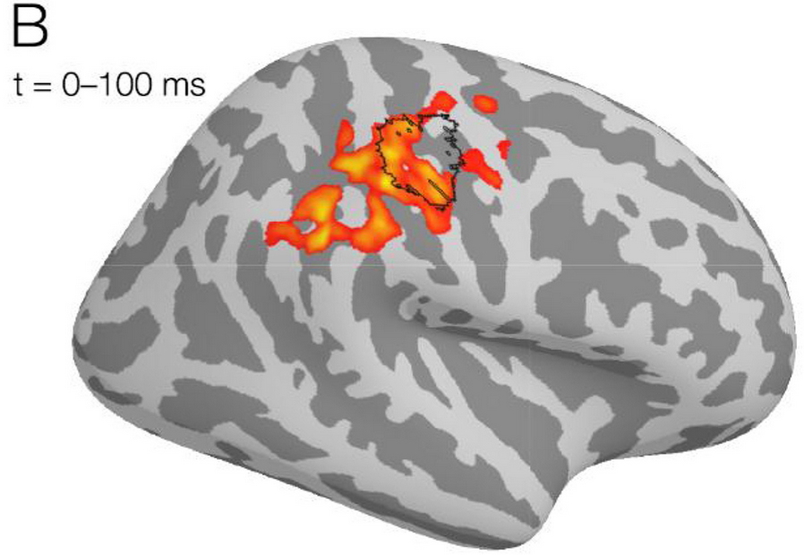
Source reconstruction
Forward problem
Inverse problem
From sensors…
…to sources!

Slide 33
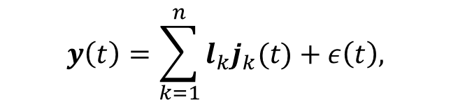

A generative model of sources
Starting from our sensor-level M/EEG data, y, for a given time, t, the we can assume is generated by $k$ sources in the brain:
$$y\left(t\right)=\sum_{k=1}^{n}{l_{k}j_{k}(t)}+ε\left(t\right),$$
Lead fields:
How a source is represented at sensors
Everything unexplained (noise)
Source strength at time t
Encapsulate all time and we can turn this into a set of matrices.
All data across all time
$$Y=LJ+ε$$
‘noise’ across all time
All lead fields
All source activity across all time

Slide 34
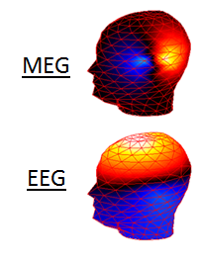
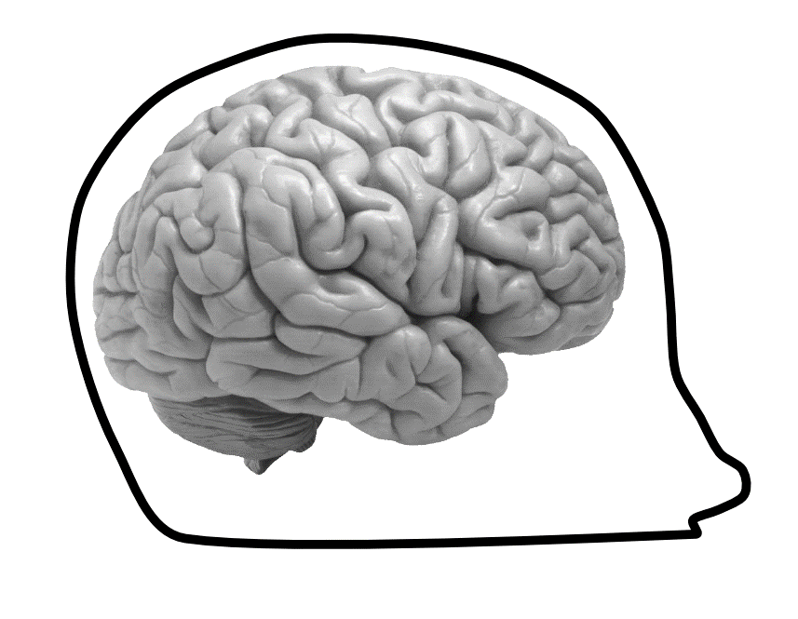

Lead fields: the forward problem
$$Y=LJ+ε$$
The forward problem
If we know the precise position/orientation/amplitude of a dipole in the brain, can we estimate what the associated senor-level pattern should be?
Lead fields
YES!
For a given dipole, there exists one unique solution. This makes it straightforward to solve!
For MEG data, the solutions are typically a lot simpler than for MEG data.

Slide 35
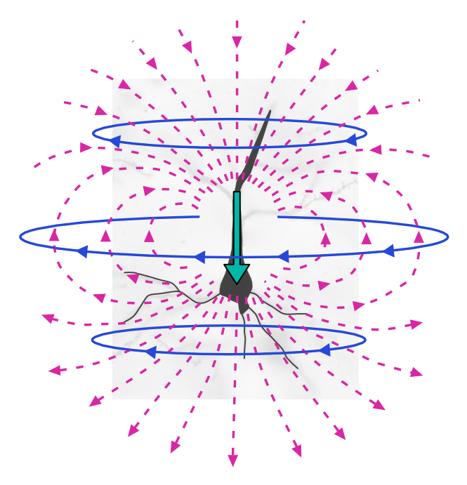
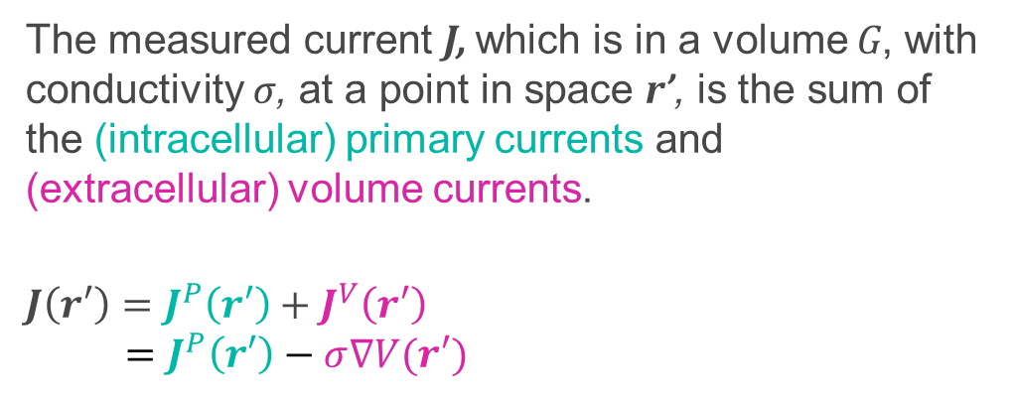
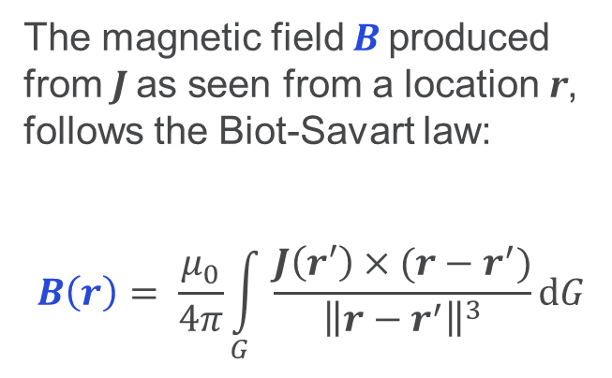
Lead fields: the mathematical formulation
Sorry. But this is for your own good.
The measured current J, which is in a volume G, with conductivity σ, at a point in space r’, is the sum of the (intracellular) primary currents and (extracellular) volume currents.
$$J\left(r′\right)=J^{P}\left(r′\right)+J^{V}\left(r′\right) \\ =J^{P}\left(r′\right)−σ∇V(r′)$$
J^{V}
J^{P}
B
Electric Potential
The magnetic field B produced from J as seen from a location r, follows the Biot-Savart law:
$$B\left(r\right)= \frac{μ_{0}}{4π}\int_{G}{\frac{J\left(r′\right)×(r−r^{′})}{{\left\|r−r^{′}\right\|}^{3}}dG}$$

Slide 36
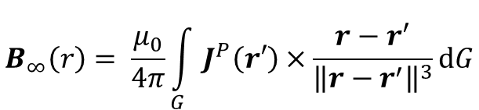
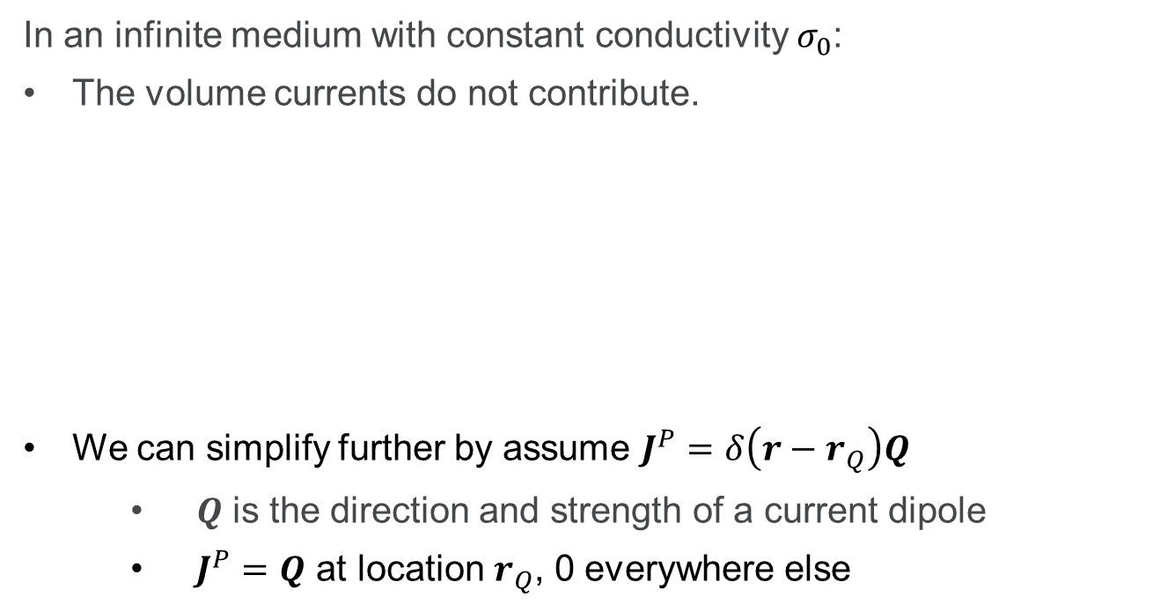
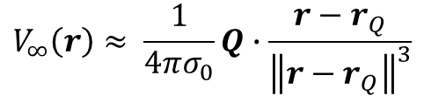
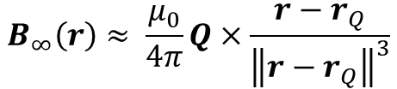
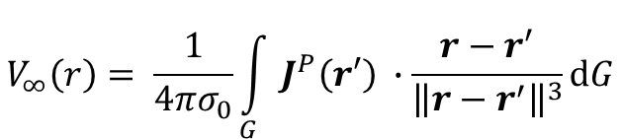
Fields in an infinite medium
In an infinite medium with constant conductivity $σ_{0}$:
The volume currents do not contribute.
We can simplify further by assume $J^{P}=δ\left(r−r_{Q}\right)Q$
  $Q$ is the direction and strength of a current dipole
  $J^{P}=Q$ at location $r_{Q}$, 0 everywhere else
$$B_{∞}\left(r\right)= \frac{μ_{0}}{4π}\int_{G}{J^{P}\left(r′\right)×\frac{r−r^{′}}{{\left\|r−r^{′}\right\|}^{3}}dG}$$
$$V_{∞}\left(r\right)= \frac{1}{4πσ_{0}}\int_{G}{J^{P}\left(r′\right) ∙\frac{r−r^{′}}{{\left\|r−r^{′}\right\|}^{3}}dG}$$
Q
Primary Magnetic Field
Primary Electric Potential
r-r_{Q}
Sensor
$$B_{∞}\left(r\right)≈ \frac{μ_{0}}{4π}Q×\frac{r−r_{Q}}{{\left\|r−r_{Q}\right\|}^{3}}$$
$$V_{∞}\left(r\right)≈ \frac{1}{4πσ_{0}}Q∙\frac{r−r_{Q}}{{\left\|r−r_{Q}\right\|}^{3}}$$

Slide 37
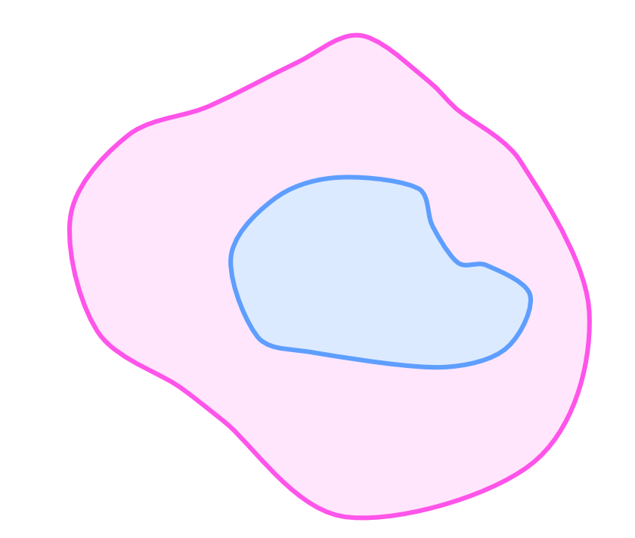
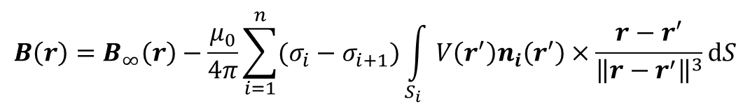

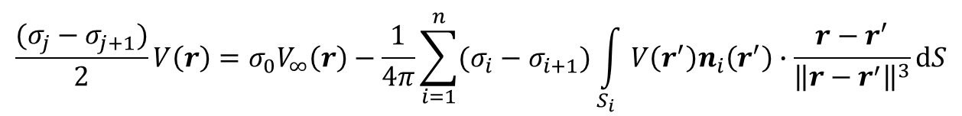
Fields in an inhomogeneous medium
The infinite model, whilst a nice toy is too simplistic…
Assuming the head is set of domains with constant conductivity within each encapsulated by a surface S…
$$\frac{(σ_{j}−σ_{j+1})}{2}V\left(r\right)={σ_{0}V}_{∞}\left(r\right)−\frac{1}{4π}\sum_{i=1}^{n}{(σ_{i}−σ_{i+1})\int_{S_{i}}{V\left(r^{′}\right)n_{i}\left(r^{′}\right)∙\frac{r−r^{′}}{{\left\|r−r^{′}\right\|}^{3}}dS}}$$
n₂
$$B\left(r\right)=B_{∞}\left(r\right)−\frac{μ_{0}}{4π}\sum_{i=1}^{n}{(σ_{i}−σ_{i+1})\int_{S_{i}}{V\left(r^{′}\right)n_{i}\left(r^{′}\right)×\frac{r−r^{′}}{{\left\|r−r^{′}\right\|}^{3}}dS}}$$
S₂
σ₂
σ₁
$$σ_{n+1}=0$$
S₁
n₁

Slide 38








What?
$$B\left(r\right)=B_{∞}\left(r\right)−\frac{μ_{0}}{4π}\sum_{i=1}^{n}{(σ_{i}−σ_{i+1})\int_{S_{i}}{V\left(r^{′}\right)n_{i}\left(r^{′}\right)×\frac{r−r^{′}}{{\left\|r−r^{′}\right\|}^{3}}dS}}$$
$$B\left(r\right)=B_{∞}\left(r\right)−\frac{μ_{0}}{4π}\sum_{i=1}^{n}{(σ_{i}−σ_{i+1})\int_{S_{i}}{V\left(r^{′}\right)n_{i}\left(r^{′}\right)×\frac{r−r^{′}}{{\left\|r−r^{′}\right\|}^{3}}dS}}$$
$$B\left(r\right)=B_{∞}\left(r\right)−\frac{μ_{0}}{4π}\sum_{i=1}^{n}{(σ_{i}−σ_{i+1})\int_{S_{i}}{V\left(r^{′}\right)n_{i}\left(r^{′}\right)×\frac{r−r^{′}}{{\left\|r−r^{′}\right\|}^{3}}dS}}$$
$$B\left(r\right)=B_{∞}\left(r\right)−\frac{μ_{0}}{4π}\sum_{i=1}^{n}{(σ_{i}−σ_{i+1})\int_{S_{i}}{V\left(r^{′}\right)n_{i}\left(r^{′}\right)×\frac{r−r^{′}}{{\left\|r−r^{′}\right\|}^{3}}dS}}$$
$$\frac{(σ_{j}−σ_{j+1})}{2}V\left(r\right)={σ_{0}V}_{∞}\left(r\right)−\frac{1}{4π}\sum_{i=1}^{n}{(σ_{i}−σ_{i+1})\int_{S_{i}}{V\left(r^{′}\right)n_{i}\left(r^{′}\right)∙\frac{r−r^{′}}{{\left\|r−r^{′}\right\|}^{3}}dS}}$$
$$\frac{(σ_{j}−σ_{j+1})}{2}V\left(r\right)={σ_{0}V}_{∞}\left(r\right)−\frac{1}{4π}\sum_{i=1}^{n}{(σ_{i}−σ_{i+1})\int_{S_{i}}{V\left(r^{′}\right)n_{i}\left(r^{′}\right)∙\frac{r−r^{′}}{{\left\|r−r^{′}\right\|}^{3}}dS}}$$
$$\frac{(σ_{j}−σ_{j+1})}{2}V\left(r\right)={σ_{0}V}_{∞}\left(r\right)−\frac{1}{4π}\sum_{i=1}^{n}{(σ_{i}−σ_{i+1})\int_{S_{i}}{V\left(r^{′}\right)n_{i}\left(r^{′}\right)∙\frac{r−r^{′}}{{\left\|r−r^{′}\right\|}^{3}}dS}}$$
I’ve probably lost you, so lets break this down what this is telling us.
The observable magnetic fields are partly dependent on the volume currents, so need to consider potentials.
To calculate the potentials outside of the head, you need to first numerically solve potentials on the boundaries between each regions.
Anatomical properties needs to be considered!
This could be incredibly tedious…

Slide 39





Forward models
Various approximations to the problem are available.
Single Sphere
Local Spheres
Corrected Sphere
(a.k.a. single shell)
Boundary Element Model (BEM)
Finite Element Model (FEM)
Simple
Complex
EEG requires more complex models which are able to predict electric potential differences better than the simple spherical models (typically a 3-shell BEM or better).
This does require more knowledge about the anatomy.

Slide 40
Forward models
MEG may benefit from more complex models and accurate segmentations.
Reference model
Increased segmentation accuracy
Stenroos et al. NIMG (2014)
Simpler models

Slide 41
Forward models
Which model do I recommend?
Note: this is my personal opinion.
For most users…
EEG: 3-Shell Boundary Element Model (BEM) (or better)
MEG: Nolte’s Correct Sphere (a.k.a. Single Shell) (or better)

Slide 42


The Inverse problem
$$Y=LJ+ε$$
The inverse problem
Given a set of observations at the sensor level, can we estimate where in the brain they originate from?
Can we solve for J by doing…. $J=YL^{−1}$
Source Activity
No!
This problem is ill-posed for a number of reasons.
There are many more sources than sensors
Opposing neighbouring dipoles can cancel out, leading to an infinite number of possible solutions…
How we solve for J in these limitations will be discussed later in the course!

Slide 43
Summary
MEG and EEG are direct measures of neural activity, with high temporal resolution.
This signal is predominantly based on the ensemble postsynaptic currents of 10s of thousands of pyramidal cells.
MEG is biggest challenge is ensuring that the SNR is high enough given interference several orders of magnitude larger than the signal.
EEG has higher sensitivity to both deep and radial sources, but the signal is strongly affected by conductivity changes between brain, scull and scalp. Which makes spatial precision a challenge.
Forward models describe how the currents in the brain give rise to electric potentials or magnetic fields measured outside the head

Slide 44
Thanks for listening!
Any questions?

Slide 45

Lead fields: the forward solution
The forward solutions describes the sensor activity you’d expect to see from a unit strength source given a location and orientation.
The leadfield matrix L depends on:
sensors type, location and orientation
source space, (is it a cortical surface or volumetric grid?)
head geometry
conductivity of the head tissues

