Slide 1
DCM for EEG - Demo
Ashley Tyrer
University of Bristol

Slide 2
Analysis Pipeline
Visual Recognition Task
Novel vs Repeated images
Raw Data: 64-channel EEG
Instructions
Pre-processing:
Band-pass filter (2-30 Hz)
Epoching (-52-500 ms)
Manual artefact correcting
~2 sec
Source
Identification
“old”
…
DCM
“new”
Tyrer, et al. 2020

Slide 3
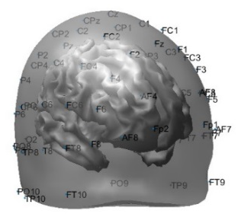
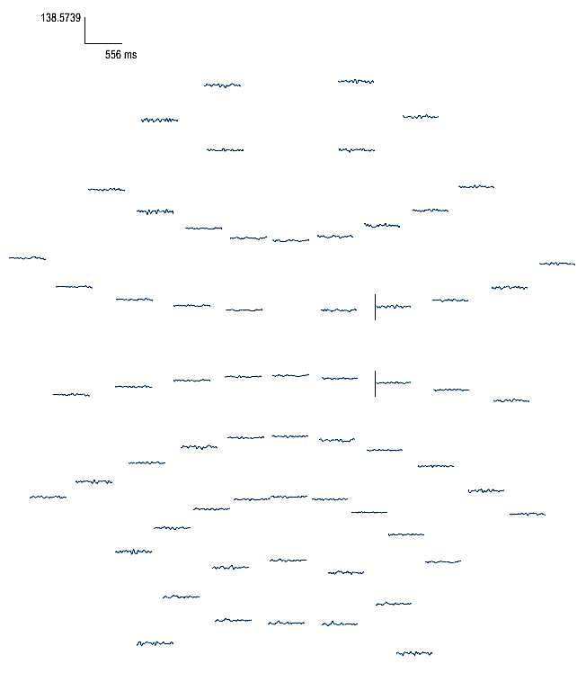
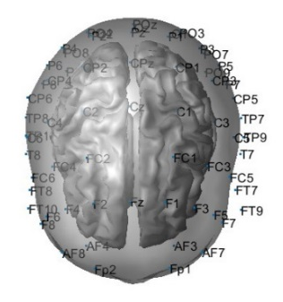
64-channel EEG recordings
Controls Recognition
4
0
-4
0
150
300
450
Amplitude (μV)
AD Patients Recognition
4
0
-4
0
150
300
450
Time (ms)
Novel
Repeated
Tyrer, et al. 2020

Slide 4
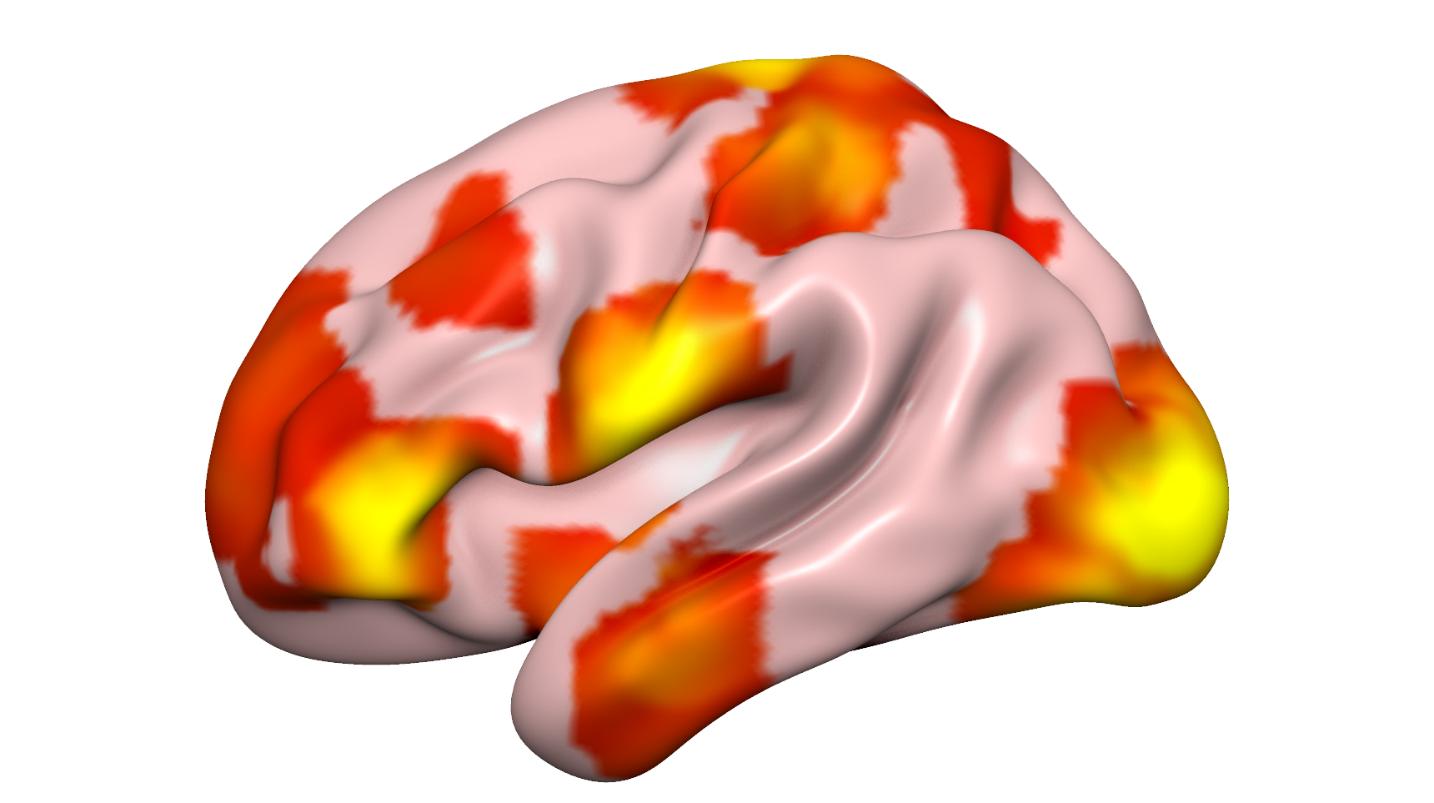
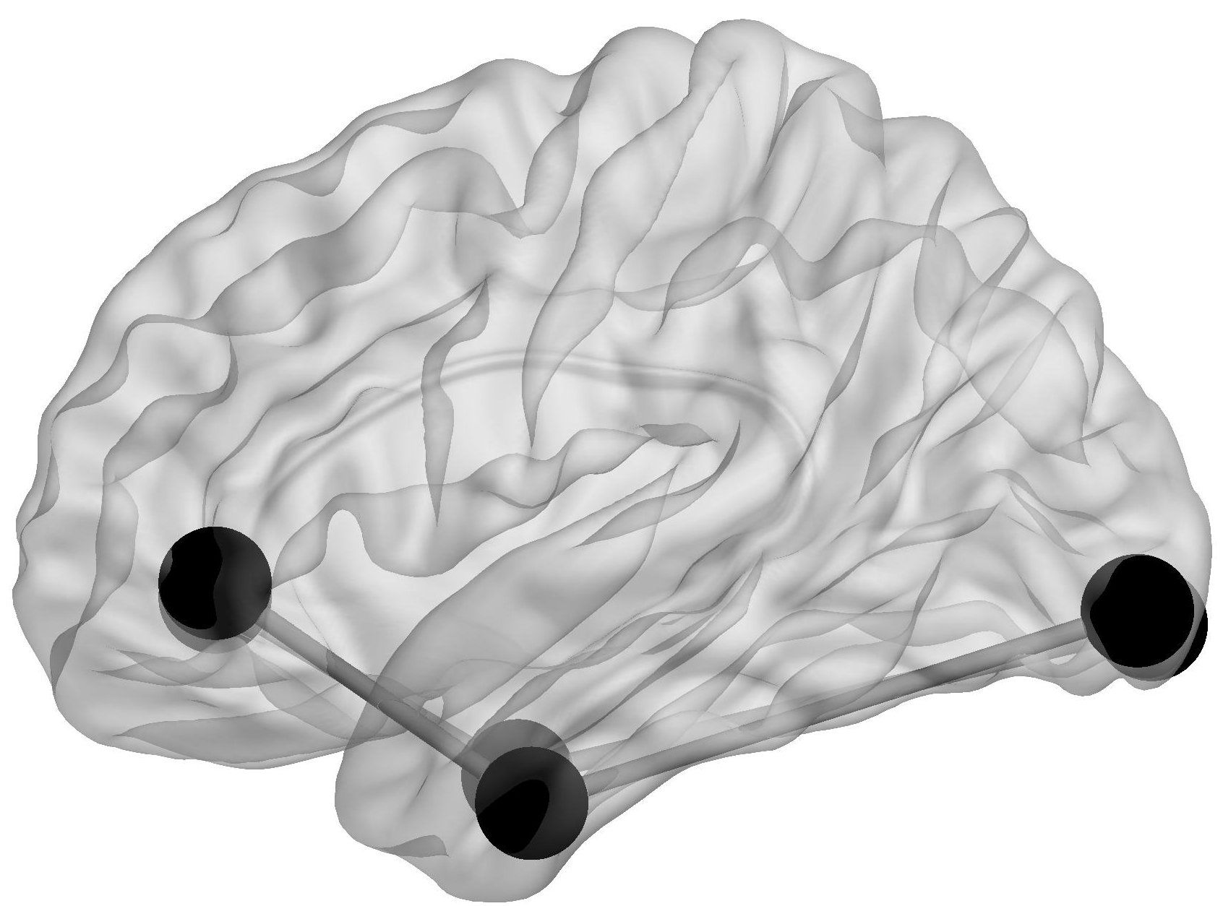
A (forward) =
[ 0 0 0 0 0 0
0 0 0 0 0 0
1 0 0 0 0 0
0 1 0 0 0 0
0 0 1 0 0 0
0 0 0 1 0 0 ]
B (modulatory) =
[ 1 0 1 0 0 0
0 1 0 1 0 0
1 0 1 0 1 0
0 1 0 1 0 1
0 0 1 0 1 0
0 0 0 1 0 1 ]
Source Identification
IFG
IFG
Z score
5
6
R. OCP
ITG
ITG
L. OCG
A (backward) =
[ 0 0 1 0 0 0
0 0 0 1 0 0
0 0 0 0 1 0
0 0 0 0 0 1
0 0 0 0 0 0
0 0 0 0 0 0 ]
C (inputs) =
[ 1 1 0 0 0 0 ]
L. IFG
L. ITG
R. ITG
R. IFG
3
4
OCG
OCP
IFG
OCG
1
2
ITG
Source selection in line with previous analyses (Gilbert and Moran, 2016)
Tyrer, et al. 2020

Slide 5
Old/New Judgement
Naming
Conductance-based Neural Mass Model
Neural state equation:
Amplitude (μV)
x = states
θ = parameters
Time (ms)
Electromagnetic forward model: neural activity EEG
Subcortical input
p(θ|y,m)
ITG-IFG connectivity
ITG-OCP connectivity
model
model parameters
observed data
detailed neuronal model
(synaptic time scales)
Moran, et al. 2013

Slide 6
Summary of Analyses
Pre-Processing
Band-pass filtering (2-30 Hz)
Epoching (-52-500ms PST)
Artefact correcting
Source Identification via 3D source reconstruction
Dynamic Causal Modelling
Bayesian Model Selection
Further Analyses, e.g. Parametric Empirical Bayes
Determine parameters associated with task performance, disease state, on the group level

Slide 7
Thank you for listening

