Slide 1

Bayesian model selection and averaging
Richard Rosch
Sir Henry Wellcome Fellow
King’s College London, UK; University of Pennsylvania, US
Wellcome Centre Human Neuroimaging (honorary)
Clinical Fellow Epilepsy / Epilepsy Surgery
University Children’s Hospital Zürich, CH

Slide 2
DCM Recap
Dynamic Causal Modelling
Contents
Comparing models
Bayesian Model Comparison and Selection (BMS)
Rapidly evaluating models
Bayesian Model Reduction (BMR)
Investigating Parameters
Bayesian Model Averaging (BMA)
Multi-Subject Analysis
Parametric Empirical Bayes (PEB)

Slide 3
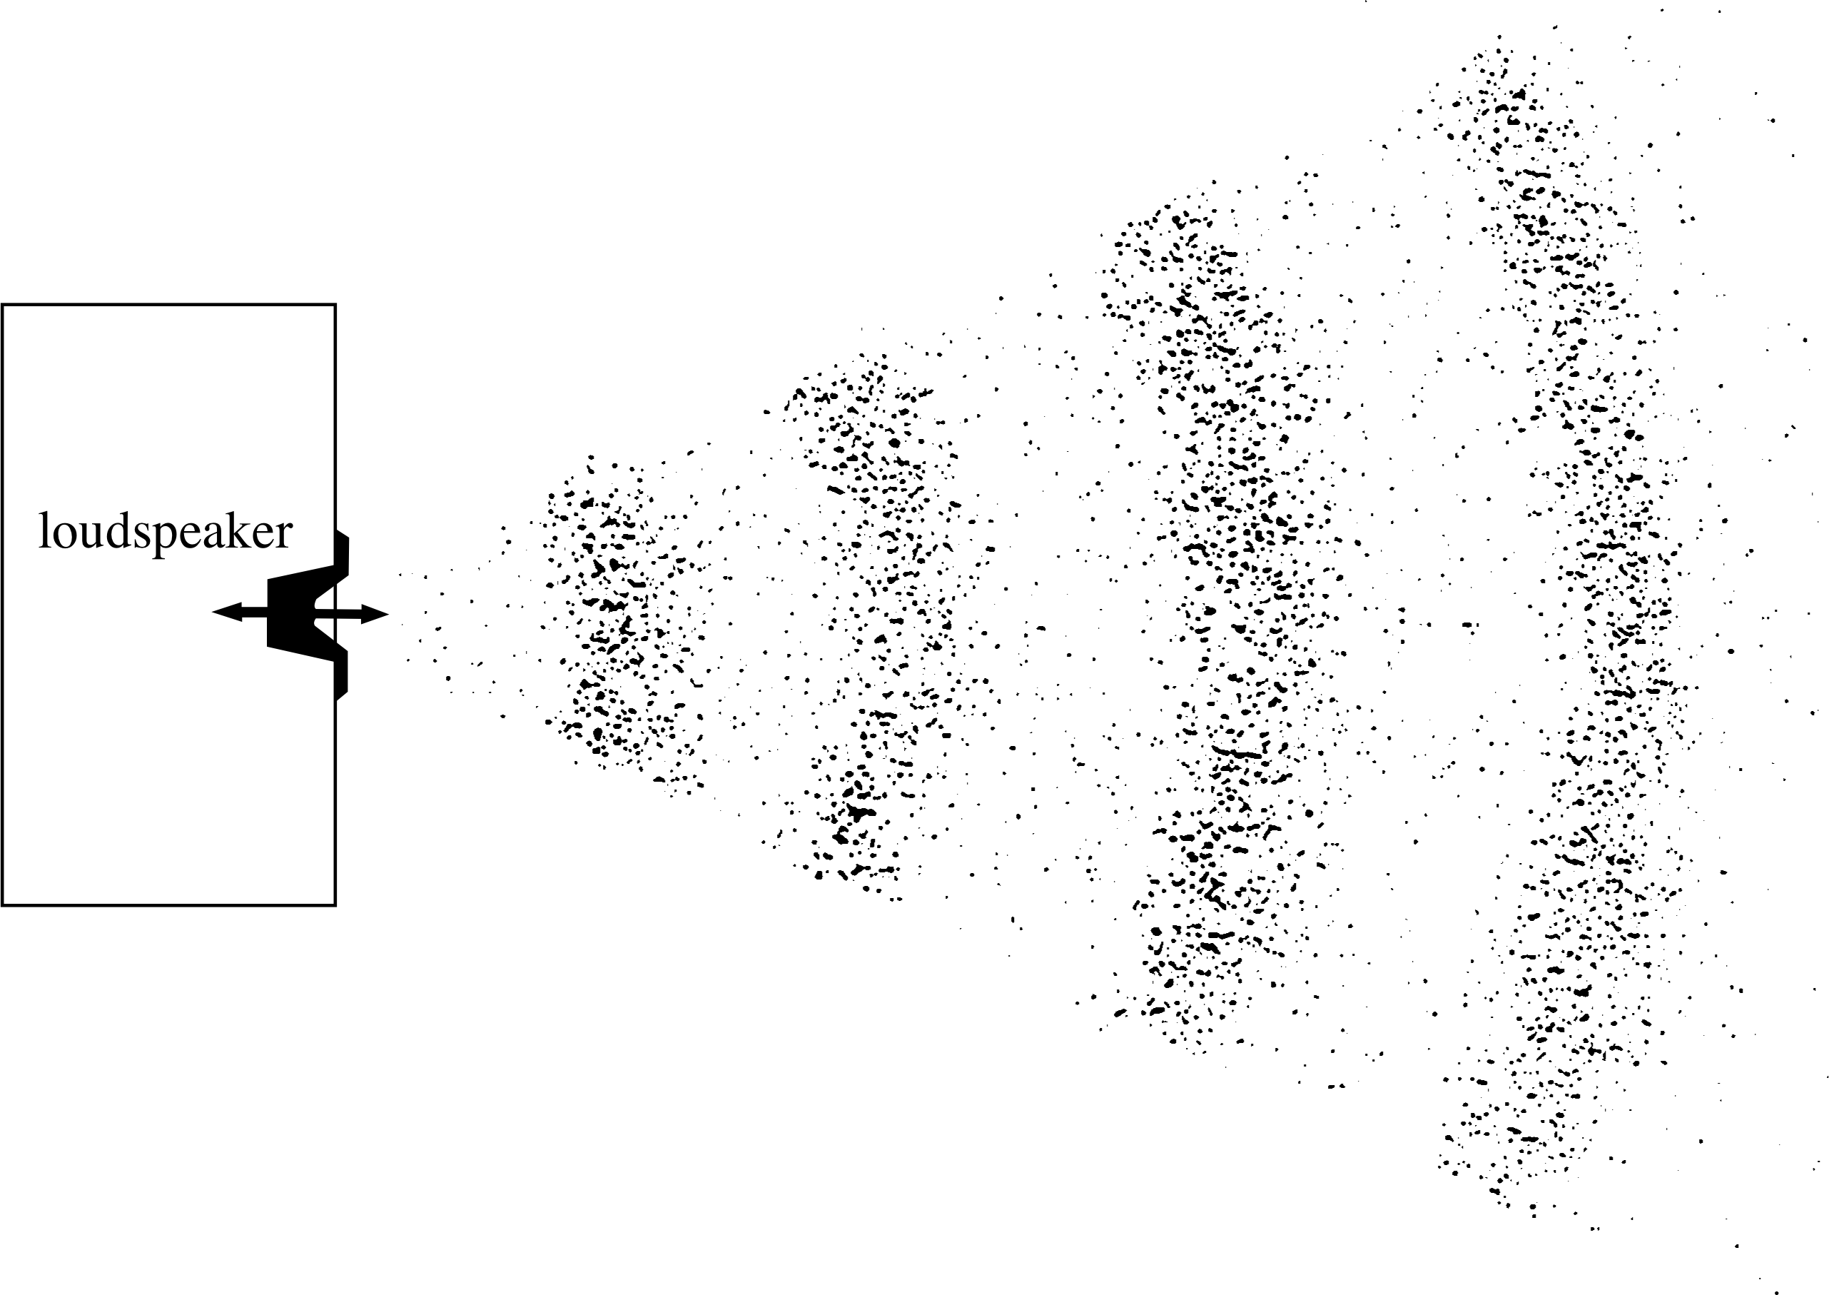
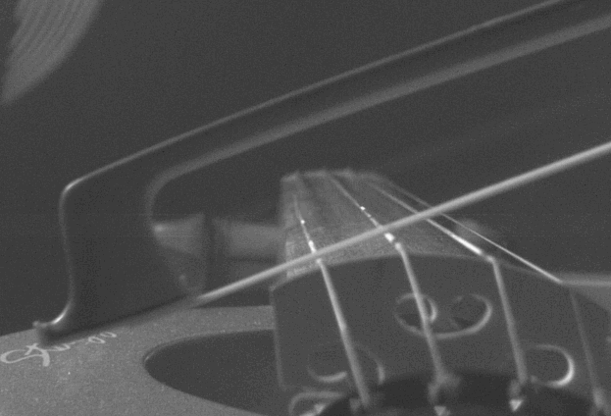
DCM Recap
Dynamic Causal Modelling
Data
Inverse Problem
Forward Problem
Dynamic state
Parameters
Input
Model

Slide 4
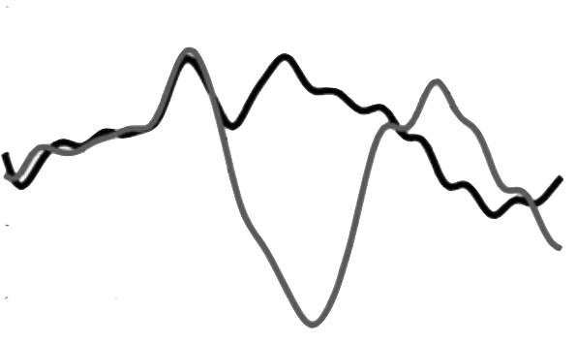
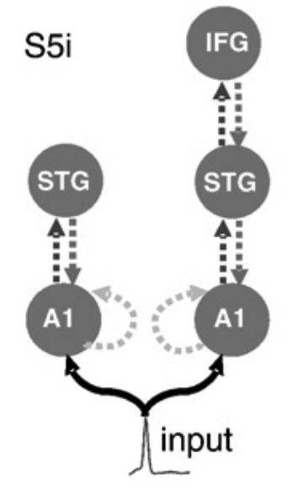
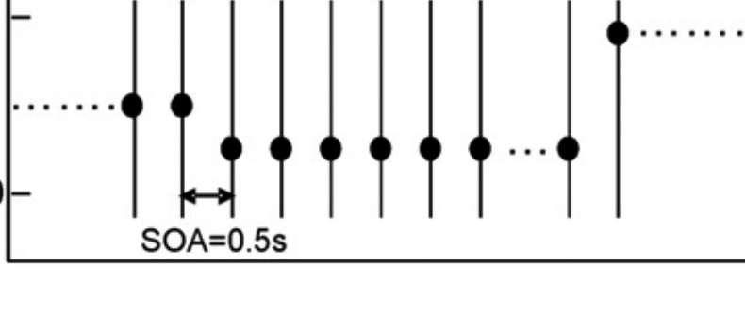






DCM Recap
Dynamic Causal Modelling
$$Y$$
Data
DCM rests on estimating certain conditional probabilities
$$p(Y|m)$$
Evidence
$$p(Y|θ,m)$$
Inverse Problem
Forward Problem
Dynamic state
Likelihood
$$p(θ|Y,m)$$
Posterior
Input
Parameters
$$θ$$
Model $m$
Garrido et al. 2008 NeuroImage doi.org/10.1016/j.neuroimage.2008.05.018

Slide 5










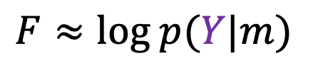
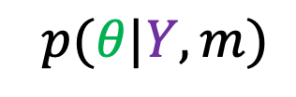
DCM Recap
Dynamic Causal Modelling
DCM rests on estimating certain conditional probabilities
DCM analysis provides a score for model likelihood and posterior parameter estimates
$$m$$
model
prior probability
$$p(θ|m)$$
$$p(θ|Y,m)$$
posterior probability
$$Y$$
data
$$F≈log p(Y|m)$$
Free energy

Slide 6
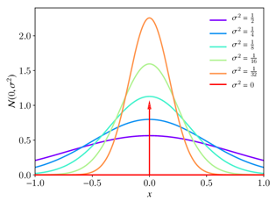
DCM Recap
Dynamic Causal Modelling
R1
R2
DCM rests on estimating certain conditional probabilities
DCM analysis provides a score for model likelihood and posterior parameter estimates
Priors are used to restrict the parameters to a specific search space
Connection ‘on’
Probability
R1
R2
prior probability
$$p(θ|m)$$
0
Connection ‘off’
Prior Connection strength (Hz)
0
Prior Connection strength (Hz)

Slide 7
DCM Recap
Dynamic Causal Modelling
Contents
Comparing models
Bayesian Model Comparison and Selection (BMS)
Rapidly evaluating models
Bayesian Model Reduction (BMR)
Investigating Parameters
Bayesian Model Averaging (BMA)
Multi-Subject Analysis
Parametric Empirical Bayes (PEB)

Slide 8
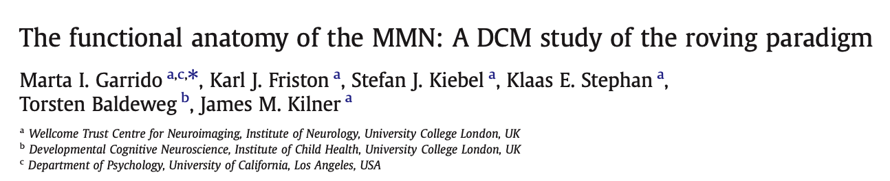
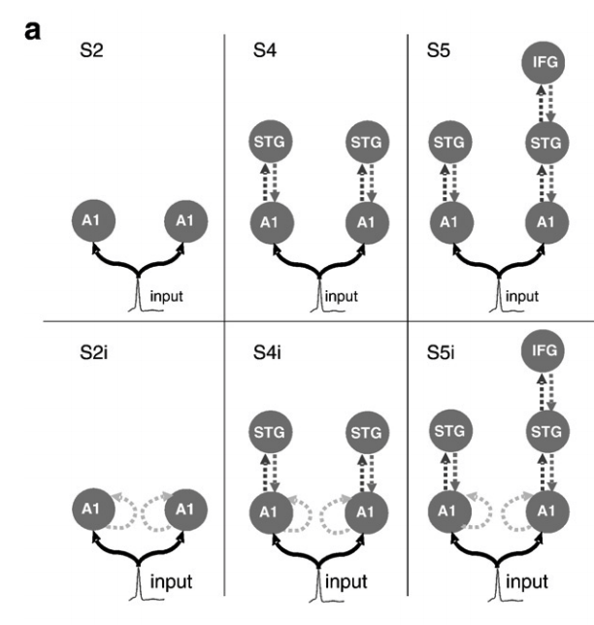
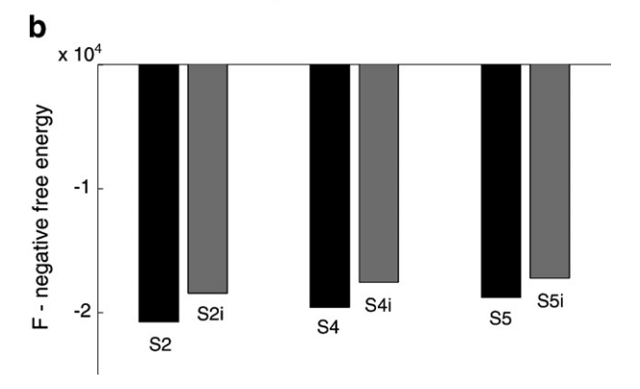
Comparing models
Bayesian Model Selection
Free Energy allows scoring of models against each other
Garrido et al. 2008 NeuroImage doi.org/10.1016/j.neuroimage.2008.05.018

Slide 9
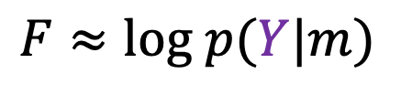
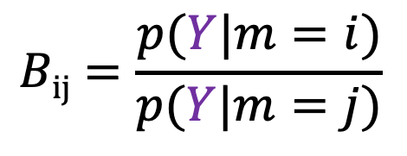
Comparing models
Bayesian Model Selection
Free energy allows scoring of models against each other
We can convert free energy to measures of evidence for particular models
$$Bij=\frac{p(Y|m=i)}{p(Y|m=j)}$$
$$log Bij=\log{ p\left(Y | m=i\right)−\log{ p\left(Y | m=j\right)}}≈Fi −Fj$$
$$F≈log p(Y|m)$$

Slide 10
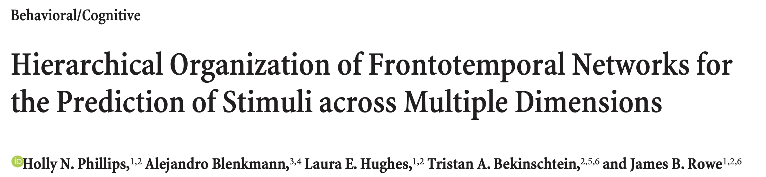
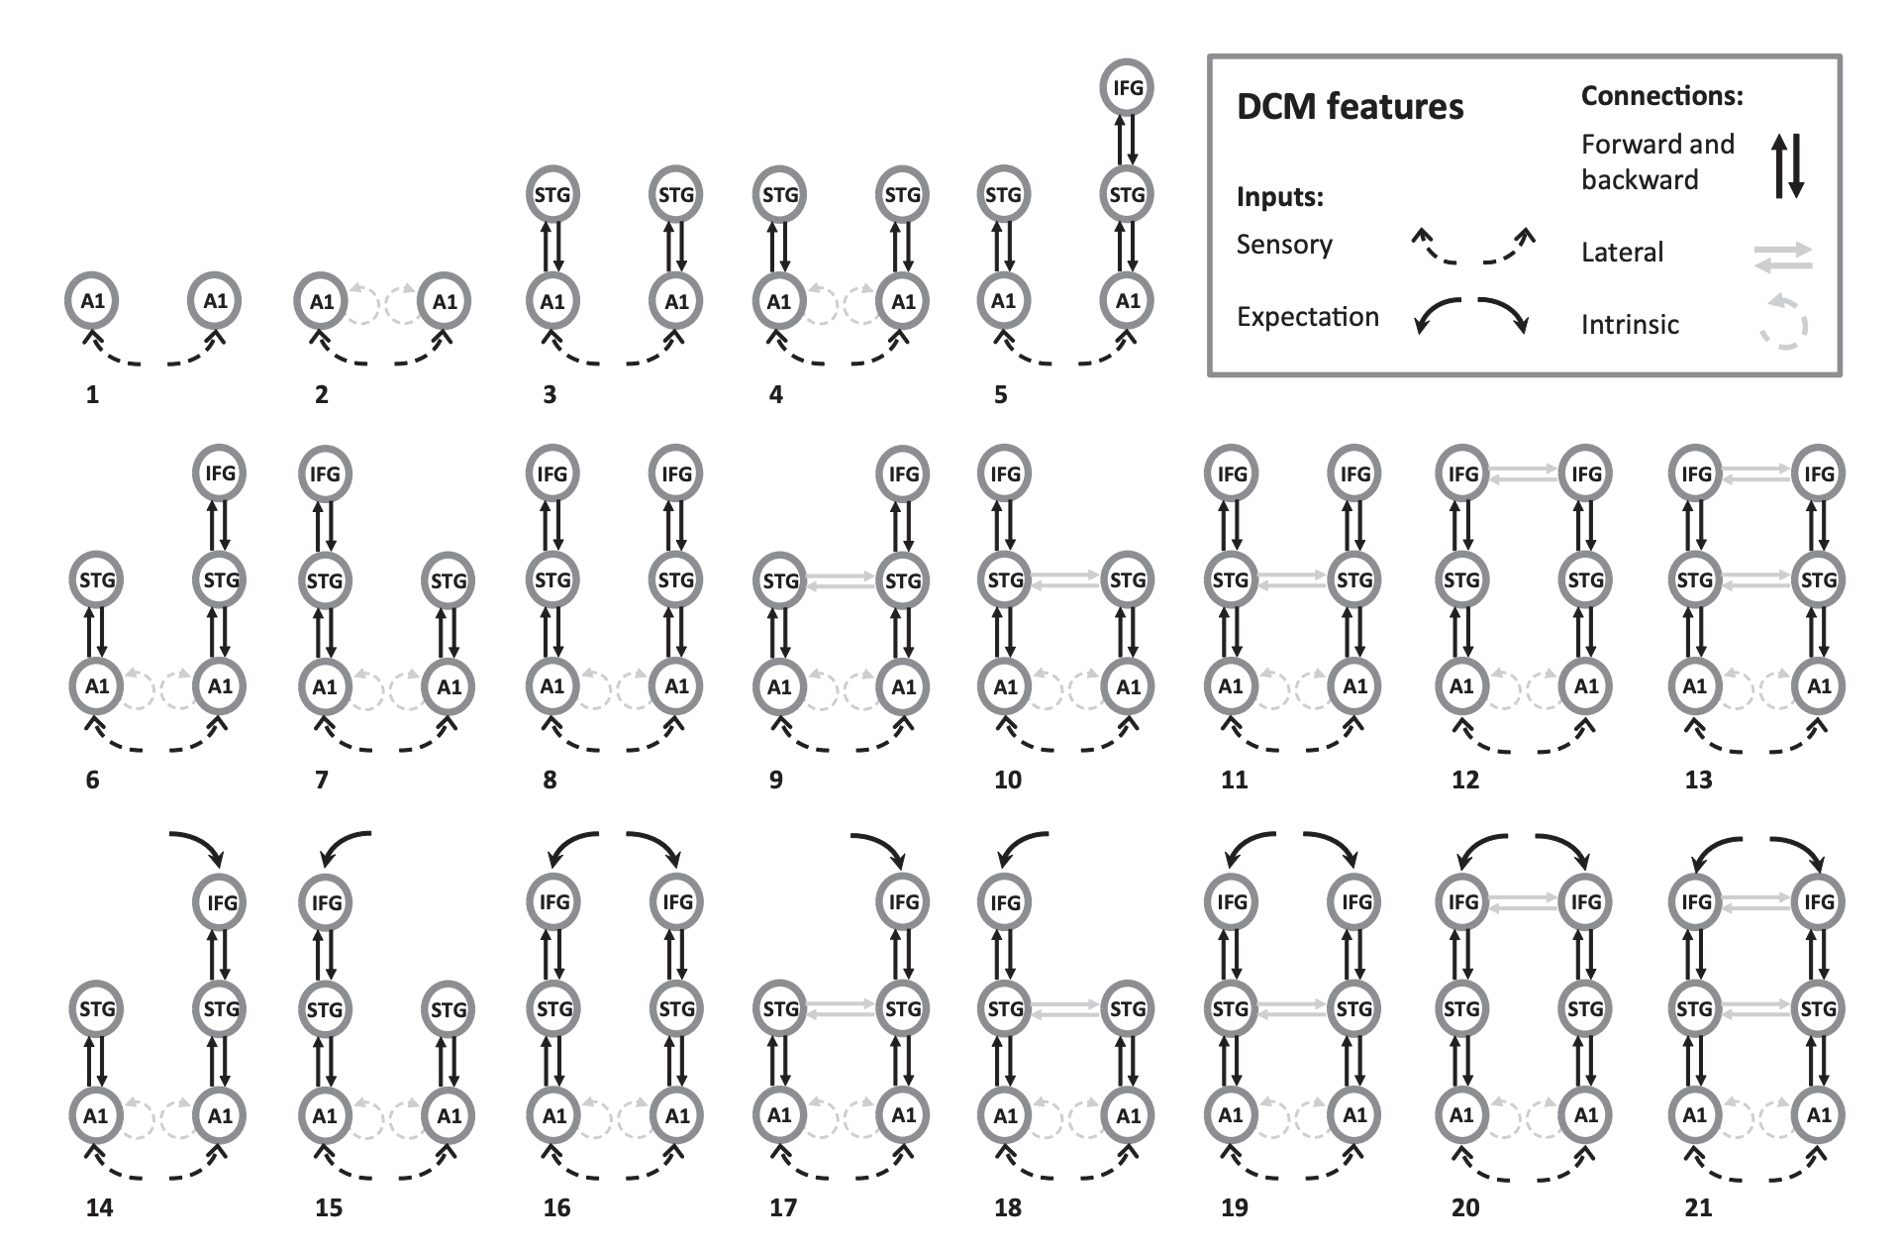
Comparing models
Bayesian Model Selection
Free energy allows scoring of models against each other
We can convert free energy to measures of evidence for particular models
Phillips et al. 2015 J Neurosci doi.org/10.1523/JNEUROSCI.5095-14.2015

Slide 11
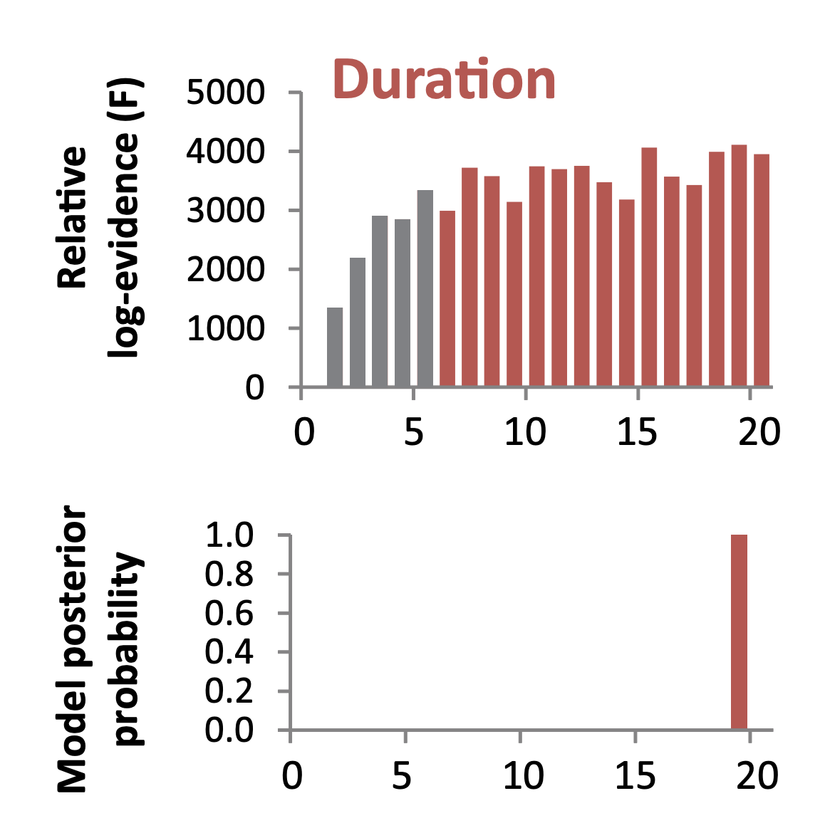
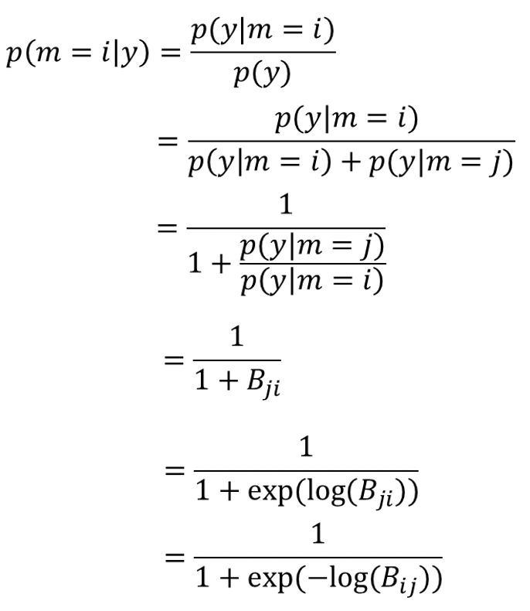



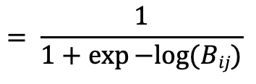
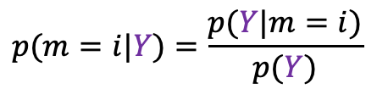
Comparing models
Bayesian Model Selection
Free energy allows scoring of models against each other
We can convert free energy to measures of evidence for particular models
$$p(m=i|Y)=\frac{p(Y|m=i)}{p(Y)}$$
$$∗$$
$$= \frac{1}{1+\exp{−log⁡(Bij)}}$$
$$∗$$

Slide 12
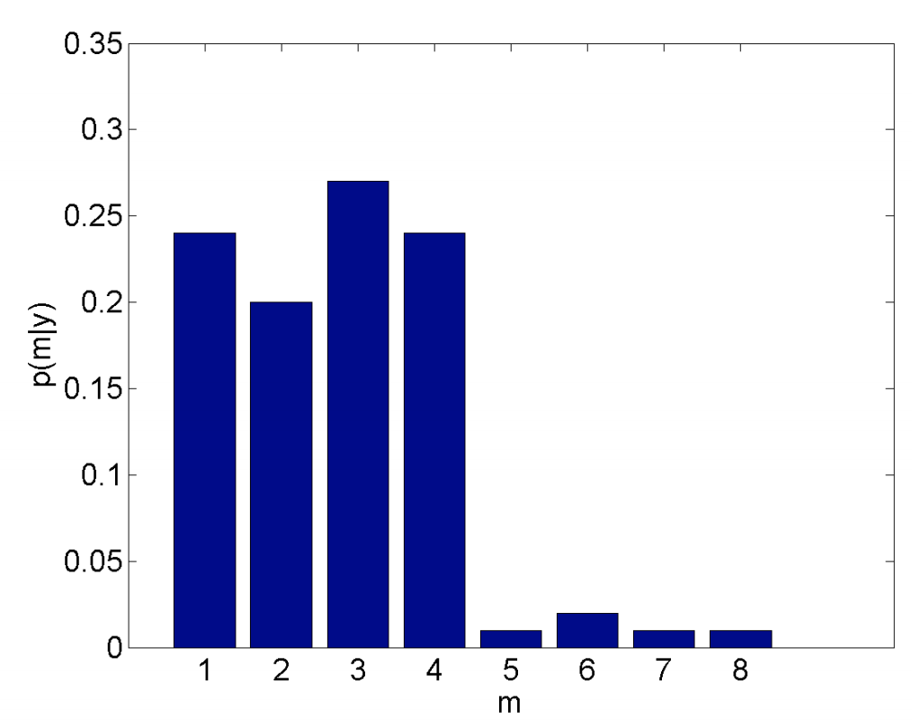
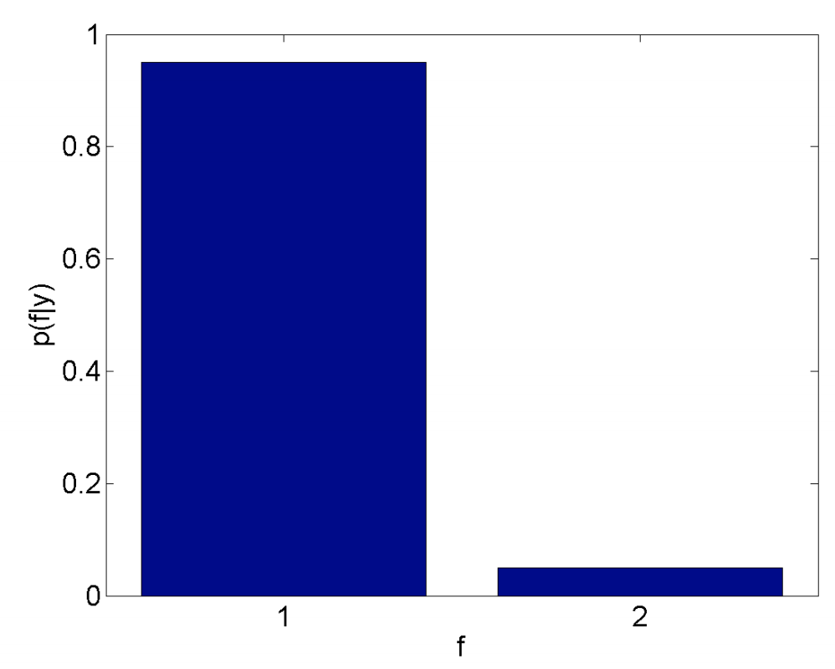
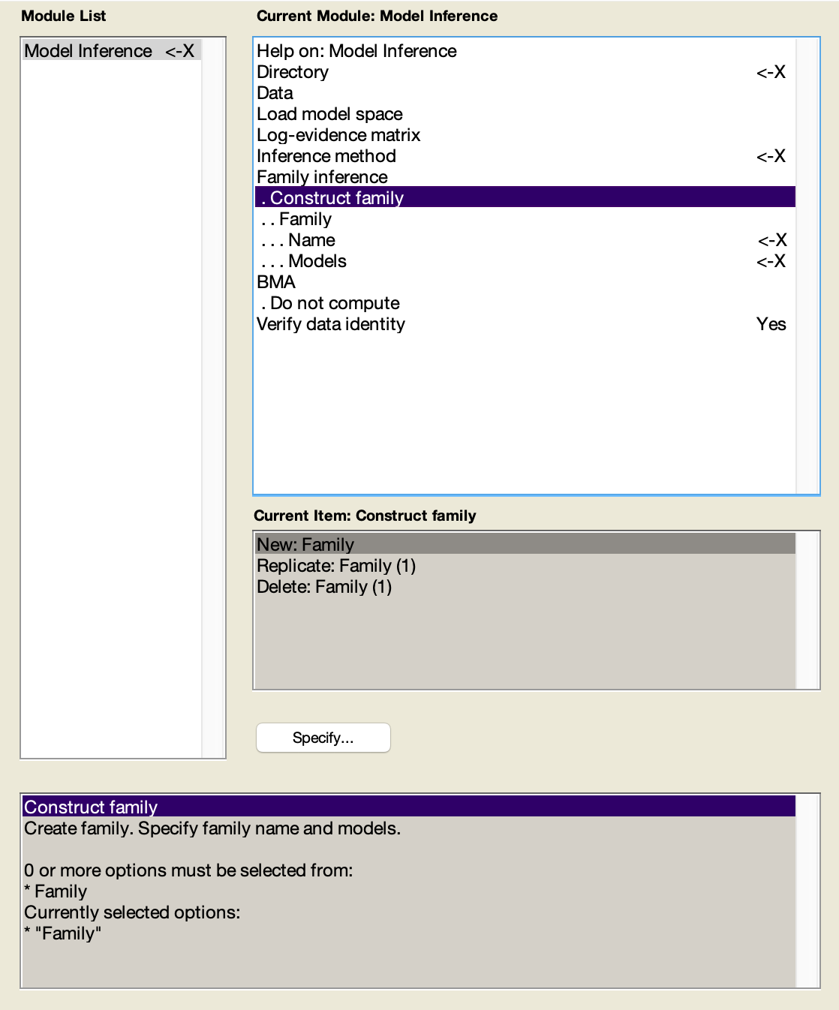
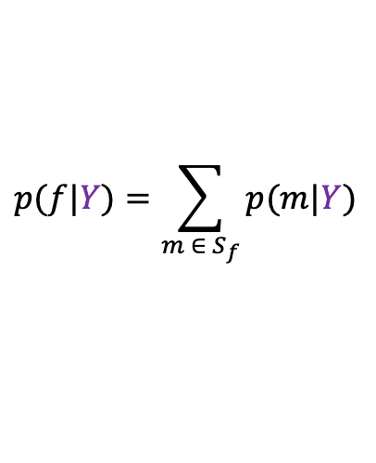
Comparing models
Bayesian Model Selection
Free energy allows scoring of models against each other
We can convert free energy to measures of evidence for particular models
By structuring the model space into families one can avoid evidence dilution
$$p(f|Y)=\sum_{m ∈ S_{f}}{p(m|Y})$$

Slide 13
DCM Recap
Dynamic Causal Modelling
Contents
Comparing models
Bayesian Model Comparison and Selection (BMS)
Rapidly evaluating models
Bayesian Model Reduction (BMR)
Investigating Parameters
Bayesian Model Averaging (BMA)
Multi-Subject Analysis
Parametric Empirical Bayes (PEB)

Slide 14
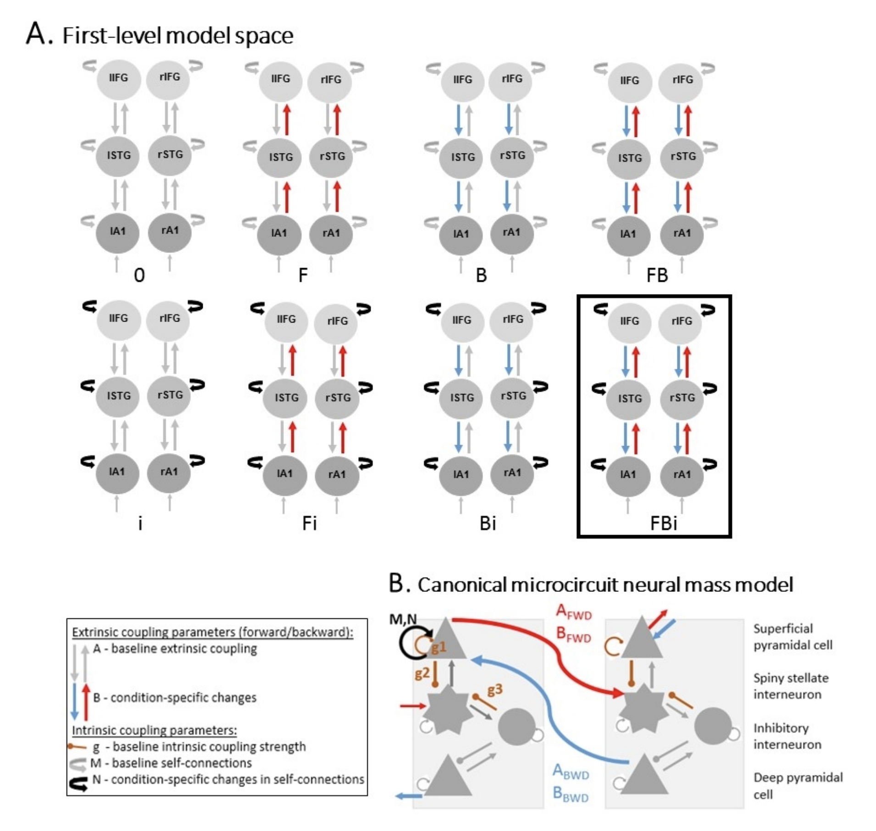
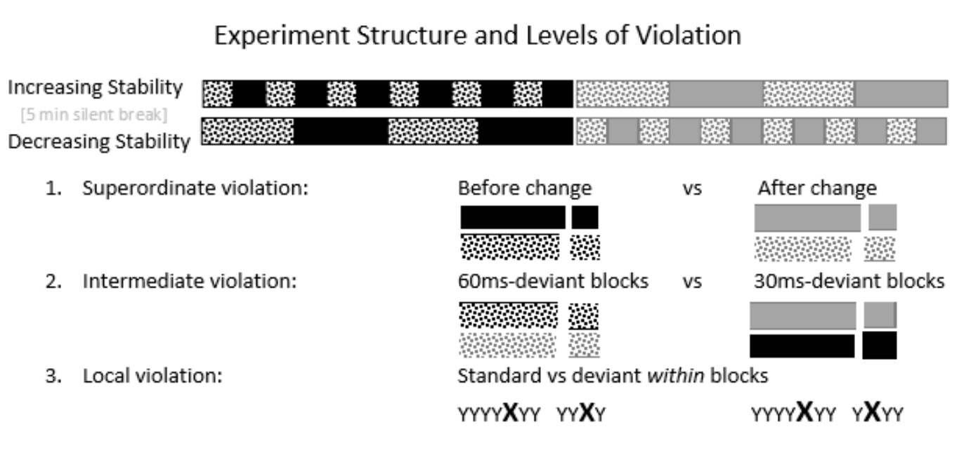
Rapidly evaluating models
Bayesian Model Reduction (BMR)
Model spaces can quickly become very large when considering multiple factors
Fitzgerald et al. 2019 bioRxiv doi.org/10.1101/768846

Slide 15





Rapidly evaluating models
Bayesian Model Reduction (BMR)
Individual model inversions
Model spaces can quickly become very large when considering multiple factors
Bayesian model reduction allows estimation of parameters and free energy from a single inverted model
$m$₁
$$m64$$
…
…
Bayesian model reduction
$m$₁
$$m64$$
…
…

Slide 16
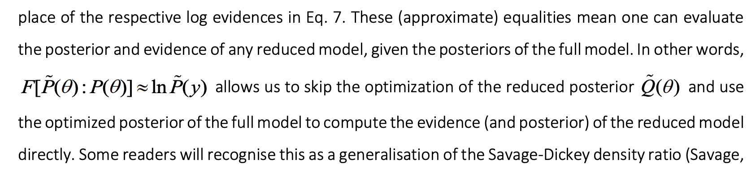
Rapidly evaluating models
Bayesian Model Reduction (BMR)
Model spaces can quickly become very large when considering multiple factors
Bayesian model reduction allows estimation of parameters and free energy from a single inverted model
BMR requires an inverted ‘full model’ and a set of structurally identical ‘reduced models’
Connection ‘off’
Connection ‘on’
Probability
0
0
Prior Connection strength (Hz)
Prior Connection strength (Hz)
Friston et al. 2018 arxiv.org/pdf/1805.07092.pdf

Slide 17
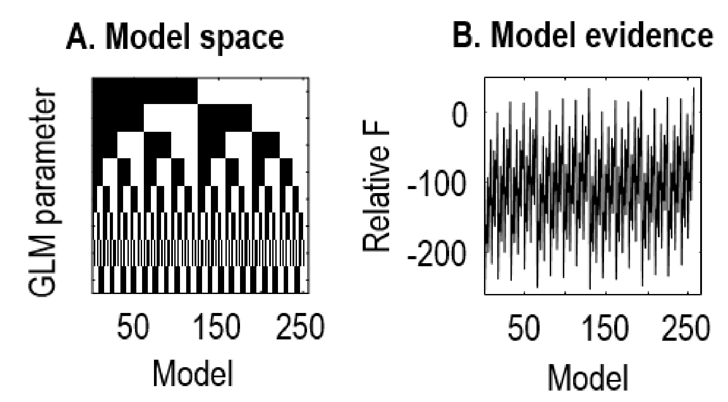
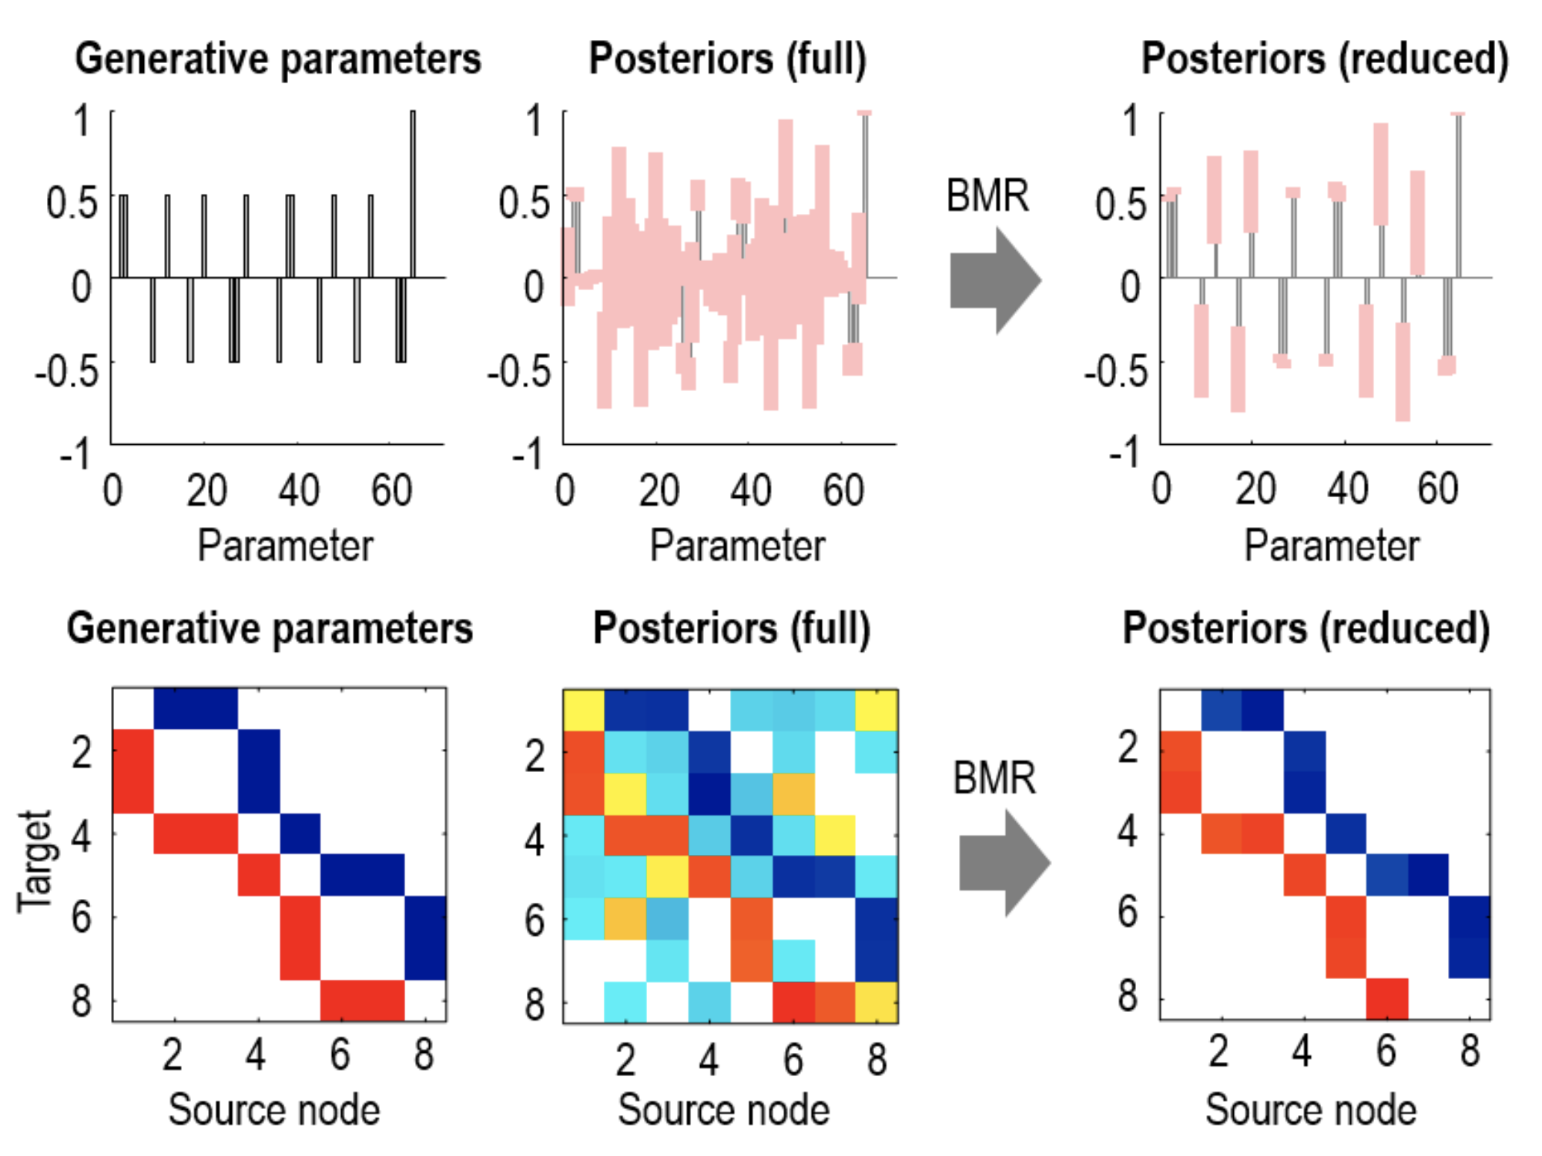
Rapidly evaluating models
Bayesian Model Reduction (BMR)
Model spaces can quickly become very large when considering multiple factors
Bayesian model reduction allows estimation of parameters and free energy from a single inverted model
BMR requires an inverted ‘full model’ and a set of structurally identical ‘reduced models’
This efficient evaluation of models allows exhaustive search over all possible reduced models

Slide 18
DCM Recap
Dynamic Causal Modelling
Contents
Comparing models
Bayesian Model Comparison and Selection (BMS)
Rapidly evaluating models
Bayesian Model Reduction (BMR)
Investigating Parameters
Bayesian Model Averaging (BMA)
Multi-Subject Analysis
Parametric Empirical Bayes (PEB)

Slide 19
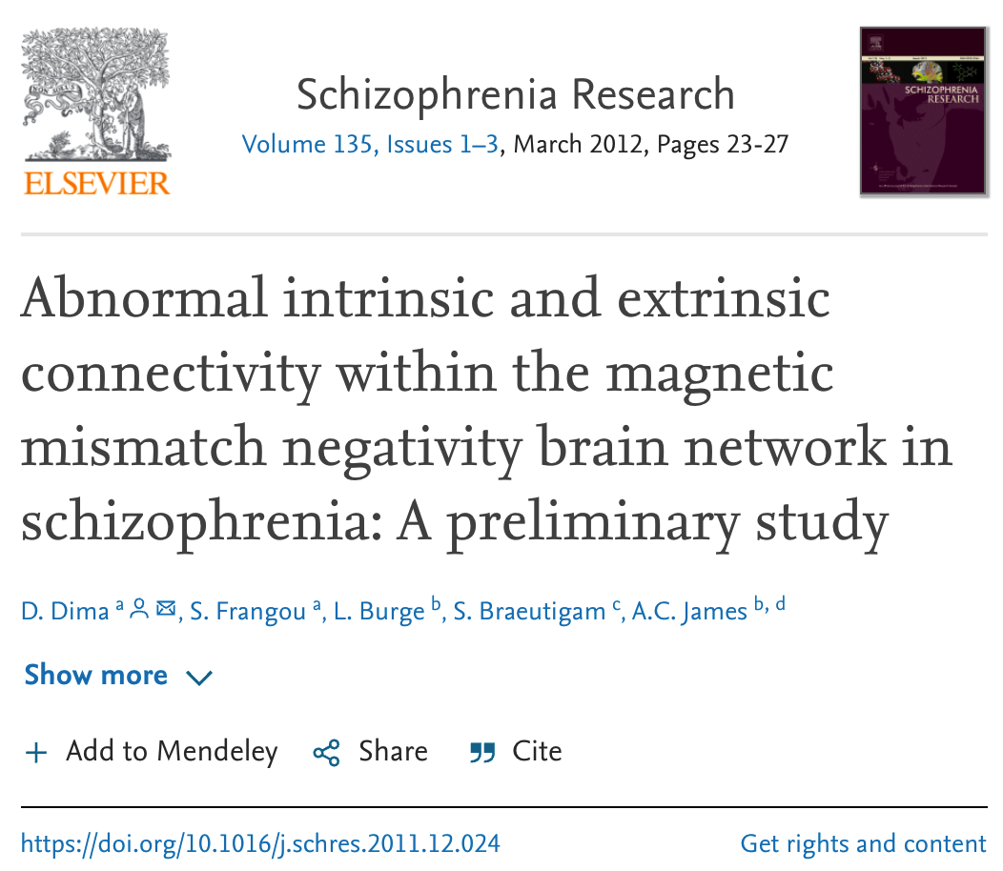
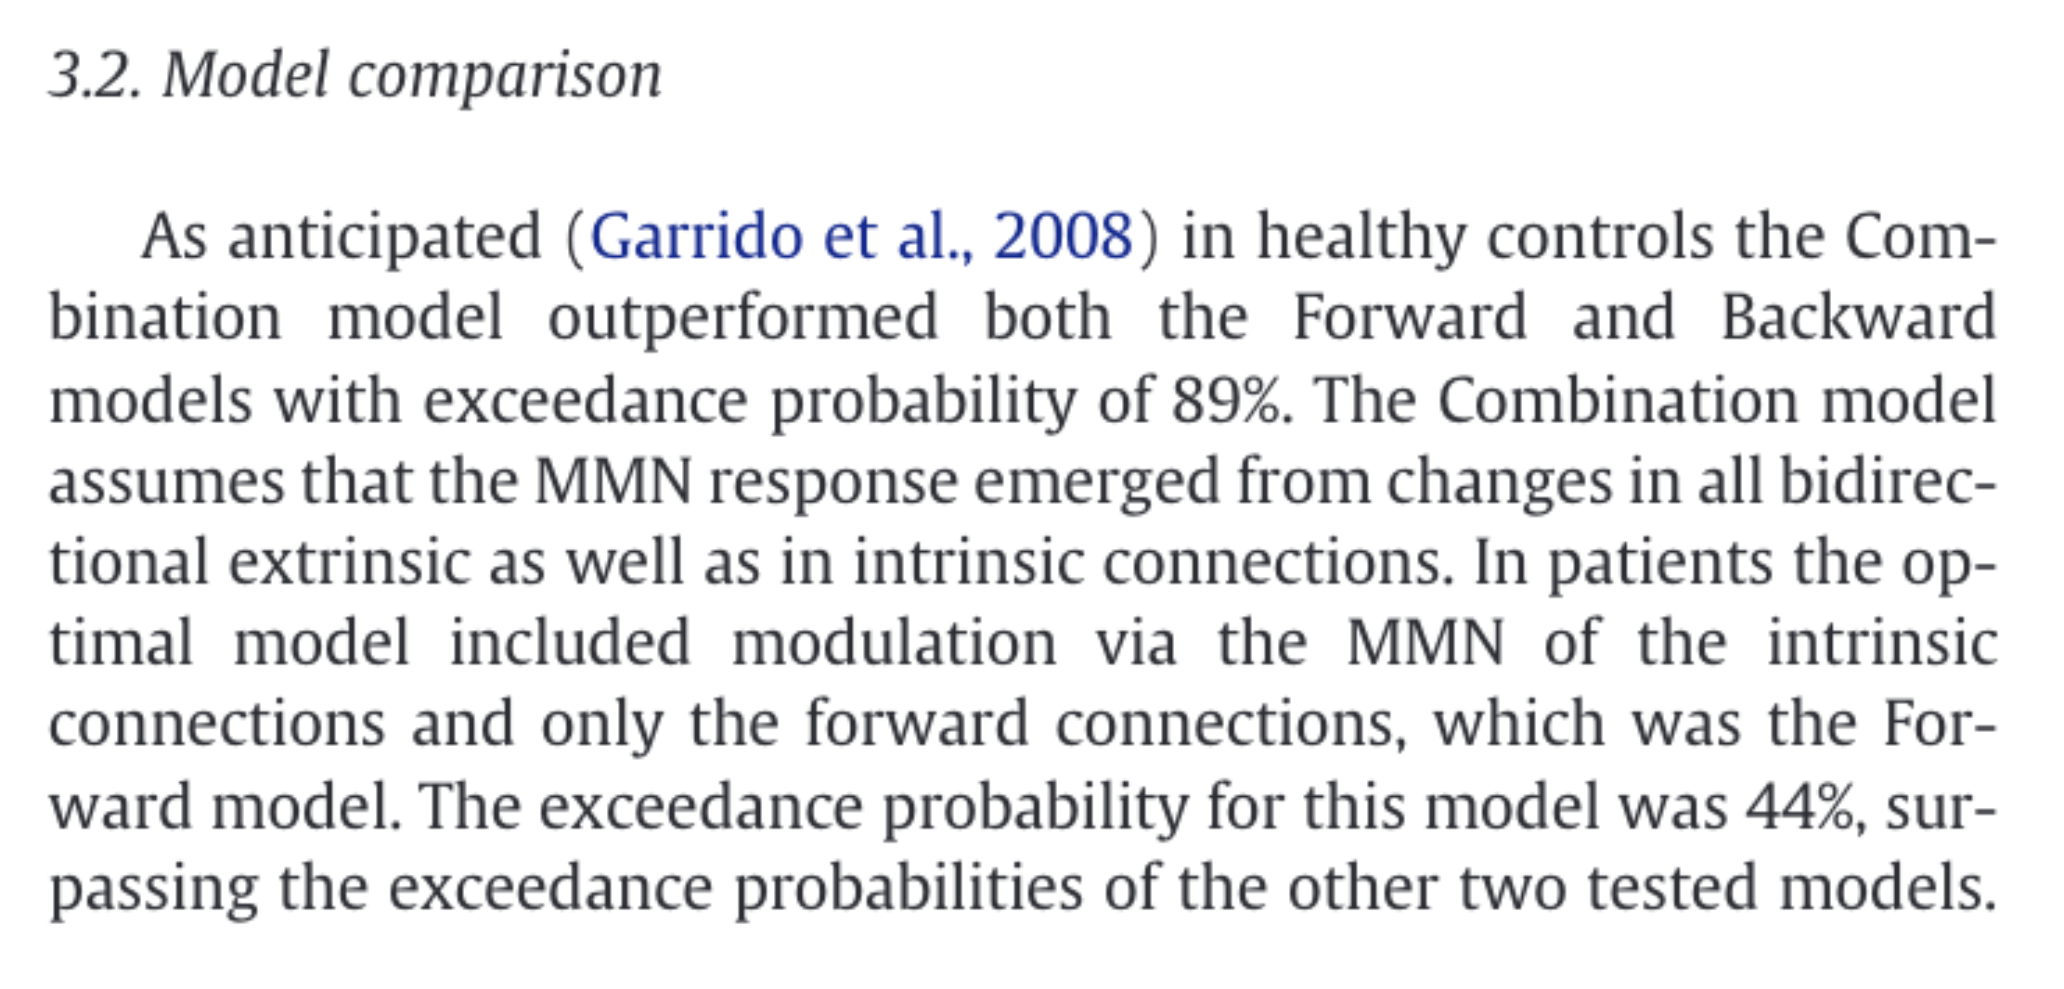
Investigating Parameters
Bayesian Model Averaging (BMA)
You might want to compare parameters even where model structure is uncertain
Controls
Patients
Dima et al Schiz Res doi.org/10.1016/j.schres.2011.12.024

Slide 20
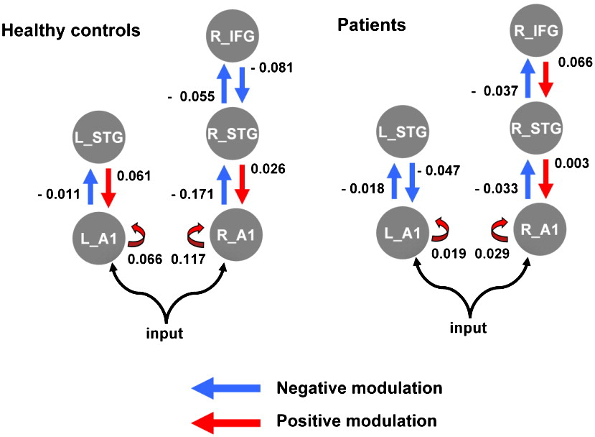
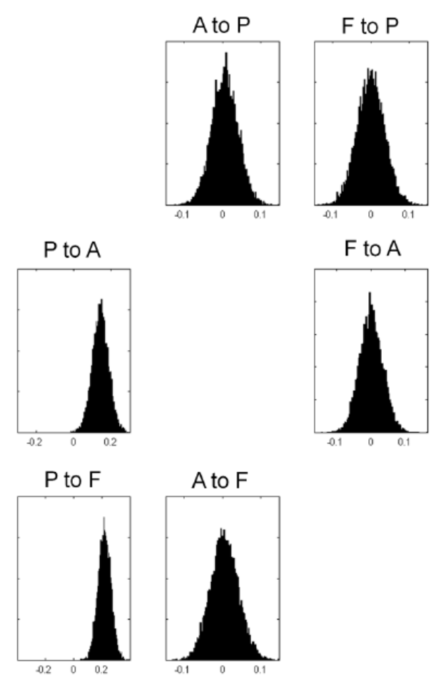

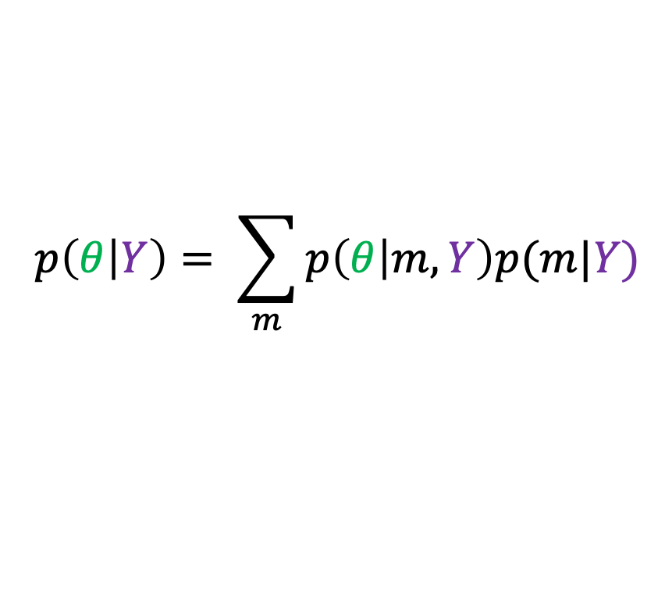
Investigating Parameters
Bayesian Model Averaging (BMA)
You might want to compare parameters even where model structure is uncertain
We can estimate posterior densities over parameters across different models (using sampling*)
$$p\left(θ | Y\right)= \sum_{m}{p\left(θ | m,Y\right)p(m|Y)}$$
Controls
*
Patients
Dima et al Schiz Res doi.org/10.1016/j.schres.2011.12.024

Slide 21
DCM Recap
Dynamic Causal Modelling
Contents
Comparing models
Bayesian Model Comparison and Selection (BMS)
Rapidly evaluating models
Bayesian Model Reduction (BMR)
Investigating Parameters
Bayesian Model Averaging (BMA)
Multi-Subject Analysis
Parametric Empirical Bayes (PEB)

Slide 22
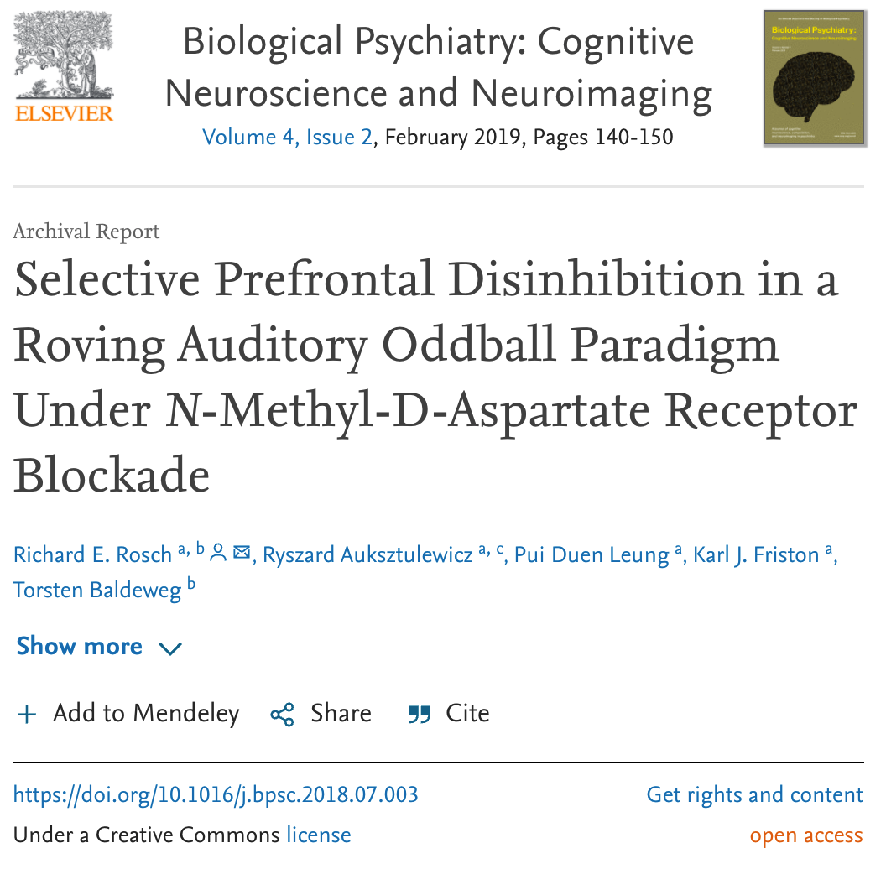
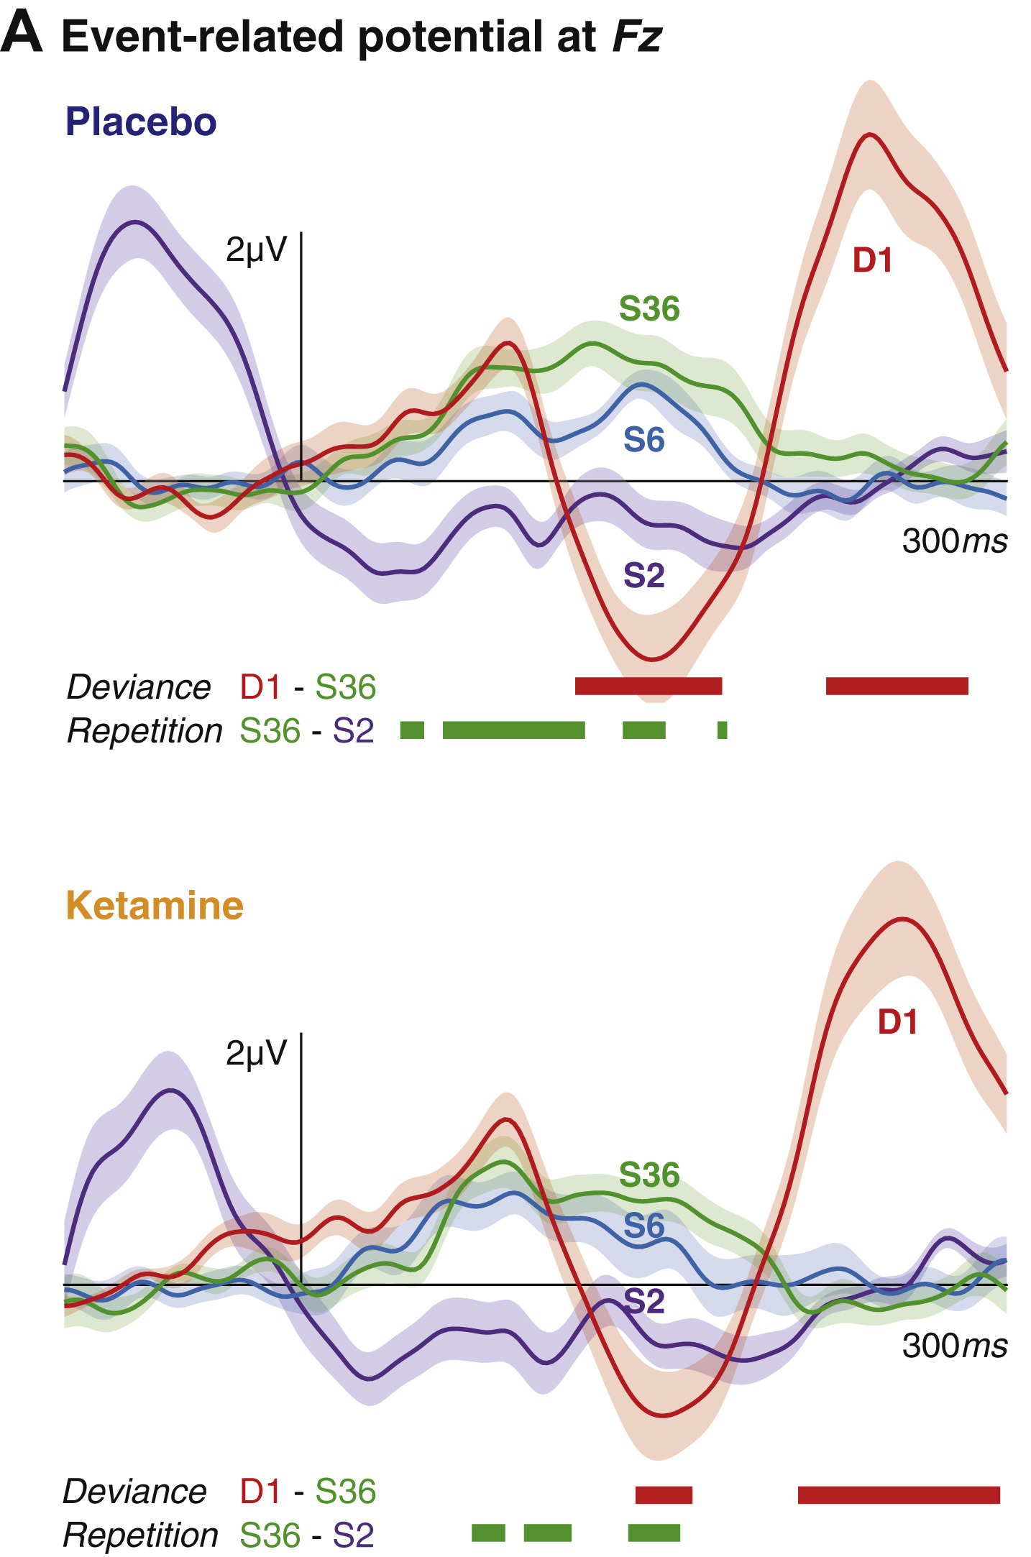
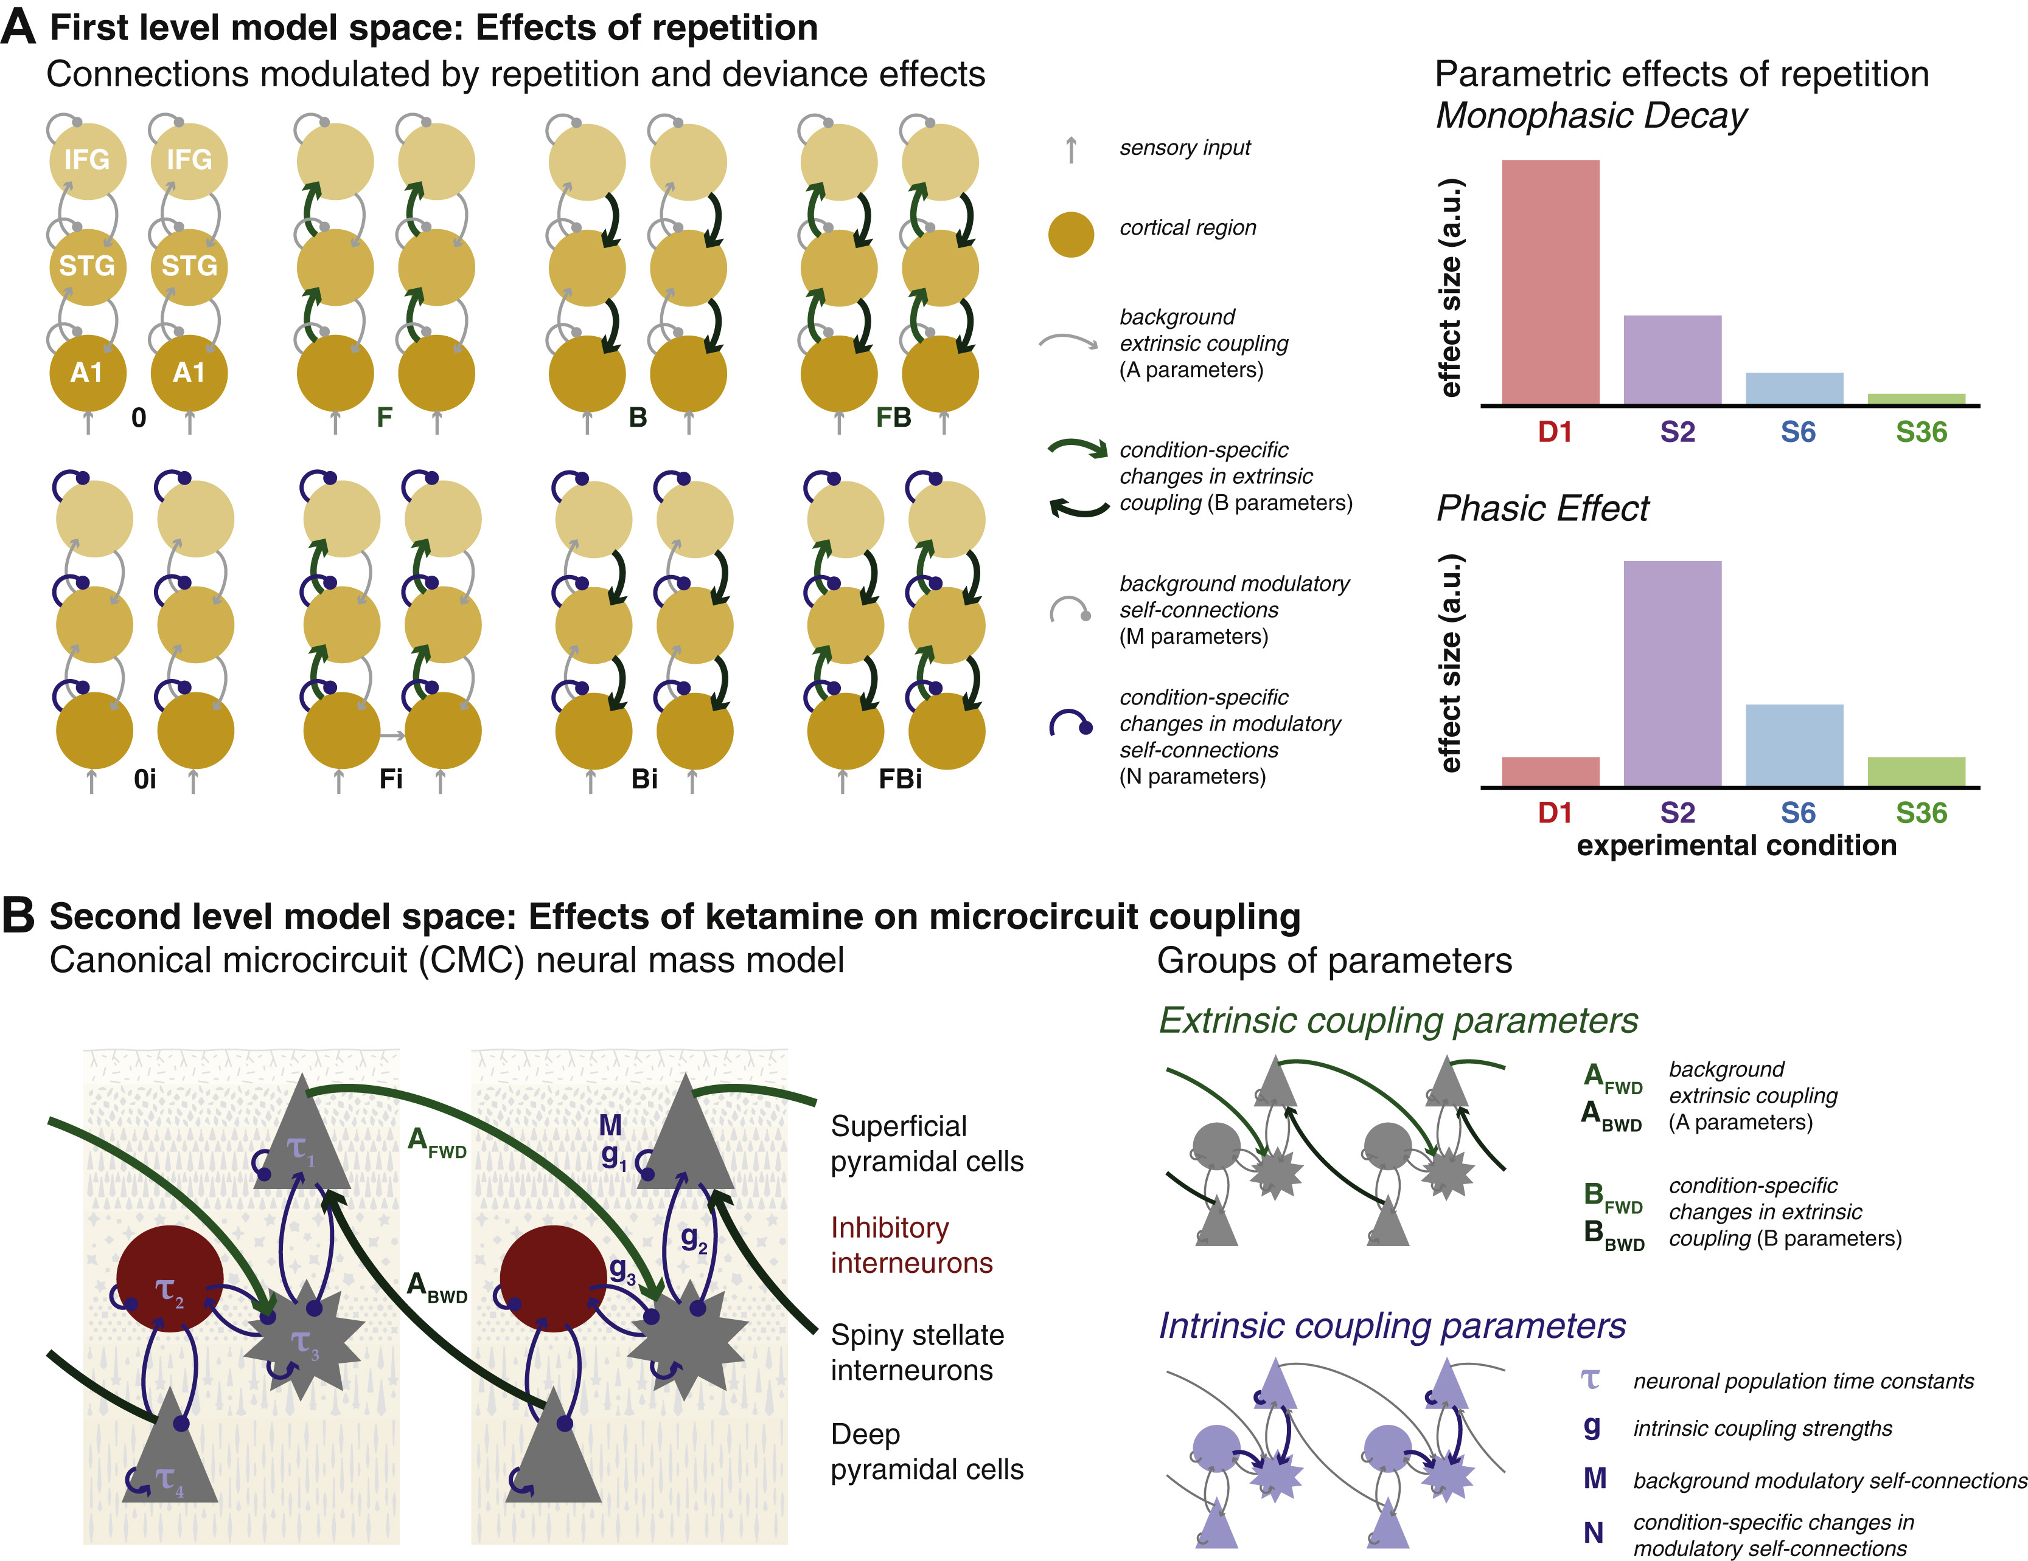
Multi-Subject Analysis
Parametric Empirical Bayes (PEB)
Many scientific questions centre on group comparisons in connectivity parameters
Rosch et al. (2019) Biol Psychiatr CNNI 10.1016/j.bpsc.2018.07.003 - https://github.com/roschkoenig/Ketamine_DCM

Slide 23



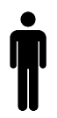

Multi-Subject Analysis
Parametric Empirical Bayes (PEB)
Many scientific questions centre on group comparisons in connectivity parameters
We can explicitly model this relationship in a Bayesian context
Priors on second level parameters
Second level
Between-subject error
Second level (linear) model
First level
Measurement noise
DCM for subject i

Slide 24
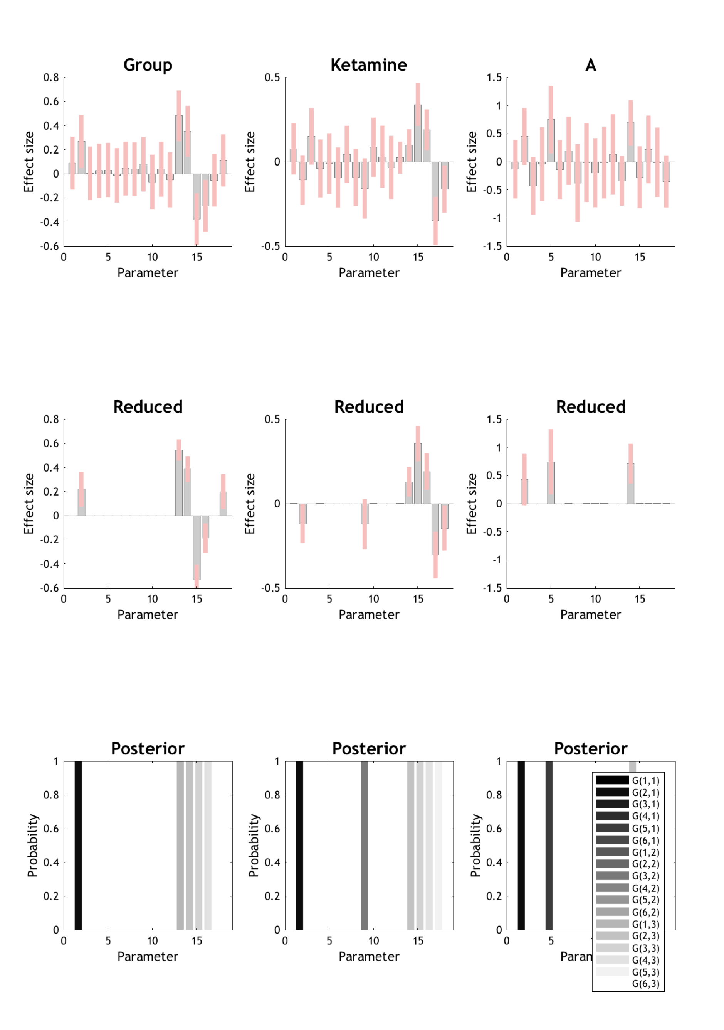


















Multi-Subject Analysis
Parametric Empirical Bayes (PEB)
$$m1$$
$$m2$$
$$m3$$
$$m4$$
$$m5$$
Many scientific questions centre on group comparisons in connectivity parameters
We can explicitly model this relationship in a Bayesian context
$$s1$$
$$s2$$
$$s3$$
$$s4$$
$$s5$$
$$s6$$
$$m_{1}^{2}$$
$$m_{1}^{2}$$
$$m_{2}^{2}$$
$$m_{2}^{2}$$
$$m_{3}^{2}$$
$$m_{3}^{2}$$

Slide 25
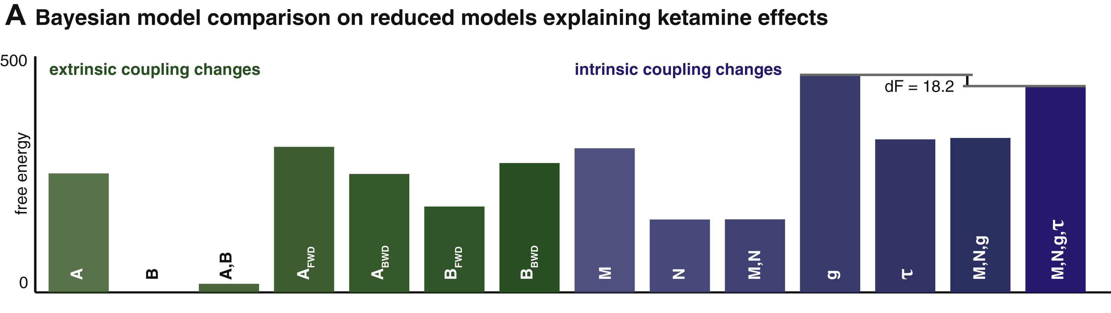
Multi-Subject Analysis
Parametric Empirical Bayes (PEB)
2nd Level
Model Comparison
Many scientific questions centre on group comparisons in connectivity parameters
We can explicitly model this relationship in a Bayesian context
1st Level
DCM
2nd Level
PEB Design Matrix
2nd Level
Model Average

Slide 26
Multi-Subject Analysis
Parametric Empirical Bayes (PEB)
PEB Advantages / Applications
Properly conveys uncertainty about parameters from the subject level to the group level
Can improve first level parameters estimates
Can be used to compare specific reduced PEB models (switching off combinations of group-level parameters)
Or to search over nested models (BMR)
Prediction (leave-one-out cross validation)

Slide 27
DCM Recap
Dynamic Causal Modelling
Recap
Comparing models
Bayesian Model Comparison and Selection (BMS)
Rapidly evaluating models
Bayesian Model Reduction (BMR)
Investigating Parameters
Bayesian Model Averaging (BMA)
Thank you for your attention
Multi-Subject Analysis
Parametric Empirical Bayes (PEB)

Slide 28
More Reading Material
https://www.fil.ion.ucl.ac.uk/spm/course/slides14-may/11_DCM_Advanced_1.pdf
Will Penny’s excellent lecture notes
https://www.tnu.ethz.ch/fileadmin/user_upload/teaching/Methods_Models2018/Fra__ssle_MethodsAndModels.pdf
Great lecture notes by Stefan Frässle on Bayesian model selection and averaging
https://github.com/pzeidman/dcm-peb-example
Fantastic Tutorial for PEB
Stephan et al. 2010 NeuroImage doi.org/10.1016/j.neuroimage.2009.11.015
10 Simple Rules for Group studies before PEB
https://gitlab.com/tallie/edcm
Great worked example using PEB with all code made available by Natalie Adams

Slide 29
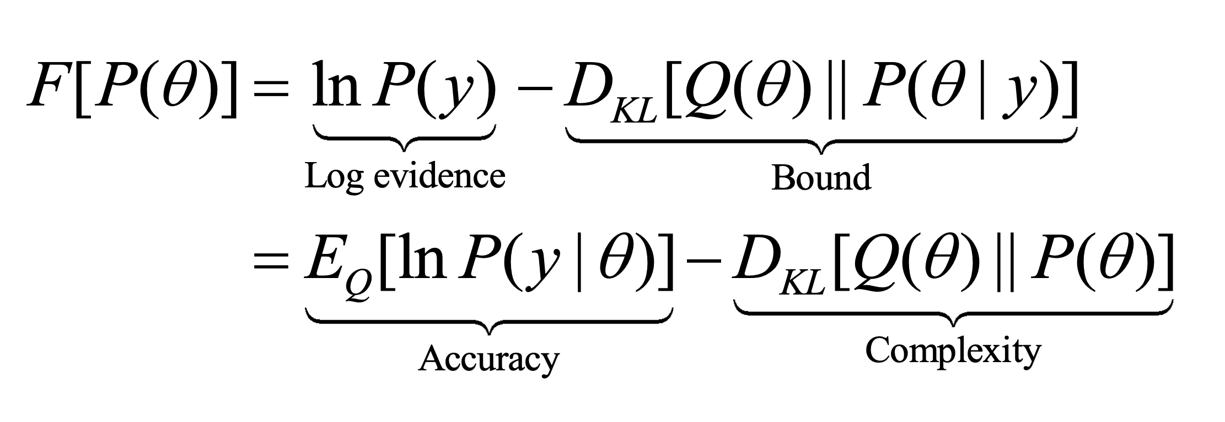
Leftovers
Bayes Rule

Slide 30
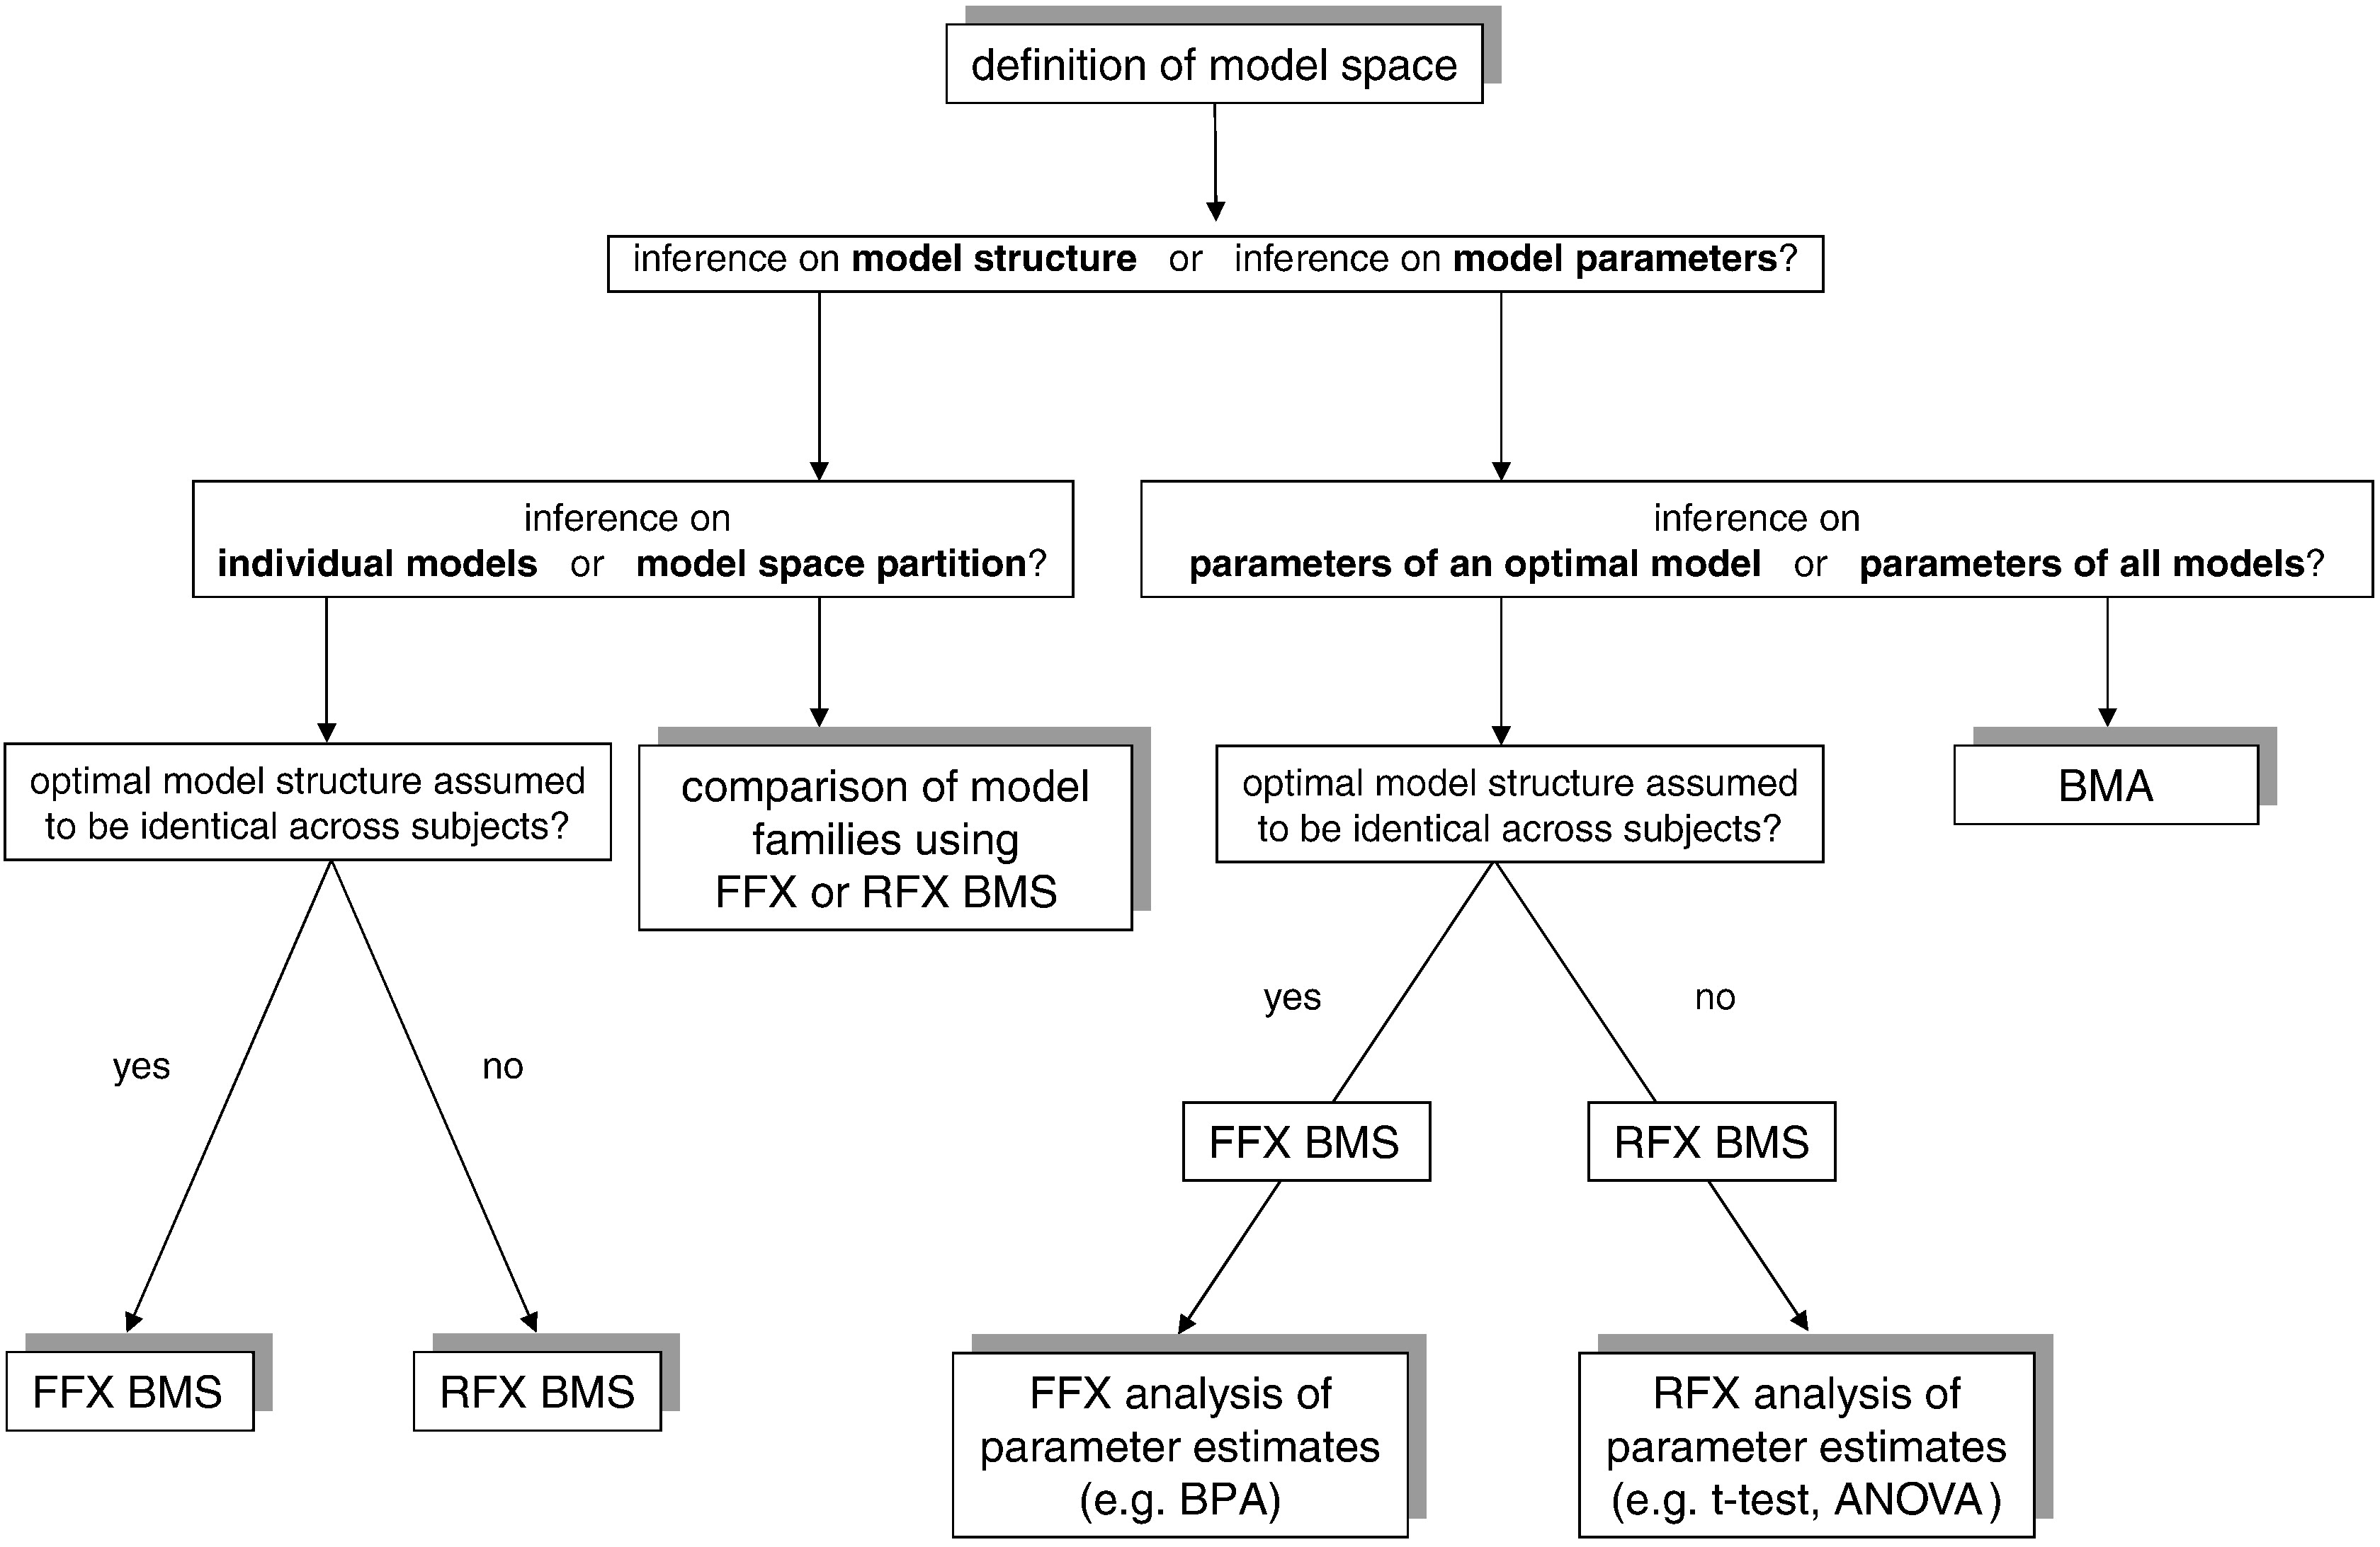
Leftovers
Stephan et al. 2010 NeuroImage doi.org/10.1016/j.neuroimage.2009.11.015

Slide 31
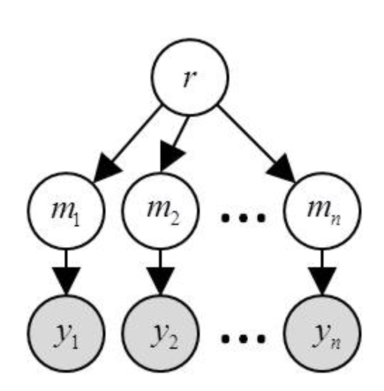
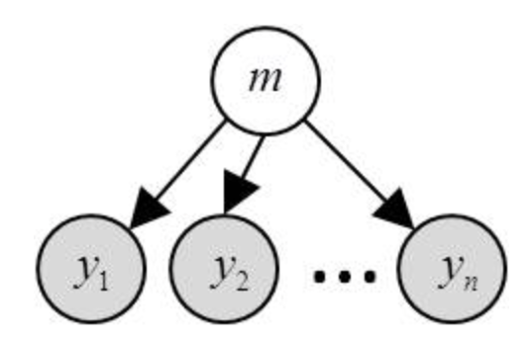
Leftovers
https://mbb-team.github.io/VBA-toolbox/wiki/BMS-for-group-studies/

