Slide 1
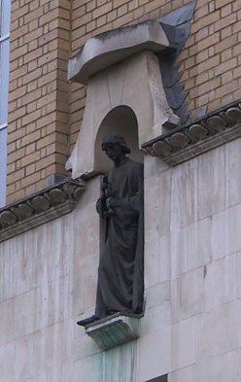
fMRI Preprocessing
John Ashburner
Wellcome Centre for Human Neuroimaging,
12 Queen Square, London, UK.

Slide 2
Contents
Preliminaries
  Rigid-body and affine transformations
  Optimisation and objective functions
  Transformations and interpolation
Within-subject: Realignment
Within-subject: EPI Distortion Correction
Within-subject: Coregistration
Between-subject: Normalise/Segment
Between-subject: Dartel
Between-subject: Smoothing

Slide 3
Image registration
Most “preprocessing” involves aligning images together.
Two components:
Registration - i.e. Optimise the parameters that describe spatial transformations between the images.
Transformation - i.e. Re-sample according to the determined transformation parameters.

Slide 4
Rigid-body transformations
Assume that brain of the same subject doesn’t change shape or size in the scanner.
  Head can move, but remains the same shape and size.
  Some exceptions:
    Image distortions.
    Brain slops about slightly because of gravity.
    Brain growth or atrophy over time.
If the subject’s head moves, we need to correct the images.
  Do this by image registration.

Slide 5
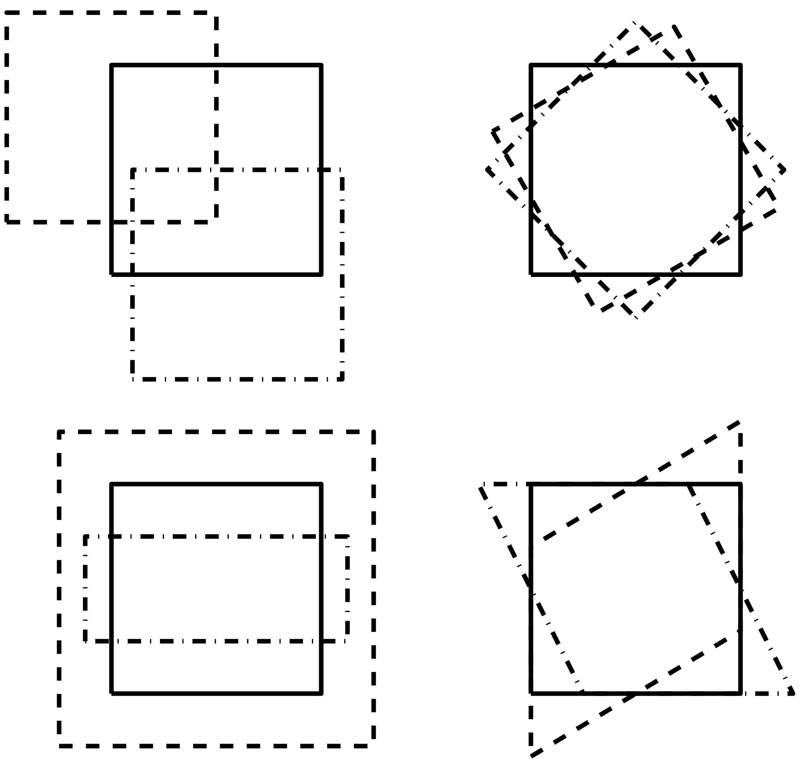
2D affine transforms
Translations by t_{x} and t_{y}
  x₁ = x₀ + t_{x}
  y₁ = y₀ + t_{y}
Rotation around the origin by Θ radians
  x₁ = cos(Θ) x₀ + sin(Θ) y₀
  y₁ = -sin(Θ) x₀ + cos(Θ) y₀
Zooms by s_{x} and s_{y}
  x₁ = s_{x} x₀
  y₁ = s_{y} y₀
Shear
  x1 = x0 + h y0
  y1 = y0

Slide 6
2D affine transforms
Translations by t_{x} and t_{y}
  x₁ = 1 x₀ + 0 y₀ + t_{x}
  y₁ = 0 x₀ + 1 y₀ + t_{y}
Rotation around the origin by Θ radians
  x₁ = cos(Θ) x₀ + sin(Θ) y₀ + 0
  y₁ = -sin(Θ) x₀ + cos(Θ) y₀ + 0
Zooms by s_{x} and s_{y}:
  x₁ = s_{x} x₀ + 0 y₀ + 0
  y₁ = 0 x₀ + s_{y} y₀ + 0
Shear
  x1 = 1 x0 + h y0 + 0
  y1 = 0 x0 + 1 y0 + 0

Slide 7
3D rigid-body transformations
A 3D rigid body transform is defined by:
  3 translations - in X, Y & Z directions
  3 rotations - about X, Y & Z axes
The order of the operations matters
Translations
Pitch
about x axis
Roll
about y axis
Yaw
about z axis

Slide 8
Voxel-to-world transforms
Affine transform associated with each image
  Maps from voxels (x=1..n_{x}, y=1..n_{y}, z=1..n_{z}) to some world co-ordinate system. e.g.,
    Scanner co-ordinates - images from DICOM toolbox
    T&T/MNI coordinates - spatially normalised
Registering image B (source) to image A (target) will update B’s voxel-to-world mapping
  Mapping from voxels in A to voxels in B is by
    A-to-world using M_{A}, then world-to-B using M_{B}⁻¹
    M_{B}⁻¹ M_{A}

Slide 9
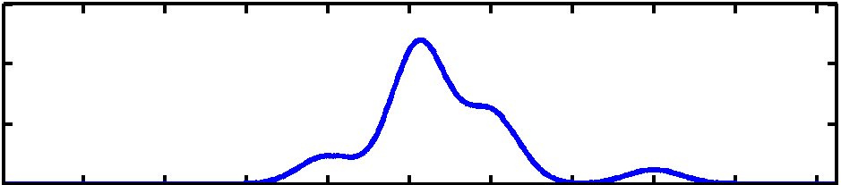
Optimisation
Image registration is done by optimisation.
Optimisation involves finding some “best” parameters according to an “objective function”, which is either minimised or maximised
The “objective function” is often related to a probability based on some model
Most probable solution (global optimum)
Objective function
Local optimum
Local optimum
Value of parameter

Slide 10
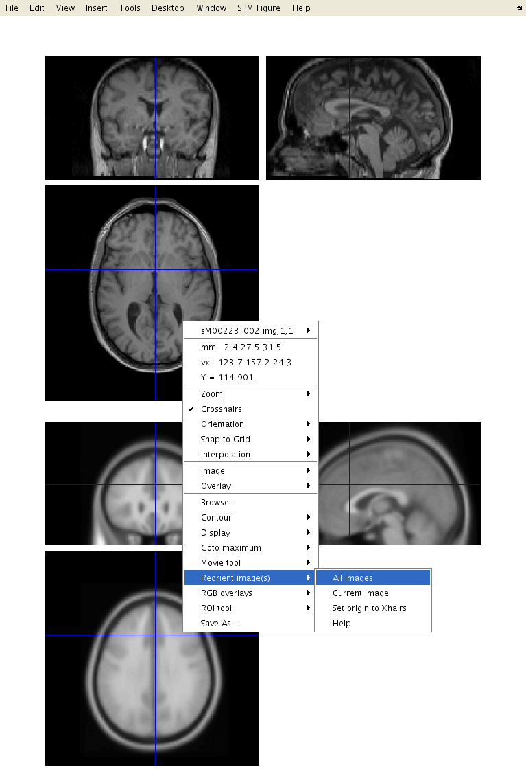
Optimisation
Because registration only finds a local optimum, some manual reorienting of the images may be needed before doing anything else in SPM.
An MNI-space image from spm12/canonical directory.

Slide 11
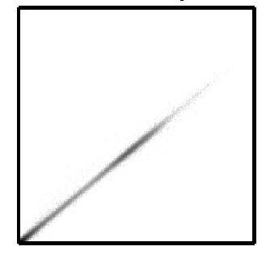
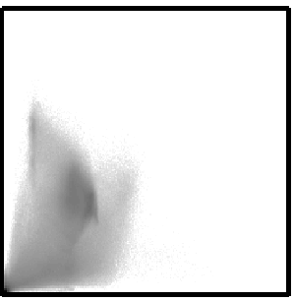
Objective functions
Intra-modal
  Mean squared difference (minimise)
  Normalised cross correlation (maximise)
Inter-modal (or intra-modal)
  Mutual information (maximise)
  Normalised mutual information (maximise)
  Entropy correlation coefficient (maximise)

Slide 12
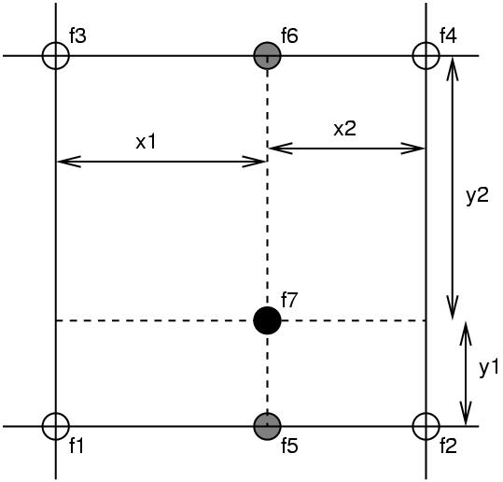
Simple interpolation
Nearest neighbour
  Take the value of the closest voxel
Tri-linear
  Just a weighted average of the neighbouring voxels
  f₅ = f₁ x₂ + f₂ x₁
  f₆ = f₃ x₂ + f₄ x₁
  f₇ = f₅ y₂ + f₆ y₁

Slide 13
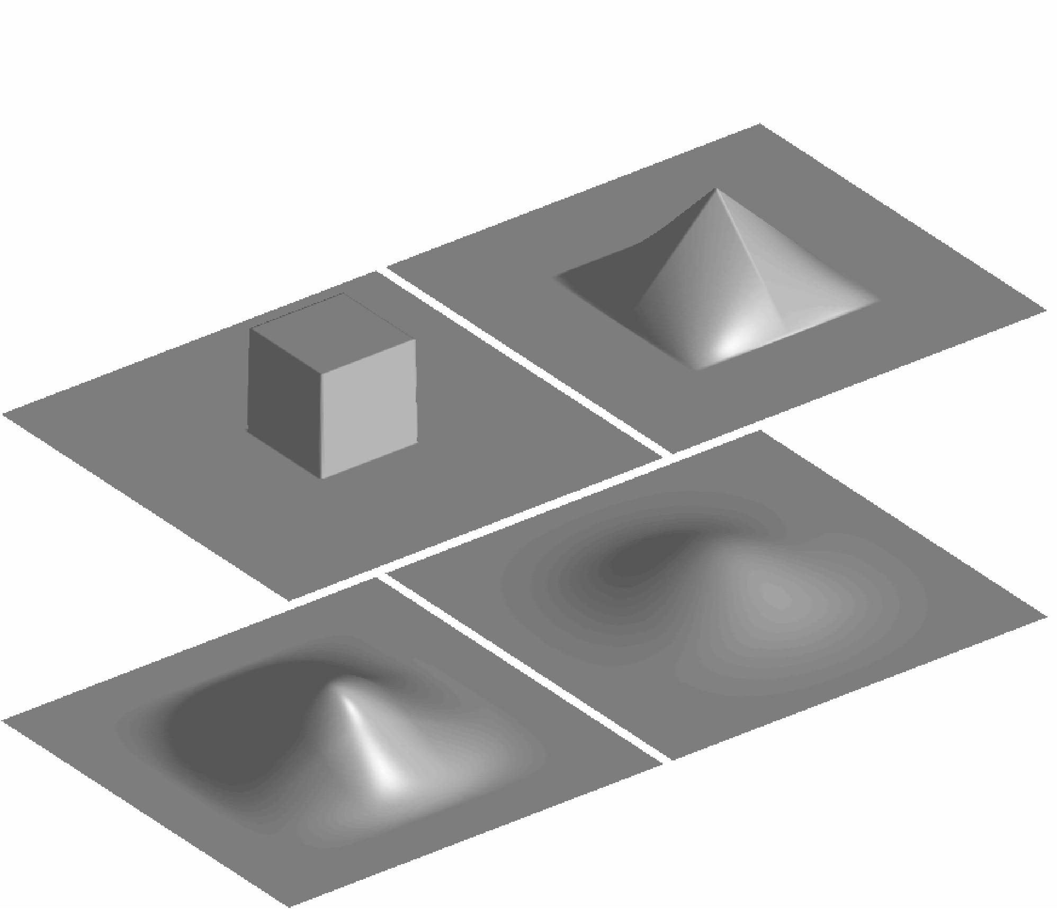
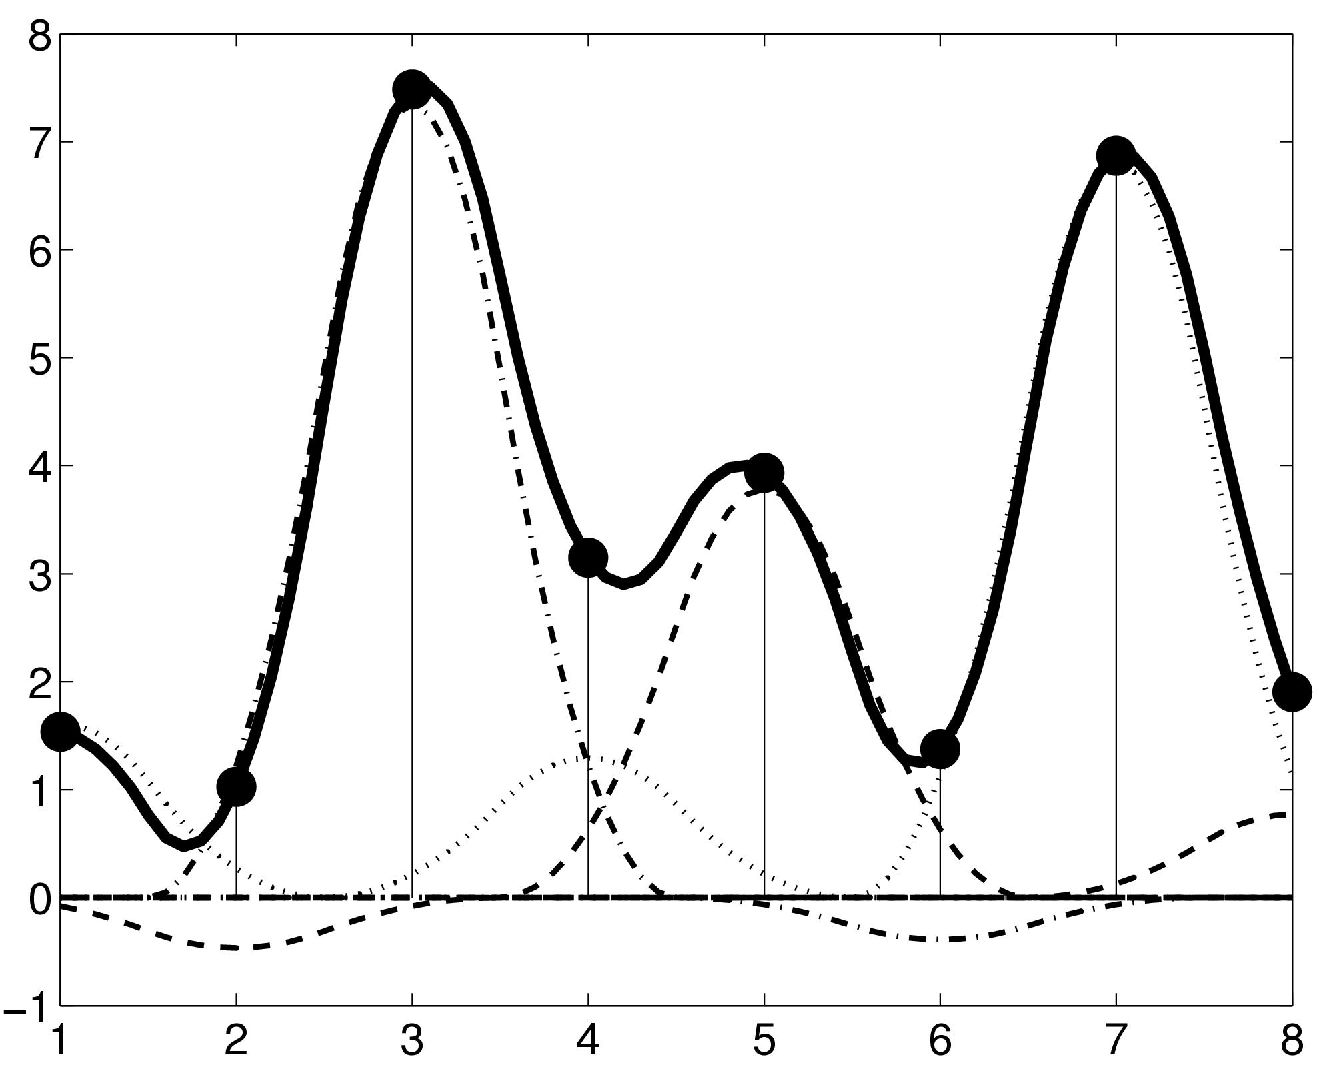
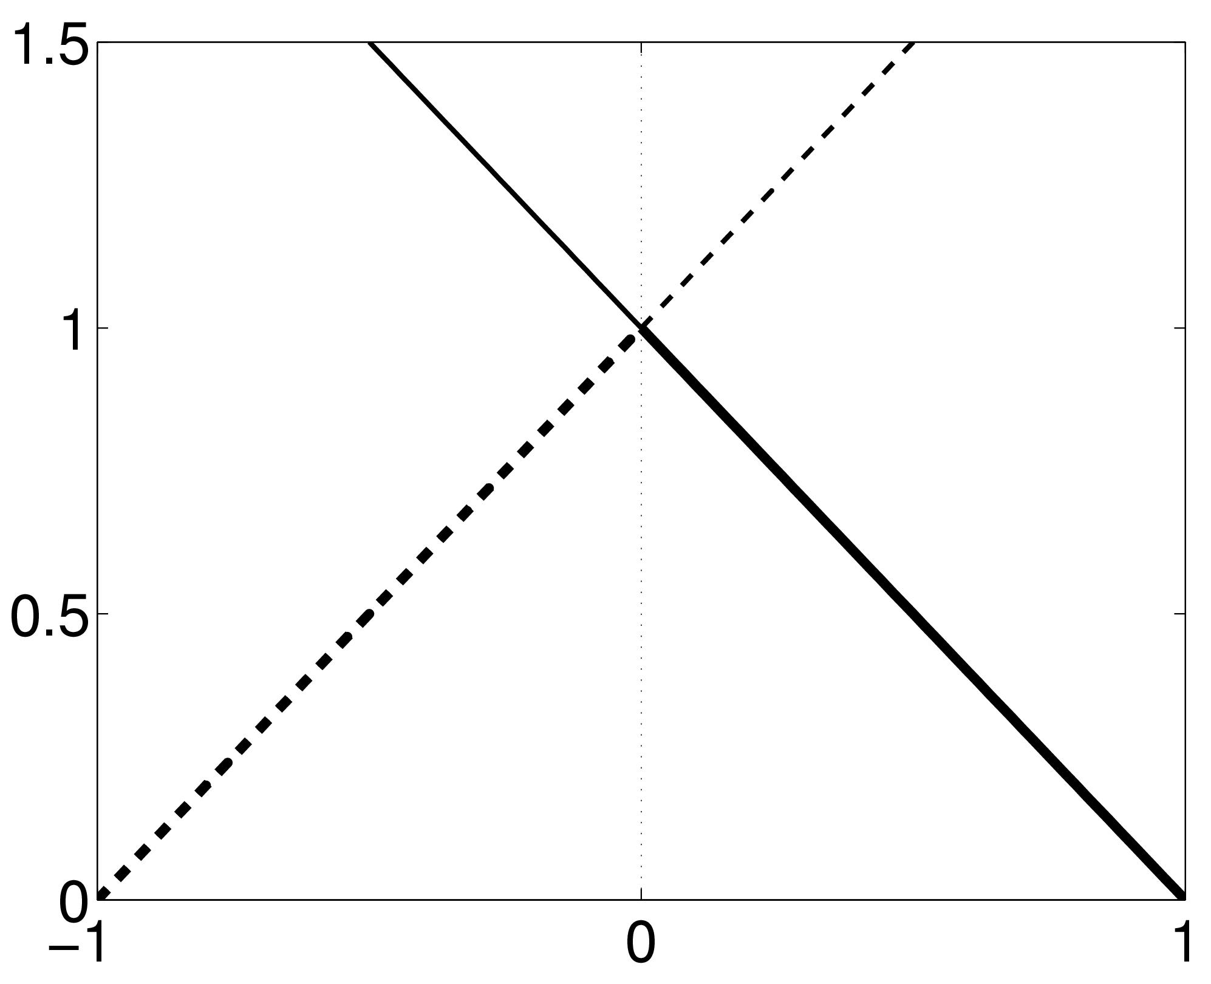
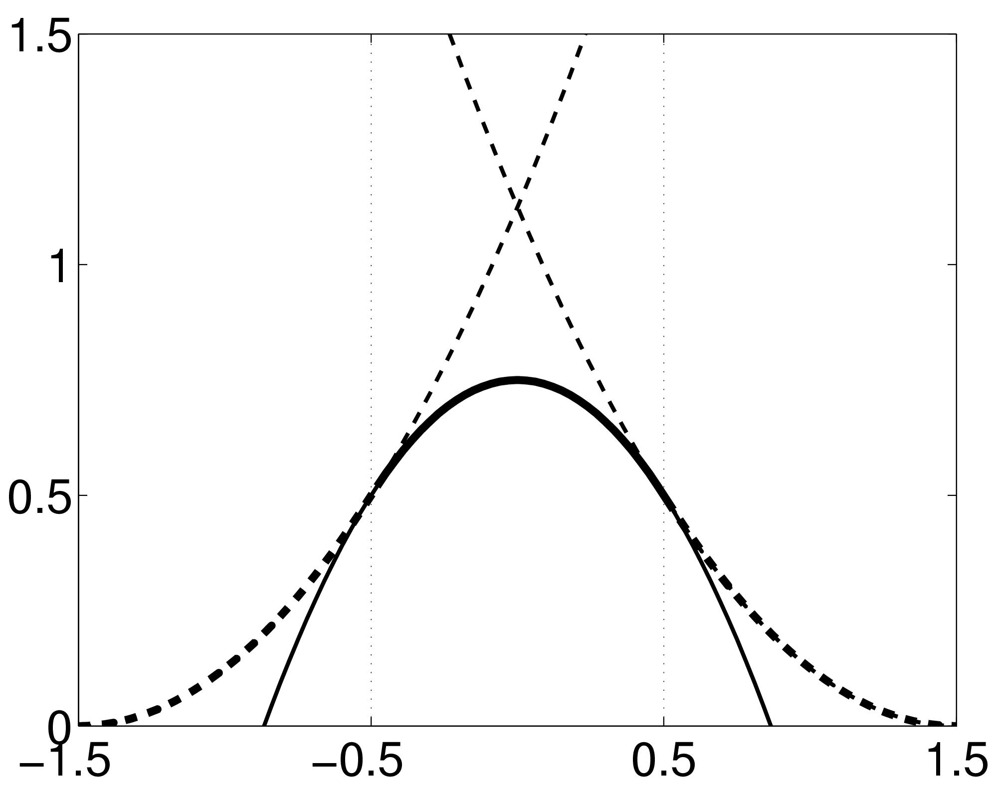
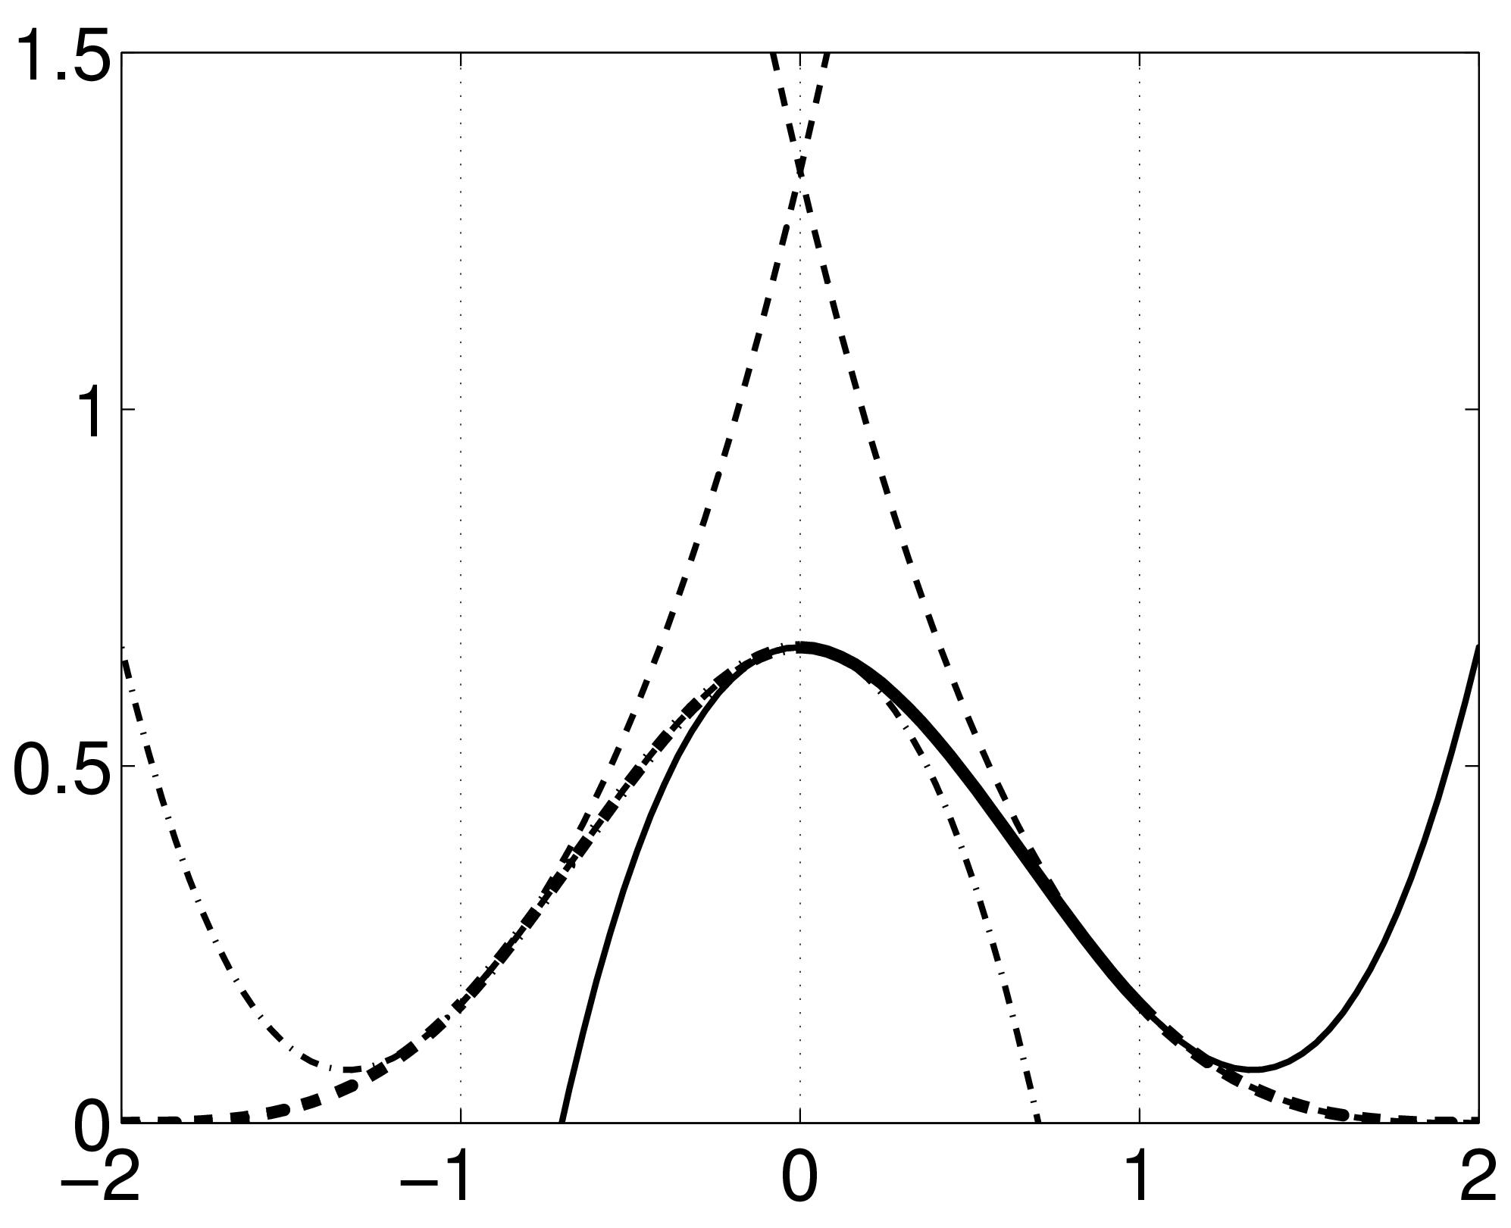
B-spline interpolation
A continuous function is represented by a linear combination of basis functions
2D B-spline basis functions of degrees 0, 1, 2 and 3
B-splines are piecewise polynomials
Nearest neighbour and trilinear interpolation are the same as B-spline interpolation with degrees 0 and 1.

Slide 14
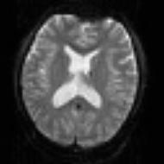
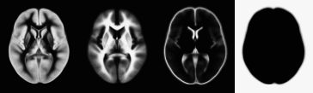
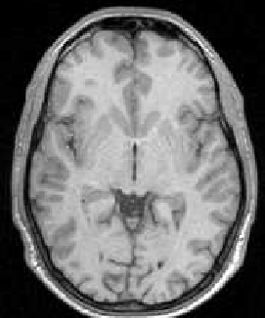

Pre-processing overview
Statistics or whatever
fMRI time-series
Anatomical MRI
Template
Smoothed
Estimate Spatial Norm
Motion/Distortion Correct
Smooth
Coregister
Spatially normalised
Deformation

Slide 15
Contents
Preliminaries
Within-subject: Realignment
  Realignment by minimising mean-squared difference
  Residual artifacts
Within-subject: Realignment
Within-subject: EPI Distortion Correction
Within-subject: Coregistration
Between-subject: Normalise/Segment
Between-subject: Dartel
Between-subject: Smoothing

Slide 16
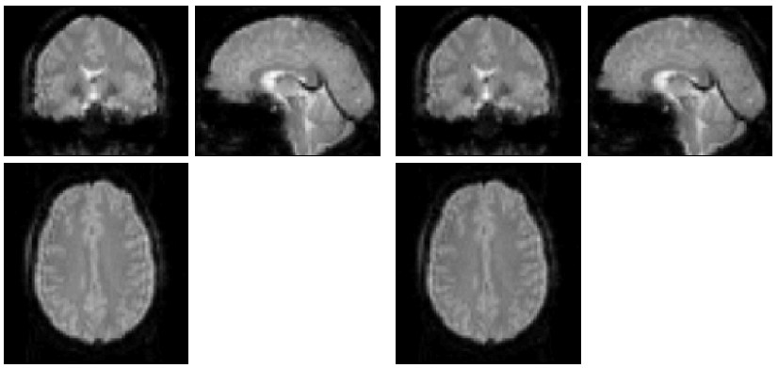
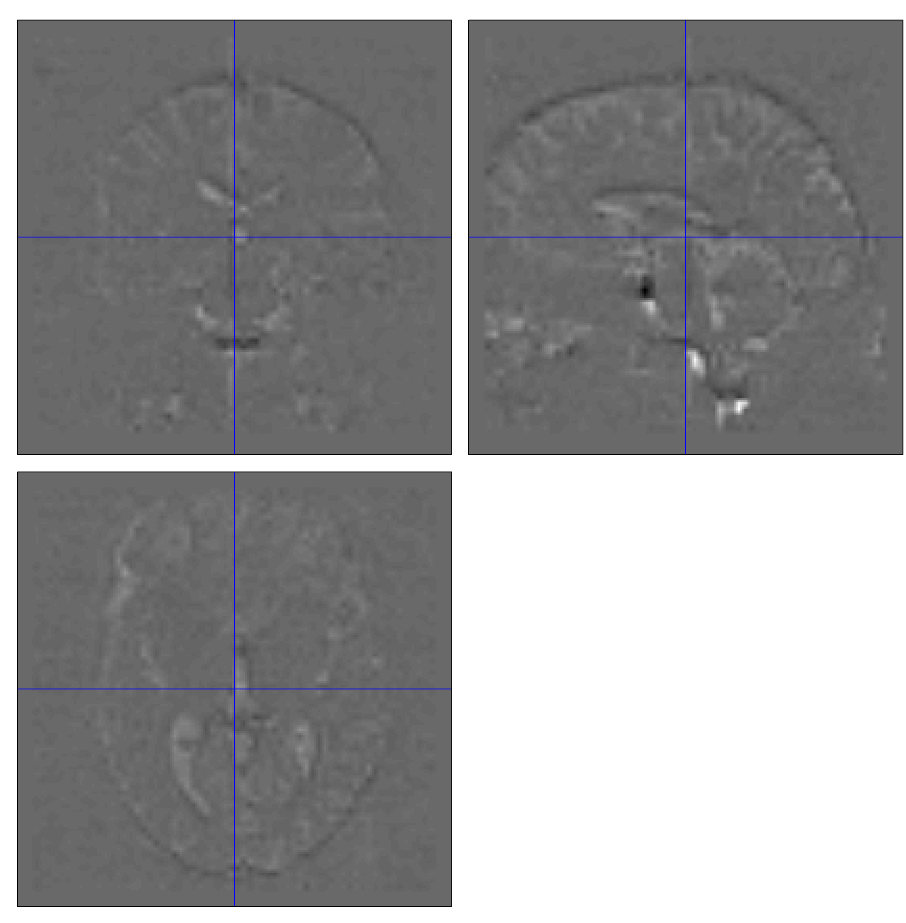
Mean-squared difference
Minimising mean-squared difference works for intra-modal registration (realignment)
Simple relationship between intensities in one image, versus those in the other
  Assumes normally distributed differences

Slide 17
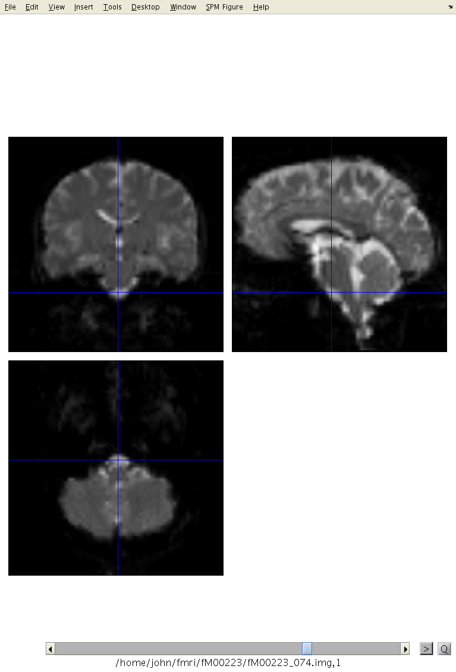
Motion estimates
“Browse” option from Check Reg allows fMRI time series to be shown as a movie.

Slide 18
Residual errors from aligned fMRI
Re-sampling can introduce interpolation errors
  especially tri-linear interpolation
Gaps between slices can cause aliasing artefacts
Slices are not acquired simultaneously
  rapid movements not accounted for by rigid body model
Image artefacts may not move according to a rigid body model
  image distortion
  image dropout
  Nyquist ghost
BOLD signal changes influence the estimated motion.
Functions of the estimated motion parameters can be modelled as confounds in subsequent analyses

Slide 19
Contents
Preliminaries
Within-subject: Realignment
Within-subject: EPI Distortion Correction
  FieldMap Toolbox
  Movement by distortion interaction
Within-subject: Coregistration
Between-subject: Normalise/Segment
Between-subject: Dartel
Between-subject: Smoothing

Slide 20
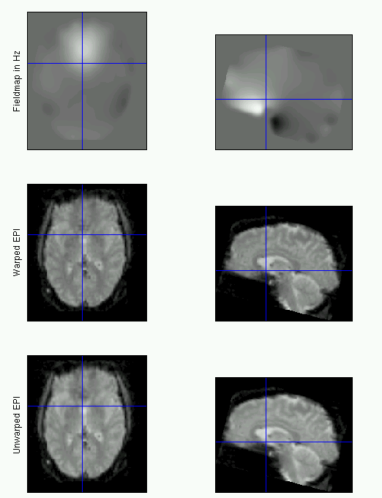
EPI distortion
Magnetic susceptibility differs among tissues.
Greatest difference is between air and tissue.
Subject disrupts B0 field, rendering it inhomogeneous
Distortions in phase-encode direction

Slide 21
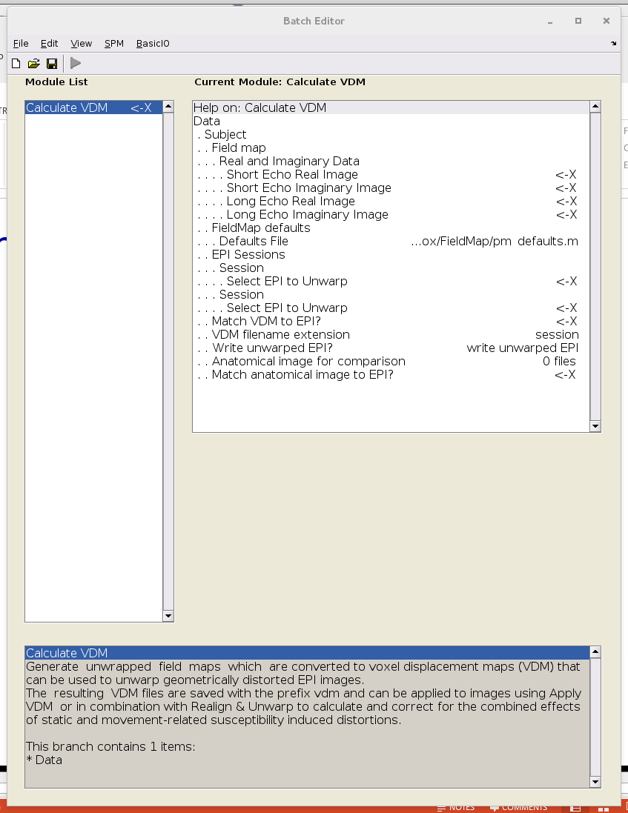
FieldMap toolbox
Computes a voxel-displacement map (VDM) from fieldmap scans.
Used to correct distortions in EPI.

Slide 22
Phase unwrapping
Phase of complex data used.
- π/2 < phase < π/2
Phase-unwrapping needed.
  Part that is most likely to go wrong.
  Phase is poorly defined when magnitude is small relative to noise.

Slide 23
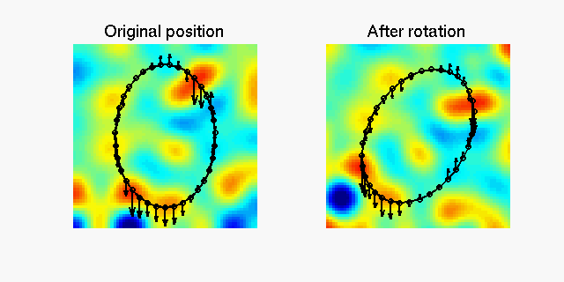
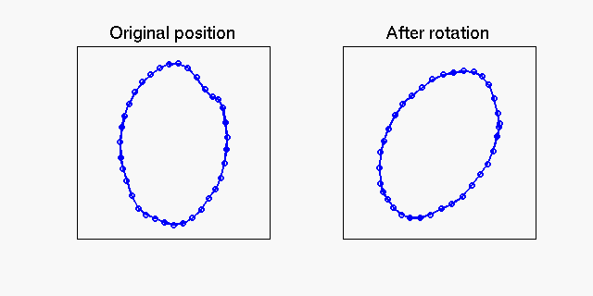
Movement-by-distortion interaction

Slide 24
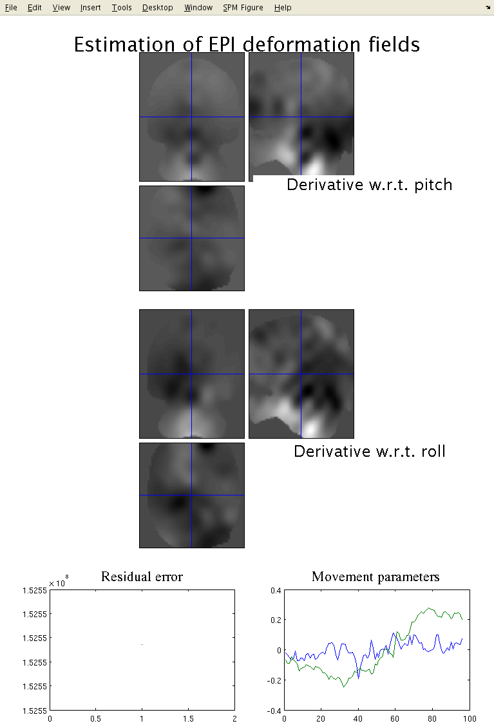
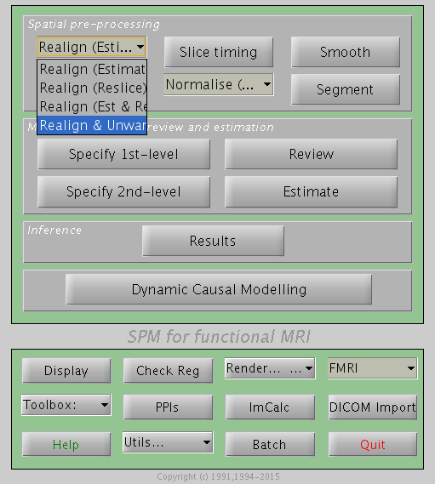
Realign & Unwarp

Slide 25
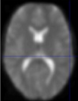
Correcting for distortion changes
Estimate reference from mean of all scans.
Estimate new distortion fields for each image:
estimate rate of change of field with respect to the current estimate of movement parameters in pitch and roll.
Unwarp time series.
Estimate movement parameters.
Δϕ
+Δθ
Andersson et al, 2001

Slide 26
Contents
Preliminaries
Within-subject: Realignment
Within-subject: EPI Distortion Correction
Within-subject: Coregistration
    Coregistration by maximising mutual information
Between-subject: Normalise/Segment
Between-subject: Dartel
Smoothing

Slide 27
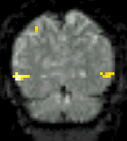
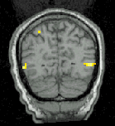
Coregistration
Inter-modal registration.
Match images from same subject but different modalities:
  anatomical localisation of single subject activations
  achieve more precise spatial normalisation of functional image using anatomical image.

Slide 28
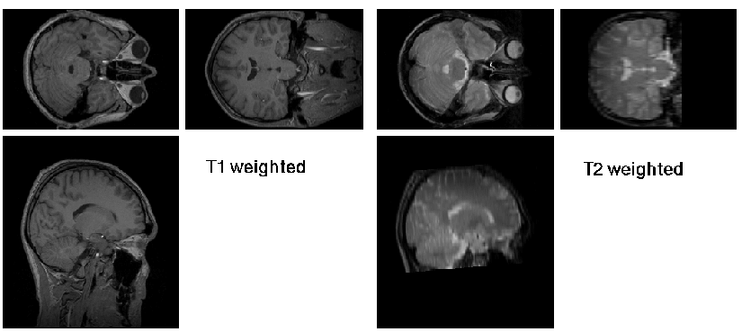
Coregistration maximises Mutual Information
Used for between-modality registration
Derived from joint histograms
MI= ∫_{ab} P(a,b) log₂ [P(a,b)/( P(a) P(b) )]
  Related to entropy: MI = -H(a,b) + H(a) + H(b)
      Where H(a) = -∫_{a} P(a) log₂P(a) and H(a,b) = -∫_{a} P(a,b) log₂P(a,b)

Slide 29
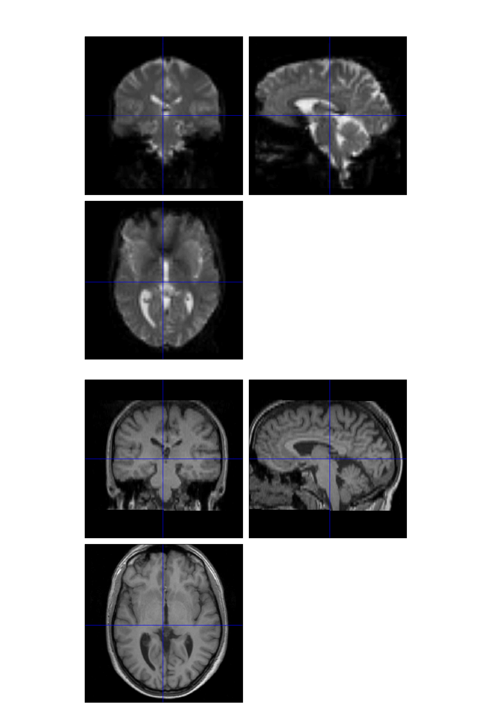
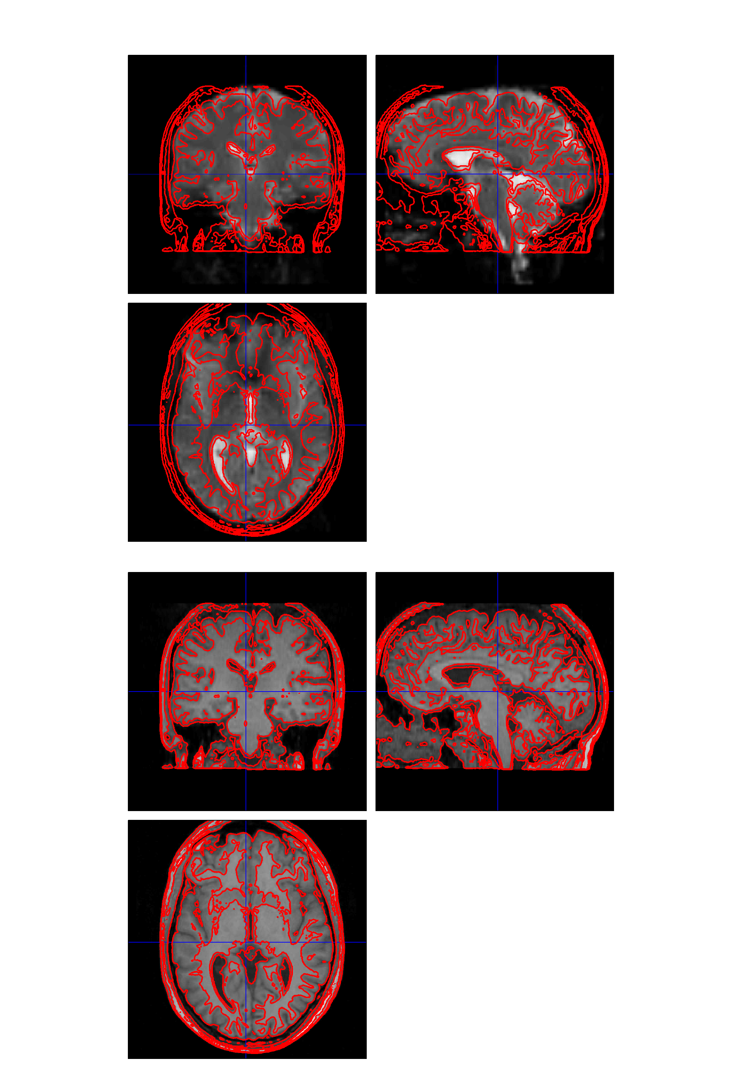
“Check Reg” to assess alignment
Check Reg allows contours from one image to be shown superimposed on another

Slide 30
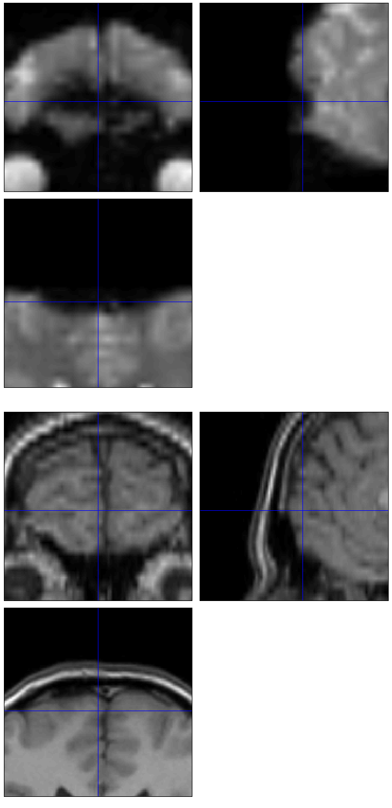
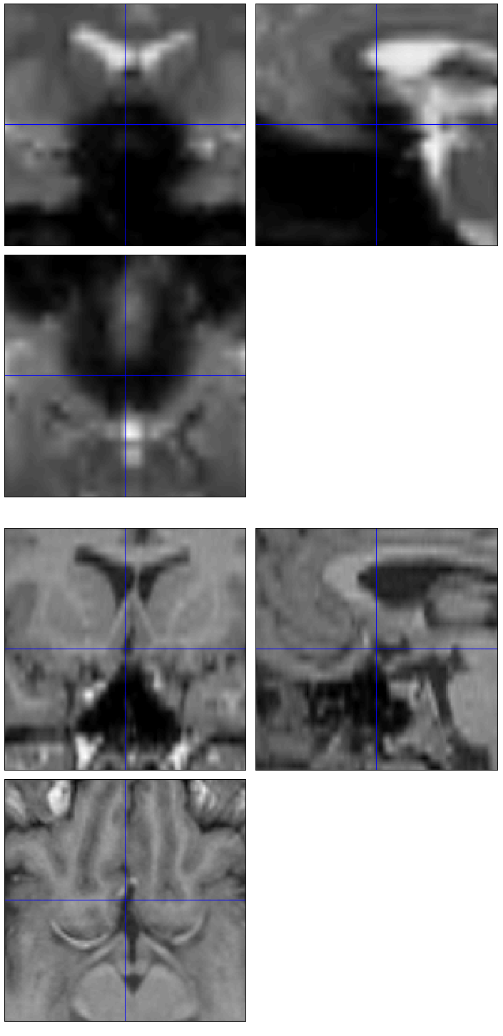
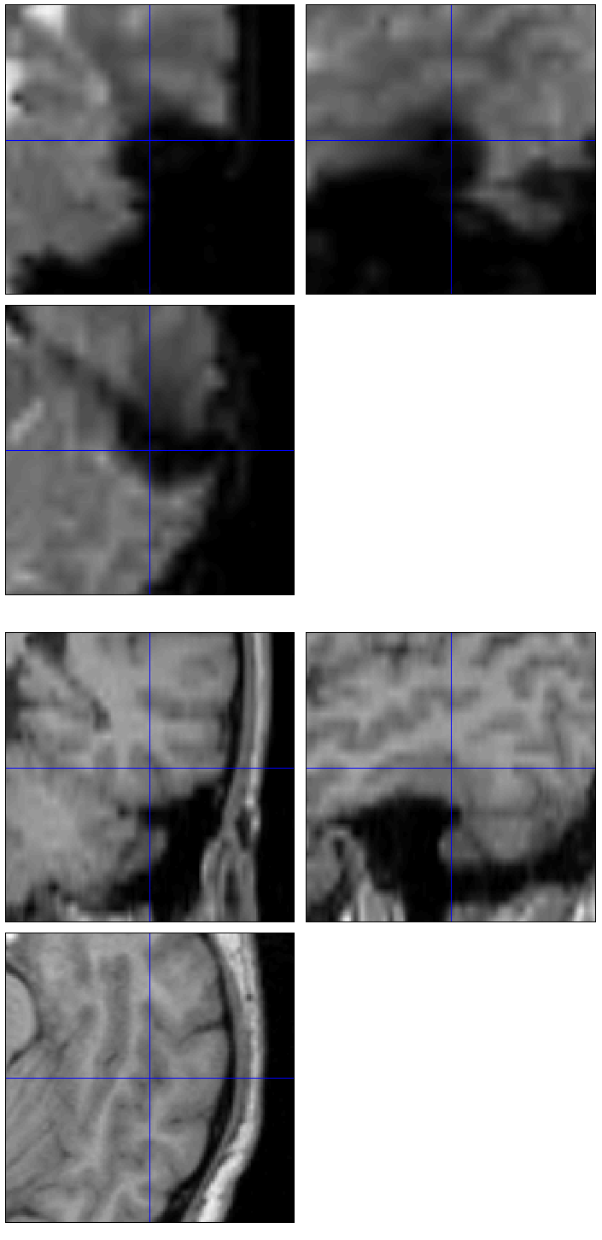
EPI dropout and distortion
EPI
EPI
EPI
structural
structural
structural

Slide 31
References
Friston et al. Spatial registration and normalisation of images. Human Brain Mapping 3:165-189 (1995).
Collignon et al. Automated multi-modality image registration based on information theory. IPMI’95 pp 263-274 (1995).
Thévenaz et al. Interpolation revisited.
IEEE Trans. Med. Imaging 19:739-758 (2000).
Andersson et al. Modeling geometric deformations in EPI time series. Neuroimage 13:903-919 (2001).
Hutton et al. Image distortion correction in fMRI: a quantitative evaluation. NeuroImage 16:217-240 (2002).

Slide 32
Pre-processing overview
Statistics or whatever
fMRI time-series
Anatomical MRI
Template
Smoothed
Estimate Spatial Norm
Motion Correct
Smooth
Coregister
Spatially normalised
Deformation

Slide 33
Alternative pipeline
Statistics or whatever
fMRI time-series
Template
Smoothed
Estimate Spatial Norm
Motion Correct
Smooth
Spatially normalised
Deformation

Slide 34
Contents
Preliminaries
Within-subject: Realignment
Within-subject: EPI Distortion Correction
Coregistration
Between-subject: Normalise/Segment
  Use segmentation routine for spatial normalisation
  Gaussian mixture model
  Intensity non-uniformity correction
  Deformed tissue probability maps
Between-subject: Dartel
Between-subject: Smoothing

Slide 35
Spatial normalisation
Brains of different subjects vary in shape and size.
Need to bring them all into a common anatomical space.
  Examine homologous regions across subjects
    Improve anatomical specificity
    Improve sensitivity
  Report findings in a common anatomical space (eg MNI space)
In SPM12, alignment is achieved by matching grey matter with grey matter and white matter with white matter.
  With possible alignment of other tissues.

Slide 36
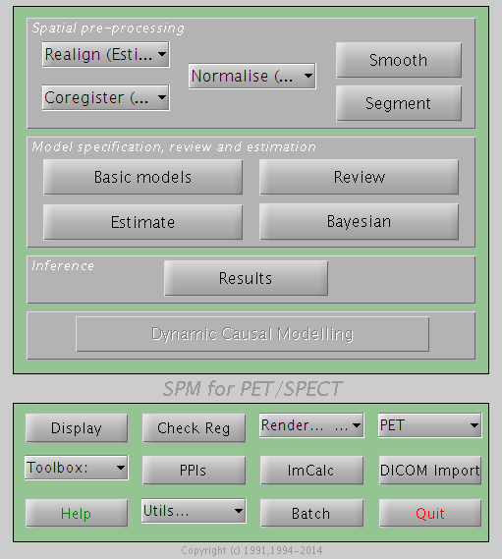
Normalise/Segment
This is the same algorithm as for tissue segmentation.
Combines:
  Mixture of Gaussians (MOG)
  Bias Correction Component
  Warping (Non-linear Registration) Component

Slide 37
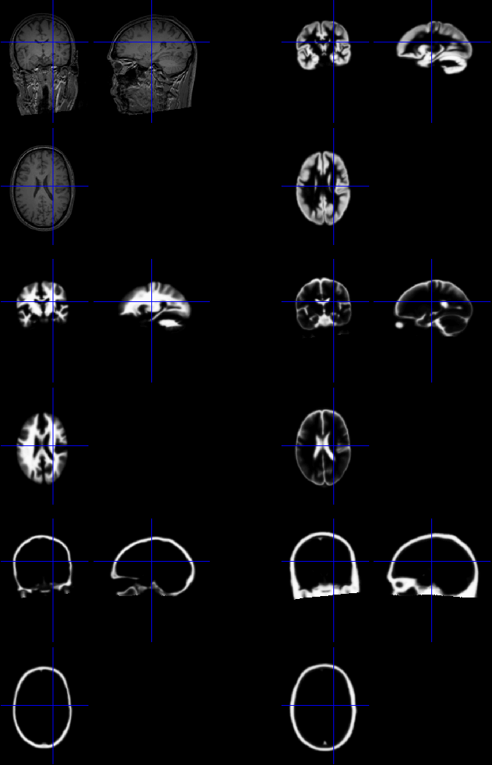
Spatial normalisation
Default spatial normalisation in SPM12 estimates nonlinear warps that match tissue probability maps to the individual image.
Spatial normalisation achieved using the inverse of this transform.

Slide 38
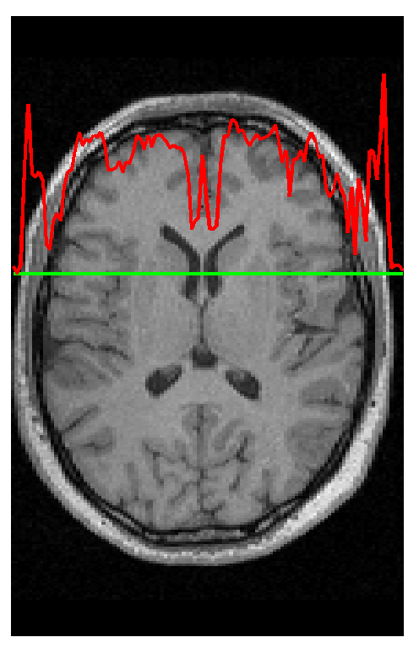
Segmentation
Segmentation in SPM12 also estimates a spatial transformation that can be used for spatially normalising images.
It uses a generative model, which involves:
  Mixture of Gaussians (MOG)
  Warping (Non-linear Registration) Component
  Bias Correction Component

Slide 39
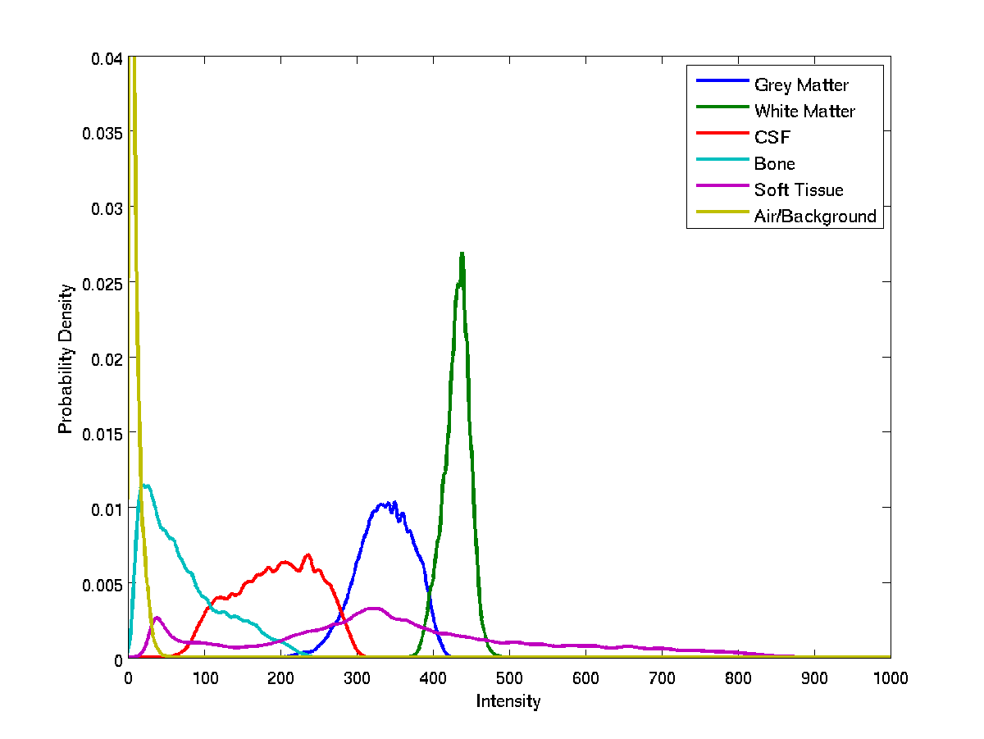
Image Intensity Distributions (T1-weighted MRI)

Slide 40
Modelling tissue intensities
Classification is based on a Mixture of Gaussians model (MOG), which represents the intensity probability density by a number of Gaussian distributions.
Frequency
Image Intensity

Slide 41
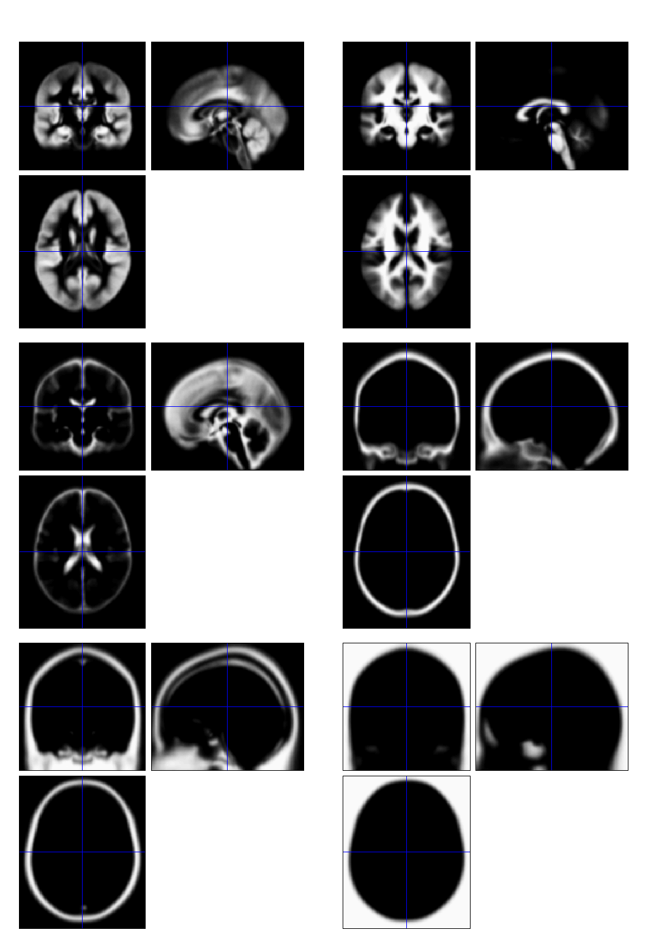
Tissue probability maps in SPM12
Includes additional non-brain tissue classes (bone, and soft tissue)

Slide 42
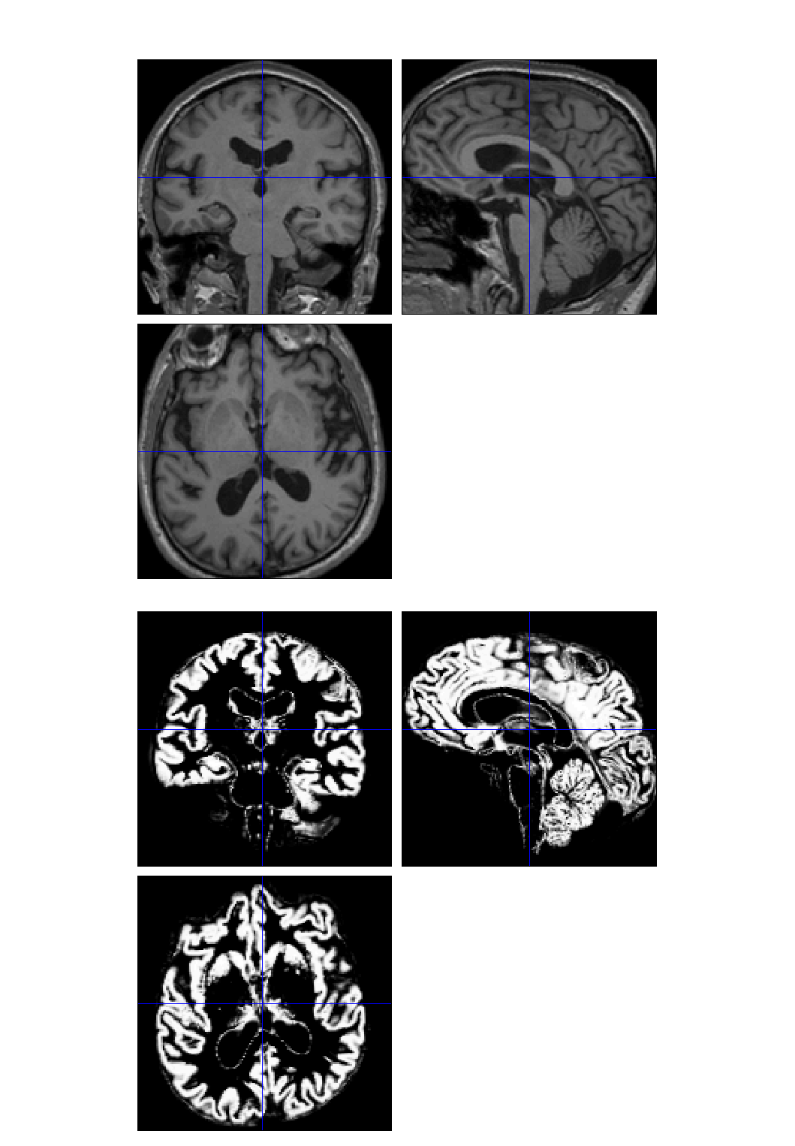
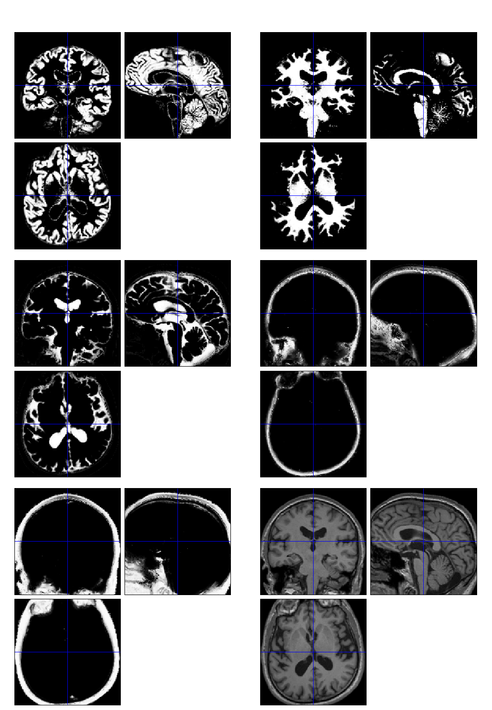

Slide 43
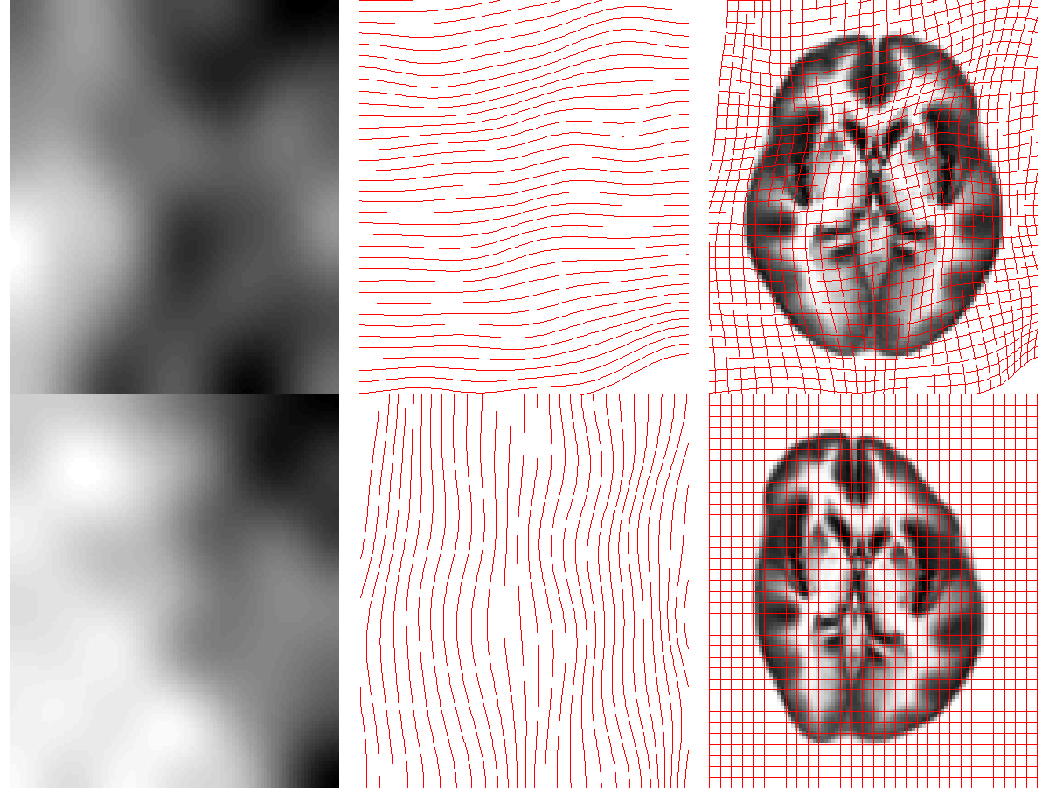
Modelling deformations

Slide 44
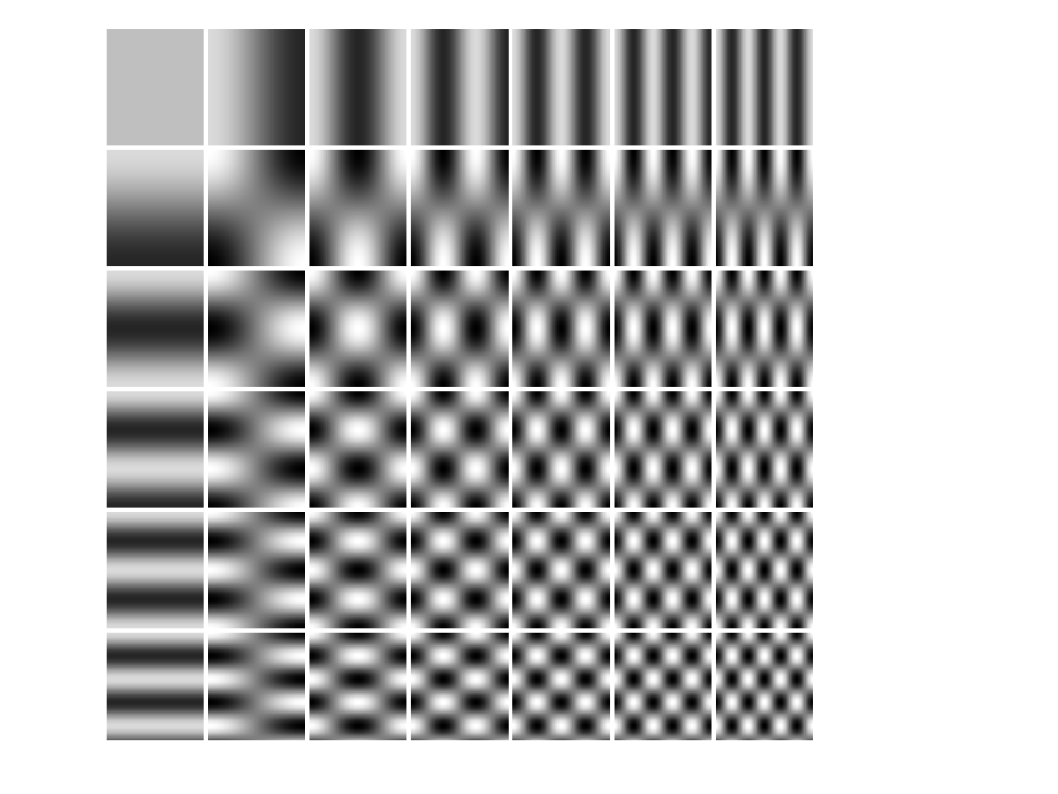
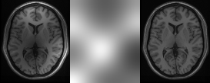
Modelling a bias field
A bias field is modelled as a linear combination of basis functions.
Corrupted image
Bias Field
Corrected image

Slide 45
Iterative optimisation scheme
Update tissue estimates
Update deformation estimates
Update bias field estimates
Converged?
No
Yes

Slide 46
Contents
Preliminaries
Within-subject: Realignment
Within-subject: EPI Distortion Correction
Within-subject: Coregistration
Between-subject: Normalise/Segment
Between-subject: Dartel
  Velocity field parameterisation
  Objective function
  Template creation
  Examples
Between-subject: Smoothing

Slide 47
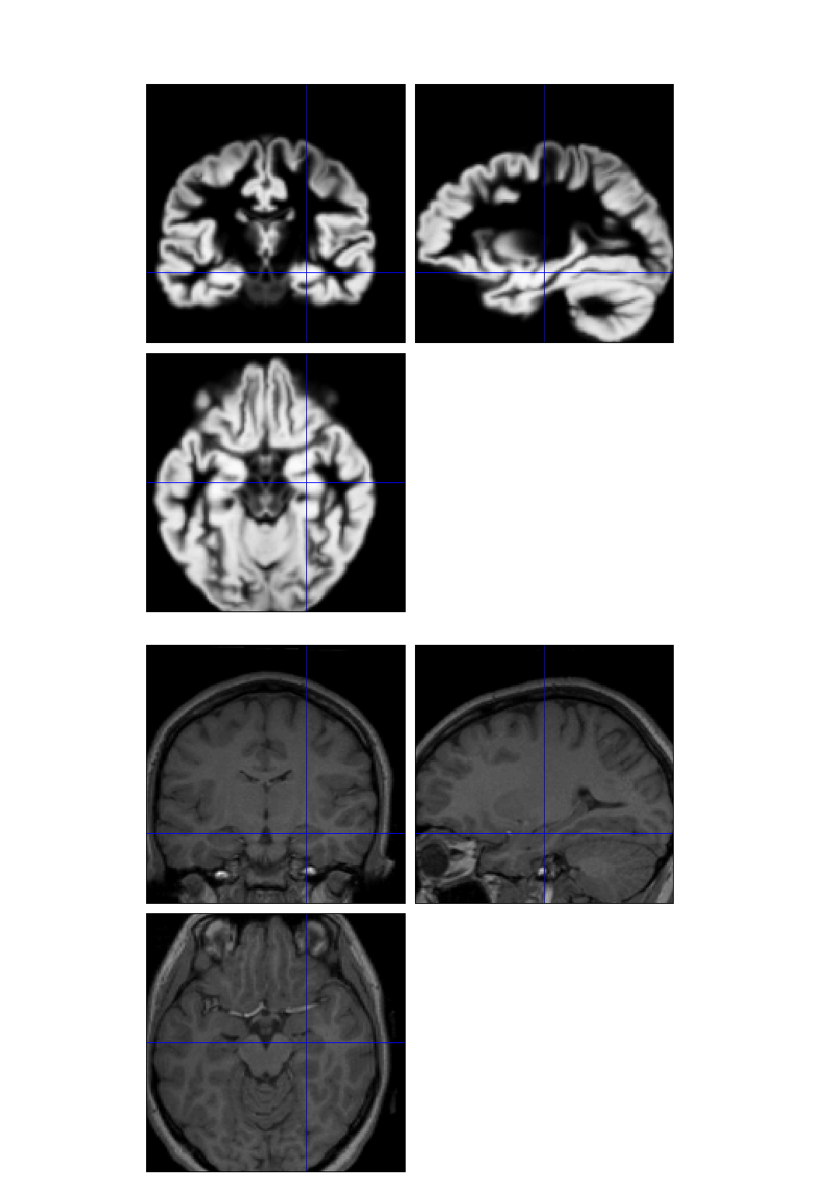
Dartel image registration
Uses fast approximations
  Deformation integrated using scaling and squaring
Uses Levenberg-Marquardt optimiser
  Multi-grid matrix solver
Matches GM with GM, WM with WM etc
Diffeomorphic registration takes about 30 mins per image pair (121×145×121 images).
Grey matter template warped to individual
Individual scan

Slide 48
Scaling and squaring example

Slide 49
Registration objective function
Simultaneously minimize the sum of:
  Matching Term
    Drives the alignment of the images.
    Multinomial assumption
  Regularisation term
    A measure of deformation roughness
    Keeps the warps spatially smooth.
A balance between the two terms.

Slide 50

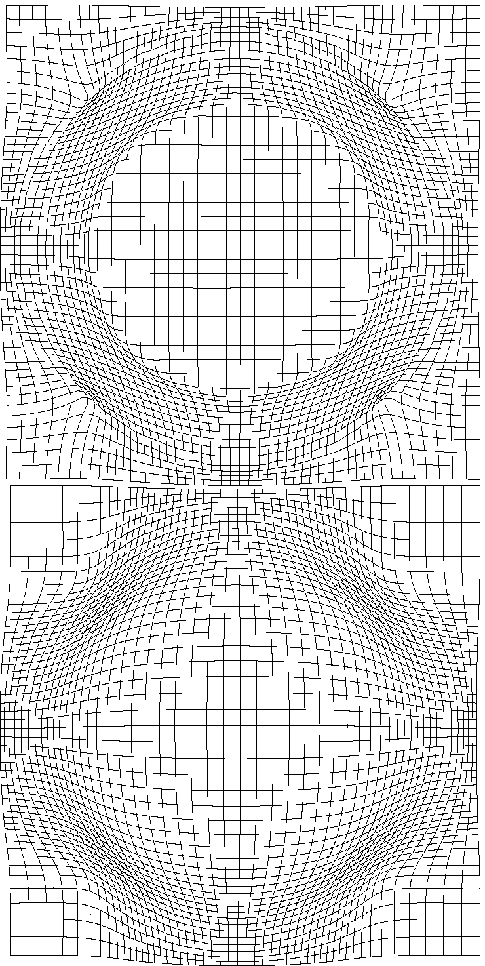
Effect of different forms of regularisation

Slide 51
Simultaneous registration of GM to GM and WM to WM
Grey matter
Subject 1
White matter
Grey matter
Subject 3
White matter
Grey matter
White matter
Grey matter
Template
Grey matter
White matter
White matter
Subject 2
Subject 4

Slide 52
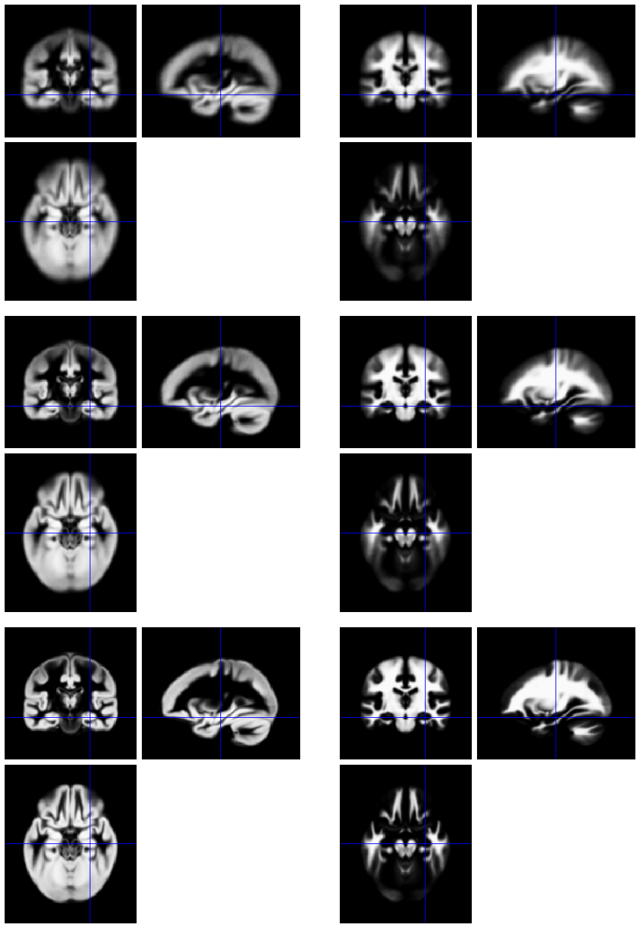
Template
Initial Average
Iteratively generated from 471 subjects
Began with rigidly aligned tissue probability maps
After a few iterations
Final template

Slide 53
Grey matter average of 452 subjects – affine

Slide 54
Grey matter average of 471 subjects

Slide 55
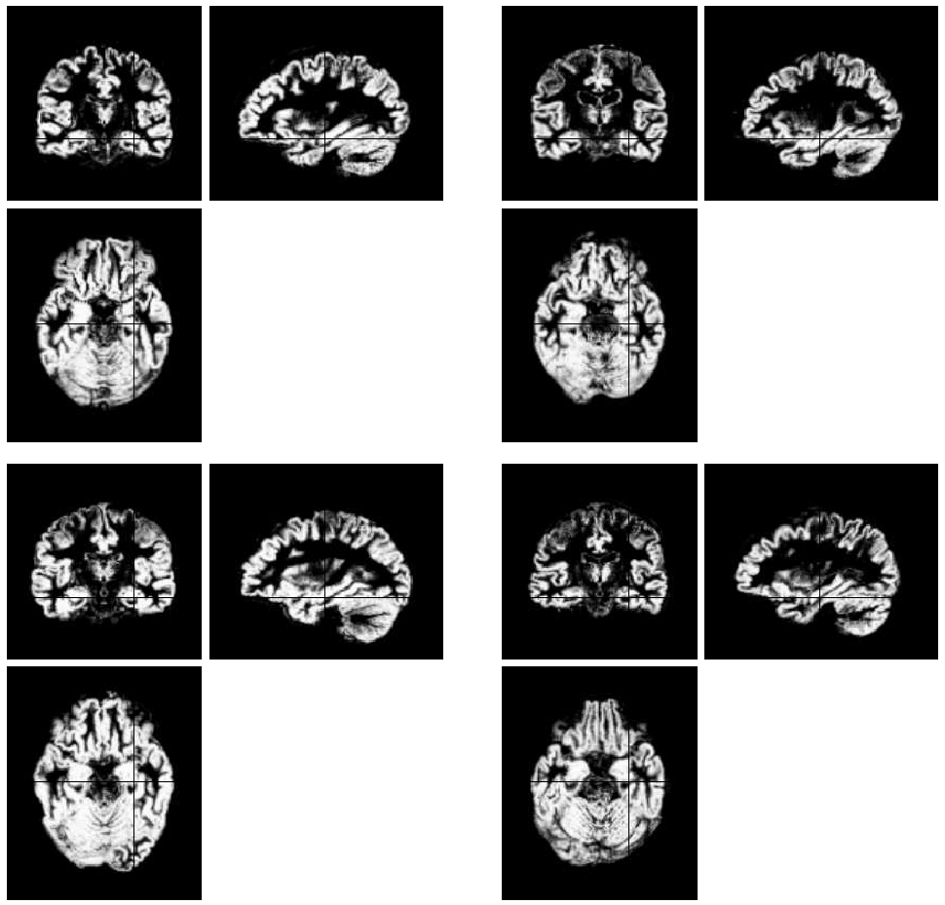
Initial
GM images

Slide 56
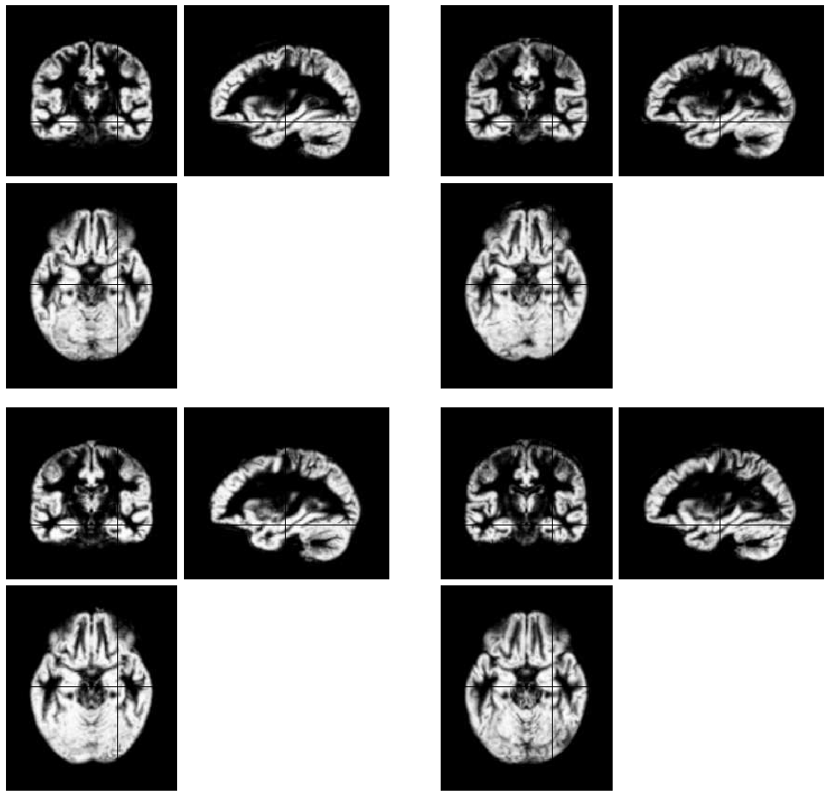
Aligned
GM images

Slide 57
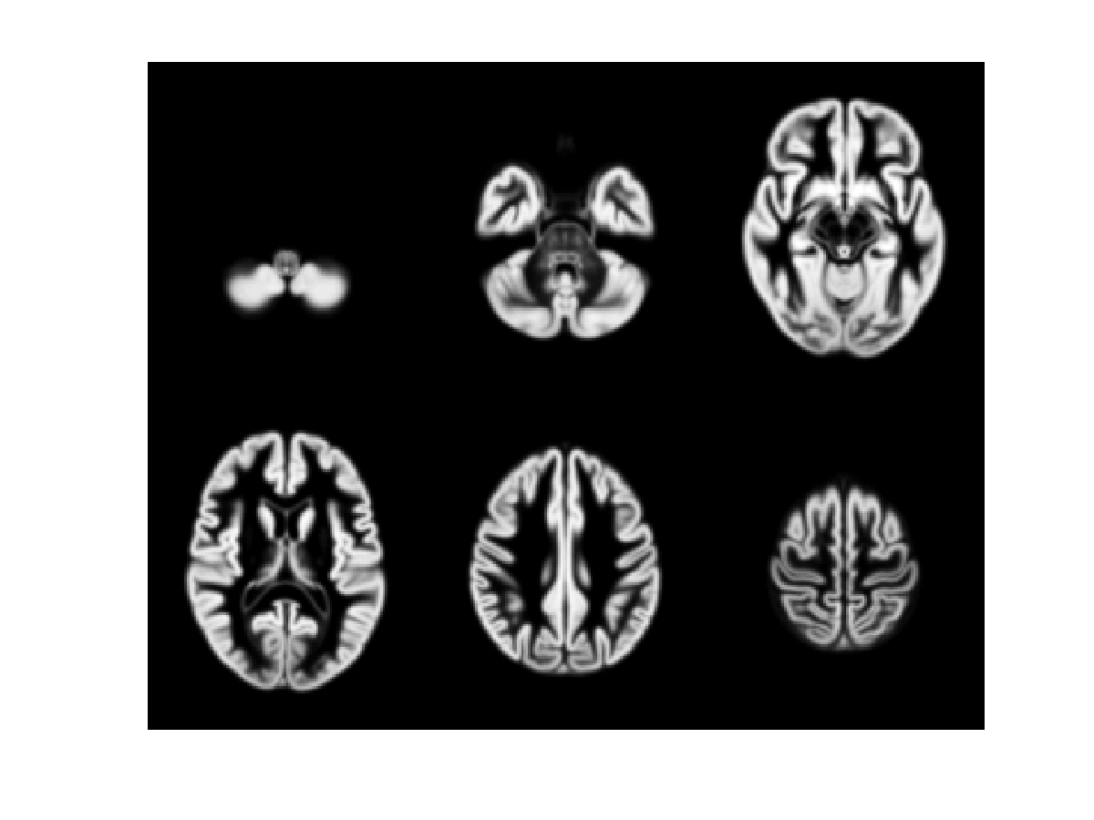
471 Subject Average

Slide 58
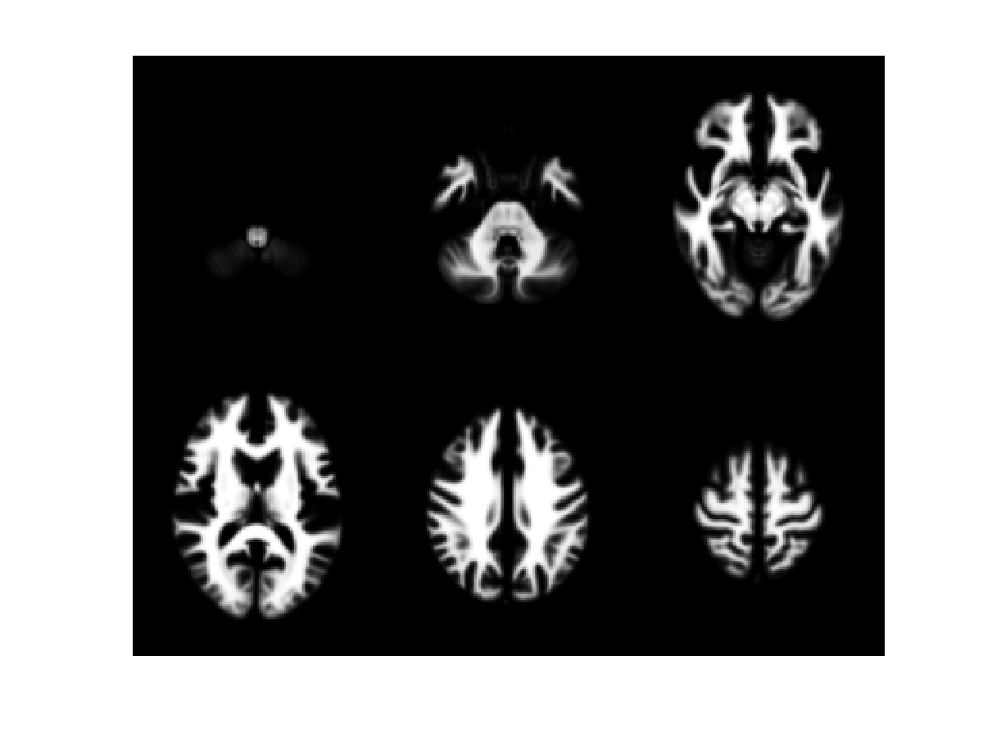
471 Subject Average

Slide 59

471 Subject Average

Slide 60

Subject 1

Slide 61
471 Subject Average

Slide 62

Subject 2

Slide 63
471 Subject Average

Slide 64

Subject 3

Slide 65
471 Subject Average

Slide 66


Evaluations of nonlinear registration algorithms

Slide 67
Contents
Preliminaries
Within-subject: Realignment
Within-subject: EPI Distortion Correction
Within-subject: Coregistration
Between-subject: Normalise/Segment
Between-subject: Dartel
Between subject: Smoothing
  Compensating for inaccuracies in inter-subject alignment

Slide 68


Smooth
Blurring is done by convolution.
Each voxel after smoothing effectively becomes the result of applying a weighted region of interest (ROI).
Before convolution
Convolved with a circle
Convolved with a Gaussian

Slide 69





Smooth

Slide 70
References
Ashburner & Friston. Unified Segmentation.
NeuroImage 26:839-851 (2005).
Ashburner. A Fast Diffeomorphic Image Registration Algorithm. NeuroImage 38:95-113 (2007).
Ashburner & Friston. Computing average shaped tissue probability templates. NeuroImage 45(2): 333-341 (2009).
Klein et al. Evaluation of 14 nonlinear deformation algorithms applied to human brain MRI registration. NeuroImage 46(3):786-802 (2009).

