Slide 1
Group Analyses
Emma Holmes
* Slides adapted from Will Penny

Slide 2
First Level: Subject 1
For voxel v in the brain
Effect size (c) ≈ 4

Slide 3
First Level: Subject 3
For voxel v in the brain
Effect size (c) ≈ 2

Slide 4
First Level: Subject 12
For voxel v in the brain
Effect size (c) ≈ 4

Slide 5
Second Level: Group Analysis
 | c
Subject 1 | 4
Subject 2 | 3
Subject 3 | 2
Subject 4 | 1
Subject 5 | 1
Subject 6 | 2
Subject 7 | 3
Subject 8 | 3
Subject 9 | 3
Subject 10 | 2
Subject 11 | 4
Subject 12 | 4
Group effect (mean [m]) = 2.67
Between subject variability (stand dev [sb]) = 1.07
Standard error of the mean (SEM) = sb /sqrt(N) = 0.31
Is the effect significant at voxel v? (one-sample t-test)
t = m/SEM = 2.67/0.31 = 8.61
p = 10⁻⁶
This is called a Random Effects Analysis, because we compare the group effect to the between-subjects variability

Slide 6
Second Level: Group Analysis
 | c
Subject 1 | 4
Subject 2 | 3
Subject 3 | 2
Subject 4 | 1
Subject 5 | 1
Subject 6 | 2
Subject 7 | 3
Subject 8 | 3
Subject 9 | 3
Subject 10 | 2
Subject 11 | 4
Subject 12 | 4
Group effect (mean [m]) = 2.67
Between subject variability (stand dev [sb]) = 1.07
Standard error of the mean (SEM) = sb /sqrt(N) = 0.31
Is the effect significant at voxel v? (one-sample t-test)
t = m/SEM = 2.67/0.31 = 8.61
p = 10⁻⁶
...also known as the SUMMARY STATISTIC approach: We summarise the response of each subject by a single statistic (their effect size)

Slide 7
First Level: Subject 1
FIXED EFFECTS ANALYSIS:
Not recommended for neuroimaging data
For voxel v in the brain
Root mean square error (GLM fit)
Effect size (c) ≈ 4 Within subject variability (s_{w}) ≈ 0.9

Slide 8
First Level: Subject 3
FIXED EFFECTS ANALYSIS:
Not recommended for neuroimaging data
For voxel v in the brain
Effect size (c) ≈ 2 Within subject variability (s_{w}) ≈ 1.5

Slide 9
First Level: Subject 12
FIXED EFFECTS ANALYSIS:
Not recommended for neuroimaging data
For voxel v in the brain
Effect size (c) ≈ 4 Within subject variability (s_{w}) ≈ 1.1

Slide 10
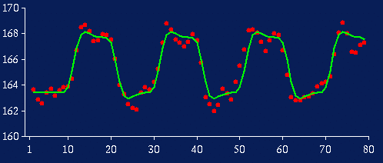
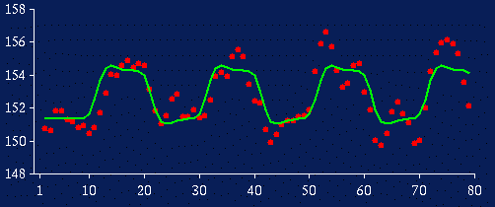
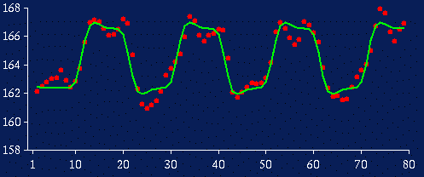
Fixed Effects Analysis
FIXED EFFECTS ANALYSIS:
Not recommended for neuroimaging data
Concatenate timeseries
Subject 1
Subject 3
Subject 12
…
… …
Each measurement is one scan from one subject
… we now have 600 scans (50 scans in each of 12 subjects)
We use this to calculate the average effect

Slide 11
Group Analysis: Fixed Effects
FIXED EFFECTS ANALYSIS:
Not recommended for neuroimaging data
 | s_{w}
Subject 1 | 0.9
Subject 2 | 1.2
Subject 3 | 1.5
Subject 4 | 0.5
Subject 5 | 0.4
Subject 6 | 0.7
Subject 7 | 0.8
Subject 8 | 2.1
Subject 9 | 1.8
Subject 10 | 0.8
Subject 11 | 0.7
Subject 12 | 1.1
Group effect (mean [m]) = 2.67
Average within subject variability (sw) = 1.07
Standard error of the mean (SEMW) = sw /sqrt(N) = 0.04
Is the effect significant at voxel v?
t = m/SEMW = 62.7
p = 10⁻⁵¹
Number of data points is now total number of scans (i.e. 600)
Overconfident?

Slide 12
Random Effects vs. Fixed Effects
Fixed Effects Analysis (FFX)
We compare the group effect to the within-subject variability.
It an inference about this specific sample of subjects.
Statistics are often inflated relative to random effects analysis.
Random Effects Analysis (RFX)
We compare the group effect to the between-subject variability.
It is an inference about the population from which the subjects were drawn: If you had a new subject from that population, you could be confident they would also show the effect.

Slide 13
Random Effects vs. Fixed Effects
Mixed Effects Analysis (MFX)
Has some random and some fixed effects.
spm_mfx

Slide 14
Beyond a single voxel…
Voxel v

Slide 15
Beyond a single voxel…
Voxel v
0
0
.
.
.
.
.
.
.
.
.
.
.
.
.
.
.
.
0
0
.
.
.
.
.
.
.
.
.
.
.
.
.
.
.
.
0
0
.
.
.
.
.
.
.
.
.
.
.
.
.
.
.
.
0
0
.
.
.
.
.
.
.
.
.
.
.
.
.
.
.
.
0
0
.
.
.
.
.
.
.
.
.
.
.
.
.
.
.
.
0
0
.
.
.
.
.
.
.
.
.
.
.
.
.
.
.
.
0
3
.
.
.
.
.
.
.
.
.
.
.
.
.
.
.
.
4
2
6
.
.
.
.
.
.
.
.
.
.
.
.
.
.
.
.
2
4
.
.
.
.
.
.
.
.
.
.
.
.
.
.
.
.
2
6
.
.
.
.
.
.
.
.
.
.
.
.
.
.
.
.
1
1
.
.
.
.
.
.
.
.
.
.
.
.
.
.
.
.
0
0
.
.
.
.
.
.
.
.
.
.
.
.
.
.
.
.
0
0
.
.
.
.
.
.
.
.
.
.
.
.
.
.
.
.
0
0
.
.
.
.
.
.
.
.
.
.
.
.
.
.
.
.

Slide 16
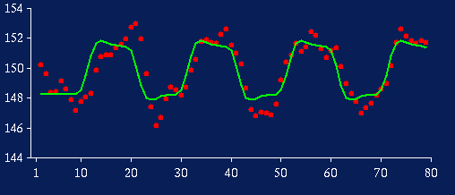
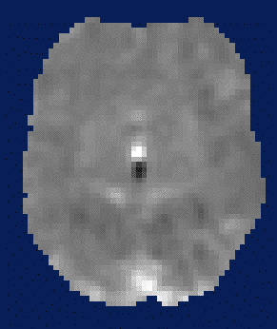
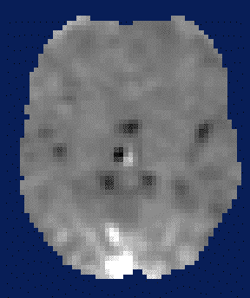
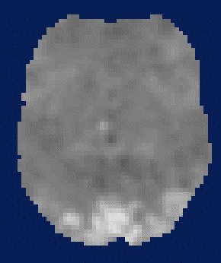
Random Effects: Summary Statistic
First level
Data (per voxel)
Design Matrix
Contrast Image
S1
S2
S11
S12

Slide 17
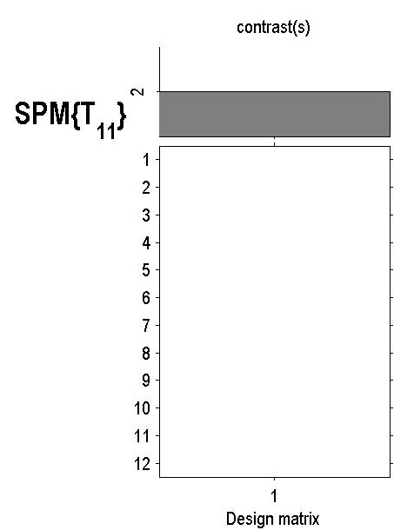
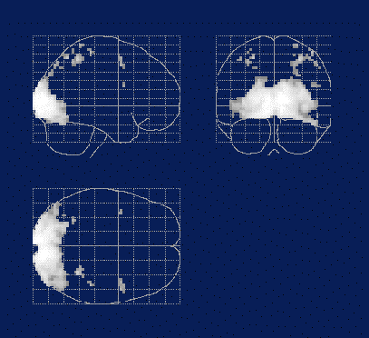
Random Effects: Summary Statistic
First level
Second level
Data (per voxel)
Design Matrix
Contrast Image
One-sample t-test
SPM(t)
S1
S2
S11
(Thresholded to correct for multiple comparisons)
S12
Random effects: summary statistic approach

Slide 18
Hierarchical model
Level 1:
Multiple variance components at each level
Level 2:
Level n:
At each level, the distribution of parameters is dependent on the level above
What we don’t know: distribution of parameters and variance parameters
Friston (2008) Hierarchical models in the brain. PLOS Comp. Bio.

Slide 19
Hierarchical Model
First level
Second level
(1) Within subject variance, s_{w}(i)
(2) Between subject variance,s_{b}
=
+
=
+
spm_reml

Slide 20
Example Results: Auditory Experiment
Summary
statistic
Separates first and second level estimates
Hierarchical
model
Computationally intensive!
Friston et al. (2004) Mixed effects and fMRI studies, Neuroimage

Slide 21
Summary Statistic vs. Hierarchical Model
The summary stats approach is exact if, for each session/subject:
Within-subject variances are the same
First-level design (e.g. number of trials) are the same
The summary stats approach is robust against typical violations (SPM book 2006; Mumford and Nichols, 2009, Neuroimage).
We might use a hierarchical model in epilepsy research where number of seizures is not under experimental control and is highly variable over subjects.

Slide 22
Beyond the one sample t-test…
Second level

Slide 23
Multiple Conditions (within subjects)
Condition 1 | Condition 2 | Condition 3
Subject 1 | Subject 1 | Subject 1
Subject 2 | Subject 2 | Subject 2
… | … | …
Subject 12 | Subject 12 | Subject 12
Second level: One-way within-subjects ANOVA

Slide 24
Multiple Conditions (between subjects)
Condition 1 | Condition 2 | Condition 3
Subject 1 | Subject 13 | Subject 25
Subject 2 | Subject 14 | Subject 26
… | … | …
Subject 12 | Subject 24 | Subject 36
e.g., effects of a drug
Second level: One-way between-subjects ANOVA (or if only two conditions, a two-sample t-test)

Slide 25
Testing for interactions
Within-within interactions: Can be done at the first level (i.e., specify contrasts according to the interaction to be tested)
Between-between interactions: Test at the second level
Within-between interactions: Specify within-subjects factor(s) at the first level, then the between-subjects factor(s) at the second level

Slide 26
Summary
Group inference usually proceeds with random effects analysis, not fixed effects analysis. Group effects are compared to between rather than within subject variability
Hierarchical models provide a gold-standard for random effects group analysis, but are computationally intensive
Summary statistics are a robust method for random effects group analysis when conditions are met
If you want to contrast two conditions within subjects, you can use a one-sample t-test at the second level. If more conditions, you can use a one-way ANOVA. If different groups, you can use a between-subjects ANOVA or two-sample t-test

