Slide 1
Inference on SPMs:
Random Field Theory
& Alternatives
Thomas Nichols, Ph.D.
Oxford Big Data Institute
Li Ka Shing Centre for Health Information and Discovery
Nuffield Department of Population Health
University of Oxford
FIL SPM Course

Slide 2
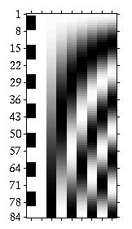
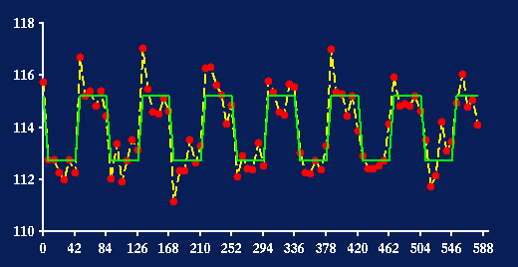
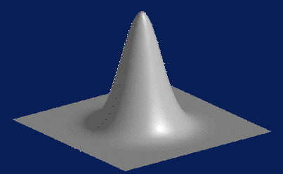
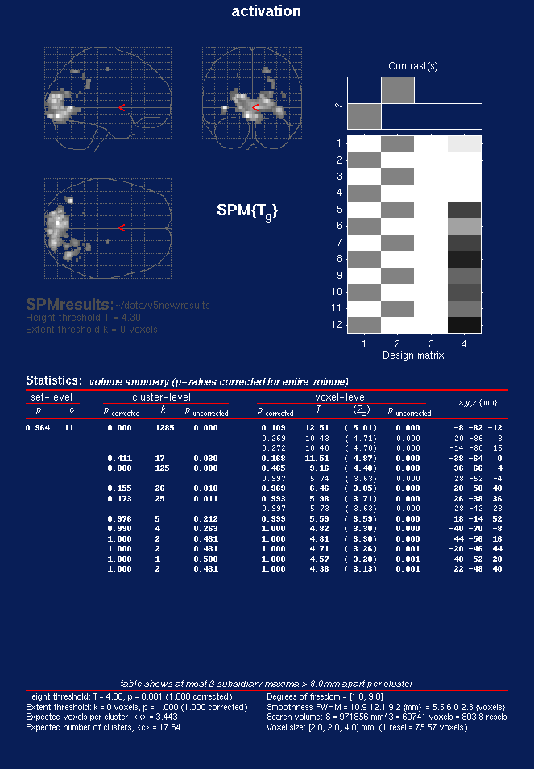
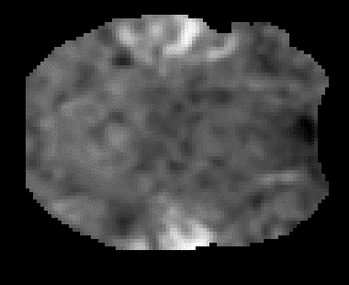

image data
parameter
estimates
design
matrix
kernel
General Linear Model
  model fitting
  statistic image
Thresholding &
Random Field Theory
realignment &
motion
correction
smoothing
normalisation
Statistical
Parametric Map
anatomical
reference
Corrected thresholds & p-values

Slide 3
Assessing Statistic
Images…

Slide 4
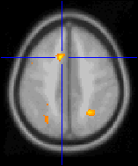
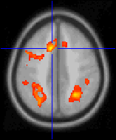
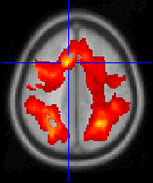
Assessing Statistic Images
Where’s the signal?
High Threshold
Med. Threshold
Low Threshold
t > 5.5
t > 3.5
t > 0.5
Good Specificity
Poor Power
(risk of false negatives)
Poor Specificity
(risk of false positives)
Good Power
  ...but why threshold?!

Slide 5
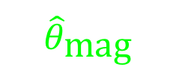


Blue-sky inference:
What we’d like
Don’t threshold, model the signal!
  Signal location?
    Estimates and CI’s on
    (x,y,z) location
  Signal magnitude?
    CI’s on % change
  Spatial extent?
    Estimates and CI’s on activation volume
    Robust to choice of cluster definition
...but this requires an explicit spatial model
  We only have a univariate linear model at each voxel!
$${\hat{θ}}_{\text{mag}}$$
$${\hat{θ}}_{\text{loc}}$$
$${\hat{θ}}_{\text{ext}}$$
space

Slide 6
Real-life inference:
What we get
Signal location
  Local maximum – no inference
Signal magnitude
  Local maximum intensity – P-values (& CI’s)
Spatial extent
  Cluster volume – P-value, no CI’s
    Sensitive to blob-defining-threshold

Slide 7
Voxel-level Inference
Retain voxels above α-level threshold u_{α}
Gives best spatial specificity
  The null hyp. at a single voxel can be rejected
u_{α}
space
Significant Voxels
No significant Voxels

Slide 8
Cluster-level Inference
Two step-process
  Define clusters by arbitrary threshold u_{clus}
  Retain clusters larger than α-level threshold k_{α}
u_{clus}
space
Cluster not significant
Cluster significant
k_{α}
k_{α}

Slide 9
Cluster-level Inference
Typically better sensitivity
Worse spatial specificity
  The null hyp. of entire cluster is rejected
  Only means that one or more of voxels in cluster active
u_{clus}
space
Cluster not significant
Cluster significant
k_{α}
k_{α}

Slide 10
Set-level Inference
Count number of blobs c
  Minimum blob size k
Worst spatial specificity
  Only can reject global null hypothesis
u_{clus}
space
k
k
Here c = 1; only 1 cluster larger than k

Slide 11
Multiple comparisons…

Slide 12
Hypothesis Testing
Null Hypothesis H₀
Test statistic T
  t observed realization of T
α level
  Acceptable false positive rate
  Level α = P( T>u_{α} | H₀ )
  Threshold u_{α} controls false positive rate at level α
P-value
  Assessment of t assuming H₀
  P( T > t | H₀ )
    Prob. of obtaining stat. as large
    or larger in a new experiment
  P(Data|Null) not P(Null|Data)
u_{α}
α
Null Distribution of T
t
P-val
Null Distribution of T

Slide 13
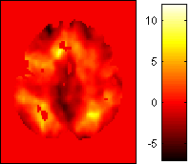
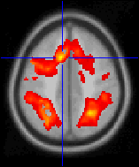
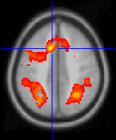
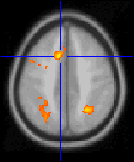
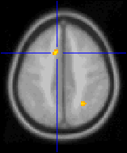
Multiple Comparisons Problem
Which of 100,000 voxels are sig.?
  α=0.05 ⇒ 5,000 false positive voxels
Which of (random number, say) 100 clusters significant?
  α=0.05 ⇒ 5 false positives clusters
t > 0.5
t > 1.5
t > 2.5
t > 3.5
t > 4.5
t > 5.5
t > 6.5

Slide 14
MCP Solutions:
Measuring False Positives
Familywise Error Rate (FWER)
  Familywise Error
    Existence of one or more false positives
  FWER is probability of familywise error
False Discovery Rate (FDR)
  FDR = E(V/R)
  R voxels declared active, V falsely so
    Realized false discovery rate: V/R

Slide 15
MCP Solutions:
Measuring False Positives
Familywise Error Rate (FWER)
  Familywise Error
    Existence of one or more false positives
  FWER is probability of familywise error
False Discovery Rate (FDR)
  FDR = E(V/R)
  R voxels declared active, V falsely so
    Realized false discovery rate: V/R

Slide 16
FWE Multiple comparisons terminology…
Family of hypotheses
  H^{k} k ∈ Ω = {1,…,K}
  H^{Ω} = ∩ H^{k}
Familywise Type I error
  weak control – omnibus test
    Pr(“reject” H^{Ω} ⎪ H^{Ω}) ≤ α
    “anything, anywhere” ?
  strong control – localising test
    Pr(“reject” H^{W} ⎪ H^{W}) ≤ α
      ∀ W: W ⊆ Ω & H^{W}
    “anything, & where” ?
Adjusted p–values
  test level at which reject H^{k}

Slide 17
FWE MCP Solutions:
Bonferroni
For a statistic image T...
  T_{i} i^{th} voxel of statistic image T
...use α = α₀/V
  α₀ FWER level (e.g. 0.05)
  V number of voxels
  u_{α} α-level statistic threshold, P(T_{i} ≥ u_{α}) = α
By Bonferroni inequality...
  FWER = P(FWE)
  = P( ∪_{i} {T_{i} ≥ u_{α}} | H₀)
  ≤ ∑_{i} P( T_{i} ≥ u_{α}| H₀ )
  = ∑_{i} α
  = ∑_{i} α₀ /V = α₀
Conservative under correlation
Independent: V tests
Some dep.: ? tests
Total dep.: 1 test

Slide 18
Random field theory…

Slide 19
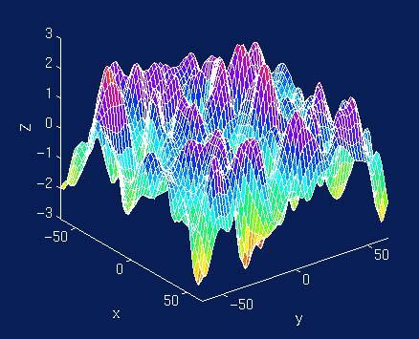
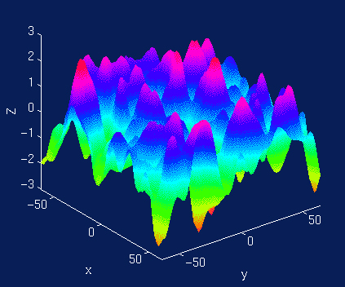
SPM approach:
Random fields…
Consider statistic image as lattice representation of a continuous random field
Use results from continuous random field theory
≈
lattice represtntation

Slide 20
FWER MCP Solutions:
Controlling FWER w/ Max
FWER & distribution of maximum
  FWER = P(FWE)
  = P( ∪_{i} {T_{i} ≥ u} | H_{o})
  = P( max_{i} T_{i} ≥ u | H_{o})
100(1-α)%ile of max dist^{n} controls FWER
  FWER = P( max_{i} T_{i} ≥ u_{α} | H_{o}) = α
  where
    u_{α} = F⁻¹_{max} (1-α)
.
α
u_{α}

Slide 21
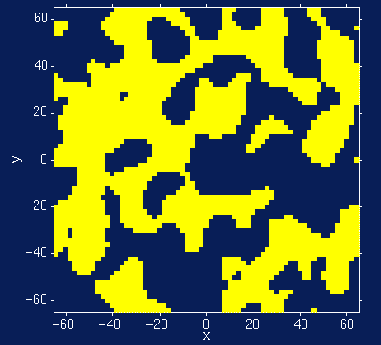
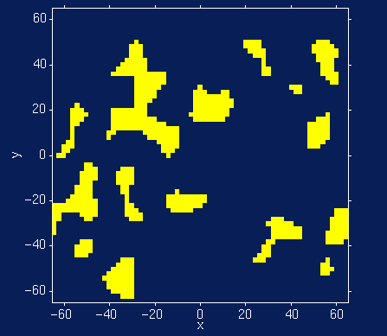
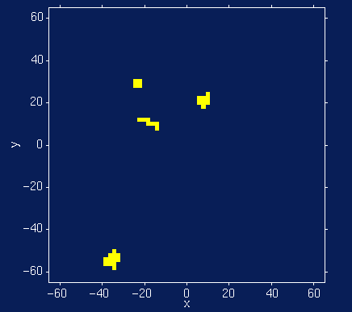
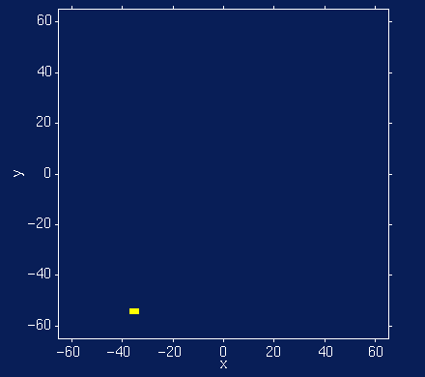
FWER MCP Solutions:
Random Field Theory
Euler Characteristic χ_{u}
  Topological Measure
    #blobs - #holes
  At high thresholds,
  just counts blobs
  FWER = P(Max voxel ≥ u | H_{o})
  = P(One or more blobs | H_{o})
  ≈ P(χ_{u} ≥ 1 | H_{o})
  ≈ E(χ_{u} | H_{o})
Threshold
Random Field
No holes
Never more than 1 blob
Suprathreshold Sets

Slide 22
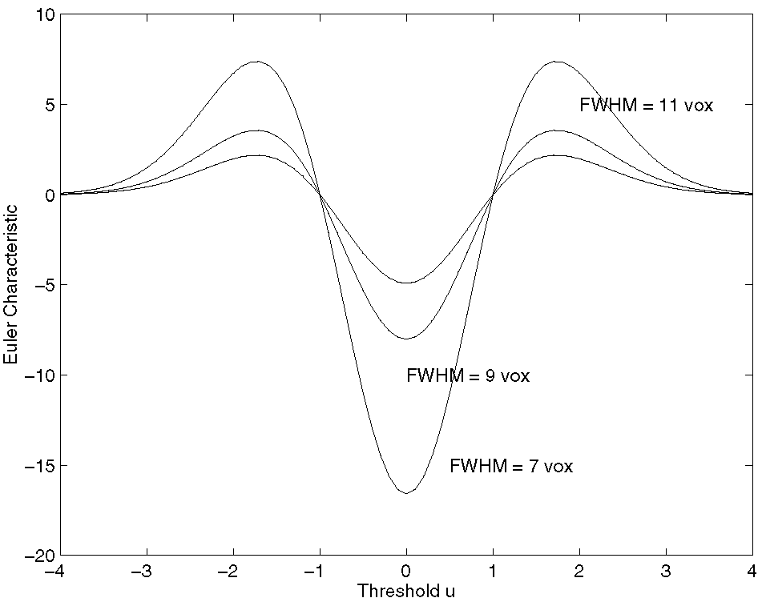
RFT Details:
Expected Euler Characteristic
E(χ_{u}) ≈ λ(Ω) |Λ|^{1/2} (u ² -1) exp(-u ²/2) / (2π)²
  Ω → Search region Ω ⊂ R³
  λ(Ω) → volume
  |Λ|^{1/2} → roughness
Assumptions
  Multivariate Normal
  Stationary*
  ACF twice differentiable at 0
Stationary
  Results valid w/out stationary
  More accurate when stat. holds
Only very upper tail approximates
1-F_{max}(u)

Slide 23
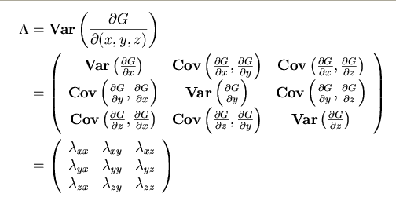
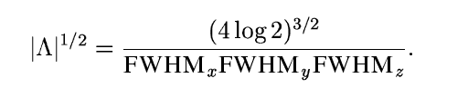
Random Field Theory
Smoothness Parameterization
E(χ_{u}) depends on |Λ|^{1/2}
  Λ roughness matrix:
Smoothness
parameterized as
Full Width at Half Maximum
  FWHM of Gaussian kernel
  needed to smooth a white
  noise random field to
  roughness Λ
FWHM
Autocorrelation Function

Slide 24
Random Field Theory
Smoothness Parameterization
RESELS
  Resolution Elements
  1 RESEL = FWHM_{x} × FWHM_{y} × FWHM_{z}
  RESEL Count R
    R = λ(Ω) √ |Λ| = (4log2)^{3/2} λ(Ω) / ( FWHM_{x} × FWHM_{y} × FWHM_{z} )
    Volume of search region in units of smoothness
    Eg: 10 voxels, 2.5 FWHM 4 RESELS
Beware RESEL misinterpretation
  RESEL are not “number of independent ‘things’ in the image”
    See Nichols & Hayasaka, 2003, Stat. Meth. in Med. Res.
    .
1
2
3
4
5
6
7
8
9
10
1
2
3
4

Slide 25
Random Field Theory
Smoothness Estimation
Smoothness est’d
from standardized
residuals
  Variance of
  gradients
  Yields resels per
  voxel (RPV)
RPV image
  Local roughness est.
  Can transform in to local smoothness est.
    FWHM Img = (RPV Img)^{-1/D}
    Dimension D, e.g. D=2 or 3
spm_imcalc_ui('RPV.img', ...
'FWHM.img','i1.^(-1/3)')

Slide 26
Random Field Intuition
Corrected P-value for voxel value t
  P^{c} = P(max T > t)
  ≈ E(χ_{t})
  ≈ λ(Ω) |Λ|^{1/2} t² exp(-t²/2)
Statistic value t increases
  P^{c} decreases (but only for large t)
Search volume increases
  P^{c} increases (more severe MCP)
Smoothness increases (roughness |Λ|^{1/2} decreases)
  P^{c} decreases (less severe MCP)

Slide 27
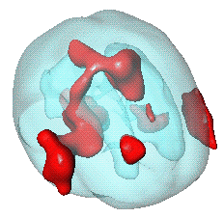
RFT Details:
Unified Formula
General form for expected Euler characteristic
    χ², F, & t fields • restricted search regions • D dimensions •
E[χ_{u}(Ω)] = _{Σd} R_{d} (Ω) ρ_{d} (u)
R_{d} (Ω): d-dimensional Minkowski
functional of Ω
– function of dimension,
space Ω and smoothness:
R₀(Ω) = χ(Ω) Euler characteristic of Ω
R₁(Ω) = resel diameter
R₂(Ω) = resel surface area
R₃(Ω) = resel volume
ρ_{d} (Ω): d-dimensional EC density of Z(x)
– function of dimension and threshold,
specific for RF type:
E.g. Gaussian RF:
ρ₀(u) = 1- Φ(u)
ρ₁(u) = (4 ln2)^{1/2} exp(-u²/2) / (2π)
ρ₂(u) = (4 ln2) exp(-u²/2) / (2π)^{3/2}
ρ₃(u) = (4 ln2)^{3/2} (u² -1) exp(-u²/2) / (2π)²
ρ₄(u) = (4 ln2)² (u³ -3u) exp(-u²/2) / (2π)^{5/2}
Ω

Slide 28
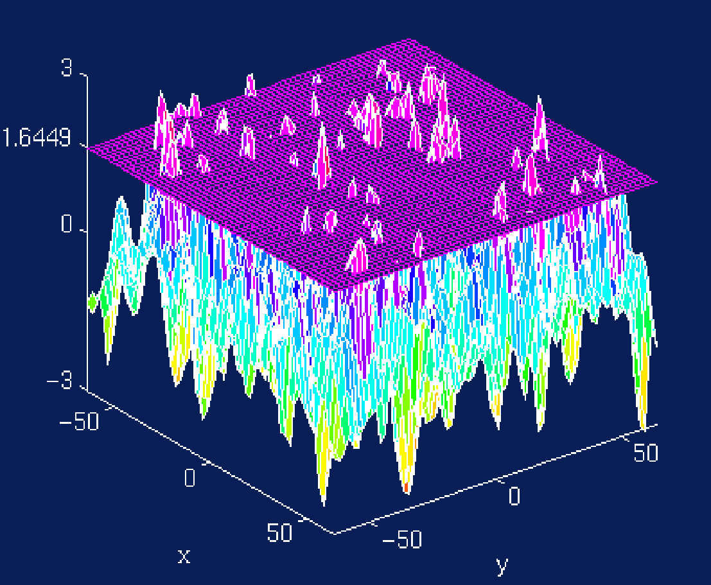
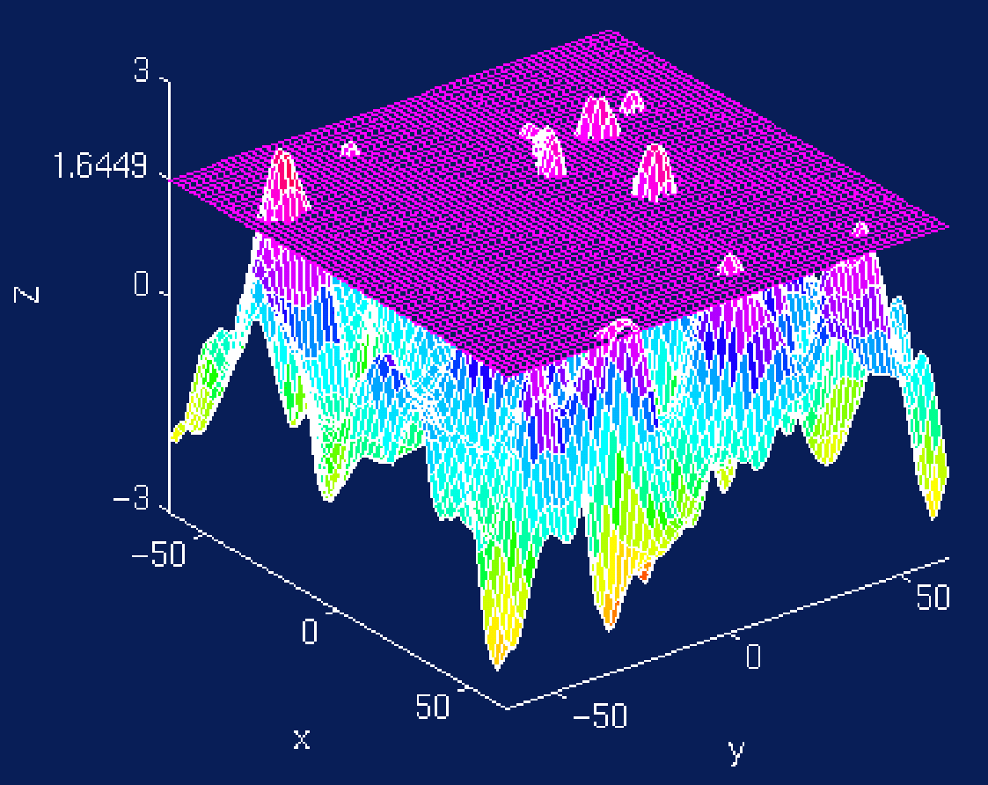
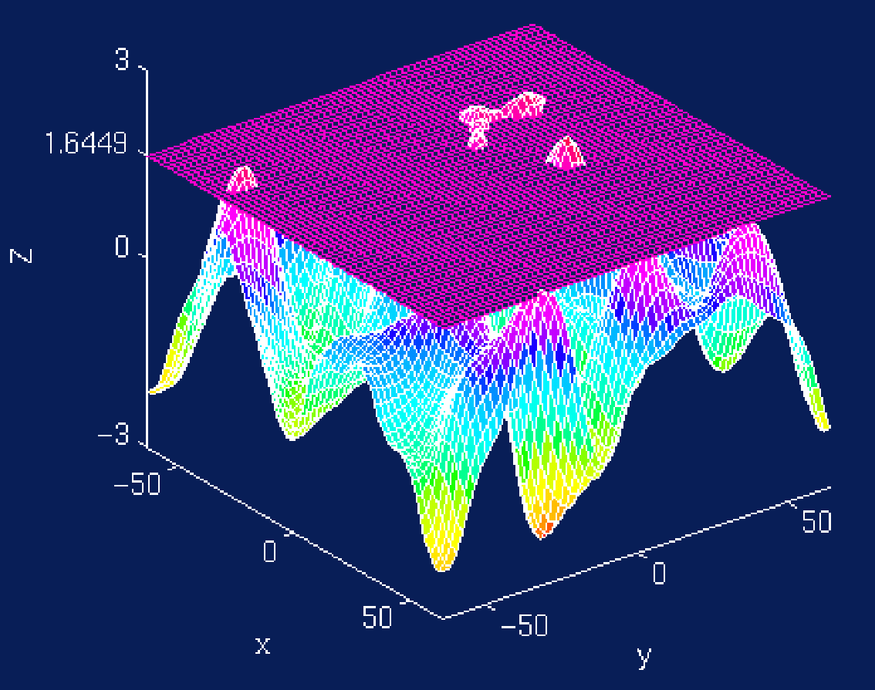
Random Field Theory
Cluster Size Tests
Expected Cluster Size
  E(S) = E(N)/E(L)
  S cluster size
  N suprathreshold volume
  λ({T > u_{clus}})
  L number of clusters
E(N) = λ(Ω) P( T > u_{clus} )
E(L) ≈ E(χ_{u})
  Assuming no holes
5mm FWHM
10mm FWHM
15mm FWHM

Slide 29
Random Field Theory
Cluster Size Distribution
Gaussian Random Fields (Nosko, 1969)
  D: Dimension of RF
t Random Fields (Cao, 1999)
  B: Beta dist^{n}
  U’s: χ²’s
  c chosen s.t.
  E(S) = E(N) / E(L)

Slide 30
Random Field Theory
Cluster Size Corrected P-Values
Previous results give uncorrected P-value
Corrected P-value
  Bonferroni
    Correct for expected number of clusters
    Corrected P^{c} = E(L) P^{uncorr}
  Poisson Clumping Heuristic (Adler, 1980)
    Corrected P^{c} = 1 - exp( -E(L) P^{uncorr} )

Slide 31
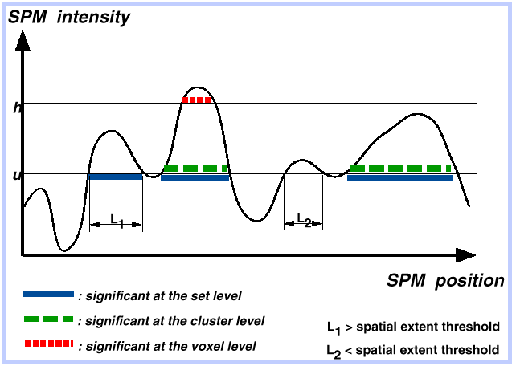
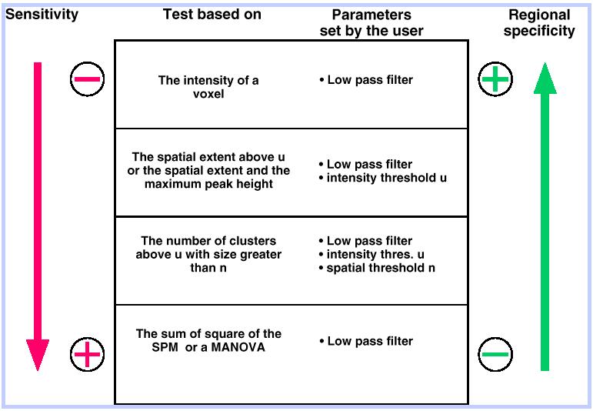
Review:
Levels of inference & power
Set level…
Cluster level…
Voxel level…

Slide 32
Random Field Theory Limitations
Lattice Image
Data
Sufficient smoothness
  FWHM smoothness 3-4× voxel size (Z)
  More like ~10× for low-df T images
Smoothness estimation
  Estimate is biased when images not sufficiently smooth
Multivariate normality
  Virtually impossible to check
Several layers of approximations
Stationary required for cluster size results
≈
Continuous Random Field

Slide 33
Real Data
Active
...
fMRI Study of Working Memory
  12 subjects, block design Marshuetz et al (2000)
  Item Recognition
    Active:View five letters, 2s pause,
    view probe letter, respond
    Baseline: View XXXXX, 2s pause,
    view Y or N, respond
Second Level RFX
  Difference image, A-B constructed
  for each subject
  One sample t test
...
D
UBKDA
yes
Baseline
...
...
N
XXXXX
no

Slide 34
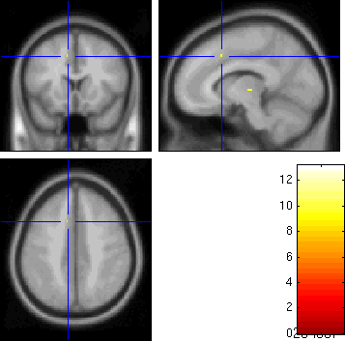
Real Data:
RFT Result
Threshold
  S = 110,776
  2 × 2 × 2 voxels
  5.1 × 5.8 × 6.9 mm
  FWHM
  u = 9.870
Result
  5 voxels above
  the threshold
  0.0063 minimum
  FWE-corrected
  p-value
-log₁₀ p-value

Slide 35
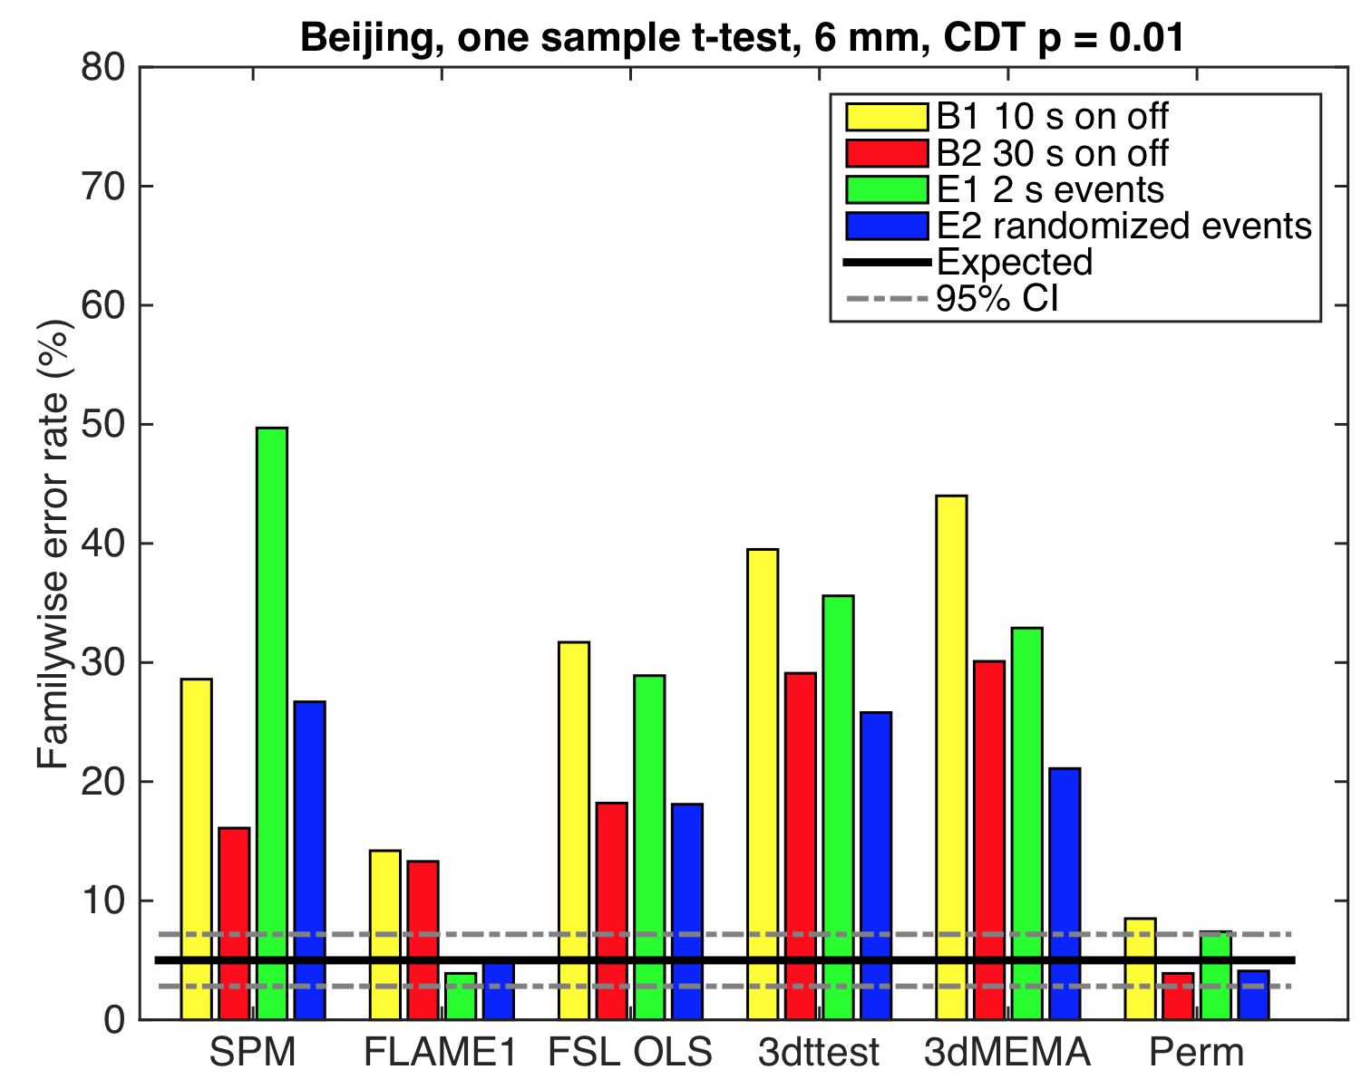
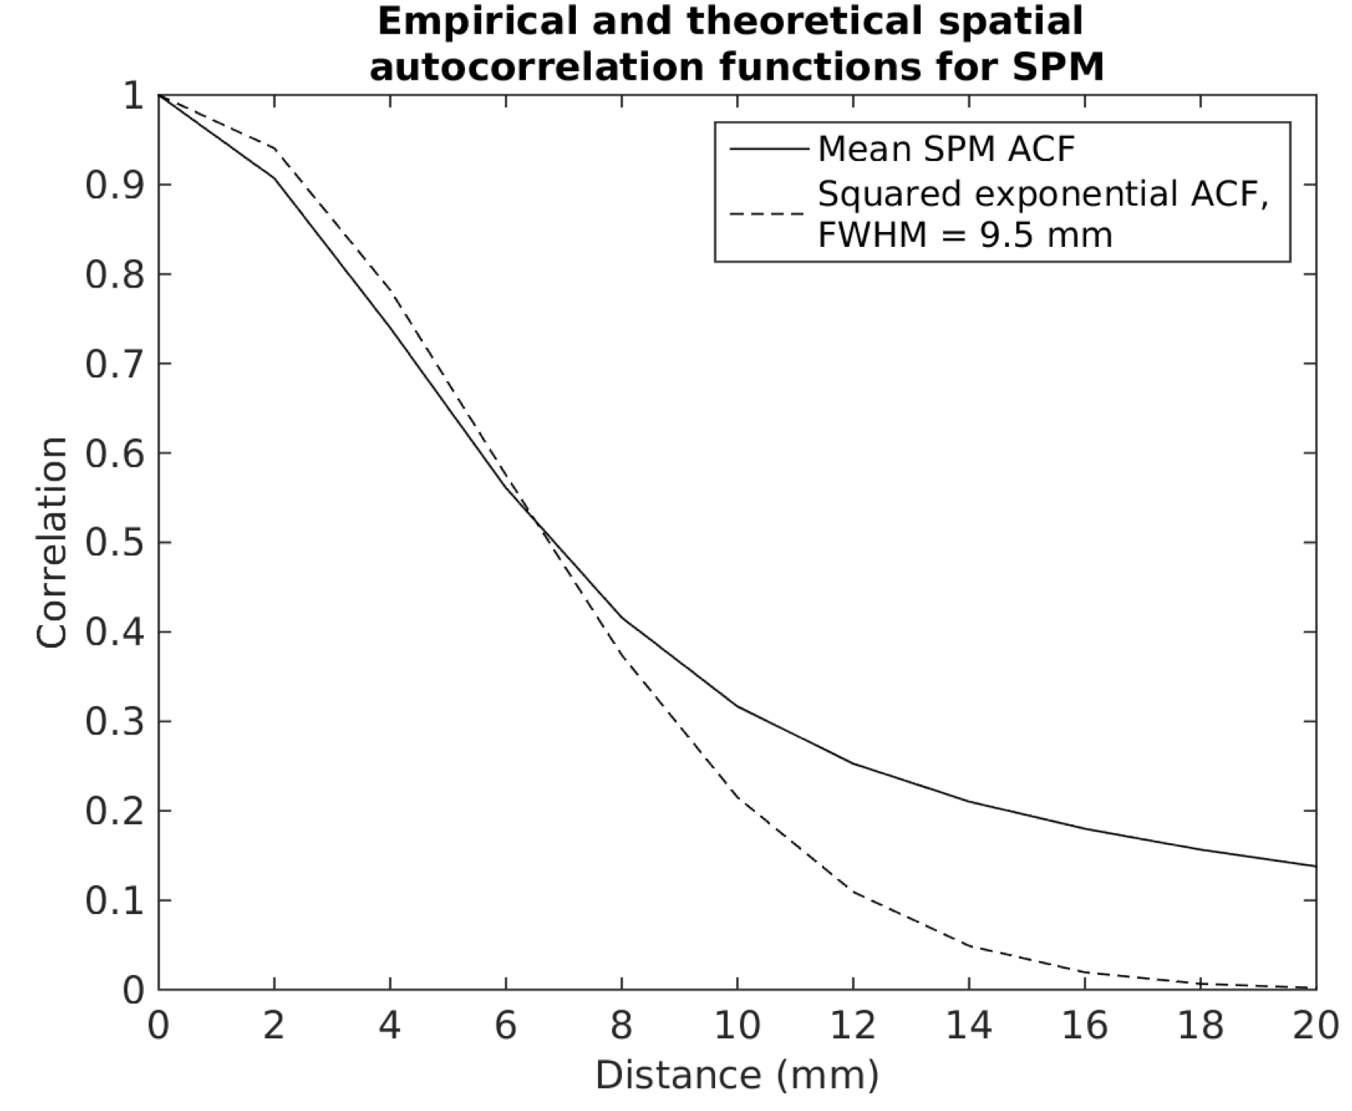
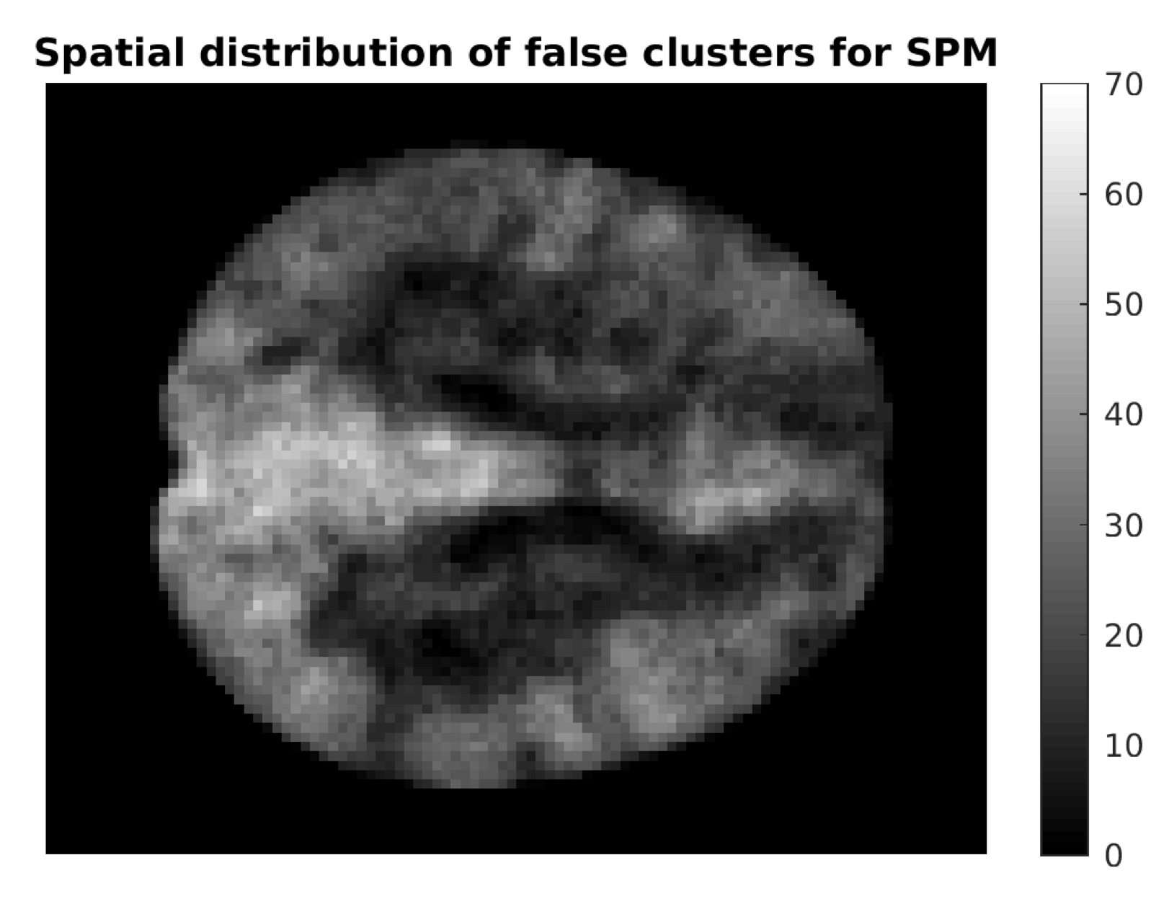
Massive Null (resting-state) fMRI Evaluation
Goal: Evaluate AFNI, FSL & SPM task fMRI with resting-state fMRI data, using 4 designs, 3 million randomised analyses
Outcome: Voxel FWE OK (Conservative)
Cluster FWE 0.001 OK
Cluster FWE 0.01 Very Bad (Liberal)
Why? Spatial ACF not Gaussian,
Nonstationarity smoothness
Cluster failure: Why fMRI inferences for spatial extent have inflated false-positive rates (2016). Eklund, TE Nichols, H Knutsson PNAS, 113(28), 7900-5

Slide 36
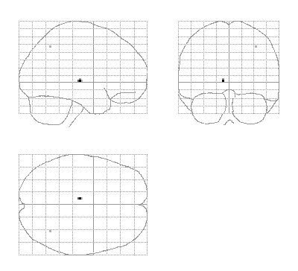
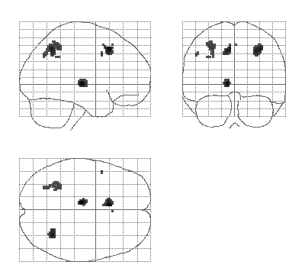
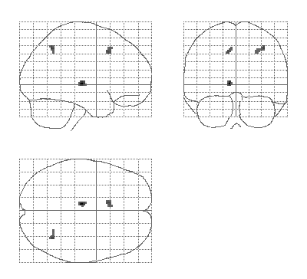
Real Data:
SnPM Promotional
Nonparametric method more powerful than RFT for low DF
“Variance Smoothing” even more sensitive
FWE controlled all the while!
http://nisox.org/Software/SnPM
u^{RF} = 9.87
u^{Bonf} = 9.80
5 sig. vox.
t₁₁ Statistic, RF & Bonf. Threshold
u^{Perm} = 7.67
58 sig. vox.
378 sig. vox.
Smoothed Variance t Statistic,
Nonparametric Threshold
t₁₁ Statistic, Nonparametric Threshold

Slide 37
False Discovery Rate…

Slide 38
MCP Solutions:
Measuring False Positives
Familywise Error Rate (FWER)
  Familywise Error
    Existence of one or more false positives
  FWER is probability of familywise error
False Discovery Rate (FDR)
  FDR = E(V/R)
  R voxels declared active, V falsely so
    Realized false discovery rate: V/R

Slide 39
False Discovery Rate
For any threshold, all voxels can be cross-classified:
Realized FDR
rFDR = V_{0R}/(V_{1R}+V_{0R}) = V_{0R}/N_{R}
  If N_{R} = 0, rFDR = 0
But only can observe N_{R}, don’t know V_{1R} & V_{0R}
  We control the expected rFDR
  FDR = E(rFDR)
 | Accept Null | Reject Null
Null True | V_{0A} | V_{0R} | m₀
Null False | V_{1A} | V_{1R} | m₁
 | N_{A} | N_{R} | V

Slide 40






















False Discovery Rate
Illustration:
Noise
Signal
Signal+Noise

Slide 41






























Control of Per Comparison Rate at 10%
11.3%
11.3%
12.5%
10.8%
11.5%
10.0%
10.7%
11.2%
10.2%
9.5%
Percentage of Null Pixels that are False Positives
Control of Familywise Error Rate at 10%
FWE
Occurrence of Familywise Error
Control of False Discovery Rate at 10%
6.7%
10.4%
14.9%
9.3%
16.2%
13.8%
14.0%
10.5%
12.2%
8.7%
Percentage of Activated Pixels that are False Positives

Slide 42
Benjamini & Hochberg
Procedure
Select desired limit q on FDR
Order p-values, p₍₁₎ ≤ p₍₂₎ ≤ ... ≤ p_{(V)}
Let r be largest i such that
Reject all hypotheses
corresponding to
p₍₁₎, ... , p_{(r)}.
JRSS-B (1995)
57:289-300
p_{(i)} ≤ i/V × q
1
p_{(i)}
p-value
i/V × q
0
0
i/V
1

Slide 43
Adaptiveness of
Benjamini & Hochberg FDR
Ordered p-values p_{(i)}
P-value threshold when no signal:
α/V
P-value threshold
when all
signal:
α
Fractional index i/V

Slide 44

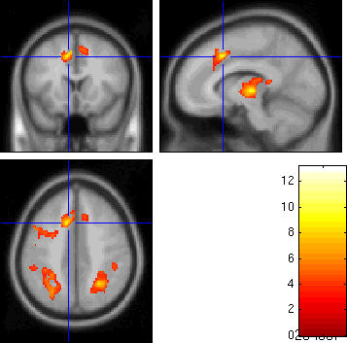
Real Data: FDR Example
Threshold
  u = 3.83
Result
  3,073 voxels above u
  <0.0001 minimum
  FDR-corrected
  p-value
FDR Threshold = 3.83
3,073 voxels
FWER Perm. Thresh. = 9.87
7 voxels

Slide 45
FDR Changes
Before SPM8
  Only voxel-wise FDR
SPM8
  Cluster-wise FDR
  Peak-wise FDR
  Voxel-wise available: edit spm_defaults.m to read
  defaults.stats.topoFDR = 0;
  Note!
    Both cluster- and peak-wise FDR depends on cluster-forming threshold!
Item Recognition data
Cluster-forming threshold P=0.001
Peak-wise FDR: t=4.84, P_{FDR} 0.836
Cluster-forming threshold P=0.01
Peak-wise FDR: t=4.84, P_{FDR} 0.027

Slide 46
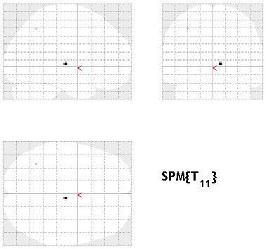
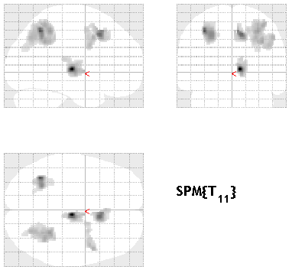
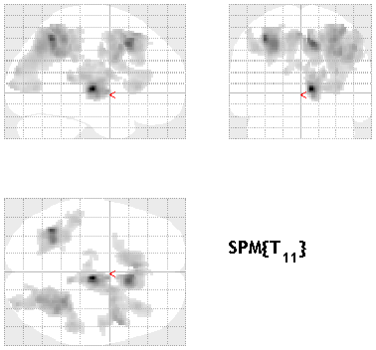
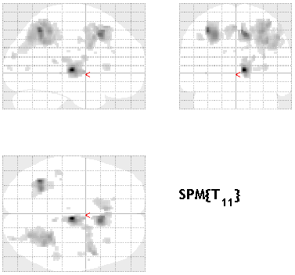
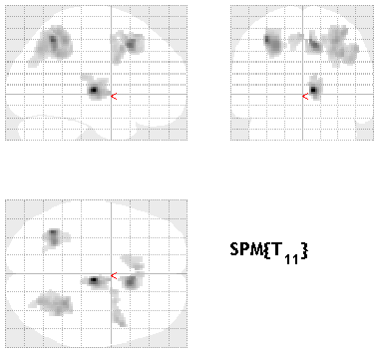
Cluster FDR: Example Data
Level 5% Voxel-FWE
Level 5% Cluster-FWE
P = 0.001 cluster-forming thresh
k_{FWE} = 241, 5 clusters
Level 5% Cluster-FWE
P = 0.01 cluster-forming thresh
k_{FWE} = 1132, 4 clusters
5 clusters
Level 5% Voxel-FDR
Level 5% Cluster-FDR,
P = 0.001 cluster-forming thresh
k_{FDR} = 138, 6 clusters
Level 5% Cluster-FDR
P = 0.01 cluster-forming thresh
k_{FDR} = 1132, 4 clusters

Slide 47
Benjamini & Hochberg Procedure Details
Standard Result
  Positive Regression Dependency on Subsets
    P(X₁≥c₁, X₂≥c₂, ..., X_{k}≥c_{k} | X_{i}=x_{i}) is non-decreasing in x_{i}
    Only required of null x_{i}’s
      Positive correlation between null voxels
      Positive correlation between null and signal voxels
    Special cases include
      Independence
      Multivariate Normal with all positive correlations
Arbitrary covariance structure
  Replace q by q/c(V),
  c(V) = Σ_{i=1,...,V} 1/i ≈ log(V)+0.5772
  Much more stringent
Benjamini &
Yekutieli (2001).
Ann. Stat.
29:1165-1188

Slide 48
Benjamini & Hochberg:
Key Properties
FDR is controlled
E(rFDR) ≤ q m₀/V
  Conservative, if large fraction of nulls false
Adaptive
  Threshold depends on amount of signal
    More signal, More small p-values,
    More p_{(i)} less than i/V × q/c(V)

Slide 49
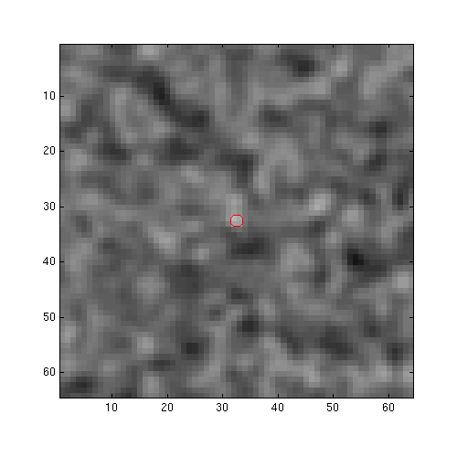
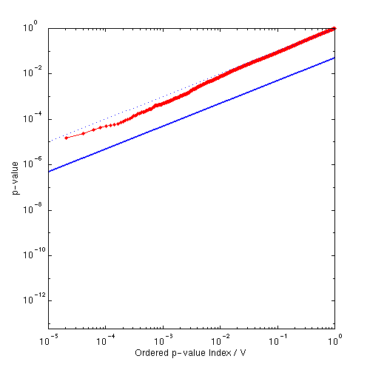
Controlling FDR:
Varying Signal Extent
p = z =
Signal Intensity 3.0
Signal Extent 1.0
Noise Smoothness 3.0
1

Slide 50
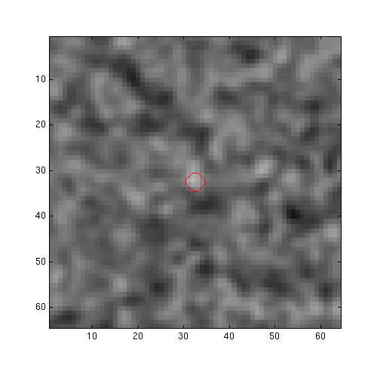

Controlling FDR:
Varying Signal Extent
p = z =
Signal Intensity 3.0
Signal Extent 2.0
Noise Smoothness 3.0
2

Slide 51
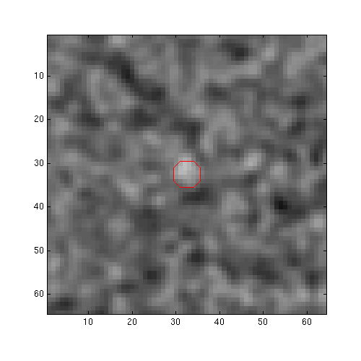

Controlling FDR:
Varying Signal Extent
p = z =
Signal Intensity 3.0
Signal Extent 3.0
Noise Smoothness 3.0
3

Slide 52
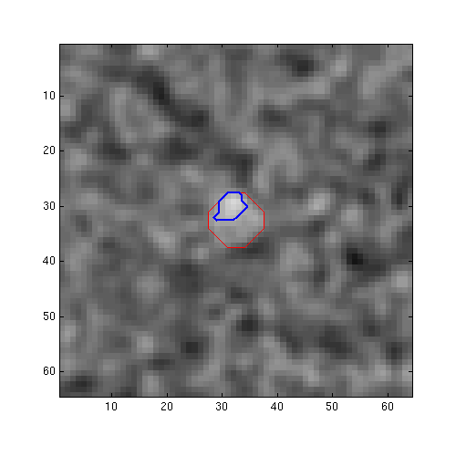
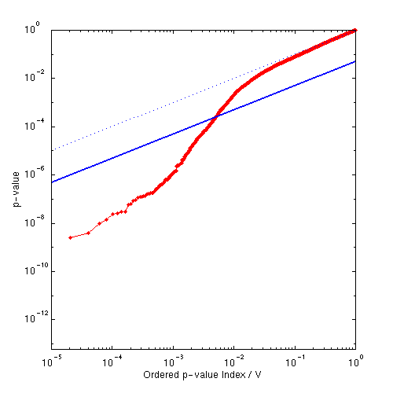
Controlling FDR:
Varying Signal Extent
p = 0.000252 z = 3.48
Signal Intensity 3.0
Signal Extent 5.0
Noise Smoothness 3.0
4

Slide 53
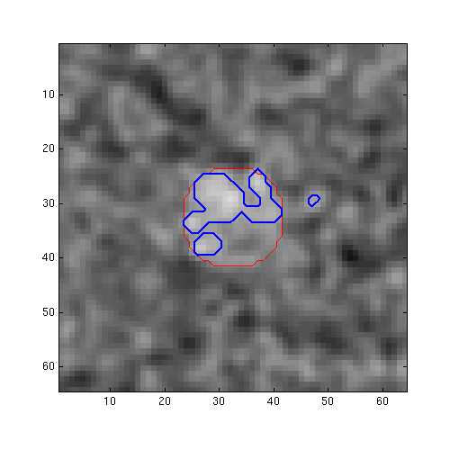
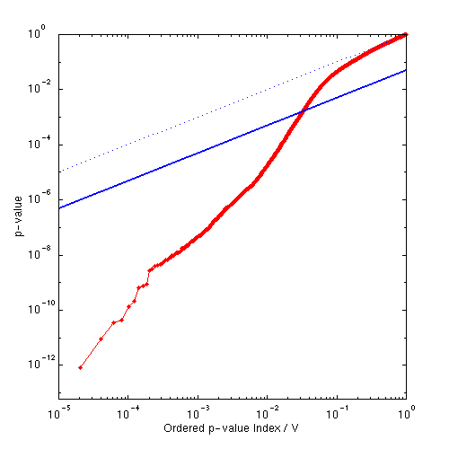
Controlling FDR:
Varying Signal Extent
p = 0.001628 z = 2.94
Signal Intensity 3.0
Signal Extent 9.5
Noise Smoothness 3.0
5

Slide 54


Controlling FDR:
Varying Signal Extent
p = 0.007157 z = 2.45
Signal Intensity 3.0
Signal Extent 16.5
Noise Smoothness 3.0
6

Slide 55


Controlling FDR:
Varying Signal Extent
p = 0.019274 z = 2.07
Signal Intensity 3.0
Signal Extent 25.0
Noise Smoothness 3.0
7

Slide 56
Controlling FDR:
Benjamini & Hochberg
Illustrating BH under dependence
  Extreme example of positive dependence
8 voxel image
1
p_{(i)}
p-value
32 voxel image
(interpolated from 8 voxel image)
i/V × q/c(V)
0
0
i/V
1

Slide 57
Conclusions
Must account for multiplicity
  Otherwise have a fishing expedition
FWER
  Very specific, not very sensitive
FDR
  Voxel-wise: Less specific, more sensitive
  Cluster-, Peak-wise: Similar to FWER

Slide 58
References
TE Nichols & S Hayasaka, Controlling the Familywise Error Rate in Functional Neuroimaging: A Comparative Review. Statistical Methods in Medical Research, 12(5): 419-446, 2003.
TE Nichols & AP Holmes, Nonparametric Permutation Tests for Functional Neuroimaging: A Primer with Examples. Human Brain Mapping, 15:1-25, 2001.
CR Genovese, N Lazar & TE Nichols, Thresholding of Statistical Maps in Functional Neuroimaging Using the False Discovery Rate. NeuroImage, 15:870-878, 2002.
JR Chumbley & KJ Friston. False discovery rate revisited: FDR and topological inference using Gaussian random fields. NeuroImage, 44(1), 62-70, 2009

