Slide 1
Testing hypotheses with SPM & DCM
Peter Zeidman, PhD
Wellcome Centre for Human Neuroimaging
University College London

Slide 2

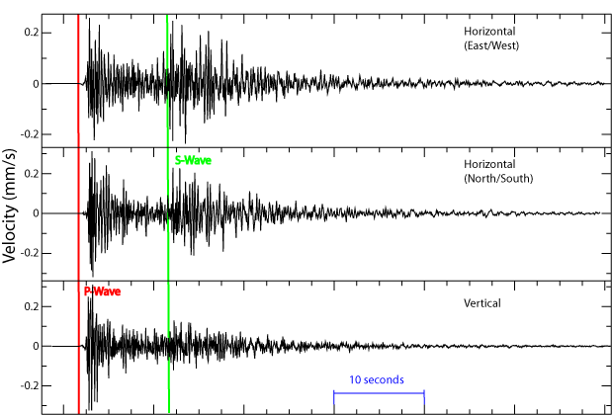
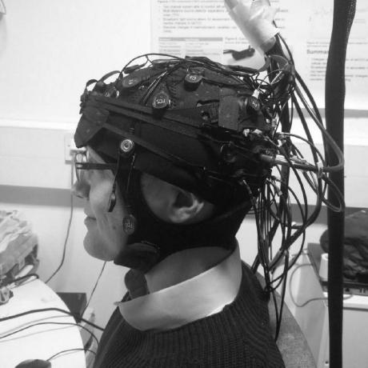
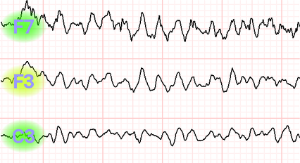
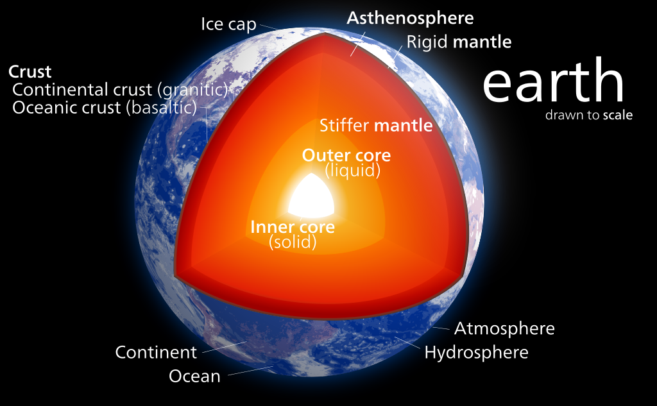
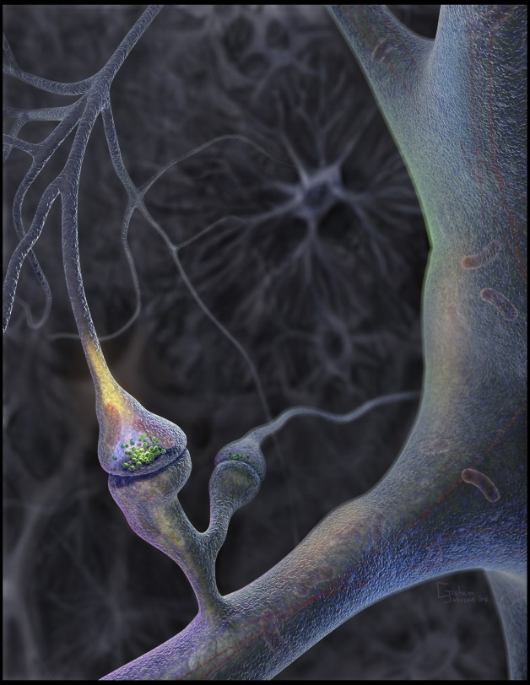
Inverse problems
Image credits: Pekachu, Anastasiia Starikova, Kelvinsong from Wikipedia

Slide 3
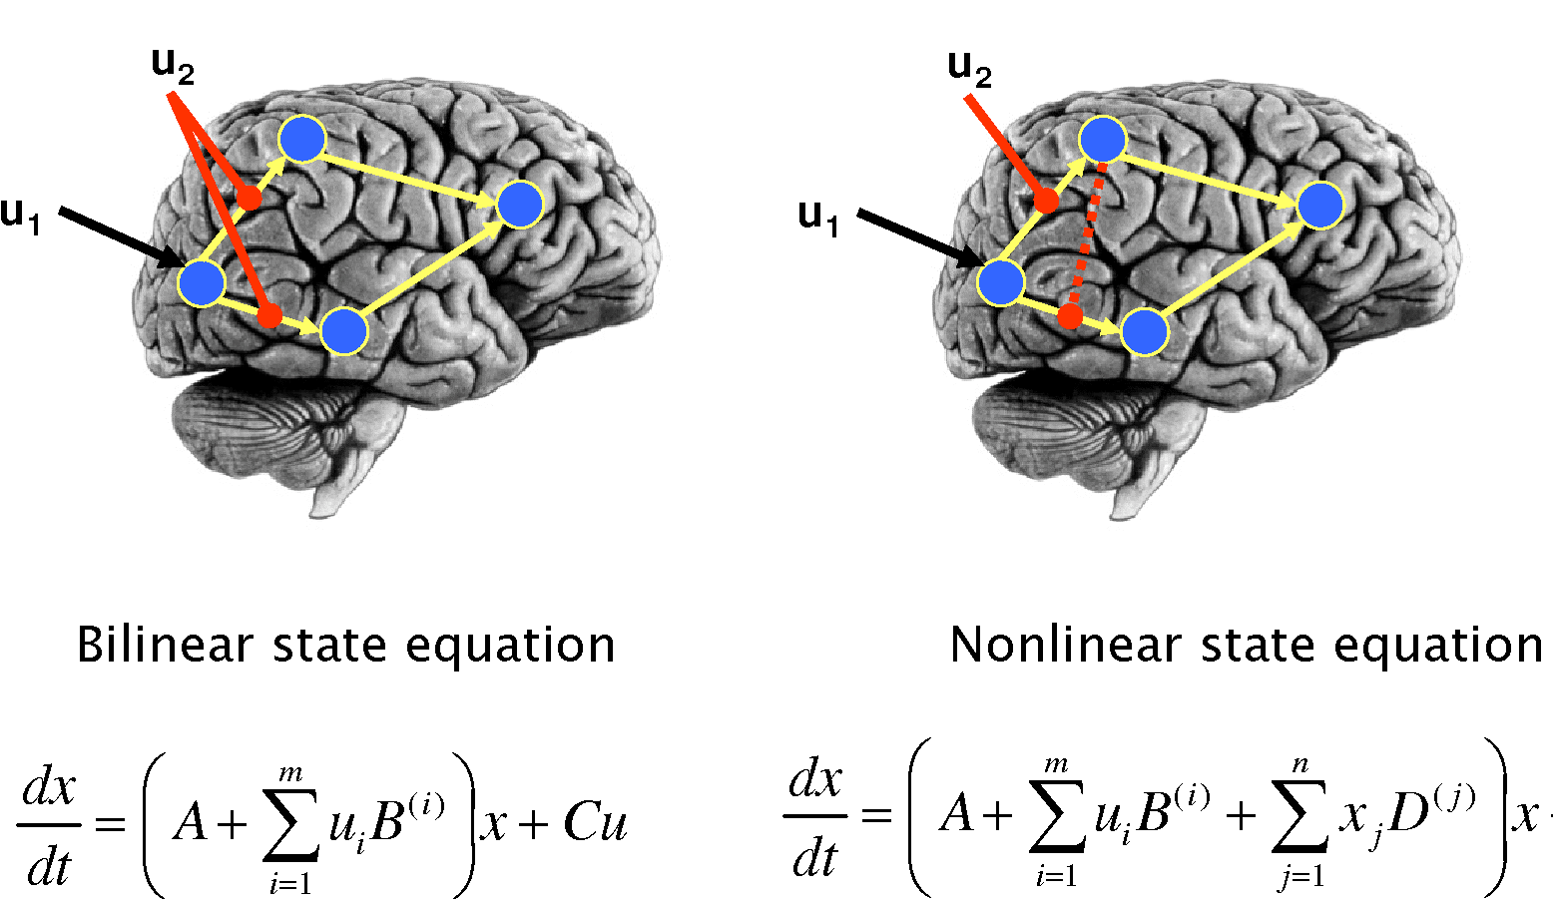




Empirical science
Bayesian model comparison
Which hypothesis (model) offers the best explanation for my data?
$$m_{1}$$
$$m_{2}$$
Model evidence
(marginal likelihood)
$$p\left(y | m_{1}\right)$$
Likelihood ratio
(Bayes factor)
$$p\left(y | m_{2}\right)$$
Stephan et al., NeuroImage, 2008

Slide 4

Eight steps to DCM for fMRI success
Write down some hypotheses
Design an experiment
Data collection and pre-processing
Functional localisation
First-level DCM
Group analysis using Parametric Empirical Bayes (PEB)
Bayesian model comparison
Assess predictive validity
(Write the paper)
(Nobel Prize)

Slide 5
1. Write down some hypotheses
Commonalities
Differences
DCM is a tool for scoring the evidence for different hypotheses. It is not an exploratory technique.
“I hypothesise that top-down connections from parietal cortex are modulated by attention to visual stimuli.”
“I hypothesise that people with a diagnosis of Mild Cognitive Impairment (MCI) have weaker modulation of top-down connections by attention.”

Slide 6
1. Write down some hypotheses
One hypothesis → one model
One hypothesis → one family of models
A “model space”
Family 1
Family 2

Slide 7
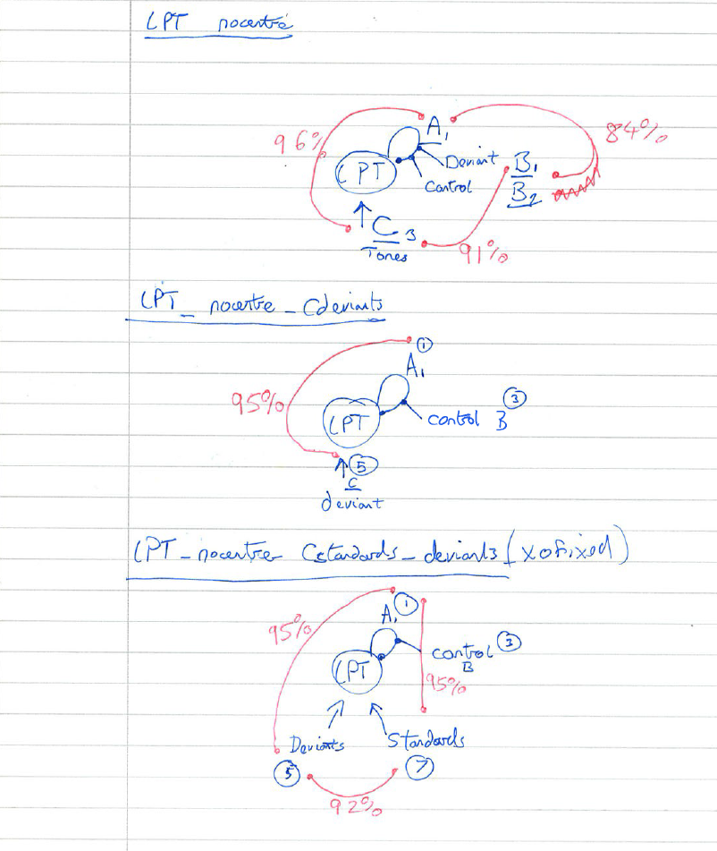
1. Write down some hypotheses
Drawing a diagram for each hypothesis can help!

Slide 8
Eight steps to DCM success
Write down some hypotheses
Design an experiment
Data collection and pre-processing
Functional localisation
First-level DCM
Group analysis using Parametric Empirical Bayes (PEB)
Bayesian model comparison
Assess predictive validity

Slide 9
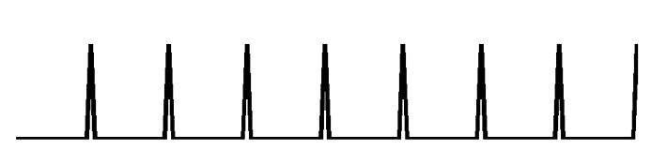

2. Design an experiment
Use a factorial design where possible
e.g. [2 x 2] design:
  Factor 1: faces or upside down faces
  Factor 2: attend to emotion or attend to hair colour
FFA
Factor 1: faces
(driving)
V1
Factor 2: emotion
(modulating)

Slide 10
2. Design an experiment
Rest is great when…
There’s a DCM for that
Favour controlled tasks over resting state where possible
Participants cannot perform tasks
You are interested in resting state brain dynamics
Any others?
Use DCM for cross-spectral densities (Spectral DCM)
Studies often have a factorial design at the between-subjects level (e.g. two groups, pre- and post-intervention)
Friston, K.J., Kahan, J., Biswal, B. and Razi, A., 2014. A DCM for resting state fMRI. Neuroimage, 94, pp.396-407.

Slide 11
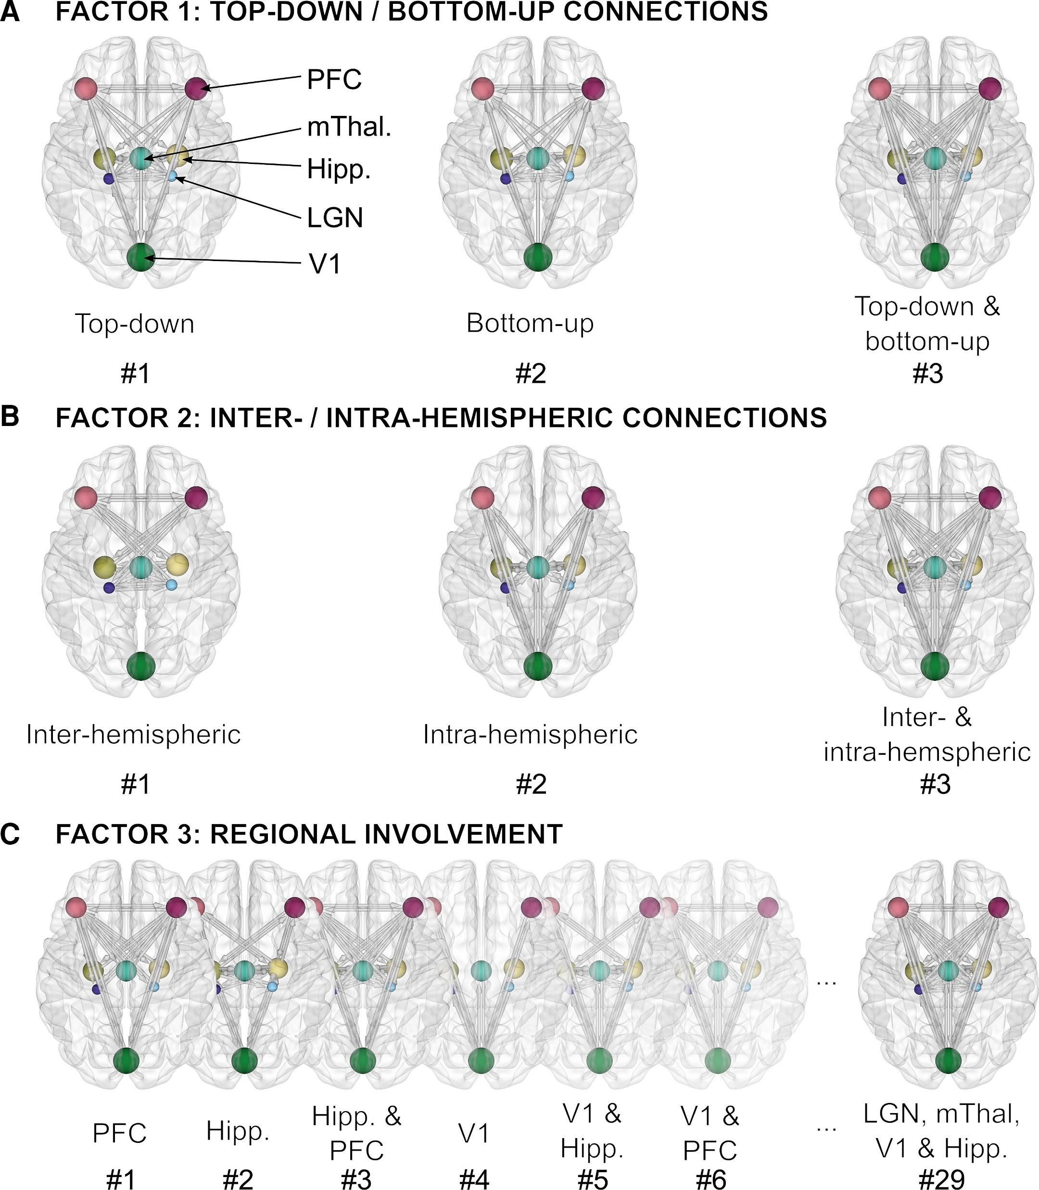
Resting state example
Model space
“Are visual hallucinations in Parkinson’s disease explained by impaired bottom-up integration of sensory information and overweighting of top-down perceptual priors within the visual system?”
Participants:
15 Parkinson’s disease visual hallucinators
75 Parkinson’s disease non-visual hallucinators.
Thomas, G.E., et al., 2023. Brain Communications, 5(1)

Slide 12
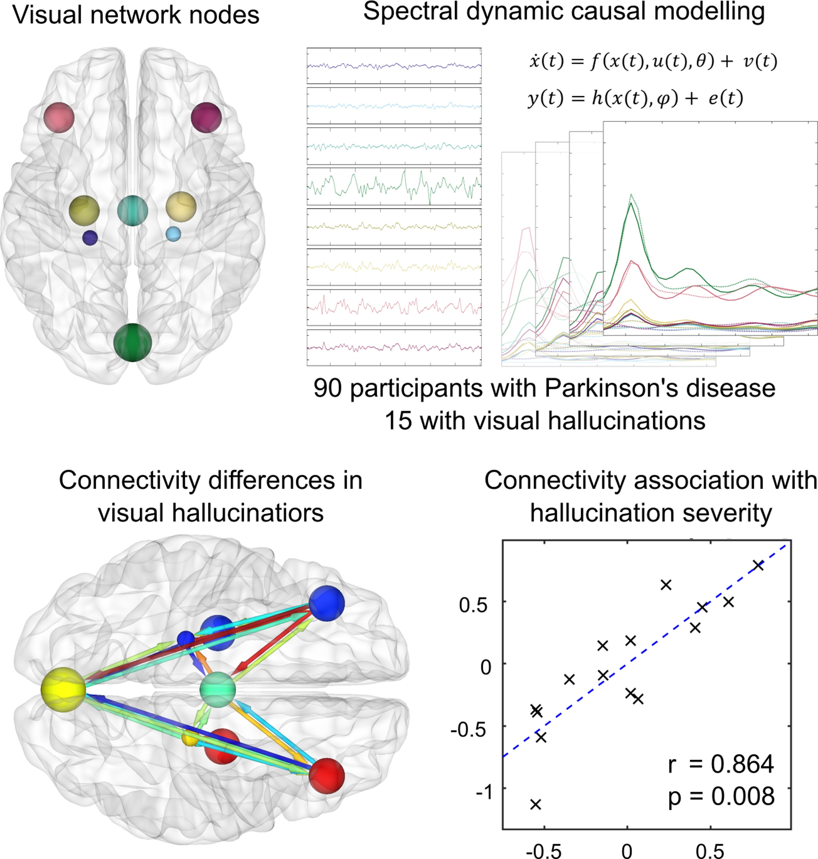
Resting state example
Thomas, G.E., et al., 2023. Brain Communications, 5(1)

Slide 13
2. Design an experiment
Rest is great when…
There’s a DCM for that
Favour controlled tasks over resting state where possible
Participants cannot perform tasks
You are interested in resting state brain dynamics
Any others?
Use DCM for cross-spectral densities (Spectral DCM)
Studies often have a factorial design at the between-subjects level (e.g. two groups, pre- and post-intervention)
Friston, K.J., Kahan, J., Biswal, B. and Razi, A., 2014. A DCM for resting state fMRI. Neuroimage, 94, pp.396-407.

Slide 14
Eight steps to DCM success
Write down some hypotheses
Design an experiment
Data collection and pre-processing
Functional localisation
First-level DCM
Group analysis using Parametric Empirical Bayes (PEB)
Bayesian model comparison
Assess predictive validity

Slide 15
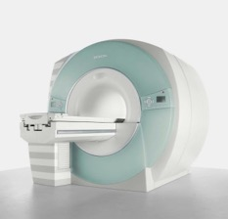
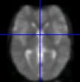
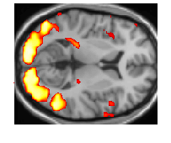
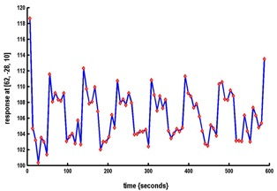
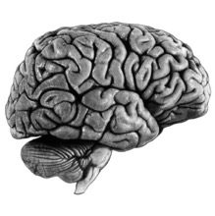
3. Data collection and pre-processing
No special considerations for DCM
Timeseries extraction from Regions of Interest (ROIs)
Dynamic Causal Modelling (DCM)
Functional MRI acquisition and image reconstruction
Image pre-processing (realignment, co-registration, normalisation, smoothing)
Statistical Parameter Mapping (SPM) / General Linear Model
DCM

Slide 16
Eight steps to DCM success
Write down some hypotheses
Design an experiment
Data collection and pre-processing
Functional localisation
First-level DCM
Group analysis using Parametric Empirical Bayes (PEB)
Bayesian model comparison
Assess predictive validity

Slide 17
4. Functional localisation
Task based experiments
Resting state experiments
A network consists of nodes (brain regions) and connections. We need to select the nodes.
The purpose of DCM is to infer the underlying neural connectivity that gave rise to your SPM results.
The purpose of DCM is to infer the underlying neural connectivity that caused the functional connectivity (correlations or cross-spectral density) among pre-selected brain regions.
→ Select Regions of Interest using your contrasts
→ Select Regions of Interest from previous literature, anatomical hypotheses or an initial PCA or ICA

Slide 18
Eight steps to DCM success
Write down some hypotheses
Design an experiment
Data collection and pre-processing
Functional localisation
First-level DCM
Group analysis using Parametric Empirical Bayes (PEB)
Bayesian model comparison
Assess predictive validity

Slide 19


5. First level DCM
Free energy
Estimated parameters
Two outputs:
Approximation of the log model evidence $P\left(Y|m\right)$
Posterior (multivariate Gaussian) probability $P\left(θ|Y,m\right)$
$$F≈\log{P\left(Y|m\right)}=\text{accuracy}−\text{complexity}$$

Slide 20
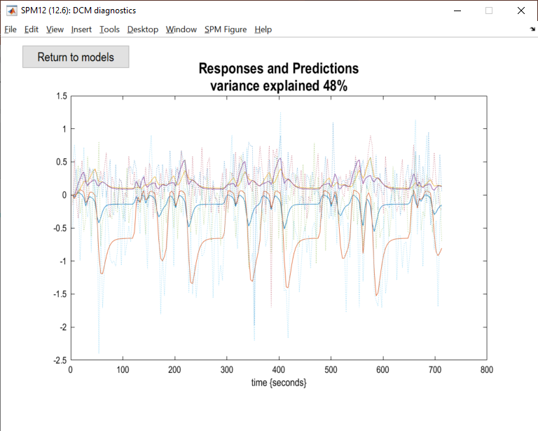
5. First level DCM
Check the variance explained by your models
(10% or more is considered non-trivial)
spm_dcm_fmri_check(DCM);

Slide 21
Eight steps to DCM success
Write down some hypotheses
Design an experiment
Data collection and pre-processing
Functional localisation
First-level DCM
Group analysis using Parametric Empirical Bayes (PEB)
Bayesian model comparison
Assess predictive validity

Slide 22
6. Group analysis using Parametric Empirical Bayes (PEB)
Group-level questions:
Are the strength of particular connections changed by an experimental manipulation?
Does belonging to a diagnostic group determine the strength of these connections?
Does the strength of the connections correlate with behavioural or clinical variables?
Could we predict a new participant’s disease status or behavioural scores using our estimate of their connections?

Slide 23







6. Group analysis using Parametric Empirical Bayes (PEB)
The connectivity parameters are taken to the group level
and modelled using a General Linear Model
Design matrix
(covariates)
Group level parameters
Outputs:
One free energy for the entire group-level model (DCMs and GLM).
Group-level parameters (effect of each covariate on each connection)
Unexplained between-subject variability
$$θ^{(1)}=Xθ^{(2)}+ε^{(2)}$$
$$θ^{(1)}$$
$$X$$
$$θ^{(2)}$$
1
Group average connection strength
2
Subject
3
$$=$$
Subject
$$×$$
Effect of group on the connection
4
5
Effect of age on the connection
6
1
2
3
Covariate

Slide 24
Eight steps to DCM success
Write down some hypotheses
Design an experiment
Data collection and pre-processing
Functional localisation
First-level DCM
Group analysis using Parametric Empirical Bayes (PEB)
Bayesian model comparison
Assess predictive validity

Slide 25



7. Bayesian model comparison
PEB model 1
PEB model 2
Design matrix
Design matrix
With age
covariate
Without age
covariate
Subject
Subject
1
2
3
1
2
Covariate
Covariate
(The free energy for nested models is derived analytically using Bayesian Model Reduction)
Free energy $F_{1}$
Free energy $F_{2}$
$$\log{BF}=F_{1}−F_{2}$$

Slide 26
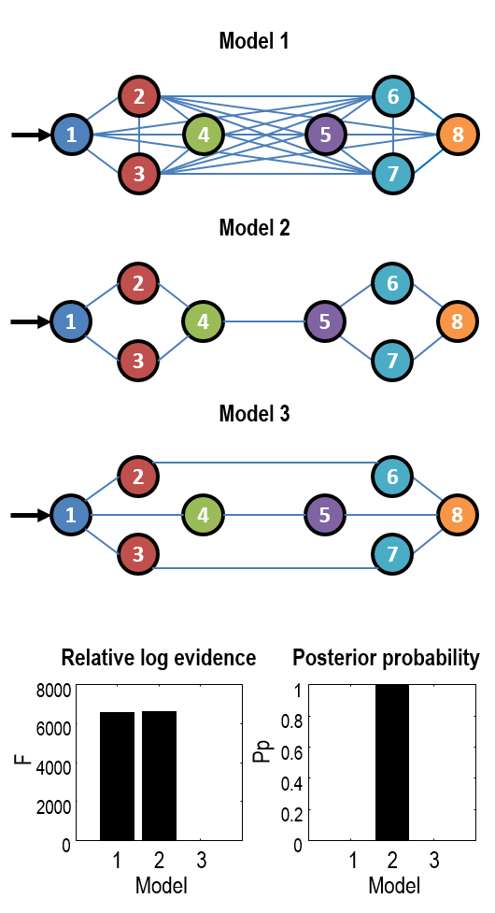
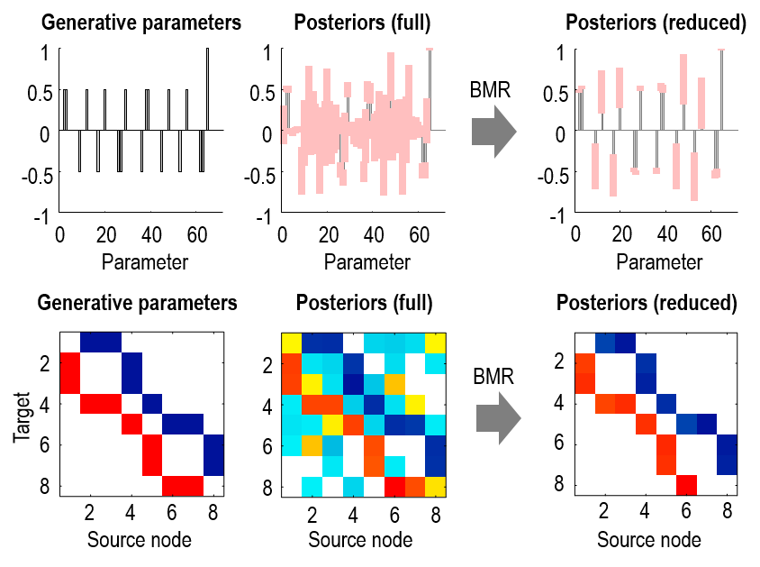
Bayesian model reduction
Pre-defined models
Automatic search
Friston, Parr, Zeidman. Bayesian model reduction. arXiv preprint arXiv:1805.07092.

Slide 27
Eight steps to DCM success
Write down some hypotheses
Design an experiment
Data collection and pre-processing
Functional localisation
First-level DCM
Group analysis using Parametric Empirical Bayes (PEB)
Bayesian model comparison
Assess predictive validity

Slide 28
8. Assess predictive validity
The question
Predicted vs actual covariates
Are the effect sizes I detected large enough to predict the group membership or clinical scores of new participants?
→ Leave-one-out (LOO) cross-validation
corr(df:22) = 0.95: p < 0.000
0.5
0.4
0.3
Estimate
0.2
0.1
0
-0.1
0
1
group effect

Slide 29
Eight steps to DCM success
Write down some hypotheses
Design an experiment
Data collection and pre-processing
Functional localisation
First-level DCM
Group analysis using Parametric Empirical Bayes (PEB)
Bayesian model comparison
Assess predictive validity

Slide 30
The ageing brain: ipsilateral M1
Main effect of age
Subjects clustered into
groups by rM1 response
BOLD
N=635 participants aged 18–88 (Cam-CAN)
Age (years)
Tak, Y.W., Knights, E., Henson, R. and Zeidman, P., 2021. Ageing and the ipsilateral M1 BOLD response: a connectivity study. Brain sciences, 11(9), p.1130.

Slide 31
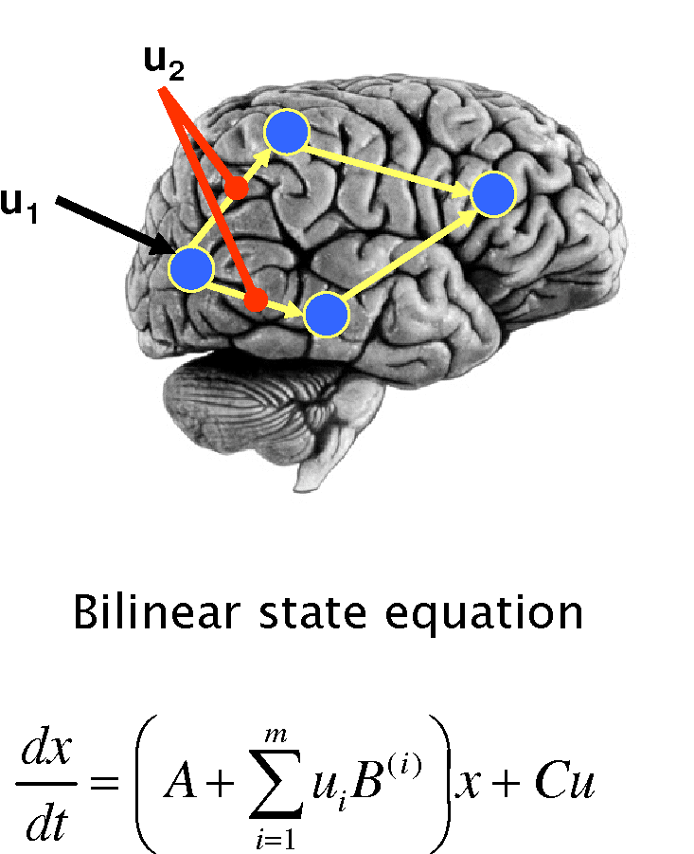













The ageing brain: DCM
Dynamic Causal Modelling (DCM) for fMRI
Neural model
Haemodynamic Model
i. Cerebral blood flow (rCBF)
ii. Venous Balloon
iii. BOLD signal
$$τ_{h}$$
volume
$$\dot{v}$$
$$τ_{h},α$$
$$γ$$
activity $z(t)$
signal
$$\dot{s}$$
flow
$${\dot{f}}_{in}$$
$$τ_{h},α$$
BOLD signal $y$
$$ε_{h},{E_{0},r}_{0},TE,θ_{0}$$
$$κ$$
dHb
$$\dot{q}$$
$$τ_{h}, E_{0}$$
Friston et al. 2000
Buxton et al. 1998
Stephan et al. 2007
Tak, Y.W., Knights, E., Henson, R. and Zeidman, P., 2021. Ageing and the ipsilateral M1 BOLD response: a connectivity study. Brain sciences, 11(9), p.1130.

Slide 32
The ageing brain: model structure
1
Modelled
rM1 BOLD
L
R
SMA
SMA
PMd
0.5
M1
PMd
PMd
0
-0.5
M1
M1
0
10
20
SMA
Time (s)
The model successfully captured the difference in the right M1 BOLD response between younger and older responders.
Tak, Y.W., Knights, E., Henson, R. and Zeidman, P., 2021. Ageing and the ipsilateral M1 BOLD response: a connectivity study. Brain sciences, 11(9), p.1130.

Slide 33
The ageing brain: model parameters
Younger subjects
Older subjects
In silico experiment
SMA
SMA
SMA
SMA
lPMd→ rM1
1
+1Hz
0.5
PMd
PMd
PMd
PMd
BOLD
0.17Hz
0.73Hz
0
M1
-0.13Hz
M1
M1
0.47Hz
M1
-1Hz
-0.12Hz
-0.43Hz
-0.5
0
5
10
15
20
25
Time (secs)
Positive connection
Negative connection
Increasing lSMA → rM1, lPMd → rM1 or lM1 → rM1 connection strengths in silico could flip the sign of the BOLD response, mirroring the ageing process.
Tak, Y.W., Knights, E., Henson, R. and Zeidman, P., 2021. Ageing and the ipsilateral M1 BOLD response: a connectivity study. Brain sciences, 11(9), p.1130.

Slide 34
The ageing brain: cross-validation
Only the lSMA → rM1 and lPMd → rM1 connections correlated with rM1 BOLD across subjects.
Total variance explained: 44%
Tak, Y.W., Knights, E., Henson, R. and Zeidman, P., 2021. Ageing and the ipsilateral M1 BOLD response: a connectivity study. Brain sciences, 11(9), p.1130.

Slide 35
Eight steps to DCM success
Write down some hypotheses
Design an experiment
Data collection and pre-processing
Functional localisation
First-level DCM
Group analysis using Parametric Empirical Bayes (PEB)
Bayesian model comparison
Assess predictive validity

Slide 36
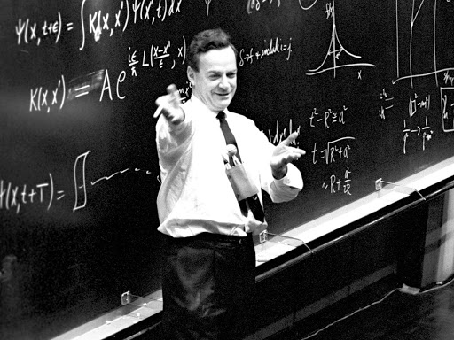

Further reading
Tutorial papers:
Zeidman, P., Jafarian, A., Corbin, N., Seghier, M.L., Razi, A., Price, C.J., Friston, K.J. A guide to group effective connectivity analysis, part 1: First level analysis with DCM for fMRI. NeuroImage, 200, pp. 174-190. 2019.
Zeidman, P., Jafarian, A., Seghier, M.L., Litvak, V., Cagnan, H., Price, C.J., Friston, K.J. A guide to group effective connectivity analysis, part 2: Second level analysis with PEB. NeuroImage, 200, pp. 12-25. 2019.
Technical papers:
  Friston, K., Parr, T. and Zeidman, P., 2018. Bayesian model reduction. arXiv:1805.07092.
  Friston, K.J., Litvak, V., Oswal, A., Razi, A., Stephan, K.E., Van Wijk, B.C., Ziegler, G. and Zeidman, P., 2016. Bayesian model reduction and empirical Bayes for group (DCM) studies. Neuroimage, 128, pp.413-431.
  Zeidman, P., Friston, K. and Parr, T., 2022. A primer on Variational Laplace. https://doi.org/10.31219/osf.
“What I cannot create I do not understand.”
—Richard Feynman

