Slide 1

SPM for M/EEG
Vladimir Litvak showing slides from Guillaume Flandin
Wellcome Centre for Human Neuroimaging
University College London
SPM Short Course
London, 2023

Slide 2
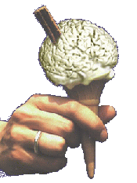
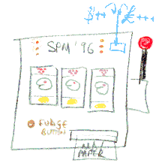
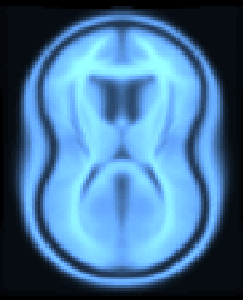
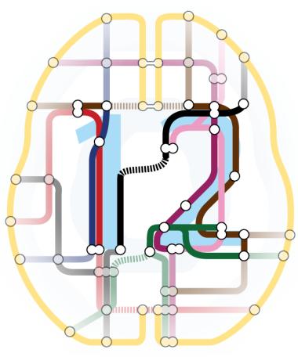
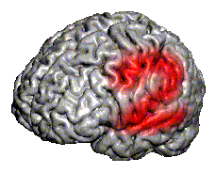
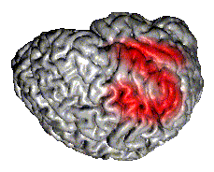
SPM Software
“The SPM software was originally developed by Karl Friston for the routine statistical analysis of functional neuroimaging data from PET while at the Hammersmith Hospital in the UK, and made available to the emerging functional imaging community in 1991 to promote collaboration and a common analysis scheme across laboratories.”
SPMclassic, SPM’94, SPM’96, SPM’99, SPM2, SPM5, SPM8 and SPM12 represent the ongoing theoretical advances and technical improvements of the original version.

Slide 3
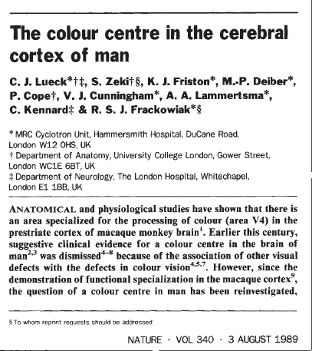
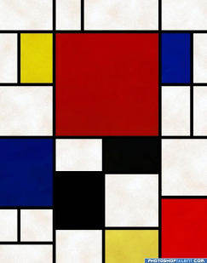
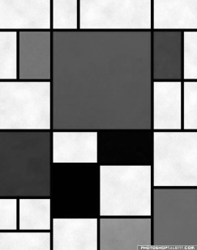
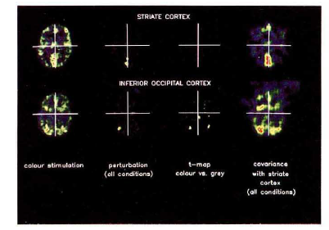
The very first SPM{t}
An area specialised for the processing of colour, the“colour centre” (V4) highlighted by cognitive substraction using PET.
Three subjects:
Compatible with earlier findings on monkeys using electrophysiology.
Colour trials
(2 scans)
Grey trials
(2 scans)
Notes:
3

Slide 4



Image time-series
Spatial filter
Design matrix
Statistical Parametric Map
Realignment
Smoothing
General Linear Model
Statistical
Inference
RFT
Normalisation
Anatomical
reference
p <0.05
Parameter estimates

Slide 5
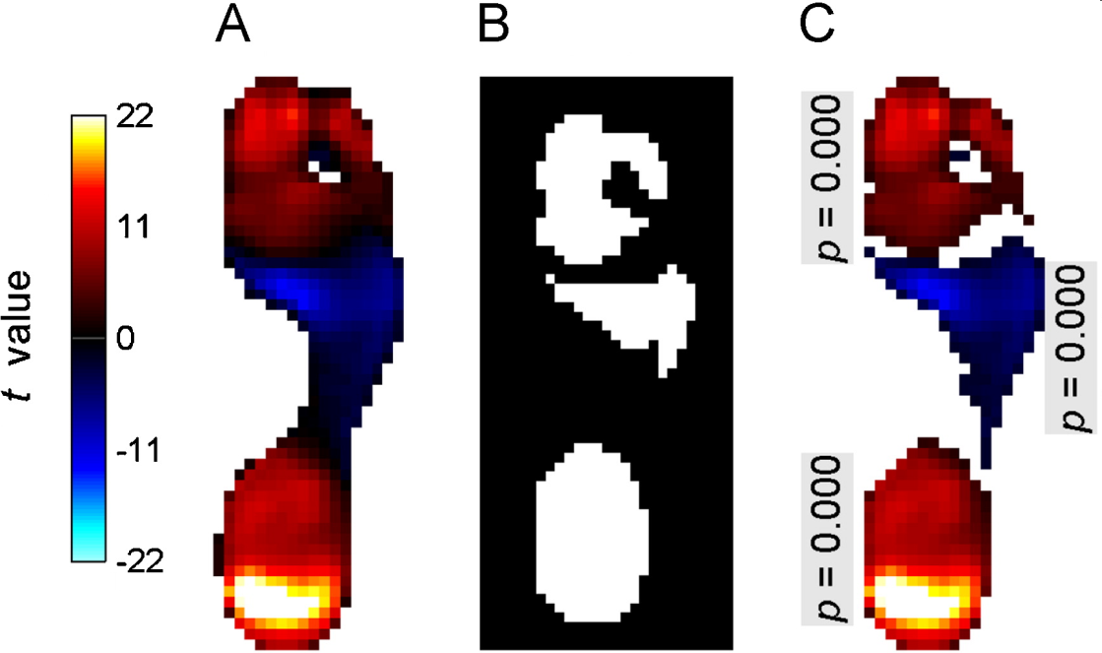
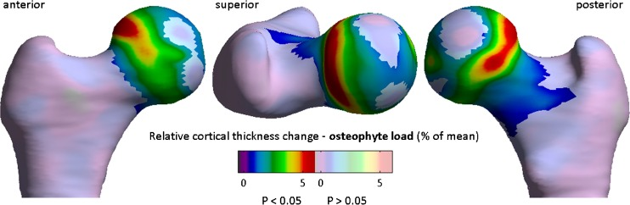
Statistical Parametric Mapping refers to the construction and assessment of spatially extended statistical processes used to test hypotheses about functional imaging data.
Quantitative 3D analysis of bone in hip osteoarthritis using clinical computed tomography, Tom Turmezei et al, European Radiology, 2016.
Pedobarographic statistical parametric mapping (pSPM), T. Pataky, Journal of Foot and Ankle Research, 2008.

Slide 6
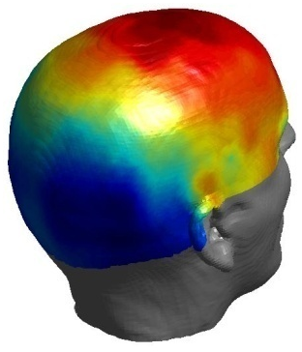
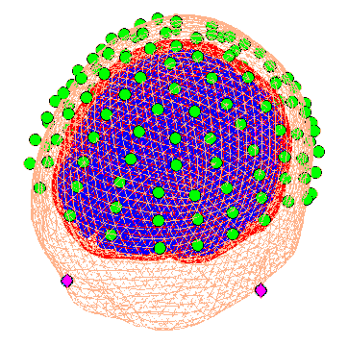
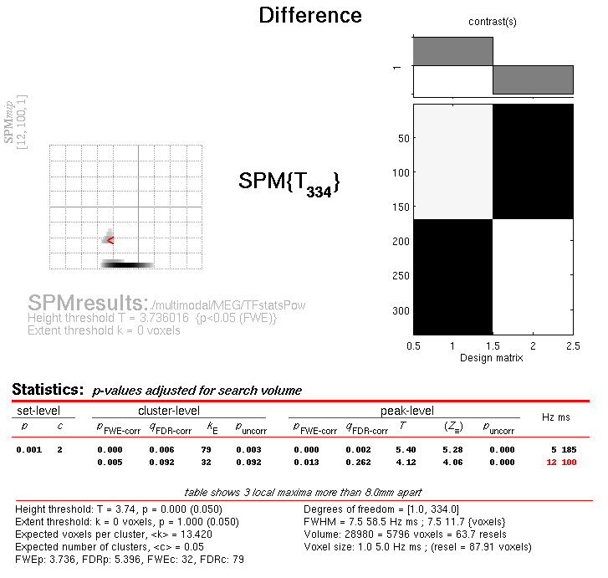
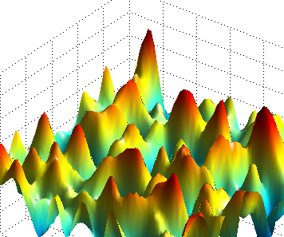
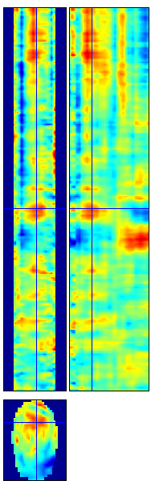
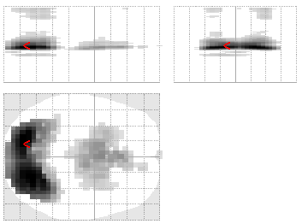
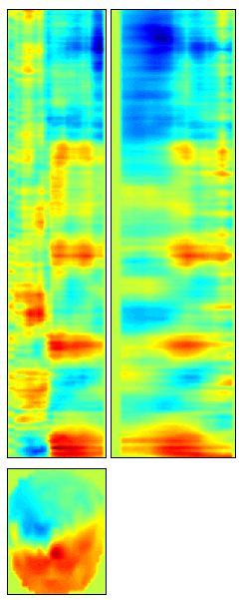
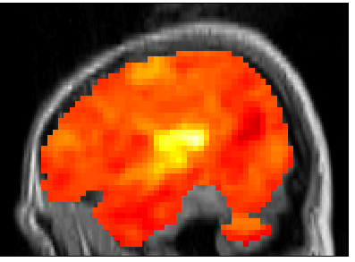
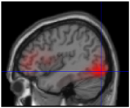
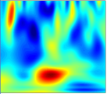
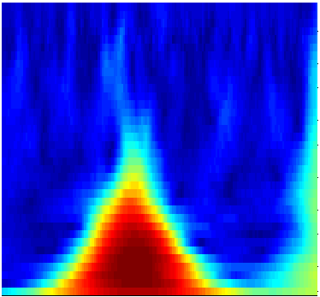

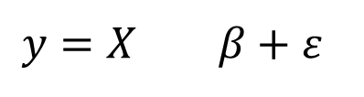
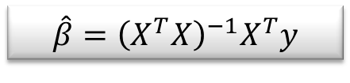
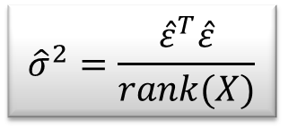
Random
Field Theory
$$y=X β+ε$$
Contrast c
Pre-
processings
General
Linear
Model
Statistical Inference
$$\hat{β}={\left(X^{T}X\right)}^{−1}X^{T}y$$
$${\hat{σ}}^{2}=\frac{{\hat{ε}}^{T}\hat{ε}}{rank(X)}$$
$$SPM\{T,F\}$$

Slide 7
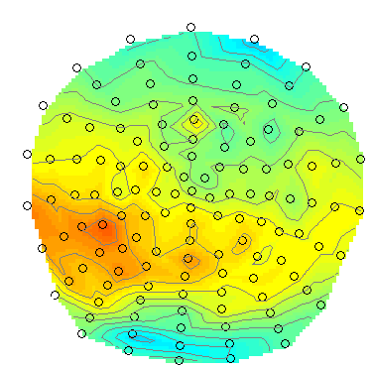
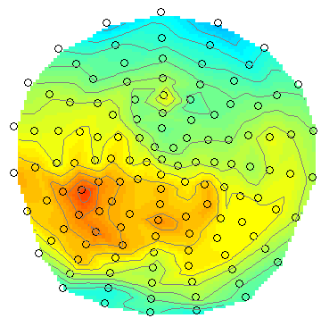
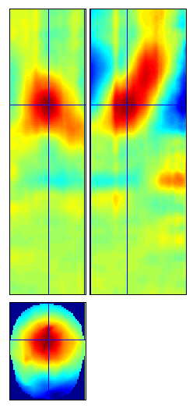
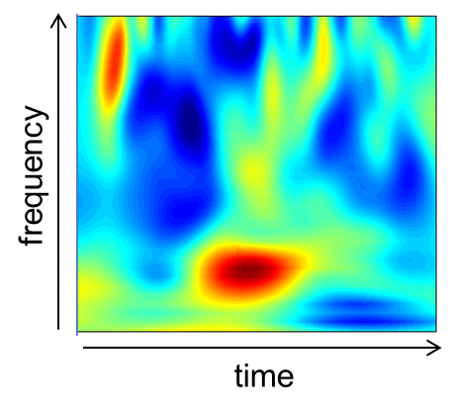
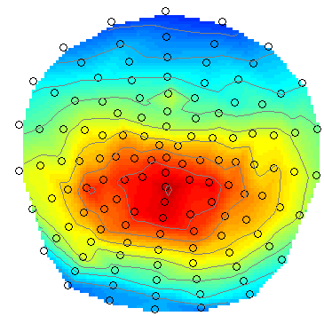
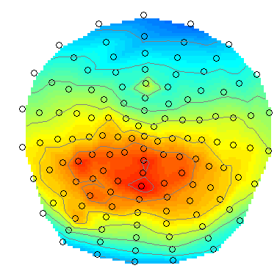
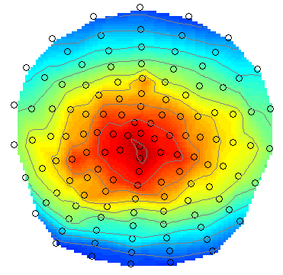
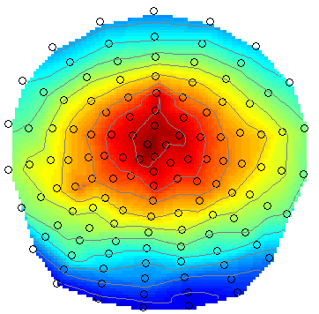
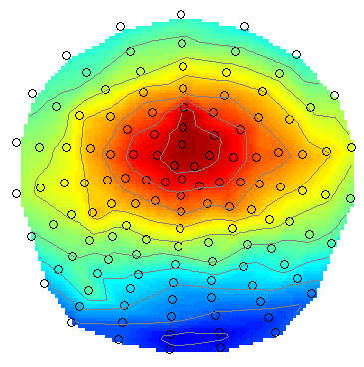
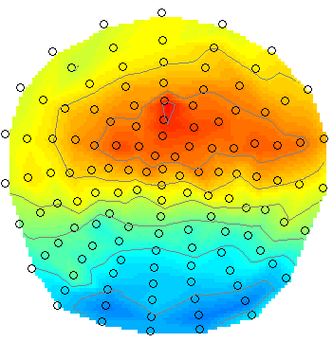
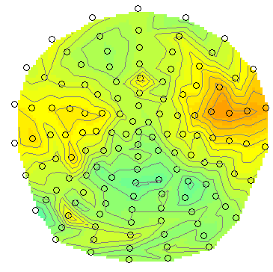
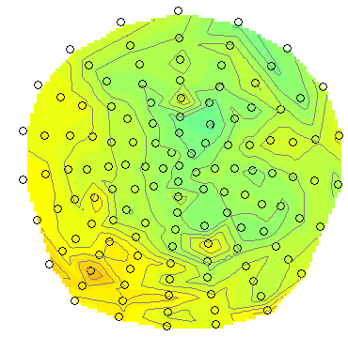
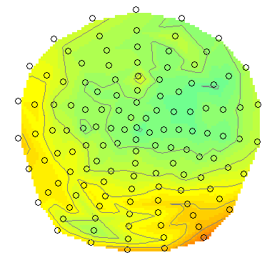
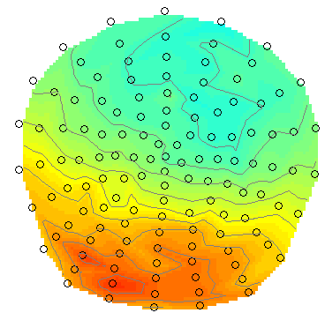
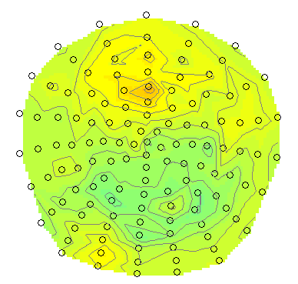
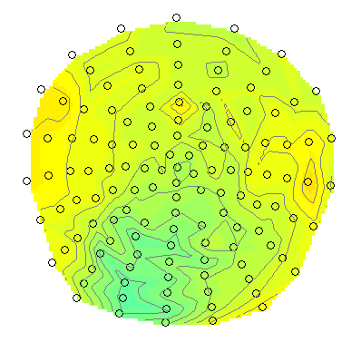
Day 1
Statistical Parametric Mapping refers to the construction and assessment of spatially extended statistical processes used to test hypotheses about functional imaging data.
Sensor to voxel
transform
Time
Statistical Parametric Mapping for Event-Related Potentials I: Generic Considerations. S.J. Kiebel and K.J. Friston. NeuroImage, 2004.
Topological inference for EEG and MEG, J. Kilner and K.J. Friston, Annals of Applied Statistics, 2010.

Slide 8
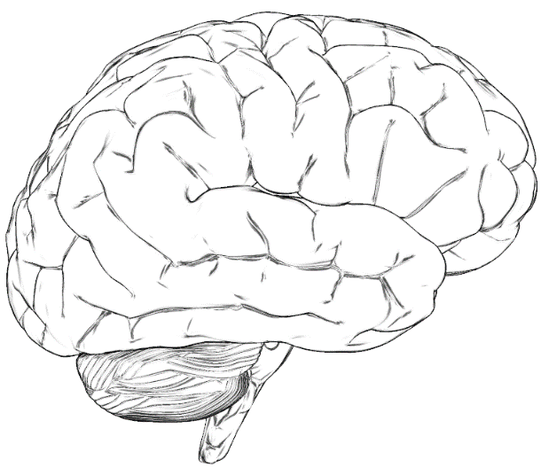
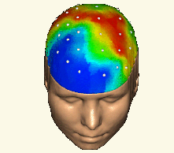
M/EEG Source Analysis
~Day 2
Forward Problem
Data
Likelihood Prior
Posterior Evidence
Parameters
Inverse Problem

Slide 9
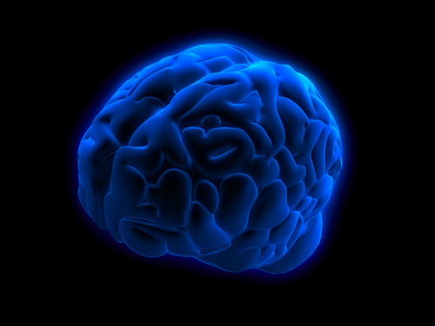
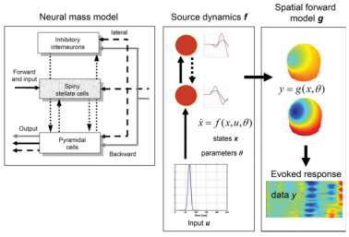
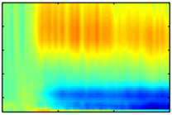
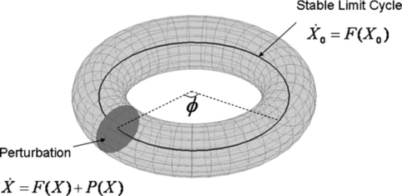
Day 3
Dynamic Causal Modelling
for M/EEG
• DCM for event-related potentials
• DCM for cross-spectral density
• DCM for induced responses
• DCM for phase coupling
Notes:
9
Physiological (neurophysiological model: electromagnetic forward model included. States different from data y)
Phenomenological: models a particular data feature: Source locations not optimized. States x and data y in the same “format”.
The main principle of DCM is the use of data and generative models in a
Bayesian framework to infer parameters and compare models.
Implementation details may vary – e.g. variational Bayes vs. sampling methods
Model inversion is an optimization procedure where the objective function is the
free energy which approximates the model evidence.
Model evidence is the goodness of fit expected under the prior parameter values.
The best model is the one with precise priors that yield good fit to the data.
Different models can be compared as long as they were fitted to the same data.
Models and priors can be gradually refined from one study to the next, making it
possible to use DCM as an integrative framework in neuroscience.

Slide 10



Software: SPM
Free and Open Source Software
Development on GitHub
Requirements:
  MATLAB: 7.4 (R2007a) to 9.14 (R2023a)
  no MathWorks toolboxes required
  Supported platforms:
  Linux, Windows and Mac
Standalone version available.

Slide 11
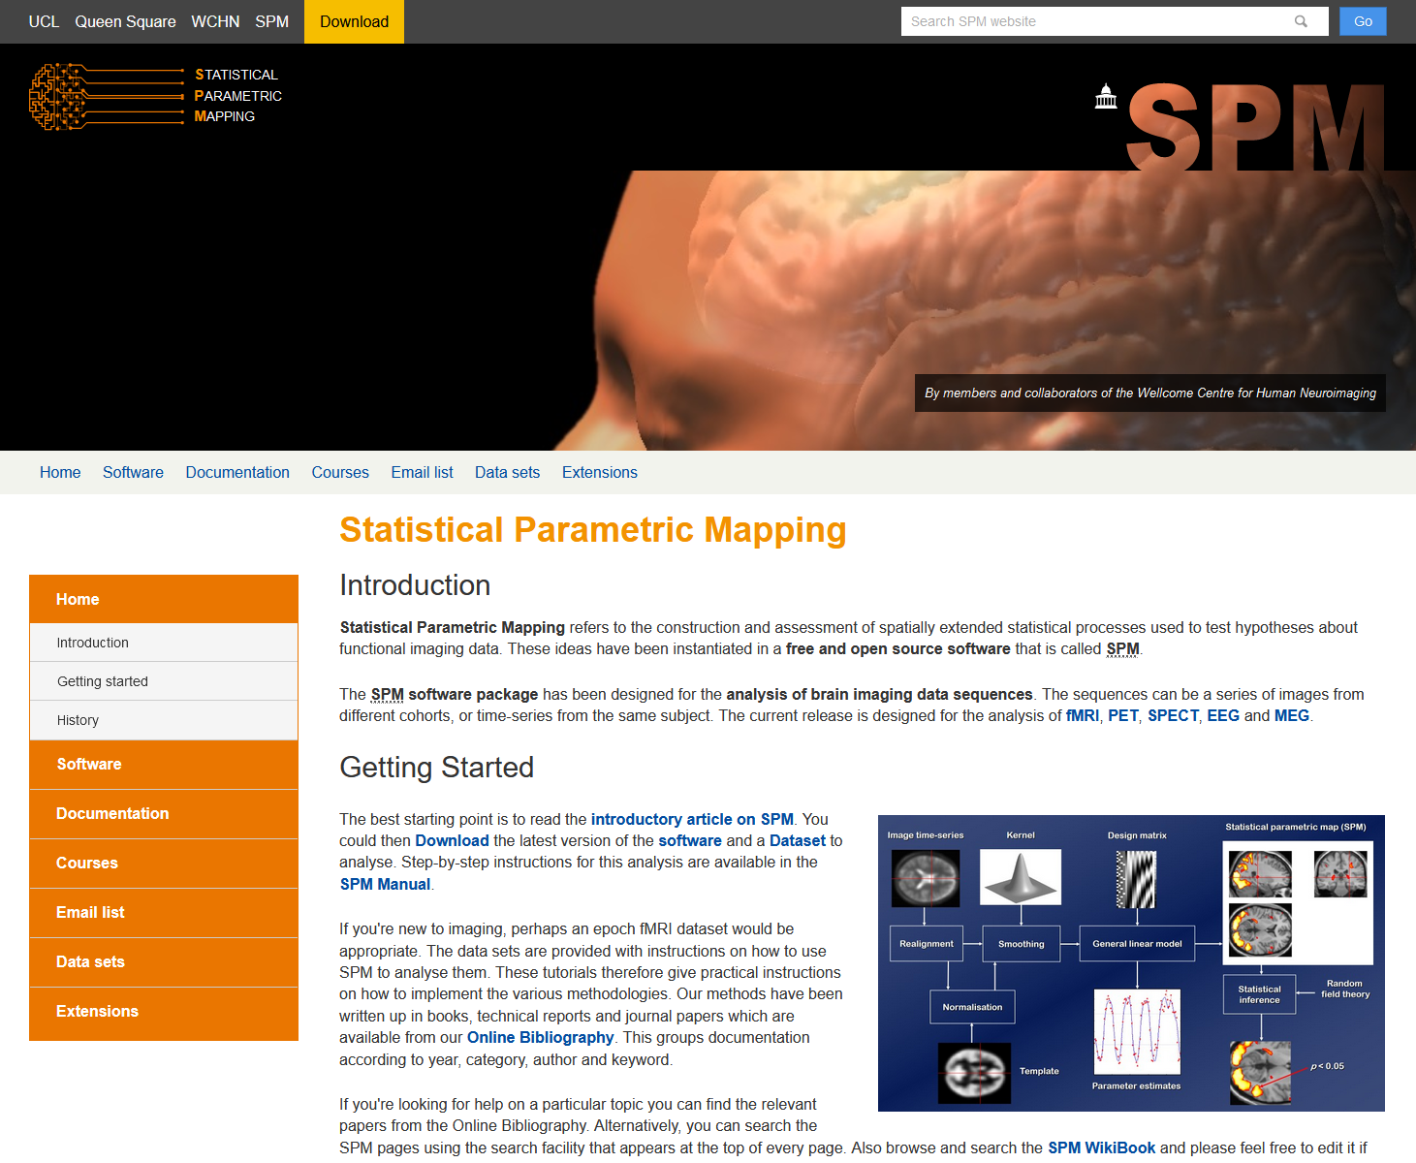
SPM Website
https://www.fil.ion.ucl.ac.uk/spm/
SPM software
Documentation &
Bibliography
Example data sets

Slide 12
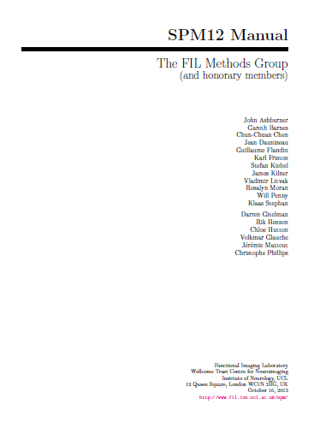




SPM documentation
SPM Manual
https://dx.doi.org/10.1155/2011/852961
SPM Book
Open Source
https://doi.org/10.3389/fnins.2019.00300

Slide 13

New documentation
https://www.fil.ion.ucl.ac.uk/spm/docs/

Slide 14

SPM datasets
PET, fMRI (1st and 2nd level), PPI, DCM, EEG, MEG, LFP.

Slide 15

SPM Toolboxes
User-contributed SPM extensions

Slide 16

SPM Mailing List
https://www.fil.ion.ucl.ac.uk/spm/support/
spm@jiscmail.ac.uk

Slide 17
The SPM co-authors
Jesper Andersson
John Ashburner
Yael Balbastre
Nelson Trujillo-Barreto
Gareth Barnes
Matthew Brett
Mikael Brudfors
Christian Buchel
CC Chen
Justin Chumbley
Jean Daunizeau
Olivier David
Guillaume Flandin
Karl Friston
Darren Gitelman
Daniel Glaser
Volkmar Glauche
Lee Harrison
Rik Henson
Andrew Holmes
Chloe Hutton
Amirhossein Jafarian
Maria Joao
Stefan Kiebel
James Kilner
Vladimir Litvak
Andre Marreiros
Jérémie Mattout
Rosalyn Moran
Tom Nichols
George O’Neil
Robert Oostenveld
Thomas Parr
Will Penny
Christophe Phillips
Dimitris Pinotsis
Jean-Baptiste Poline
Ged Ridgway
Holly Rossiter
Mohamed Seghier
Klaas Enno Stephan
Sungho Tak
Tim Tierney
Bernadette Van Wijk
Peter Zeidman

