Slide 1



General linear model and classical inference
SPM for M/EEG course
Martin Dietz
CFIN, Aarhus University, DK
Christophe Phillips
GIGA CRC in vivo imaging, Liege University, BE

Slide 2
Overview
Introduction
    SPM for MEG/EEG data
    ERP example
General linear model (GLM)
    Definition and design matrix
    Parameter estimation
Classical inference
    Contrasts and inference (t-tests and F-tests)
    Correlated regressors and orthogonalisation

Slide 3

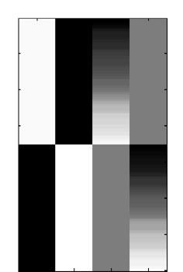
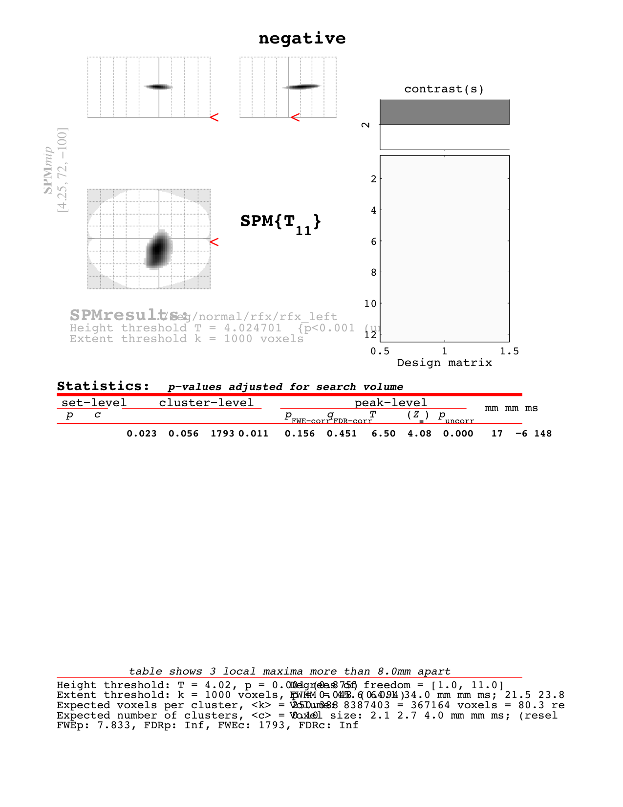


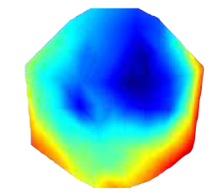
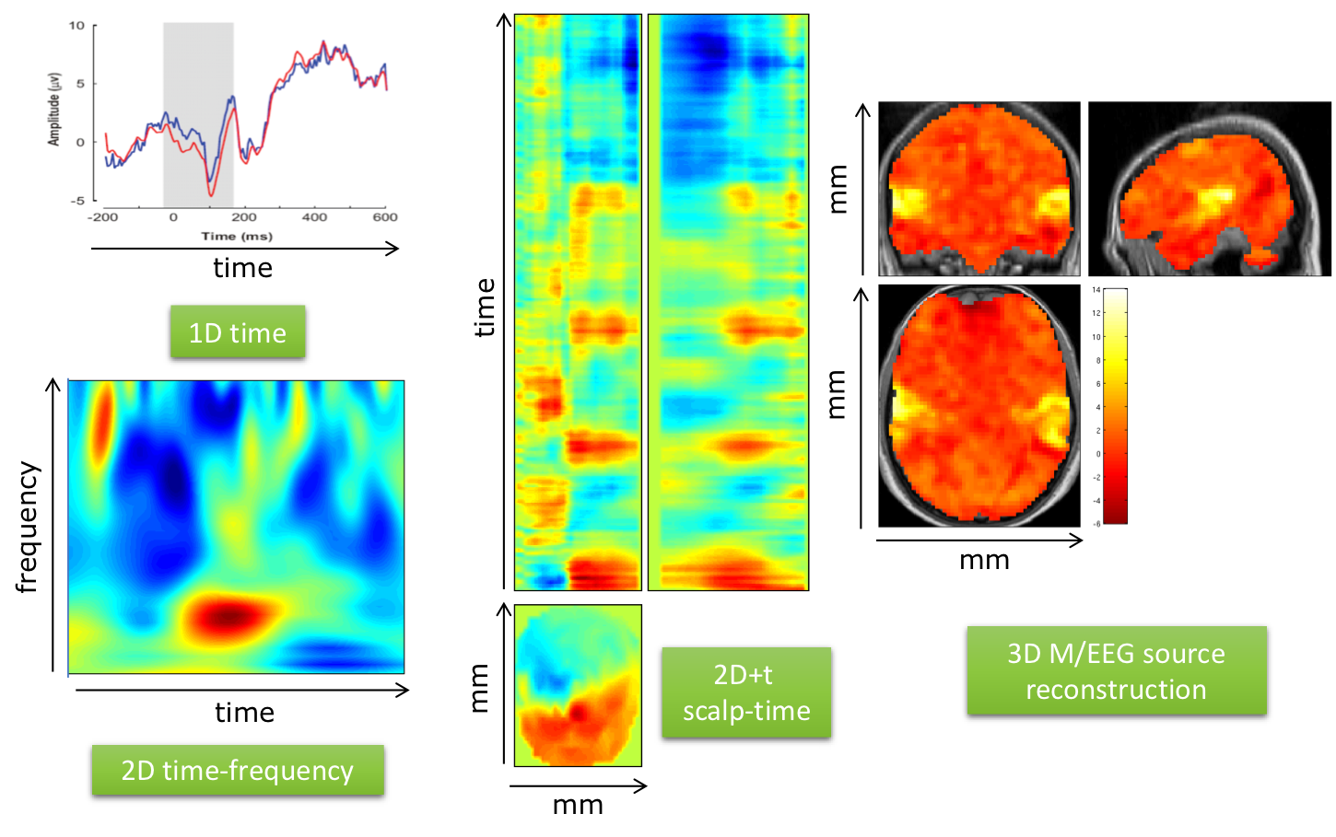
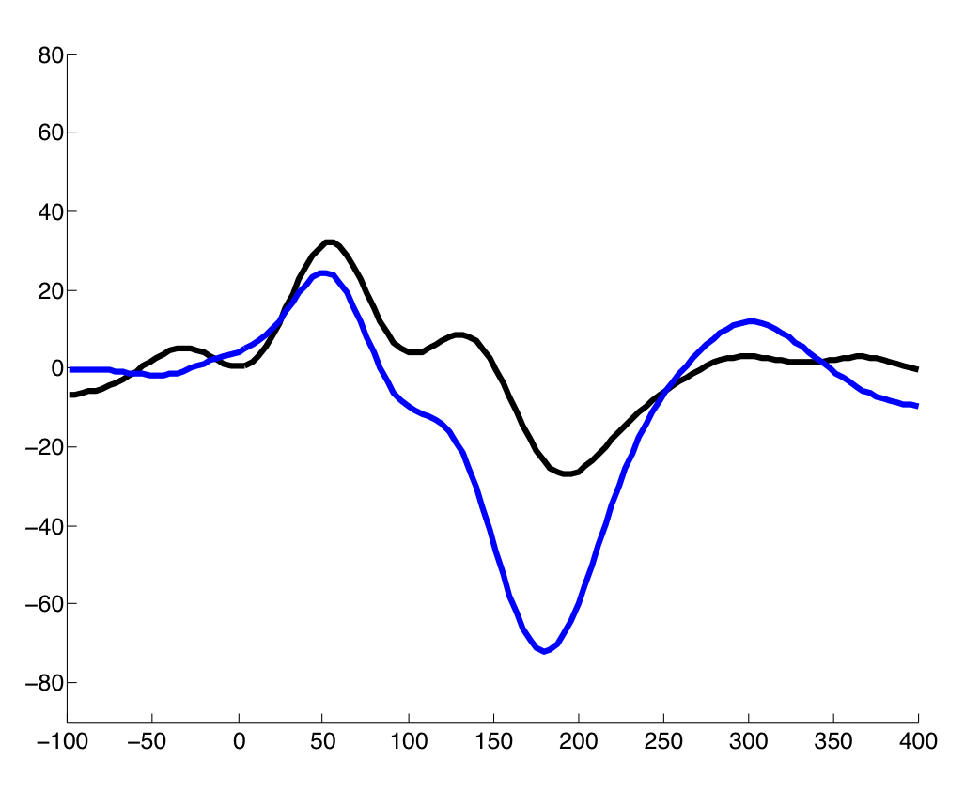


Overview of SPM for M/EEG
Design matrix
Statistical parametric map (SPM)
Preprocessing
Filtering
Epoching
Re-referencing
Artefact rejection
Averaging
…
General linear model
Inference and correction for multiple comparisons
Image conversion
Parameter estimates
Contrast
frequency
Scalp-time
time

Slide 4
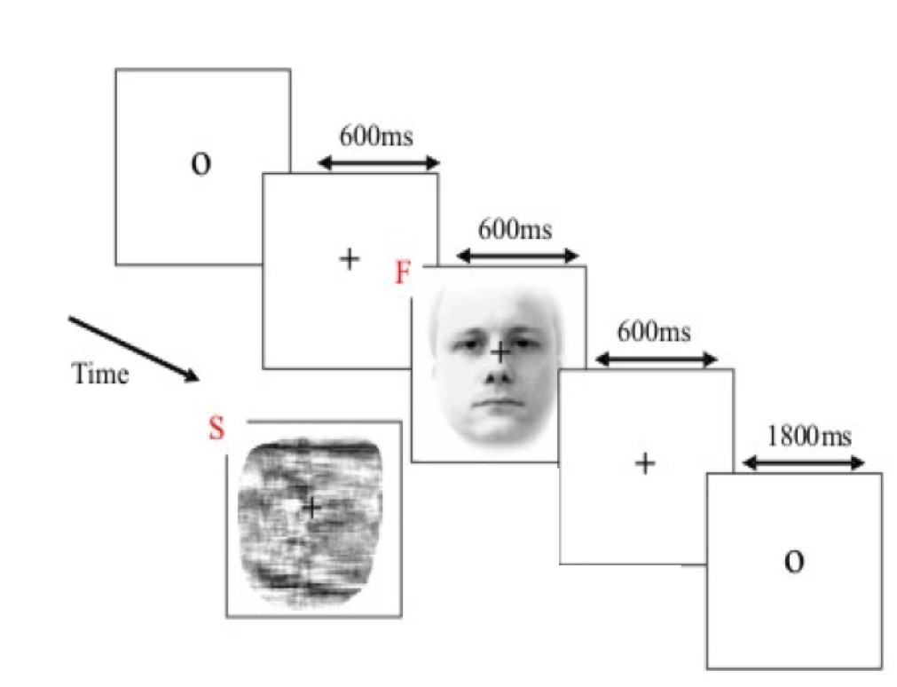
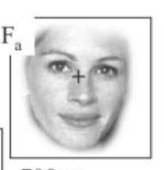
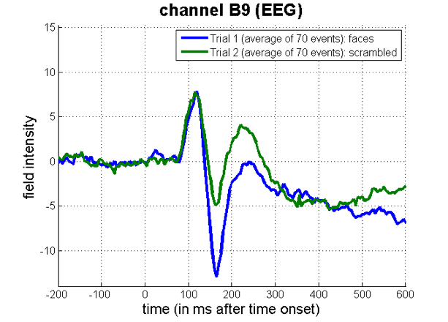
Event-related potential (ERP) example
Visual stimuli
Faces
Scrambled
Hypothesis: difference in ERP to faces and scrambled faces ?

Slide 5
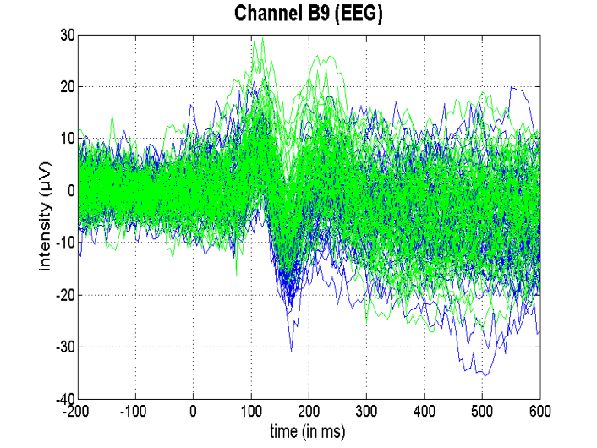
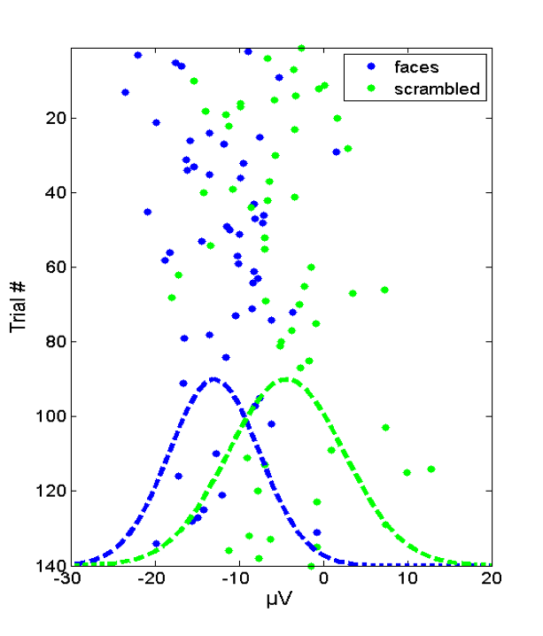
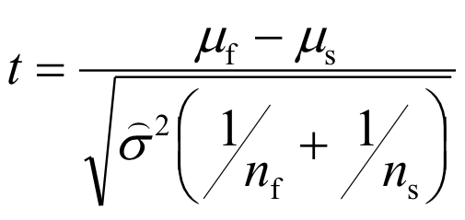
ERP example: one channel and time point
Trial-by-trial variability
Compare size of effect (average)
to its standard error (variability)
Average
t statistic (signal-to-noise ratio)

Slide 6
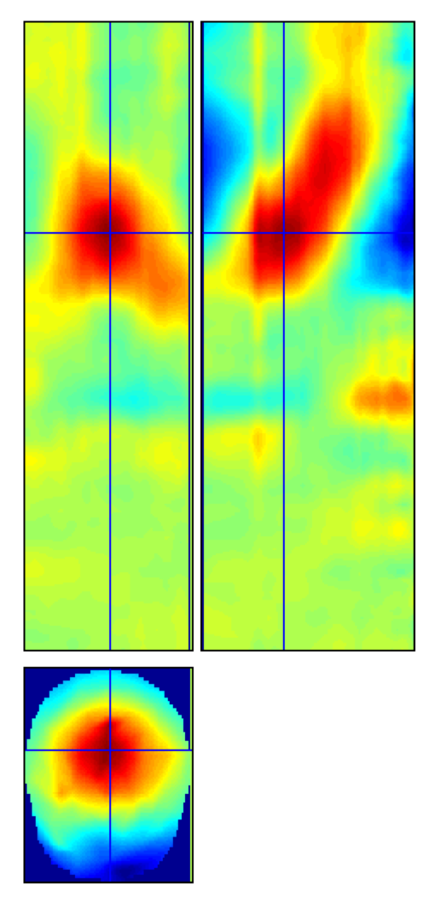
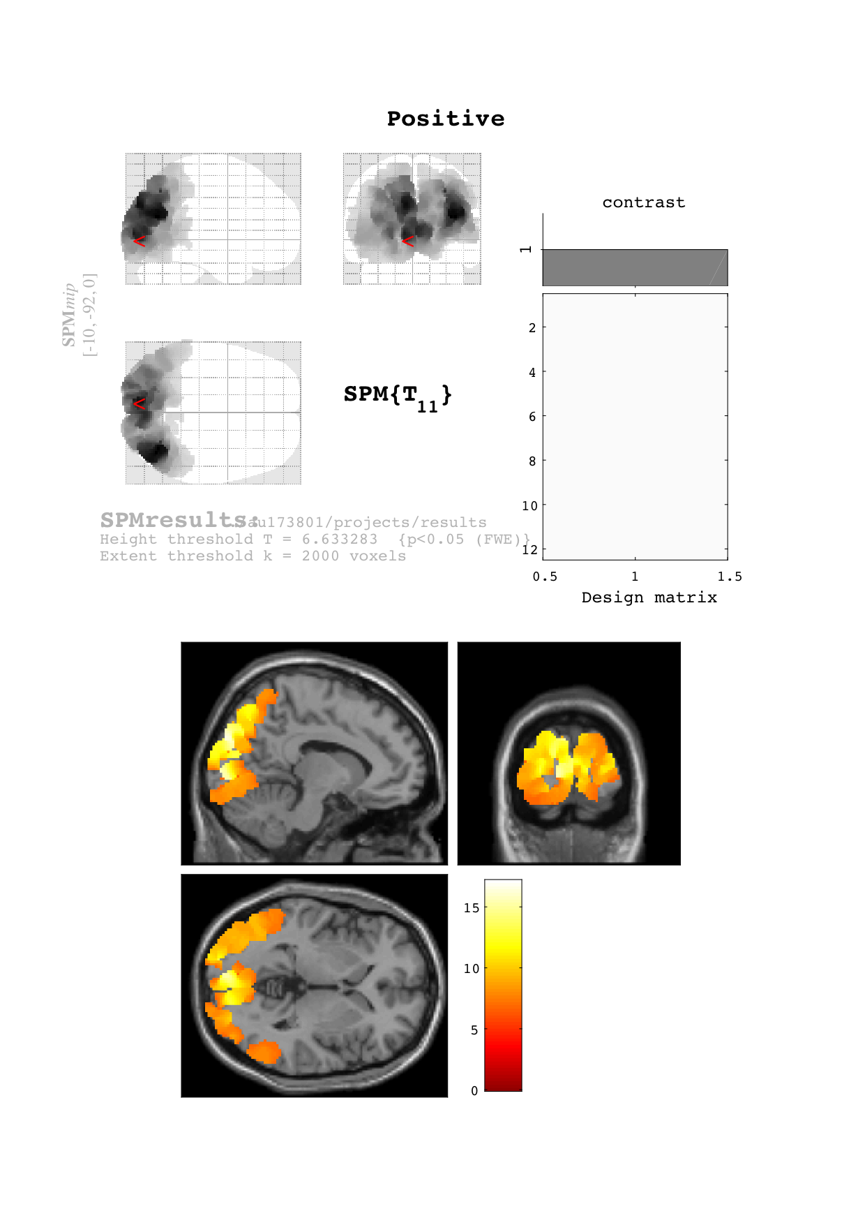
Images of MEG/EEG data
1D time
3D sensor-time
3D source images
[x, y, z] mm
time
time
2D time-frequency
frequency
mm
time
mm

Slide 7
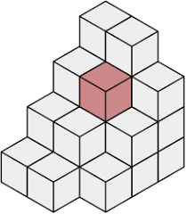
Mass-univariate statistical framework
2D time-frequency
3D source images
frequency
2D pixel or 3D voxel
time

Slide 8
Mass-univariate statistical framework
Avoid selection bias (“cherry picking”)
time
mm
mm

Slide 9
Overview
Introduction
    SPM for MEG/EEG data
    ERP example
General linear model (GLM)
    Definition and design matrix
    Parameter estimation
Classical inference
    Contrasts and inference (t-tests and F-tests)
    Correlated regressors and orthogonalisation

Slide 10
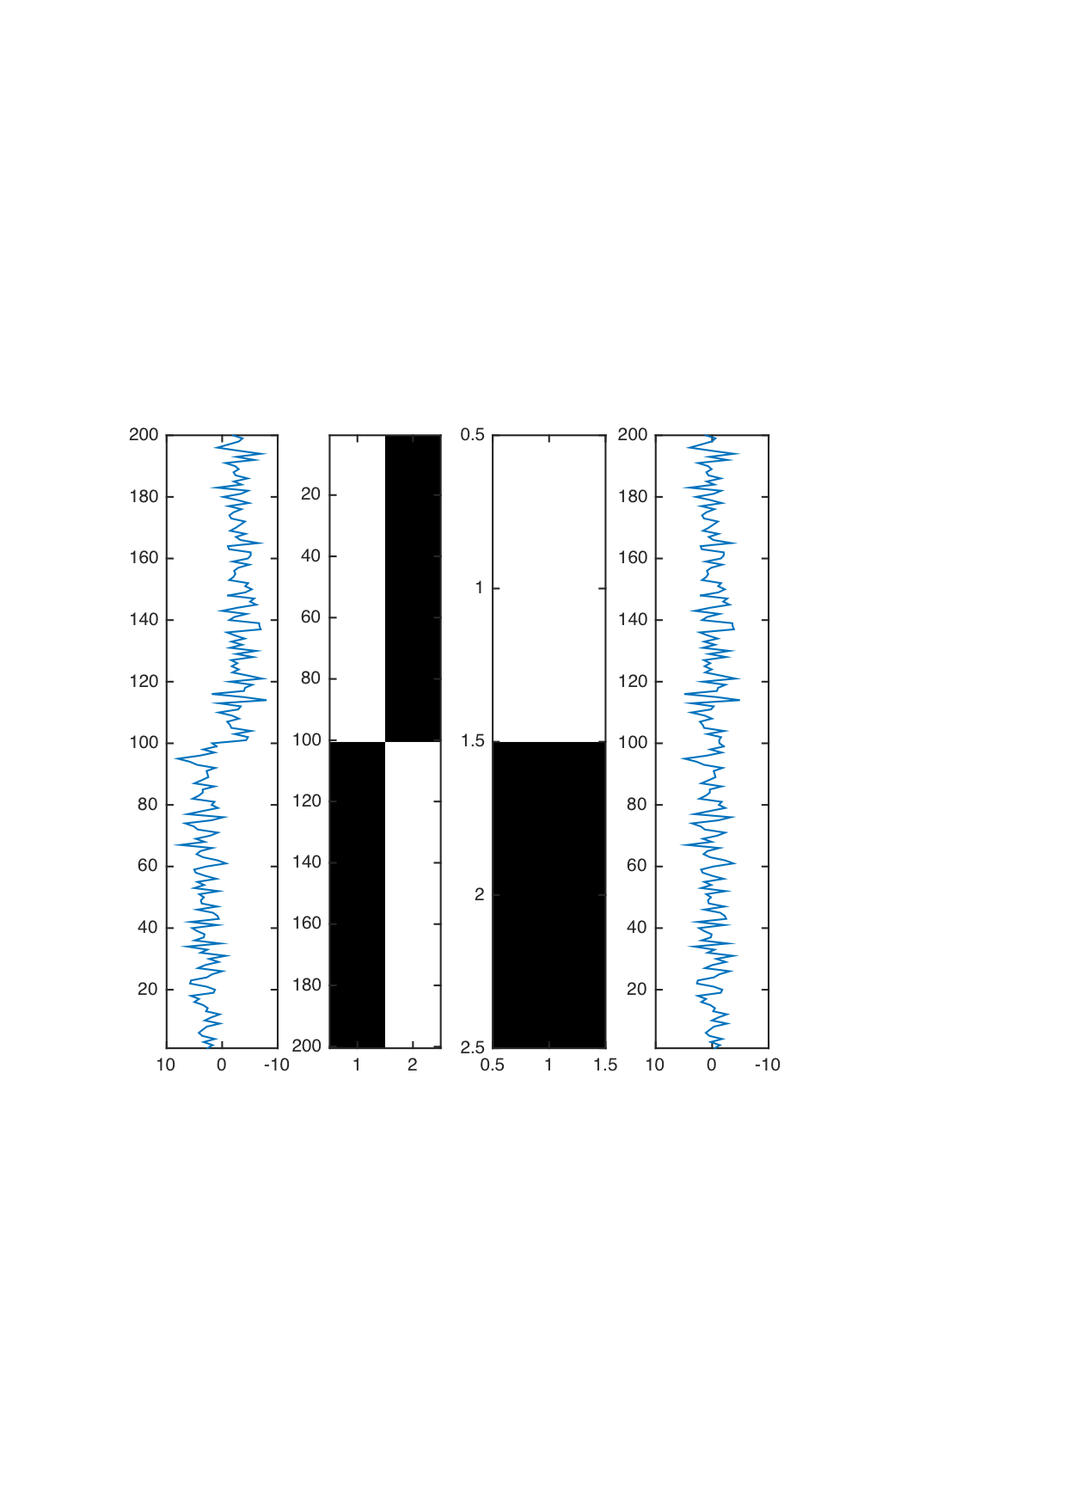
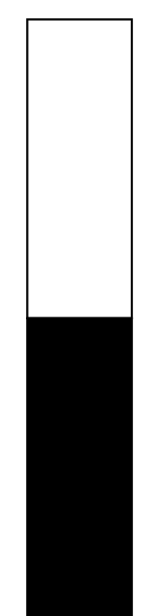
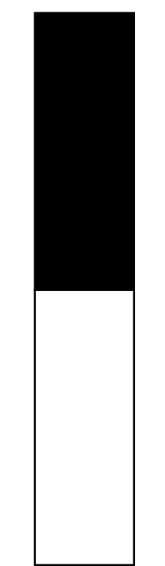




Linear model
M/EEG data
Faces
Scrambled
Residual error

Slide 11
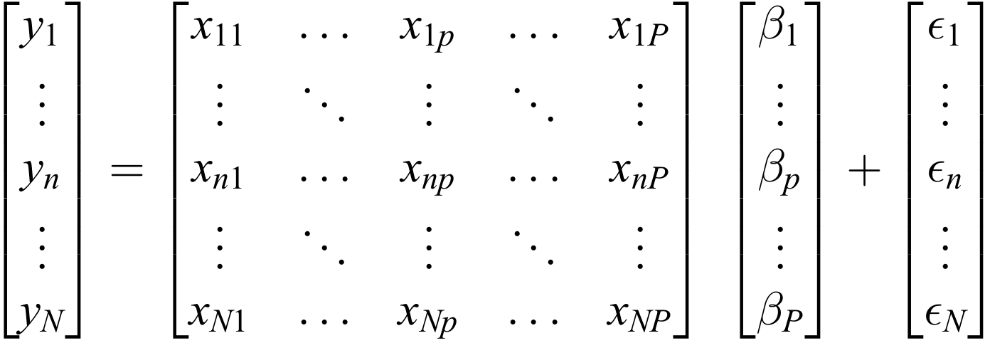
General linear model
Linear regression
Matrix formulation

Slide 12




General linear model
N x 1 data points, N x P predictors, P x 1 parameters, and N x 1 residuals
Design matrix + distribution of the residuals

Slide 13
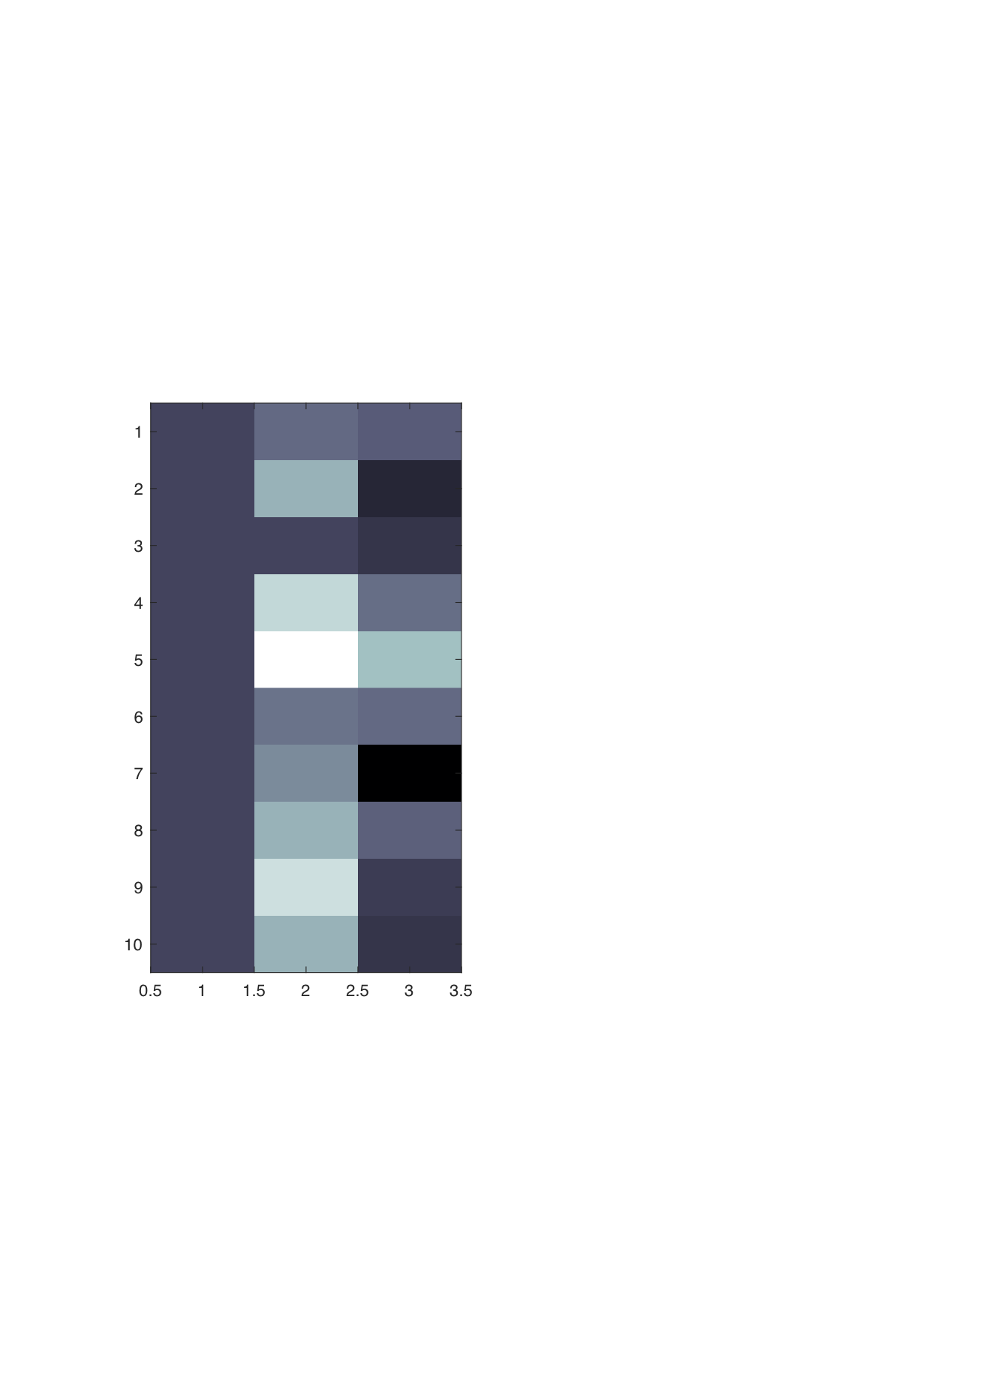
Voxel-wise linear model
2D or 3D image
Design matrix encodes
experimental factors and confounds
2D pixel or 3D voxel

Slide 14




GLM assumptions & estimation
Residual errors are independent and identically distributed (i.i.d.)
…but other distributions possible for residual errors
If X has full rank, the moment matrix is invertible
If X is overdetermined with N > P, X is rank deficient
is only invertible using Moore-Penrose pseudo-inverse

Slide 15

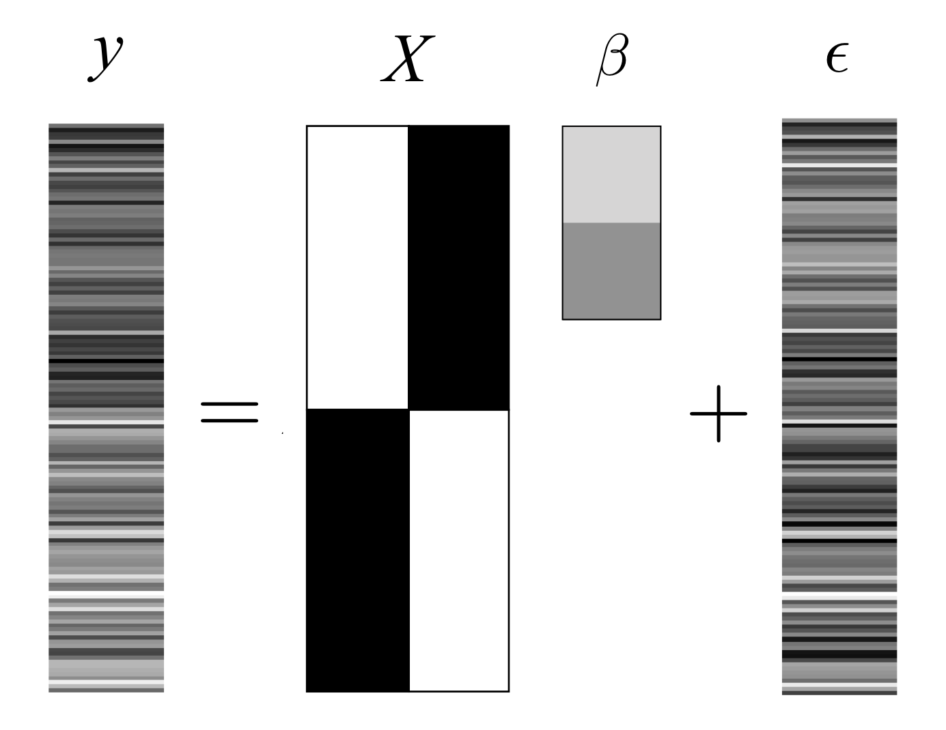
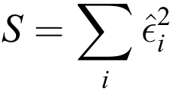

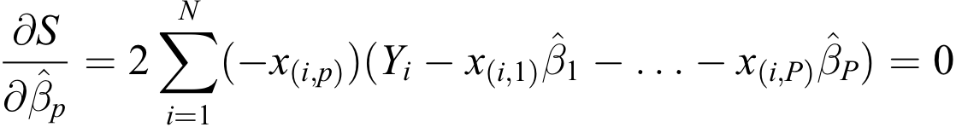
Parameter estimation
Iff residual error is i.i.d. and Gaussian
Ordinary least squares (OLS)
minimise
w.r.t
(objective function)

Slide 16



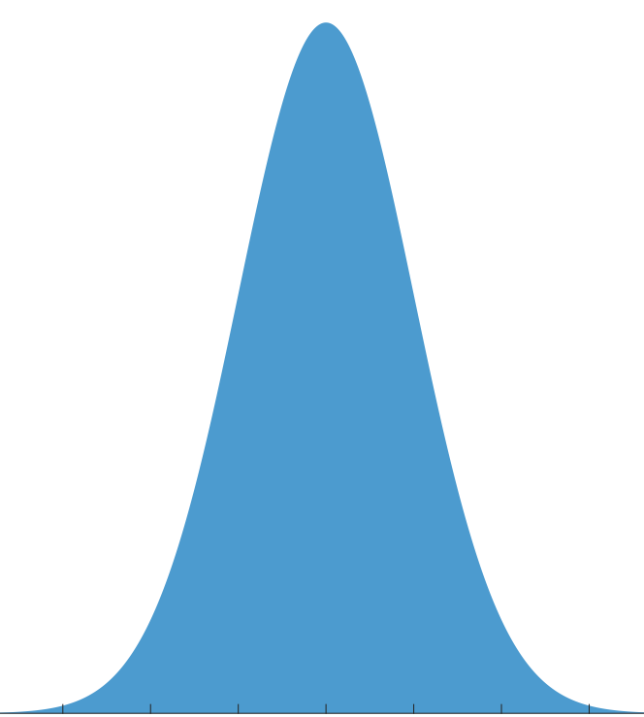
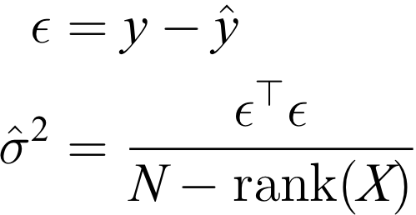
Parameter estimation
Parameter estimates
Normally distributed
Predicted responses
Variance (pooled)

Slide 17
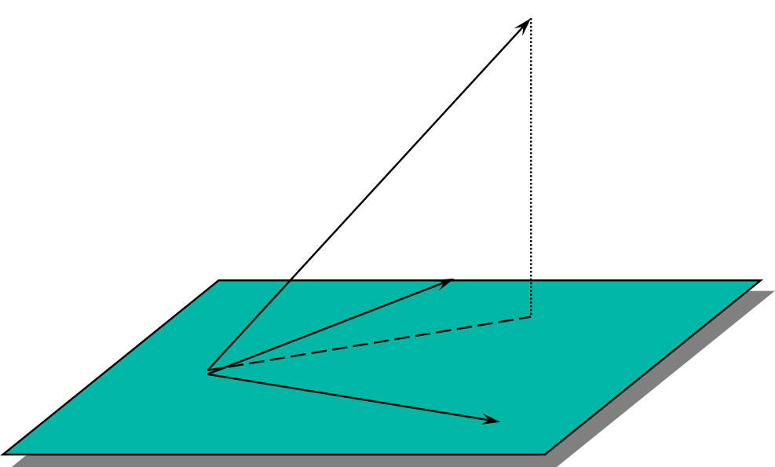








Parameter estimation: a geometric perspective
Ordinary least squares
Projection matrix
Residual forming matrix
Design space of X

Slide 18
Overview
Introduction
    SPM for MEG/EEG data
    ERP example
General linear model (GLM)
    Definition and design matrix
    Parameter estimation
Classical inference
    Contrasts and inference (t-tests and F-tests)
    Correlated regressors and orthogonalisation

Slide 19
Hypothesis testing
To test a hypothesis, we construct “test statistics”.
Null Hypothesis H₀
Typically what we want to disprove (no effect).
⇨ The Alternative Hypothesis H_{A} expresses outcome of interest.
Test Statistic T
The test statistic summarises evidence about H₀.
Typically, test statistic is small in magnitude when the hypothesis H₀ is true and large when false.
⇨ We need to know the distribution of T under the null hypothesis.
Null Distribution of T

Slide 20
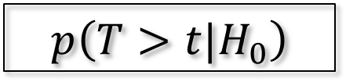
Hypothesis testing
u_{α}
Significance level α:
Acceptable false positive rate α.
⇨ threshold u_{α}
Threshold u_{α} controls the false positive rate
α
Null Distribution of T
Conclusion about the hypothesis:
We reject the null hypothesis in favour of the alternative hypothesis if t > u_{α}
t
p-value:
A p-value summarises evidence against H₀.
This is the chance of observing value more extreme than t under the null hypothesis.
p-value
Null Distribution of T
$$p\left(T>t|H_{0}\right)$$

Slide 21
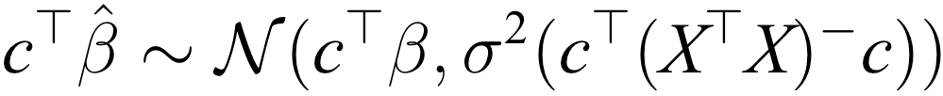
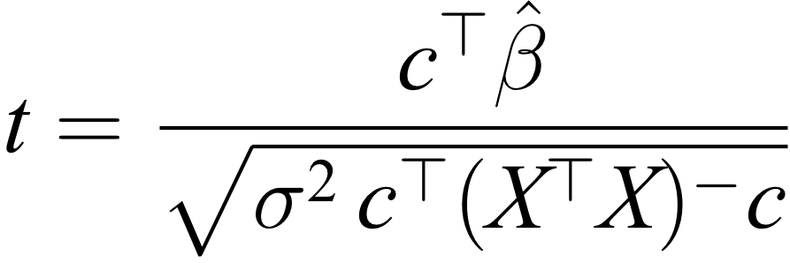
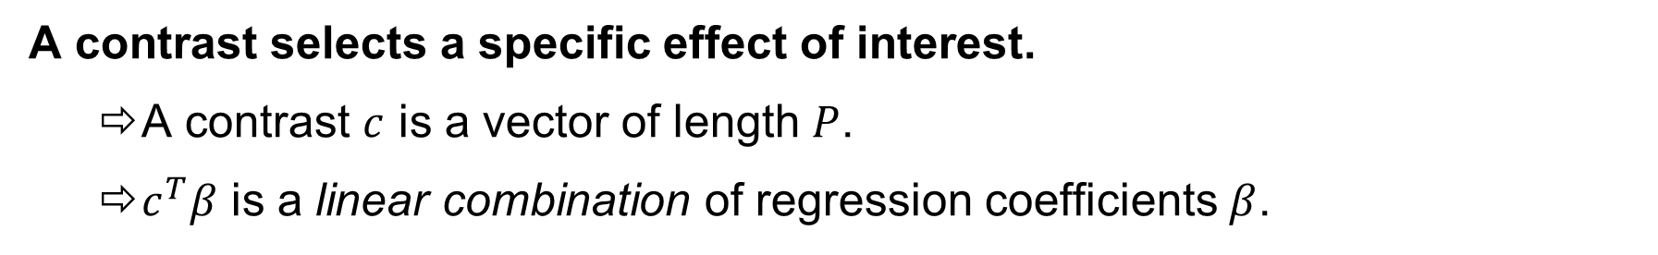
t-statistic
A contrast selects a specific effect of interest.
  A contrast $c$ is a vector of length $P$.
  $c^{T}β$ is a linear combination of regression coefficients $β$.
Contrast estimate is normally distributed
Size of effect
Variance of effect
Design efficiency

Slide 22

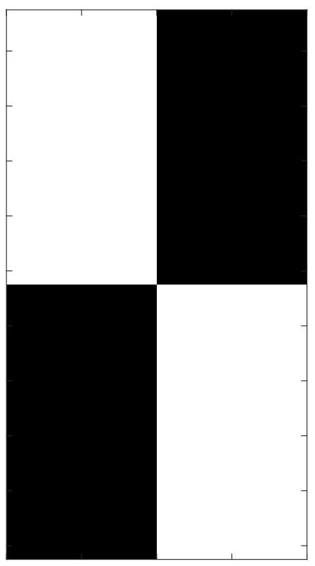




Two-sample t-test
Between-groups design
One-sided hypothesis test
voxel-wise
A
B
(null)
(alternative)
Linear combination of parameters
Constrast vector
SPM-t

Slide 23
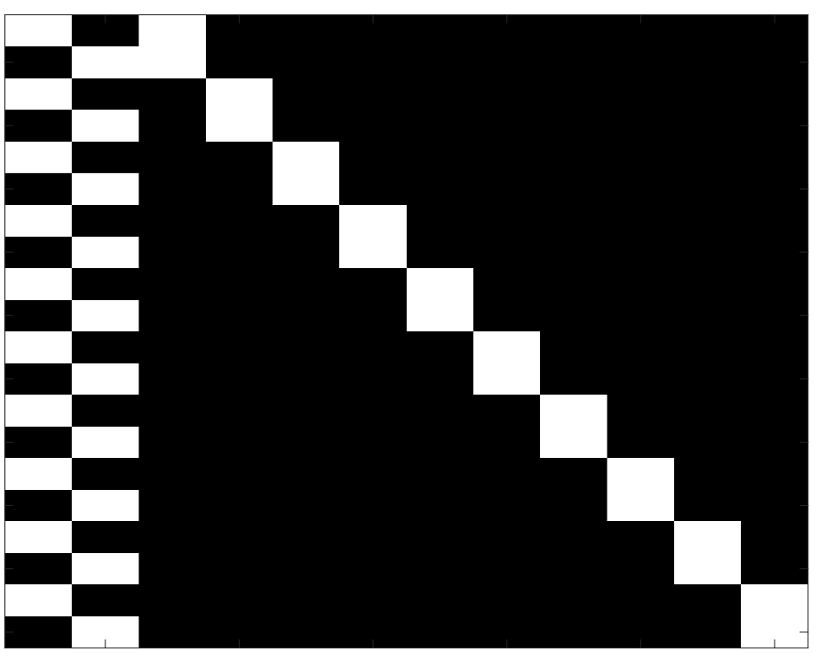

Paired t-test
Repeated-measures design
voxel-wise
A
B
Constrast
One-sided hypothesis test
(null)
(alternative)
SPM-t

Slide 24
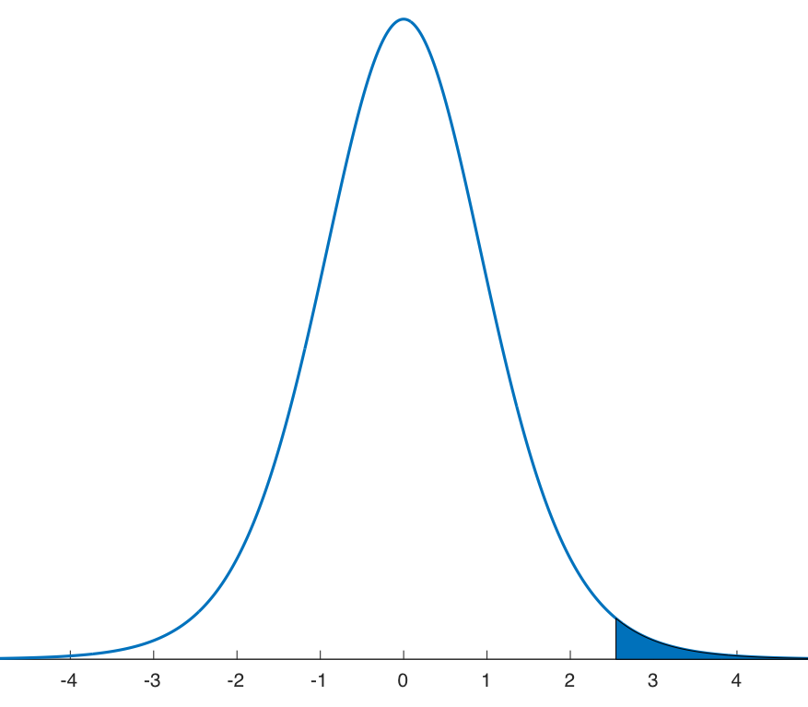

t-contrast
Constrast vector
voxel-wise
T null distribution
T statistic
P value (one-sided)

Slide 25
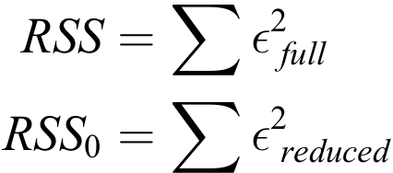




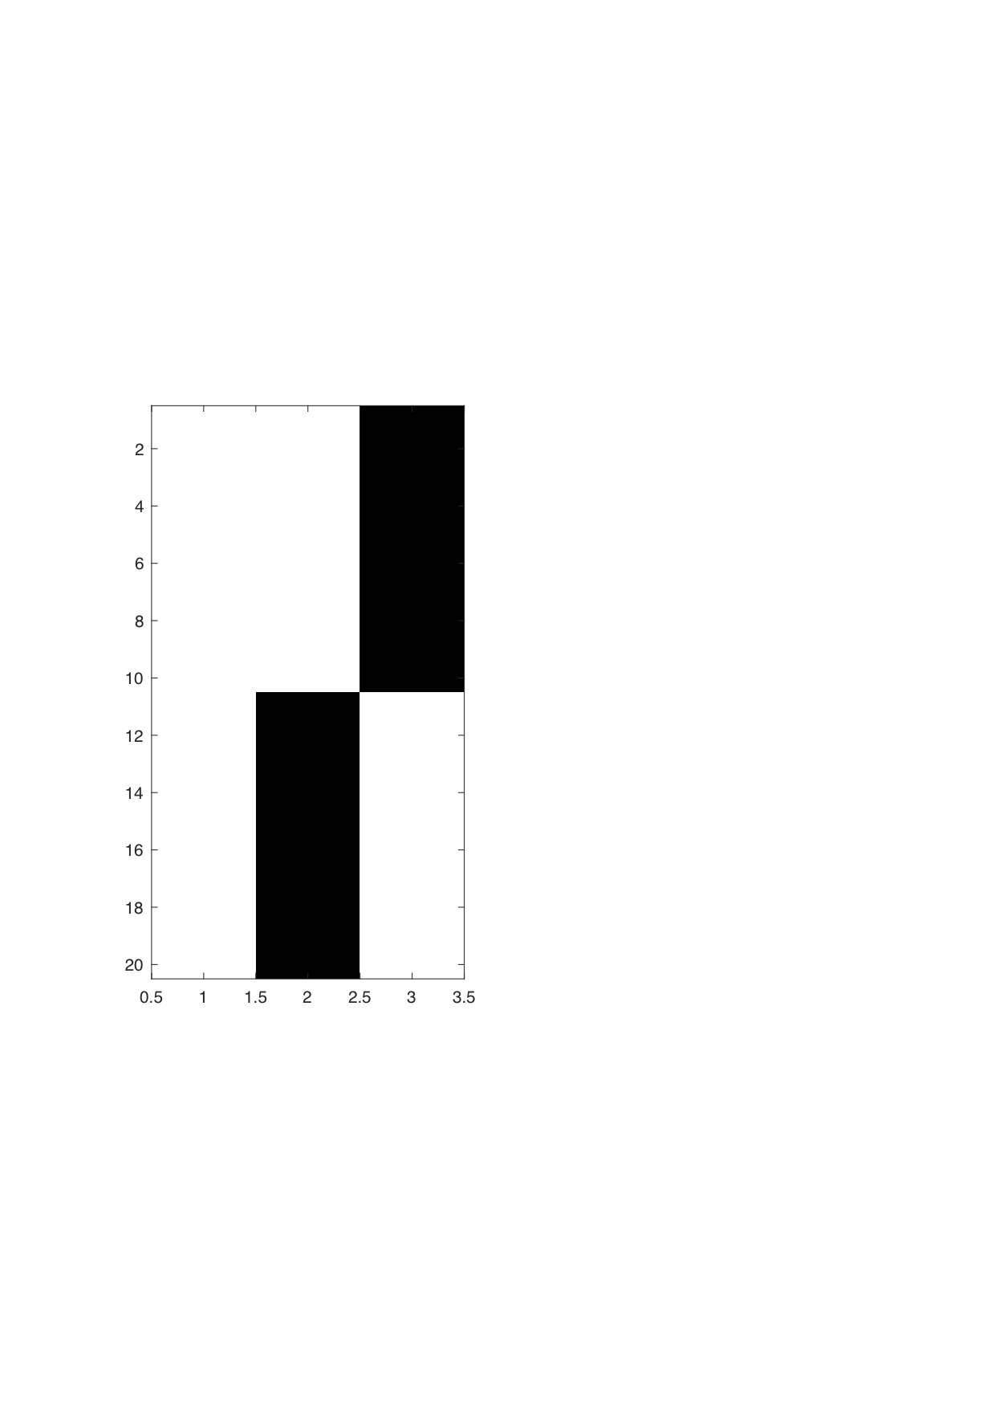
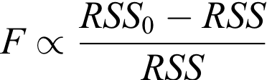
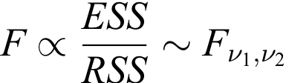
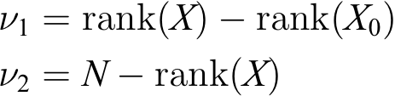
F-test: extra sum-of-squares principle
Full model
Reduced model
F-statistic
Degrees of freedom
(Design degrees of freedom)
(Error degrees of freedom)

Slide 26
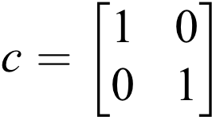
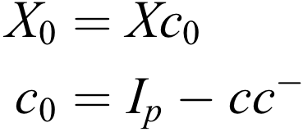
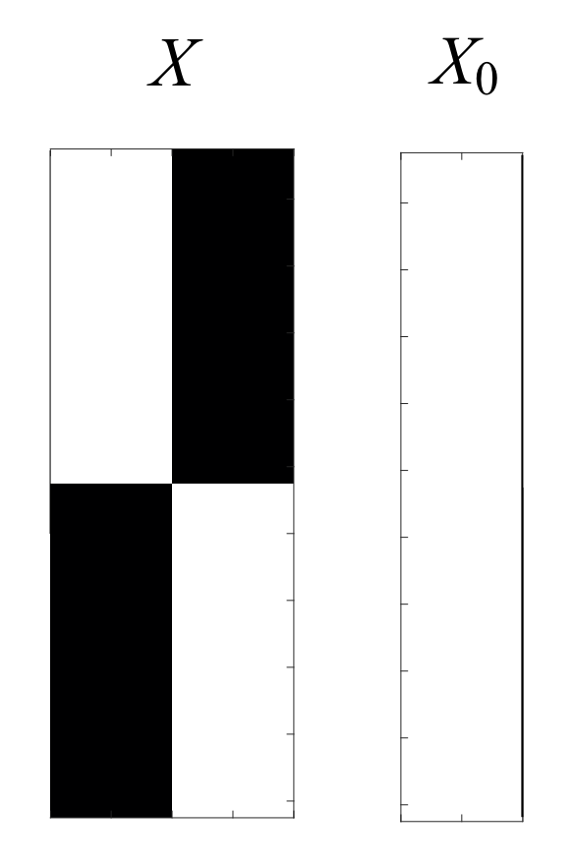
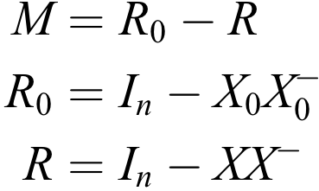
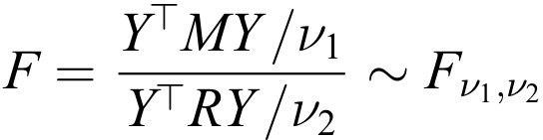
F-contrast
Contrast matrix
Reduced model
(Contrast orthogonal to c)
Projection matrix
(Residual forming matrix of X0 )
(Residual forming matrix of X )
F-statistic

Slide 27
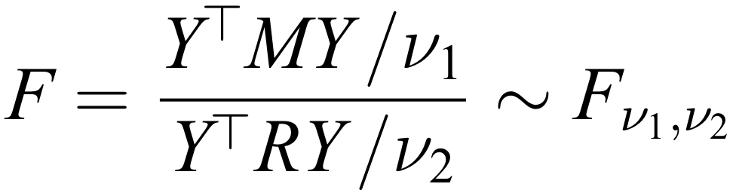
F-statistic
Variance explained by full model
Variance explained by reduced model
Degrees of freedom
(Design degrees of freedom)
(Error degrees of freedom)

Slide 28



F-test and uni-dimensional contrasts
SPM-F
Between-groups design
Constrast vector
A
B
Two-sided hypothesis test
(null)
(alternative)
Uni-dimensional test of parameters
Testing

Slide 29



F-test and multi-dimensional contrasts
SPM-F
Between-groups design
Constrast matrix
A
B
Two-sided hypothesis test
(null)
(alternative)
Multi-dimensional test of parameters
(at least one )

Slide 30
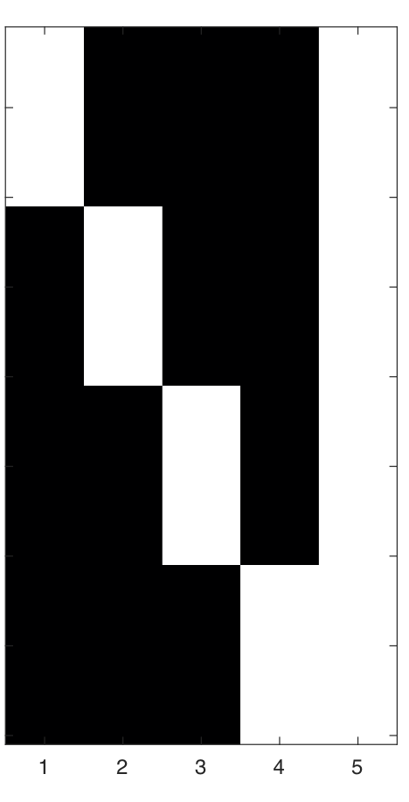
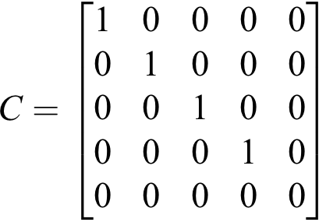
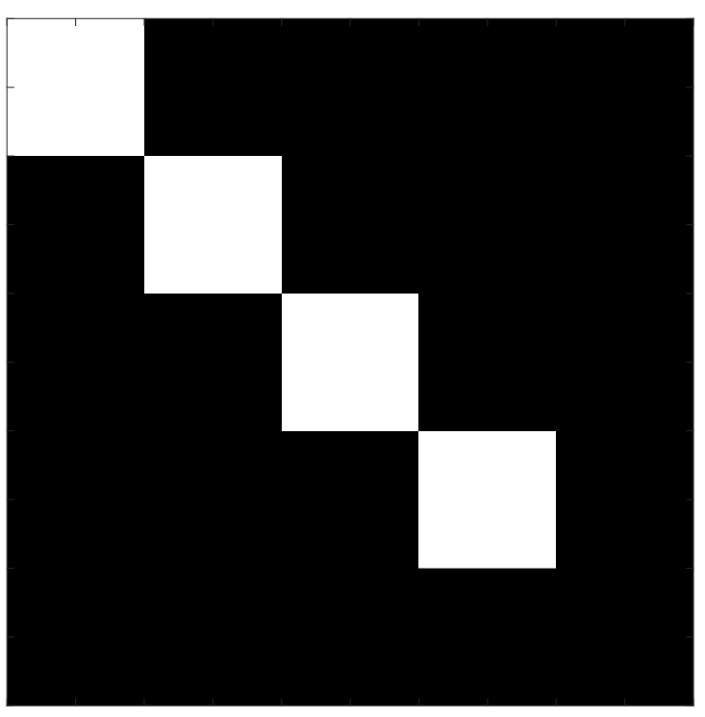

F-contrast: any effect
One-way ANOVA
Constrast matrix
Multi-dimensional hypothesis test
(at least one )

Slide 31
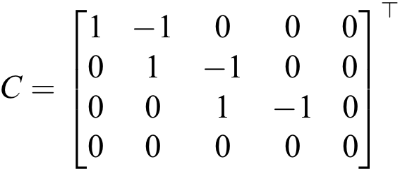
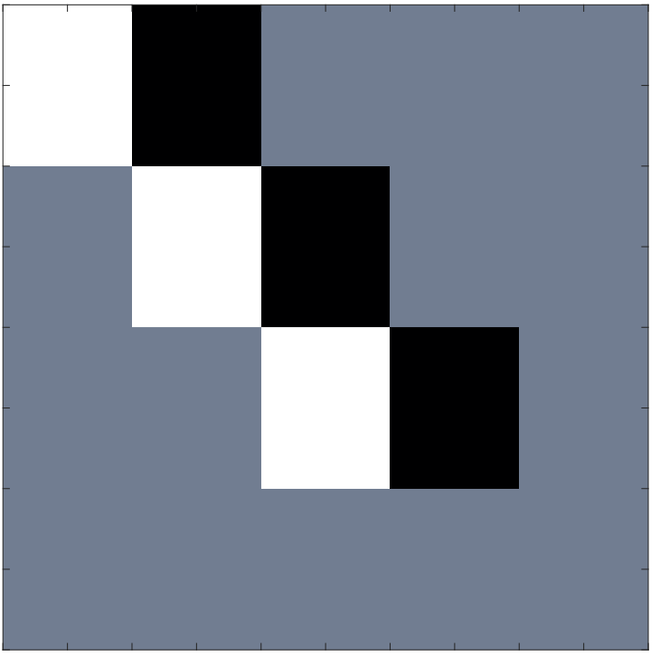


F-contrast: any difference
One-way ANOVA
Constrast matrix
Multi-dimensional hypothesis test
(at least one contrast)

Slide 32
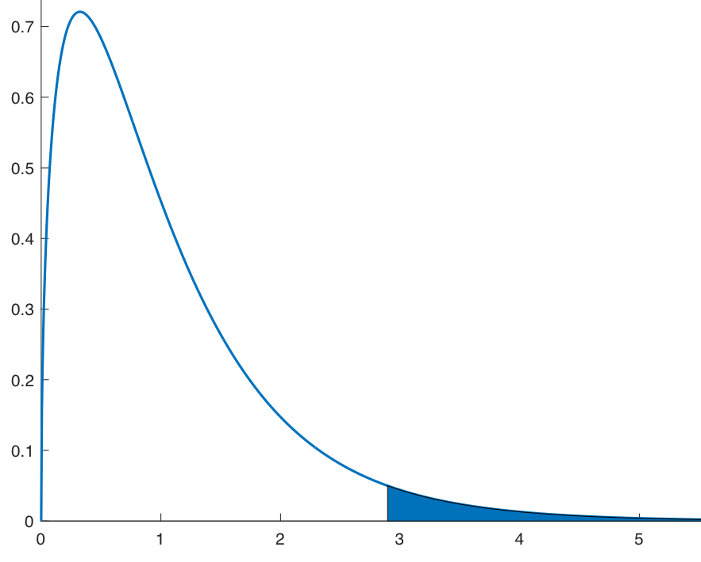


F-contrast
Constrast matrix
voxel-wise
F null distribution
F statistic
P value

Slide 33
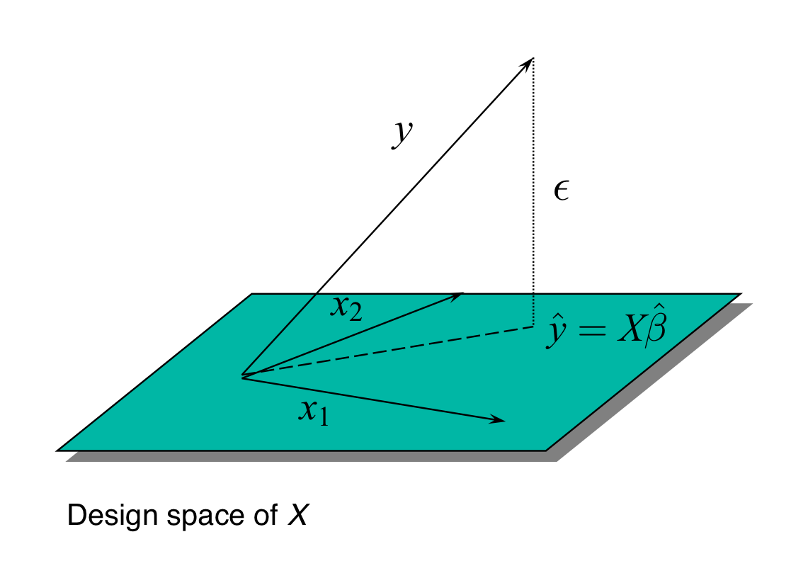
GLM summary
Special cases of the GLM
    t-test
    F-test
    multiple regression
    Analysis of variance (ANOVA)
    Analysis of covariance (AnCova)

Slide 34


Orthogonal regressors
Design matrix
Variance explained by
Variance explained by

Slide 35



Correlated regressors
Regression model
Explained variance shared between regressors

Slide 36
Correlated regressors
Testing for
Variance explained by
Variance explained by
Explained variance shared between regressors

Slide 37
Correlated regressors
Testing for
Variance explained by
Variance explained by
Explained variance shared between regressors

Slide 38


Correlated regressors
Variability described by $X_{1}$
Variability described by $X_{2}$

Slide 39



Correlated regressors
Variability described by $X_{1}$
Variability described by $X_{2}$
Testing for $X_{1}$ is very inefficient!

Slide 40




Orthogonalised regressors
Regression model

Slide 41





Orthogonalised regressors
Regression model
Gram-Schmidt
orthogonalisation
Unique parameters estimates

Slide 42



Correlated regressors
Test full subspace of Xc

Slide 43
Overview of SPM for M/EEG
Design matrix
Statistical parametric map (SPM)
Preprocessing
Filtering
Epoching
Re-referencing
Artefact rejection
Averaging
…
General linear model
Inference and correction for multiple comparisons
Image conversion
Parameter estimates
Contrast
frequency
Scalp-time
time

Slide 44


Thanks to
SPM methods group and collaborators
Bernadette van Wijk
Christoph Mathys
Christophe Phillips
Gareth Barnes
Guillaume Flandin
James Kilner
Karl Friston
Marta Garrido
Martin Dietz
Peter Zeidman
Rik Henson
Vladimir Litvak
Will Penny
Stefan Kiebel
Torben Lund

