Slide 1
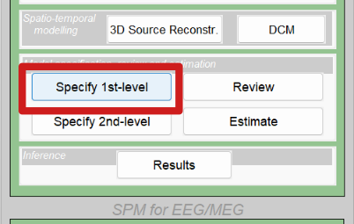
Convolution modelling
Johan Medrano
SPM

Slide 2
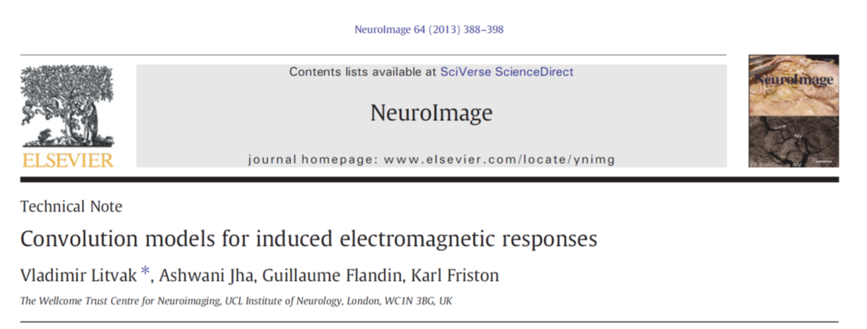
SPM

Slide 3
What are we trying to do?
SPM
Modeling signals with either
  No trivial baseline
  Overlap between consecutive responses
  Systematic differences in response timing
  No trivial way to form epochs (naturalistic experiments)

Slide 4
A first example
SPM
What is the MEG correlate of ‘stopping a planned movement’?
Parameterise behaviour:
stop-signal task
Record neural activity:
MEG
Behavioural contrast of interest:
Isolate stopping
Apply equivalent contrast to MEG data
MEG correlate of stopping

Slide 5

The stop-signal task
SPM
GO trial
STOP trial
trial n
+
trial n+1
+
>
<
Go signal
Go signal
X
Stop signal
SOA
time
time
X
response
response
‘Error’
‘Correct’

Slide 6
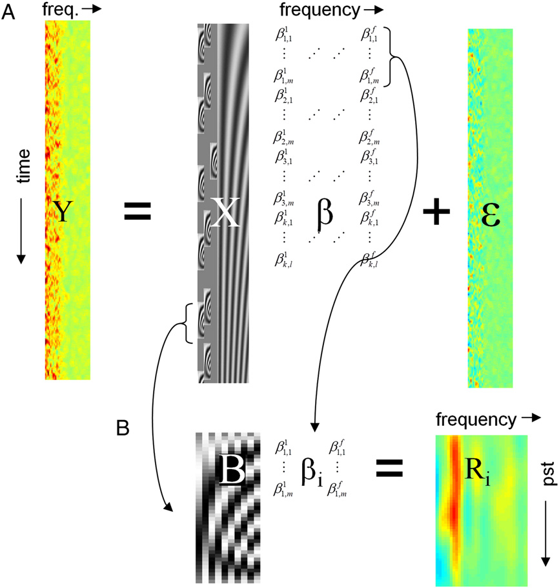

Pitfalls of the conventional approach
SPM
TF MEG
+
>
+
+
>
+
+
>
>
+
>
X
>
‘Correct’
+
>
+
+
>
>
X
+
+
>
+
>
>
‘Error’
Trial-based method
Cut into trials
Average response over trials
Compare across conditions
All sorts of problems:
Temporally overlapping neural responses
Where do you put the baseline?
Variable (absent) response timings

Slide 7

A different approach
SPM
TF MEG
+
>
+
X
+
X
+
>
All trials
+
>
X
X
PST
Accounts for temporally overlapping responses and differences in response timings
(beware of correlation)

Slide 8

First steps towards GLM
SPM
X
β
+
ε
Y
At different frequencies

Slide 9
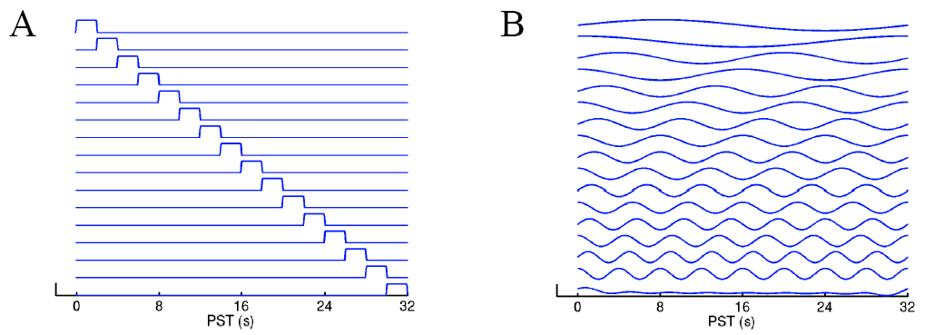
Temporal basis functions
SPM
Represent a signal as a weighted sum of basis functions
Linear composition, can be used in a GLM
Finite Impulse Response set
Fourier set

Slide 10

Temporal basis functions
SPM
Represent a signal as a weighted sum of basis functions
Linear composition, can be used in a GLM
Basis set
Weights
Signal
+
...
PST

Slide 11
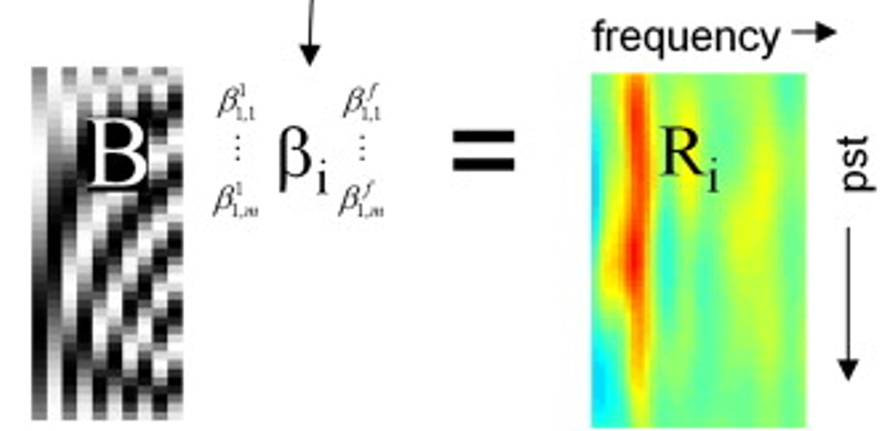
Temporal basis functions
SPM
PST

Slide 12
Updating our previous design...
SPM
TF MEG
+
>
+
X
+
X
+
>
All trials
+
>
X
X
PST

Slide 13
Updating our previous design...
SPM
TF MEG
+
>
+
X
+
X
+
>
All trials
+
>
U
X

Slide 14
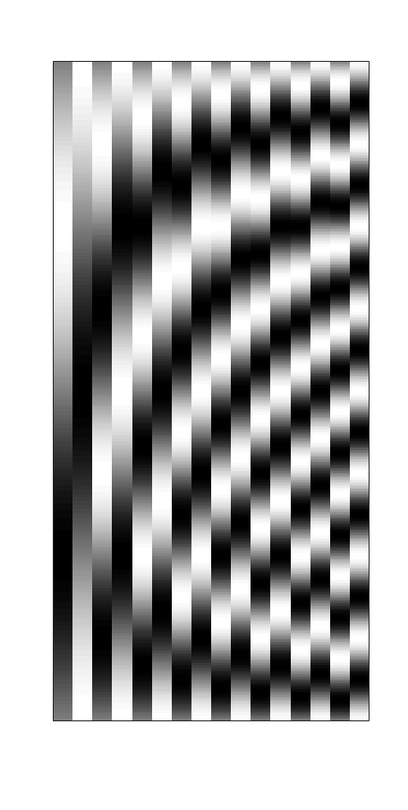
Updating our previous design...
SPM
+
>
U B
X
∗
PST
Convolution !
X

Slide 15

SPM
Updating our previous design...
TF MEG
+
>
+
X
+
X
+
>
All trials
+
>
X
X
PST

Slide 16
SPM
Updating our previous design...
TF MEG
+
>
+
X
+
X
+
>
All trials
+
>
X
X
PST
baseline drift

Slide 17
The convolution GLM
SPM

Slide 18
The convolution GLM
SPM
Beware the autocorrelations!

Slide 19
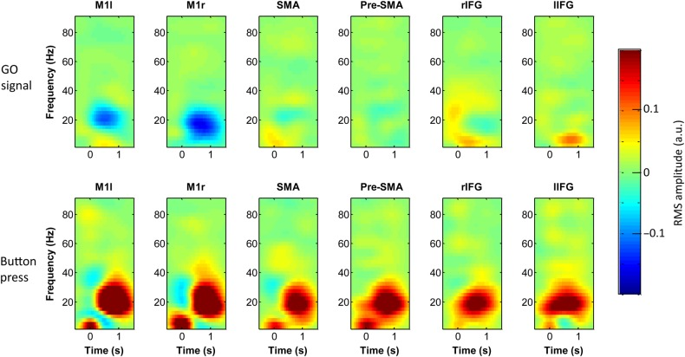
Extracted responses
SPM
>

Slide 20


From first to second level
SPM
Take contrasts of interest to second level
Subject
First-level convolution model
+
>
X
>
1
>
2
3

Slide 21
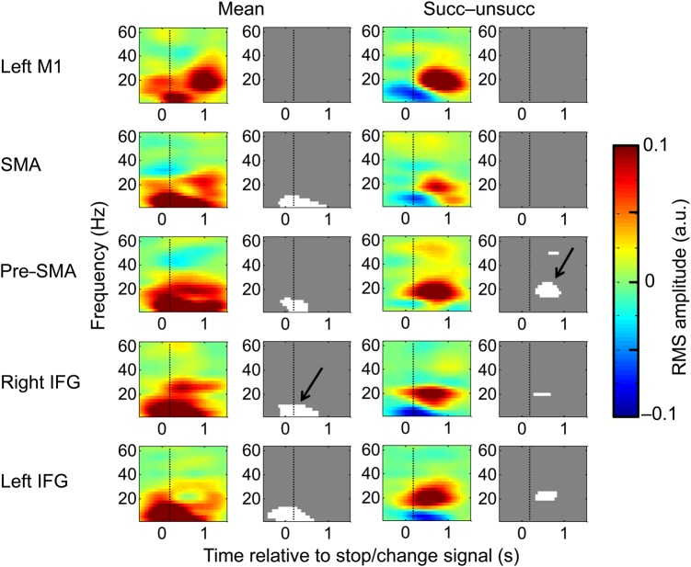
Statistical analysis
SPM

Slide 22
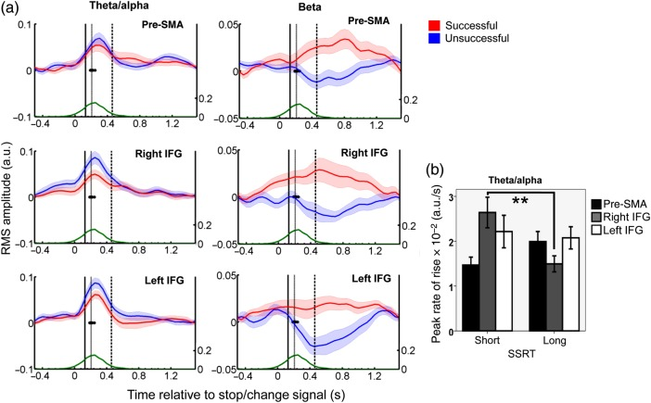
Statistical analysis
SPM
"Stop signal was associated with a global theta increase"
"Successful stops were associated with a beta increase in more frontal regions"

Slide 23
A second example: evoked responses
SPM
Supramodal integration task (visual, auditory, tactile)
N1
time
As short as 100ms
Delay: 3 seconds
N2
time
N1 > N2 or N1 < N2 ?

Slide 24
Overlapping responses
SPM
Stimuli:
time
Observed response:
M/EEG
time
Deconvolved response
peristimulus
time

Slide 25
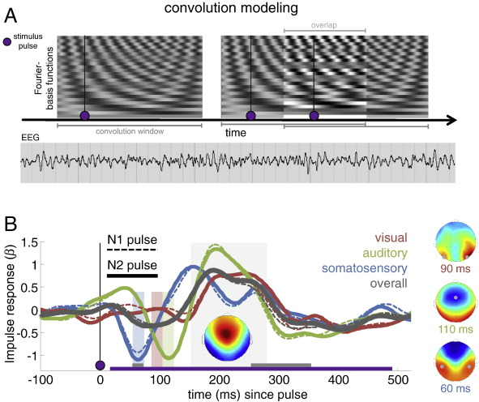
Applying convolution modelling
SPM

Slide 26
Deconvolved responses
SPM

Slide 27
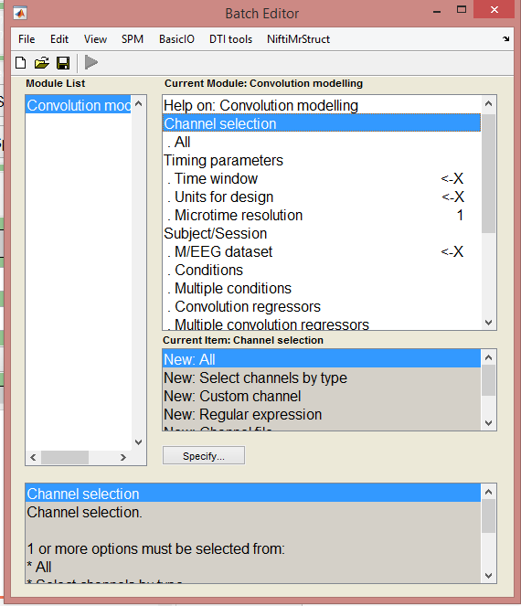
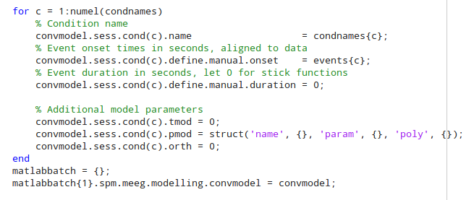
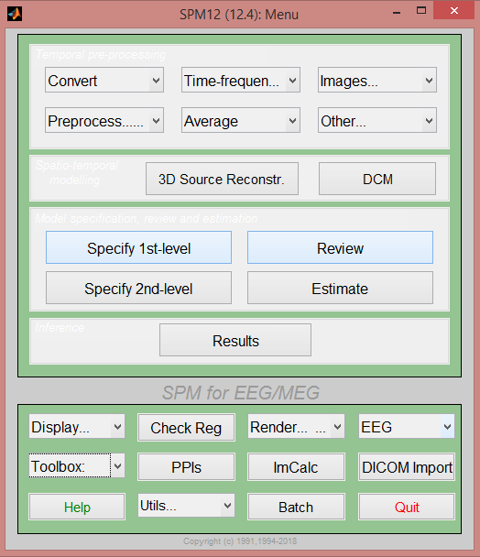
SPM implementation
SPM
Batch system with GUI/Script
Pick your favourite!

Slide 28
SPM
Summary
Sometimes the standard epoching approach doesn’t work, especially if:
  No well-defined baseline period
  Temporally overlapping neural responses (i.e. ‘long’ responses such as induced response and fMRI BOLD)
  Systematic differences in reaction times
A convolution model is better in these circumstances (but be careful of correlated regressors in trial-design)
Other advantages include the potential to model parametric regressors and continuous regressors.

Slide 29
Resources
SPM
References:
1) Litvak V, Jha A, Flandin G, Friston K. Convolution models for induced electromagnetic responses. Neuroimage. 2013 Jan 1;64:388-98. doi: 10.1016/j.neuroimage.2012.09.014
2) Jha A, Nachev P, Barnes G, Husain M, Brown P, Litvak V. The Frontal Control of Stopping. Cereb Cortex. 2015 Nov;25(11):4392-406. doi: 10.1093/cercor/bhv027
3) Spitzer B., Blankenburg F., Summerfield C. Rhythmic gain control during supramodal integration of approximate number. Neuroimage, 2016, 129:470-479
Tutorial in SPM docs/manual (GUI and script)

