Slide 1
Analysis of Optically Pumped Magnetometer (OPM) Data
Stephanie Mellor

Slide 2
Contents
Why use OPMs?
How does an OPM work?
What does that mean for data analysis?
The existing SPM M/EEG functions are still valid. We only need to think about how we apply them slightly differently

Slide 3
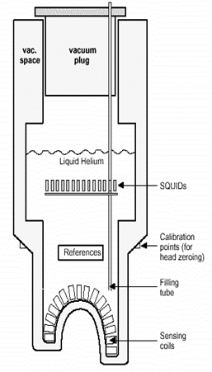
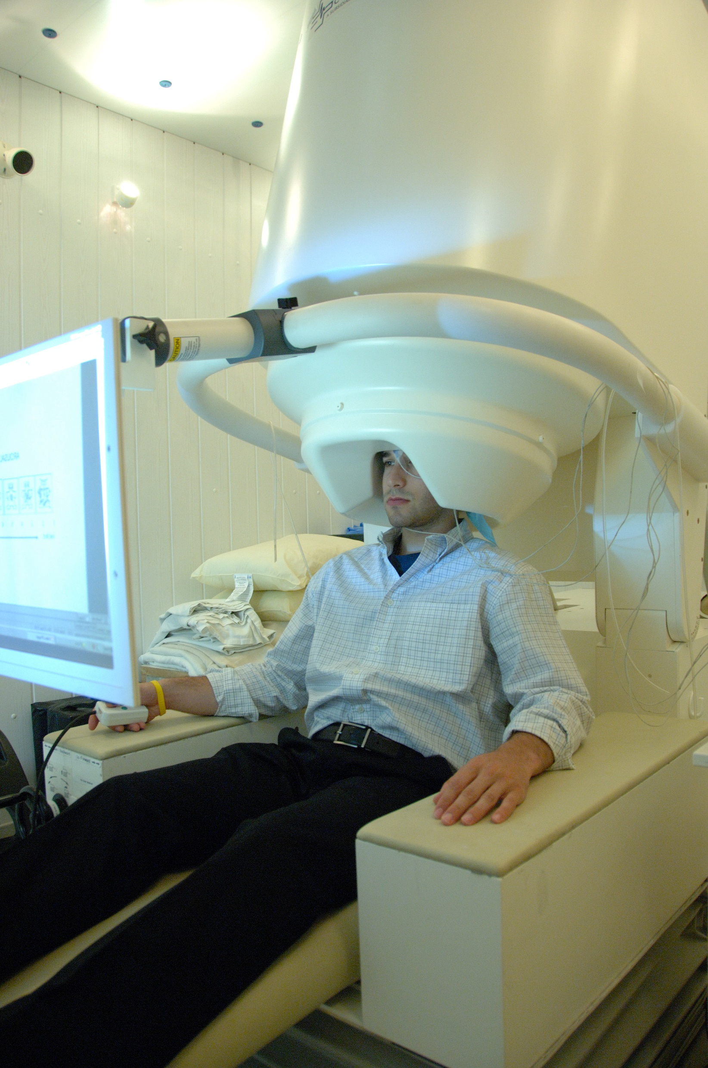
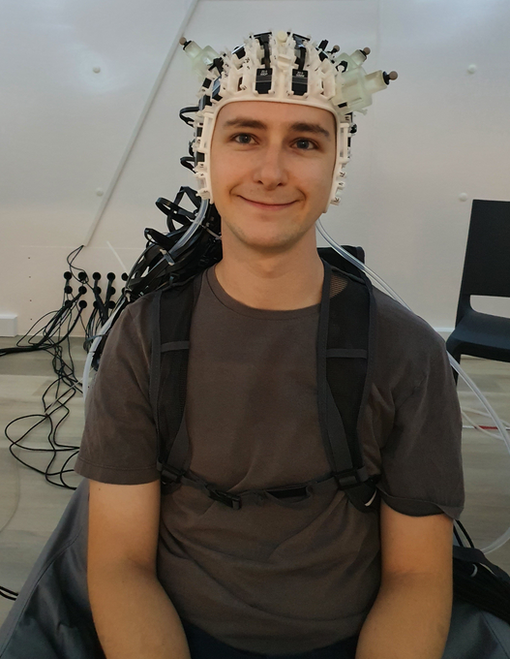
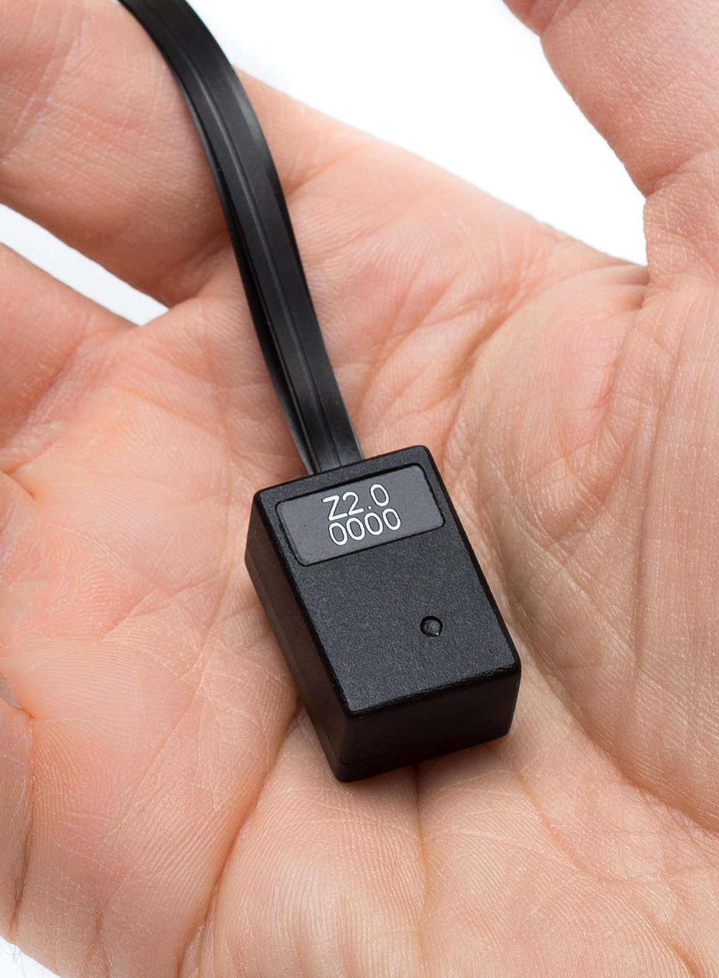
QuSpin
National Institute of Mental Health, NIH

Slide 4
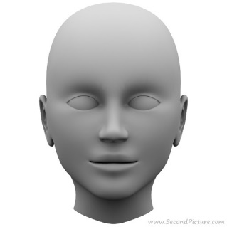
Why Use OPMs?
Wearability 1 – Higher Signal

Slide 5
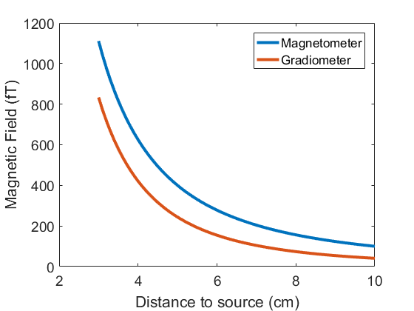
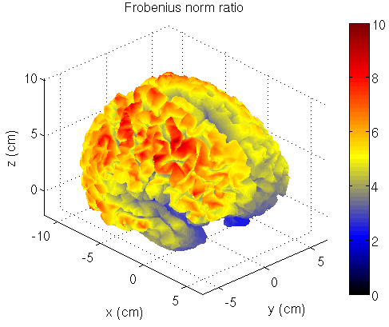

Why Use OPMs?
Wearability 1 – Higher Signal
~4 times increase
Ideal/SQUID lead field norm
~2$×$
Boto et al. 2016

Slide 6
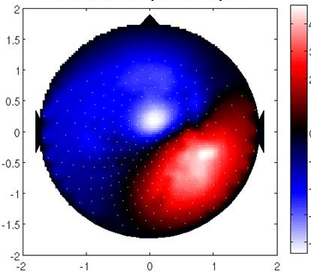
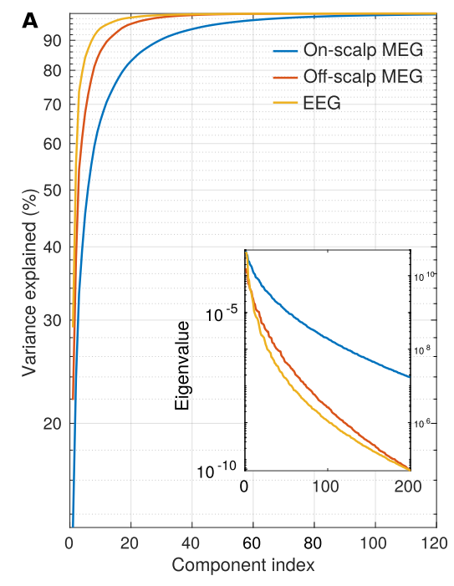
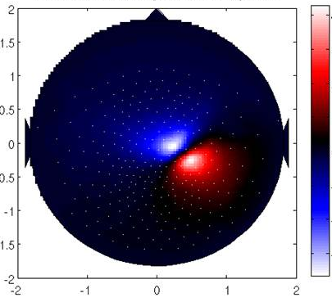
Why Use OPMs?
Wearability 2 – Spatial Information
4fT
0
-4
40fT
0
-40
Iivanainen et al (2019)

Slide 7
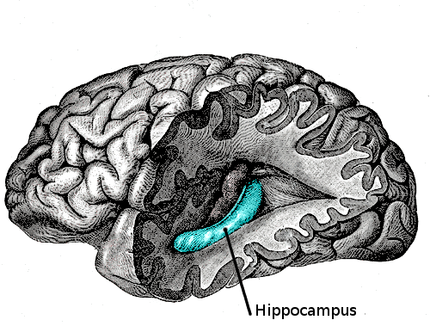
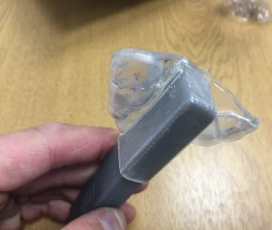
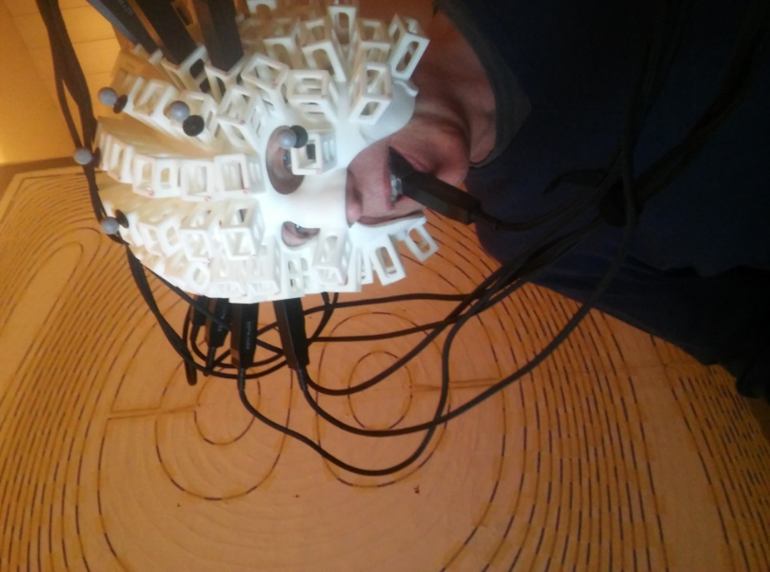
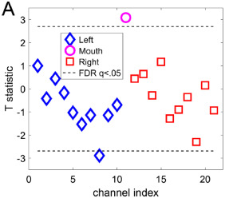
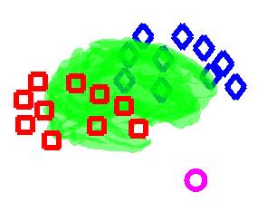
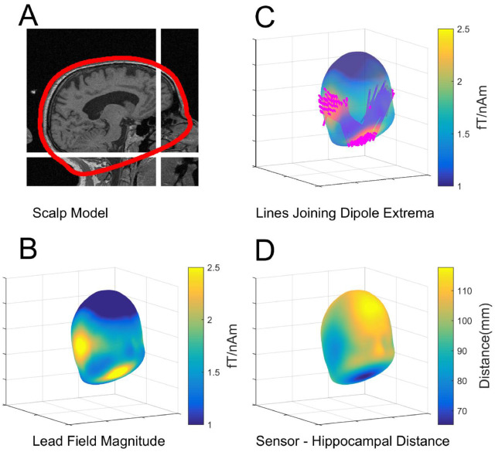
Why Use OPMs?
Flexible Sensor Placement
A
B
C
Tierney et al., 2021, NeuroImage “Mouth Magnetoencephalography: A Unique Perspective on the Human Hippocampus.”

Slide 8
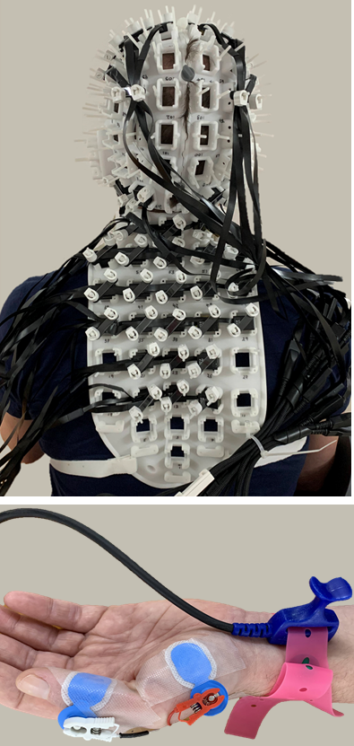
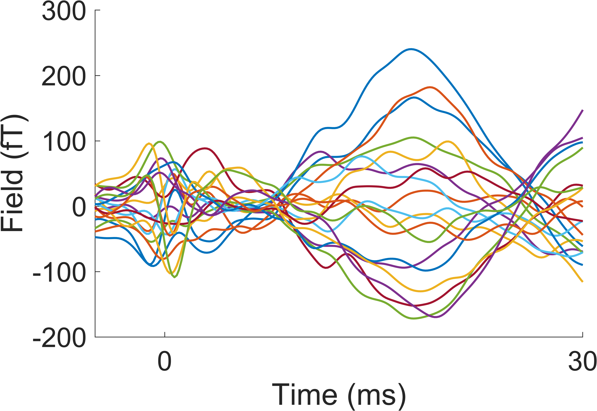
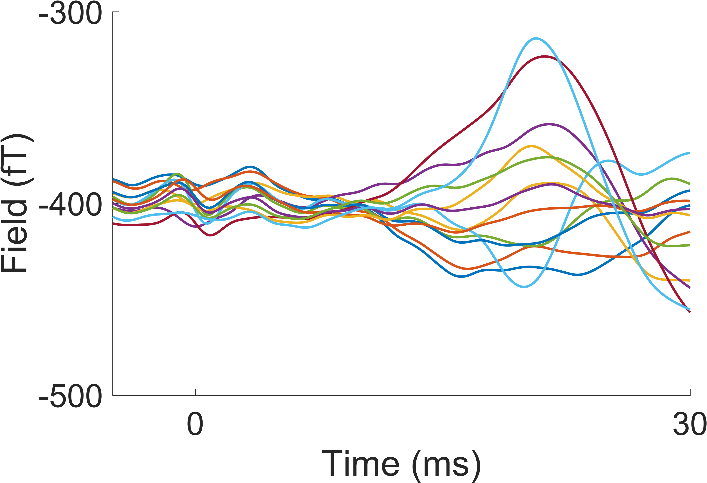
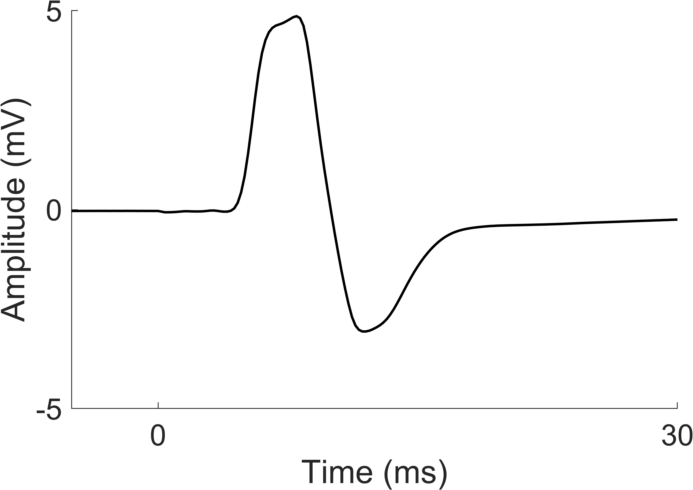
Why Use OPMs?
Flexible Sensor Placement
Spinal cord
Brain
EMG
Mardell et al., submitted
Mardell et al., 2022 BioRxiv
Notes:
Spinal MEG

Slide 9
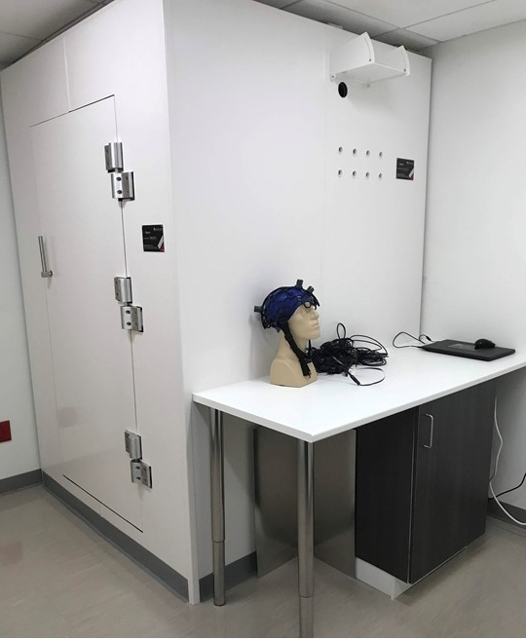
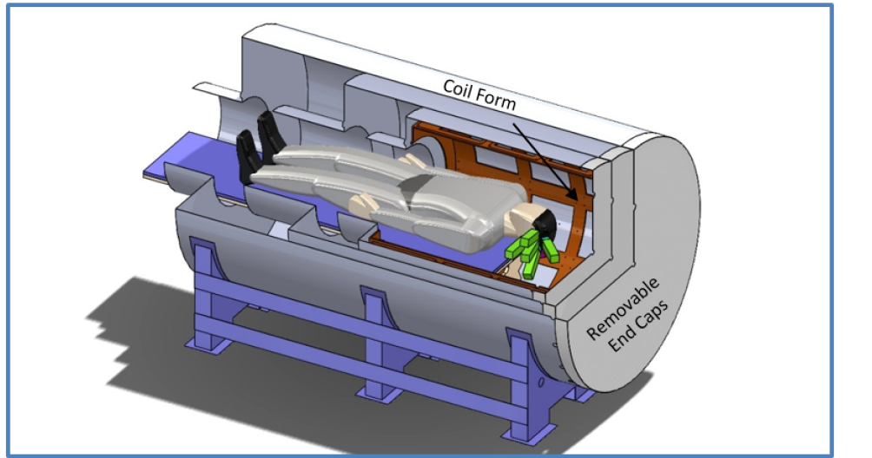
Why Use OPMs?
Space Requirements
2 m
1.3 m
1.3 m
4.3 m
3.5 m
MSL & QuSpin
Borna, 2017
National Institute of Mental Health, NIH

Slide 10
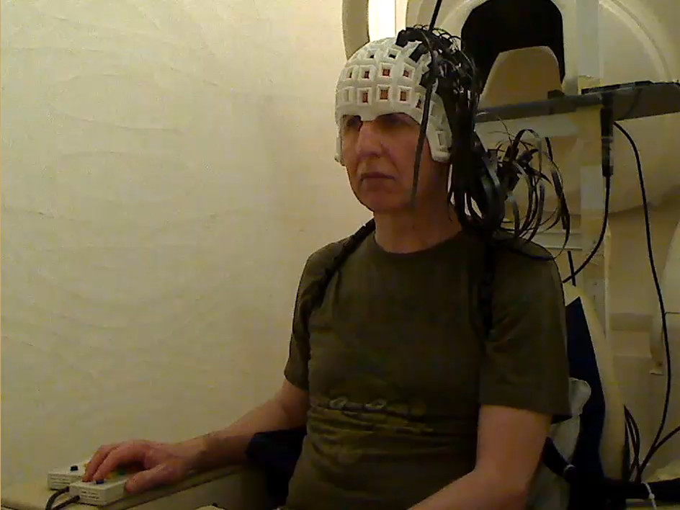
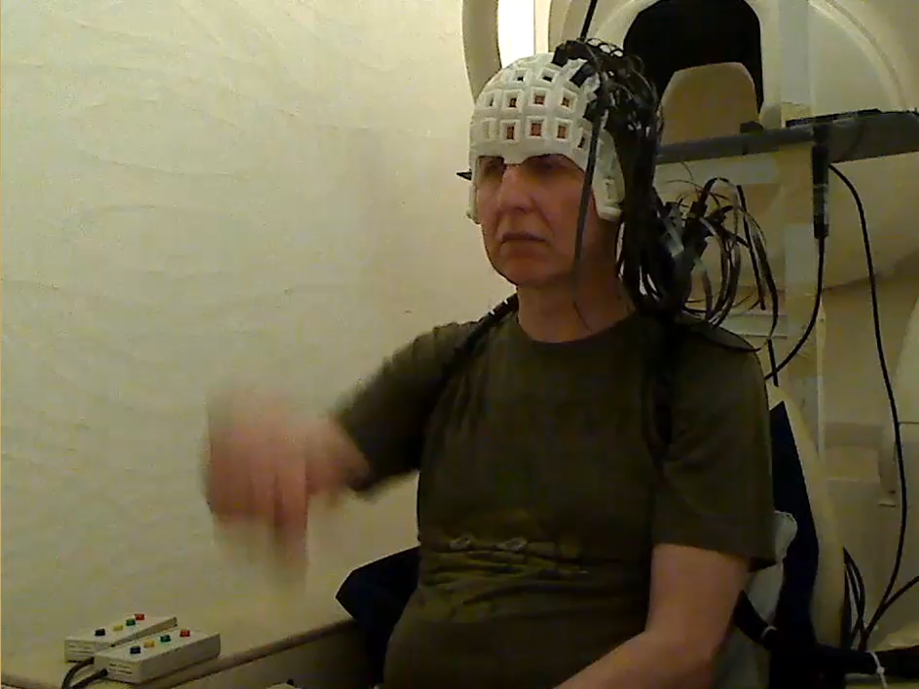
Why Use OPMs?
Movement
Evoked response to button press

Slide 11
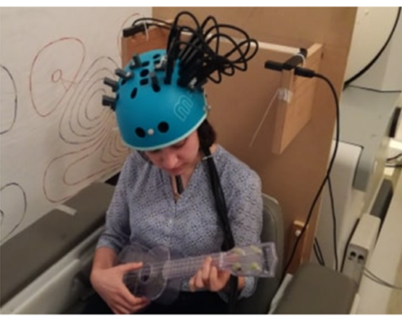
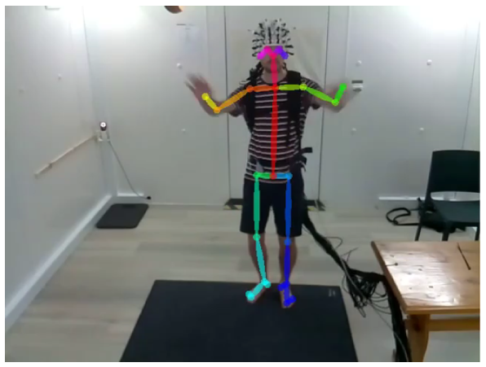
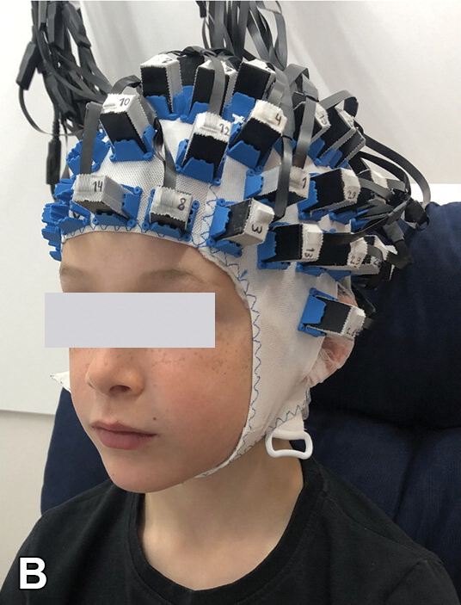
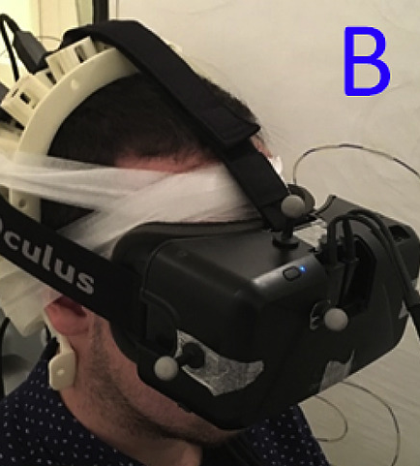
Why Use OPMs?
Movement
Hill et al., 2019
O’Neill et al., in prep
Feys et al., 2022
Roberts et al., 2019
Notes:
Exciting new experiments

Slide 12
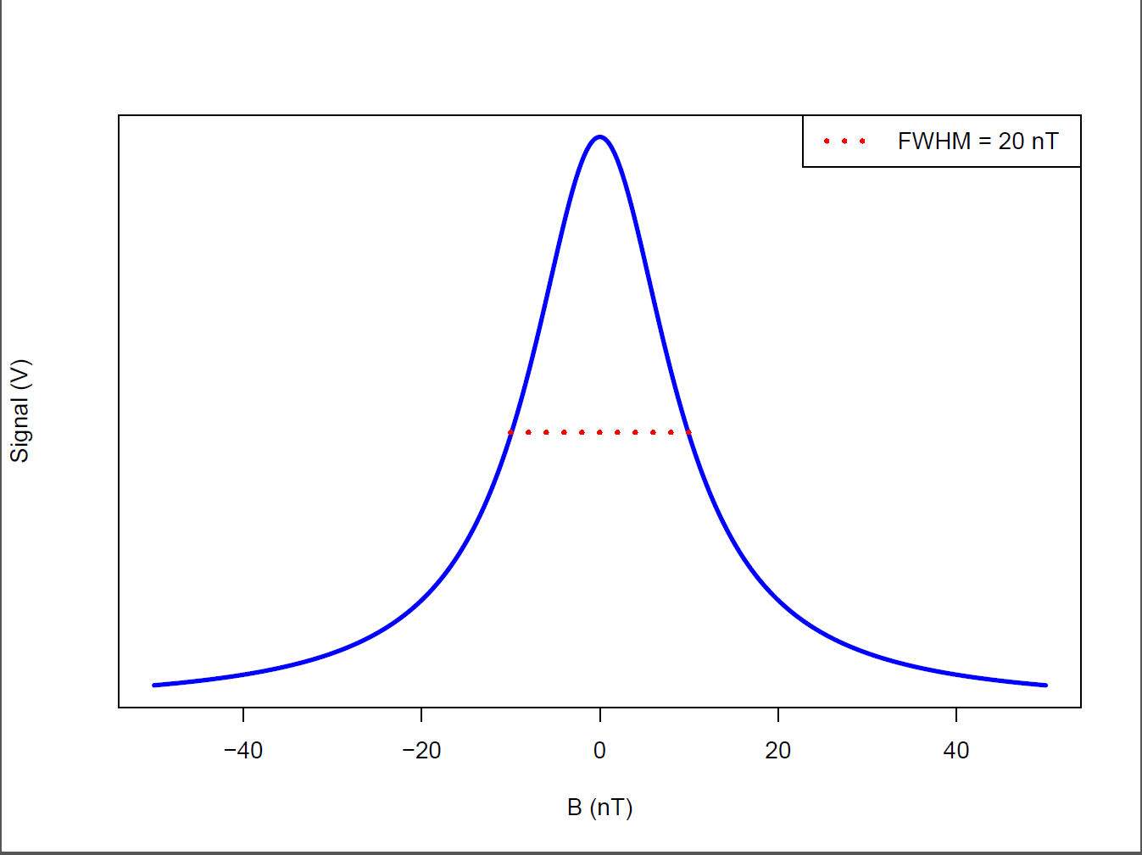
How does an OPM work?
Laser
Gaseous Rb⁸⁷
Photodiode
The laser pumps the Rubidium into a higher energy state, where the spin of each atom is aligned
Once aligned, the gas is transparent to laser light
A magnetic field transverse to the laser beam will knock atoms out of this energy state
The laser can then do work to bring the vapour back to this higher energy state. This uses energy and means less laser light arrives at the photodiode.
Output (V)
-20 0 20
Applied field (nT)
Notes:
Good morning everyone – I am going to be talking about Realising the advantages of OPM-MEG using Scanner casts and data modelling. This project is a collaborative project between UCL and and UON funded by the Wellcome trust. This talk will focus on the UCL side of the collaboration with with the aim of highlighting how we might make a transition to using OPM-MEG as a clinical tool.

Slide 13

How does an OPM work?
Spin Exchange Relaxation Free (SERF)
B
Notes:
Conditions for an OPM to work

Slide 14
How does an OPM work?
Spin Exchange Relaxation Free (SERF)
B
Notes:
Conditions for an OPM to work

Slide 15
How does an OPM work?
Spin Exchange Relaxation Free (SERF)
Short relaxation time
B
Long relaxation time
Notes:
Conditions for an OPM to work

Slide 16
How does an OPM work?
Spin Exchange Relaxation Free (SERF)
B
Increase the number of collisions by:
Increasing the density of the gas
Increasing the temperature
Notes:
Conditions for an OPM to work

Slide 17


How does an OPM work?
SERF
Reducing the magnetic field increases the time for atomic precession,
more collisions per precession
no net polarisation change in one precession
$$⇒$$
B
$$⇒$$
Notes:
Conditions for an OPM to work

Slide 18
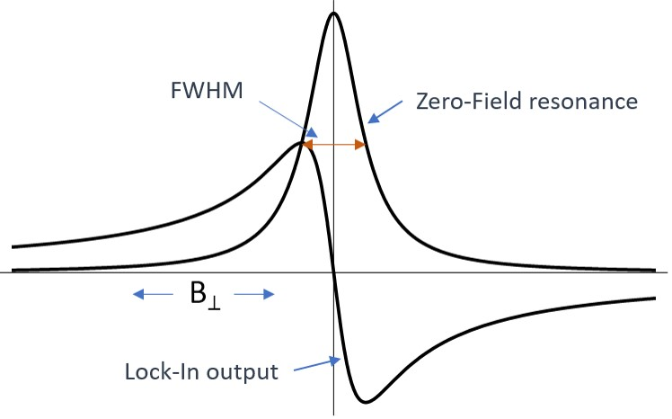
How does an OPM work?
Laser
Gaseous Rb⁸⁷
Photodiode
Conditions for SERF:
  Dense gas
  High temperature
  Zero (or extremely low) magnetic field
Apply an oscillating electric field and you can infer the direction of the magnetic field from the photodiode output
Output (V)
-20 0 20
Applied field (nT)
Notes:
Good morning everyone – I am going to be talking about Realising the advantages of OPM-MEG using Scanner casts and data modelling. This project is a collaborative project between UCL and and UON funded by the Wellcome trust. This talk will focus on the UCL side of the collaboration with with the aim of highlighting how we might make a transition to using OPM-MEG as a clinical tool.

Slide 19
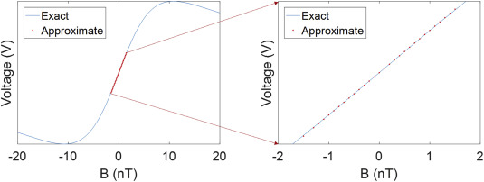
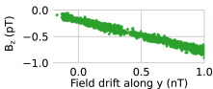

How does an OPM work?
Linearity and CAPE
Signal of interest
$$Y=K_{1}\left[\frac{ω_{z}τ}{1+ω_{z}^{2}τ^{2}}−K_{2}\left\{\frac{ω_{z}τ}{{\left(1+ω_{z}^{2}τ^{2}\right)}^{2}}\left(ω_{x}^{2}τ^{2}+ω_{y}^{2}τ^{2}\right)+\frac{ω_{x}τω_{y}τ}{1+ω_{z}^{2}τ^{2}}\right\} + ⋯\right]$$
$$ω_{z}$$
Non-linearity
Cross-axis terms
Change OPM gain and effective recording axis
Field change along axis of interest
Cross axis terms
Tim M. Tierney et al., ‘Optically Pumped Magnetometers: From Quantum Origins to Multi-Channel Magnetoencephalography’, NeuroImage (2019)
Joonas Iivanainen et al., ‘On-Scalp MEG System Utilizing an Actively Shielded Array of Optically-Pumped Magnetometers’, NeuroImage (2019)

Slide 20
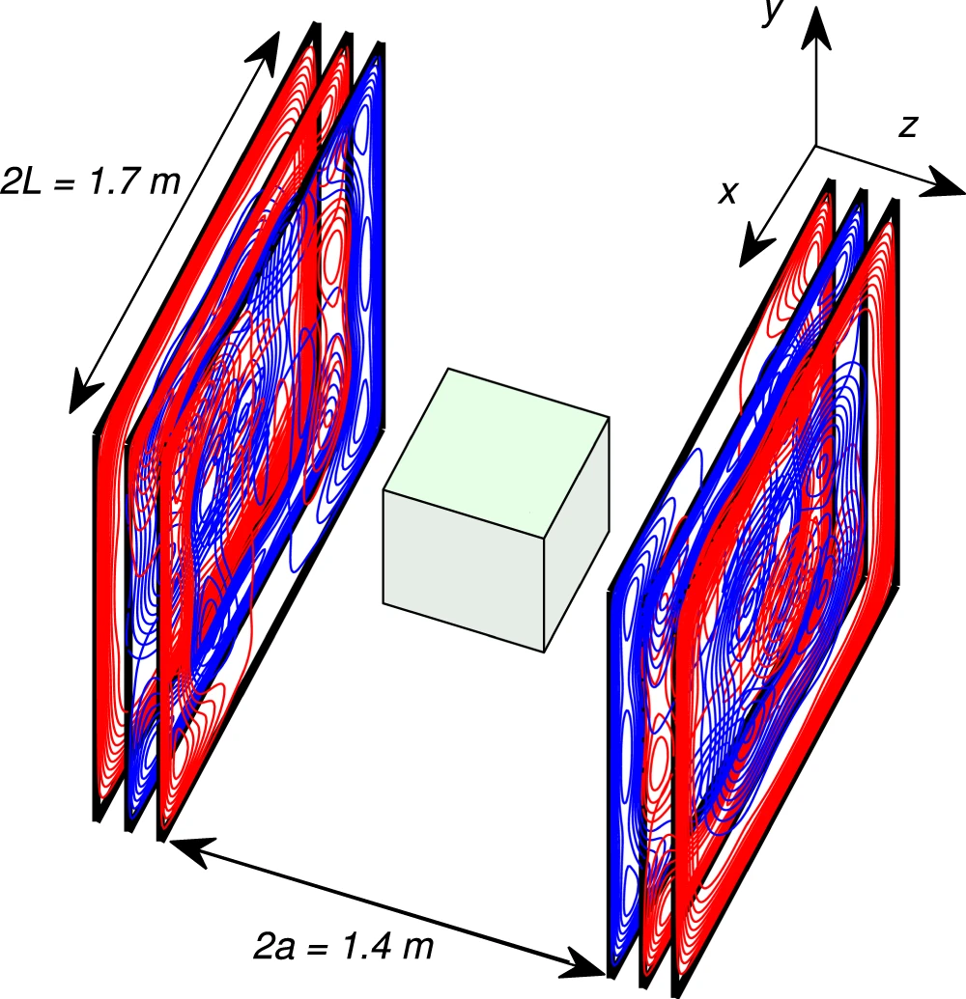
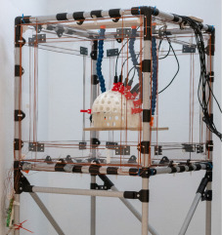
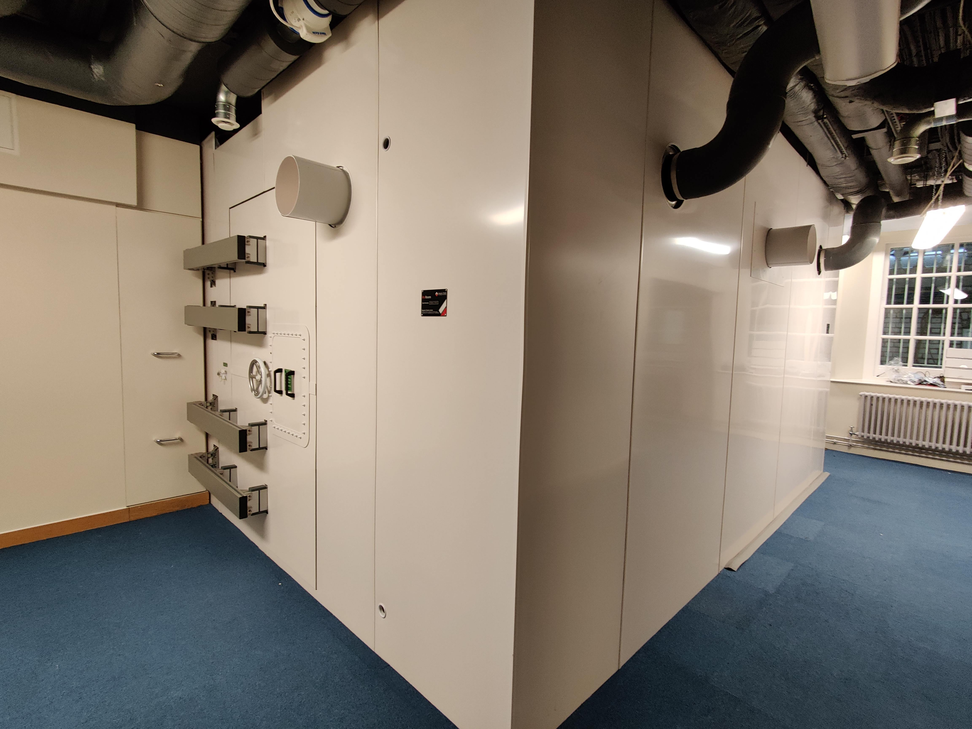
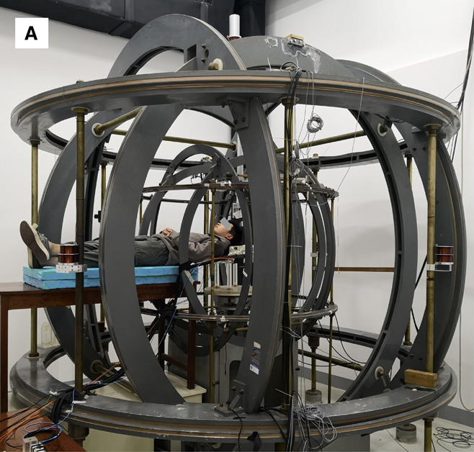
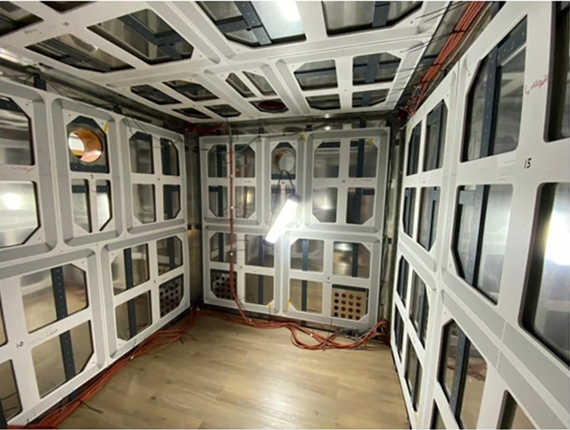
Conditions for OP-MEG
A low-field environment
Iivanainen et al., 2019
Holmes et al. 2019
Holmes et al. 2022
Zhang et al., 2020

Slide 21
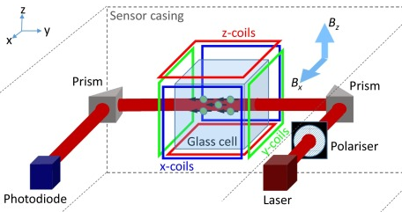
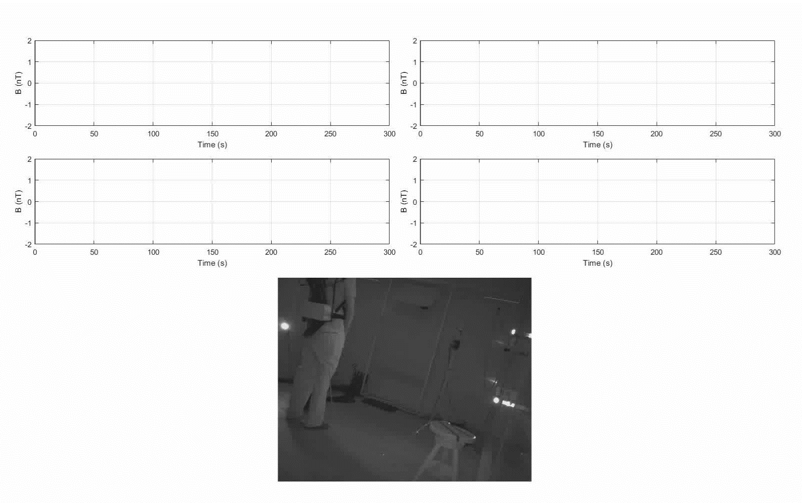
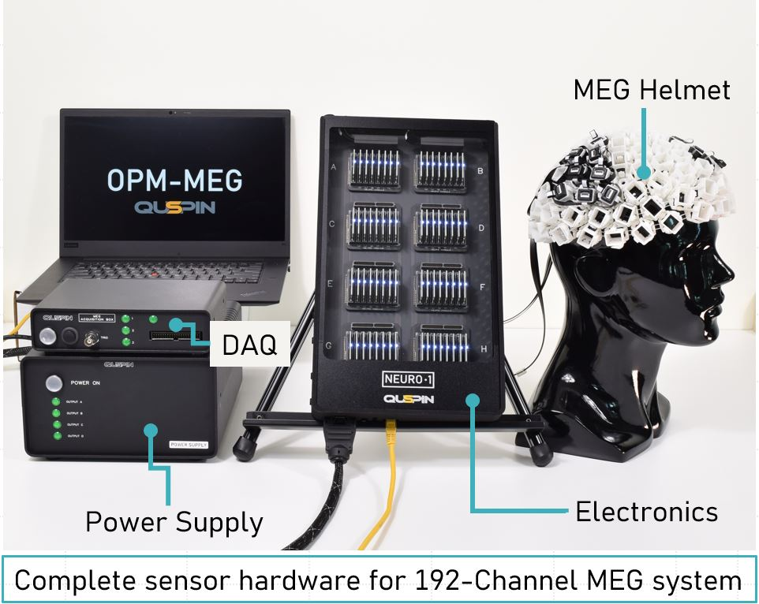
How does an OPM work?
Closed loop systems
Feedback OFF
Feedback ON
Brookes et al., 2022
QuSpin, 2023

Slide 22
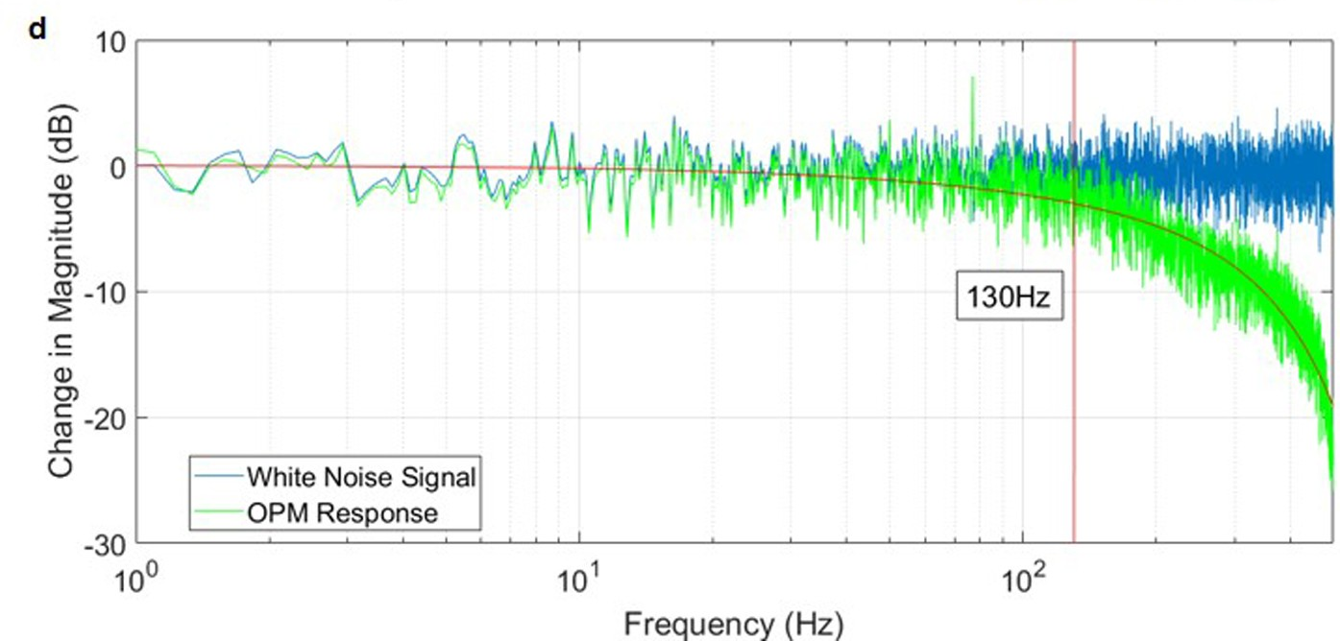
How does an OPM work?
Bandwidth
Boto et al., 2018

Slide 23
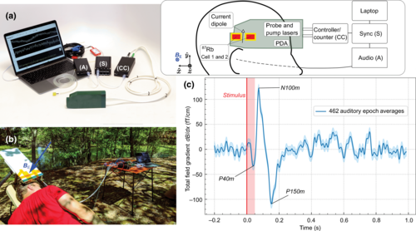
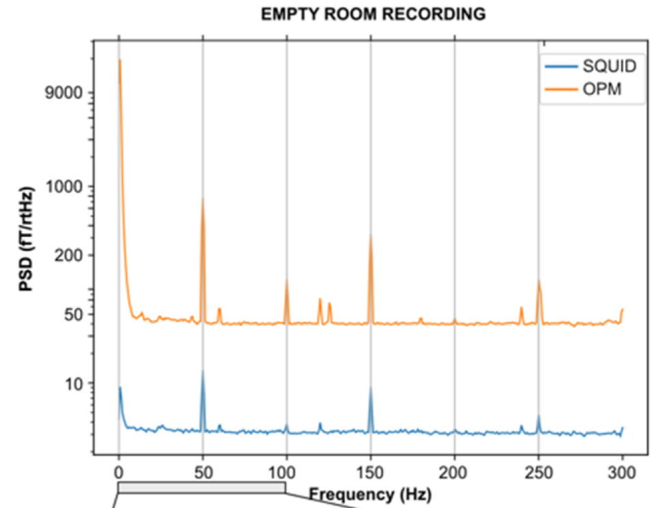
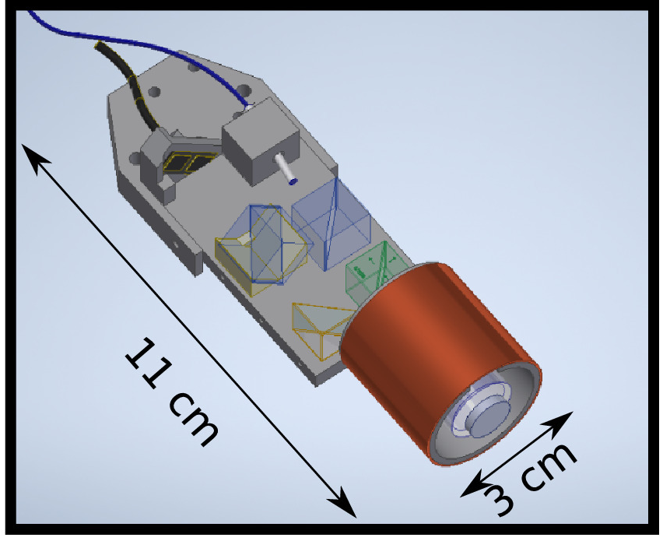
How does an OPM work?
Alternative sensor designs
Helium-4 (Mag4Health)
NMOR
Unshielded
B_{bias}
Gutteling et al., 2023
Kowalczyk et al., 2020
Limes et al., 2020

Slide 24
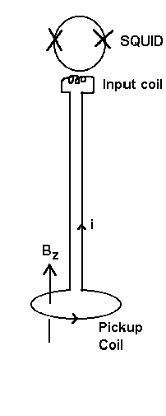
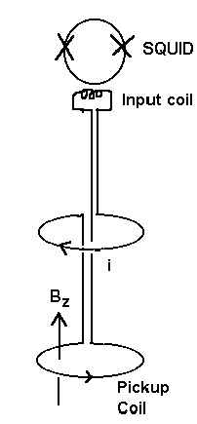
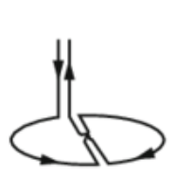
What does that mean for data analysis?
Additional Noise Sources
Magnetometers pick up more background noise than gradiometers
Axial
Gradiometer
Planar
Gradiometer
Magnetometer

Slide 25
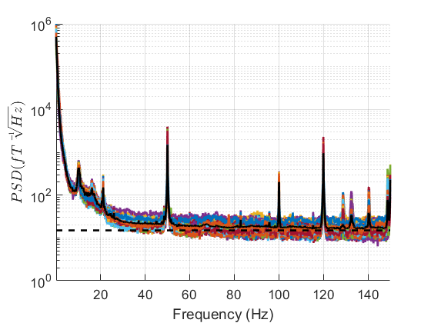
What does that mean for data analysis?
Additional Noise Sources
Drift and Vibration
ICA, SSP, DSSP, temporal filtering and reference cancellation all work but:
Need to think about the number of channels
And is the noise source moving relative to the OPMs?
Are the default settings appropriate?
Line Noise
Motion tracking camera

Slide 26
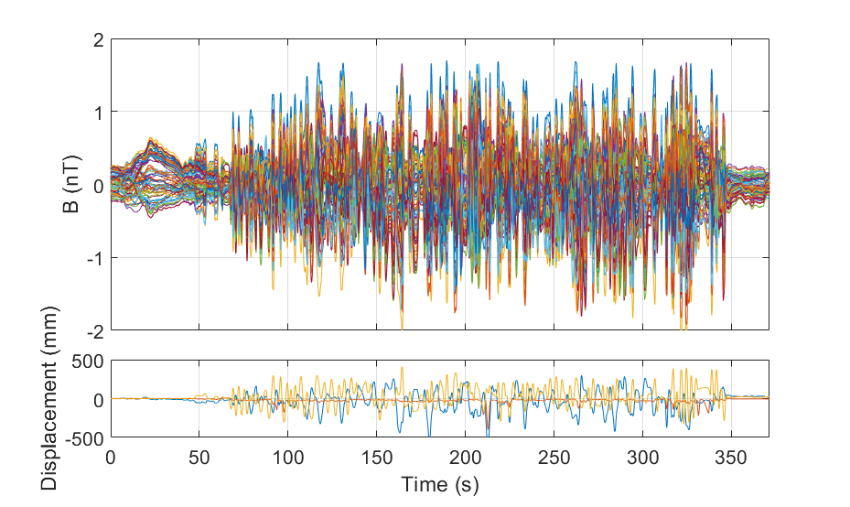
What does that mean for data analysis?
Movement Noise
The magnetic field is not constant in space. Rotations will also lead to field changes.
Movement noise can be reduced post-hoc, but it’s worth considering in your experimental design

Slide 27
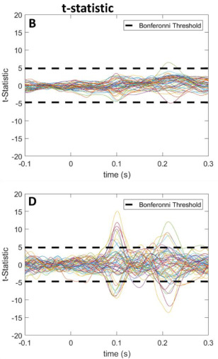


What does that mean for data analysis?
Interference Suppression
$$B=\left[\begin{matrix}B_{x} \\ B_{y} \\ B_{z}\end{matrix}\right]$$
Uncorrected
After Homogeneous Field Correction
Tierney et al., 2021

Slide 28
What does that mean for data analysis?
Course Agenda – Wednesday 31st May​
9.30-10.00​ | Day 2: Welcome and Registration​ | Registration (Conservatory)​ Refreshments (Boardroom)​
​ | Chair: Dorottya Hetenyi​ | ​
10.00-12.00​ | Group M/EEG dataset analysis- demo​ | Jason Taylor​
12.00-12.40​ | Analysis of Optically Pumped Magnetometers (OPM) data​ | Stephanie Mellor​
12.40-13:15​ | OPM data analysis- demo​ | Robert Seymour​
13.15-14.15​ | Lunch ​ | Boardroom​
​ | Chair: TBA​ | ​
14.15 - 15.15​ | Bayesian inference​ | Noor Sajid​
15.15 – 16.15​ | M/EEG source analysis​ | Jose David Lopez​
16.15-16.45​ | Break​ | Refreshments (Boardroom)​
16.45 – 17.30​ | M/EEG source analysis -demo​ | Mansoureh Fahimi​
17.30 - 18.30​ | General Q&A​ | All faculty ​
18.30- …​ | Social Event​ | Conservatory/ Reception​

Slide 29
Any Questions?

