Slide 1
Bayesian model selection and averaging
Peter Zeidman, PhD
Wellcome Centre for Human Neuroimaging
University College London

Slide 2


Seven steps to DCM for M/EEG success
Write down some hypotheses
Design an experiment
Data collection and pre-processing
First-level DCM
Group analysis using Parametric Empirical Bayes (PEB)
Bayesian model comparison
Assess predictive validity
(Write the paper)
(Nobel Prize)

Slide 3
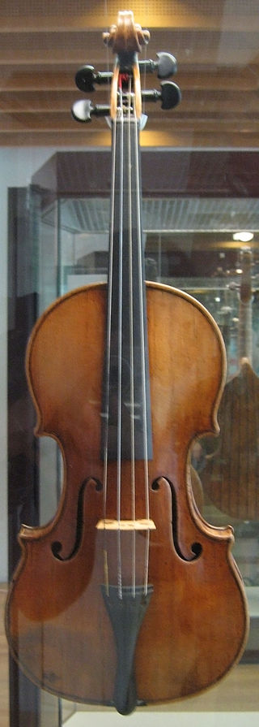
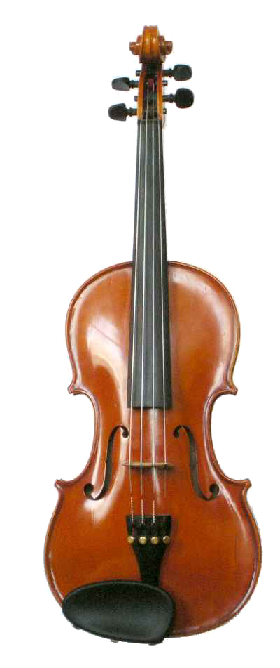
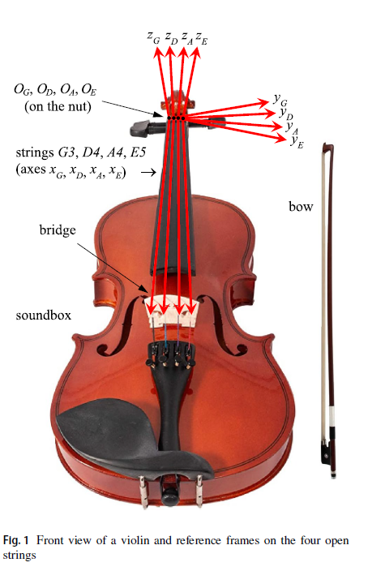
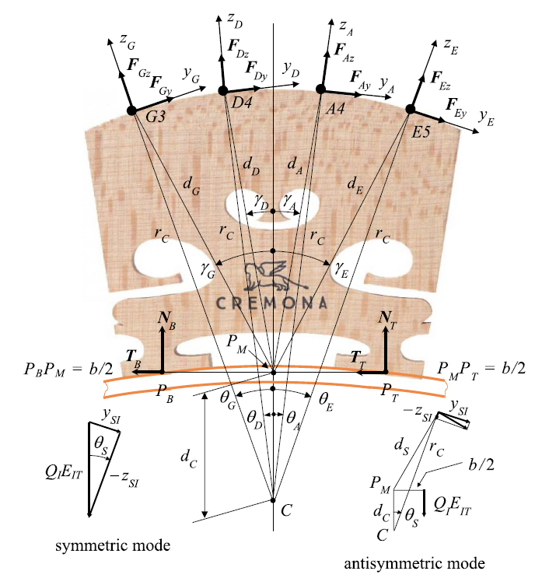

Generative models
Explaining the causes of data, rather than describing data
Stradivarius violin (1703)
Modern violin
Why do they sound different?
Model inversion
Image credits: Amitchell125 and Husky from Wikipedia,
Sorge, F., 2023. Journal of Vibration Engineering & Technologies, pp.1-13.

Slide 4
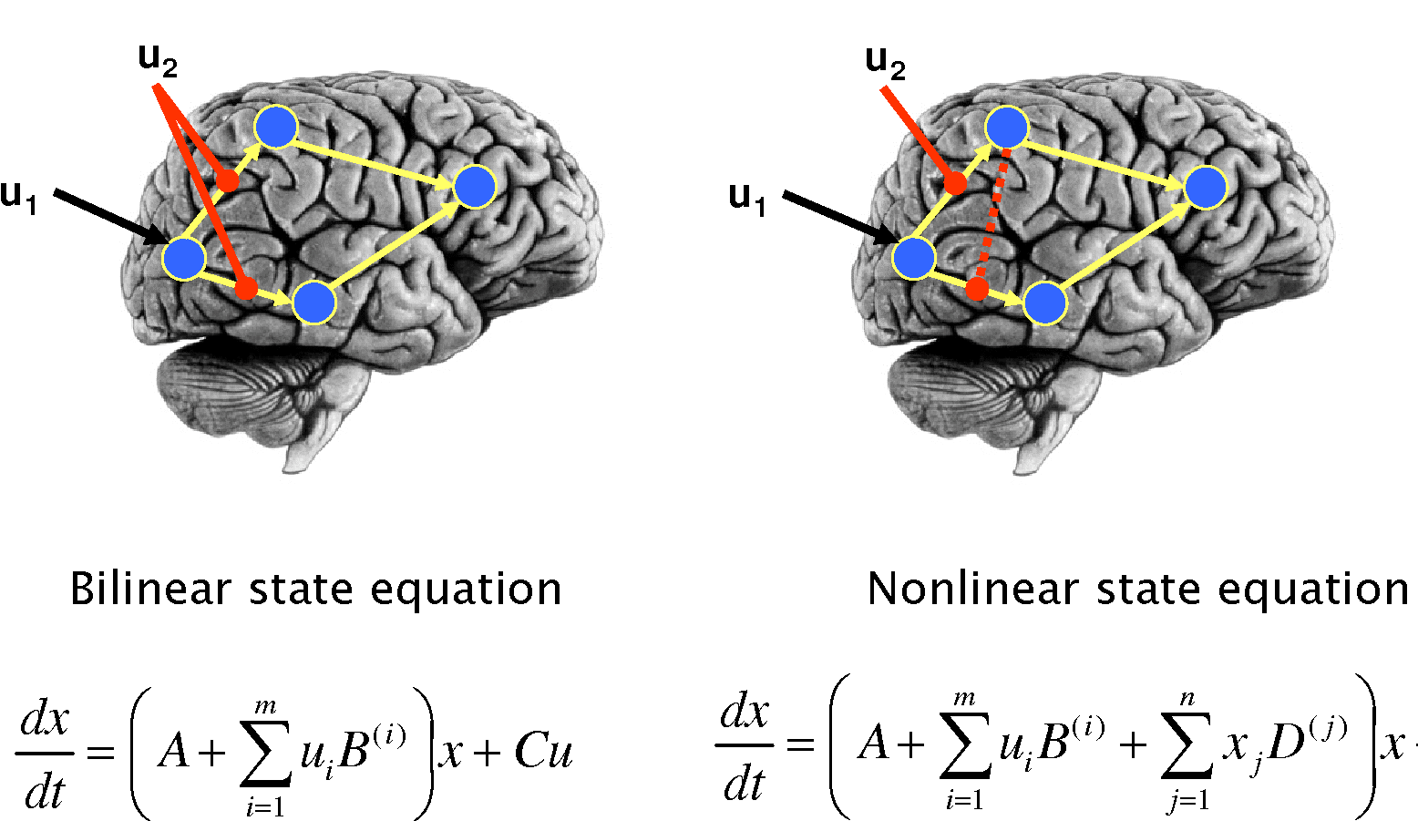




Which hypotheses (models) offer the best explanation for my data?
Bayesian model comparison
$$m_{1}$$
$$m_{2}$$
Model evidence
(marginal likelihood)
$$p\left(y | m_{1}\right)$$
Likelihood ratio
(Bayes factor)
$$p\left(y | m_{2}\right)$$
Stephan et al., NeuroImage, 2008

Slide 5
Seven steps to DCM for M/EEG success
Write down some hypotheses
Design an experiment
Data collection and pre-processing
First-level DCM
Group analysis using Parametric Empirical Bayes (PEB)
Bayesian model comparison
Assess predictive validity

Slide 6
1. Write down some hypotheses
Commonalities
Differences
DCM is a tool for scoring the evidence for different hypotheses. It is not an exploratory technique.
“I hypothesise that top-down connections from parietal cortex are modulated by attention to visual stimuli.”
“I hypothesise that people with a diagnosis of Mild Cognitive Impairment (MCI) have weaker modulation of top-down connections by attention.”

Slide 7
1. Write down some hypotheses
One hypothesis → one model
One hypothesis → one family of models
A “model space”
Family 1
Family 2

Slide 8
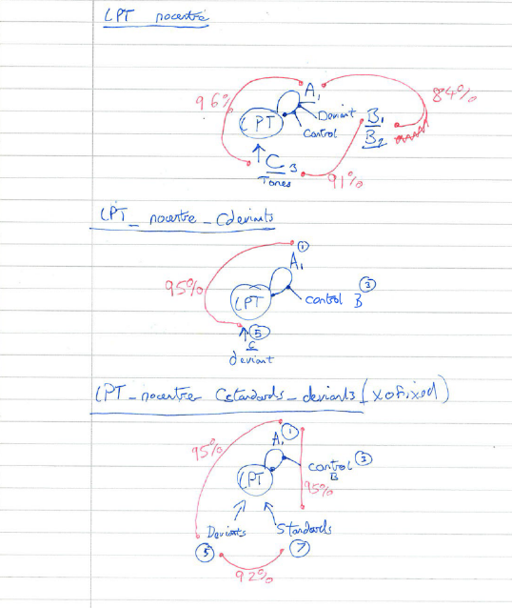
1. Write down some hypotheses
Drawing a diagram for each hypothesis can help!

Slide 9
Seven steps to DCM for M/EEG success
Write down some hypotheses
Design an experiment
Data collection and pre-processing
First-level DCM
Group analysis using Parametric Empirical Bayes (PEB)
Bayesian model comparison
Assess predictive validity

Slide 10
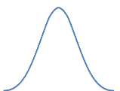
2. Design an experiment
Use a factorial design where possible
e.g. [2 x 2] design:
  Factor 1: faces or upside down faces
  Factor 2: attend to emotion or attend to hair colour
FFA
Driving
input
V1
Modulators (between-trial effects):
Main effect of faces
Main effect of emotion
Interaction
Friston, K.J., Price, C.J., Fletcher, P., Moore, C., Frackowiak, R.S.J. and Dolan, R.J., 1996. The trouble with cognitive subtraction. Neuroimage, 4(2), pp.97-104.

Slide 11
Seven steps to DCM for M/EEG success
Write down some hypotheses
Design an experiment
Data collection and pre-processing
First-level DCM
Group analysis using Parametric Empirical Bayes (PEB)
Bayesian model comparison
Assess predictive validity

Slide 12
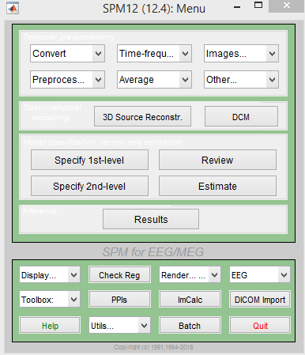
3. Data collection and pre-processing
Precise pipeline depends on intended DCM analysis
Conversion
Filtering
Downsampling
Epoching
Re-referencing for EEG
Artefacts
Averaging
Time-frequency analysis
Coregistration

Slide 13
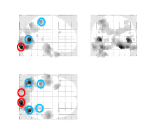
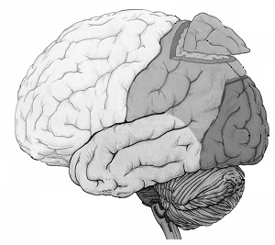
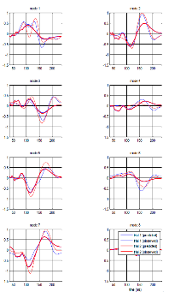
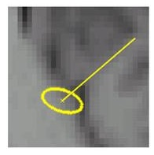
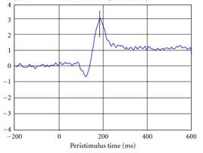
Two modelling options…
Use DCM to model the whole head
Use DCM to model extracted data features
E.g.
Use “virtual electrodes” to extract time series
Apply DCM
Principal components
(modes)

Slide 14
Seven steps to DCM for M/EEG success
Write down some hypotheses
Design an experiment
Data collection and pre-processing
First-level DCM
Group analysis using Parametric Empirical Bayes (PEB)
Bayesian model comparison
Assess predictive validity

Slide 15
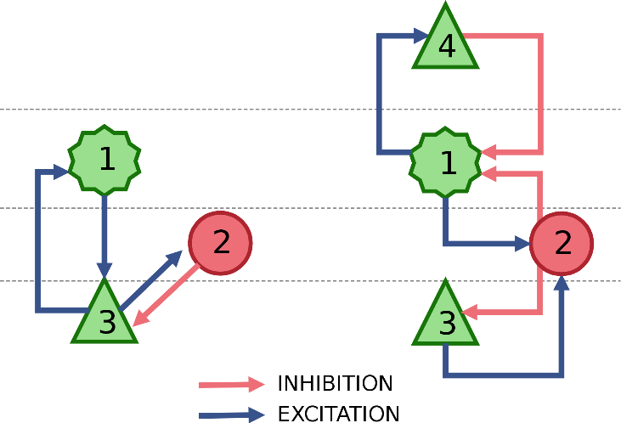
4. Choose first level DCM(s)
Physiological models
Convolution:
                DCM for ERP
                DCM for LFP
                Canonical microcircuit (CMC)
                Neural field model (NFM)
                Conductance:
                Neural Mass Model (NMM)
                Mean-field model (MFM)
                Phenomenological models
                DCM for Phase Coupling
                DCM for Induced Responses
Choose a model based on:
Type of data
Model features you need
Bayesian model comparison if unsure
https://en.wikipedia.org/wiki/Dynamic_causal_modeling

Slide 16



4. First level DCM
Free energy
Estimated parameters
Two outputs:
Approximation of the log model evidence $P\left(Y|m\right)$
Posterior (multivariate Gaussian) probability $P\left(θ|Y,m\right)$
$$F≈\log{P\left(Y|m\right)}$$

Slide 17
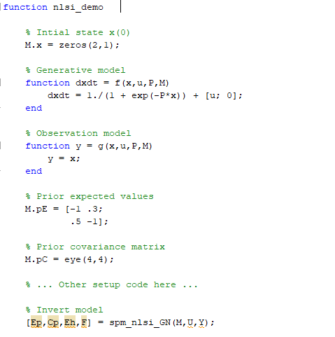
Variational Laplace Demo
0
10
20
30
40
50
60
70
Time (secs)
Generative model
$$\dot{x}\left(t\right)=\frac{1}{1+\exp\left(−P x\left(t\right)\right)}+u(t)$$
$$y\left(t\right)=x\left(t\right)+ε\left(t\right)$$
Parameters
Initial states
Priors
$$N\left(μ,Σ\right)$$
$$μ={\left[−1, 0.5, 0.3,−1\right]}^{T}$$
$$P=\left[\begin{matrix}P_{11} & P_{12} \\ P_{21} & P_{22}\end{matrix}\right]$$
$$x(0)=\left[\begin{matrix}x_{1}(0) \\ x_{2}(0)\end{matrix}\right]$$
$$Σ=I_{4}$$
Code provided in the help text of spm_nlsi.m

Slide 18
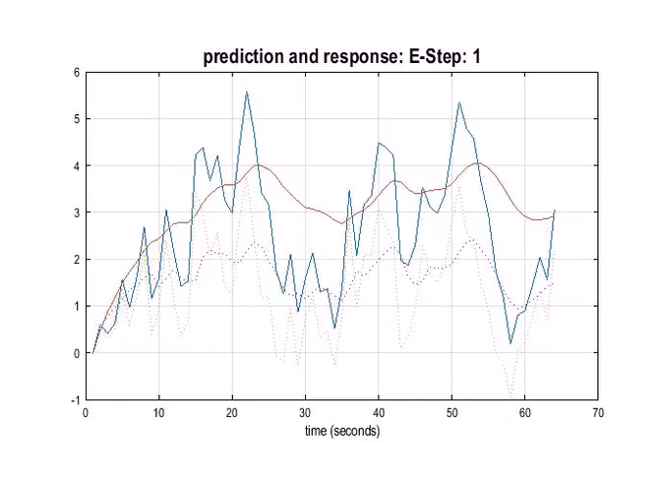
F=102.0854
1.5
Posterior expectation of parameters
1
0.5
0
-0.5
-1
-1.5
-2
-2.5
P1
P2
P3
P4

Slide 19
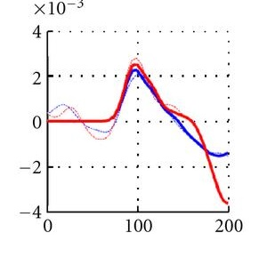
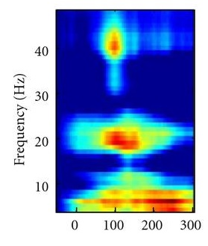
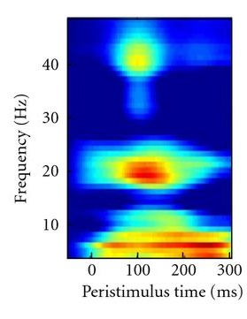
4. First level DCM
Check the model fits
Observed
Modelled
Observed
Modelled

Slide 20
Seven steps to DCM for M/EEG success
Write down some hypotheses
Design an experiment
Data collection and pre-processing
First-level DCM
Group analysis using Parametric Empirical Bayes (PEB)
Bayesian model comparison
Assess predictive validity

Slide 21
5. Group analysis using Parametric Empirical Bayes (PEB)
Group-level questions:
Are the strength of particular connections changed by an experimental manipulation?
Does belonging to a diagnostic group determine the strength of these connections?
Does the strength of the connections correlate with behavioural or clinical variables?
Could we predict a new participant’s disease status or behavioural scores using our estimate of their connections?

Slide 22




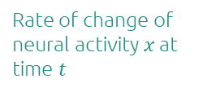

5. Group analysis using Parametric Empirical Bayes (PEB)
PEB extends DCM to the group level
First level
(within-subject)
Second level
(between-subjects)
Rate of change of neural activity $x$ at time $t$
Connectivity parameters from all subjects
DCM for subject $i$
Neural model
$$\frac{dx_{t}}{dt}=f\left(x_{t},u_{t},θ_{i}\right)$$
$$θ=\left[\begin{aligned}θ_{1} \\ ⋮ \\ θ_{N}\end{aligned}\right]=Xβ+ε^{(2)}$$
$$y_{t}=g\left(x_{t}\right)+ε_{t}$$
M/EEG data at time $t$
General Linear Model
Observation model

Slide 23







5. Group analysis using Parametric Empirical Bayes (PEB)
The connectivity parameters are taken to the group level
and modelled using a General Linear Model
Design matrix
(covariates)
Group level parameters
Outputs:
One free energy for the entire group-level model (DCMs and GLM).
Group-level parameters (effect of each covariate on each connection)
Unexplained between-subject variability
$$θ^{(1)}=Xθ^{(2)}+ε^{(2)}$$
$$θ^{(1)}$$
$$X$$
$$θ^{(2)}$$
1
Group average connection strength
2
Subject
3
$$=$$
Subject
$$×$$
Effect of group on the connection
4
5
Effect of age on the connection
6
1
2
3
Covariate

Slide 24
Seven steps to DCM for M/EEG success
Write down some hypotheses
Design an experiment
Data collection and pre-processing
First-level DCM
Group analysis using Parametric Empirical Bayes (PEB)
Bayesian model comparison
Assess predictive validity

Slide 25



6. Bayesian model comparison
PEB model 1
PEB model 2
Design matrix
Design matrix
With age
covariate
Without age
covariate
Subject
Subject
1
2
3
1
2
Covariate
Covariate
(The free energy for nested models is derived analytically using Bayesian Model Reduction)
Free energy $F_{1}$
Free energy $F_{2}$
$$\log{BF}=F_{1}−F_{2}$$

Slide 26
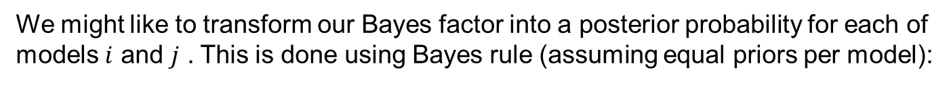

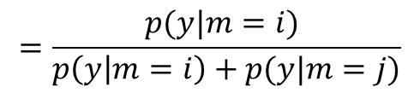
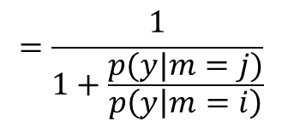



6. Bayesian model comparison
Reporting the posterior probability for each model is simpler for readers
Posterior probability of a model is
the sigmoid function of the log Bayes factor

Slide 27
Why do we use the model evidence?
✖
$$AIC=\text{accuracy}\text{(}\text{m}\text{)}−p$$
✖
$$BIC=\text{accuracy}\text{(}\text{m}\text{)}−\frac{p}{2}\ln{N}$$
✔
$$F=\text{accuracy}\text{(}\text{m}\text{)}−D_{KL}\left[Q\left(θ\right)∥P\left(θ\right)\right]$$
Free energy
(Evidence Lower Bound, ELBO)
Posterior
Prior
Penny, NeuroImage, 2012

Slide 28
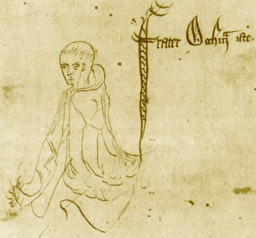

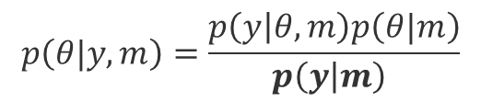

Why do we use the model evidence?
Bayes rule
Accuracy - complexity
1. Occam’s razor
William of Ockham, 1287–1347
Likelihood
Prior
Posterior
$$\ln{p\left(y | m\right)}=\underset{\text{accuracy}}{\underbrace{{\left\langle \ln{p\left(y | θ,m\right)}\right\rangle }_{p\left(θ|y,m\right)}}}$$
$$p\left(θ|y,m\right)=\frac{p\left(y | θ,m\right)p\left(θ|m\right)}{p\left(y | m\right) }$$
$$−\underset{\text{complexity}}{\underbrace{KL\left[p\left(θ|y,m\right)||p\left(θ|m\right)\right]}}$$
Model evidence
https://statproofbook.github.io/P/lme-anc.html

Slide 29
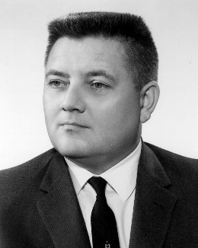




Why do we use the model evidence?
Energy plus entropy
Jaynes’ principle
2. Jaynes’ principle of maximum entropy
Edwin Jaynes,
1922-1998
Posterior $P\left(θ|y\right)$
0.9
$$\ln{p\left(y | m\right)}=\underset{\text{log} \text{joint}}{\underbrace{{\left\langle \ln{p\left(y,θ\right)}\right\rangle }_{p\left(θ|y\right)}}}$$
$$+\underset{\text{entropy}}{\underbrace{H\left[P\left(θ|y\right)\right]}}$$
0.8
Lower entropy
H=1.3
0.7
0.6
0.5
0.4
0.3
0.2
0.1
0
-8
-6
-4
-2
0
2
4
6
8
Higher entropy
H=1.98
$$θ$$

Slide 30
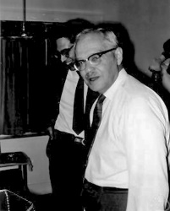
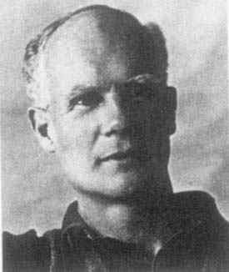








Why do we use the model evidence?
3. Neyman-Pearson Lemma
Jerzy Neyman
1894-1981
Egon Pearson
1895-190
False positive (Type I error)
Power
$$α=Pr(\left|t\right|>\text{critical} \text{value}|H_{0})$$
$$Pr\left(\left|t\right|>\text{critical} \text{value} | H_{1}\right)=1−β$$
$$H_{0}$$
$$H_{1}$$
$$H_{0}$$
$$H_{1}$$
$$\left|t\right|$$
$$\left|t\right|$$

Slide 31
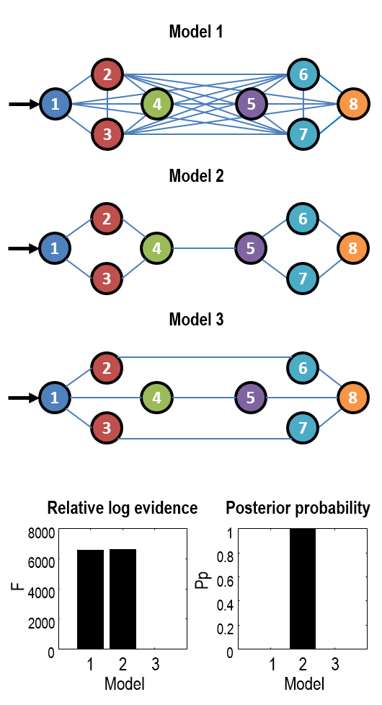
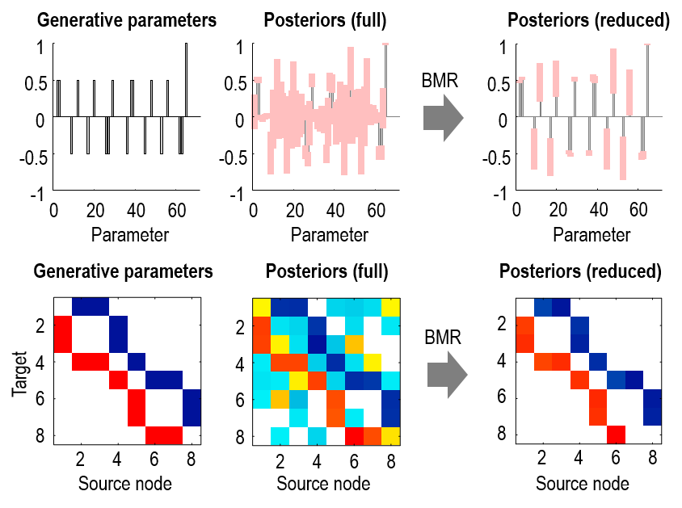
Bayesian model reduction
Pre-defined models
Automatic search
Friston, Parr, Zeidman. Bayesian model reduction. arXiv preprint arXiv:1805.07092.

Slide 32
Seven steps to DCM for M/EEG success
Write down some hypotheses
Design an experiment
Data collection and pre-processing
First-level DCM
Group analysis using Parametric Empirical Bayes (PEB)
Bayesian model comparison
Assess predictive validity

Slide 33
7. Assess predictive validity
The question
Predicted vs actual covariates
Are the effect sizes I detected large enough to predict the group membership or clinical scores of new participants?
→ Leave-one-out (LOO) cross-validation
corr(df:22) = 0.95: p < 0.000
0.5
0.4
0.3
Estimate
0.2
0.1
0
-0.1
0
1
group effect

Slide 34


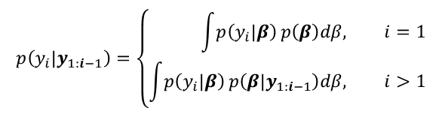

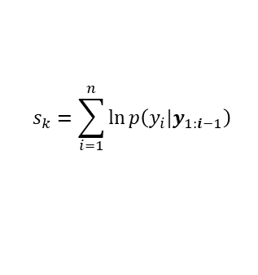
Hypothesis testing and machine learning
Which model best explains the data? → Bayes factors.
Are the inferred effect sizes large enough to be useful? → Cross-validation.
Posterior predictive probability density:
$$p\left(y_{i}|y_{1:i−1}\right)=\left\{\begin{aligned}\int{p\left(y_{i}|β\right)}p\left(β\right)dβ, &i=1 \\ \int{p\left(y_{i}|β\right)}p\left(β|y_{1:i−1}\right)dβ, &i>1\end{aligned}\right.$$
Kass and Raftery (1995)
Predictive score:
$$\ln{p\left(y_{i}|y_{1:i−1}\right)}$$
Good (1952) p. 112
Relation to log evidence:
$$s_{k}=\sum_{i=1}^{n}{\ln{p\left(y_{i}|y_{1:i−1}\right)}}$$
$$=\ln{p\left(y|m\right)}$$
Log evidence is equivalent to leave-n-out cross validation averaged over all values of n (Fong and Holmes, 2020)

Slide 35

Seven steps to DCM success
Write down some hypotheses
Design an experiment
Data collection and pre-processing
First-level DCM
Group analysis using Parametric Empirical Bayes (PEB)
Bayesian model comparison
Assess predictive validity

Slide 36
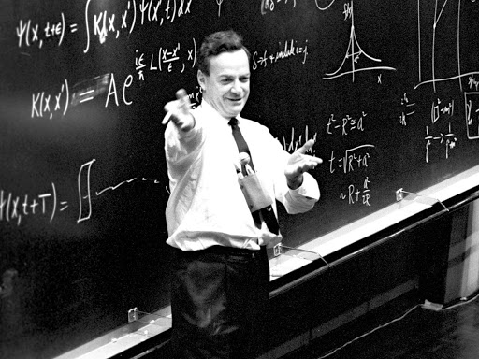

Further reading
Tutorial papers:
Zeidman, P., Jafarian, A., Corbin, N., Seghier, M.L., Razi, A., Price, C.J., Friston, K.J. A guide to group effective connectivity analysis, part 1: First level analysis with DCM for fMRI. NeuroImage, 200, pp. 174-190. 2019.
Zeidman, P., Jafarian, A., Seghier, M.L., Litvak, V., Cagnan, H., Price, C.J., Friston, K.J. A guide to group effective connectivity analysis, part 2: Second level analysis with PEB. NeuroImage, 200, pp. 12-25. 2019.
Technical papers:
  Friston, K., Parr, T. and Zeidman, P., 2018. Bayesian model reduction. arXiv:1805.07092.
  Friston, K.J., Litvak, V., Oswal, A., Razi, A., Stephan, K.E., Van Wijk, B.C., Ziegler, G. and Zeidman, P., 2016. Bayesian model reduction and empirical Bayes for group (DCM) studies. Neuroimage, 128, pp.413-431.
  Zeidman, P., Friston, K. and Parr, T., 2022. A primer on Variational Laplace. https://doi.org/10.31219/osf.
“What I cannot create I do not understand.”
—Richard Feynman

