Slide 1


Second waves, social distancing, and the spread of Covid-19 across America
Abstract: We recently described a dynamic causal model of a COVID-19 outbreak within a single region. Here, we combine several of these (epidemic) models to create a (pandemic) model of viral spread among regions. Our focus is on second wave of new cases that may result from loss of immunity—and the exchange of people between regions—and how mortality rates can be ameliorated under different strategic responses. In particular, we consider hard or soft social distancing strategies predicated on national (Federal) or regional (State) estimates of the prevalence of infection in the population. The modelling is demonstrated using timeseries of new cases and deaths from the United States to estimate the parameters of a factorial (compartmental) epidemiological model of each State and, crucially, coupling between States. Using Bayesian model reduction, we identify the effective connectivity between States that best explains the initial phases of the outbreak in the United States. Using the ensuing posterior parameter estimates, we then evaluate the likely outcomes of different policies in terms of mortality, working days lost due to lockdown and demands upon critical care. The provisional results of this modelling suggest that social distancing and loss of immunity are the two key factors that underwrite a return to endemic equilibrium.
Key words: coronavirus; epidemiology; compartmental models; dynamic causal modelling; variational; Bayesian

Slide 2
Introduction
Dynamic causal modelling
Results
Mitigation strategies
Conclusion

Slide 3
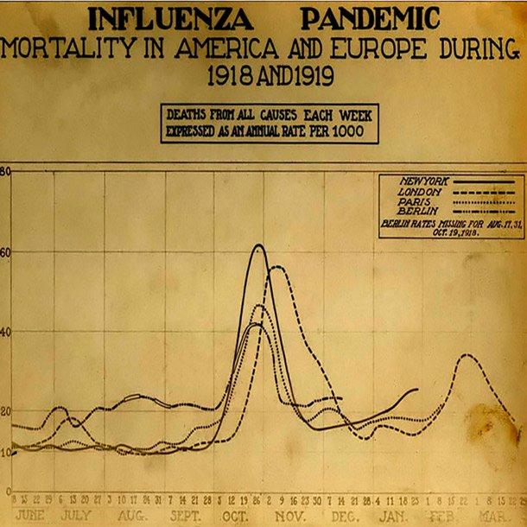
Second waves

Slide 4
Second waves
China 2020
Rates (per day)
800
700
Death rate
600
New cases
y
Empirical daily deaths
a
Empirical new cases
d
500
r
e
p
r
400
e
b
m
u
300
n
200
100
0
0
5
10
time (weeks)

Slide 5
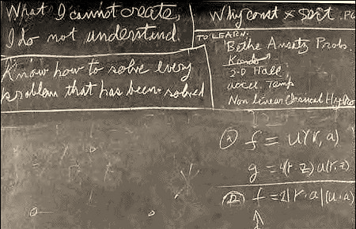
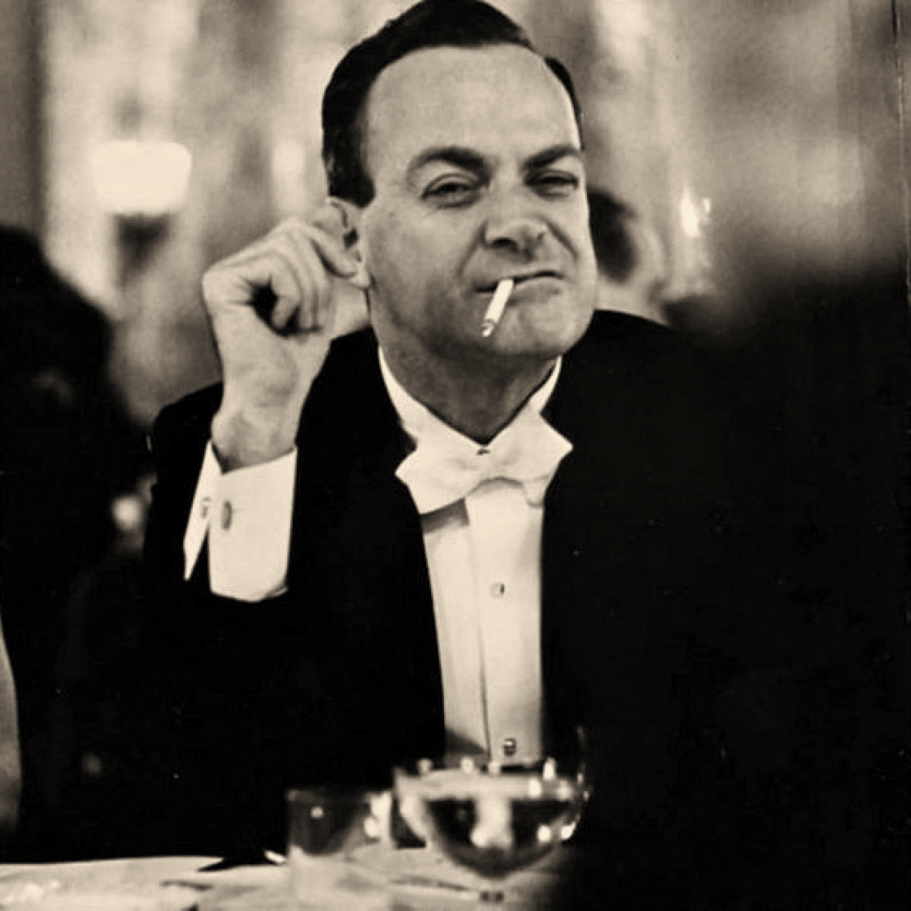
Generative models

Slide 6
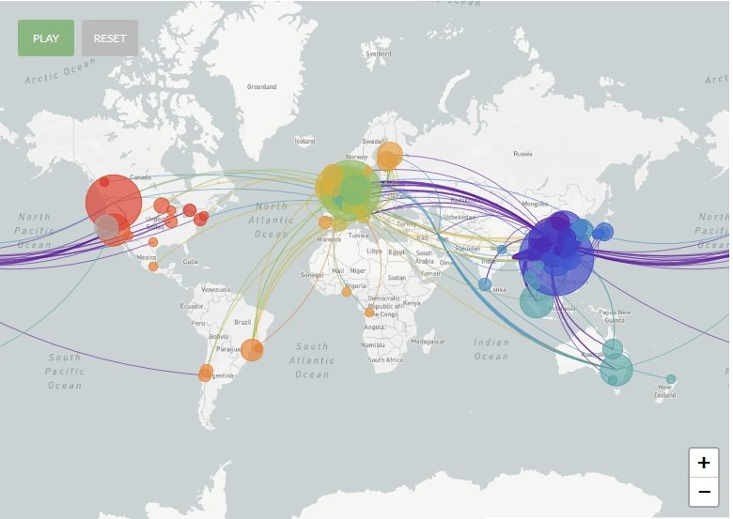
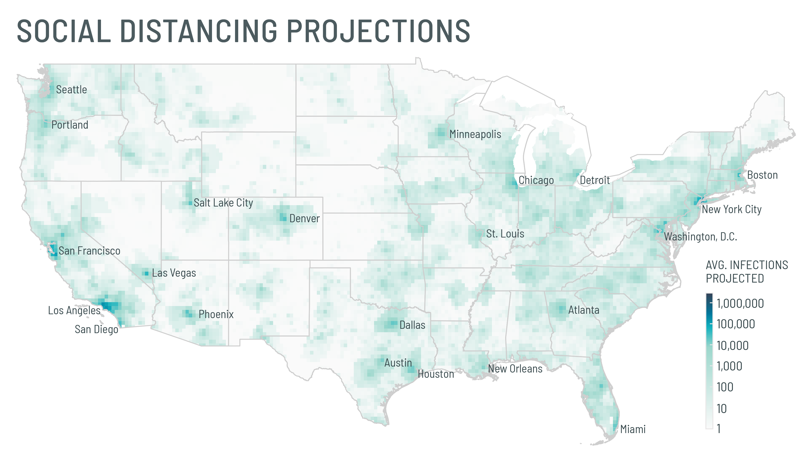
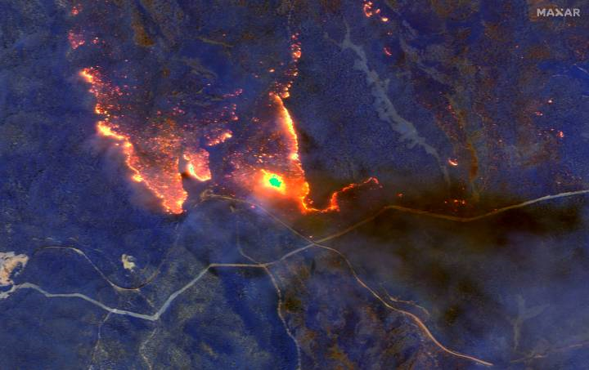
Generative models
of spread
https://nextstrain.org/ncov

Slide 7
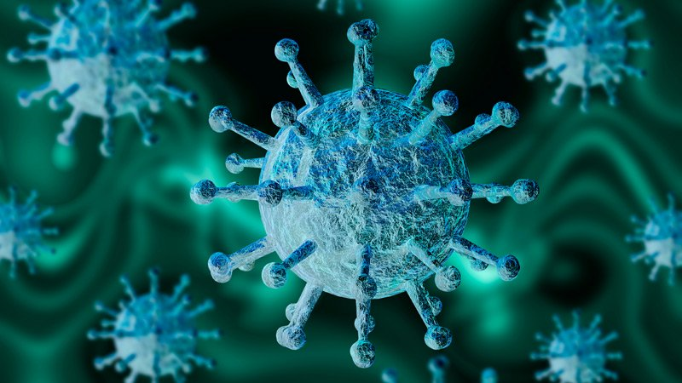
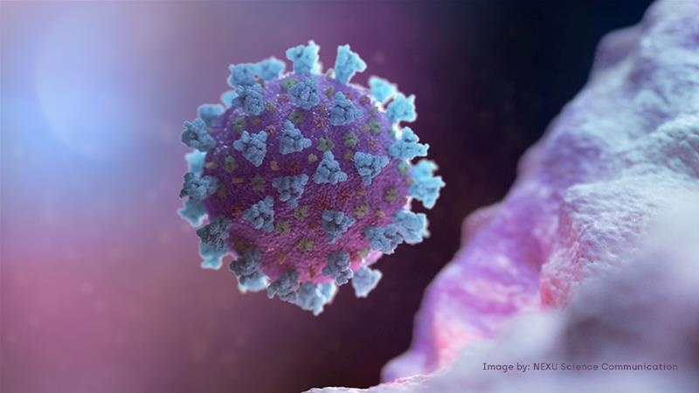
Generative models and immunity
Immunity to HCoV-OC43 and HCoV-HKU1 appears to be lost over a few months. However, betacoronaviruses can induce immune responses against each another. For example, SARS can generate neutralizing antibodies against HCoV-OC43 that can endure for years (Chan et al., 2013), while HCoV-OC43 infection can generate cross-reactive antibodies against SARS (Chan et al., 2013). Now, the question is: does SARS-CoV-2 behave like SARS, conveying long-lasting immunity or does it behave like HCoV-OC43, conferring immunity for just a few months?

Slide 8
Generative model of a single region:
Infection
Susceptible
Infected
Immune
Infectious
LIST model
Location
Symptoms
Home
Work
CCU
Morgue
asymptomatic
Symptoms
ARDS
Deceased
Testing
Untested
Waiting
Positive
Negative
Death
Recorded death
Positive
Test for coronavirus

Slide 9
Infection
LIST model
Lh
Is
Lw
Is
Lc
Is
Lm
Is
Im
In
Im
Ii
Im
Ii
Im
In
Lh: home
Lw: work
Lc: CCU
Lm: Morgue
Is: susceptible
Ii: infected
Ic: contagious
Im: immune
Sa: asymptomatic
Ss: symptomatic
Sr: ARDS
Sd: deceased
Tu: untested
Tw: weighting
T+: positive
T-: negative
Ic
Ic
Ic
Ic
Location
Symptoms
Sa
Lh
SD
Ss
Lh
Sr
Lh
Sd
Lh
Is,Im
Sa
Ii,Ic
Sa
Lc
Ii,Ic
Sa
Lh
Lm
Lw
Lm
Lw
Lm
Lw
Lm
Lw
Sd
Ss
Sd
Ss
Sd
Ss
Lc
Lc
Lc
Lc
Sr
Sr
Sr
Testing
Is,Im
Tu
Ii,Ic
Tu
T-
Tw
T-
Tw
Positive test
T+
T+
Recorded death

Slide 10

Generative model of social distancing
Social distancing rules
1
$$θ$$
Sigmoid function
)
Power function
%
0.8
(
g
n
i
c
n
a
t
0.6
s
i
d
l
a
i
c
o
s
0.4
f
o
e
e
r
g
e
0.2
d
0
0
10
20
30
40
percentage of the population affected (%)
SD
Regional (State)
National (Federal)

Slide 11
Generative model of multiple regions
Infection
Im
Is
In
Location
Ic
Symptoms
Infection
Sa
Lh
Testing
Sa
Lm
Lc
Lw
Tu
Sd
Sr
Ss
Is
T-
Tw
Im
In
T+
Recorded death
Ic
Positive test
Infection
Location
Symptoms
Is
Sa
Im
Ic
In
Lh
Testing
Sa
Location
Symptoms
Lm
Lw
Sd
Ss
Sa
Lh
Testing
Sa
Lc
Tu
Sr
Lm
Lc
Lw
Tu
Sd
Sr
Ss
T-
Tw
Infection
T-
T+
Tw
Recorded death
T+
Recorded death
Is
Positive test
Positive test
Im
In
Location
Ic
Symptoms
Sa
Lh
Sa
Lm
Lw
Testing
Sd
Ss
Lc
Tu
Sr
T-
Tw
T+
Recorded death
Positive test

Slide 12
Model inversion or fitting
Large number assumptions
The likelihood model
Variational Bayes (Laplace)

Slide 13
Within region parameters

Slide 14

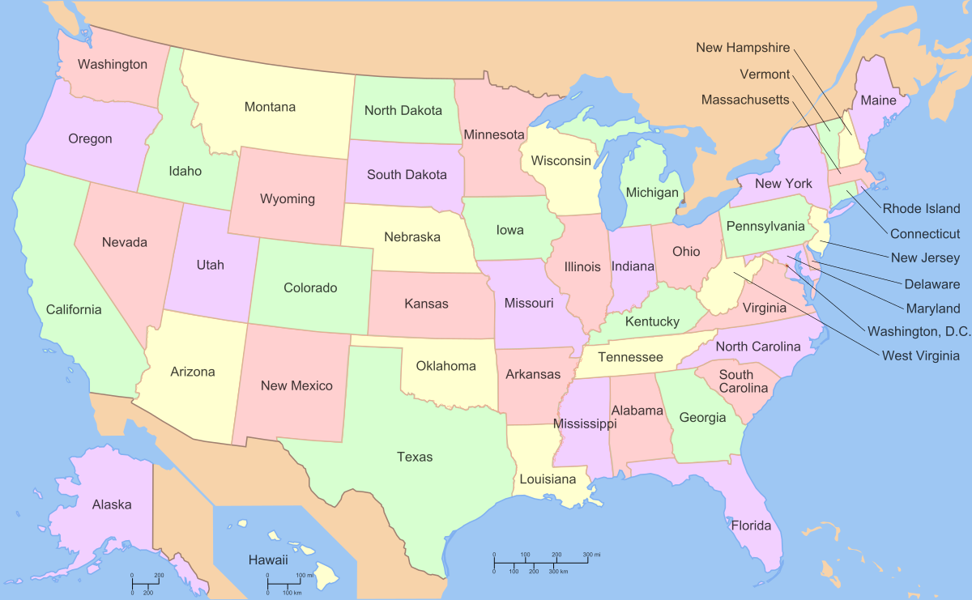
Between region parameters
log-posterior
Regional connectivity
2
New York
1.5
New Jersey
y
Michigan
t
i
l
i
1
b
Massachusetts
a
b
o
r
p
Illinois
-
g
0.5
o
l
Louisiana
0
Pennsylvania
-0.5
California
0
50
100
150
200
250
300
2
4
State
6
8
model
1
posterior
0.8
0.6
0.4
0.2
0
0
5
10
15
20
25
parameter

Slide 15
Between region parameters
200
First-order sensitivity
0
-200
y
t
i
-400
v
i
t
i
s
n
e
-600
s
-800
-1000
-1200
0
10
20
30
40
50
60
connectivity parameter
0.3
MAP connectivity estimates
e
0.25
t
a
t
S
a
0.2
g
n
i
v
a
e
l
0.15
f
o
y
t
i
l
i
b
0.1
a
b
o
r
p
0.05
0
0
10
20
30
40
50
60
connectivity parameter

Slide 16
Predictions

Slide 17
Predictions
Long-term immunity

Slide 18
Predictions
Short-term immunity

Slide 19

Predictions
of immunity
The authors measured the seroprevalence of antibodies to SARS-CoV-2 in Santa Clara County on the third and fourth of April 2020, using a lateral flow immunoassay. Under three scenarios for their test performance, the population prevalence of COVID-19 in Santa Clara ranged from 2.49% (95CI 1.80-3.17%) to 4.16% (2.58-5.70%).
Initial results from the first large-scale study tracking the spread of the coronavirus in LA county found that 4.1% of adults have antibodies. This translates to roughly 221,000 to 442,000 adults who have recovered from an infection. LA county had reported fewer than 8,000 cases at that time. Our thanks to Virginia Webber for forwarding this material.
16
infection status
14
infected
12
infectious
immune
)
10
prevalence
%
prevalence
(
e
c
n
LA Times
e
8
l
a
v
e
r
p
6
4
2
0
0
10
20
30
40
50
60
70
80
time (days)

Slide 20
Mitigation
(social distancing)

Slide 21
Mitigation
(social distancing)
10
4
Cumulative deaths
1.8
10
10
Working days
6.4
6.2
1.6
s
6
s
1.4
h
h
t
t
a
5.8
a
1.2
e
e
d
d
e
e
v
v
i
5.6
i
1
t
t
a
a
l
l
u
u
m
5.4
m
0.8
u
u
c
c
5.2
0.6
5
0.4
4.8
-4
-2
0
2
4
0.2
-4
-2
0
2
4
social distancing threshold
social distancing threshold
Lost weeks
6.4
10
4
Exit strategies
70
60
6.2
50
s
6
h
t
a
5.8
e
s
40
d
k
e
e
v
e
i
5.6
t
w
a
l
30
u
m
5.4
u
20
c
5.2
10
5
0
-4
-2
0
2
4
4.8
0
5
10
15
social distancing threshold
weeks

Slide 22
Mitigation
(regional vs. national)
Under MAP parameters
State policy
Federal policy
With the loss of immunity
With return to work

Slide 23
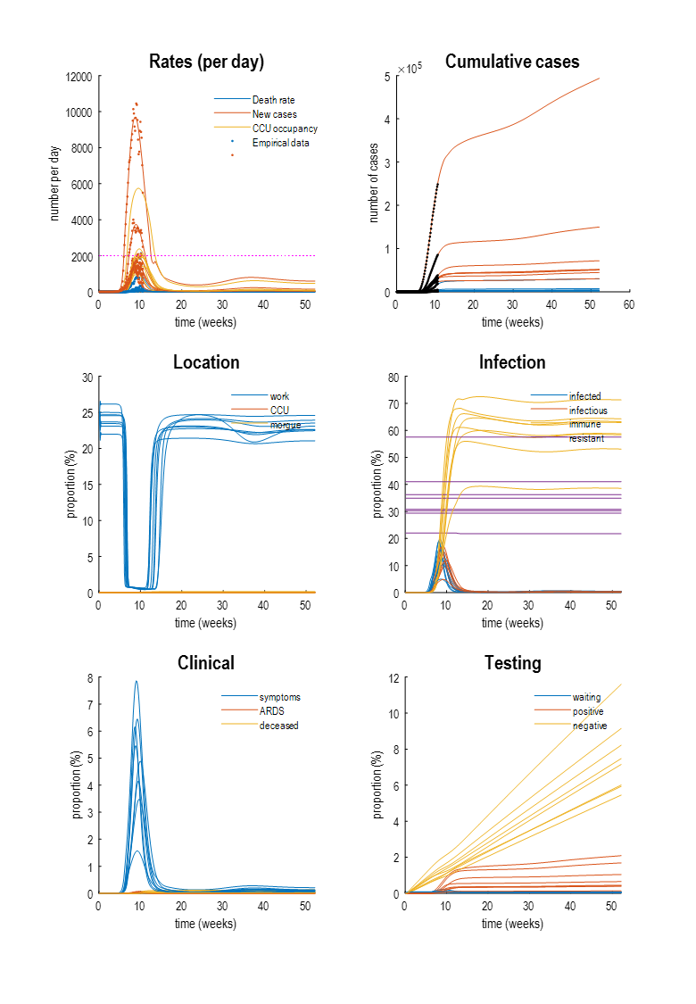
A narrative
““Endemic equilibrium will be reached by the end of the year, by which time Covid-19 will become ‘another way to die’. Covid-19 will account for a small proportion of deaths due to interstitial pneumonia—with mortality rates that are less than seasonal influenza (approximately 1/3). This state of affairs rests upon an adaptive (i.e., reactive) response to intervening fluctuations in the prevalence of infection (and demands upon critical care). Operationally, this response could be characterised by social distancing when either the prevalence of infection in the population exceeds 3% for the number of Covid-19 patients in critical care surpasses a quarter of maximum capacity. Comprehensive social distancing (i.e. lockdown) is currently in force and will last, on average, about 7.5 weeks in each affected region. For most countries, at the time of writing, this suggests a relaxing of lockdown in 3 weeks.
However, this relaxation will not return to pre-pandemic levels of interpersonal contact. In other words, there will be an enduring pressure to reduce interpersonal contact, which will reduce the time spent in the company of others by 5% or less. The road to equilibrium will be relatively smooth with a slight bump (second wave) at about seven months following the initial outbreak (i.e., November). This will not require lockdown but there will be an appreciable increase in the number of cases and critical care uptake. This second wave should last for about five weeks and may be confounded by the onset of a flu season.”
Under this narrative, social distancing that will become ‘a way of living’ with Covid-19 and reflect changing attitudes to prosocial behaviour; much like our attitudes to climate change, recycling, smoking or outdated practices, such as the use of laudanum or Mercury in the Victorian age. For example, unnecessary commuting and international meetings may be seen as antisocial and unhygienic. Similarly, coughing in public may become socially sanctioned as urinating in public. In short, changing attitudes, affordances and dispositions may be sufficient social distancing mechanisms to guarantee an endemic equilibrium.

Slide 24

Outstanding issues
Have we already established a substantive herd immunity?
How long will it last?
BUSINESS NEWS
APRIL 23, 2020 / 5:28 PM / UPDATED 8 HOURS AGO
New York survey suggests nearly 14% in state may have coronavirus antibodies
20
18
16
14
14% immunity
)
%
12
(
e
c
n
e
l
10
a
v
e
r
p
8
6
4
2
0
0
10
20
30
40
50
60
70
80
time (days)

Slide 25
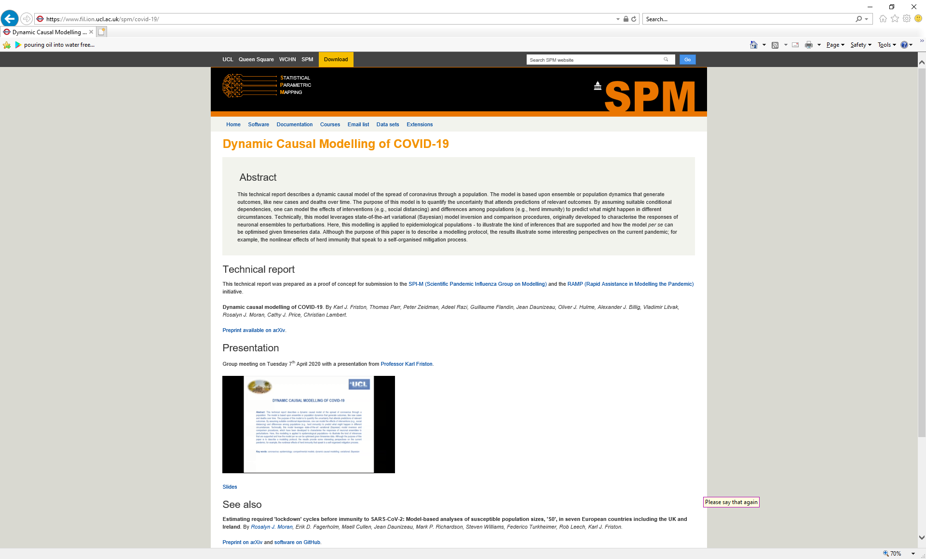
https://www.fil.ion.ucl.ac.uk/spm/covid-19/.
Thank you – to lots of people

