Slide 1

Co-registration &
Spatial Normalisation
Gordon Wright & Marie de Guzman
15 December 2010

Slide 2

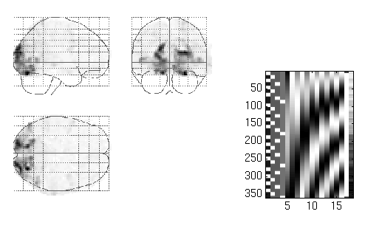
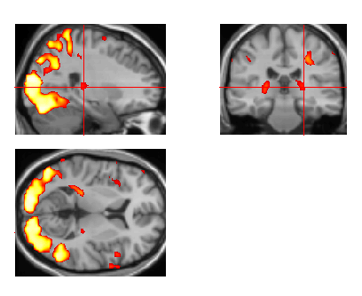
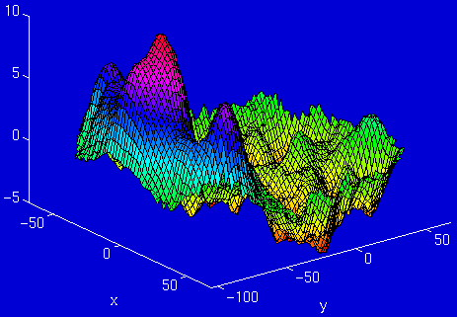
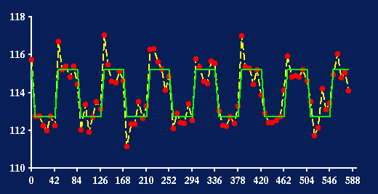
Overview
fMRI time-series
kernel
Design matrix
Statistical Parametric Map
Motion
correction
Smoothing
General Linear Model
(Co-registration and) Spatial
normalisation
Parameter Estimates
Standard
template

Slide 3
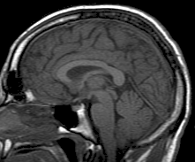
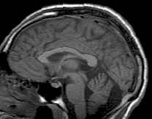
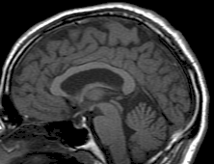
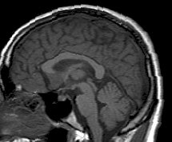
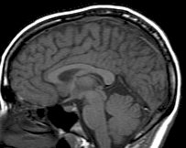
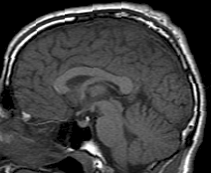
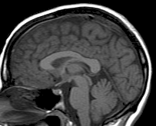
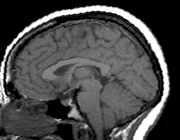
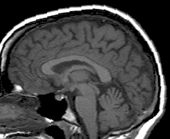
Within Person vs. Between People
Co-registration: Within Subjects
Spatial Normalisation: Between Subjects
PET
T1 MRI

Slide 4
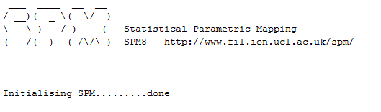
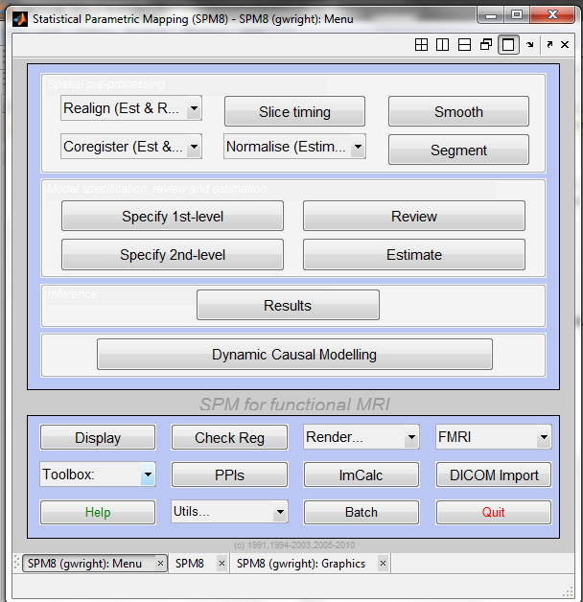
SPM

Slide 5
Co-Registration (single subject)
Structural (T1) images:
- high resolution
- to distinguish different types of tissue
Functional (T2*) images:
- lower spatial resolution
to relate changes in BOLD signal
due to an experimental manipulation
→ Time series:
A large number of images that
are acquired in temporal
order at a specific rate
Condition B
Condition A
t

Slide 6
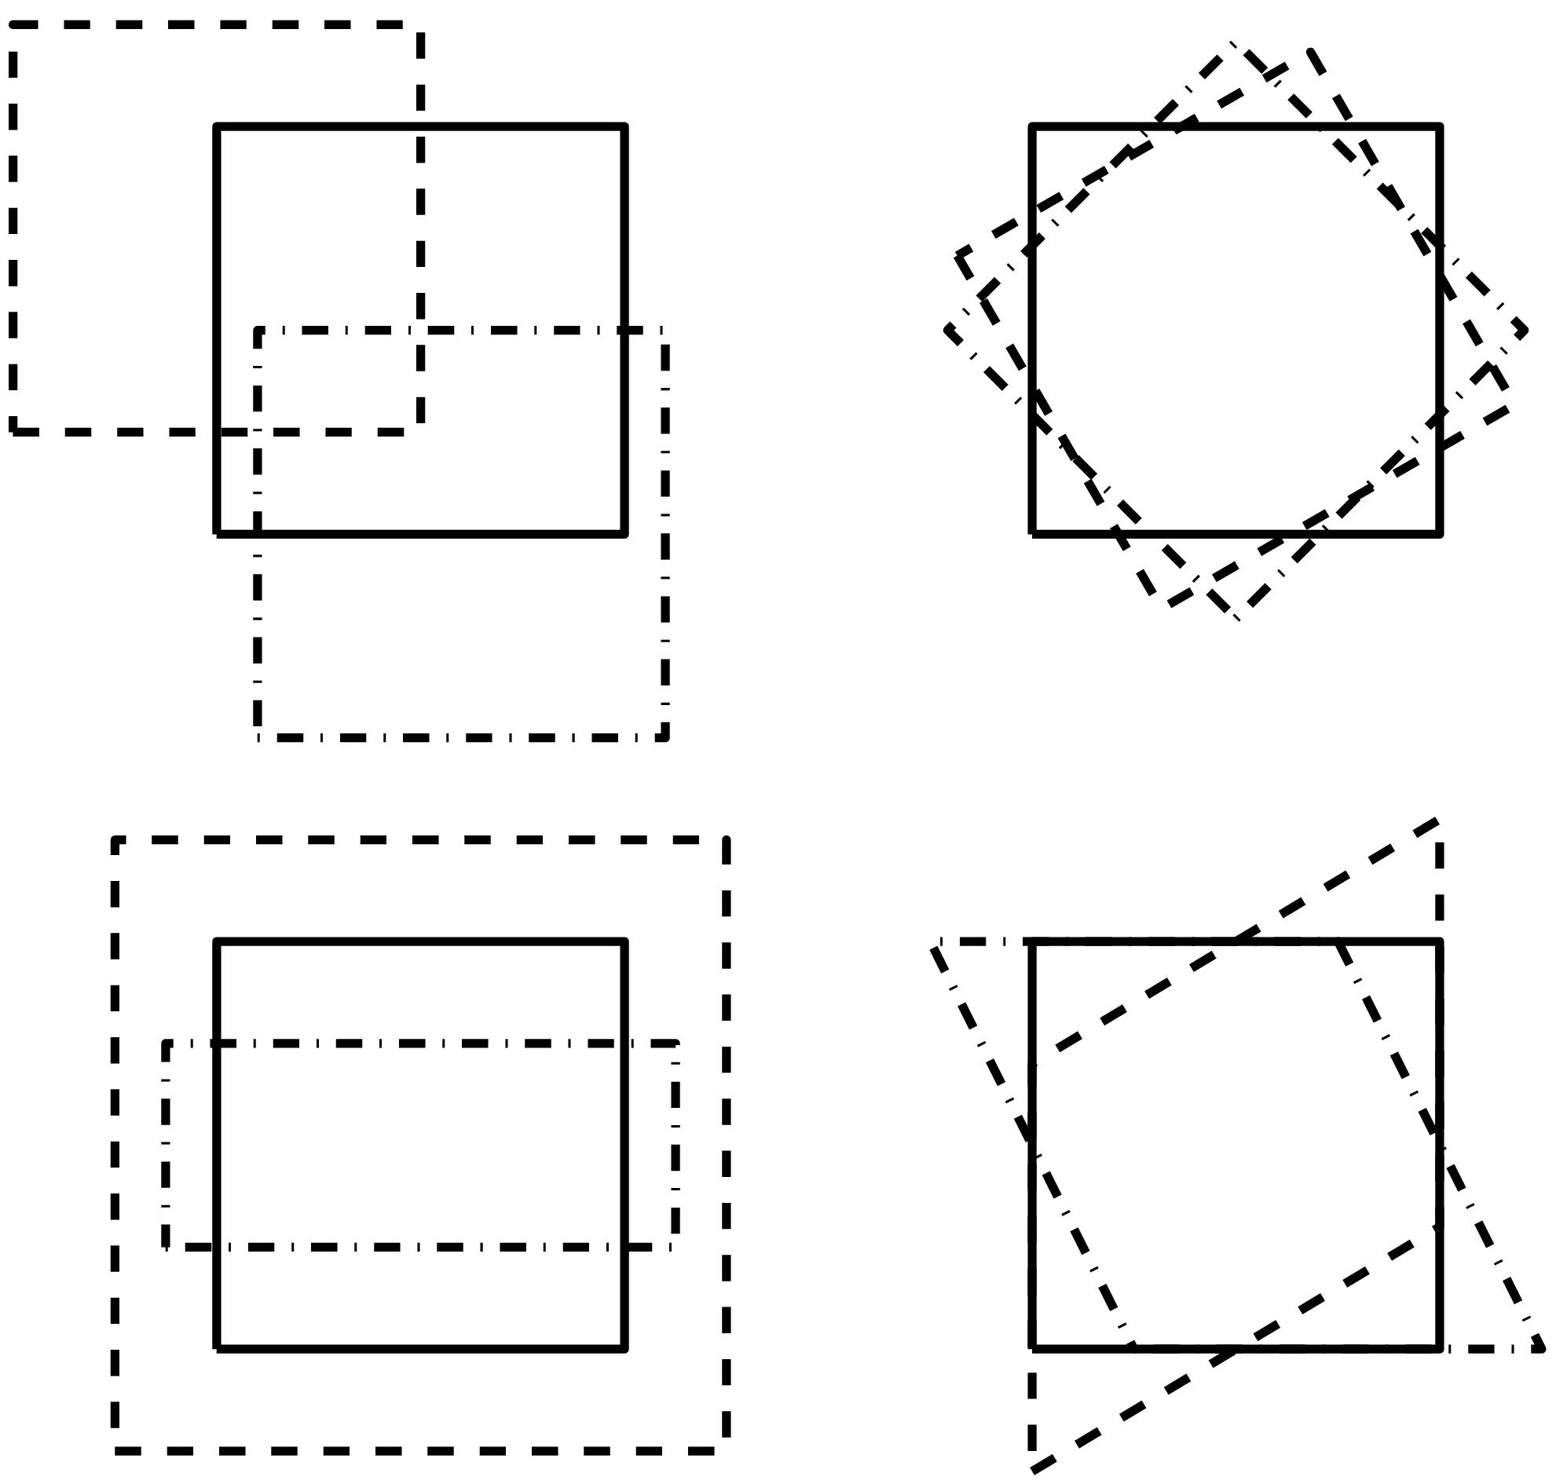
Apply Affine Registration
12 parameter affine transform
  3 translations
  3 rotations
  3 zooms
  3 shears
Fits overall shape and size

Slide 7
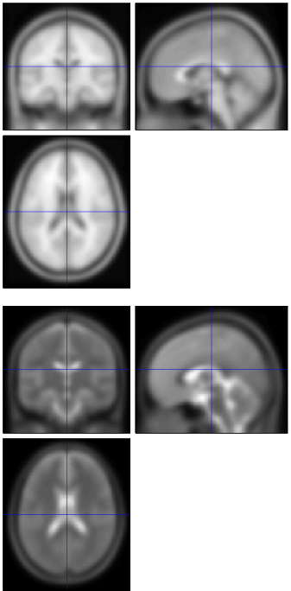
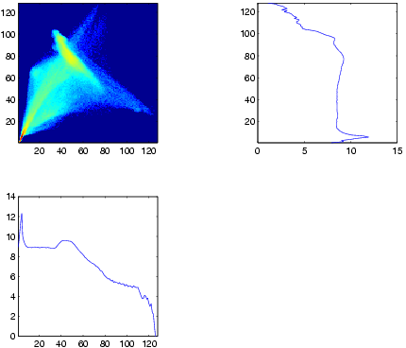
Maximise Mutual Information

Slide 8
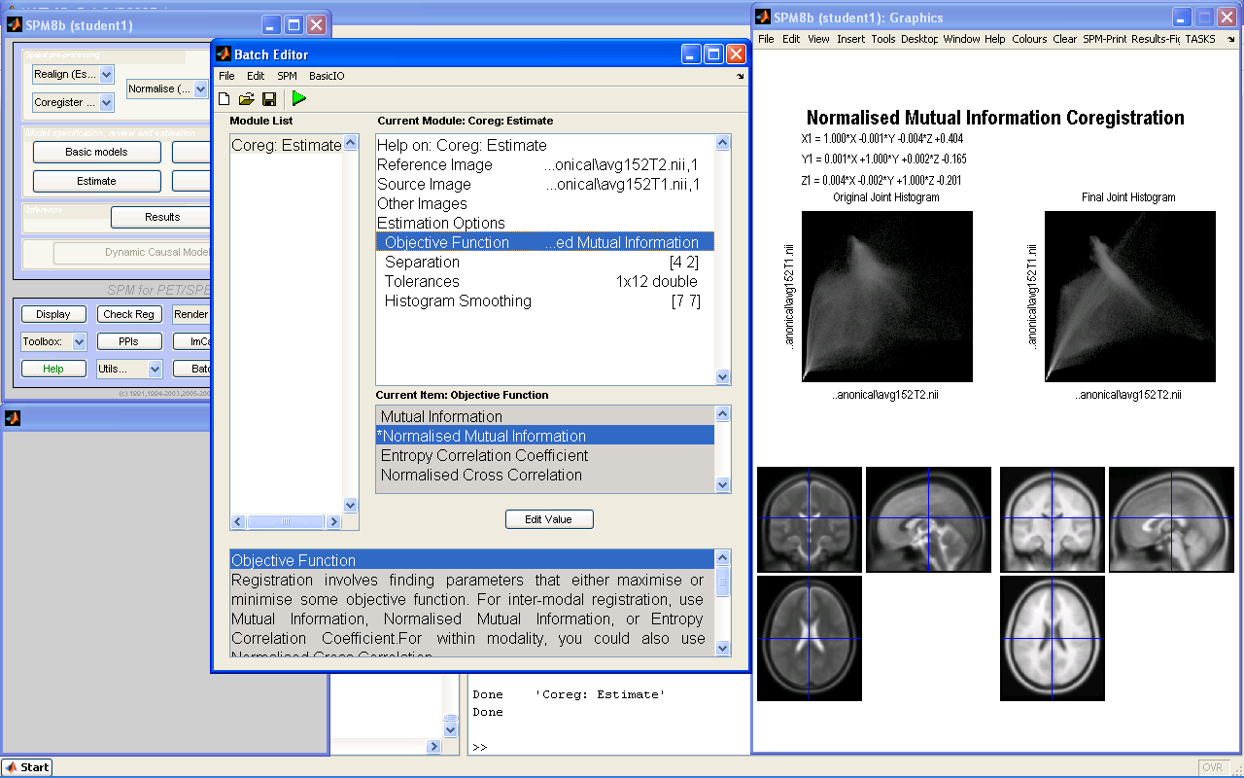
SPM

Slide 9
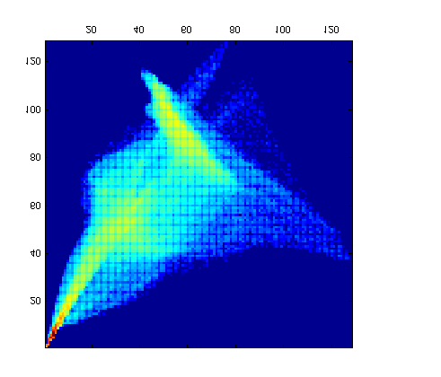
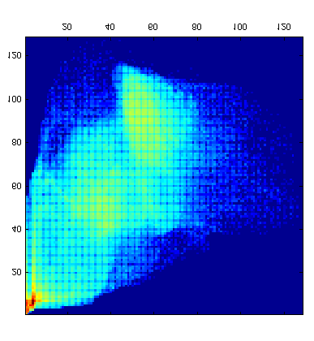
Joint histogram
Initially registered T1 and T2 templates
After deliberate misregistration
(10mm relative x-translation)
Joint histogram sharpness correlates with image alignment
Mutual information and related measures attempt to quantify this

Slide 10
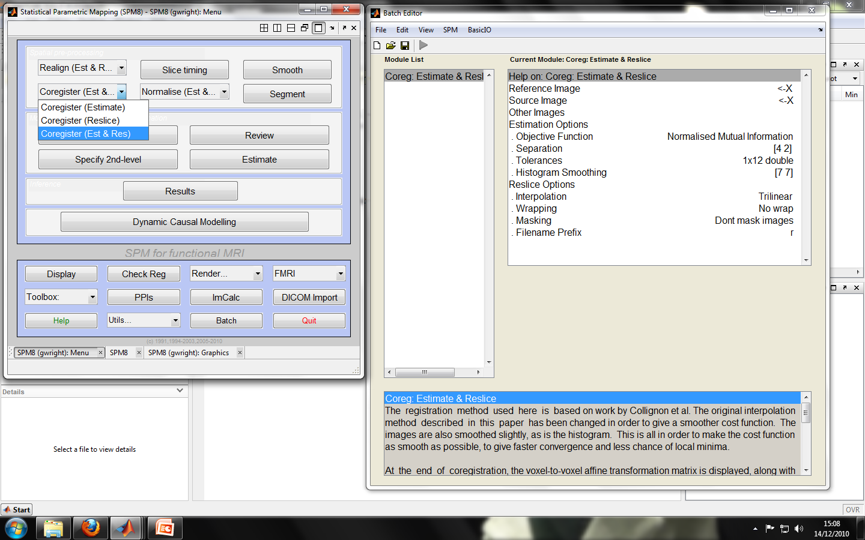
SPM
Reference Image:
Your template or the image you want to register others to
Source Image:
Your template or the image you want to register others TO
Mutual Information:
Method for coregistering data

Slide 11
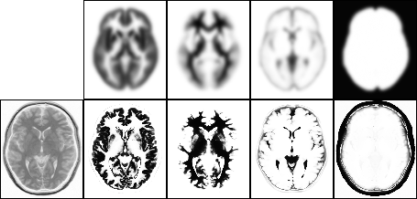
Segmentation
Partition in GM, WM, CSF
Overlay images on probability images (large N)
  Gives us a priori probability of a voxel being GM, WM or CSF
Priors:
Image:
GM
WM
CSF
Brain/skull
Notes:
Useful for functional data (activation should only be in GM)
Images consists of number of dictinct tissue types (clusters) from which every voxel has been drawn, intensities of these voxels belong to one of these clusters and confirm to a multivariate normal distribution (generalization of the one-dimensional normal distribution to higher dimensions)
Therefore we overlay these images on probability images (images from a large N number of subjects segmented in GM, WM, CSF normalized in same space using affine transformations) this gives us the a priori probability of a voxel being GM, WM or CSF

Slide 12
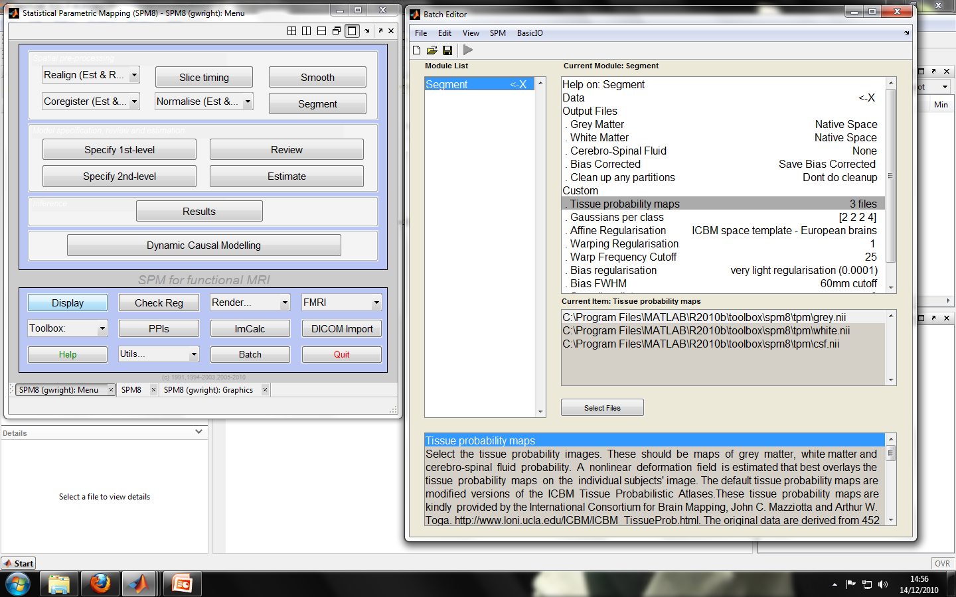
Segmentation in SPM
Tissue Probability Maps:
GM, WM, CSF

Slide 13
Spatial Normalisation
Differences between subjects
Compare Subjects
Extrapolate findings to the population as a whole

Slide 14
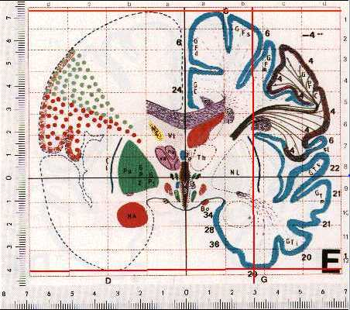
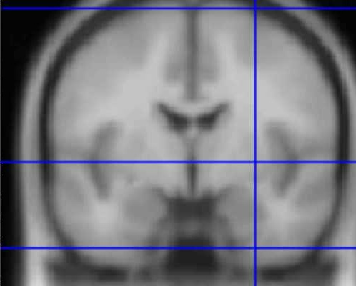
Aligning to Standard Spaces
The Talairach Atlas
The MNI/ICBM AVG152 Template
http://imaging.mrc-cbu.cam.ac.uk/imaging/MniTalairach

Slide 15
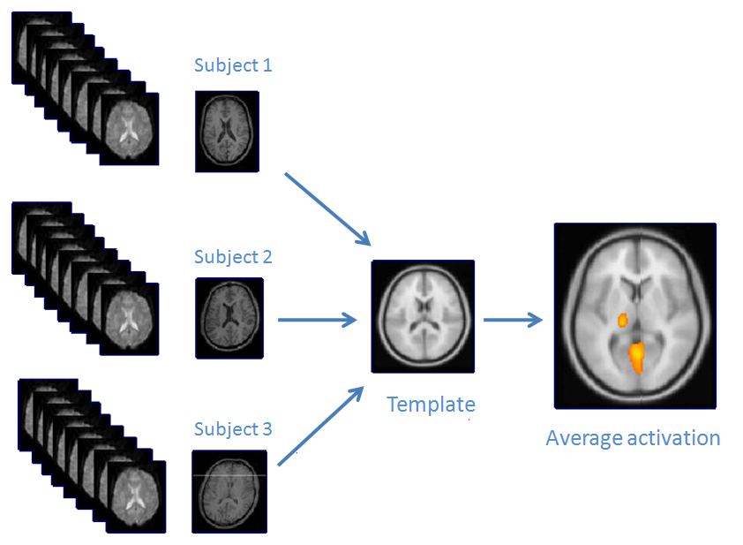
‘Inter-Subject’ averaging

Slide 16
Spatial Normalisation: 2 Methods
Label-based
  Identifies homologous features (points, lines and surfaces) in the image and template and finds the transformations that best superimpose them
  Limitations: few identifiable features; features can be identified manually (time consuming & subjective)
Non-label based (aka intensity based)
  Identifies a spatial transformation that optimizes some voxel-similarity between a source and image measure
  Limitation: susceptible to poor starting estimates

Slide 17
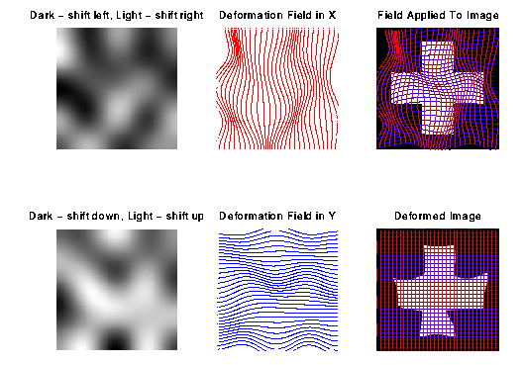
Spatial Normalisation: 2 Steps
Linear Registration
  Apply 12 parameter affine transformation (translations, rotations, zooms, shears)
  Major differences in head shape & position
Non-linear Registration (Warping)
  Smaller scale anatomical differences

Slide 18
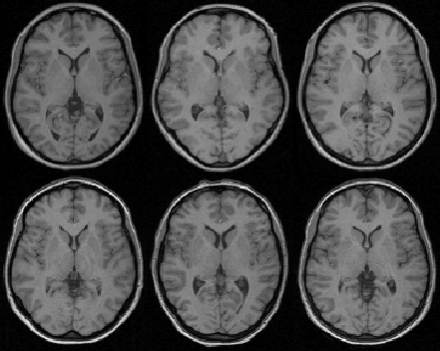
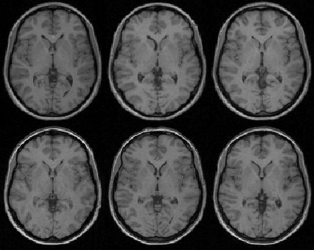
Results from Spatial Normalisation
Affine registration
Non-linear registration

Slide 19
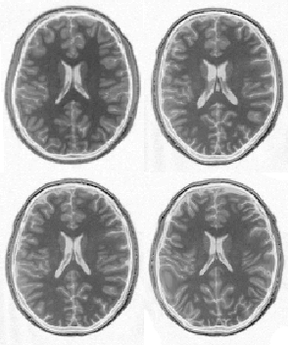
Risk: Over-fitting
Affine registration.
(χ² = 472.1)
Template
image
Non-linear
registration
(χ² = 287.3)

Slide 20
Apply Regularisation
‘Best’ parameters may not be realistic
Regularisation – necessary so that nonlinear registration does not introduce unnecessary deformations
Ensures voxels stay close to their neighbours
Without regularisation, the non-linear normalisation can introduce unnecessary deformation

Slide 21
Risk: Over-fitting
Affine registration.
(χ² = 472.1)
Template
image
Non-linear
registration
using
regularisation.
(χ² = 302.7)
Non-linear
registration
without
regularisation.
(χ² = 287.3)

Slide 22
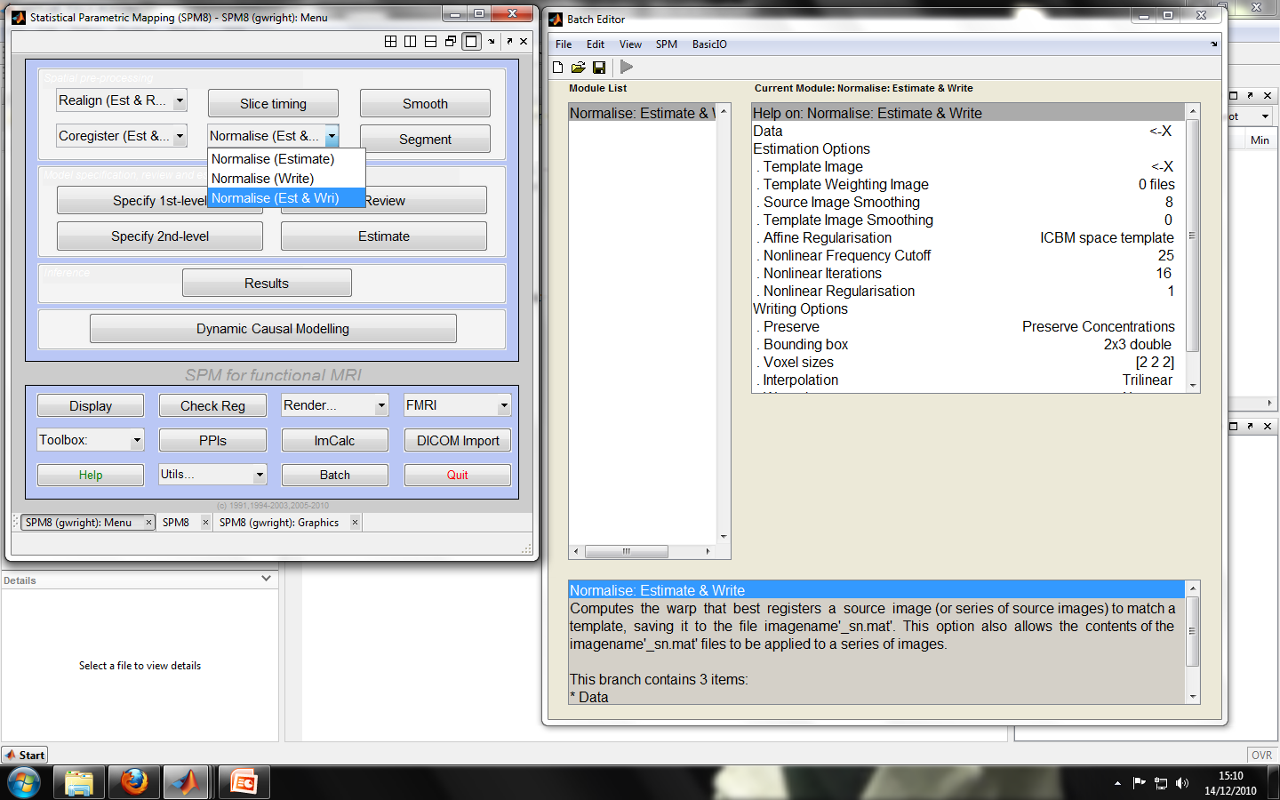
Spatial Normalisation in SPM
Template Image:
Standard space you wish to normalise your data to

Slide 23
Issues with Spatial Normalisation
Want to warp images to match functionally homologous regions from different subjects
Never exact - due to individual anatomical differences
  No exact match between structure and function
  Different brains = different structures
  Computational problems (local minima, etc.)
This is particularly problematic in patient studies with lesioned brains
Solution = compromise by correcting for gross differences followed by smoothing of normalised images

Slide 24
Smoothing
Blurring the data
  Suppress noise and effects due to differences in anatomy by averaging over neighbouring voxels
    Better spatial overlap
    Enhanced sensitivity
Improves the signal-to-noise ratio (SNR)
BUT will reduce the resolution in each image
Therefore need to strike a balance:
SNR vs. Image Resolution

Slide 25
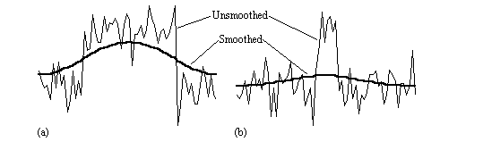
Smoothing
  Via convolution (like a general moving average)
    = 3D Gaussian kernel, of specified Full-width at half-maximum (FWHM) in mm
    Choice of filter width greatly affects detection of activation
Width of activated region is same size as filter width – smoothing optimises signal to noise
Filter width greater than width of activated region - barely detectable after smoothing
Notes:
A convolution is a kind of very general moving average.
3D: First you convolve in one direction, than in the other two directions.
The choice of filter width greatly affects the detection of activation.
Example - Image:
Image source://users.fmrib.ox.ac.uk/~stuart/thesis/chapter_6/section6_2.html:
Here two signals are filtered with the same Gaussian kernel.
In (a) the width of the activated region is the same as the size of the filter, and smoothing optimises the signal to noise.
However in (b) the filter width is greater than the width of the activated region, which barely remains detectable after the smoothing.
A general rule of thumb is to use a smoothing kernel of 6 mm for single subject analyses and a smoothing kernel of 8 or 10 mm when you are going to do a group analysis.

Slide 26
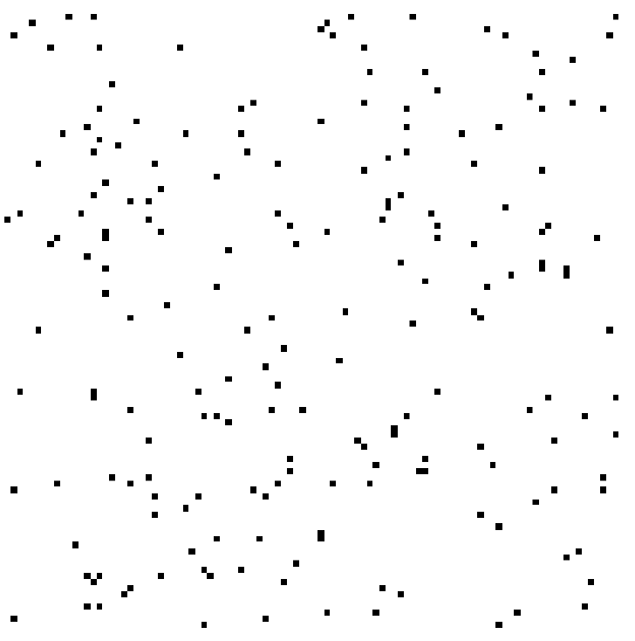
Smoothing – Weighted Average
After smoothing: each voxel effectively represents a weighted average over its local region of interest (ROI)
After
Before

Slide 27
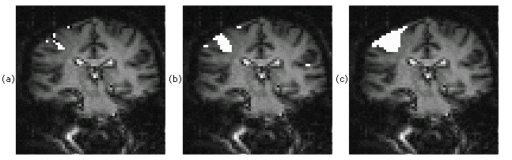
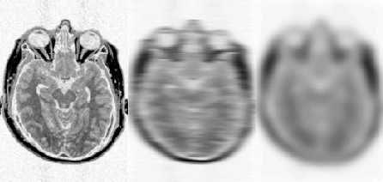
SNR vs. Image Resolution
No filter
7mm filter FWHM
15 FWHM filter
Notes:
First image - Spatially smoothing each of the images improves the signal-to-noise ratio (SNR), but will reduce the resolution in each image, and so a balance must be found between improving the SNR and maintaining the resolution of the functional image.
Second image (Source: http://users.fmrib.ox.ac.uk/~stuart/thesis/chapter_6/section6_2.html) - the use of three different smoothing filters on the same fMRI data set of a hand clenching experiment, of 3 x 3 mm2 in-plane resolution.
Areas that correlate well to the task are shaded in white, with the same p-value used for all three activation maps. (a) No filtering applied. (b) 7 mm FWHM filter applied. (c) 15 mm FWHM filter applied.

Slide 28
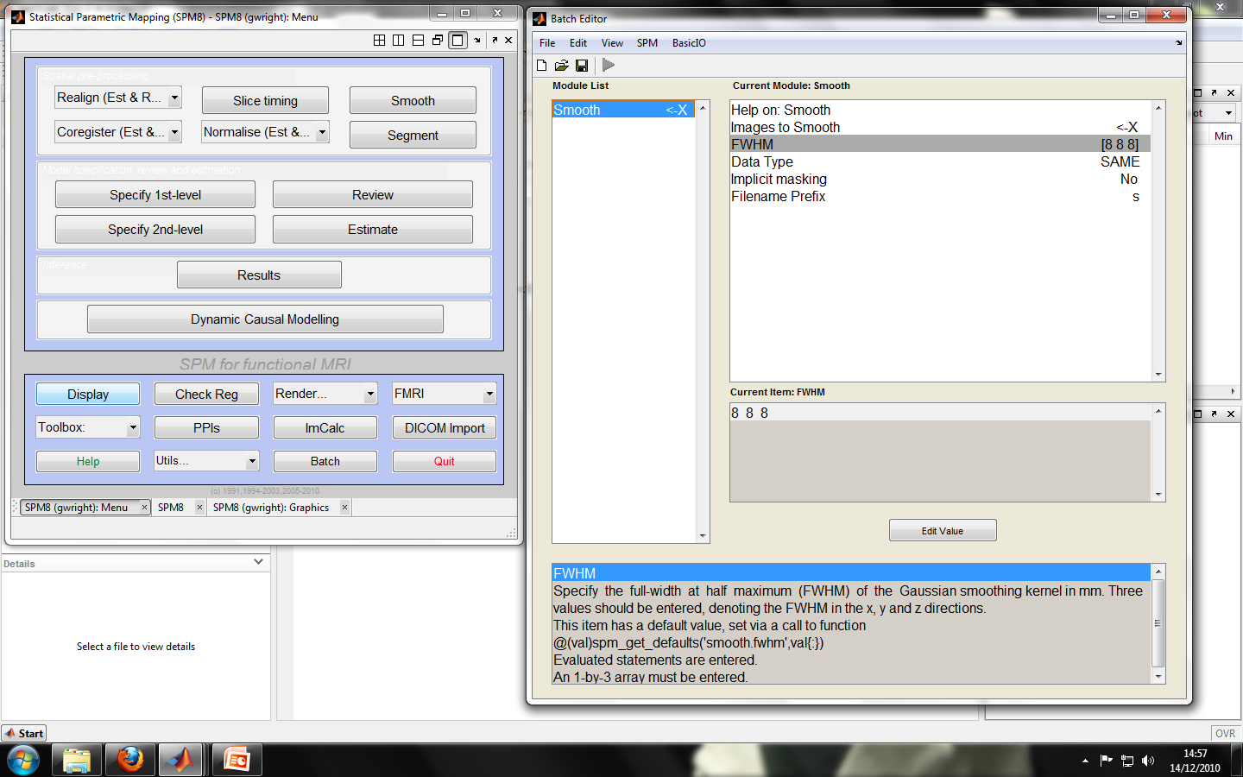
Smoothing in SPM
FWHM (Full-width at half max)
A general rule of thumb:
6 mm for single subject analyses
8 or 10 mm when you are going to do a group analysis.

Slide 29
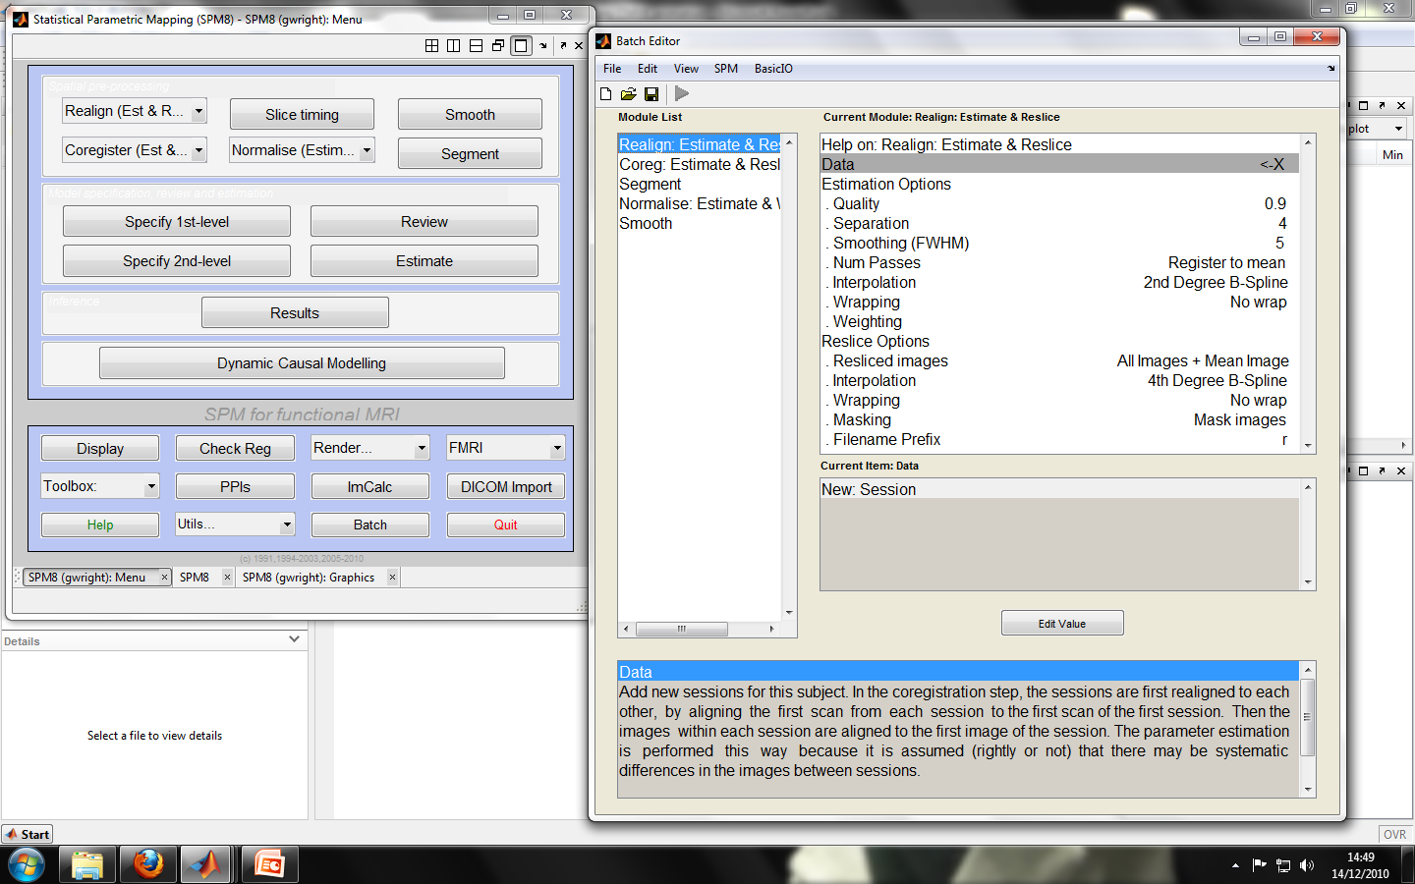
SPM: Batching
Tip: Batch
Pre-processing!
Notes:
Batch pre-processing: Do once – Repeat Many

Slide 30
Thank You & Merry Christmas!
Expert: Ged Ridgway, UCL
http://www.fil.ion.ucl.ac.uk/spm/course/slides10-zurich/
MfD Slides – 2009
Introduction to SPM: http://www.fil.ion.ucl.ac.uk/spm/doc/intro/#_III._Spatial_realignment_and normal

