Slide 1
Methods for Dummies
Preprocessing: Realigning and Unwarping
Rashmi Gupta and Luke Palmer

Slide 2
Overview
Motion in fMRI
Motion Prevention
Motion Correction
Realignment – Two Steps
Registration
Transformation
Realignment in SPM
Unwarping
Rashmi Gupta
Luke Palmer

Slide 3
Why Preprocess?
Data is noisy!
Subjects move
Inhomogeneity in MF
Physiological noise: heart beat, respiration
Etc etc etc…

Slide 4
Preprocessing: Two principal goals
To remove uninteresting variability from the data and to prepare the data for statistical analysis.
If done correctly, preprocessing steps can greatly increase the functional resolution of an fMRI experiment.

Slide 5
fMRI
fMRI
fMRI data as consisting of a 3D matrix of voxels that is repeatedly sampled over time.
A single experiment might have an imaging volume of 64 x 64 x 30 voxels that is sampled every 2 seconds for a total of 10 minutes, resulting in 300 time points per voxel.
fMRI data analysis assumptions
Each voxel represents a unique and unchanging location in the brain
Subject head motion

Slide 6
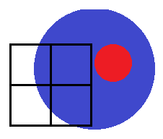
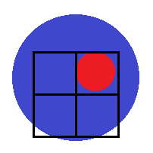
Preprocessing
Preprocessing
For various reasons, image corresponding to Region A may not be in the same location on the image, throughout the entire time series.
These preprocessing steps aim to ensure that, when we compare voxel activation corresponding to different times (and presumably different cognitive processes), we are comparing activations corresponding to the same part of the brain.
Voxel A: Inactive
Subject
moves
Very important because the movement-induced variance is often much larger than the experimental-induced variance.
Voxel A: Active
Notes:
Overview of the preprocessing steps covered in today’s session, and where they fit in the process
4 preprocessing steps: realignment, unwarping, co-registration, spatial normalization
Realignment and unwarping ensure that the same unit of brain matter is being compared with itself (i.e. to see how activation in this area changes), over time
Distinct from: comparing how activation in area A is different with activation in area B
Co-registration: combining functional and anatomical images, for the same subject
This is a linear transformation, because you’re combining two images for the same brain (different types of images, but should roughly look the same)
Spatial normalization: combining images from multiple subjects, and finding out which anatomical locations the activations correspond to
This is a non-linear transformation, because you will have substantial small-scale variations in brain structure → you want to fit all of this into a standardized anatomical space (e.g. MNI)

Slide 7
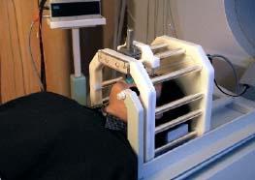
Motion Correction
Motion Correction
Head movement is the LARGEST source of variance in fMRI data.
Steps to minimise head movement;
Limit subject head movement with padding
Give explicit instructions to lay down as still as possible, not to talk between sessions, and swallow as little as possible
Try not to scan for too long* – everyone will move after while!
Make sure your subject is as comfortable as possible before you start.

Slide 8
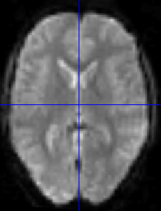
Realigning: Motion Correction
fMRI time series
Motion Correction
Realigns a time-series of images acquired from the same subject (fmri)
As subjects move in the scanner, realignment increases the sensitivity of data by reducing the residual noise of the data.
NB: subject movement may correlate with the task therefore realignment may reduce sensitivity.
Motion corrected
Mean functional
Reference Image: First image acquired in the session

Slide 9
Realignment - Two Steps
Realignment (of same-modality images from same subject) involves two stages:
Registration
Estimate the 6 parameters that describe the rigid body transformation between each image and a reference image (first image acquired in the session)
2. Transformation
Re-sample each image according to the determined transformation parameters
Notes:
Each volume in the time-series is realigned
Using rigid-body registration
Assumes that brain shape doesn’t change
Least squares cost function
Realigned images must be resliced for analysis
Not necessary if they will be normalised anyway

Slide 10
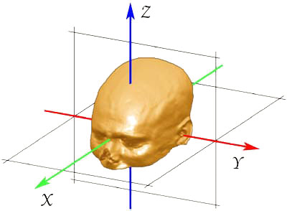
1. Registration
Registration – determine the 6 parameters of the rigid body transformation between each source image and a reference image (i.e. How much each image needs to move to fit the source image by a combination of 6 parameters)
Rigid body transformation assumes the size and shape of the 2 objects are identical and one can be superimposed onto the other via 3 translations and 3 rotations
Translation
Rotation
Yaw
Pitch
Roll
Notes:
Rotation:
Pitch is rotation around the x axis up and down, like nodding ‘Yes’
Yaw is rotation around the z axis, side to side, like ‘No’
Roll is ration around the y axis, like ‘Maybe’

Slide 11
1. Registration
Operations can be represented as affine transformation matrices:
x₁ = m_{1,1}x₀ + m_{1,2}y₀ + m_{1,3}z₀ + m_{1,4}
y₁ = m_{2,1}x₀ + m_{2,2}y₀ + m_{2,3}z₀ + m_{2,4}
z₁ = m_{3,1}x₀ + m_{3,2}y₀ + m_{3,3}z₀ + m_{3,4}
Rigid body transformations parameterised by:
Translations
Pitch about X axis
Roll about Y axis
Yaw about Z axis
Notes:
Operations (translation and rotation) are performed by matrices
The order in which you perform the operations matters. In SPM it is done by:
Rotating about Z axis
Rotating about Y axis
Rotating about X axis
Then translating
Each of the operations can be performed by matrices and these matrices can be multiplied together

Slide 12
2. Transformation
Reslice/resample a series of registered images such that they match the first image selected onto the same grid of voxels
We need to take the value of the voxels from the original image and put it in our new, re-aligned image.
Various methods of transformation / interpolation:
Nearest neighbour
Linear interpolation
B-Spline
Notes:
So, in the registration process each of the images are matched to the first image of the time series and a mean of these aligned images is generated. Then each of the individual images is matched to this mean image. At this point, the data can be resampled

Slide 13
Simple Interpolation
Nearest neighbour
Takes the value of the closest voxel
Tri-linear
Weighted average of the neighbouring voxels
f₅ = f₁ x₂ + f₂ x₁
f₆ = f₃ x₂ + f₄ x₁
f₇ = f₅ y₂ + f₆ y₁
Notes:
In the re-slicing or transformation step we need to take the value of the voxels from the original image and put it in our new, re-aligned image. There are a number of ways of doing this. The simplest one is to take the value of the nearest neighbour.
A rather better option is tri-linear interpolation (illustrated here in 2 dimensions, so it’s bi-linear interpolation) but it’s easier to explain.
The white circles represent original voxels (f1, f2, f3, f4) and the black circle (f7) represents the point we’re trying to sample
So, we take the weighted average intensity of these 2 values (f1 and f2) and we get f5
We also take the weighted average of f3 and f4 to get f6
Finally, we take the weighted average of f5 and f6 to get f7.
This would generalize into 3 dimensions
This method is not really optimal because by taking the weighted average of the neighbouring voxel we are introducing smoothness into the resampled image. It’s a bit messy and you will lose information.
There are better ways of doing interpolation, although such methods could be slower.

Slide 14
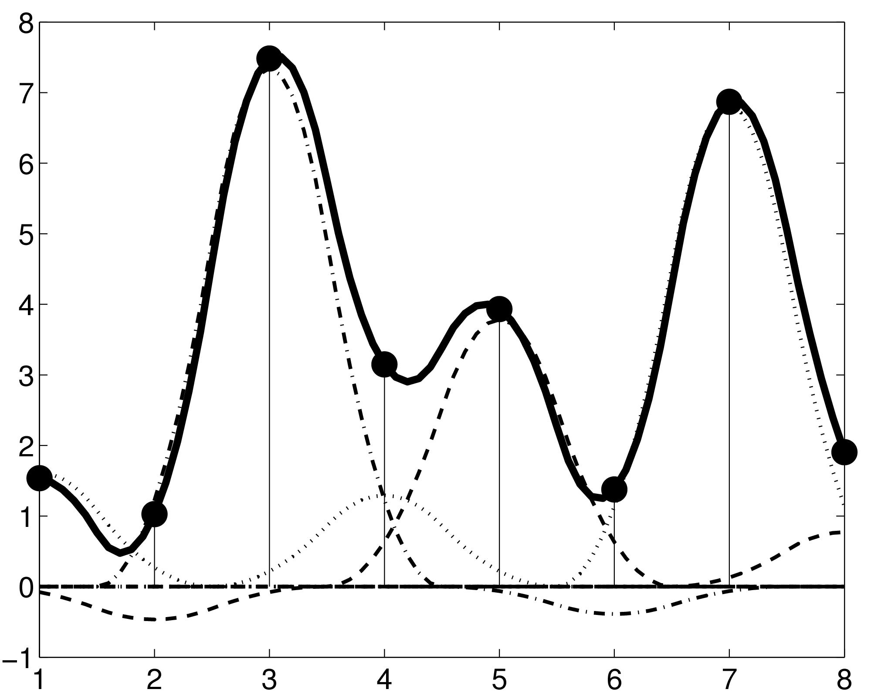
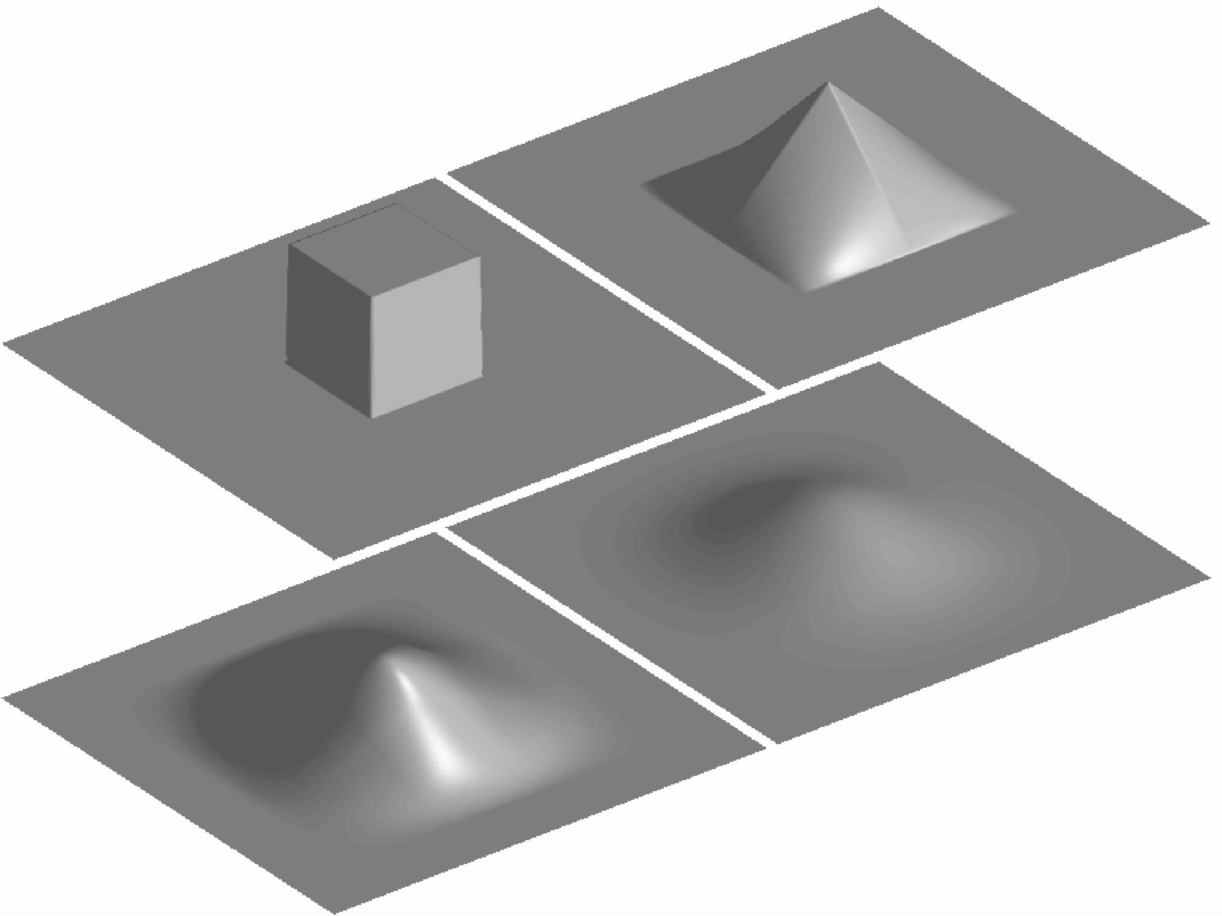
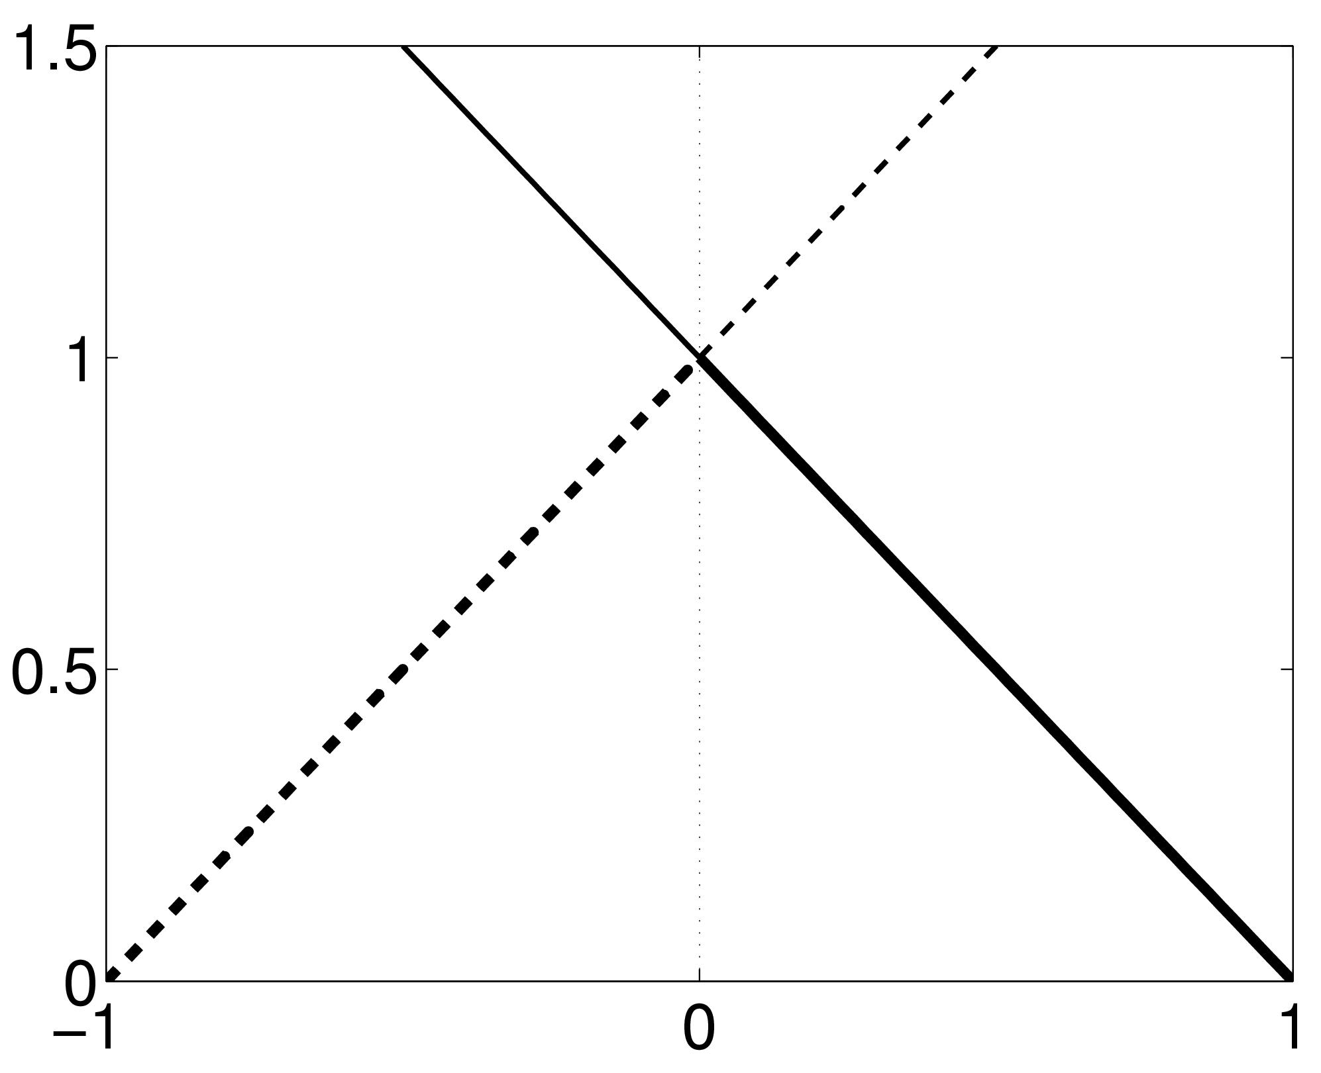
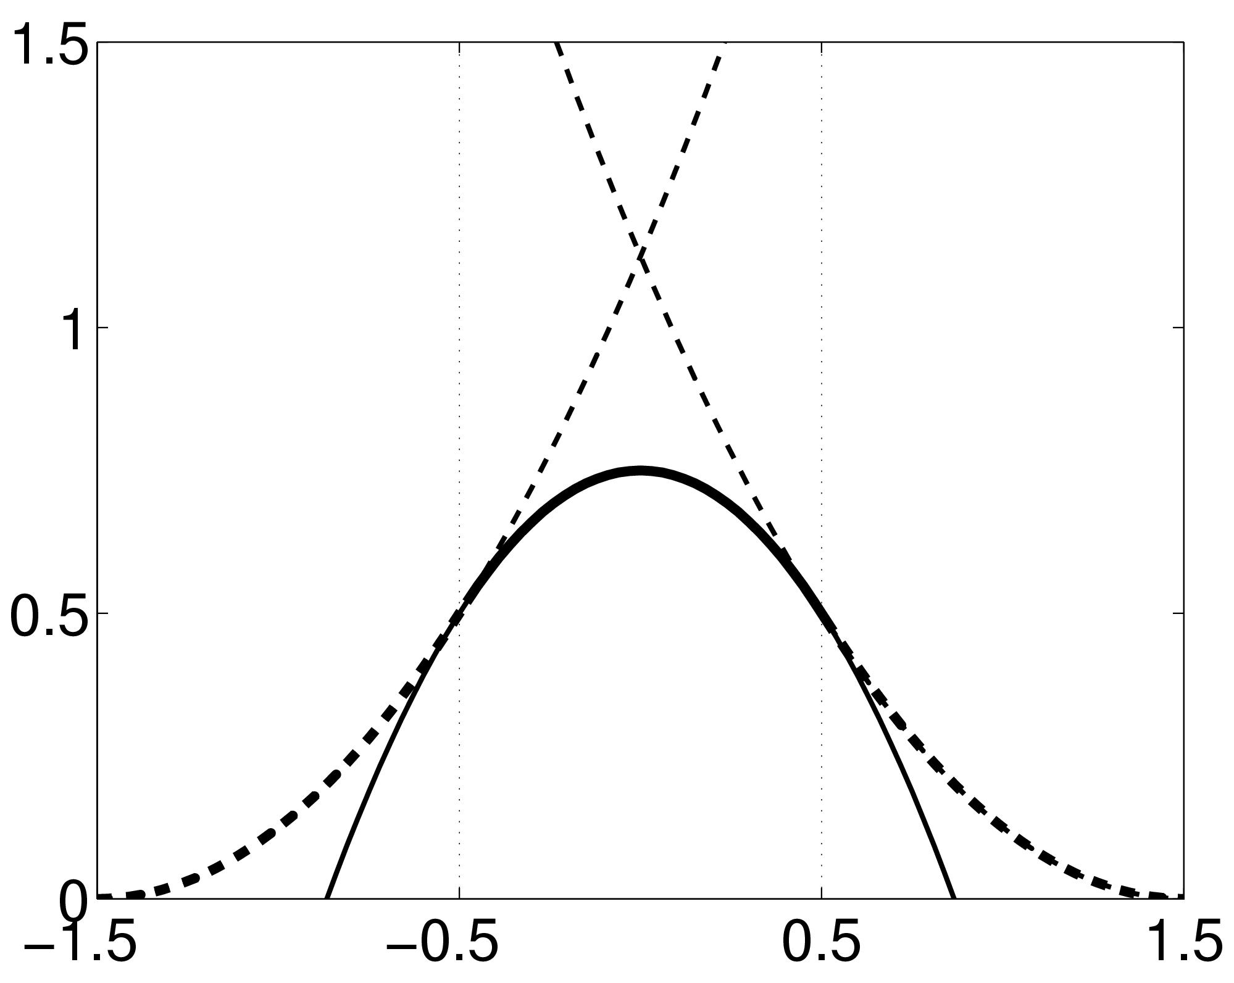
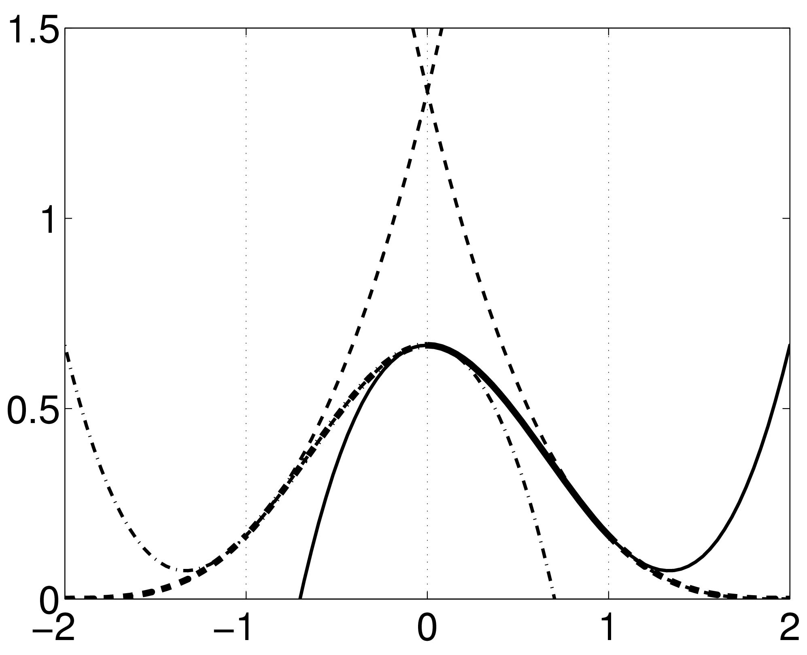
B-spline Interpolation
Interloping smooth function between voxels
A continuous function is represented by a linear combination of basis functions
2D B-spline basis functions of degrees 0, 1, 2 and 3
B-splines are piecewise polynomials
B-spline interpolation with degrees 0 and 1 is the same as nearest neighbour and bilinear/trilinear interpolation.
Notes:
So, a better method of interpolation is B-spline. In this graph, the perpendicular thin lines represent the value of individual voxels in the original image and the black line is interpoling the smooth function between voxels. When we want to sample a new value, we just take the height of the black line. This black line consists of the linear combination of these gaussian shaped basis functions. There are a few options of B-spline interpolation in SPM. I’ll try to explain some
We have a function that is a little triangle shape and this is a 1st degree b-spline, which is identical to a bilinear / tri-linear interpolation
2nd degree b-spline is slightly more sophisticated. This function consists of some polynomials that are stuck together. There’s a gaussian shape here which consists of a bit of this curve (left) a bit of the right curve and a bit of the top curve which are stuck together.
3rd degree b-spline uses a few more curves
This is how they would appear in 2D, there’s also a 3D version as well.

Slide 15
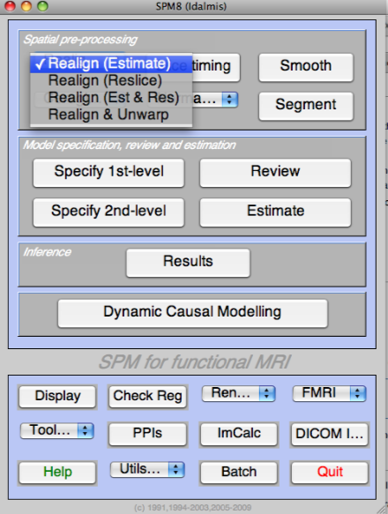
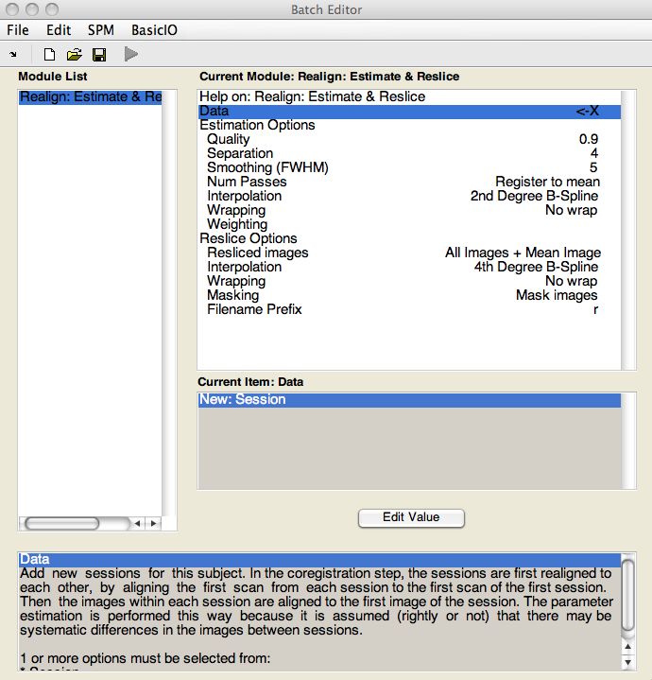
Realignment in SPM - Options

Slide 16
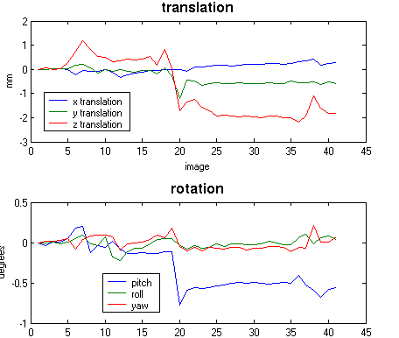
Realignment in SPM - Output
Notes:
These data were specifically made to see what happens when a person nods. The images you saw were 15 and 20, like three mm difference. Shift in y and z direction, and a clear pitch.

Slide 17
Residual Errors in Realigned fMRI
Even after realignment a considerable amount of the variance can be accounted for by effects of movement
This can be caused by e.g.:
Movement between and within slice acquisition
Interpolation artefacts due to resampling
Non-linear distortions and drop-out due to inhomogeneity of the magnetic field
Incorporate movement parameters as confounds in the statistical model

Slide 18
Unwarping
Non-linear distortions due to inhomogeneities in the magnetic field
Luke Palmer

Slide 19
Slice Selection
Apply gradient field, B0, in z-axis
For target dipoles B0 ∝ ω (Larmor or resonant frequency: frequency of precession about z-axis)
Can send a pre-calculated RF pulse of frequency ω which will only be absorbed by a plane of dipoles
The subsequent precession signal received at the coil is attributed to activity in that plane

Slide 20
Slice Selection in Practice
BUT!
Unlike our homogenous substance, the brain is differentially susceptible to magnetization in different areas
This makes the field inhomogeneous, breaking the homogeneity assumption used in slice selection
The signal/image obtained is therefore distorted
Notes:
-e.g. air/matter boundaries
-we cannot therefore assume that all of the signal comes from a single plane in reality

Slide 21
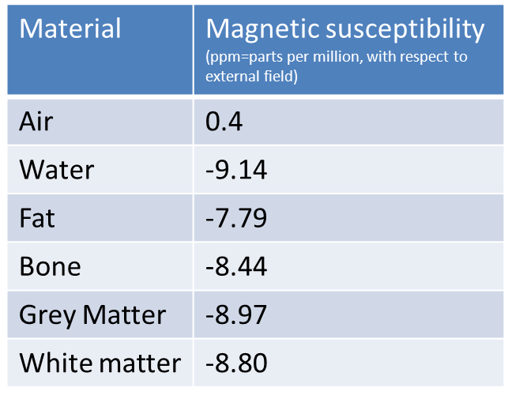
Magnetic Susceptibility
Some common susceptibilities. They describe the magnetisation of a material in response to an applied magnetic field
Distortion of a uniform magnetic field
Notes:
-e.g. air/matter boundaries
-we cannot therefore assume that all of the signal comes from a single plane in reality

Slide 22
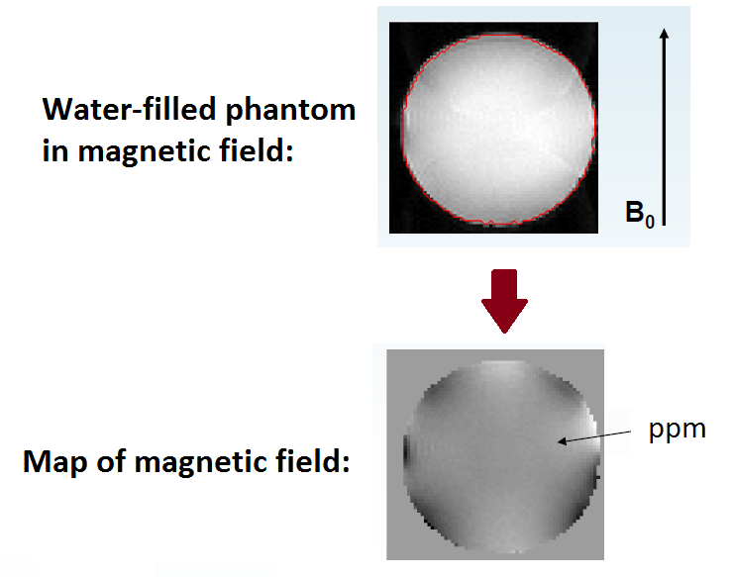
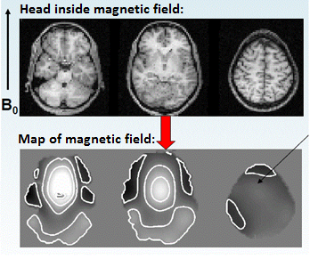
MRI Example
Uniform object having little variance in magnetic field. This would not produce much distortion in a final image
Large susceptibility variation in the human brain leads to greater field inhomogeneity and therefore image distortion

Slide 23
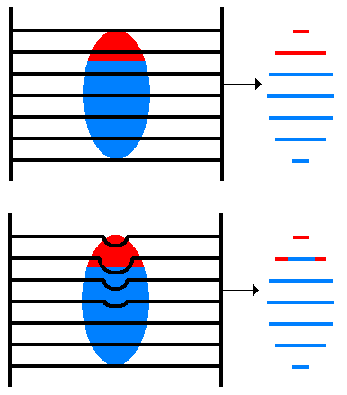
Image Distortion
Image distortion occurs because image locations are effectively ‘deflected’ by an inhomogeneous field.
The inhomogeneity means that dipoles from outside of the target plane may also precess when the RF pulse is applied.
Therefore, image slices which are assumed to be from a flat plane of the volume in fact contain signals from other parts, resulting in a warping of the ‘real’ image.

Slide 24
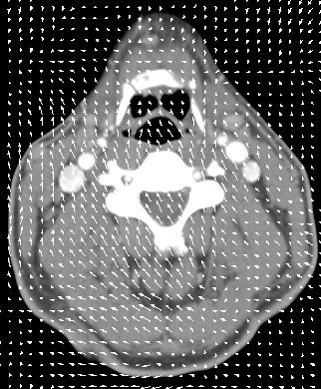
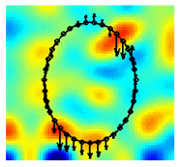
One Slice Solution: Field Maps
We can explicitly measure the field inhomogeneity using a field map.
-Dedicated scan before the start of experiment to measure this
Using this map we can derive a deformation field, which details how the voxels in the volume are deflected due to the distorted field.
By applying the inverse of this deformation field,
voxel displacement due to inhomogeneity is undone

Slide 25
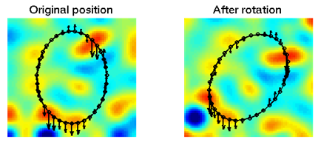
Susceptibility X Movement
Field inhomogeneities change with the position of the object in the field, so there can be non-rigid, as well as rigid distortion over subsequent scans.
The movement-by-inhomogeneity interaction can be observed by changes in the deformation field over subsequent scans.
Therefore, the field map and deformation field calculated for a slice at t=0 cannot be used at t=1 if there was subject movement, as the distortion on the object has changed

Slide 26
Accounting for the Interaction
One possibility would be to measure the field inhomogeneity explicitly and generate a field/deformation map for each scan in the series.
Measurement of field-maps is complicated by noise, and rapid loss of signal towards the edges of the object.
BETTER SOLUTION:
Calculate a deformation field from a single field map at the beginning of the series, then use the pre-calculated (from the realign procedure) rigid movement parameters to estimate the warping of that field map for each time point in the series.
Now we can apply inverse deformation fields to each slice in the volume

Slide 27
Modelling Field Warping
Estimated change in deformation field wrt change in pitch (x-axis)
Estimated change in deformation field wrt change in roll (y-axis)
Deformation field at time t
Measured deformation field
=
+Δϕ
+Δθ
Changes in the deformation field, due to subject movement (estimated via iteration procedure in UNWARP)
Apply the inverse of this to your raw image, to unwarp
Static deformation field
(calculated using field map)
NB: SPM can estimate an anatomically dubious distortion field series which reduces the slices
to an ‘average distortion’ state without the need for a field map

Slide 28
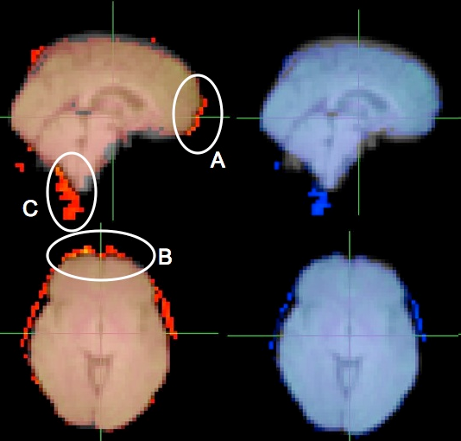
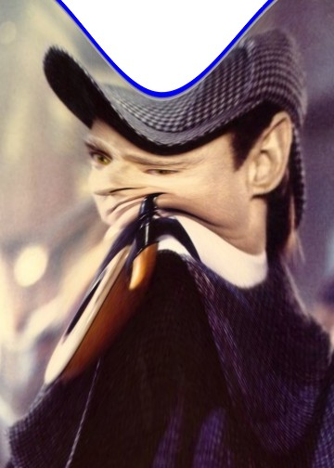
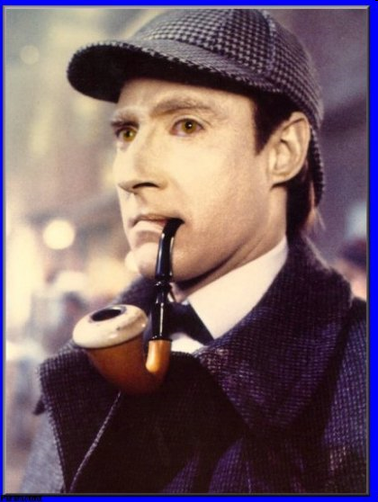
Results
Original EPI
Unwarped EPI
Original EPI shows stretching of data in the anterior direction near the frontal pole (A, B), and a movement of the cerebellum and spinal cord in the posterior direction (C). These are corrected in the unwarped version (blue).
Images are overlaid on top of the structural field map image

Slide 29
Covariation
Could instead include the movement parameters as confounds in the statistical model of
activations. However, this may remove activations of interest if they are (heavily)
correlated with the movement, and can only account for linear transformations.
No correction
Correction by covariation
Correction by Unwarp
t_{max}=13.38
t_{max}=5.06
t_{max}=9.57

Slide 30
Summary
The problem:
Different substances differentially modify the magnetic field
Inhomogeneity in the magnetic field (which interacts with subject movement)
Distortion of image
The solution:
1) Measure the field inhomogeneities (with the field map), given a known subject position.
2) Use this info about field inhomogeneities to predict how the image is distorted/deflected at each time point (the ‘deformation map’).
3) Using subject movement parameters, estimate the deformation map for each time point (since the deformation map changes with subject movement)
4) Re-slices your data, using the deformation map to ensure that the same portion of the brain is always found in the same location of the image, throughout all your scans.

Slide 31
References
References
A detailed explanation of EPI distortion (the problem):
ww.fil.ion.ucl.ac.uk/~mgray/Presentations/Unwarping.ppt
http://cast.fil.ion.ucl.ac.uk/documents/physics_lectures/Hutton_epi_distortion_300408.pdf
SPM material on unwarping (rationale, limitations, toolbox, sample data set) http://www.fil.ion.ucl.ac.uk/spm/toolbox/unwarp/
http://www.fil.ion.ucl.ac.uk/spm/data/
The physics wiki: step-by-step instructions on how to go about everything
http://intranet.fil.ion.ucl.ac.uk/pmwiki/ (only accessible to FIL/ICN)
SPM manual: http://www.fil.ion.ucl.ac.uk/spm/doc/manual.pdf
Last year’s MFD slides

Slide 32
References
Step-by-Step Unwarping
Step 1: (During scanning) acquire 1 set of field maps for each subject
See the physics wiki for detailed how-to instructions(reference at end)
Field map files will either be in the structural directories, or in the same subject folders as the fMRI data
Step 2: (After scanning) Convert fieldmaps (prefixed with ‘sMT’) into .img files (DICOM import in SPM menu)
Which files: prefixed with ‘s’, if acquired at the FIL, but generally you should keep track of the order in which you perform your scans (e.g. if you did field maps last, it’ll be the last files)
You should end up with 3 files, per field map (phase and magnitude files – see wiki for identification)
File names: sXXXXX-YYYYY -- XXX is scan number, YYY is series number
There will be 2 files with the same series number – these are the magnitude images, 1 for short TE and 1 for long TE (short TE one is the first one)
1 file will have a different series number= phase image
Step 3: (Using the Batch system) Use fieldmap toolbox to create .vdm (voxel displacement map) files for each run for each subject.
vdm map = deformation map! Describes how image has been distorted. This is what is applied to the EPI time series.
You need to enter various default values in this step, so check the physics wiki for what’s appropriate to your scanner type and scanning sequence. OR, there are some default files you can use, depending on your scanner & sequence.
Step 4
Feed the vdm file into the Realign & Unwarp step
Batch → SPM → Spatial → Realign & Unwarp
Or: Batch → File: Load Batch → Select the appropriate values for your scanner & sequence (consult physics wiki) → RUN

Slide 33
A special thanks to Dr. Guillaume Flandin

