Slide 1
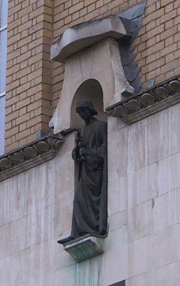
Preprocessing I:
Within Subject
John Ashburner
Wellcome Trust Centre for Neuroimaging,
12 Queen Square, London, UK.

Slide 2
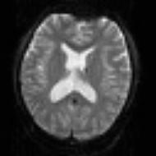
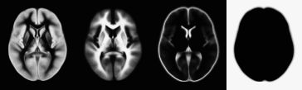
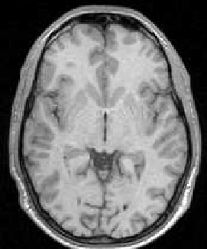

Pre-processing overview
Statistics or whatever
fMRI time-series
Anatomical MRI
Template
Smoothed
Estimate Spatial Norm
Motion Correct
Smooth
Coregister
Spatially normalised
Deformation

Slide 3
Contents
Preliminaries
  Rigid-body and affine transformations
  Optimisation and objective functions
  Transformations and interpolation
Realignment
Coregistration

Slide 4
Rigid-body transformations
Assume that brain of the same subject doesn’t change shape or size in the scanner.
  Head can move, but remains the same shape and size.
  Some exceptions:
    Image distortions.
    Brain slops about slightly because of gravity.
    Brain growth or atrophy over time.
If the subject’s head moves, we need to correct the images.
  Do this by image registration.

Slide 5
Image registration
Two components:
Registration - i.e. Optimise the parameters that describe a spatial transformation between the source and reference images
Transformation - i.e. Re-sample according to the determined transformation parameters

Slide 6
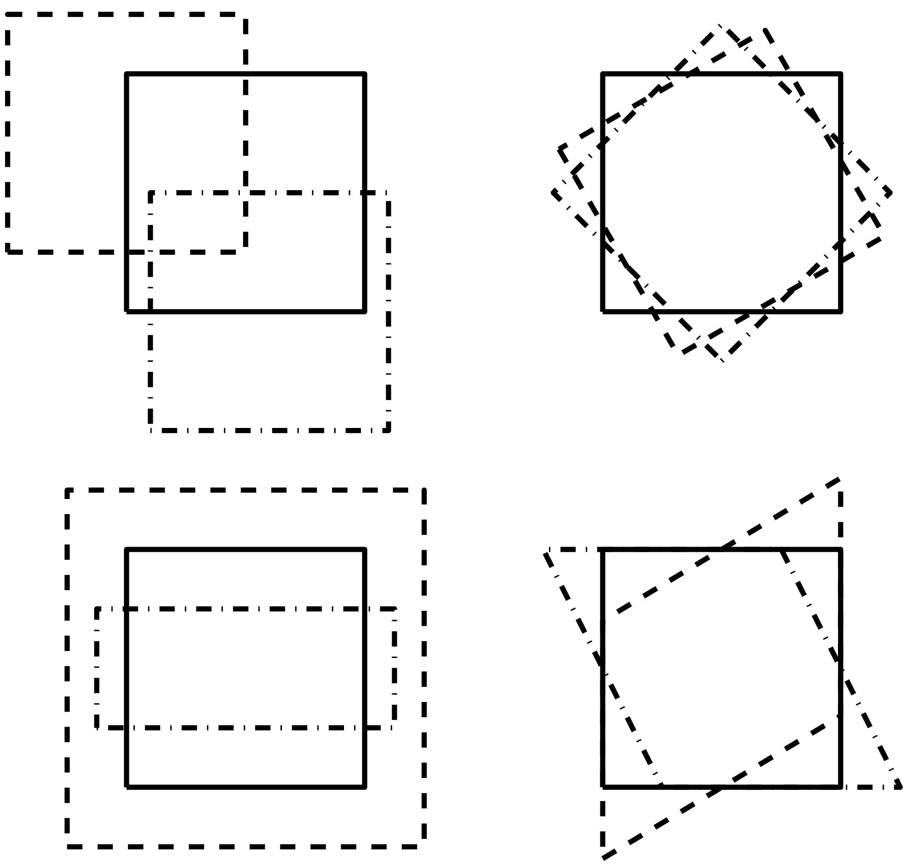
2D affine transforms
Translations by t_{x} and t_{y}
  x₁ = x₀ + t_{x}
  y₁ = y₀ + t_{y}
Rotation around the origin by Θ radians
  x₁ = cos(Θ) x₀ + sin(Θ) y₀
  y₁ = -sin(Θ) x₀ + cos(Θ) y₀
Zooms by s_{x} and s_{y}
  x₁ = s_{x} x₀
  y₁ = s_{y} y₀
Shear
  x1 = x0 + h y0
  y1 = y0

Slide 7
2D affine transforms
Translations by t_{x} and t_{y}
  x₁ = 1 x₀ + 0 y₀ + t_{x}
  y₁ = 0 x₀ + 1 y₀ + t_{y}
Rotation around the origin by Θ radians
  x₁ = cos(Θ) x₀ + sin(Θ) y₀ + 0
  y₁ = -sin(Θ) x₀ + cos(Θ) y₀ + 0
Zooms by s_{x} and s_{y}:
  x₁ = s_{x} x₀ + 0 y₀ + 0
  y₁ = 0 x₀ + s_{y} y₀ + 0
Shear
  x1 = 1 x0 + h y0 + 0
  y1 = 0 x0 + 1 y0 + 0

Slide 8
3D rigid-body transformations
A 3D rigid body transform is defined by:
  3 translations - in X, Y & Z directions
  3 rotations - about X, Y & Z axes
The order of the operations matters
Translations
Pitch
about x axis
Roll
about y axis
Yaw
about z axis

Slide 9
Voxel-to-world transforms
Affine transform associated with each image
  Maps from voxels (x=1..n_{x}, y=1..n_{y}, z=1..n_{z}) to some world co-ordinate system. e.g.,
    Scanner co-ordinates - images from DICOM toolbox
    T&T/MNI coordinates - spatially normalised
Registering image B (source) to image A (target) will update B’s voxel-to-world mapping
  Mapping from voxels in A to voxels in B is by
    A-to-world using M_{A}, then world-to-B using M_{B}⁻¹
    M_{B}⁻¹ M_{A}

Slide 10
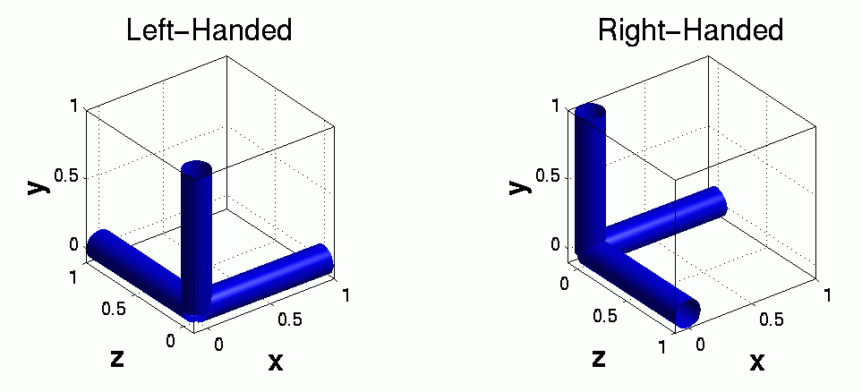
Left- and right-handed coordinate systems
NIfTI format files are stored in either a left- or right-handed system
  Indicated in the header
Talairach & Tournoux uses a right-handed system
Mapping between them sometimes requires a flip
  Affine transform has a negative determinant

Slide 11
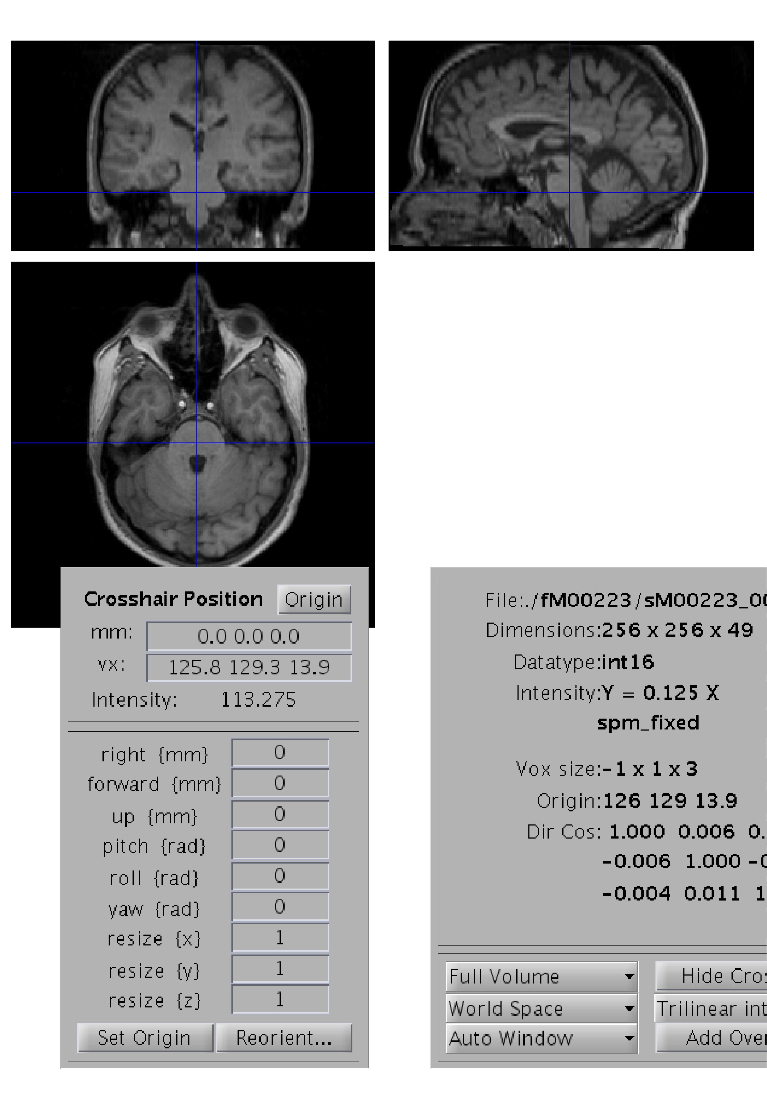
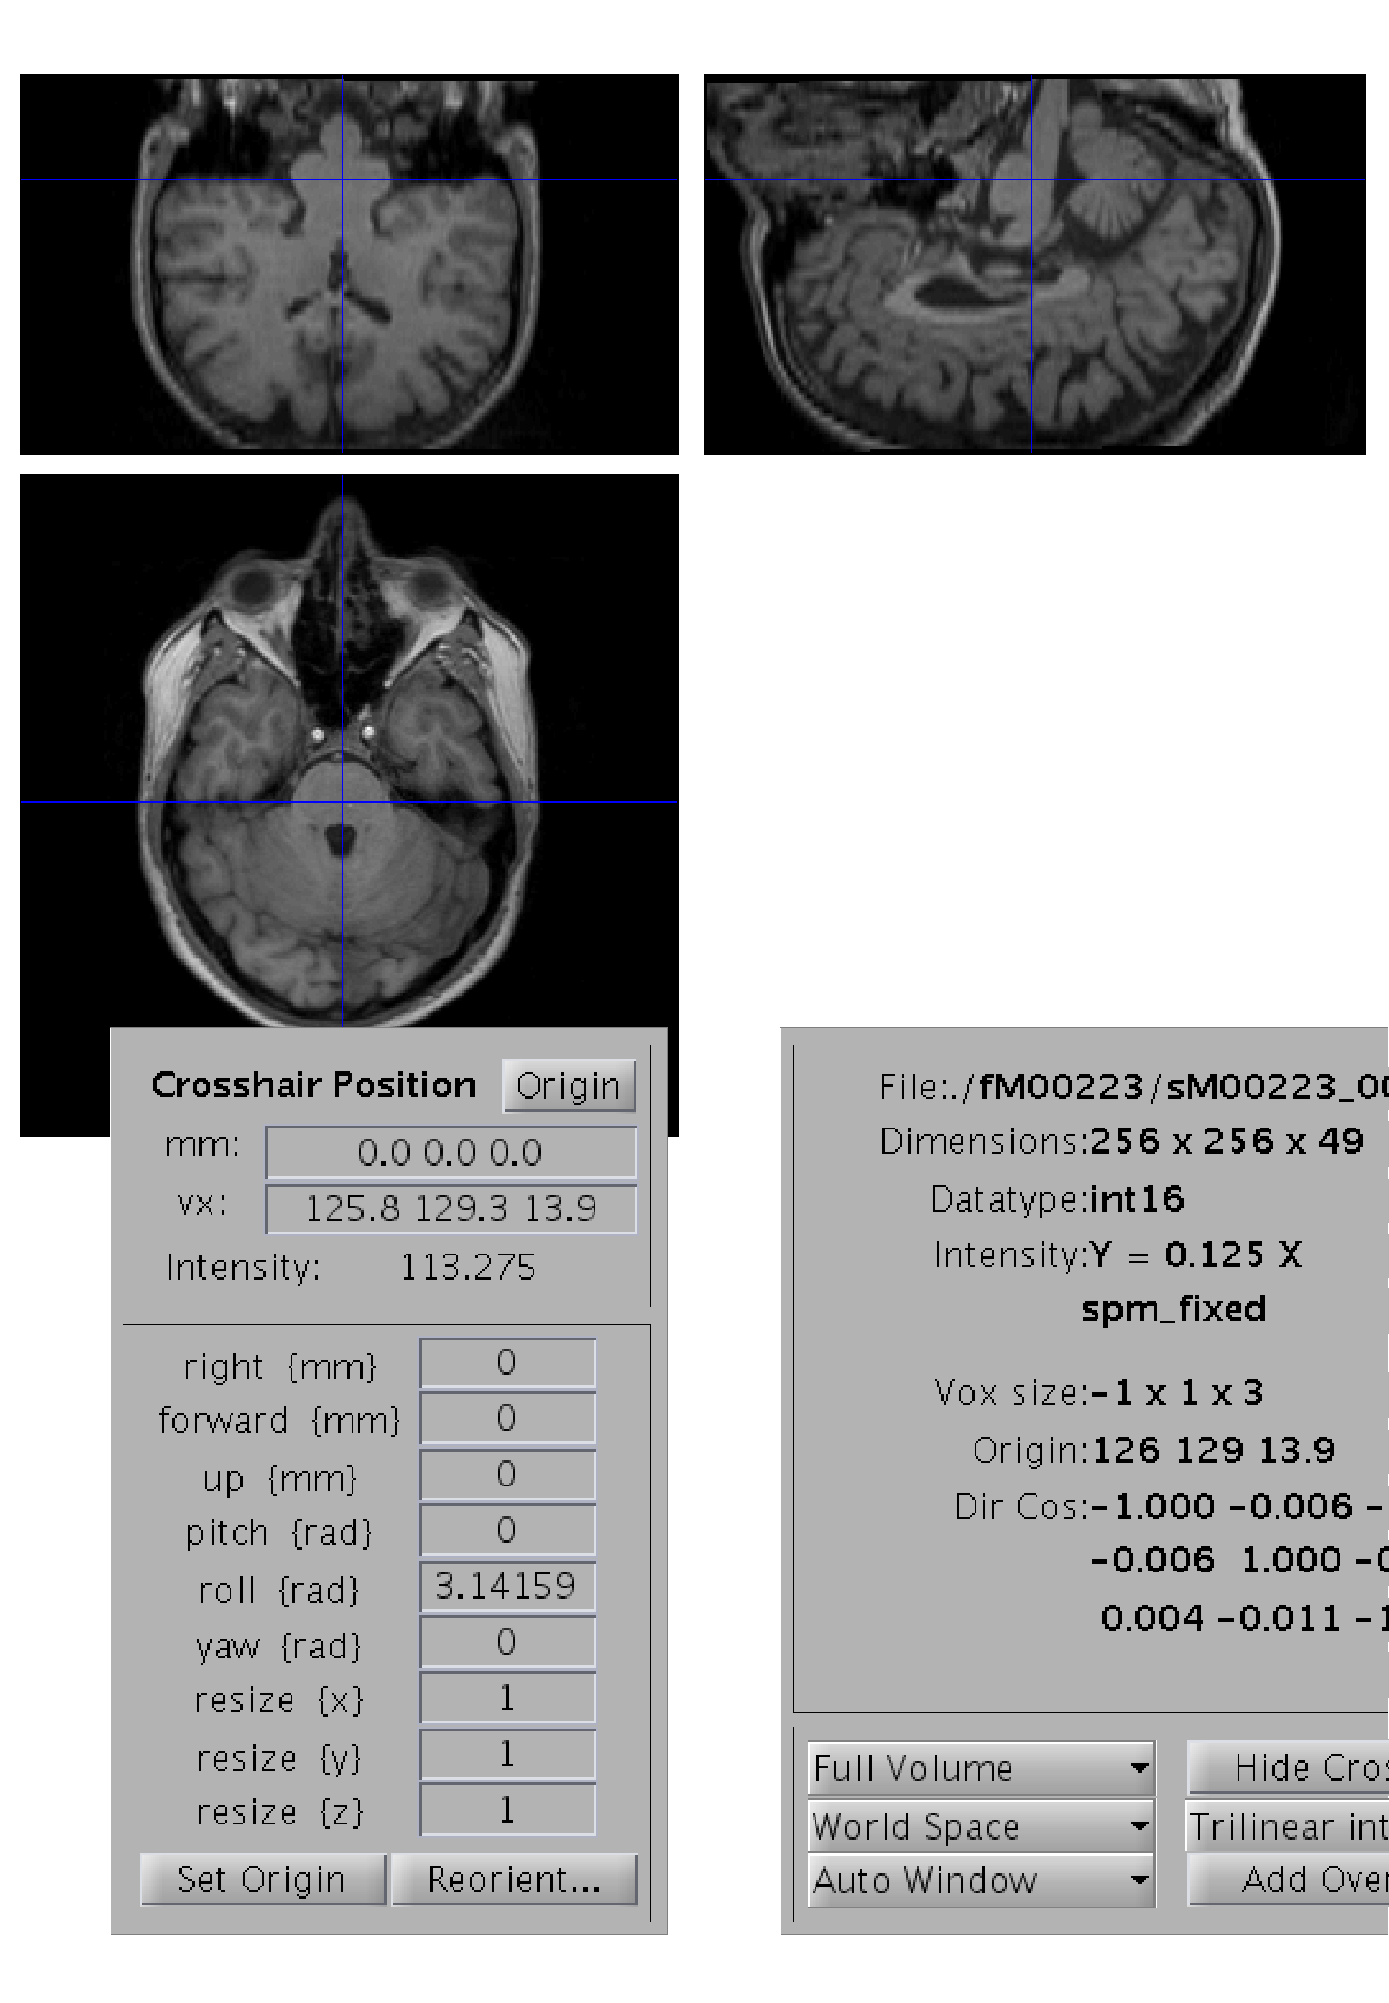
“Radiological” and “neurological” conventions
Left
Right
Right
Left

Slide 12
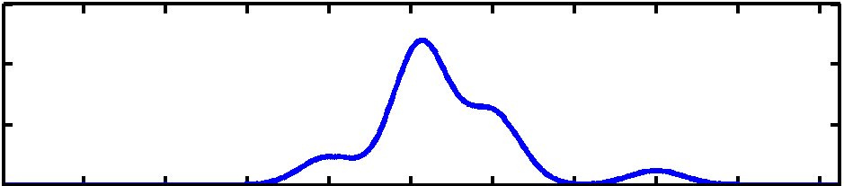
Optimisation
Image registration is done by optimisation.
Optimisation involves finding some “best” parameters according to an “objective function”, which is either minimised or maximised
The “objective function” is often related to a probability based on some model
Most probable solution (global optimum)
Objective function
Local optimum
Local optimum
Value of parameter

Slide 13
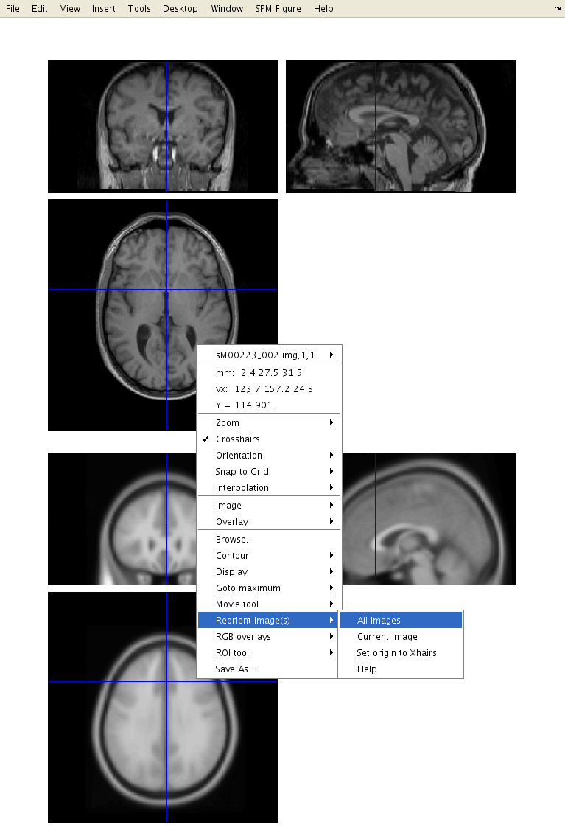
Optimisation
Because registration only finds a local optimum, some manual reorienting of the images may be needed before doing anything else in SPM.
An MNI-space image from spm12/canonical directory.

Slide 14
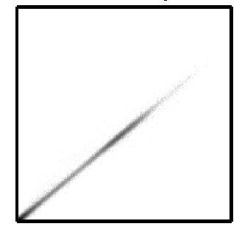
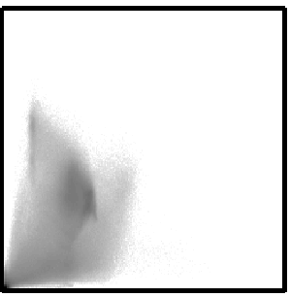
Objective functions
Intra-modal
  Mean squared difference (minimise)
  Normalised cross correlation (maximise)
Inter-modal (or intra-modal)
  Mutual information (maximise)
  Normalised mutual information (maximise)
  Entropy correlation coefficient (maximise)

Slide 15
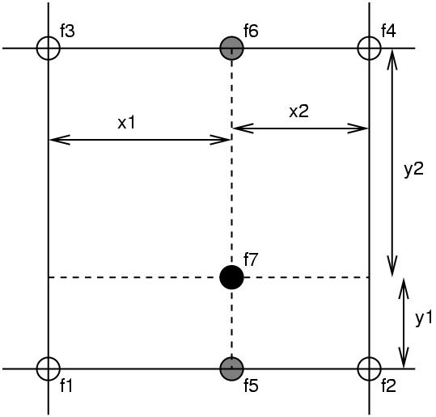
Simple interpolation
Nearest neighbour
  Take the value of the closest voxel
Tri-linear
  Just a weighted average of the neighbouring voxels
  f₅ = f₁ x₂ + f₂ x₁
  f₆ = f₃ x₂ + f₄ x₁
  f₇ = f₅ y₂ + f₆ y₁

Slide 16
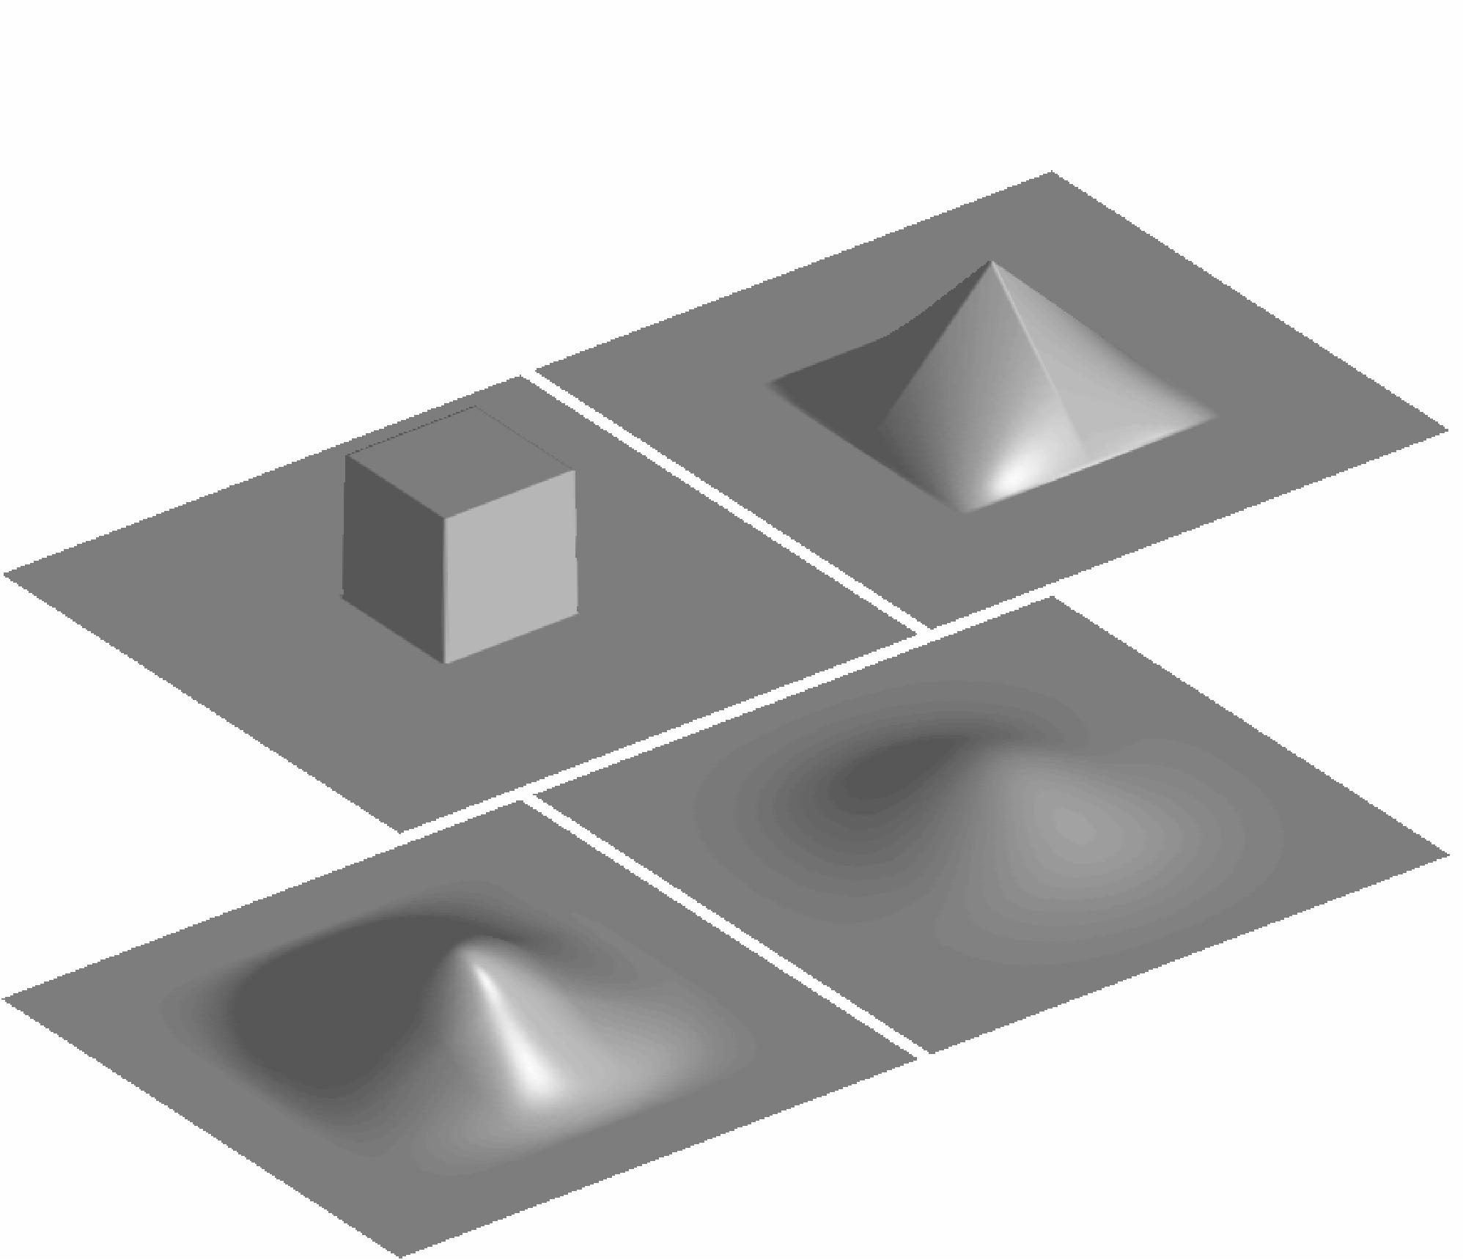
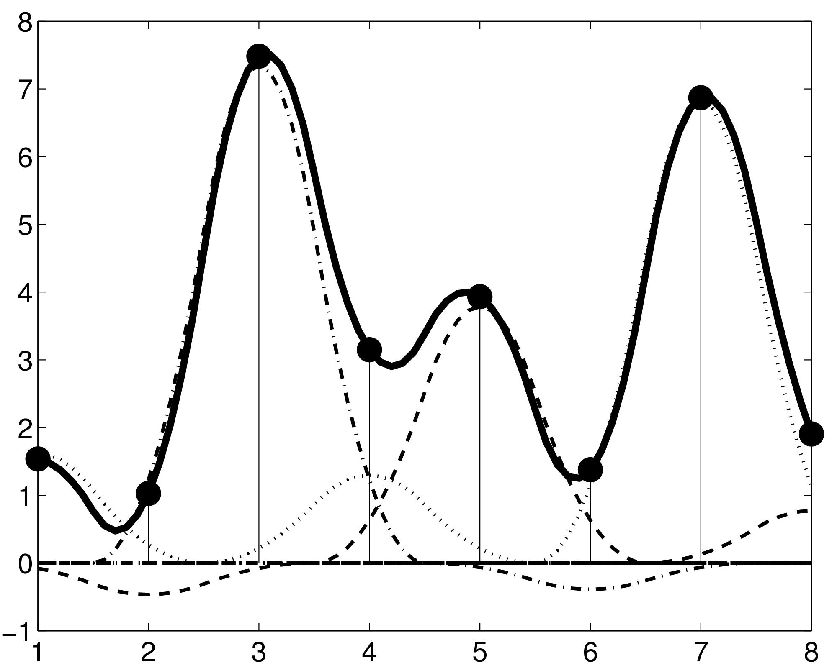
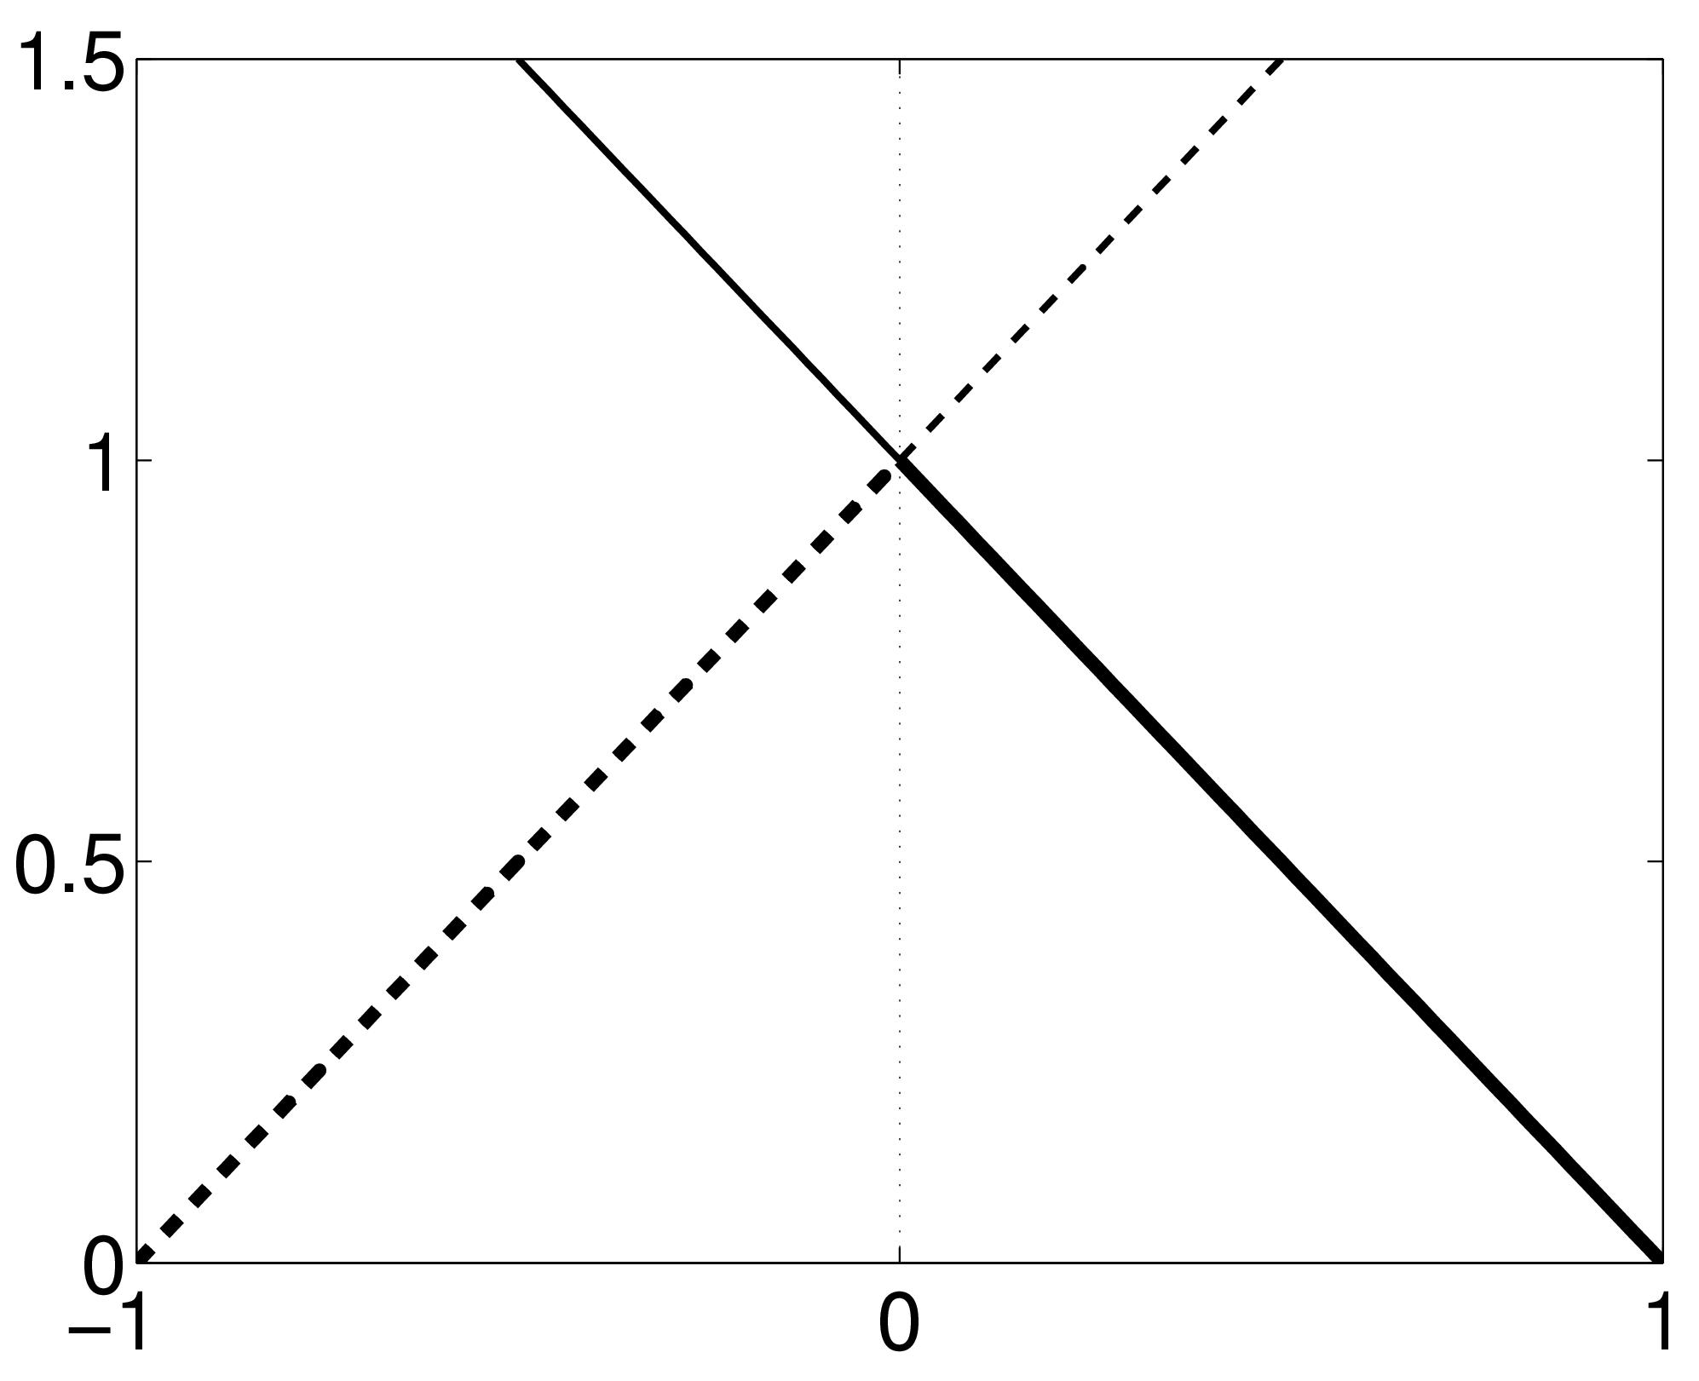
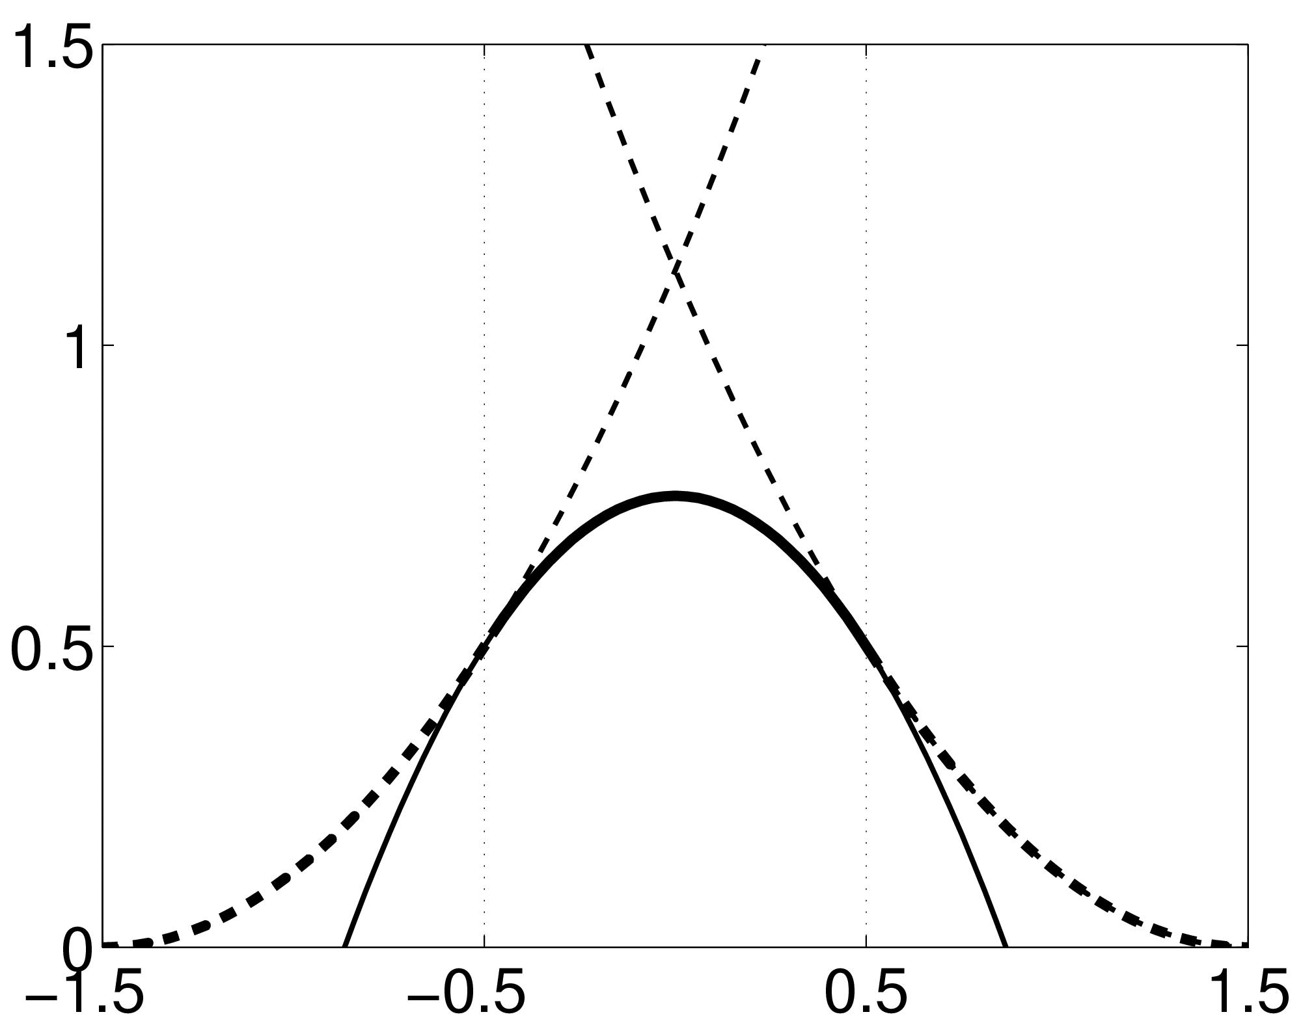
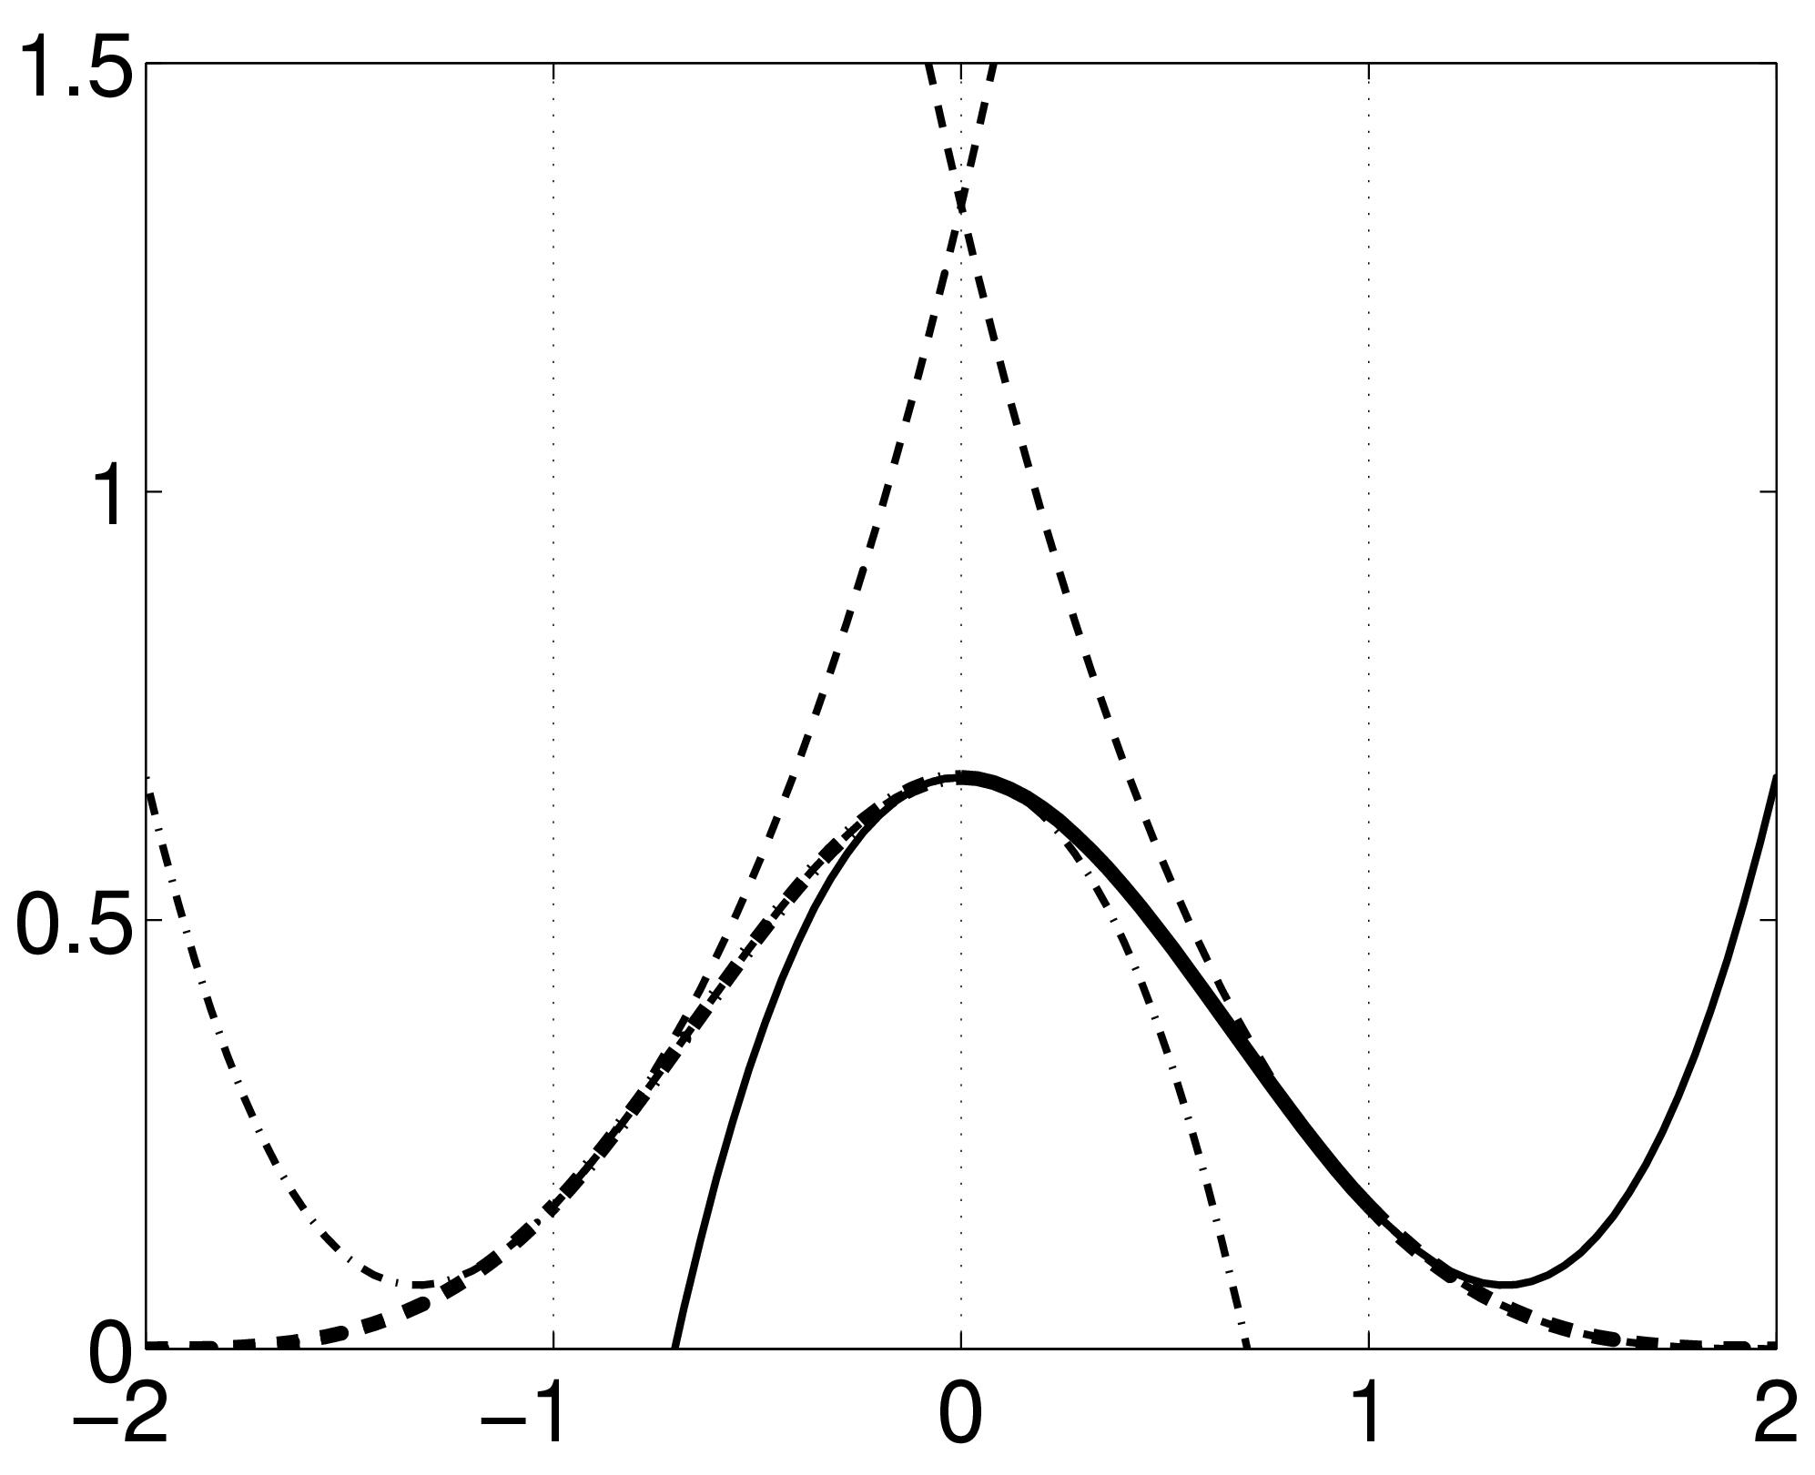
B-spline interpolation
A continuous function is represented by a linear combination of basis functions
2D B-spline basis functions of degrees 0, 1, 2 and 3
B-splines are piecewise polynomials
Nearest neighbour and trilinear interpolation are the same as B-spline interpolation with degrees 0 and 1.

Slide 17
Contents
Preliminaries
Realignment
  Realignment by minimising mean-squared difference
  Residual artifacts and distortion correction
Coregistration

Slide 18
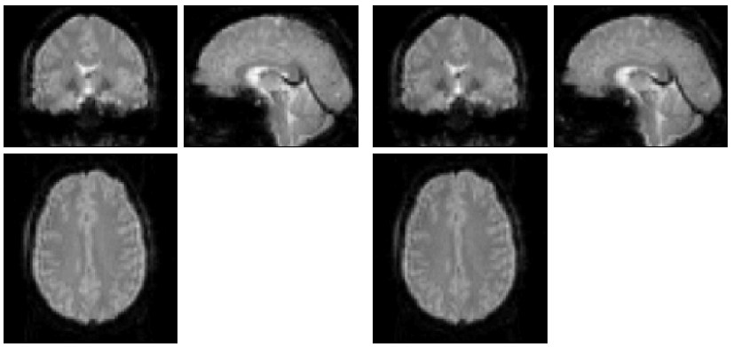
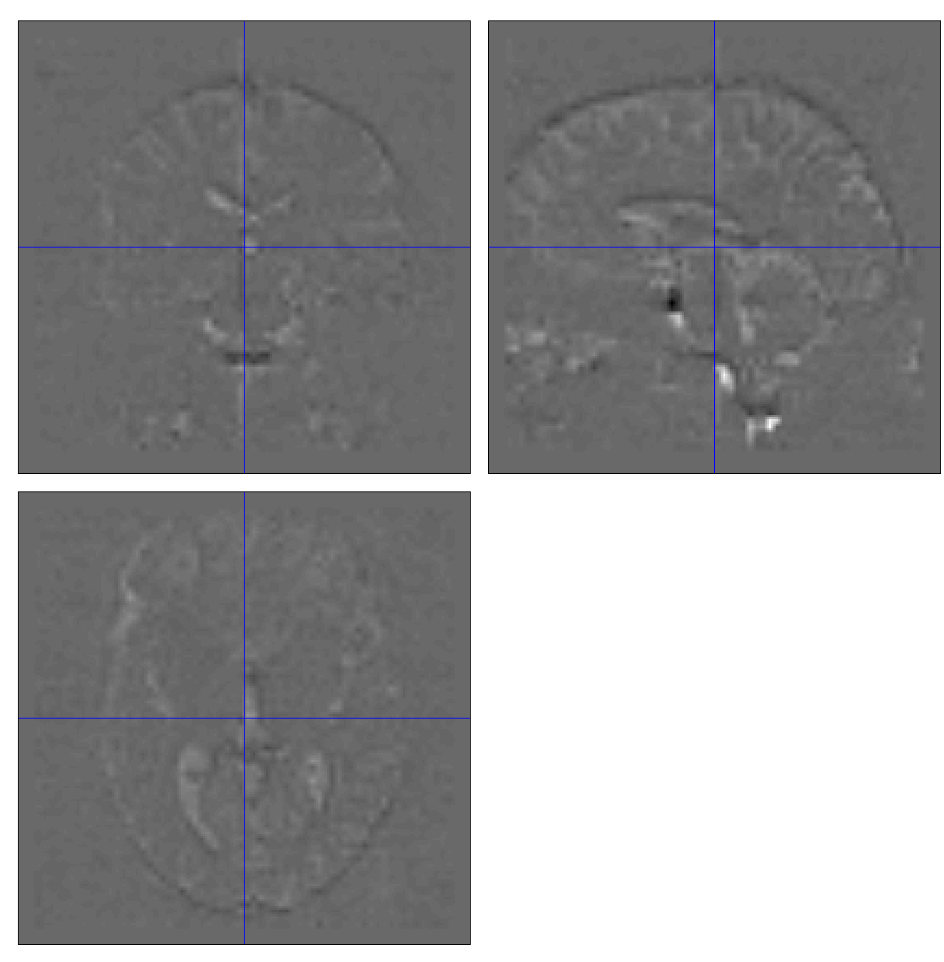
Mean-squared difference
Minimising mean-squared difference works for intra-modal registration (realignment)
Simple relationship between intensities in one image, versus those in the other
  Assumes normally distributed differences

Slide 19
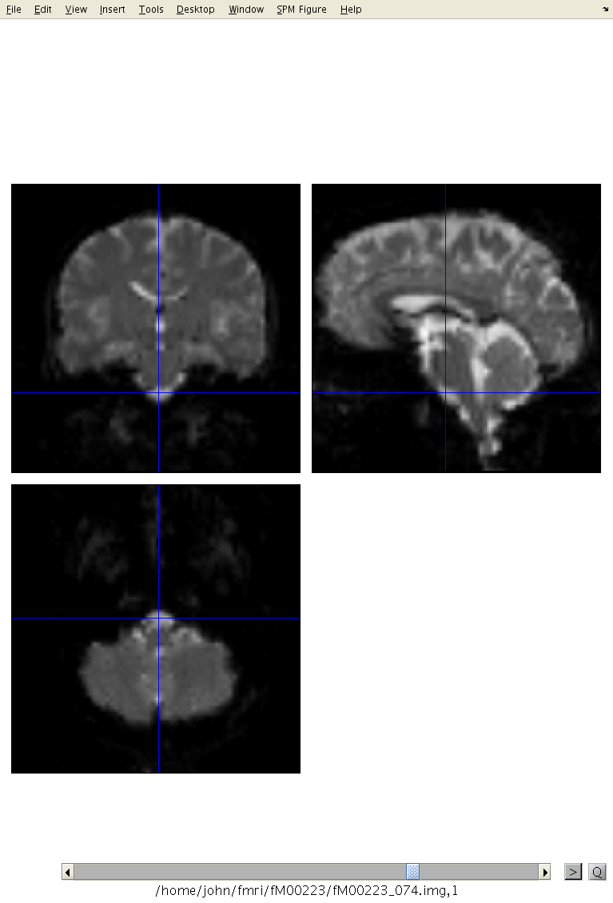
Motion estimates
“Browse” option from Check Reg allows fMRI time series to be shown as a movie.

Slide 20
Residual errors from aligned fMRI
Re-sampling can introduce interpolation errors
  especially tri-linear interpolation
Gaps between slices can cause aliasing artefacts
Slices are not acquired simultaneously
  rapid movements not accounted for by rigid body model
Image artefacts may not move according to a rigid body model
  image distortion
  image dropout
  Nyquist ghost
BOLD signal changes influence the estimated motion.
Functions of the estimated motion parameters can be modelled as confounds in subsequent analyses

Slide 21
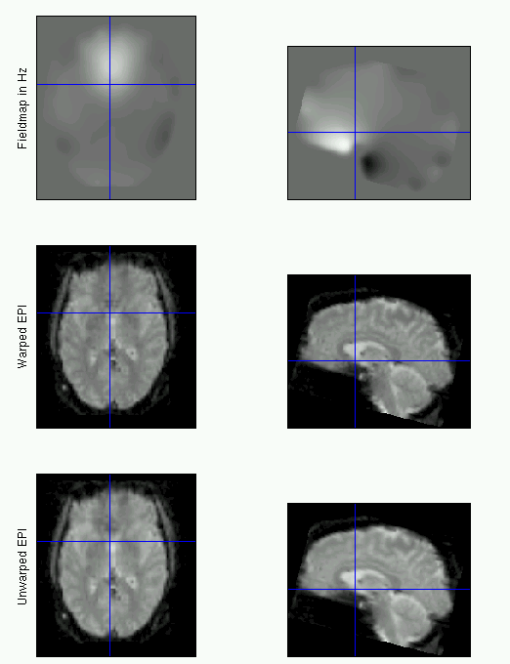
Movement-by-distortion interaction of fMRI
Subject disrupts B0 field, rendering it inhomogeneous
  distortions in phase-encode direction
Subject moves during EPI time series
Distortions vary with subject orientation
  shape varies

Slide 22
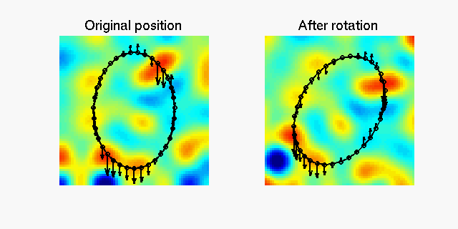
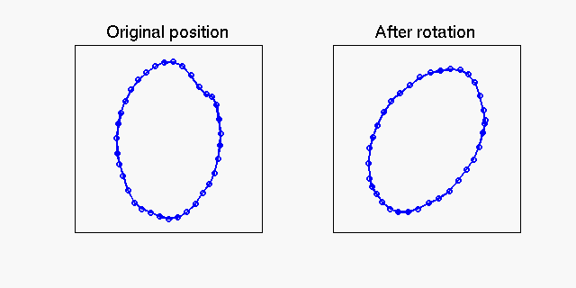
Movement-by-distortion interaction

Slide 23
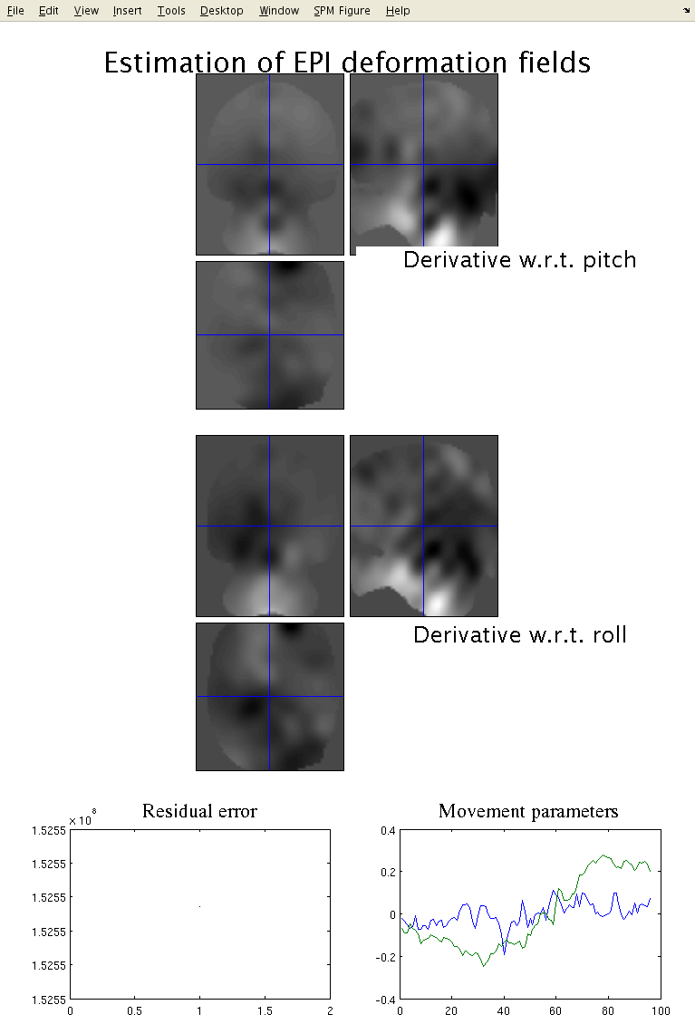
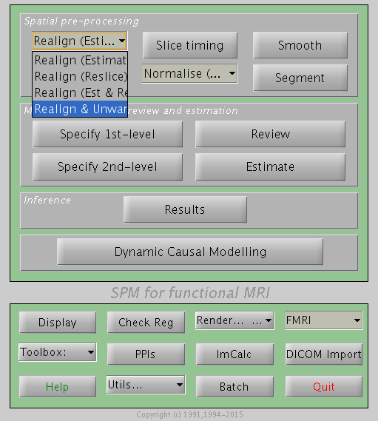
Realign & Unwarp

Slide 24
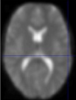
Correcting for distortion changes
Estimate reference from mean of all scans.
Estimate new distortion fields for each image:
estimate rate of change of field with respect to the current estimate of movement parameters in pitch and roll.
Unwarp time series.
Estimate movement parameters.
Δϕ
+Δθ
Andersson et al, 2001

Slide 25
Contents
Preliminaries
Realignment
Coregistration
    Coregistration by maximising mutual information

Slide 26
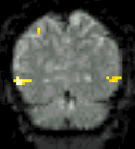
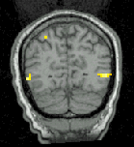
Coregistration
Inter-modal registration.
Match images from same subject but different modalities:
  anatomical localisation of single subject activations
  achieve more precise spatial normalisation of functional image using anatomical image.

Slide 27
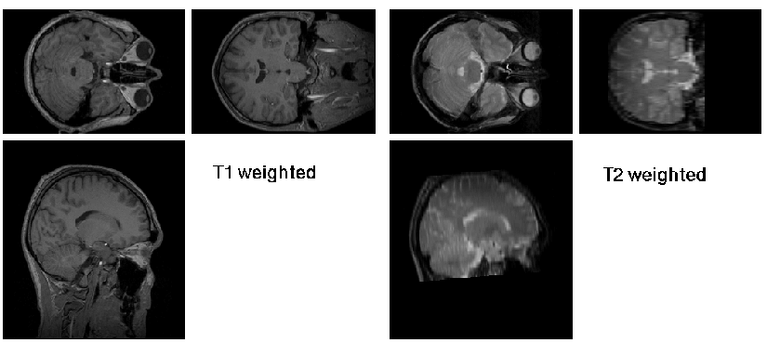
Coregistration maximises Mutual Information
Used for between-modality registration
Derived from joint histograms
MI= ∫_{ab} P(a,b) log₂ [P(a,b)/( P(a) P(b) )]
  Related to entropy: MI = -H(a,b) + H(a) + H(b)
      Where H(a) = -∫_{a} P(a) log₂P(a) and H(a,b) = -∫_{a} P(a,b) log₂P(a,b)

Slide 28
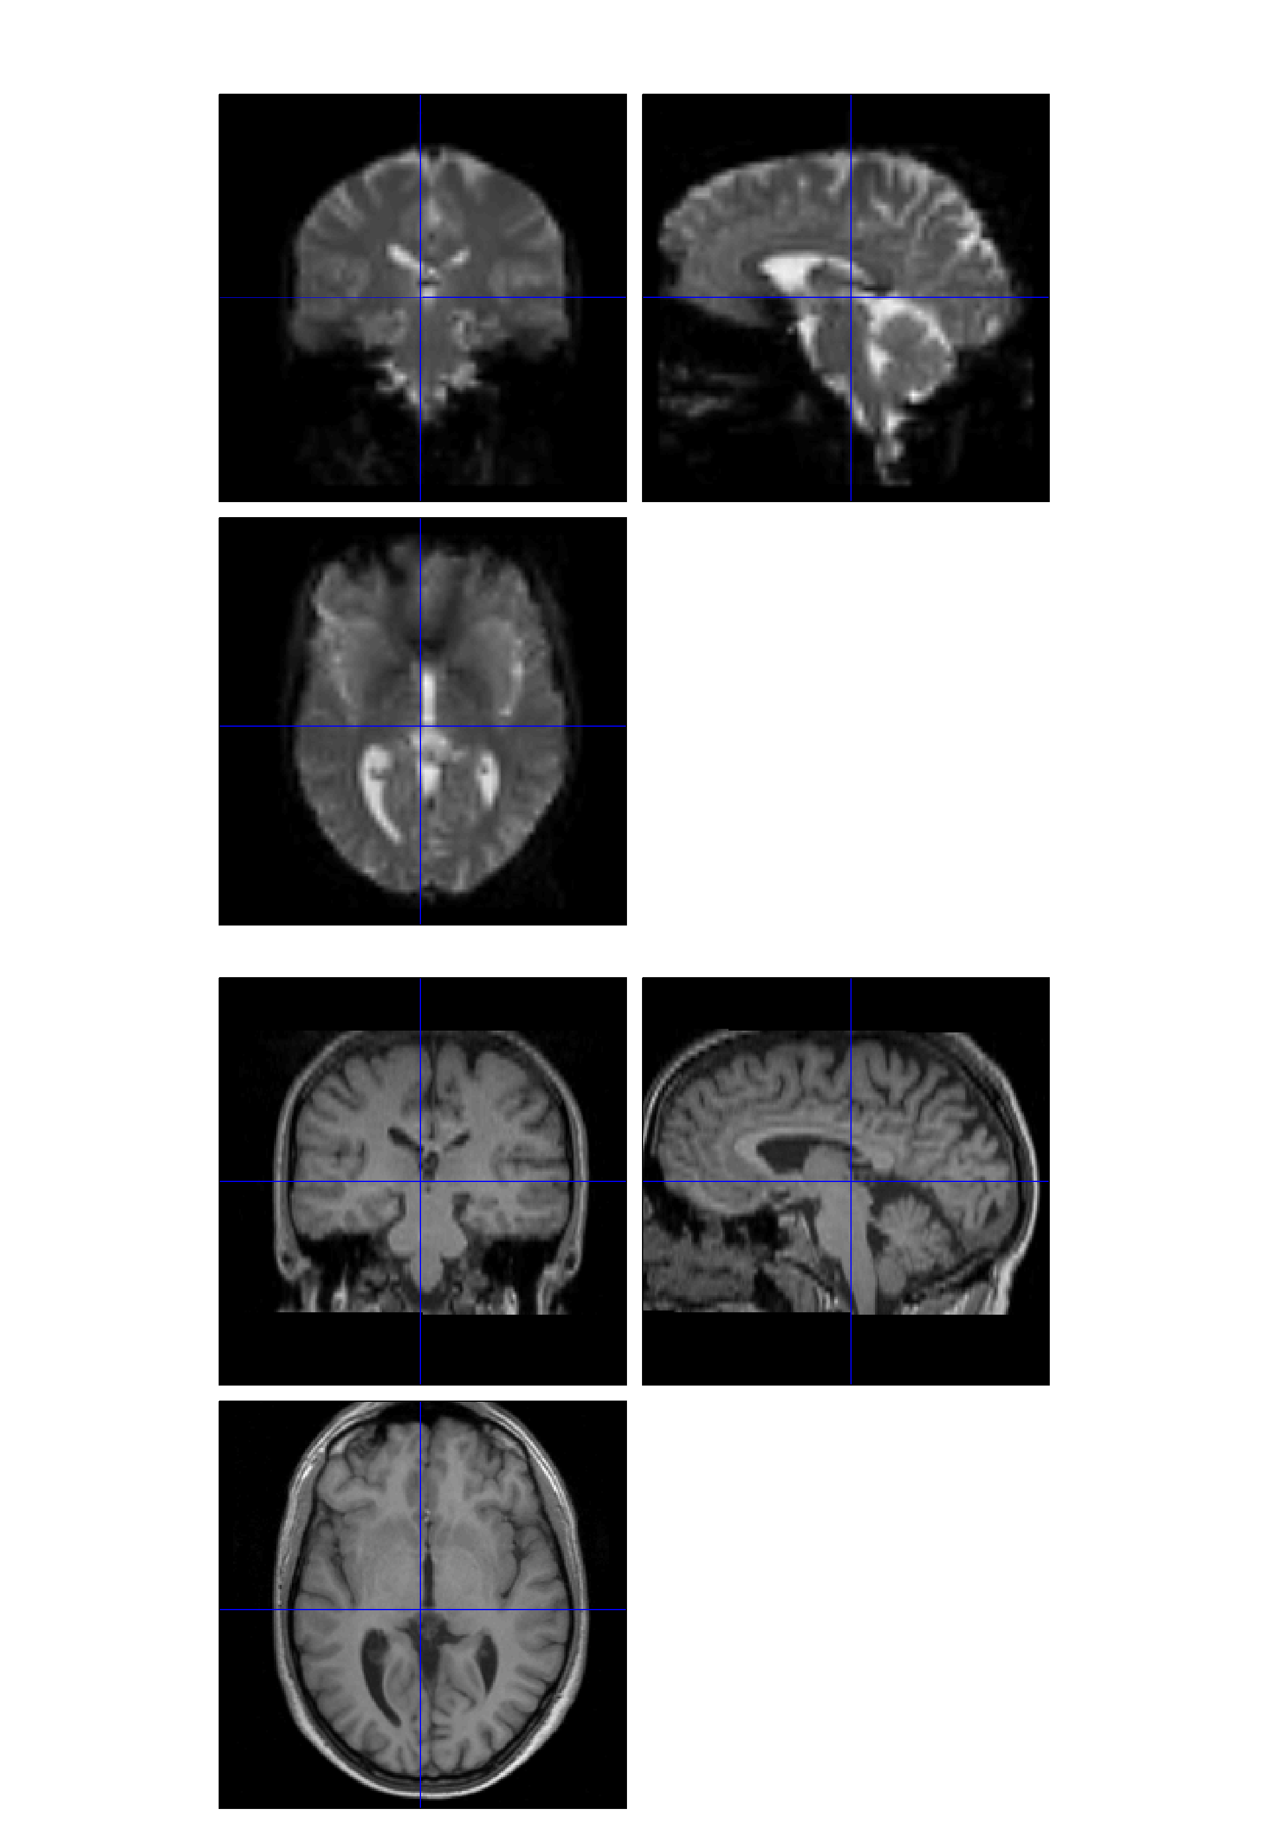
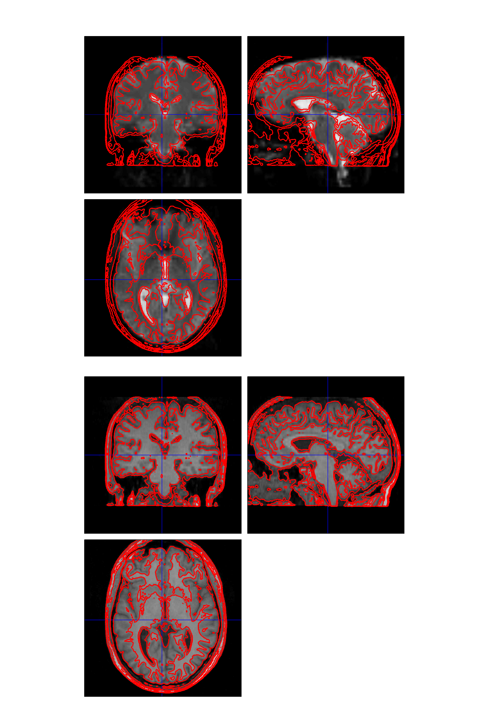
“Check Reg” to assess alignment
Check Reg allows contours from one image can be shown superimposed on another

Slide 29
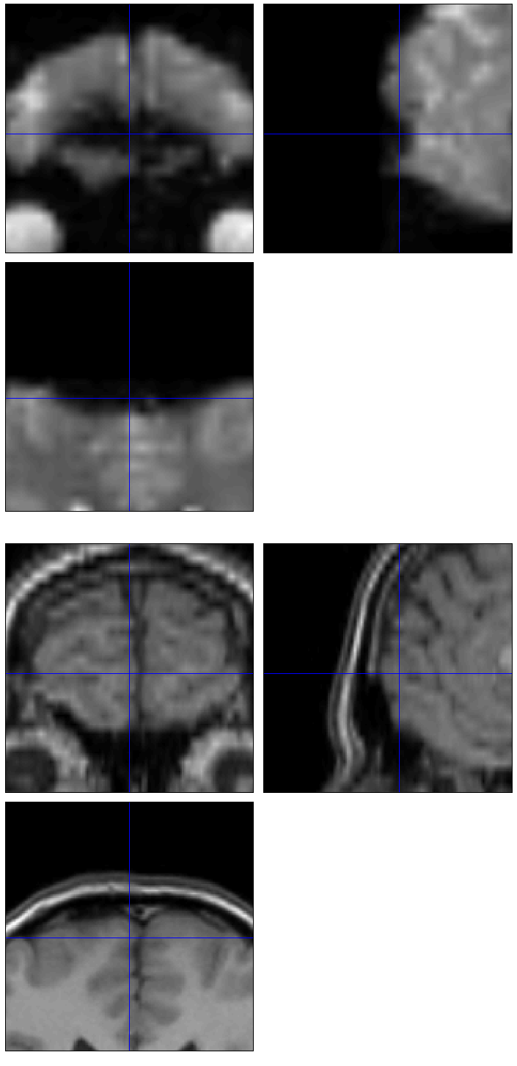
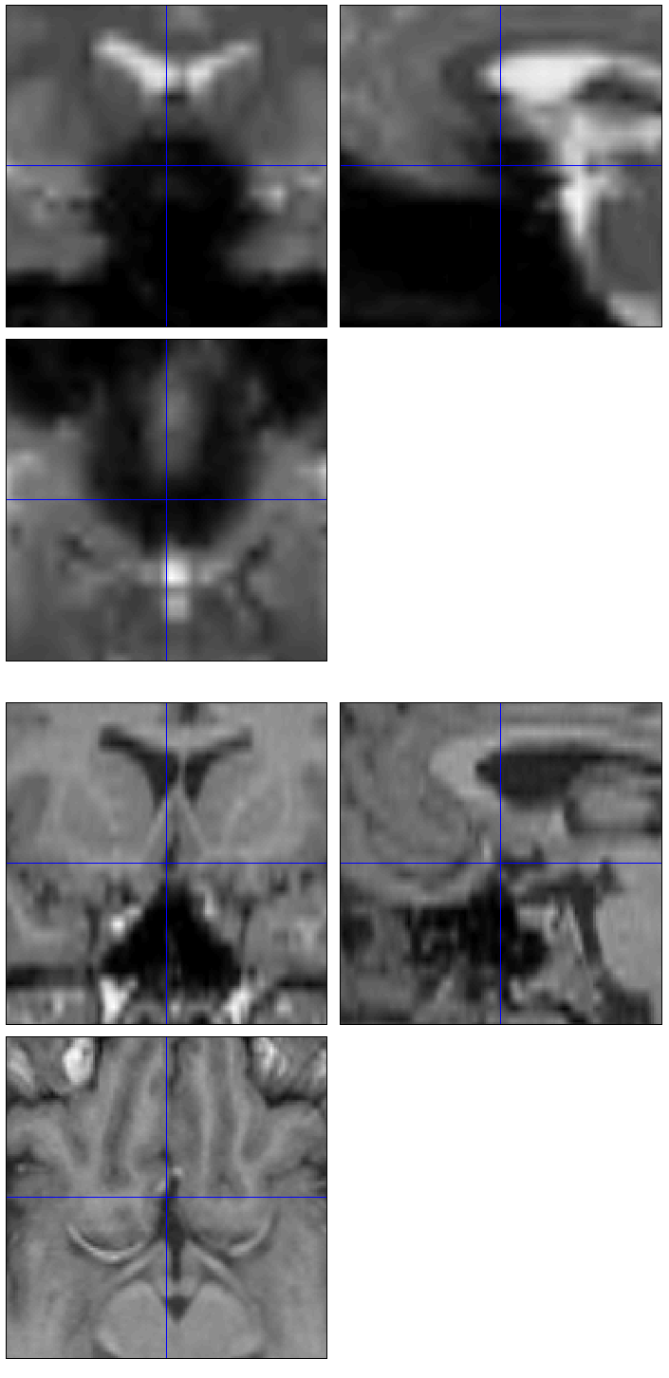
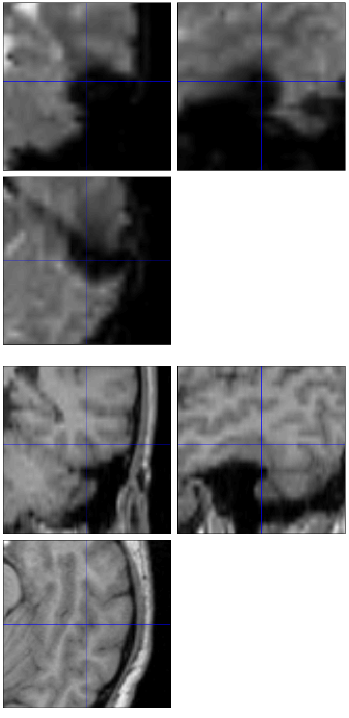
EPI dropout and distortion
EPI
EPI
EPI
structural
structural
structural

Slide 30
References
Friston et al. Spatial registration and normalisation of images. Human Brain Mapping 3:165-189 (1995).
Collignon et al. Automated multi-modality image registration based on information theory. IPMI’95 pp 263-274 (1995).
Thévenaz et al. Interpolation revisited.
IEEE Trans. Med. Imaging 19:739-758 (2000).
Andersson et al. Modeling geometric deformations in EPI time series. Neuroimage 13:903-919 (2001).

