Slide 1
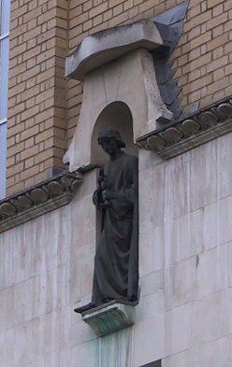
Preprocessing II:
Between Subjects
John Ashburner
Wellcome Trust Centre for Neuroimaging,
12 Queen Square, London, UK.

Slide 2
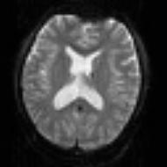
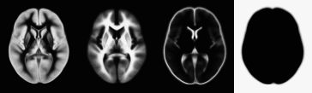
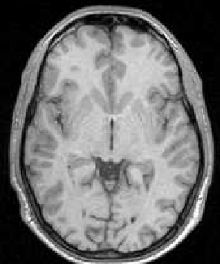

Pre-processing overview
Statistics or whatever
fMRI time-series
Anatomical MRI
Template
Smoothed
Estimate Spatial Norm
Motion Correct
Smooth
Coregister
Spatially normalised
Deformation

Slide 3
Alternative pipeline
Statistics or whatever
fMRI time-series
Template
Smoothed
Estimate Spatial Norm
Motion Correct
Smooth
Spatially normalised
Deformation

Slide 4
Contents
Normalise/Segment
  Use segmentation routine for spatial normalisation
  Gaussian mixture model
  Intensity non-uniformity correction
  Deformed tissue probability maps
Dartel
Smoothing

Slide 5
Spatial normalisation
Brains of different subjects vary in shape and size.
Need to bring them all into a common anatomical space.
  Examine homologous regions across subjects
    Improve anatomical specificity
    Improve sensitivity
  Report findings in a common anatomical space (eg MNI space)
In SPM, alignment is achieved by matching grey matter with grey matter and white matter with white matter.
  Need to segment.

Slide 6
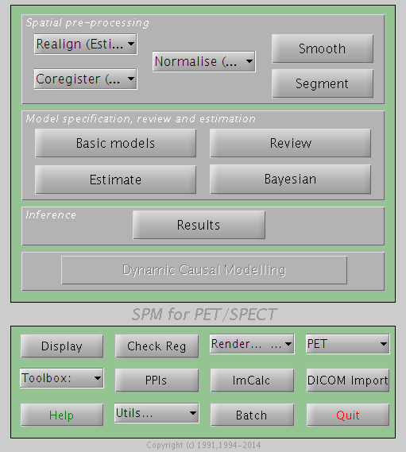
Normalise/Segment
This is the same algorithm as for tissue segmentation.
Combines:
  Mixture of Gaussians (MOG)
  Bias Correction Component
  Warping (Non-linear Registration) Component

Slide 7
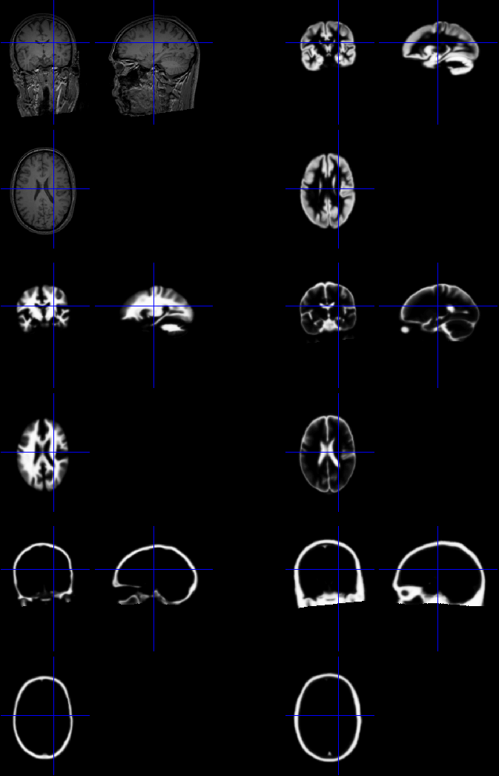
Spatial normalisation
Default spatial normalisation in SPM12 estimates nonlinear warps that match tissue probability maps to the individual image.
Spatial normalisation achieved using the inverse of this transform.

Slide 8
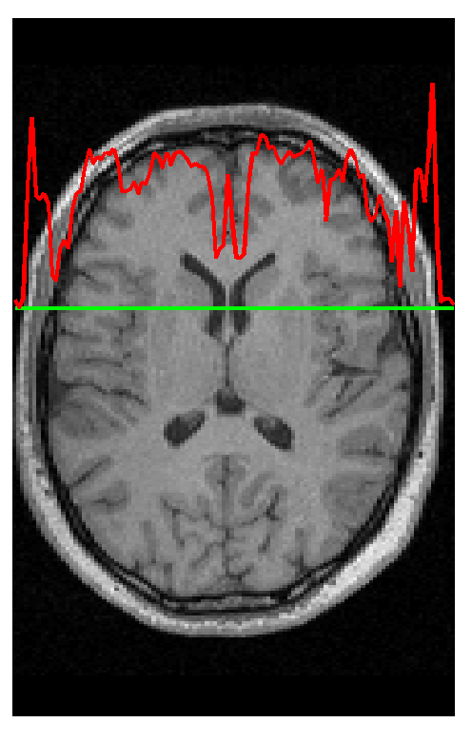
Segmentation
Segmentation in SPM12 also estimates a spatial transformation that can be used for spatially normalising images.
It uses a generative model, which involves:
  Mixture of Gaussians (MOG)
  Warping (Non-linear Registration) Component
  Bias Correction Component

Slide 9
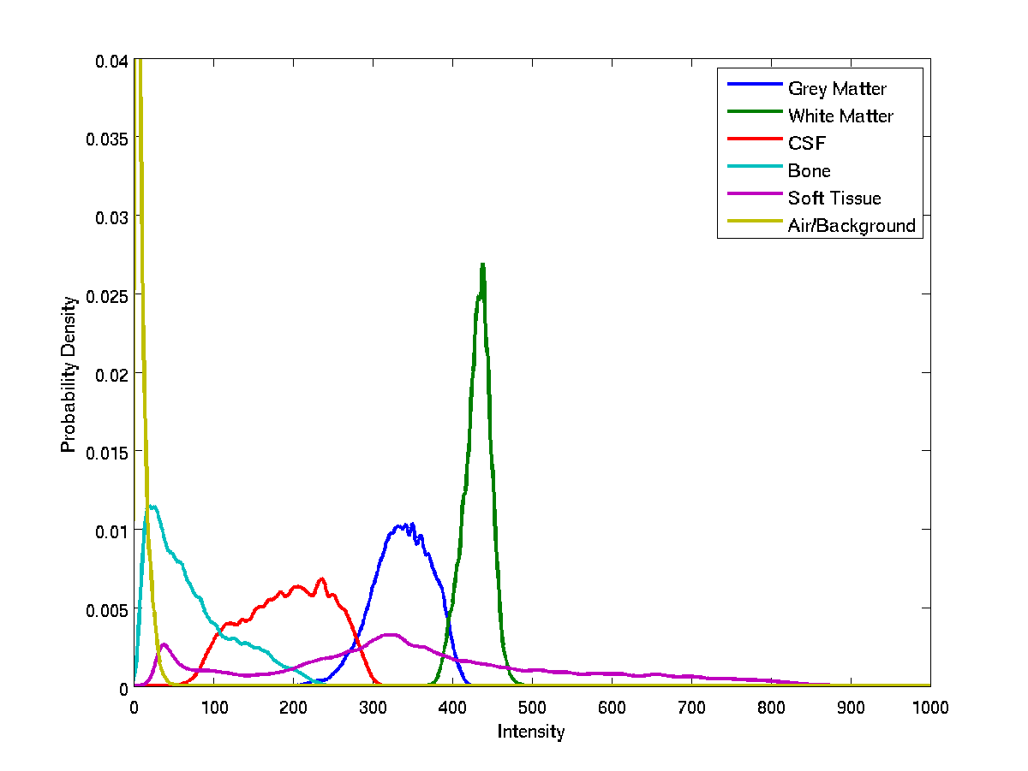
Image Intensity Distributions (T1-weighted MRI)

Slide 10
Modelling tissue intensities
Classification is based on a Mixture of Gaussians model (MOG), which represents the intensity probability density by a number of Gaussian distributions.
Frequency
Image Intensity

Slide 11
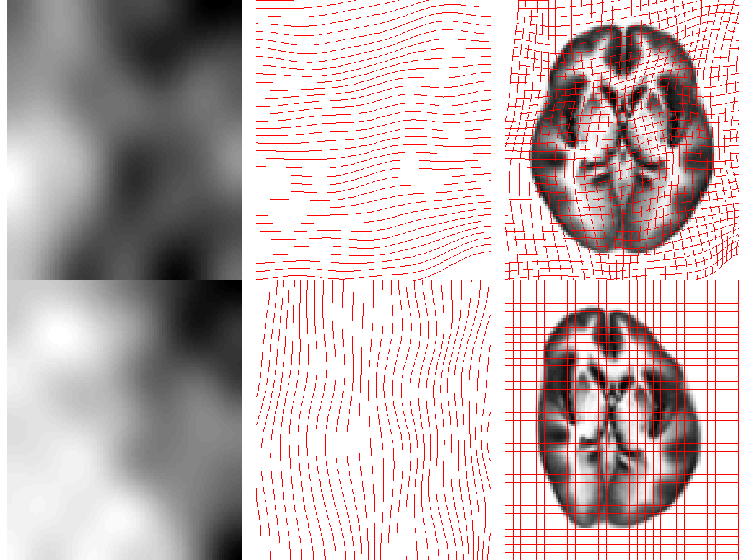
Modelling deformations

Slide 12
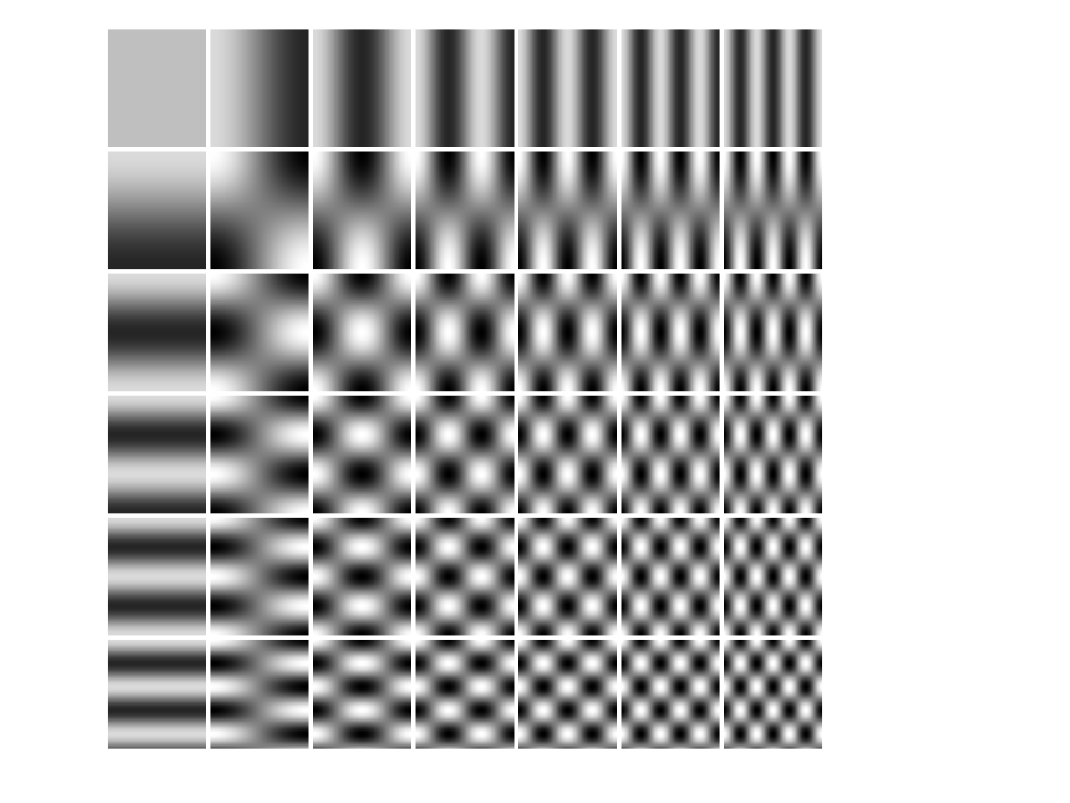
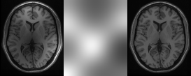
Modelling a bias field
A bias field is modelled as a linear combination of basis functions.
Corrupted image
Bias Field
Corrected image

Slide 13
Iterative optimisation scheme
Update tissue estimates
Update deformation estimates
Update bias field estimates
Converged?
No
Yes

Slide 14
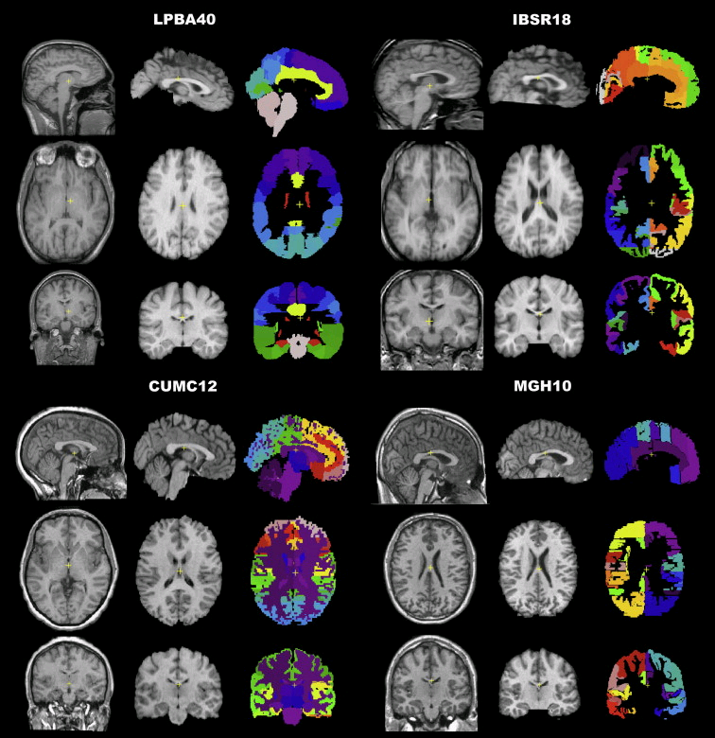
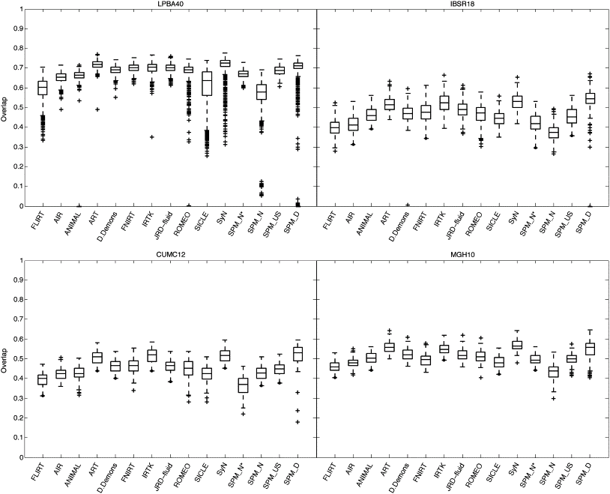
Evaluations of nonlinear registration algorithms

Slide 15
Old tissue probability maps
Tissue probability maps (TPMs) are used instead of the proportion of voxels in each Gaussian as the prior.
ICBM Tissue Probabilistic Atlases. These tissue probability maps are kindly provided by the International Consortium for Brain Mapping, John C. Mazziotta and Arthur W. Toga.

Slide 16
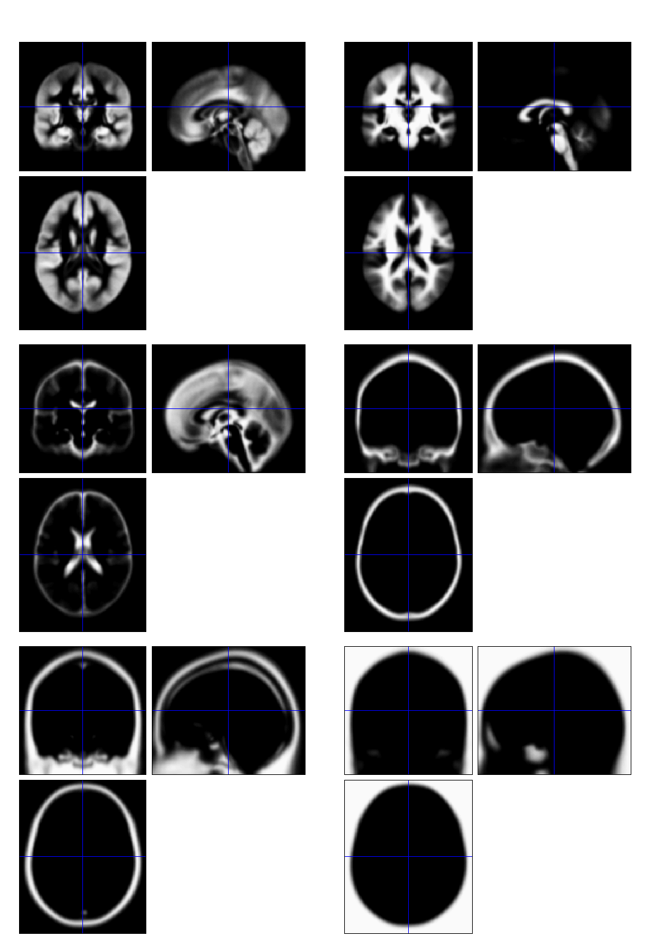
Tissue probability maps in SPM12
Includes additional non-brain tissue classes (bone, and soft tissue)

Slide 17
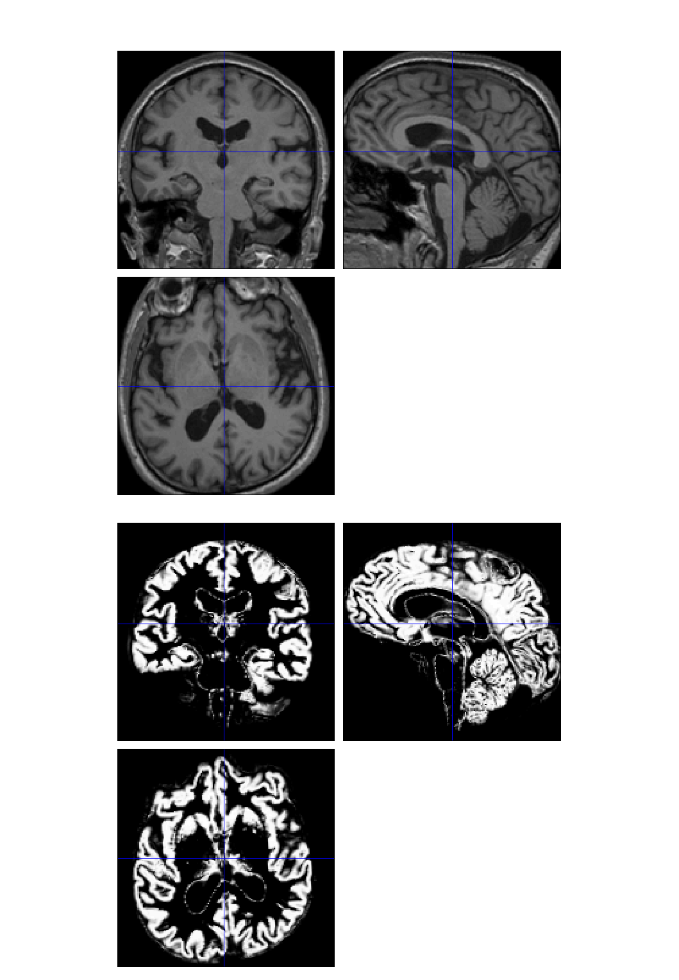
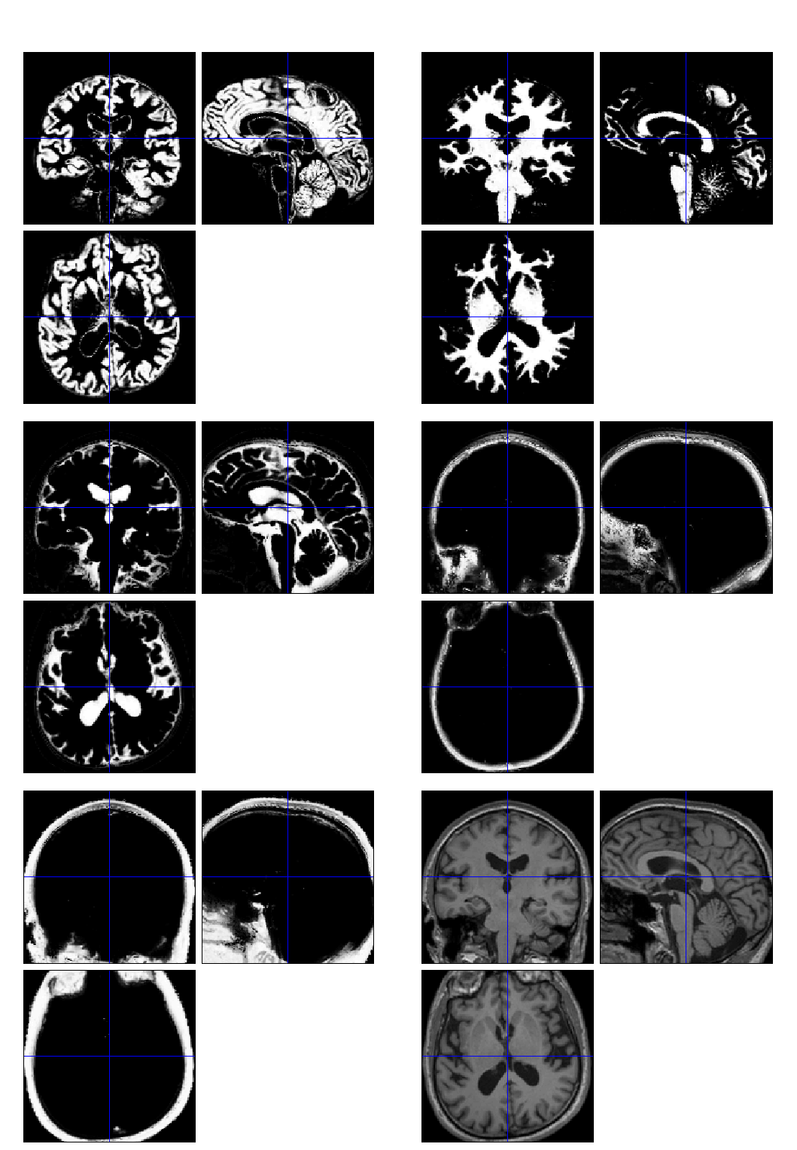

Slide 18
Contents
Normalise/Segment
Dartel
  Velocity field parameterisation
  Objective function
  Template creation
  Examples
Smooth

Slide 19
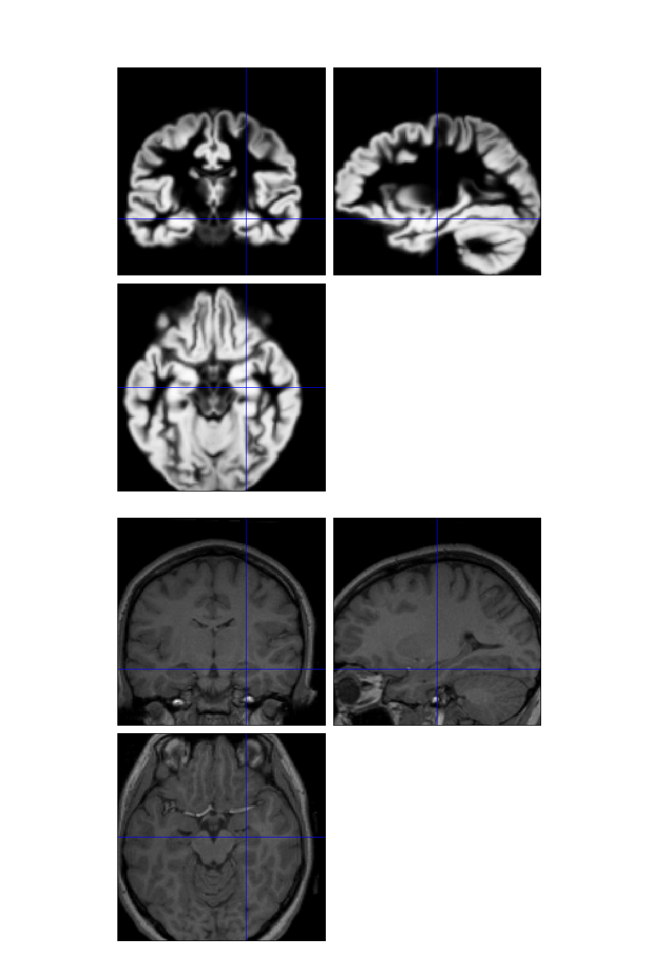
Dartel image registration
Uses fast approximations
  Deformation integrated using scaling and squaring
Uses Levenberg-Marquardt optimiser
  Multi-grid matrix solver
Matches GM with GM, WM with WM etc
Diffeomorphic registration takes about 30 mins per image pair (121×145×121 images).
Grey matter template warped to individual
Individual scan

Slide 20
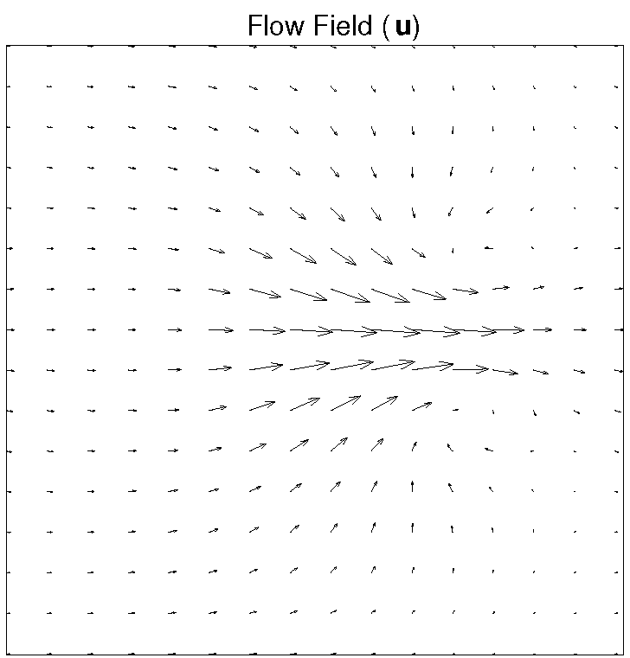
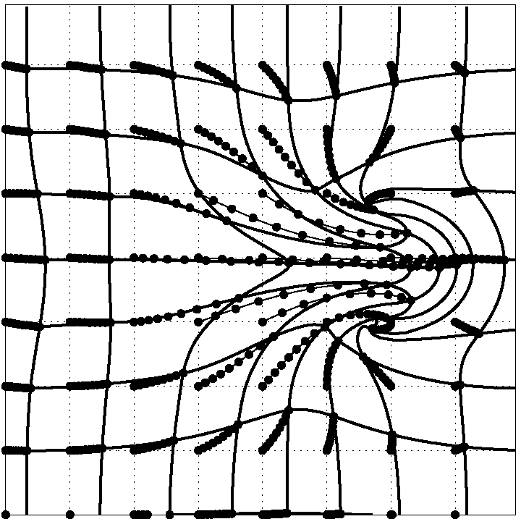
Dartel
Parameterising the deformation
φ⁽⁰⁾ = Identity
φ⁽¹⁾ = ∫ v(φ^{(t)})dt
v is an estimated velocity field.
Scaling and squaring is used to generate deformations.
1
t=0

Slide 21
Scaling and squaring example

Slide 22
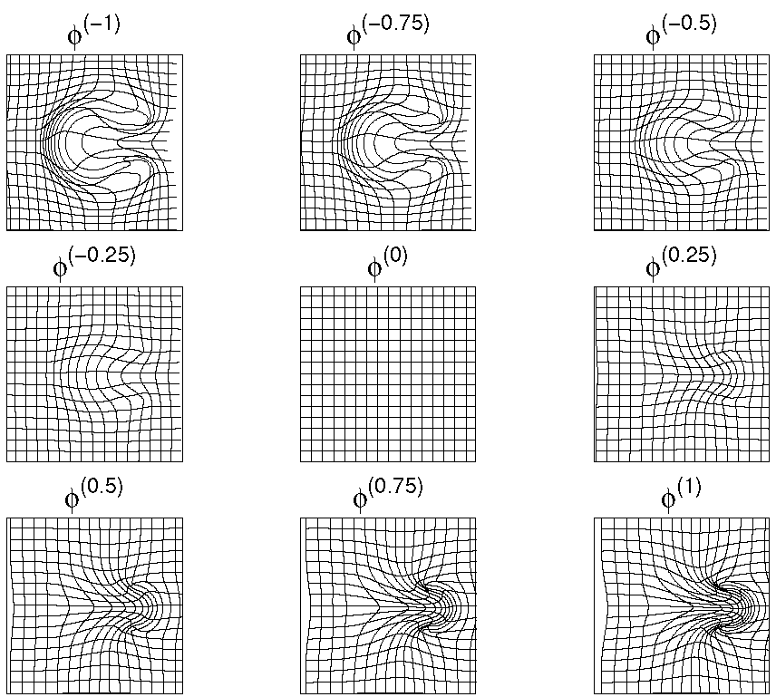
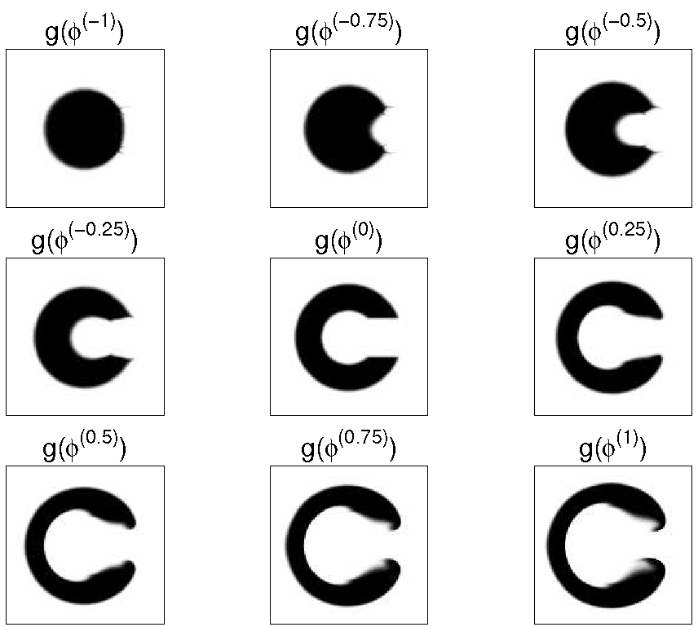
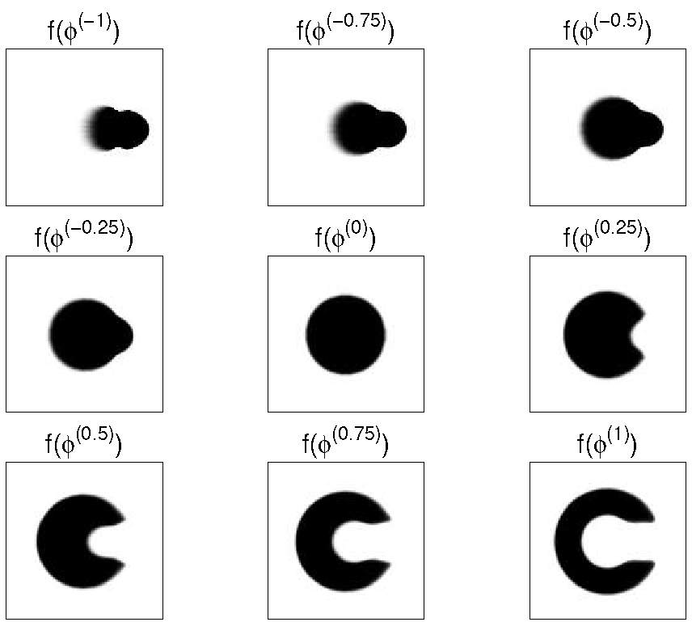
Forward and backward transforms

Slide 23
Registration objective function
Simultaneously minimize the sum of:
  Matching Term
    Drives the alignment of the images.
    Multinomial assumption
  Regularisation term
    A measure of deformation roughness
    Keeps the warps spatially smooth.
A balance between the two terms.

Slide 24

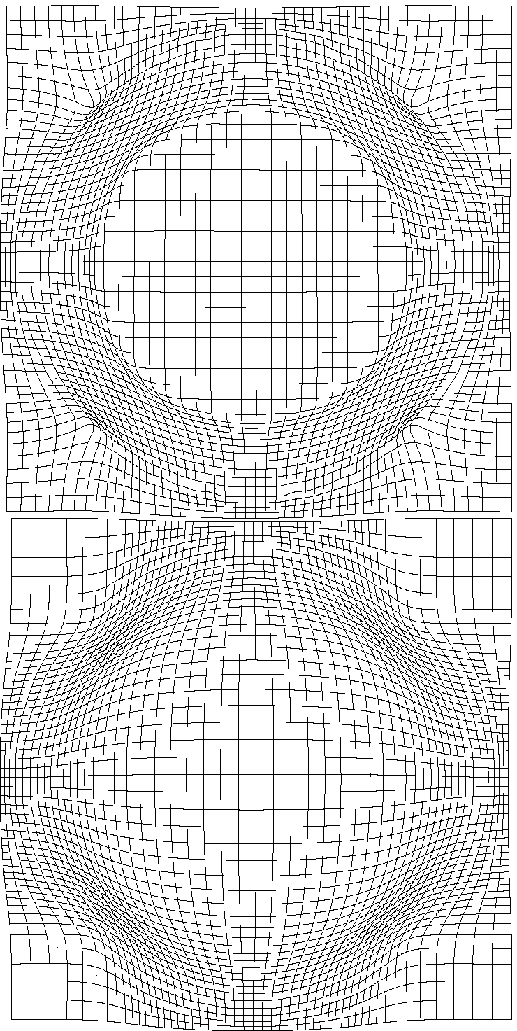
Effect of different forms of regularisation

Slide 25
Simultaneous registration of GM to GM and WM to WM
Grey matter
Subject 1
White matter
Grey matter
Subject 3
White matter
Grey matter
White matter
Grey matter
Template
Grey matter
White matter
White matter
Subject 2
Subject 4

Slide 26
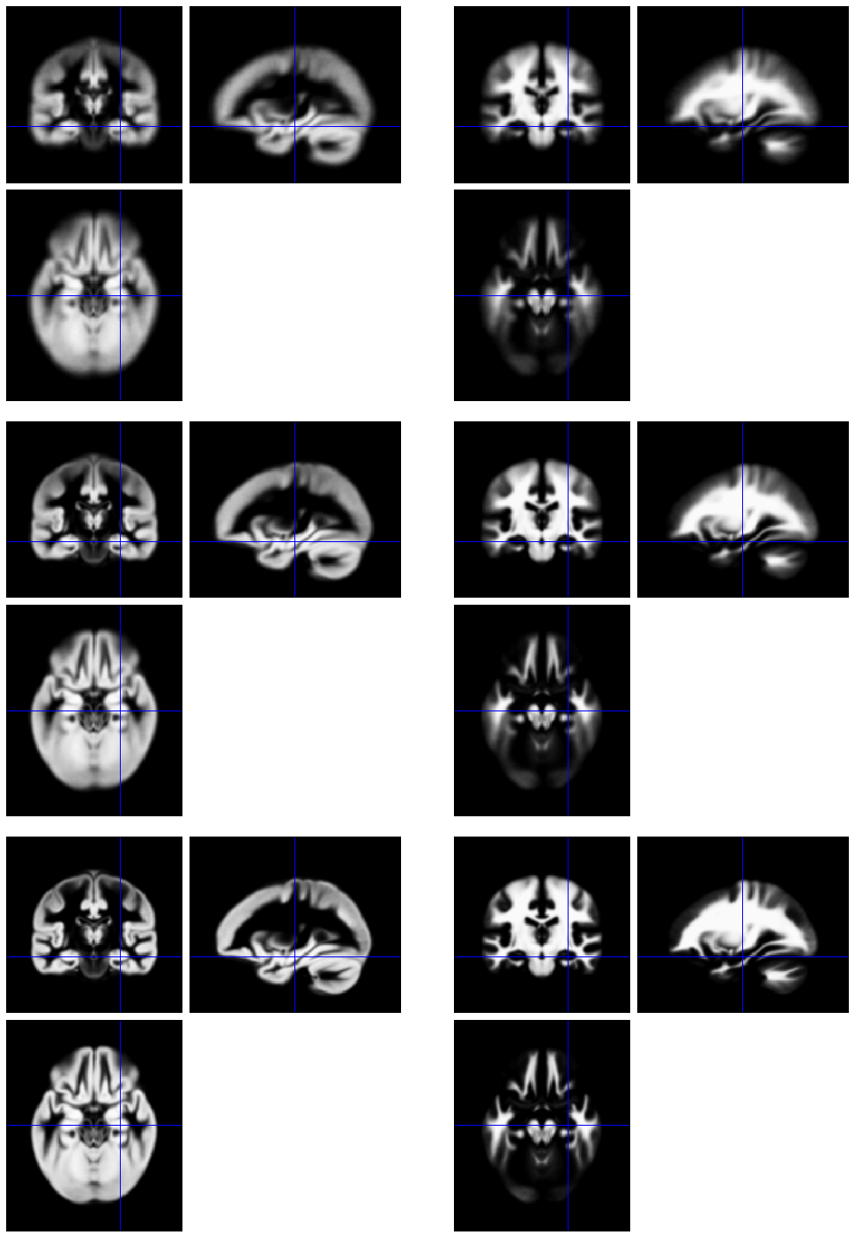
Template
Initial Average
Iteratively generated from 471 subjects
Began with rigidly aligned tissue probability maps
After a few iterations
Final template

Slide 27
Grey matter average of 452 subjects – affine

Slide 28
Grey matter average of 471 subjects

Slide 29
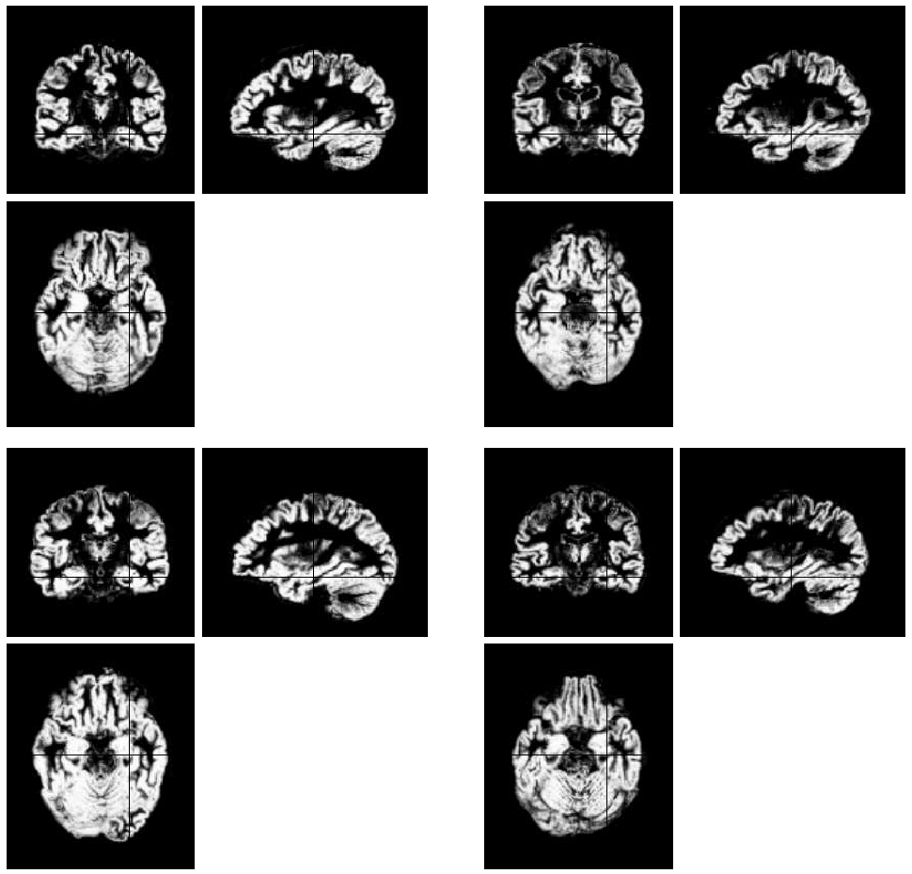
Initial
GM images

Slide 30
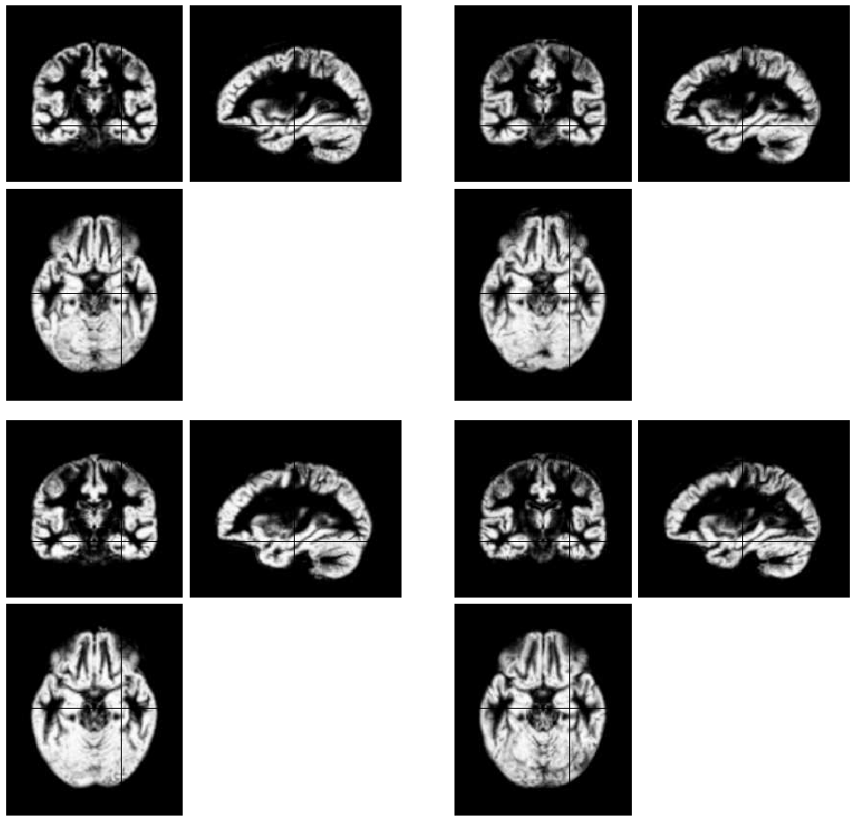
Aligned
GM images

Slide 31
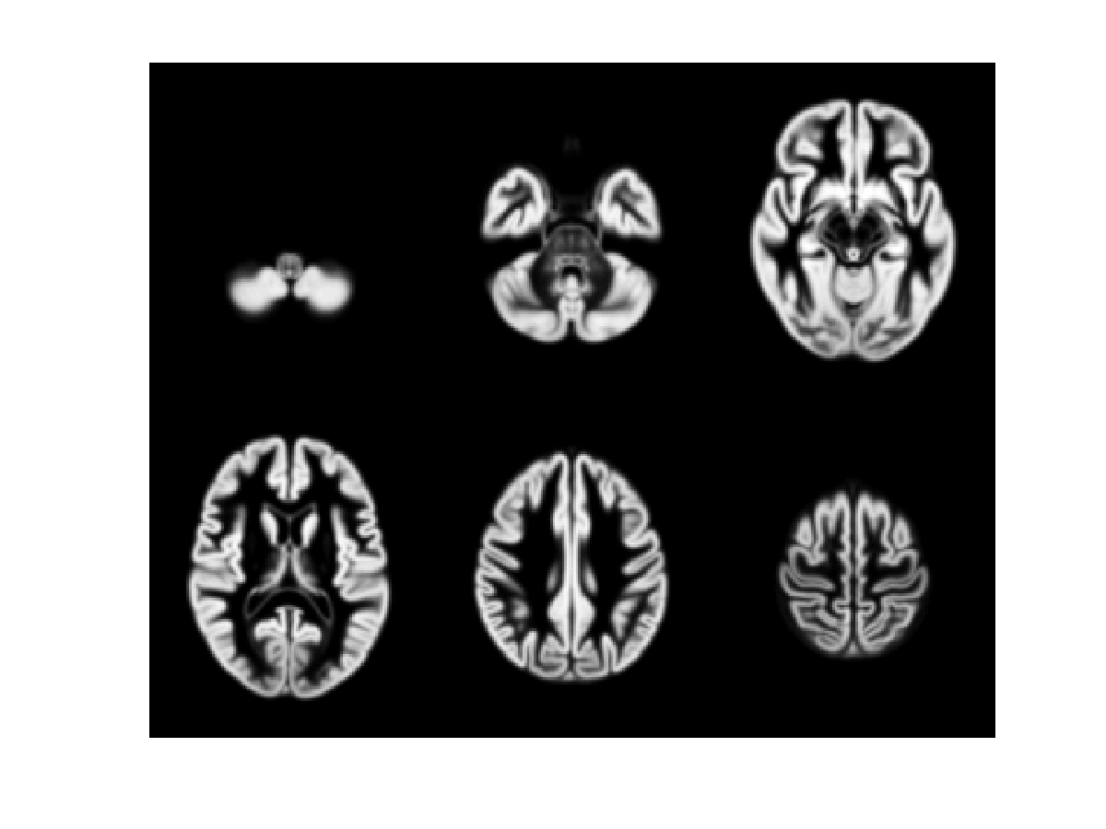
471 Subject Average

Slide 32
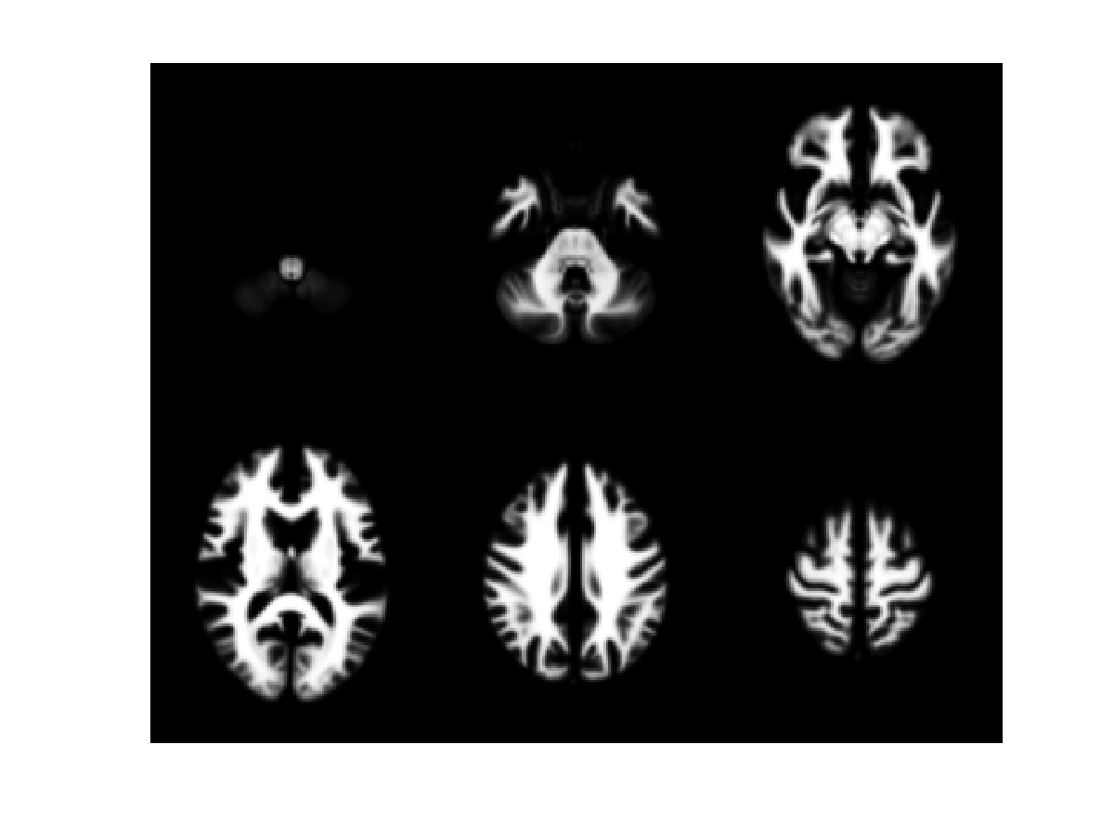
471 Subject Average

Slide 33
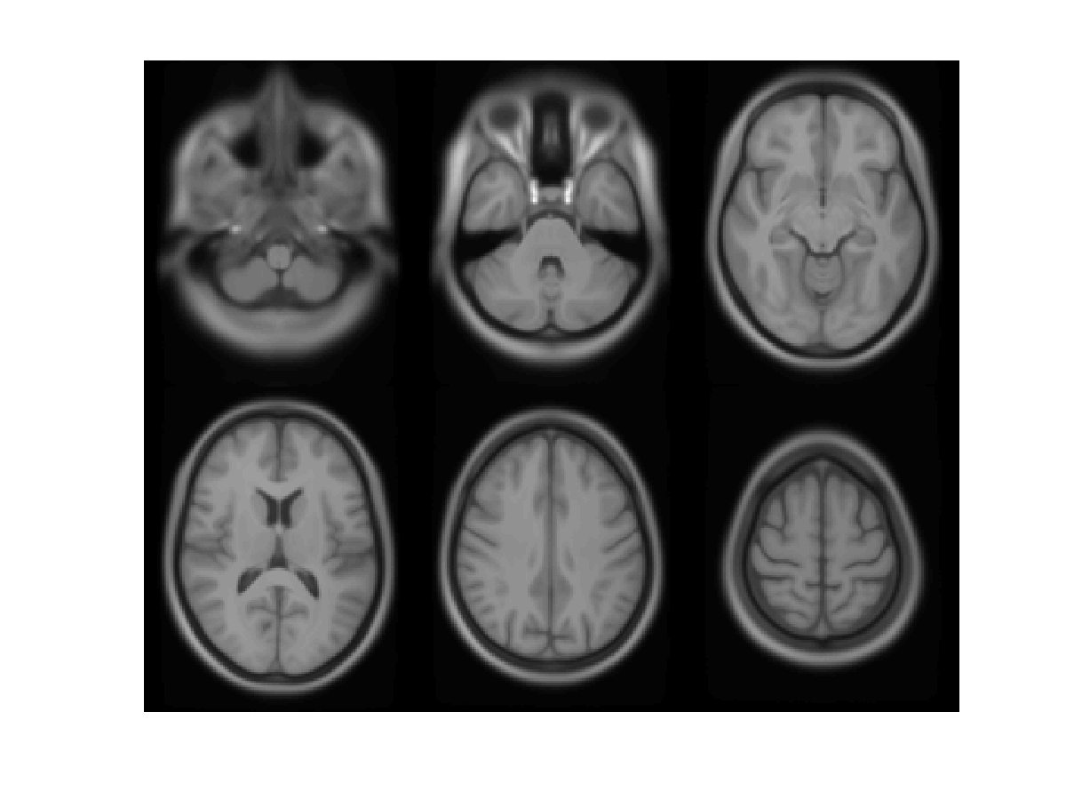
471 Subject Average

Slide 34
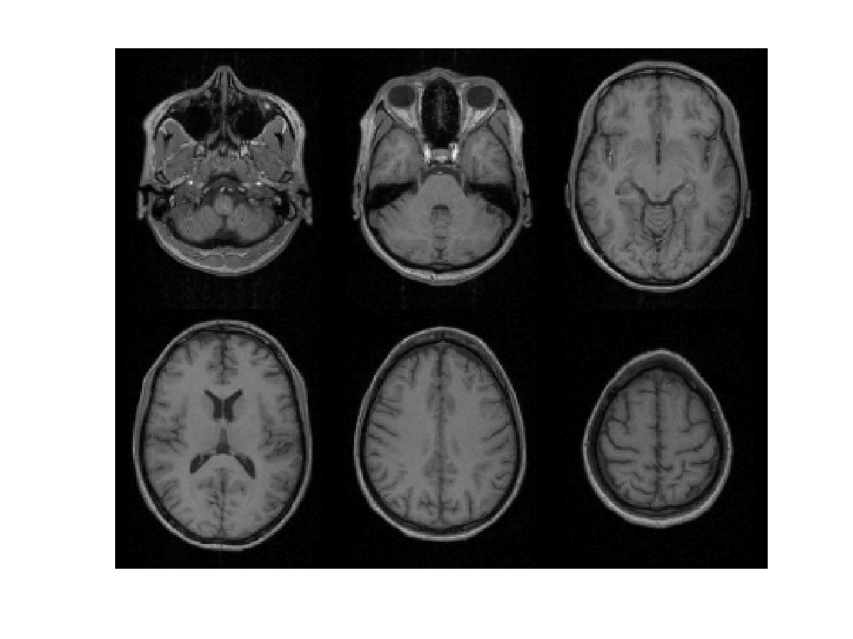
Subject 1

Slide 35
471 Subject Average

Slide 36
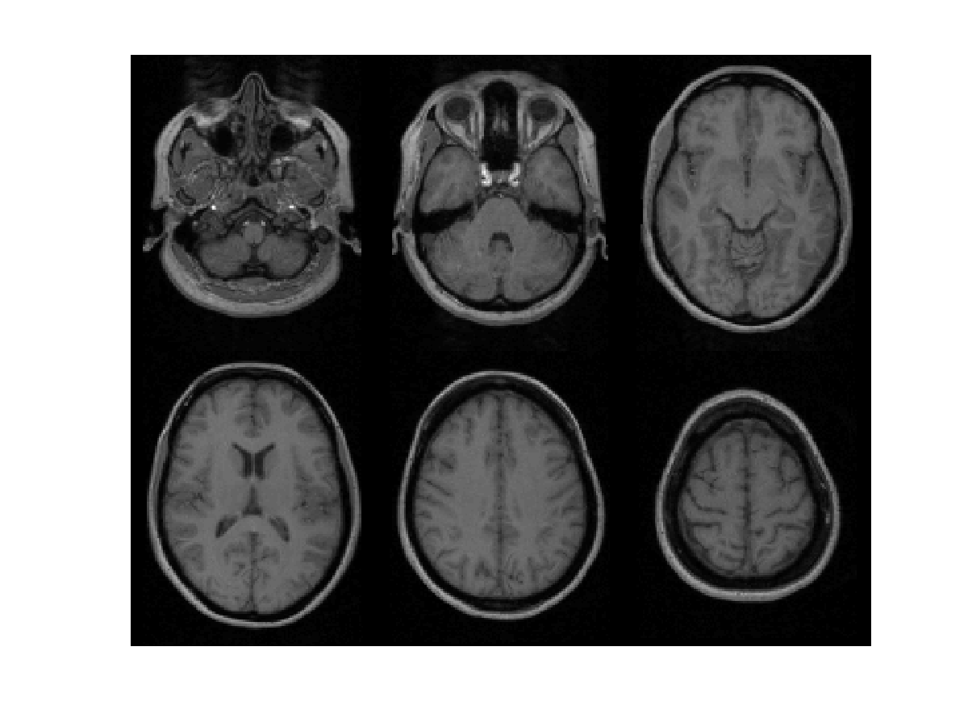
Subject 2

Slide 37
471 Subject Average

Slide 38
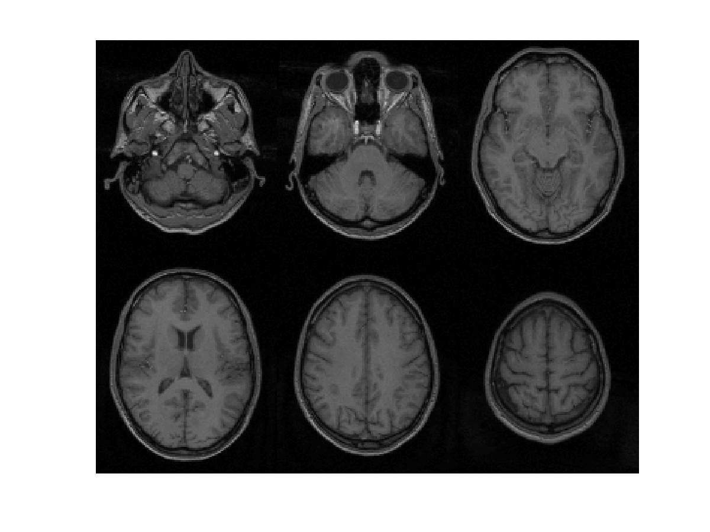
Subject 3

Slide 39
471 Subject Average

Slide 40
Evaluations of nonlinear registration algorithms

Slide 41
Contents
Normalise/Segment
Dartel
Smoothing
  Compensating for inaccuracies in inter-subject alignment

Slide 42
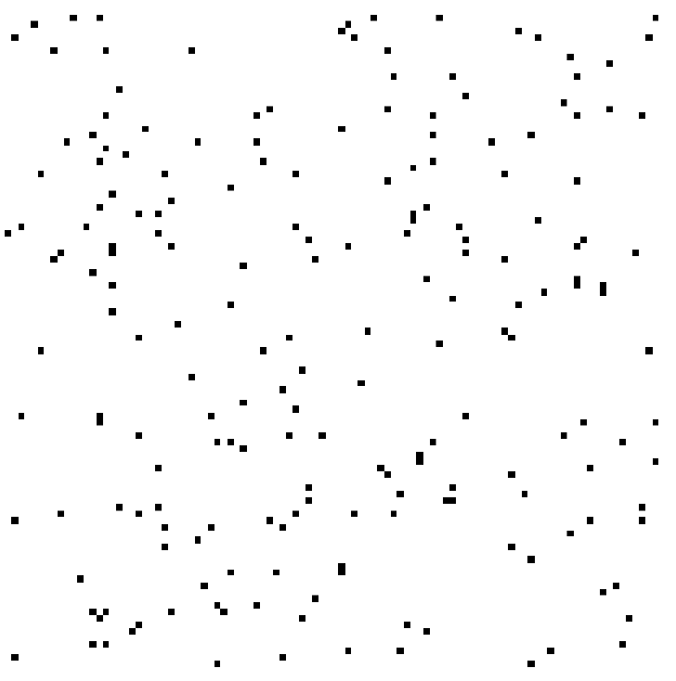

Smooth
Blurring is done by convolution.
Each voxel after smoothing effectively becomes the result of applying a weighted region of interest (ROI).
Before convolution
Convolved with a circle
Convolved with a Gaussian

Slide 43





Smooth

Slide 44
References
Ashburner & Friston. Unified Segmentation.
NeuroImage 26:839-851 (2005).
Ashburner. A Fast Diffeomorphic Image Registration Algorithm. NeuroImage 38:95-113 (2007).
Ashburner & Friston. Computing average shaped tissue probability templates. NeuroImage 45(2): 333-341 (2009).
Klein et al. Evaluation of 14 nonlinear deformation algorithms applied to human brain MRI registration. NeuroImage 46(3):786-802 (2009).

