Slide 1
Factorising large image datasets
John Ashburner

Slide 2
Principal Component Analysis
Need to reduce dimensions for data mining
  Reduced feature set that explains as much of the data as possible
PCA can be optimised via an EM algorithm
  Preserve privacy across sites
  Deal with missing data
Simple PCA not a good model of brain images

Slide 3
Privacy-preserving decomposition
Data (F)
Features (W)
P
K
Hospital 1
F₁
W₁
N
N
Hospital 2
F₂
W₂
P
Spatial basis functions (H)
H
K

Slide 4
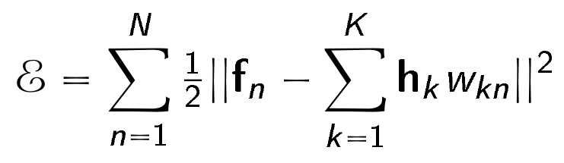
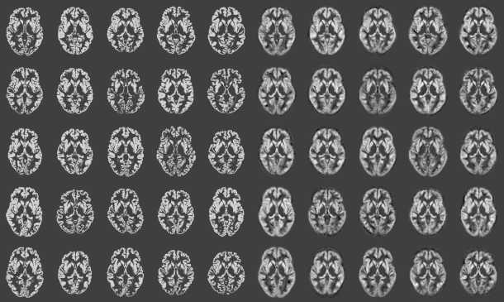
Simple PCA approach
Reconstructions from 64 components
Original images (from 581)

Slide 5
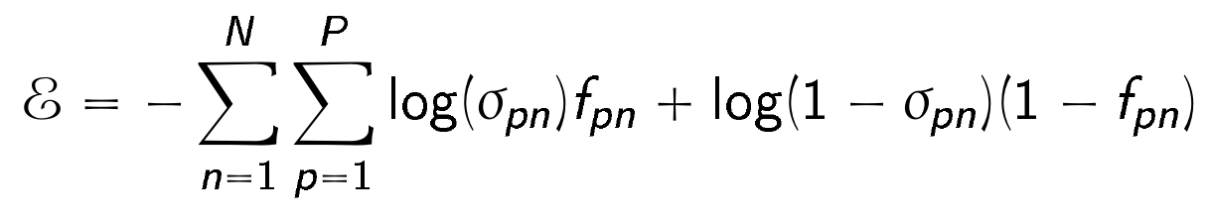
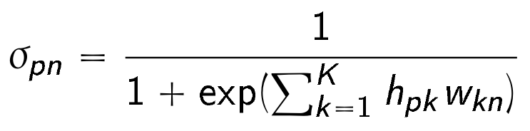
Generalised PCA
Logistic PCA suitable for factorising binary data

Slide 6
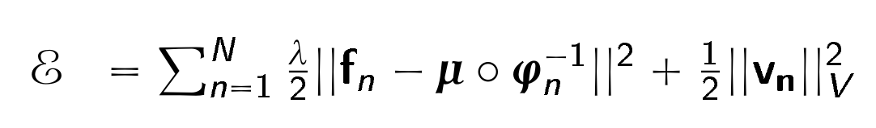
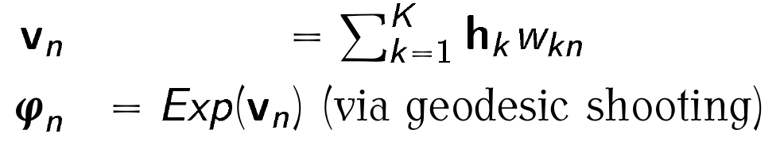
Principal Geodesic Analysis
For learning shape models

Slide 7
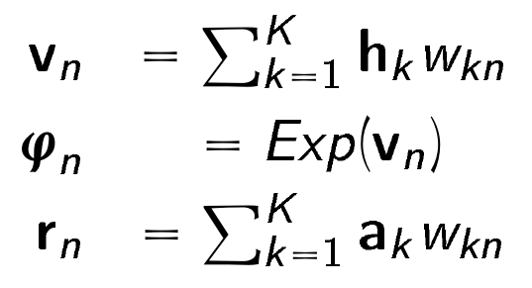
Shape and appearance model
Mininise the following objective function w.r.t. W (features), μ (average), A (“eigen-appearances”) and H (“eigen-warps”):
Shape
Regularisation
Appearance

Slide 8
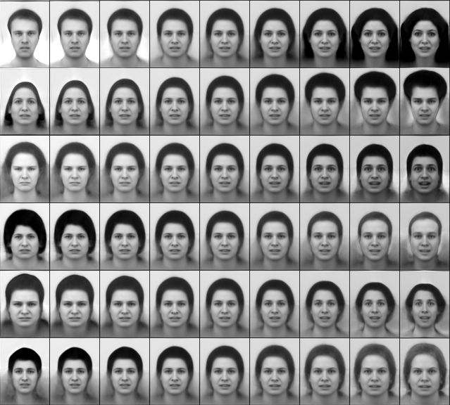
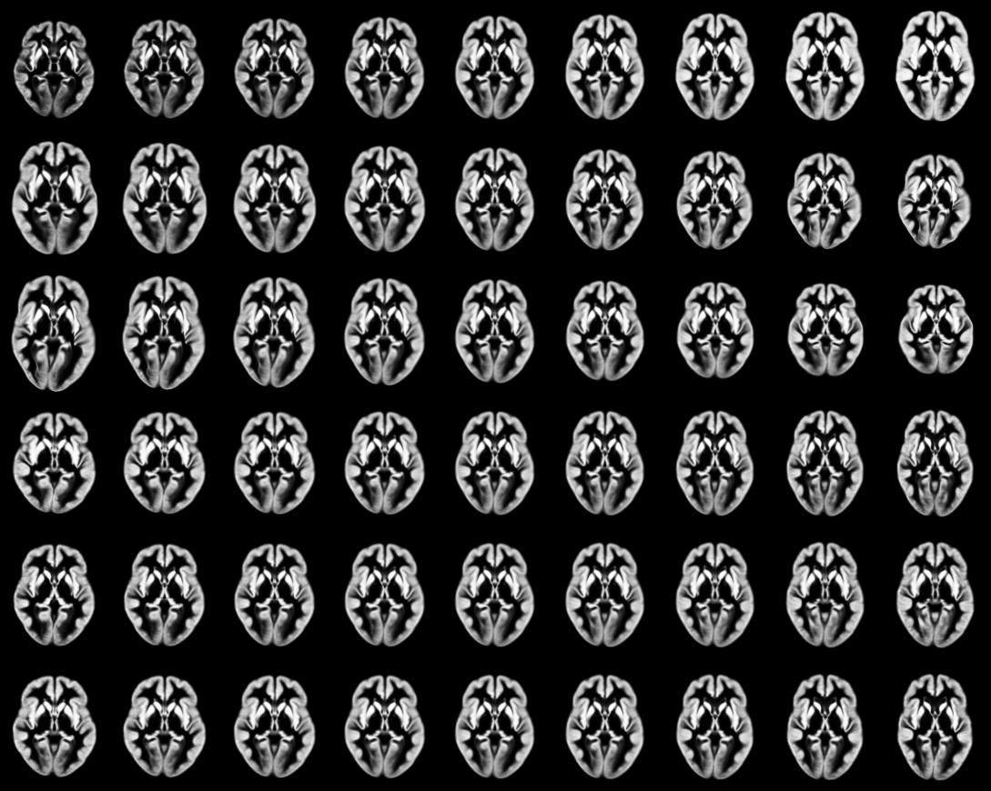
Shape and appearance “eigen-modes”
First of 50 eigenmodes
First of 64 eigenmodes

Slide 9
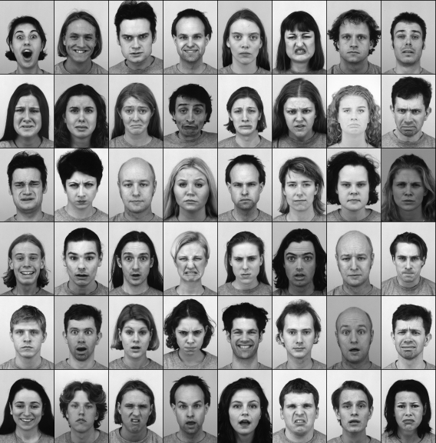
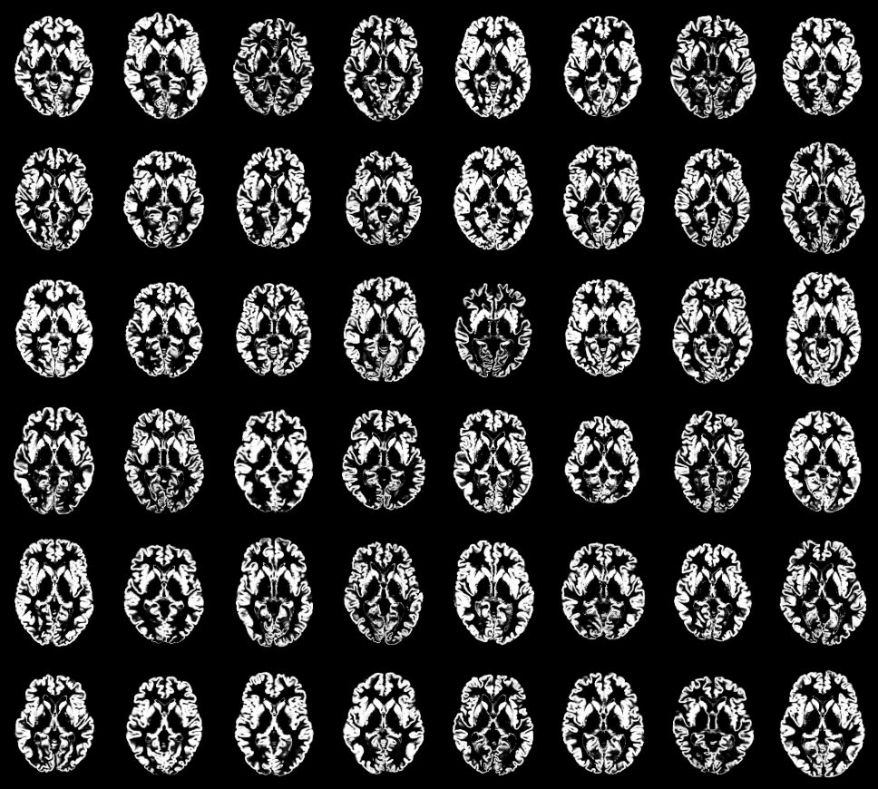
Data (only 2D)
Faces (64 out of 490)
Grey matter maps (64 of 581)

Slide 10

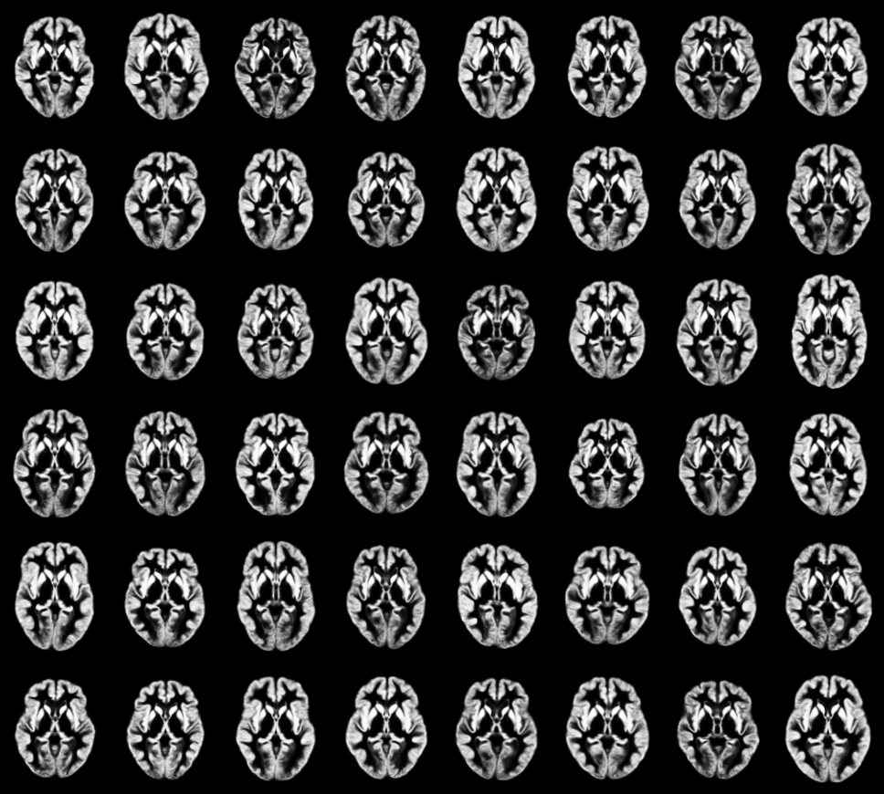
Full model fit
Shape and appearance
Shape and appearance (logistic)

Slide 11
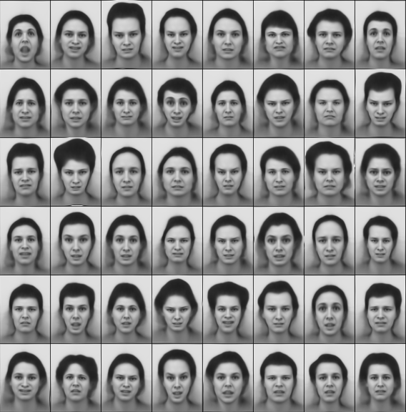
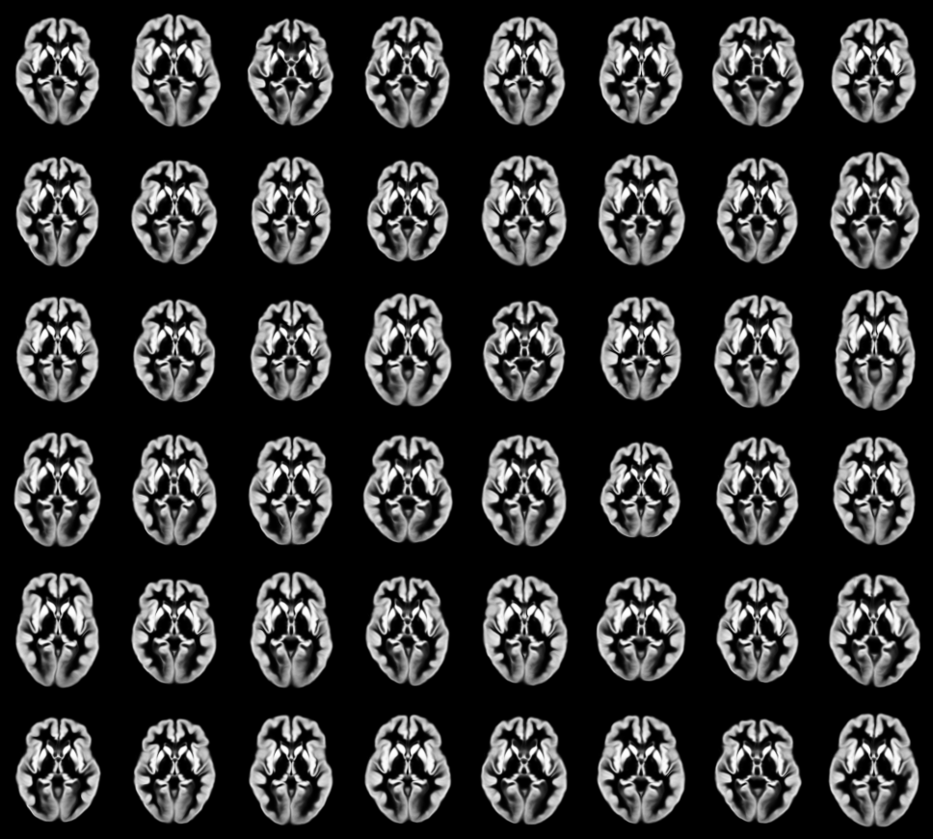
Shape model only
Warped average face
Warped average GM

Slide 12
Full model fit
Shape and appearance
Shape and appearance (logistic)

Slide 13
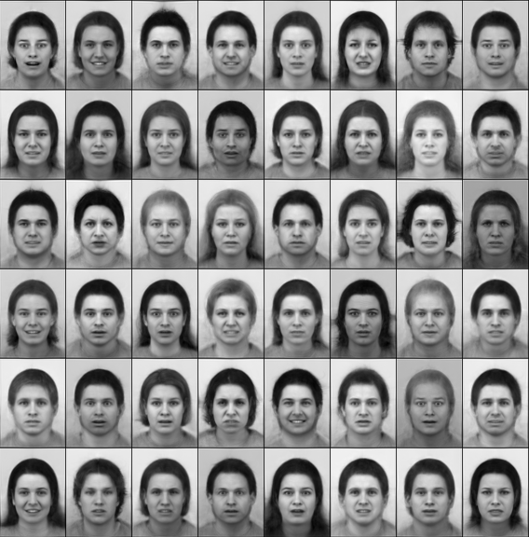
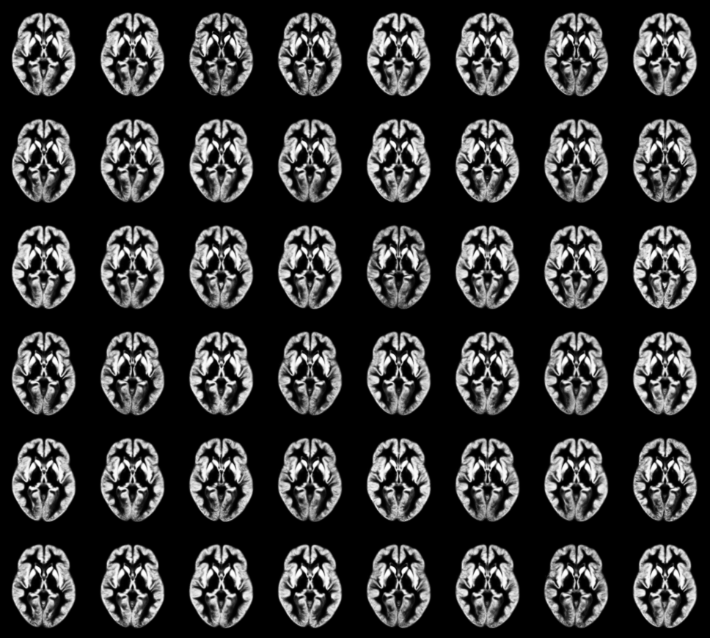
Appearance model only
Appearance fit (no warping)
Appearance fit (no warping)

Slide 14
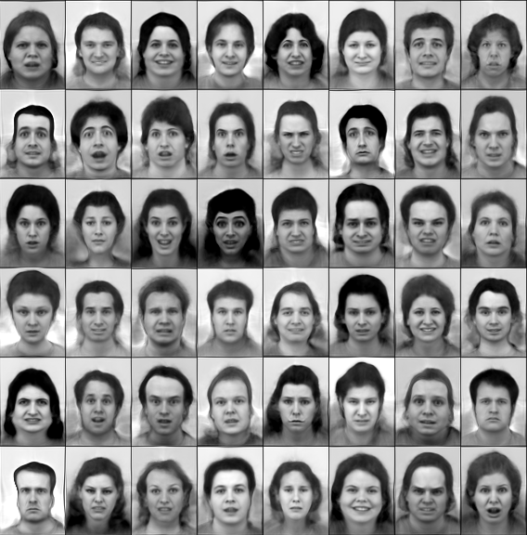
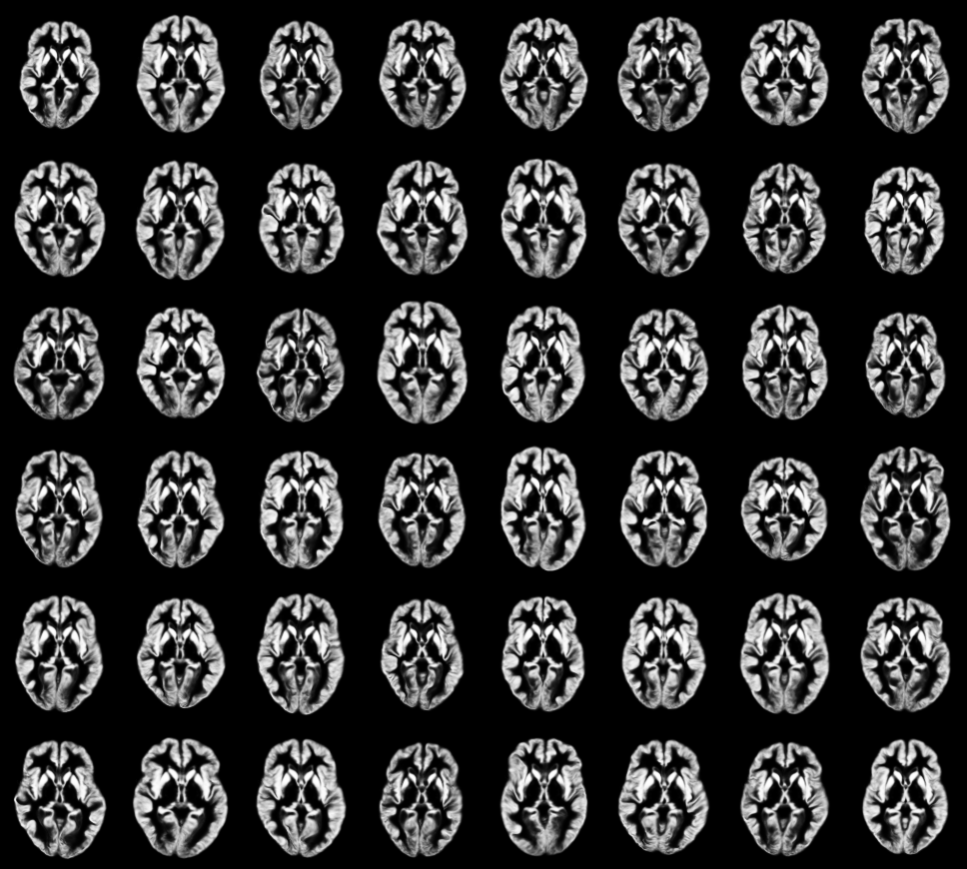
Model samples (1)
Samples from face model
Samples from brain model

Slide 15
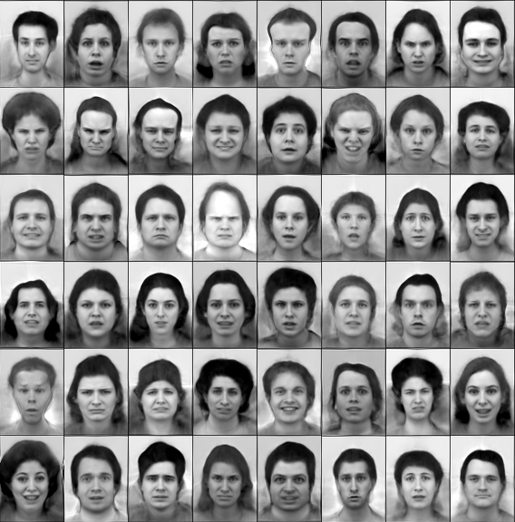
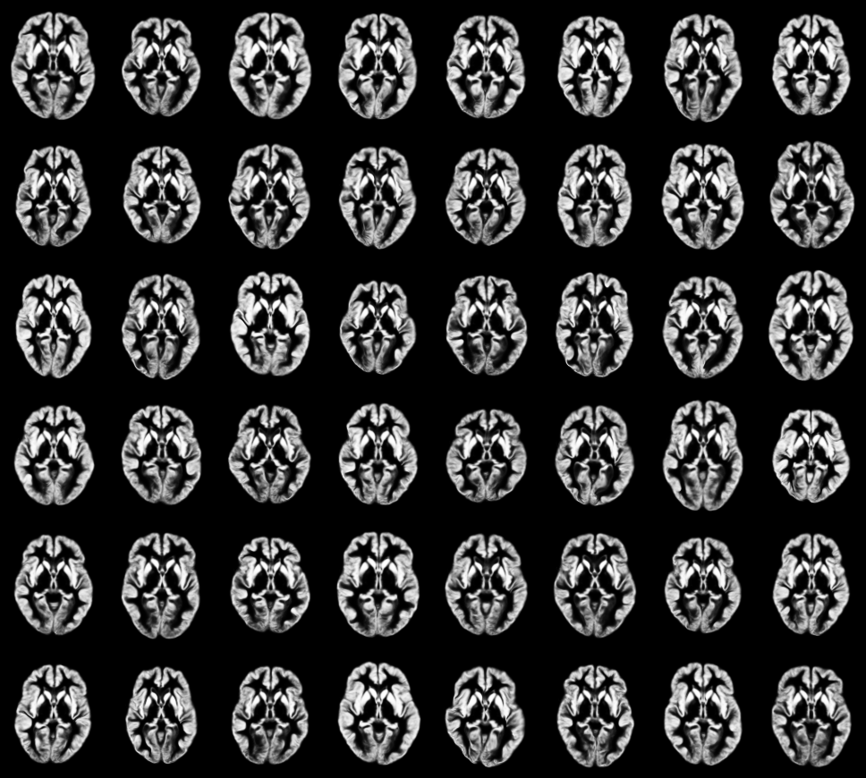
Model samples (2)
Samples from face model
Samples from brain model

