Slide 1


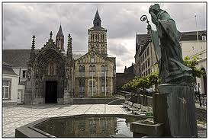
Dynamic causal modelling
of electromagnetic responses
Karl Friston - Wellcome Trust Centre for Neuroimaging, Institute of Neurology, UCL
In recent years, dynamic causal modelling has become established in the analysis of invasive and non-invasive electromagnetic signals. In this talk, I will briefly review the basic idea behind dynamic causal modelling – namely to equip a standard electromagnetic forward model, used in source reconstruction, with a neural mass or field model that embodies interactions within and between sources. A key point here is that the resulting forward or generative models can predict a large variety of data features – such as event or induced responses, or indeed their complex cross spectral density – using the same underlying neuronal model.
Dynamic causal modelling brings a new perspective to characterising event and induced responses – empirical response components, previously reified as objects of study in their own right (such as the mismatch negativity or P300) now become data features that have to be explained in terms of neuronal dynamics and changes in distributed connectivity. In other words, dynamic causal modelling emphasises the neurobiological mechanisms that underlie responses – over all channels and peristimulus time – without particular regard for the phenomenology of classical response components. My hope is to incite some discussion of this shift in perspective and its implications.

Slide 2
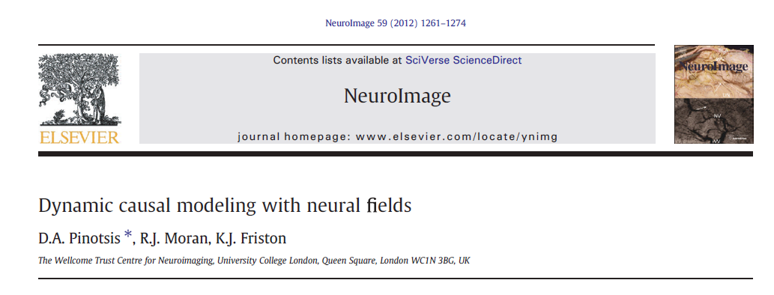
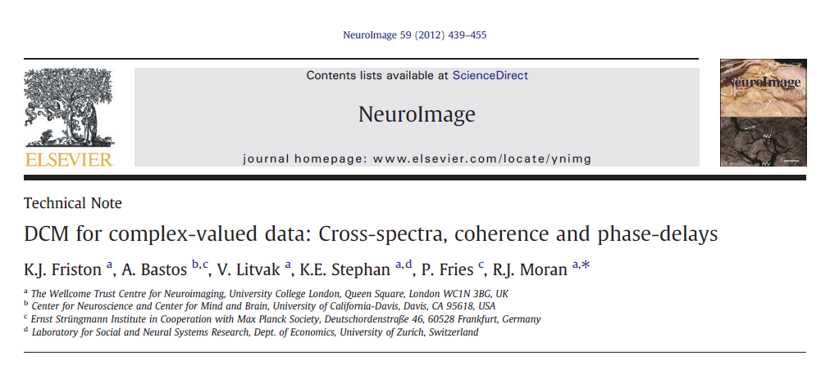
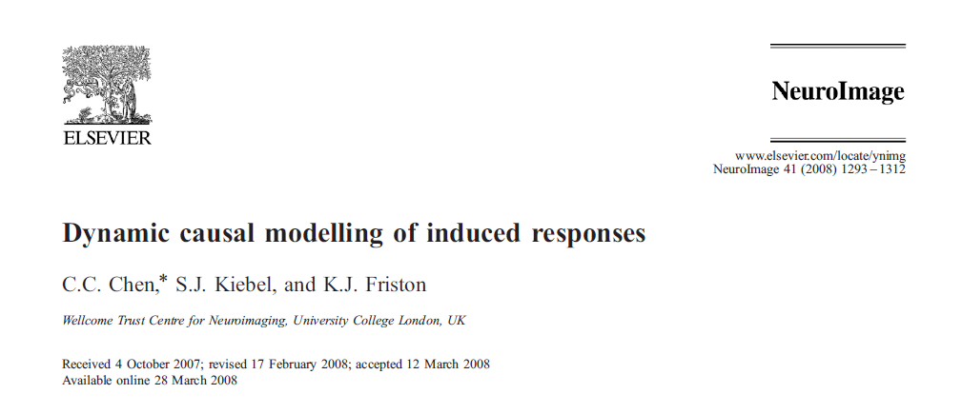
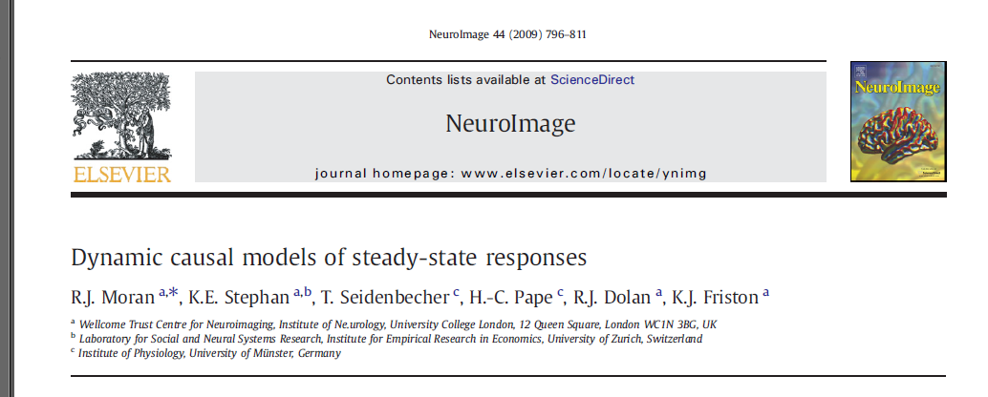
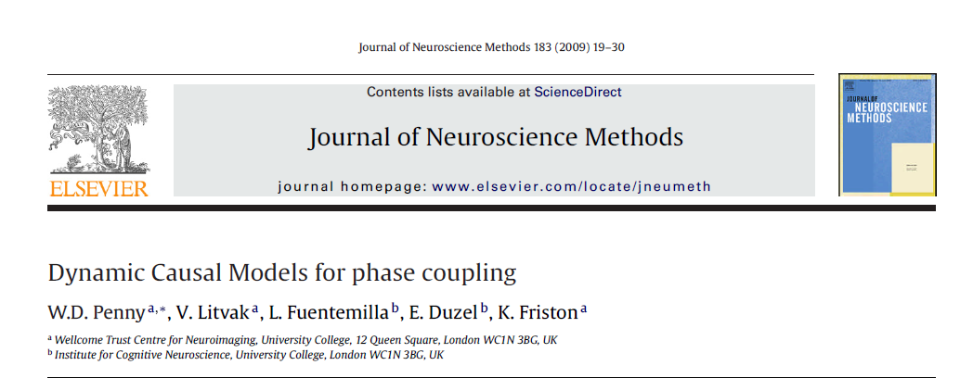
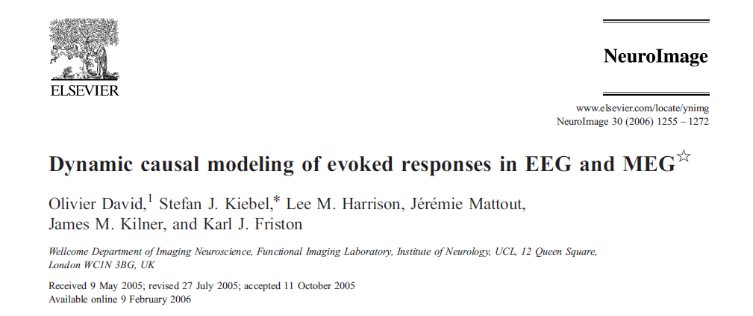

Slide 3

One ring to rule them all, one ring to find them, one ring to bring them all, and in the darkness bind them

Slide 4

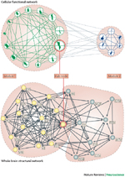
Overview
The basic idea (functional and effective connectivity)
Generative model and face validation
An empirical example

Slide 5
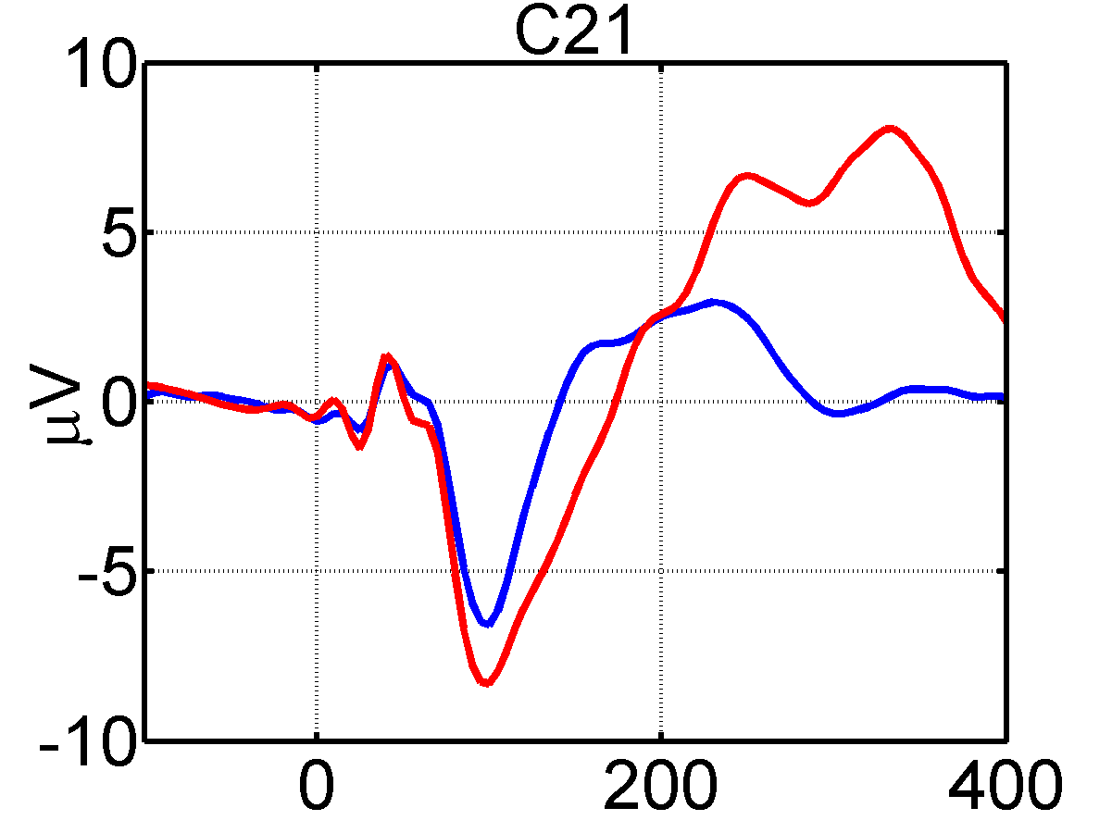
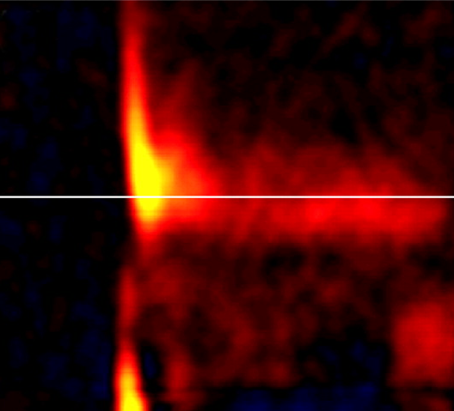
Exogenous and endogenous fluctuations
Generative model
Neuronal dynamics
Evoked responses
Induced responses

Slide 6
Exogenous and endogenous fluctuations
Model inversion

Slide 7
Bayesian model inversion and parameter averaging
Invert model of evoked responses
We seek the posterior conditioned on both evoked and induced responses.
Using Bayes rule we have:
Update priors
Giving the likelihood and prior for induced responses
Invert model of induced responses
Inference on parameters
and models

Slide 8

Models of effective connectivity among hidden states causing observed responses
State-space model
Convolution kernel representation
Functional Taylor expansion
Spectral representation
Convolution theorem
Autoregressive representation
Yule Walker equations
Spectral representation
Convolution theorem
Cross-covariance
Cross-spectral density
Auto-regression coefficients
Directed transfer functions
Cross-correlation
Coherence
Auto-correlation
Granger causality
Measures of functional connectivity or statistical dependence among observed responses

Slide 9
Effective connectivity
Volterra kernels
Modulation transfer functions
Cross covariance functions
Cross spectral density
Spectral measures
Auto regression coefficients
Spectral factors
Director transfer functions
parametric
Granger causality
nonparametric

Slide 10
Overview
The basic idea
Generative model and face validation
An empirical example

Slide 11
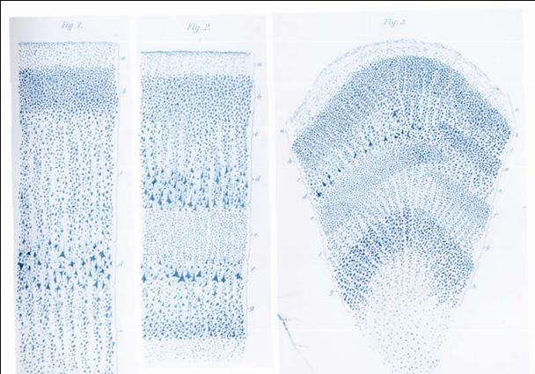
Generative (conductance based neural mass) model based on the canonical microcircuit
Inhibitory connections: k = E
Excitatory connections: k = I
Superficial pyramidal cells
Forward extrinsic connections
Inhibitory interneurons
supragranular layer
Granular layer
Spiny stellate cells
Intrinsic connections
Infragranular layer
Backward extrinsic connections
Deep pyramidal cells
Exogenous (subcortical) input
Endogenous fluctuations
Endogenous fluctuations
Higher source (2)
Early source (1)

Slide 12


The effect of parameters on transfer functions – contribution analysis
Self-inhibition of superficial cells
Transfer functions
5
60
4
50
3
40
Frequency
2
30
1
20
0
10
0
10
20
30
40
50
60
70
-2
-1
0
1
2
frequency {Hz}
(log) parameter scaling
32
8
1
2
32
8
4
8
4
4
Intrinsic backward connections)
Transfer functions
4
60
3
50
40
2
Frequency
30
1
20
0
10
0
10
20
30
40
50
60
70
-2
-1
0
1
2
frequency {Hz}
(log) parameter scaling

Slide 13



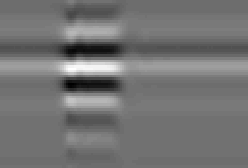
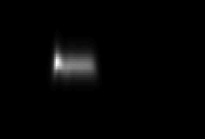

Predicted responses to sustained exogenous (stimulus) input
8
6
Exogenous input
4
2
0
50
100
150
200
250
300
350
400
450
500
peristimulus time (ms)
Hidden neuronal states (conductance and depolarisation)
0
-20
source 2
source 1
-40
-60
50
100
150
200
250
300
350
400
450
500
peristimulus time (ms)
Spectral density
Coherence
Evoked response: source 1
Induced response
60
60
6
60
50
50
4
50
Hz
40
Hz
40
2
Hz
40
30
30
0
30
20
20
20
10
10
-2
10
100
200
300
400
500
100
200
300
400
500
100
200
300
400
500
100
200
300
400
500
peristimulus time (ms)
peristimulus time (ms)
peristimulus time (ms)
peristimulus time (ms)
Cross-covariance
Spectral density
Evoked response: source 2
Induced response
60
60
60
40
50
4
50
20
40
2
40
lag (ms)
0
Hz
30
0
Hz
30
-20
20
-2
20
-40
10
-4
10
-60
100
200
300
400
500
100
200
300
400
500
100
200
300
400
500
100
200
300
400
500
peristimulus (ms)
peristimulus time (ms)
peristimulus time (ms)
peristimulus time (ms)

Slide 14
Transfer functions and spectral asymmetries
Forward connections (gamma)
backward connections (beta)
Endogenous fluctuations
Endogenous fluctuations

Slide 15
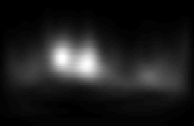
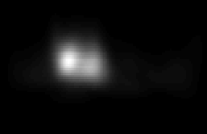
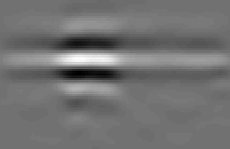
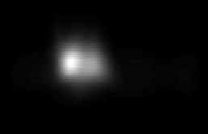



evoked: source 1
Spectral density
Coherence
Simulated responses
(sample estimates over16 trials)
6
60
60
4
50
50
2
Hz
40
Hz
40
0
30
30
-2
20
20
-4
10
10
100
200
300
400
500
100
200
300
400
500
100
200
300
400
500
peristimulus time (ms)
peristimulus time (ms)
peristimulus time (ms)
evoked: source 2
Cross-covariance
Spectral density
5
50
60
50
0
lag (ms)
0
Hz
40
30
-5
20
-50
10
100
200
300
400
500
100
200
300
400
500
100
200
300
400
500
peristimulus time (ms)
peristimulus (ms)
peristimulus time (ms)
Predicted responses
(expectation under known input)
evoked: source 1
Spectral density
Coherence
6
60
60
4
50
50
2
Hz
40
Hz
40
0
30
30
-2
20
20
10
10
100
200
300
400
500
100
200
300
400
500
100
200
300
400
500
peristimulus time (ms)
peristimulus time (ms)
peristimulus time (ms)
evoked: source 2
Cross-covariance
Spectral density
4
50
60
2
50
lag (ms)
0
Hz
40
0
30
-2
20
-4
-50
10
100
200
300
400
500
100
200
300
400
500
100
200
300
400
500
peristimulus time (ms)
peristimulus (ms)
peristimulus time (ms)

Slide 16
Overview
The basic idea
Generative model and face validation
An empirical example

Slide 17
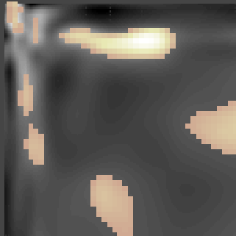
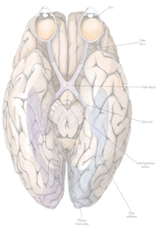
Functional asymmetries in forward and backward connections
Phenomenological DCM for induced responses (Chen et al 2008)
F_{L}B_{L}
F_{N}B_{L}
F_{L}B_{N}
F_{N}B_{N}
4 12 20 28 36 44
0
-10000
Frequency (Hz)
-20000
44 36 28 20 12 4
SPM t
-30000
-40000
-50000
From 32 Hz (gamma) to 10 Hz (alpha)
t = 4.72; p = 0.002
-60000
LF
RF
-70000
0.1
0.1
LV
RV
0.08
0.08
0.06
0.06
0.04
0.04
0.02
0.02
input
0
0
-0.02
-0.02
-0.04
-0.04
-0.06
Forward Backward
-0.06
Forward Backward
-0.08
-0.08
-0.1
Left hemisphere
-0.1
Right hemisphere

Slide 18
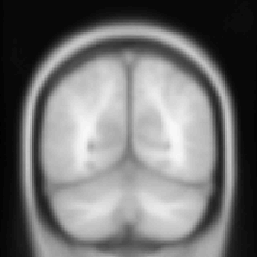
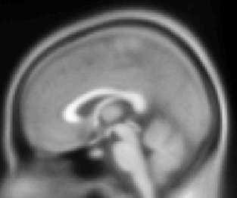
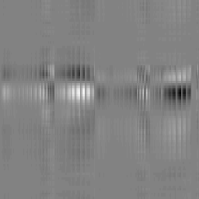
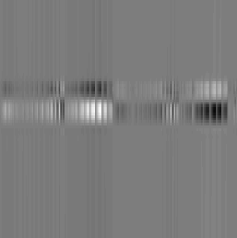
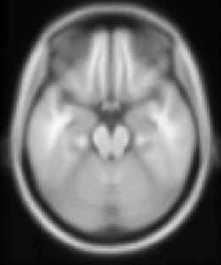
Posterior predictions following inversion of event responses
Sensor level observations
Estimates of dipole orientation
-100
Observed (adjusted) 1
-100
Predicted
0
0
100
100
time (ms)
200
time (ms)
200
300
300
LF
RF
400
400
500
50
100
150
200
250
500
50
100
150
200
250
LV
RV
channels
channels
input
and DCM predictions

Slide 19
Posterior predictions following inversion of induced responses

Slide 20




Transfer functions and spectral asymmetries
transfer function: 1 to 1
transfer function: 3 to 1
30
30
Hz
20
Hz
20
10
10
Forward connections (gamma?)
0
200
400
0
200
400
Backward connections (beta)
peristimulus time (ms)
peristimulus time (ms)
transfer function: 1 to 3
transfer function: 3 to 3
30
30
Hz
20
Hz
20
10
10
0
200
400
0
200
400
LF
RF
peristimulus time (ms)
peristimulus time (ms)
LF
RF
LV
RV
0.5
kernel: 1 to 1
2
kernel: 3 to 1
LV
RV
0
0
input
-0.5
-2
input
0
100
0
100
lag (ms)
lag (ms)
10
kernel: 1 to 3
0.5
kernel: 3 to 3
0
0
-10
0
100
-0.5
0
100
lag (ms)
lag (ms)

Slide 21
Thank you
And thanks to
Gareth Barnes
Andre Bastos
CC Chen
Jean Daunizeau
Marta Garrido
Lee Harrison
Martin Havlicek
Stefan Kiebel
Marco Leite
Vladimir Litvak
Andre Marreiros
Rosalyn Moran
Will Penny
Dimitris Pinotsis
Krish Singh
Klaas Stephan
Bernadette van Wijk
And many others

Slide 23

Errors (superficial pyramidal cells)
Forward transfer function
14
12
Expectations (deep pyramidal cells)
10
8
spectral power
6
Andre Bastos
4
2
V4
0
0
20
40
60
80
100
V1
0.3
0.25
0.2
0.15
superficial
0.1
0.05
0
0
20
40
60
80
100
120
6
5
4
spectral power
2
3
2
deep
1
1
0
0
20
40
60
80
100
frequency (Hz)
Backward transfer function
0
0
20
40
60
80
100
120
frequency (Hz)

