Slide 1


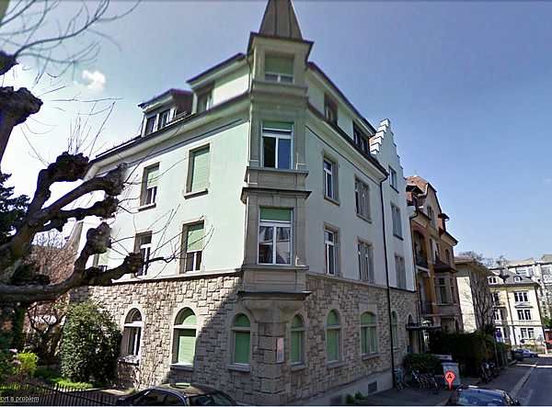
Opening Symposium of the
Translational Neuromodeling Unit
Zurich, 18-20 September 2013
The computational anatomy of psychosis
Karl Friston
Abstract
If we assume that neuronal activity encodes a probabilistic representation of the world that optimizes free-energy in a Bayesian fashion, then this optimization can be regarded as evidence accumulation or (generalized) predictive coding. Crucially, both predictions about the state of the world generating sensory data and the precision of (confidence in) those data have to be optimized. In other words, we have to make predictions (test hypotheses) about the content of the sensorium and predict our confidence in those hypotheses. I hope to demonstrate the metacognitive aspect of this inference using simulations of action observation and sensory attenuation - to illustrate the nature of active inference and elucidate the computational anatomy of psychosis.

Slide 2
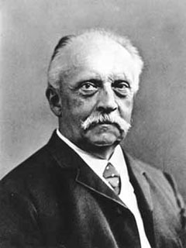
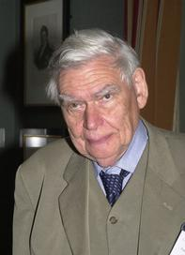
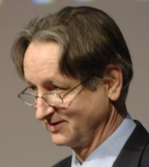
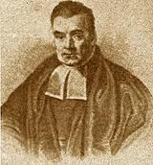

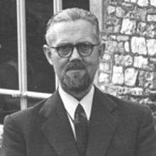
“Objects are always imagined as being present in the field of vision as would have to be there in order to produce the same impression on the nervous mechanism” - von Helmholtz
Hermann von Helmholtz
Richard Gregory
Geoffrey Hinton
From the Helmholtz machine to the Bayesian brain and self-organization
Thomas Bayes
Richard Feynman
Ross Ashby

Slide 3
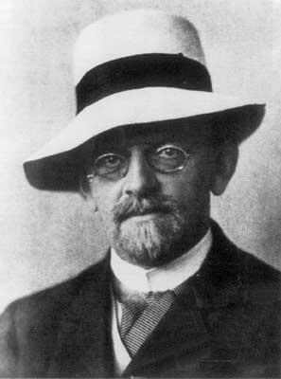

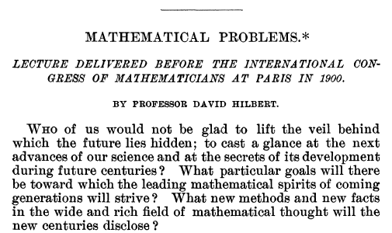
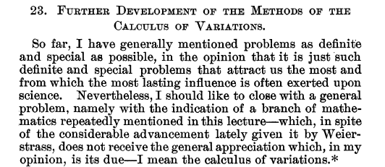

Slide 4
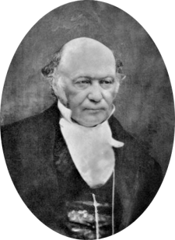
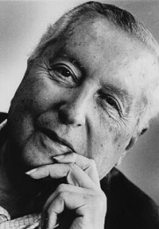
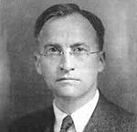
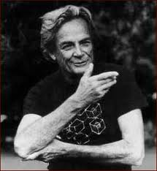
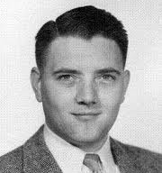
Self organisation and Hamilton’s principle of least action
The calculus of variations and the enigma of the brain:
or how do we resist the second law of thermodynamics?
Ergodic theorem
surprise
divergence
energy
entropy
(precise) prediction error
complexity
…we minimise variational free energy or prediction error

Slide 5
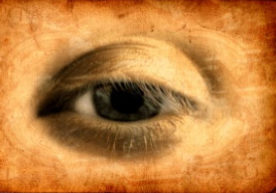
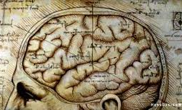
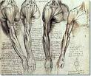
How can we minimize free energy (prediction error)?
sensations – predictions
Prediction error
Action
Perception
Change sensations
Change predictions

Slide 6

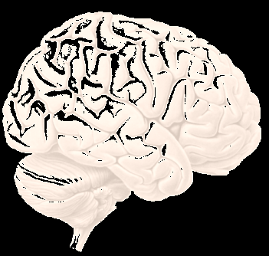
Active inference, predictive coding and precision
Precision and false inference
Simulations of :
  Auditory perception (and omission related responses)
  Handwriting (and action observation)
  Smooth pursuit eye movements (under occlusion)
  Sensory attenuation (and the force matching illusion)

Slide 7
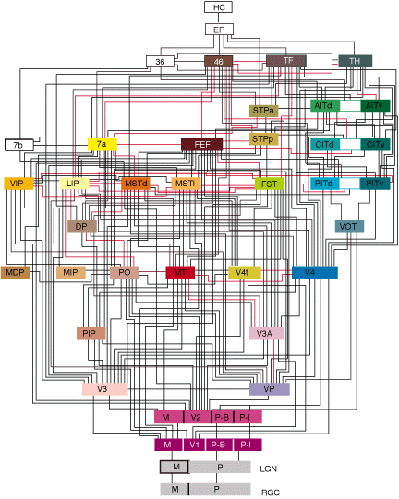
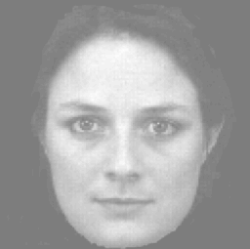
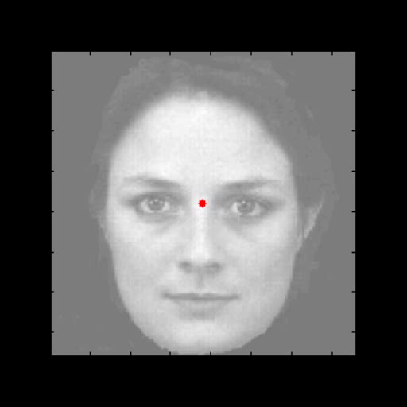
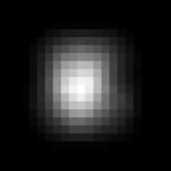
Generative models and predictions
A simple hierarchy
what
where
Sensory fluctuations

Slide 8
From models to perception
A simple hierarchy
Generative model
Descending
predictions
Model inversion (inference)
Expectations:
Ascending prediction errors
Predictions:
Prediction errors:

Slide 9

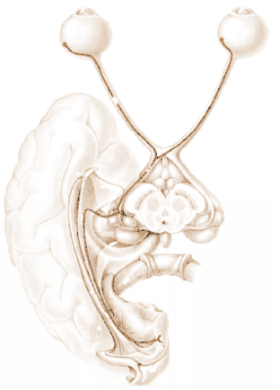
David Mumford
Predictive coding with reflexes
Action
oculomotor signals
reflex arc
proprioceptive input
pons
retinal input
Perception
Precision
Prediction error (superficial pyramidal cells)
frontal eye fields
geniculate
VTA
Top-down or backward predictions
Conditional predictions (deep pyramidal cells)
Bottom-up or forward prediction error
visual cortex

Slide 10
Prediction error can be reduced by changing predictions (perception)
Prediction error can be reduced by changing sensations (action)
Perception entails recurrent message passing in the brain to optimize predictions
Action fulfils descending predictions
Both perception (attention) and action (affordance) rest on optimizing precision
Precision contextualizes prediction errors though neuromodulatory gain control

Slide 11
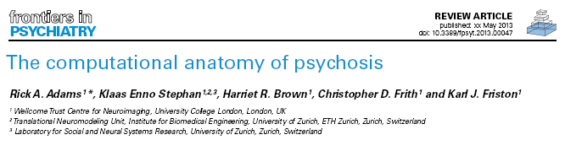
De-compensation
(trait abnormalities)
Attenuated violation responses
Loss of perceptual Gestalt
SPEM abnormalities
Psychomotor poverty
Resistance to illusions
Hallucinations
Delusions
+
Neuromodulatory failure (of sensory attenuation)
-
Compensation
(to psychotic state)

Slide 12
Active inference, predictive coding and precision
Precision and false inference
Simulations of :
  Auditory perception (and omission related responses)
  Handwriting (and action observation)
  Smooth pursuit eye movements (under occlusion)
  Sensory attenuation (and the force matching illusion)

Slide 13

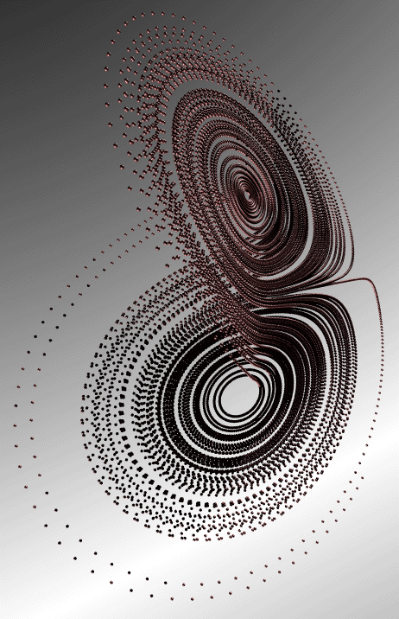
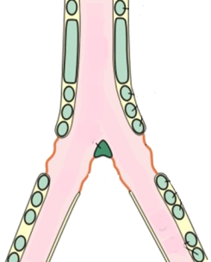
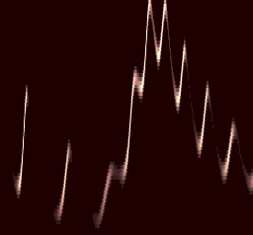
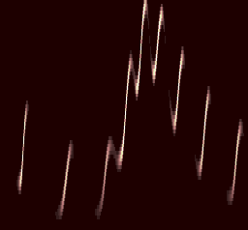

Neuronal hierarchy
Generative process (and model)
Syrinx
Model inversion
sonogram
percept
prediction error
10
8
6
Frequency (KHz)
Frequency (Hz)
4
LFP (micro-volts)
2
0
-2
-4
-6
0.5
1
1.5
500
1000
1500
2000
Time (sec)
peristimulus time (ms)

Slide 14
Omission related responses, MMN and hallucinosis
Reduced precision at second level
Compensatory reduction of sensory precision

Slide 15
Active inference, predictive coding and precision
Precision and false inference
Simulations of :
  Auditory perception (and omission related responses)
  Handwriting (and action observation)
  Smooth pursuit eye movements (under occlusion)
  Sensory attenuation (and the force matching illusion)

Slide 16


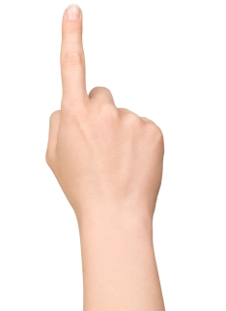
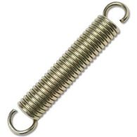
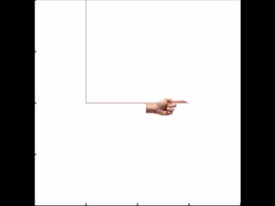
Action and agency
Heteroclinic cycle (central pattern generator)
Descending
proprioceptive predictions
action
observation
0.4
0.6
0.8
position (y)
1
1.2
1.4
0
0.2
0.4
0.6
0.8
1
1.2
1.4
0
0.2
0.4
0.6
0.8
1
1.2
1.4
position (x)
position (x)

Slide 17
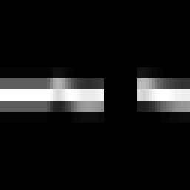
Angular direction of target in extrinsic coordinates
Smooth pursuit eye movements
Angular direction of gaze in extrinsic coordinates
Angular position of target in intrinsic coordinates
oculomotor signals
proprioceptive input
reflex arc
pons
retinal input
visual channels
time
Generative process
Generative model

Slide 18
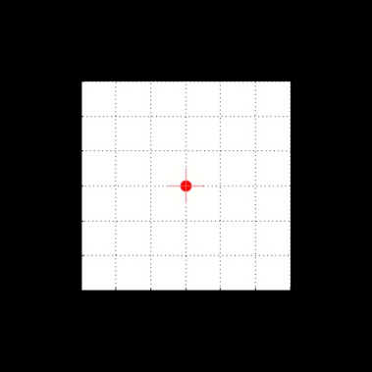
Eye movements under occlusion – and reduced precision
Angular position
2
1
eye
target
displacement (degrees)
0
-1
-2
eye (reduced precision)
500
1000
1500
2000
2500
3000
Angular velocity
50
40
30
velocity (degrees per second)
20
10
0
-10
-20
500
1000
1500
2000
2500
3000
time (ms)

Slide 19
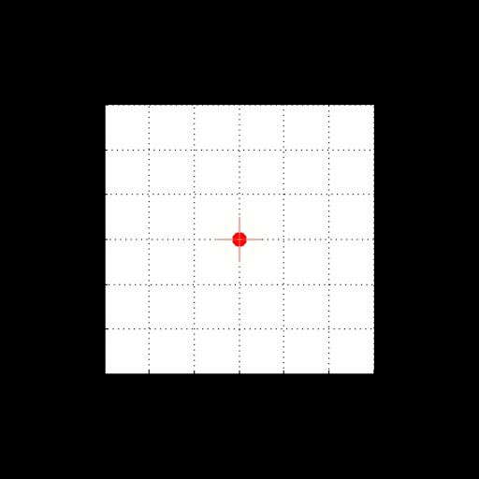
Paradoxical responses to violations
target and oculomotor angles
2
eye
1
target
displacement (degrees)
0
eye (reduced precision)
-1
-2
100
200
300
400
500
600
700
800
900
1000
time (ms)
target and oculomotor velocities
30
20
10
velocity (degrees per second)
0
-10
-20
-30
100
200
300
400
500
600
700
800
900
1000
time (ms)

Slide 20
Active inference, predictive coding and precision
Precision and false inference
Simulations of :
  Auditory perception (and omission related responses)
  Handwriting (and action observation)
  Smooth pursuit eye movements (under occlusion)
  Sensory attenuation (and the force matching illusion)

Slide 21

Making your own sensations
Generative process
Generative model

Slide 22
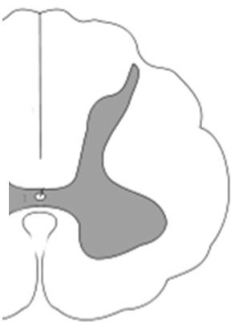
sensorimotor cortex
descending predictions
prefrontal cortex
descending sensory predictions
descending modulation
ascending prediction errors
thalamus
descending motor predictions
motor reflex arc

Slide 23
Self-made acts
prediction and error
hidden states
2
2
1.5
1.5
1
1
0.5
0.5
0
0
-0.5
-0.5
5
10
15
20
25
30
5
10
15
20
25
30
Time (bins)
Time (bins)
High sensory attenuation
hidden causes
perturbation and action
1
1
0.8
0.5
0.6
0.4
0.2
0
0
-0.2
-0.5
-0.4
-0.6
-0.8
5
10
15
20
25
30
5
10
15
20
25
30
Time (bins)
Time (bins)

Slide 24
and psychomotor poverty
prediction and error
hidden states
2
2
1.5
1.5
1
1
0.5
0.5
0
0
-0.5
-0.5
5
10
15
20
25
30
5
10
15
20
25
30
time
time
Failure of sensory attenuation
hidden causes
perturbation and action
1
1
0.8
0.5
0.6
0.4
0.2
0
0
-0.2
-0.5
-0.4
-0.6
-0.8
5
10
15
20
25
30
5
10
15
20
25
30
time
time

Slide 25
prediction and error
hidden states
prediction and error
hidden states
2
2
2
2
1.5
1.5
1.5
1.5
1
1
1
1
0.5
0.5
0.5
0.5
0
0
0
0
-0.5
-0.5
-0.5
10
20
30
40
50
60
-0.5
10
20
30
40
50
60
10
20
30
40
50
60
10
20
30
40
50
60
Time (bins)
Time (bins)
Time (bins)
Time (bins)
Sensory attenuation
Force matching illusion
Intrinsic and extrinsic
hidden causes
perturbation and action
hidden causes
perturbation and action
2
2
1.5
1.5
1.5
1.5
1
1
1
1
0.5
0.5
0.5
0.5
0
0
0
0
-0.5
-0.5
-0.5
10
20
30
40
50
60
-0.5
10
20
30
40
50
60
10
20
30
40
50
60
10
20
30
40
50
60
Time (bins)
Time (bins)
Time (bins)
Time (bins)

Slide 26
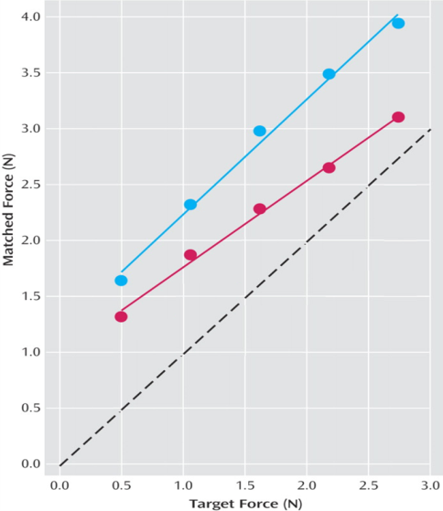
Failures of sensory attenuation, with compensatory increases in non-sensory precision
Normal subjects
3
Simulated
Empirical (Shergill et al)
2.5
2
Self-generated(matched) force
Self-generated(matched) force
Schizophrenic subjects
1.5
1
0.5
0
0
0.5
1
1.5
2
2.5
3
External (target) force
External (target) force

Slide 27
prediction and error
hidden states
3.5
3.5
3
3
2.5
2.5
2
2
1.5
1.5
1
1
0.5
0.5
0
0
-0.5
10
20
30
40
50
60
-0.5
10
20
30
40
50
60
Time (bins)
Time (bins)
Failure of sensory attenuation and delusions of control?
hidden causes
perturbation and action
3.5
3.5
3
3
2.5
2.5
2
2
1.5
1.5
1
1
0.5
0.5
0
-0.5
0
-1
10
20
30
40
50
60
-0.5
10
20
30
40
50
60
Time (bins)
Time (bins)

Slide 28
Signs (of trait abnormalities)
Attenuated violation responses
Loss of perceptual Gestalt
SPEM abnormalities
Psychomotor poverty
Resistance to illusions
+
Neuromodulatory failure
(of sensory attenuation)
-
Symptoms (of the psychotic state)
Hallucinations
Delusions

Slide 29

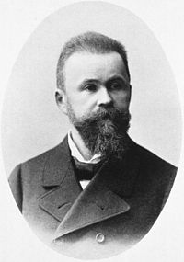

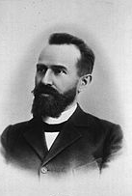
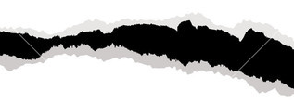

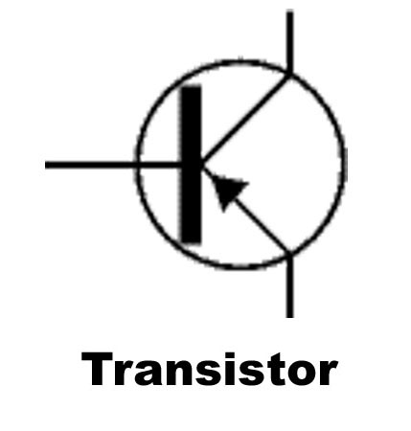
Dysconnection in schizophrenia: from abnormal synaptic plasticity to failures of self-monitoring. Schizophr Bull. 2009 May;35(3):509-27
Klaas E. Stephan, Karl J. Friston and Chris D. Frith
Wernicke C. Grundrisse der Psychiatrie. 1906:
Sejunction – disruption of associative connectivity
Bleuler E. Dementia Praecox oder Gruppe der Schizophrenien, 1911: Disintegration – of conscious processing (the psyche)
Anatomical disconnection
Functional disconnection

Slide 30
Summary
and a Hilbert list for schizophrenia
What is the functional deficit?
What is the pathophysiology?
How can we measure it?
What is the aetiology?
What is the therapeutic intervention?
False inference due to aberrant encoding of precision
A neuromodulatory failure of postsynaptic excitability:
Aberrant DA/NMDAr subunit interactions
Aberrant synchronous gain and fast (gamma) dynamics
Aberrant cortical gain control and E-I (GABAergic) balance
Aberrant dendritic integration (neuromorphology)
Biophysical modelling of non-invasive brain responses
dynamic casual modelling of recurrent inhibition
…

Slide 31
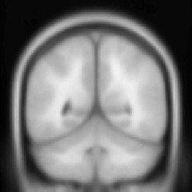
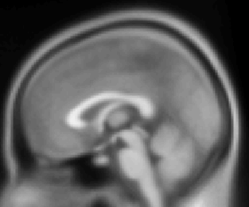
Noa Fogelson et al., The functional anatomy of schizophrenia: a DCM study of predictive coding
control subjects - predictable
control subjects - unpredictable
schizophrenia - predictable
Prefrontal input
schizophrenia - unpredictable
PC
PC
Effects of predictability on recurrent inhibition
1.5
control subjects
IT
IT
1
schizophrenics
0.5
0
V5
V5
log modulation
-0.5
-1
-1.5
V1
-2
V1
R V5
L V5
R IT
L IT
R PC
L PC
cortical source
Visual input

Slide 32
Thank you
And thanks to collaborators:
Rick Adams
Andre Bastos
Sven Bestmann
Harriet Brown
Jean Daunizeau
Mark Edwards
Xiaosi Gu
Lee Harrison
Stefan Kiebel
James Kilner
Jérémie Mattout
Rosalyn Moran
Will Penny
Lisa Quattrocki Knight
Klaas Stephan
And colleagues:
Andy Clark
Peter Dayan
Jörn Diedrichsen
Paul Fletcher
Pascal Fries
Geoffrey Hinton
James Hopkins
Jakob Hohwy
Henry Kennedy
Paul Verschure
Florentin Wörgötter
And many others

