Slide 1



Free energy and active inference
Karl J. Friston, University College London
How much about our interaction with – and experience of – our world can be deduced from basic principles? This talk reviews recent attempts to understand the self-organised behaviour of embodied agents, like ourselves, as satisfying basic imperatives for sustained exchanges with the environment. In brief, one simple driving force appears to explain many aspects of action and perception. This driving force is the minimisation of surprise or prediction error. In the context of perception, this corresponds to Bayes-optimal predictive coding that suppresses exteroceptive prediction errors. In the context of action, motor reflexes can be seen as suppressing proprioceptive prediction errors. We will look at some of the phenomena that emerge from this scheme, such as hierarchical message passing in the brain and the ensuing perceptual inference. I hope to illustrate these points using simple simulations of perception, action and action observation.
.
No conflicts of interest or financial disclosures

Slide 2

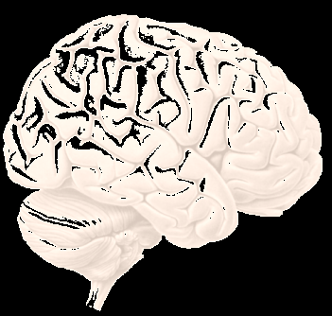
Overview
The statistics of life Markov blankets and ergodic systems
simulations of a primordial soup
The anatomy of inference graphical models and predictive coding
canonical microcircuits
Action and perception perceptual omission responses
simulations of action observation

Slide 3
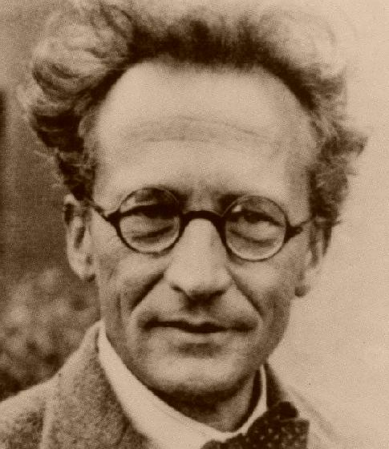
“How can the events in space and time which take place within the spatial boundary of a living organism be accounted for by physics and chemistry?”
(Erwin Schrödinger 1943)
The Markov blanket as a statistical boundary (parents, children and parents of children)
Internal states
External states
Sensory states
Active states

Slide 4
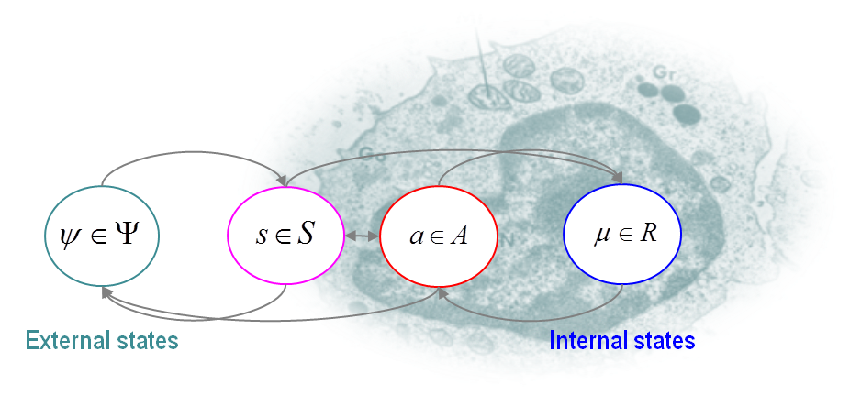
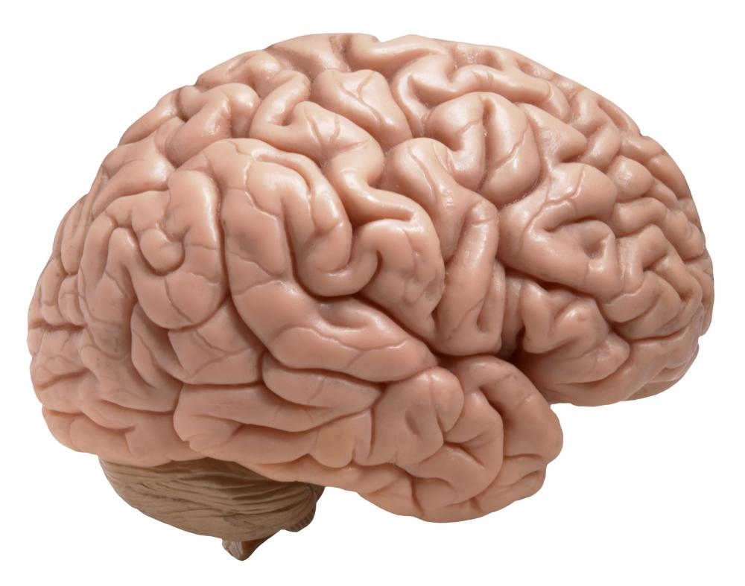
The Markov blanket in biotic systems
Sensory states
External states
Internal states
Active states

Slide 5
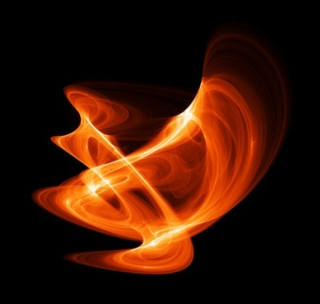

lemma: any (ergodic random) dynamical system (m) that possesses a Markov blanket will appear to actively maintain its structural and dynamical integrity
The Fokker-Planck equation
And its solution in terms of curl-free and divergence-free components
Notes:
5

Slide 6
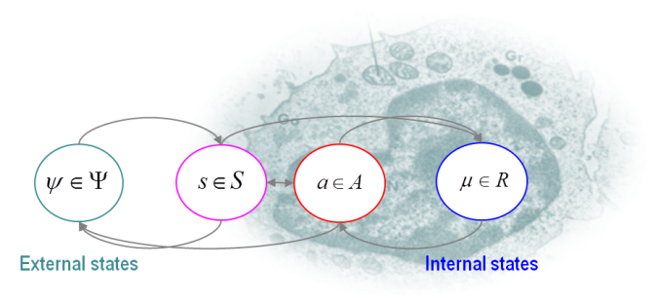
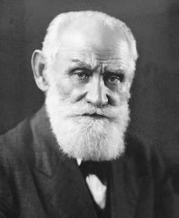
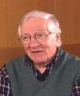
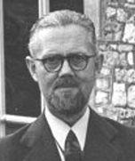
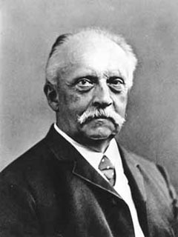
But what about the Markov blanket?
Value
Surprise (free energy)
Entropy
Model evidence
Reinforcement learning, optimal control
and expected utility theory
Information theory and minimum redundancy
Self-organisation, cybernetics and homoeostasis
Bayesian brain, active inference and predictive coding
Pavlov
Barlow
Ashby
Helmholtz

Slide 7
Overview
The statistics of life Markov blankets and ergodic systems
simulations of a primordial soup
The anatomy of inference graphical models and predictive coding
canonical microcircuits
Action and perception perceptual omission responses
simulations of action observation

Slide 8
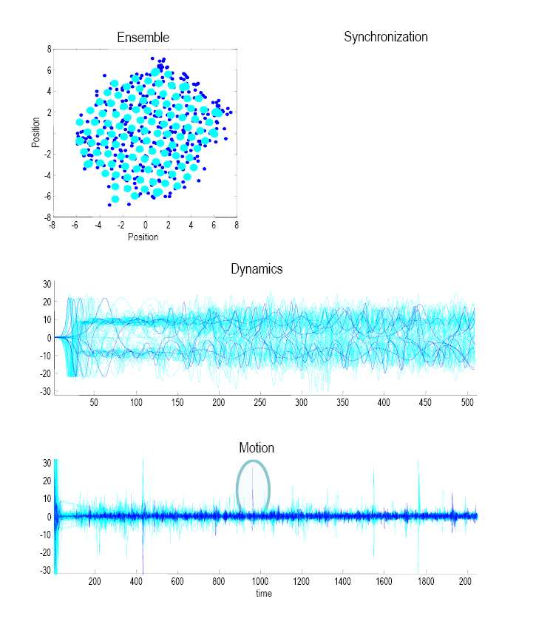
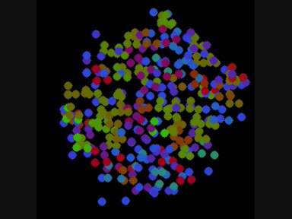
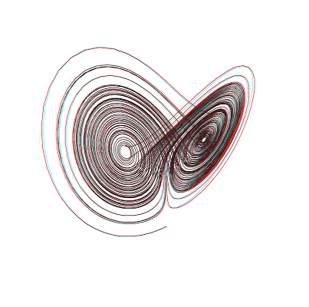
Simulations of a (prebiotic) primordial soup
Position
Short-range forces
Strong repulsion
Weak electrochemical attraction

Slide 9
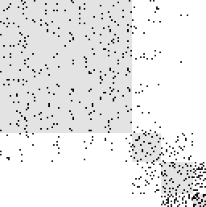
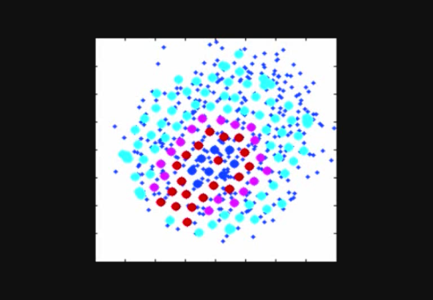
Finding the (principal) Markov blanket
Markov blanket matrix: encoding the children, parents and parents of children
Markov Blanket = [B · [eig(B) > τ]]
Adjacency matrix
Markov Blanket
20
Hidden states
40
A
60
80
Sensory states
100
Active states
Internal states
120
20
40
60
80
100
120
Element

Slide 10
Autopoiesis, oscillator death and simulated brain lesions

Slide 11
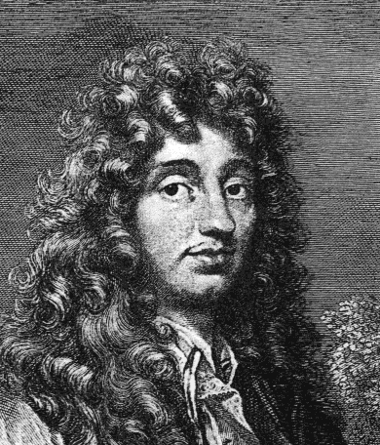
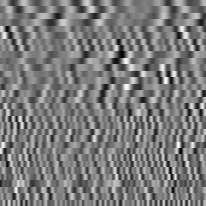
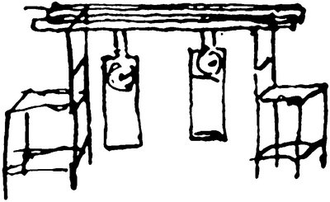
Decoding through the Markov blanket and simulated brain activation
True and predicted motion
0
Christiaan Huygens
-0.1
Motion of external state
Predictability
-0.2
8
-0.3
6
-0.4
4
2
100
200
Time
300
400
500
Position
0
-2
Internal states
-4
-6
5
-8
-5
0
5
10
Position
Modes
15
20
25
30
100
200
Time
300
400
500

Slide 12
The existence of a Markov blanket necessarily implies a partition of states into internal states, their Markov blanket (sensory and active states) and external or hidden states.
Because active states change – but are not changed by – external states they minimize the entropy of internal states and their Markov blanket. This means action will appear to maintain the structural and functional integrity of the Markov blanket (autopoiesis).
Internal states appear to infer the hidden causes of sensory states (by maximizing Bayesian evidence) and influence those causes though action (active inference)

Slide 13
Overview
The statistics of life Markov blankets and ergodic systems
simulations of a primordial soup
The anatomy of inference graphical models and predictive coding
canonical microcircuits
Action and perception perceptual omission responses
simulations of action observation

Slide 14
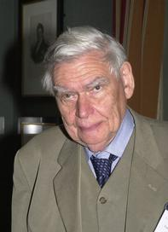
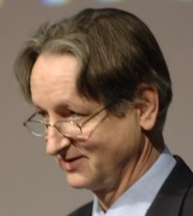
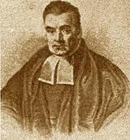

“Objects are always imagined as being present in the field of vision as would have to be there in order to produce the same impression on the nervous mechanism” - von Helmholtz
Hermann von Helmholtz
Richard Gregory
Geoffrey Hinton
The Helmholtz machine and the Bayesian brain
Thomas Bayes
Richard Feynman

Slide 15

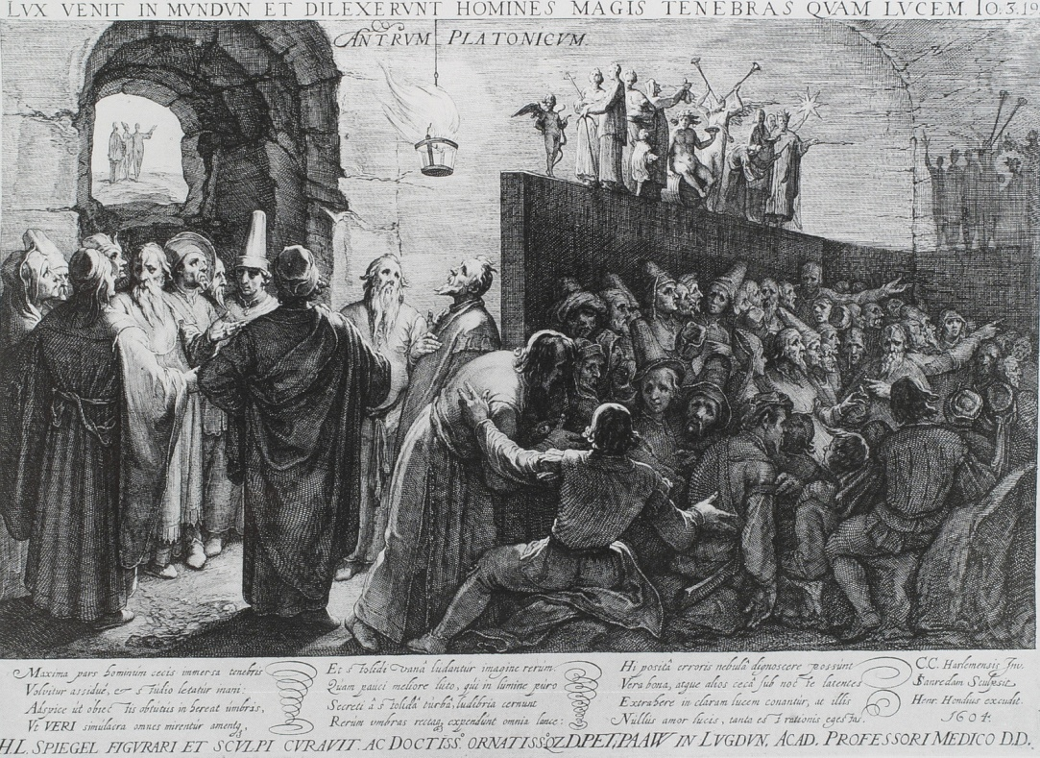
“Objects are always imagined as being present in the field of vision as would have to be there in order to produce the same impression on the nervous mechanism” - von Helmholtz
Hermann von Helmholtz
Richard Gregory
Impressions on the Markov blanket…
Plato: The Republic (514a-520a)

Slide 16
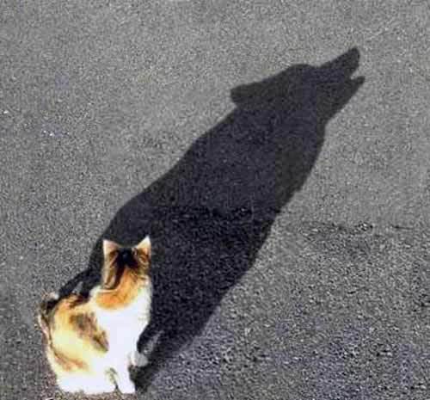
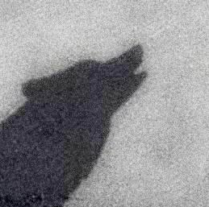
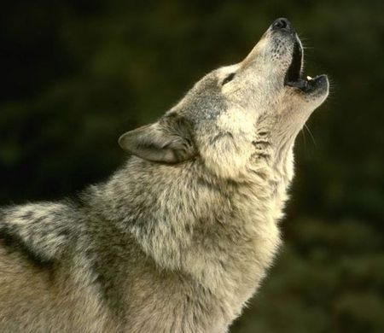
Bayesian filtering and predictive coding
prediction update
prediction error

Slide 17
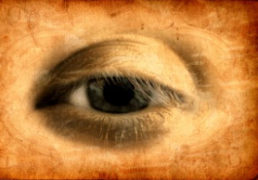
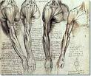
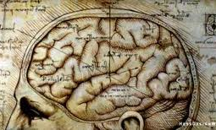
Making our own sensations
sensations – predictions
Prediction error
Action
Perception
Changing sensations
Changing predictions

Slide 18
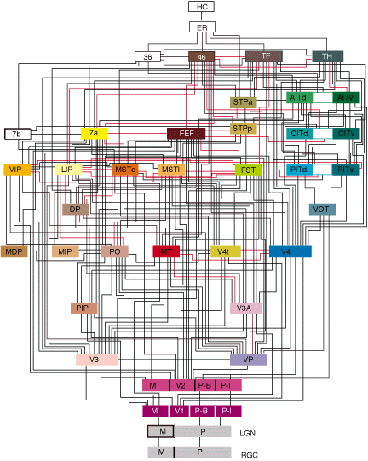
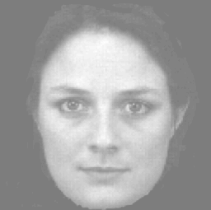
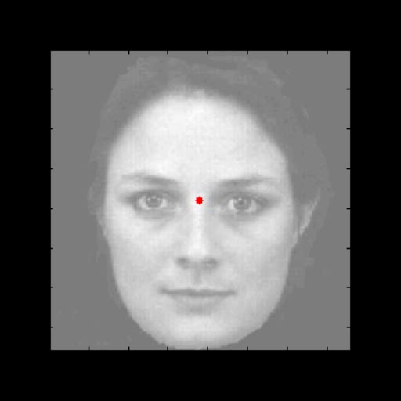

Hierarchical generative models
A simple hierarchy
what
where
Descending
predictions
Ascending prediction errors
Sensory fluctuations

Slide 19

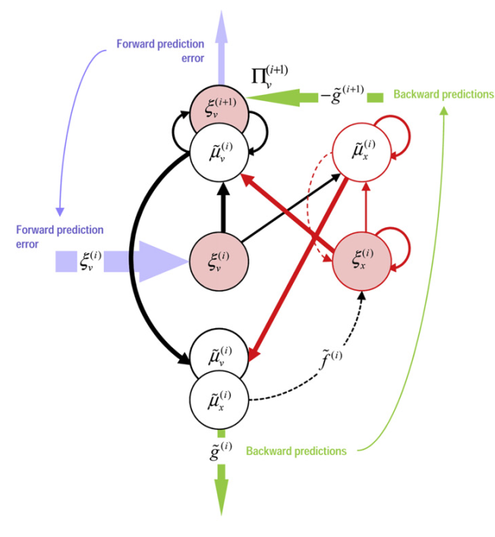
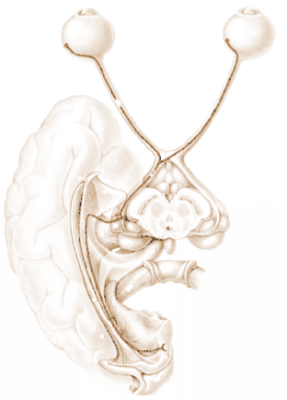
David Mumford
Predictive coding with reflexes
Action
oculomotor signals
reflex arc
proprioceptive input
pons
retinal input
Perception
Prediction error (superficial pyramidal cells)
frontal eye fields
geniculate
Top-down or backward predictions
Expectations (deep pyramidal cells)
Bottom-up or forward prediction error
visual cortex

Slide 20
Biological agents minimize their average surprise (entropy)
They minimize surprise by suppressing prediction error
Prediction error can be reduced by changing predictions (perception)
Prediction error can be reduced by changing sensations (action)
Perception entails recurrent message passing to optimize predictions
Action makes predictions come true (and minimizes surprise)

Slide 21
Overview
The statistics of life Markov blankets and ergodic systems
simulations of a primordial soup
The anatomy of inference graphical models and predictive coding
canonical microcircuits
Action and perception perceptual omission responses
simulations of action observation

Slide 22
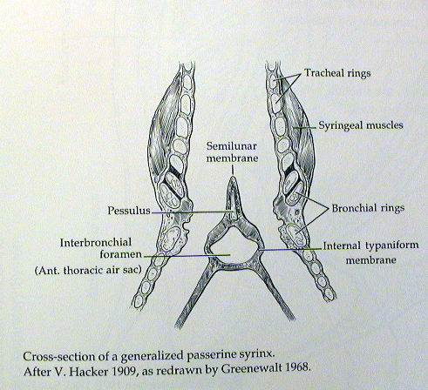
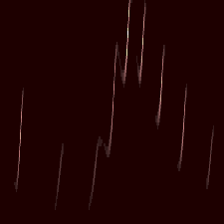


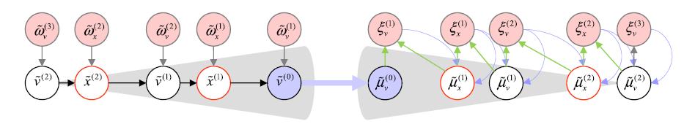
Perceptual inference and sequences of sequences
Neuronal hierarchy
Syrinx
sonogram
Frequency (KHz)
0.5
1
1.5
Time (sec)
External states
Sensory states
Internal states

Slide 23

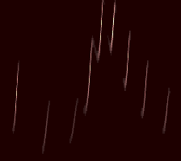
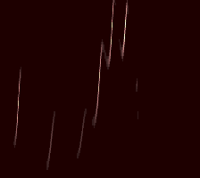
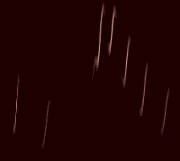
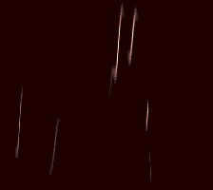
4500
4000
3500
Frequency (Hz)
3000
2500
stimulus (sonogram)
without last syllable
omission and violation of predictions
4500
4000
3500
Frequency (Hz)
3000
2500
percept
percept
0.5
1
1.5
0.5
1
1.5
Time (sec)
Time (sec)
ERP (prediction error)
with omission
100
100
50
50
Stimulus but no percept
0
0
LFP (micro-volts)
LFP (micro-volts)
-50
-50
Percept but no stimulus
-100
500
1000
1500
2000
-100
500
1000
1500
2000
peristimulus time (ms)
peristimulus time (ms)

Slide 24
Overview
The statistics of life Markov blankets and ergodic systems
simulations of a primordial soup
The anatomy of inference graphical models and predictive coding
canonical microcircuits
Action and perception perceptual omission responses
simulations of action observation

Slide 25
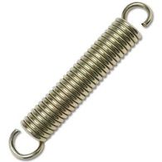
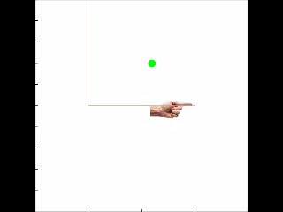
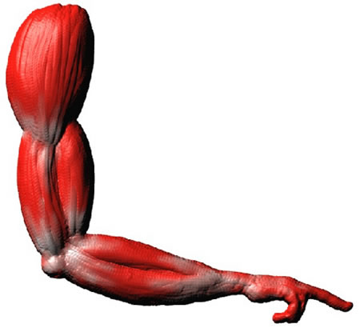
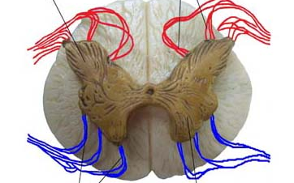
Action with point attractors
visual input
Descending
proprioceptive predictions
proprioceptive input

Slide 26
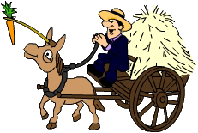


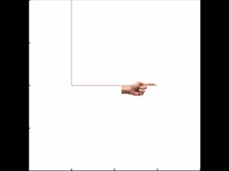
Heteroclinic cycle (central pattern generator)
Descending
proprioceptive predictions
action
observation
0.4
0.6
0.8
position (y)
1
1.2
1.4
0
0.2
0.4
0.6
0.8
1
1.2
1.4
0
0.2
0.4
0.6
0.8
1
1.2
1.4
position (x)
position (x)

Slide 27
Hermann von Helmholtz
“Each movement we make by which we alter the appearance of objects should be thought of as an experiment designed to test whether we have understood correctly the invariant relations of the phenomena before us, that is, their existence in definite spatial relations.”
‘he Facts of Perception’(1878) in The Selected Writings of Hermann von Helmholtz, Ed. R. Karl, Middletown: Wesleyan University Press, 1971 p. 384

Slide 28
Thank you
And thanks to collaborators:
Rick Adams
Andre Bastos
Sven Bestmann
Harriet Brown
Jean Daunizeau
Mark Edwards
Xiaosi Gu
Lee Harrison
Stefan Kiebel
James Kilner
Jérémie Mattout
Rosalyn Moran
Will Penny
Lisa Quattrocki Knight
Klaas Stephan
And colleagues:
Andy Clark
Peter Dayan
Jörn Diedrichsen
Paul Fletcher
Pascal Fries
Geoffrey Hinton
James Hopkins
Jakob Hohwy
Henry Kennedy
Paul Verschure
Florentin Wörgötter
And many others

Slide 29
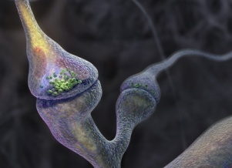
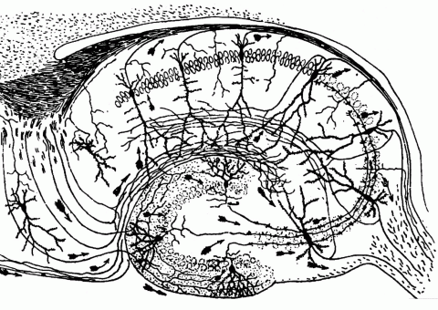
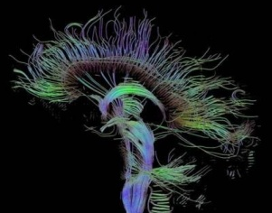
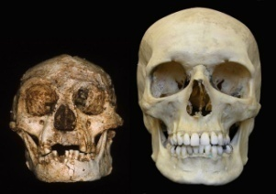
Time-scale
Free-energy minimisation leading to…
Perception and Action: The optimisation of neuronal and neuromuscular activity to suppress prediction errors (or free-energy) based on generative models of sensory data.
Learning and attention: The optimisation of synaptic gain and efficacy over seconds to hours, to encode the precisions of prediction errors and causal structure in the sensorium. This entails suppression of free-energy over time.
Neurodevelopment: Model optimisation through activity-dependent pruning and maintenance of neuronal connections that are specified epigenetically
Evolution: Optimisation of the average free-energy (free-fitness) over time and individuals of a given class (e.g., conspecifics) by selective pressure on the epigenetic specification of their generative models.

Slide 30


Searching to test hypotheses – life as an efficient experiment
Free energy principle
minimise uncertainty

