Slide 1
DCM for Time Frequency
Will Penny
Wellcome Trust Centre for Neuroimaging,
University College London, UK
SPM MEG/EEG Course, Oct 27, 2009

Slide 2
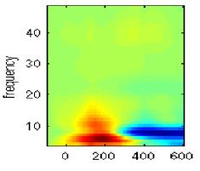
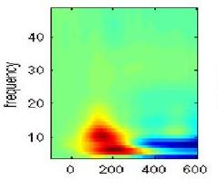
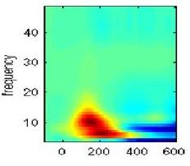
DCM for Induced Responses
Region 1
Region 2
?
?
Relate change of power
in one region and frequency
to change in power in others.
How does slow activity
in one region affect
fast activity in another ?
Region 3

Slide 3
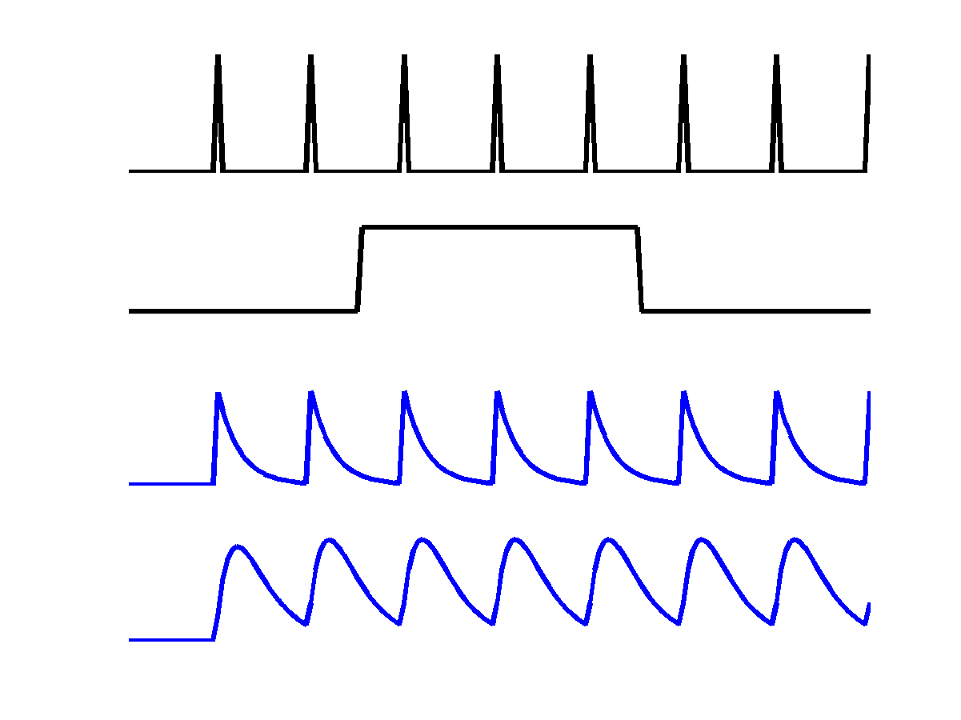
Single region
DCM for fMRI
u₁
c
a₁₁
u₁
z₁
u₂
z₁
z₂

Slide 4
Multiple regions
u₁
c
a₁₁
u₁
z₁
u₂
a₂₁
z₁
z₂
z₂
a₂₂

Slide 5
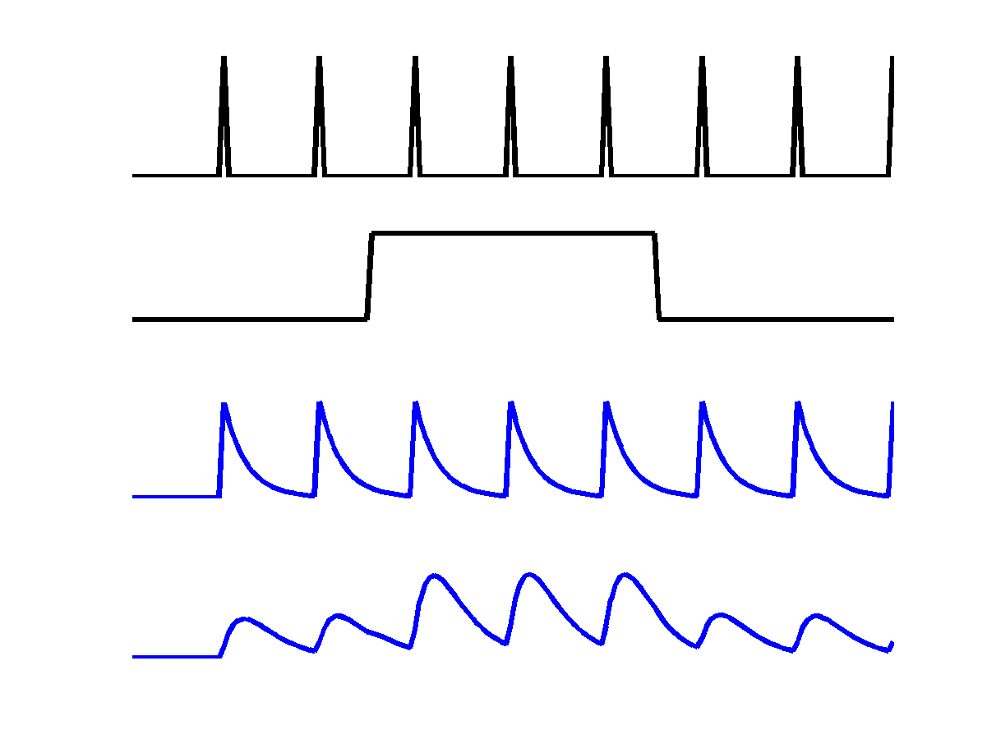
Modulatory inputs
u₁
u₂
c
a₁₁
u₁
z₁
u₂
b₂₁
a₂₁
z₁
z₂
z₂
a₂₂

Slide 6
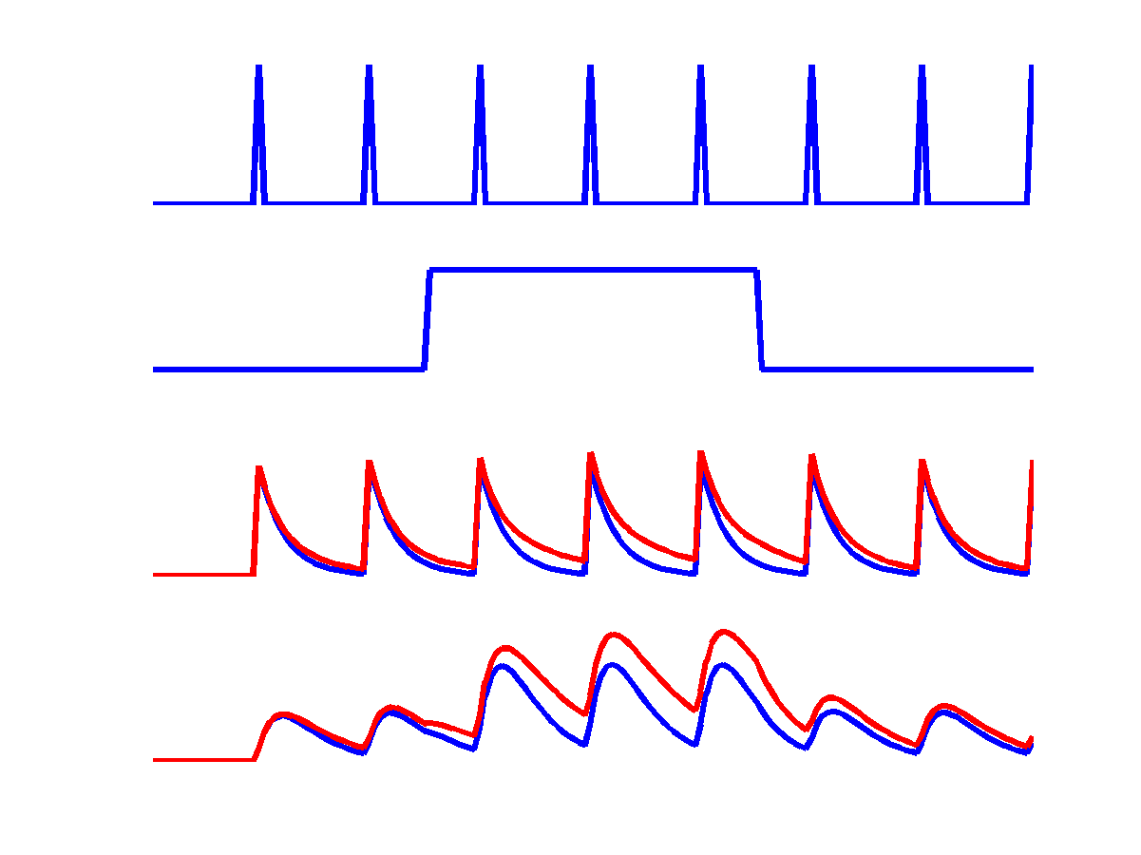
Reciprocal connections
u₁
u₂
c
a₁₁
u₁
z₁
u₂
a₁₂
b₂₁
a₂₁
z₁
z₂
z₂
a₂₂

Slide 7
DCM for induced responses
Single Region
dg(t)/dt=Ag(t)+Cu(t)
Where g(t) is a K x 1 vector of spectral responses
A is a K x K matrix of frequency coupling parameters
Diagonal elements of A (linear – within freq)
Off diagonal (nonlinear – between freq)
Also allow A to be changed by experimental condition

Slide 8
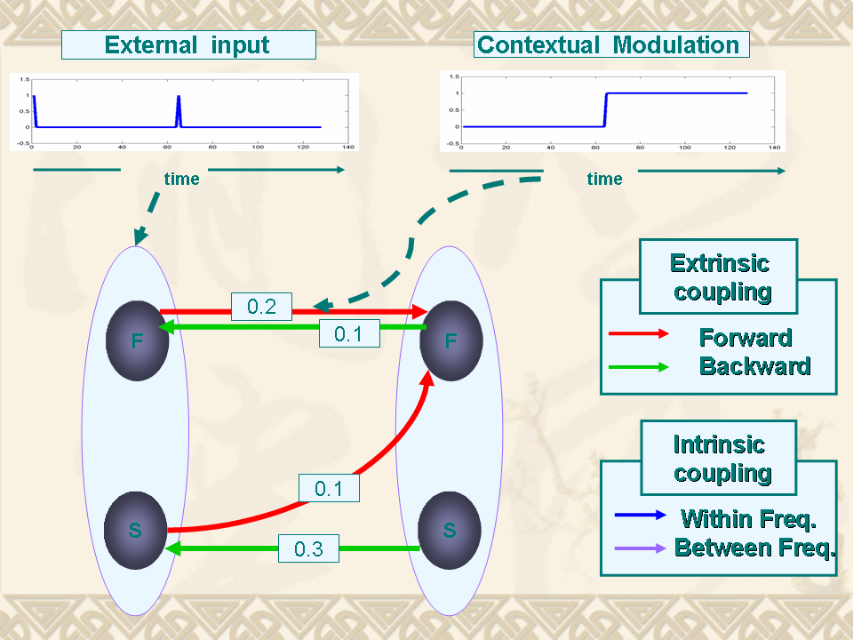
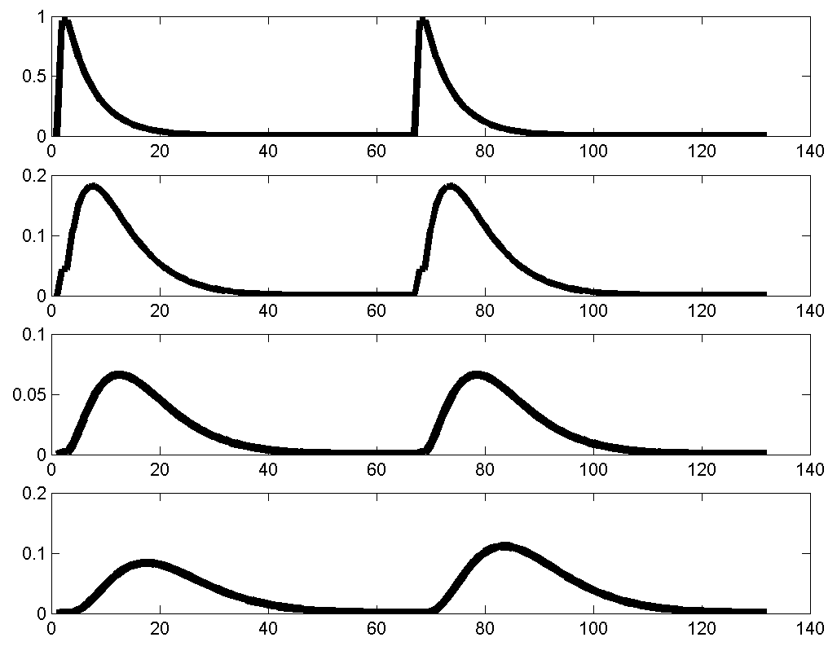
DCM for induced responses
Specify the DCM:
2 areas (A1 and A2)
2 frequencies (F and S)
2 inputs (Ext. and Con.)
Extrinsic and intrinsic coupling
Integrate
the state equations
A1
A2

Slide 9
Differential equation model for spectral energy
Intrinsic (within-source) coupling
Extrinsic (between-source) coupling
Linear (within-frequency) coupling
How frequency K in
region j affects
frequency 1 in region i
Nonlinear (between-frequency) coupling

Slide 10
Modulatory connections
state equation
Intrinsic (within-source) coupling
x
⎡
A
A
⎤
⎡
B
B
⎤
⎡
C
⎤
.
&
L
L
1
⎢
11
1
J
⎥
∑
⎢
11
1
J
⎥
⎢
1
⎥
x
(
W, t
)
=
M
=
⎢
M
O
M
⎥
+
u
(
t
)
⎢
M
O
M
⎥
x
(
w
,
t
)
+
u
(
t
)
⎢
M
⎥
x
⎢
A
A
⎥
⎢
B
B
⎥
⎢
C
⎥
&
⎣
K
⎦
⎣
K
⎦
⎣
⎦
J
J
1
JJ
J
1
JJ
J
Extrinsic (between-source) coupling

Slide 11
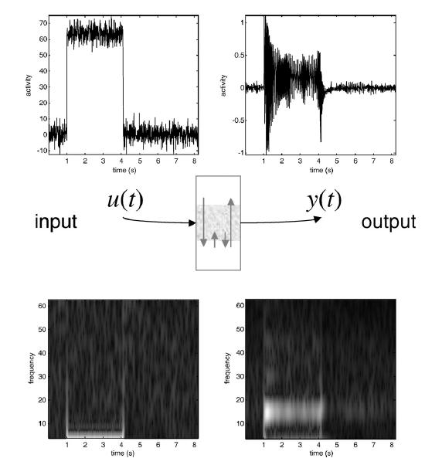
Connection to Neurobiology
First and
Second order
Volterra kernels
From Neural
Mass model.
Strong
(saturating)
input leads to
cross-frequency
coupling

Slide 12
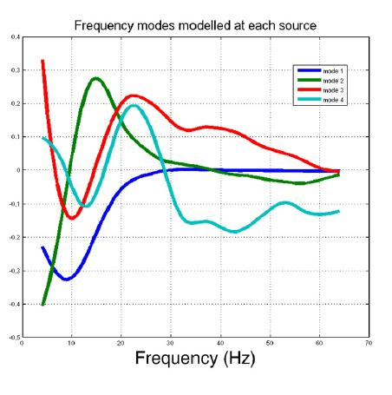
Use of Frequency Modes
Single Region
G=USV’
Where G is a K’ x T spectrogram
U is K’xK matrix with K frequency modes
V is K’ x T and contains spectral mode responses
Hence A is only K x K, not K’ x K’

Slide 13
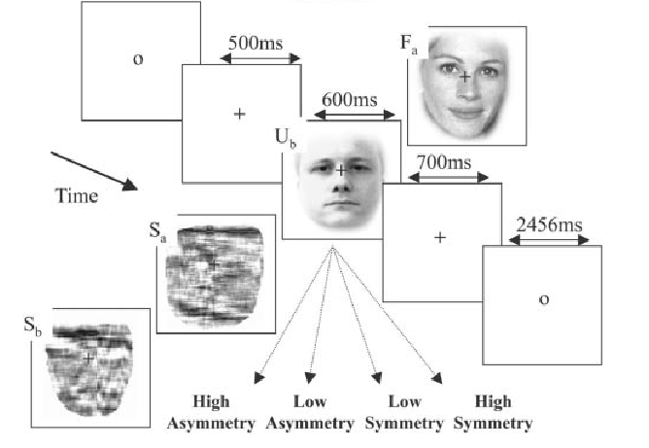
MEG Data

Slide 14
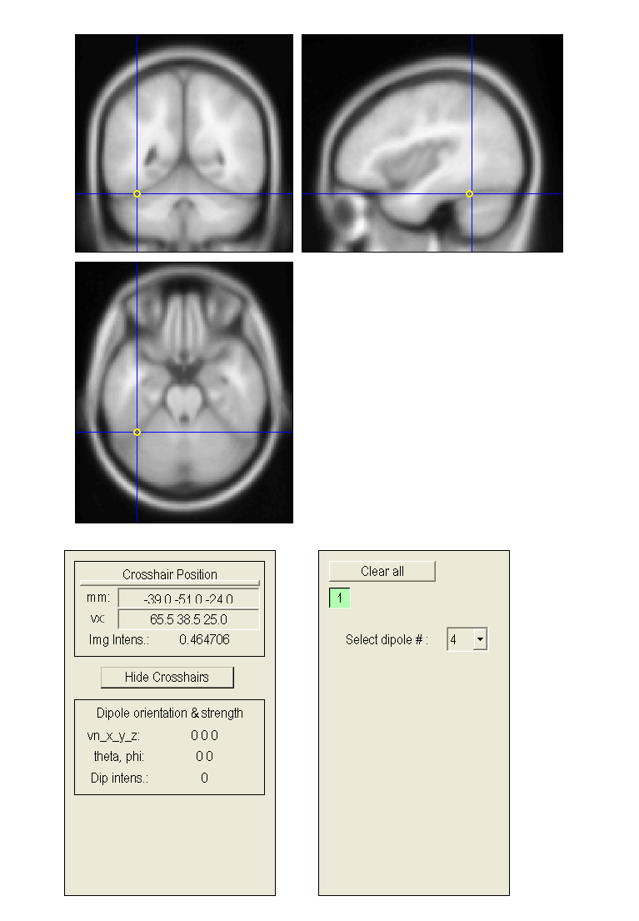
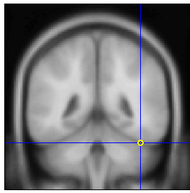
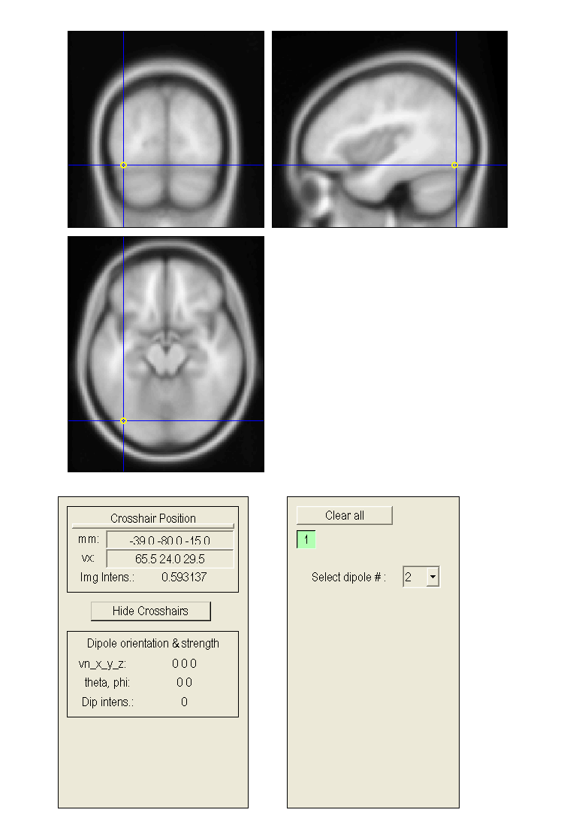
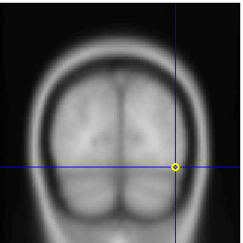
The “core” system
FFA
FFA
OFA
OFA
input

Slide 15
Forward
linear
nonlinear
linear
F_{L}B_{L}
F_{N}B_{L}
nonlinear (and linear)
linear
Backward
nonlinear
F_{L}N_{B}
F_{N}B_{N}
F_{L}B_{L}
F_{N}B_{L}
F_{L}B_{N}
F_{N}B_{N}
FFA
FFA
FFA
FFA
FFA
FFA
FFA
FFA
OFA
OFA
OFA
OFA
OFA
OFA
OFA
OFA
Input
Input
Input
Input

Slide 16
Inference on model I
Both forward and backward connections are nonlinear
F_{L}B_{L}
F_{N}B_{L}
F_{L}B_{N}
*F_{N}B_{N}
1000
backward linear
backward nonlinear
0
0
-10000
-1000
-16308
-16306
-11895
-2000
-20000
-3000
-30000
-4000
-40000
-5000
-6000
forward linear
-50000
forward nonlinear
-7000
-60000
-59890
-8000
-70000

Slide 17
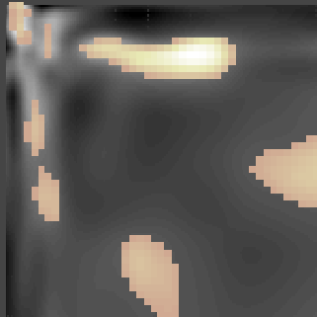
Gamma affects Alpha
Left forward – excitatory -- activating effect of gamma- alpha coupling in the forward connections
Right backward - inhibitory -- suppressive effect of gamma- alpha coupling in backward connections
SPM t df 72; FWHM 7.8 x 6.5 Hz
0.1
0.1
4 12 20 28 36 44
0.08
0.08
0.06
0.06
0.04
0.04
0.02
0.02
Frequency (Hz)
0
0
44 36 28 20 12 4
-0.02
-0.02
-0.04
-0.04
-0.06
Forward Backward
-0.06
Forward Backward
-0.08
-0.08
-0.1
Left hemisphere
-0.1
Right hemisphere
From 32 Hz (gamma) to 10 Hz (alpha)
t = 4.72; p = 0.002

Slide 18
“Gamma activity in input areas induces slower
dynamics in higher areas as prediction error is accumulated. Nonlinear coupling in high-level area induces gamma activity in that higher area which then accelerates the decay of activity in the lower level. This decay is manifest as damped alpha oscillations.”
C.C. Chen , S. Kiebel, KJ Friston , Dynamic causal modelling of induced responses. NeuroImage, 2008; (41):1293-1312.
C.C. Chen, R.N. Henson, K.E. Stephan, J.M. Kilner, and K.J. Friston1. Forward and backward connections in the brain: A DCM study of functional asymmetries in face processing. NeuroImage, 2009 Apr 1;45(2):453-62

Slide 19
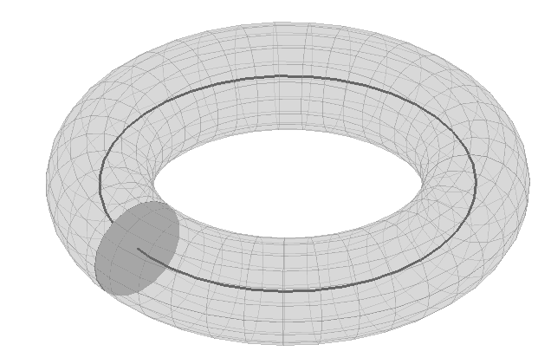
DCM for Phase Coupling
For studying synchronization among brain regions
Relate change of phase in one region to phase in others
Region 1
Region 2
?
?
Region 3

Slide 20
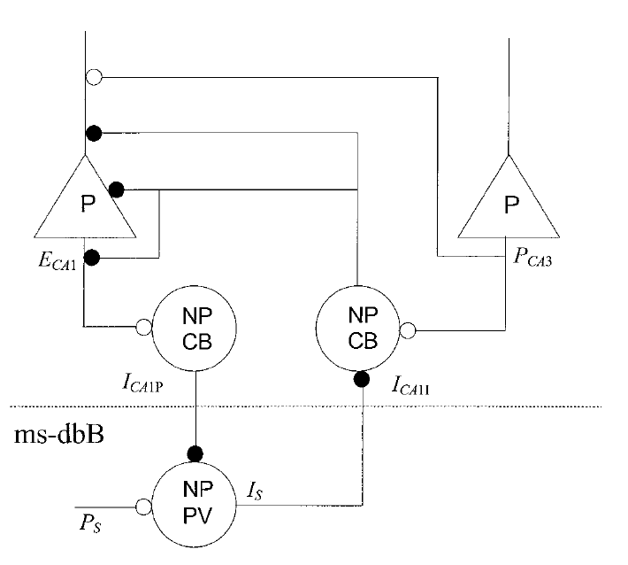
Connection to Neurobiology:
Septo-Hippocampal theta rhythm
Denham et al. 2000:
Hippocampus
Septum
Wilson-Cowan style model

Slide 21
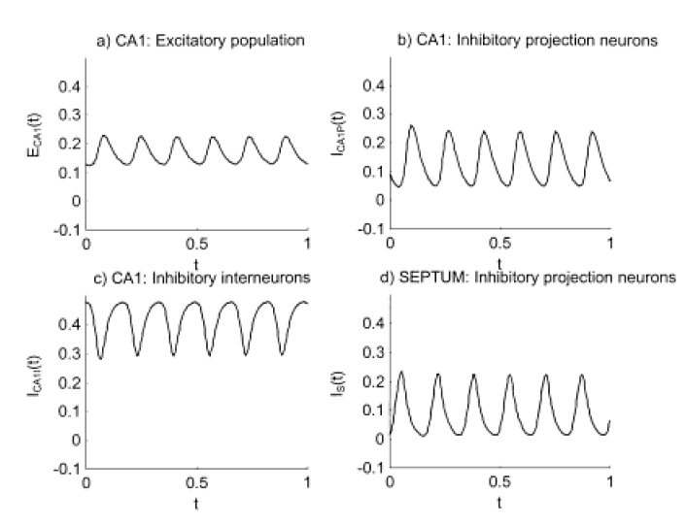

Slide 22
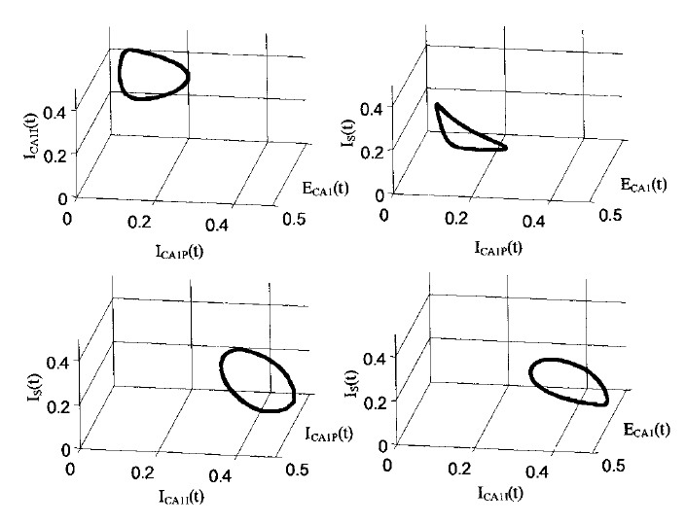
Four-dimensional state space

Slide 23
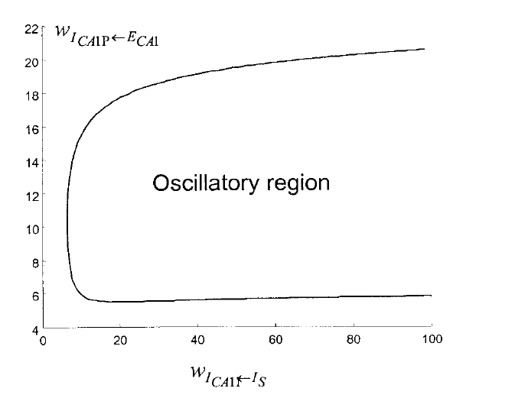
Hopf Bifurcation
Hippocampus
A
B
Septum
A
B

Slide 24
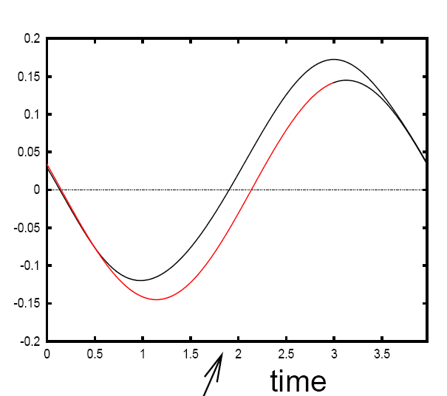
For a generic Hopf bifurcation (Erm & Kopell…)
See Brown et al. 04, for PRCs corresponding to other bifurcations

Slide 25
DCM for Phase Coupling

Slide 26
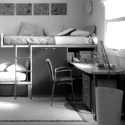
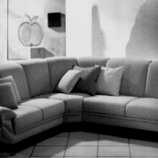
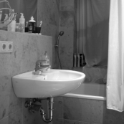
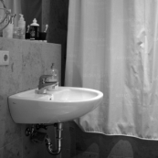
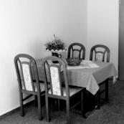
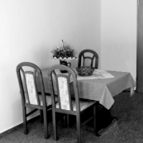
MEG Example Fuentemilla et al 09
1) No retention (control condition): Discrimination task
+
2) Retention I (Easy condition): Non-configural task
+
3) Retention II (Hard condition): Configural task
+
1 sec
3 sec
5 sec
5 sec
ENCODING
MAINTENANCE
PROBE

Slide 27
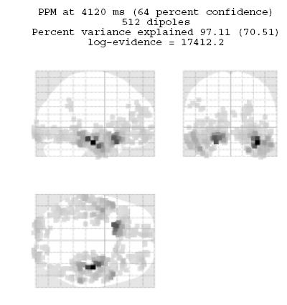
Delay activity (4-8Hz)

Slide 29
Questions
Duzel et al. find different patterns of theta-coupling in the delay period
dependent on task.
Pick 3 regions based on [previous source reconstruction]
1. Right MTL [27,-18,-27] mm
2. Right VIS [10,-100,0] mm
3. Right IFG [39,28,-12] mm
Fit models to control data (10 trials) and hard data (10 trials). Each trial
comprises first 1sec of delay period.
Find out if structure of network dynamics is Master-Slave (MS) or
(Partial/Total) Mutual Entrainment (ME)
Which connections are modulated by (hard) memory task ?

Slide 30
Data Preprocessing
Source reconstruct activity in areas of interest (with fewer sources than
sensors and known location, then pinv will do; Baillet 01)
Bandpass data into frequency range of interest
Hilbert transform data to obtain instantaneous phase
Use multiple trials per experimental condition

Slide 31
MTL Master
VIS Master
IFG Master
1
IFG
VIS
3
IFG
VIS
5
IFG
VIS
Master-
Slave
MTL
MTL
MTL
2
IFG
VIS
4
IFG
VIS
6
IFG
VIS
Partial
Mutual
Entrainment
MTL
MTL
MTL
7
IFG
VIS
Total
Mutual
Entrainment
MTL

Slide 32
LogEv
Model

Slide 33
0.77
2.46
IFG
VIS
0.89
2.89
MTL

Slide 34
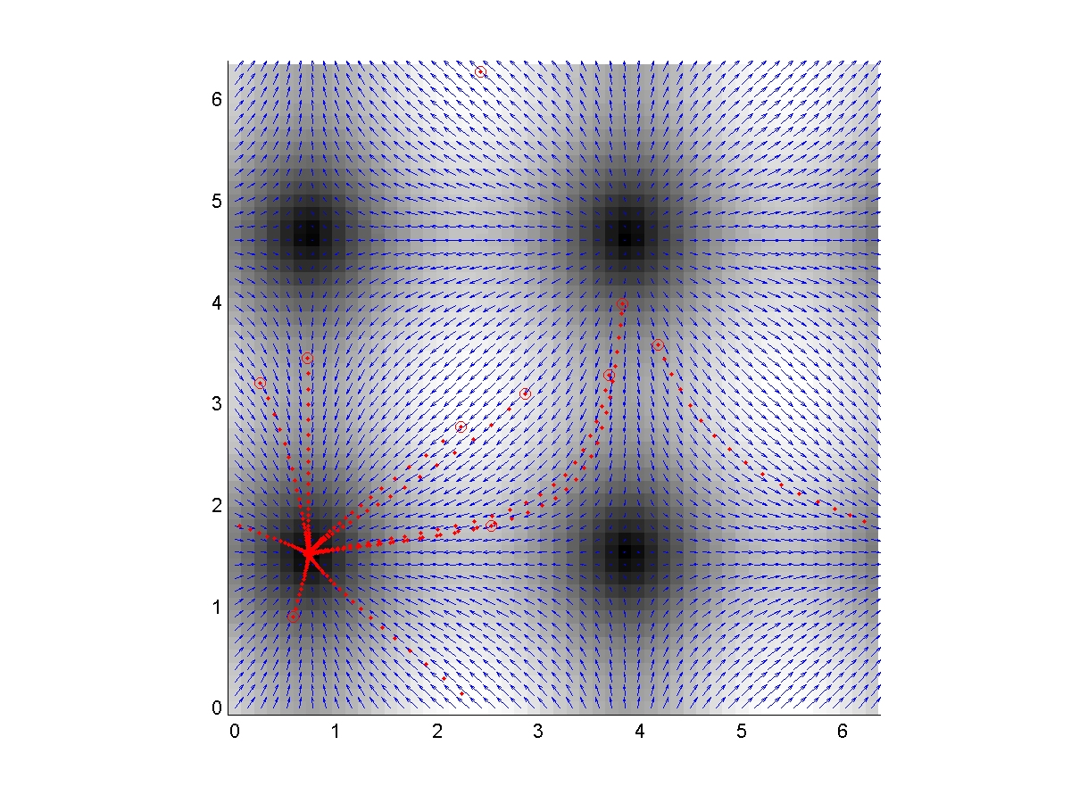
Control
φ_{IFG}-φ_{VIS}
φ_{MTL}-φ_{VIS}

Slide 35
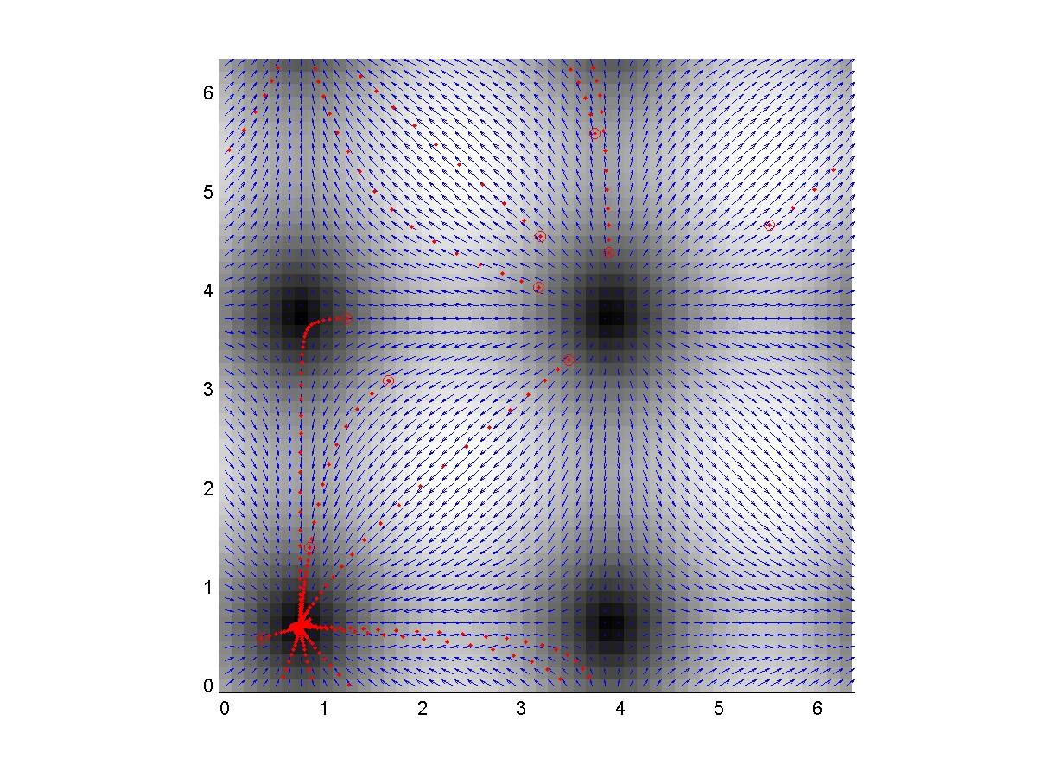
Memory
φ_{IFG}-φ_{VIS}
φ_{MTL}-φ_{VIS}

Slide 36
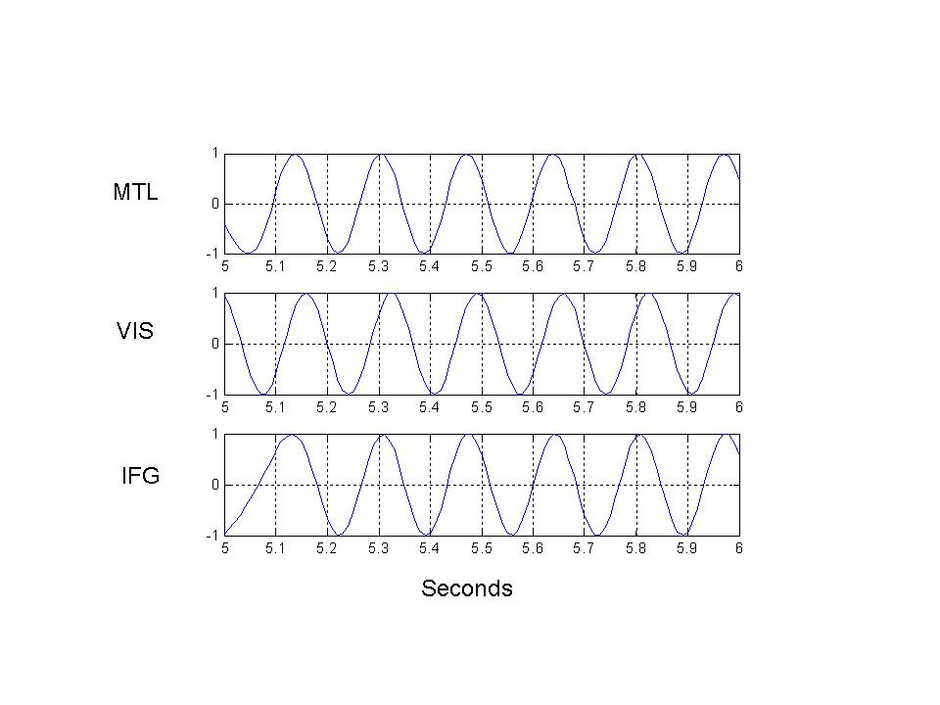

Slide 37
