Slide 1
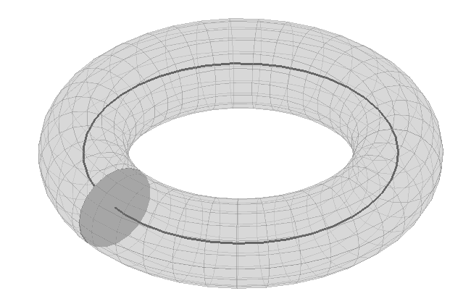
Dynamic Phase Coupling
For studying synchronization among brain regions
Relate change of phase in one region to phase in others
Region 1
Region 2
?
?
Phase
Interaction
Function
Region 3

Slide 2
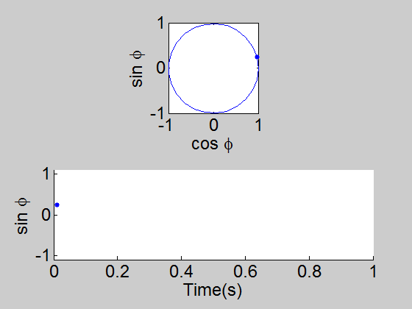
One Oscillator

Slide 3
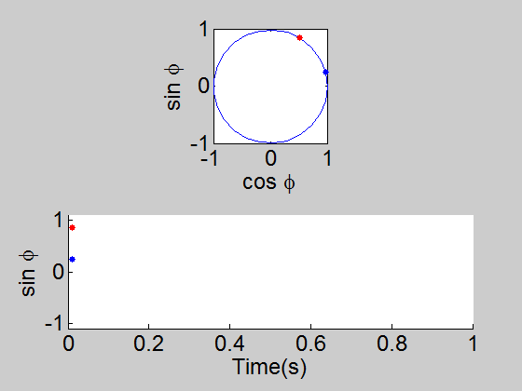
Two Oscillators

Slide 4

Two Coupled Oscillators
0.3

Slide 5
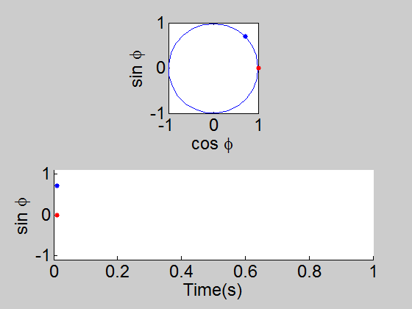
Different initial phases
0.3

Slide 6
Stronger coupling
0.6

Slide 7
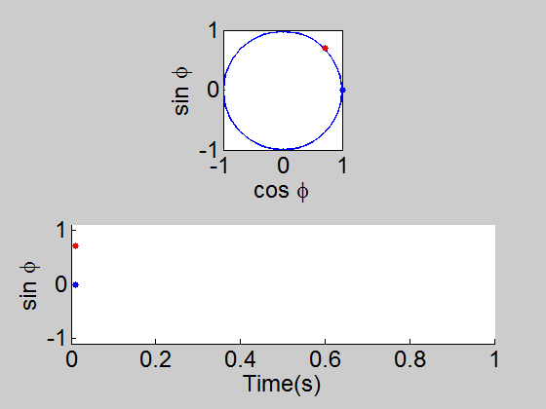
Bidirectional coupling
0.3
0.3

Slide 8
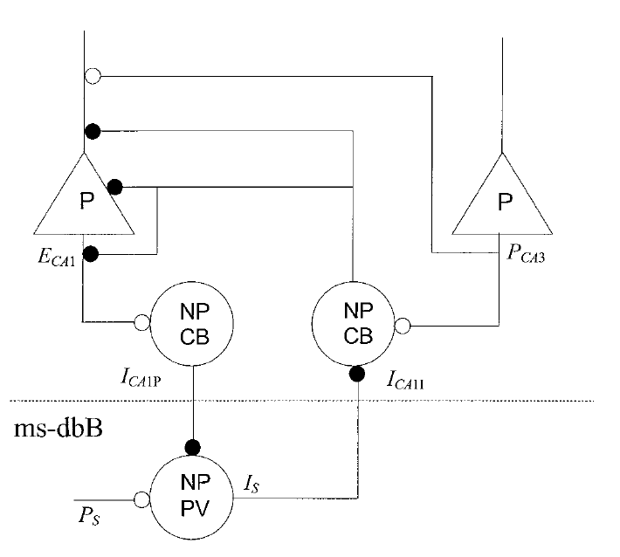
Connection to Neurobiology:
Septo-Hippocampal theta rhythm
Denham et al. 2000:
Hippocampus
Septum
Wilson-Cowan style model

Slide 9
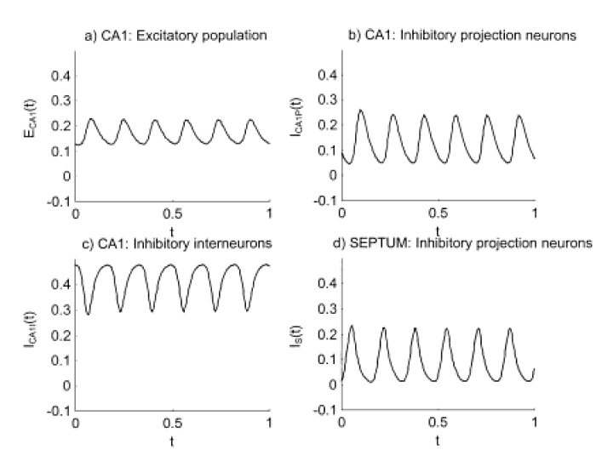

Slide 10
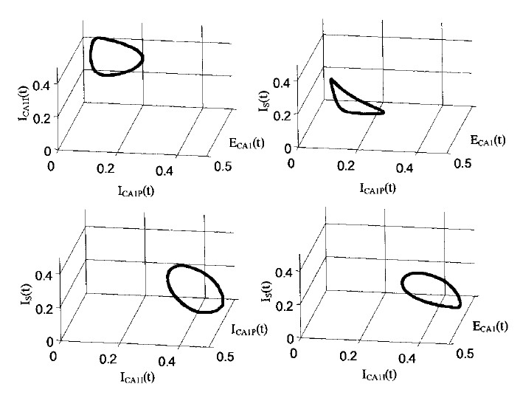
Four-dimensional state space

Slide 11
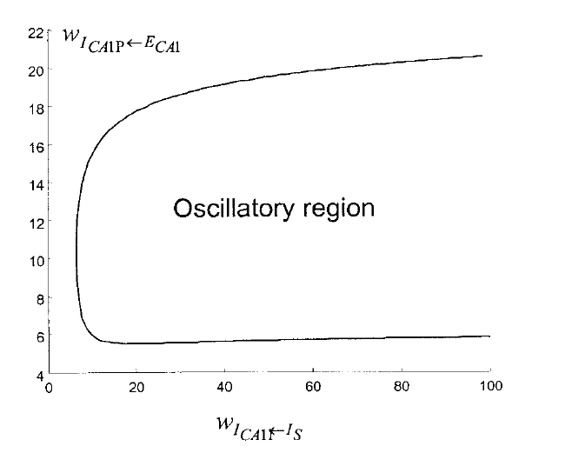
Hopf Bifurcation
Hippocampus
A
B
Septum
A
B

Slide 12
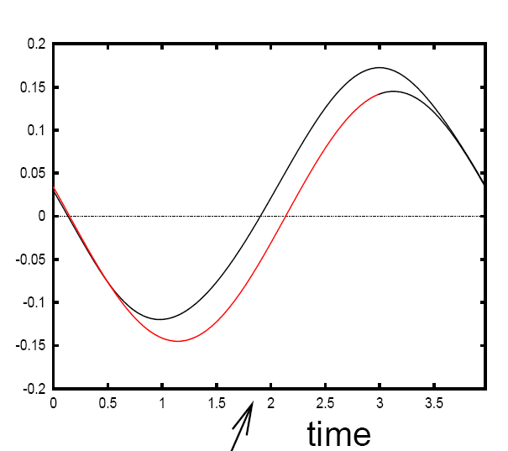
For a generic Hopf bifurcation (Ermentrout, Mathemat. Neurosci, 2010)
See Brown et al. 04, for PRCs corresponding to other bifurcations

Slide 13
Dynamic Phase Coupling Model

Slide 14
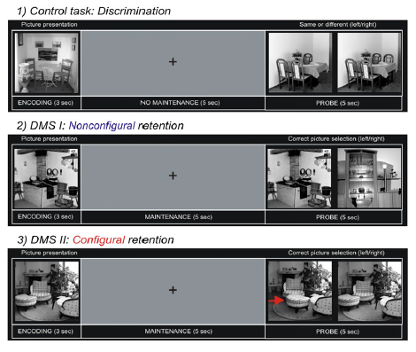

Slide 15
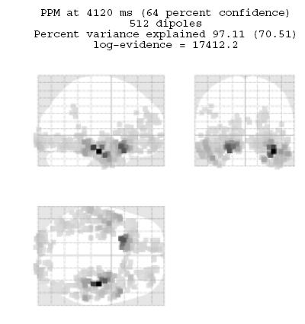
Delay activity (4-8Hz)

Slide 16
Questions
Duzel et al. find different patterns of theta-coupling in the delay period
dependent on task.
Pick 3 regions based on [previous source reconstruction]
1. Right MTL [27,-18,-27] mm
2. Right VIS [10,-100,0] mm
3. Right IFG [39,28,-12] mm
Fit models to control data (10 trials) and hard data (10 trials). Each trial
comprises first 1sec of delay period.
Find out if structure of network dynamics is Master-Slave (MS) or
(Partial/Total) Mutual Entrainment (ME)
Which connections are modulated by (hard) memory task ?

Slide 17
Data Preprocessing
Source reconstruct activity in areas of interest (with fewer sources than
sensors and known location, then pinv will do; Baillet 01)
Bandpass data into frequency range of interest
Hilbert transform data to obtain instantaneous phase
Use multiple trials per experimental condition

Slide 18
MTL Master
VIS Master
IFG Master
1
IFG
VIS
3
IFG
VIS
5
IFG
VIS
Master-
Slave
MTL
MTL
MTL
2
IFG
VIS
4
IFG
VIS
6
IFG
VIS
Partial
Mutual
Entrainment
MTL
MTL
MTL
7
IFG
VIS
Total
Mutual
Entrainment
MTL
See also Rosa et al. Post-hoc Model Selection, J. Neurosci. Meth. 2011

Slide 19
When comparing two models, a posterior probability of 0.95 corresponds
to a Bayes factor of 20. Or log Bayes factor of 3.
LogEv
Model
See also Random Effects Bayesian Model Inference to look for consistency
of model selection in a group of subjects (Stephan, Neuroimage, 2009).

Slide 20
Summary
Statistical Parametric Mapping
Multivariate Analysis
Connectivity Modelling
Role of Oscillations in Memory
http://www.fil.ion.ucl.ac.uk/~wpenny

Slide 21
Thank you to
Wellcome Trust
Kai Miller (WashU)
Emrah Duzel (UCL)
Gareth Barnes (UCL)
Lluis Fuentemilla (UCL)
Vladimir Litvak (UCL)
STAMLIN organisers !

Slide 22
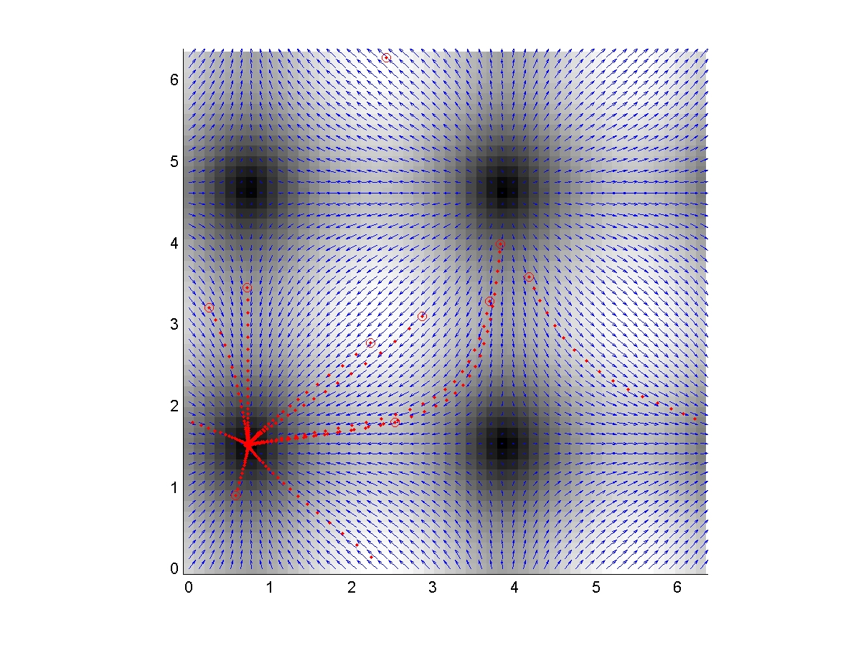
Control
φ_{IFG}-φ_{VIS}
φ_{MTL}-φ_{VIS}

Slide 23
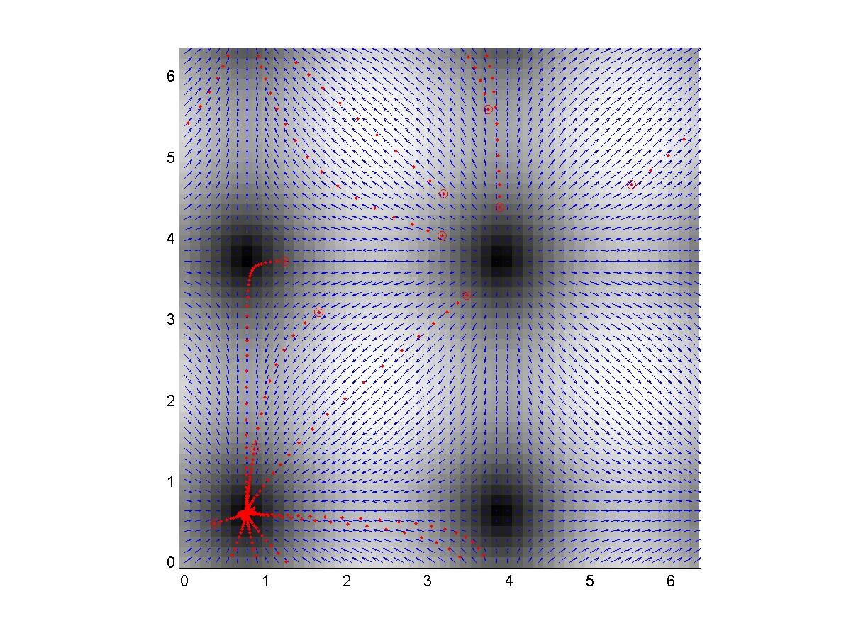
Memory
φ_{IFG}-φ_{VIS}
φ_{MTL}-φ_{VIS}

Slide 24
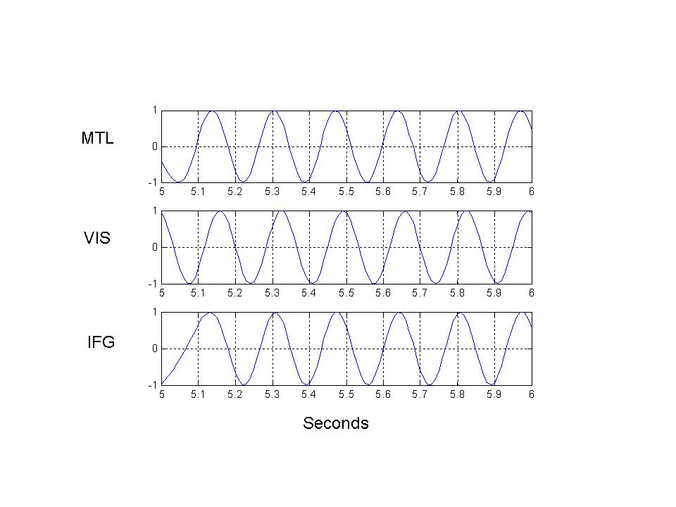

Slide 25
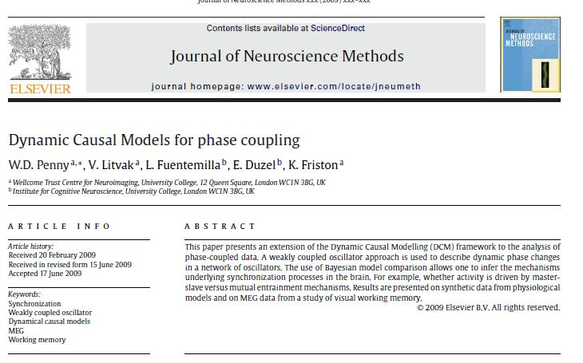

Slide 26
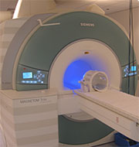
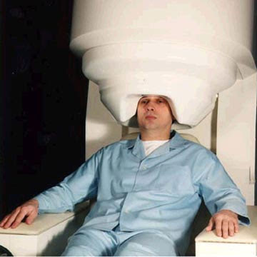
MRI
MEG

