Slide 1
Weakly Coupled Oscillators
Will Penny
Wellcome Trust Centre for Neuroimaging,
University College London, UK
IMN Workshop on Interacting with Brain Oscillations,
33 Queen Square, London. Friday 12th March 2010

Slide 2
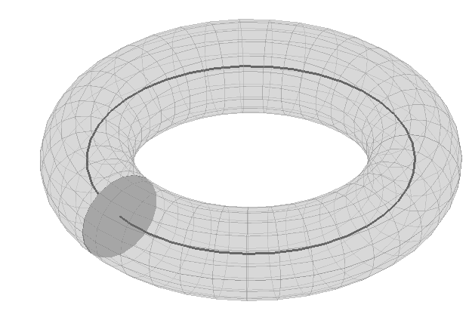
For studying synchronization among brain regions
Relate change of phase in one region to phase in others
Region 1
Region 2
?
?
Region 3

Slide 3
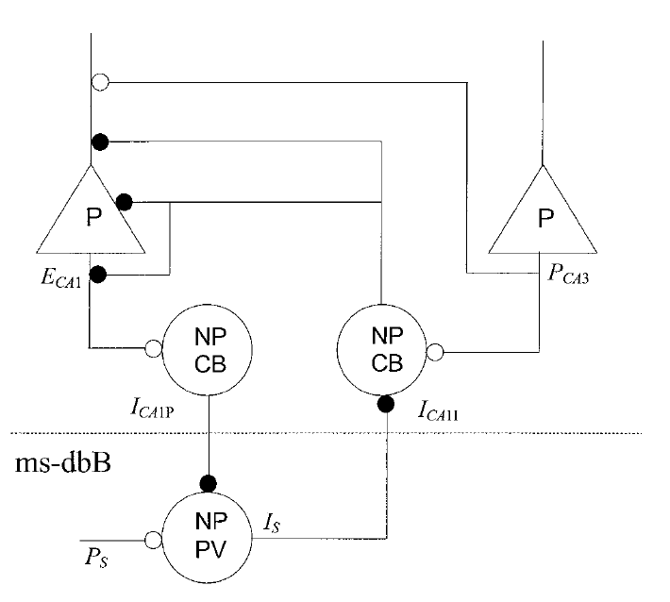
Connection to Neurobiology:
Septo-Hippocampal theta rhythm
Denham et al. Hippocampus. 2000:
Hippocampus
Septum
Wilson-Cowan style model

Slide 4
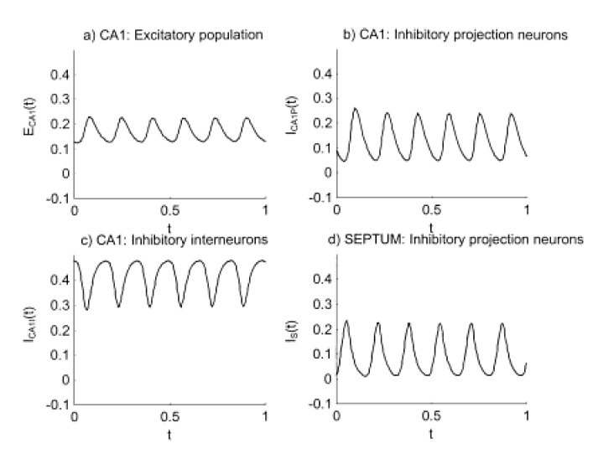

Slide 5
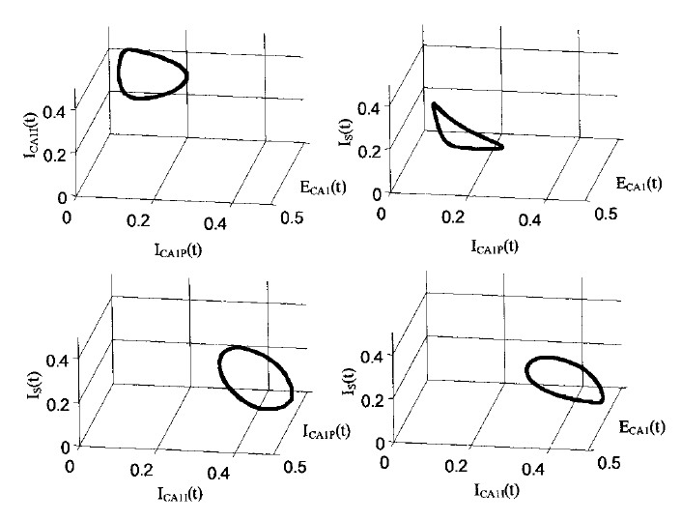
Four-dimensional state space

Slide 6
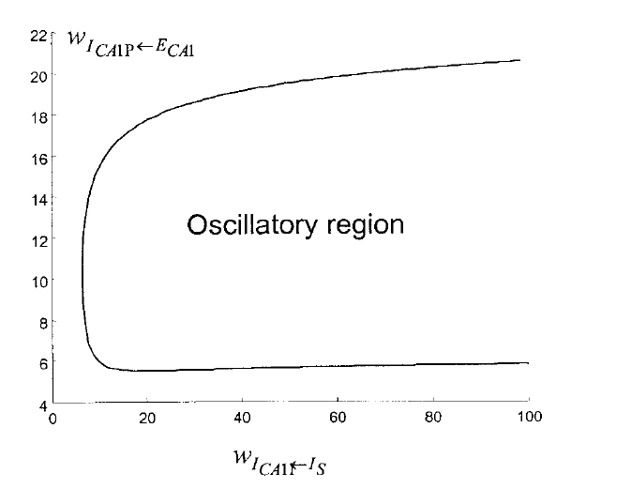
Hopf Bifurcation
Hippocampus
A
B
Septum
A
B

Slide 7
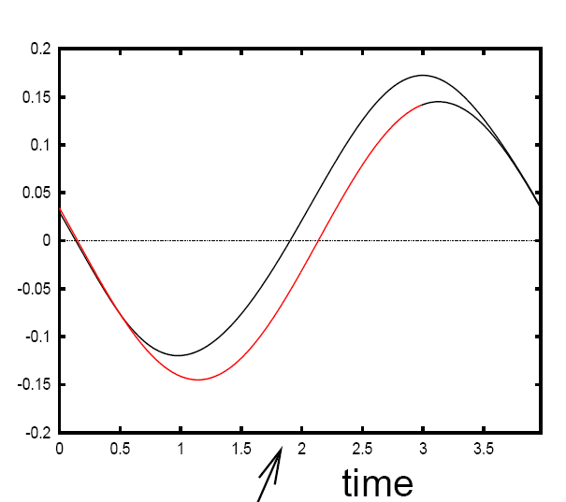
For a generic Hopf bifurcation (Ermentrout & Kopell, SIAM Appl Math, 1990)
See Brown et al. Neural Computation, 2004 for PRCs corresponding to other bifurcations

Slide 8
DCM for Phase Coupling – SPM8

Slide 9
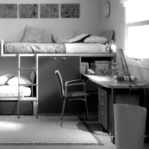
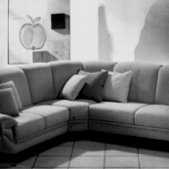
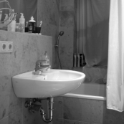
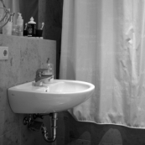
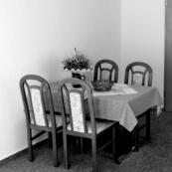
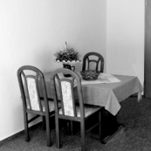
MEG Example Fuentemilla et al, Current Biology, 2009
1) No retention (control condition): Discrimination task
+
2) Retention I (Easy condition): Non-configural task
+
3) Retention II (Hard condition): Configural task
+
1 sec
3 sec
5 sec
5 sec
ENCODING
MAINTENANCE
PROBE

Slide 10
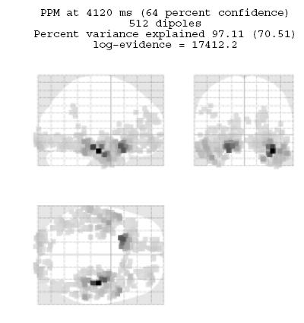
Delay activity (4-8Hz)
Friston et al. Multiple Sparse Priors. Neuroimage, 2008

Slide 11
Difference in theta power between conditions

Slide 12
Questions
Duzel et al. find different patterns of theta-coupling in the delay period
dependent on task.
Pick 3 regions based on [previous source reconstruction]
1. Right MTL [27,-18,-27] mm
2. Right VIS [10,-100,0] mm
3. Right IFG [39,28,-12] mm
Fit models to control data (10 trials) and hard data (10 trials). Each trial
comprises first 1sec of delay period.
Find out if structure of network dynamics is Master-Slave (MS) or
(Partial/Total) Mutual Entrainment (ME)
Which connections are modulated by (hard) memory task ?

Slide 13
Data Preprocessing
Source reconstruct activity in areas of interest (with fewer sources than
sensors and known location, then pinv will do; Baillet et al, IEEE SP, 2001)
Bandpass data into frequency range of interest
Hilbert transform data to obtain instantaneous phase
Use multiple trials per experimental condition

Slide 14
MTL Master
VIS Master
IFG Master
1
IFG
VIS
3
IFG
VIS
5
IFG
VIS
Master-
Slave
MTL
MTL
MTL
2
IFG
VIS
4
IFG
VIS
6
IFG
VIS
Partial
Mutual
Entrainment
MTL
MTL
MTL
7
IFG
VIS
Total
Mutual
Entrainment
MTL

Slide 15
Bayesian Model Comparison
LogEv
Model
Penny et al, Comparing Dynamic Causal Models, Neuroimage, 2004

Slide 16
Estimated parameter values:
0.77
2.46
IFG
VIS
0.89
2.89
MTL

Slide 17
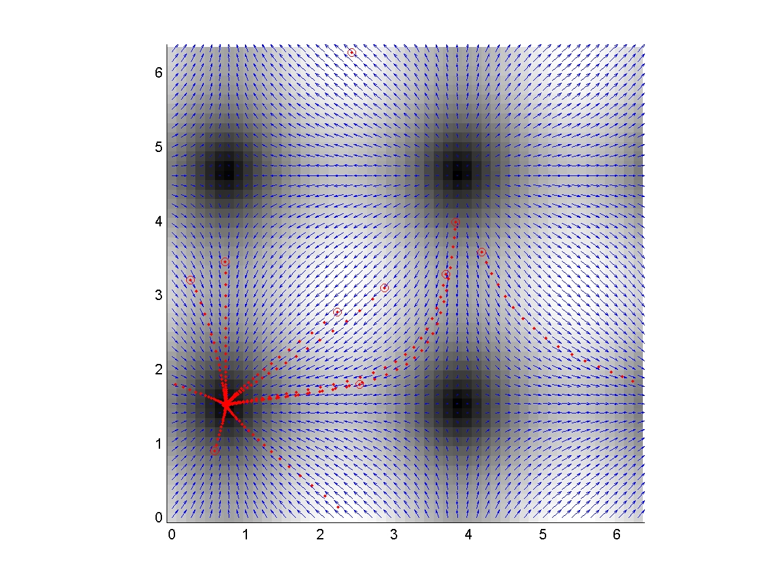
Control
φ_{IFG}-φ_{VIS}
φ_{MTL}-φ_{VIS}

Slide 18
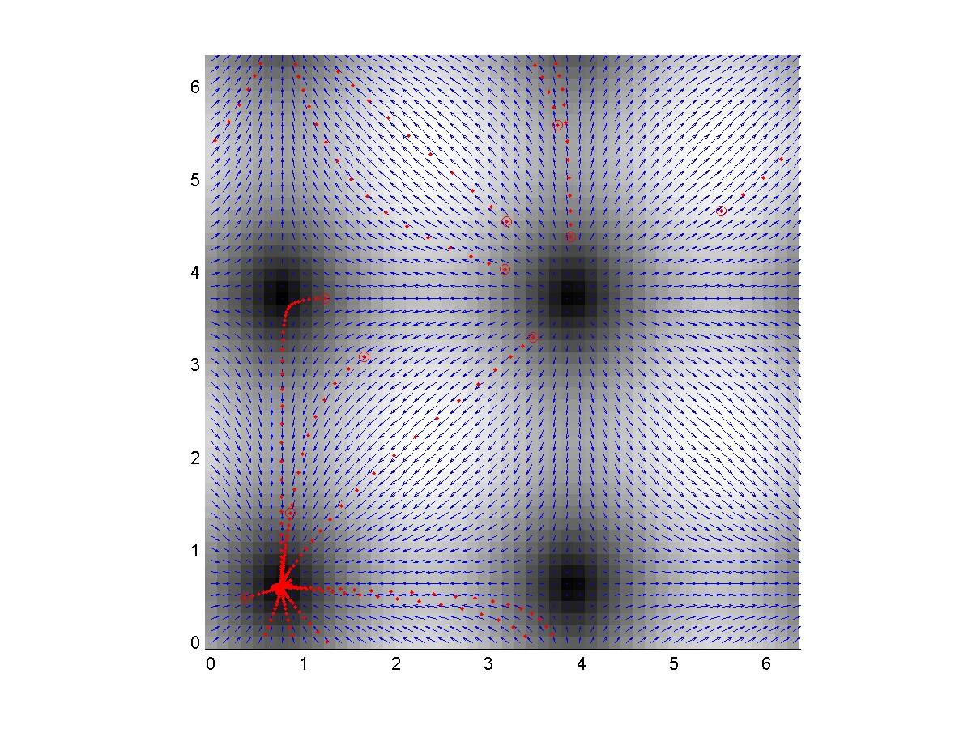
Memory
φ_{IFG}-φ_{VIS}
φ_{MTL}-φ_{VIS}

Slide 19
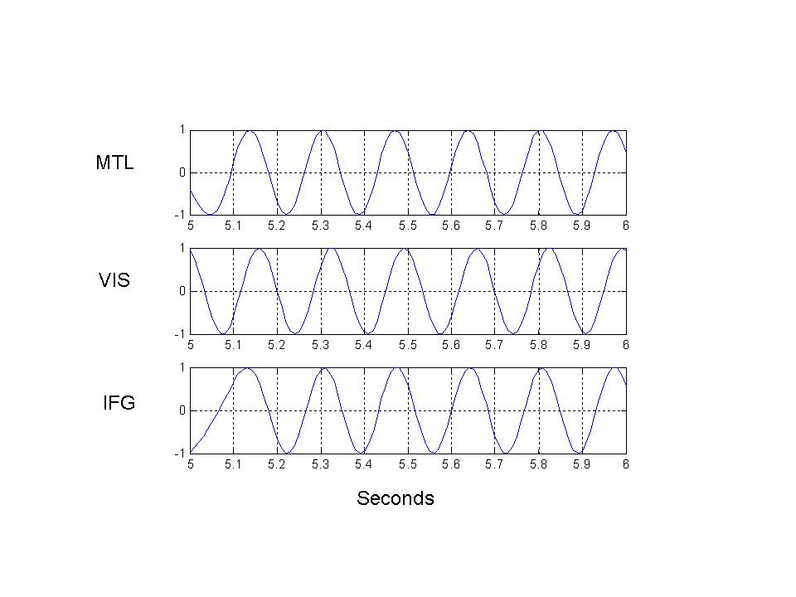
In agreement with spike-LFP recordings by Jones & Wilson, PLoS Biol 2005

Slide 20
