Slide 1
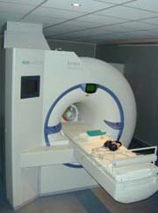
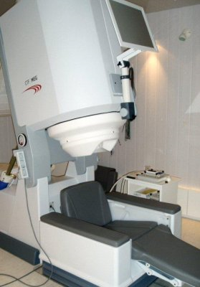
Will Penny
Wellcome Centre for Neuroimaging at UCL
Language
Memory
fMRI
MEG
Attention
Vision
Theoretical
Neurobiology
Emotion
Methods
Physics

Slide 2



Statistical Parametric Mapping (SPM)
Image time-series
Kernel
Design matrix
Statistical parametric map
Realignment
Smoothing
General linear model
Statistical
inference
Random
Field Theory
Normalisation
p <0.05
Template
Parameter estimates

Slide 3
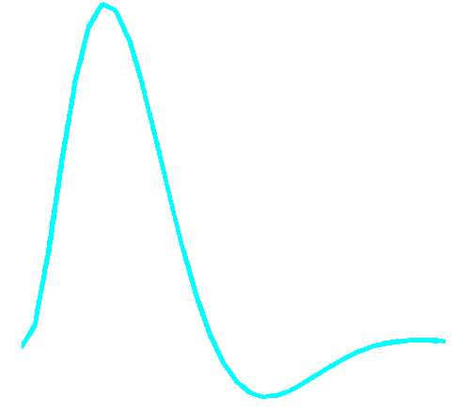
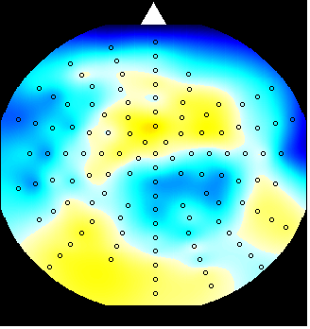
Dynamic Models of Brain Interactions
Hemodynamic
forward model:
neural activity→BOLD
(nonlinear)
Electric/magnetic
forward model:
neural activity→EEG
MEG
LFP
(linear)
Neural state equation:
fMRI
MEG
Neural model:
1 state variable per region
bilinear state equation
no propagation delays
Neural model:
8 state variables per region
nonlinear state equation
propagation delays
inputs

Slide 4
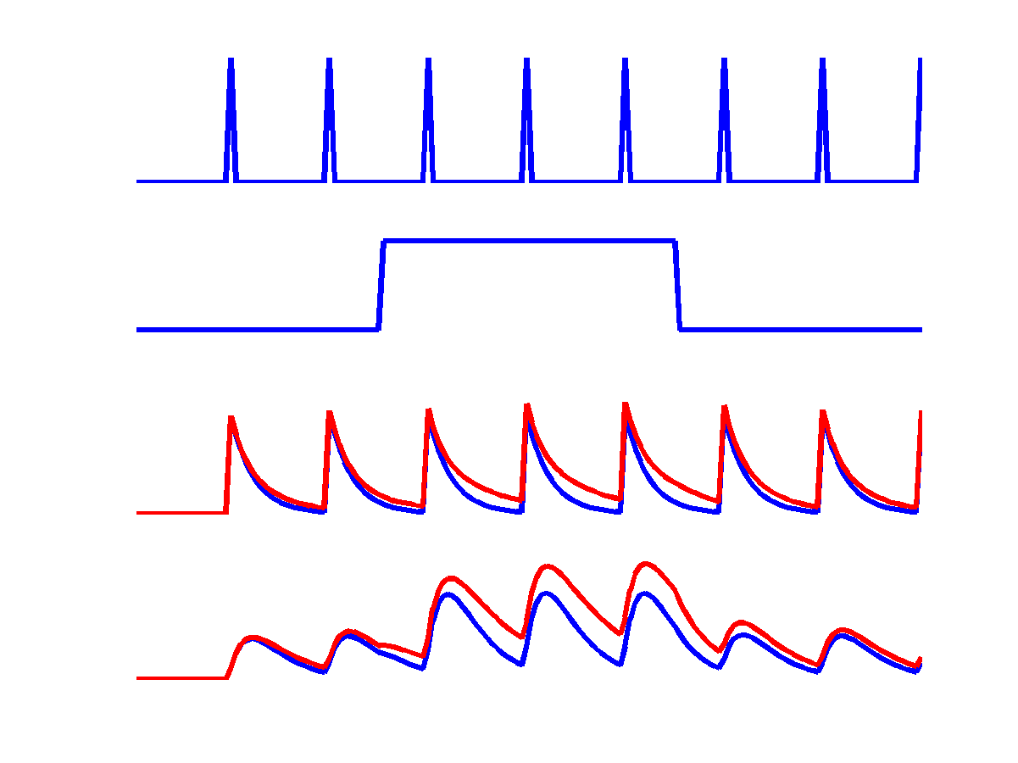
Dynamical Neural Network Model for fMRI
u₁
u₂
c
a₁₁
u₁
z₁
u₂
a₁₂
b₂₁
a₂₁
z₁
z₂
z₂
a₂₂

Slide 5
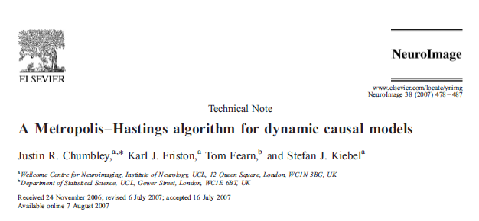
Opportunities
Computer Science
Engineering
Physics
Statistics
UCL CoMPLEX

