Slide 1
Brain Connectivity Inference for fMRI data
Will Penny,
Wellcome Trust Centre for Neuroimaging,
University College London
fNIRS Conference, UCL, 26-28 October 2012

Slide 2
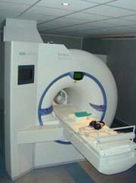
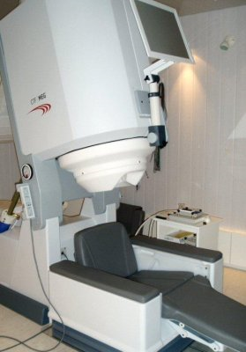
Wellcome Trust Centre for Neuroimaging at UCL
Language
Memory
fMRI
MEG
Attention
Vision
Theoretical
Neurobiology
Emotion
Methods
Physics

Slide 3



Statistical Parametric Mapping (SPM)
Image time-series
Kernel
Design matrix
Statistical parametric map
Realignment
Smoothing
General linear model
Statistical
inference
Random
Field Theory
Normalisation
p <0.05
Template
Parameter estimates

Slide 4
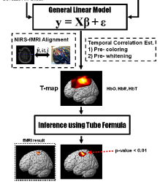
SPM for NIRS
Sungho Tak
Chul Ye et al. Neuroimage (2009)

Slide 5
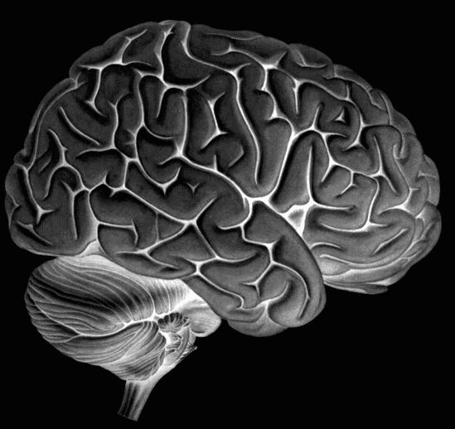
Dynamic Causal Modelling (DCM)
Neural state equation:
inputs

Slide 6
Dynamic Causal Modelling (DCM)
Neural state equation:
MEG
Neural model:
8 state variables per region
nonlinear state equation
propagation delays
inputs

Slide 7
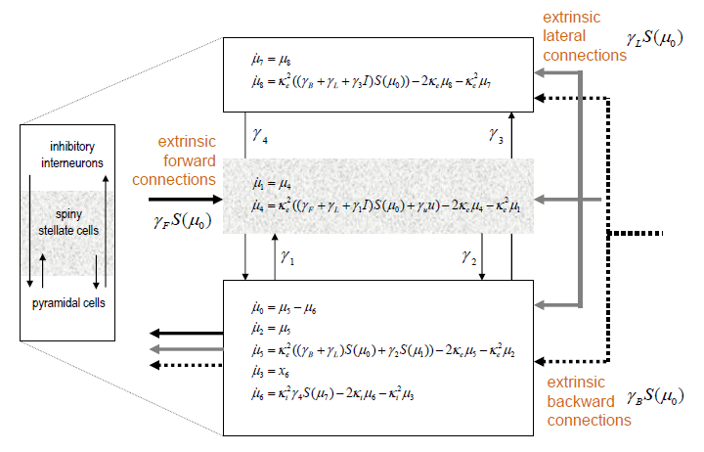
Neuronal Model for EEG/MEG
Jansen & Ritt, Biol Cyb, 1995 David & Friston Neuroimage, 2006

Slide 8
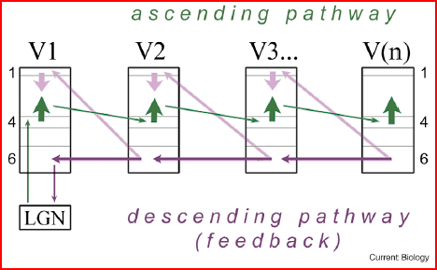
Shipp, Current Biology, 2010

Slide 9
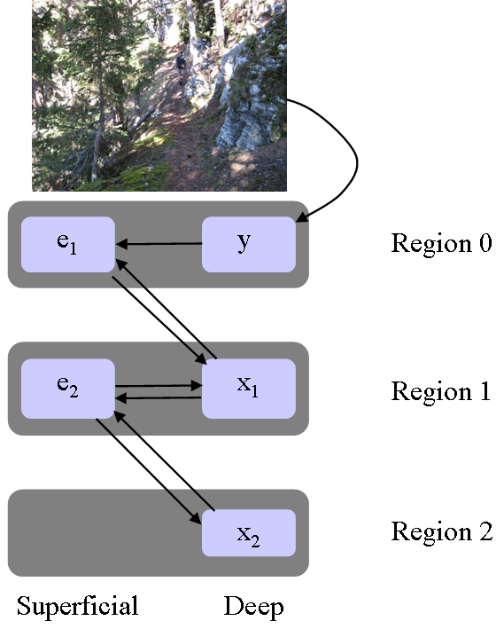
Predictive Coding

Slide 10
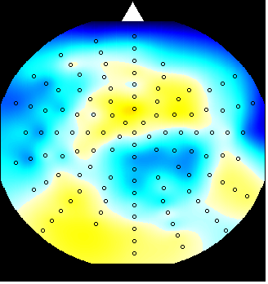
Dynamic Causal Modelling (DCM)
Electric/magnetic
forward model:
neural activity→EEG
MEG
LFP
(linear)
Neural state equation:
MEG
Neural model:
8 state variables per region
nonlinear state equation
propagation delays
inputs

Slide 11
Dynamic Causal Modelling (DCM)
Electric/magnetic
forward model:
neural activity→EEG
MEG
LFP
(linear)
Neural state equation:
fMRI
MEG
Neural model:
1 state variable per region
bilinear state equation
no propagation delays
Neural model:
8 state variables per region
nonlinear state equation
propagation delays
inputs

Slide 12
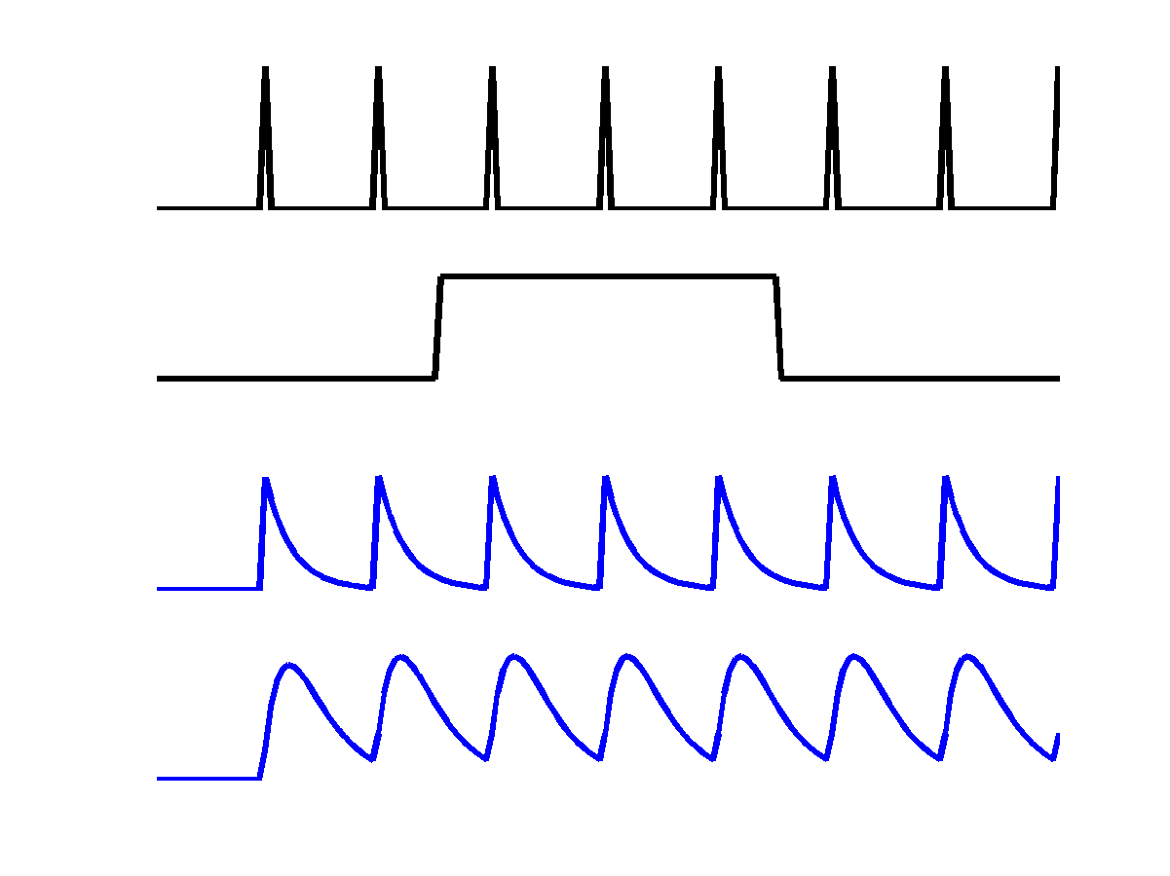
Single region
Neuronal Model for fMRI
u₁
c
a₁₁
u₁
z₁
u₂
z₁
z₂

Slide 13
Multiple regions
u₁
c
a₁₁
u₁
z₁
u₂
a₂₁
z₁
z₂
z₂
a₂₂

Slide 14
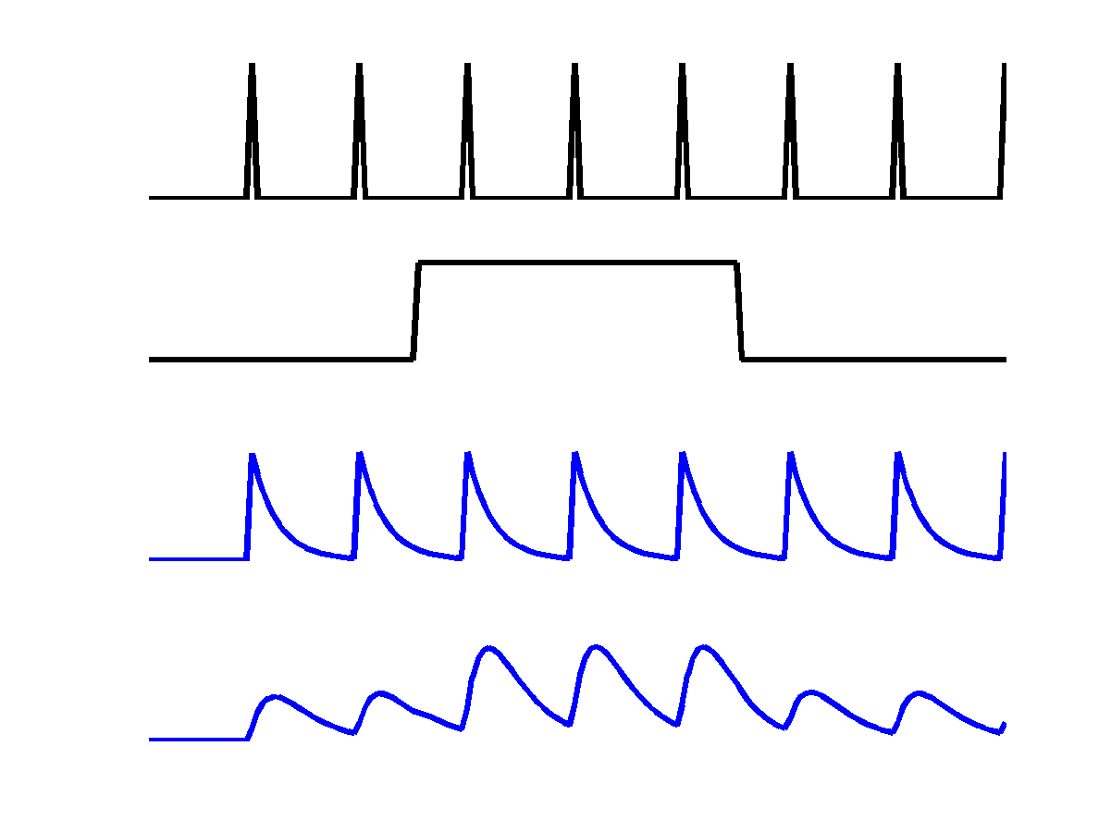
Modulatory inputs
u₁
u₂
c
a₁₁
u₁
z₁
u₂
b₂₁
a₂₁
z₁
z₂
z₂
a₂₂

Slide 15
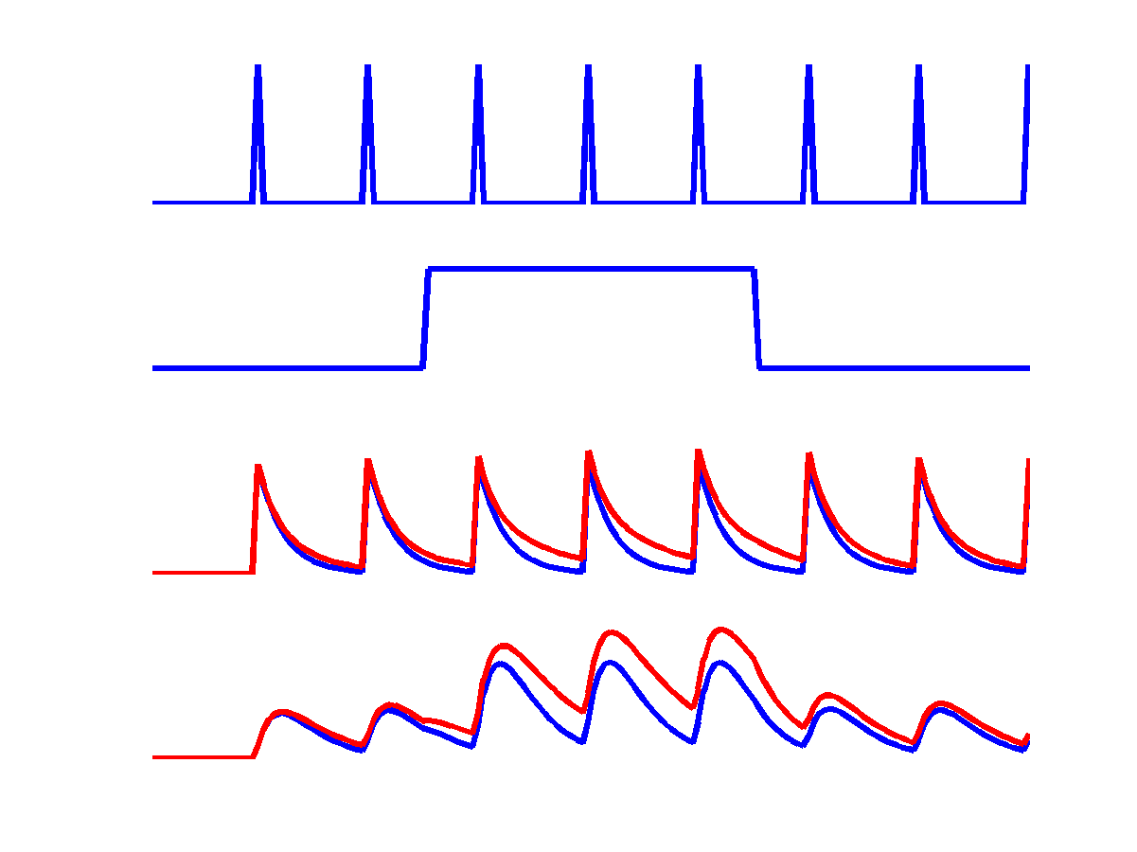
Reciprocal connections
u₁
u₂
c
a₁₁
u₁
z₁
u₂
a₁₂
b₂₁
a₂₁
z₁
z₂
z₂
a₂₂

Slide 16
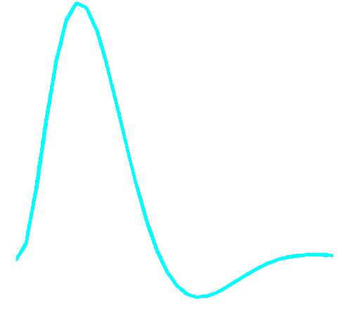
Dynamic Causal Modelling (DCM)
Hemodynamic
forward model:
neural activity→BOLD
(nonlinear)
Electric/magnetic
forward model:
neural activity→EEG
MEG
LFP
(linear)
Neural state equation:
fMRI
MEG
Neural model:
1 state variable per region
bilinear state equation
no propagation delays
Neural model:
8 state variables per region
nonlinear state equation
propagation delays
inputs

Slide 17
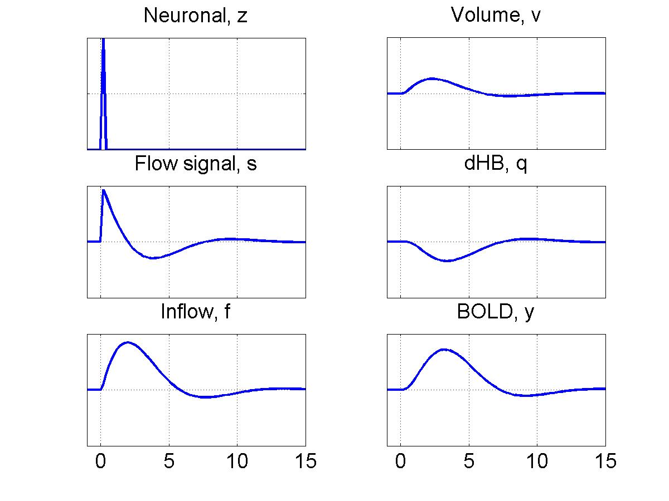
Hemodynamics
For each region:
Hemodynamic
variables
Dynamics
Hemodynamic
parameters
Seconds

Slide 18
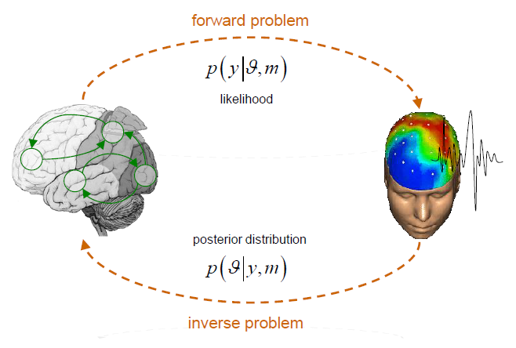
Bayesian Inference
Integrate Neuronal
and Hemodynamic
equations
Approximate posterior
from Variational Bayes
Same inference
algorithms for
fMRI/MEG

Slide 19
Bayesian Inference
V1
Model 1
Photic
SPC
V1
V5
V5
Motion
Att
SPC
Time (seconds)

Slide 20
Posterior Inference
γ
How much
attention
(input 3)
changes
connection
from
V1 (region 1)
to
V5 (region 2)
P(B³₂₁|y)
B³₂₁

Slide 21
Positive
Bayes Factor
B₁₃=3.6
Model 1
Model 3
Photic
SPC
Photic
SPC
V1
V1
Att
V5
V5
Motion
Motion
Att

Slide 22
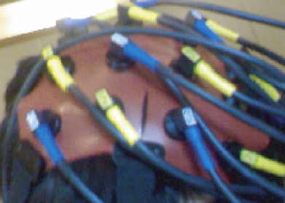
Dynamic Models of Brain Interactions
Hemodynamic and Optical
Forward Model ?
Neural state equation:
fMRI
NIRS
Neural model:
1 state variable per region
bilinear state equation
no propagation delays
Multiple state variables
per region ?
inputs

Slide 23
Papers
Friston KJ, Harrison L, Penny W (2003) Dynamic causal modelling. NeuroImage 19:1273-1302.
O David et al. Dynamic Causal Modelling of Evoked Responses in EEG and MEG. NeuroImage, 30:1255-1272, 2006.
Friston K, Penny W (2011) Post hoc Bayesian model selection. Neuroimage 56: 2089-2099.
Penny WD, Stephan KE, Mechelli A, Friston KJ (2004a) Comparing dynamic causal models. NeuroImage 22:1157-1172.
Penny WD, Stephan KE, Daunizeau J, Joao M, Friston K, Schofield T, Leff AP (2010) Comparing Families of Dynamic Causal Models. PLoS Computational Biology 6: e1000709.
Penny WD (2012) Comparing dynamic causal models using AIC, BIC and free energy. Neuroimage, 59: 319-330.
Stephan KE, Weiskopf N, Drysdale PM, Robinson PA, Friston KJ (2007) Comparing hemodynamic models with DCM. NeuroImage 38:387-401.
Stephan KE, Penny WD, Moran RJ, den Ouden HEM, Daunizeau J, Friston KJ (2010) Ten simple rules for Dynamic Causal Modelling. NeuroImage 49: 3099-3109.

